Slide 1
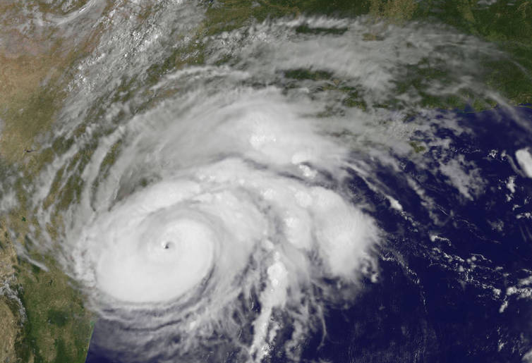
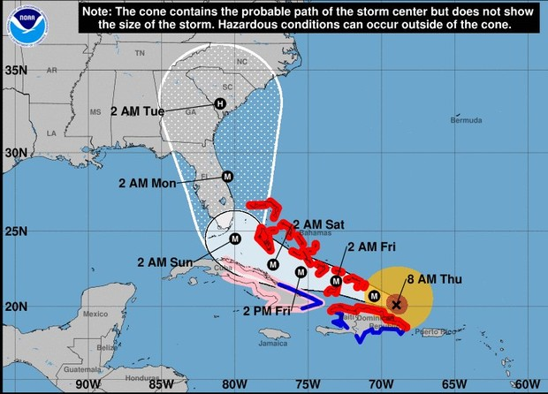
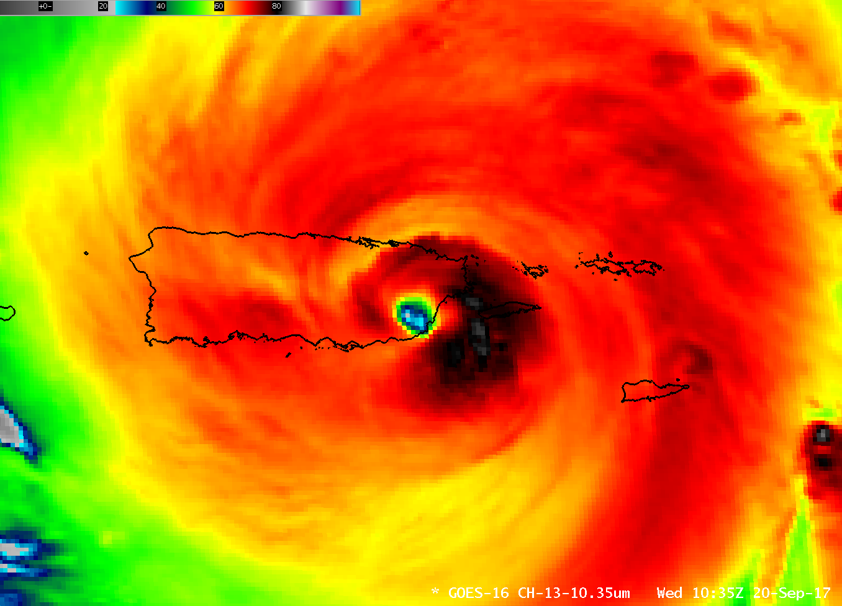
Tropical Cyclones and Extratropical Transition
Hurricane Harvey (2017)
Hurricane Irma (2017)
Hurricane Maria (2017)
Josh Alland
ATM 305 Guest Lecture

Slide 2
Outline
Conditions necessary for tropical cyclone (TC) formation
Global distribution of TCs
Extratropical transition (ET)
Tropical cyclogenesis
Tropical cyclone intensification
Wind-induced surface heat exchange (WISHE) mechanism
My research
Rapid intensification

Slide 3
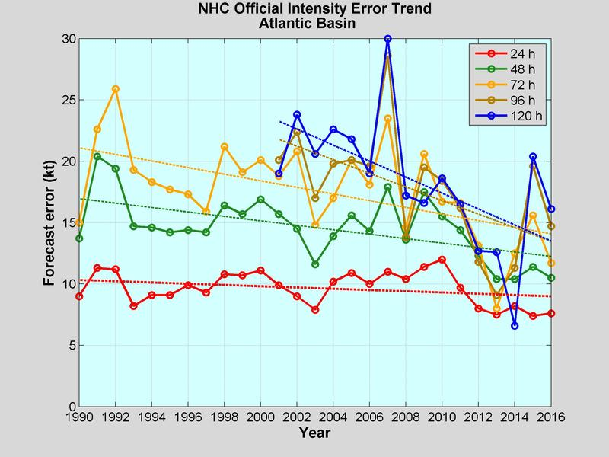

Slide 4
What are favorable ingredients for TC formation?

Slide 5
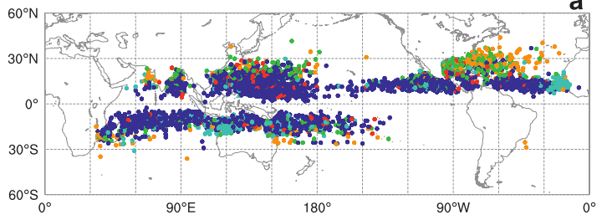
Where do Tropical Cyclones Form
TC Formation Locations 1948-2010
From McTaggart-Cowan et al. (2013)
Mainly between 5ºN/S to 30ºN/S (Tropics and Subtropics)
Favorable ingredients for tropical cyclone formation
Warm sea surface temperatures
Sufficient Coriolis Force
Low vertical wind shear
Enhanced mid-troposphere relative humidity
Conditional instability
Enhanced lower troposphere relative vorticity
Notes:
Explain vertical wind shear…. Ask if student know what this is?

Slide 6
How Do Tropical Cyclones Form
Mainly between 5ºN/S to 30ºN/S (Tropics and Subtropics)
Favorable ingredients for tropical cyclone formation
Warm sea surface temperatures
26.5ºC (80ºF)
Allows thunderstorms (deep convection) to form

Slide 7
How Do Tropical Cyclones Form
Mainly between 5ºN/S to 30ºN/S (Tropics and Subtropics)
Favorable ingredients for tropical cyclone formation
Warm sea surface temperatures
26.5ºC (80ºF)
Allows thunderstorms (deep convection) to form

Slide 8
How Do Tropical Cyclones Form
WHY NO TCs Here?
Mainly between 5ºN/S to 30ºN/S (Tropics and Subtropics)
Favorable ingredients for tropical cyclone formation
Warm sea surface temperatures
26.5ºC (80ºF)
Allows thunderstorms (deep convection) to form

Slide 9
How Do Tropical Cyclones Form
Ingredient number 2: Coriolis Force
30N
Flow deflected to the right over long distances
Aids cyclonic circulation around low pressure
Coriolis force absent at equator, therefore lack of large scale cyclonic flow to produce circulation
20N
L
10N

Slide 10
How Do Tropical Cyclones Form
Ingredient number 3: Low environmental vertical wind shear
Defined as a change in wind magnitude and direction with height
Low vertical wind shear implies a relatively uniform wind profile throughout the troposphere
Allows building convection to release heat and moisten up tropospheric column
Increasing In Height
L
Winds
Notes:
Illustrate when there is no shear and when there is high shear

Slide 11
How Do Tropical Cyclones Form
Ingredient number 3: Low environmental vertical wind shear
When vertical wind shear increases, thunderstorms become displaced from the center of the forming tropical cyclone
Can inhibit formation
Increasing In Height
L
Winds
Notes:
Better illustration or create your own.

Slide 12
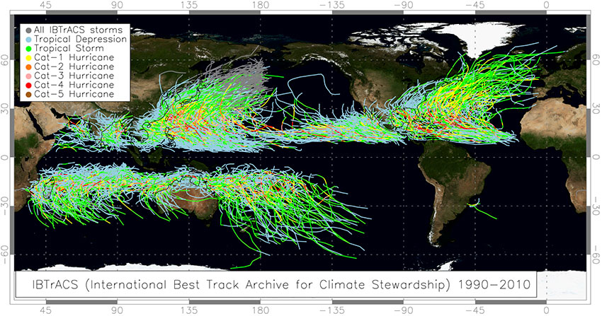
Tropical Cyclone Tracks
Source: NOAA/NCEI
Notes:
Global TC tracks from 1990-2010. Tracks are from IBTrACS best track dataset.
The western North Pacific is the most active tropical cyclone region. It is also the region with the largest number of intense tropical cyclones (orange through red tracks);
Tropical cyclones in the western North Pacific and the North Atlantic can have tracks that extend to very high latitudes. Storms following these long tracks generally undergo extratropical transition;

Slide 13
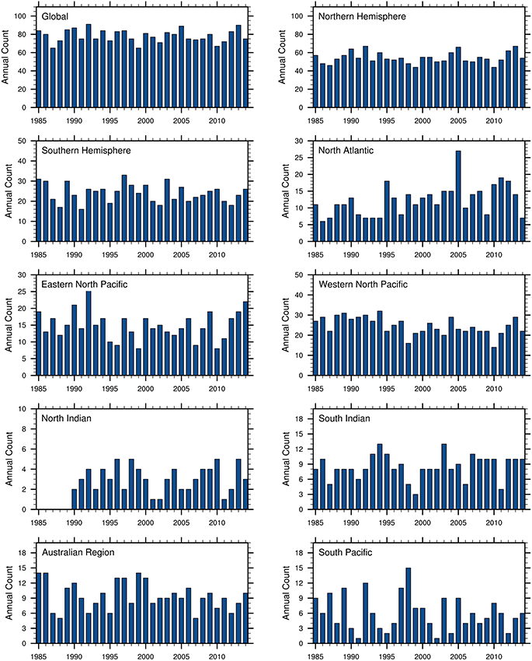
Ramsay (2017)
Notes:
Tropical cyclone count from 1985 to 2014 (Ramsey 2017).
80 TCs a year, a number that is consistent year to year, which mystifies climate scientists (Emanuel and Nolan 2004). Individual basins have much more variability (see next slide).

Slide 14
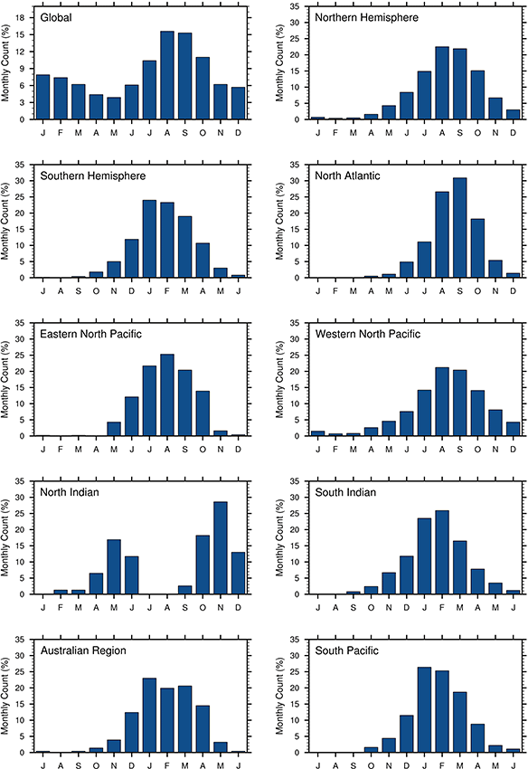
Ramsay (2017)
Notes:
Seasonality of TC formation in ocean basins (Ramsey 2017)

Slide 15
Is there a better way to measure TC activity?
Ramsay (2017)
Notes:
Seasonality of TC formation in ocean basins (Ramsey 2017)

Slide 16
Tropical Cyclone Activity
Measured by accumulated cyclone energy (ACE)
Accounts for intensity and duration of all named storms during the season.
ACE statistics from Colorado State website:
http://tropical.atmos.colostate.edu/Realtime/
Notes:
Data from the past is not as good – less coverage and accurate measurements of intensity.

Slide 17
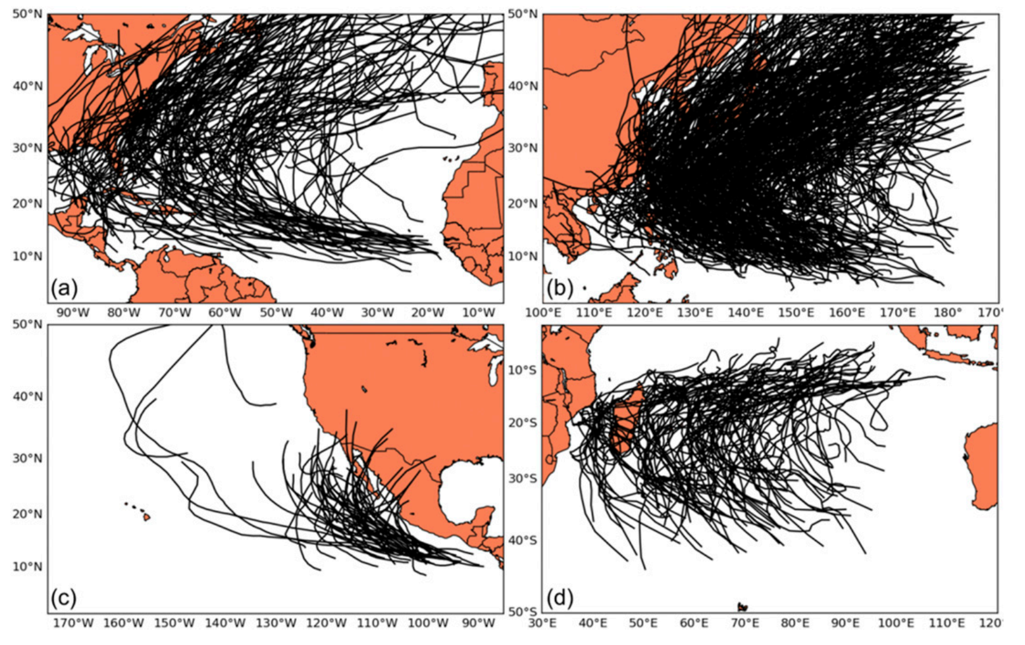
Extratropical Transition
Evans et al. 2017
Notes:
Tracks of TCs that completed the transformation stage of ET in different basins.

Slide 18
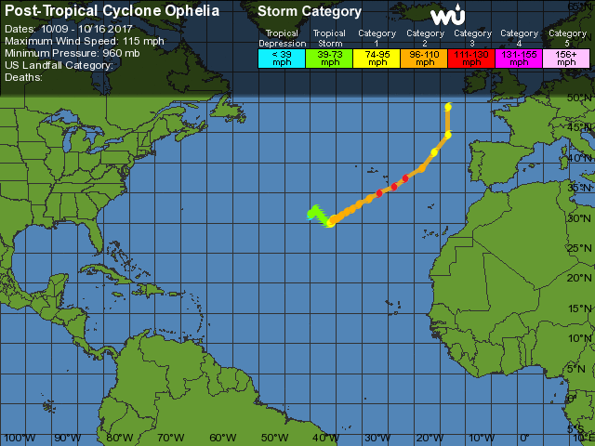
Extratropical Transition

Slide 19
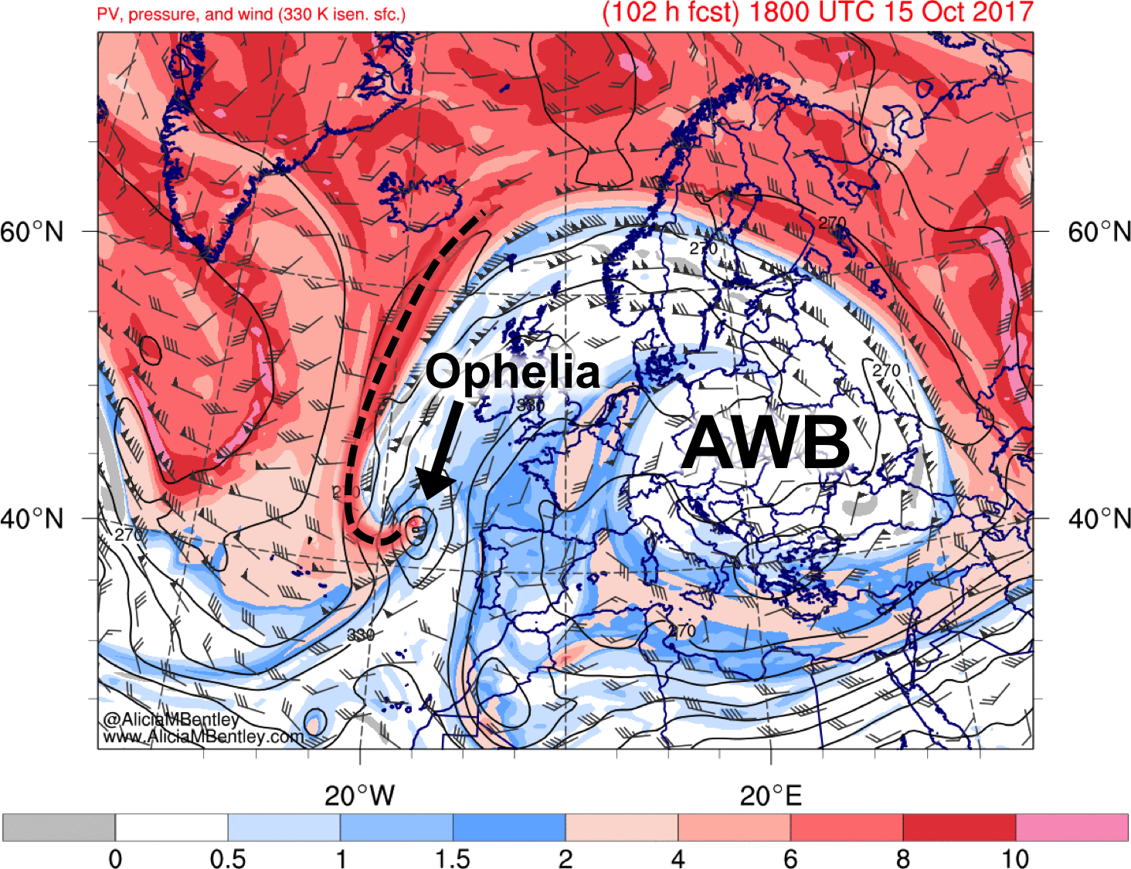
Extratropical Transition Effects
Ophelia PV: http://manunicast.seaes.manchester.ac.uk/view.php?t=20171013&d=d01&p=10,14,12&l=0,0,0
Ophelia MSLP: http://manunicast.seaes.manchester.ac.uk/view.php?t=20171015&d=d01&p=14,12&l=0,0

Slide 20
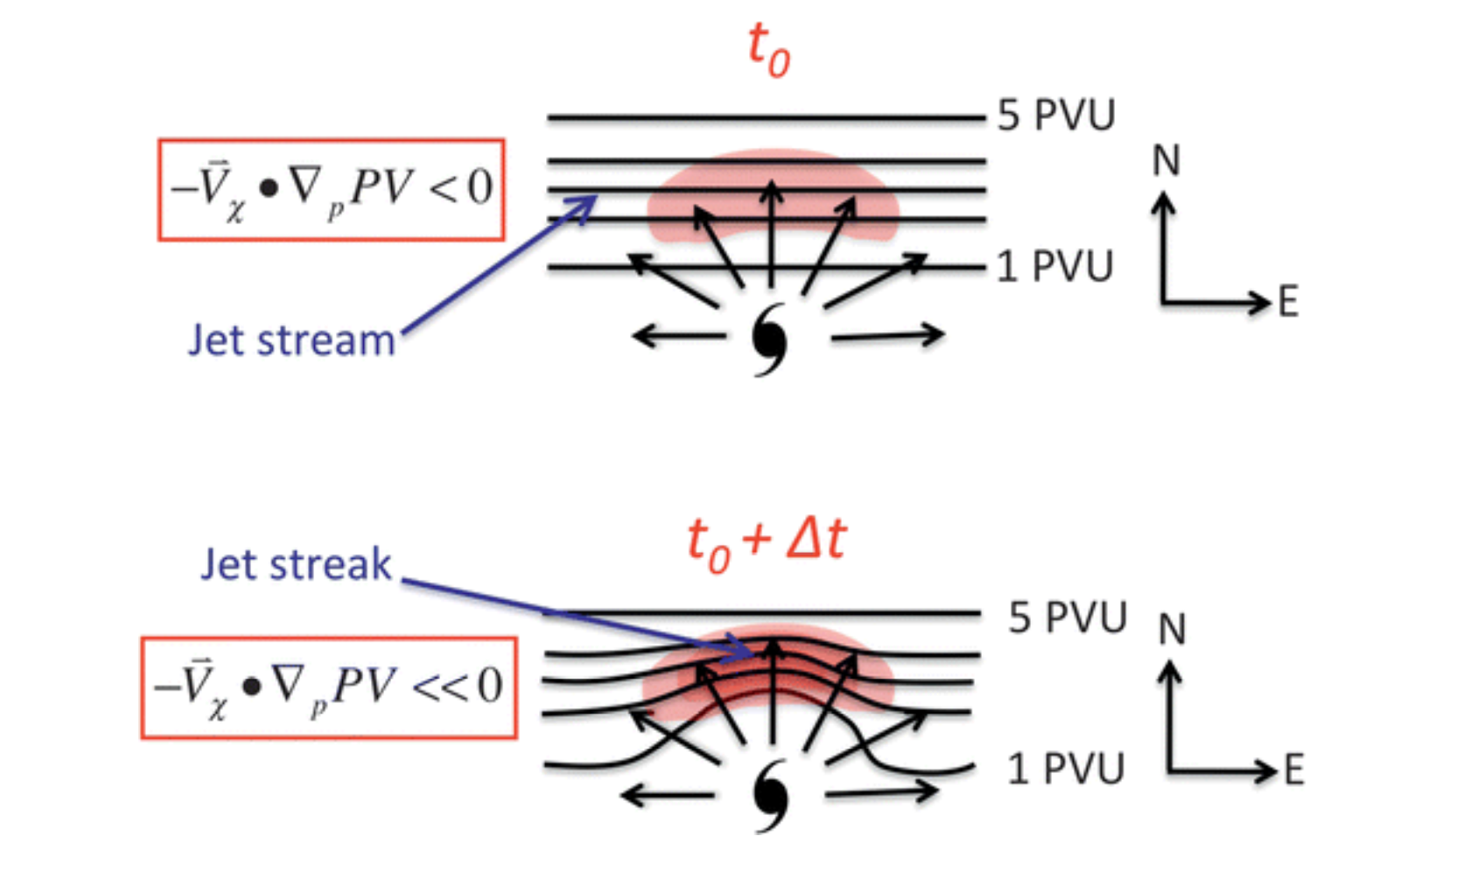
Extratropical Transition Effects
Archambault et al. 2013
Flow amplification determined by strength of TC--jet interaction.

Slide 21
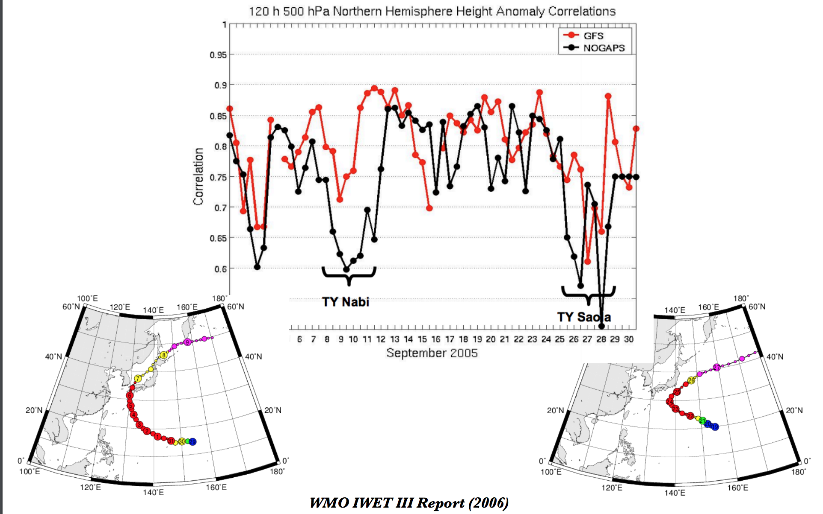
Extratropical Transition Effects
Notes:
Measure of forecast skill. Anomaly pattern and observed pattern= 1. Ridge with trough = 0. Magic number is 0.6=skill.
Research topics: Error growth, influence on extreme weather events,

Slide 22
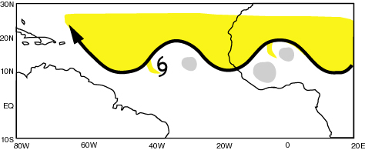
Tropical Cyclogenesis
African easterly waves initiate tropical cyclogenesis in both the North Pacific and North Atlantic Oceans.
Mesoscale convective systems move with and through the synoptic-scale AEWs
AEWs
TC
MCSs
Source: Chris Thorncroft
Notes:
Mesoscale influneces

Slide 23
Tropical Cyclogenesis
African easterly waves initiate tropical cyclogenesis in both the North Pacific and North Atlantic Oceans.
Mesoscale convective systems move with and through the synoptic-scale AEWs
AEWs
How is relative vorticity created within the AEW?
TC
MCSs
Source: Chris Thorncroft
Notes:
Mesoscale influneces

Slide 24
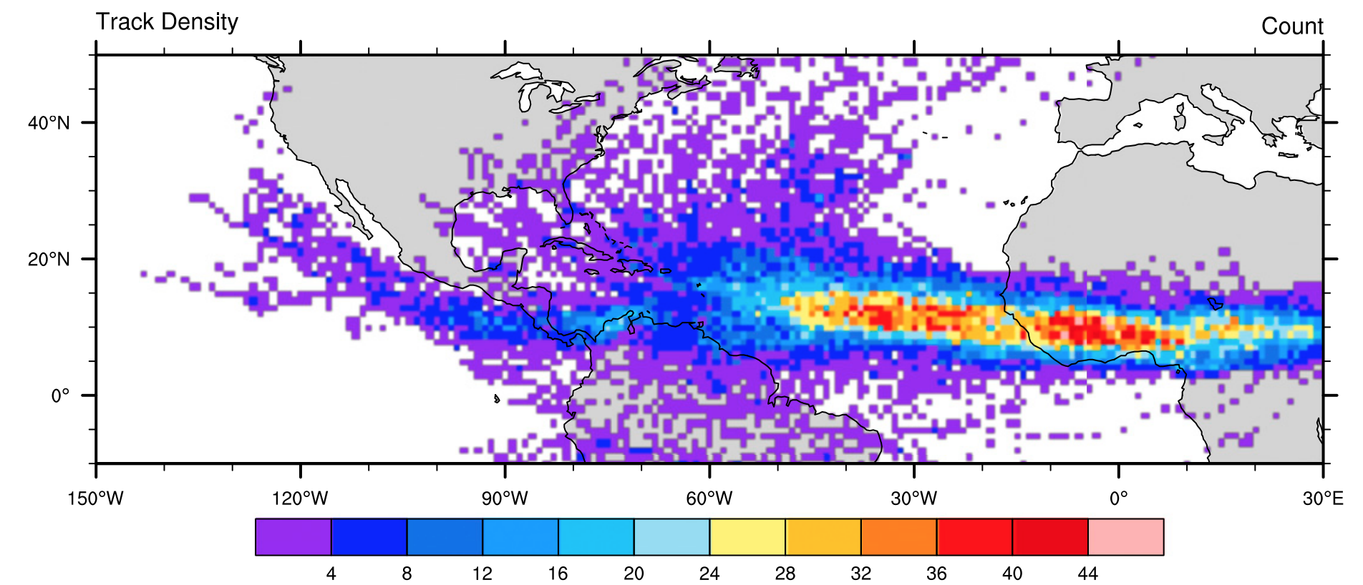
Tropical Cyclogenesis
Brammer and Thorncroft (2015)

Slide 25
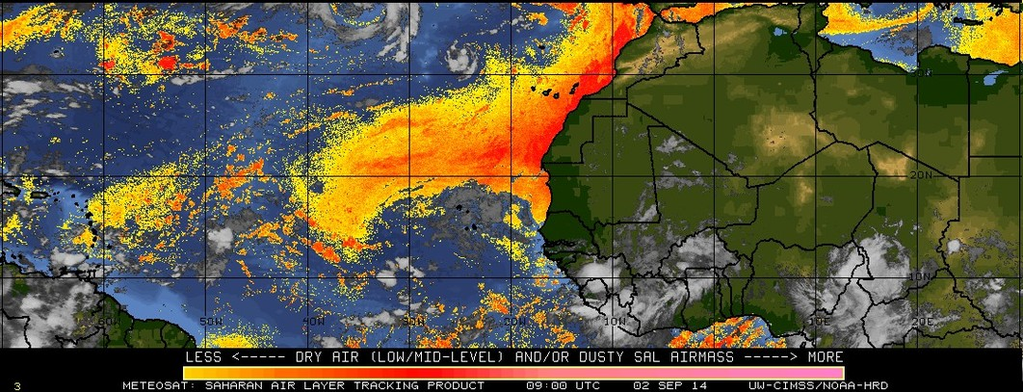
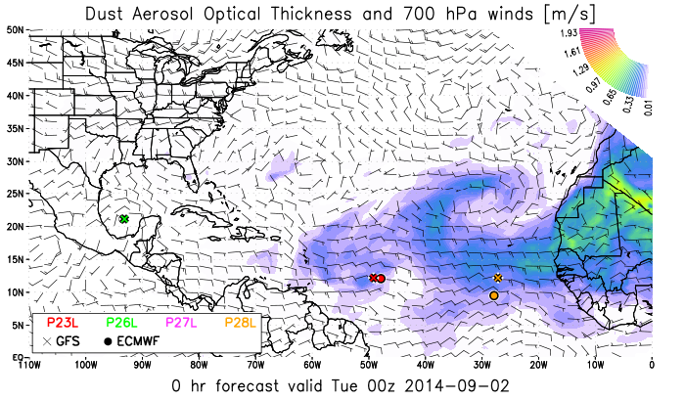

Slide 26
Tropical Cyclogenesis
Research challenges:
Which waves will actually develop?
Is VWS good or bad for tropical cyclogenesis?
Discussion case:
An incipient disturbance is in an environment conducive for tropical cyclogenesis, except for moderate VWS of 7 m s⁻¹. Will development occur?

Slide 27
Tropical Cyclogenesis
Research challenges:
Which waves will actually develop?
Is VWS good or bad for tropical cyclogenesis?
Discussion case:
An incipient disturbance is in an environment conducive for tropical cyclogenesis, except for moderate VWS of 7 m s⁻¹. Will development occur?
Pre-Hurricane Danny (1997) is one storm that likely benefited from the presence of moderate vertical wind shear (5-11 m s⁻¹ over 850-200 hPa). The shear acted to promote convection downshear of Danny, creating additional cyclonic vorticity in that region. This newly formed cyclonic vorticity became organized into a low-level vortex, and then ingested the vorticity associated with the original storm, becoming the primary “Danny”.

Slide 28
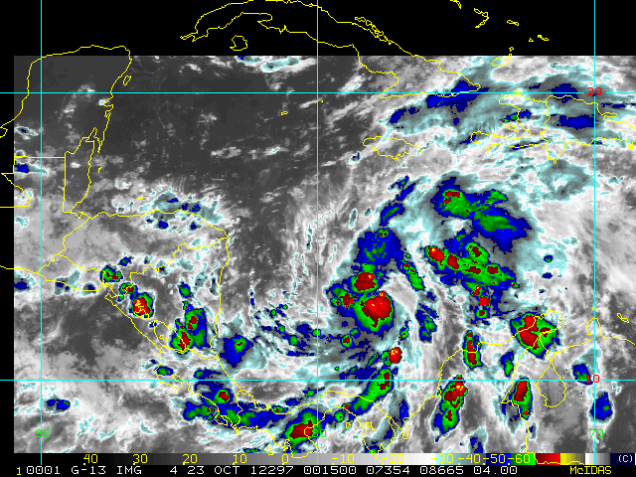
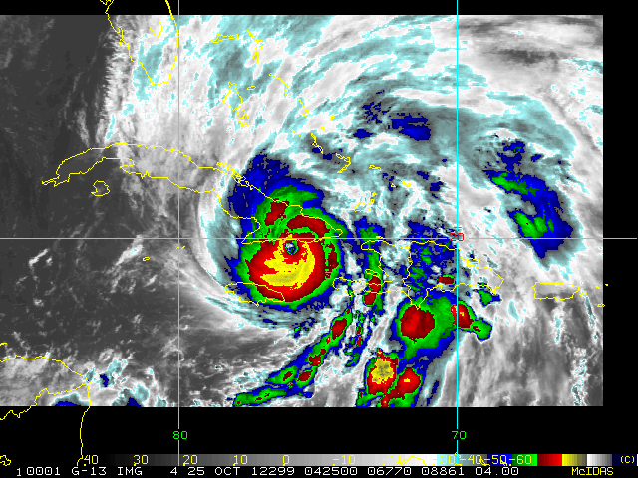
The Intensification of a Tropical Cyclone
How do we get this weak tropical storm to strengthen into a full-blown hurricane?
Sandy as a 45 mph tropical storm
Scattered thunderstorms
Sandy as a 115 mph hurricane
Densely packed thunderstorms

Slide 29
The Intensification of a Tropical Cyclone
How do we get this weak tropical storm to strengthen into a full-blown hurricane?
Activity: Wind-Induced Surface Heat Exchange
Sandy as a 45 mph tropical storm
Scattered thunderstorms
Sandy as a 115 mph hurricane
Densely packed thunderstorms

Slide 30
The Intensification of a Tropical Cyclone
Hurricanes are a mass of thick, tall clouds (thunderstorms) resulting from condensation of water vapor.
45 mph tropical storm
115 mph hurricane

Slide 31
The Intensification of a Tropical Cyclone
Hurricanes are a mass of thick, tall clouds (thunderstorms) resulting from condensation of water vapor.
Condensation!
Condensation
45 mph tropical storm
115 mph hurricane

Slide 32
The Intensification of a Tropical Cyclone
Hurricanes are a mass of thick, tall clouds (thunderstorms) resulting from condensation of water vapor. This releases latent heat → warming.
Condensation!
Condensation
Latent heating!
Latent heating
45 mph tropical storm
115 mph hurricane
Discussion: What is the balanced dynamic response to this heating?

Slide 33
The Intensification of a Tropical Cyclone
More condensational warming → lower pressure → stronger pressure gradient and stronger winds!
Condensation!
Condensation
Latent heating!
Latent heating
L
L
45 mph tropical storm
115 mph hurricane

Slide 34
The Intensification of a Tropical Cyclone
?
More condensation, clouds/thunderstorms, latent heating
Lower pressure, stronger winds

Slide 35
The Intensification of a Tropical Cyclone
More water vapor in the air
More condensation, clouds/thunderstorms, latent heating
Lower pressure, stronger winds

Slide 36
The Intensification of a Tropical Cyclone
We need more water vapor, but where do we get the water vapor from??
Condensation!
Condensation
Latent heating!
Latent heating
L
L
45 mph tropical storm
115 mph hurricane

Slide 37
The Intensification of a Tropical Cyclone
We need more water vapor, but where do we get the water vapor from??
Evaporation from the ocean
Condensation!
Condensation
Latent heating!
Latent heating
L
L
45 mph tropical storm
115 mph hurricane

Slide 38
The Intensification of a Tropical Cyclone
We need more water vapor, but where do we get the water vapor from??
Evaporation from the ocean
Condensation!
Condensation
Latent heating!
Latent heating
L
L
45 mph tropical storm
115 mph hurricane

Slide 39
The Intensification of a Tropical Cyclone
More water vapor in the air
Evaporation from the ocean
More condensation, clouds/thunderstorms, latent heating
Lower pressure, stronger winds

Slide 40
The Intensification of a Tropical Cyclone
More water vapor in the air
Evaporation from the ocean
More condensation, clouds/thunderstorms, latent heating
Stronger winds → more evaporation
Lower pressure, stronger winds

Slide 41
The Intensification of a Tropical Cyclone
More water vapor in the air
Evaporation from the ocean
More condensation, clouds/thunderstorms, latent heating
Stronger winds → more evaporation
Lower pressure, stronger winds
Wind-Induced Surface Heat Exchange

Slide 42
The Intensification of a Tropical Cyclone
More water vapor in the air
Evaporation from the ocean
More condensation, clouds/thunderstorms, latent heating
Stronger winds → more evaporation
Lower pressure, stronger winds
Activity: What vertical profile of heating is most efficient at spinning up a low-level vortex?

Slide 43
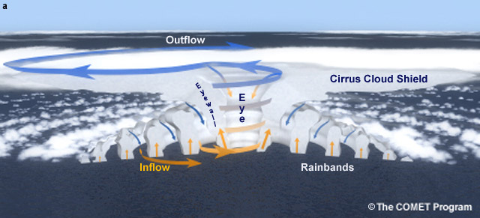
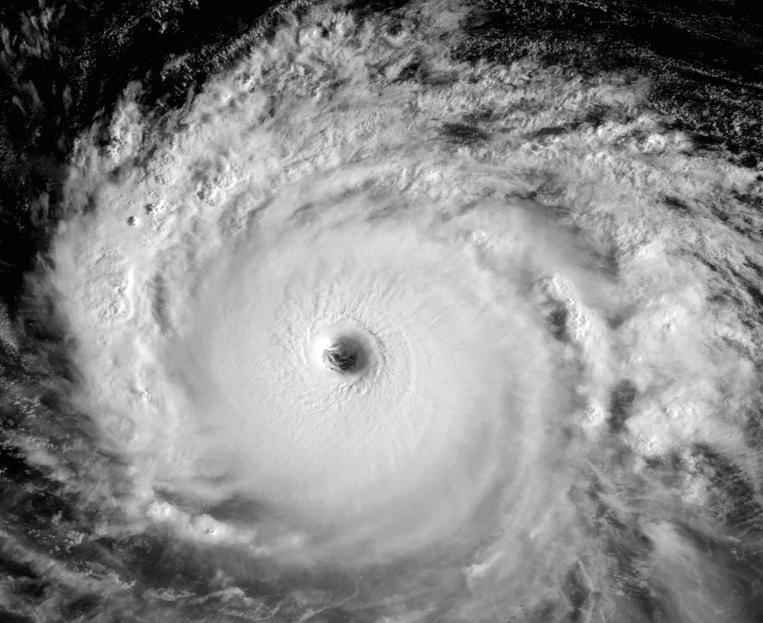
Structure of a Mature Tropical Cyclone
Features of a hurricane:

Slide 44
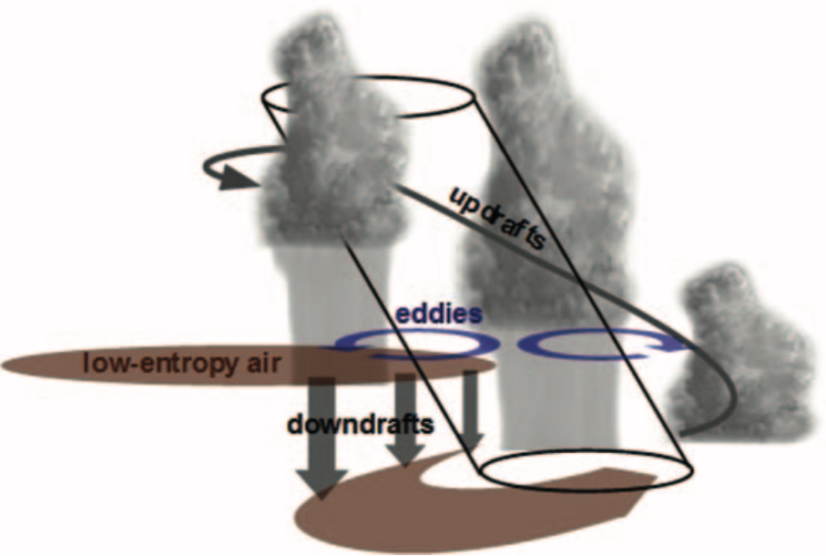
The Intensification of a Tropical Cyclone
Vertical wind shear and dry air is considered bad for intensification.
Tang and Emanuel (2012)
Josh’s research: http://www.atmos.albany.edu/student/jalland/Images/Research/CM1_Model/3D/MSE_evolution/MSE.html

Slide 45
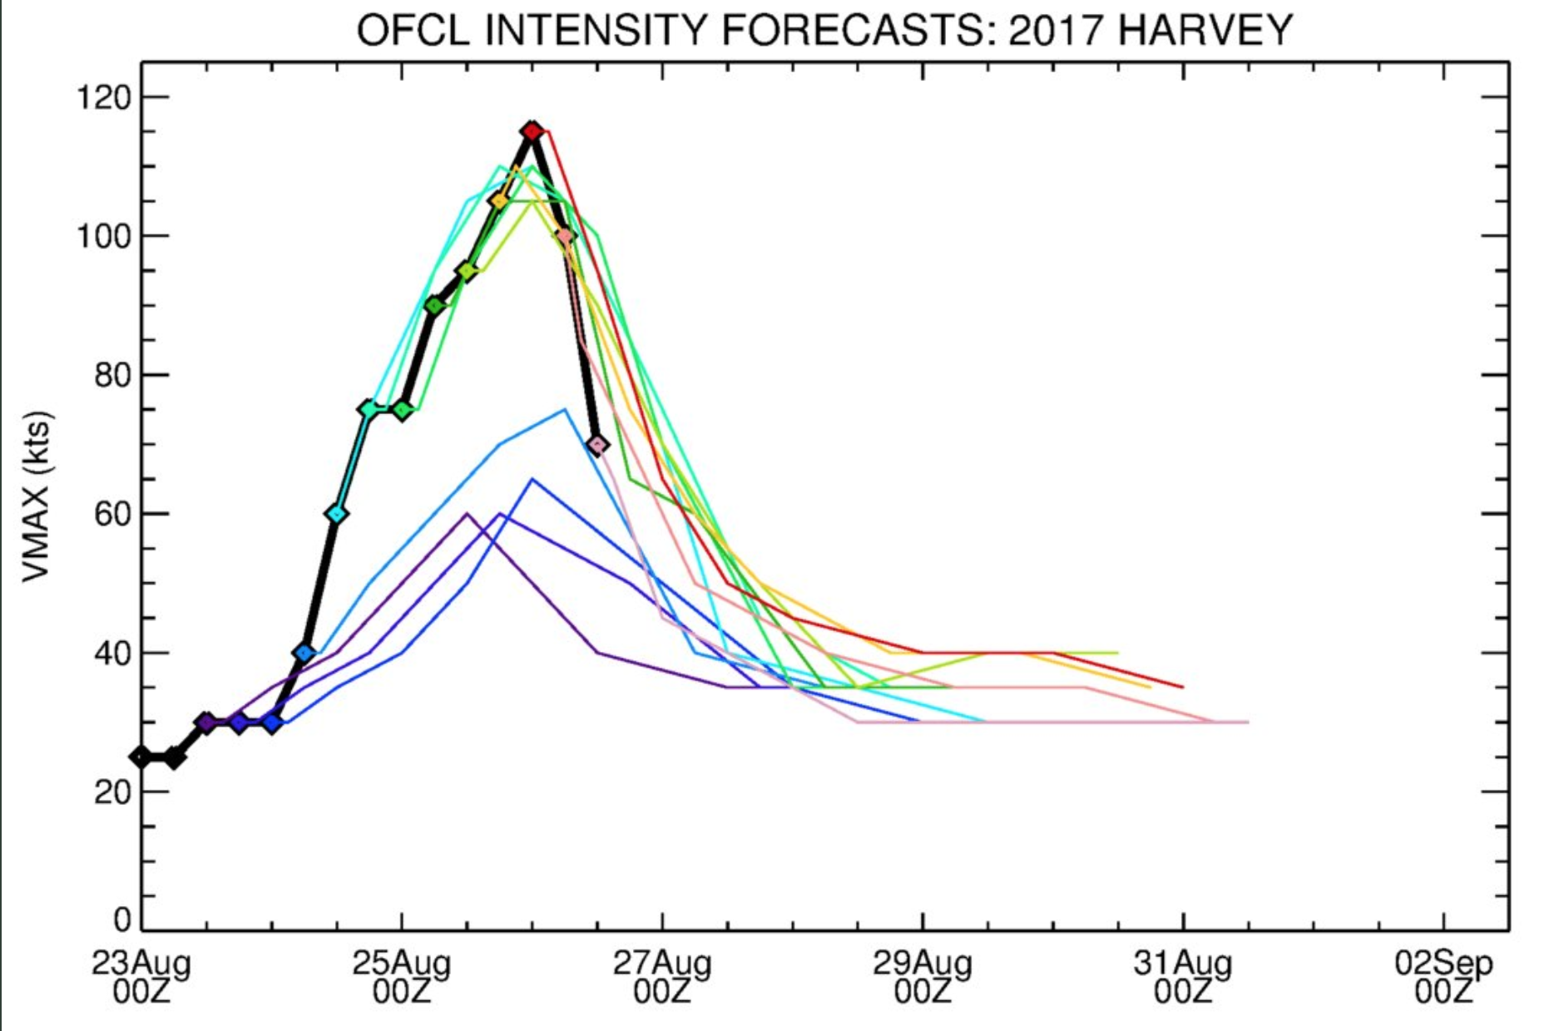
Rapid Intensification
From Brian McNoldy

Slide 46
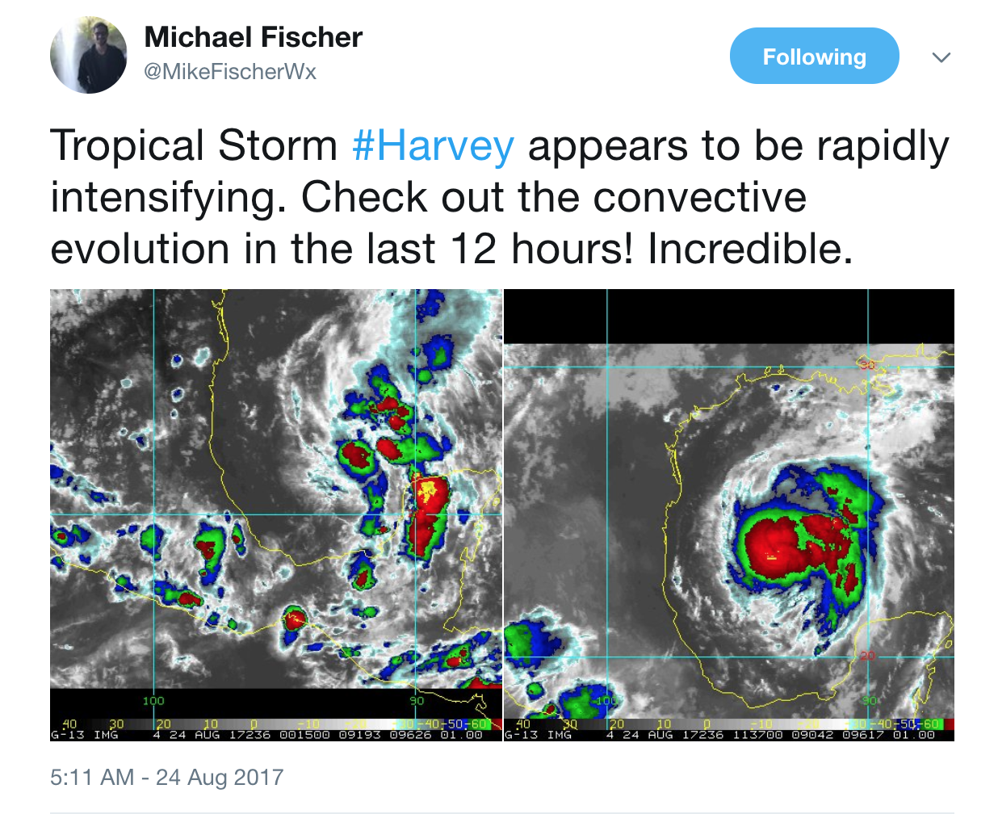
Rapid Intensification

Slide 47
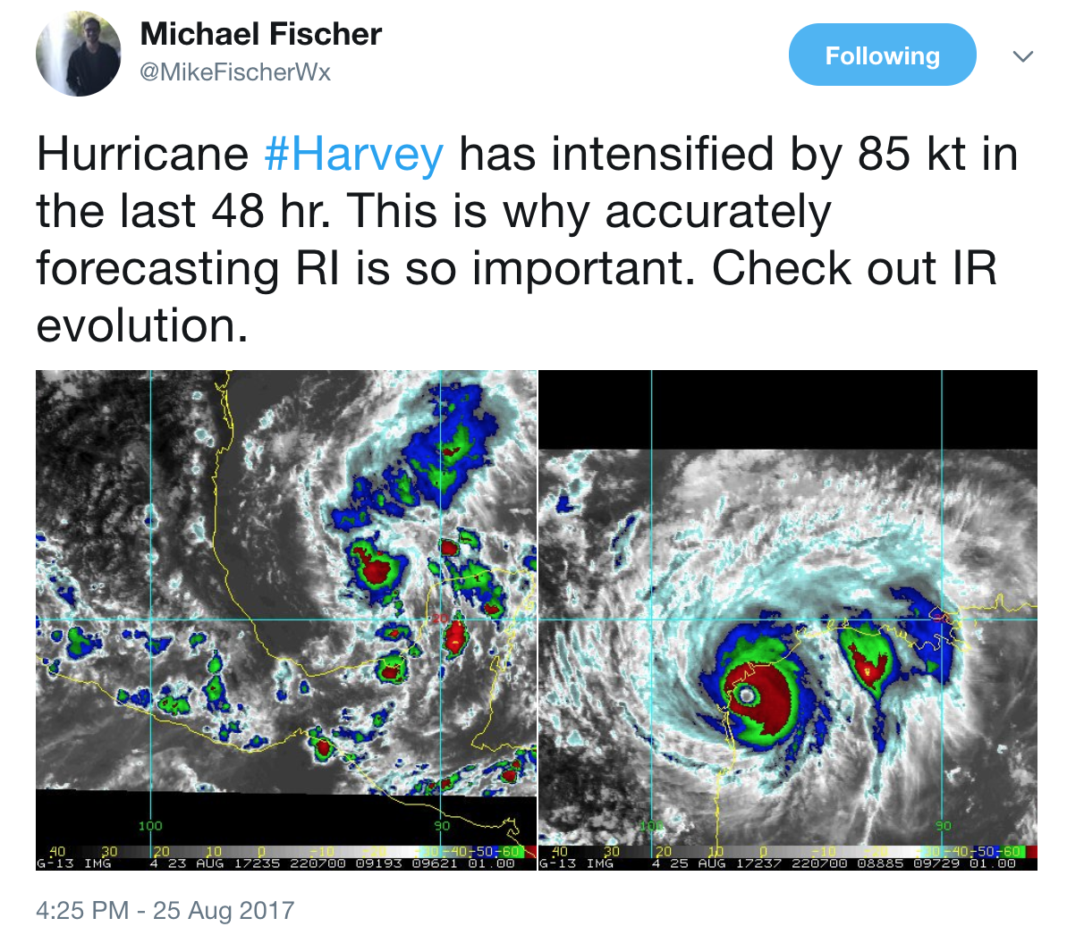
Rapid Intensification

Slide 48
Rapid Intensification
Discussion: Do you think unique processes are occurring during rapid intensification (compared to non-rapid intensification)?

Slide 49
Summary
Conditions necessary for tropical cyclone (TC) formation
Global distribution of TCs
Extratropical transition (ET)
Forecast issue: Impact on midlatitude waveguide
Tropical cyclogenesis
Forecast issue: What wave will develop into TC?
Tropical cyclone intensification
Forecast issues: How does dry air and vertical wind shear affect development? Can we predict rapid intensification?

