Slide 1
Multiscale Interactions during the Winters of
2009−2010 and 2010−2011: A Link to the February 1979 Presidents’ Day Storm
Lance F. Bosart
Heather M. Archambault and Jason M. Cordeira
Department of Atmospheric and Environmental Sciences
University at Albany, SUNY
NCEP 35th Presidents’ Day Storm Colloquium
28 May 2014
Support provided by NSF grant AGS-0935830 and
NOAA grant NA09OAR4310192

Slide 2
Motivation
Winter 1978-1979 featured distinct large-scale weather regimes
Transitions between these 1978-1979 weather regimes were very abrupt
The Presidents’ Day storm marked a transition from cold and dry to warm and wet
Gridded datasets available at that time were insufficient to study large-scale regime changes
The 2009-2010 and 2010-2011 featured prominent large-scale regime transitions.

Slide 3
Outline of presentation
Large-scale regime transitions before and after the Presidents’ Day Storm of February 1979
Large-scale blocking, extreme weather, and the “Coast-to-Coast” and “Screaming Eastern Pacific Jet” storms
“Flavors” of cyclone-jet interactions in late winter 2010
The “half and half” winter of 2010-2011: Cold early and mild late
CONUS weather variability during the winter 2010-2011 transition from cold early to mild late
A comparison of the CONUS bomb of 25-26 Oct 2010 and the “Cleveland Superbomb” of 25-26 January 1978 (time permitting)

Slide 4
North American 500-hPa height and 850-hPa Temperature Patterns: 1 Jan to 15 Mar 1979

Slide 5
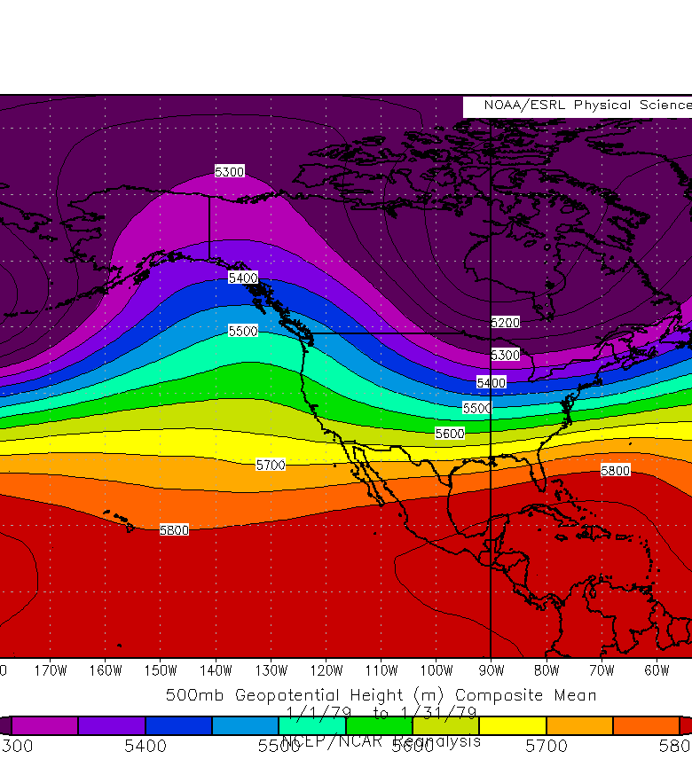
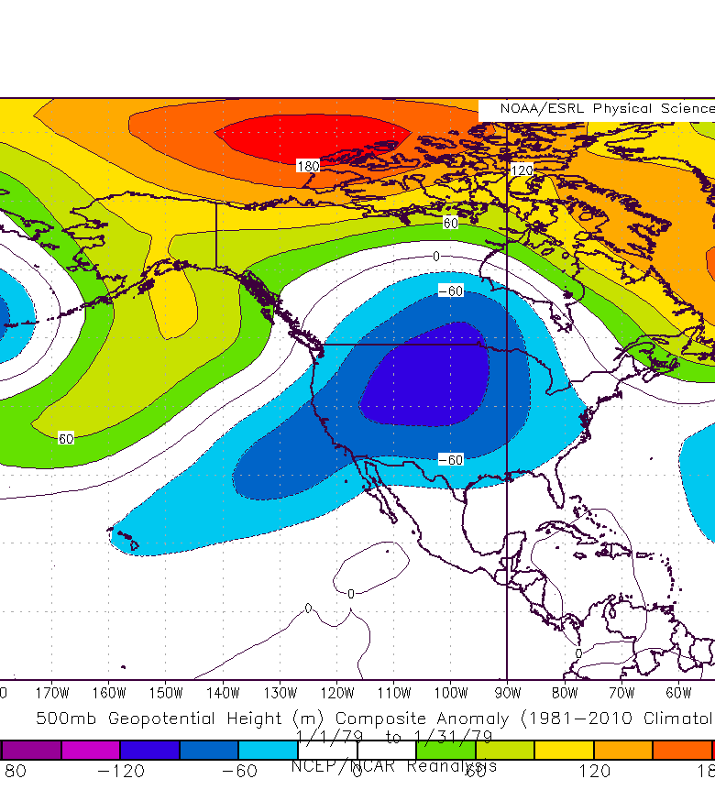
500-hPa Z(dam)/Z’(m): 1-31 Jan 1979

Slide 6
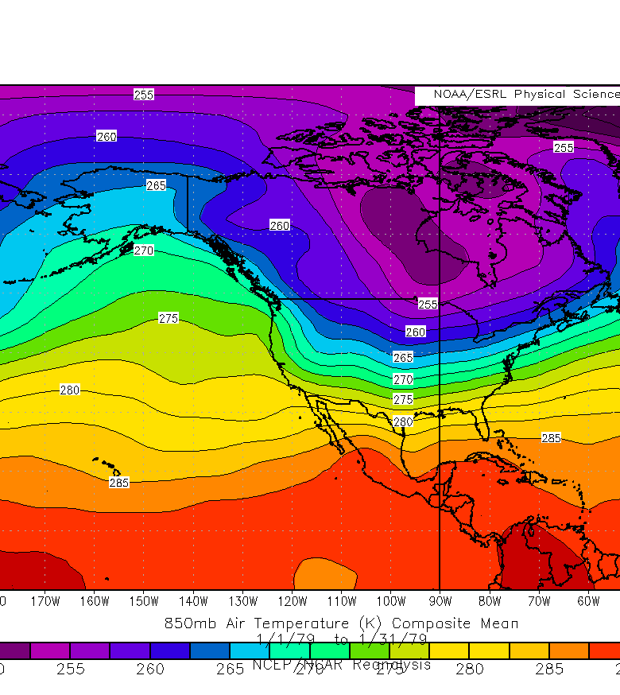
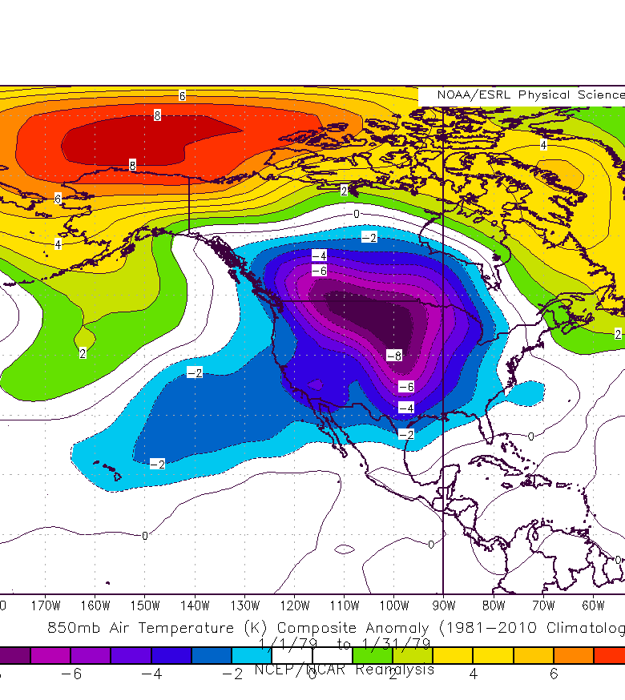
850-hPa T(C)/T’(C): 1-31 Jan 1979

Slide 7
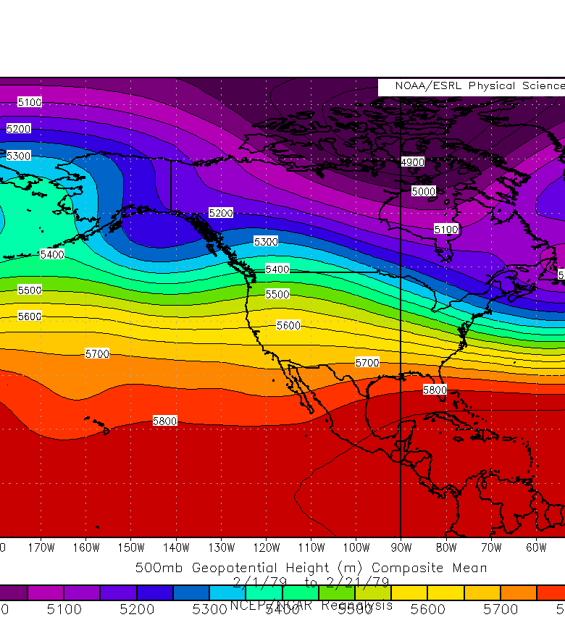
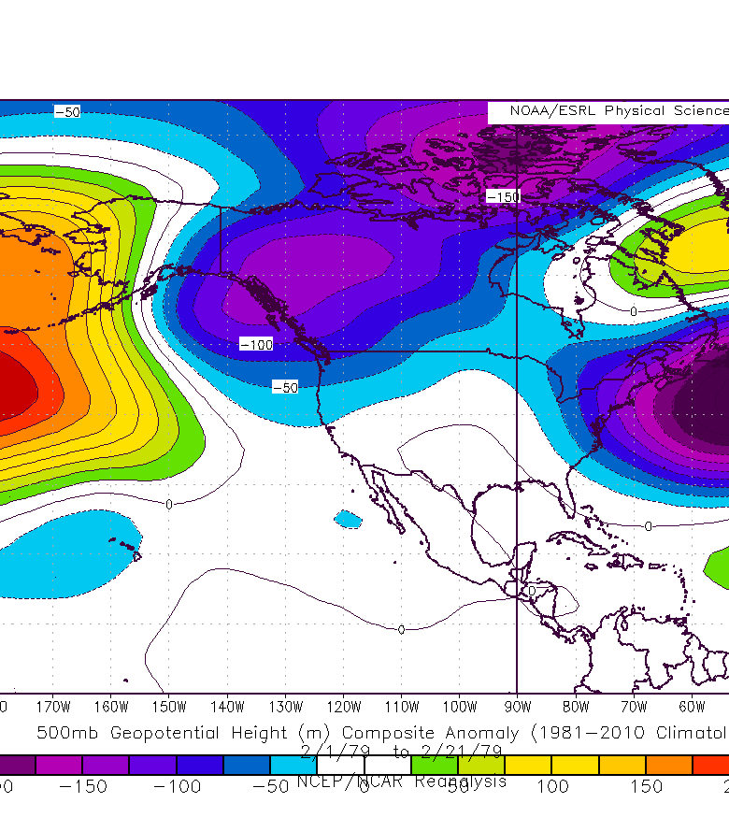
500-hPa Z(dam)/Z’(m): 1- 21 Feb 1979

Slide 8
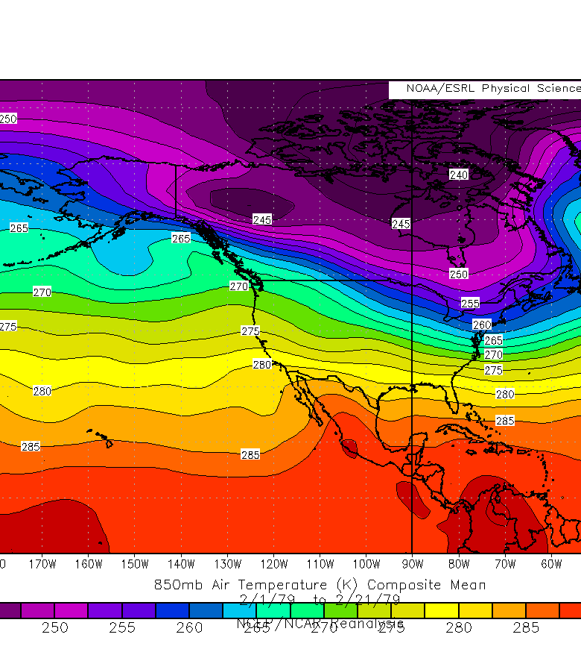
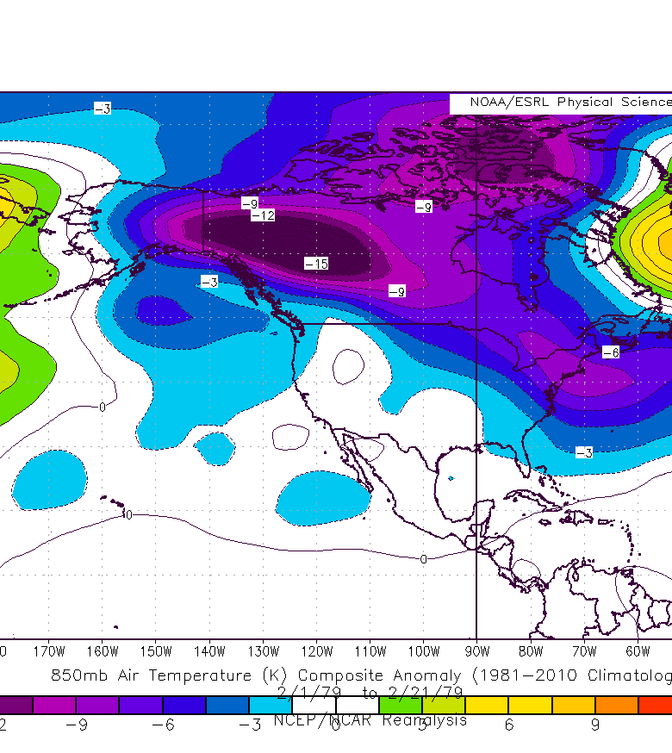
850-hPa T(C)/T’(C): 1-21 Feb 1979

Slide 9
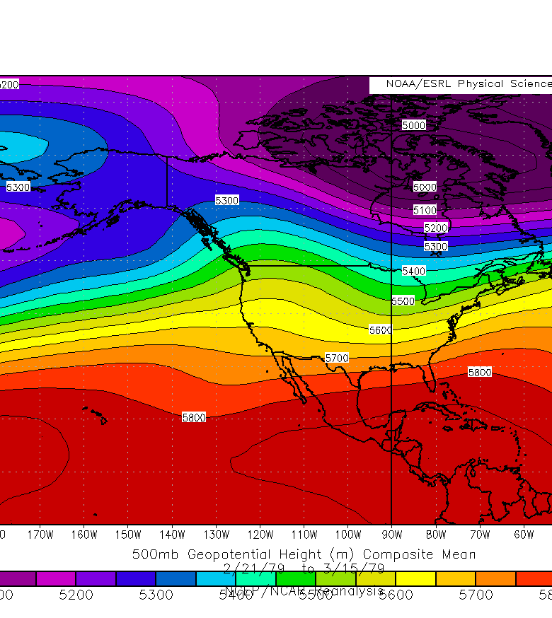
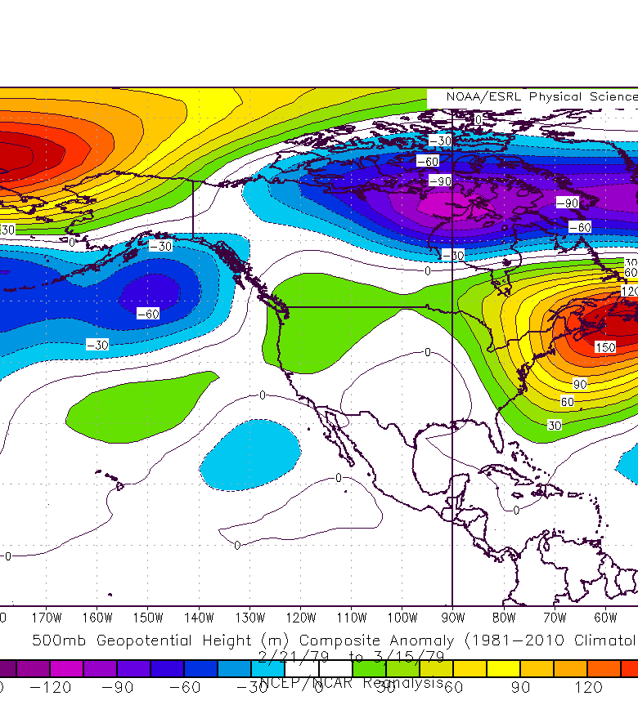
500-hPa Z(dam)/Z’(m): 21 Feb-15 Mar 1979

Slide 10
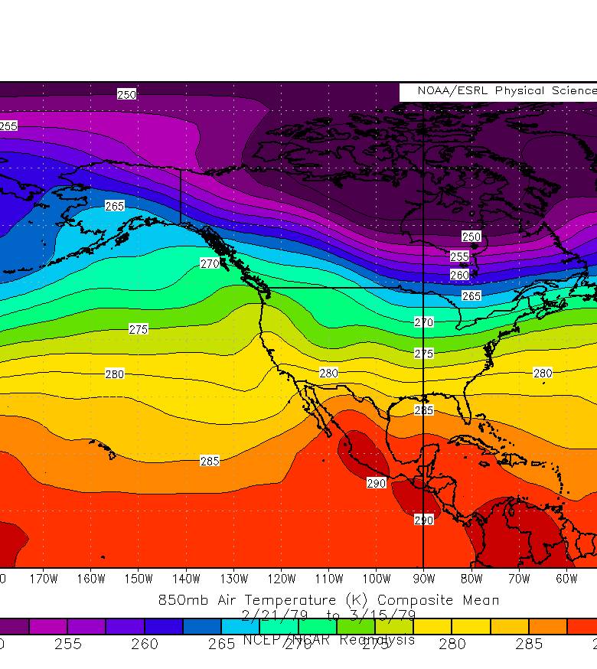
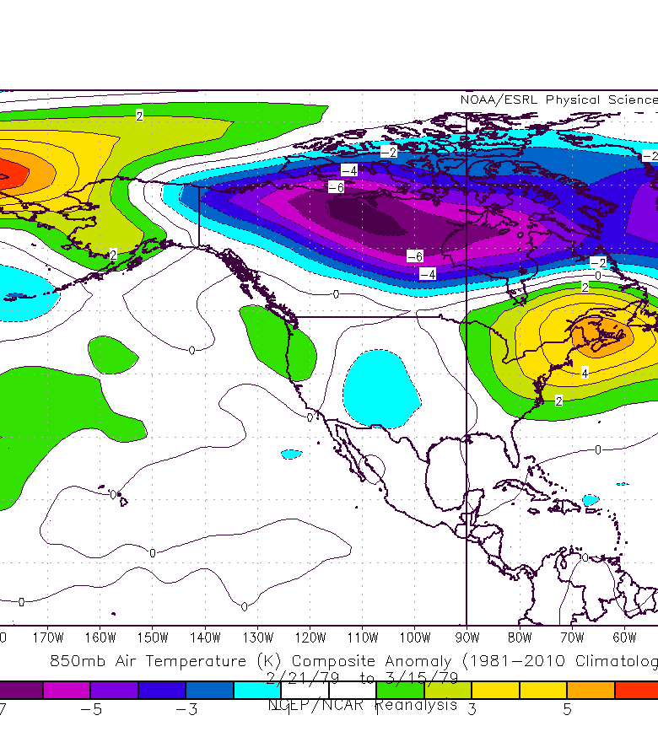
850 T(C)/T’(C): 21 Feb – 15 Mar 1979

Slide 11
Winters 2009–2010 and 2010–2011
Given that these winters were:
  Dominated by disruption of the NH polar vortex, which enables arctic air masses to reach lower latitudes,
  Characterized by extreme weather events along the margins of the arctic air masses,
  Associated with El Niño (2009–2010) and La Niña (2010–2011),
We ask: What are the ingredients behind this observed extreme weather variability?

Slide 12
Winter 2009–2010

Slide 13
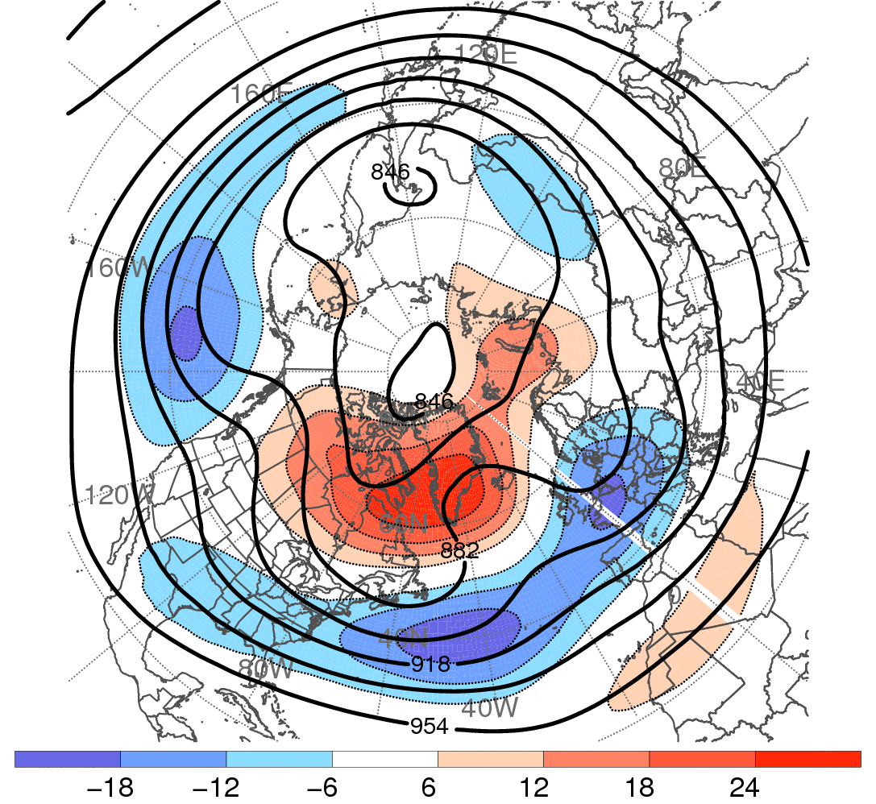
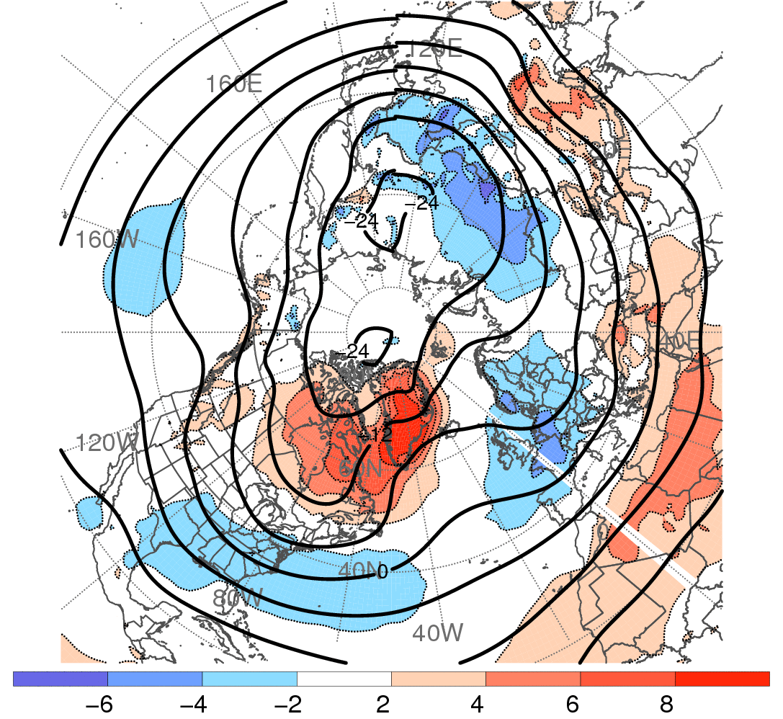
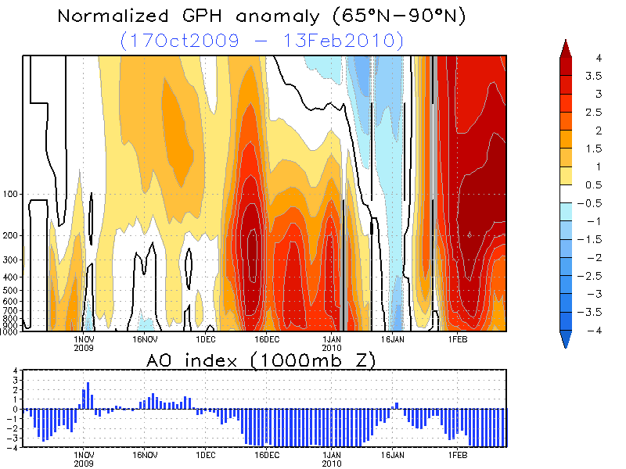
Winter 2009–2010: “Blocked” Flow Pattern
300-hPa Geo. Height (contoured, dam)
and Geo. Height Anomaly (shaded, dam)
850-hPa Temperature (contoured, °C)
and Temperature Anomaly (shaded, °C)
1 Dec 2009
to
15 Feb 2010
−
−
+
−
+
−
−
−
Data: 1.0° NCEP−GFS Analyses
Data: 1.0° NCEP−GFS Analyses
dam
°C
CPC AO Index: 1 Dec 2009 – 15 Feb 2010
+4
+4
Source: Climate Prediction Center
Index (SD)
0
0
-4
-4
1 Dec 09
16 Dec 09
1 Jan 10
16 Jan 10
1 Feb 10

Slide 14
Part III: Two Major North Atlantic Blocking Events
Episode I: 9 Dec 2009 – 18 Dec 2009
Episode II: 31 Dec 2009 – 8 Jan 2010
Western Atlantic cyclones build/reinforce block
Omega/Rex block transition
European cold and storminess
Southeast U.S. cold

Slide 15
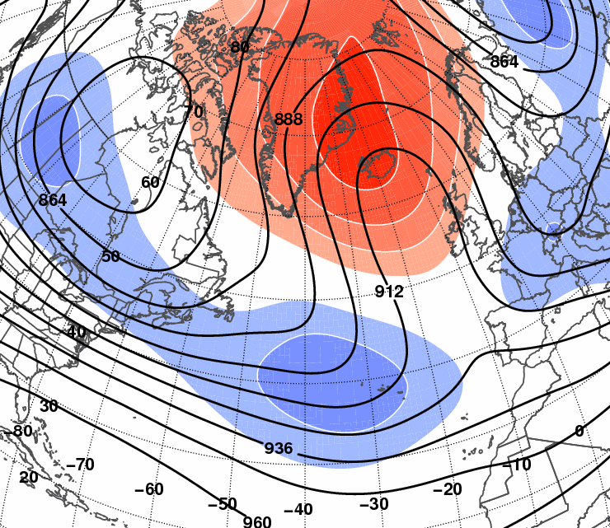
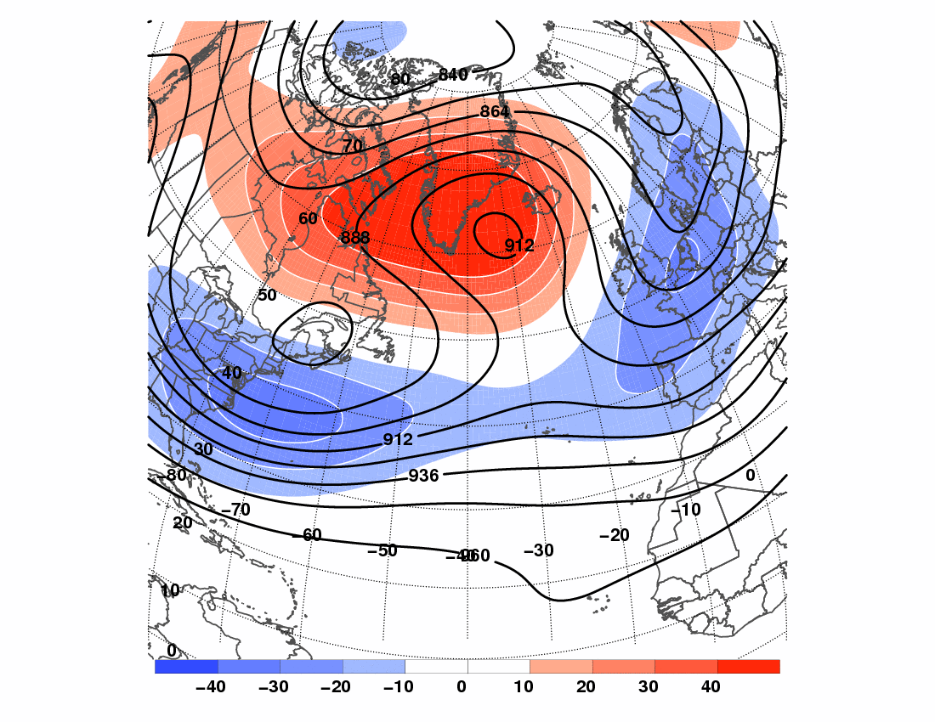
3. North Atlantic Blocking Episodes I and II
300-hPa Geopotential Height (dam, solid) and geopotential height anomaly (dam, shaded):
I) 9 Dec 2009 to 18 Dec 2009
L1: 6 to 9 Dec (944 hPa)
L2: 8 to 11 Dec (976 hPa)
L3: 9 to 13 Dec (960 hPa)
L4: 14 to 18 Dec (988 hPa)
L3 represents coastal redevelopment of “Coast-to-Coast” Storm
L
L
L
L
L
L
L
L
L
L
L
L
L
L
L
L
L
L
L
L
L
L
L
L
L
L
L
L
Data: 2.5° NCEP−NCAR Reanalyses
dam

Slide 16
3. North Atlantic Blocking Episodes I and II
300-hPa Geopotential Height (dam, solid) and geopotential height anomaly (dam, shaded):
II) 31 Dec 2009 to 8 Jan 2010
L1: 29 to 31 Dec (980 hPa)
L2: 31 Dec to 1 Jan (992 hPa)
L3: 1 to 6 Jan (972 hPa)
L4: 7 to 10 Jan (972 hPa)
L5: 29 Dec to 1 Jan (984 hPa)
L6: 1 to 3 Jan (1016 hPa)
L7: 5 to 7 Jan (1004 hPa)
L
L
L
L
L
L
L
L
L
L
L
L
L
L
L
L
L
L
L
L
L
L
L
L
L
L
L
L
L
L
L
L
L
L
L
L
L
L
L
L
L
Data: 2.5° NCEP−NCAR Reanalyses
dam

Slide 17
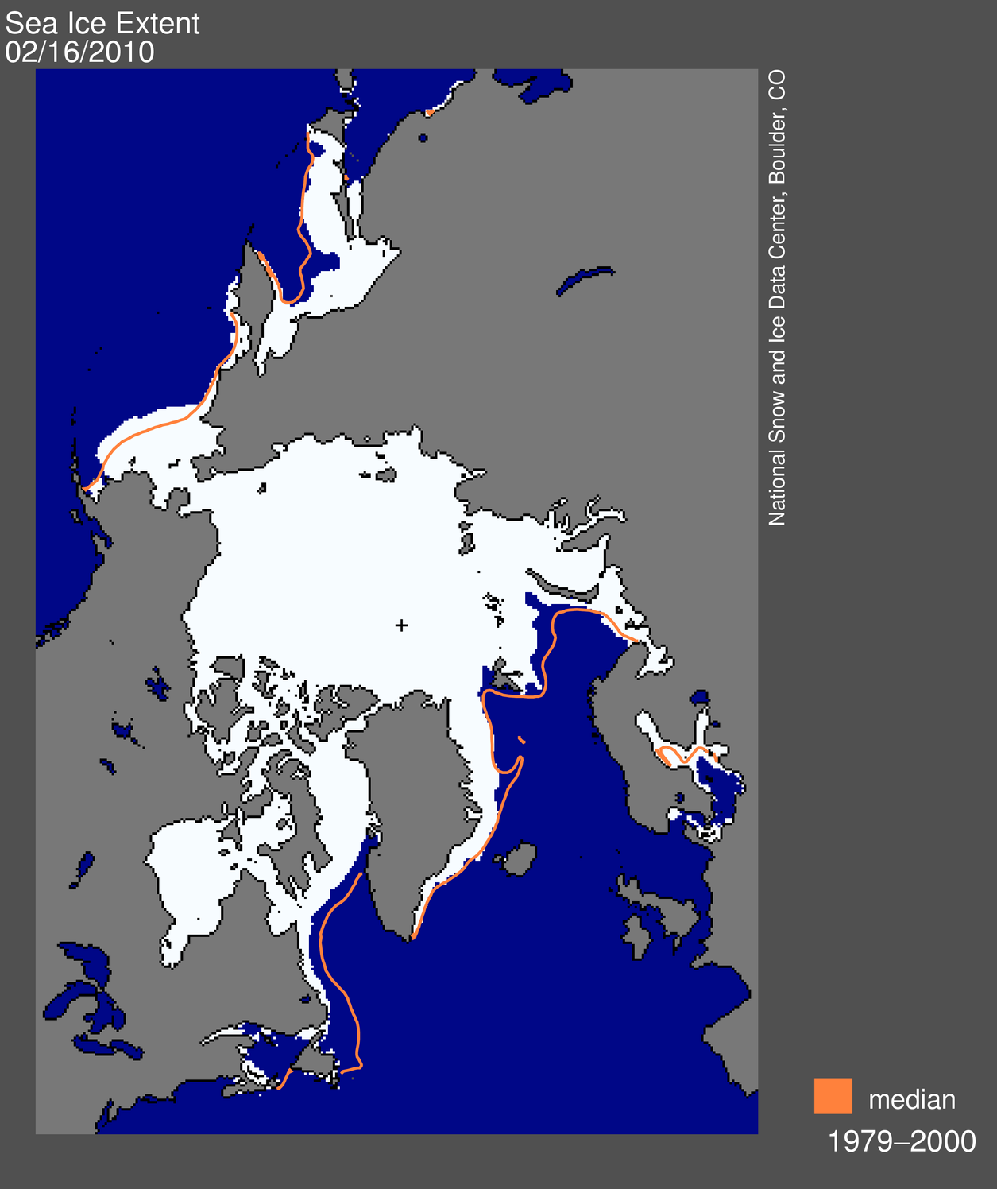
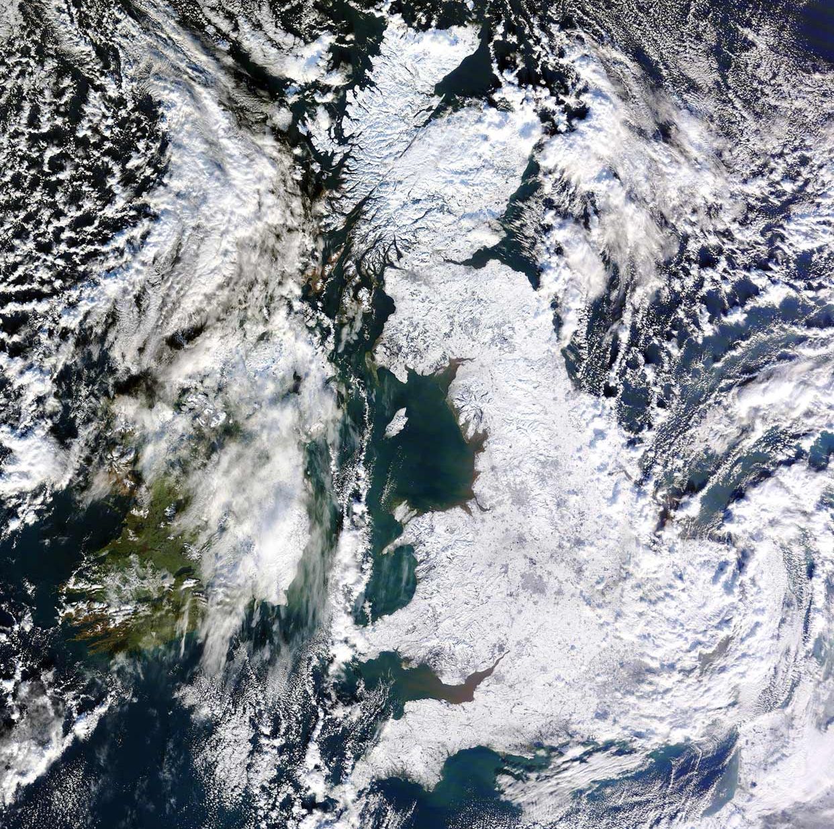
Winter 2009−2010: North Atlantic Blocking – Episodes I and II
Impact: Upstream warmth and ultimate influence on polar ice cover
Impact: Downstream snow storms and unprecedented snow cover
16 Feb 2010 Sea Ice Extent
7 Jan 2010 Visible Image
Glasgow
Dublin
London
Source: National Snow and Ice Data Center
Source: MODIS Rapid Fire Online Server

Slide 18
Winter 2009−2010: Extreme Weather Events
 | Day | Month | Year | Event
Dec 2009 | 8−10 | Dec | 2009 | “Coast-to-Coast” Storm (influenced by Typhoon Nida)
 | 20 | Dec | 2009 | Mid-Atlantic (I) and Southeast New England Snowstorm
Jan 2010 | 14 | Jan | 2010 | Two-week cold air outbreak sets records in Florida
 | 22 | Jan | 2010 | Record-breaking West Coast Wind/Rain Storm
 | 24−25 | Jan | 2010 | Midwest Snowstorm
 | 29−30 | Jan | 2010 | Southern Plains Ice Storm
Feb 2010 | 6 | Feb | 2010 | Mid-Atlantic Snowstorm (II)
 | 10−11 | Feb | 2010 | Mid-Atlantic Snowstorm (III)
 | 15 | Feb | 2010 | Second cold air outbreak sets records in Florida

Slide 19
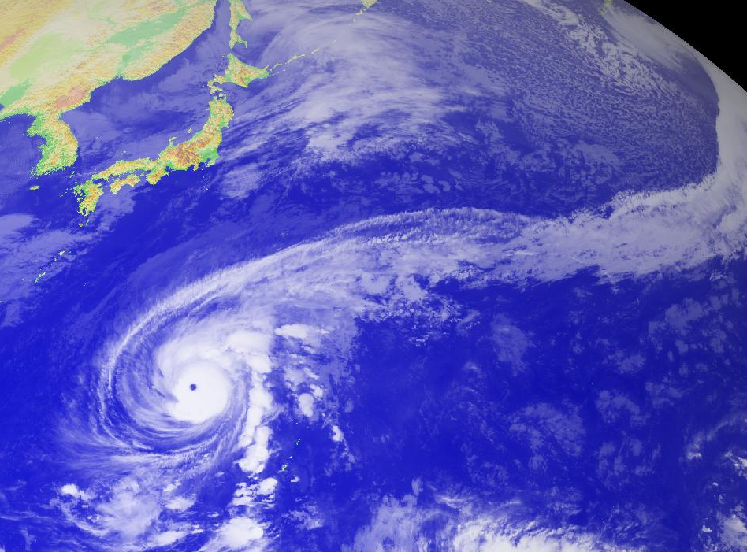
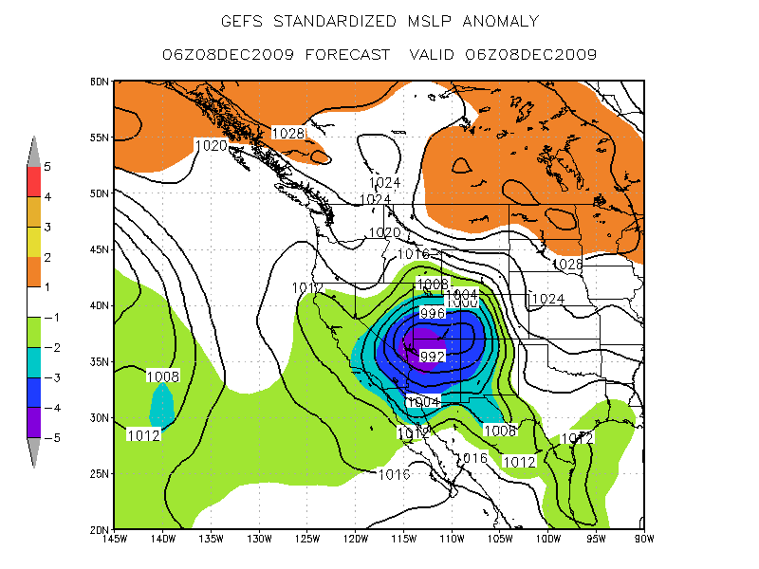
Pacific precursors and “Coast-to-Coast” Storm
27 November to 9 December 2009
SD
1800 UTC 27 November
0600 UTC 8 December
L
992
Typhoon Nida
Satellite imagery courtesy Digital Typhoon
GFS SLP and Anomaly courtesy Rich Grumm
TY Nida as a moisture source for mid-Pacific cyclones
Mid-Pacific cyclones build Alaskan ridge/block
Downstream development/coast-to-coast storm

Slide 20
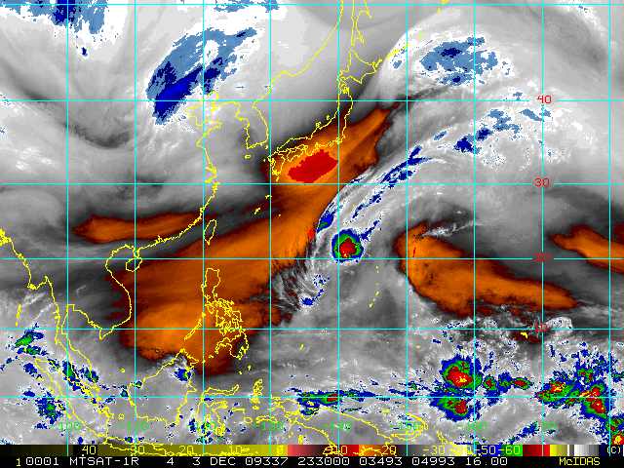
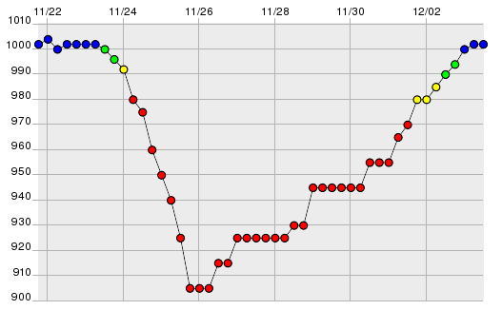
Pacific Precursors and the “Coast-to-Coast Storm”
Water Vapor: 2330 UTC 3 Dec
SLP vs. Time (22 Nov – 3 Dec)
Nida

Slide 21
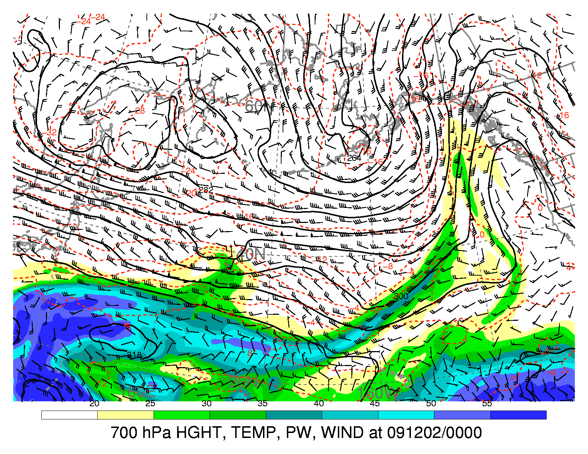
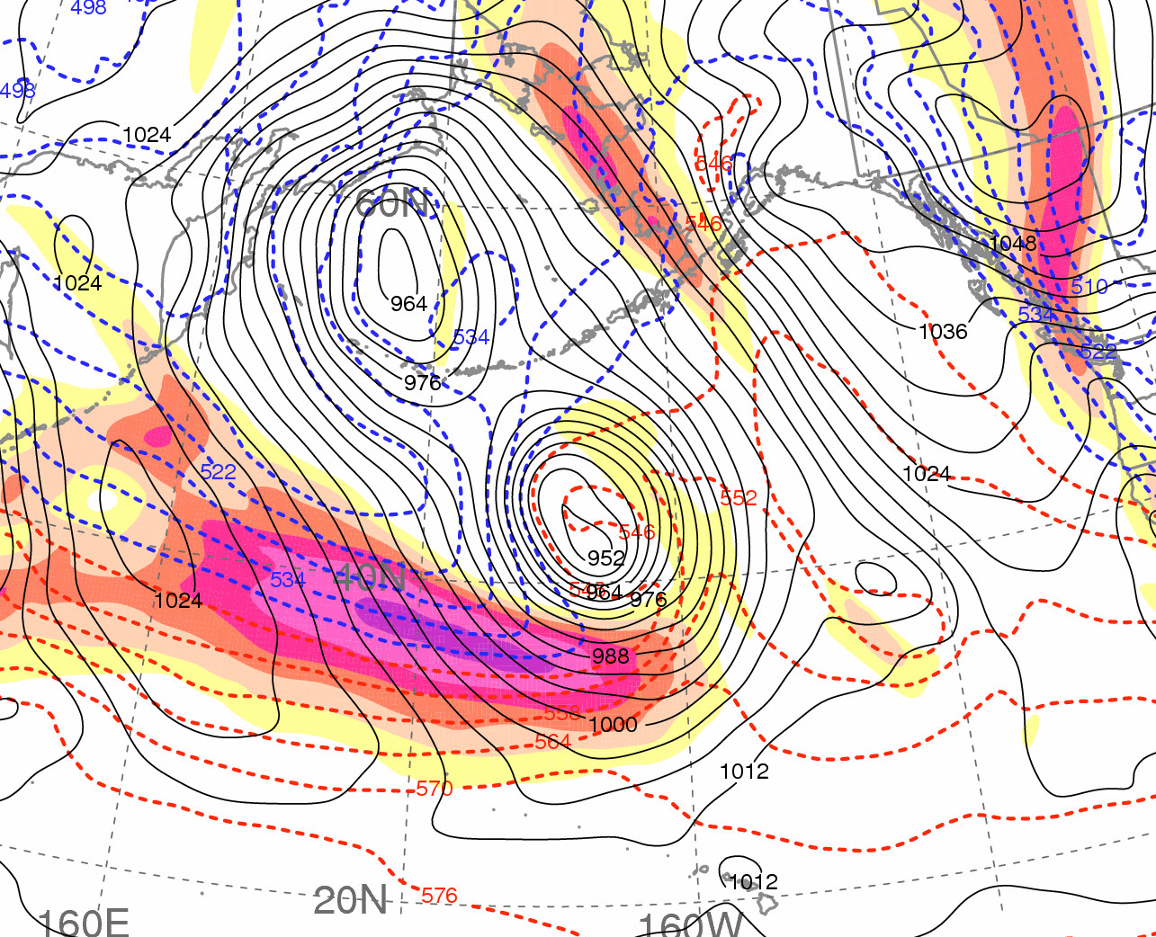
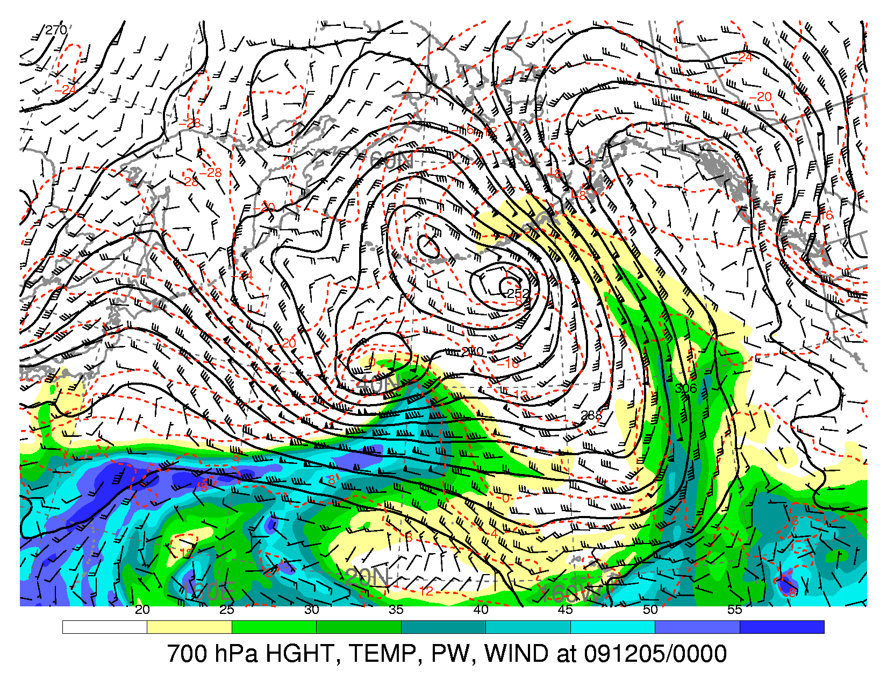
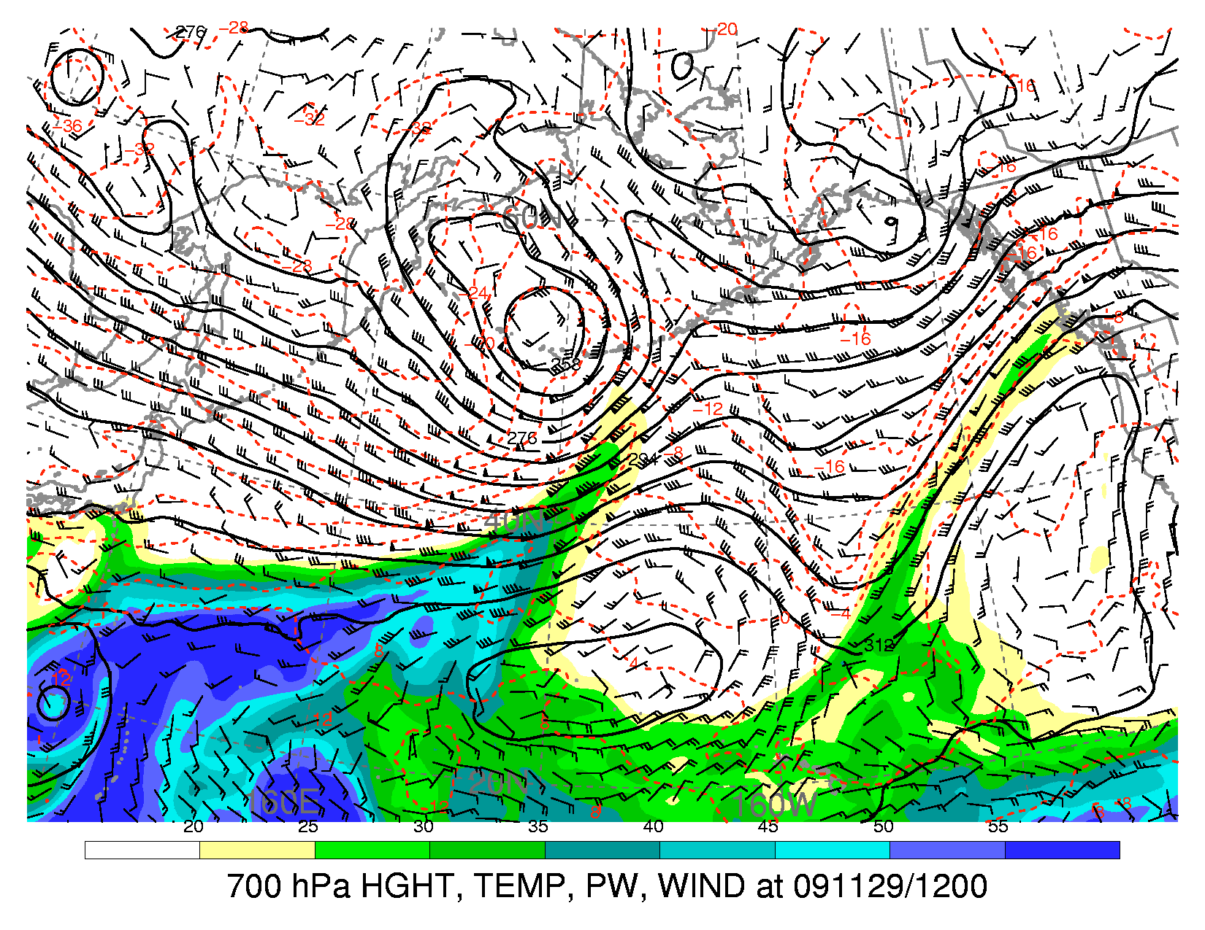
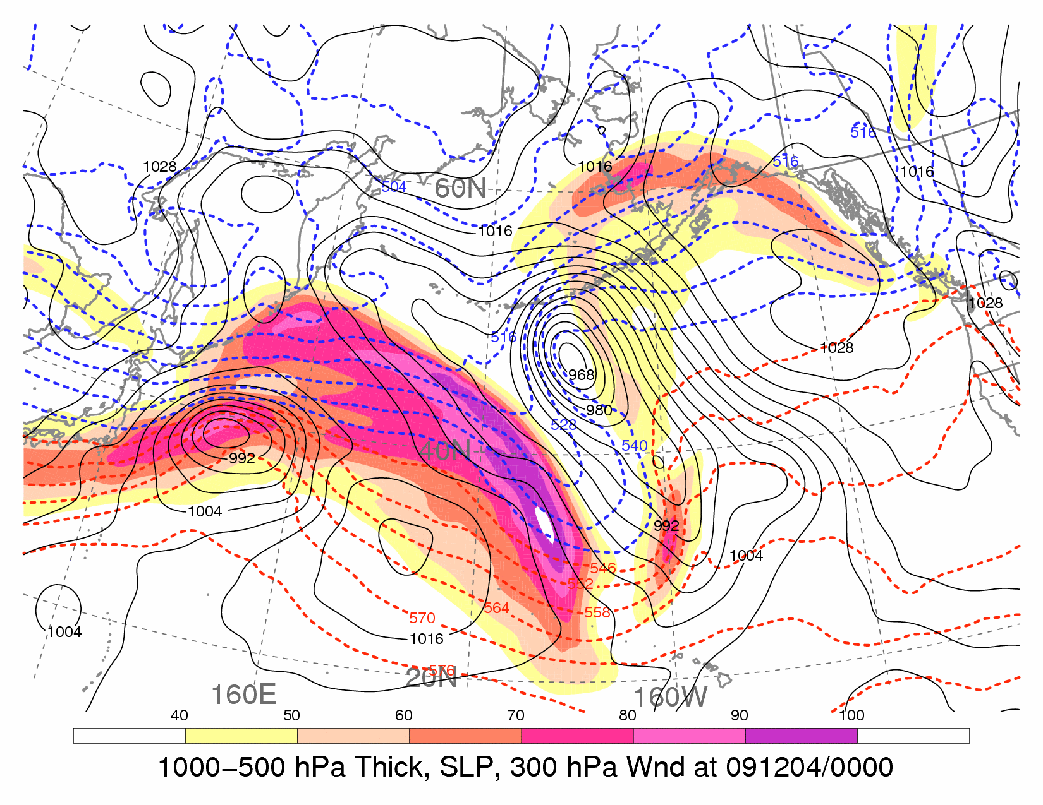
Pacific precursors and “Coast-to-Coast” Storm
700-hPa Geo. Height (dam; solid black),
Temperature (°C; dashed red),
Wind (kt; barbs), and
Precipitable Water (mm; shaded)
1000−500-hPa Thickness (dam; dashed),
SLP (hPa; solid black), and
300-hPa Wind Speed (m s⁻¹; shaded)
a) 0000 UTC 2 December
c) 0000 UTC 6 December
Russia
Alaska
US
H
1056
Japan
3
2
1
L
964
Nida
b) 0000 UTC 5 December
L
952
540
Japan
US
3
4
Nida
PW > 25 mm
Hawaii
Data: 1.0° NCEP−GFS Analyses
Data: 1.0° NCEP−GFS Analyses
20
25
30
35
40
45
50
55 mm
40
50
60
70
80
90
100 m s⁻¹

Slide 22
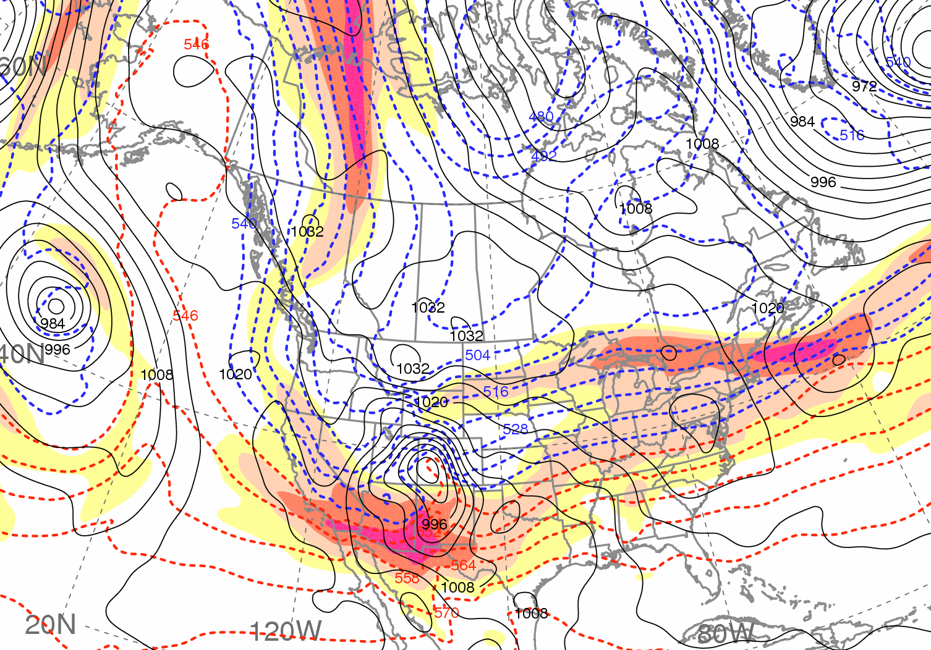
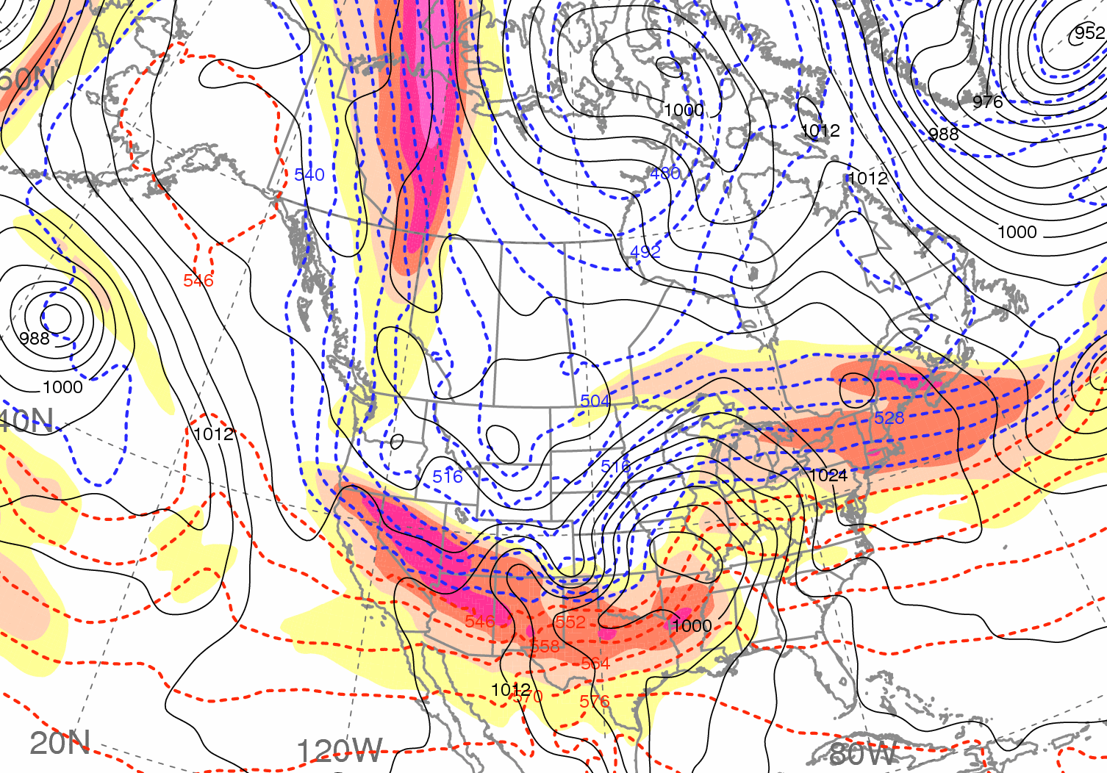
Pacific Precursors and the “Coast-to-Coast Storm”
1200 UTC 8 December
0000 UTC 9 December
H
H
H
H
L
L
40
50
60
70
80
90
100 m s⁻¹
1000−500-hPa Thickness (dam; dashed), SLP (hPa; solid black),
and 300-hPa Wind Speed (m s⁻¹; shaded)

Slide 23
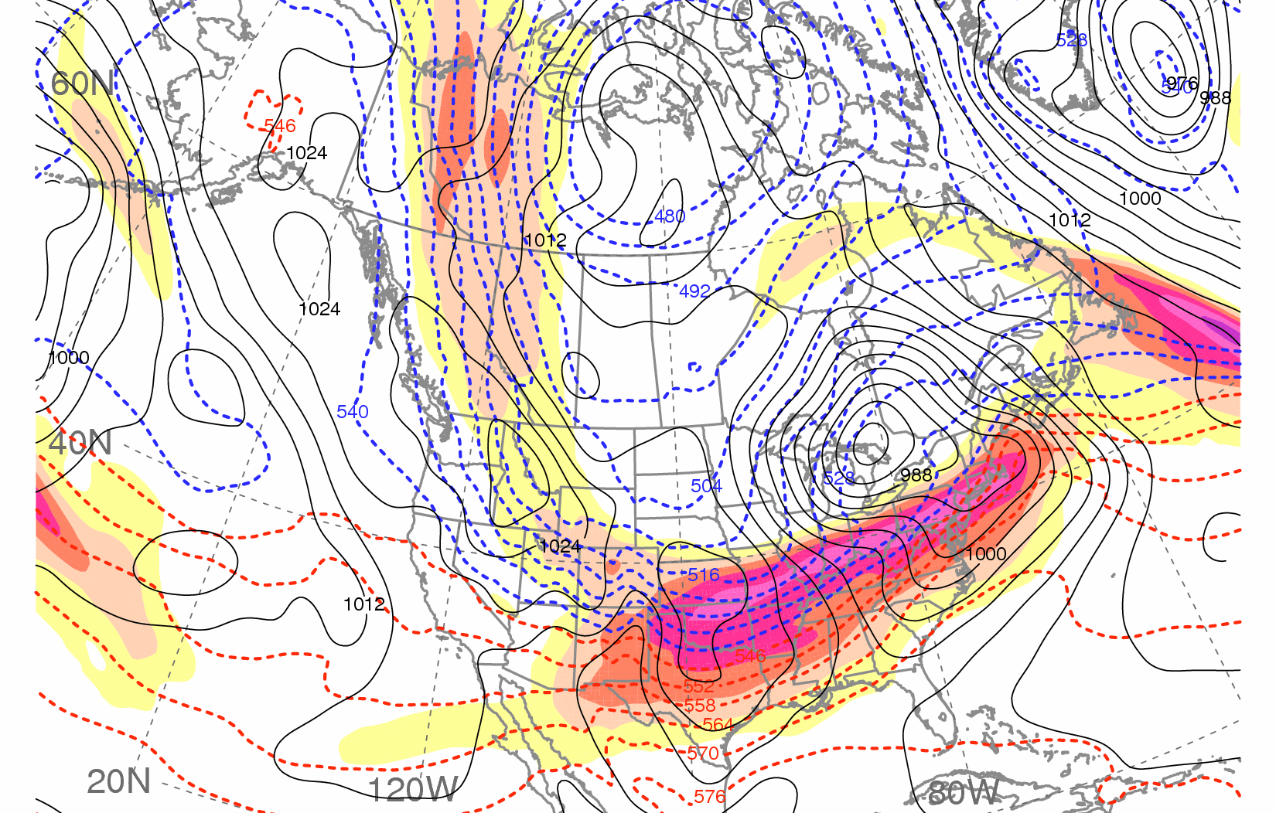
Pacific Precursors and the “Coast-to-Coast Storm”
0000 UTC 10 December
H
L
L
40
50
60
70
80
90
100 m s⁻¹
1000−500-hPa Thickness (dam; dashed), SLP (hPa; solid black),
and 300-hPa Wind Speed (m s⁻¹; shaded)

Slide 24
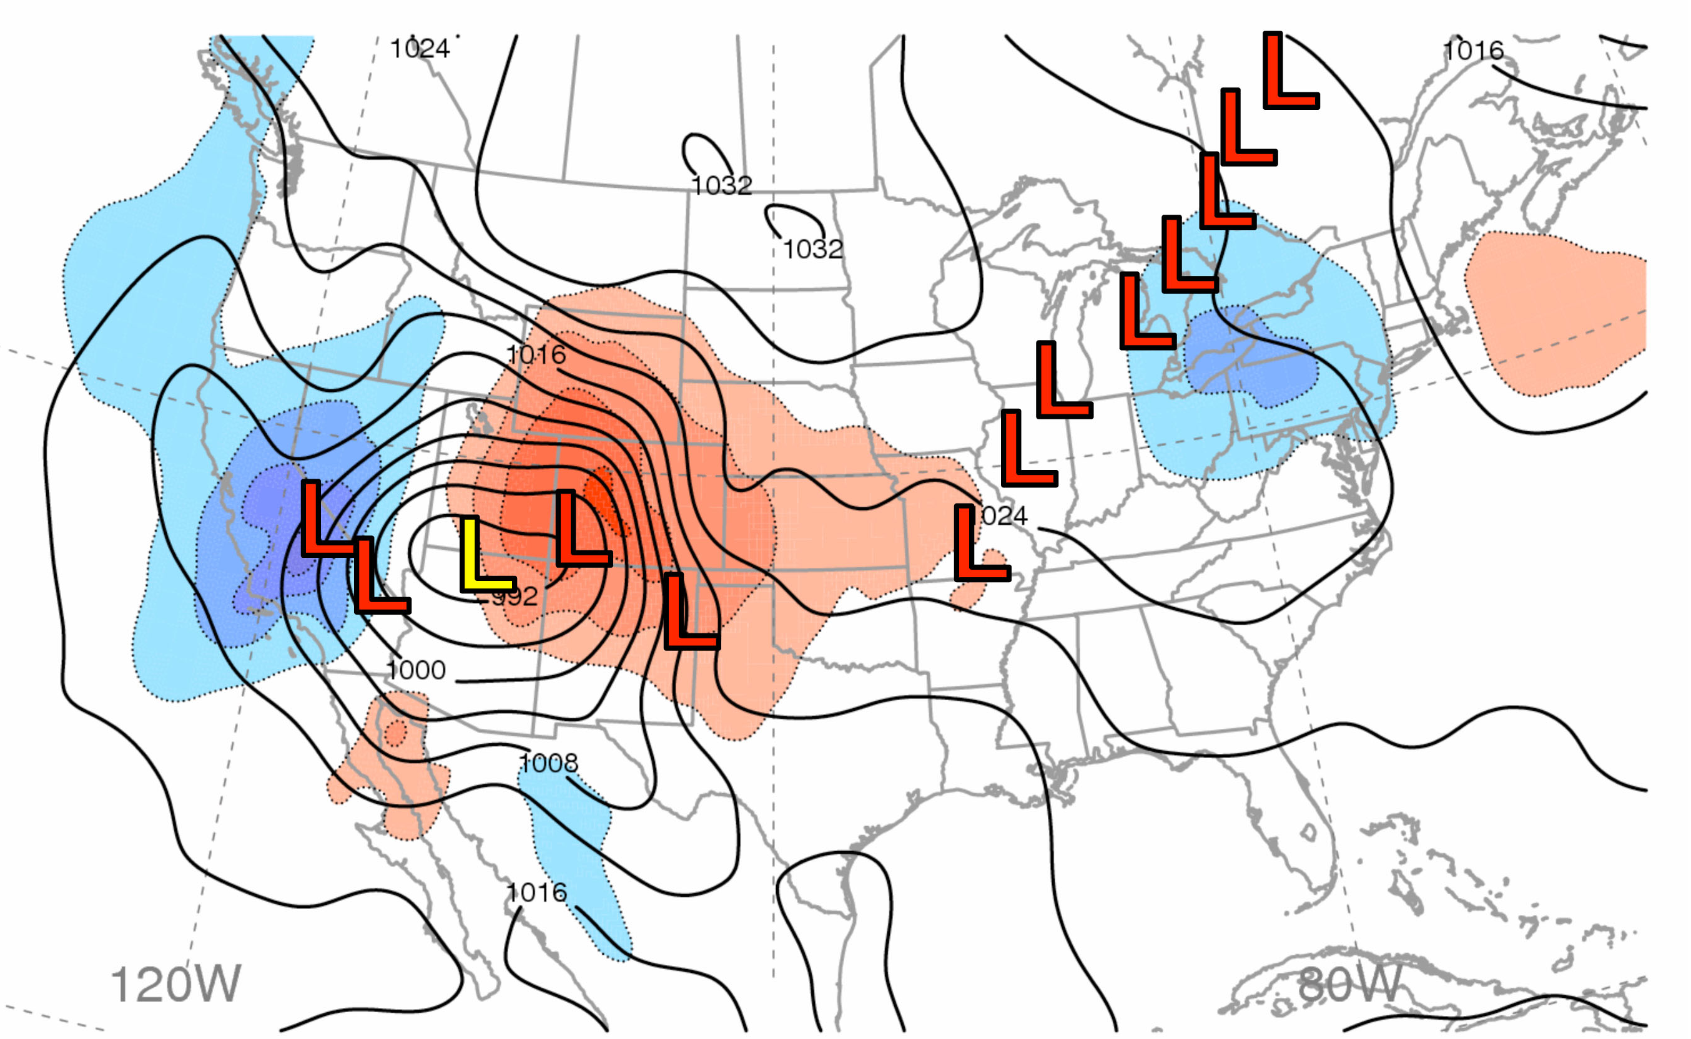
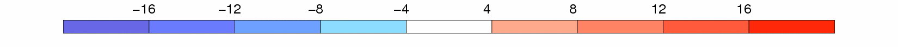
“Coast-to-Coast” Storm
700-hPa QG Forcing (RHS of Q-vector Eqn; shaded, 10⁻¹¹ Pa m⁻² s⁻¹) and SLP (black, every 4 hPa) at 0600 UTC 8 Dec 2009; L’s denote 6-hourly surface low positions for
1800 UTC 7 Dec – 0000 UTC 11 Dec 2009
00Z 11 Dec
0600 UTC 8 December 2009:
L
00Z 10 Dec
L
L
Coastal
Redevelopment
of “Coast-to-
Coast” Storm
Snow/wind
06Z 8 Dec
00Z 9 Dec
Data: 1.0° NCEP−GFS Analyses
× 10⁻¹¹ Pa m⁻² s⁻¹

Slide 25
Part IV: Screaming Eastern Pacific Jet and the Downstream Impact
16 Jan 2010 – 25 Jan 2010
STJ strengthens/expands eastward across Pacific
AO phase is briefly positive
Downstream flow amplifies; major western U.S. storm
Brief El Nino signature over western U.S.
Significant full-latitude trough over eastern U.S.

Slide 26
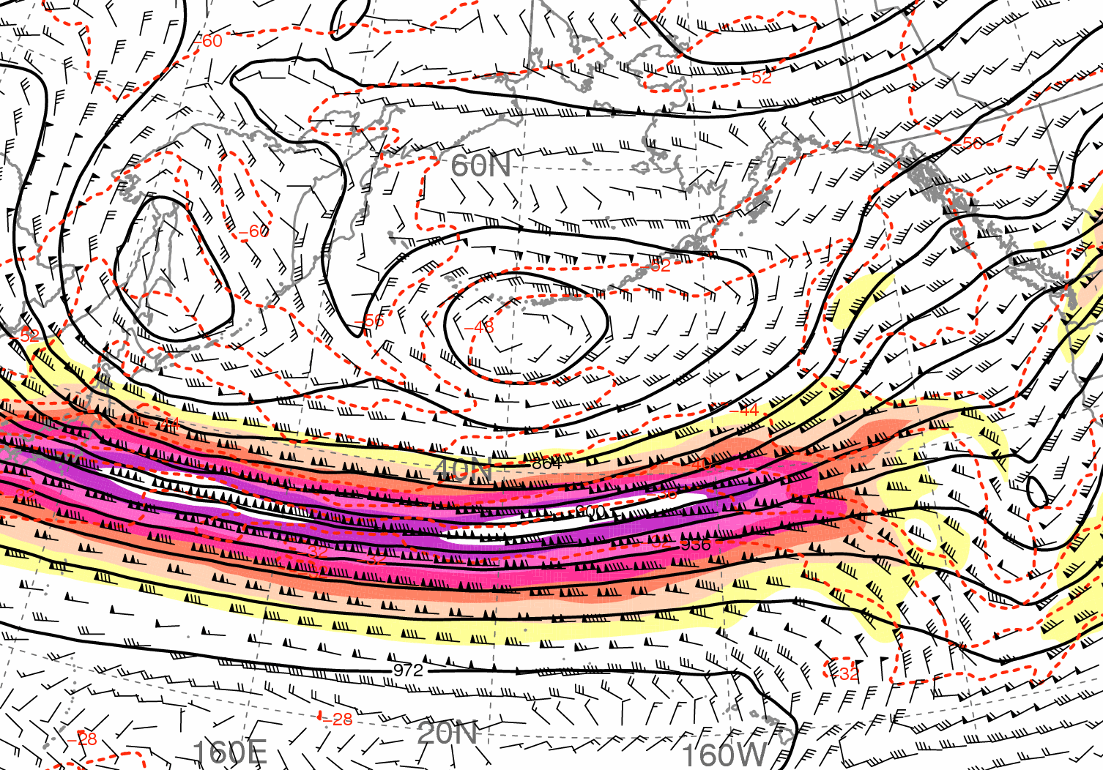
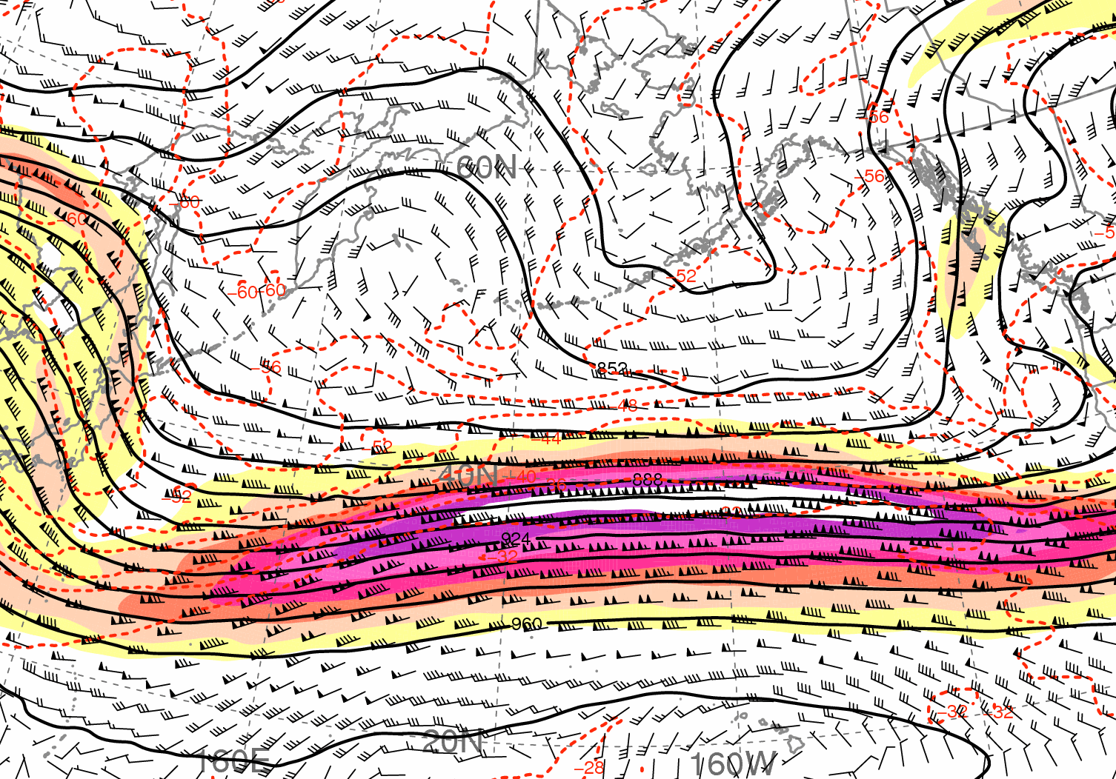
Screaming Eastern Pacific Jet and Downstream Impact
0000 UTC 16 January
0000 UTC 19 January
40
50
60
70
80
90
100 m s⁻¹
300-hPa Geo. Height (dam; solid), Temperature (°C; dashed), Wind (kt; barbs),
and Wind Speed (m s⁻¹; shaded)

Slide 27
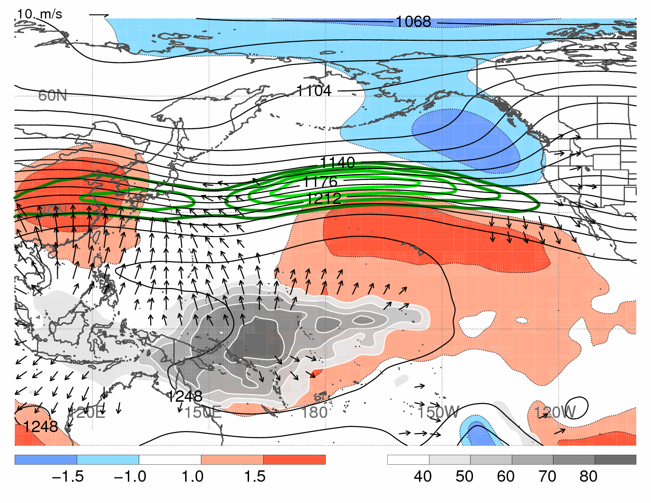
4. Screaming East Pacific Jet and Downstream Impact
400–100-hPa Rel. Humidity (%; gray shading, south of 20°N); 200-hPa Wind Speed (green every 10 m s⁻¹, starting at 60 m s⁻¹), Irrot. Wind (vectors, above 5 m s⁻¹ only), Geo. Height (black every 12 dam) and Anomaly (std dev, color shading)
15–20 January 2010
10 m s⁻¹
Data: 1.0° NCEP−GFS Analyses
⁻
⁺
⁺
MJO
STD DEV
%

Slide 28
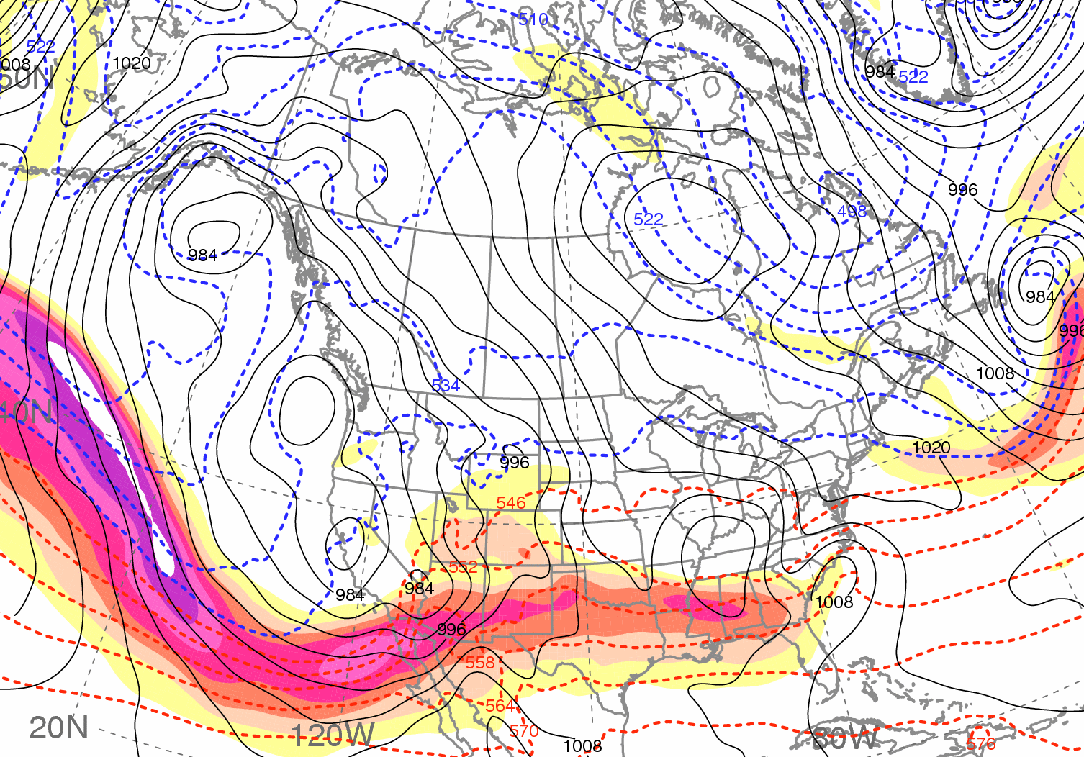
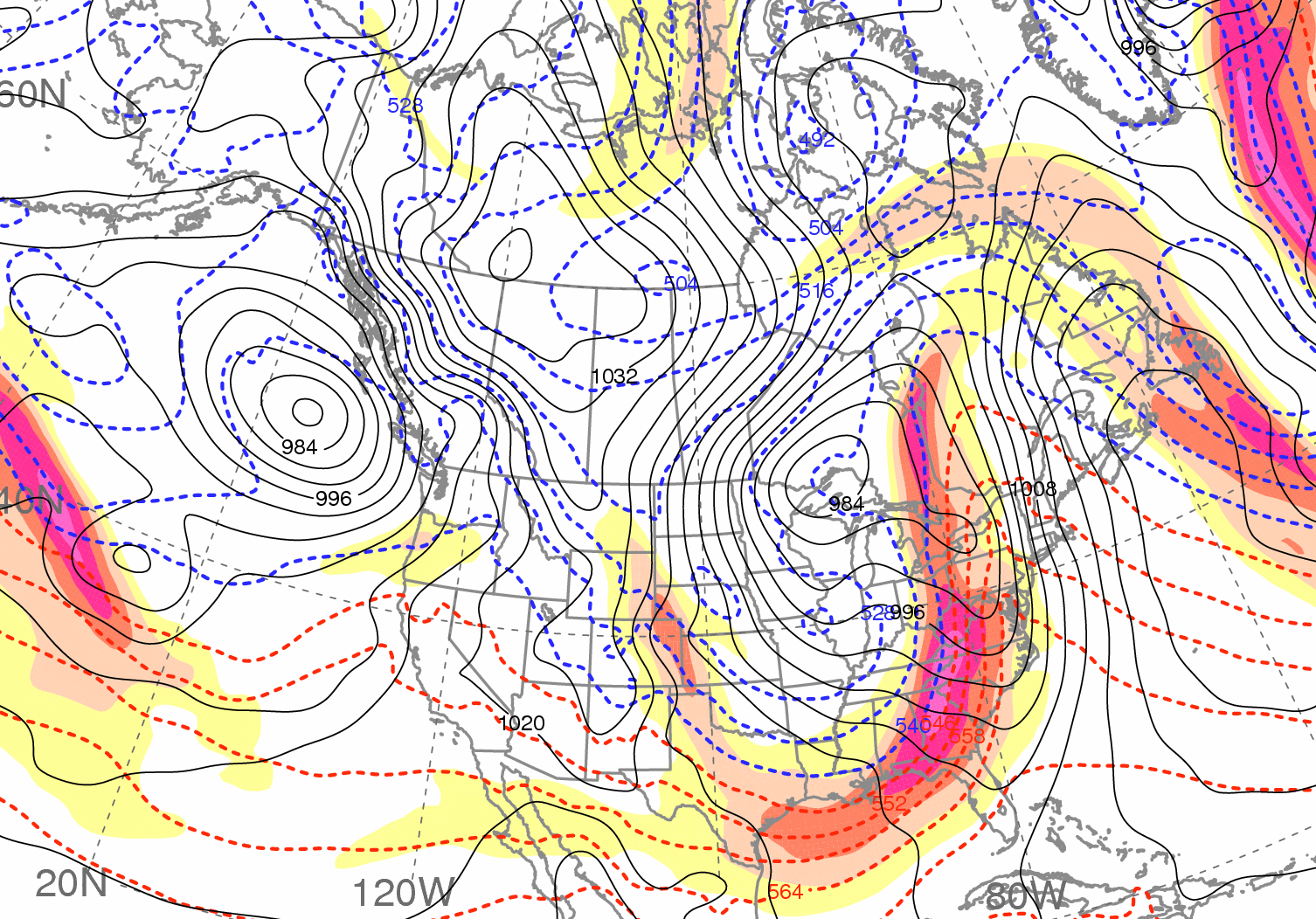
Screaming Eastern Pacific Jet and Downstream Impact
0000 UTC 22 January
1200 UTC 25 January
L
L
40
50
60
70
80
90
100 m s⁻¹
1000−500-hPa Thickness (dam; dashed), SLP (hPa; solid black),
and 300-hPa Wind Speed (m s⁻¹; shaded)

Slide 29
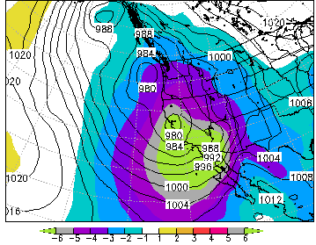
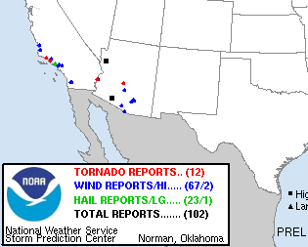
4. Screaming East Pacific Jet and Downstream Impact
All-Time Minimum SLP Records 21−22 Jan 2010
978-hPa: Medford, OR | 983-hPa: Las Vegas, NV
979-hPa: Eureka, CA | 984-hPa: L.A., CA
979-hPa: Reno, NV | 987-hPa: San Diego, CA
980-hPa: SLC, UT | 989-hPa: Phoenix, AZ
22 Jan GFS SLP and Anomaly
Image courtesy Rich Grumm
All-Time Wind Records 21−22 January 2010
88 knots: Kingman, AZ
82 knots: Ajo, AZ
81 knots: Newport Beach, CA
80 knots: Huntington Beach, CA
21 Jan SPC Storm Reports

Slide 30
Conclusions
Anomalous high-impact extreme weather events occurred on intraseasonal time scales during an unusual NH flow pattern characterized by negative AO and El Niño conditions
TC Nida acted as a catalyst for tropical moisture surges that contributed to Alaskan blocking, downstream development, and the “Coast-to-Coast” Storm
“Coast-to-coast” Storm contributed to first North Atlantic blocking episode; continued western Atlantic storminess helped initiate second blocking episode
Screaming jet, downstream development, a second western U.S. storm, and short-lived positive AO marked onset of a brief El Niño signature over western U.S.
Contact: bosart@atmos.albany.edu, heathera@atmos.albany.edu, cordeira@atmos.albany.edu

Slide 31
Winter 2010–2011

Slide 32
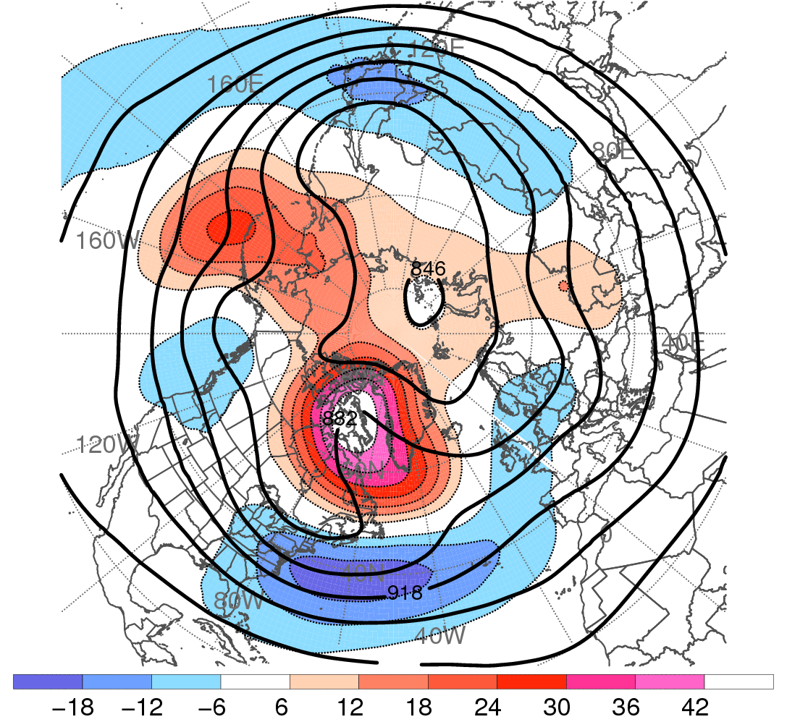
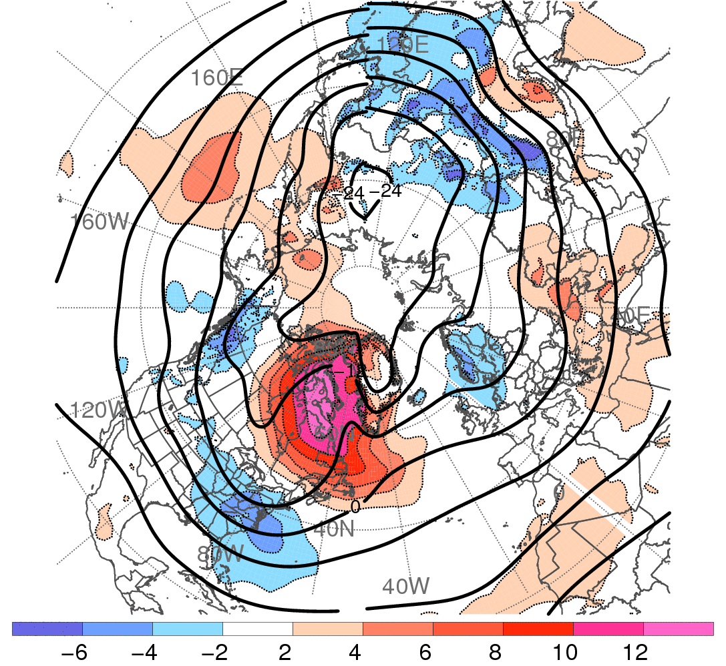
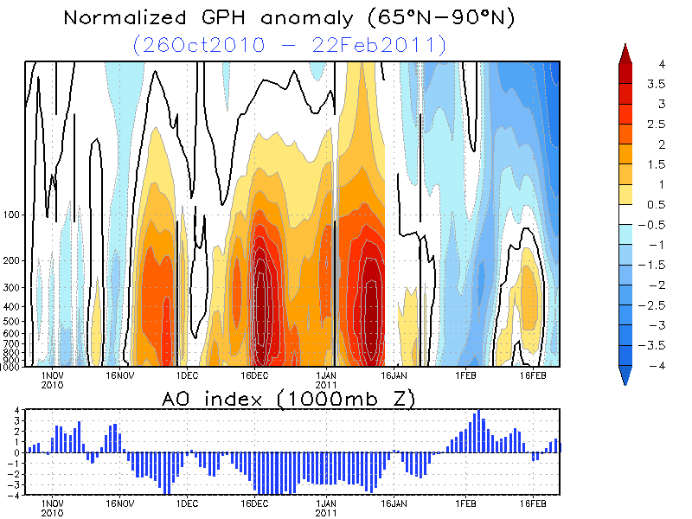
Winter 2010–2011: Blocked Flow Pattern
300-hPa Geo. Height (contoured, dam)
and Geo. Height Anomaly (shaded, dam)
850-hPa Temperature (contoured, °C)
and Temperature Anomaly (shaded, °C)
−
15 Dec 2010
to
15 Jan 2011
−
+
+
+
+
−
−
Data: 1.0° NCEP−GFS Analyses
Data: 1.0° NCEP−GFS Analyses
dam
°C
CPC AO Index: 1 Dec 2010 – 15 Feb 2010
+4
+4
Source: Climate Prediction Center
Index (SD)
0
0
-4
-4
1 Dec 10
16 Dec 10
1 Jan 11
16 Jan 11
1 Feb 11

Slide 33
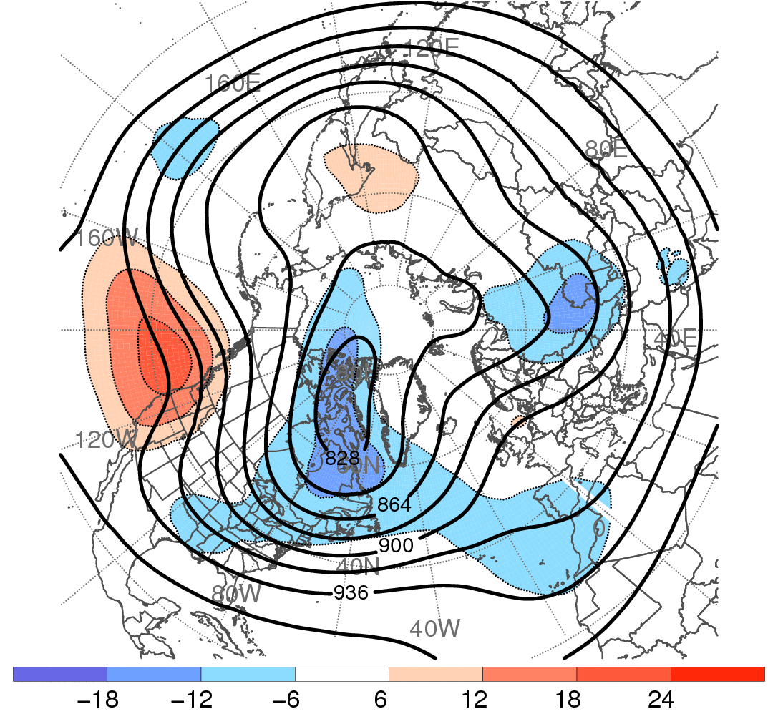
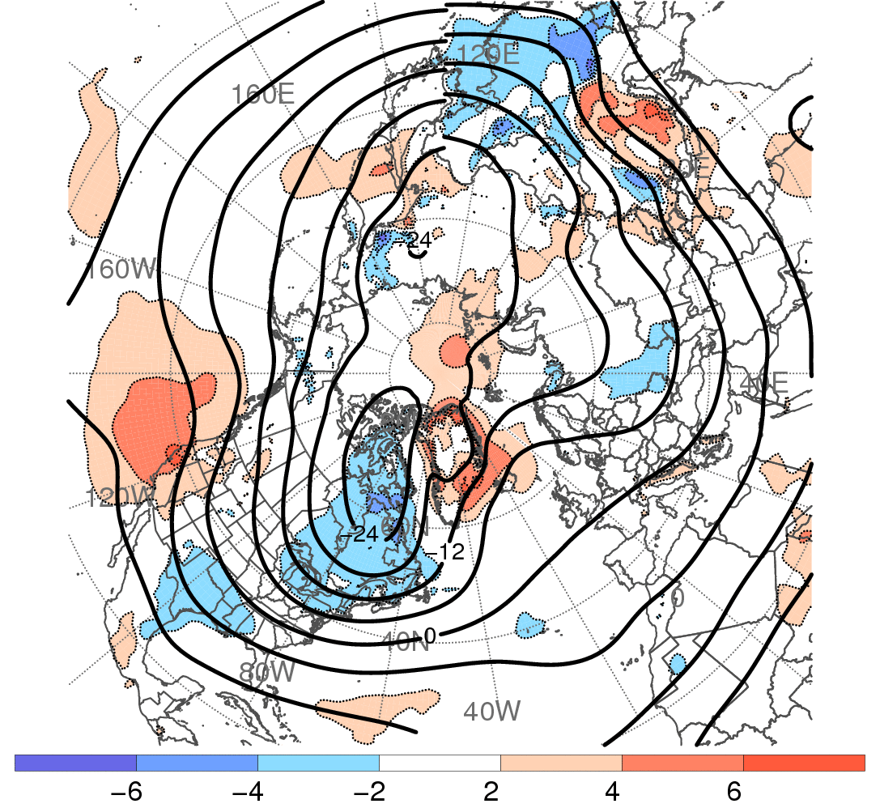
Winter 2010–2011: Transitioning Flow Pattern
300-hPa Geo. Height (contoured, dam)
and Geo. Height Anomaly (shaded, dam)
850-hPa Temperature (contoured, °C)
and Temperature Anomaly (shaded, °C)
15 Jan 2011
to
15 Feb 2011
−
−
−
+
+
−
+
−
Data: 1.0° NCEP−GFS Analyses
Data: 1.0° NCEP−GFS Analyses
dam
°C
CPC AO Index: 1 Dec 2010 – 15 Feb 2010
+4
+4
Source: Climate Prediction Center
Index (SD)
0
0
-4
-4
1 Dec 10
16 Dec 10
1 Jan 11
16 Jan 11
1 Feb 11

Slide 34
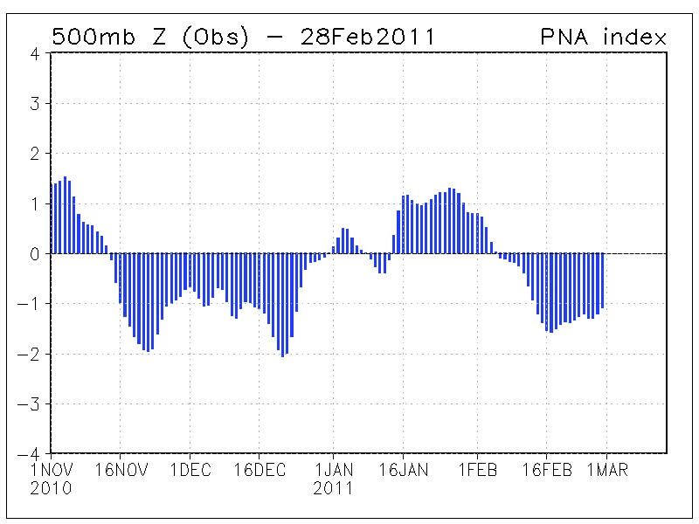
Winter 2010–2011: Transitioning Flow Pattern
300-hPa Geo. Height (contoured, dam)
and Geo. Height Anomaly (shaded, dam)
850-hPa Temperature (contoured, °C)
and Temperature Anomaly (shaded, °C)
15 Jan 2011
to
15 Feb 2011
−
−
−
+
+
−
+
−
Data: 1.0° NCEP−GFS Analyses
Data: 1.0° NCEP−GFS Analyses
dam
°C
CPC PNA Index: 1 Dec 2010 – 15 Feb 2010
+2
+2
Source: Climate Prediction Center
Source: Climate Prediction Center
Index (SD)
0
0
Index (SD)
-2
-2
1 Dec 10
16 Dec 10
1 Jan 11
16 Jan 11
1 Feb 11

Slide 35
Weather Variability within
These Large-Scale Flow Patterns

Slide 36
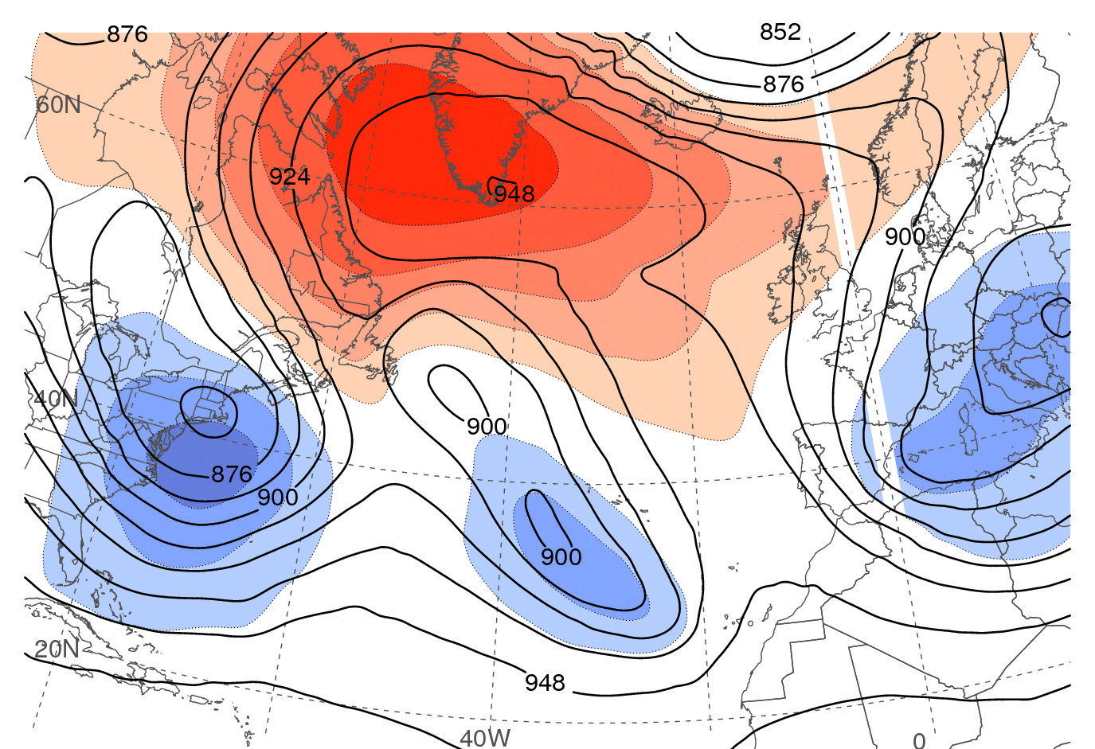
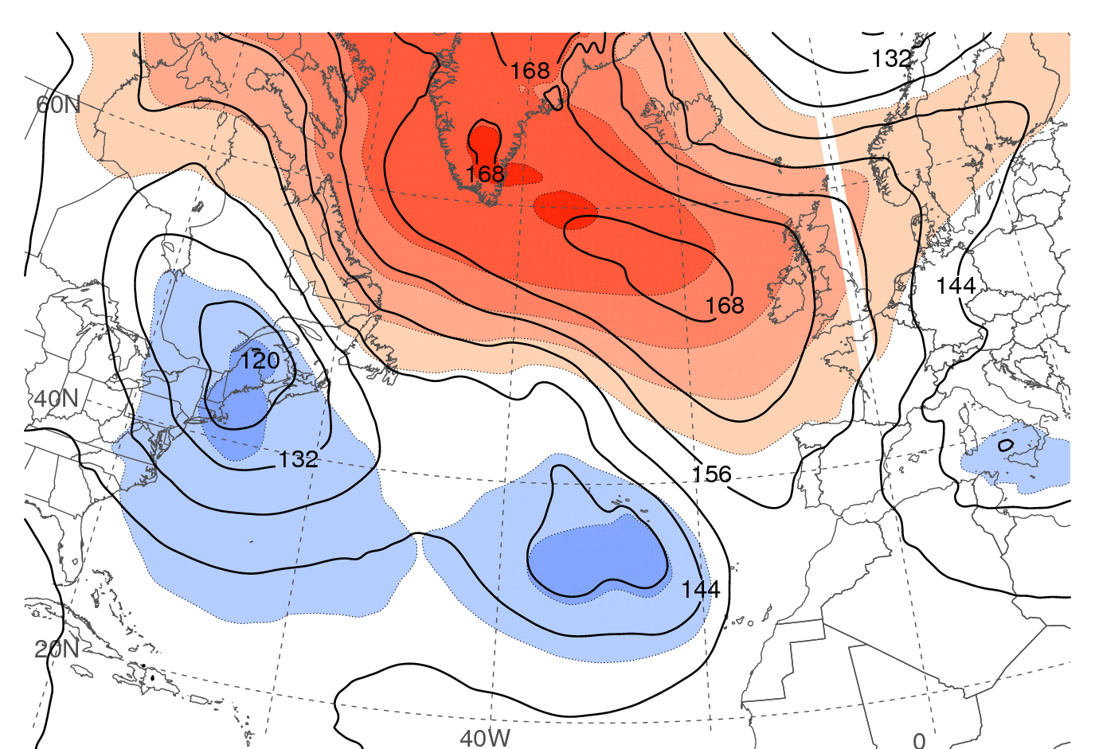
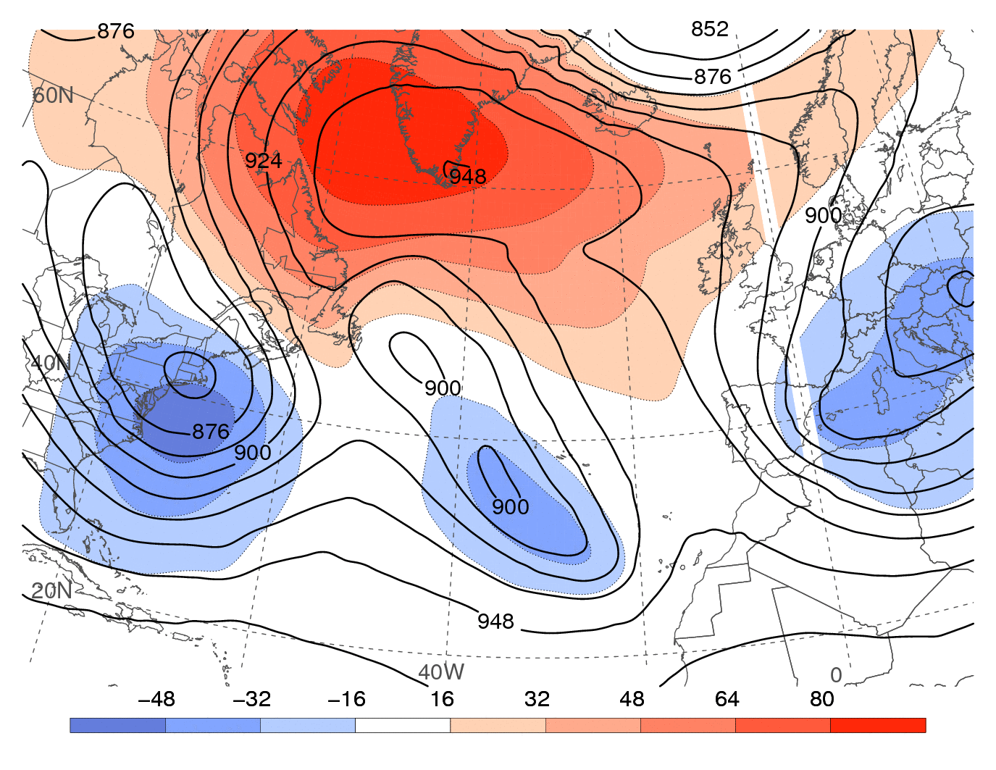
Winter 2010−2011: Blocked Flow Pattern
300-hPa HGHT (solid, dam) and
HGHT ANOM (departure from long-term
climatology, shaded, dam)
850-hPa HGHT (solid, dam) and
HGHT ANOM (departure from long-term
climatology, shaded, dam)
dam
-48 -32 -16 16 32 48 64 80
dam
-24 -16 -8 8 16 2 32 40
1200 UTC 15 Dec 2010

Slide 37
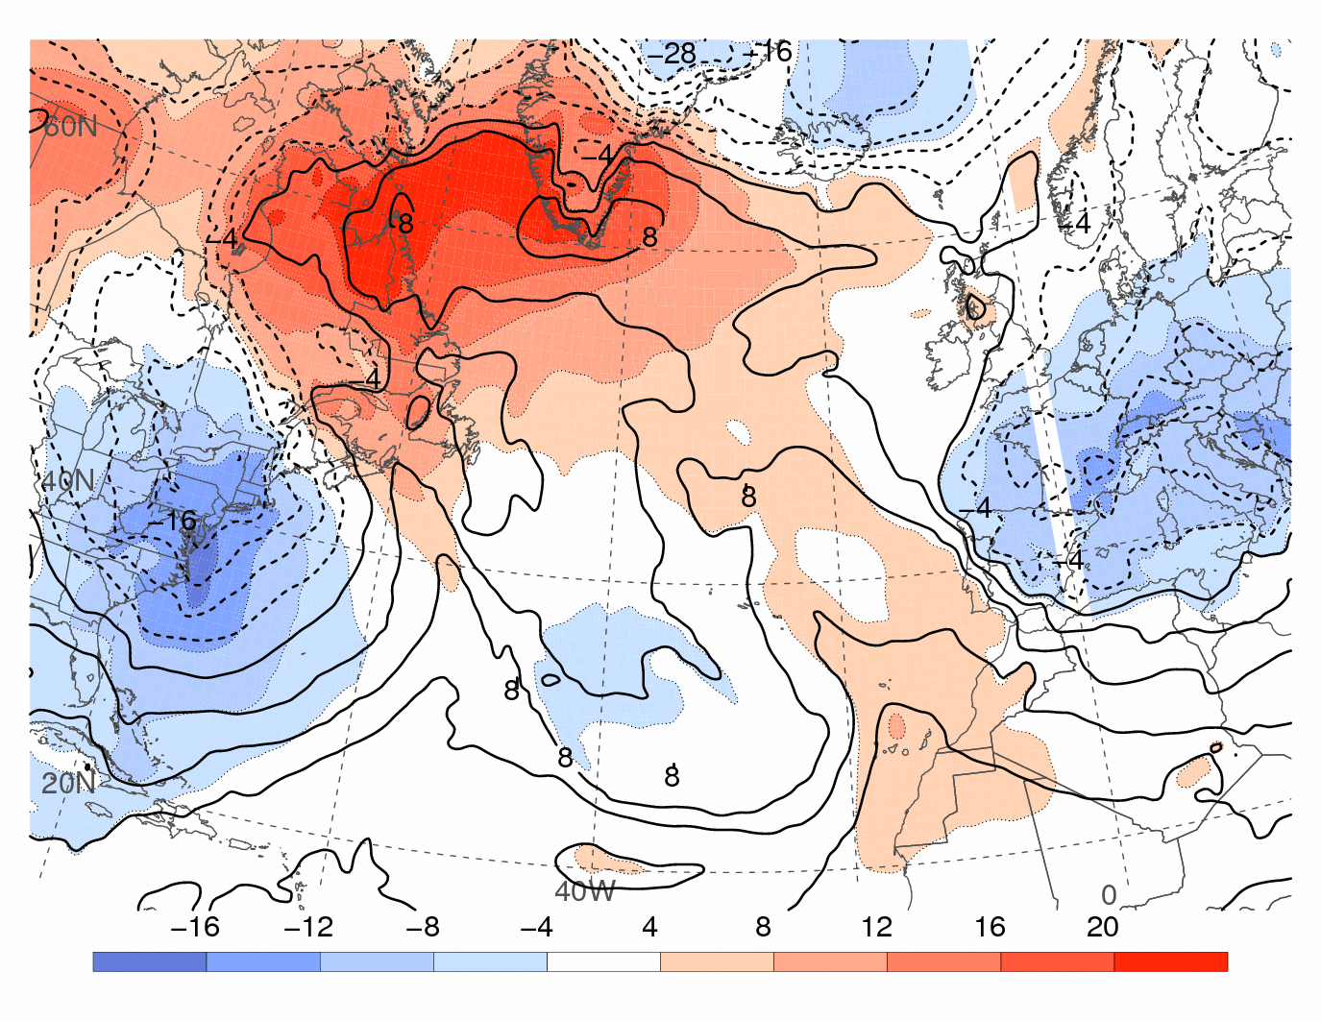


Winter 2010−2011: Blocked Flow Pattern
850-hPa TEMP (solid, °C) and
TEMP ANOM (departure from long-term
climatology, shaded, °C)
1000–500-hPa THICK (dashed, dam),
PRECIP WATER (mm, gray shading), SLP
(solid contours, hPa), and 250-hPa
WND SPEED (m s⁻¹, color shading)
-16 -12 -8 -4 4 8 12 16 20
20 25 30 35 40 45
°C
mm
50 60 70 80 90 100
m s⁻¹
1200 UTC 15 Dec 2010

Slide 38


2010−2011 Regimes: Blocked Flow Pattern
Mild, onshore flow over eastern Canada limits extent of sea ice
Anomalous cold air over northern Europe promotes extensive U.K. snow cover
2 Jan 2011 Sea Ice Extent
24 Dec 2010 Visible Image
Glasgow
Dublin
London
Source: National Snow and Ice Data Center
Source: MODIS Rapid Fire Online Server

Slide 39

Hudson Bay Ice Extent: 26 Nov–28 Jan (2006/07–2010/11)
2010/2011

Slide 40
Weather Highlights: December 2010 through February 2011
 | Day | Month | Year | Event
Dec 2010 | 10−12 | Dec | 2010 | Heavy rain in Pacific Northwest
 | 18−22 | Dec | 2010 | Heavy rain/snow in southern California
 | 26−27 | Dec | 2010 | Coastal Northeast snowstorm
 | 9−10 | Jan | 2011 | Southeast snow and ice storm
Jan 2011 | 18−19 | Jan | 2011 | NY/NJ and southern New England snowstorm
 | 20−21 | Jan | 2011 | Northeast snowstorm
 | 26−27 | Jan | 2011 | Northeast snowstorm
Feb 2011 | 1−3 | Feb | 2011 | Southern plains to lower Great Lakes snowstorm
 | 8−10 | Feb | 2011 | OK/AR snowstorm
 | 10 | Feb | 2011 | OK breaks all-time minimum temperature (−30.5°F)

Slide 41

Late Jan–Early Feb 2011: AO−/AO+ and PNA+/PNA− transition

Slide 42
1–3 February 2011 Snowstorm: 0000 UTC 1 Feb
1000–500-hPa THICK (dashed, dam), PRECIP WATER (mm, gray shading),
SLP (solid contours, hPa), and 250-hPa WND SPEED (m s⁻¹, color shading)
L
mm
m s⁻¹

Slide 43

1–3 February 2011 Snowstorm: 1200 UTC 1 Feb
1000–500-hPa THICK (dashed, dam), PRECIP WATER (mm, gray shading),
SLP (solid contours, hPa), and 250-hPa WND SPEED (m s⁻¹, color shading)
L
mm
m s⁻¹

Slide 44

1–3 February 2011 Snowstorm: 0000 UTC 2 Feb
1000–500-hPa THICK (dashed, dam), PRECIP WATER (mm, gray shading),
SLP (solid contours, hPa), and 250-hPa WND SPEED (m s⁻¹, color shading)
L
mm
m s⁻¹

Slide 45

1–3 February 2011 Snowstorm: 1200 UTC 2 Feb
1000–500-hPa THICK (dashed, dam), PRECIP WATER (mm, gray shading),
SLP (solid contours, hPa), and 250-hPa WND SPEED (m s⁻¹, color shading)
L
mm
m s⁻¹

Slide 46

1–3 February 2011 Snowstorm: 0000 UTC 3 Feb
1000–500-hPa THICK (dashed, dam), PRECIP WATER (mm, gray shading),
SLP (solid contours, hPa), and 250-hPa WND SPEED (m s⁻¹, color shading)
L
mm
m s⁻¹

Slide 47

1–3 February 2011 Snowstorm: 0000 UTC 1 Feb
250-hPa WND (m s⁻¹, color shading), POT VORT (PVU, solid gray), REL HUM (%, gray shading); 300–200-hPa IRROT WND (vectors, m s⁻¹) and 600–400-hPa OMEG
(red, every 5 x 10⁻³ hPa s⁻¹, neg. values only)
L
%
%
%
m s⁻¹

Slide 48

1–3 February 2011 Snowstorm: 1200 UTC 1 Feb
250-hPa WND (m s⁻¹, color shading), POT VORT (PVU, solid gray), REL HUM (%, gray shading); 300–200-hPa IRROT WND (vectors, m s⁻¹) and 600–400-hPa OMEG
(red, every 5 x 10⁻³ hPa s⁻¹, neg. values only)
L
%
%
%
m s⁻¹

Slide 49

1–3 February 2011 Snowstorm: 0000 UTC 2 Feb
250-hPa WND (m s⁻¹, color shading), POT VORT (PVU, solid gray), REL HUM (%, gray shading); 300–200-hPa IRROT WND (vectors, m s⁻¹) and 600–400-hPa OMEG
(red, every 5 x 10⁻³ hPa s⁻¹, neg. values only)
L
%
%
%
m s⁻¹

Slide 50

1–3 February 2011 Snowstorm

Slide 51


1–3 February 2011 Snowstorm
Daily Snow, Precipitation, and Temperature Records for 30 Jan–5 Feb 2011
GOES East IR Satellite Image: 3:01 pm EST on 1 Feb 2011
Images taken from Weekly Weather and Crop Bulletin

Slide 52

Extensive Snow Cover: January–February 2011
Snow Depth: 27 January 2011
NOAA National Operational Hydrologic Remote Sensing Center

Slide 53

Extensive Snow Cover: January–February 2011
Snow Depth: 3 February 2011
NOAA National Operational Hydrologic Remote Sensing Center

Slide 54

Extensive Snow Cover: January–February 2011
Snow Depth: 10 February 2011
NOAA National Operational Hydrologic Remote Sensing Center

Slide 55
Summary
Extreme winter weather can be related to:
  Amplified flow pattern allowing mild Atlantic air to reach eastern Canada and cold air to reach western Europe and the southern U.S.
  Cold high pressure systems that deliver cold air to the southern U.S.
  Extensive snow cover at lower latitudes east of the Rockies that reinforces frontal boundaries
  Frequent storminess along these reinforced frontal boundaries
Contact: bosart@atmos.albany.edu, heathera@atmos.albany.edu, cordeira@atmos.albany.edu

Slide 56
The CONUS Continental “Bomb” of 25-26 October 2010

Slide 57


Cyclone statistics: High-impact weather
SLP of 955.2 hPa at Bigfork, MN (ASOS) at 2213 UTC 26 Oct
  Set MN state record for lowest observed SLP
  Record lowest observed SLP between Rockies and Appalachians, breaking record set by Jan 1978 Cleveland Superbomb
Strong SLP gradient resulted in 55–65 kt wind gusts
Long-lived squall line was associated with 400+ severe reports on 26 Oct
SPC Storm Reports: 26 Oct 2010

Slide 58

Cyclone statistics: High-impact weather
Weekly Weather and Crop Bulletin

Slide 59

Antecedent conditions: 0000 UTC 24 Oct IR
L
CP₁
STJ axis
TD-17W remnants
GOES-11 satellite

Slide 60




Antecedent conditions: 96-h trajectories ending 0000 UTC 24 Oct
TD-17W at
0000 UTC
22 Oct
TD-17W at
0000 UTC
22 Oct
TC Megi
at 0000 UTC 20 Oct
TC Megi
at 0000 UTC 20 Oct
L
TD-17W
remnant low
at 0000 UTC 24 Oct
0000 UTC 23 Oct
0000 UTC 22 Oct

Slide 61


Cyclone evolution: 0000 UTC 25 Oct
CP₁
WP₃
L
L
CP₁
WP₃
250-hPa wind speed (color shading, m s⁻¹), precipitable water (gray shading, mm), SLP (black, hPa) and 1000–500-hPa thickness (dashed, dam)

Slide 62



Cyclone evolution: 0000 UTC 26 Oct
TC Megi: 0000 UTC
19 Oct
CP₁
TD-17W
0000 UTC
22 Oct
WP₃
L
CP₁
WP₃
250-hPa wind speed (color shading, m s⁻¹), precipitable water (gray shading, mm), SLP (black, hPa) and 1000–500-hPa thickness (dashed, dam)

Slide 63



Cyclone evolution: 0000 UTC 27 Oct
TC Megi
1200 UTC
19 Oct
CP₁
WP₃
TD-17W
0000 UTC
22 Oct
L
CP₁
WP₃
250-hPa wind speed (color shading, m s⁻¹), precipitable water (gray shading, mm), SLP (black, hPa) and 1000–500-hPa thickness (dashed, dam)

Slide 64

Cyclone evolution: Irrotational wind, jet – 0000 UTC 27 Oct
L
250-hPa WND (m s⁻¹, color shading), PV (PVU, gray), REL HUM (%, gray shading); 300–200-hPa IRROT WND (vectors, m s⁻¹), 600–400-hPa OMEG (red, every 5 x 10⁻³ hPa s⁻¹, neg. values only)

Slide 65
A Comparison of the CONUS bomb of 25-26 October 2010 with the “Cleveland Superbomb” of 25-26 January 1978

Slide 66




Comparison with 1978 Superbomb: 850 hPa
0000 UTC 26 October 2010
0000 UTC 26 January 1978
H
L
L
H
1200 UTC 26 October 2010
1200 UTC 26 January 1978
H
L
L
H
2.5° NCEP–NCAR reanalysis
SD
850-hPa temp. (K, dashed), std. temp. anomaly (SD, shaded), and geo. height (dam, solid)

Slide 67




Comparison with 1978 Superbomb: 250-hPa
0000 UTC 26 October 2010
0000 UTC 26 January 1978
H
L
L
H
1200 UTC 26 October 2010
1200 UTC 26 January 1978
H
L
L
H
2.5° NCEP–NCAR reanalysis
m s⁻¹
250-hPa temp. (K, dashed), geo. height (dam, solid), and wind speed (m s⁻¹, shaded)

Slide 68




Comparison with 1978 Superbomb: Static stability
0000 UTC 26 October 2010
0000 UTC 26 January 1978
H
L
L
H
1200 UTC 26 October 2010
1200 UTC 26 January 1978
H
H
L
L
H
2.5° NCEP–NCAR reanalysis
10⁻⁴ K Pa⁻¹
850−500-hPa static stability parameter (10⁻⁴ K Pa⁻¹) and sea level pressure (hPa)

Slide 69
Conclusions
Strong Pacific STJ originated from juxtaposition of TC/TD-related warm pools and trough-related cold pools
Pacific frontal zone was a focus for deep ascent, increased baroclinicity, and a strengthened STJ
TC/TD related diabatic outflow strengthened the PV gradient and STJ from Asia eastward across the Pacific
STJ entrance & exit region dynamics governed the structure & evolution of the surface cyclone from the Pacific to the Midwest
Oct 2010 intense Midwest cyclone featured a strong STJ, modest low-level baroclinicity, and relatively low stability
Jan 1978 intense Ohio Valley cyclone featured coupled jets, strong baroclinicity, and relatively high stability

