Slide 1
Predicting Weather and Climate: Scientific progress and future opportunities
Alan Thorpe
AMS Presidential Forum

Slide 2
What has it taken to realise Vilhelm Bjerknes’ 1904 vision?
SCIENTIFIC and TECHNICAL INNOVATION:
Predictability theory
Represent physical processes
Evaluate forecast reliability
Data assimilation & observations
International collaboration
Computational power
Talented scientists

Slide 3
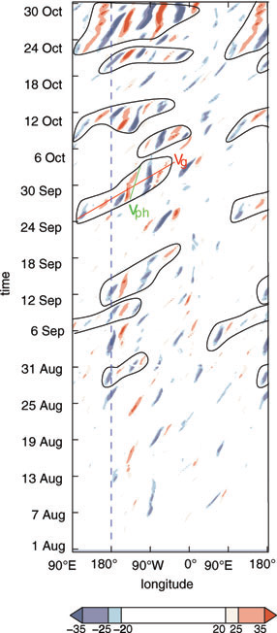
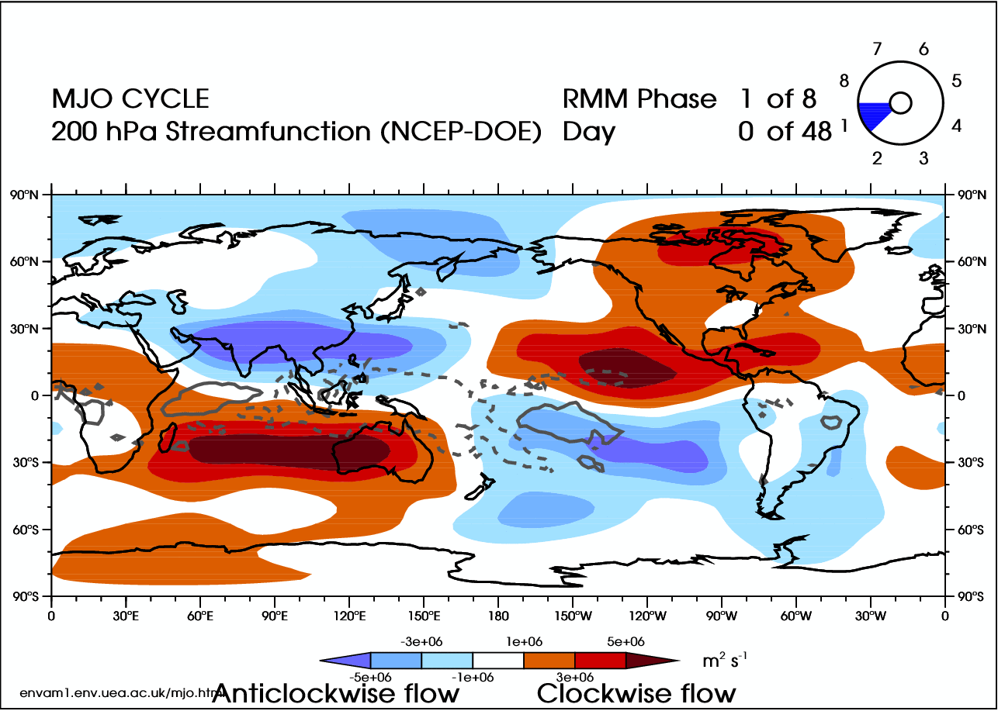
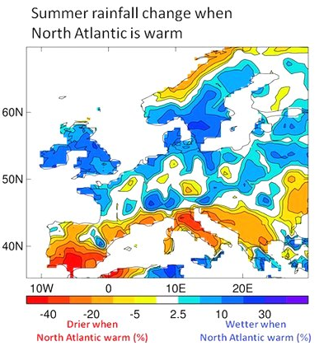
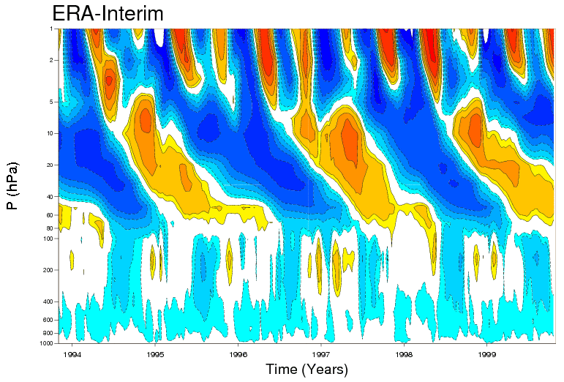
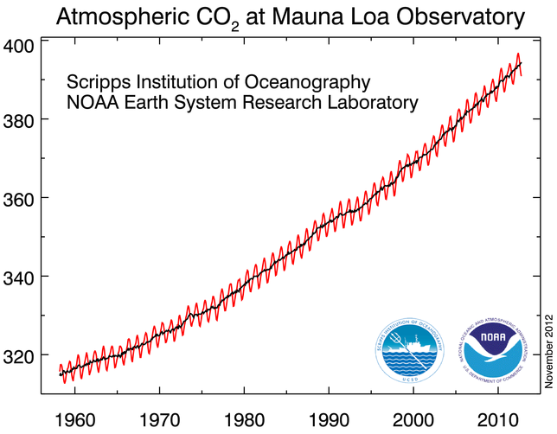
Sources of predictability
days
months
seasons
years
decades

Slide 4
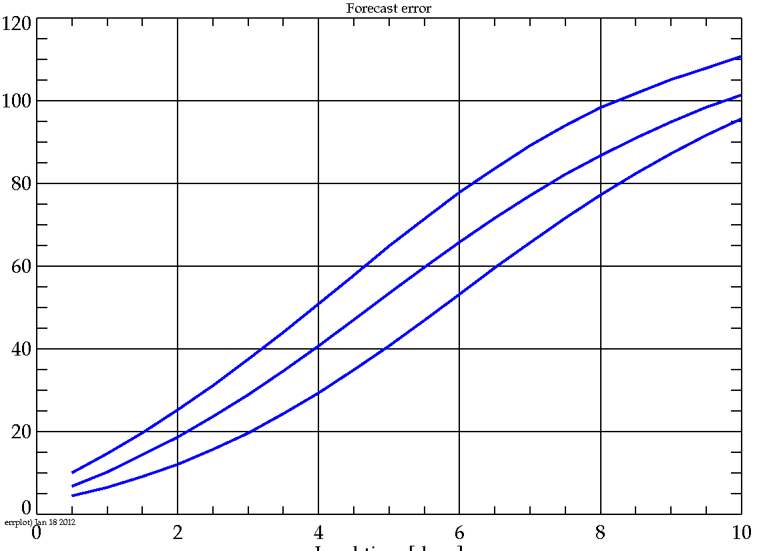
Sources of unpredictability
1990
2000
2010
RMS error (m)
Average medium-range forecast error growth
Initial condition uncertainty
Forecast lead time (days)
Notes:
Note the reduction in analysis errors and the (greater) reduction in forecast errors at day 10. Plus the shape of the curve is flatter in 2010 than before for days 1 and 2 of the forecast.

Slide 5
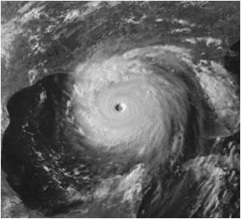
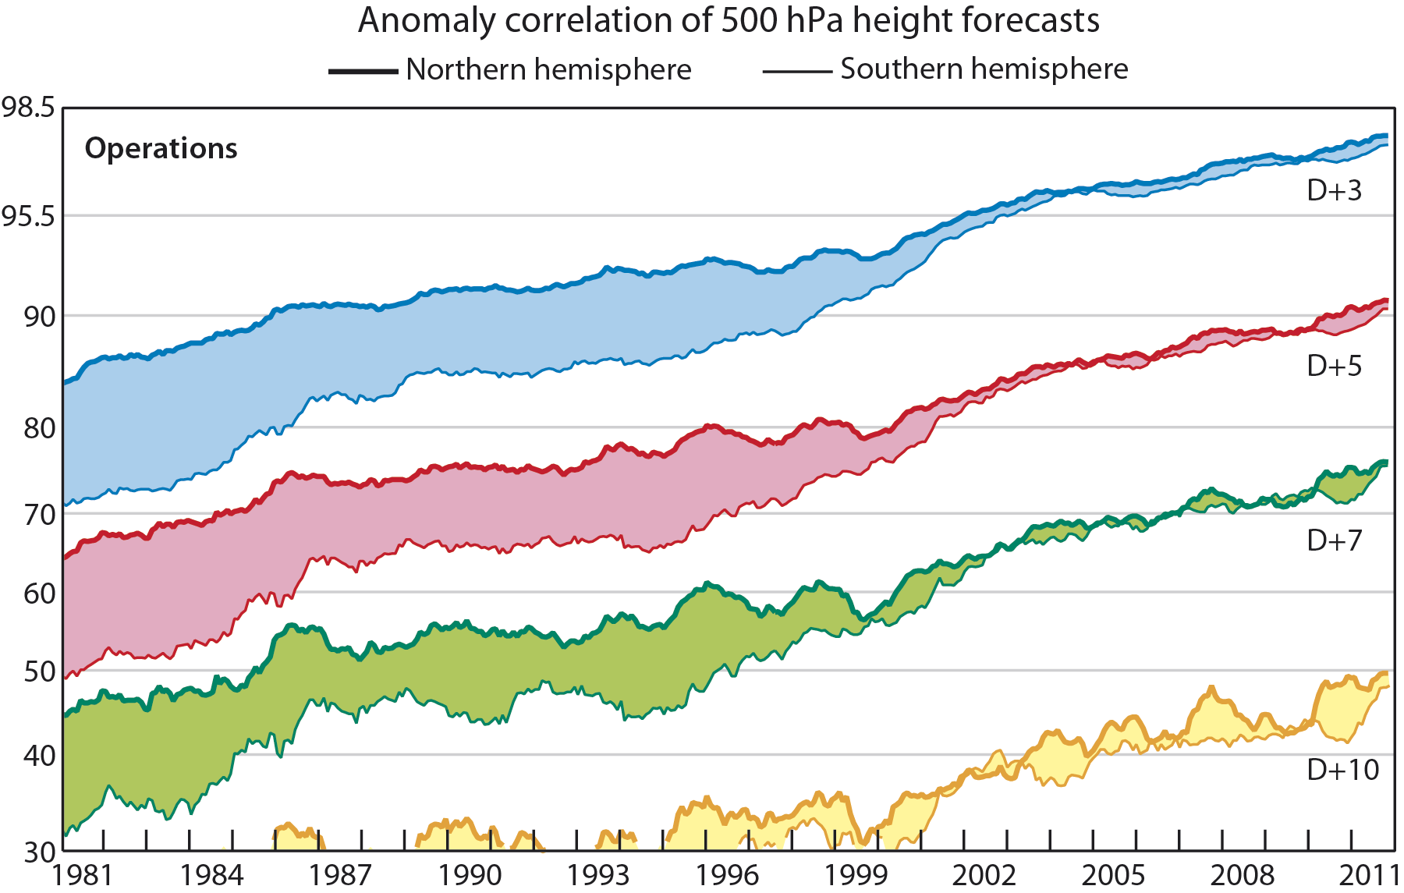
Evolution of ECMWF forecast skill
~25km
~16km
~39km
~125km
~63km
~210km
Notes:
Horizontal mesh size has reduced exponentially over time with a halving roughly every 8 years.

Slide 6
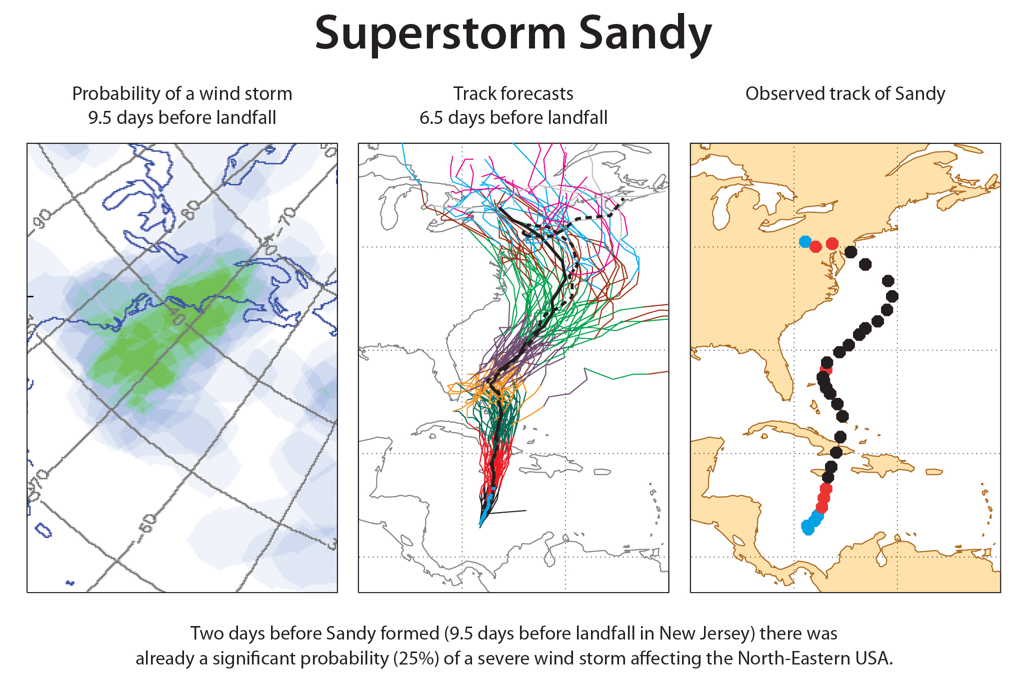

Slide 7
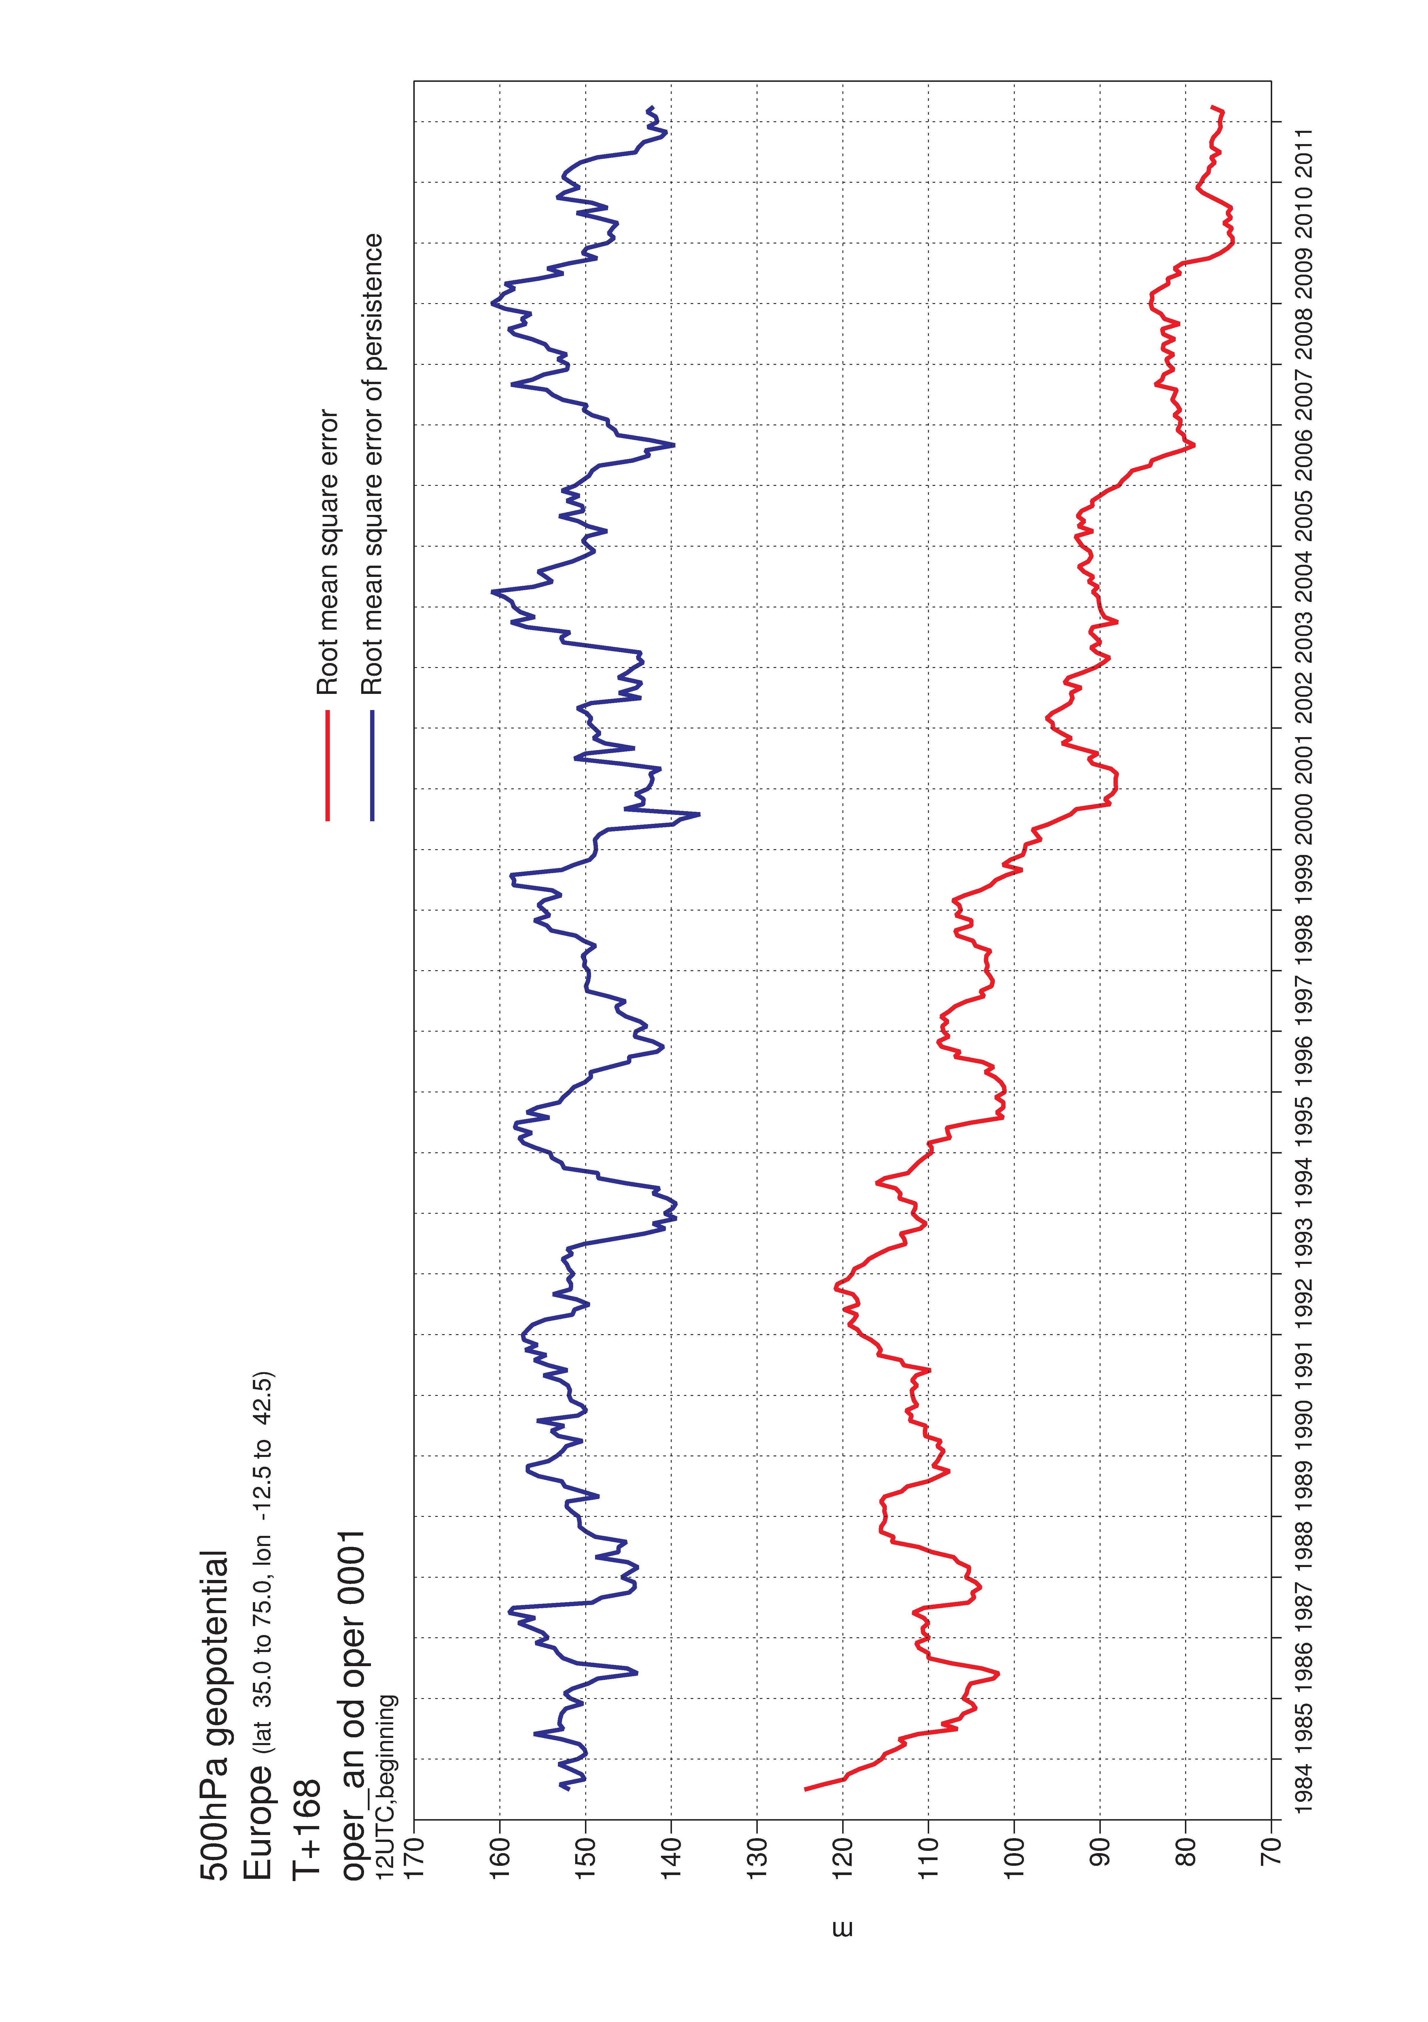
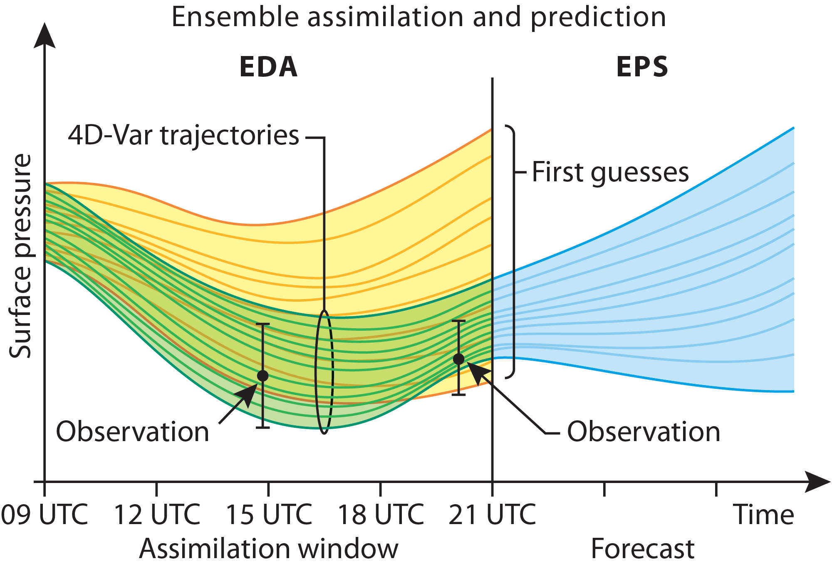
Research and development frontiers
Day 7
High resolution: accuracy of initial conditions and the model; fidelity of weather systems
n.b., effective resolution ~ 8x mesh size
Identify sources of predictability: coupling to models of ocean, land, sea-ice, biosphere etc
Extend period of skill for high-impact weather out to day 7: ensemble of data assimilations to assess “errors of the day”
persistence
HRES

Slide 8
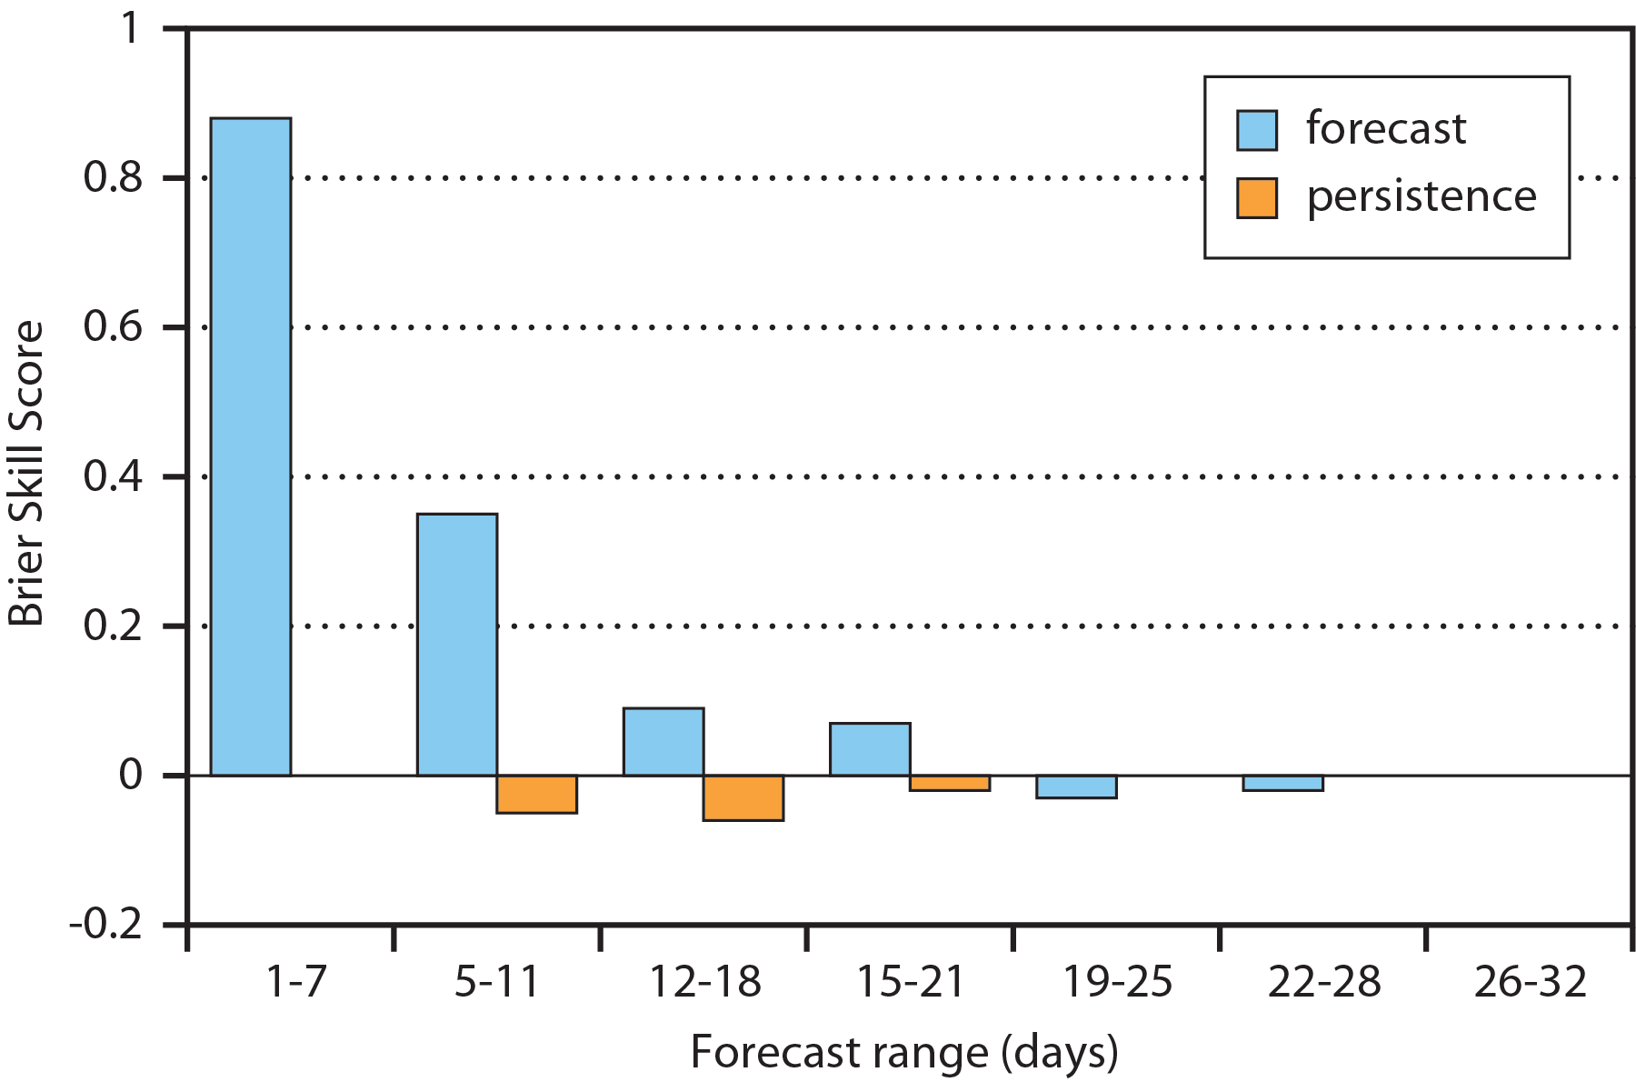
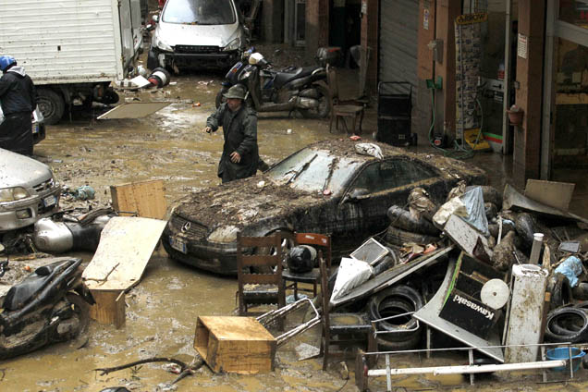
Research and development frontiers
Extending skill to weeks 2, 3 and 4: e.g., regimes and regime transitions
Predicting a season ahead in the extra-tropics: identifying space and time-dependent predictability
Seamless prediction: focus on predicting weather and climate extremes
Month 1 - regimes
Extreme rainfall in UK “increasing”
News : 3 January 2013
Extreme forecast index: rainfall
Genoa flood

Slide 9
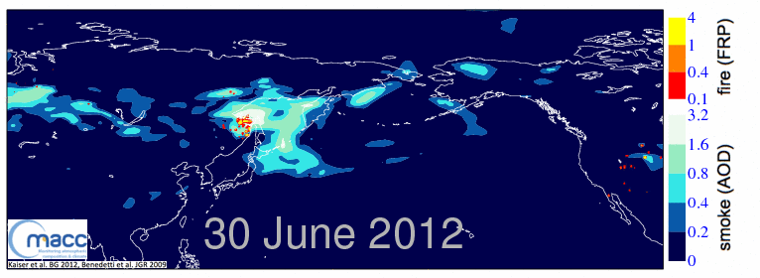
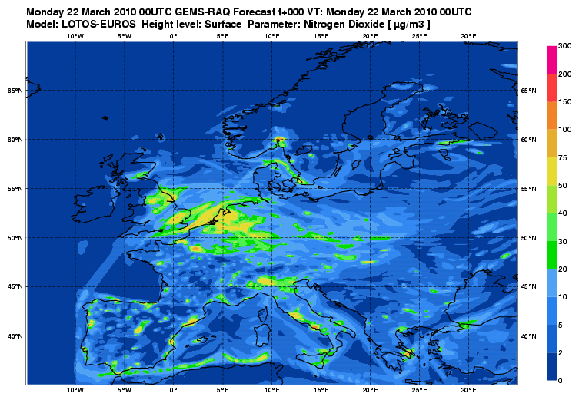
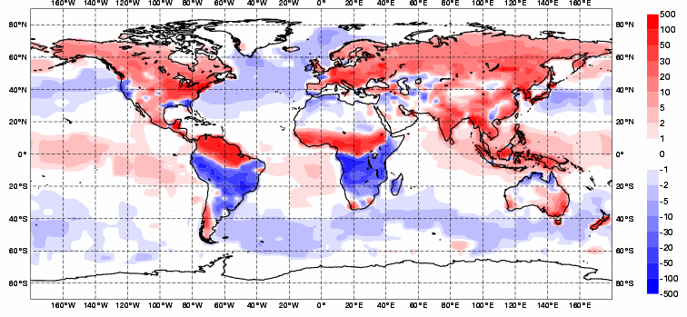
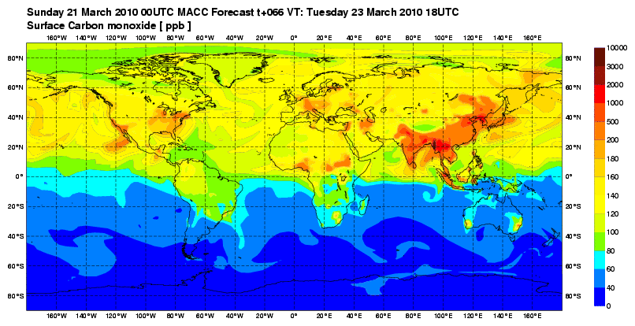
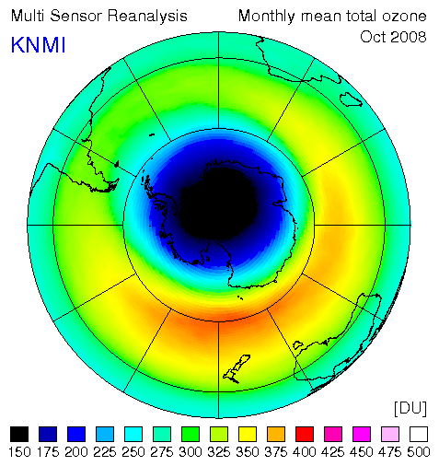
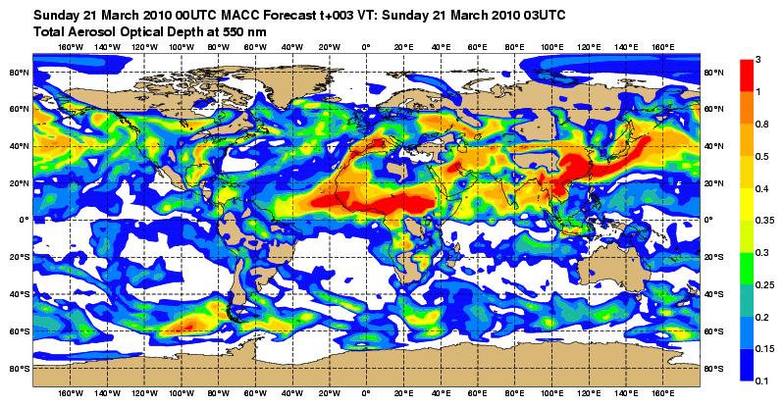
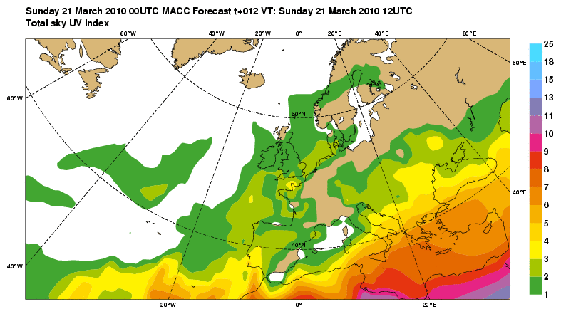
Super-seamless: environmental prediction
Ash
Fire and smoke
Air quality: NO₂
Global pollution: CO
Flux inversions: CO₂
UV index
Ozone
Aerosol

Slide 10
International collaboration
Global Atmospheric Research Program: 1967 - 1982
ICSU, WMO, IPCC and Belmont Forum
WWRP: THORPEX Legacy post 2014
Subseasonal-to-Seasonal
Polar Prediction Project
High-impact weather prediction
Linking WCRP and WWRP on seamless prediction
ECMWF: extended TIGGE archive
World Weather Open Science Conference: 17 – 23 August 2014, Montreal

Slide 11
Predicting Weather and Climate: Scientific progress and future opportunities
Alan Thorpe
AMS Presidential Forum
Reduce and Quantify Uncertainties
=
Accuracy and Reliability

