Slide 1
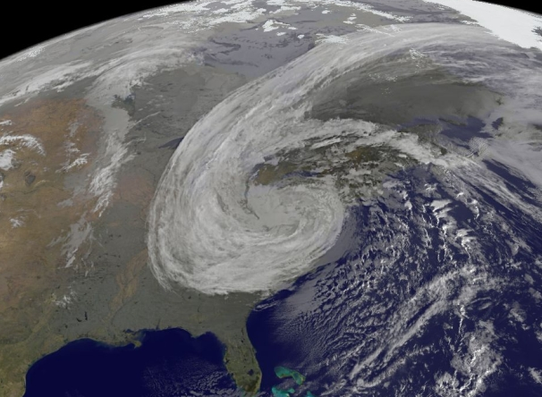
Post-Tropical Cyclone Sandy
Rain, Snow, and Inland Wind Impacts
David Novak
Jim Hoke, Wallace Hogsett, Mark Klein, Anthony Fracasso, Dan Petersen
Hydrometeorological Prediction Center

Slide 2
Jamaica
Landfall
973 mb
Cuba Landfall
Pressure (mb)
957 mb
New Jersey Landfall
946 mb
Symmetric Warm Core
Asymmetric Warm Core
Asymmetric Cold Core

Slide 3
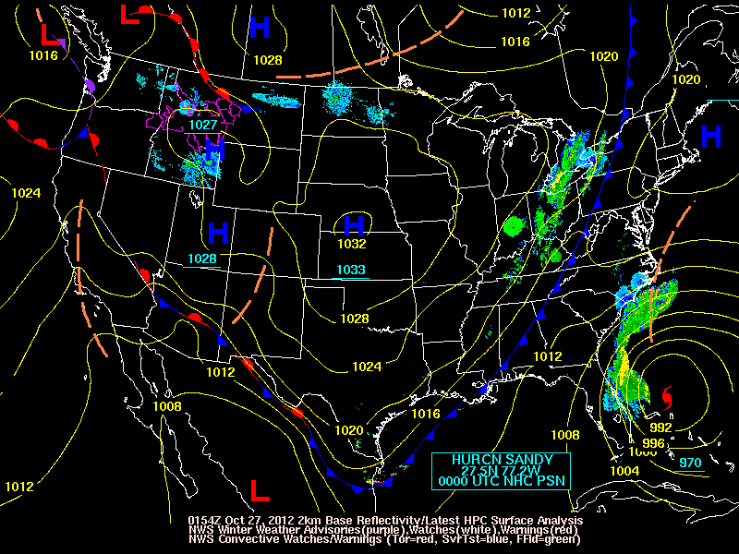

Slide 4
Track

Slide 5
A Success for Ensembles and Forecasters
Charts Valid 12Z October 29, 2012
Surface Analysis
7 day forecast
247 nm Displacement
GEFS Member
558 DM Height
FOR NOW, HAVE KEPT THE INCREASINGLY HYBRID CYCLONE OFF THE EAST COAST, THOUGH NOT AS FAR OUT TO SEA AS THE GFS AND GEFS MEMBERS.
CONSIDERING THE WILDLY DIVERSE DETERMINISTIC SOLUTIONS AND ENSEMBLE MEMBERS…THAT SEEMS TO HAVE BEEN A SAFE BET.
CISCO
ECMWF Member
CMC Member
ECMWF Mean
NAEFS Mean
GEFS Mean
GFS
ECMWF

Slide 6
A Success for Ensembles and Forecasters
Charts Valid 12Z October 29, 2012
Surface Analysis
7 day forecast
6 day forecast
247 nm Displacement
186 nm Displacement
GEFS Member
558 DM Height
THERE HAVE BEEN GFS ENSEMBLE MEMBERS QUITE SIMILAR TO THE ECMWF/GEM CAMP FOR THE LAST FEW DAYS OF MODEL CYCLES,
PUTTING THE DETERMINISTIC GFS SOLUTIONS IN A BROADER FRAMEWORK…
CISCO
ECMWF Member
CMC Member
ECMWF Mean
NAEFS Mean
GEFS Mean
GFS
ECMWF

Slide 7
A Success for Ensembles and Forecasters
Charts Valid 12Z October 29, 2012
Surface Analysis
7 day forecast
6 day forecast
5 day forecast
247 nm Displacement
186 nm Displacement
89 nm Displacement
GEFS Member
558 DM Height
THE DETERMINISTIC SOLUTIONS… ARE OUTLIERS TO THE MAJORITY OF THEIR ENSEMBLE BROTHERS AND SISTERS, WITH THE LION'S SHARE OF THE ENSEMBLE GUIDANCE INDICATING A WHOLESALE INCORPORATION OF SANDY'S POST-TROPICAL CIRCULATION INTO THE UPPER VORTEX…
ECMWF Member
CMC Member
ECMWF Mean
NAEFS Mean
GEFS Mean
GFS
ECMWF

Slide 8
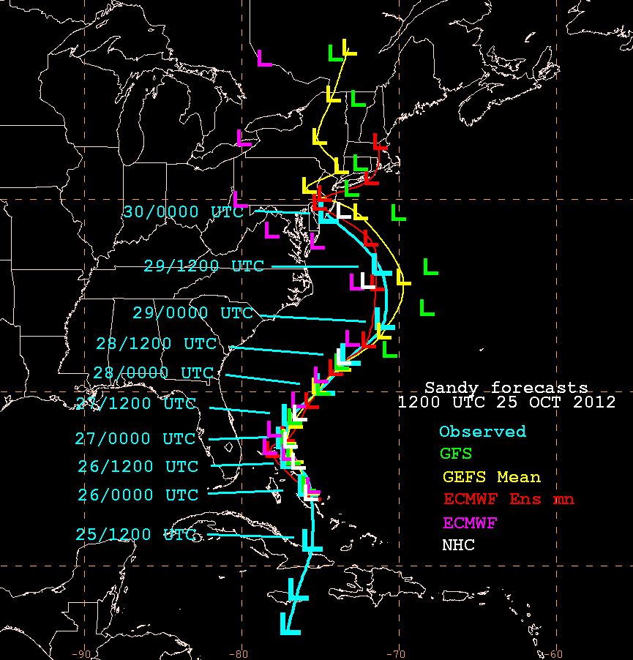
Forecasters Used Ensemble Information for Track Forecasts

Slide 9
Low Track Forecast – 1.5 days prior to landfall
* Note the ensemble spread at each forecast time.
SREF uncertainty in acceleration of storm 36 hours before landfall
Ensemble mean was very accurate (00 UTC landfall)
Storm accelerated towards New Jersey coast

Slide 10
A Success for Ensembles and Forecasters
Charts Valid 12Z October 29, 2012
Surface Analysis
7 day forecast
6 day forecast
5 day forecast
4 day forecast
3 day forecast
2 day forecast
1 day forecast

Slide 11
Inland Winds

Slide 12
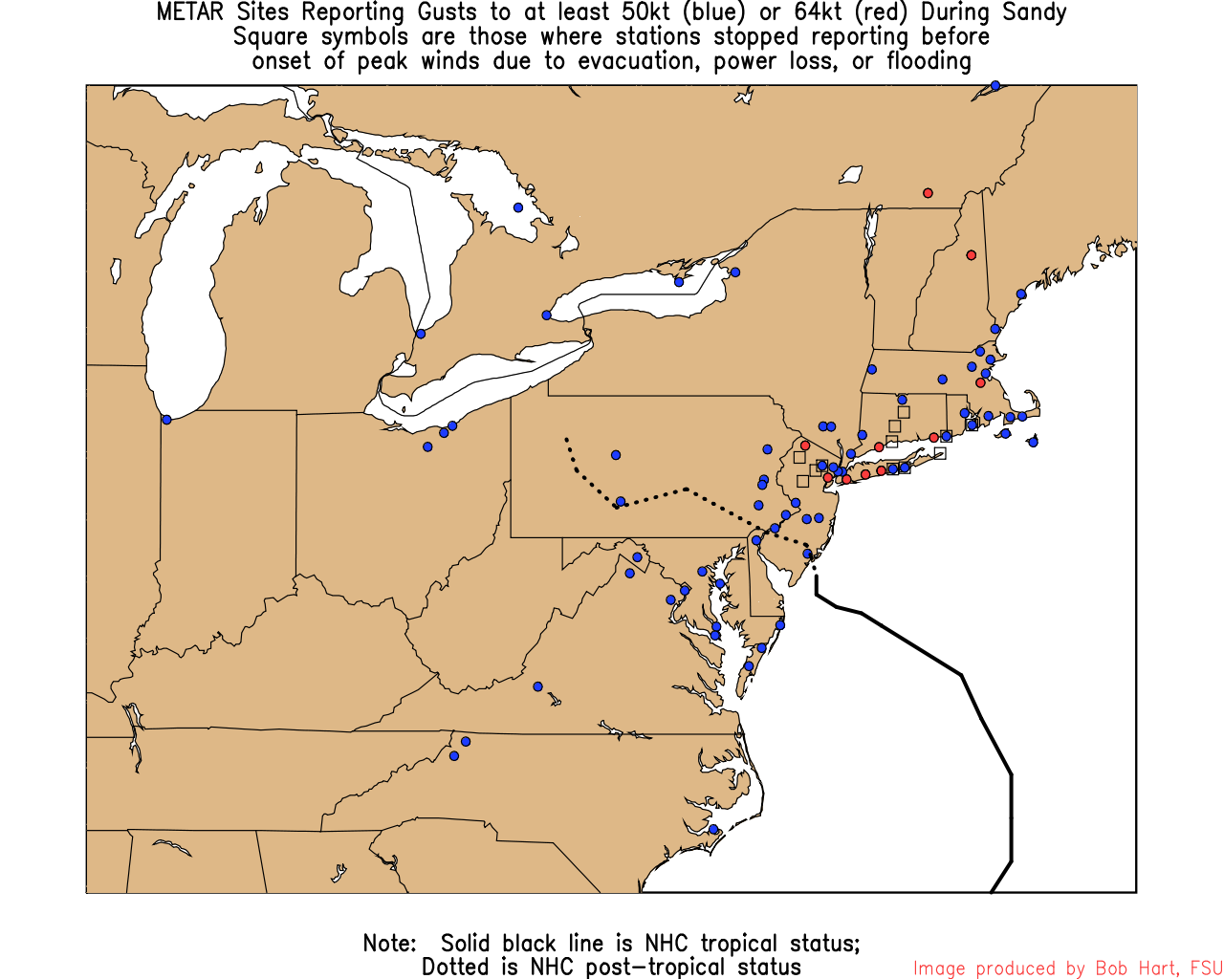
H
1028
L
940

Slide 13
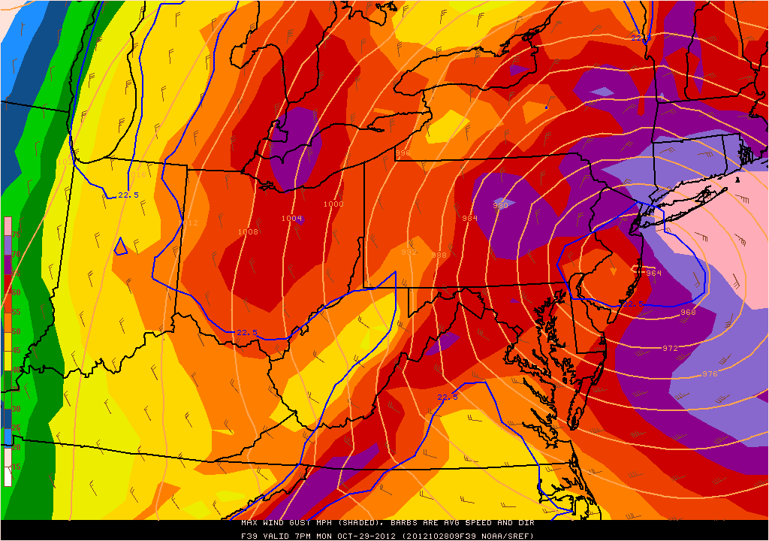
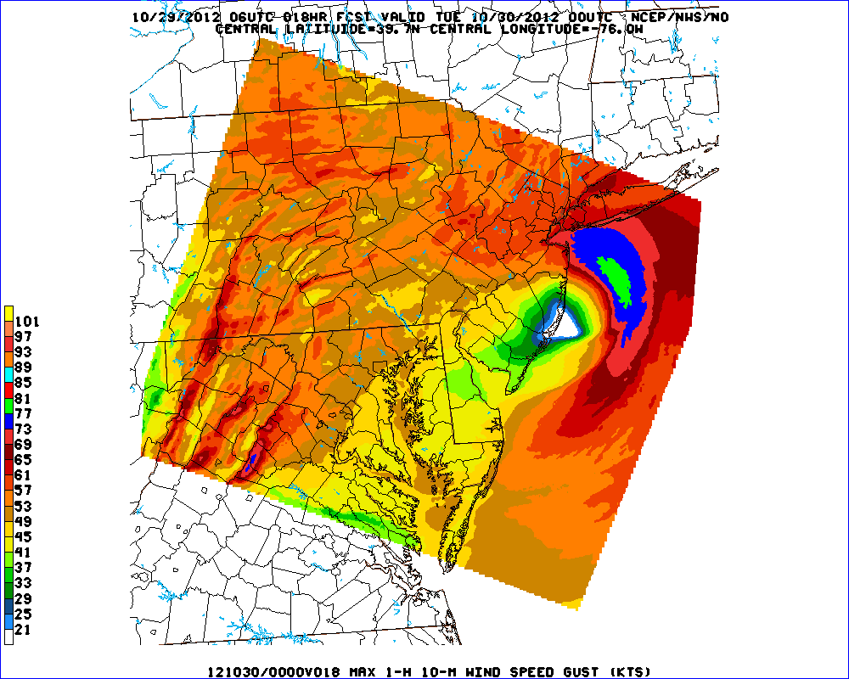
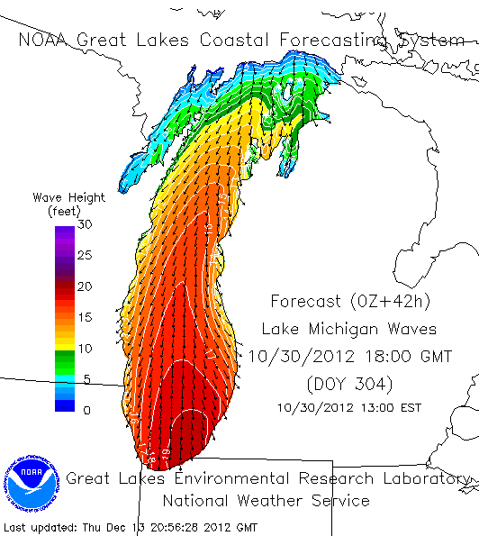
Wind and Wave Forecasts
39 h Forecast SREF Max Wind Gust
65 mph
18 h Forecast 1.33 km NAM
Wind Gust
75+ mph
Great Lakes Coastal Forecast System
Issued Sunday Morning, Oct 28
Courtesty Peter Manousos (First Energy)
77 kts
19’
Issued Saturday Evening, Oct 27
Issued Monday Morning, Oct 28

Slide 14
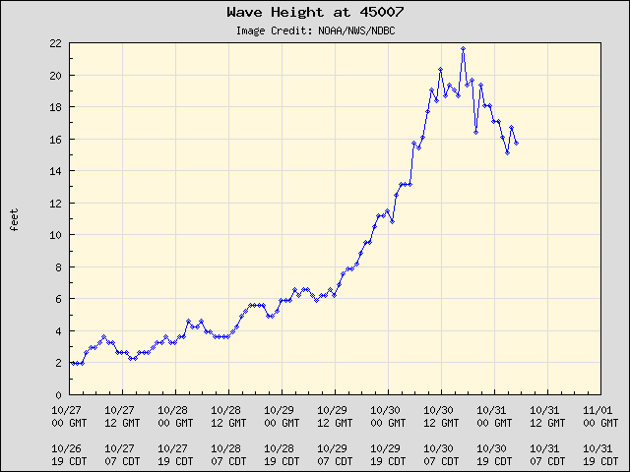
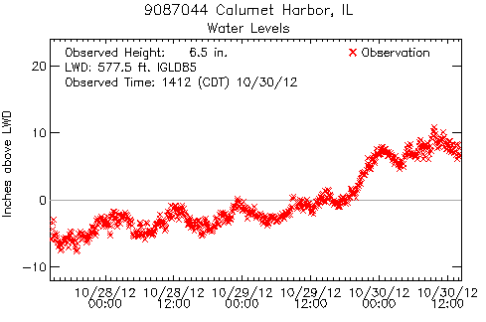
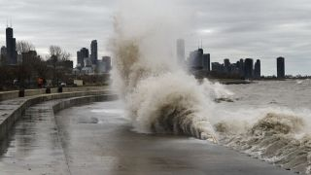
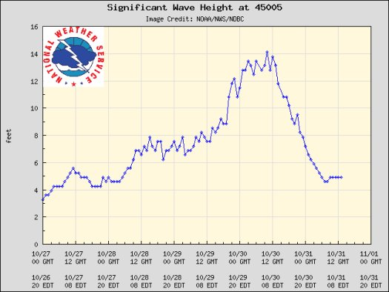
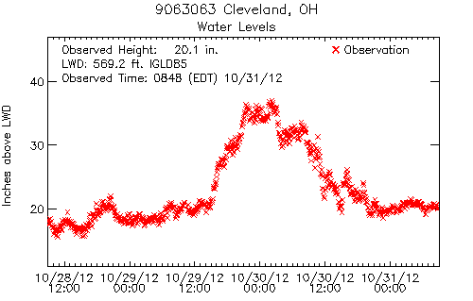
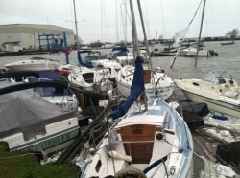
Great Lakes Impacts
Wave Height
Water Level
Impacts
21.7’
Second Highest since 1980
Lake Michigan
1’ Surge
AP
14’
1-2’ Surge
Lake Erie
USCG

Slide 15
Rainfall

Slide 16
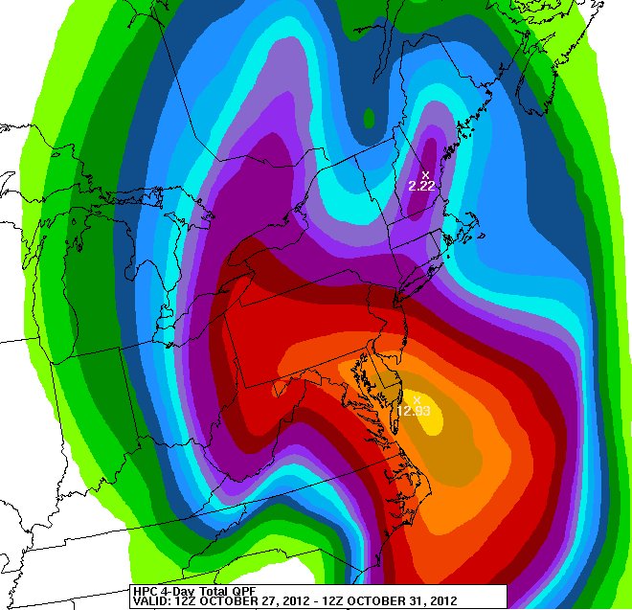
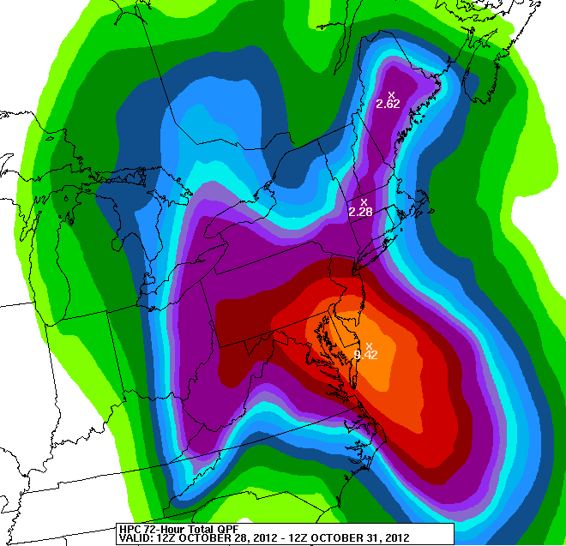
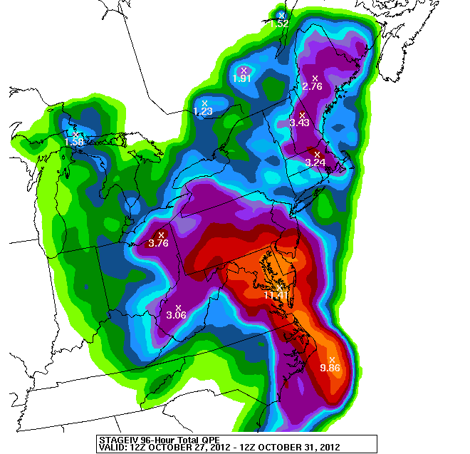
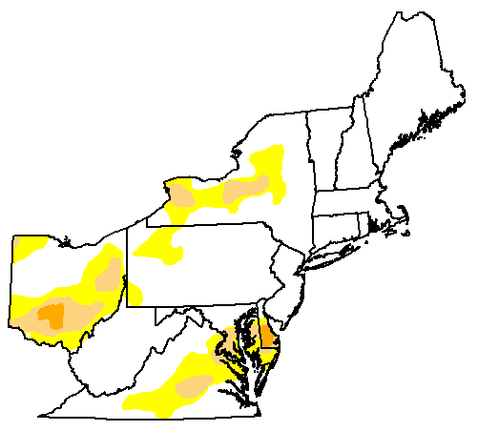
Rainfall
Very accurate rainfall forecasts
5 Day Precipitation Forecast:
Issued Friday morning, Oct 26
3 Day Precipitation Forecast:
Issued Sunday morning, Oct 28
Observed Rainfall
Oct 23, 2012
Rainfall alleviated drought
D0-D4: 24% of area
16

Slide 17
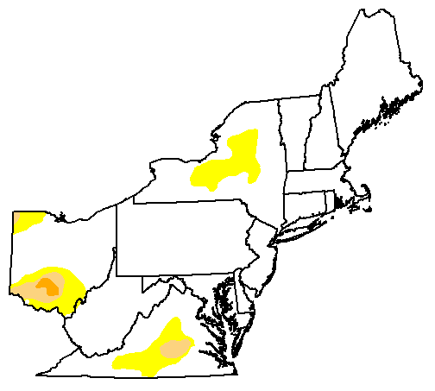
Rainfall
Very accurate rainfall forecasts
5 Day Precipitation Forecast:
Issued Friday morning, Oct 26
3 Day Precipitation Forecast:
Issued Sunday morning, Oct 28
Observed Rainfall
Oct 30, 2012
Rainfall alleviated drought
D0-D4: 12% of area

Slide 18
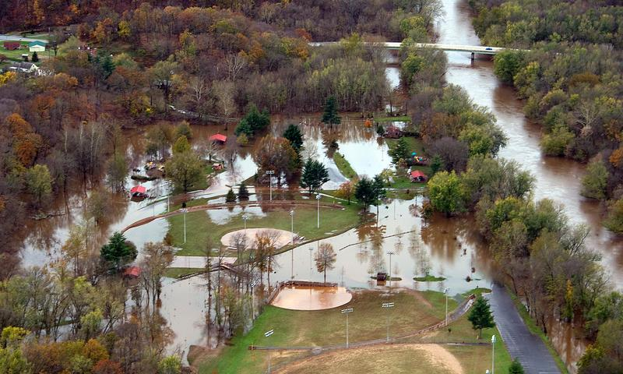
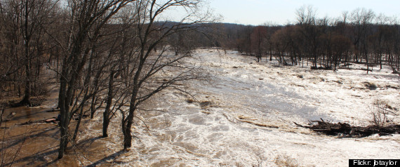
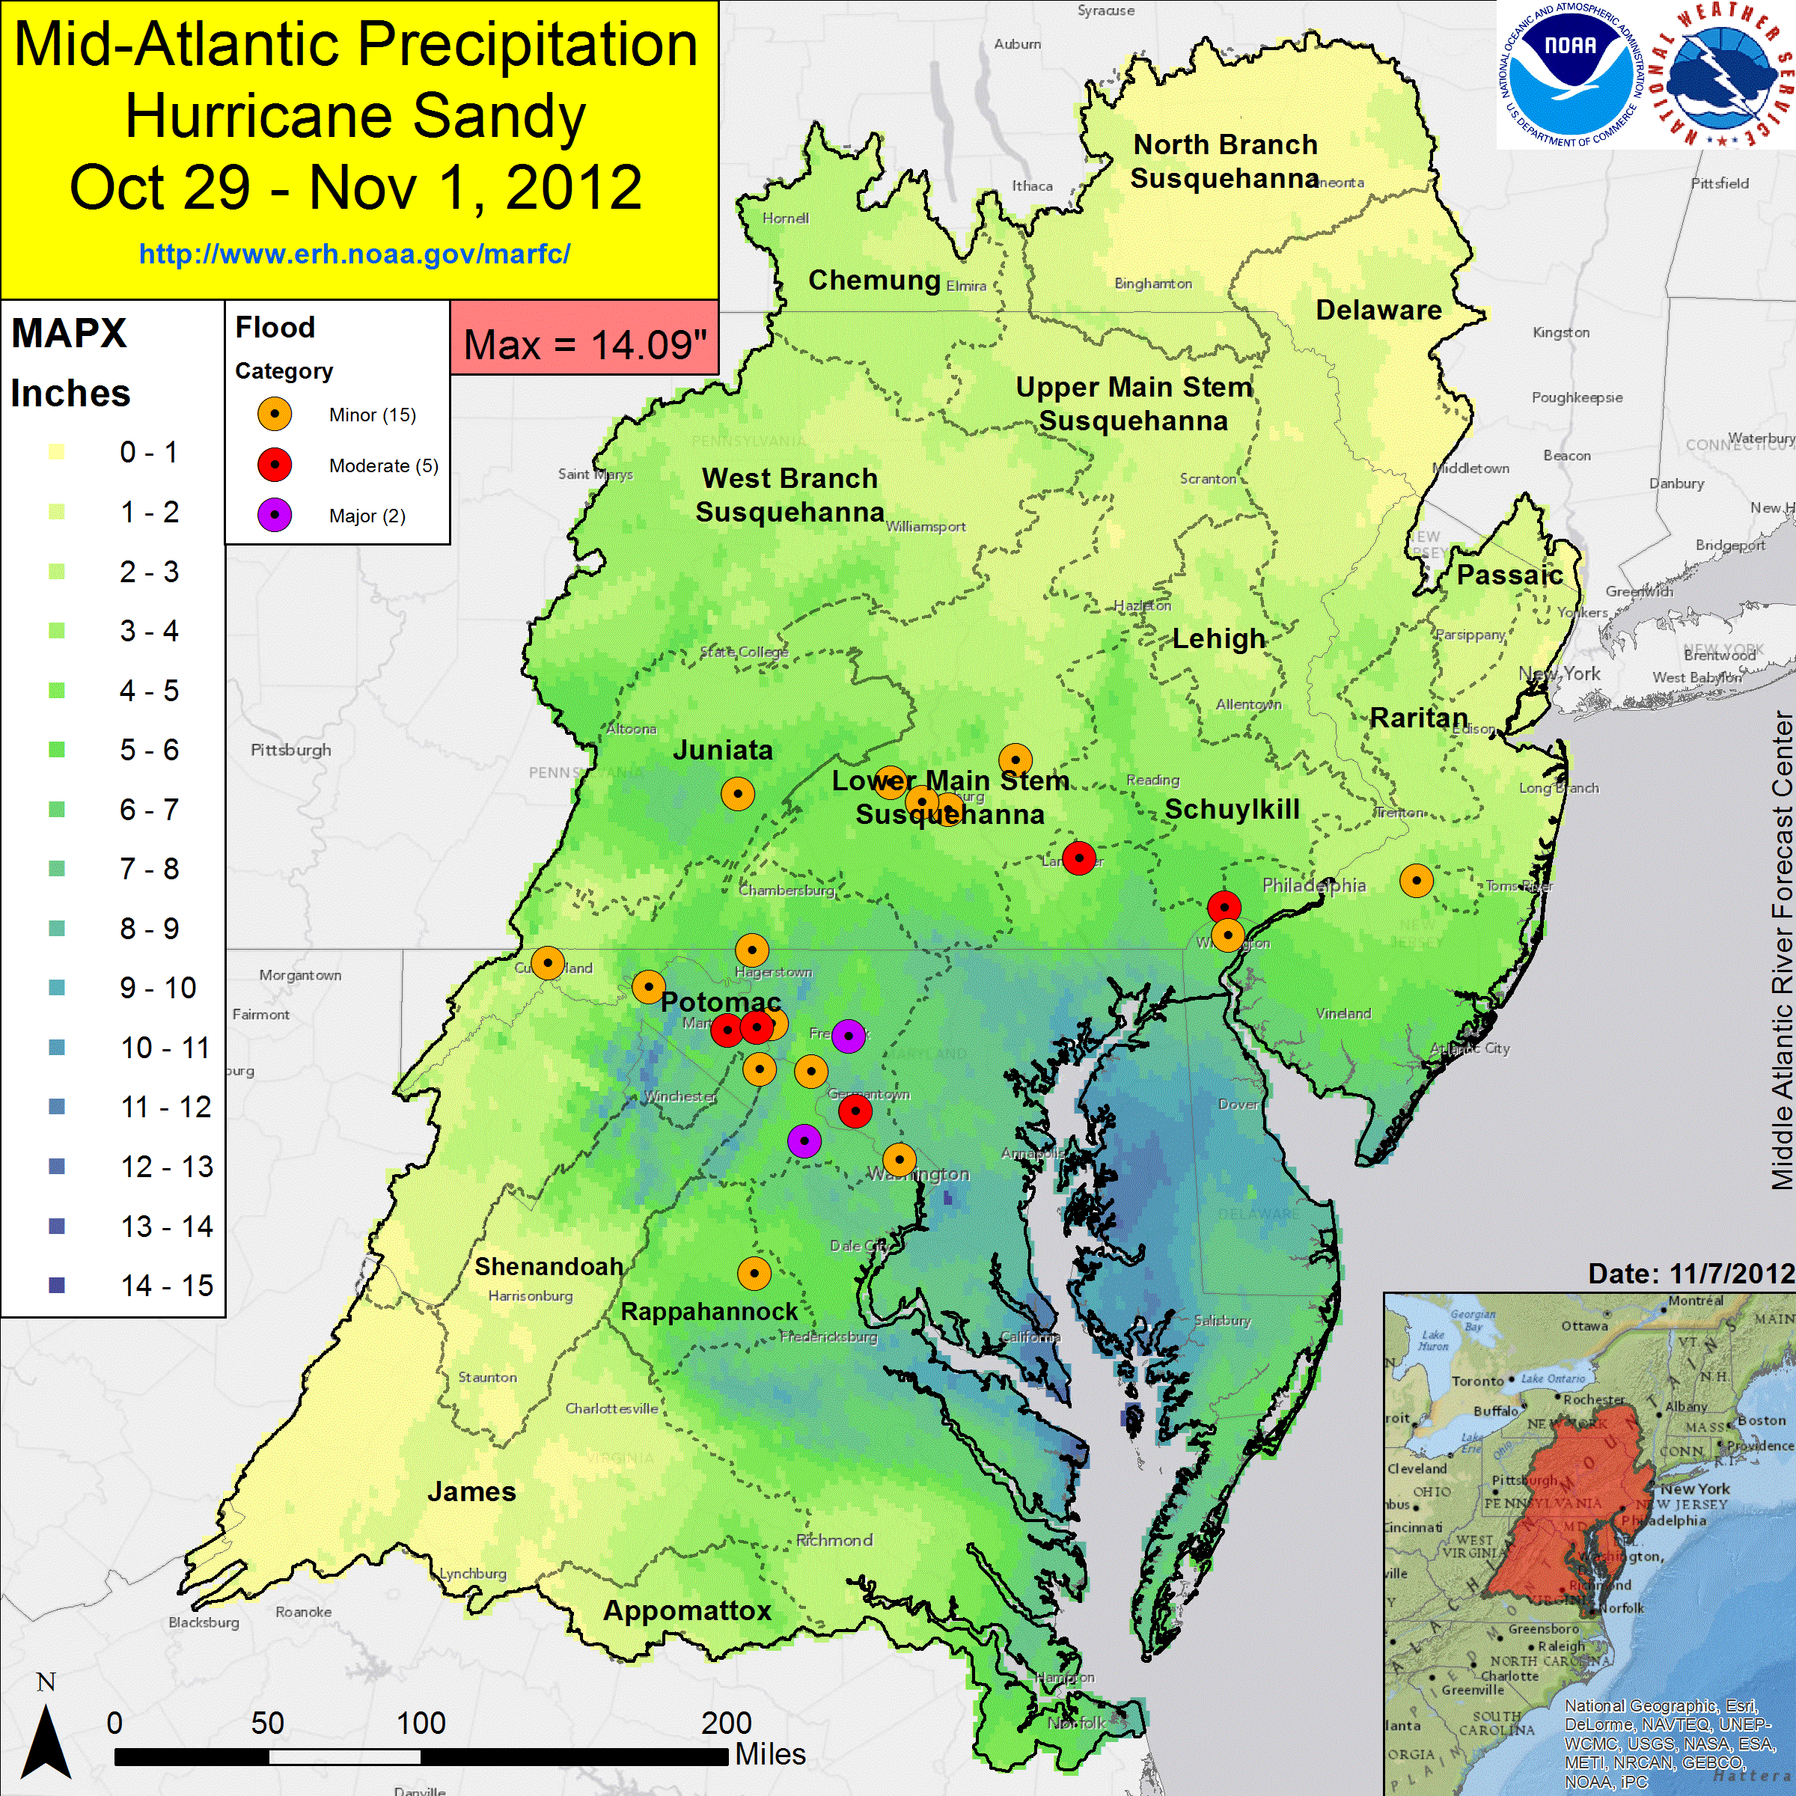
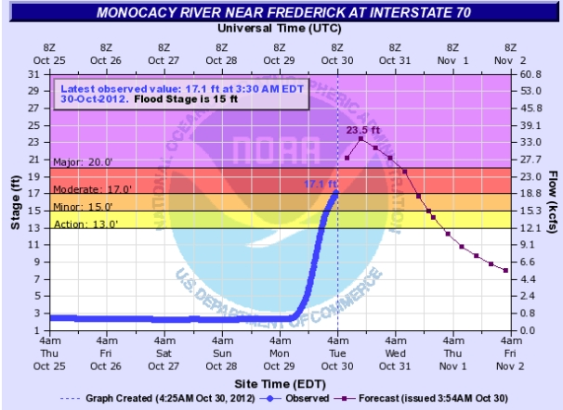
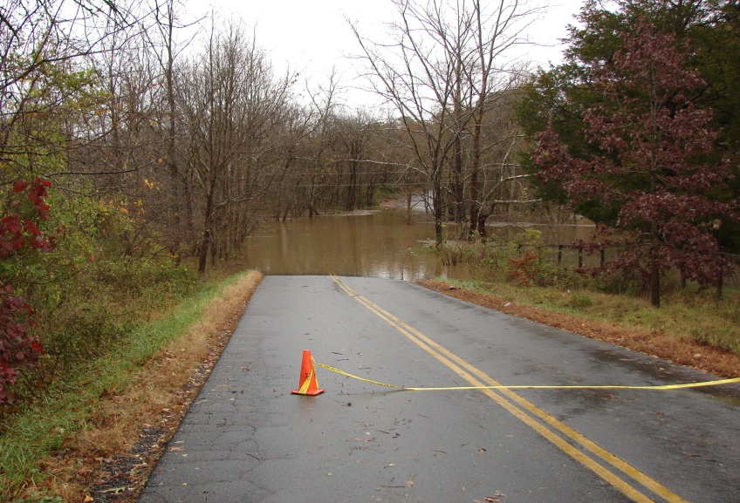
Inland Flooding
Monocacy
Potomac
Goose Creek

Slide 19
Snowfall

Slide 20
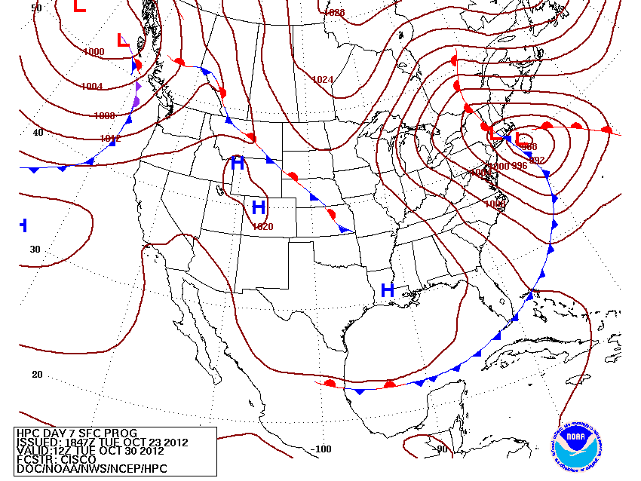
Snowfall
7 Days Prior to Landfall:
“…BESIDES THE WIND, THE OTHER SENSIBLE WEATHER THREAT IS HEAVY RAINS, WITH HEAVY SNOWS POSSIBLE ON THE SOUTHWEST SIDE OF THE HYBRID CIRCULATION…”
CISCO
30”+
3 day Snow Total:
Issued Sunday morning, Oct 28

Slide 21
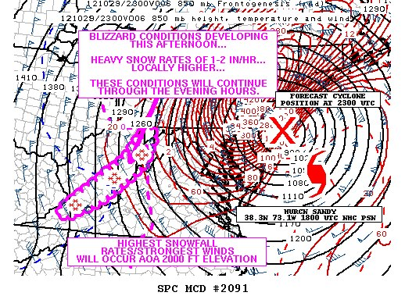
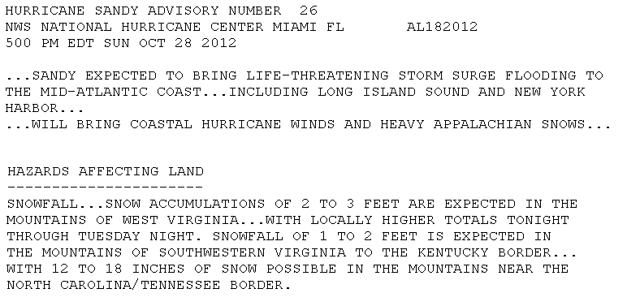
Have you ever seen this?!

Slide 22
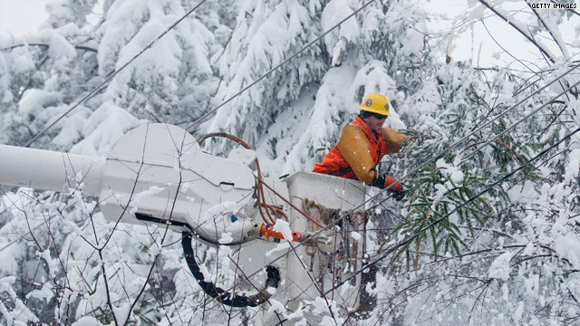
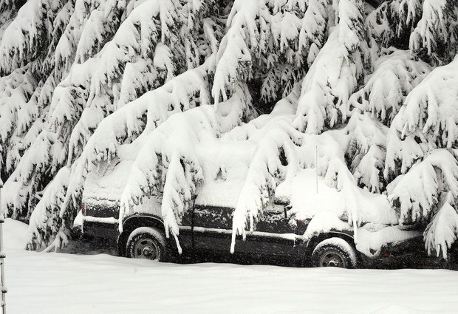
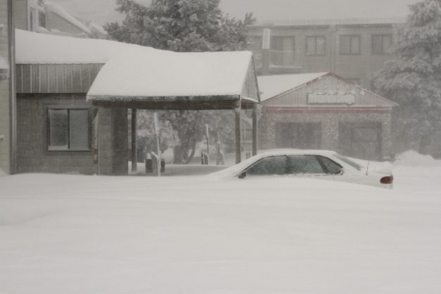
Sandy Snowfall
30”+
Snowshoe, WV

Slide 23
Decision Support

Slide 24
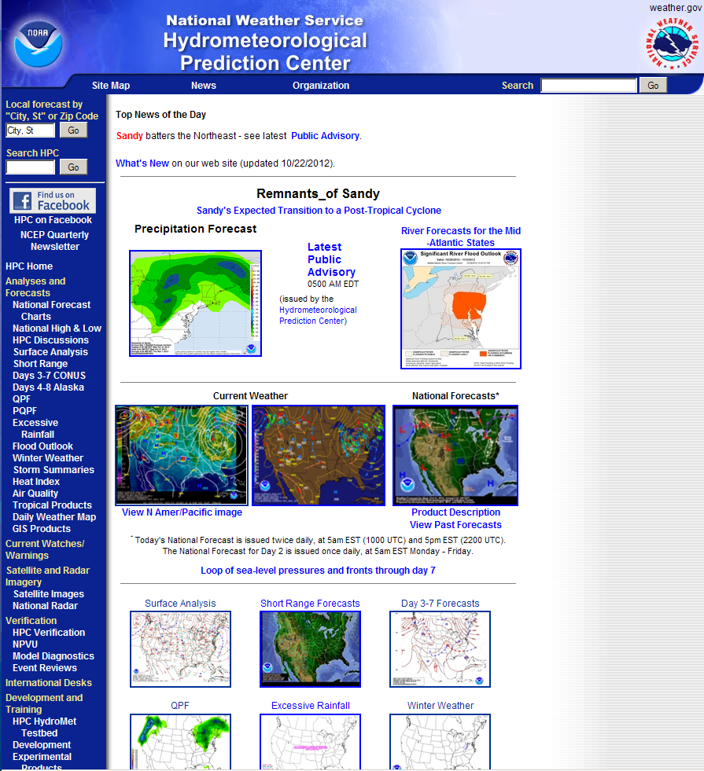
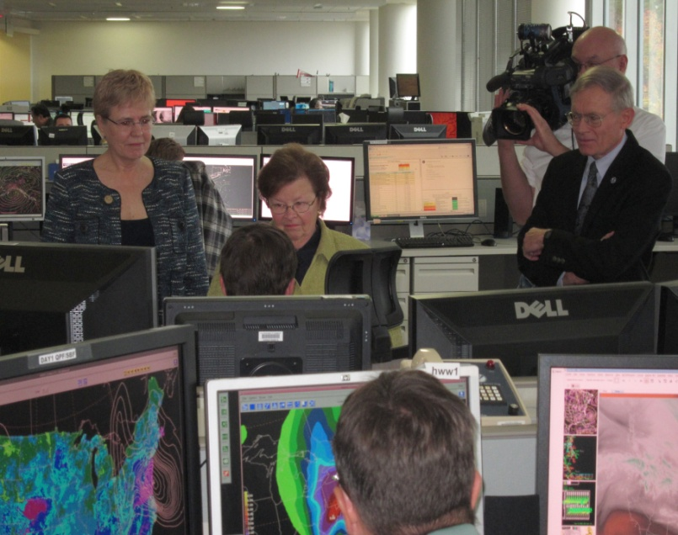
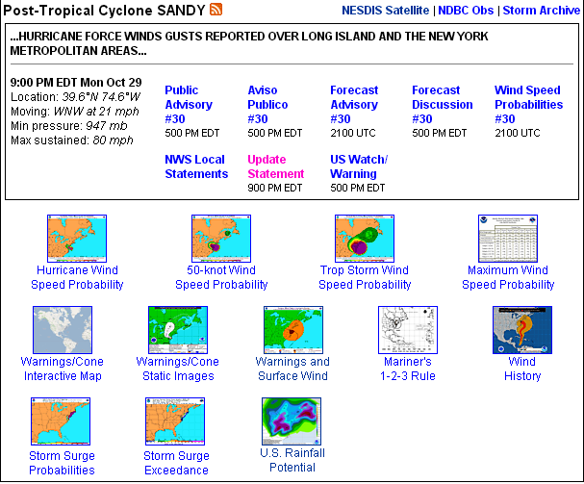
Coordinating the Message
HPC QPF linked at NHC
Sandy-specific products highlighted on HPC homepage
Internal: NOC, FEMA, Regions, WFOs
External: Media (CNN, Univision, ABC, etc.), Congressional visitors, etc.
Notes:
*

Slide 25
Post-Tropical Cyclone Sandy
Summary
A historic event
Unusual track
Rare evolution
Historic impacts
An accurate forecast
Heavy reliance on ensemble datasets
Accomplishment of the Weather Enterprise
A coordinated message
The Weather Enterprise saved lives and property

