Slide 1





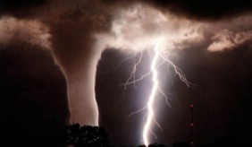
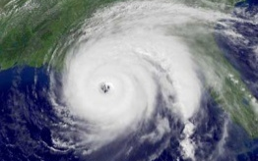

Advancing Ensemble Modeling Systems within and Operational Environment – the Status of Ensemble Forecasts at the National Centers for Environmental Prediction
Dr. Louis W. Uccellini
Director, NCEP
T.N. Krishnamurti Symposium
92th AMS Annual Meeting
New Orleans, LA
January 26, 2012
“Where America’s Climate, Weather, Ocean and Space Weather Services Begin”

Slide 2
Outline
Pre-Ensemble Era: The first revolution in forecasting
Expansion of the Operational Ensemble System: The second revolution in forecasting
  Current status of NCEP’s operational Ensemble Forecast System
The case that made the case for operationalizing the SREF: January 24-25, 2000
Pay Off
  Forecasting extreme events
  Snowmageddon, February 2010
A wake up call: NYC Blizzard, December 2010
Summary: ongoing research and transition issues

Slide 3


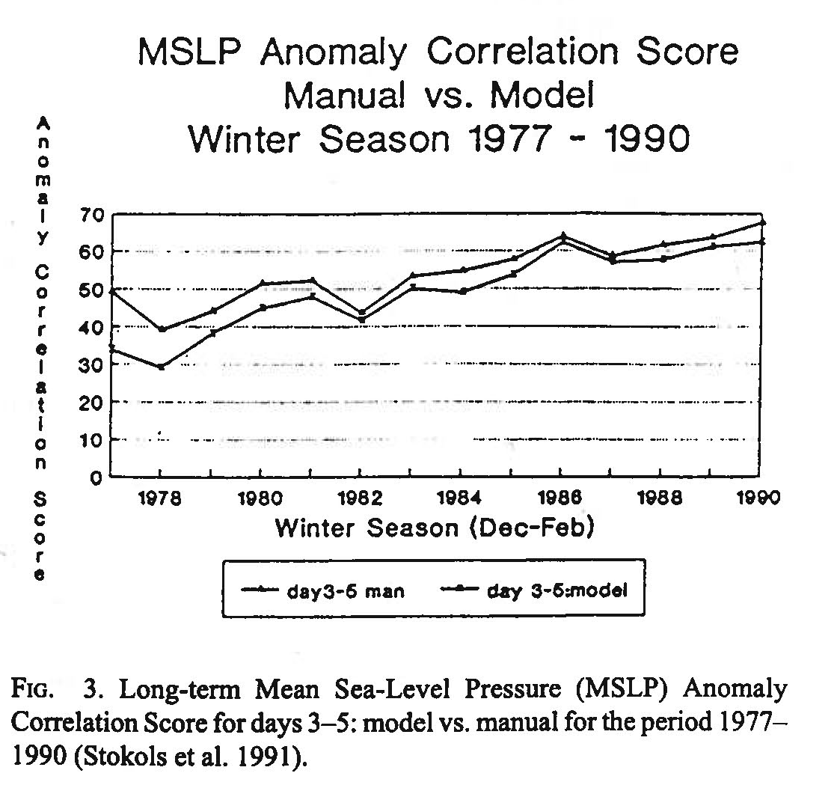
Pre-Ensemble Era
1954 2000: focus of operational centers: run single models
  Global, regional
  Highest possible resolution
  Extend model simulation to longest possible time
  Provide ready access to all model runs
  “Model of the day” approach dominated forecast decisions
1980s early 1990s
  Models run globally with full complement of satellite observations
  Skill extended from day 1 out into the medium range (day 3-5)
  Extreme events predicted with regularity (rapid cyclogenesis)
  Models becoming fully accepted by the forecast community (only took 30+ years!)

Slide 4
The Advance from Subjective to Model-Based Forecasts
1970s Limits of Predictability
“…abandon research that uses “weather sequences” generated in a computer as bases for deduction about the real atmosphere.” C.S. Ramage, 1976: Prognosis for Weather Prediction. Bull Amer. Meteor. Soc., 57, 4-10.
Cressman, 1970

Slide 5
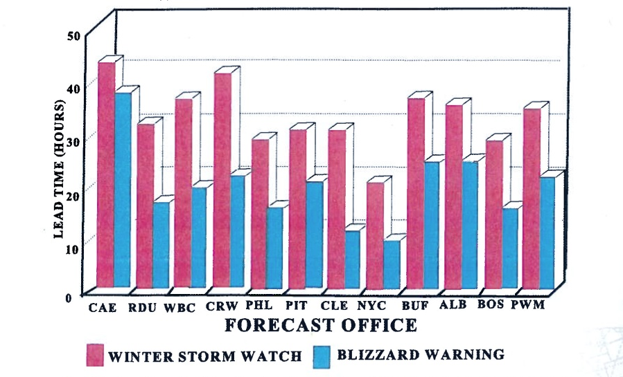
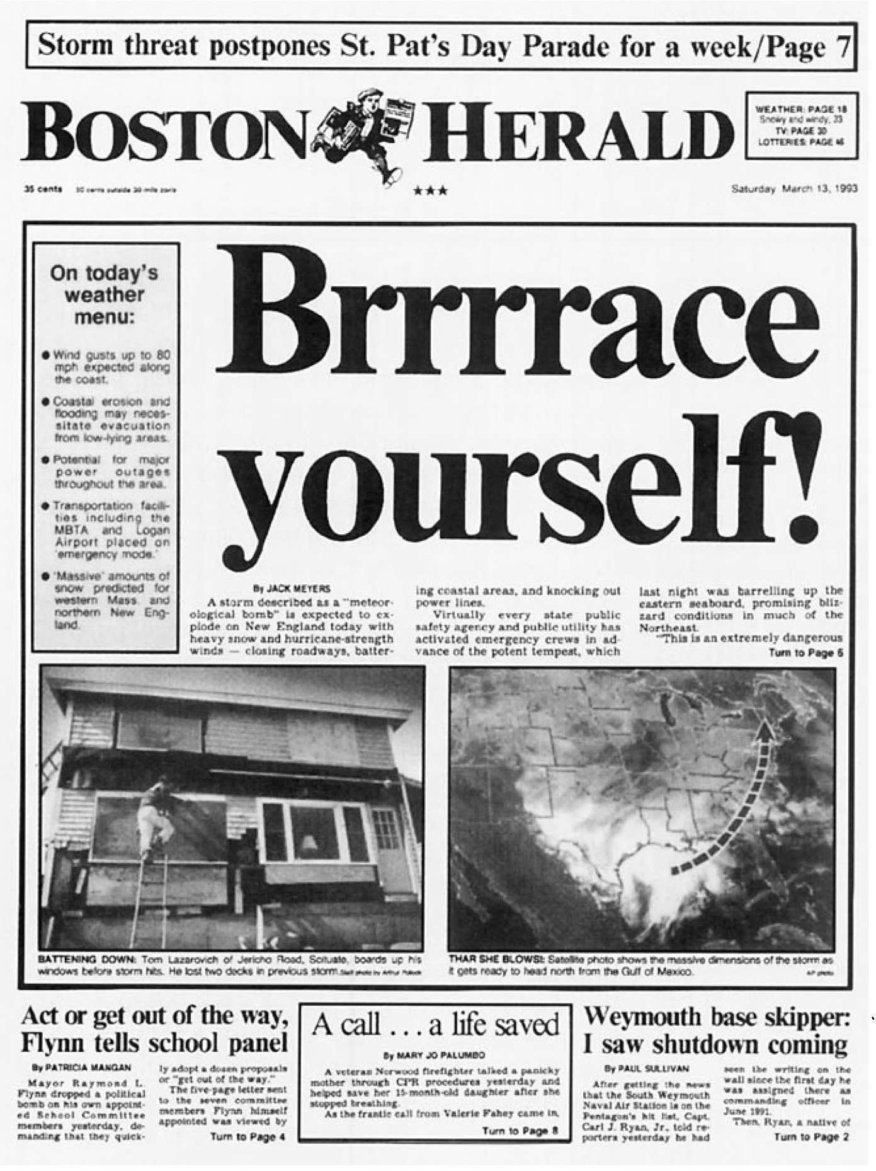
Rapid Improvements in Operational Models for Predicting Extreme Events
NCEP model performance tracked by Sanders, Grumm and others
By early 1990s – global models predicting rapid cyclogenesis 3+ days in advance with remarkable skill
Specific forecasts for March 1993 superstorm (4+ days in advance) and January 1996 East Coast Blizzard became defining moments in the ability to predict big storms
12-14 March 1993 Superstorm
WATCH AND WARNING LEAD TIME

Slide 6
The Double-Edged Sword
Better forecasts translated into decision makers actually using the forecasts
  with no measure of uncertainty
User/customer expectations exceeded forecast capabilities (lead time, accuracy)
The pressure to predict every storm with the lead times and accuracy of the ‘93/’96 storms set the trap:
January 2000 – surprise East Coast blizzard
December 2000 – no show/no snow for Washington, D.C.
March 2001 – the “one in fifty year event” - Not! (big rainstorm)

Slide 7



National Research Council Reports
2003
2010
2003

Slide 8
Expansion of the Operational Ensemble System
Many players at NCEP
  Kalnay, Toth, Zhu,Tracton, Du, …
Research community
  Krisnamurti, Mullen, Stensrud, Palmer, Mass, …
First big issue in 1990s: over what time scale will ensembles be useful
  ECMWF: Medium range and beyond
  NCEP: from short range and beyond

Slide 9
NCEP Operational Ensemble Systems
Historical Review
Global
Regional
1991: Startup (Kalnay, Toth)
  Breeding technique single dynamic core
1992-94: Implemented
late 90s early 2000s: THORPEX, improved resolution, number of members, 4 cycles per day (Toth, Zhu)
2004: Combined with Canada’s GEM to create North American Ensemble Forecast System (NAEFS)
2/2012: 50 km GEFs to 10 days, 60 km GEM
1994: SREF Workshop (Tracton)
1997: Regional breeding (Du)
1998: SAMEX – first real time test
2001: First operational implementation, 10 members
2006: 21 member (RSM, Eta, WRF NMM, WRF ARW)
4/2012: Current (NMMB, WRF ARW, WRF NMM) run at 16 km

Slide 10
Current NCEP Operational Ensemble Configuration
 | NAEFS | SREF | CFS | EUROSIP***
Members | GEFS – 84/day GEM – 42/day | 84/day | 4/day | CFS ECMWF UKMet MeteoFrance
Resolution | GEFS* 50 km GEM 60km | 16 km** | 100 km
Forecast Length | 16 days | 87 hours | 9 months | 6 months
 | *starting 2/12 | **starting 4/12 |  | *** 3 forecast parameters starting Dec ‘11

Slide 11
NOAA Seamless Suite of Forecast
Products Spanning Climate and Weather
NCEP Model Perspective
Years
Forecast
Uncertainty
Outlook
Seasons
Guidance
Months
Climate Forecast System
EUROSIP
Threats Assessments
2 Week
North American Ensemble
Forecast System
Climate/Weather
Linkage
Forecast Lead Time
1 Week
Ocean Model
HYCOM
Wave Watch III
Forecasts
Global Forecast System
Days
Short-Range Ensemble Forecast
Watches
North American Forecast
GLOFS
Bays
Chesapeake
Tampa
Delaware
Hours
Hurricane – GFDL, WRF
Warnings & Alert Coordination
Rapid Update Cycle for Aviation
Minutes
NARRE
Benefits
Maritime
Health
Aviation
Agriculture
Commerce
Recreation
Life & Property
Fire Weather
Hydropower
Ecosystem
Environment
Space Operations
Emergency Mgmt
Energy Planning
Reservoir Control
Notes:
Products are being generated based on the CFS combined with EUROSIP.

Slide 12
Day at which forecast loses useful skill (AC=0.6)
N. Hemisphere 500hPa height calendar year means
8 d
Forecast day

Slide 13
North American Ensemble Forecast System (NAEFS)
Impact on NH Anomaly Correlation for 500hPa Height
Period: September 1st – November 30th 2011
Week 2:
Adding 3-4 days of skill

Slide 14
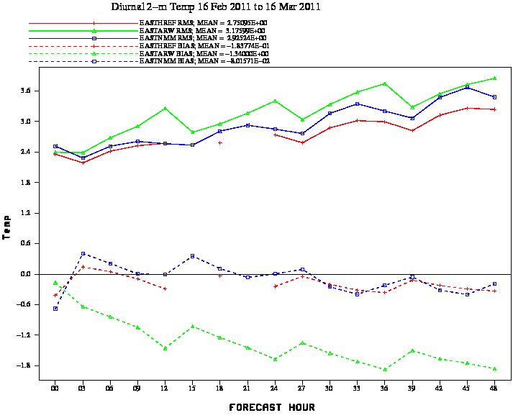
HREF Mean, ARW & NMM
2m Temperature vs Surface Obs
HREF has Lowest RMS & BIAS Near Zero
ARW RMS
HREF RMS
NMM RMS
NMM BIAS
HREF BIAS
ARW BIAS

Slide 15

Some Products
Covering the Spectrum:
Short – range mesoscale → Medium-range → Seasonal

Slide 16
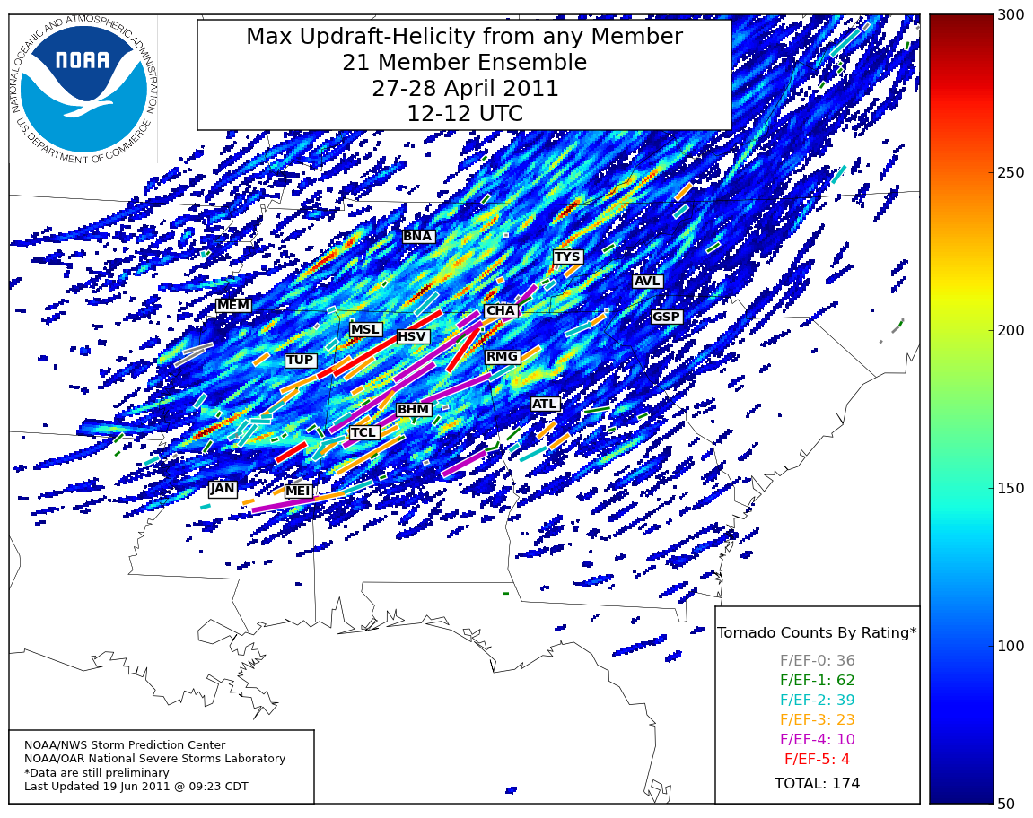
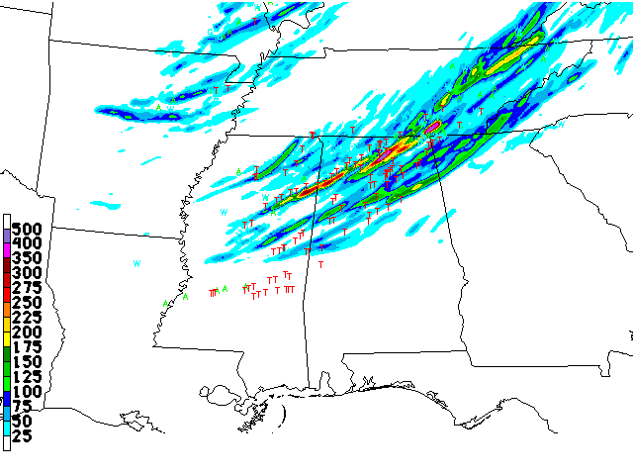
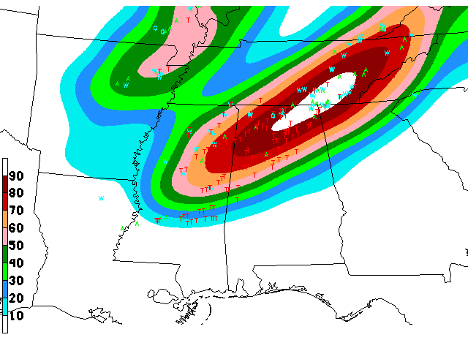
Storm Scale Ensembles
6 hour ensemble of max Updraft Helicity (UH) valid ending 00Z April 28
SPC SSEO
Accumulated over 24-hr period
12 – 36 hrs into forecast
6 hour smoothed ensemble neighborhood (40 km) probability of UH > 25 m2/s2 valid ending 00Z 28 April
OU-CAPS
Storm Scale Ensemble
Hazardous Weather Testbed
SSEO – 7 model Storm Scale Ensemble of Opportunity
SPC SSEO
Notes:
SSEO – Storm Scale Ensemble of Opportunity – 7 models
NSSL WRF-ARW
EMC HRW WRF-ARW
EMC HRW WRF_ARW (12 hour time lag)
EMC CONUS WRF-NMM
EMC HRW WRF-NMM
EMC HRW WRF-NMM (12 hr time lag)
EMC NMMB nest
Upper right – 6 hour ensemble of max Updraft Helicity valid ending 00Z April 28
Lower right – 6 hour smoothed ensemble neighborhood (40 km) probability of UH > 25 m2/s2 valid ending 00Z 28 April

Slide 17
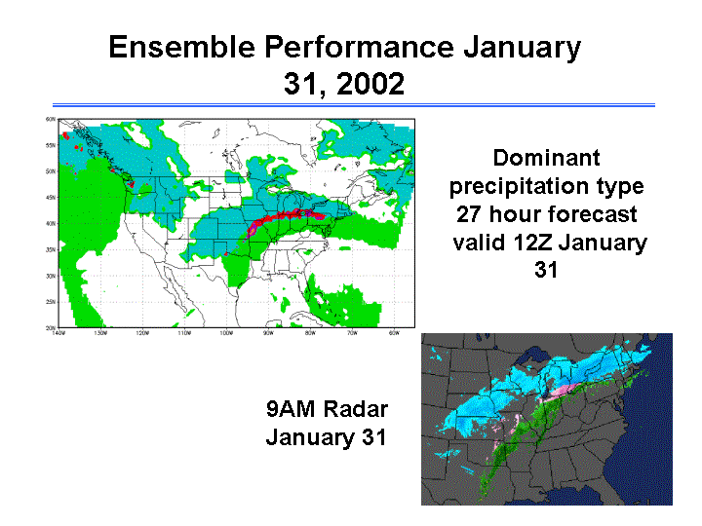
SREF-based Probability of Precipitation Type

Slide 18
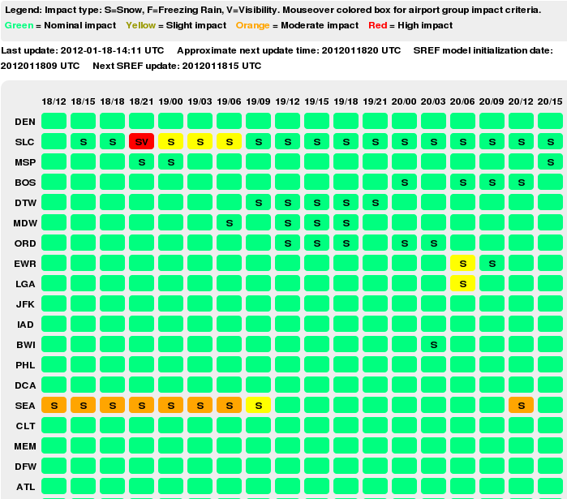
AWC’s SREF-based risk forecast for U.S. Airports

Slide 19
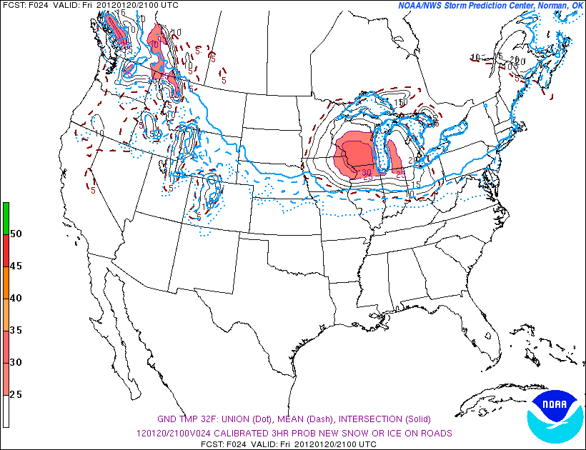
Example: Calibrated Accumulations
NCEP SREF 3h Probability of Road Accumulation –
24-hour Forecast Valid 21 UTC 20 January 2012
http://www.spc.noaa.gov/exper/sref
Under “Post-Processed Guidance”

Slide 20
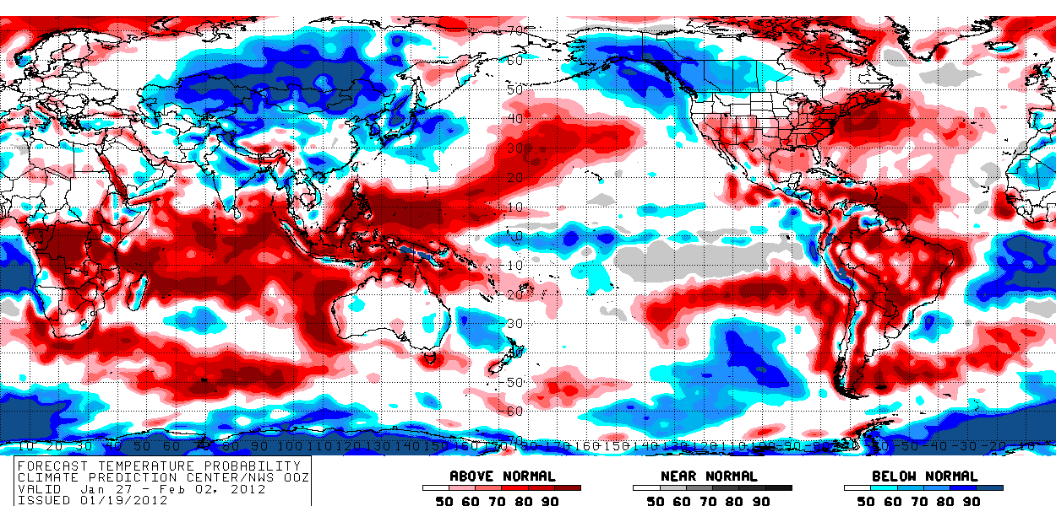
North American Ensemble Forecast System
8 to 14 Day Temperature Guidance
Experimental
Valid: January 27, 2012 to February 02, 2012, Issued: Jan 19, 2012

Slide 21
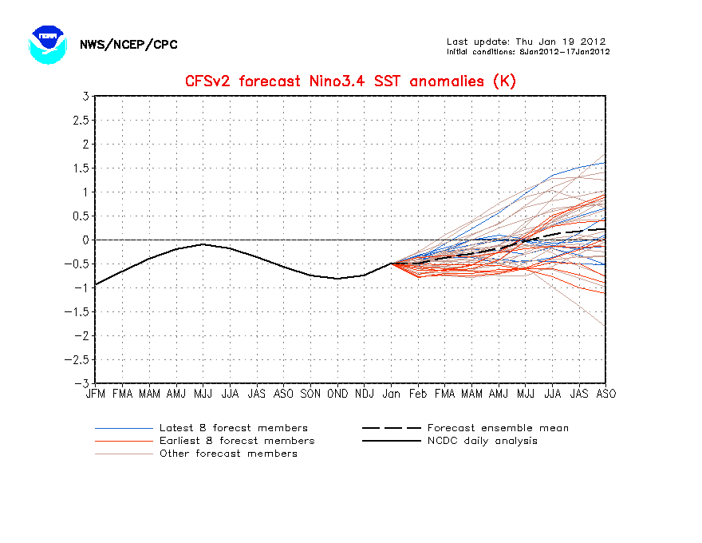

Slide 22
The Case that Made the Case for an Operational SREF
January 24-25, 2000

Slide 23
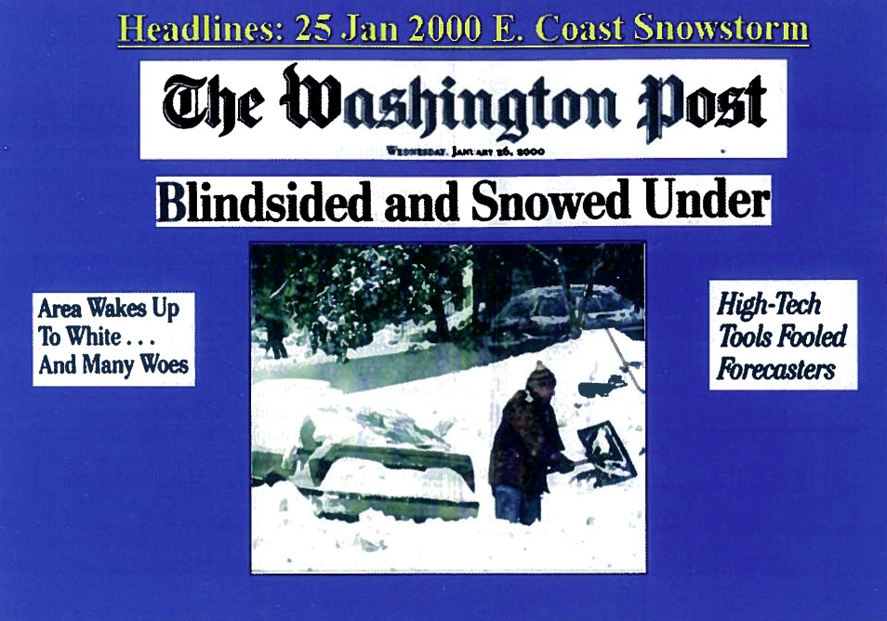
From Tracton (2008) and Jun Du

Slide 24
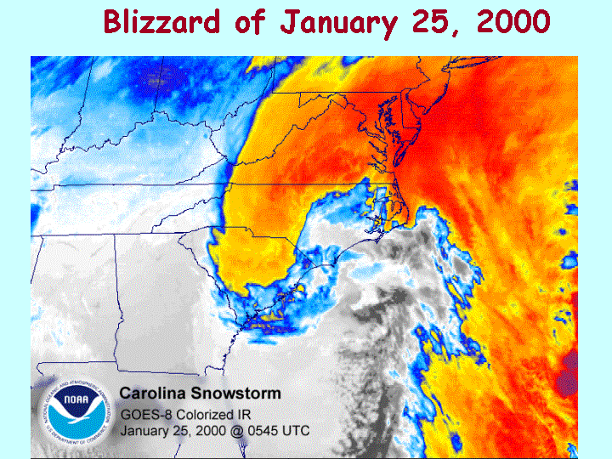
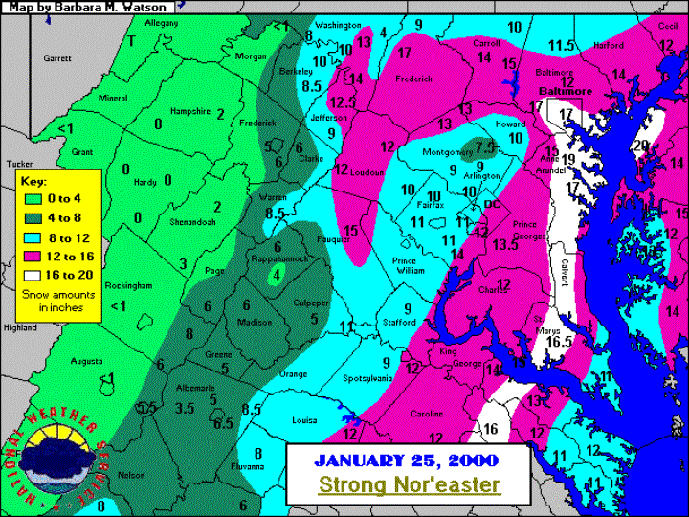
Jan. 25, 2000 East Coast snow storm: observation

Slide 25
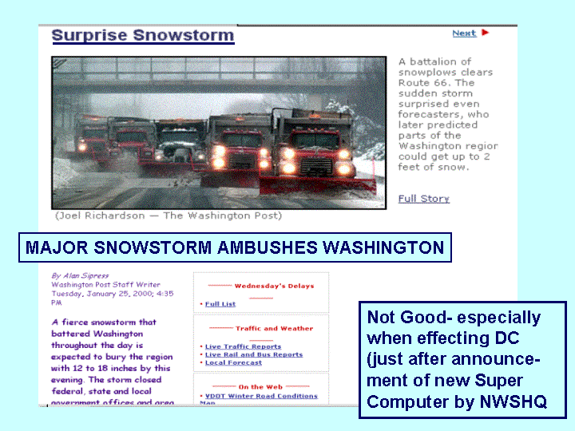
Not Good – especially due to its effect on DC (just after announcement of new supercomputer by NWS HQ)

Slide 26
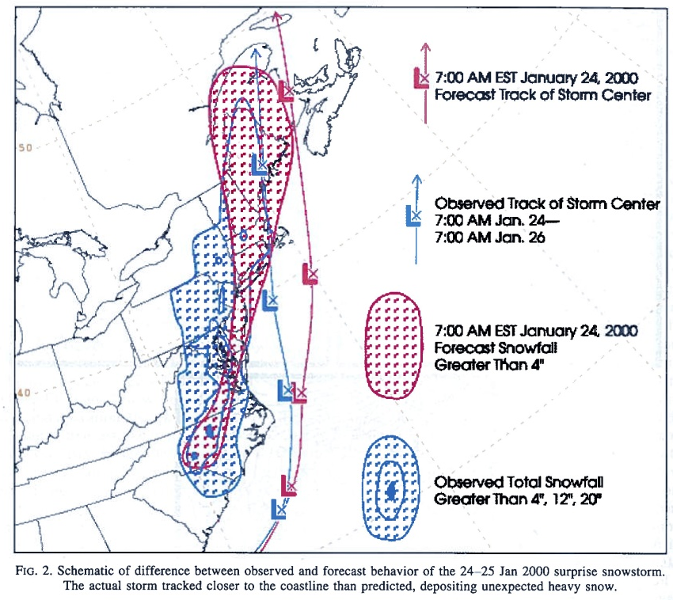

Slide 27
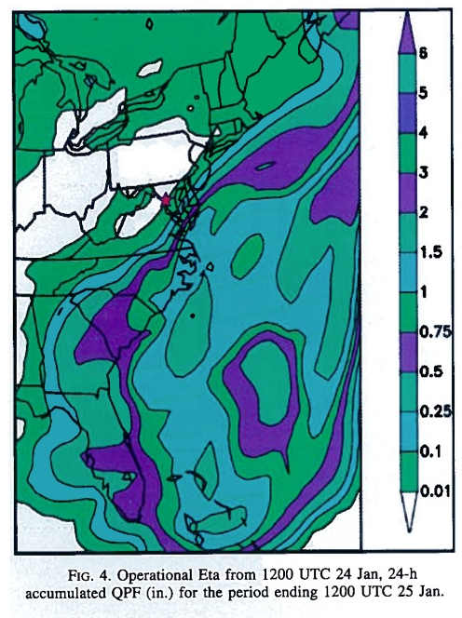
Operational Eta
From 12Z
January 24, 2000
24 hour
accumulated QPF (in.)
for period ending
12Z January 25, 2000

Slide 28
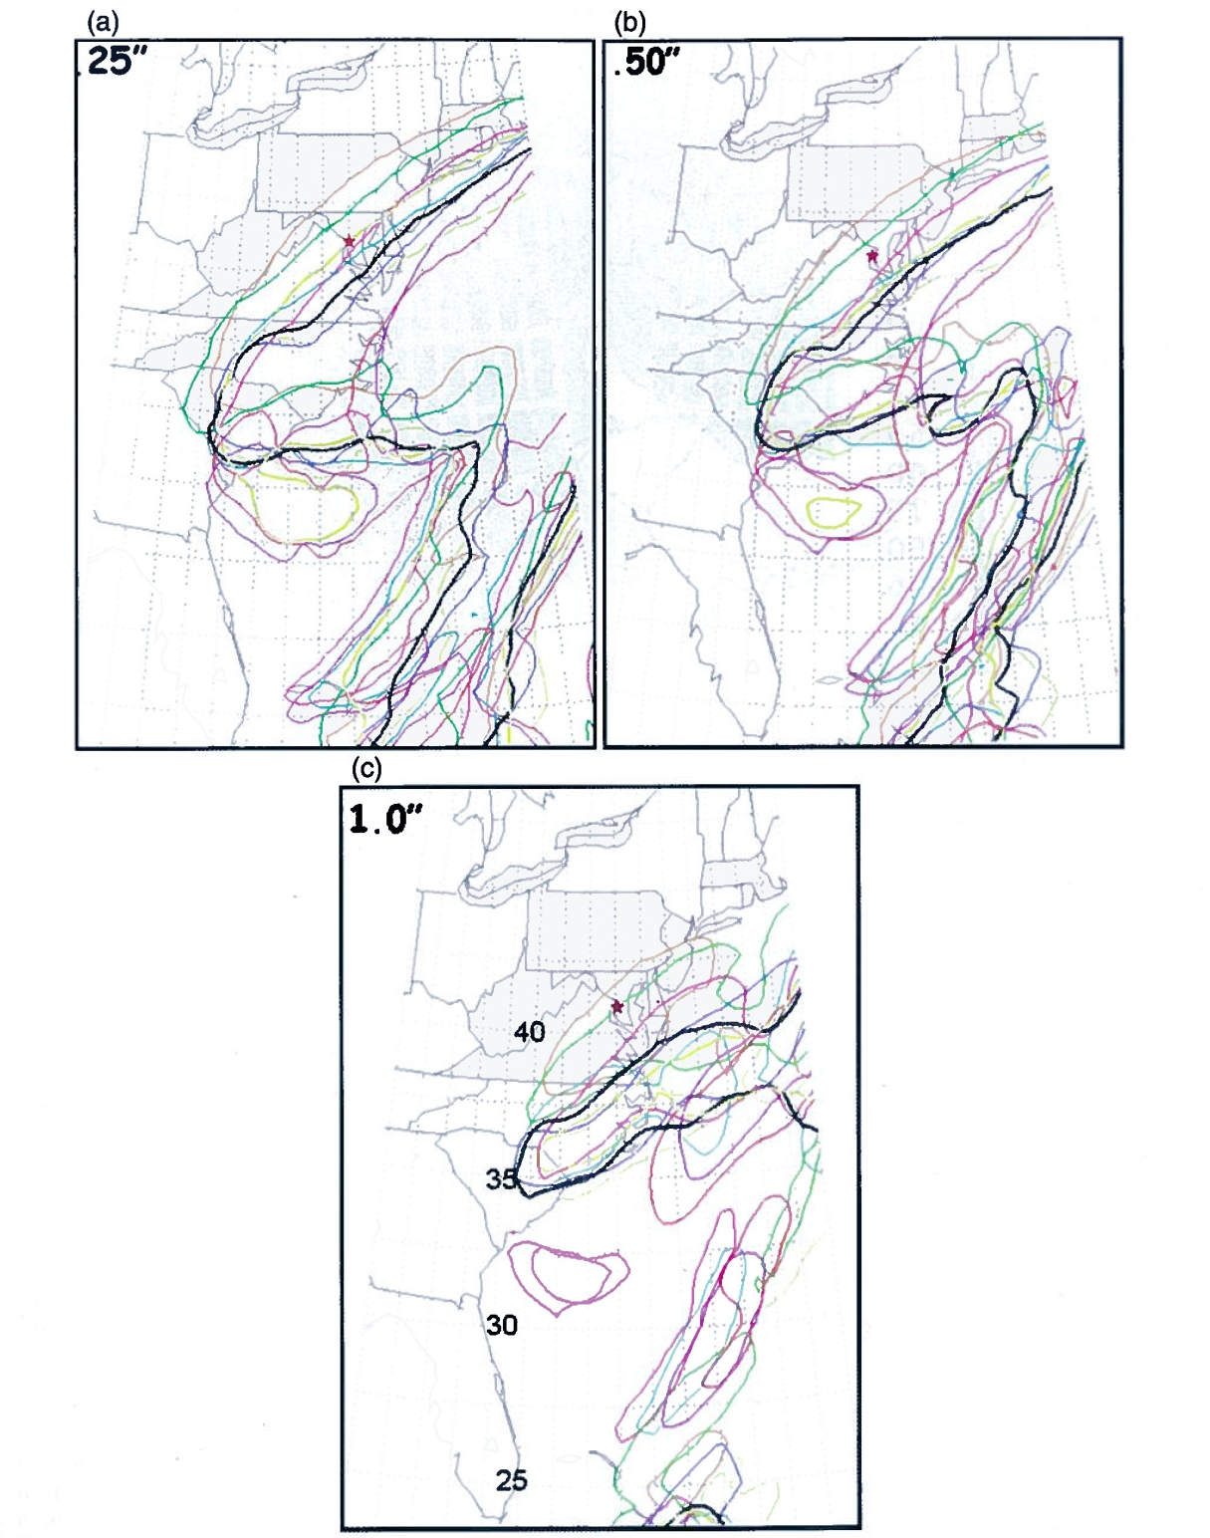
24-hr Eta Ensemble from 12Z January 24, 2000
Spaghetti diagrams of
0.25, .50, 1.0 inch QPF
for period ending
12Z January 25, 2000

Slide 29
January 24-25, 2000
Surface analysis points to storm potential on January 24
Developing trough pointed to potential major storm along the East Coast
Single runs pointed to snow staying out of metropolitan area from Washington to west of NYC
No watches, no warnings in Washington, D.C.
“Near real-time” SREF points to increasing probability that no snow/snow line would shift west
- received 24 hours after the event!

Slide 30
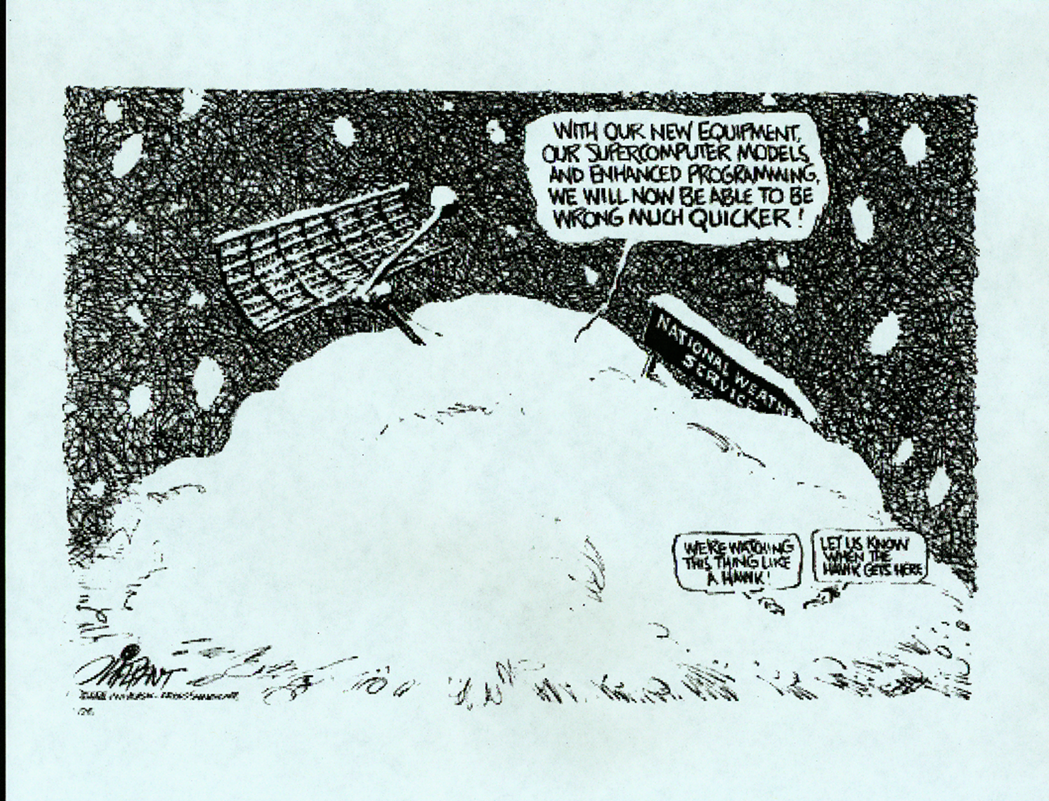

Slide 31

Pay Off: Forecasting Extreme Events
Today
West Coast cyclones
Mid-west severe weather outbreaks and blizzards
Hurricanes
East Coast storms
Predicted up to 7-8 days in advance for many cases

Slide 32
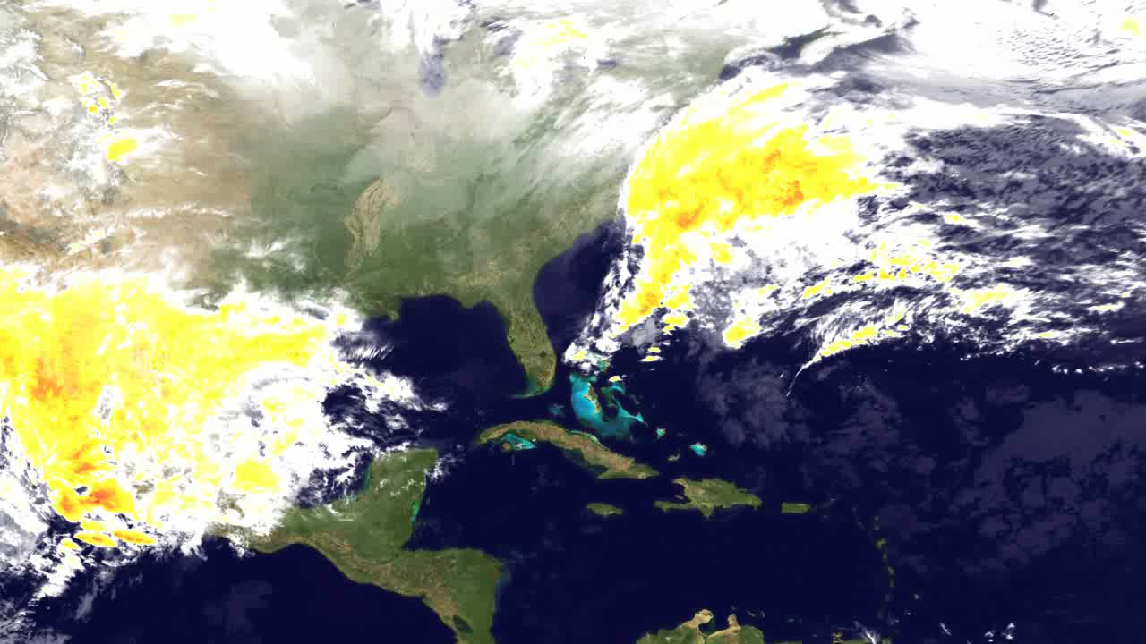
February 2-7, 2010: Snowmageddon

Slide 33
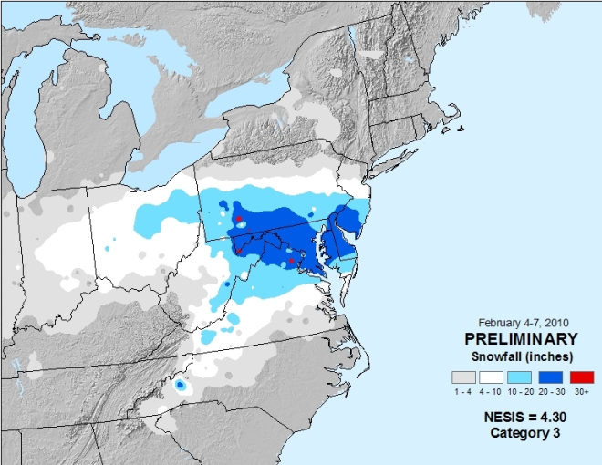

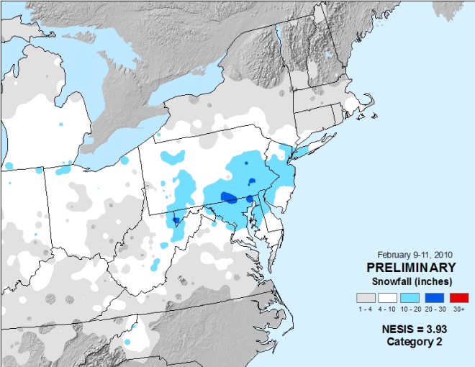
February 4-11, 2010: “Snowmageddon”
February 4-7, 2010: massive winter storm paralyzes mid-Atlantic region
  Locations in Maryland, Pennsylvania, Virginia, and West Virginia recorded more than 30 inches of snow.
  Washington DC’s two-day total of 17.8 inches ranked as the fourth highest total storm amount in history.
  Philadelphia’s 28.5 inches ranked as the second highest amount
  Baltimore’s 24.8 inches ranked as its third highest storm total amount
Strong blizzard during February 9-11 affects same areas still digging out from earlier storm.
  Produced as much as 14 inches in the D.C. area, 20 inches in Baltimore, 17 inches in New Jersey, more than 27 inches in Pennsylvania, and 24 inches in northern Maryland.
Storm system predicted 7+ days in advance; potential for heavy snow 3-5 days in advance
States implement COOP plans, airlines cancel flights, retail industry pre-stocks shelves
Feb 4-7, 2010
Feb 9-11, 2010
Notes:
Came from a Washington Post poll held two days (the evening of Feb 3) prior to snow asking “As we gear up for the impending storm on Friday: we face an urgent decision. What are we going to call it?“
”My recommendation – SNOWMAGEDDON
Posted by: 300_sq_ft | February 3, 2010 8:56 PM “

Slide 34
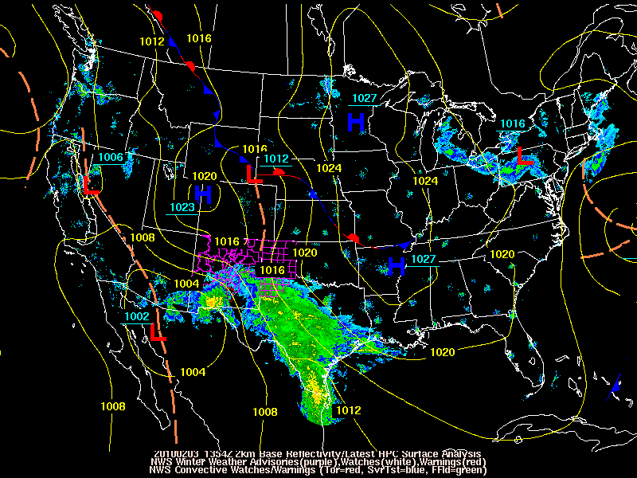
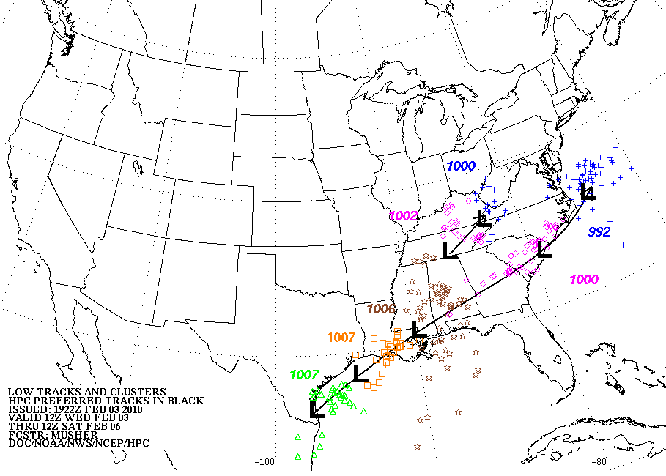
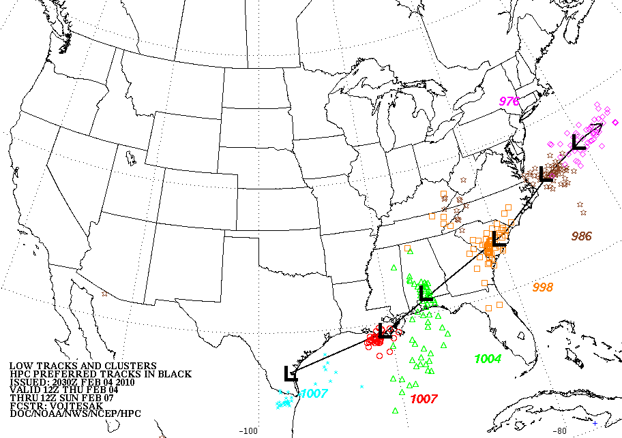
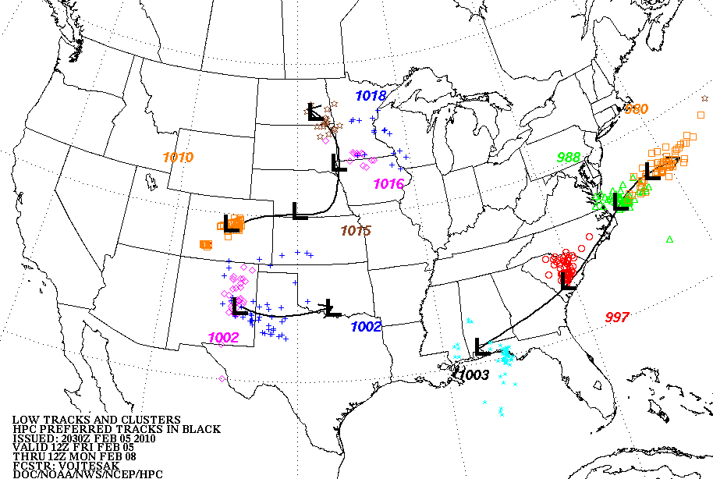
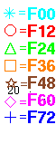
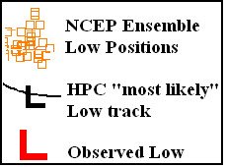
SREF Forecasts for Feb 5, 2010: “Snowmageddon”
3 days
prior
2 days
prior
1 day
prior

Slide 35
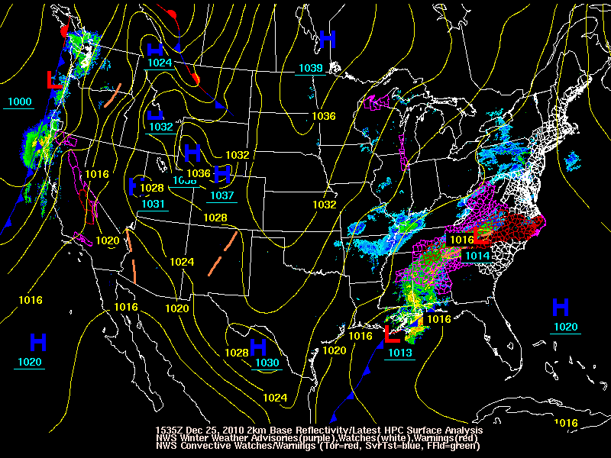
A Wake Up Call: NYC Blizzard

Slide 36
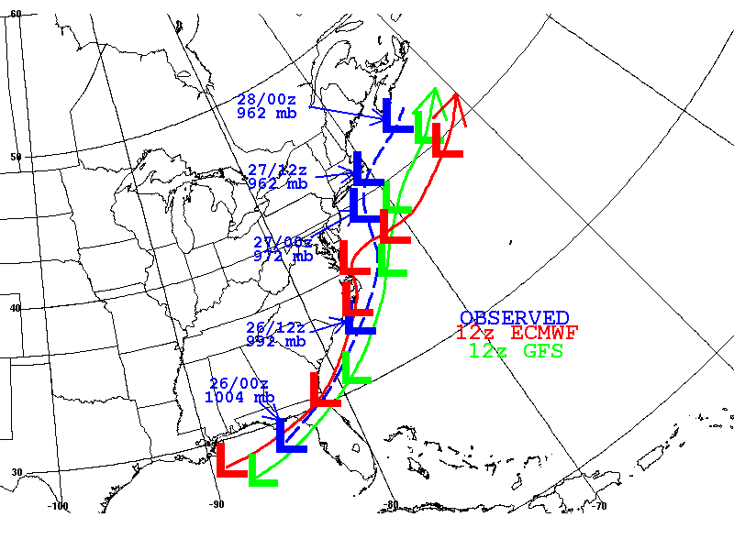
Forecast uncertainty led to inaction that increased the overall impact of the storm
Observed – Blue
ECMWF – Red
GFS - Green
Guidance from 12Z December 22 - Wednesday

Slide 37
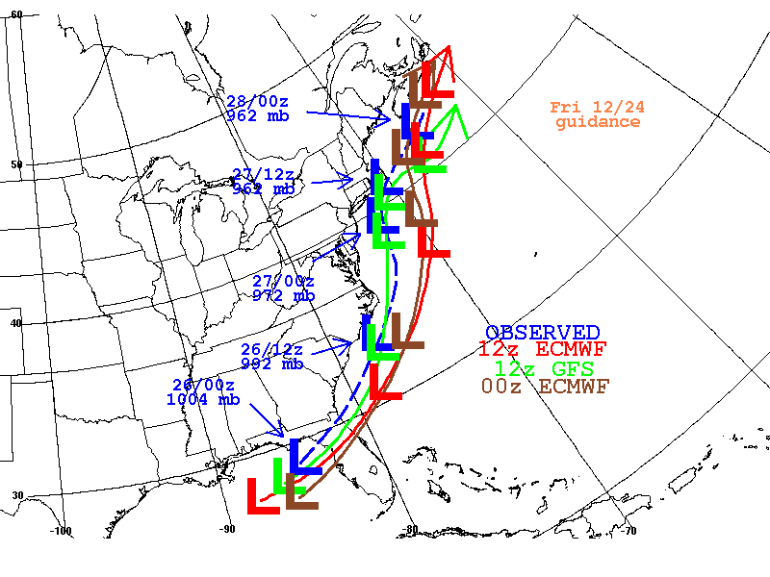
Observed – Blue
12Z ECMWF – Red
12Z GFS – Green
00Z ECMWF - Brown
Guidance from 12Z December 24 - Friday

Slide 38
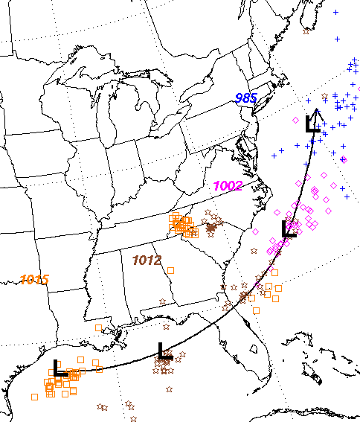
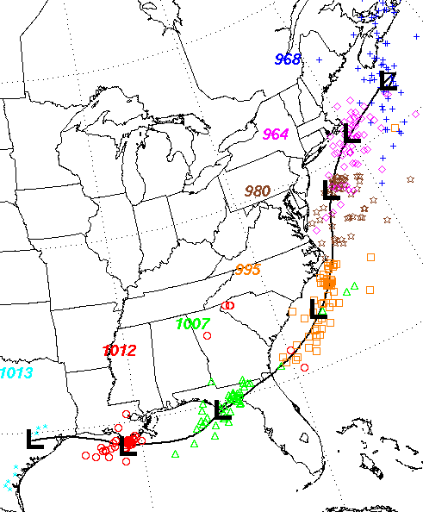
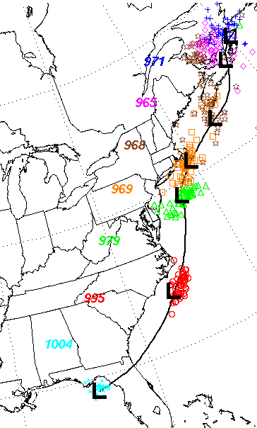
SREF/GEFS Forecasts for Dec 26, 2010: NYC Blizzard
3 days
prior
2 days
prior
1 day
prior

Slide 39
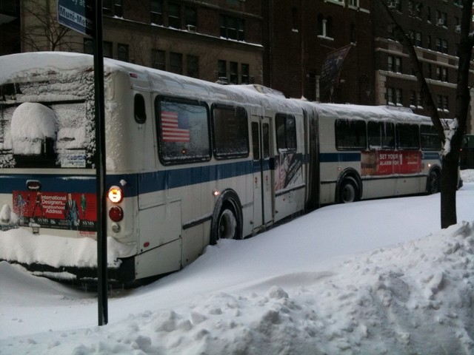
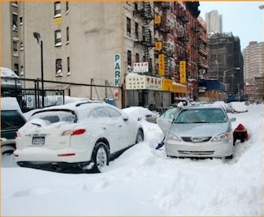
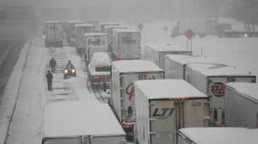
December 26-27, 2010
Potential for major east coast storm highlighted 5 days in advance
Low confidence about model predictions – especially track forecasts – until late December 24
Blizzard warning issued for NYC at 4PM Saturday, December 25 (14 hours prior to onset)
By December 24-25, special effort made to reach out to Emergency managers and airline industry prior to onset of heavy snow in Northeast corridor/NYC
Airline industry takes action
Snow emergency not declared in NYC
NYC/NJ/West CT gets buried by 2+ feet of snow with 50+ mph winds
39

Slide 40


Impacts:
Forecast for 26-27 December 2010
Airlines/airports are prepared for crippling event
  Cancel thousands of flights
  Attempt to mitigate impact on national and international flight operations
  Fully recover in 3-4 days
NYC does not declare snow emergency despite blizzard warning – results in major gridlock within city
40

Slide 41
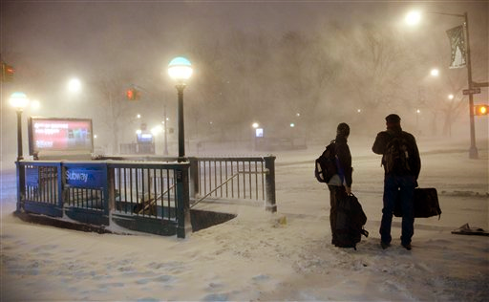
New York City Report:
Preliminary Review of the City’s Response to the
December 2010 Blizzard - Report and Recommendations
From Introduction – “On December 26, 2010, a blizzard struck New York City and surrounding areas. Though earlier forecasts had called for only a light to moderate snow falls, the National Weather Service issued a blizzard warning at 3:55 PM on December 25th. At that time, between 11 and 16 inches of snow were predicted, along with high winds and low visibility. Even this forecast underestimated the storm’s ferocity. ”
Third of six key problems – “Insufficient and delayed deployment of City assets. The weather forecast for the storm got significantly worse rather quickly, culminating in a blizzard warning issued at 3:55pm on Christmas Day. Due to the late change in the forecast, as well as the fact that DSNY has adeptly handled large snowfalls so many times previously without assistance, agencies that are not typically involved in snow removal—such as the Taxi and Limousine Commission --were not mobilized expeditiously.”

Slide 42
Ongoing Issues/Opportunities
Decentralized product generation (distribute all ensemble members - NOMADS)
What is optimal configuration? How many members, at what resolution?
  “High resolution matters” (Richard Grumm from recent forecast discussion on West Coast storm)
What constitutes best MME? Physics? Dynamic cores? Both?
How best to serve research communities to address these and other issues – O2R!
Enormous opportunities to build off THORPEX and provide research community with hundreds of ensemble runs/day

Slide 43
Summary
Ensemble prediction systems represent the second revolution in numerical weather prediction
Operational ensembles have been developed and implemented hand in hand with research communities – great example of R2O!
Multi-model ensemble approaches have extended and improved forecast skill
  Especially for extreme weather and climate events
  Useful skill attained for 7 days and beyond
Many opportunities/issues remain to be addressed
  Preferably through a research/operational partnership

Slide 44



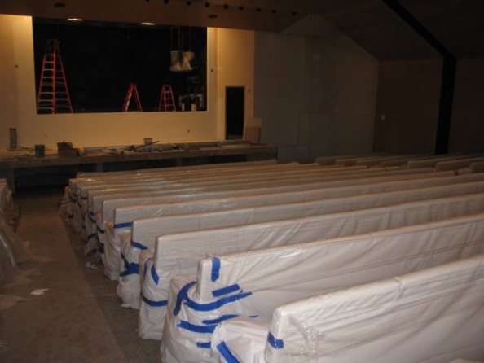
The Building!
Move Schedule
February 2, 2012 – data center setup begins
August 2012 – begin phased move-in
  Front offices
  Non-operational groups
August 2012 – dual operations
October 2012 – complete move
September/October 2012 – ribbon-cutting ceremony

Slide 45
Appendix

Slide 46
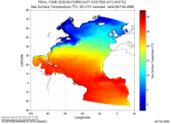
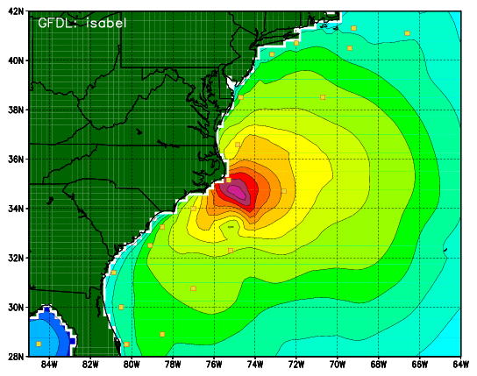
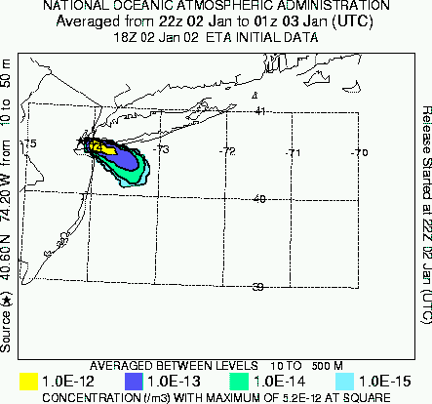
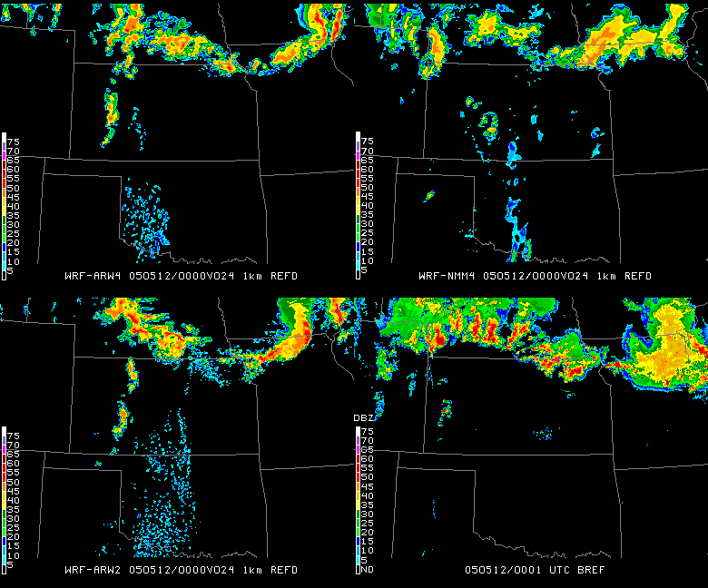
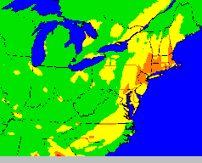
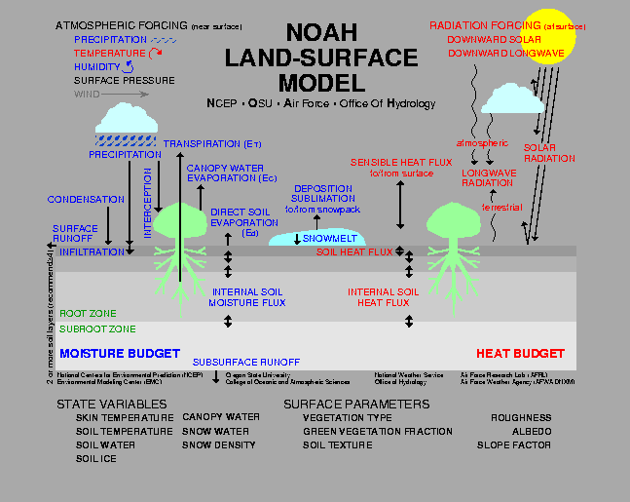
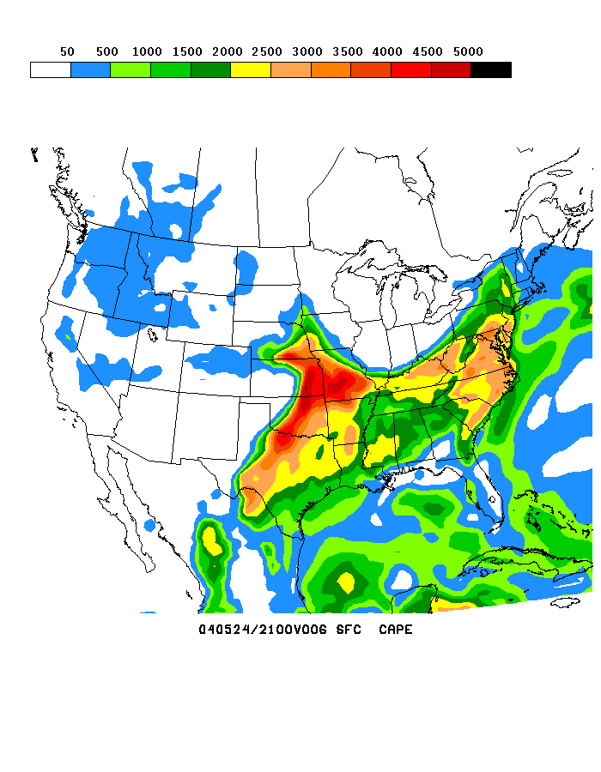
NOAA’s NWS Model Production Suite
Climate
CFS
MOM4
NOAH
Sea Ice
Oceans
HYCOM
WaveWatch
III
NOS
PORTS
GLOFS
Chesapeake
Tampa
Delaware
ADCIRC
Hurricane GFDL
HWRF
Coupled
3.5B Obs/Day
Coupled
(Future)
Satellites + Radar
99.9%
Regional
DA
Regional NAM
WRF NMM
Dispersion
ARL/HYSPLIT
Global
Forecast
System
Global Data
Assimilation
Severe Weather
WRF NMM/ARW
Workstation WRF
Short-Range
Ensemble Forecast
Space
Weather
(Future)
North American Ensemble Forecast System
Regional DA
WRF: ARW, NMM
ETA, RSM
Air Quality
GFS, Canadian Global Model
ENLIL
NAM/CMAQ
Forecast
Rapid Update
for Aviation
46
46
NOAH Land Surface Model
Notes:
46

Slide 47
NOAA Climate Forecast System (CFS)
Attribute | CFS v1.0 Operational Since 2004 | CFS v2.0 Operational Since March 2011
Analysis Resolution | 200 km | 27 km
Atmosphere model | 2003: 200 km/64 levels Humidity based clouds | 2010: 100 km/64 levels Variable CO2 AER SW & LW radiation Prognostic clouds & liquid water Retuned mountain blocking Convective gravity wave drag
Ocean model | MOM-3: 60N-65S 1/3 x 1 deg. Assim depth 750 m | MOM-4 fully global ¼ x ½ deg. Assim depth 4737 m
Land surface model (LSM) and assimilation | 2-level OSU LSM No separate land data assim | 4 level Noah model GLDAS driven by obs precip
Sea ice | Climatology | Daily analysis and 3-layer interactive sea ice model
Coupling | Daily | 30 minutes
Data assimilation | Retrieved soundings, 1995 analysis, uncoupled background | Radiances assimilated, 2008 GSI, coupled background
Reforecasts | 15/month seasonal output | 24/month (seasonal) 124/month (week 3-6)

Slide 48
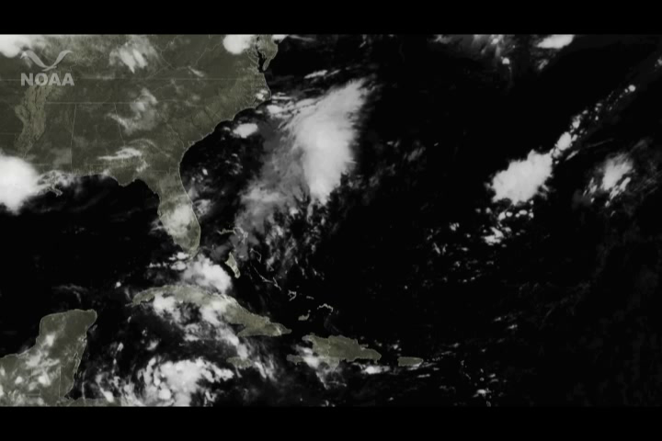
Hurricane Irene Track Forecast
The Use of Ensembles Pays Off
August 20, 2011 – August 27, 2011

Slide 49

Hurricane Irene Precipitation
Precipitation Forecast Loop
Precipitation Verification Loop
August 26 – 29, 2011

Slide 50





April 27-28, 2011
Southeast Tornado Outbreak
April 27-28, 2011
~190 tornadoes, ~311 fatalities
Deadliest outbreak since March 21, 1932
Outlook issued 5 days prior; Moderate Risk issued 3 days in advance; High Risk issued 16 hours in advance
Coordination calls initiated w/FEMA and state emergency managers 3 days in advance
POD 96% for tornadoes occurring in SPC watches
Average warning lead time 24 min
50
10AM – 11PM CDT April 27, 2011
Notes:
50
DR. UCCELLINI
2008 is already tied as the 23rd deadliest tornado year since record keeping began in 1950, and it is only mid-February.
America is vulnerable to severe weather.
90% of all presidential disaster declarations are weather related. We still have an average 500 deaths per year and $14 billion damage.
We average 1,300 tornadoes a year in this country (10 year average).
2008 is the 60th anniversary of the first tornado forecast. March 25, 1948, two Air Force Officers, predicted that tornadoes would hit Tinker Air Force Base, Okla., where they were weather officers. They issued the first successful tornado forecast in America, saving many lives.
So far this year we are far above average with 291 tornadoes and 67 deaths.
Despite our best efforts, the past few years have seen a steady increase in the number of tornado deaths in the U.S.
2008: 67 fatalities so far this year (number of tornadoes: 291; killer tornadoes: 16)
2007: 81 (number of tornadoes: 1,074; killer tornadoes: 26)
2006: 67 (number of tornadoes: 1,106; killer tornadoes: 25)
2005: 38 (number of tornadoes: 1,264; killer tornadoes: 13)
Event Synopsis:
The February 5-6 tornado outbreak in the South was the deadliest February tornado outbreak since Feb. 1971. (Southern Mississippi Valley tornado outbreak with 121 fatalities)
Deadliest single day tornado event since May 31, 1985. (Ohio, Pennsylvania tornado outbreak with 76 fatalities)
This event was well forecast.
Storm Prediction Center warned a tornado outbreak was possible 6 days in advance.
SPC issued a high-risk warning early in the morning of Feb. 5, and a moderate-risk warning two days before. This captured the attention of broadcast media and emergency managers since we only issue a handful of the high-risk warnings each year.
The average lead time for the tornado watches was 2 days.
The average lead time for the warnings was 17 minutes.
In terms of the destruction, the numbers are devastating:
63 confirmed tornadoes (spawned by a long-lived squall line that developed out of a strong upper level storm system) across SR and into CR
11 killer tornadoes
59 people killed and more than 350 injured in five states (Alabama, Arkansas, Kentucky, Tennessee, and Mississippi)
Extensive damage across the affected areas
The service performed by our national centers, regional staff, and field staff was exemplary

Slide 51


April 27-28, 2011
Tornado Outbreak
Day 4-8
Day 5 – 12Z April 27- 12Z April 28, 2011
Day 4 – 12Z April 27- 12Z April 28, 2011

Slide 52




Categorical
Day 3
Probabilistic
April 27-28, 2011 Tornado Outbreak
Day 2
Categorical
Probabilistic

Slide 53





Day 1
Categorical
Tornado
April 27-28, 2011 Tornado Outbreak
Hail
High Winds

Slide 54


