Slide 1


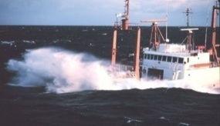
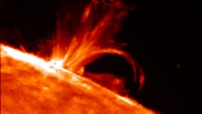
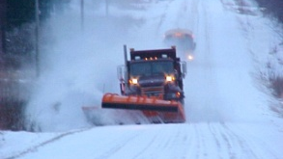
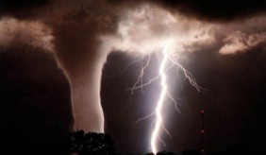
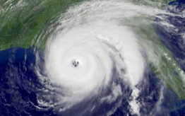

National Centers for
Environmental Prediction:
Entering a New Era in Earth System Prediction “From the Sun to the Sea”
Dr. Louis W. Uccellini
National Centers for Environmental Prediction
Director
SUNY Albany
Albany, NY
November 12, 2012
“Where America’s Climate, Weather, Ocean and Space Weather Services Begin”

Slide 2
Outline
“The Weatherman is not a Moron”
Recent Forecast Successes: Contrasting Then and Now
NCEP’s Role in NOAA’s Forecast Process
Model Production Suite
  Newest Members
Increasing Reliance on Ensemble Forecasts
Application of Uncertainty in Hurricane Prediction
Forces for Change
  Ecosystem Forecasting
NOAA Center for Weather and Climate Prediction
Concluding Remarks
  2013 Annual Meeting “Taking Predictions to the Next Level”

Slide 3


September 9, 2012
IN THE HOCUS POCUS REALM OF PREDICTING THE FUTURE, WEATHER FORECASTING STANDS
OUT AS AN AREA OF GENUINE, MEASURABLE PROGRESS. YOUR OWN EXPERIENCE MAY DIFFER. BY NATE SILVER
THE WEATHERMAN IS NOT A MORON

Slide 4

From the inside, the National Centers for Environmental Prediction looked like a cross between a submarine command center and a Goldman Sachs trading floor.
Quoted from “The Weatherman is not a Moron” New York Times Magazine, September 9, 2012

Slide 5
“The Weatherman is not a Moron” - Nate Silver, New York Times
Weather prediction has progressed when most other predictions have failed
Progress can be “measured”/verified in a quantitative way
Prediction capabilities include uncertainty and have already been integrated into key decision support services
Actually goes as far as stating the NWS does the best job in conveying uncertainty in forecast products

Slide 6
Recent Forecast Successes
Contrasting Then and Now

Slide 7
The Transformation from Subjective to Model-Based Forecasts
1970s Limits of Predictability
Numerical models were introduced in the 1950s, by the mid 1970s, frustration was rampant.
“…abandon research that uses “weather sequences” generated in a computer as bases for deduction about the real atmosphere.” C.S. Ramage, 1976: Prognosis for Weather Prediction. Bull Amer. Meteor. Soc., 57, 4-10.
Cressman, 1970
1970s 1980s 1990s
Despite this opinion, research continued on real-time numerical prediction models, which have now become the central core of the successful modern forecast process.
(Nate Silver, The Weatherman is not a Moron, NY Times, 2012

Slide 8
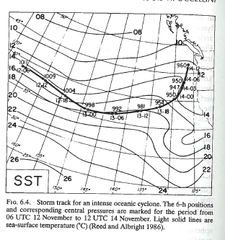
Rapidly Developing Pacific Storm: Not Predicted
13-14 November 1981
Reed and Albright, MWR, 1986

Slide 9
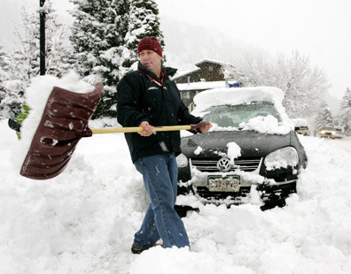
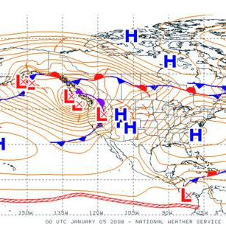
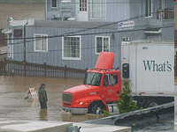
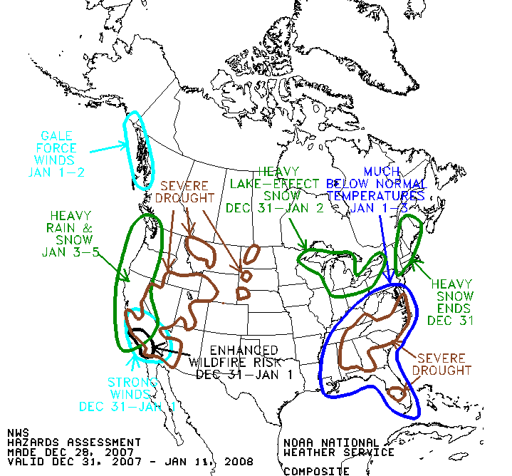
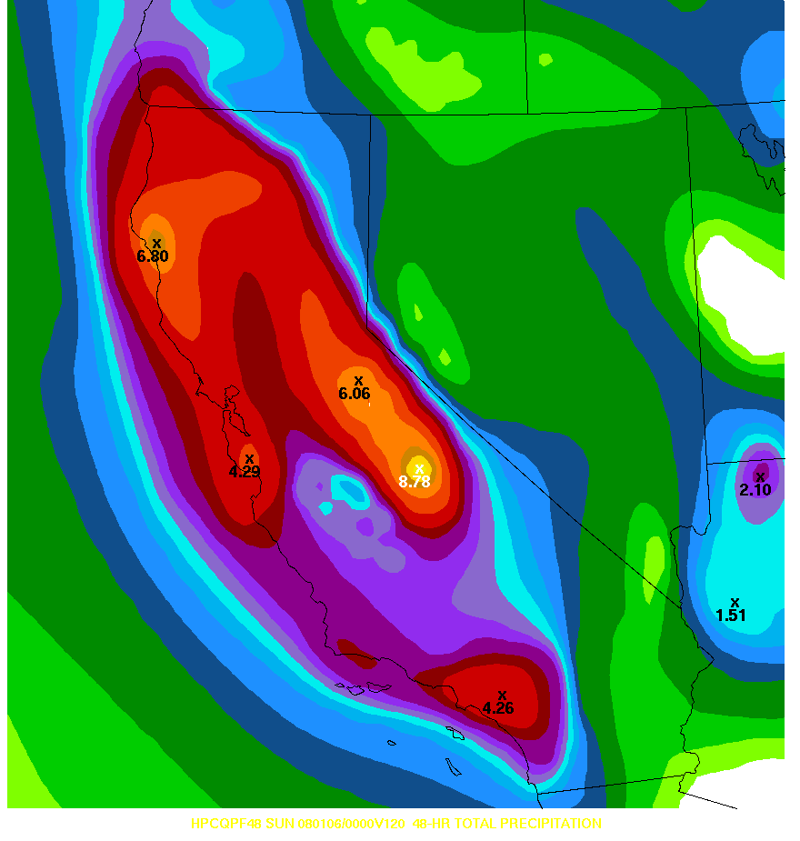
January 3-7, 2008
West Coast Rain/Snow Event
Snowfall in CA mountains of up to 10 feet
00Z 5 January, 2008
Rainfall amounts 2-10 inches
Localized flooding caused by heavy rains at lower elevations
2 Weeks Prior to Event
6 Days Prior to Event
4 Days Prior to Event
MJO Update: issued by Climate Prediction Center December 24, 2007
“Some potential exists for a heavy precipitation event tied to tropical convection by week 3 … along the west coast of the US ”
Hazards Assessment
Issued December 28, 2009
HPC 48-h QPF ending 00Z 6 Jan
Issued 00Z 1 Jan
Day 4-5 forecast

Slide 10
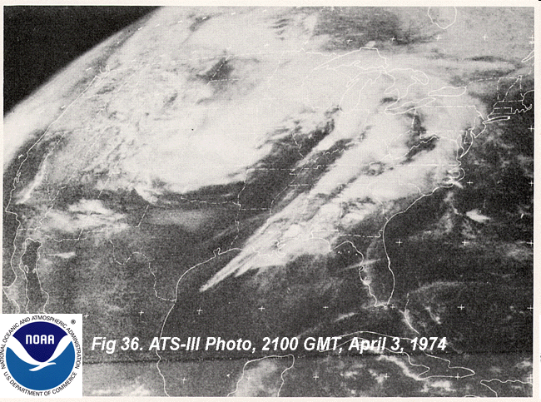
April 3-4, 1974 Super Outbreak
One of the deadliest tornado outbreaks in the 20th Century (330 fatalities)
Involved over one-quarter of the country
  148 tornadoes in 13 states
Potential for severe weather was recognized only the afternoon before event
Magnitude of event not realized until evening news – April 3
Tornado Tracks
12Z April 3 – 12Z April 4, 1974
10
Notes:
10

Slide 11
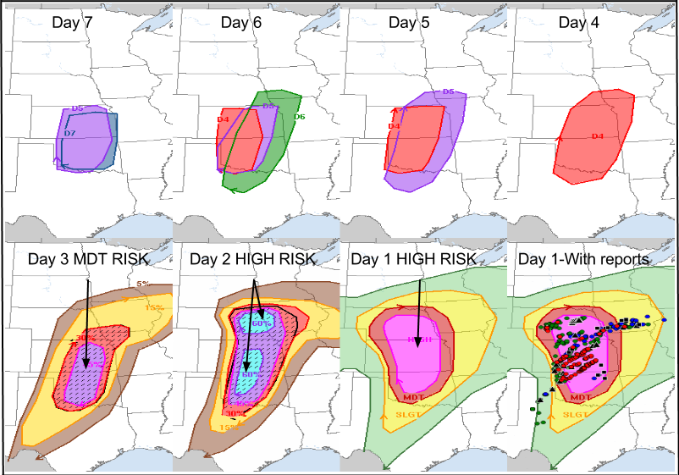
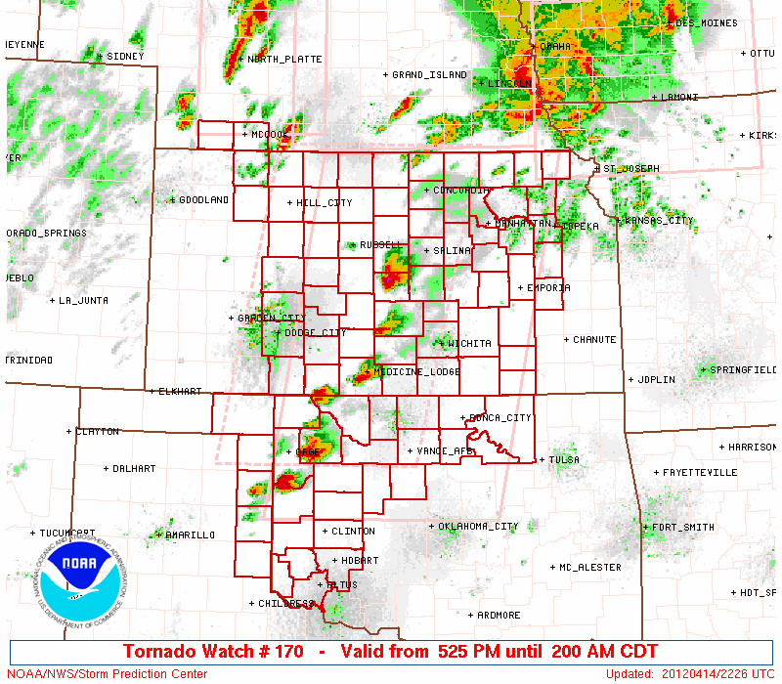
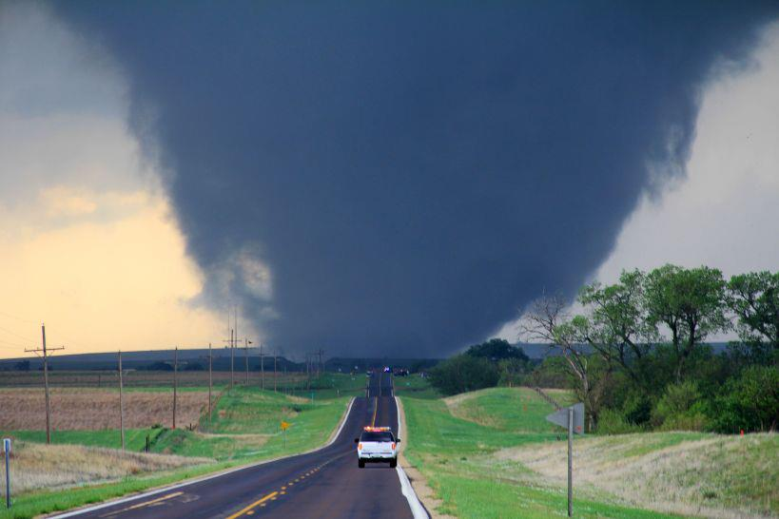

14 April 2012 Great Plains Outbreak
60 Tornadoes (1 EF4, 3 EF3 & 3 EF2)
Outlook first issued 7 days in advance; Moderate Risk 3 days in advance; High Risk 2 days in advance (only 2nd time)
NWS average warning lead time (Tornadoes) : 13 minutes
6 Fatalities in Woodward, OK near midnight
FEMA/State/local emergency managers engaged starting 3 days before the event
Notes:
11

Slide 12
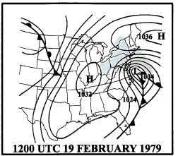
Presidents’ Day Storm 18-20 February, 1979
1830Z 19 Feb 1979
22 inches of snow buries Washington D.C. area
Rapid cyclogenesis off the coast
Not predicted even hours in advance

Slide 13
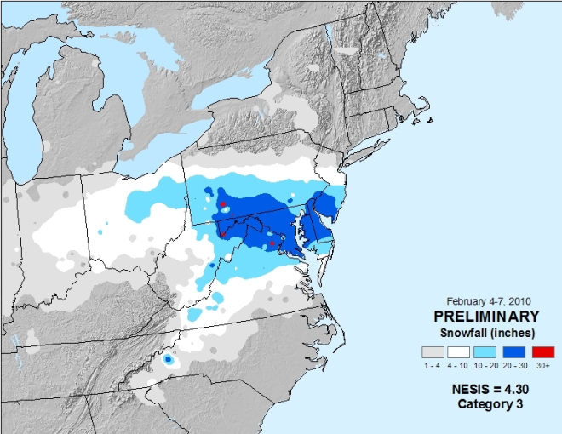

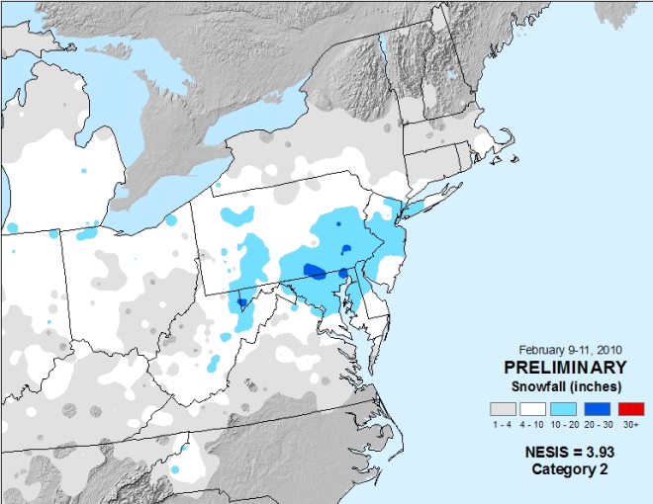
February 4-11, 2010: “Snowmageddon”
February 4-7, 2010: massive winter storm paralyzes mid-Atlantic region
  Locations in Maryland, Pennsylvania, Virginia, and West Virginia recorded more than 30 inches of snow.
  Washington DC’s two-day total of 17.8 inches ranked as the fourth highest total storm amount in history.
  Philadelphia’s 28.5 inches ranked as the second highest amount
  Baltimore’s 24.8 inches ranked as its third highest storm total amount
Strong blizzard during February 9-11 affects same areas still digging out from earlier storm.
  Produced as much as 14 inches in the D.C. area, 20 inches in Baltimore, 17 inches in New Jersey, more than 27 inches in Pennsylvania, and 24 inches in northern Maryland.
Storm system predicted 7+ days in advance; potential for unprecedented heavy snow (up to 3 feet) 3-5 days in advance
States implement COOP plans, airlines cancel flights, retail industry pre-stocks shelves
Feb 4-7, 2010
Feb 9-11, 2010
Notes:
Came from a Washington Post poll held two days (the evening of Feb 3) prior to snow asking “As we gear up for the impending storm on Friday: we face an urgent decision. What are we going to call it?“
”My recommendation – SNOWMAGEDDON
Posted by: 300_sq_ft | February 3, 2010 8:56 PM “

Slide 14
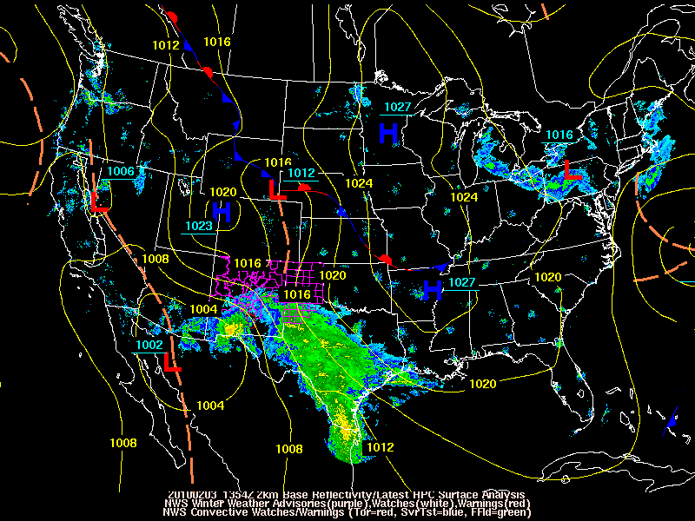

Slide 15
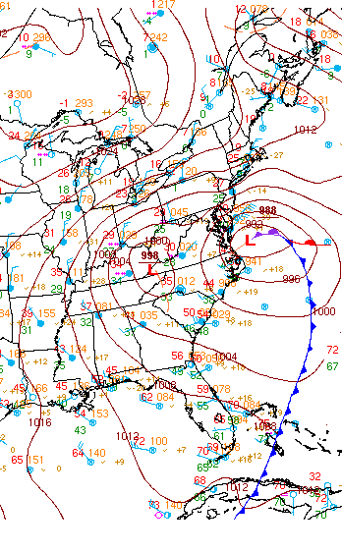
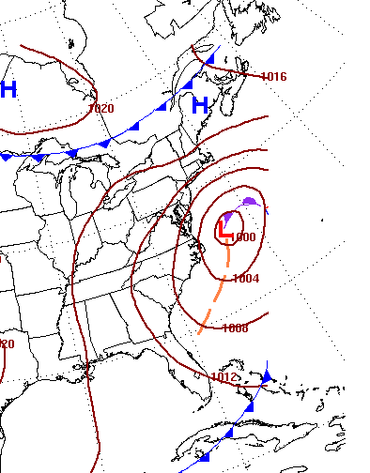
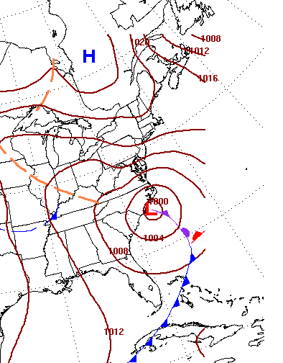
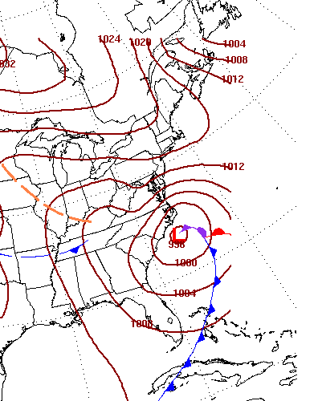
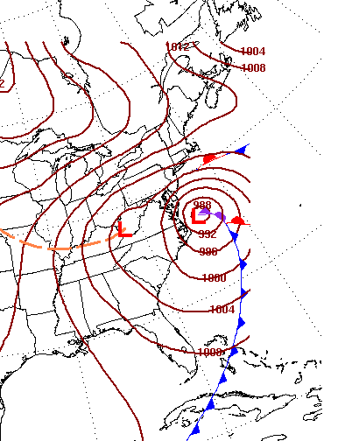
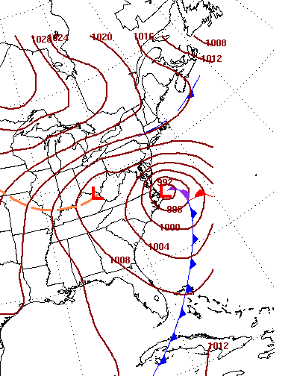
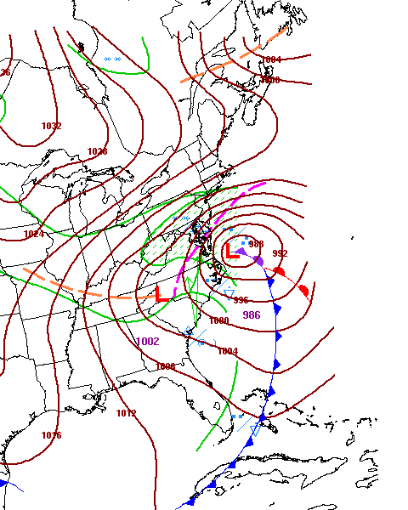
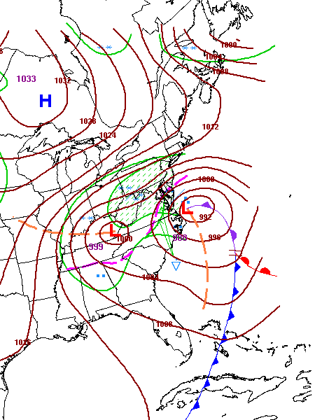
Snowmageddon: All Charts Valid 12Z February 6, 2010
Surface Analysis
7 day forecast
6 day forecast
5 day forecast
4 day forecast
3 day forecast
2 day forecast
1 day forecast
Storm system predicted 7+ days in advance; potential for heavy snow (up to 3 feet) 3-5 days in advance
States implement COOP plans, airlines cancel flights, retail industry pre-stocks shelves

Slide 16
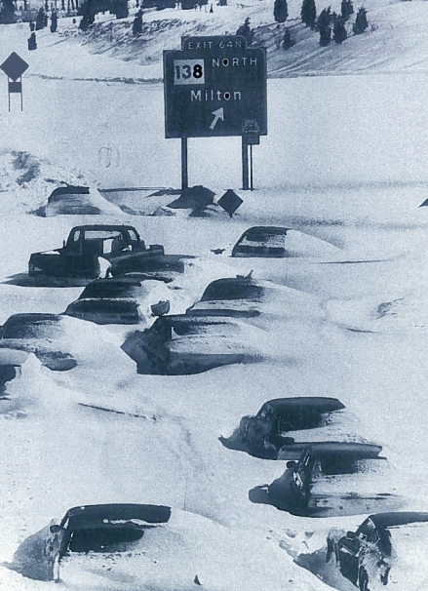
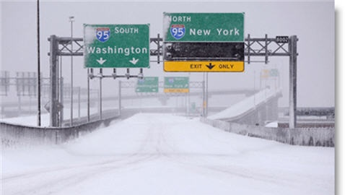
Impacts
“Snowmageddon”
States declare emergency days before snow
Airlines cancel thousands of flights at least a day in advance
Stores adjust to optimize retail sales entire week before the storm
  Low to no impact on GNP¹
Federal disaster declared; facilitates snow removal, and faster recovery!
¹Some studies (Liscio Reports from 1993-1996) show that major NE snowstorms in the 1990s negatively impacted economic indices for months after the event, including GNP.

Slide 17
Define NCEP’s Role in NOAA’s Seamless Suite

Slide 18


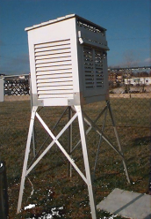
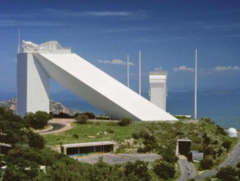

NCEP’s Role in NOAA’s Seamless Suite of Products and Forecast Services
Observe
To Serve Diverse
Customer Base
e.g., Energy Officials, DHS/FEMA, Emergency Managers, Water Resource Planning, Transportation, Health organizations (CDC…)
- Process
- Assimilate
- Predict
Products & Forecast Services
Central
Guidance
Local
Offices
Respond &
Feedback
NCEP
Distribute
IBM Supercomputer Gaithersburg, MD
Research, Development and Technology Infusion
Feedback
Prediction is now inherently linked to numerical models

Slide 19
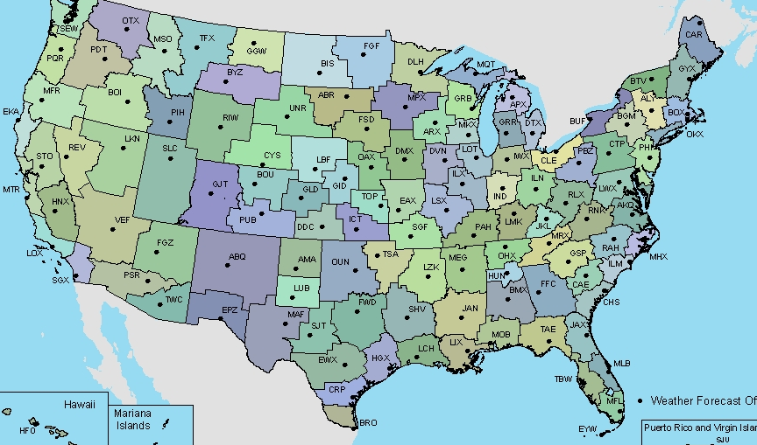
NCEP Supports the NOAA Seamless Suite of Climate Weather and Ocean Products
Organization: Central component of NOAA National Weather Service
Mission: NCEP delivers science-based environmental predictions to the nation and the global community. We collaborate with partners and customers to produce reliable, timely, and accurate analyses, guidance, forecasts and warnings for the protection of life and property and the enhancement of the national economy.
Aviation Weather Center
Space Weather Prediction Center
NCEP Central Operations
Climate Prediction Center Environmental Modeling Center Hydromet Prediction Center Ocean Prediction Center
Storm Prediction Center
National Hurricane Center
Vision: The Nation’s trusted source, first alert and preferred partner for environmental prediction services

Slide 20
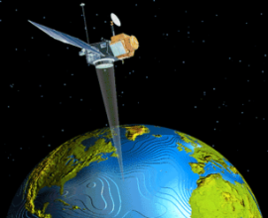

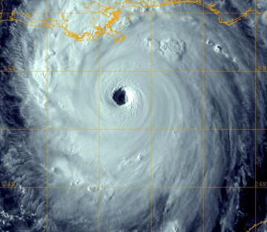
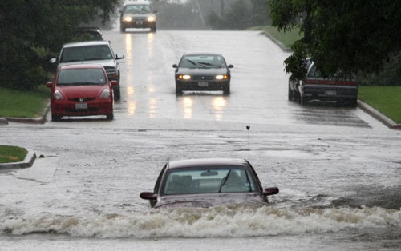
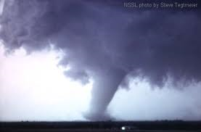



Test Beds
Service – Science Linkage with the Outside Community
EMC WRF Developmental Test Center, NASA/ NOAA/DoD Joint Center for Satellite Data Assimilation
CPC Climate Test Bed
NHC Joint Hurricane Test Bed
HPC Hydrometeorological Test Bed
SPC Hazardous Weather Test Bed with NSSL
SWPC Space Weather Prediction Test Bed with AFWA
AWC Aviation Weather Test Bed
OPC linked with EMC’s Marine Modeling and Analysis Branch

Slide 21

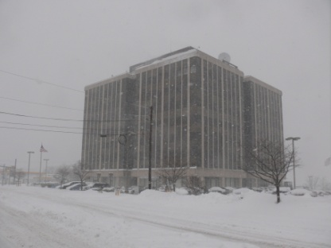
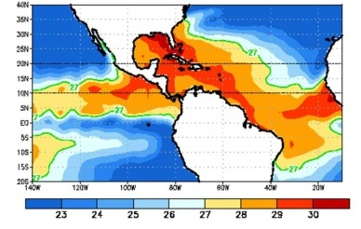
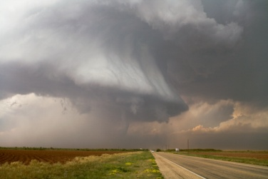
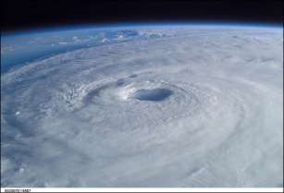


What Does NCEP Do?
“From the Sun to the Sea”
Solar Monitoring, Warnings and Forecasts
Climate Seasonal Forecasts
El Nino – La Nina Forecast
Weather Forecasts to Day 7
Extreme Events (Hurricanes, Severe Weather, Snowstorms, Fire Weather)
Aviation Forecasts and Warnings
High Seas Forecasts and Warnings
Model Development, Implementation and Applications for Global and Regional Weather, Climate, Oceans and now Space Weather
International Partnerships in Ensemble Forecasts
Data Assimilation including the Joint Center for Satellite Data Assimilation
Super Computer, Workstation and Network Operations
21

Slide 22
Model Production Suite

Slide 23
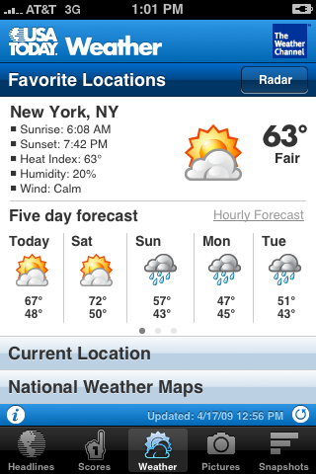
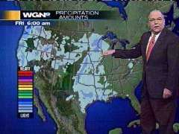



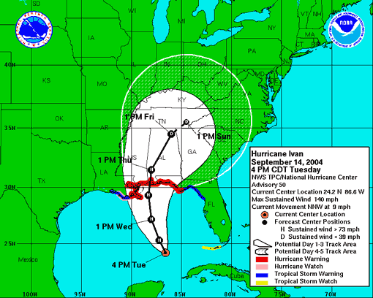

Everything you read, see or hear about weather, climate and ocean forecasts begins with NCEP numerical prediction models
Three Major Components of the Numerical Prediction Enterprise
Global Observing System
Computers (supercomputers, work stations)
Data Assimilation & Modeling/Science
Notes:
23

Slide 24
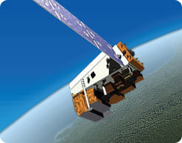
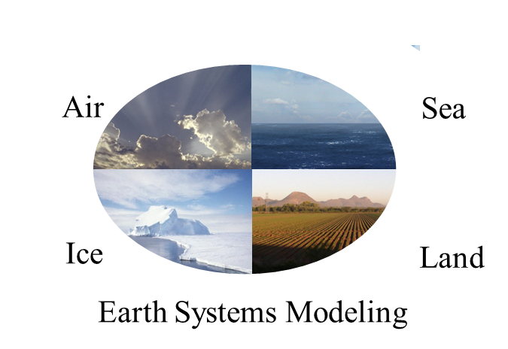

Three Major Components of Today’s
Operational Numerical Prediction Enterprise
Observations
  ~2 billion/day
  99.9% remotely sensed, mostly from satellites
Model
  Earth System model; coupled
  Global resolution (27km)
  North American resolution (4km)
Computer
  2012
    Primary/backup15 minute switchover
    73 trillion calc/sec – IBM Power 6
  2013
    146 trillion calc/sec – IBM iDataPlex Intel/Linux

Slide 25
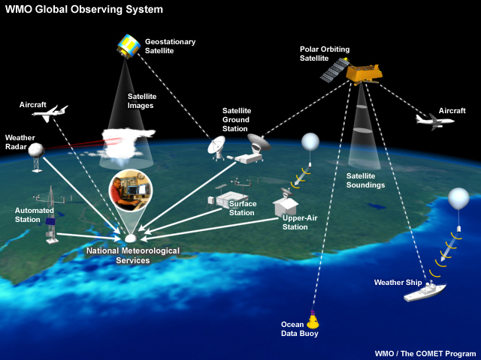
Global Observing Critical
for Successful Numerical Weather Prediction

Slide 26
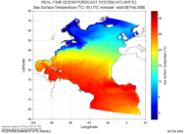
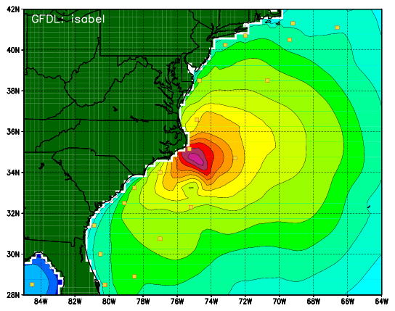
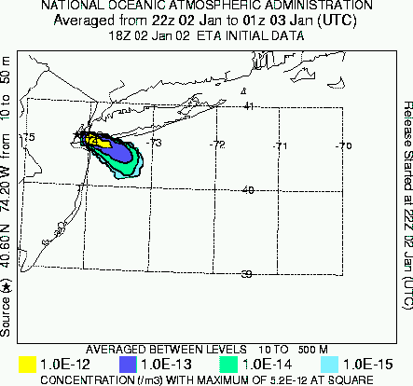
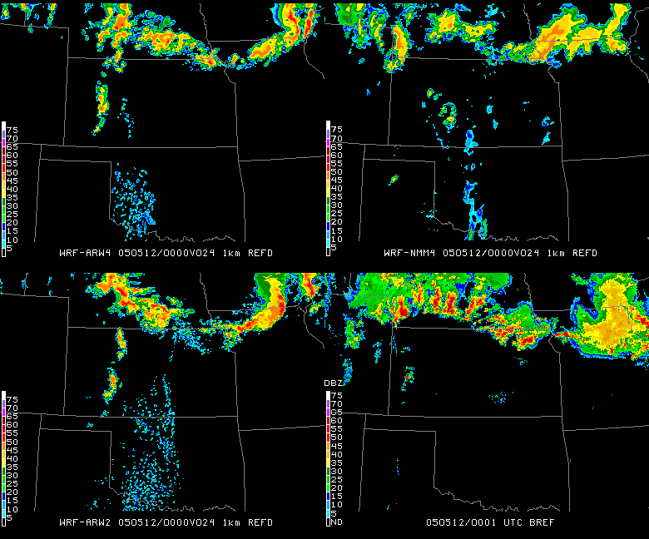



NOAA’s Model Production Suite
Climate Forecast
System
NOS – OFS
Great Lakes
Northern Gulf of Mex
Columbia R.
Bays
Chesapeake
Tampa
Delaware
Oceans
HYCOM
WaveWatch
III
GFS MOM4
NOAH Sea Ice
Hurricane GFDL
HWRF
Coupled
~2B Obs/Day
Satellites + Radar
99.9%
Regional NAM
WRF NMMB
Dispersion
ARL/HYSPLIT
Global
Forecast
System
Regional
DA
Global Data
Assimilation
Severe Weather
WRF NMM/ARW
Workstation WRF
Short-Range
Ensemble Forecast
Space
Weather
North American Ensemble Forecast System
Regional DA
WRF: ARW, NMM, NMMB
Air Quality
GFS, Canadian Global Model
ENLIL
NAM/CMAQ
Forecast
Rapid Refresh
for Aviation
26
26
NOAH Land Surface Model
Notes:
26

Slide 27
NOAA Seamless Suite of Forecast
Products Spanning Climate and Weather
NCEP Model Perspective
Years
Forecast
Uncertainty
Outlook
Seasons
Guidance
Months
Climate Forecast System
Threats Assessments
2 Week
North American Ensemble
Forecast System
Climate/Weather
Linkage
Forecast Lead Time
1 Week
Global Forecast System
Ocean Model
HYCOM
Wave Watch III
Forecasts
Short-Range Ensemble Forecast
Days
North American Forecast
GLOFS
Bays
Chesapeake, N. GoM
Tampa, Columbia R,
Delaware
Watches
Hurricane – GFDL, WRF
Hours
Rapid Update Cycle for Aviation
Warnings & Alert Coordination
Enlil – Space Wx Model
Minutes
Dispersion Models for DHS
Benefits
Maritime
Health
Aviation
Agriculture
Commerce
Recreation
Life & Property
Fire Weather
Hydropower
Ecosystem
Environment
Space Operations
Emergency Mgmt
Energy Planning
Reservoir Control

Slide 28



Computing Capability
“reliable, timely and accurate”
Current computers
  IBM Power6
  73.1 trillion calculations/sec
  2 billion observations/day
  27.8 million model fields/day
  Primary: Gaithersburg, MD
  Backup: Fairmont, WV
  Guaranteed switchover in 15 minutes
Next generation computer: by Oct 2013
  IBM iDataPlex Intel/Linux
  208 trillion calc/sec
  Primary: Reston, VA
  Backup: Orlando, FL
Popularity of NCEP Models Web Page
2001
2003
2005
2007
2009
2011
2011
Web access to models as they run on the CCS

Slide 29
Newest Members of the
Model Production Suite

Slide 30

Space Weather: Enlil
First large-scale, physics-based space weather prediction model to be put into operations
Jointly developed by scientists with NOAA, NASA, the Air Force Research Laboratory, the Cooperative Institute for Research in Environmental Sciences at the University of Colorado at Boulder, Boston University, the National Center for Atmospheric Research, and George Mason University.
Provide 1-4 day advance warning of geomagnetic storms
Provides perspective on structures 1-27 days in advance
Reduces error in geomagnetic storm onset time from ±12 hrs to ±6 hrs
Notes:
WSA-Enlil predictions of Coronal Mass Ejections (CMEs) hitting the earth.
Radial Ve

Slide 31

Global Real-Time Ocean Forecast System
First global eddy-resolving ocean forecast system at NOAA/NCEP.
Based on a 1/12 degree HYCOM (HYbrid Coordinate Ocean Model) – Community model developed under National Oceanographic Partnership Program (NOPP)
  Led by Navy/FSU
Attributes
  1/12th degree horizontal resolution
  Run once per day out six days
  32 vertical hybrid layers
Earth System Modeling Framework compatible
Provide boundary conditions for coastal models
Implemented operationally on October 25, 2011
Output: global sea surface height and three dimensional fields of temperature, salinity, density and velocity

Slide 32

Surface Water Salinity Forecast Guidance
Delaware Bay Operational Forecast System

Slide 33

Surface Water Temperature Forecast Guidance
Delaware Bay Operational Forecast System

Slide 34
Increasing Reliance on Ensemble Forecasts

Slide 35

Increasing Reliance on Ensembles
“The Next Revolution in Weather Forecasts”
Multi-model ensembles now used across entire spectrum
  Climate: NCEP Climate Forecast System (CFS) now used within EUROPSIP Partnership (ECMWF, UKMet, MeteoFrance)
Medium Range: North American Ensemble Forecast System (NAEFS)
Short Range: Short Range Ensemble Forecast System (SREF)
Mesoscale

Slide 36
NOAA Climate Forecast System (CFS)
Attribute | CFS v1.0 Operational Since 2004 | CFS v2.0 Operational Since March 2011 | Multi-model Ensembles (MME)
Analysis Resolution | 200 km | 27 km | International MME (Operational) NCEP UKMet ECMWF MeteoFrance
Atmosphere model | 2003: 200 km/64 levels Humidity based clouds | 2010: 100 km/64 levels Variable CO2 AER SW & LW radiation Prognostic clouds & liquid water Retuned mountain blocking Convective gravity wave drag
Ocean model | MOM-3: 60N-65S 1/3 x 1 deg. Assim depth 750 m | MOM-4 fully global ¼ x ½ deg. Assim depth 4737 m
Land surface model (LSM) and assimilation | 2-level OSU LSM No separate land data assim | 4 level Noah model GLDAS driven by obs precip | National MME (Research) NCEP GFDL NCAR GSFC COLA U.Miami/RSMAS U.CO/CIRES Princeton
Sea ice | Climatology | Daily analysis and 3-layer interactive sea ice model
Coupling | Daily | 30 minutes
Data assimilation | Retrieved soundings, 1995 analysis, uncoupled background | Radiances assimilated, 2008 GSI, coupled background
Reforecasts | 15/month seasonal output | 24/month (seasonal) 124/month (week 3-6)

Slide 37


Increasing Reliance on Ensembles
“The Next Revolution in Weather Forecasts”
Medium Range: NCEP GFS/GEFS now combined with Canadian and (soon) the Navy NOGAPS model → NAEFS

Slide 38

Increasing Reliance on Ensembles
“The Next Revolution in Weather Forecasts”
Short Range: NCEP SREF used extensively for prediction of extreme events, aviation, precipitation …
SREF Forecasts for Feb 5, 2010: “Snowmageddon”

Slide 39



Increasing Reliance on Ensembles
“The Next Revolution in Weather Forecasts”
Mesoscale: Mesoscale ensembles now used in tornado forecasting – April 27-28, 2011
~190 tornadoes, ~311 fatalities
Deadliest outbreak since March 21, 1932
Outlook issued 5 days prior; Moderate Risk issued 3 days prior; High Risk issued 16 hours prior
Coordination calls initiated w/FEMA and state emergency managers 3 days in advance
POD 96% for tornadoes occurring in SPC watches
Average warning lead time 24 min
SSEO – 7 model Storm Scale Ensemble of Opportunity
10AM – 11PM CDT April 27, 2011
Notes:
SSEO – Storm Scale Ensemble of Opportunity – 7 models
NSSL WRF-ARW
EMC HRW WRF-ARW
EMC HRW WRF_ARW (12 hour time lag)
EMC CONUS WRF-NMM
EMC HRW WRF-NMM
EMC HRW WRF-NMM (12 hr time lag)
EMC NMMB nest
Upper right – 6 hour smoothed ensemble neighborhood (40 km) probability of UH > 25 m2/s2 valid ending 00Z 28 April

Slide 40
Application of Uncertainty in Hurricane Prediction

Slide 41
Hurricane Prediction Skill
NHC Atlantic 72 hr Track Forecast Errors
Major Upgrades in Global and Hurricane Numerical Models
Advances Related to USWRP
Error (nautical miles)
1997-2001 trendline
2003-2011 trendline
1970-1986 trendline
1987-1996 trendline
Year
Better Model Physics and Resolution
Improved Data Assimilation

Slide 42

White cone – 2003
Brown cone - 2010
3:40 PM
Notes:
42

Slide 43

Hurricane Irene Track Forecast
August 20, 2011 – August 27, 2011

Slide 44

Hurricane Irene Precipitation
Precipitation Forecast Loop
Precipitation Verification Loop
August 26 – 29, 2011

Slide 45






































































Hurricane Sandy – GOES-14 SRSO – October 29, 2012 1430-1530 UTC
NOAA Satellite and Information Service: National Environmental Satellite, Data, and Information Service (NESDIS)
45
Notes:
To see animation again, simply arrow up once and then click once.

Slide 46








Oct 26
Oct 27
Oct 28
Oct 29
Oct 30
Surface Analysis: Friday October 26 – Tuesday October 30, 2012

Slide 47








Hurricane Sandy: All Charts Valid 12Z October 29, 2012
Surface Analysis
7 day forecast
6 day forecast
5 day forecast
4 day forecast
3 day forecast
2 day forecast
1 day forecast

Slide 48

Official 5 – day Track Forecast from 8AM, Saturday, October 27, 2012

Slide 49

Official 5 – day Track Forecast from 8AM, Sunday, October 28, 2012

Slide 50

Hurricane Sandy
October 21, 2012 0345Z through October 31, 2012 1315Z
National Hurricane Center's 5 day forecast track issued at 11 a.m. EDT on Thursday, October 25

Slide 51



Slide 52

Wave Watch III model output valid 8PM Mon Oct 30
36 hour Wave height forecast (ft)

Slide 53


Extratropical Storm Surge
Extratropical Surge and Tide Operational Forecast System (ESTOFS)
Storm Surge relative to MSL(feet)
30 hour forecast
Initial time: 2PM Sunday, Oct 28
Extratropical Surge and Tide Operational Forecast System (ESTOFS)
Total Water Level (feet)
30 hour forecast
Initial time: 2PM Sunday, Oct 28

Slide 54


Slide 55


Slide 56

Hurricane Sandy Precipitation
HPC Forecast
Verification
October 24 – November 1, 2012

Slide 57


Probability of 48 hour snowfall > 12 inches
Issued 2PM, Saturday, Oct 27, 2012
Valid 8PM, Sunday Oct 28 – 8PM Tuesday Oct 30
3 day Snow Accumulation (inches)
Issued 2PM, Saturday, Oct 27, 2012
Valid 8PM Saturday Oct 28 – 8PM Tuesday Oct 30

Slide 58
Hurricane Sandy
All the forecasts were based on ensemble model approach with models from U.S., Europe and Canada
Beginning Thursday – Friday communicated/coordinated all forecasts with FEMA/emergency management community
Media coordination started on Friday and continued through the event
Conveyed consistent forecast message on the historic nature and destructive potential for this storm; evacuation initiated 48-72 hours in advance
The forecasts were taken to “the next level”
The forecasts saved lives!

Slide 59
Forces for Change
NRC: “Completing the Forecast”…focus on probabilistic forecasts to address uncertainty → impact-based forecasts
Increasing emphasis on multi-model ensemble approaches that build on the NCEP model suite
  SREF
  NAEFS
  Climate Forecast System (EUROSIP)
Entering the JPSS era
  More rapid access to hyperspectral data
  Data assimilation implications
All models run within ESMF/NEMS
  Models run concurrently
  Coupled/interoperable
Model data accessed through NOAA Operational Model Archive & Distribution System (NOMADS)
Operational Earth System model – enable more explicit hydro, coastal, ecosystems and health applications
ESMF-based System
Global/Regional Model Domain
Model Region 1
Model Region 2

Slide 60


Extending Prediction Models into Nontraditional Areas
Coupled Models: Atmosphere – Ocean – Land → provide opportunities for ecosystem prediction: beach/water quality, health, ”critters”
Regional Earth System Modeling
Coupling models
and linking products

Slide 61

Ecosystem Prediction
Predicting Sea Nettles in Chesapeake Bay
Automatically generate daily nowcasts and 2-day forecasts of Sea Nettles, Chrysaora quinquecirrha, in Chesapeake Bay
Generated since 2002 in a research mode
Important for water management and recreational purposes
Put into operational production suite April, 2012
* Research initiated, developed and results demonstrated by NOS and NESDIS with regional partners and customers
Predicted chance of encountering sea nettles, C. quinquecirrha, on October 4, 2012

Slide 62


Surface Water Temperature Forecast Guidance
Tampa Bay Operational Forecast System
Surface Water Salinity Forecast Guidance
Tampa Bay Operational Forecast System

Slide 63
NOAA Harmful Algal Bloom Operational Forecast System
Gulf of Mexico Harmful Algal Bloom Bulletin
Region: Southwest Florida
Monday, 27 August 2012
NOAA Ocean Service
NOAA Satellite and Information Service
NOAA National Weather Service
Relies on satellite imagery, field observations, models, public health reports and buoy data to assess and predict bloom conditions, location and movements.
Satellite chlorophyll image with possible HAB areas shown by red polygon(s).

Slide 64


NOAA Center for Weather and Climate Prediction
Four-story, 268,762 square foot building in Riverdale, MD houses 800+ Federal employees, and contractors
  5 NCEP Centers (NCO, EMC, HPC, OPC, CPC)
  NESDIS Center for Satellite Applications and Research (STAR)
  NESDIS Satellite Analysis Branch (SAB)
  OAR Air Resources Laboratory
Includes 40 spaces for visiting scientists
Includes 464 seat auditorium/ conference center, library, deli, fitness center and health unit
Move complete August 24, 2012

Slide 65


Concluding Remarks
We have made revolutionary progress in weather forecasting – especially for extreme events
Forecasts increasingly based on multi-model ensembles: “next revolution in numerical weather prediction”
NCEP is
  Strategically aligned with NOAA’s “seamless suite” of products from the “Sun to the Sea”
  Working with NOAA and larger coastal/ocean communities on expanded responsibilities (e.g, oceans air and water quality, ecology, space weather…); success is based on interdisciplinary partnerships
  A critical transition agent in the NOAA “research to operations” process involving observations, data assimilation, modeling, and service delivery (R2O → O2R); working with national and international communities
  Moved into NOAA Center for Weather and Climate Prediction in August 2012 – opens up a new era for entire enterprise
65

Slide 66

Preparing for the American Meteorological Society Annual Meeting
Austin, TX, January 4-9, 2013
2013 AMS Annual Meeting theme:
  “Taking Predictions to the Next Level: Expanding Beyond Today’s Weather, Water and Climate Forecasts and Projections”
  Designed to build off interdisciplinary partnerships
  Applications include coastal, health vectors, ecosystem prediction
An important developing partnership involving the atmospheric-ocean sciences-bio/chem communities
Completing the “last mile” to expand beyond today’s forecasts points to a physical science-social science intersection/overlap, especially for mitigation and adaptation → Decision Support and Services
Issue: How to keep academic/research communities fully engaged with the AMS
Focus on the Teacher, Student and Young Professional Conferences

Slide 67

THANK YOU

Slide 68
Appendix

