Slide 1
Brief Overview of Severe Weather Forecasting
ATM 401–Synoptic Meteorology II
Spring 2014
Lance Bosart, Tom Galarneau, Jr., Heather Archambault,
Nick Metz, Jay Cordeira, Jaymes Kenyon
and now featuring Philippe Papin

Slide 2
Ingredients Needed for Severe Wx
Lift, instability, moisture
Lift: Surface boundary (front) or disturbance
Instability: Warm at surface/cold aloft
Moisture: Warm, humid boundary layer
Wind shear
Speed shear: Winds increase with height
Directional shear: Winds change direction with height (Ideal: Veering → SE near surface, SW at midlevels, NW at upper levels)
High wind events: High speed shear
Tornadoes: High speed and directional shear

Slide 3
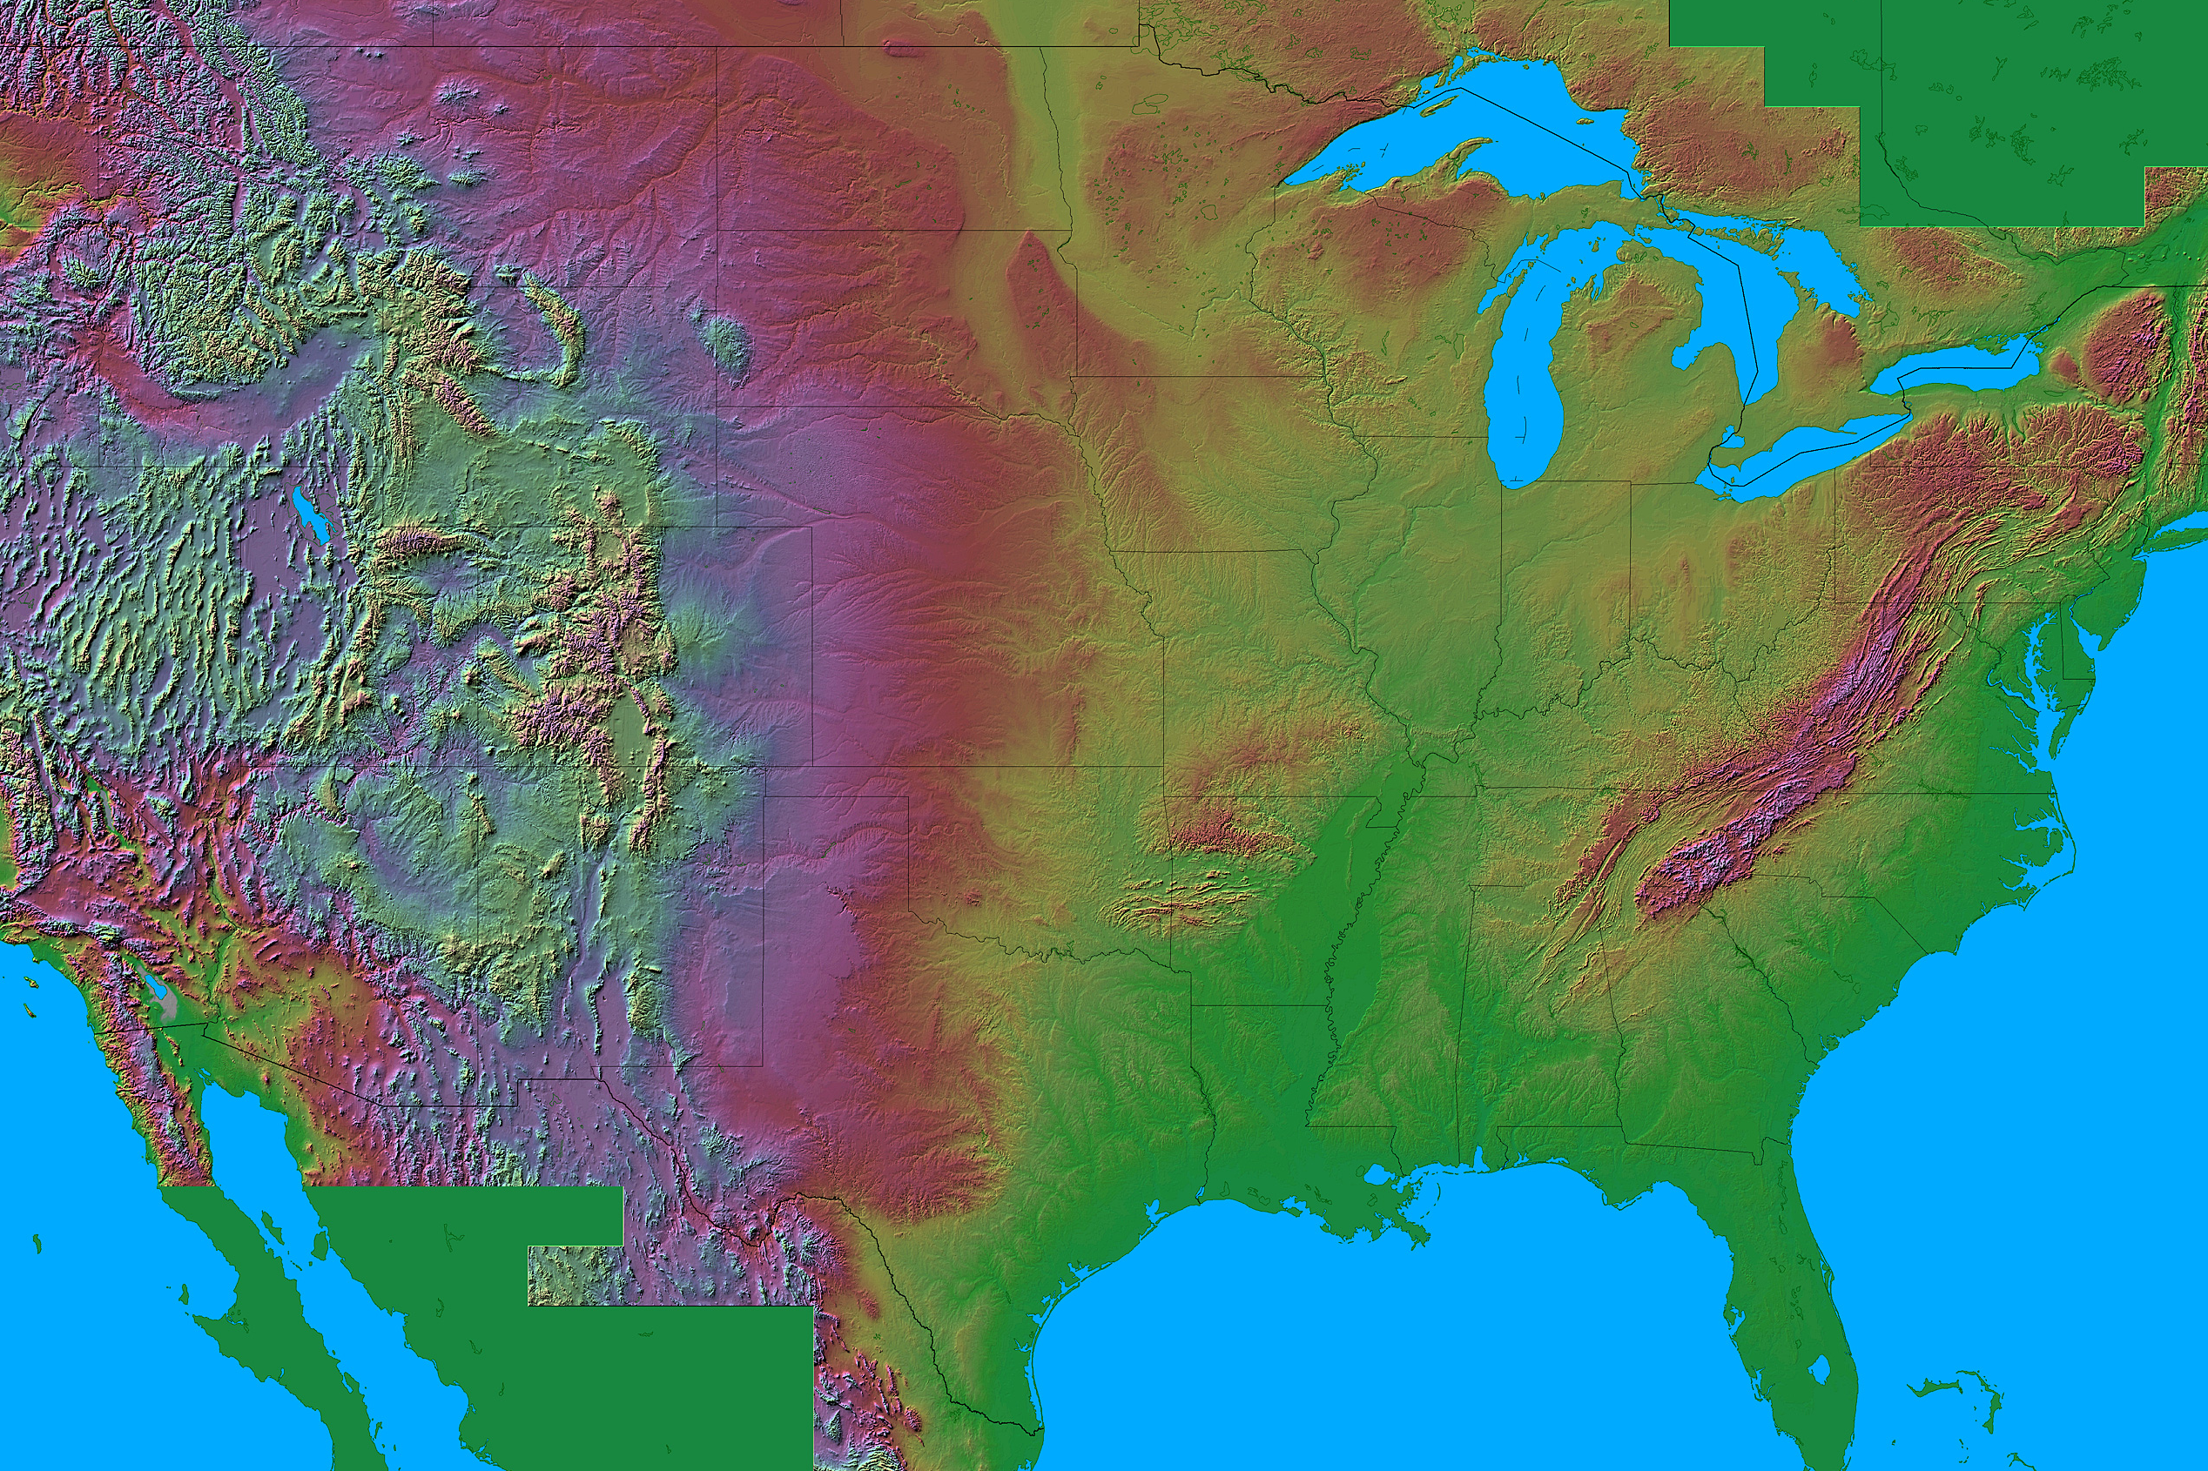
Severe Thunderstorm Formation
Upper-level
Trough
PFJ
L
Atlantic
Ocean
STJ
Warm Moist
Air (mT)
Gulf of Mexico
Relief map © Sterner 1995

Slide 4
Severe Thunderstorm Formation
Rocky
Mountains
L
Hot Dry
Air (cT)
Atlantic
Ocean
Warm Moist
Air (mT)
Gulf of Mexico
Relief map © Sterner 1995

Slide 5
Severe Thunderstorm Formation
Cold dry air (cP)
Rocky
Mountains
Cool moist air (mP)
L
Atlantic
Ocean
Gulf of Mexico
Relief map © Sterner 1995
Warm moist air (mT)

Slide 6
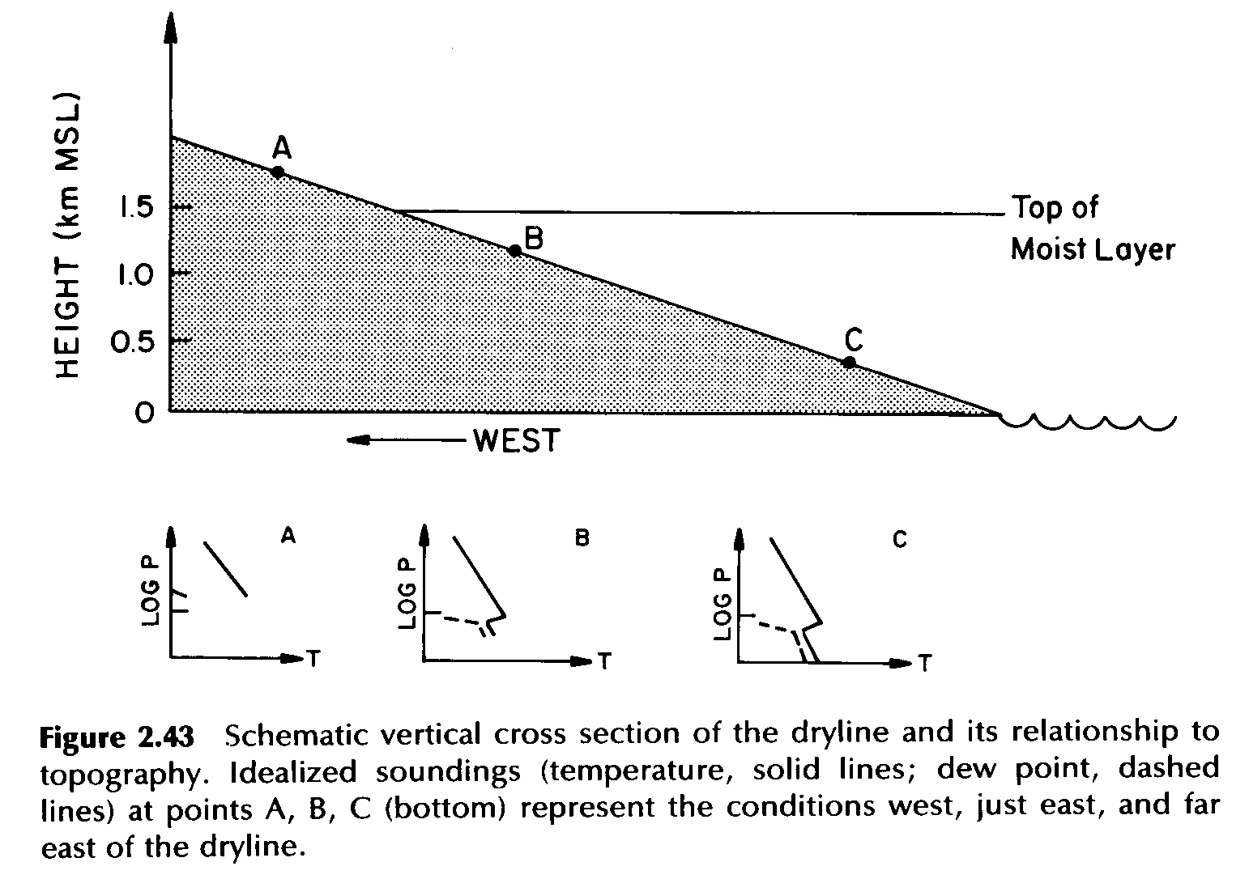
Source: Bluestein (1993)
Notes:
Bluestein Volume II (288)

Slide 7
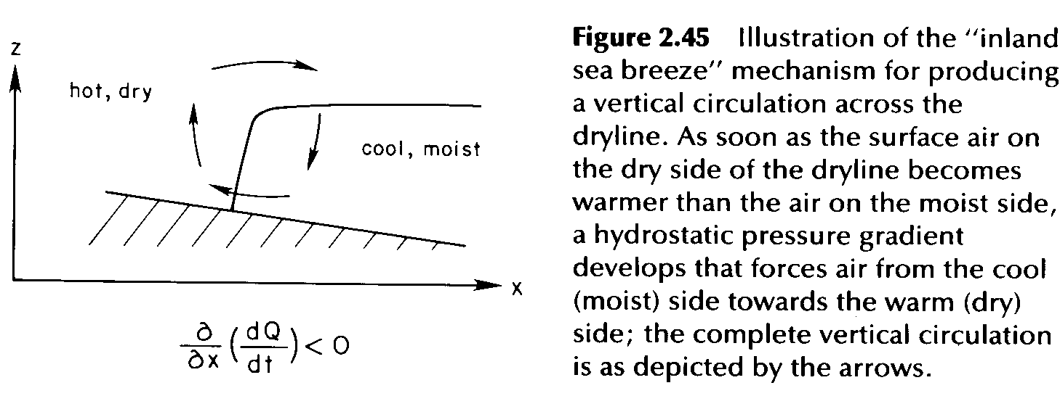
Source: Bluestein (1993)
Notes:
Bluestein Volume II (290)

Slide 8
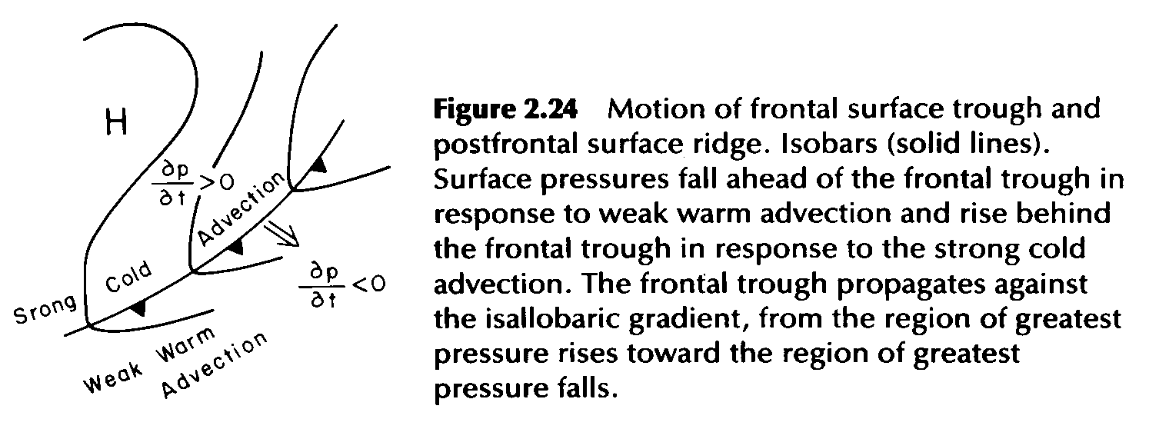
Source: Bluestein (1993)
Notes:
Bluestein Volume II (268)

Slide 9
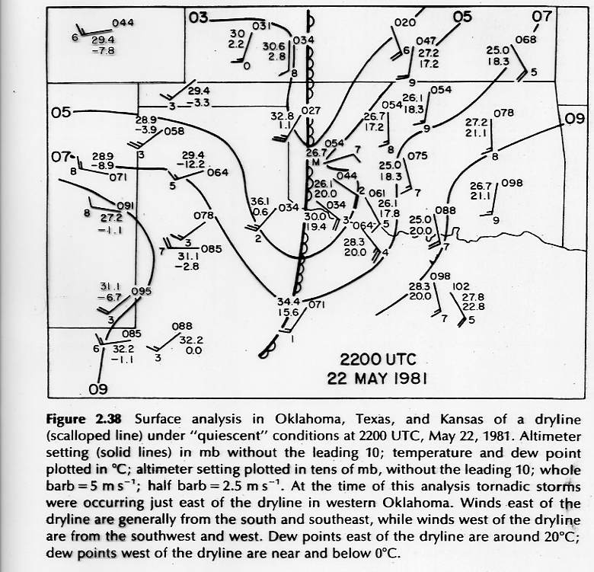
cT
mT
Bluestein 1993

Slide 10
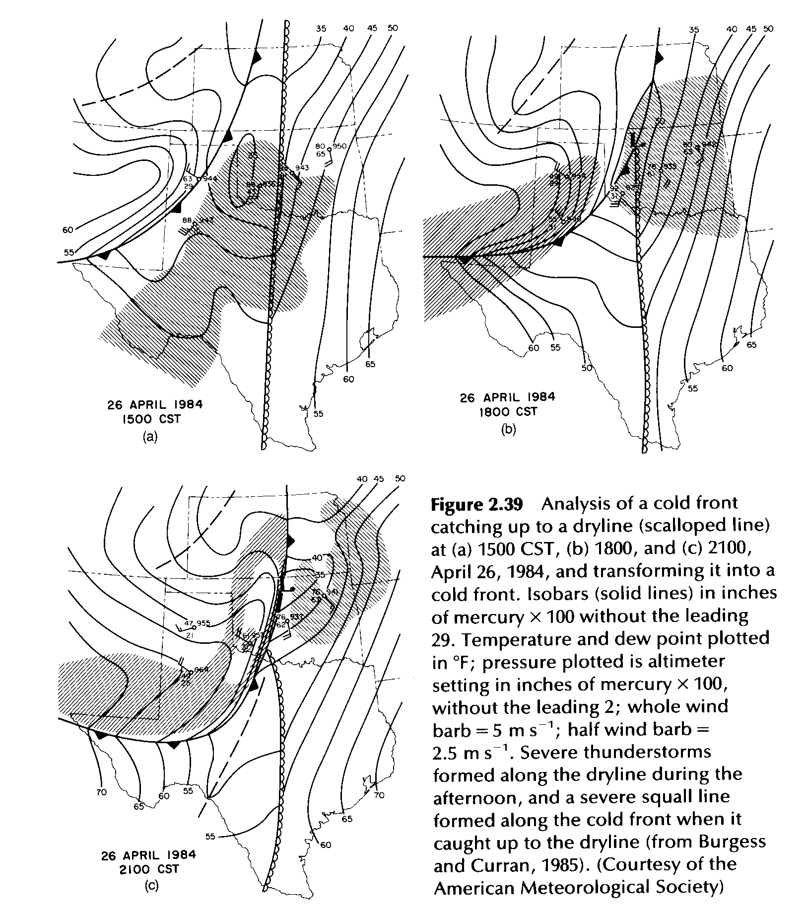
Source: Bluestein (1993)
Notes:
Bluestein Volume II (283)

Slide 11
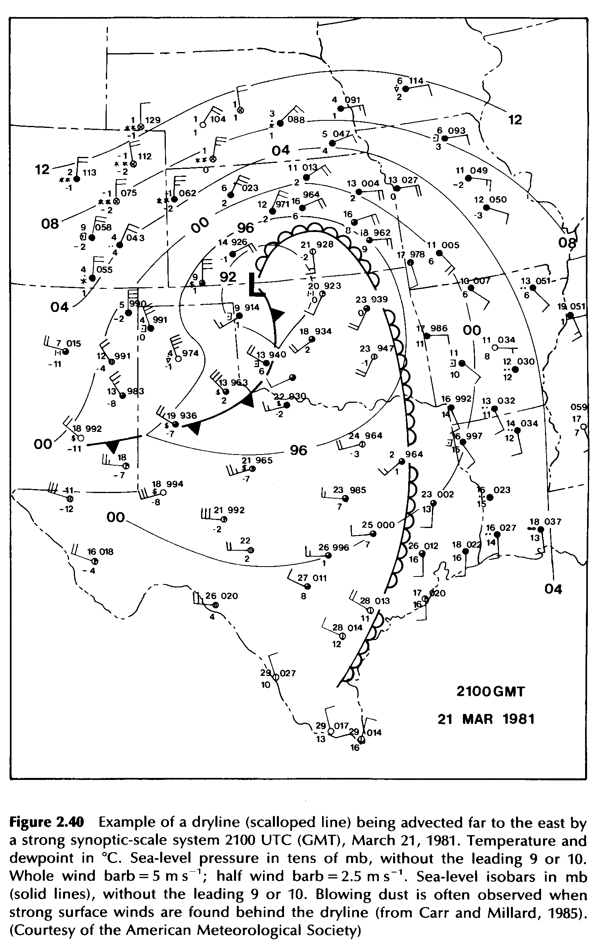
Source: Bluestein (1993)
Notes:
Bluestein Volume II (285)

Slide 12
Examples of Surface Boundaries
1700 UTC 8 April 2008
Source:http://www.atmos.albany.edu/index.php?d=wx_surfupprdata
Surface θ (°C) and and θ gradient (K 100 km⁻¹)

Slide 13
Examples of Surface Boundaries
1700 UTC 8 April 2008
Source:http://www.atmos.albany.edu/index.php?d=wx_surfupprdata
Surface θ (°C) and mixing ratio (g kg⁻¹)

Slide 14
Cold Front
Dryline
Source:http://www.atmos.albany.edu/index.php?d=wx_surfupprdata
Surface θ (°C) and mixing ratio (g kg⁻¹)
0500 UTC 8 April 2008

Slide 15
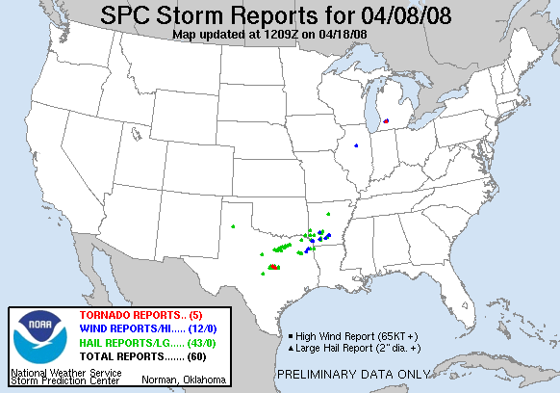
Total Number of Storm Reports for 8 April 2008

Slide 16
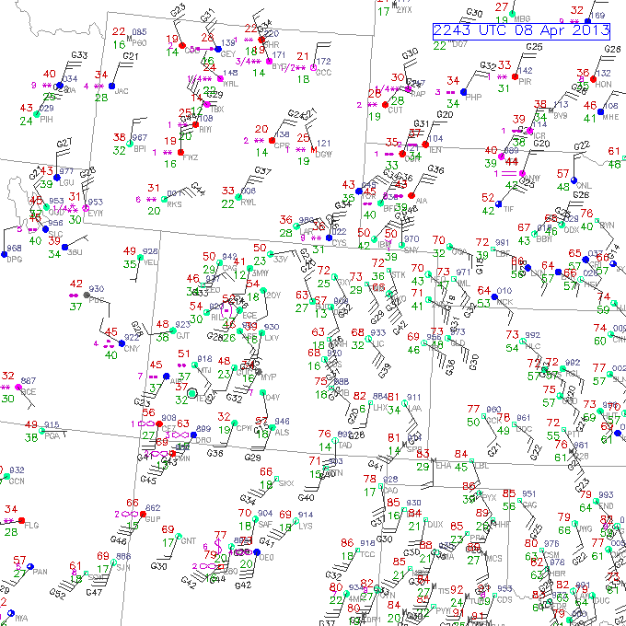
2200 UTC 8 April 2013
source: NCAR / RAL

Slide 17
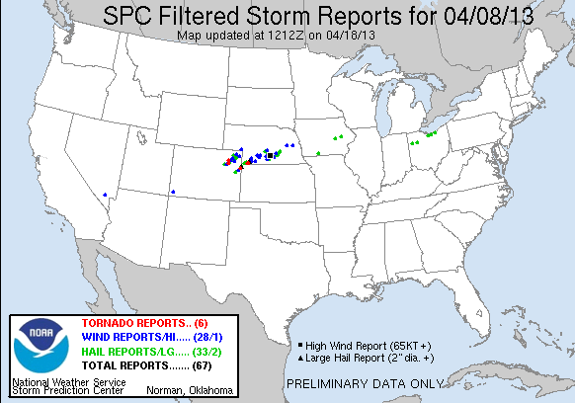
Total Number of Storm Reports for 8 April 2013

Slide 18
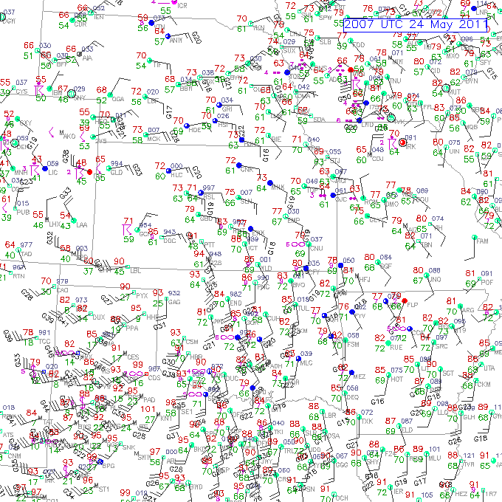
2000 UTC 24 May 2011
source: NCAR / RAL

Slide 19
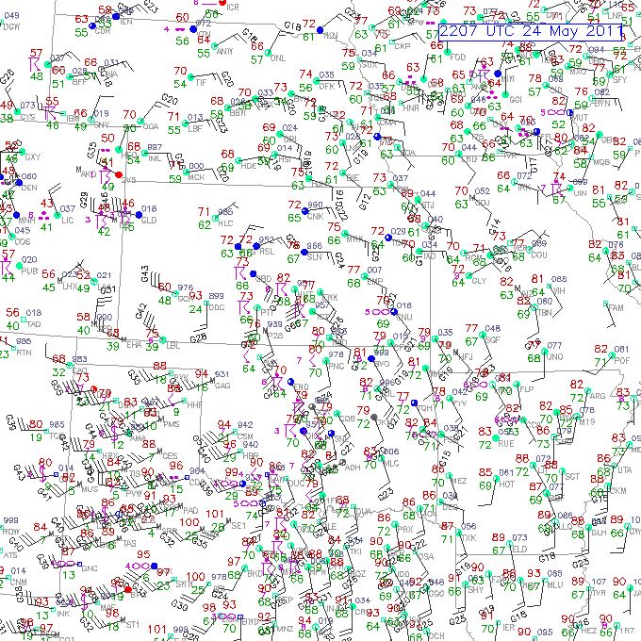
2200 UTC 24 May 2011
source: NCAR / RAL
visible satellite image
on next slide…

Slide 20
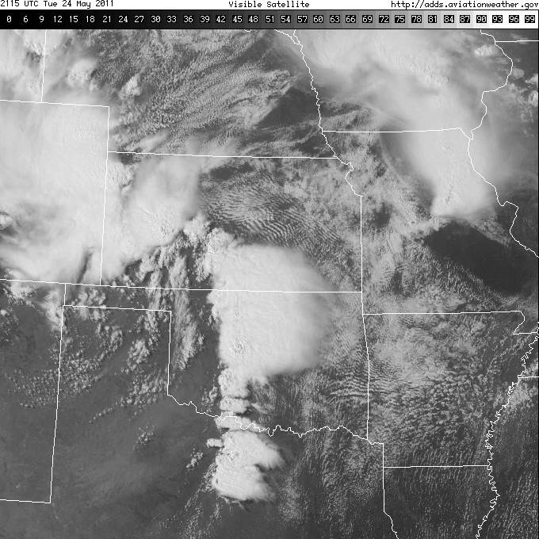
2115 UTC 24 May 2011
source: NCAR / RAL

Slide 21
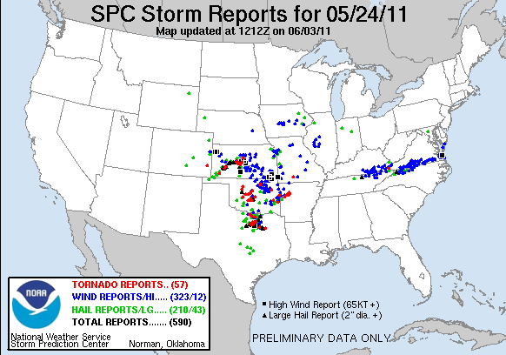
Total Number of Storm Reports for 24 May 2011

Slide 22
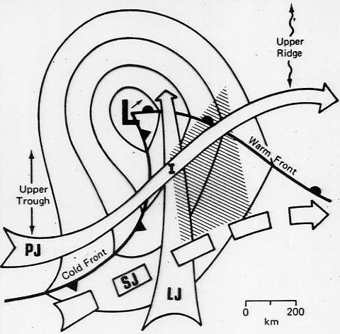
Lift provided by cold
front and upper trough.
Moisture advected from
south in warm sector.
Instability from heating
in warm sector.
Severe Wx
threat
cP
mT
Source: Barnes and Newton (1983)

Slide 23
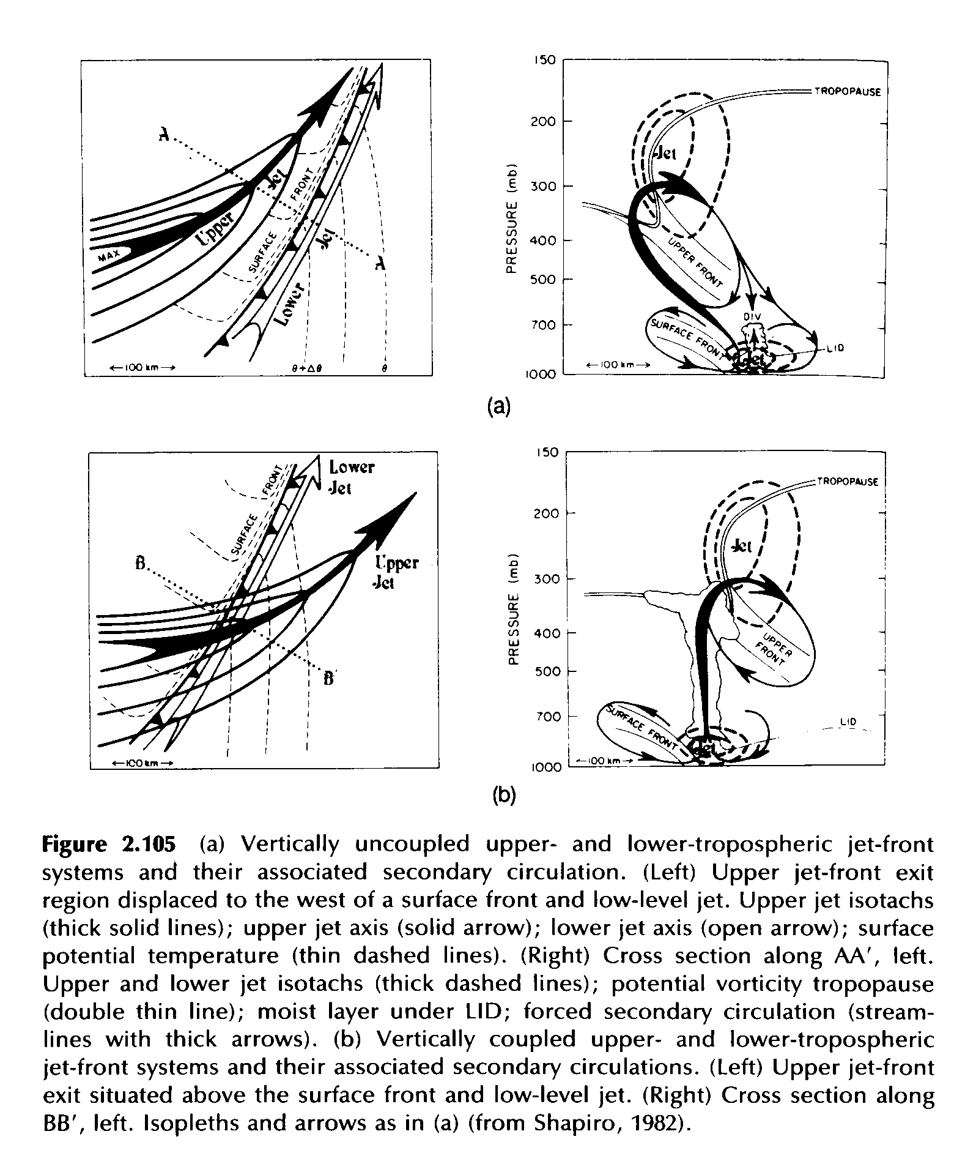
Source: Bluestein (1993)
Notes:
Bluestein Volume II
(406)

Slide 24
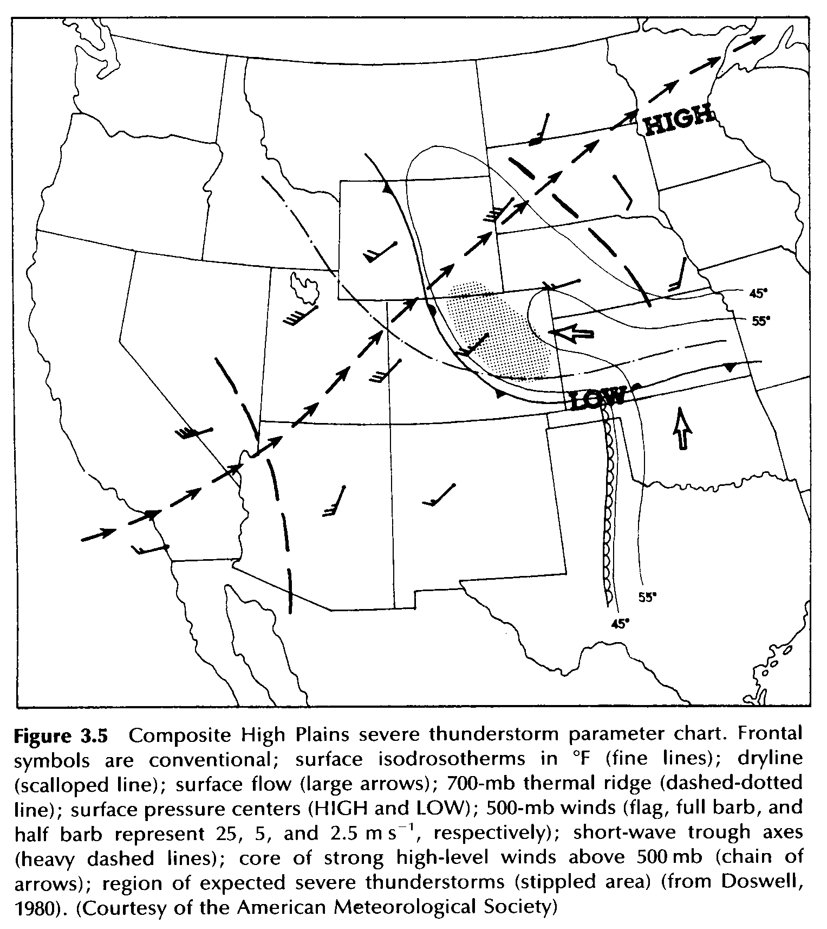
Source: Bluestein (1993)
Notes:
Bluestein Volume II
(440)

Slide 25
Return of "Gulf Air"

Slide 27
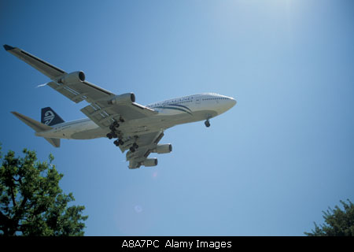
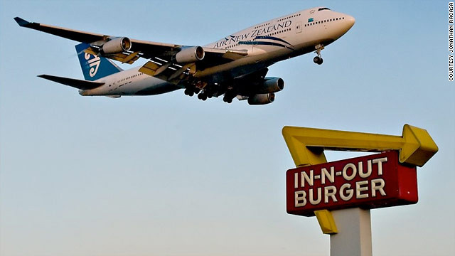
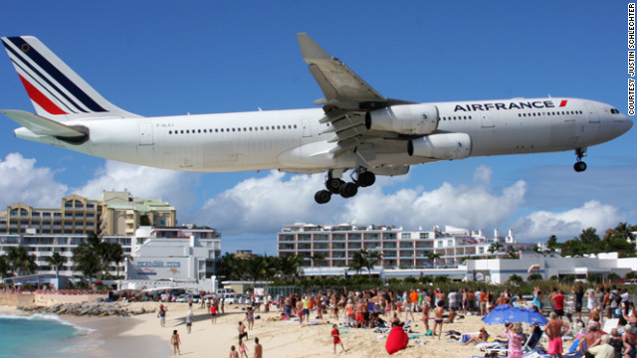
"Low-level Jet"

Slide 28
“Low Level Jets” at Hong Kong’s Kai Tak Airport(link to CNN article)

Slide 29
Source: Uccellini (1980)

Slide 30
Source: Uccellini (1980)

Slide 31
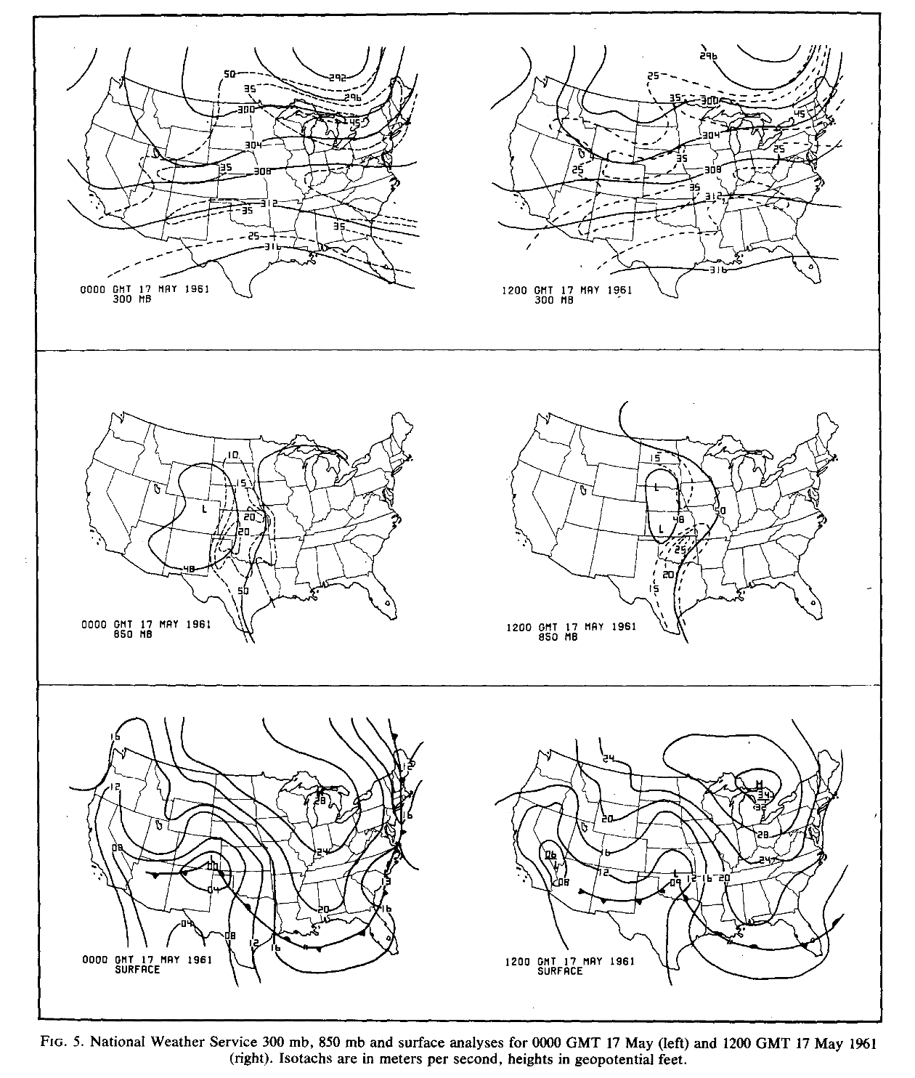
Source: Uccellini (1980)

Slide 32
Speed and Directional Shear
(supercells and tornadoes)
Speed Shear
(wind events)
NW
Altitude
10,000 m
(33,000 ft)
W
W
5,500 m
(18,000 ft)
W
1,500 m
(5,000 ft)
W
SW
Ground
W
SE
“Clockwise Turning Hodograph”
20 knots
“Straight Line Hodograph”

Slide 33
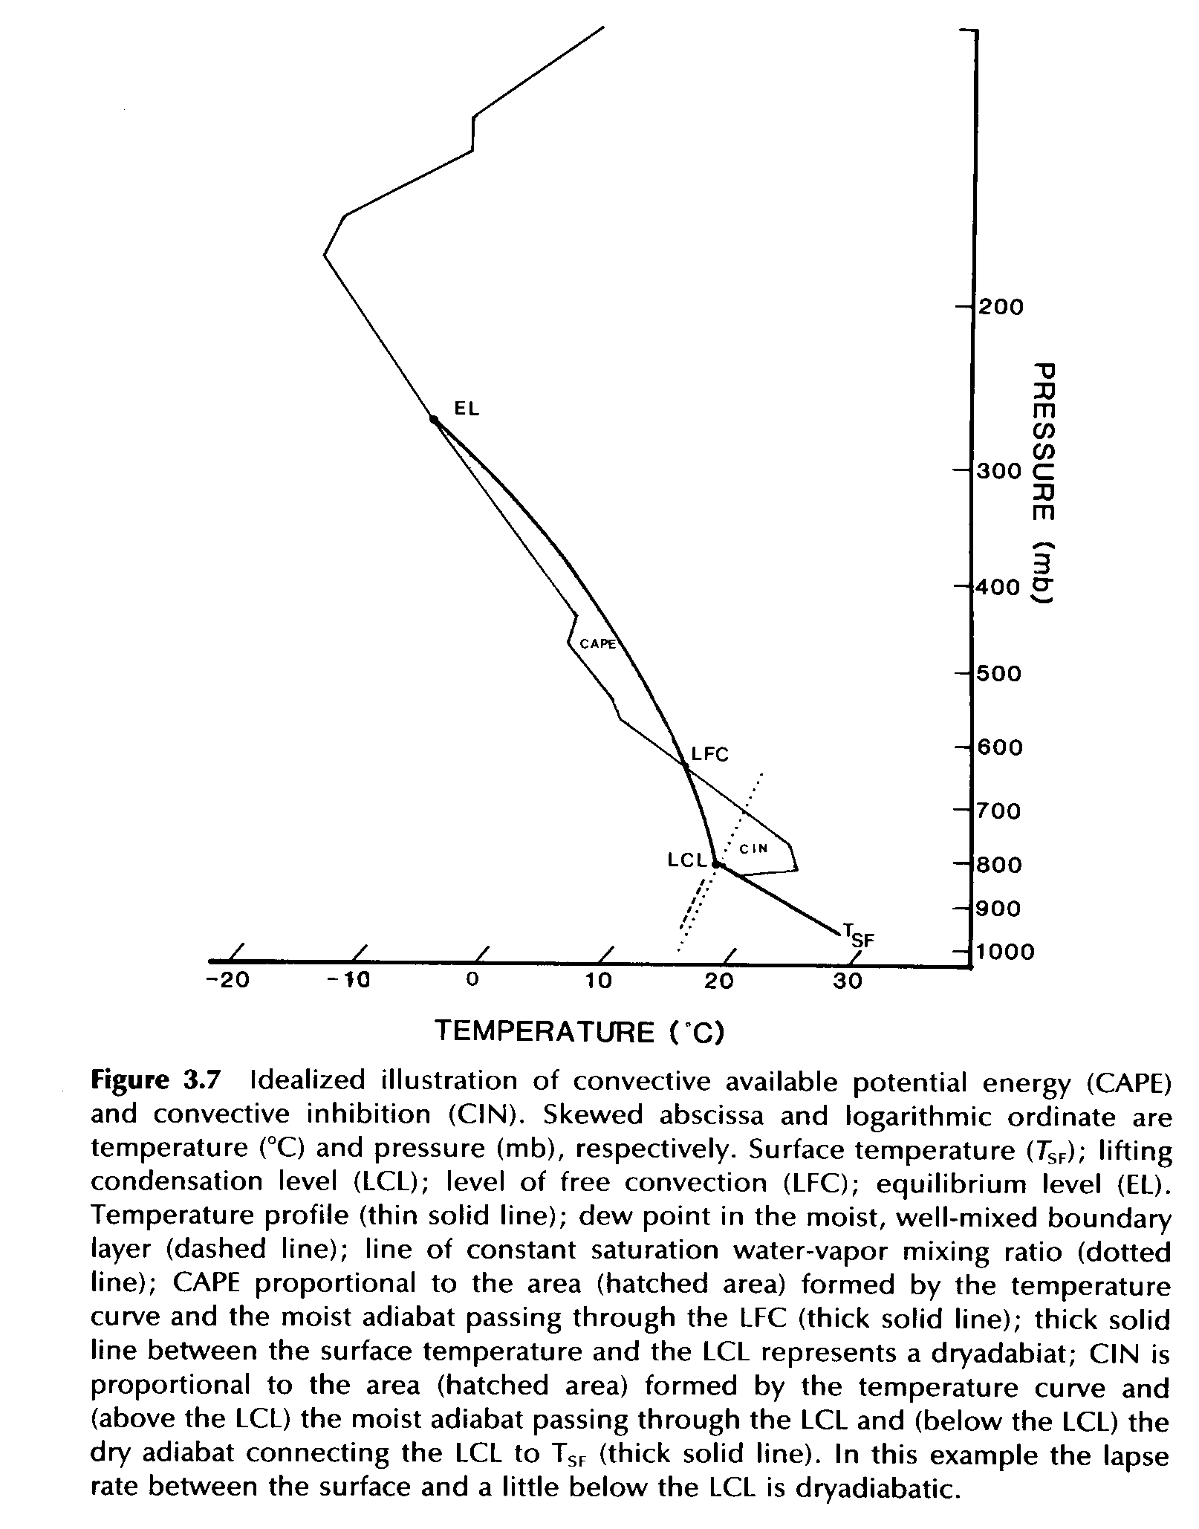
Source: Bluestein (1993)
Notes:
Bluestein Volume II
(445)

Slide 34
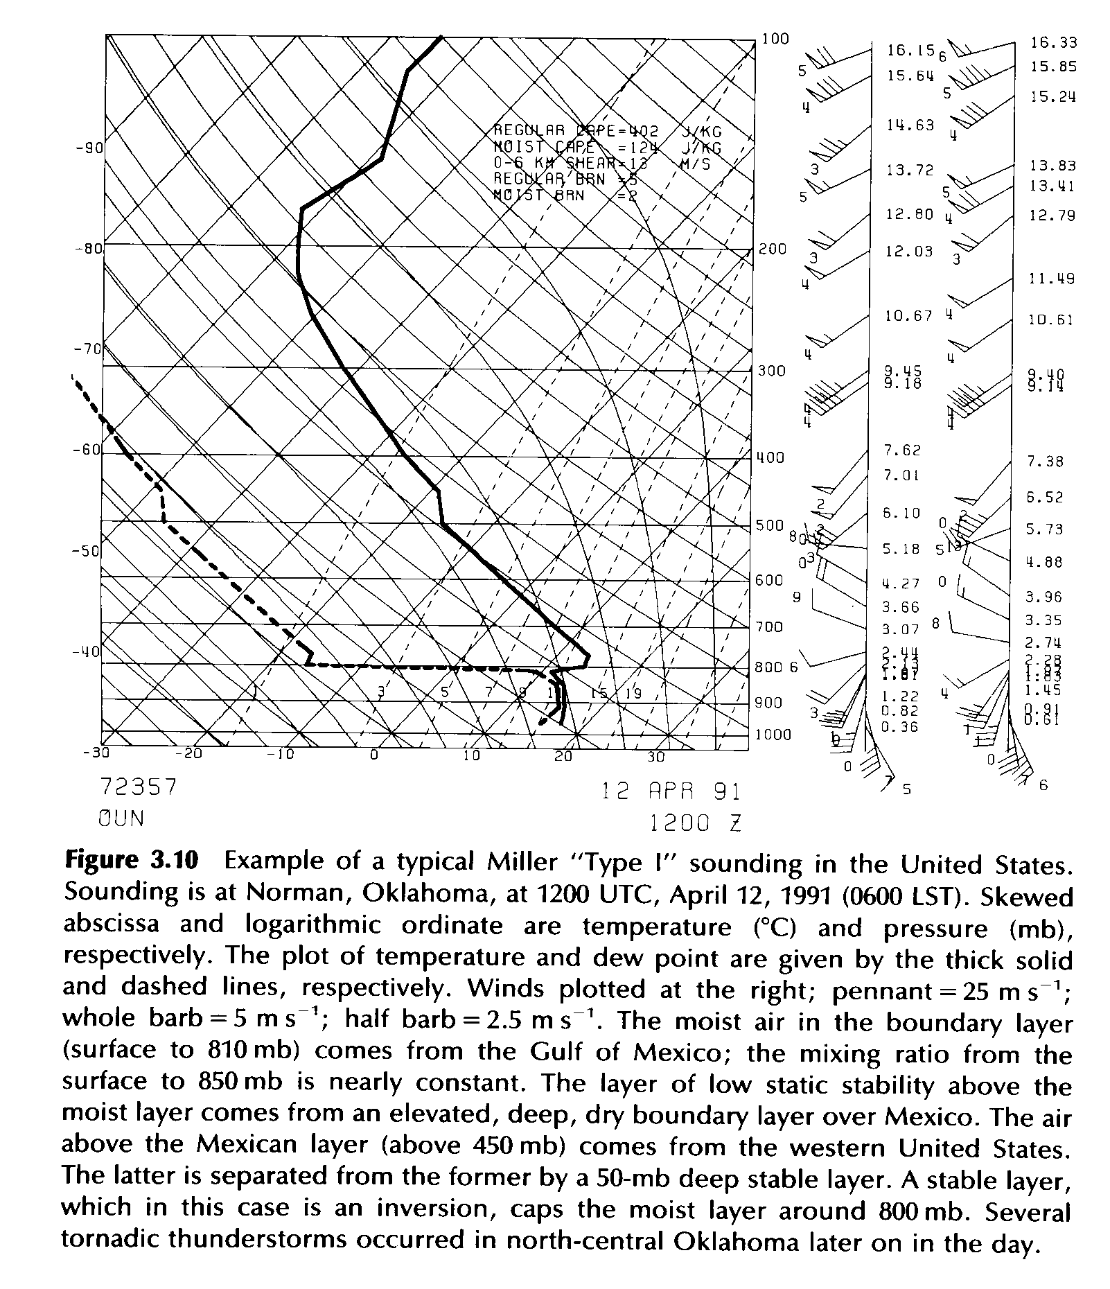
Source: Bluestein (1993)
Notes:
Bluestein Volume II
(450)

Slide 35
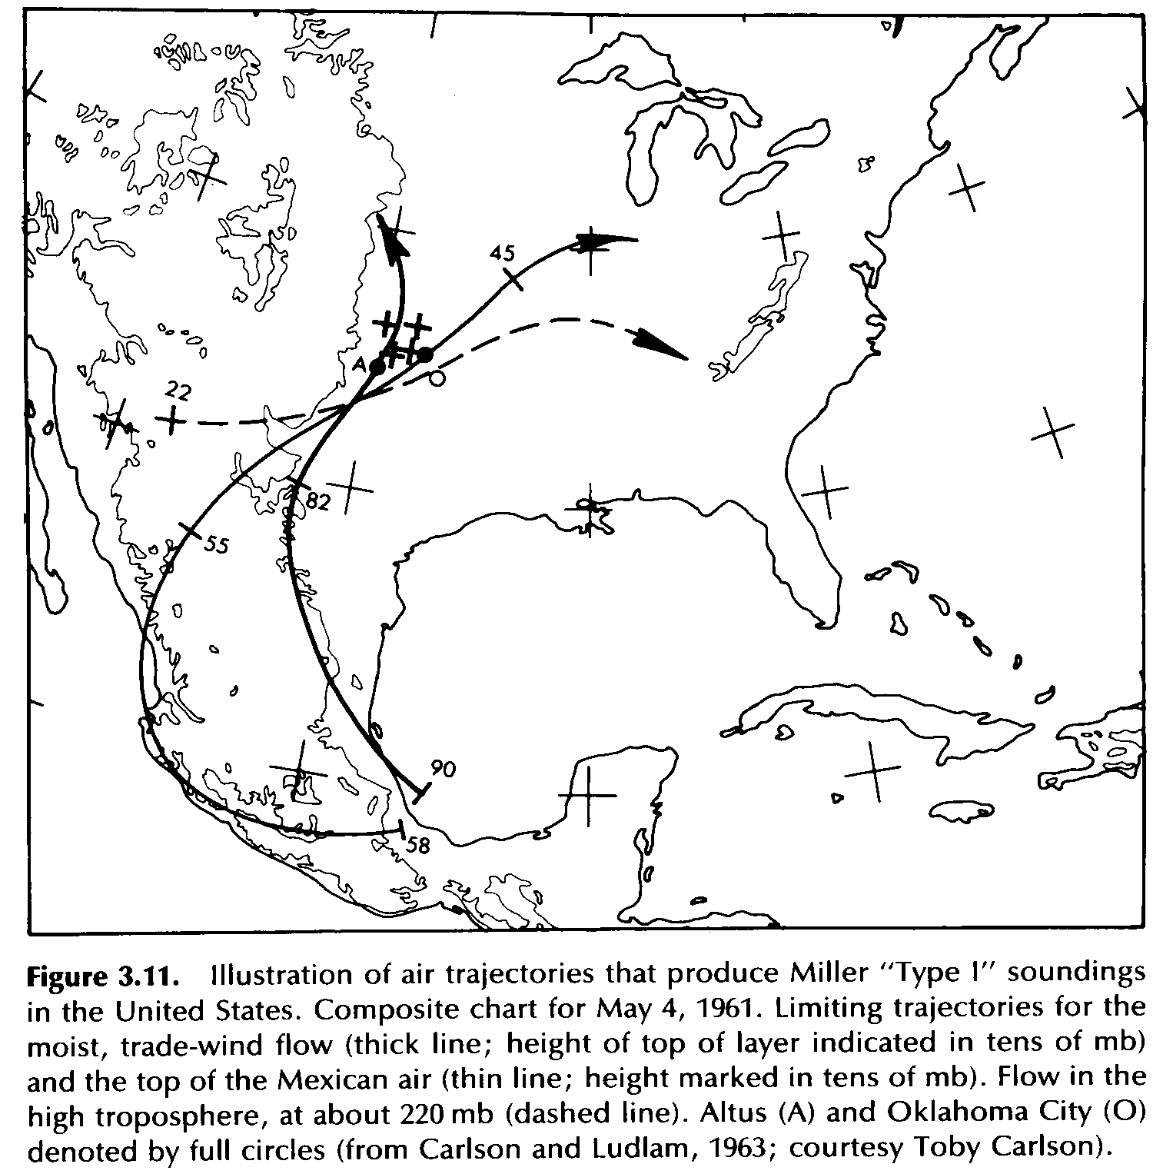
Source: Bluestein (1993)
Notes:
Bluestein Volume II
(451)

Slide 36
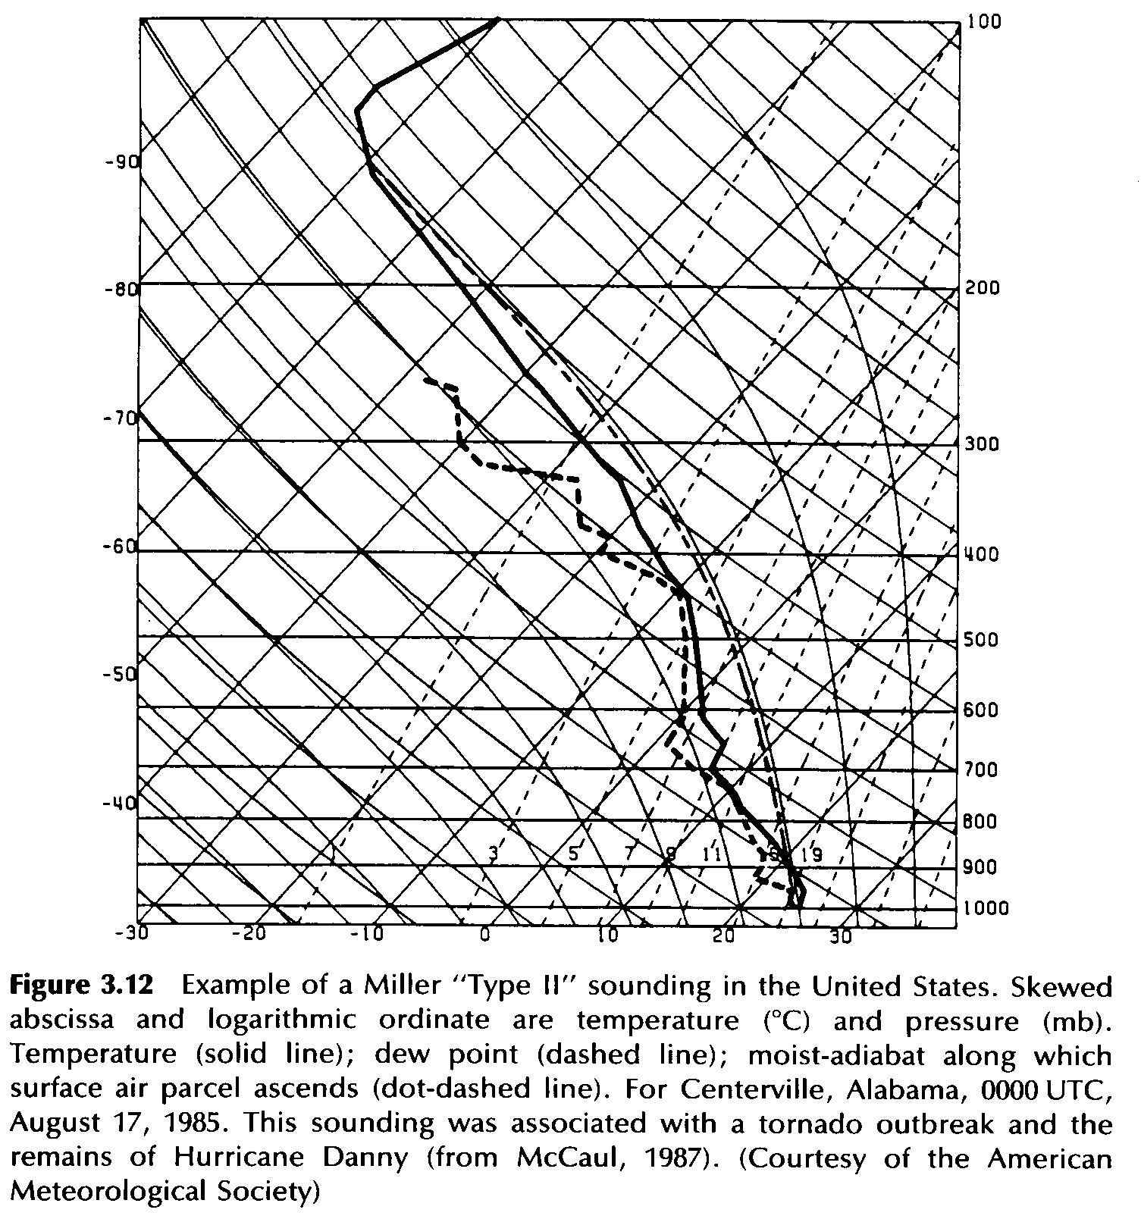
Source: Bluestein (1993)
Notes:
Bluestein Volume II
(452)

Slide 37
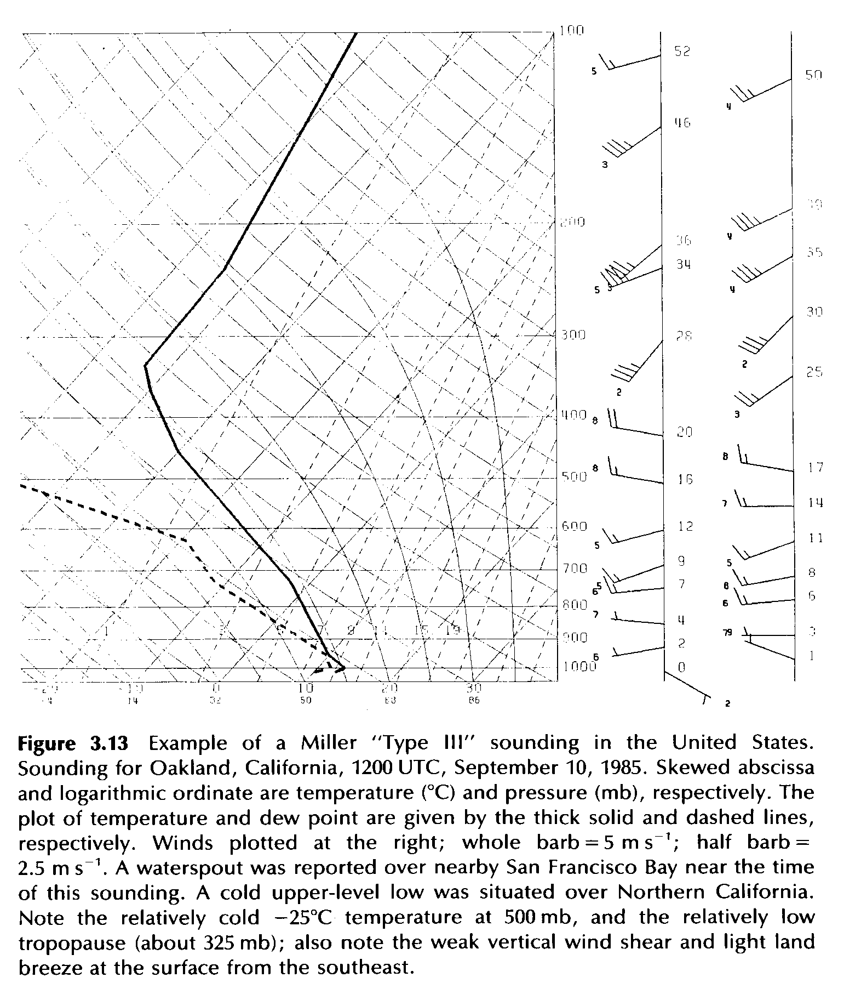
Source: Bluestein (1993)
Notes:
Bluestein Volume II
(453)

Slide 38
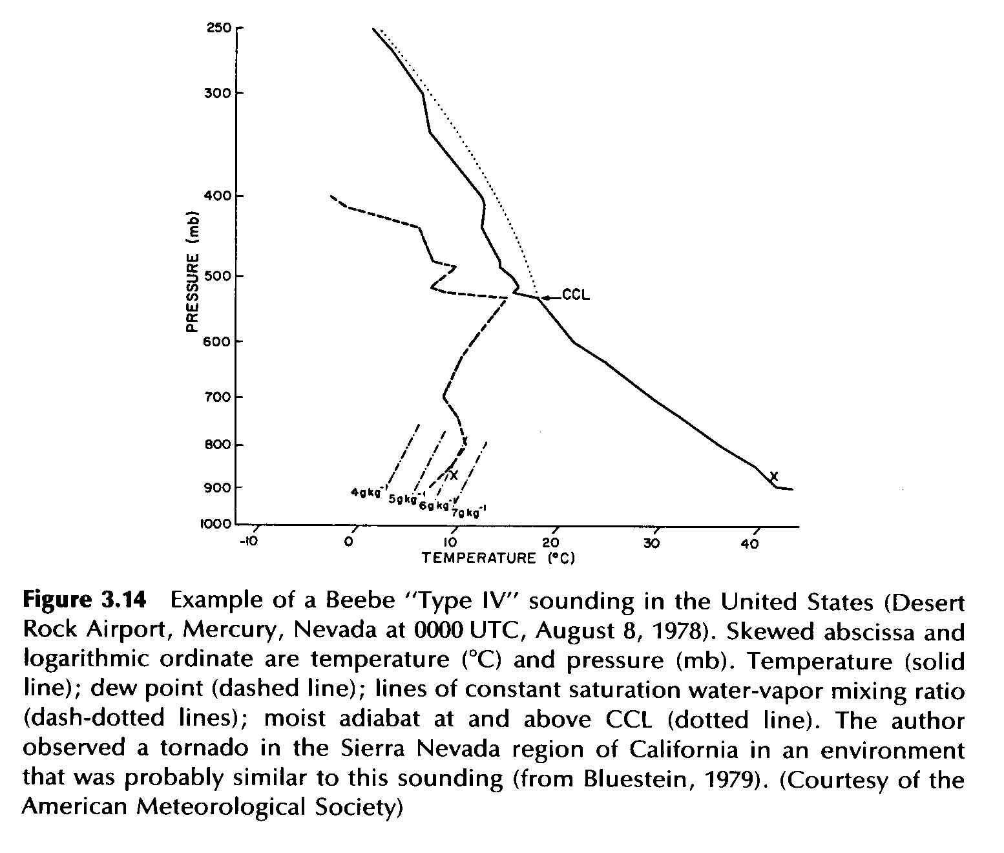
Source: Bluestein (1993)
Notes:
Bluestein Volume II
(454)

Slide 39
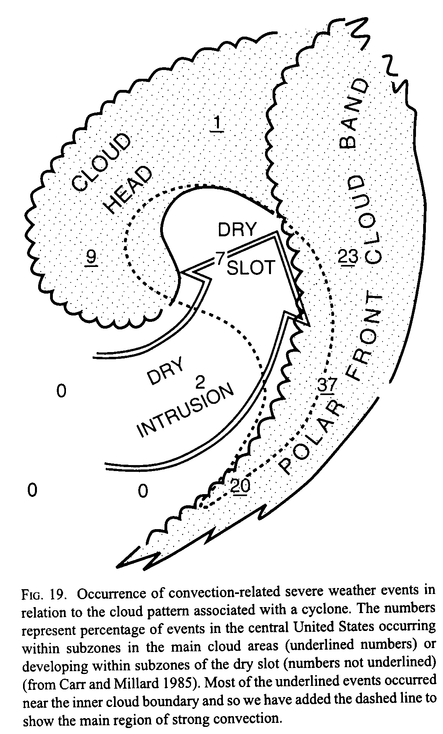
Source: Browning (1999)
Notes:
Life Cycles of Extratropical Cyclones AMS Monograph
Fig. 19 (281)

Slide 40
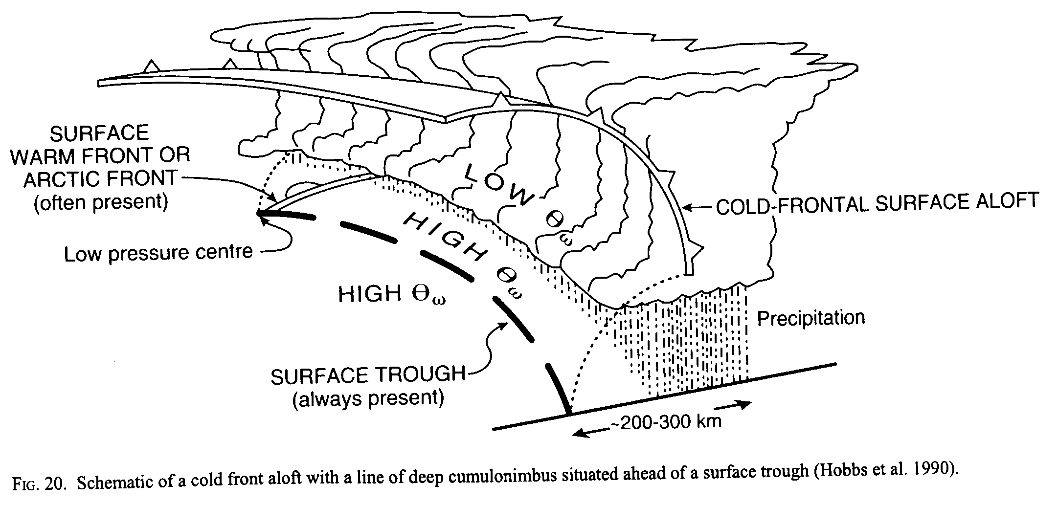
Source: Browning (1999)
Notes:
Life Cycles of Extratropical Cyclones AMS Monograph
Fig. 20 (281)

Slide 41
Storm Structure

Slide 42
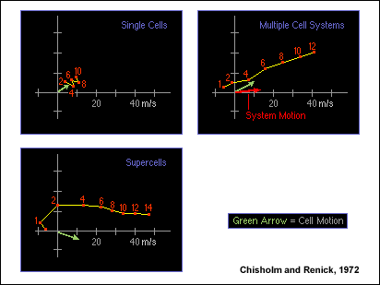
weak shear
unidirectional
clockwise turning
veering

Slide 43
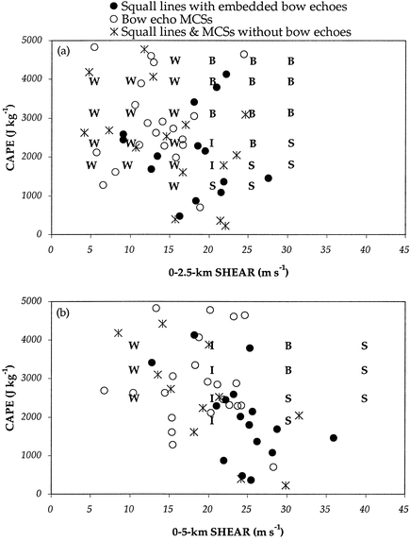
CAPE/shear phase space governs the type of convective organization
W: weakly organized (ordinary)
B: bow echoes
I: intermediate between weak updrafts and bow echoes
S: supercells
Letters are from idealized simulations while shapes are from actual observations
Sources: Weisman (1993); Coniglio et al. (2004)

Slide 44
Ordinary Cells
Bluestein (1993)

Slide 46
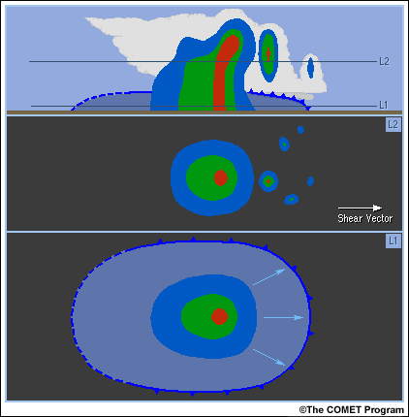
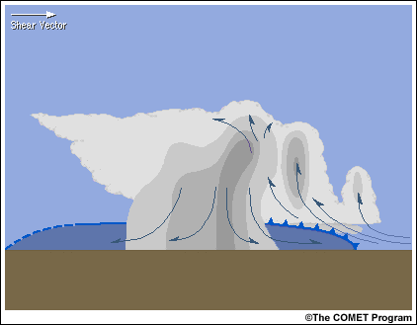
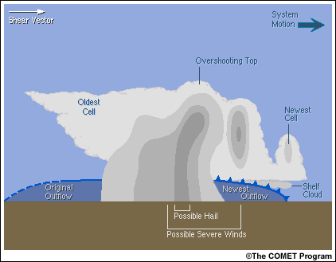
Multicell Storms

Slide 47
Bow echo structure
Wakimoto 2001

Slide 48
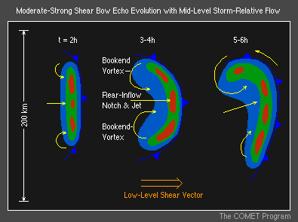
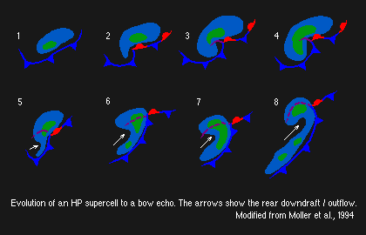

Slide 49
Bluestein (1993)
Courtesy: M. Weisman

Slide 50
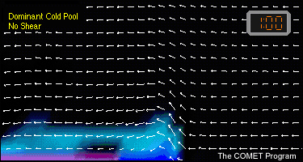
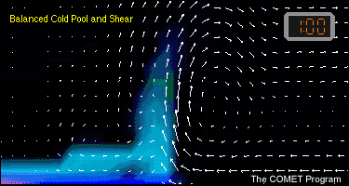
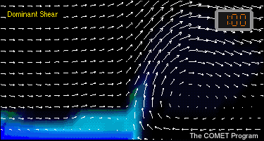
RKW Theory
Rotunno et al. (JAS, 1988)
C/∆u > 1
“Optimal” condition for cold pool lifting
C/∆u = 1
C/∆u < 1
Courtesy: M. Weisman

Slide 51
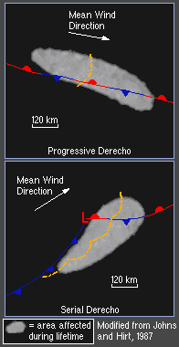
Derechos
Extremely intense bow echoes that produce swaths of significant wind damage
3-4 July 2003 progressive derecho

Slide 52
Serial Derecho Schematic
(courtesy Corey Guastini)
Mean Wind Direction
Favor springtime
High shear
Relatively high predictability
150 km
Adapted from Johns and Hirt (1987)

Slide 53
Progressive Derecho Schematic
(courtesy Corey Guastini)
Mean Wind Direction
Favor summertime
High CAPE
Relatively low predictability
Ridge
150 km
Adapted from Johns and Hirt (1987)

Slide 54
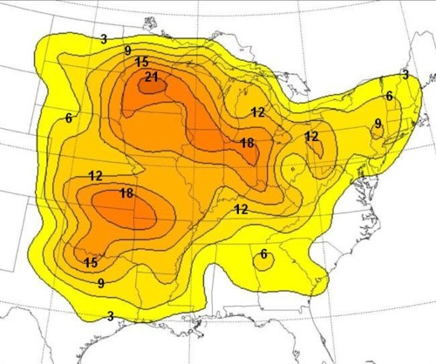
Number of Derechos May-August 1980-2001
Source: Coniglio and Stensrud (2004)

Slide 55
Example of Bow Echo/Derecho
Courtesy NWS Albany, NY
15 July 1995 5:21 a.m. EDT

Slide 56
Courtesy NWS Albany, NY
Example of Bow Echo/Derecho
15 July 1995 5:51 a.m. EDT

Slide 57
Courtesy NWS Albany, NY
Example of Bow Echo/Derecho
15 July 1995 6:50 a.m. EDT

Slide 58
Derecho of 29−30 June 2012 (Figures courtesy Corey Guastini, Lance Bosart, Ross Lazear, and Thomas Galarneau)

Slide 59
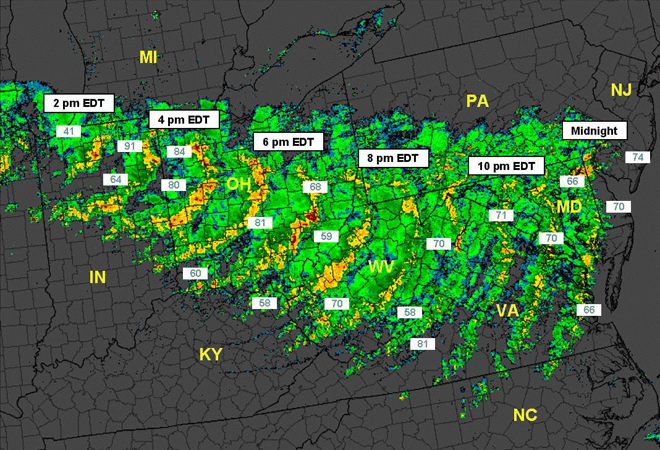
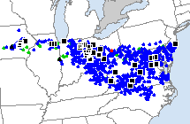
Derecho Continuity Map:
1800 UTC 29 June to 0400 UTC 30 June 2012
SPC Severe Weather Reports
Source: Storm Prediction Center

Slide 60
Maximum Composite Reflectivity (dBZ)
Source: Wikipedia (Iowa Environmental Mesonet)

Slide 61
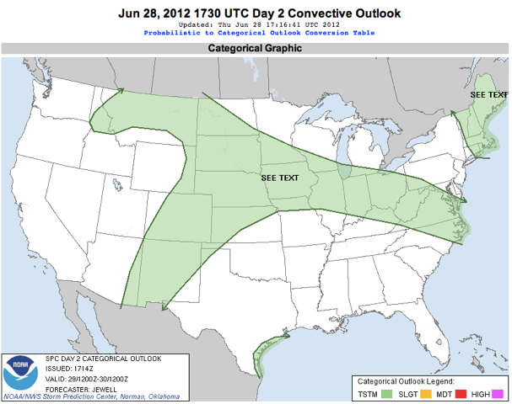
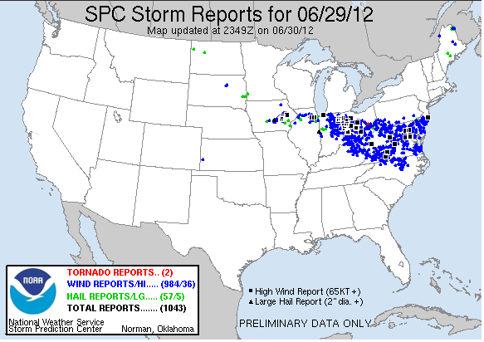
SPC Day 2 Convective Outlook vs. SPC Storm Reports

Slide 62
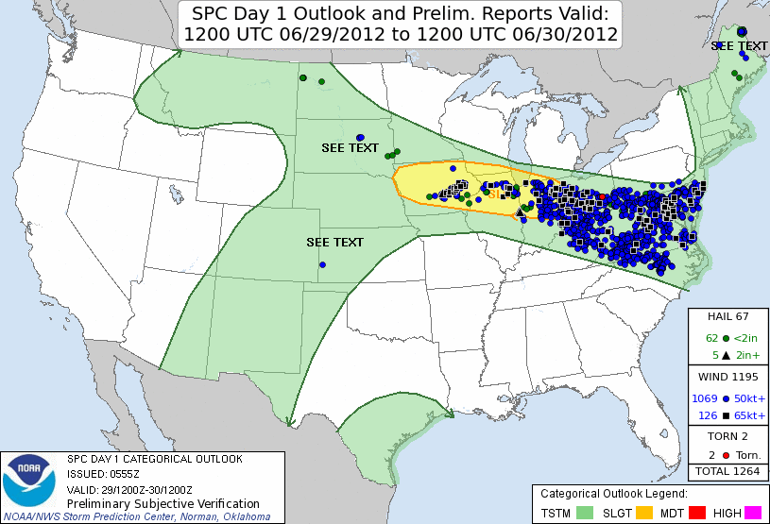
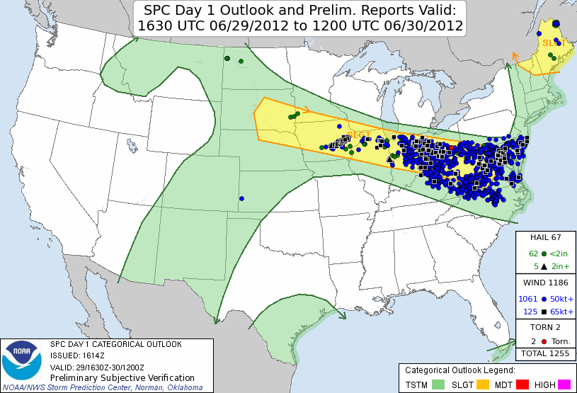
SPC Day 1 Convective Outlook Verification

Slide 63
Flight Tracks: 1700 UTC 29 June to 0500 UTC 30 June 2012
A look at how the FAA and the airlines managed flight tracks during the long-lived derecho of 29-30 June 2012
Source: Daniel Vietor¹ and David Bright²
1: Senior Research Meteorologist, CIRA-CSU and NCEP Aviation Weather Center
2: Chief, Aviation support Branch, NCEP Aviation Weather Center

Slide 64
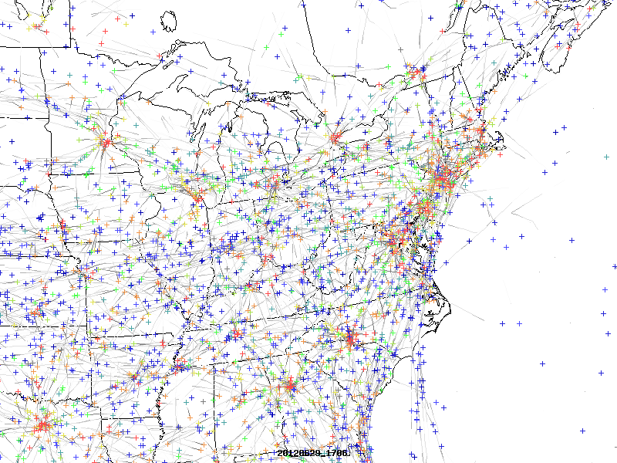
> 30,000 feet
20,000-30,000 feet
10,000-20,000 feet
< 10,000 feet

Slide 65
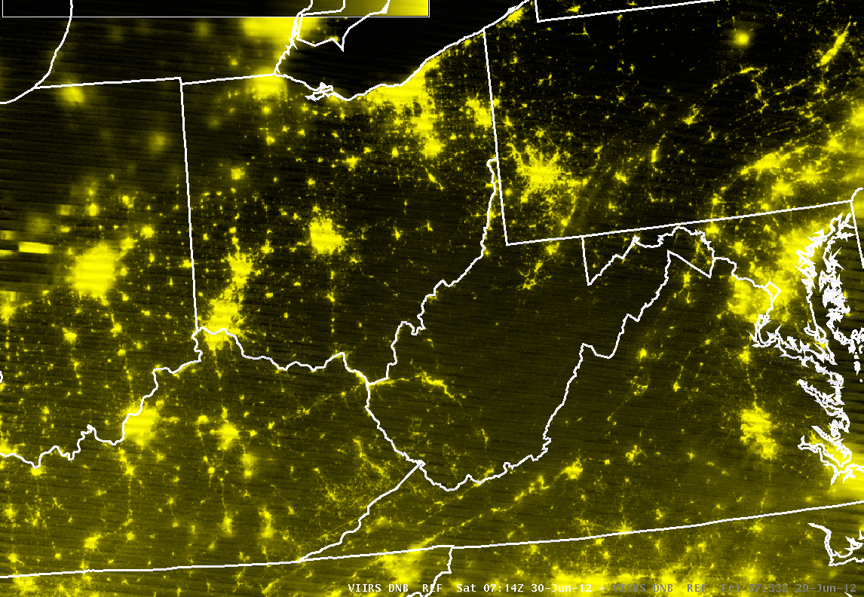
Derecho-Induced Power Outages
Cloud Cover
Cloud Cover
Suomi NPP VIIRS 0.7 µm Day/Night Band images on 0700 UTC 29 June and 0700 UTC 30 June

Slide 66
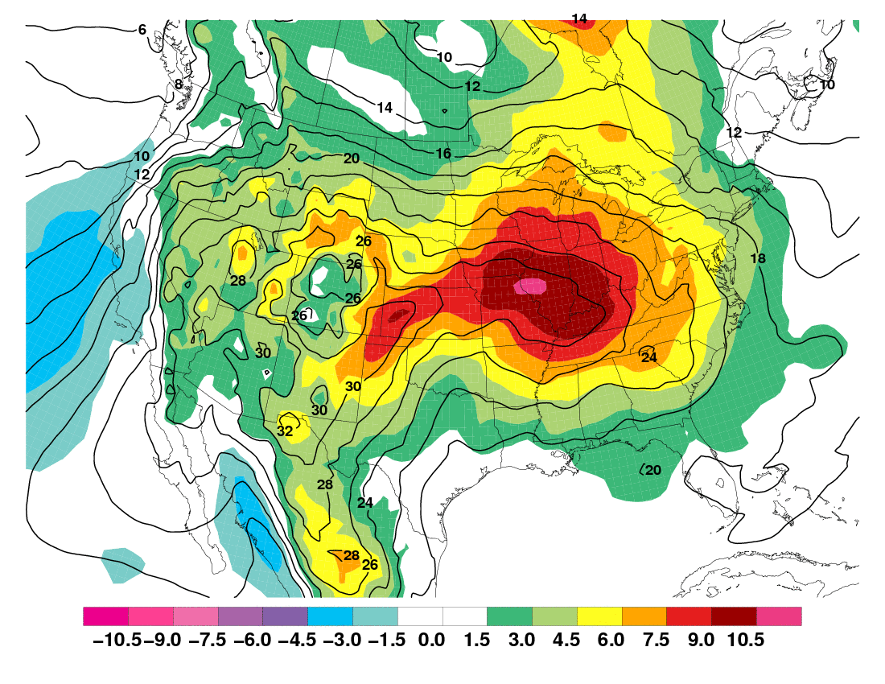
850-hPa Mean Temperature (°C; contoured) and Anomaly (shaded)
0000 UTC 28 - 0000 UTC 30 June 2012

Slide 67
850-hPa Mean Wind (m s⁻¹; shaded), Mean Geopotential Height (m; contoured) and Anomalous Wind (vectors)
0000 UTC 28 - 0000 UTC 30 June 2012
10 m s⁻¹

Slide 68
Mean Precipitable Water (mm; contoured) and Anomaly (shaded)
0000 UTC 28 - 0000 UTC 30 June 2012
Anticyclonic shear side of an upper level jet (30-40 kt shear)
Surface boundary along which convection can initiate
Heat and moisture combining for extreme instability
(>5000 J kg⁻¹ CAPE)

Slide 69
Mean Sea Level Pressure (hPa; contoured) and Anomaly (shaded)
0000 UTC 28 - 0000 UTC 30 June 2012

Slide 70
200-hPa Mean Wind (m s⁻¹; shaded), Mean Geopotential Height (m; contoured) and Anomalous Wind (vectors)
0000 UTC 28 - 0000 UTC 30 June 2012
10 m s⁻¹
10 m s⁻¹
5
10
15
20
25
30
35
40

Slide 71
0000 UTC 28 June 2012
DT potential temperature (shaded, K) and winds (kt); layer-mean 925-850 hPa relative vorticity (contours x 10⁻⁵ s ⁻¹)
SLP (hPa), 1000-500 hPa thickness (dam), and 250 hPa winds (kt)

Slide 72
0000 UTC 28 June 2012
850 hPa heights (black contours, dam), temperatures (red contours, °C), winds (barbs, kt) and mixing ratio (shaded, g kg⁻¹)
500 hPa heights (black contours, dam), temperatures (red contours, °C), winds (barbs, kt), relative vorticity (shaded, x 10⁻⁵ s ⁻¹), and upward motion (blue contours x 10⁻³ hPa s ⁻¹)

Slide 73
Denver (DNR), CO 0000 UTC 28 June 2012 North Platte (LBF), NE 0000 UTC 28 June 2012
PW: 25.31 THCK: 5833
PW: 23.18 THCK: 5909

Slide 74
High Wind Events Climatology and Physical Processes

Slide 75
Fritsch and Forbes 2001

Slide 76
Wakimoto 2001

Slide 77
Wakimoto 2001

Slide 78
Microburst
structure
Wakimoto 2001

Slide 79
http://severewx.atmos.uiuc.edu/21/online.21.1.html
Wakimoto 2001

Slide 80
Supercell Structure

Slide 81
Supercell Structure
modified from Lemon and Doswell (1979)

Slide 82
Supercell Structure
W
E
Davies-Jones et al. 2001

Slide 83
Moller 2001

Slide 84
Moller 2001

Slide 85
http://severewx.atmos.uiuc.edu/18/050399.reflectivity.html
Moller 2001

Slide 86
Bluestein (1993)

Slide 87
Bluestein (1993)

Slide 91
Severe Weather Examples from
Doswell and Bosart (2001)

Slide 92
Source: Doswell and Bosart (2001)
Notes:
Severe Convective Storms AMS Monograph
Fig. 2.5 (36)
GS 35-255

Slide 93
Source: Doswell and Bosart (2001)
Notes:
Severe Convective Storms AMS Monograph
Fig. 2.15 (47)
GS 35-255

Slide 94
Source: Doswell and Bosart (2001)
Notes:
Severe Convective Storms AMS Monograph
Fig. 2.18 (49)
GS 35-255

Slide 95
Source: Doswell and Bosart (2001)
Notes:
Severe Convective Storms AMS Monograph
Fig. 2.19 (49)

Slide 96
Source: Doswell and Bosart (2001)
Notes:
Severe Convective Storms AMS Monograph
Fig. 2.20 (50)

Slide 97
Source: Doswell and Bosart (2001)
Notes:
Severe Convective Storms AMS Monograph
Fig. 2.24 (53)
GS 35-255

Slide 98
Source: Doswell and Bosart (2001)
Notes:
Severe Convective Storms AMS Monograph
Fig. 2.25 (54)

Slide 99
Source: Doswell and Bosart (2001)
Notes:
Severe Convective Storms AMS Monograph
Fig. 2.26 (55)
GS 35-255

Slide 100
Source: Doswell and Bosart (2001)
Notes:
Severe Convective Storms AMS Monograph
Fig. 2.27 (56)
GS 35-255

Slide 101
Source: Doswell and Bosart (2001)
Notes:
Severe Convective Storms AMS Monograph
Fig. 2.28 (57)
GS 35-255

Slide 102
Source: Doswell and Bosart (2001)
Notes:
Severe Convective Storms AMS Monograph
Fig. 2.32 (64)

Slide 103
Tornado Climatology
http://severewx.atmos.uiuc.edu/18/tornado.freq.html
Davies-Jones et al. 2001

Slide 104
Davies-Jones et al. 2001

Slide 105
Source: Patrick March (OU)
- More details (and other graphics) are available at: http://www.atmos.albany.edu/daes/atmclasses/atm401/PPTs-PDFs_files/tornado_probs.pdf

Slide 106
Doppler On Wheels (DOWs)

Slide 107
Davies-Jones et al. 2001

Slide 108
Davies-Jones et al. 2001

Slide 109
Non-Supercell Tornadoes
Source: Johnson and Mapes (2001), AMS Meteor. Monogr., No. 50
http://severewx.atmos.uiuc.edu/18/182-landspout/landspout-tr/landspouttr_wilhelmson-lee.mov

Slide 110
Hail Formation
http://severewx.atmos.uiuc.edu/19/2.inch.hail.probs.html

Slide 111
22 June 2003
Aurora, NE
Largest hailstone ever recorded
18.75” Circumference
1.5 Lbs.

Slide 112
22 June 2003 6:16 p.m. CDT

Slide 113
Tom
Lance
Aurora
22 June 2003 6:16 p.m. CDT

Slide 114
17.5” Circumference
2 Lbs.
3 September 1970
Coffeyville, KS
Heaviest hailstone ever recorded

Slide 115
Severe Weather Forecasting Example
18–19 October 2004

Slide 116
http://www.rap.ucar.edu/weather/

Slide 117
45 F
50 F
55 F
60 F
65 F
70 F
55 F
75 F
80 F
Td >60 F
60 F
65 F
70 F
75 F
Td >65 F
http://www.rap.ucar.edu/weather/

Slide 118
http://www.rap.ucar.edu/weather/

Slide 119
http://www.rap.ucar.edu/weather/

Slide 120
http://www.rap.ucar.edu/weather/

Slide 124
http://www.spc.noaa.gov

Slide 125
http://www.spc.noaa.gov

Slide 126
http://www.spc.noaa.gov

Slide 127
http://www.spc.noaa.gov

Slide 128
http://www.spc.noaa.gov

Slide 154
http://www.spc.noaa.gov

Slide 155
Sources and References
Internet sources are indicated on the applicable figures.
References:
Barnes, S. L., and C. W. Newton, 1983: Thunderstorms in the synoptic setting. Thunderstorm Morphology and Dynamics, E. Kessler, Ed., University of Oklahoma, 75–112.
Bluestein, H. B., 1993: Observations and Theory of Weather Systems. Vol. II: Synoptic-Dynamic Meteorology in Midlatitudes., Oxford University Press, 594 pp.
Coniglio, M. C., D. J. Stensrud, and M. B. Richman, 2004: An observational study of derecho-producing convective systems. Wea. Forecasting, 19, 320–337.
Davies-Jones, R., R. J. Trapp, and H. B. Bluestein, 2001: Tornadoes and tornadic storms. Severe Convective Storms, Meteor. Monogr., No. 50, Amer. Meteor. Soc., 167–221.
Fritsch, J. M., and G. S. Forbes, 2001: Mesoscale convective systems. Severe Convective Storms, Meteor. Monogr., No. 50, Amer. Meteor. Soc., 323–357.
Johns, R. H., and W. D. Hirt, 1987: Derechos: Widespread convectively induced windstorms. Wea. Forecasting, 2, 32–49.
Johnson, R. H., and B. E. Mapes, 2001: Mesoscale processes and severe convective weather. Severe Convective Storms, Meteor. Monogr., No. 50, Amer. Meteor. Soc., 71–122.
Lemon, L. R., and C. A. Doswell, III, 1979: Severe thunderstorm evolution and mesocyclone structure as related to tornadogenesis. Mon. Wea. Rev., 107, 1184–1197.
Moller, A. R., 2001: Severe local storms forecasting. Severe Convective Storms, Meteor. Monogr., No. 50, Amer. Meteor. Soc., 433–480.
Wakimoto, R. M., 2001: Convectively driven high wind events. Severe Convective Storms, Meteor. Monogr., No. 50, Amer. Meteor. Soc., 255–298.
Weisman, M. L., 1993: The genesis of severe, long-lived bow echoes. J. Atmos. Sci., 50, 645–670

