Slide 1
NCEP Operational Regional Hurricane Modeling Strategy for 2014 and beyond
Environmental Modeling Center,
NCEP/NOAA/NWS, NCWCP, College Park, MD
National Hurricane Center
NCEP/NOAA/NWS, Miami, FL
UCACN Meeting, January 21-22, 2014
Notes:
1
1

Slide 2
Outline
Current status and progress of operational hurricane forecast skills from NHC
HWRF’s evolution as an important dynamical model guidance tool for NHC
Plans for FY14 HWRF Upgrades
Focus areas for further improvements
Strategies for future regional hurricane model developments at EMC

Slide 3
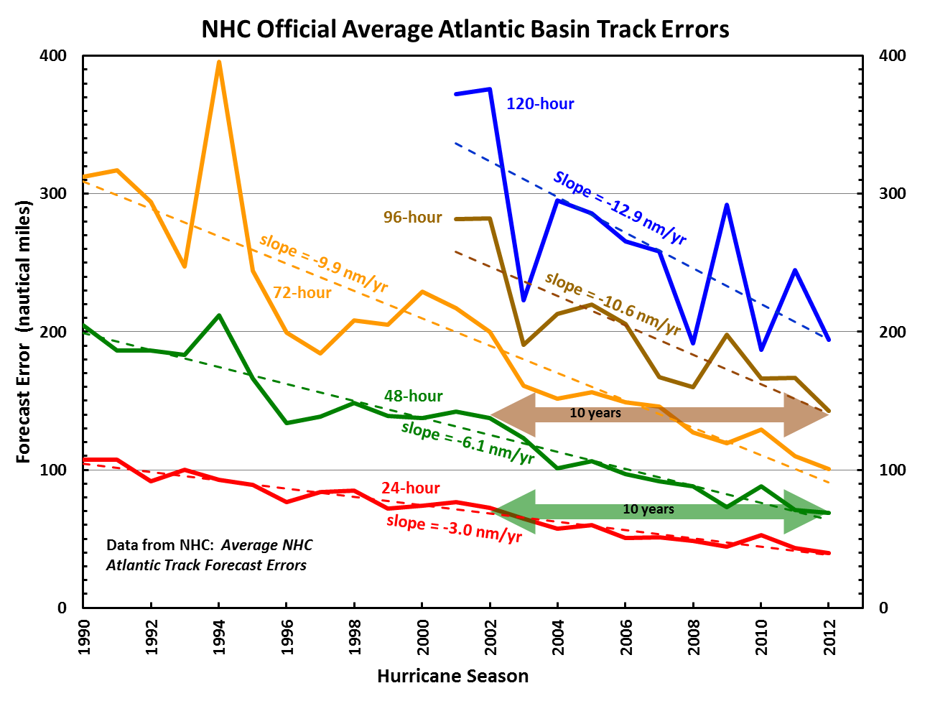
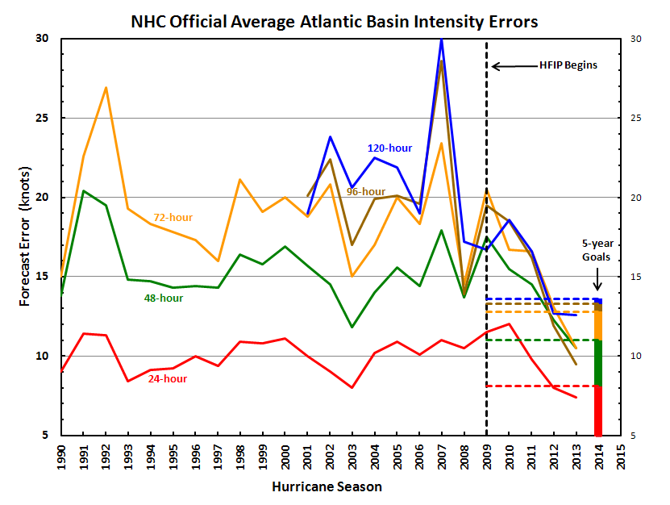
Good – track forecast improvements
NHC Official Forecast Performance
Atlantic Basin
Intensity - recent trend indicating significant improvements in the past few years
Errors cut in half over past 15 yrs
10-yr improvement - As accurate at 48 hrs as we were at 24 hrs in 2000
24-48h intensity forecast historically off by 1 category (2 or more categories 5-10% of time)

Slide 4
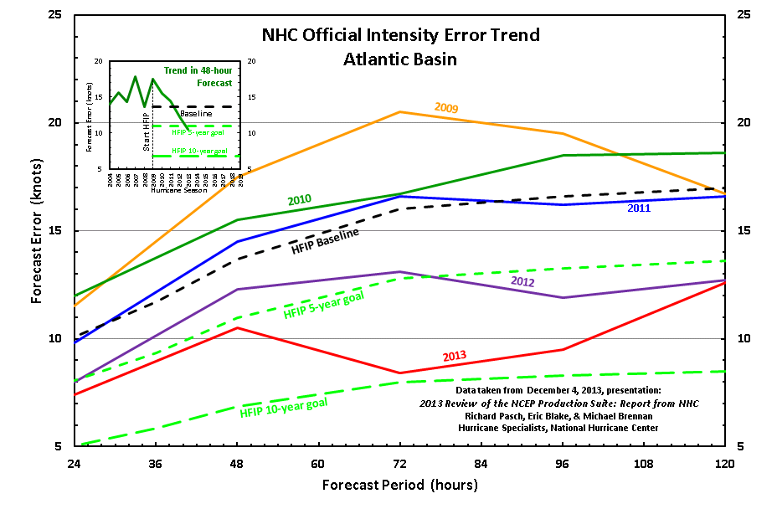
Significant Reduction in Forecast Errors
for 2013 Hurricane Season
Only 14 cases at 120 hr verified for 2013

Slide 5
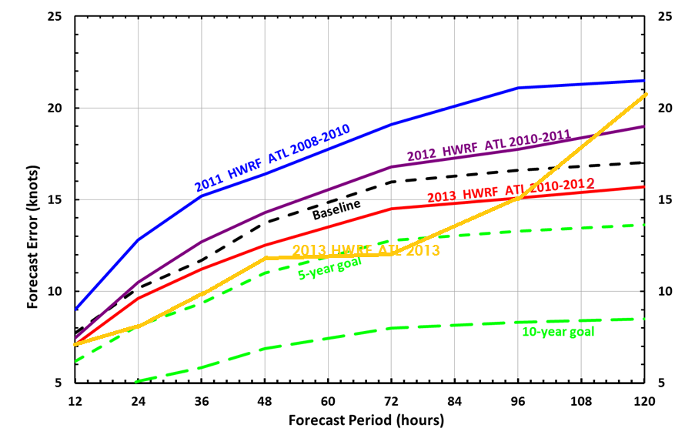
NCEP Operational HWRF showing systematic improvements in intensity forecasts
Intensity Forecast Errors from Operational HWRF 2008-2013
Only 14 cases at 120 hr verified for 2013
5

Slide 6
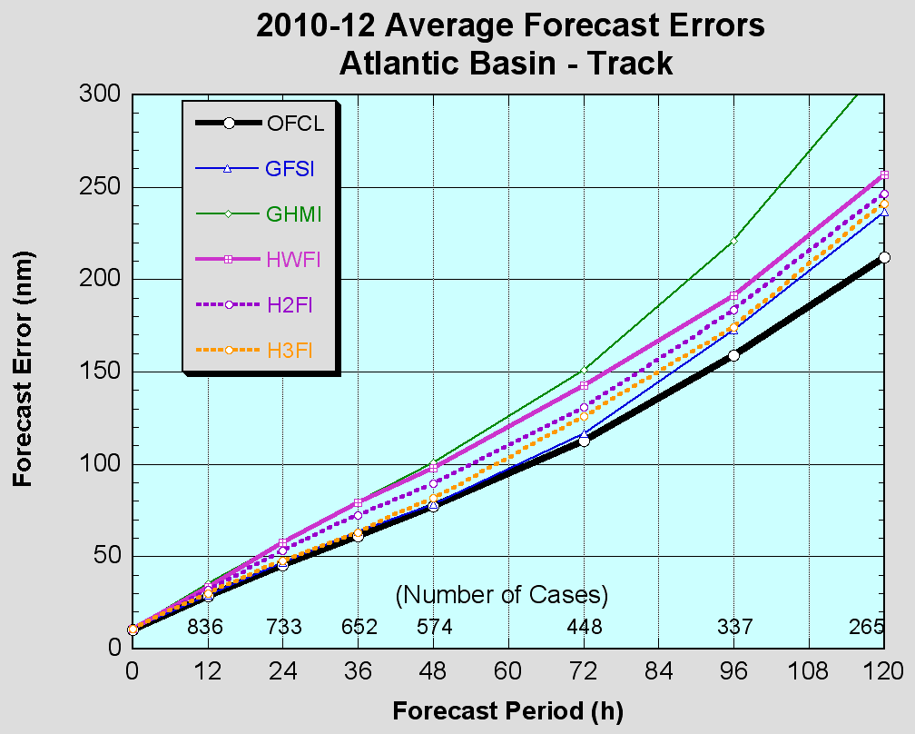
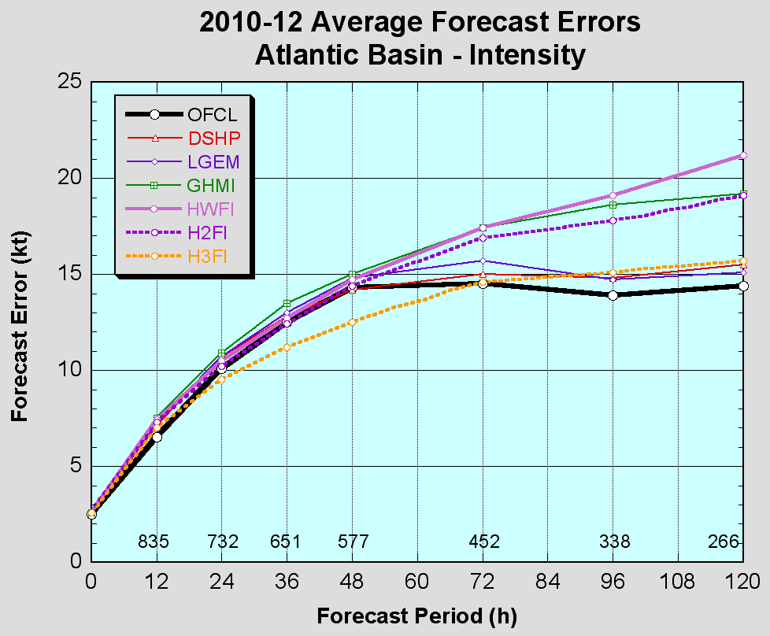
How did we get there? Role of NCEP High-Resolution HWRF Modeling System
HWRF is one of the best operational intensity forecast guidance tools for NHC.
For the first time, a very high-resolution hurricane model operating at cloud-permitting 3km resolution implemented into NCEP operations during the 2012 hurricane season, is a result of multi-agency efforts supported by HFIP
2013 HWRF implementation on WCOSS included more advanced upgrades followed by extensive 3-season T&E
Highlights of 2013 HWRF:
Sophisticated 9-point nest tracking algorithm
Advanced nest-parent interpolations
Increased frequency of physics calls
Observations based PBL and Surface Layer Physics
Improved air-sea fluxes for ocean coupling (POM-TC)
Data Assimilation and Vortex Initialization upgrades:
One-way hybrid EnKF-3DVAR data assimilation and assimilate real-time inner-core NOAA P3 Tail Doppler Radar datasets
Improved storm size correction, modified filter domain and use of GFS vortex when the storm is weaker than 16 m/s
Extensive evaluation:
Three-season (2010-12) comprehensive evaluation for NATL/EPAC showing intensity skill superior to NHC forecasts
Experimental Real-time support to JTWC for all other basins
FY13 HWRF
Notes:
6

Slide 7
2014 HWRF pre-implementation test plan
 | Infrastructure/DA Upgrades |  | Physics upgrades |  |  |  |  | Combined (best of all upgrades)
 | H14A | H14B | Nest motion (H140) | NOAH LSM (H141) | Upgraded Ferrier (H142) | RRTMG (H143) | Ocean (H144) | H214 (proposed 2014 HWRF)
Description | 1. Sat Da with 61 levels, 2mb top 2. Extended d02/d03 3. Upgraded vortex init. 4. GSI upgrades | 1. No Sat DA 2. Include Invests in cycling | 1. New nest motion & diagnostics | NOAH LSM | Separate species and F_rime advection with other upgrades | Radiation | MPI-POM with new coupler | Baseline + physics + python based scripts *need to do test runs with new GFS in WCOSS
Cases | Whole 2011-2013 & selected 2008-2010 storms | Whole 2011-2013 & selected 2008-2010 storms | Priority cases | Priority cases | Priority cases | Priority cases | Priority cases | Whole 2011-2013 & selected 2008-2010 storms
Due date | Feb. 15 | Feb. 15 | Feb. 15 | Feb. 15 | Feb. 15 | Feb. 15 | Feb. 15 | March 31
Platform | Jet/WCOSS | Jet/WCOSS | Jet | Jet | Jet | Jet | Jet | Jet/WCOSS
Continuing on the same path of extensive testing of individual upgrades and their combination for multiple seasons that resulted in higher confidence in the model. Joint NHC/EMC collaboration during the pre-implementation testing.
7

Slide 8
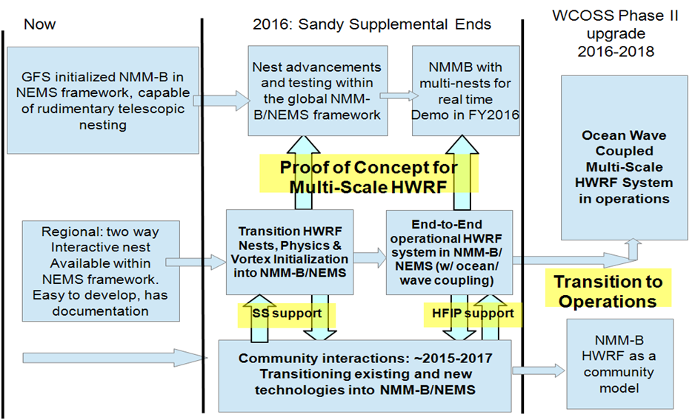
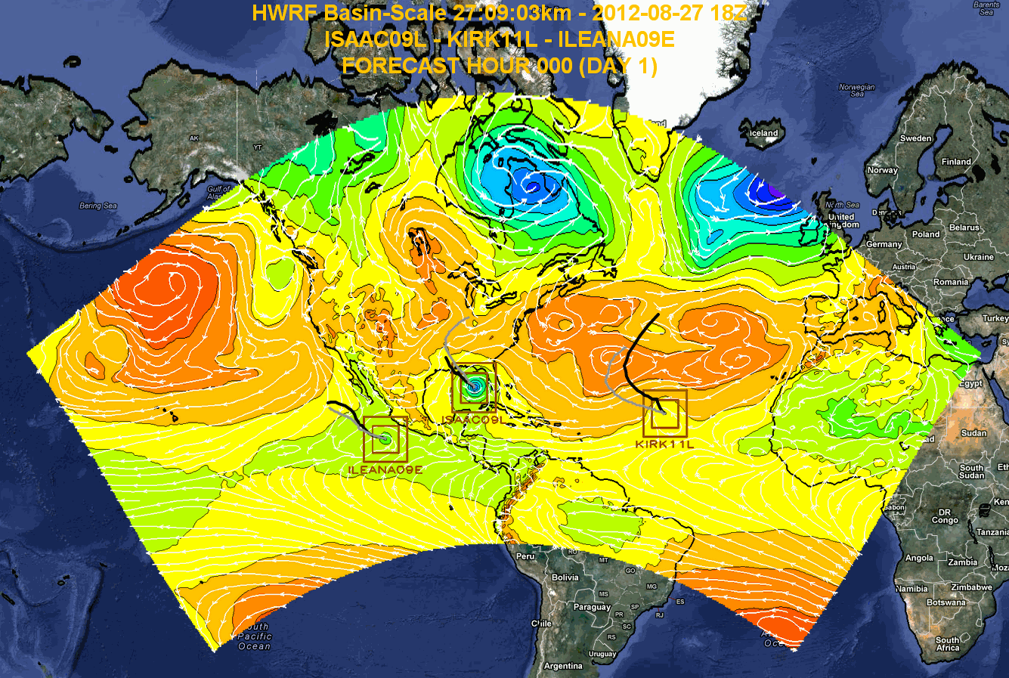
Advancements to Operational HWRF – Transition to NMM-B/NEMS Multi-Scale Modeling System
NCEP/AOML Collaborative effort supported by OAR Sandy Supplemental High Impact Weather Prediction Project (HIWPP) and leveraged by NOAA’s HFIP support
Take advantage of NMMB in NEMS infrastructure for developing next generation global-to-local-scale modeling system for tropical cyclone forecasting needs and for comprehensive solutions for landfalling storms
Planned development, testing and evaluation leading to potential transition to operations in the next 3-5 years
Scientific advancements include:
Scale aware and feature aware physics for high-resolution domains and for multi-scale interactions
Advanced techniques for inner core data assimilation with use all available aircraft recon data including TDR, FL, SFMR, and satellite radiance data
High-resolution ensembles for prediction of RI/RW
Enhanced land-air-sea-wave-hydrology coupled system
8

Slide 9
Operational Hurricane Model
Implementation Strategy on WCOSS
System | Current (Q4FY13) | End of Phase 2 (2018)
Atmosphere | 27:9:3 km, 42 levels | 18:6:2 km, 64 levels
Ocean | POM (3D ATL and 1 D EPAC) 1/6º resolution 23 levels | HYCOM (1/12º resolution 32 levels)
Waves | None | WAVEWATCH III
Data Assimilation | One-Way Hybrid EnKF-3DVAR with vortex initialization, inner core NOAA-P3 TDR DA | One-Way Hybrid with inner core recon data (TDR/FL/Dropsonde/SFMR); clear and inner core cloudy radiance DA
Hurricane Physics | Ferrier Microphysics with explicit convection in 3km domain, Observations based PBL and Surface Physics | Scale and feature aware physics (advanced microphysics, RRTM-G radiation and NOAH LSM) land-air-sea-wave interactions including sea-spray and aerosols
Basins | NATL, EPAC, CPAC | All Tropical Ocean Basins
9

Slide 10
Evolution of HWRF beyond 2018
System | Beyond 2018
Atmosphere | High-resolution Hurricane nests within the global model (NMM-B/NEMS)
 | 2km or higher resolution hurricane nests with 128 Levels, global model top, with 10 member ensembles for each storm
Ocean | Global HYCOM (1/12º resolution, 100 levels)
Waves | Wave Watch III
Data Assimilation | Two-way hybrid 3D/4D En-Var with inner core aircraft (TDR, FL, SFMR, Dropsonde), clear and cloudy satellite radiance DA
Hurricane Physics | Scale and feature aware physics coupled to wave, hydrology, surge and inundation models
Basins | All Tropical Ocean basins
Max. storms | All existing tropical storms including genesis forecasts out to 7 days
10

