Slide 1
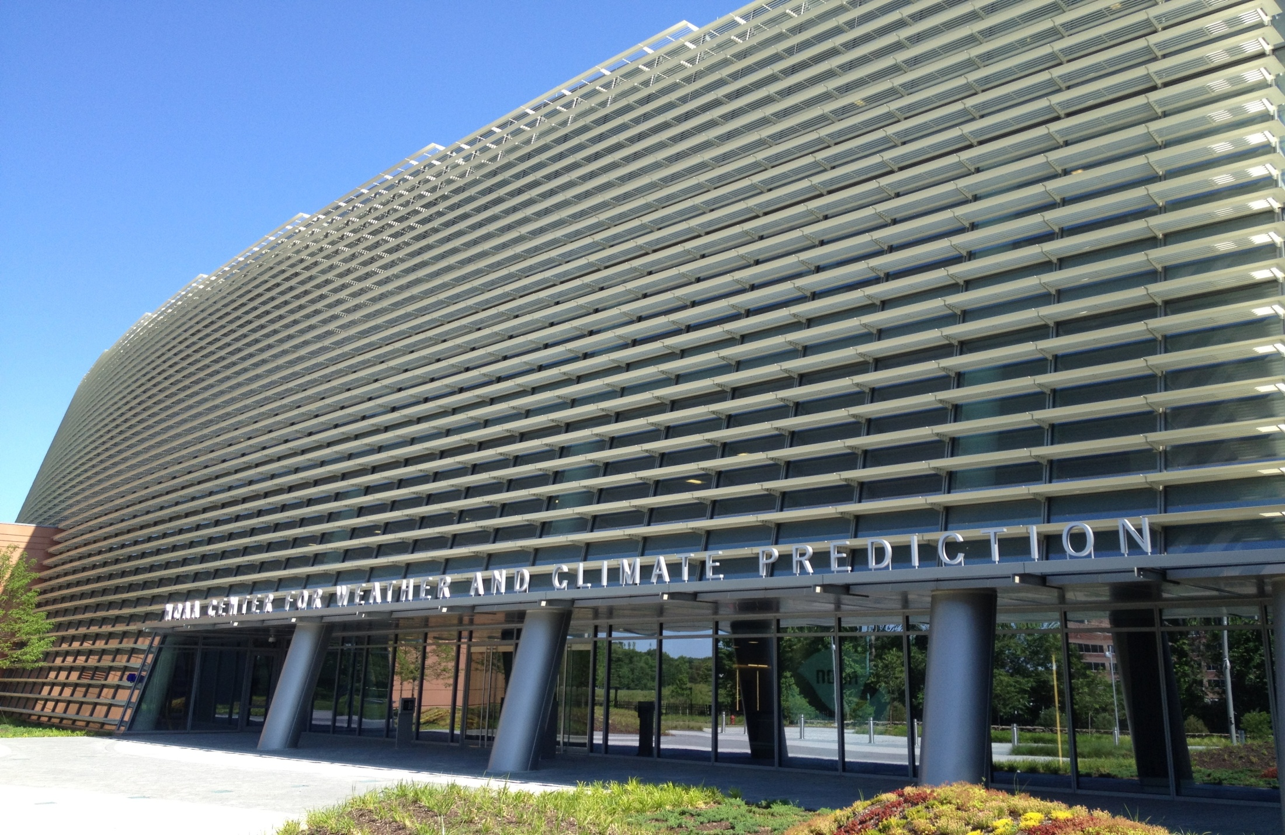
Precipitation and Temperature Forecast Performance at the Weather Prediction Center
David Novak
WPC Acting Deputy Director
Christopher Bailey, Keith Brill, Patrick Burke, Wallace Hogsett, Robert Rausch, and Michael Schichtel
Results from Novak et al. (2014) Wea. Forecasting
2014 WAF/NWP Conference – January 2014

Slide 2
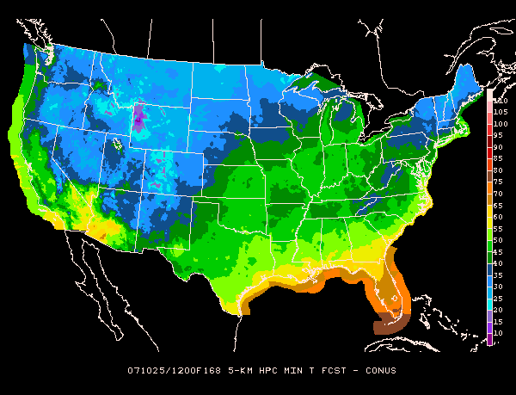
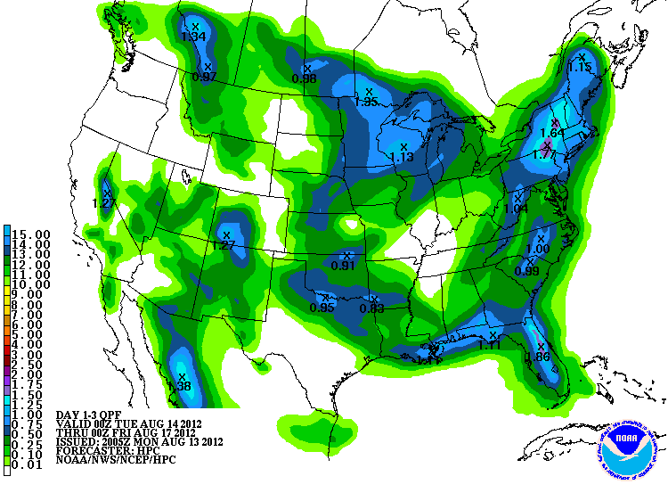
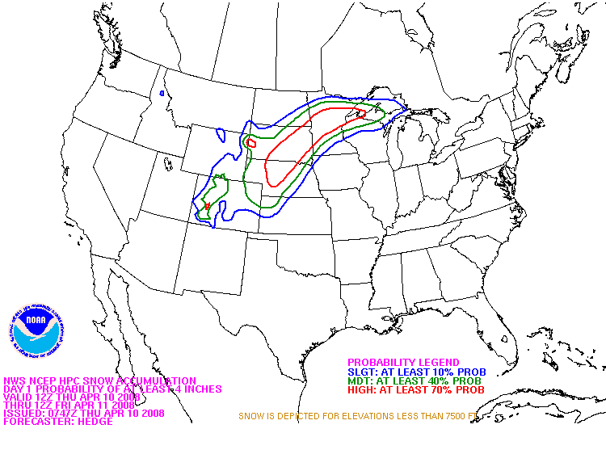
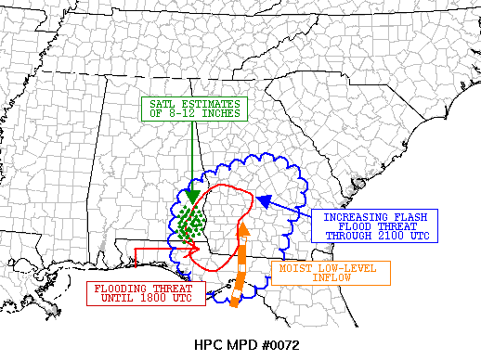
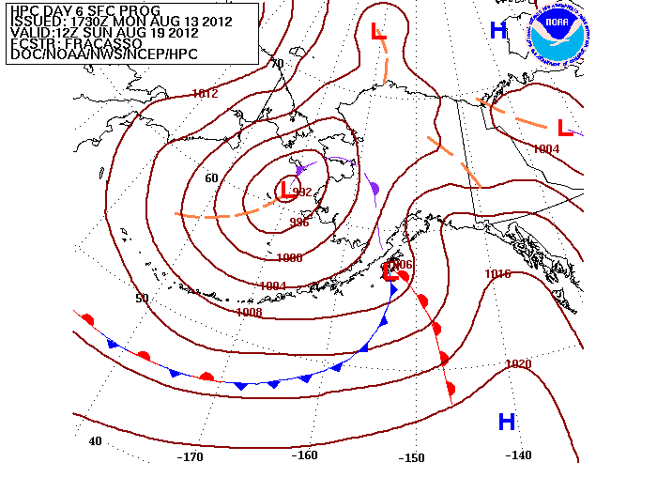
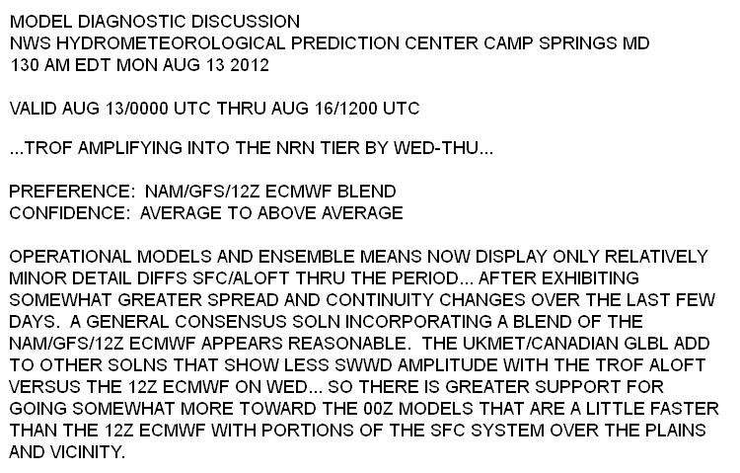
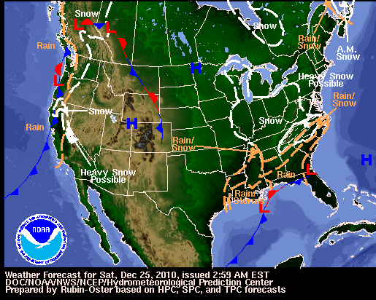
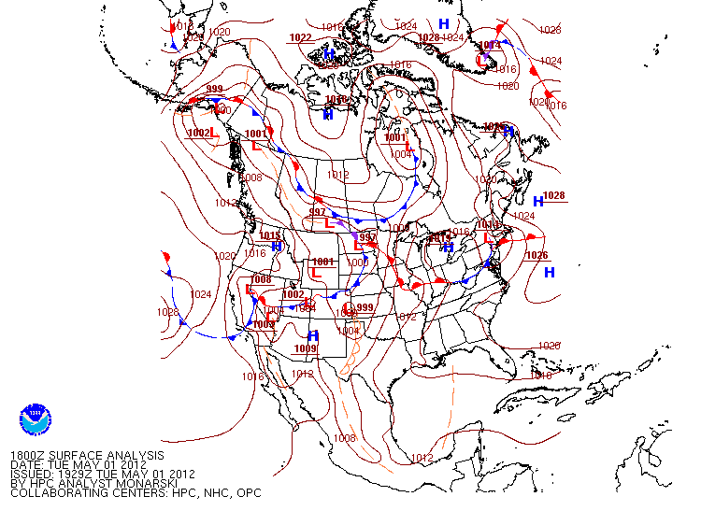
WPC Operations
International Model Guidance Suite
NCEP, MDL, CMC, NAEFS, ECMWF, UKMET, FNMOC
Medium Range
QPF
Winter Weather
Met Watch
Alaska
Model Diagnostics
Short Range
Surface Analysis
7 Days
forecast lead time
hours

Slide 3
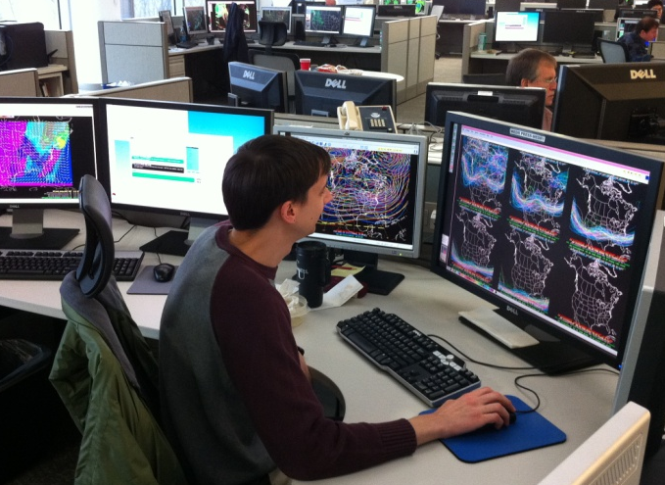
Motivation
With access to the full international model guidance suite, and midway through the transition to ‘forecaster over the loop’, can the human forecaster improve over the accuracy of modern NWP*?
*Does not address value added by retaining run-to-run continuity, assuring element consistency, or helping users make informed decisions.

Slide 4
Verification Method
Test against most skillful benchmark
-QPF: Bias corrected ensemble (ENSBC)
-Medium Range Temp: Bias corrected and downscaled ECMWF ensemble
Use bias-removed threat score to reduce sensitivity of QPF results to bias
-Ebert (2001); Clark et al. (2009)
Test for statistical significance
-Random resampling (Hamill 1999)

Slide 5
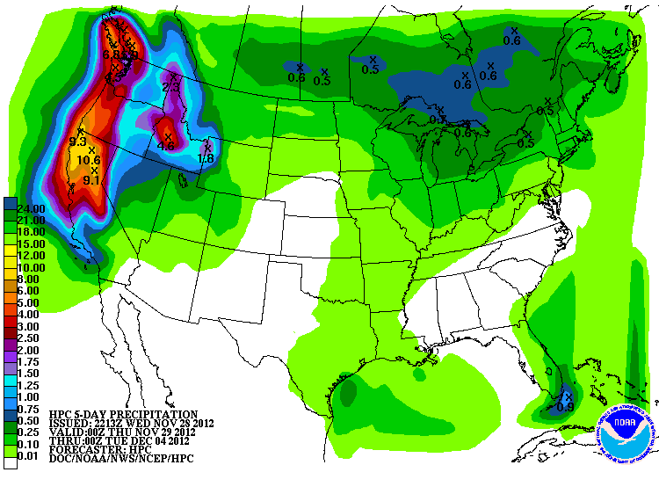
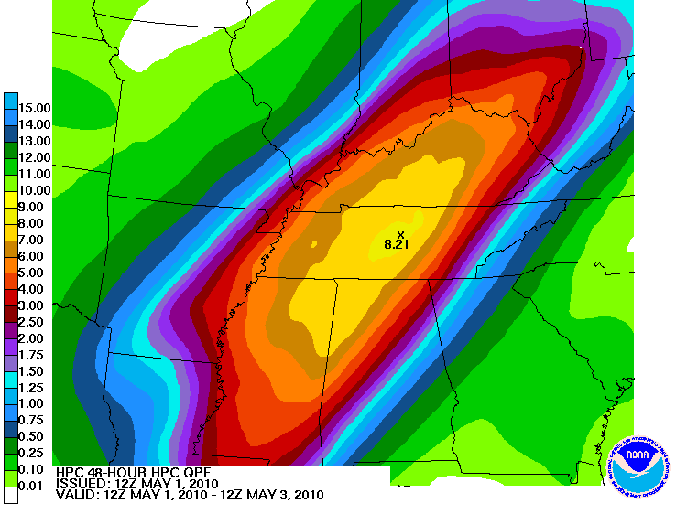
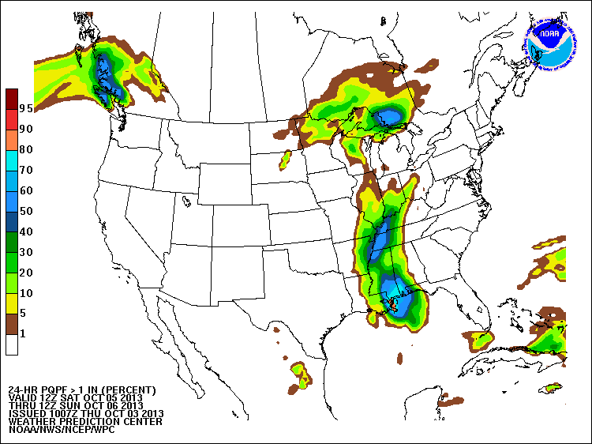
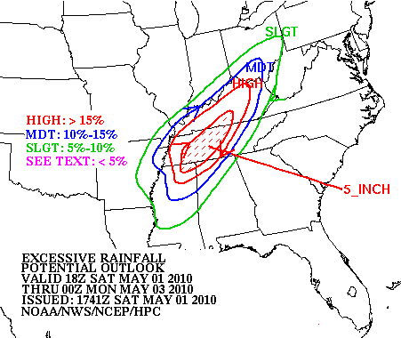
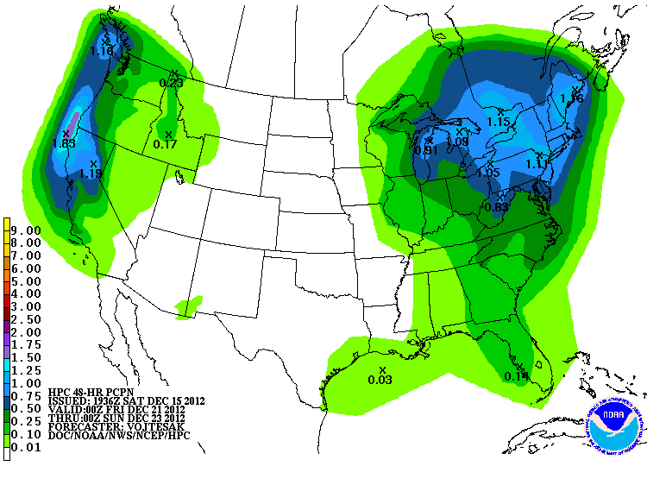
QPF
Deterministic QPF
Probabilistic QPF
Mesoscale Precipitation Discussion
Day 4-7 QPF
Excessive Rainfall
7 Days
forecast lead time
hours

Slide 6
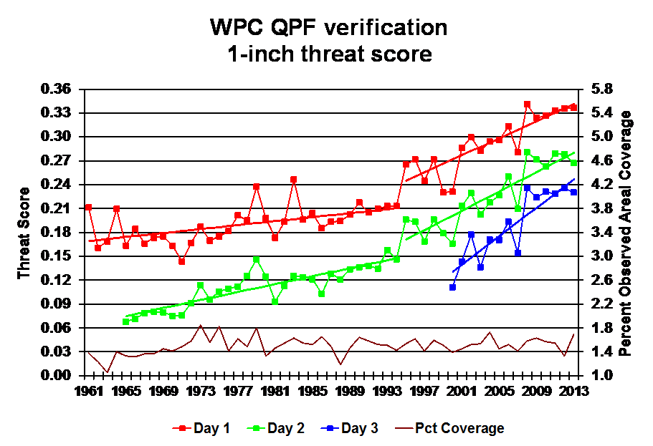
Long-Term WPC QPF Verification
WPC
Current Day 3 WPC forecast skill is nearly equal to Day 1 forecast skill in 1990s.
6
Notes:
*

Slide 7
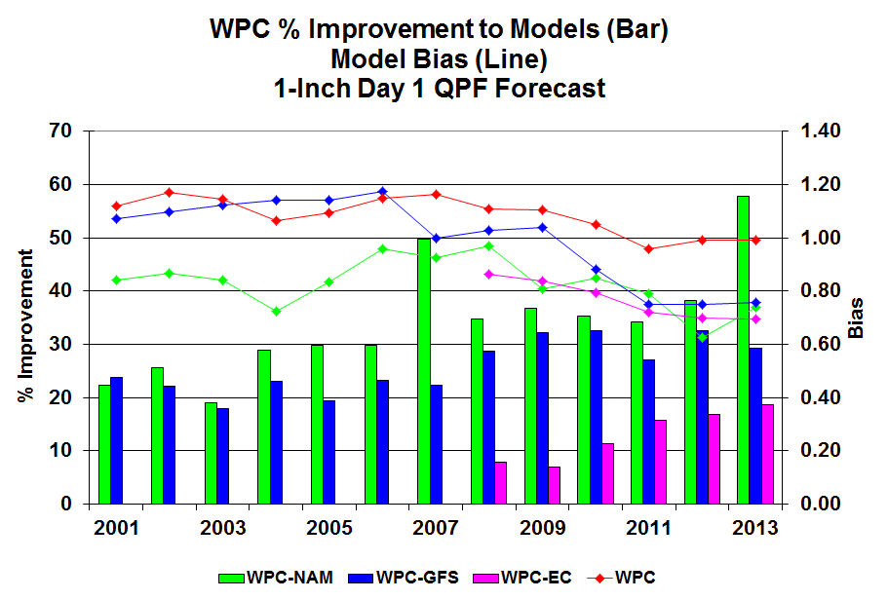
Day 1 QPF: 1 in Threshold
* Statistical significance
WPC outperforms all individual models
Most guidance under-biased
WPC-generated ENSBC is competitive with WPC
9
Notes:
*

Slide 8
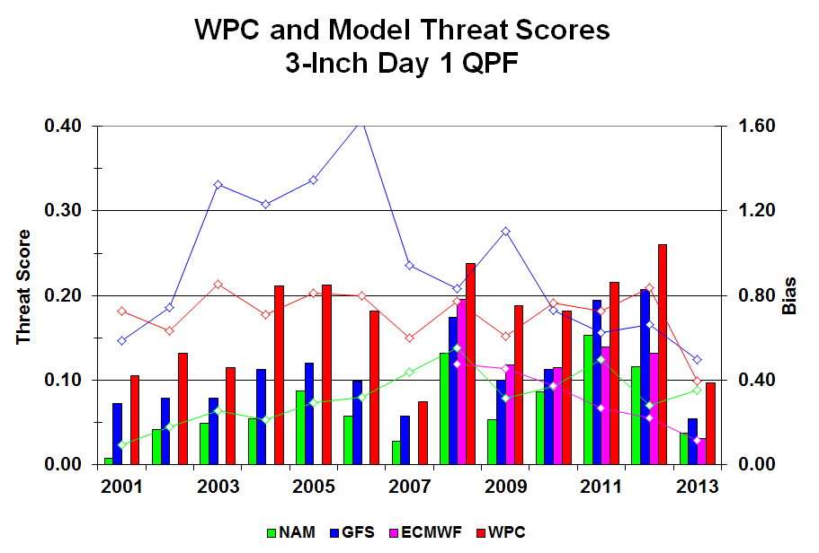
Day 1 QPF: 3 in Threshold
* Statistical significance
WPC outperforms all individual models
Performance improving through time (Sukovich et al. 2013)
Most guidance under-biased
ENSBC is competitive with WPC
9
Notes:
*

Slide 9
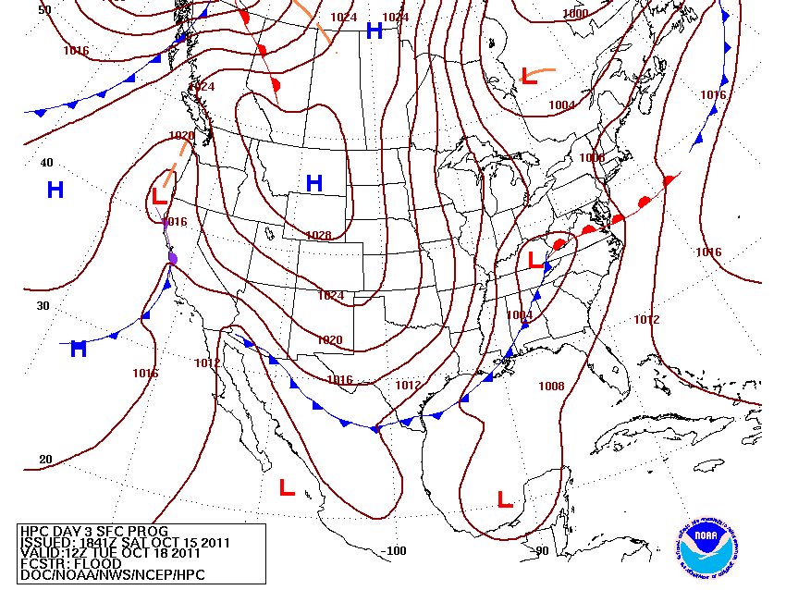
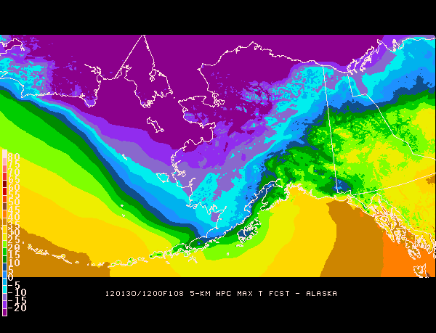
Medium Range
Fronts & Pressure
CONUS Sensible Wx Elements
Alaska Sensible Wx Elements

Slide 10
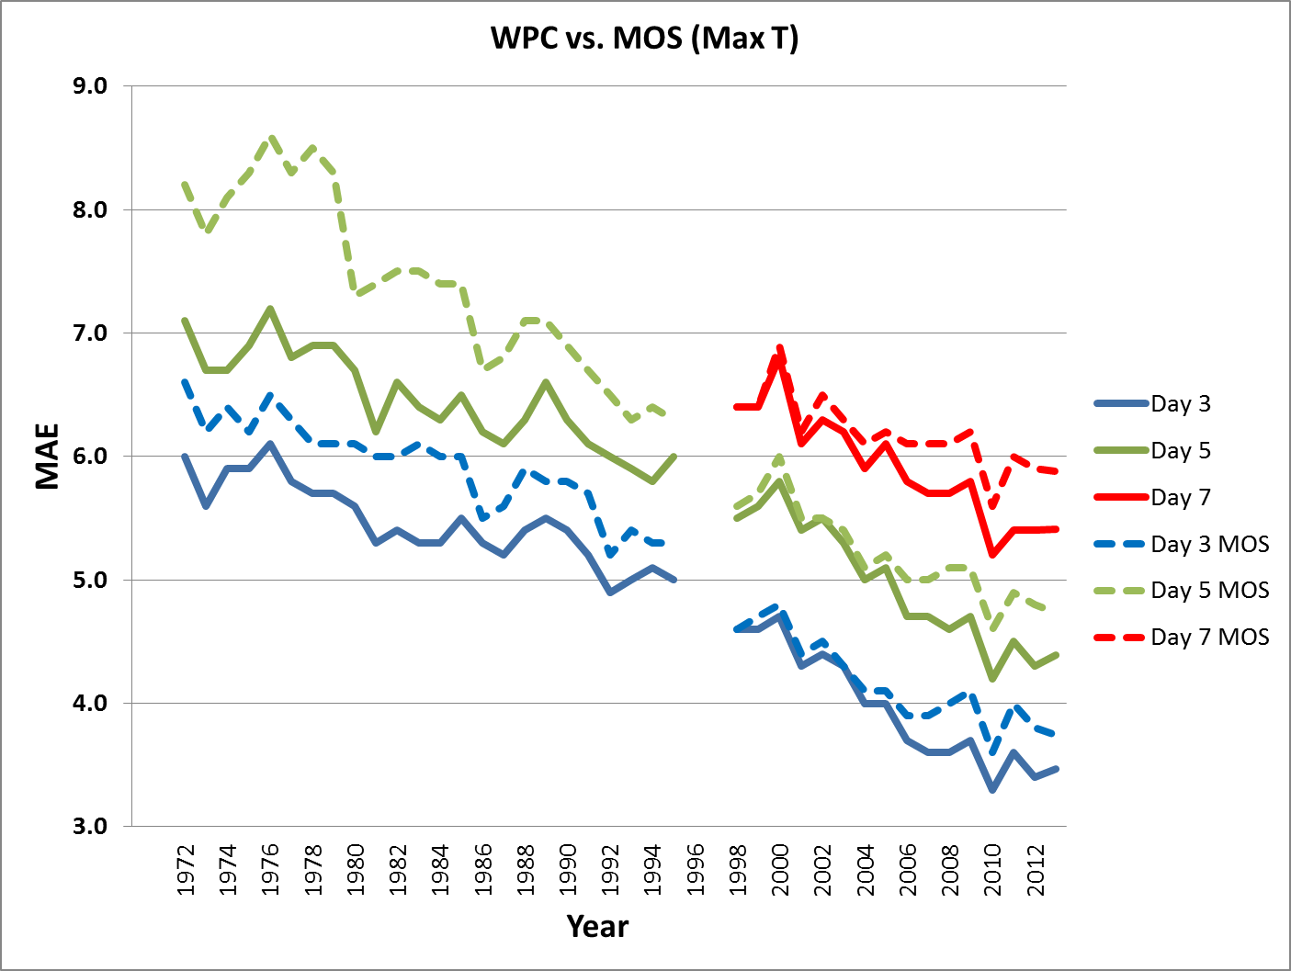
Max Temp Verification

Slide 11
Max Temp Verification
2012
* Statistical significance
* Statistical significance
WPC statistically significantly better than individual raw guidance
Bias-corrected and downscaled ECMWF ensemble superior to WPC

Slide 12
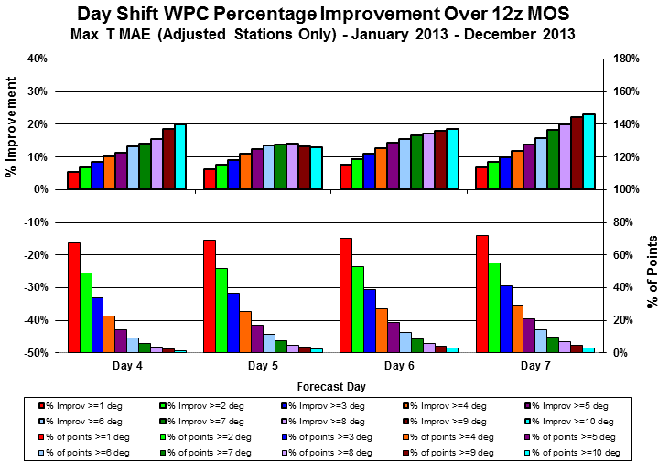
Max Temp Verification
When forecasters make large changes to MOS, they are often the correct choice

Slide 13
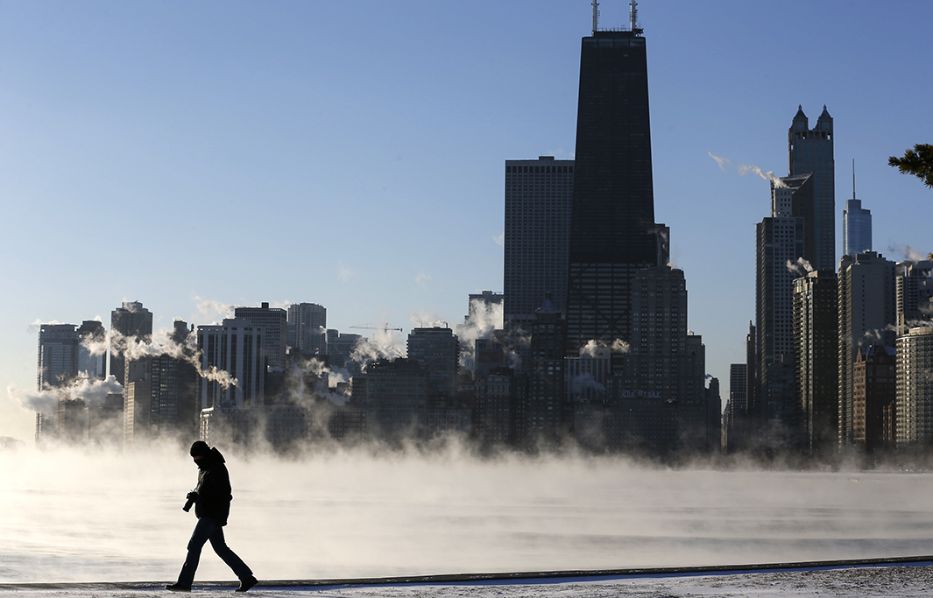
‘Polar Vortex’ Event
Image adapted from talk-politics.livejournal.com

Slide 14
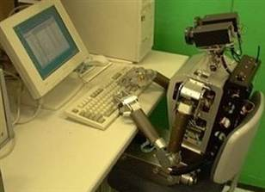
Automation Conundrum
Downscaled bias-corrected ensemble guidance is competitive with the human forecaster.
However, such automated guidance is most likely to struggle in unusual (often the most critical) weather situations.

Slide 15
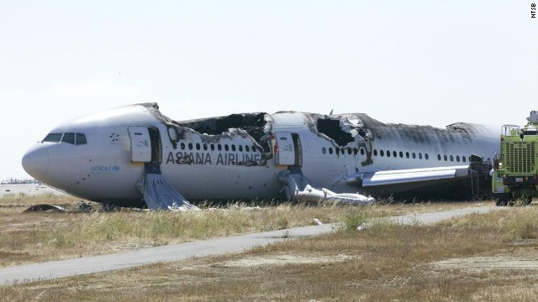
Automation Conundrum
Automation improves efficiency.
However, too much reliance on automation can erode skills that are often needed at the most critical times
“The safety board investigation is focusing on whether pilots have become overly reliant on automation to fly commercial planes, and whether basic manual flying skills have eroded.”
(CNN, Dec 11, 2013)
“Contributing to the survivability of the accident was the decision-making of the flight crewmembers …” (NTSB)

Slide 16
A Possible Way Forward
Elevate role of forecaster to higher-order decisions such as:
Removing or accepting outlier forecast guidance,
Adjusting for regime dependent biases,
Deciding when to substantially deviate from the skillful automated guidance.
Help forecasters learn when to intervene
Emphasis on the most skillful datasets,
Investment in training, tools, and verification
After establishing the above, test whether forecasters can learn to make statistically significant improvements over the most skillful guidance, with particular attention on high-impact events
Results from Novak et al. (2014) Wea. Forecasting

