Slide 1
Presidents’ Day Storm of 19 Feb 1979: A Big Picture Perspective
Large-scale flow pattern was characterized by distinct multi-week weather regimes
Major teleconnection indices (PNA, NAO, and AO) were all negative
Madden-Julian Oscillation transitioned from warm to cold phases during January-February
The Oceanic Nino Index was near zero during Jan-Feb and transitioned to weakly positive during March

Slide 2
Northern Hemisphere 300-hPa height and Anomaly Patterns: 1 Jan to 15 Mar 1979

Slide 3
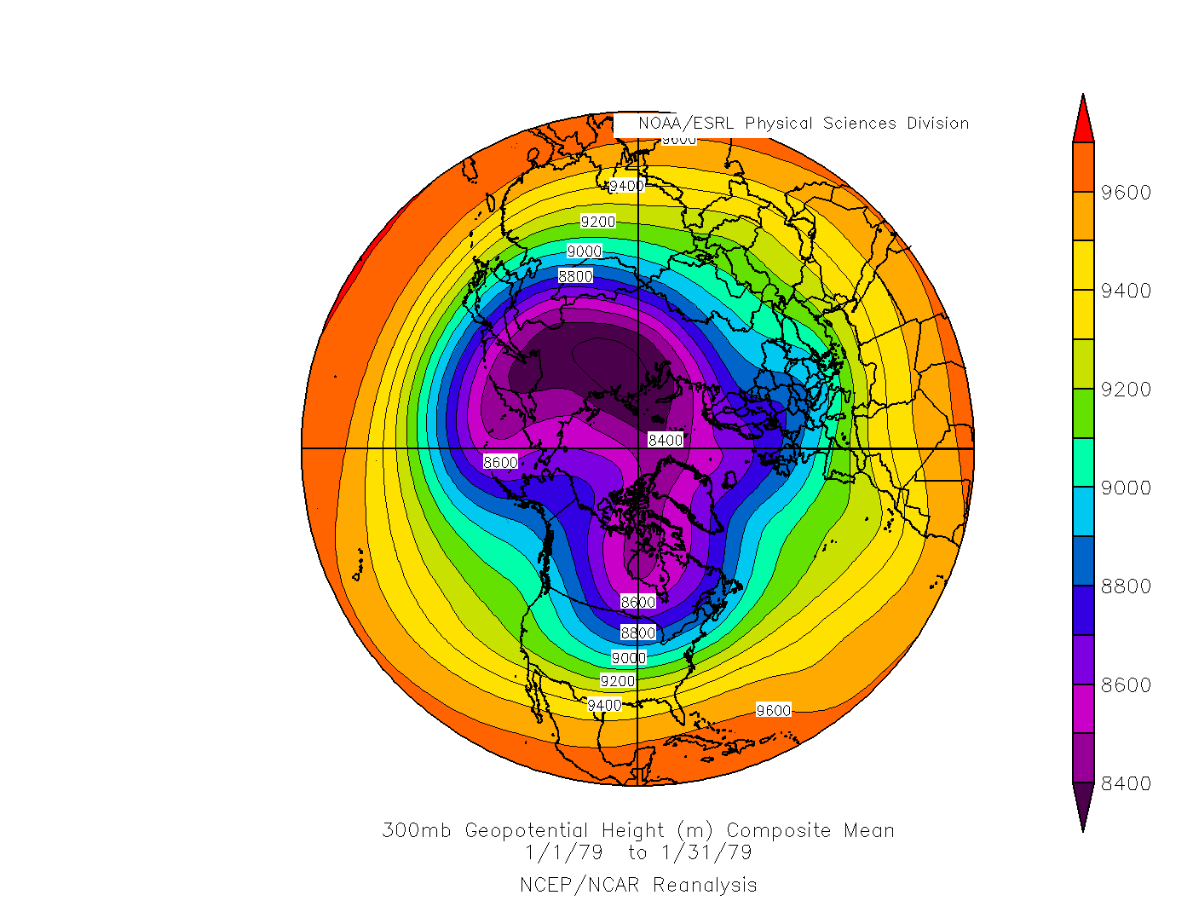

Slide 4
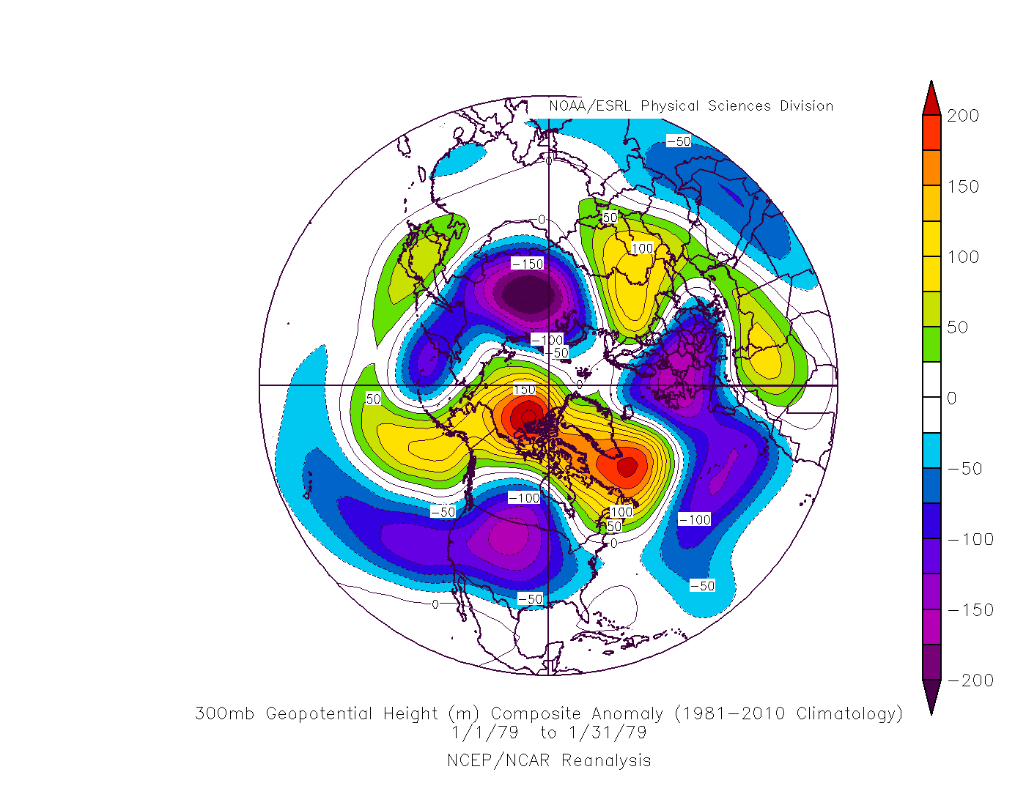

Slide 5
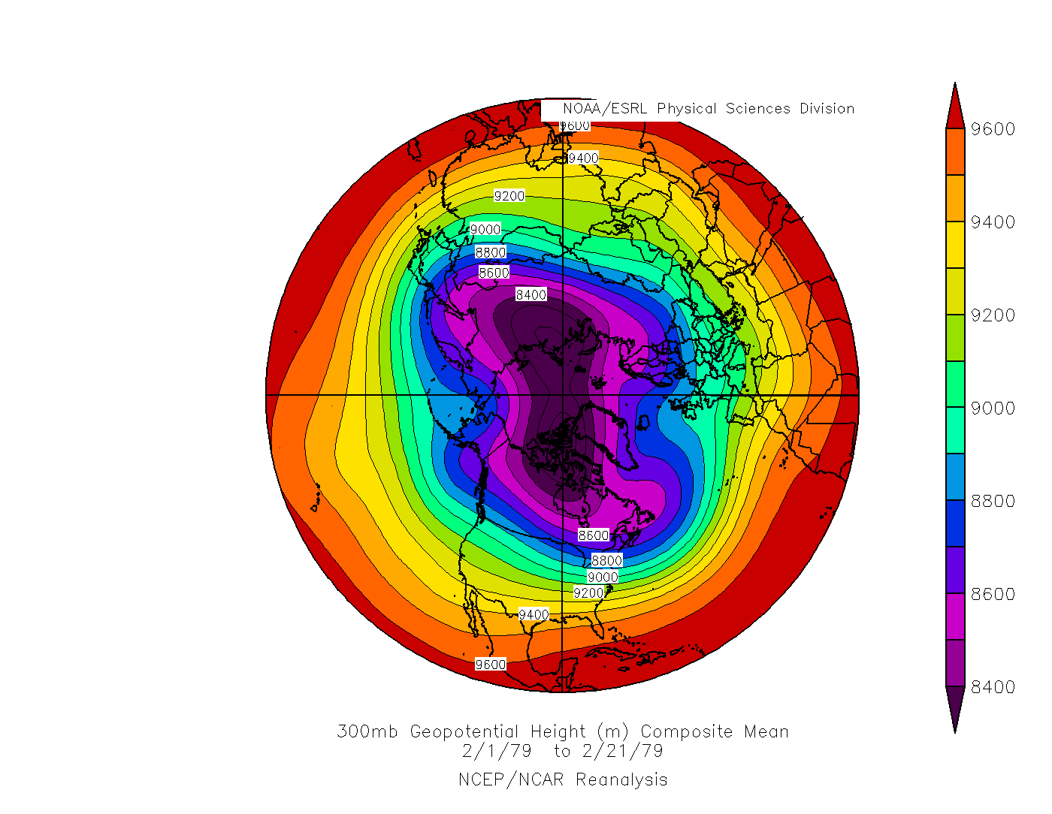

Slide 6
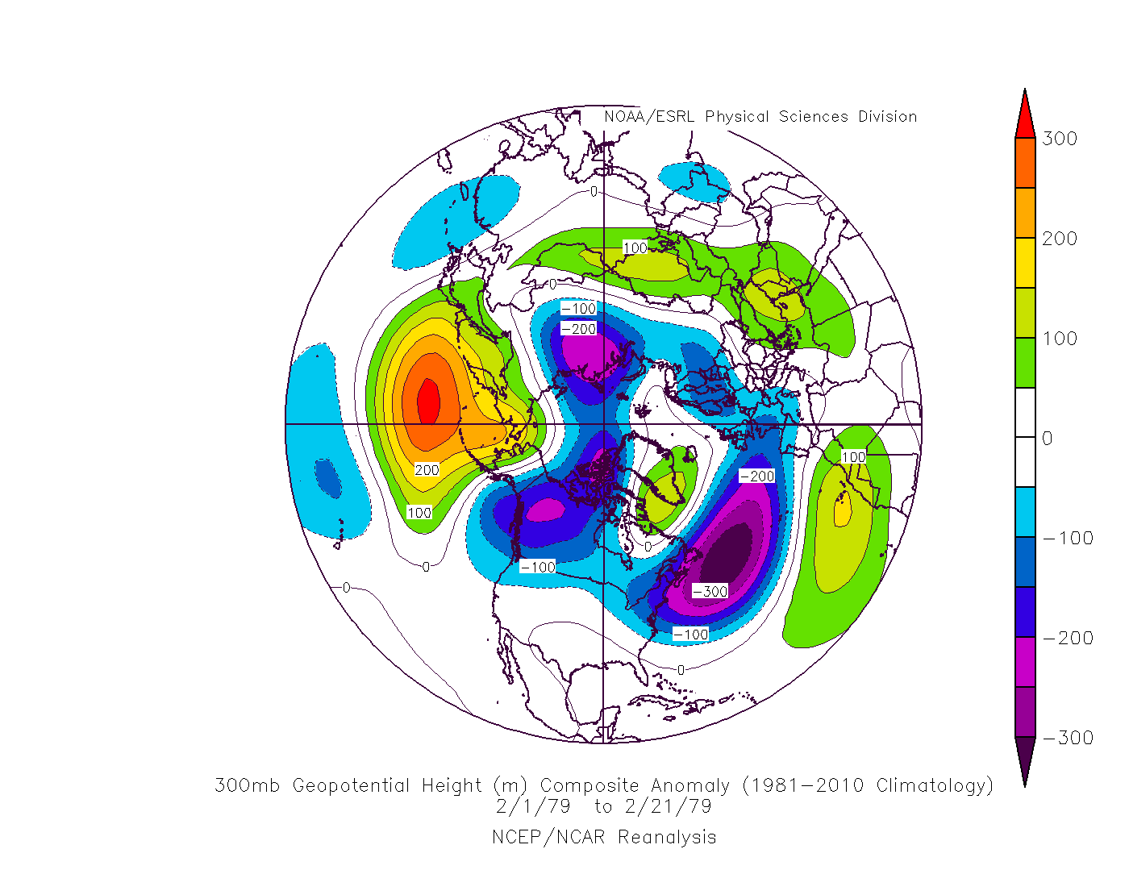

Slide 7
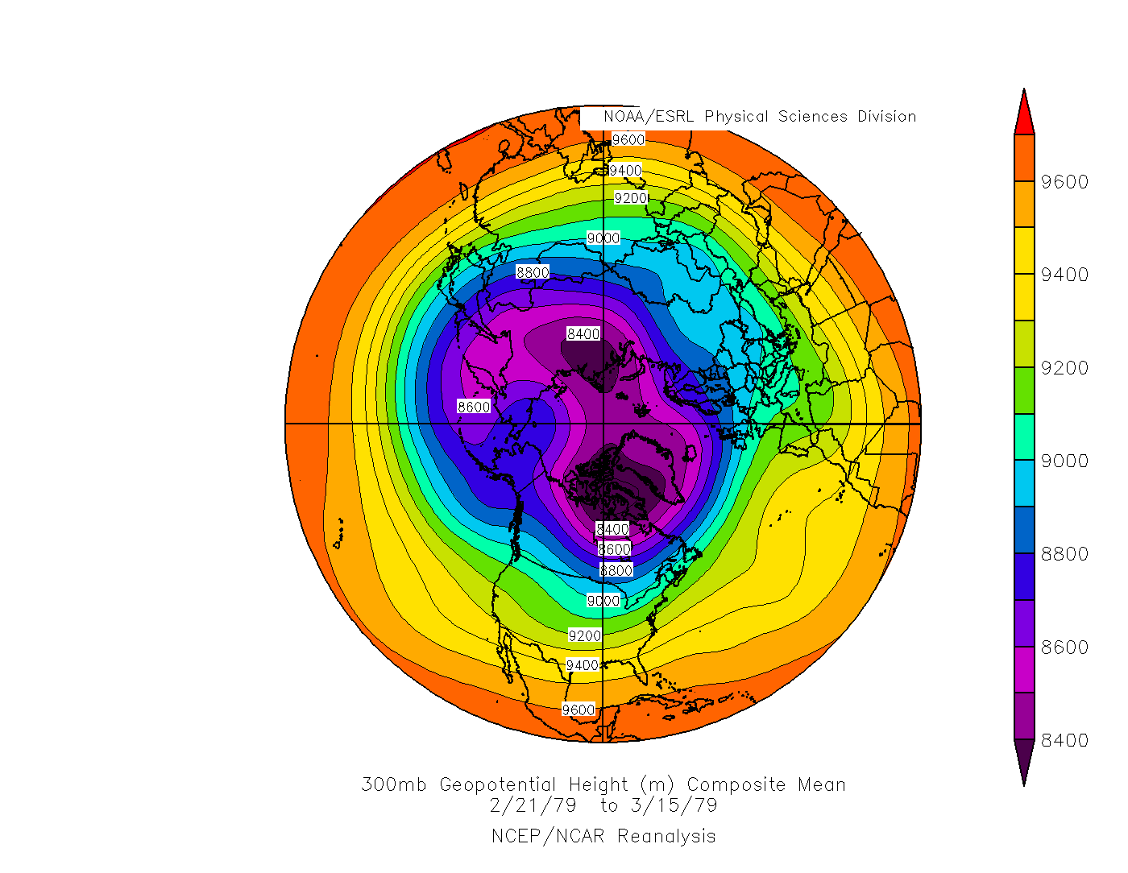

Slide 8
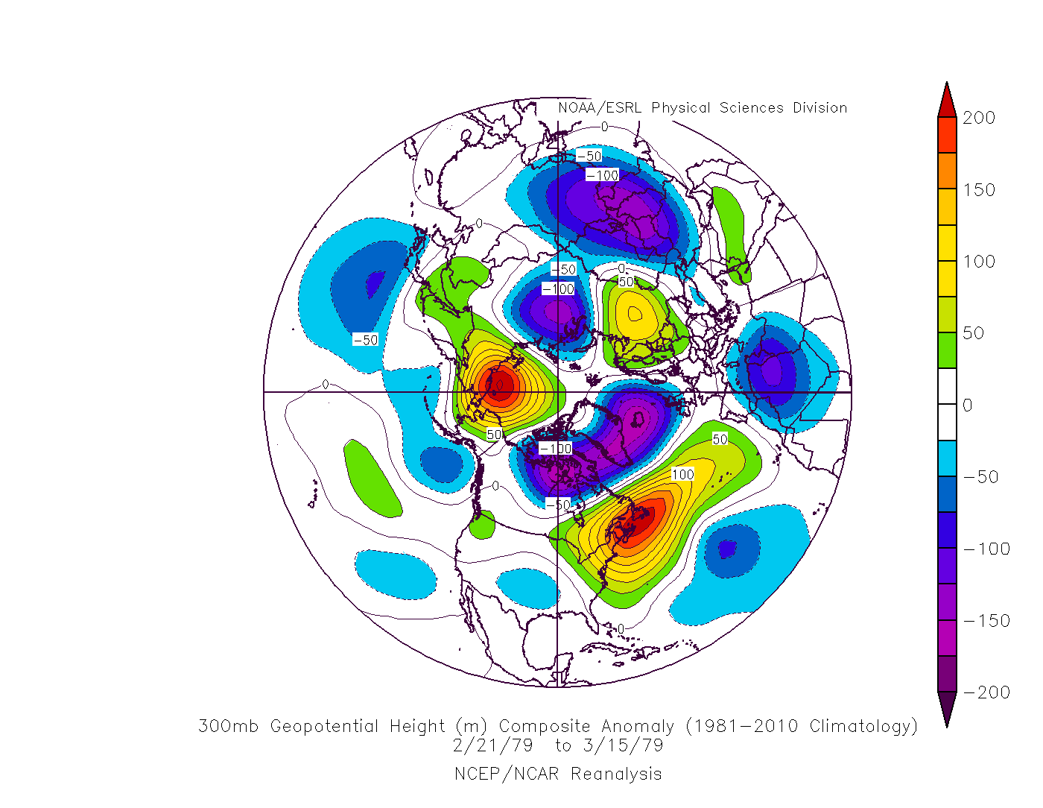

Slide 9
North American 500-hPa height and 850-hPa Temperature Patterns: 1 Jan to 15 Mar 1979

Slide 10
Mean and Anomaly 500-hPa Geopotential Heights (m): 1–31 Jan 1979

Slide 11
Mean and Anomaly 850-hPa Temperatures (°C): 1–31 Jan 1979

Slide 12
Mean and Anomaly 500-hPa Geopotential Heights (m): 1–21 Feb 1979

Slide 13
Mean and Anomaly 850-hPa Temperatures (°C): 1–21 Feb 1979

Slide 14
Mean and Anomaly 500-hPa Geopotential Heights (m): 21 Feb–15 Mar 1979

Slide 15
Mean and Anomaly 850-hPa Temperatures (°C): 21 Feb–15 Mar 1979

Slide 16
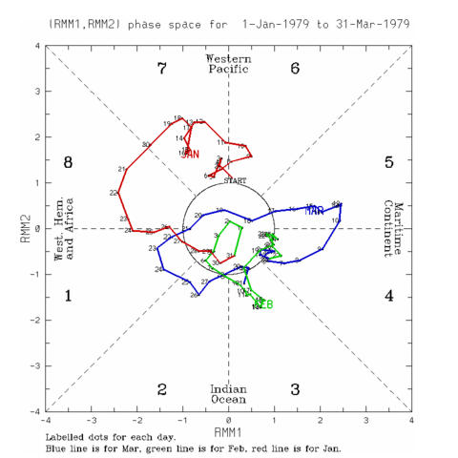

Slide 17
Teleconnection and Oceanic Nino Indices: February 1979
Pacific-North American Pattern: -1.82
North Atlantic Oscillation: -0.67
Arctic Oscillation: -0.70
Oceanic Nino Index: -0.04

