Slide 1
Divergent Circulations Associated with the
Presidents’ Day (1979) Storm
19 February 2019

Slide 2
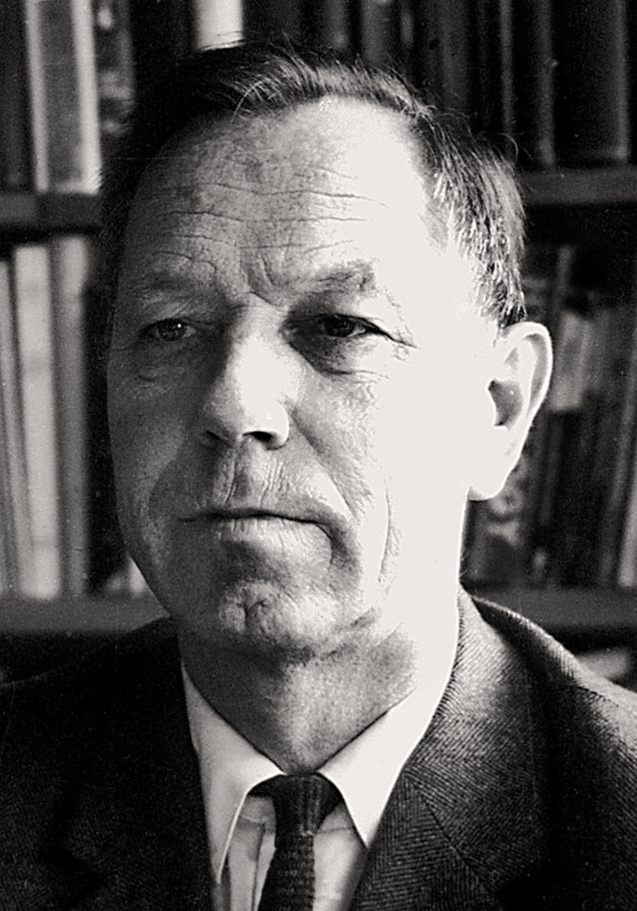
The Sawyer–Eliassen Circulation Equation
The Sawyer (1956)–Eliassen (1962) Circulation Equation provides a way to diagnose the transverse circulations associated with active fronts.
Arnt Eliassen
Norwegian Encyclopedia

Slide 3
Sawyer–Eliassen Circulation Equation
Where:
X
Y

Slide 4
Sawyer–Eliassen Circulation Equation
Where:
X
Y

Slide 5
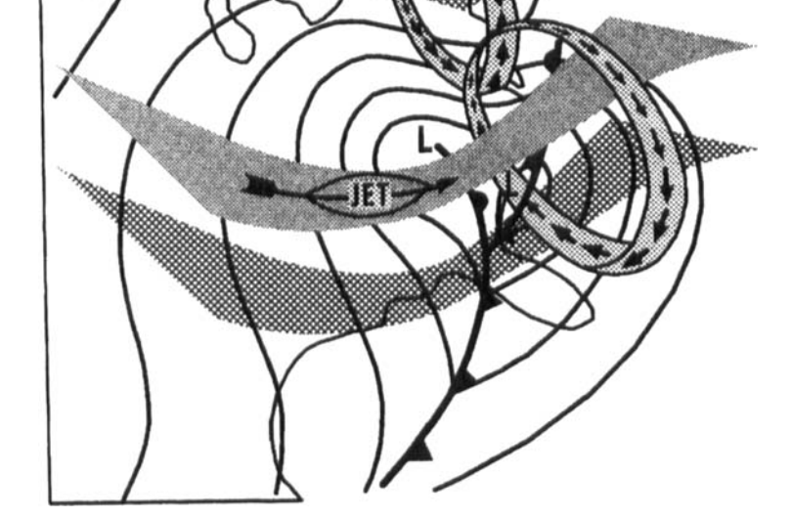
Sawyer–Eliassen Circulation Equation
Uccellini and Kocin (1987)

Slide 6
Sawyer–Eliassen Circulation Equation
Where:
X
Y

Slide 7
Sawyer–Eliassen Circulation Equation
Static Stability
Where:
X
Y

Slide 8
Sawyer–Eliassen Circulation Equation
Static Stability
Across-Front Baroclinicity
Where:
X
Y

Slide 9
Sawyer–Eliassen Circulation Equation
Static Stability
Across-Front Baroclinicity
Geo. Absolute Vorticity
Where:
X
Y

Slide 10
Sawyer–Eliassen Circulation Equation
Static Stability
Across-Front Baroclinicity
Geo. Absolute Vorticity
Frontal Characteristics
Where:
X
Y

Slide 11
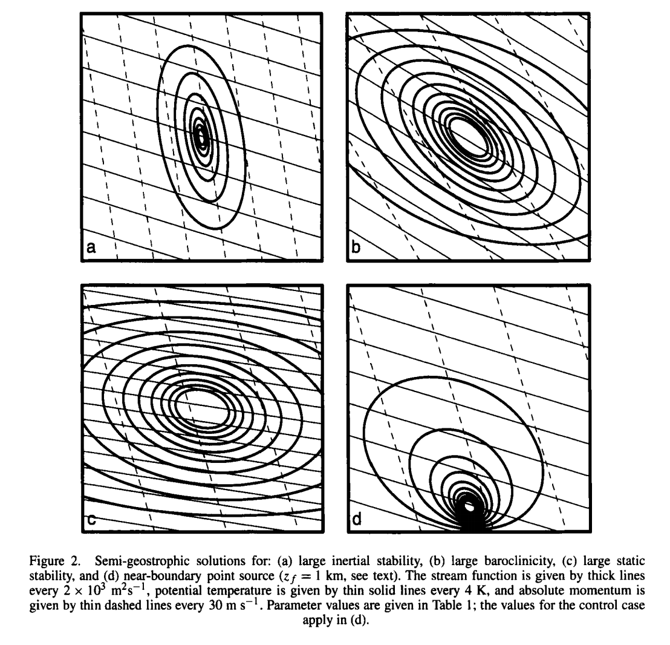
Sawyer–Eliassen Circulation Equation
Abs. Vorticity
Baroclinicity
Hakim and Keyser (2001)
How do the coefficients of the Sawyer–Eliassen Equation modulate the resultant circulation?
Static Stability
Near Boundary

Slide 12
Sawyer–Eliassen Circulation Equation
Static Stability
Across-Front Baroclinicity
Geo. Absolute Vorticity
Geostrophic and Diabatic Forcing
Frontal Characteristics
Where:
X
Y
Shearing
Confluence

Slide 13
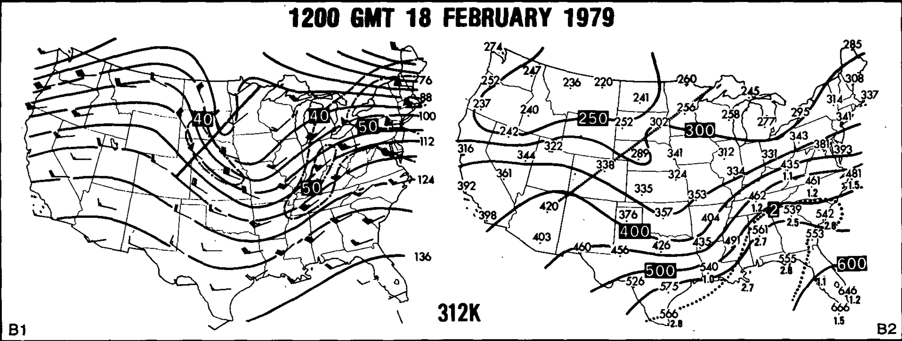
Overview –312 K Surface
A
A
A’
A’
Uccellini et al. (1985)

Slide 14
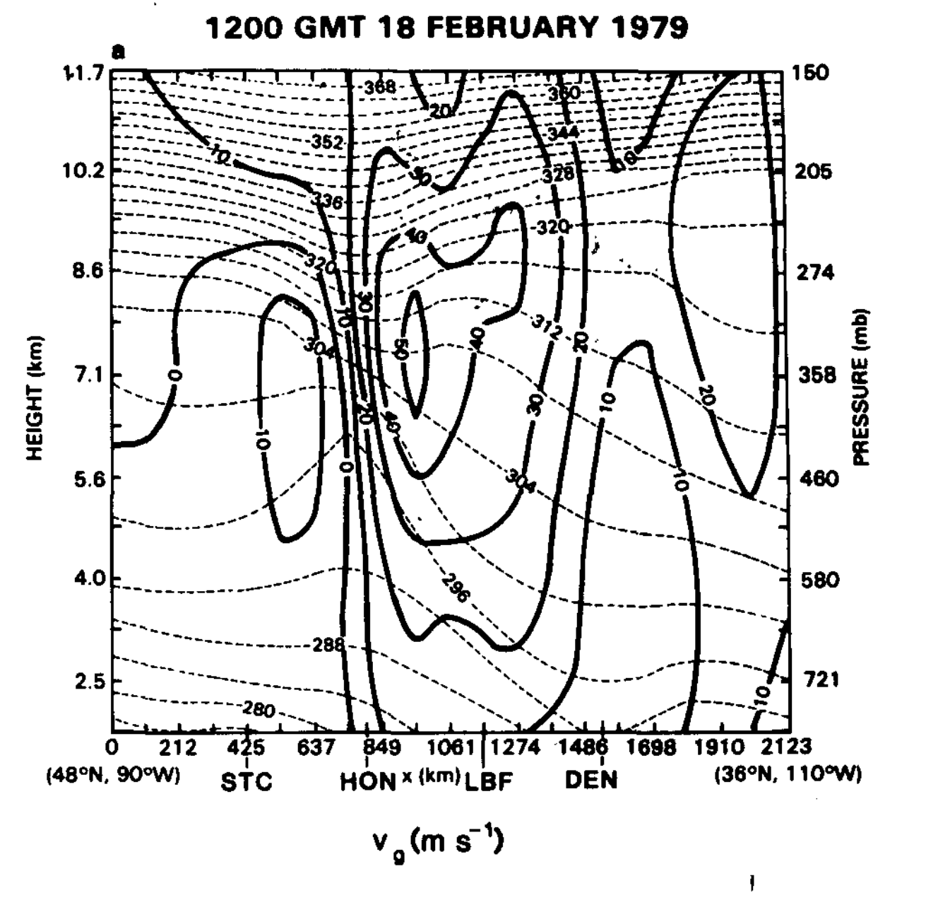
Wind Perpendicular to Cross Section
A’
CFSR
A
A
A’
Uccellini et al. (1985)

Slide 15
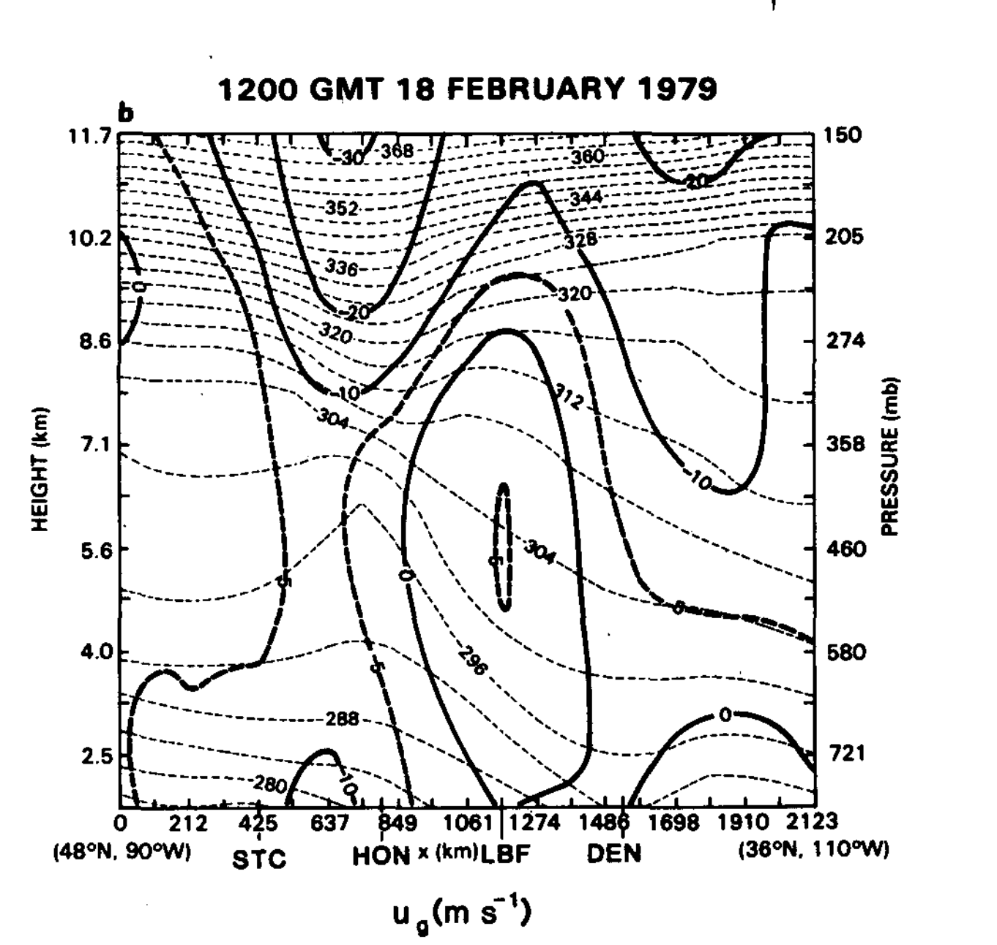
Wind Parallel to Cross Section
A’
A
A
A’
CFSR
Uccellini et al. (1985)

Slide 16
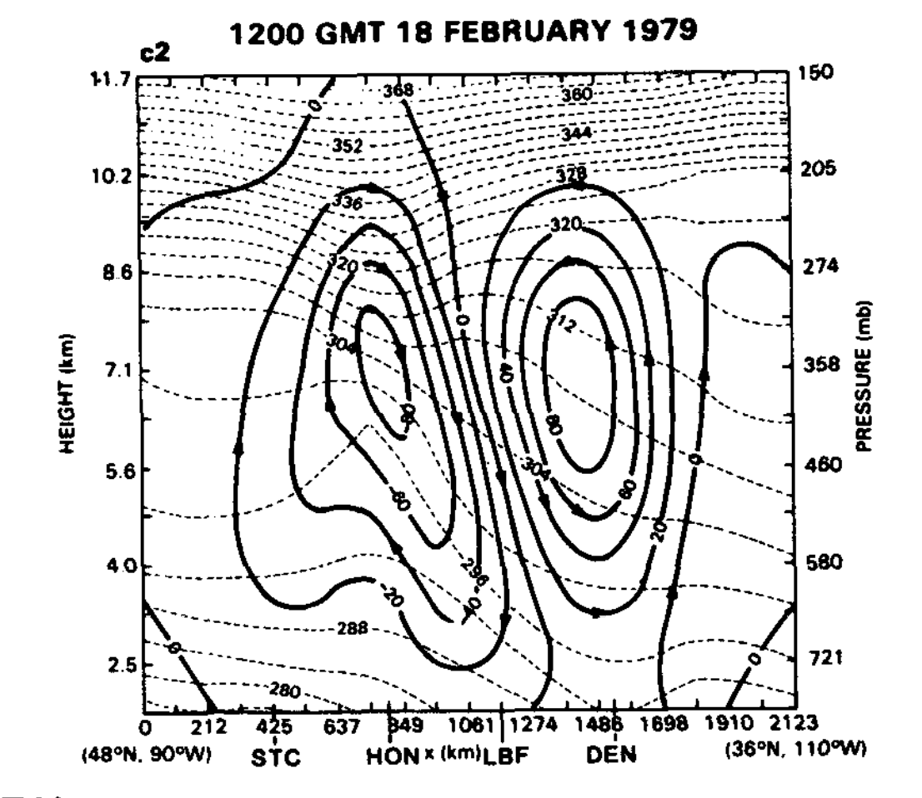
Full Sawyer–Eliassen Circulation
A’
A
A
A’
CFSR
Uccellini et al. (1985)

Slide 17
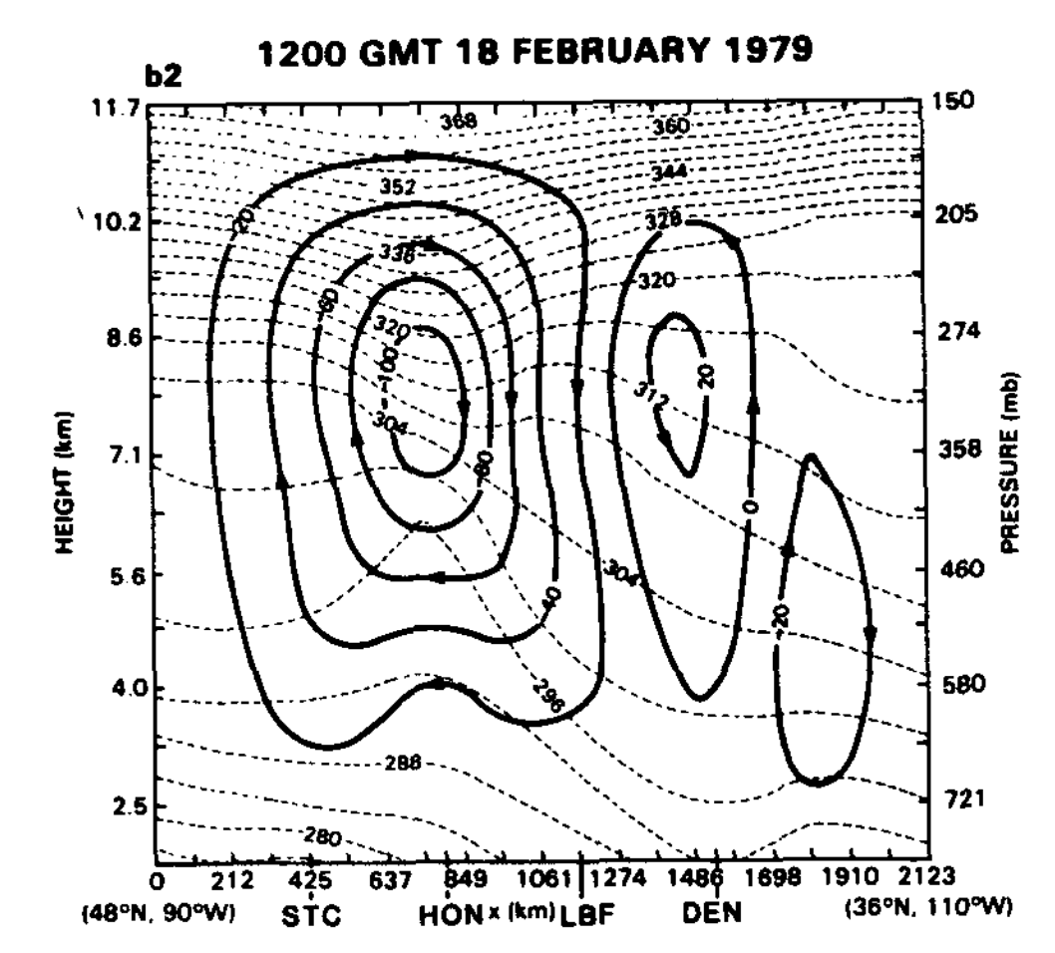
Contribution from Horizontal Shear Term
A’
A
A
A’
CFSR
Uccellini et al. (1985)

Slide 18
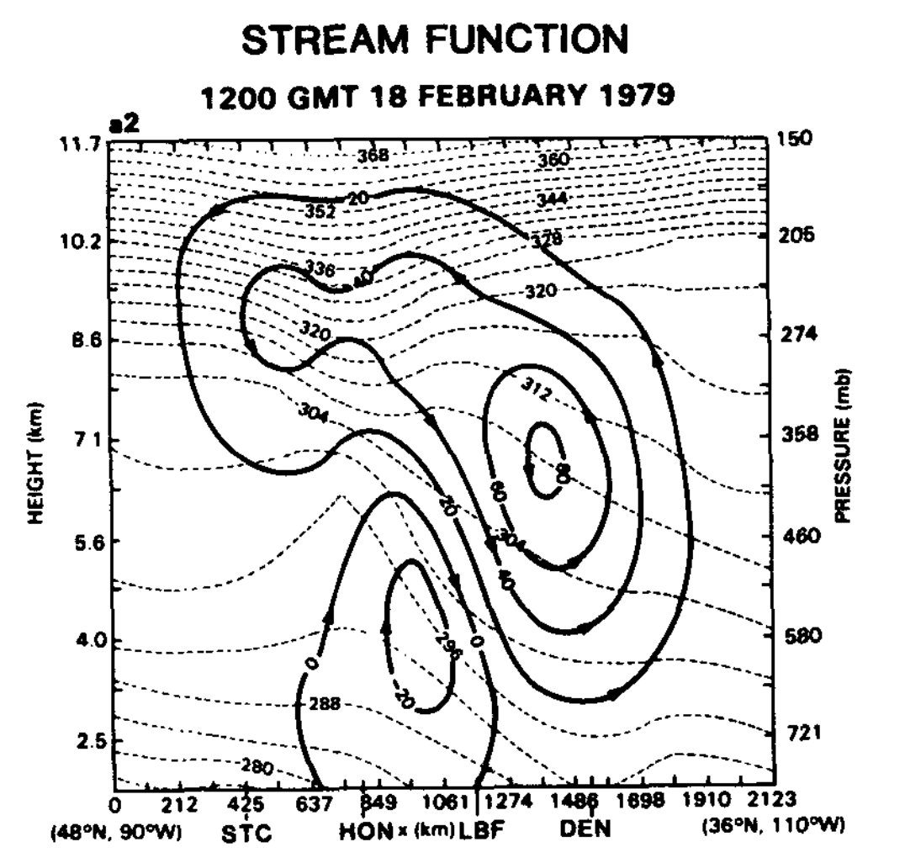
Contribution from Confluence Term
A’
A
A
A’
CFSR
Uccellini et al. (1985)

Slide 19
Full Sawyer–Eliassen Circulation
A’
A
A
A’
CFSR
Uccellini et al. (1985)

Slide 20
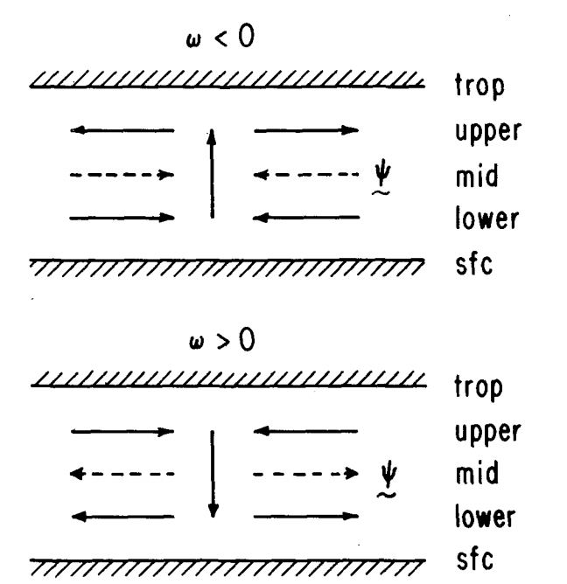

The Psi Vector
Keyser et al. (1989)

Slide 21
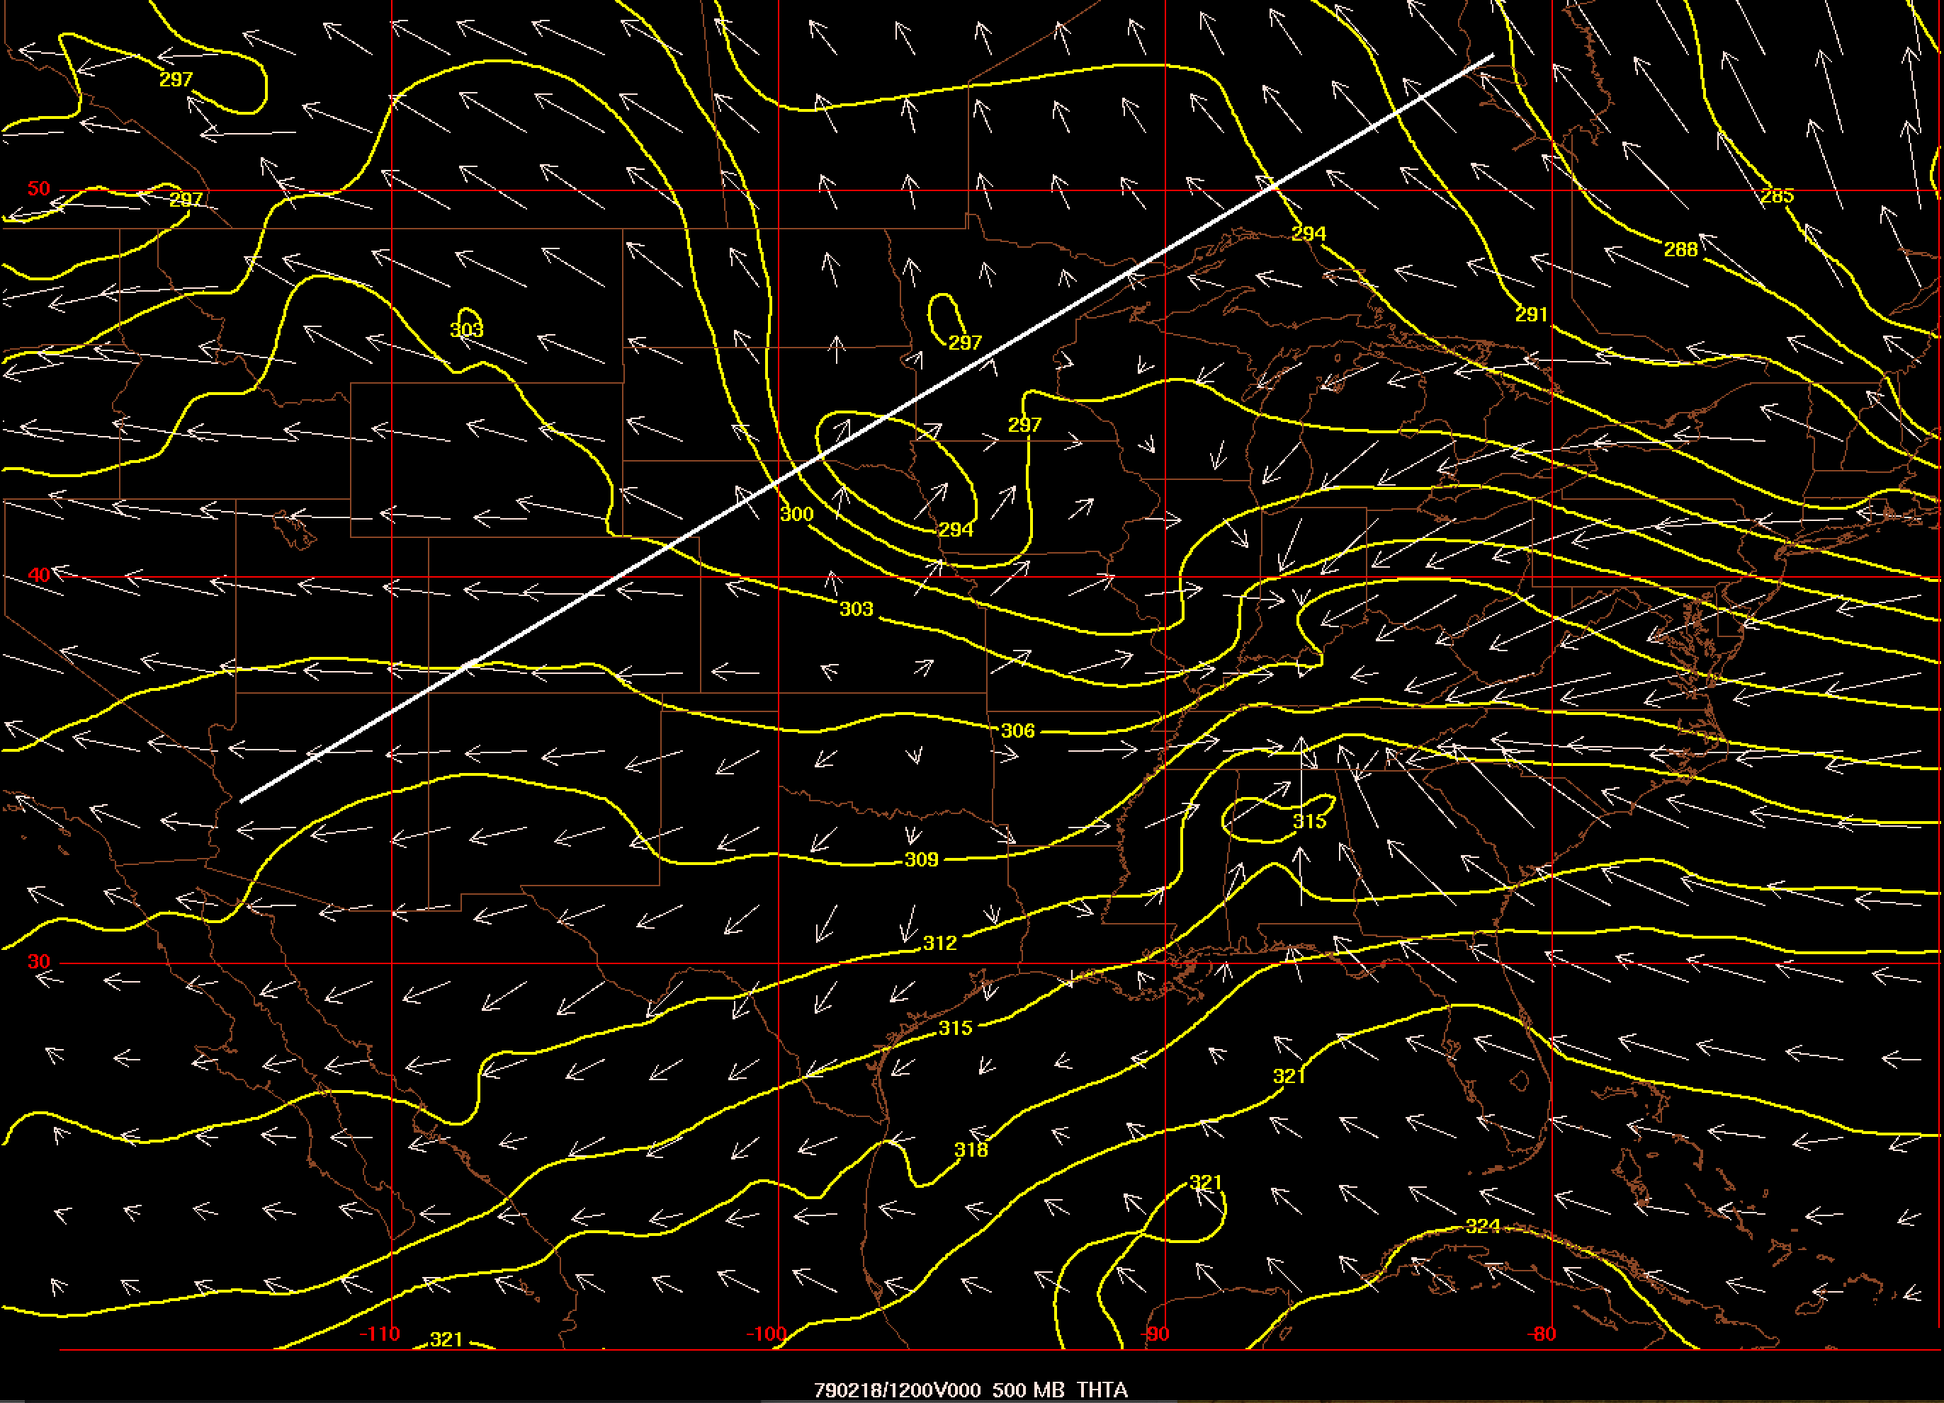
500-hPa Psi Vectors – 12Z 18 Feb 1979

Slide 22
References
Eliassen, A., 1962: On the vertical circulation in frontal zones. Geophys. Publ., 24, 147-160.
Hakim, G. J., and D. Keyser, 2001: Canonical frontal circulation patterns in terms of Green’s functions for the Sawyer–Eliassen equation. Quart. J. Roy. Meteor. Soc., 127, 1795–1814.
Keyser, D., B. D. Schmidt, and D. G. Duffy, 1989: A technique for representing three-dimensional vertical circulations in baroclinic disturbances. Mon. Wea. Rev., 117, 2463–2494.
Sawyer, J. S., 1956: The vertical circulation at meteorological fronts and its relation to frontogenesis. Proc. Roy. Soc. London, 234A, 346-362.
Uccellini, L. W., D. Keyser, K. F. Brill, and C. H. Wash, 1985: The Presidents’ Day cyclone of 18-19 February 1979: Influence of upstream trough amplification and associated tropopause folding on rapid cyclogenesis. Mon. Wea. Rev., 113, 962-988.
________, and P. J. Kocin, 1987: The interaction of jet streak circulations during heavy snow events along the East Coast of the United States. Wea. Forecasting, 2, 289-308.

