Slide 1
Reflecting on the Presidents’ Day Storm
18-19 February 1979
Dr. Louis W. Uccellini
Director, National Weather Service
NOAA Assistant Administrator for Weather Services
February 19, 2018
University of Albany

Slide 2
Outline
Overview of the Presidents’ Day Snowstorm
Forecast Failures Launched the Community to Address Cyclone Research and Forecast Challenges
After the Storm – A Rebirth of Synoptic Meteorology
– A Surge in Mesoscale Model Development
and Research Applications
Opportunities/Challenges
Summary
Appendix A: References
Appendix B: We Have Made a Difference: The Jan 2016 Northeast Blizzard
Appendix C: Telephone Interview. 23 February 1979
First Vis 5D of Tropopause Fold Influence on Pres. Day Storm 1979

Slide 3
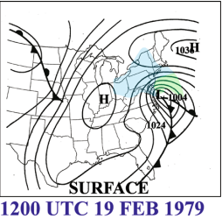
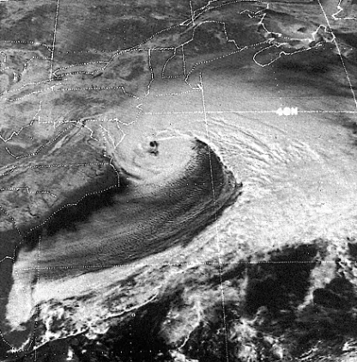
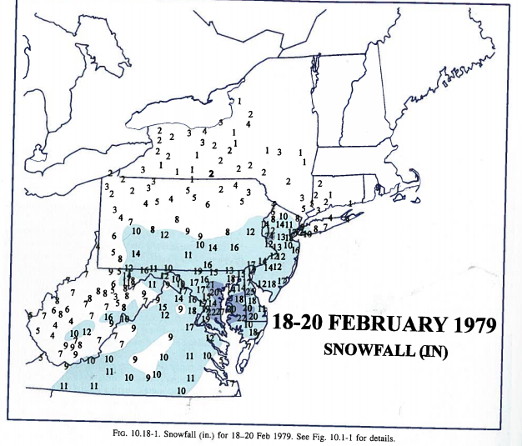
Presidents’ Day Snowstorm:
18-19 February 1979
Kocin and Uccellini, “Northeast Snowstorms”, Vol. II, pp 506-508

Slide 4
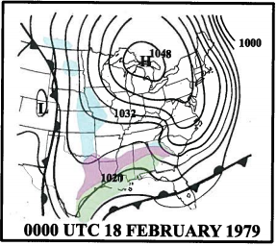
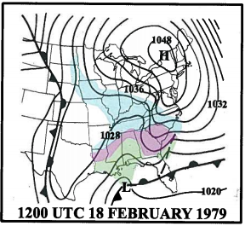
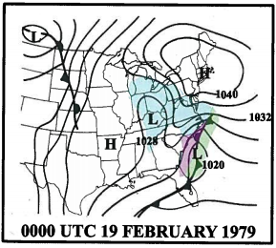
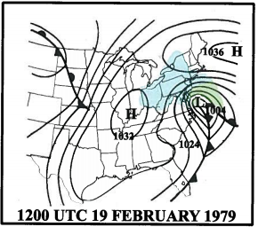
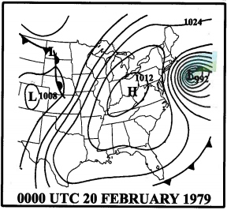
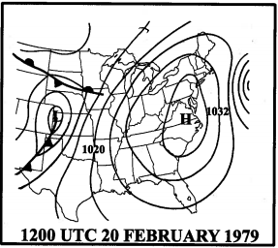
Presidents’ Day Snowstorm:
18-19 February 1979
A
B
C
D
E
F
Kocin and Uccellini, “Northeast Snowstorms”, Vol. II, p 507

Slide 5
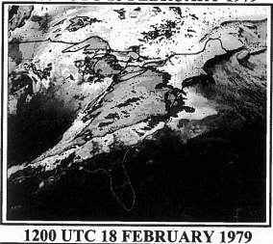
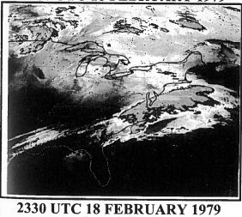
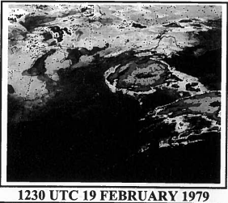
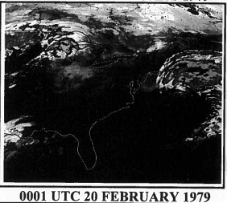
Presidents’ Day Snowstorm:
18-19 February 1979 - Satellite Images
A
B
C
D
Kocin and Uccellini, “Northeast Snowstorms”, Vol. II, p 511
Notes:
7-Level Model
Did not use significant level, radiosonde, satellite or boundary layer.

Slide 6
18-19 February 1979
Mid-Atlantic experienced 2 periods of cold, heavy snow.
Heavy snow warnings – posted early morning of 18 Feb.
During the day of 18 February, 4 to 7” of snow fell, associated with developing coastal front
Snow stopped in the Washington DC area about 00Z 19 February
  Heavy snow warning taken down before midnight
Early morning of 19 February 18”-20” of snow fell in DC area
4 to 5” of snow fell per hour for 3 hours just before sunrise.

Slide 7
The Presidents’ Day Storm
Motivated the Community!
The Magnitude of the Event
The “Forcing” Debate
  Low Level vs. Upper Level
  Diabatic vs. Adiabatic
The Operational Model Failures
Cyclone Workshop Initiated by NSF/Ron Taylor
  (Donald R. Johnson; Peter Hobbs – Principal Investigators)
Notes:
7-Level Model
Did not use significant level, radiosonde, satellite or boundary layer.

Slide 8
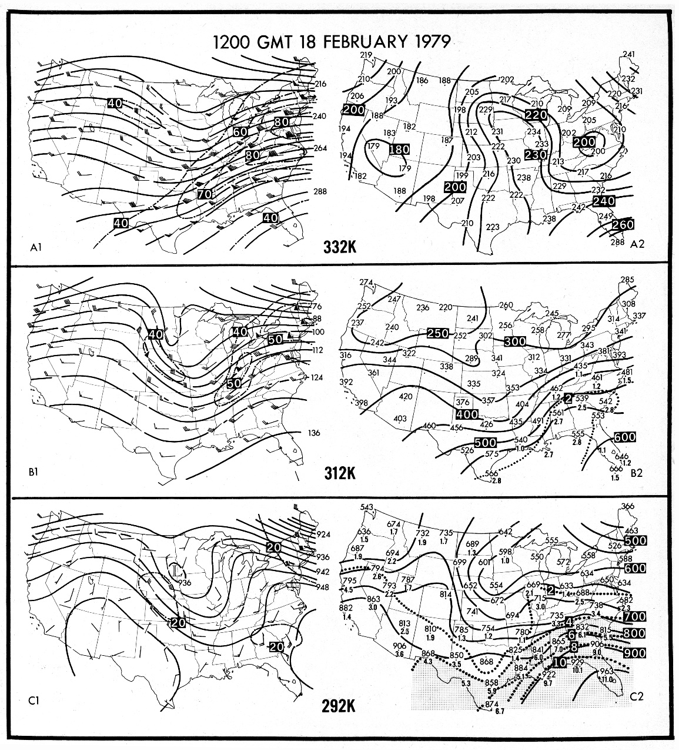
Upper Air
Phase 1
18 February 1979
Major upper-level feature: 80 m/s STJ
amplifies over East Coast as coastal front/LLJ forms

Slide 9
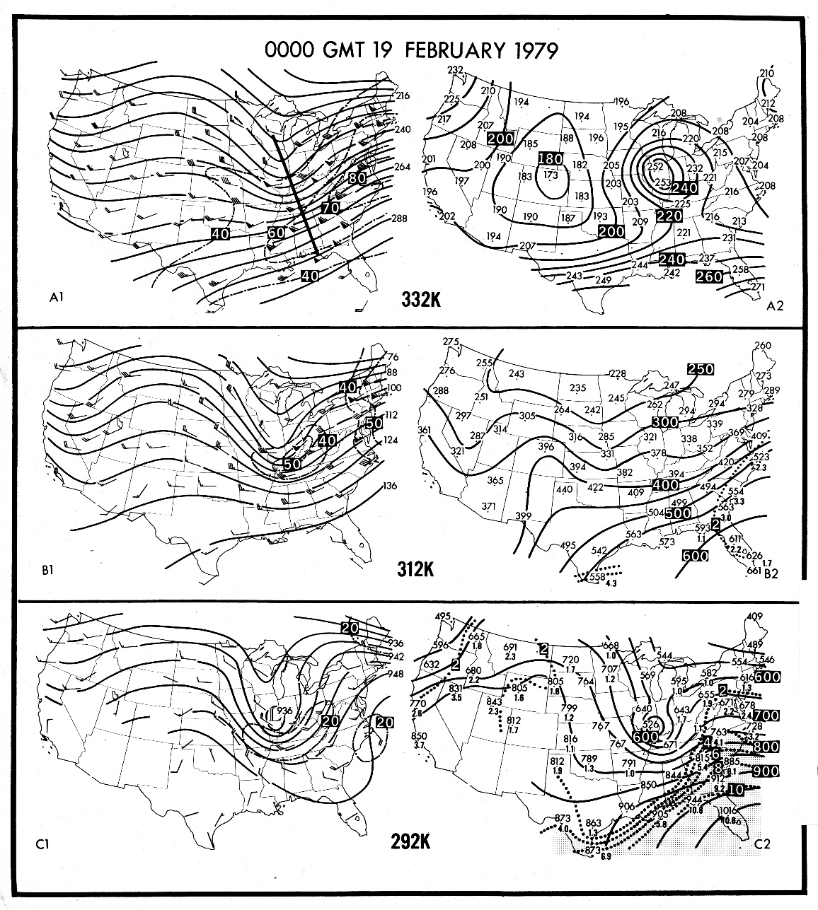
Upper Air
Phase 2
19 February 1979
Major upper-level feature: amplifying trough; PFJ preceding rapid cyclogenesis

Slide 10
The “Forcing” Debate

Slide 11
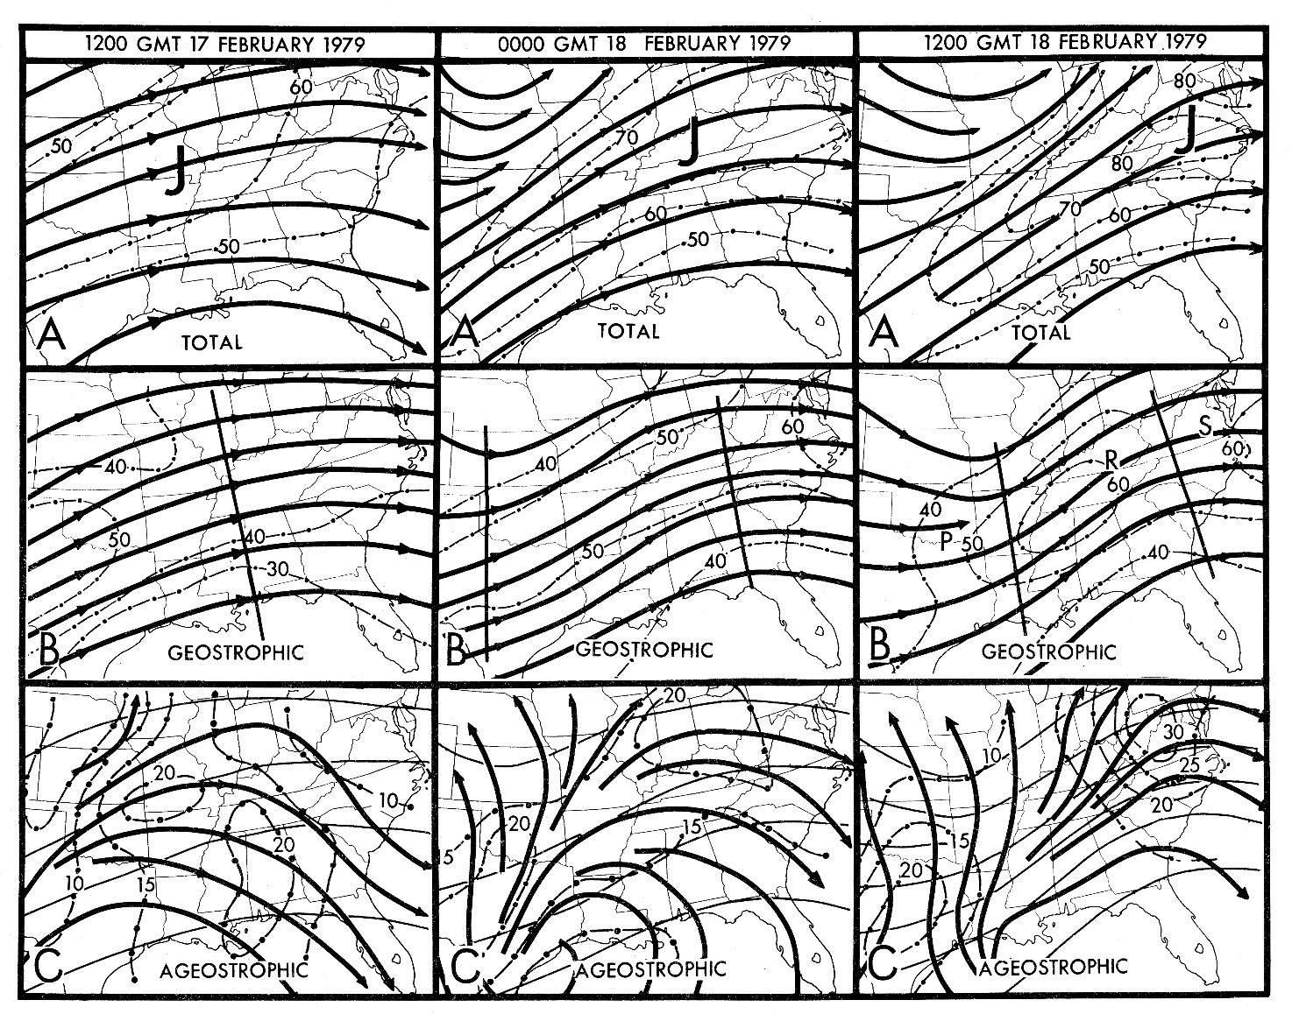
Presidents Day Storm
18-19 February 1979 – Phase 1
The STJ — amplifies to
80 m/s with decreasing
wave length between
trough-ridge couplet
Upper level forcing
related to unbalanced
flow

Slide 12
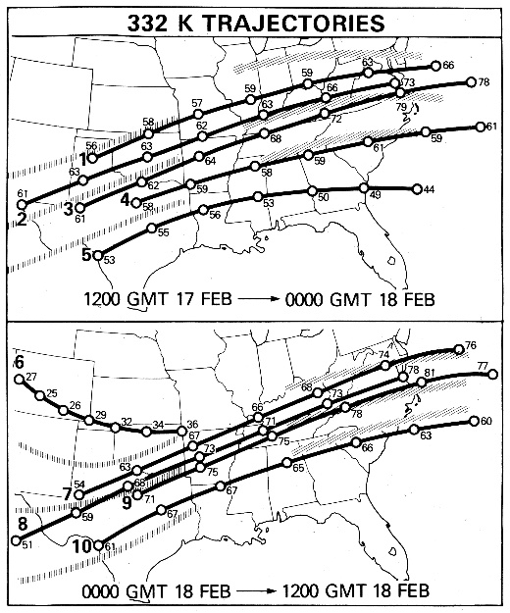
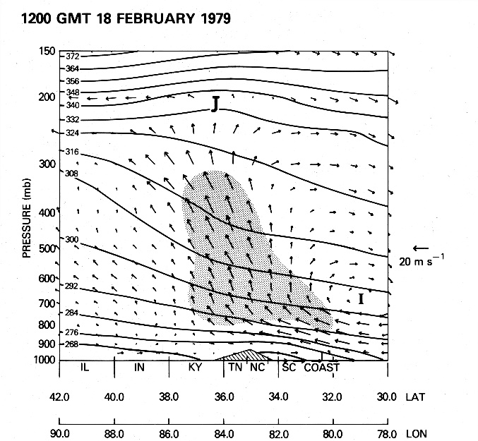
Presidents Day Storm
18-19 February 1979 – Phase 1
Precyclogenetic Stage (18 February)
  Inverted trough—coastal front forms along Carolina Coast
  Record-breaking cold in precyclogenetic environment ensured snowfall across wide swath in Mid-Atlantic
  Anticyclonic STJ—coupled LLJ within indirect circulation/above coastal
  front – Provided divergence aloft/low-level moisture flux for heavy snow
  Lower level forcing; sensible heat off the ocean
Parcels accelerate through ridge crest along East Coast
Vertical cross section of potential temperature (contour interval 8 K, solid) at 1200 UTC 18 February 1979 and vector representation of ageostrophic indirect (I) circulation derived from the objective analysis scheme. Cross section derived along rhumb line illustrated in Fig. 2b. shading indicates region where ascent is greater than -6 μb/s. Scale for magnitudes of horizontal component shown on right. J indicates position of core of subtropical jet streak. No inferences should be made from this figure concerning the extent of cross-isentropic flow within the two-dimensional plane of the cross section, given that only the horizontal ageostrophic wind (and not the total wind) is used in this representation of the circulation.

Slide 13
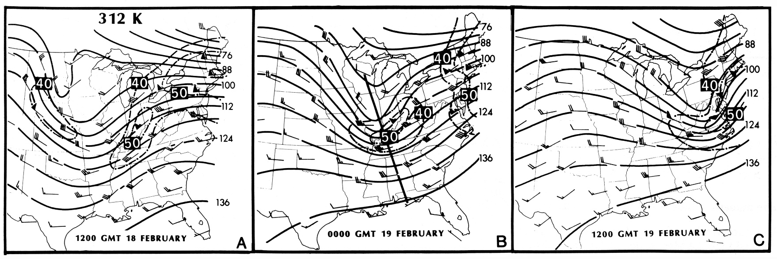
Presidents Day Storm
18-19 February 1979 – Phase 2
Rapid Development Phase (19 February)
  PFJ/Digging Trough approaches East Coast/coastal front
  Tropopause fold prior to and upstream of rapid cyclogenesis
  Heaviest snow fell in Mid-Atlantic Region, associated with rapid cyclogenesis 4"-5"/hr
  Heavy snow on 19 February occurred AFTER warnings were dropped late on 18 February; rapid cyclogenesis not predicted!
  An example of the mesoscale influencing (forcing?) the synoptic scale

Slide 14
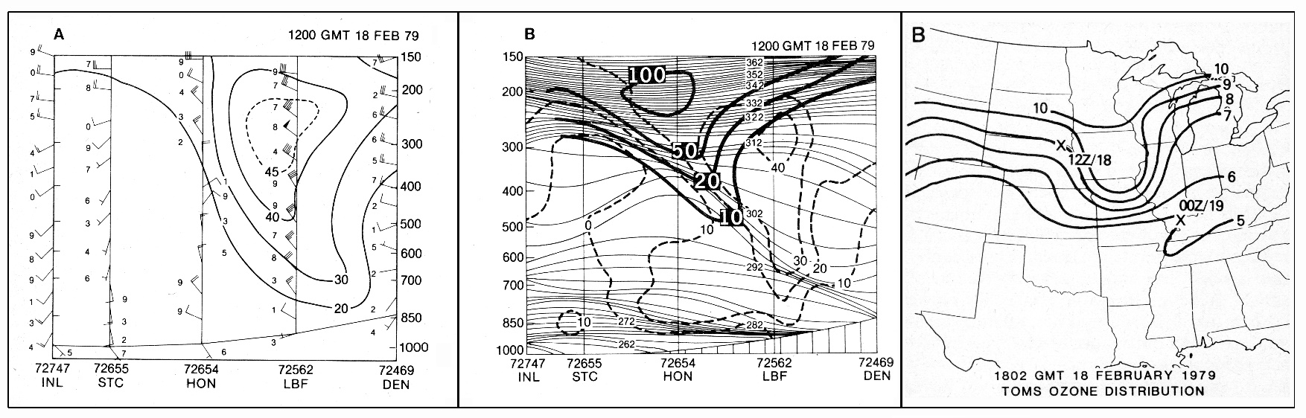
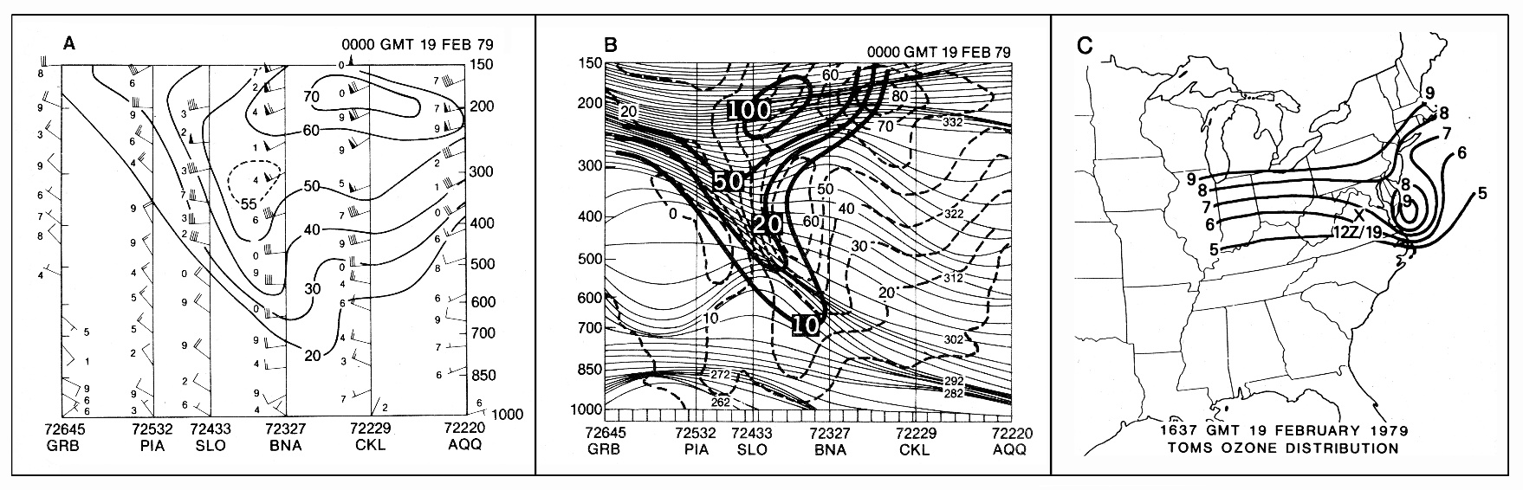
Presidents Day Storm
18-19 February 1979 – Phase 2
Tropopause fold upstream and preceding rapid cyclogenesis

Slide 15
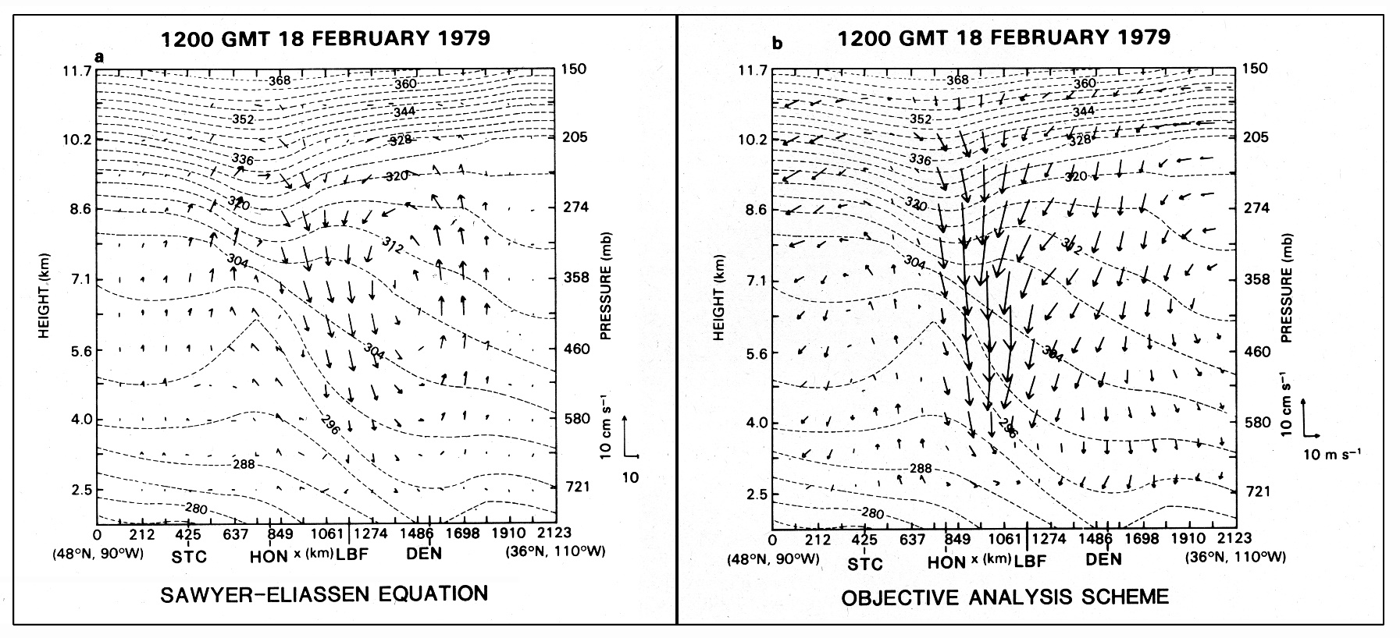
Presidents Day Storm
18-19 February 1979 – Phase 2
First application of Sawyer-Eliassen Equation with actual data
Transverse circulation/tropopause fold prior to cyclogenesis
The Norm Phillips question to Mel Shapiro at the first cyclone workshop: “Why
should we care about this – after all, we simulate cyclogenesis with 2 layer models.”
(Norm loved to provoke…)

Slide 16
Operation Model Failure
Models failed to predict the rapid cyclogenesis on 19 Feb.
MRF/LFM PE LFM
  Horizontal Resolution 190.5km 127 km
  Vertical Levels ___7___ __7___
  Essentially no boundary layer _______ ______
Primary data Source: RAOB data/SFC data
  No significant level data; no satellite data
Research Community Reaction
  Enough Is Enough!
  Cyclone Workshop energized

Slide 17
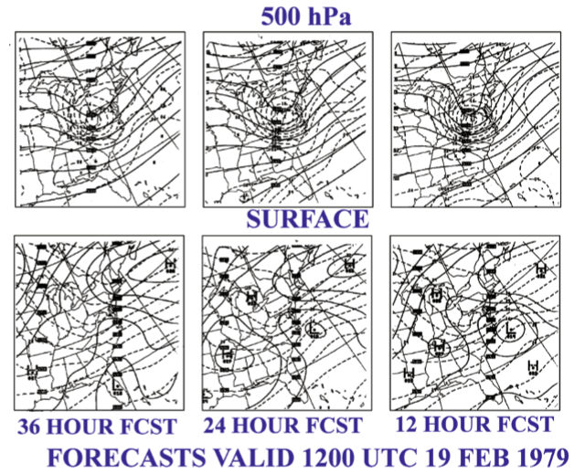
Second Phase of Presidents’ Day Storm Not Predicted
Kocin and Uccellini, “Northeast Snowstorms”, Vol. I, p 242
Notes:
7-Level Model
Did not use significant level, radiosonde, satellite or boundary layer.

Slide 18
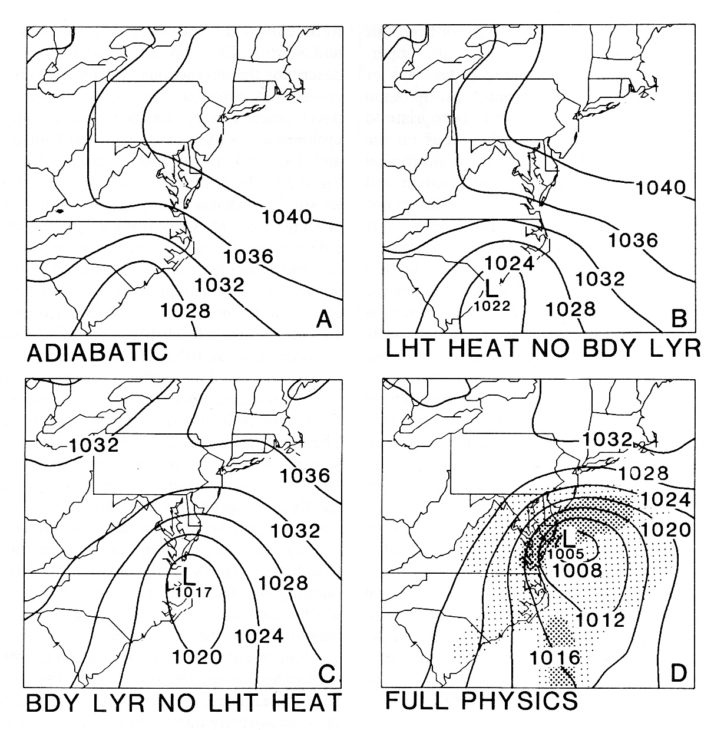
Research Model Sensitivity Studies: Synergistic Interactions (dynamics, LHT, BDY layer) required for rapid cyclogenesis
Process contributing to the rapid development of extratropical cyclones

Slide 19
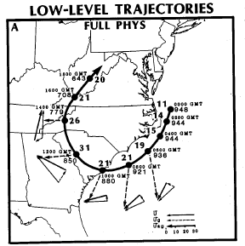
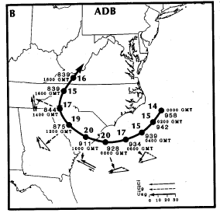
Research Models with 15 Minute Output Used to Compute Low Level Trajectories
Uccellini et al., 1987

Slide 20
Research Model Low Level Trajectories
Rapid Development of LLJ & Associated Ageostrophic Component
I
III
0900 GMT
1100 GMT
II
IV
1000 GMT
1200 GMT

Slide 21

Total Mass Divergence
LLJ → focused area of low-level mass divergence in area of inverted trough
I
III
06Z
09Z
12Z
15Z
18Z
21Z
06Z
09Z
12Z
15Z
18Z
21Z
II
IV
06Z
09Z
12Z
15Z
18Z
21Z
06Z
09Z
12Z
15Z
18Z
21Z
Uccellini, et al., 1987

Slide 22
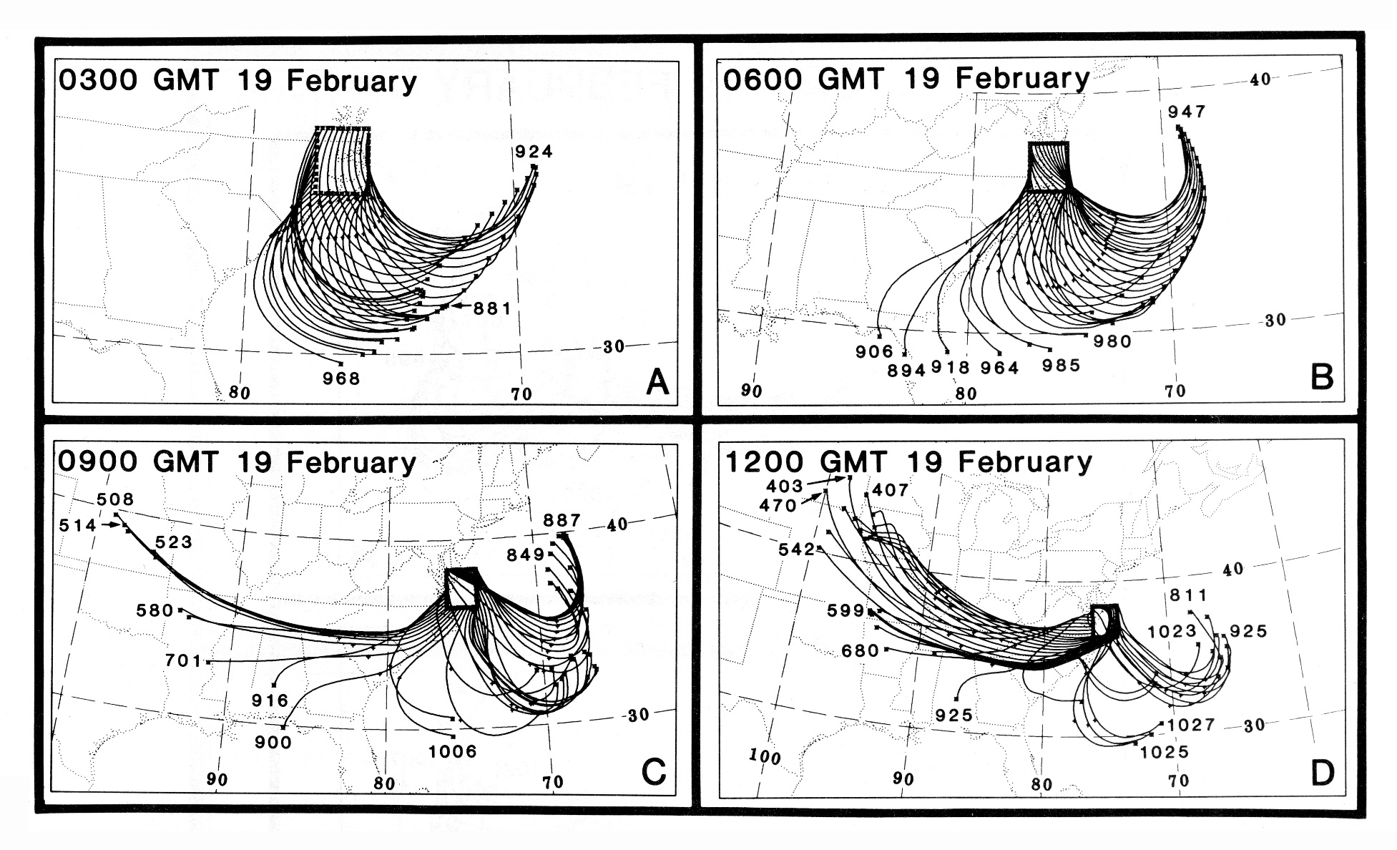
Flow through cyclone, Whittaker et al.

Slide 23
Mass Divergence Profiles
Whittaker, et al., 1988

Slide 24
Mass Divergence Profiles
Whittaker, et al., 1988

Slide 25
3D Perspective of the Presidents’ Day Storm: 18-19 February
Hibbard, et al.,
1989

Slide 26
Research Results from the GSFC Team (Uccellini, Kocin, Keyser, Brill, Whittaker, Petersen, Wash)
Unbalanced flow through STJ provided vertical circulation pattern for first phase of heavy snowfall – QG “restoration” of Geostrophic and hydrostatic balances not at play during the phase I.
LLJ developed rapidly within 3 hrs. above coastal front/within indirect circulation (related to unbalanced STJ) provided moisture flux for heavy snow
LLJ development related to vertical parcel displacement within indirect circulation (confirming importance of vertical displacement on horizontal acceleration – Newton, 1954 J. Meteor)
Tropopause Fold preceded and contributed to rapid cyclogenesis in phase II “synoptic” development forced by mesoscale circulation patterns
______________________________________________________
Research Model Studies
  Confirming synergistic interaction among latent sensible heating, and adiabatic/dynamic is essential
  Trajectories: complex forcing/yet coherent flow through developing cyclone
  L. Bosart, R. Atlas and others focus on its boundary layer forcing, an important component for the initial and rapid development phases of this storm

Slide 27
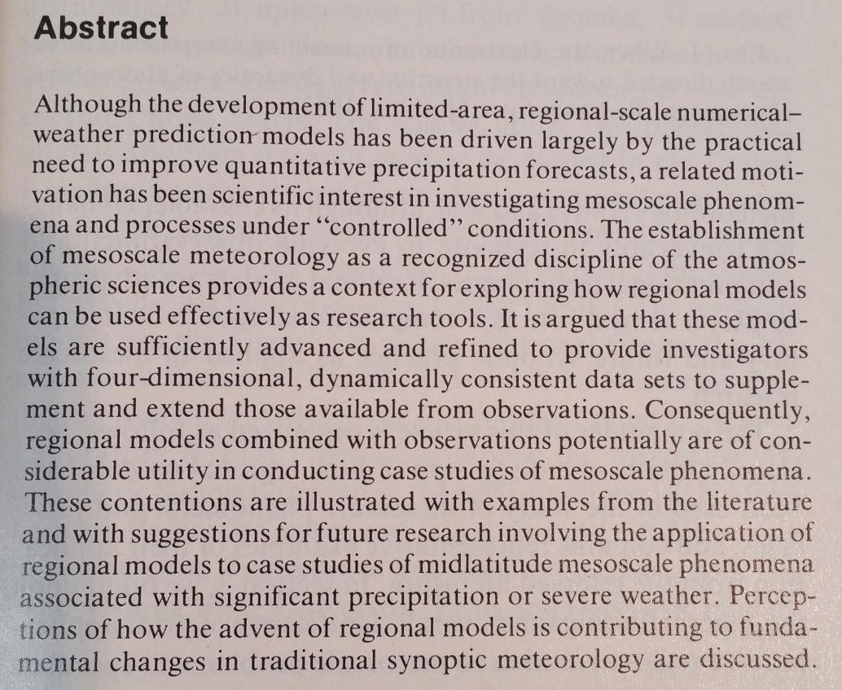
After the Storm – A Rebirth of Synoptic Meteorology
(Keyser and Uccellini, 1987)
Bottom Line: Regional-Mesoscale models based on hydrostatic and non-hydrostatic system of “primitive equations” can be used for cause and effect “synoptic” – diagnostic studies
Keyser, D and L.W. Uccellini; 1987: Regional Models: Emerging Research Tools for Synoptic Meteorologists. BAMS, 68, pp 306-320

Slide 28
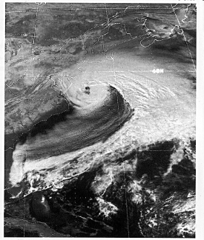
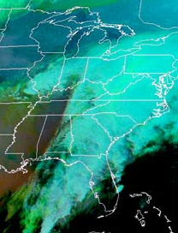

Comparison
1979 and 2003 Storms
Presidents’ Day Storm I
February 18-19, 1979
Presidents’ Day Storm II
February 16-17, 2003
Top 5 storm for DC snowfall
S++ with rapid cyclogenesis
Major amplifying trough – moisture feed from Atlantic
Not forecast even 6 hours in advance; major data feed into models → RAOB – standard levels only, no satellite data
Years spent collecting, plotting, analyzing data
Major effort by research community; synoptic-mesoscale studies, model enhancements
  - “Bosart vs Uccellini” “Low level vs
  Upper level” – we met in the middle!
Total snowfall record for
Baltimore
S++ preceded cyclogenesis
Near constant trough amplitude - moisture feed from the tropics
Forecast 5,4,3 days in advance – AMS conference attendees change plans to get back home in time for this event
“Data” related to this analysis/model put together in weeks (Grumm)
Very little research; no case studies nor model enhancements

Slide 29
Summary
What I learned? –
  Everything was on the table for unraveling the mysteries, upper & lower level dynamics – thermodynamics – balance constraints - unbalanced flow.
  Synoptic meteorology is not dead – this case drove the research community and the operational communities to work together to everyone’s benefit (O2R accelerates R2O).
  Snowstorms are mesoscale events cloaked in synoptic scale lore.
  The “time” rate of change related to development/cyclogenesis from minutes to hours should inform us of the balance/imbalance assumptions being made to understand what is really going on – (more “imbalance” please including gravity waves!).
  There is just as much joy in learning about how these storms develop as there is experiencing them – with Lance Bosart being your teacher – you already know that.

Slide 30


THANK YOU!

Slide 31
Appendix: A
References
Uccellini, L.W., P.J. Kocin, R.A. Petersen, C.H. Wash, and K.F. Brill, 1984: The Presidents’ Day cyclone of 18-19 February 1979: Synoptic overview and analysis of the subtropical jet streak influencing the precyclogenetic period. Mon. Wea. Rev., 112, 31-55.
Uccellini, L.W., D. Keyser, K.F. Brill, and C.H. Wash, 1985: The Presidents’ Day cyclone of 18-19 February 1979: Influence of upstream trough amplification and associated tropopause folding on rapid cyclogenesis. Mon. Wea. Rev., 115, 2227-2261.
Uccellini, L.W., R.A. Petersen, K.F. Brill, P.J. Kocin, and J.J. Tuccillo, 1987: Synergistic interactions between an upper-level jet streak and diabatic processes that influence the development of a low-level jet and a secondary coastal cyclone. Mon. Wea. Rev., 115, 2227-2261.
Whitaker, J.S., L.W. Uccellini, and K.F. Brill, 1988: A model-based diagnostic study of the explosive development phase of the Presidents’ Day cyclone. Mon. Wea. Rev., 116, 2337-2365.
Hibbard, W., D. Santek, L. Uccellini, and K. Brill, 1989: Application of the 4-D McIDAS to a model diagnostic study of the Presidents’ Day cyclone. Bull. Amer. Meteor. Soc., 70, 1394-1403.
Uccellini, L.W., 1990: Processes contributing to the rapid development of extratropical cyclones. Extratropical Cyclones: The Eric Palmén Memorial Volume, C. W. Newton and E.O. Holopainen, Eds., Amer. Meteor. Soc., 81-105.
Kocin, P.J. and L.W. Uccellini, 2004: Northeast Snowstorms, Vol 1 Overview, Chapter 7 Dynamical and physical processes influencing Northeast Snowstorms., 207-232
Bosart, L.F., 1981: The Presidents’ Day snowstorm of 18-19 February 1979; A subsynoptic-scale event. Mon. Wea. Rev., 109, 1542-1566.
Atlas, R, 1987: The role of oceanic fluxes and initial data in the numerical prediction of an intense coastal storm. Dyn. of Atm. and Oce., 10, 359-388

Slide 32
Appendix: B
We Have Made a Difference:
The Northeast Blizzard of January 2016

Slide 33
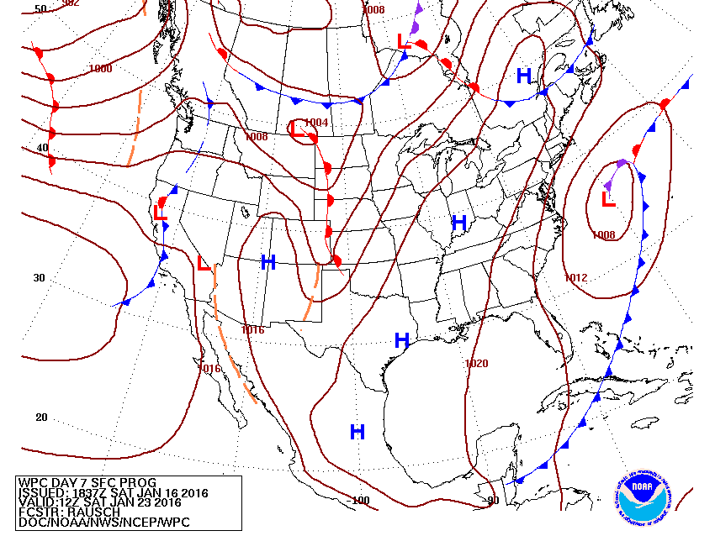
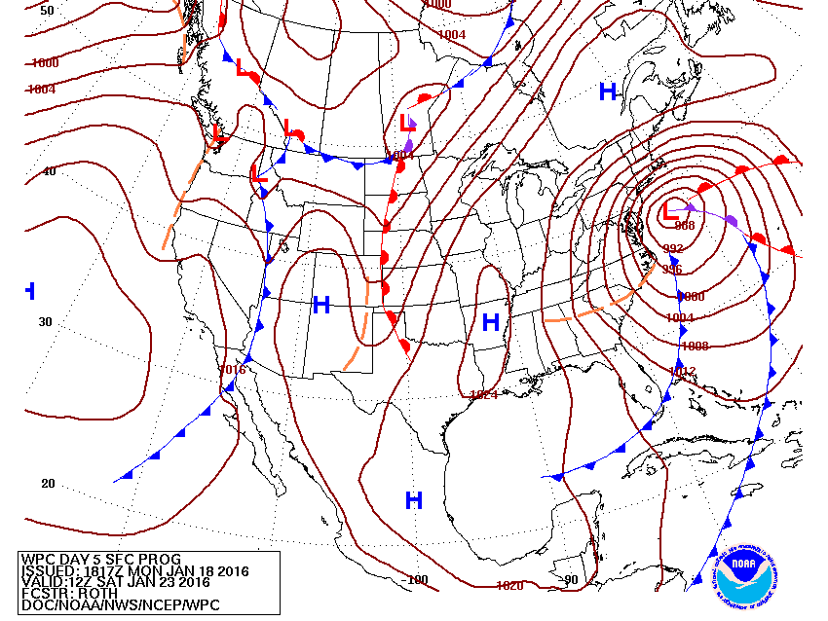
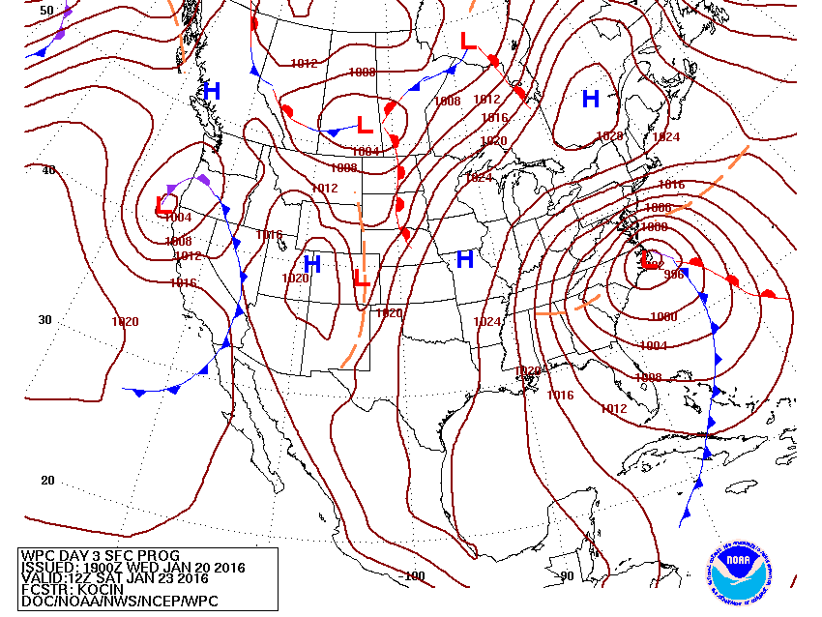
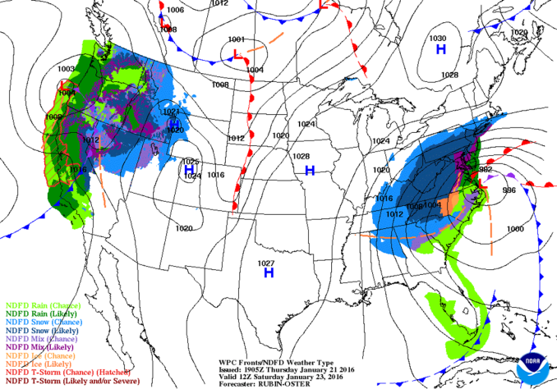
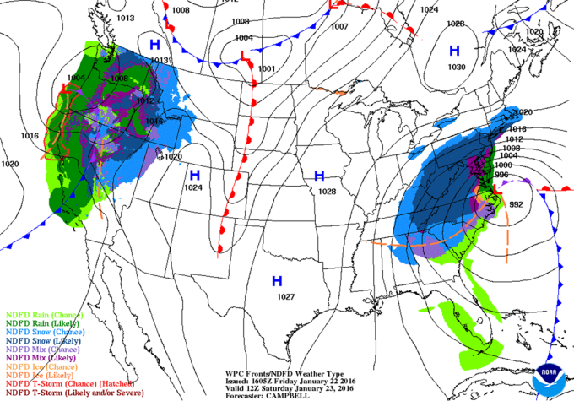
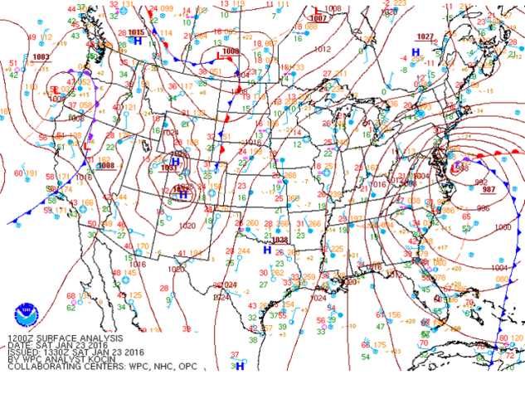
Northeast Blizzard
January 23, 2016
Day 7
Day 5
Day 3
Day 2
Day 1
Analysis

Slide 34
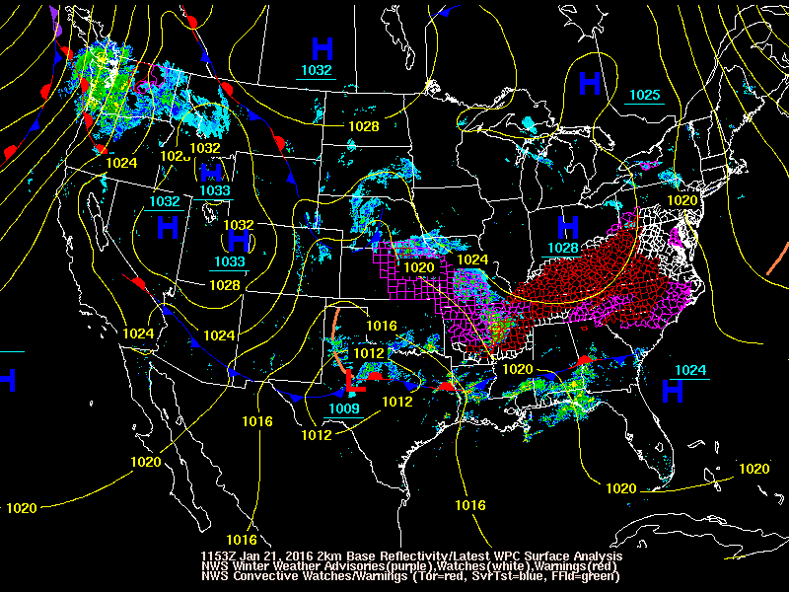
34

Slide 35
Seamless Suite of Forecasts Increasingly Based on Multi-Model Ensembles
Spanning Weather and Climate
Forecast
Uncertainty
Years
Outlook
Seasons
Guidance
Months
North American Multi-Model Ensemble
Threats Assessments
2 Week
Climate Forecast System
North American Ensemble Forecast System
1 Week
Global Ensemble Forecast System
Forecast Lead Time
Global Forecast System
Global Dust
Forecasts
Days
Short-Range Ensemble Forecast
Wave Ensemble
Watches
North American Mesoscale
Space Weather Prediction Models
Hours
Fire Wx
Regional Hurricane
Real Time Ocean Forecasts
Warnings & Alert Coordination
Rapid Refresh/HRRR
SSEO (Storm Scale Ensemble of Opportunity)
Minutes
Dispersion (smoke)
Benefits
Aviation
Recreation
Health
Life & Property
Maritime
Fire Weather
Commerce
Hydropower
Agriculture
Ecosystem
Environment
Emergency Mgmt
Energy Planning
Reservoir Control
Notes:
Making Progress Related to Concerns Expressed in 2013 - When I arrived
Seamless Suite of Models

Slide 36
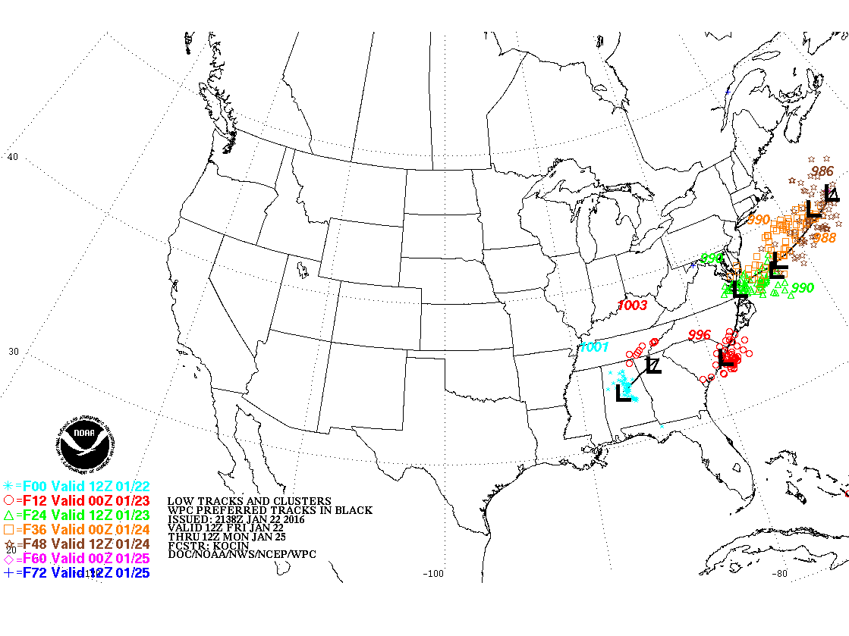
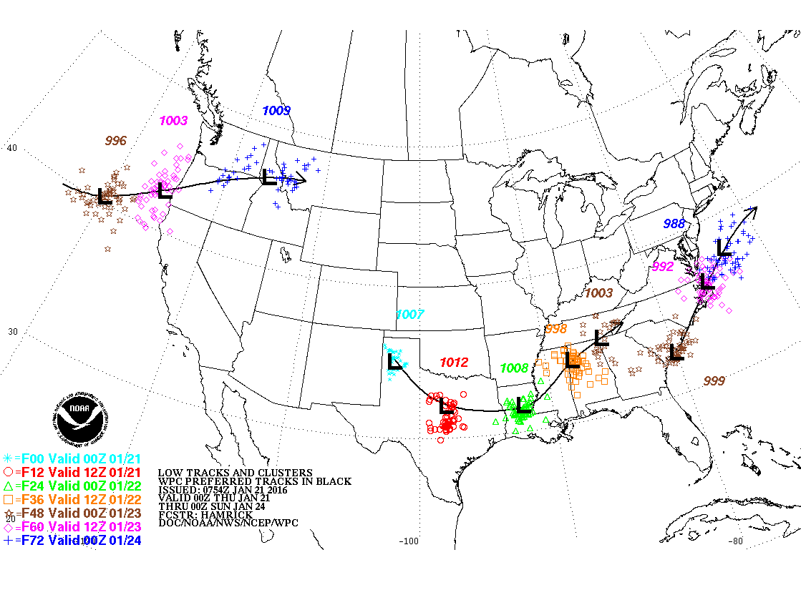
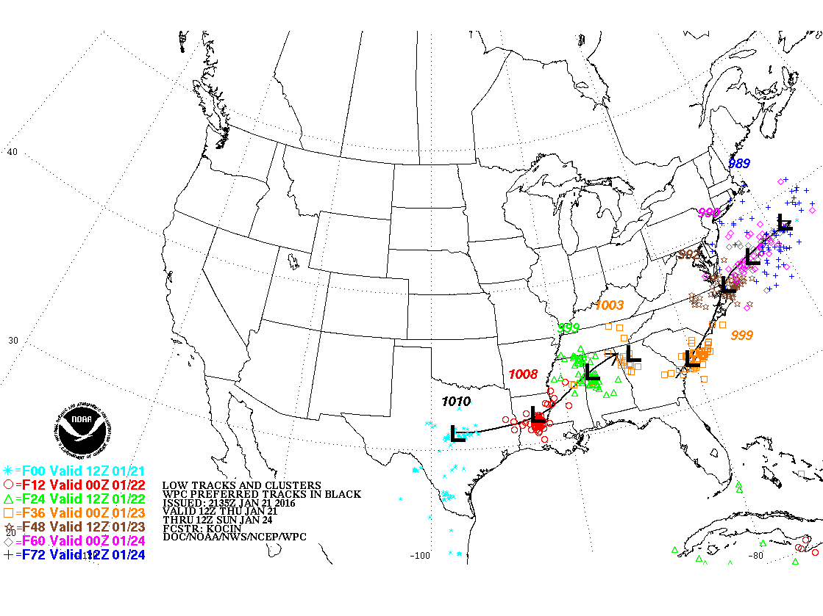
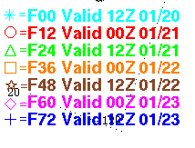
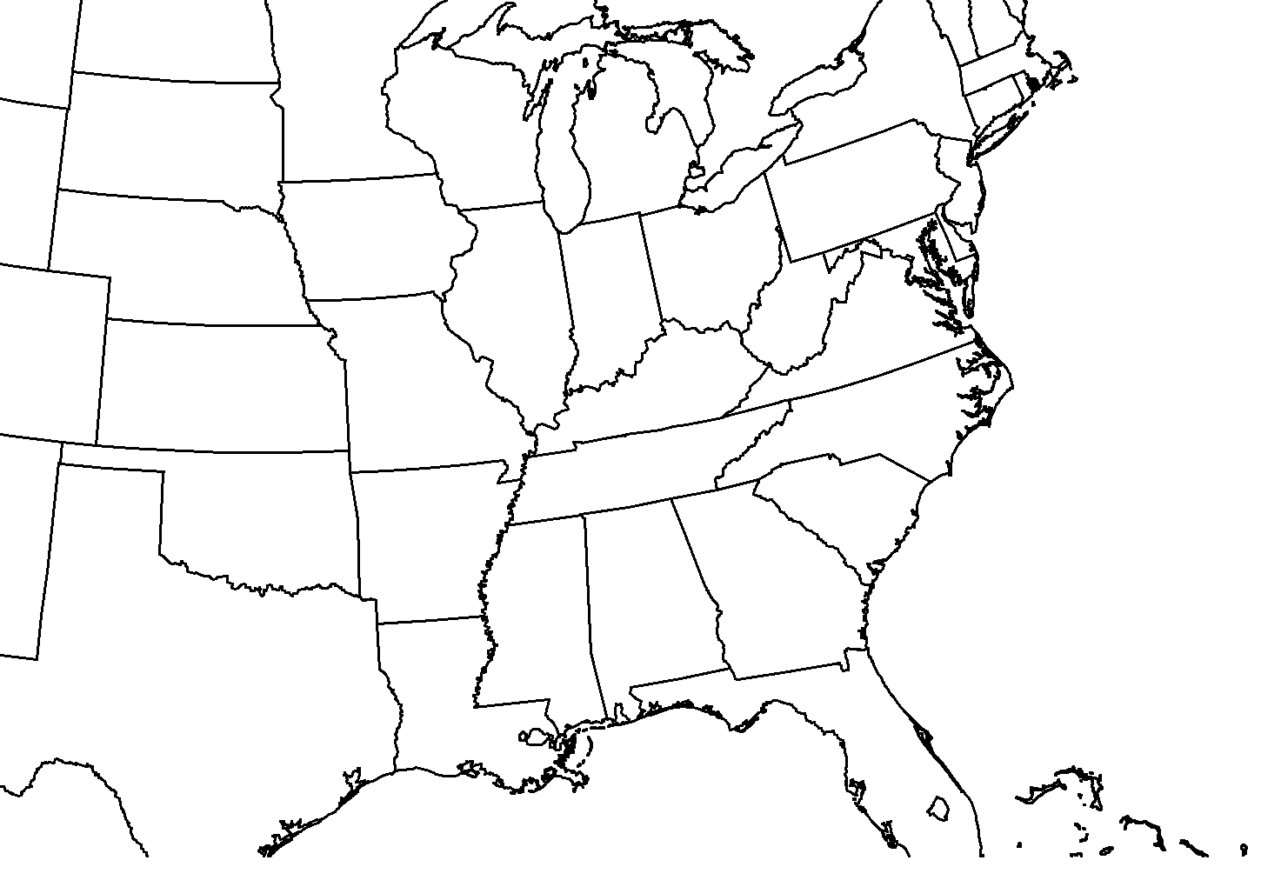
WPC Forecast Low Tracks (Day 1-3):
Issued 22 UTC 1/20
Issued 22 UTC 1/21
Issued 22 UTC 1/22
Issued 22 UTC 1/22
Observed Low Tracks
(12 UTC 1/21 – 12 UTC 1/24)
985 mb
(12 UTC 1/24)
L
L
984 mb
(00 UTC 1/24)
L
L
985 mb
(00 UTC 1/24)
1003 mb
(00 UTC 1/23)
L
987 mb
(12 UTC 1/23)
L
997 mb
(00 UTC 1/23)
1001 mb
(12 UTC 1/22)
L
L
1010 mb
(12 UTC 1/21)
L
1007 mb
(00 UTC 1/22)
36

Slide 37
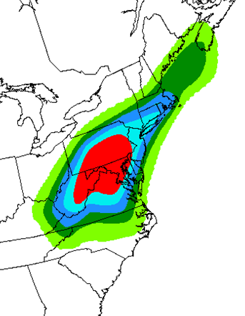
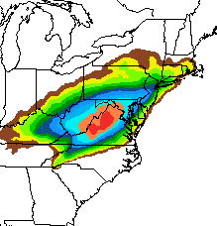
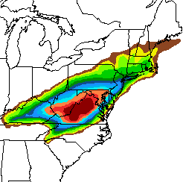

Northeast Blizzard
January 23, 2016
Experimental Probability Forecast
4 days prior to event
Probability Forecast for
48-hour Snowfall
3 days prior to event
Probability Forecast for
48-hour Snowfall
2 days prior to event

Slide 38
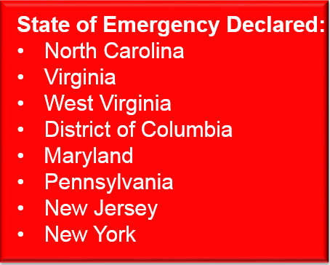
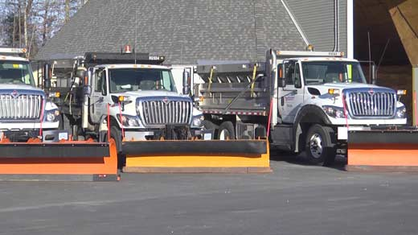
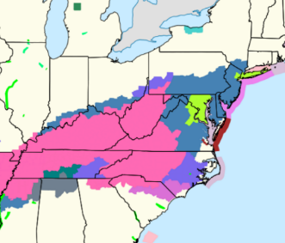
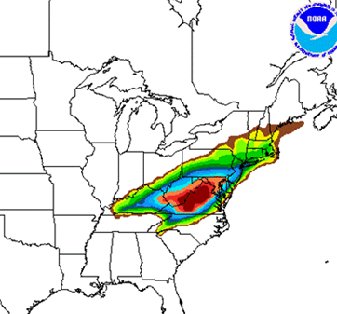
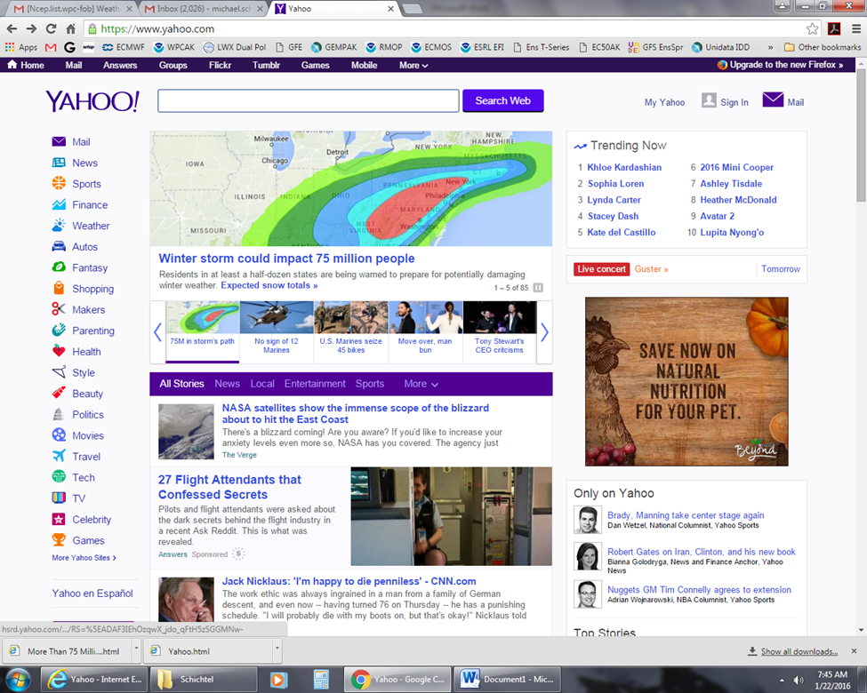


January 2016 Blizzard & Costal Storm: Connecting All of the Pieces
Jan 15 - 18
Jan 19
Jan 20
Jan 21
Jan 22
Medium range products begin
identifying heavy snow threat for the end of next week
NWS offices begin briefing partners on potential storm
Confidence increasing
Partner Coordination/ Briefings
Media interviews
Partner Coordination/ Briefings
Blizzard Watches
Issued
Media interviews
Fed./state/local govts make critical decisions before the snow begins
Blizzard Warnings Issued
Coastal Impact Emphasized
1 pm: Press Briefing
Snow begins in the Mid-Atlantic
Snow forecast adjusted to include NYC in Blizzard Warning
Schools/Govt Close
Flights Canceled
Roads Closed
38
Notes:
Blizzard “Tic Tock”

Slide 39



Opportunities/Challenges
Becoming a Weather-Ready Nation: Going beyond the forecast and warning to connect decision makers for public safety.
2016 Snowstorm
2013 Snowstorm
Long Island Expressway
With NWS Decision Support
Without NWS Decision Support
The Past
Pennsylvania Turnpike
Notes:
IDSS – WITH PA TURNPIKE

Slide 40
Appendix: C

Slide 41

Personal Reflection
I still enjoy these storms – stayed up most of the night – experienced the 4” – 5”/hr snowfall around sunrise.
I was invited to call in with the UW Weekly Weather Watch about my experience and observations during the Presidents’ Day Storm (23 February 1979).
My phone call arranged by Chuck Wash (who organized the Weekly Weather Watch) provided an eyewitness account.
Click to Play Audio
Notes:
7-Level Model
Did not use significant level, radiosonde, satellite or boundary layer.

Slide 42
Mesoscale-Tropopause Fold
First Vis 5D Application
Produced by Hibbard, Santek, Uccellini, Brill (1989)

