Slide 1
Back to My Roots:
Deep Joy of a Snow Storm

Slide 2
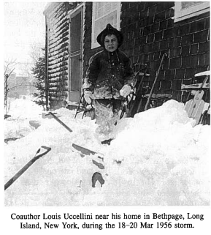
Started Early - Roots Run Deep
 | The Thrills of Victory: “Started talking about snow when I started talking” – my parents Snowstorms, snow, flurries…. I remember when Carol (1954), Diane (1955) and Donna (1960) came across Long Island The Disappointments: The complete miss Always on the wrong side of the rain-snow line! 4” or more – NOT; The letdown of the anticipated snowstorm

Slide 3
Back to My Roots
“This Ever New Self: Thoreau, a Sense of Wonder”*
………A daily balancing act between recording scrupulous observations of nature and expressing sheer joy at the beauty of it all……….
“He felt disjunction acutely, and his journal lays bare both his fascinated scrutiny of the most intricate factual details and the fear of losing his grasp of nature or the cosmos as a whole.”
*The Atlantic, “What Thoreau Saw.” November 2017, pp107-110

Slide 4
Back to My Roots
“This Ever New Self: Thoreau, a Sense of Wonder”*
Crucial though the data and reports are, they eclipse precisely the sort of immediate, intuitive, sensual experience of nature that are, in our Anthropocene era, all too rare. For Thoreau, a sense of wonder – of awe toward, but also oneness with, nature – was essential. We will, he understood, protect only what we love.
*The Atlantic, “What Thoreau Saw.” November 2017, pp107-110

Slide 5
“Snowbound”
“The sun that brief December day
Rose cheerless over hills of gray,
And, darkly circled, gave at noon
A sadder light than waning moon.
Slow tracing down the thickening sky
Its mute and ominous prophecy,
A portent seeming less than threat,
It sank from sight before it set…..”
-- John Greenleaf Whittier
Included in Kocin and Uccellini, 2004, “Northeast Snowstorms Volume 1”

Slide 6
“Red Sky in Morning, Sailors Take Warning…” January 22, 2016 - Sunrise over Baltimore
Credit: Tim Shahan
https://youtu.be/HQP9Y49u-5w

Slide 7
Snowstorms Awaken the Deep Spiritual Connections with Natural Wonders Which Surround All of Us
-Walking Home from Oak-Head
By Mary Oliver

