Slide 1
Model Adjoint Sensitivity Impacts

Slide 2
Operational ECMWF system September to December 2008. Averaged over all model layers and entire global atmosphere. % contribution of different observations to reduction in forecast error.
Note:
1) Sounders on Polar Satellites reduce forecast error most
2) Results are relevant for other NWP Centers, including NWS/NCEP
Forecast error contribution (%)
Courtesy: Carla Cardinali
and Sean Healy, ECMWF
Notes:
2

Slide 3
Impact of Various Observing Systems in GEOS-5
01 Sep – 31 Dec 2010 00z
Total Impact
AMSU-A radiances have
the largest impact globally,
but conventional data
(raob, aircraft) still very
important. GPSRO now a
significant contributor.
Impact Per Observation
Raobs get large weight in
the analysis and have large
IPO. Ship obs are few, but
are located where there
are few other in-situ data.
Total Impact
beneficial
Impact Per Observation

Slide 4
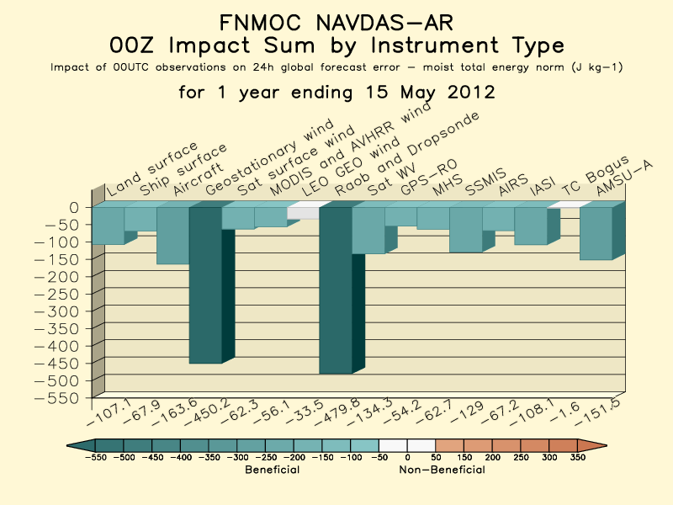
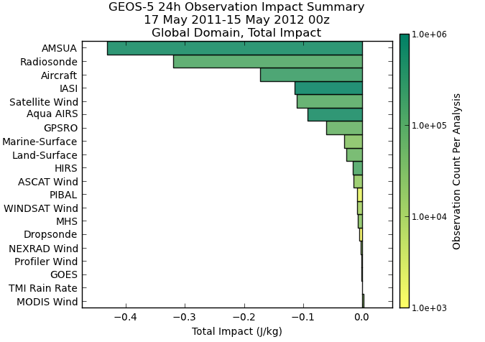
FSO diagnostics (Gelaro, 5th WMO Impact Workshop, Sedona 2012)
http://www.nrlmry.navy.mil/obsens/fnmoc/obsens_main_od.html
http://gmao.gsfc.nasa.gov/products/forecasts/systems/fp/obs_impact/
Much larger relative impact of AMVs in Navy system compared to NASA’s. Note that IASI has moved up in NASA system compared to 2010 (previous slide), and GPSRO has moved down as COSMIC ages/degrades.

