Slide 1
Ensemble Forecasting
Yuejian Zhu
Ensemble & Probabilistic Guidance Team Leader
Environmental Modeling Center
December 3rd 2013
Acknowledgment for:
Members of Ensemble & Probabilistic Guidance Team

Slide 2
Responsibilities of Ensemble Team
- Assess, model, communicate uncertainty in numerical forecasts
Present uncertainty in numerical forecasting
Tasks
Design, implement, maintain, and continuously improve ensemble systems
Presents
Initial value related uncertainty
Model related forecast uncertainty
Ensemble systems
Global – GEFS / NAEFS / NUOPC
Regional – SREF / HREF / NARRE-TL / HWAF ensemble
Climate – CFS, IMME and NMME
NAEFS/GEFS downscaled
Ocean wave ensemble (MMA/EMC)
Other systems
CCPA – Climate Calibrated Precipitation Analysis
WSR – Winter Storm Reconnaissance
CSTAR - Collaborative Science, Technology, and Applied Research Program
Statistical correction of ensemble forecasts
Tasks
Correct for systematic errors on model grid
Downscale information to fine resolution grid (NDFD)
Combine all forecast info into single ensemble/probabilistic guidance
Probabilistic product generation / user applications
Contribute to design of probabilistic products
Support use of ensembles by
Internal users (NCEP Service Center, WFOs, OHD/RFC forecasters and et al.)
External users (research, development, and applications)

Slide 3
Coverage of This Presentation
Will mainly focus on:
GEFS upgrade and future plan
NAEFS upgrade and future plan
GEFS/NAEFS post products and future plan (?)
CCPA – Climate Calibrated Precipitation Analysis
WSR – Winter Storm Reconnaissance
CSTAR - Collaborative Science, Technology, and Applied Research Program
GEFS extended forecast
IMME and NMME
Wave ensemble and its products will be reviewed by Hendrik Tolman (tomorrow)
Regional ensemble and related products will be reviewed by Jun Du (this afternoon)
Regional hurricane ensemble (HWRF experimentally) will be reviewed by Vijay Tallapragada (tomorrow)

Slide 4
Main Accomplishments in 2013 for WCOSS transition
GEFS
NAEFS
CCPA
WSR
SREF

Slide 5
SREF interim upgrade package (has been delivered to NCO which is running in real time daily, to be implemented in Jan./Feb. 2014) – Jun Du
Part I: Bug fix
Correct / improve initial conditions:
replace GFS land states (too moist) with NDAS land states in NMM & ARW members;
correct inadvertent use of global initial conditions (too moist) with use of RAP for ARW members to reduce the surface wet and cold biases
Fix bugs in NOAH LSM:
eliminate negative soil moisture fractions for NMM and ARW members;
eliminate “urban swamp” (causing too cold surface temperature over urban regions during heat wave periods) for NMMB members
Correct GFS physics in 2 NMMB members to produce compatible cloud & ceiling guidance with the rest of SREF members
Fix Post-Processor to remove use of snow in diagnosing cloud base height
Correct a mapping bug (eastward shift) in NMM member’s pressure-grib output files.
Part II: New products
Add 4 winter weather variables:
low-level Rime Factor of 21 members;
snow depth of 21 members;
% of frozen precipitation of 21 members;
water equivalent accumulated snow of 7 ARW members
Add 2m temperature and 3-hourly accumulated precipitation of 21 SREF members from the 32km North American domain (grid 221) into AWIPS for RFC to drive their hydrological ensemble system
Modify the clustering algorithm to “make up” time-continuity within a cluster over each of the three preselected forecast periods (00-24hr, 27-51hr, 54-87hr)
Add “Department of Homeland Security” sites in SREF bufr sounding output as well as unify the SREF bufr station list with that used in NAM and RAP.

Slide 6
Ensemble Performance Review --- NUOPC Verification Metrics
For all three individual bias corrected ensemble forecast (NCEP/GEFS, CMC/GEFS and FNMOC/GEFS) and combined (NAEFS=NCEP+CMC and NUOPC=NCEP+CMC+FNMOC) ensemble (equal weights) against UKMet analysis
EMC/NCEP
November 3rd 2013

Slide 7
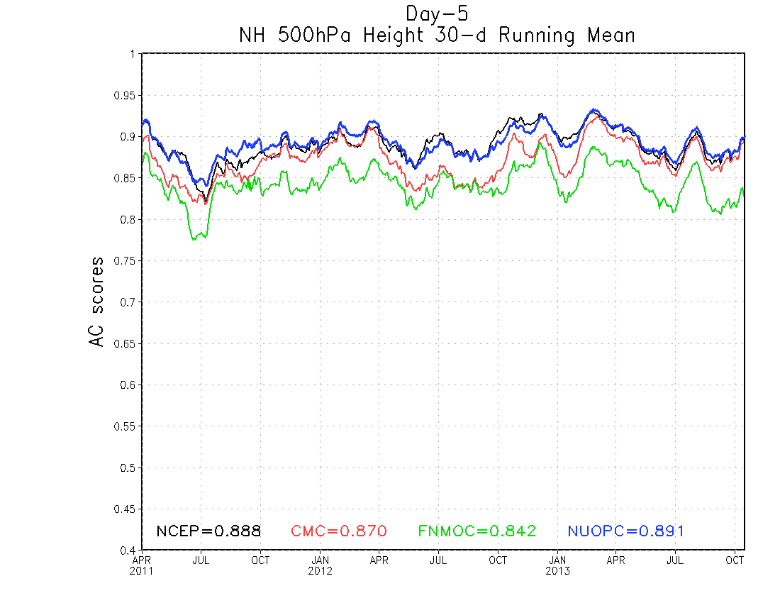
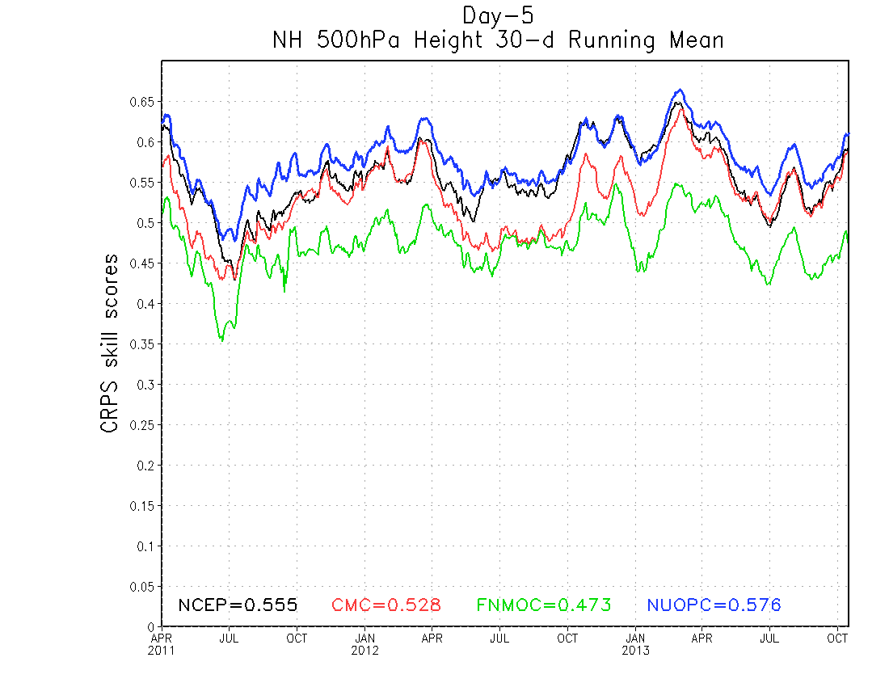
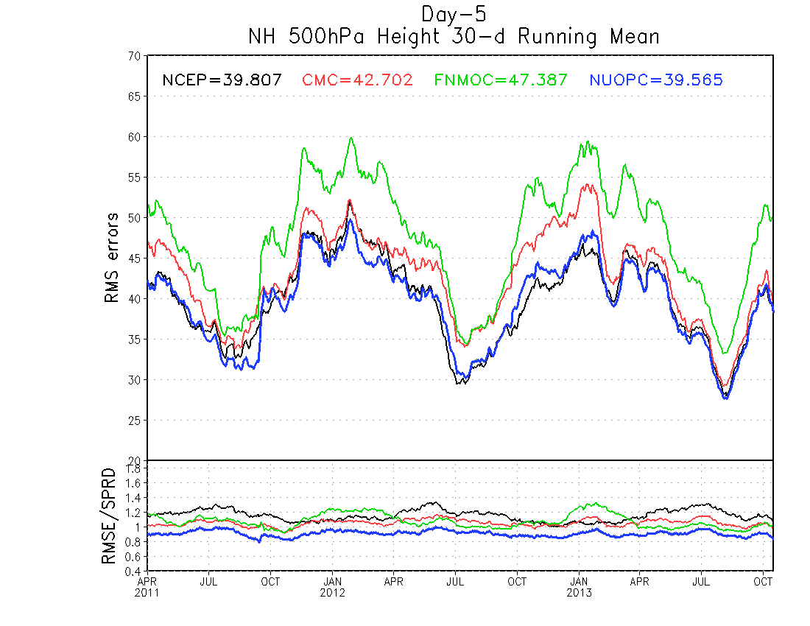
5-day forecast
NH 500hPa anomaly correlation
NH 500hPa CRPS skill scores
Northern Hemisphere 500hPa height:
30-day running mean scores of day-5
CRPS skill score
RMS error and ratio of RMS error / spread
Anomaly correlation
All other regions could be seen from: http://www.emc.ncep.noaa.gov/gmb/yluo/naefs/VRFY_STATS/T30_P500HGT
NH 500hPa RMS errors
Under-dispersion
Over-dispersion
Ratio of RMS error over spread

Slide 8
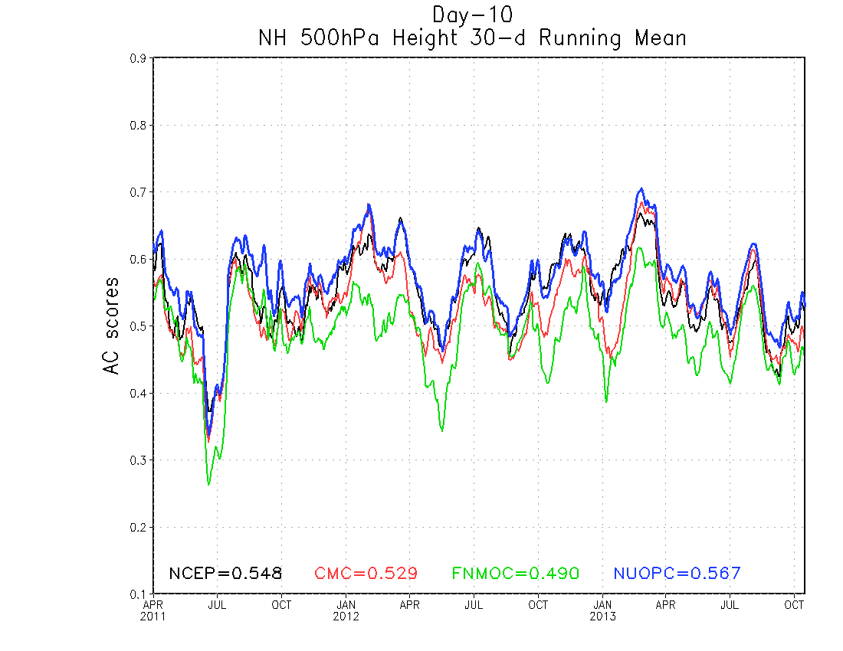
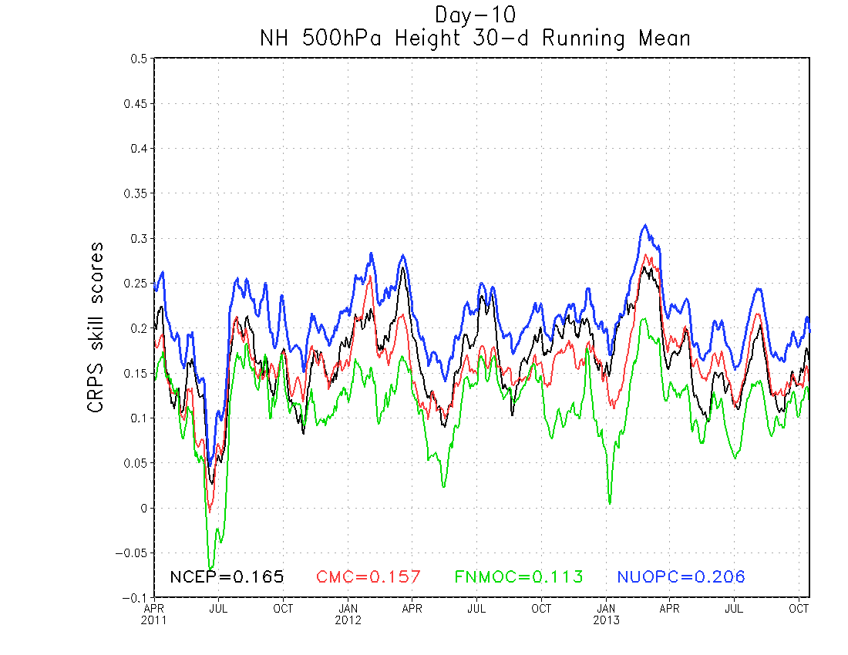
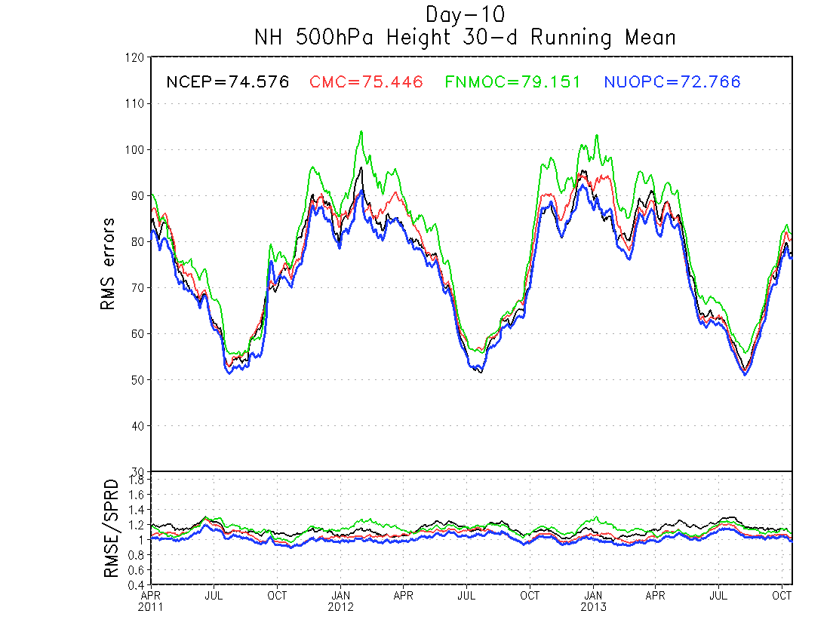
10-day forecast
Northern Hemisphere 500hPa height:
30-day running mean scores of day-10
CRPS skill score
RMS error and ratio of RMS error / spread
Anomaly correlation
All other regions could be seen from: http://www.emc.ncep.noaa.gov/gmb/yluo/naefs/VRFY_STATS/T30_P500HGT

Slide 9
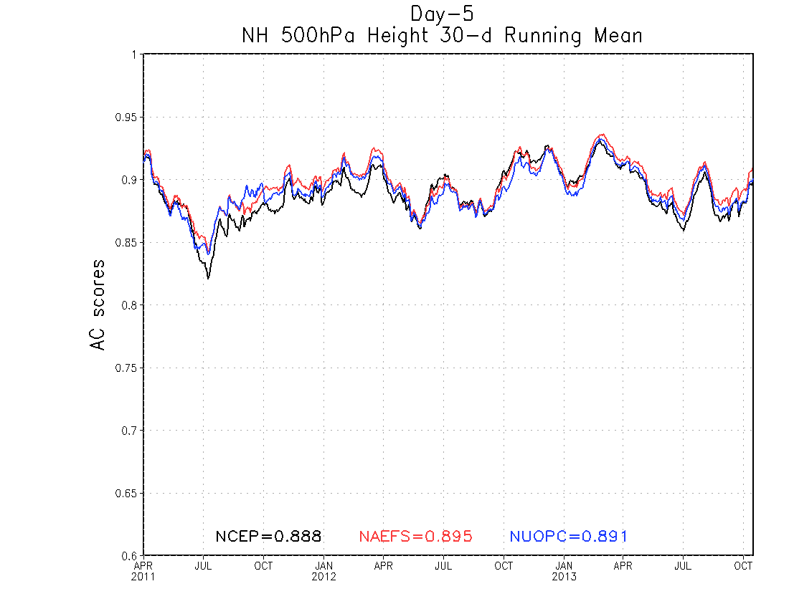
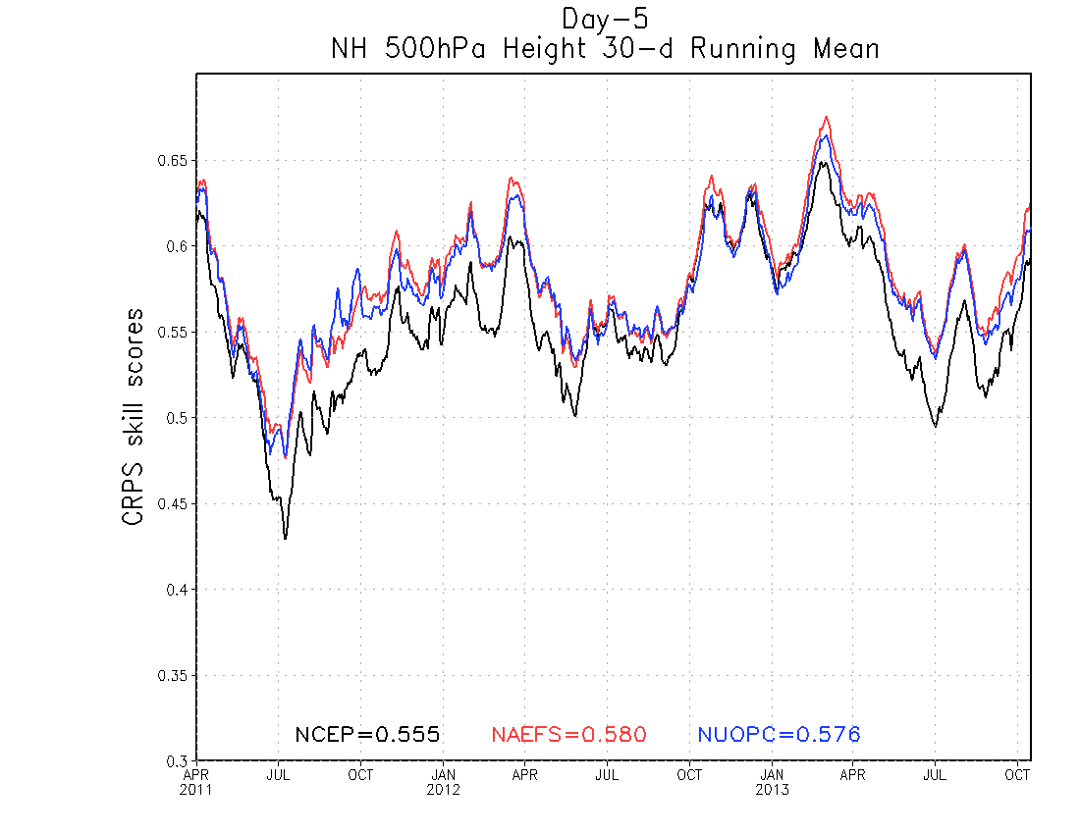
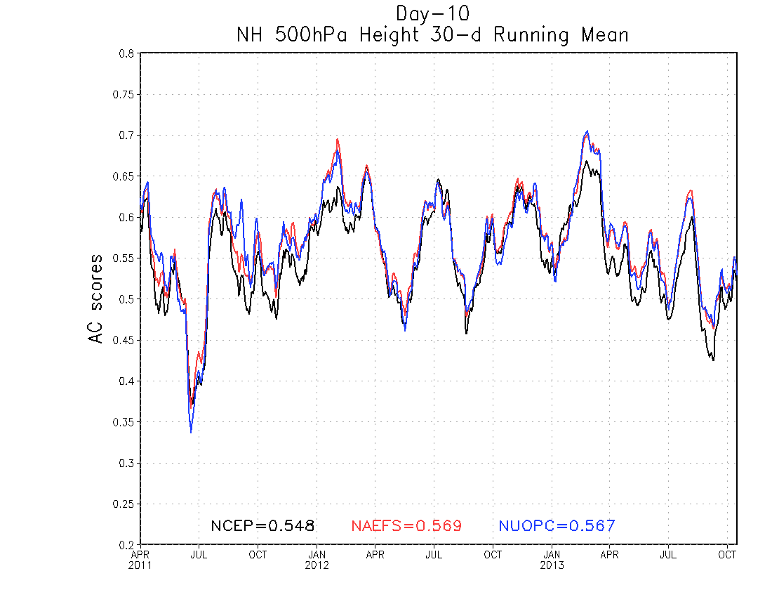
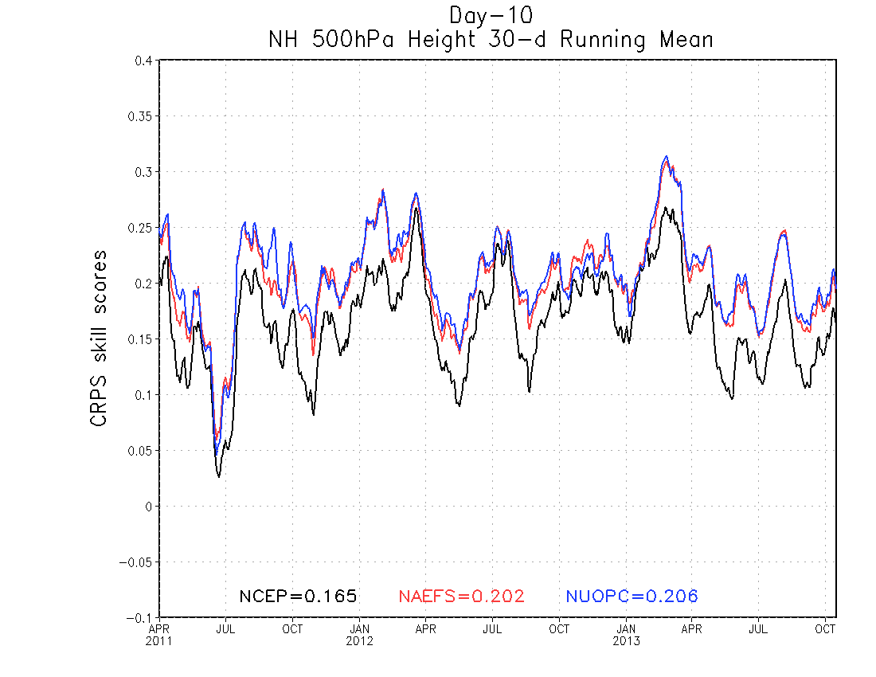
Day-5 NH 500hPa height
Day-10 NH 500hPa height

Slide 10
AL01-13, EP01-17, WP03-29, May-October, 2013
Track error(NM)
Forecast hours
CASES 493 448 401 356 300 206 129 81

Slide 11
JTWC, WP03-29, 2013
Verification:
2NAE looks better
Please note: Model guidance is usually delayed 06~12 hours which means model forecast is not fully comparable to official forecast. Here is for reference only.
Track error(NM)
Forecast hours
CASES 224 216 200 180 158 114 74 44
AVNO ----NCEP (GFS) deterministic run (T574L64)
AEMN----NCEP (GEFS) 20-member mean
2NAE----NCEP(20)+ECMWF(50) 70-member mean
JTWC---- JTWC official forecast

Slide 12
Next Ensemble (GEFS) Implementation
Model
Current: GFS Euler model
Plan: GFS Semi-Lagrangian model
Horizontal resolution
Current: T254 (55km for 0-192 hours), T190 (73km for 192-384 hours)
Plan: T574 (T382 physics - 34km for 0-384 hours)
Vertical resolution
Current: L42 hybrid levels
Plan: L42 hybrid levels (will not match with GFS and DA)
Ensemble memberships:
The same as current operational – 21 members for each cycle (additional discussion)
Computation cost:
Current: 84 nodes (+ post process) for 55 minutes
Plan: 231 nodes (+ post process) within one hour for integration only
Output:
Current: every 6-hr for 1*1 degree pgrb files
Plan: every 3-hr for 0.5*0.5 degree pgrb files
Challenge:
T574L42 configuration will need about 250+ nodes in totally for one hour
A estimation is based on dt=900s, dphyscis=450s, output every 3 hours
T574L64 configuration will need about 300+ nodes for one hour (almost impossible)
Concern:
The quality of forecast for 42 vertical levels, especially for extended range (?)

Slide 13
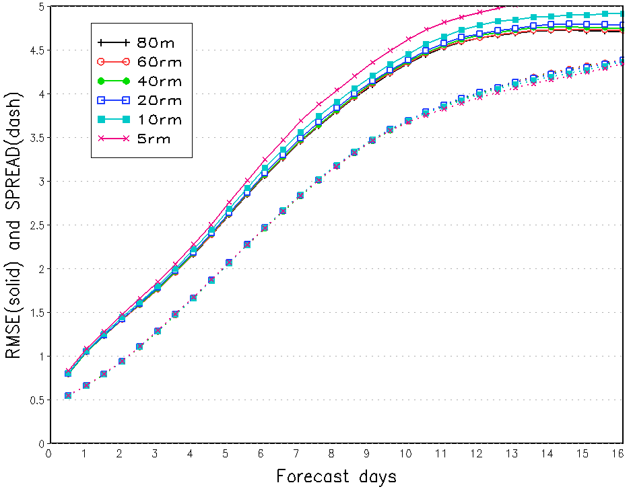
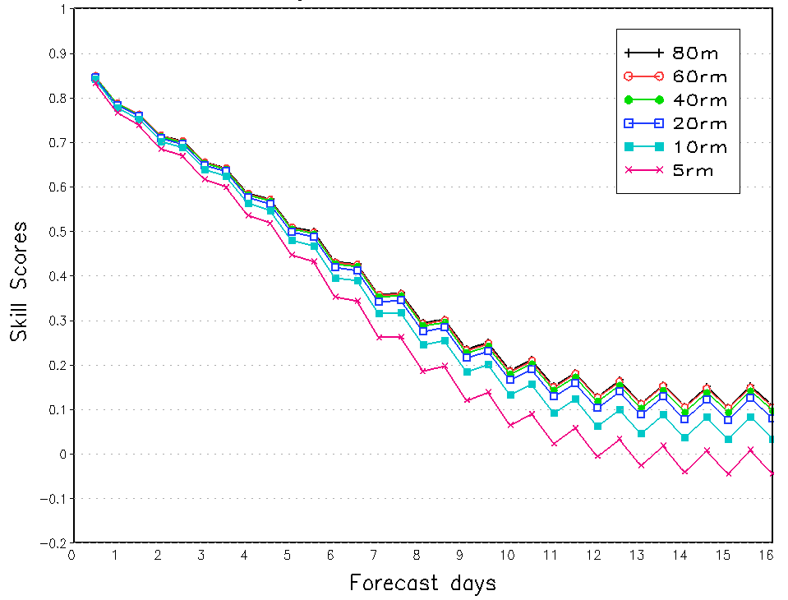
Ensemble (GEFS) Highlights
NH850hPa T
Reference: Ma and et al, 2012: “An Effective Configuration of Ensemble Size and Horizontal Resolution for the NCEP GEFS”, AAS Vol. 29 p782-794
 | RMSE | AC | CRPSS
20T190 | 1-5d |  | 3-5d
80T126 | 12-16d | 13-16d | 11-16d

Slide 14
Next Ensemble (GEFS) Implementation
Initial perturbations
Base: EnKF 6hr forecast
TS relocation – modified version by Yoichiro Ota
Ensemble Transform (ET) and Centralization
ET will apply to EnKF f06 vectors
Centered for 20 initial perturbations
3 dimensional rescaling (3DR) - option
Based on accumulated (EnKF) analysis error variance (total energy norm)
Rescaling EnKF f06 perturbations
Stochastic perturbations
Tuning STTP for model change and initial perturbation changes
What do we expect from this upgrade?
Improve probabilistic forecast?
Improve TS forecast?

Slide 15
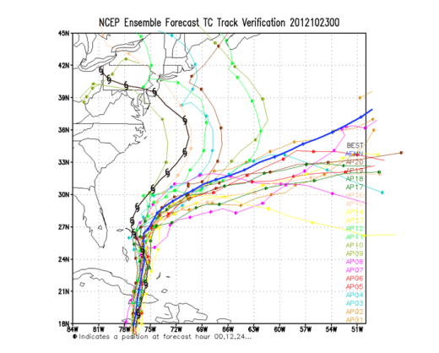
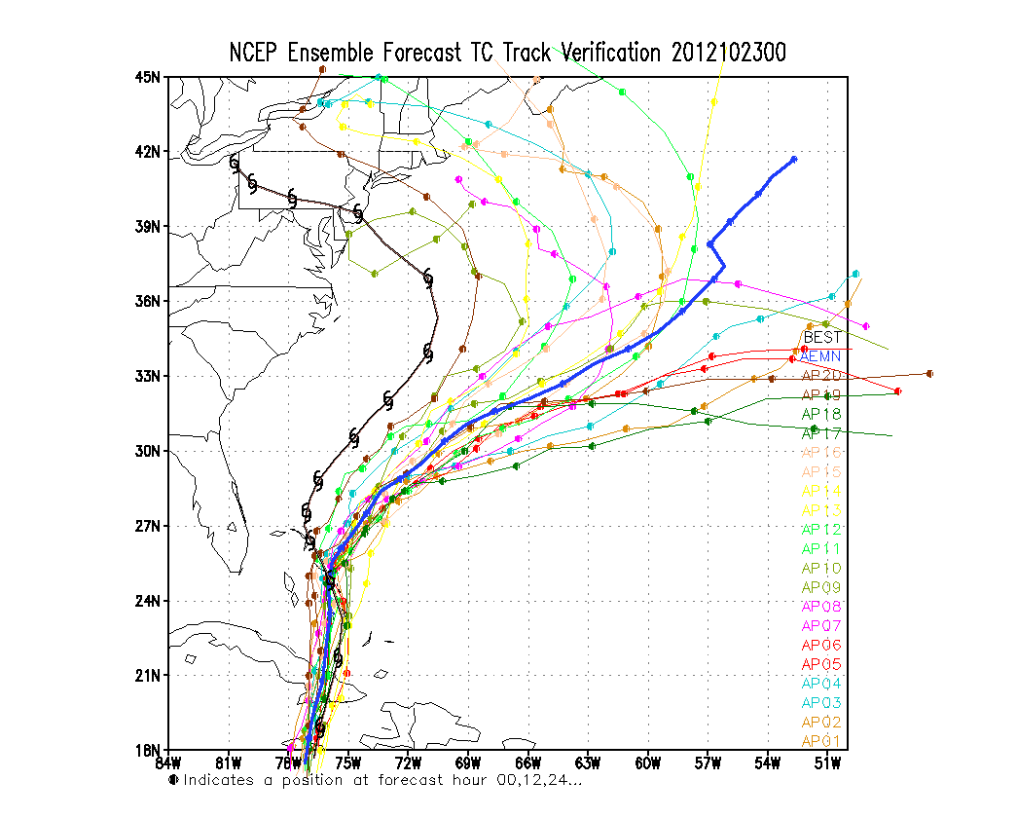
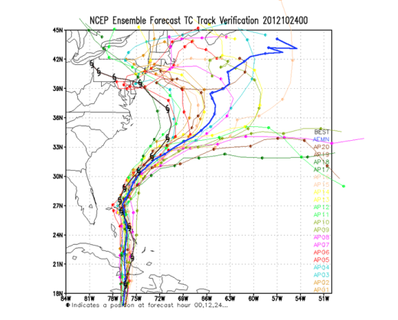
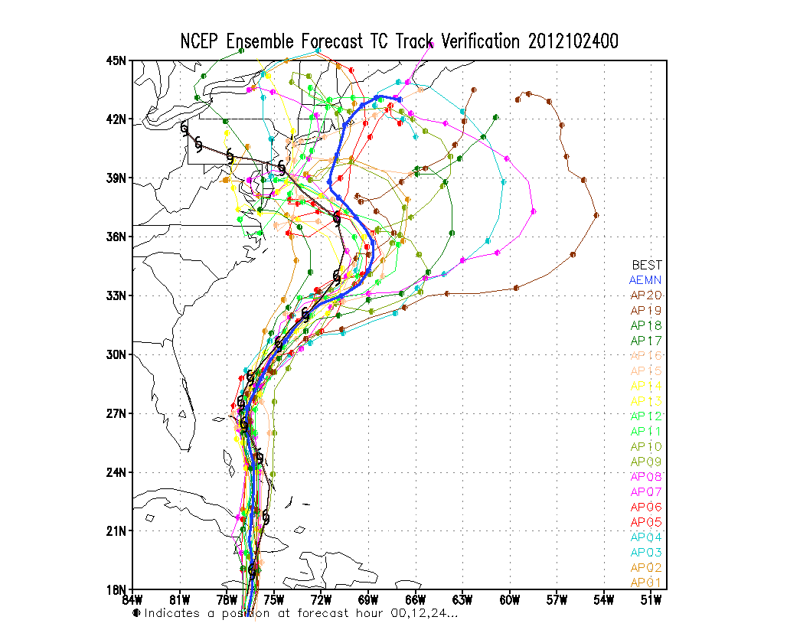
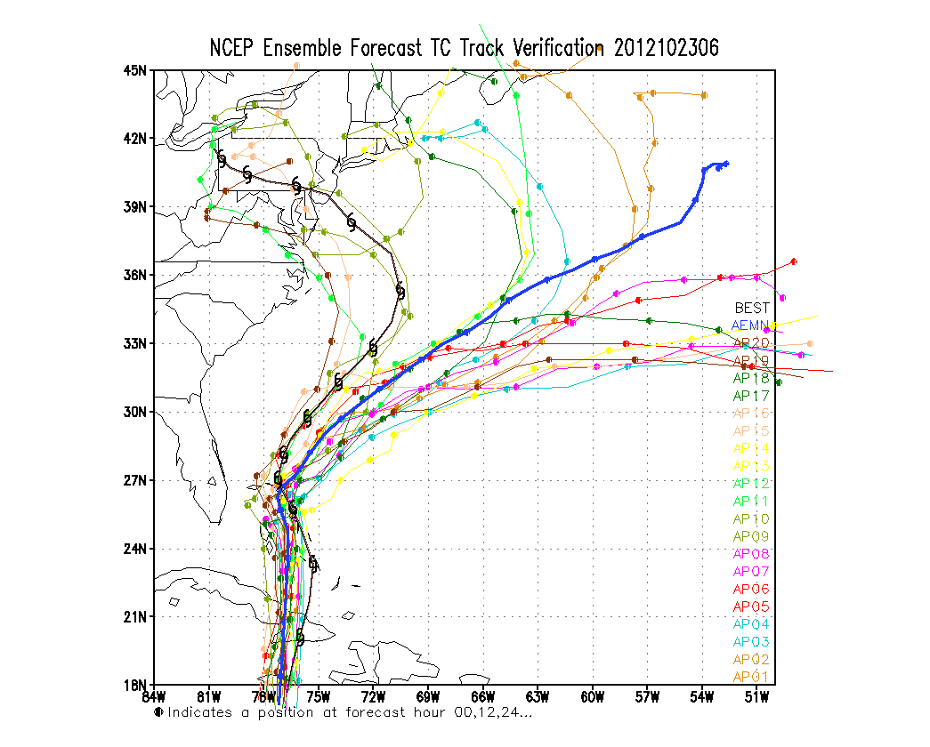
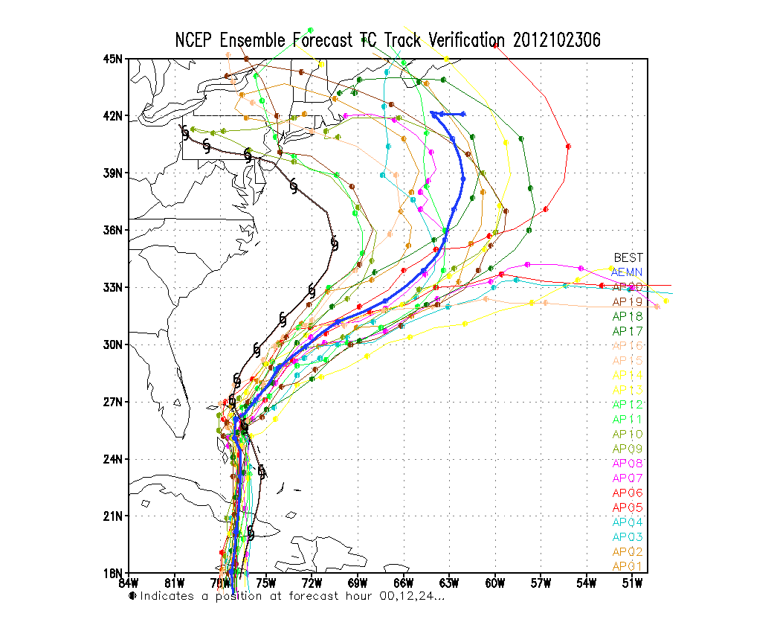
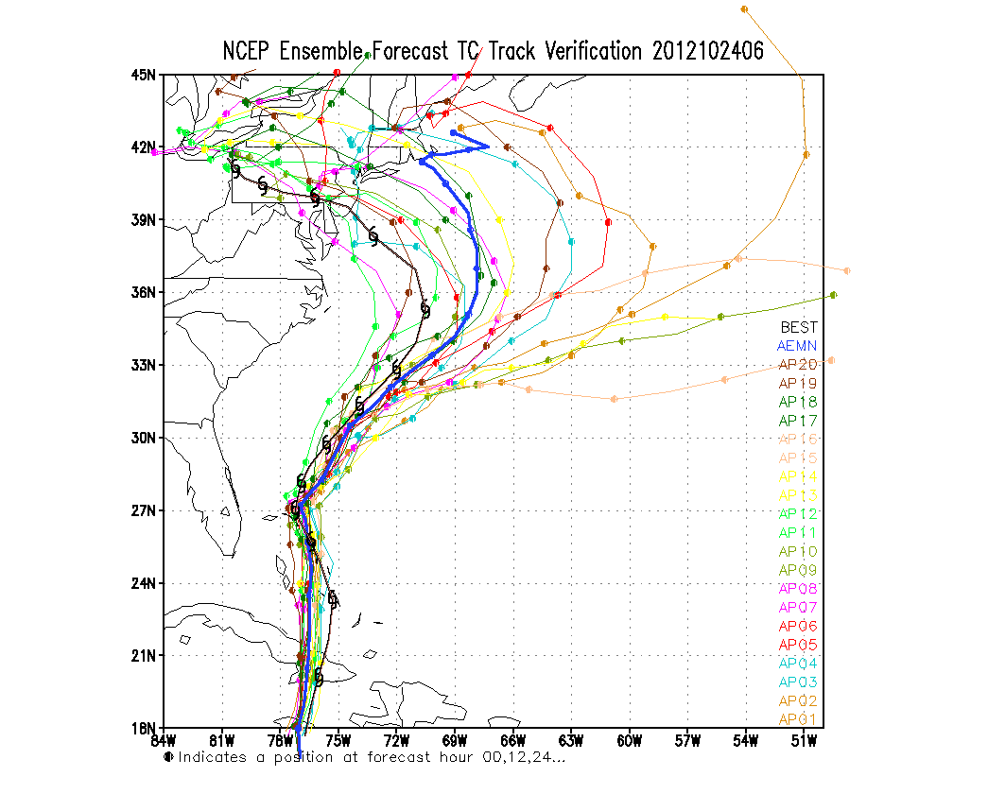
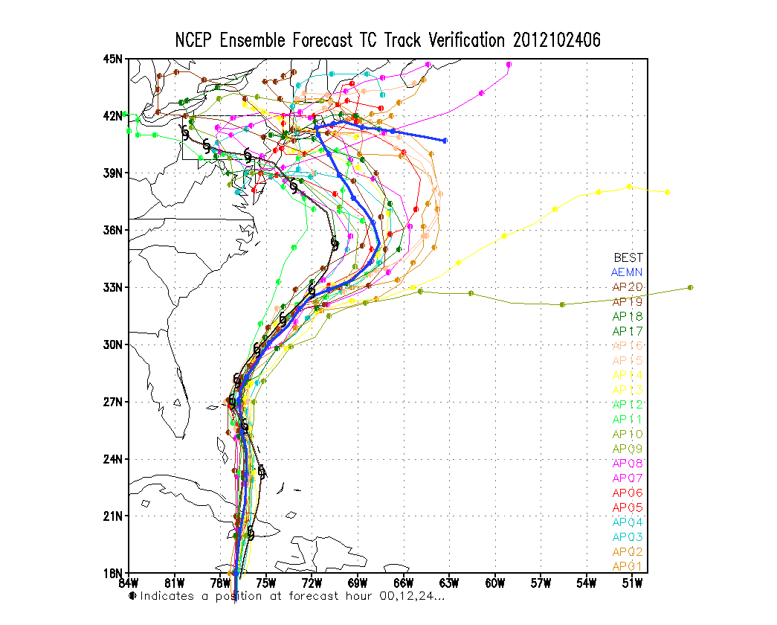
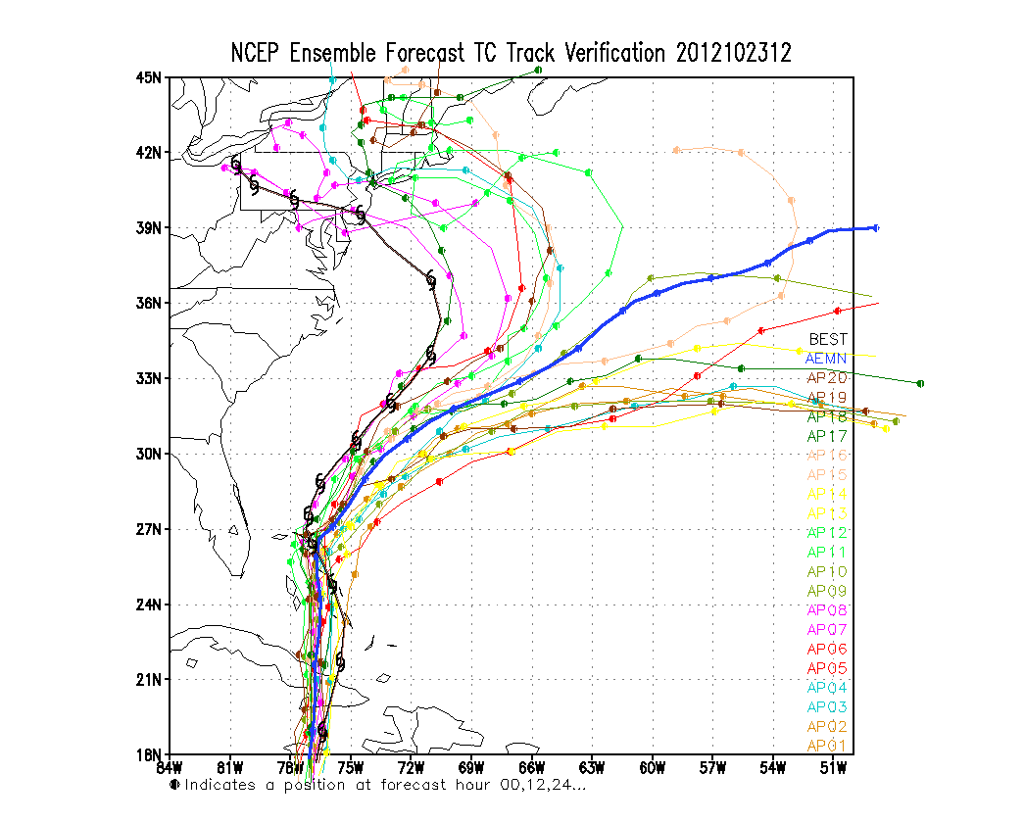
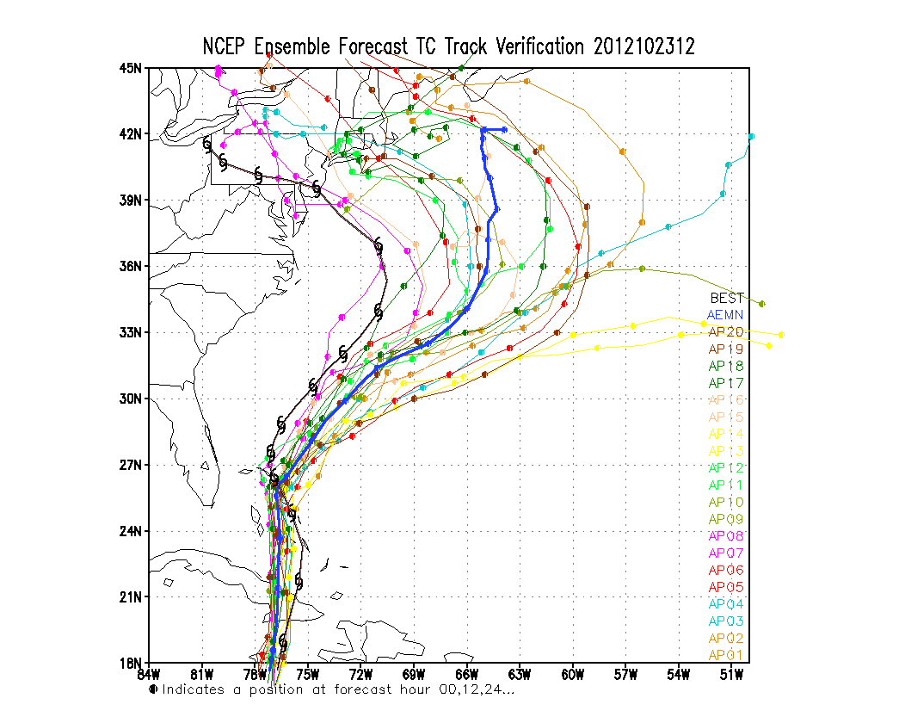
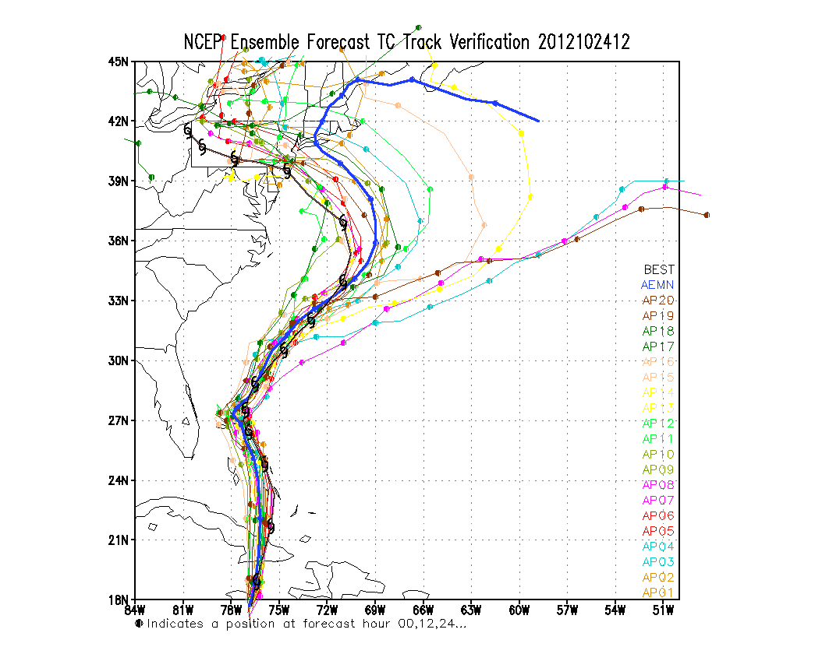
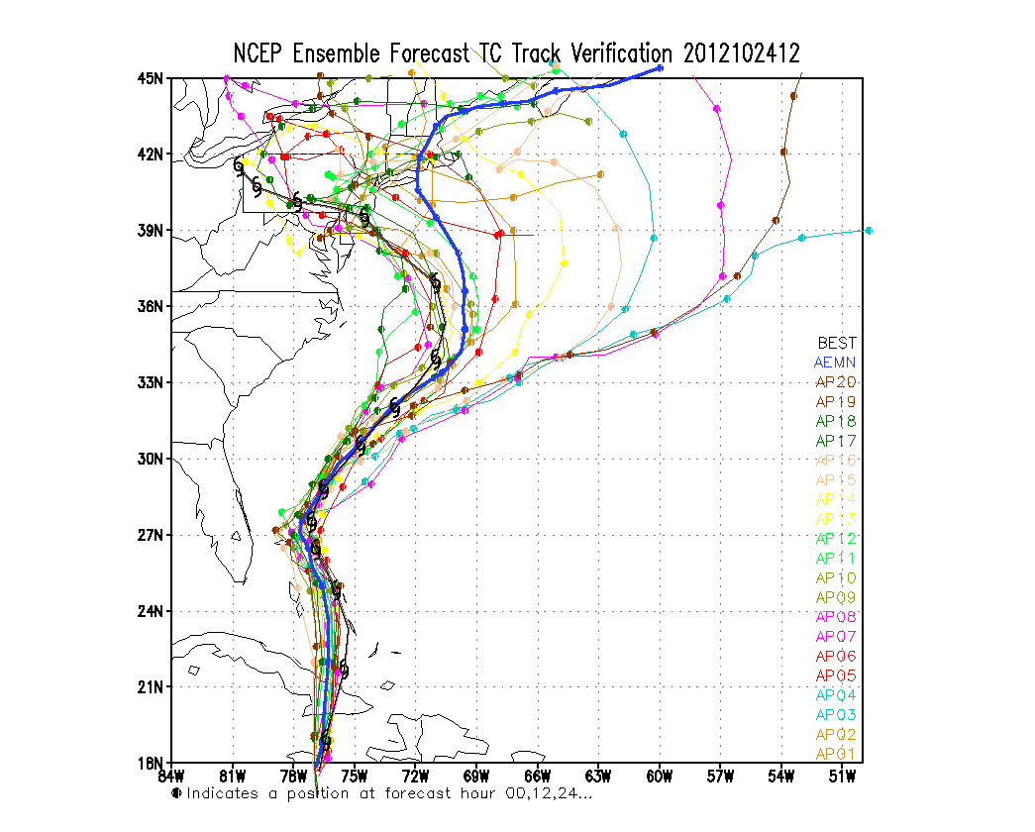
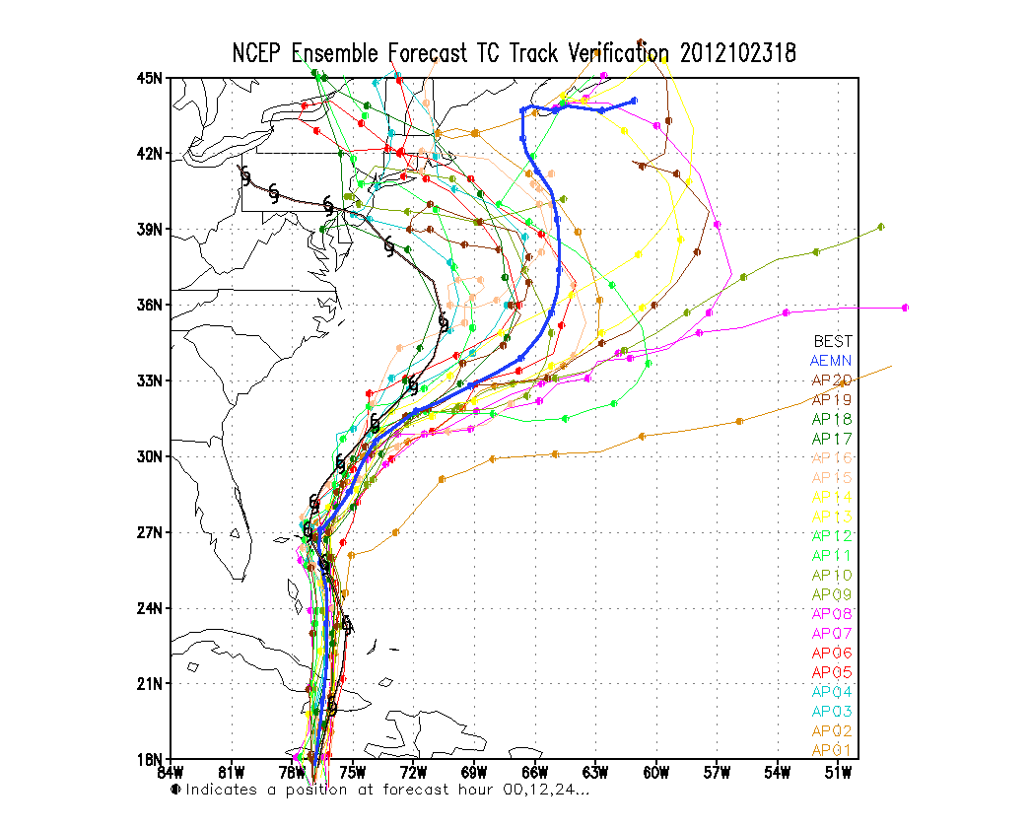
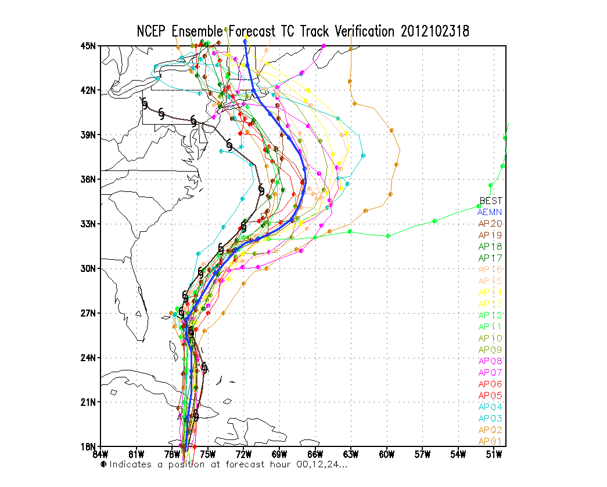
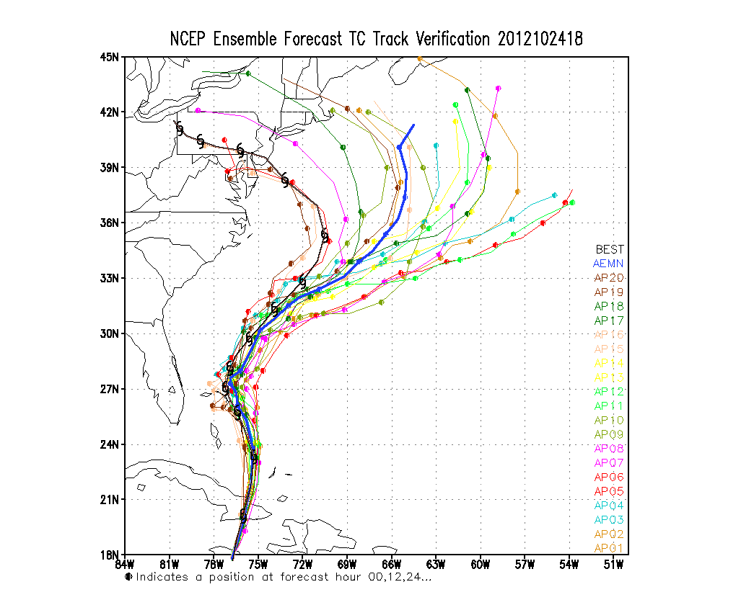
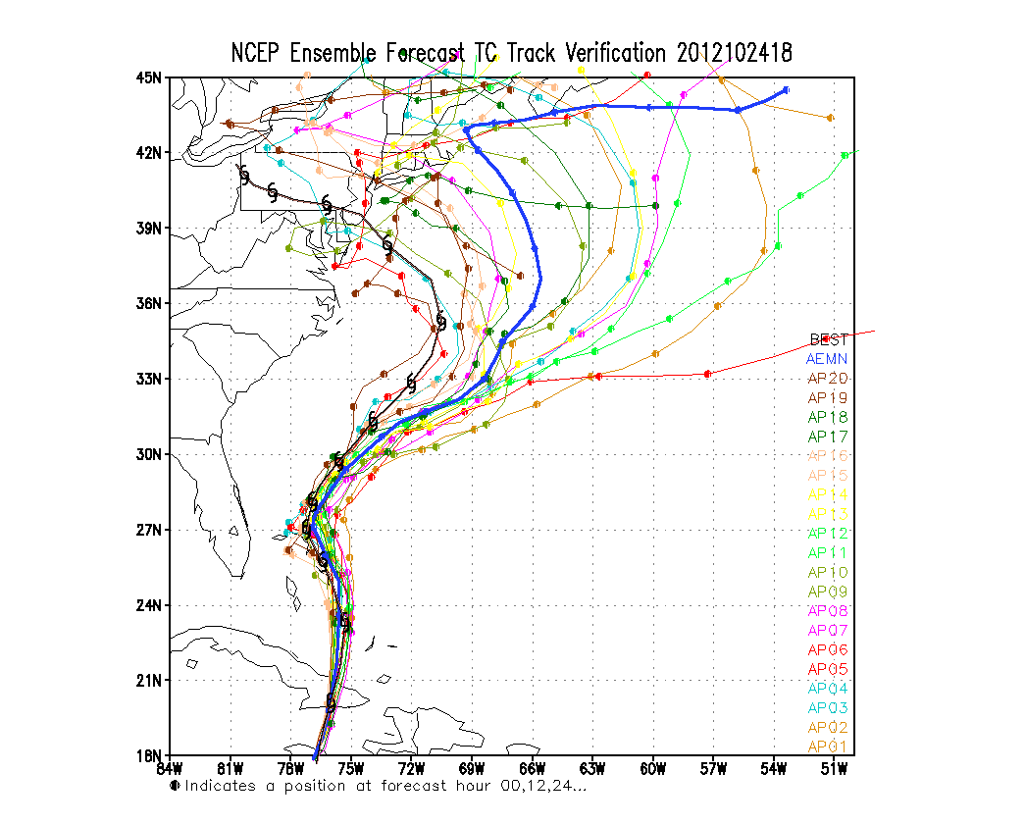
20121023
20121024
Operation
~50km
High resolution
SL testing
~33km
00UTC
00UTC
New high resolution ensemble has about 12 hour’s advantage in predicting Sandy’s turned to North
06UTC
06UTC
12UTC
12UTC
18UTC
18UTC

Slide 16
Sandy case study for new GEFS
GFS-OPR: NCEP high resolution deterministic – 27km
GEFS-OPR: NCEP global ensemble forecast system – 50km
GEFS-SL64: NCEP experimental GEFS (T574L64 SL) – 34km
GEFS-SL42: NCEP experimental GEFS (T574L42 SL) – 34km
CASES 33 33 33 31 29 25 21 17 13 9

Slide 17
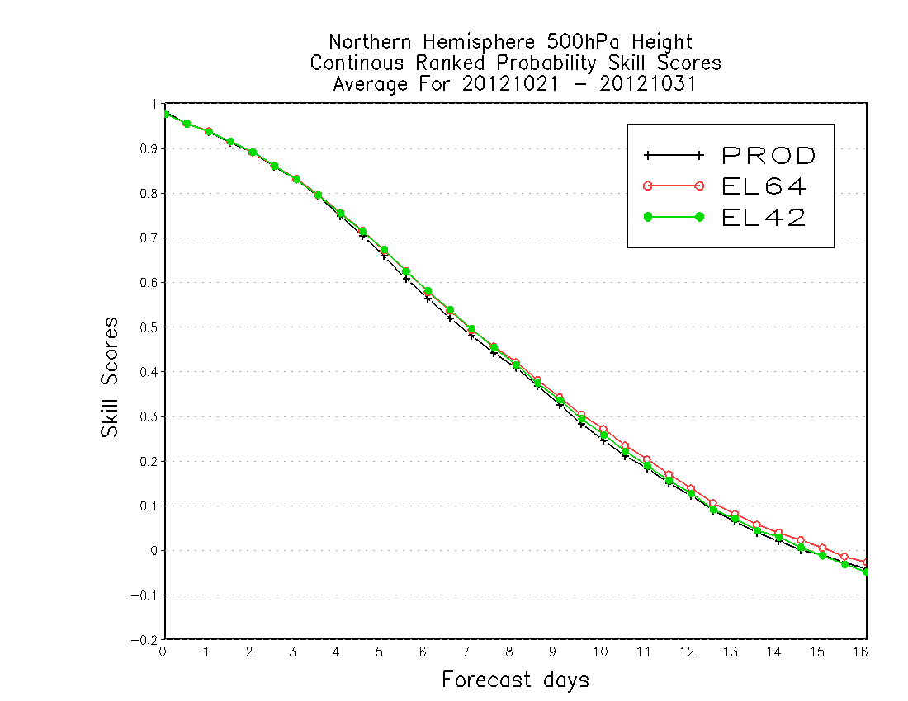
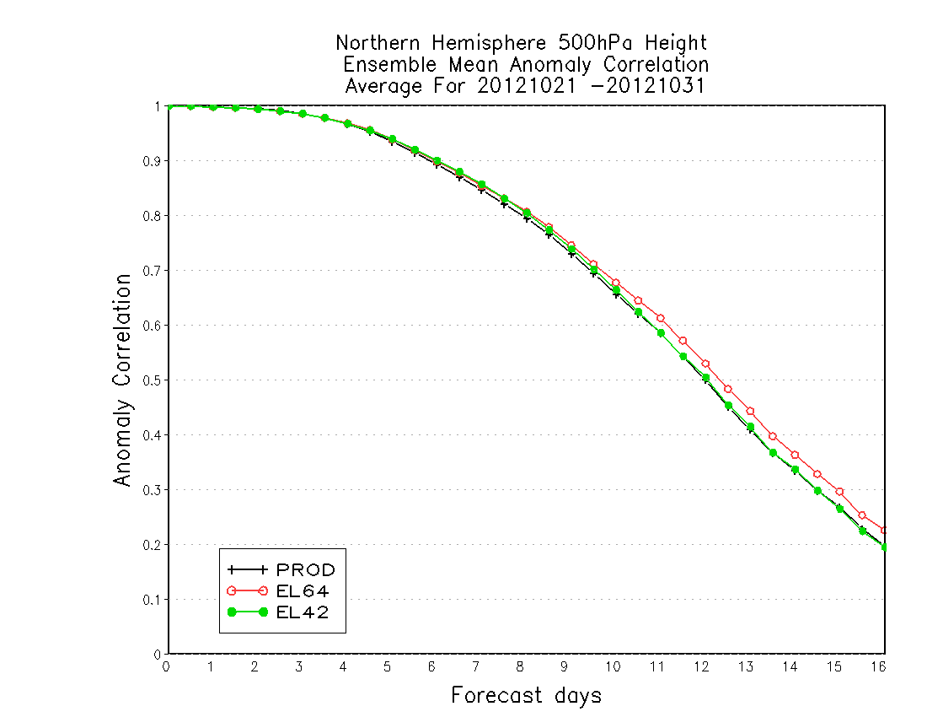
Sandy case study for new GEFS

Slide 18
NAEFS Current Status
Updated: February 13 2013
 | NCEP | CMC | NAEFS
Model | GFS | GEM | NCEP+CMC
Initial uncertainty | ETR | EnKF | ETR + EnKF
Model uncertainty/Stochastic | Yes (Stochastic Pert) | Yes (multi-physics and stochastic) | Yes
Tropical storm | Relocation | None
Daily frequency | 00,06,12 and 18UTC | 00 and 12UTC | 00 and 12UTC
Resolution | T254L42 (d0-d8)~55km T190L42 (d8-16)~70km | 600*300 (66km) L72 | 1*1 degree
Control | Yes | Yes | Yes (2)
Ensemble members | 20 for each cycle | 20 for each cycle | 40 for each cycle
Forecast length | 16 days (384 hours) | 16 days (384 hours) | 16 days
Post-process | Bias correction (same bias for all members) | Bias correction for each member | Yes
Last implementation | February 14th 2012 | February 13 2013

Slide 19
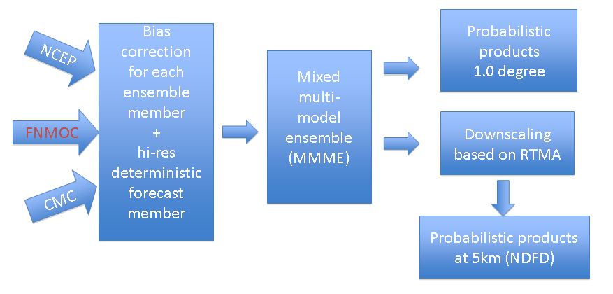
Current NAEFS SPP System
Bias corrected NCEP/CMC GEFS and NCEP/GFS forecast (up to 180 hrs), same bias correction algorithm
Combine bias corrected NCEP/GFS and NCEP/GEFS ensemble forecasts
Dual resolution ensemble approach for short lead time
NCEP/GFS has higher weights at short lead time
NAEFS products
Combine NCEP/GEFS (20m) and CMC/GEFS (20m), FNMOC ens. will be in soon
Produce Ensemble mean, spread, mode, 10% 50%(median) and 90% probability forecast at 1*1 degree resolution
Climate anomaly (percentile) forecasts also generated for ens. mean
Statistical downscaling
Use RTMA as reference - NDGD resolution (5km/6km), CONUS and Alaska
Generate mean, mode, 10%, 50%(median) and 90% probability forecasts

Slide 20
NAEFS Bias Correction Variables
Variables | pgrba_bc file | Total 49 (3)
GHT | 10, 50, 100, 200, 250, 500, 700, 850, 925, 1000hPa | 10
TMP | 2m, 2mMax, 2mMin, 10, 50, 100, 200, 250, 500, 700, 850, 925, 1000hPa | 13
UGRD | 10m, 10, 50, 100, 200, 250, 500, 700, 850, 925, 1000hPa | 11
VGRD | 10m, 10, 50, 100, 200, 250, 500, 700, 850, 925, 1000hPa | 11
VVEL | 850hPa | 1
PRES | Surface, PRMSL | 2
FLUX (top) | ULWRF (toa - OLR) | 1
New | Td2m, RH2m and Precipitation | 3
NAEFS Downscaled Variables
Variables
Variables | Domains | Resolutions | Total 11/10
Surface Pressure | CONUS/Alaska | 5km/6km | 1/1
2-m temperature | CONUS/Alaska | 5km/6km | 1/1
10-m U component | CONUS/Alaska | 5km/6km | 1/1
10-m V component | CONUS/Alaska | 5km/6km | 1/1
2-m maximum T | CONUS/Alaska | 5km/6km | 1/1
2-m minimum T | CONUS/Alaska | 5km/6km | 1/1
10-m wind speed | CONUS/Alaska | 5km/6km | 1/1
10-m wind direction | CONUS/Alaska | 5km/6km | 1/1
2-m dew-point T | CONUS/Alaska | 5km/6km | 1/1
2-m relative humidity | CONUS/Alaska | 5km/6km | 1/1
precipitation | CONUS | 5km | 1/0
20

Slide 21
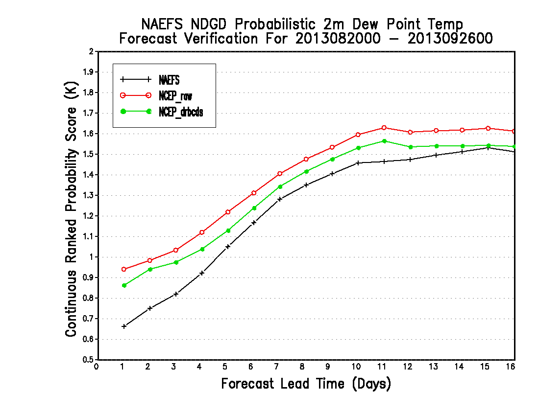
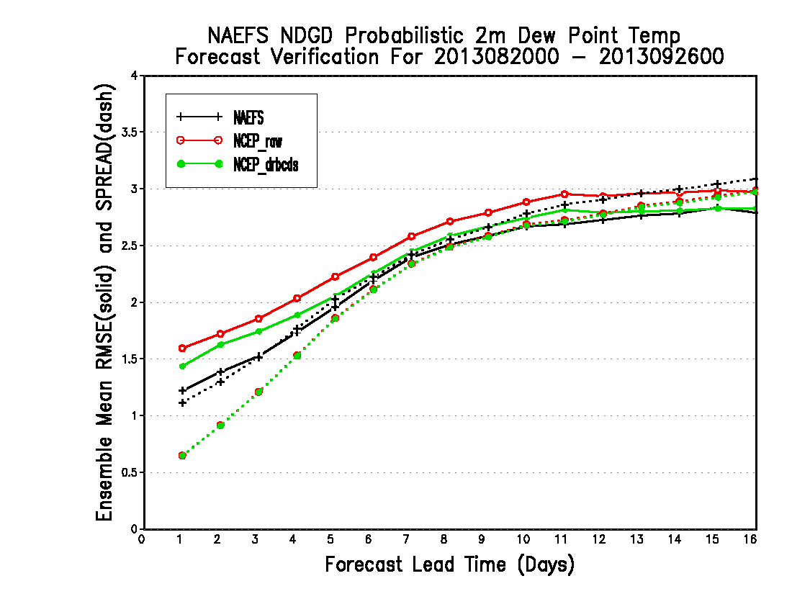
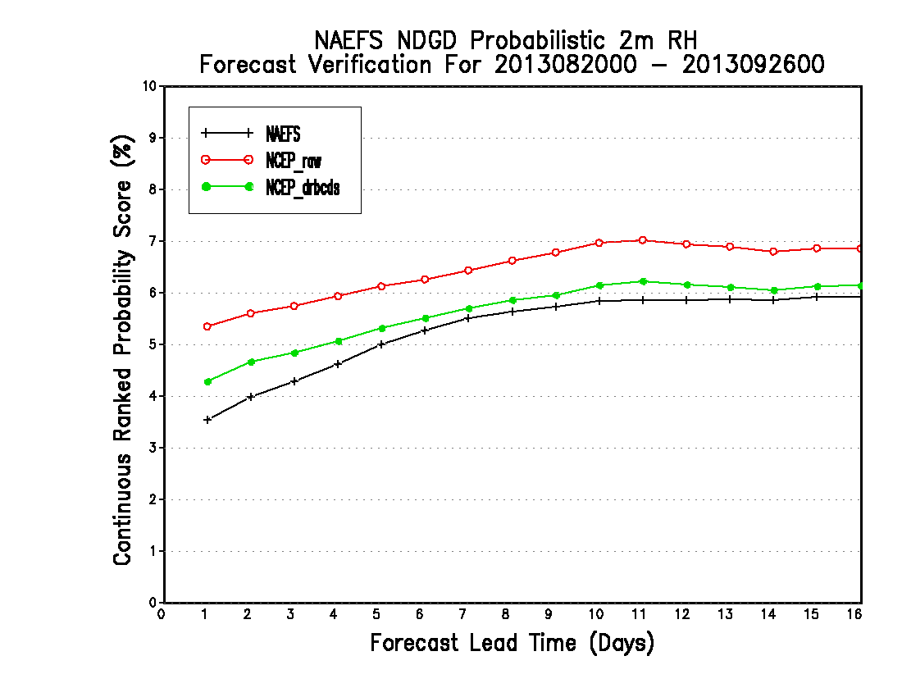
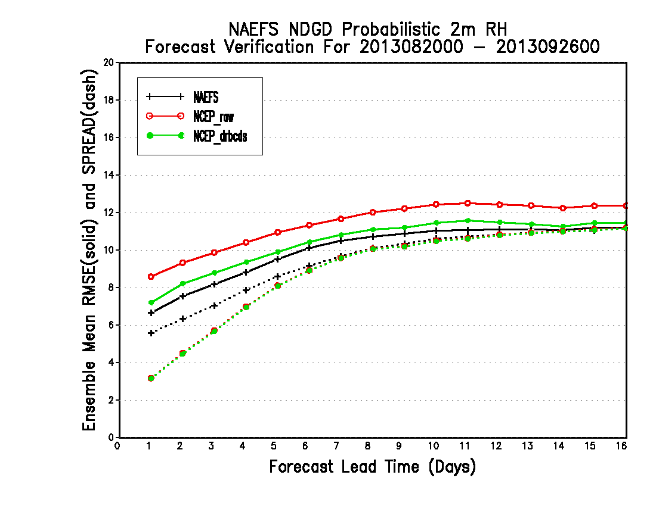
Dew point T
Dew point T
CRPS
RMS & Spread
RH
RH
CRPS
RMS & Spread

Slide 22
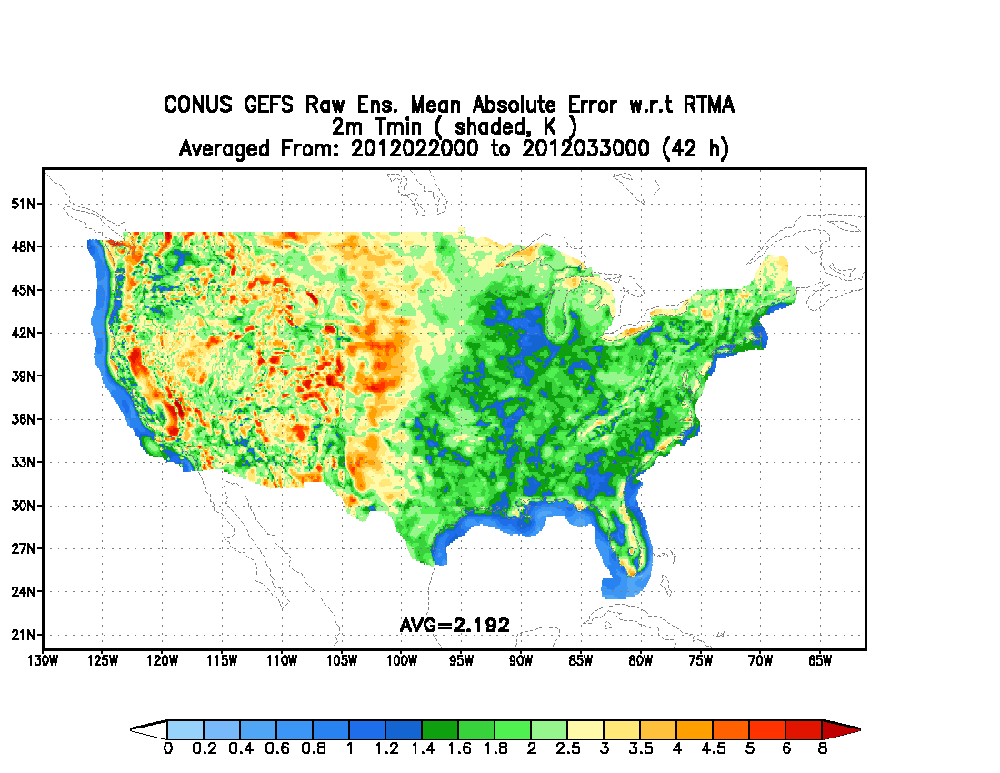
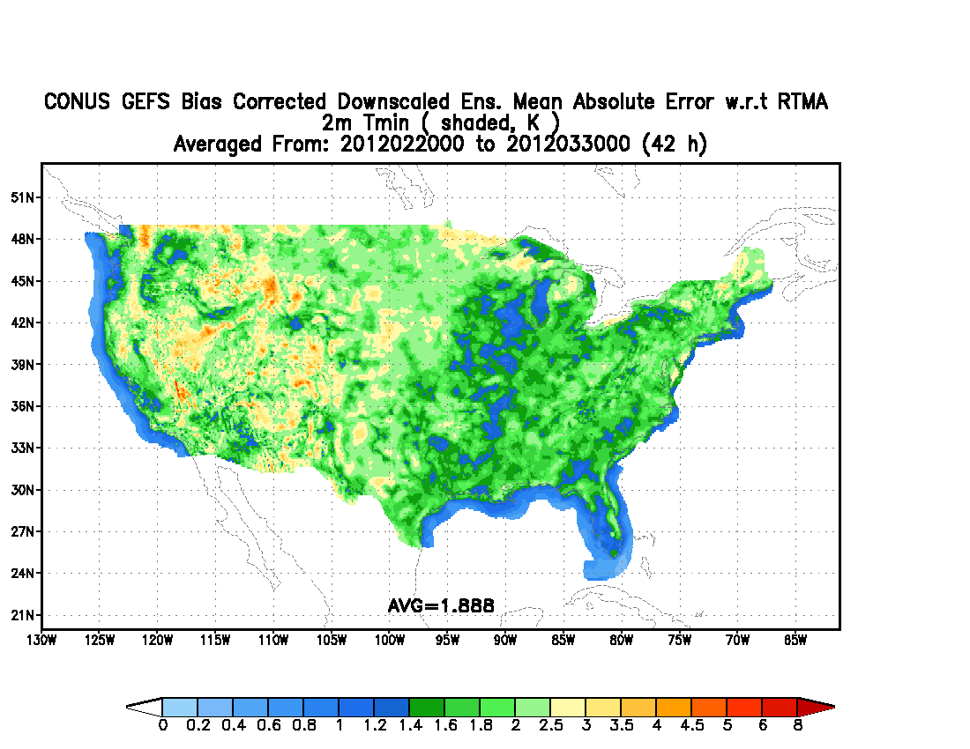
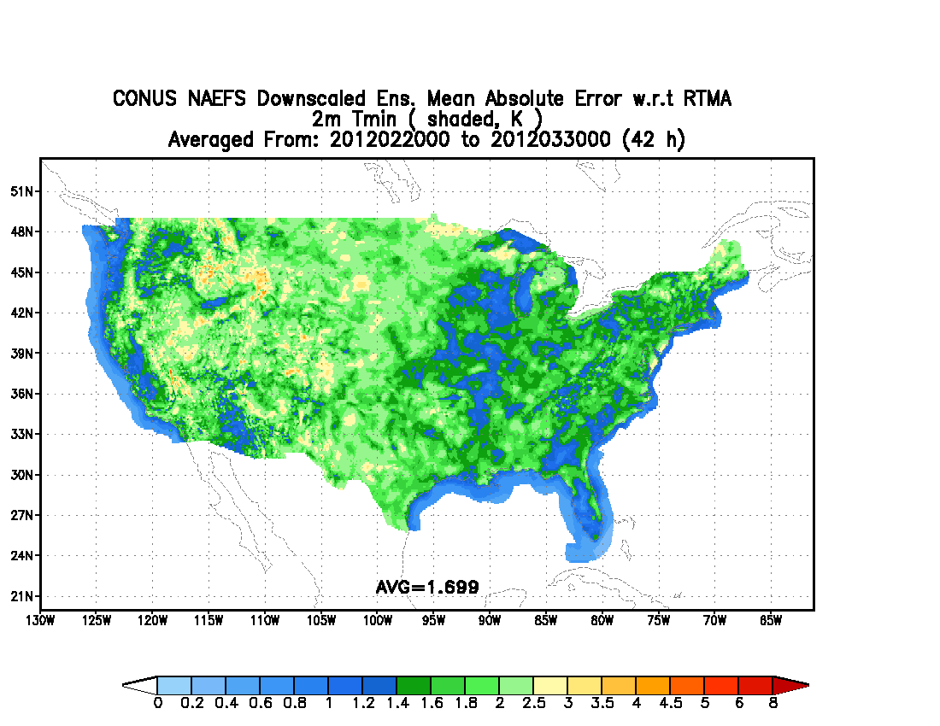
T2m (Minimum)
RAW
BC+HB+DS
Surface minimum temperature for latest 40 days (2/20/2012 – 3/30/3012) after GEFS upgrade.
Average MAE improvements:
14% from NCEP model post-process only
23% from NAEFS – final product
NAEFS

Slide 23
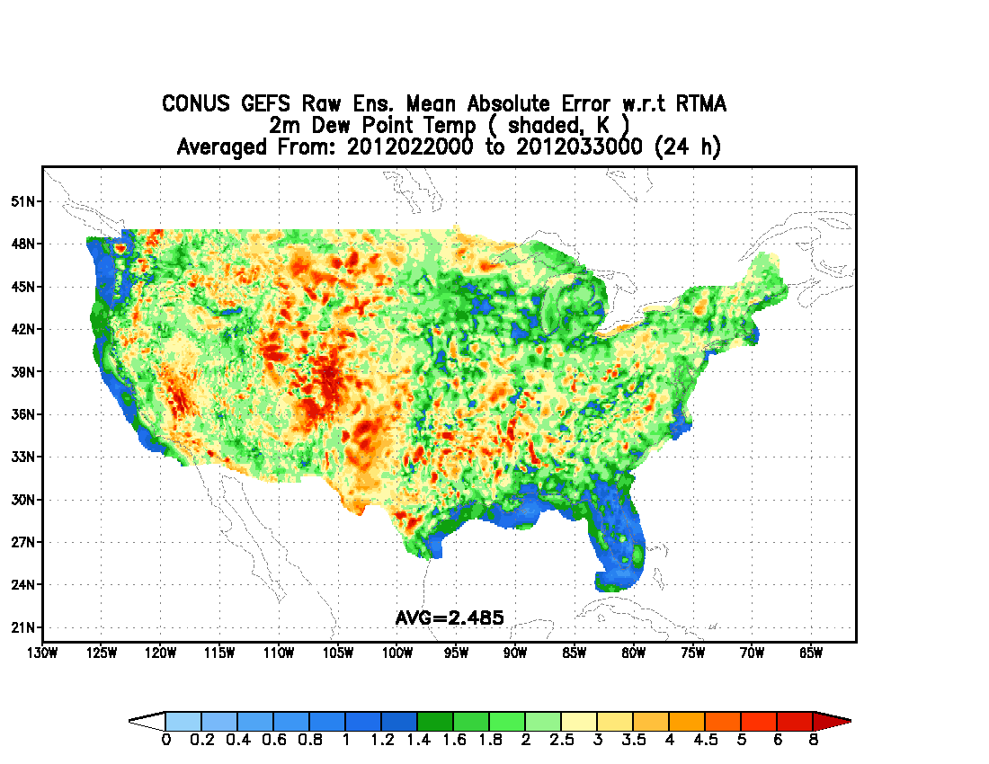
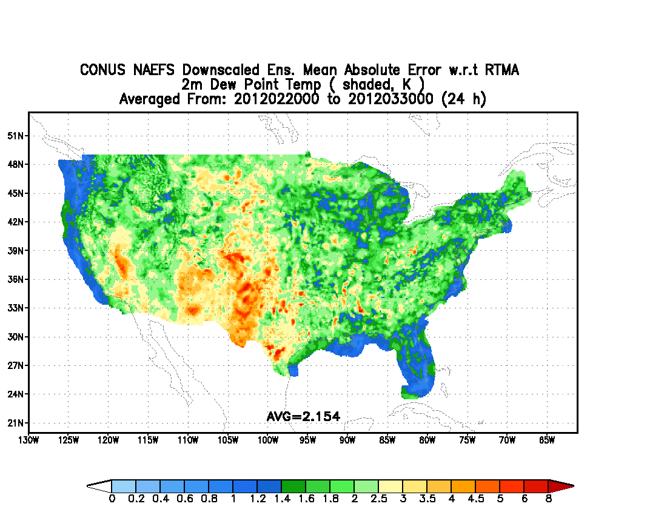
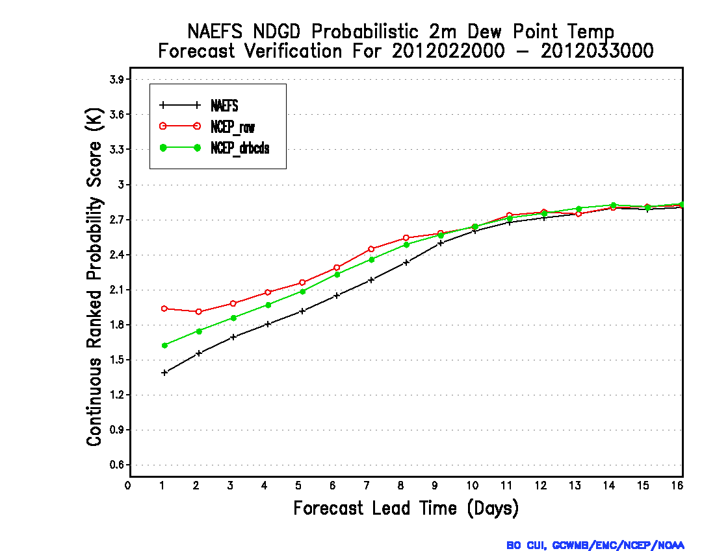
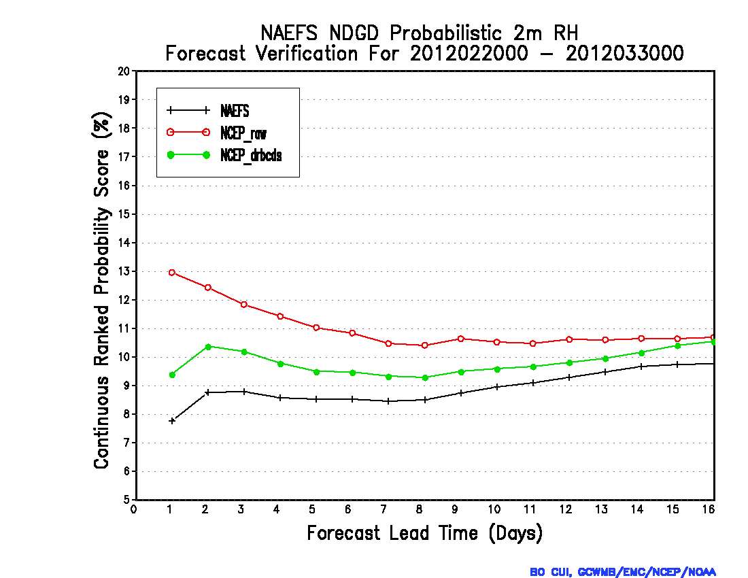
2-m dew point T
MAE - Raw
MAE - NAEFS
24hr
2-m dew point T
2-m RH
CRPS
CRPS

Slide 24
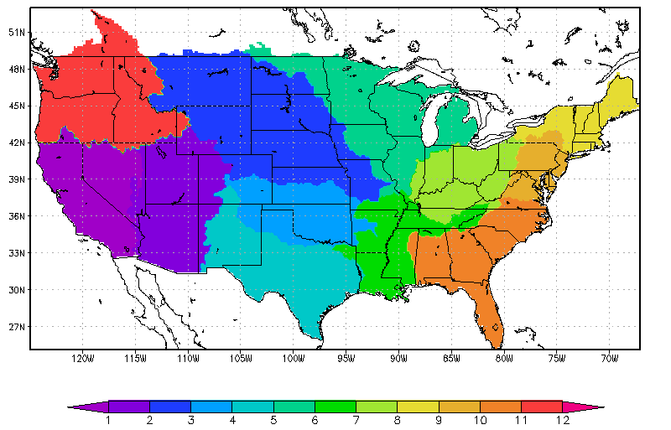
Significantly reduced bias for CONUS and each RFC
CONUS
NWRFC
NCRFC
MBRFC
NERFC
CNRFC
MARFC
Consistently effective along with leading time
Bias=1.0
OHRFC
CBRFC
ABRFC
WGRFC
LMRFC
SERFC
More effective on lower amount precip
1 * 1 deg
CBRFC
OHRFC
before bias correction
before bias correction
after bias correction
1 * 1 deg
after bias correction
1 * 1 deg

Slide 25
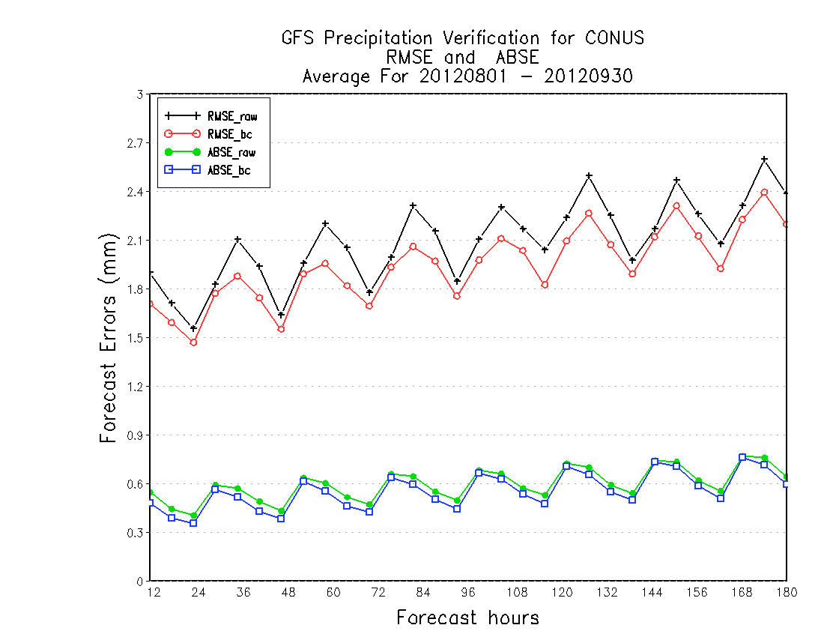
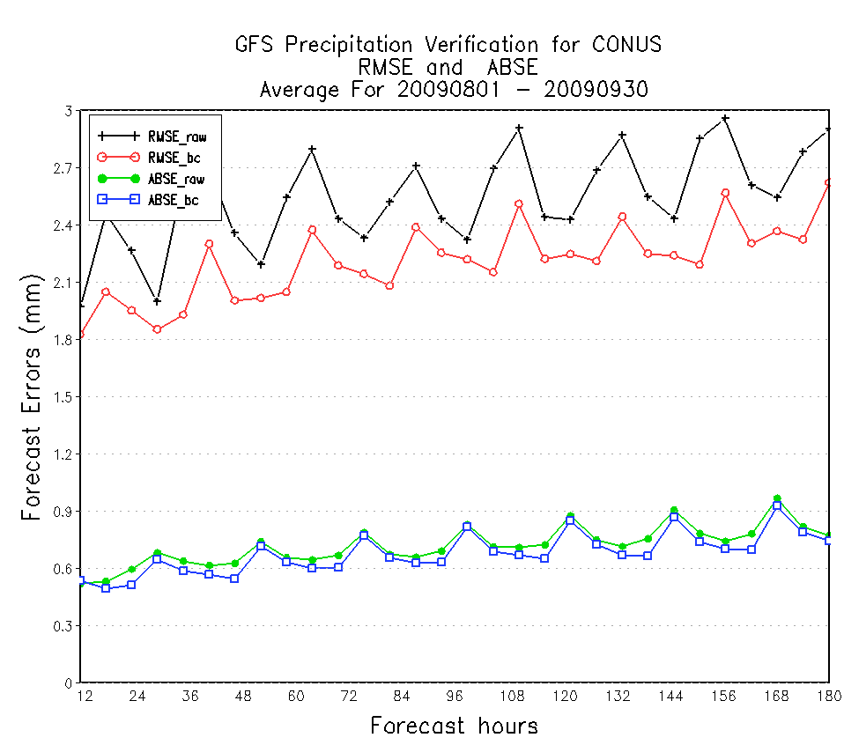
Reduced RMSE and ABSE for GFS and GEFS/CTL
GFS - 2009
GFS -2012
RMSE_raw
RMSE_raw
RMSE_bc
RMSE_bc
ABSE_raw
ABSE_bc
ABSE_raw
1 * 1 deg
1 * 1 deg
1 * 1 deg
ABSE_bc
DUE to GFS upgrade, errors are significantly reduced in the RAW FCST,
and then the errors are further reduced by bias correction.
Notes:
verified against 6-hourly CCPA

Slide 26
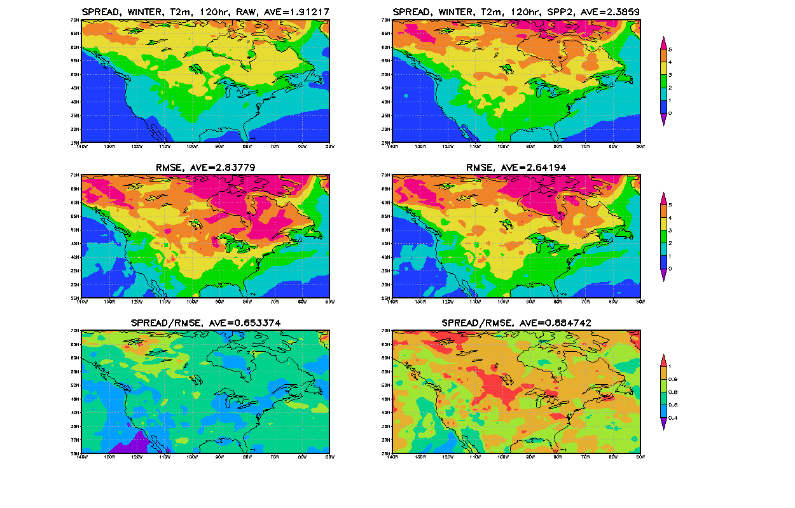
Surface Temperature (T2m)
for Winter (Dec. 2009 – Feb. 2010), 120-hr Forecast
SPREAD
25% spread increased
RMSE
7% RMSE reduced
SPREAD/RMSE
Future Improvement of 2nd moment for Temperature

Slide 27
Improvement of 2nd moment for North America (Dec. 2010 – Nov. 2011)
Winter
Spring
Summer
Autumn
Winter
Spring
Summer
Autumn
2nd moment adjustment helps improve under-dispersion for all seasons with a maximum benefit in summer.

Slide 28
Climatology Calibrated Precipitation Analysis
Background - (QPF bias correction in NCEP)
Implemented on 2004 (HPC, CPC endorsed)
Bias corrected GFS/GEFS forecasts
At 2.5 degree resolution, every 24 hours, using Gauge (12UTC-12UTC)
Using decay average (or Kalman Filter) method for sampling
Using frequency match algorithm for CDF of OBS/FCST
Climatological Calibrated Precipitation Analysis (CCPA)
Use CPC unified analysis at 1/8 degree, daily, global land - reliability
Use RFC/QPE (stage IV) 5km resolution, 6-h(CONUS) – resolution
Use regression method to generate a and b from above two datasets
Produce CCPA analysis ( CCPA = a*QPErfc + b)
Resolution is 5km (NDFD) grid (and subsets) for CONUS
Update every year by apply longer stage IV to produce better regression coefficients
Important Applications
Improving QPF/PQPF bias correction – GEFS, NAEFS, SREF and etc…
Statistical downscaling QPF/PQPF forecast for GEFS, NAEFS, SREF and etc…
HPC daily precipitation analysis products – CCPA web products (2012)
Daily precipitation verifications (WPC and EMC map discussion)
Future NAM’s precipitation analysis (replaced CPC’s analysis)
Hydrological application – OHD and RFC
Research Communities
Reference
Publication: http://journals.ametsoc.org/doi/abs/10.1175/JHM-D-11-0140.1
Web display (EMC): http://www.emc.ncep.noaa.gov/gmb/yluo/CCPA.html

Slide 29
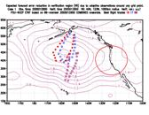
WSR - Winter Storm Reconnaissance
Improving high impact weather forecasts by adaptive observing, data processing
Using NCEP, CMC and ECMWF ensemble forecasts
4 cycles per day for NCEP ensembles
2 cycles per day for CMC and ECMWF ensembles
NCEP operational since 2007
NCO and EMC
Winter period:
December – March every year
Maintenance
Codes/scripts will be tested for each system upgrade
Codes/scripts will be tested before every winter season started
Evaluations
Through THORPEX funding (out now?)
Limited evaluations – collaborated with ESRL and ECMWF to target observation evaluation (Fanglin Yang)
Limited support due to resources

Slide 30
CSTAR Program
CSTAR - Collaborative Science, Technology, and Applied Research Program
Collaborate with SUNYSB, EMC, HPC, OPC of NCEP and ESRL
Predictability of high impact weather during the cool season over the eastern U.S: from model assessment to the role of the forecaster
Produce daily ensemble sensitivity analysis maps based on
NCEP GEFS
CMC GEFS
ECMWF GEFS (passwd protected)
A set of variables
MSLP and 500hPa height
CSTAR web-site: http://dendrite.somas.stonybrook.edu/CSTAR/
EMC web-site: http://www.emc.ncep.noaa.gov/gmb/yluo/CSTAR/

Slide 31
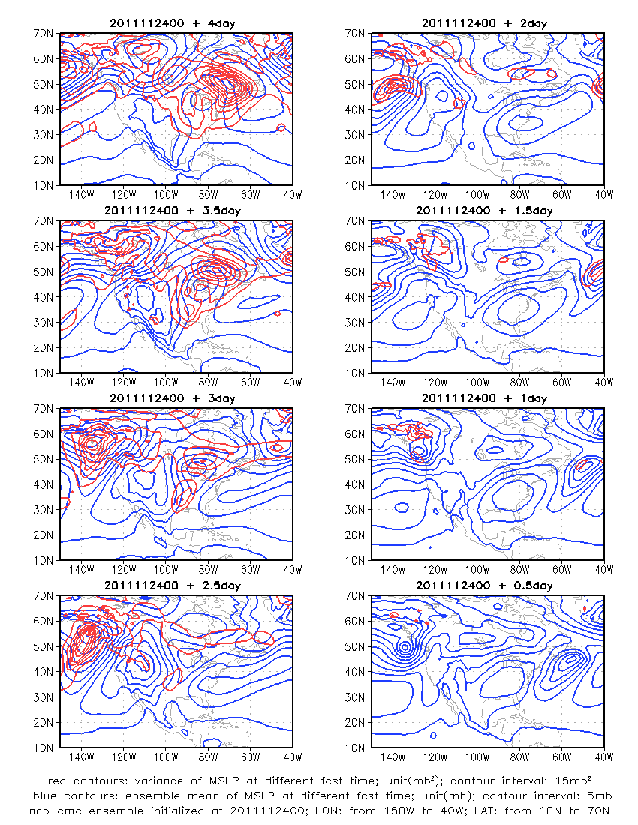
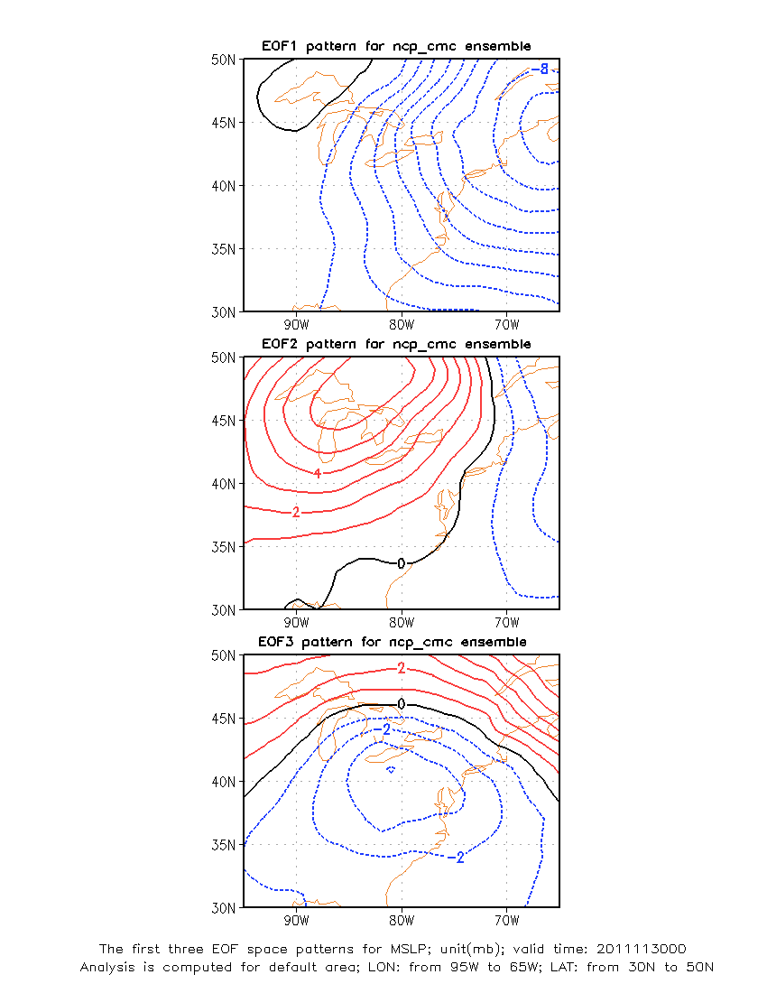
Daily maps to support CSTAR program for winter season

Slide 32
GEFS/NAEFS Product/Data Distribution
System | Current available products
Config. | deg 0-384h, every 6 hours, 20 members (NCEP) and 20 members (CMC), ens. control (NCEP and CMC)
Format | GRIB1 (and GRIB2, GIF images for web display)
CCS | NCEP: pgrba, pgrbb, pgrba_bc, pgrba_an, pgrba_wt, ensstat, ndgd CMC: pgrba, pgrba_bc, pgrba_an, pgrba_wt, ensstat NAEFS: ndgd, pgrba_an, pgrba_bc
NCEP FTPPRD | ftp://ftpprd.ncep.noaa.gov/pub/data/nccf/com/gens/prod cd gefs.${yyyymmdd} for NCEP ensemble 1. pgrb2a (00, 06, 12 and 18UTC) (1.0 degree, all lead times, 1(c) + 20 (p)) 2. pgrb2alr (00, 06, 12 and 18UTC (2.5 degree, all lead times, 1(c) +20 (p)) 2. pgrb2b (00, 06, 12 and 18UTC) (1.0 degree, all lead times, 1(c) + 20 (p)) 4. pgrb2blr (00 and 12UTC) (2.5 degree, all lead times, 1(c) + 20 (p)) 5. ensstat (00UTC) (prcp_bc, pqpf and pqpf_bc files) 6. wafs (00 and 12UTC) 7. ndgd_gb2 (00, 06, 12, 18UTC) (CONUS-5km, all lead times and all probability forecasts) ftp://ftpprd.ncep.noaa.gov/pub/data/nccf/com/gens/prod cd cmce.${yyyymmdd} for CMC ensemble 1. pgrba (00 and 12UTC) (1.0 degree, all lead times,1 control + 20 members) ftp://ftpprd.ncep.noaa.gov/pub/data/nccf/com/gens/prod cd naefs.${yyyymmdd} for NAEFS products 1. pgrb2a_an (00, 12UTC) (1.0 degree, all lead times, anomaly for ensemble mean) 2. pgrb2a_bc (00,12UTC) (1.0 degree, all lead times, probabilistic forecasts) 3. ndgd_gb2 (00,12UTC) (CONUS-5km, all lead times, probabilistic forecasts)
TOC | ftp://tgftp.nws.noaa.gov/SL.us008001/ST.opnl/ cd MT.ensg_CY.${cyc}/RD.${yyyymmdd} for NCEP only 1. PT.grid_DF.gr1_RE.high (00 and 12UTC) (Pgrba: 1.0 and 2.5 degree, 0-384 hrs, c + 10 (p)) 2. PT.grid_DF.gr1_RE.low (00 and 12UTC) (Pgrbb: 1.0 degree, 0-84 hrs, 2.5 d, 90-384 hrs, c + 10 (p)) 3. PT_grid_DF.bb
NOMADS | http://nomads.ncep.noaa.gov (click: GFS Ensemble High Resolution – html ) for NCEP, CMC and FNMOC raw and bias corrected ensemble forecast at all lead time (0-384 hours) http://nomad5.ncep.noaa.gov/pub/gens/archive/ for http: combined pgrba and pgrbb at 1 degree resolution

Slide 33
Ensemble Products on AWIPS?
Ensembles in NCEP operation
21 years anniversary of global ensemble in operation for both NCEP and ECMWF (Dec. 1992)
13 years of regional ensemble (SREF) for NCEP operation (2001)
Current status of ensemble products
NCEP service centers could use all possible ensemble products (information)
But regional office and WFO not, if they rely on AWIPS ……
For example: GEFS/NAEFS
wafs38, wafs39, wafs40 grids (3447 grid points)
00UTC and 12UTC initial forecasts
Every 6 hours out to 192 hours
GFS control + ens control + 10 ensemble members (+/- 5)
22 variables only
What is the expectation from AWIPS II?
We have already developed functionality of probabilistic forecast
SREC - Software Recommendation and Evaluation Committee
Increase bandwidth/storage, setup priorities?
What can we do?
Can we have ensemble mean and spread first on AWIPS?

Slide 34
Future Seamless Forecast System
NCEP/GEFS is running on T254L42 (GFS 9.0
version) resolution with tuned ETR initial
perturbations and adjusted STTP scheme
for 21 ensemble members, forecast out to
16 days and 4 cycles per day. Extended to 45
days at T126L28/42 resolution, 00UTC only
(uncoupled)
NAEFS will consider to include FNMOC ensemble in 2011,
with improving post process which include
bias correction, dual resolution and down scaling
Main products:
ENSO predictions???
Seasonal forecast???
Main event
MJO
GEFS/NAEFS
service
CFS
service
week-1
week-2
one month
Weather/Climate linkage
SEAMLESS
Main products:
Probabilistic forecasts for every 6-hr out to 16 days, 4 times per day: 10%, 50%, 90%, ensemble mean, mode and spread.
D6-10, week-2 temperature and precipitation probabilistic mean forecasts for above, below normal and normal forecast
MJO forecast (week 3 & 4 … )
Operational CFS has been implemented in
2011 with T126L64 atmospheric model
resolution (CFSv2, 2010version) which is fully
coupled with land, ocean and atmosphere
(GFS+MOM4+NOAH), 4 members per day
(using CFS reanalysis as initial conditions,
one day older?), integrate out to 9 months.
IMME and NMME - ???
The quality of NAEFS week-2 forecast
CPC will review it

Slide 35
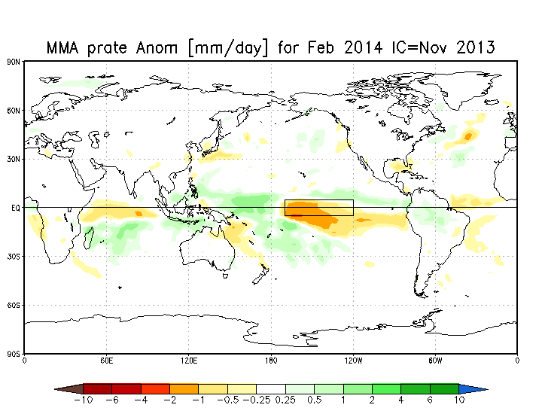
IMME Status – Malaquias Pena
Datasets:
CFSv2, ECMWF, MeteoFrance and MetOffice
Real-time forecasts and corresponding model hindcasts
Leads: 0 to 6 months. Variables: Precip Rate, 2mT, SST
Data process algorithms
Decoding, bias correction, multi-model combination and data display
Created algorithms and transitioned to WCOSS
Created algorithms for model intercomparison prediction skills
Products
Monthly mean forecasts maps: Globe and North America
Niño 3.4 forecast plumes
Posted individual model forecasts on a regular basis in a password-protected website for use by CPC’s forecasters
Developments
Probabilistic forecast products
Sophisticated multi-model combination
Potential to use for seasonal Hurricane prediction

Slide 36
NMME Status – Malaquias Pena
Data process algorithms
Decoding and encoding into a uniform GRIB format
Transitioned algorithms to WCOSS
Forecast verification algorithms
Products are generated by CPC personnel
IMME and NMME share similar product generation strategy
Developments
CFSv2 6hr data format conversion and transfer to NCAR for NMME Phase II

Slide 37
Extended GEFS
Algorithms
Setup algorithms to run GEFS out to 32 days
Forecast integrations for Summer 2011, Winter 2011-2012 and Winter 2012-2013
Developments
500hPa and MJO signal comparisons with CFSv2 benchmark (75% progress)
Retrospective GEFS generation for bias correction (10% progress)
Generation of Breeding perturbations in the coupled GFS-MOM (20% progress)
Development into prescribing realistic SST in the GEFS (5%)

Slide 38
Selected Results
For typical atmospheric variables the GEFS outperforms the operational CFS during the first two weeks
Dashed lines: GEFS T254&190L42, 21 members
Continuous lines: CFSv2 T126L64, 16 members
Beyond 3 weeks. The GEFS shows strong systematic errors. SST errors in the GEFS deteriorates skill of MJO and low-level variables.
Steps to make to improve the system:
Implement systematic error correction strategy through hindcast
Prescribe realistic SSTs or perform coupled GEFS

Slide 39
Future Plan of the Ensemble Prediction System for HWRF – Stream 1.5 - Zhan Zhang
1. IC/BC Perturbations
- Large scale flow based, from future GEFS;
- Initialize the HWRF system from Global EPS-based fields as IC and BC;
- Reduce uncertainties in model IC/BC in the large scale flows.
2. Model Physics Perturbations
- Physics –based method;
- Stochastic Perturbed Parameterization Tendencies (SPPT);
- Perturbing the convective trigger in the current SAS scheme to generate ensembles;
- Reduce uncertainties from model physics.
3. 10 ensemble members will be generated by combining the above two perturbations.

Slide 40
Comparison between HWRF Ensemble and Deterministic systems
2012-2013 Storms
ATL-Intensity
ATL-Track
comparable
~14% improvement
EP-Track
EP-Intensity
~23% improvement at day 4
~22% improvement at day 5

Slide 41
NCEP Wave Ensemble Forecast System - Contributed by Henrique Alves
Planned upgrades for wave ensembles:
Spatial (30min) and spectral (XLF=1.07) resolution upgrades
Spatial grids mosaic using 3 domains
Upgrade to new wave generation physics package used in deterministic wave model
Additional output parameters matching deterministic wave models
Additional point outputs matching deterministic wave models
Add back hindcast phase using ET data from GEFS with proper 80-member, 24 cycling
(Later) Upgrade to using higher resolution GEFS winds (30min, 3hrly)

Slide 42
On Going Activities (2014-2015)
Next GEFS upgrade – Q4FY14/Q1FY15
Resolutions will be increased.
Model will be upgraded (GFSv10.0)
Ensemble initial perturbations – hybrid EnKF (f06) and ETR
Stochastic physics perturbations – Improved STTP (and
TS relocation – very important process for TS initialization
NAEFS product upgrade – Q2FY14
Extend variables for CONUS downscaling
5km resolution from current RTMA
Consider 2.5km resolution after RTMA upgrade (soon)
Adding more variables, such as cloud cover
Precipitation calibrations which include downscaling
Anomaly forecast from CFSRR climatology and GEFS reforecast climatology
Application of GEFS reforecast - special discussion will be followed up
Article has been published in BAMS – lead by Tom Hamill
Improve week-2 forecast and precipitation forecast (CPC’s application)
Bias correction for TS forecast (is still in investigation)
CCPA update – Q3FY14
Use more historical data for calibration
Continue to support
WSR
CSTAR (the Collaborative Science, Technology, and Applied Research) program
6th Ensemble User Workshop – March 25-27 2014
Location – NCWCP auditorium
Need to follow up the priority items from each working group
Ensemble data (product) access for users, especially for NWS/WFO

Slide 43
Rescheduled 6th NCEP Ensemble User Workshop 25-27 March 2014, College Park, MD
The workshop will bring together developers and users of ensemble forecast systems and products, as well as the research and the applications communities interested in the use of ensembles.
Following topics will be planed to the workshop during three days course
Review progress on the generation and use of operational products since the 5th workshop that took place in 2011.
Discuss plans for future efforts and collaborations
Define actions to continue support the NWS in its transition from single value to probabilistic forecasting

Slide 44
Background!!!

Slide 45
NCEP Wave Ensemble Forecast System - Contributed by Henrique Alves
Current NCEP Wave Ensembles System
1°×1° wave model grid.
20 ensemble members + 1 control.
Continuous initial conditions per member from previous cycle.
10 day forecast using the GEFS bias corrected 10m wind.
Forcing from GEFS bias-corrected 1°×1°, 3h outputs.
Planned short-term upgrades (2013-2014)
Global ensembles:
Increase model resolution to 0.5°×0.5°.
80-member wave hindcast, sync with GEFS perturbation cycle.
Extend forecasts to 16 days.
Great Lakes wave ensemble system, with NAM/SREF winds.
Longer-term upgrades to NCEP Wave ensembles
2014-2015
Increase resolution of forcing fields from 3h to 1h.
Introduce 20 new members: multi-model ensemble.
2015 and beyond
Downscaling: neural networks for coastal probabilistic forecasts.
Hurricane wave ensembles using HWRF ensembles.

Slide 46
Combined FNMOC/NCEP Wave Ensembles Product - Contributed by Henrique Alves
Current Combined NCEP/FMNOC Wave Ensembles
Implemented on 1 November 2011
Total of 41 members (21 NCEP + 20 FNMOC).
Limited to wave heights.
1°×1° wave model grid.
Planned upgrades (2013-2014)
Expand to 61 members, inclusion of 21 members from Environment Canada global wave ensembles.
Becomes North American Wave Ensemble System, NAWES, integrated to NAEFS.
New grids with 0.5°×0.5° resolution.
Expanded outputs including wind speed, wave periods etc.
Great Lakes wave super-ensemble system with E. Canada.

Slide 47
EMC’s Plan to Reframe GEFS Initializations
Background:
BV-ETR: It is NCEP Global Ensemble Forecast System (GEFS) initialization since 1992 – which is dynamically breading orthogonal, fast growing perturbations in region of high baroclinicity.
HVEDAS: Hybrid Variational Ensemble Data Assimilation System has been implemented on May 22nd, to deliver better quality of analysis (or initial condition of forecast) through improved background error covariance from EnKF 6hr forecasts.
EnKF: Ensemble Kalman Filter data assimilation has been implemented on May 22nd for HVEDAS, which evolves an ensemble over data assimilation, updated at successive observation times.
Evaluations: To assess the difference by comparing BV-ETR and EnKF (F06) initialized ensemble forecast (show statistics – next slide).
Motivations:
To reduce computational cost of double cycling of 80 members ensemble short forecasts.
To enhance our Global Ensemble Forecast System (GEFS).
To take the best of BV-ETR and EnKF, improving ensemble initial perturbations and forecast (in studying).
In reality:
In daily operation, EnKF and HVEDAS run later (final - +6hrs) than GEFS (+4.5hrs). Therefore, EnKF (F06) from previous cycle could be only one for possible GEFS initial perturbations. In fact, EnKF (F06) perturbations are not ideally (optimum) representing analysis uncertainties. Additional processes, such as rescaling, adjustment and et al. are necessary.

Slide 48
Comparison of ETR .vs EnKF (f06) initialized ensemble forecasts
Summer 2011
Winter 11/12
Summer 2012
NH 500hPa Z PAC
NH 500hPa Z PAC
NH 500hPa Z PAC
Summary of comparison:
(Three seasons – Summer 2011, Winter 2011/2012 and Summer 2012)
For Northern Hemisphere ensemble mean and probabilistic forecasts – they are very similar to each other; the differences are insignificant mostly. EnKF has a little better probabilistic forecast for very short lead time due to larger spread.
For Southern Hemisphere mean and probabilistic forecast – ETR is better than EnKF, especially for the two summer seasons. EnkF is over dispersion for SH in generally.
Tropical Storm track forecast, ETR and EnKF have similar forecast errors and ensemble spread for two summer seasons. The differences are insignificant.
For summer 2012, ETR is better than EnKF’s performance over all.
Summer 2012
TS track forecast errors – Summer 2011
SH 500hPa Z PAC
Solid black – EnKF RMSE
Dash black – EnKF spread
SH 500hPa Z RMS and Spread

Slide 49
EMC’s Plan to Reframe GEFS Initializations
Short-term: mainly focus on next implementation.
Build up updated (accumulated) EnKF based analyses error variance (potential 3D rescaling mask) to replace current operational analysis error variance (2D mask).
Investigate EnKF (f06) forecast perturbations as potential candidate of GEFS initial perturbations.
Continue comparing EnKF (f06) ensemble forecast to current operation to confirm there are no major degradations.
Test ET applied to EnKF (f06) perturbations by using analysis variance as statistical reference – emphasize smaller scale analysis error.
Test ET for EnKF (F06) perturbations with 3D/2D (mask) rescaling.
Test different rescaling factors for latitude band to reduce initial spread of EnKF (f06), especial for southern hemisphere.
Other possibilities and options (depends on the resources)
Investigate BV-ETR perturbations.
At lower resolution (T62L64) with cycling (much cheaper).
Emphasize large scale initial errors, baroclinic scale (breeding) and maximum growing vectors (ET).
Combine EnKF (f06) perturbations and ET (lower resolution) perturbations (with rescaling?) – similar concept to ECMWF’s configuration (EDA+SV)
Test Analysis Error Covariance(AEC)-Singular Vector (SV) for EnKF forecast perturbation (refer to Wang and Hamill)
Long-term:
Continue our investigation for optimum global ensemble initialization.
Study the perturbations for surface variables which include soil moisture, soil temperature, SST and etc.

Slide 50
Best (super) Probabilistic Guidance
Combined all individual post processed deterministic and ensemble forecast which include:
NCEP GEFS products – hybrid GFS and GEFS
NAEFS – NCEP/GEFS + CMC/GEFS
NUOPC – NAEFS + FNMOC/GEFS (testing now)
Super Probabilistic Products - NAEFS + SREF (this presentation)
Improve Anomaly Forecast (in plan)
Introduce Extreme Forecast Index (in Plan)
Include ECMWF deterministic forecast
Include ECMWF ensemble forecast

Slide 51
NAEFS downscaled products – every 6 hours, out to 16 days
Ideally, to improve NAEFS from regional system:
6hr fcst = NAEFS (00UTC+F06) + SREF (03UTC+F03)
12hr fcst = NAEFS (00UTC+F12) + SREF (03UTC+F09)
Product delivery time
NAEFS(00) + 9:00
GEFS(00) + 6:30
03UTC
09UTC
15UTC
21UTC
00UTC
06UTC
12UTC
18UTC
00UTC
SREF(03) + 4:40
Ideally, to improve SREF products from global system:
3hr fcst = SREF (03UTC+F03) + GEFS (00UTC+F06)
6hr fcst = SREF (03UTC+F06) + ½ GEFS (00UTC+F06) + ½ GEFS(00UTC+F12) → not good for T
By using NAEFS to improve SREF products – very limited due to 1) NAEFS are twice per day; 2) late
See demonstrate by using
3hr fcst = SREF (03UTC+F03) + NAEFS (00UTC+F06)
SREF downscaled products – every 3 hours, out to 87 hours

Slide 52
All positive by adding SREF for different weights
About 10% improvement over all
NAEFS_SREF_n20 → w1=1/2; w2=1/2
NAEFS_SREF_n40 → w1=2/3; w2=1/3
NAEFS_SREF_n60 → w1=3/4; w2=1/4

Slide 53
If users could wait for 1 hours and 20 minutes, the products will like this
About 20% improvements; weights are not important at all.
SREF_NAEFS_n20 → w1=1/2; w2=1/2
SREF_NAEFS_n40 → w1=1/3; w2=2/3
SREF_NAEFS_n60 → w1=1/4; w2=3/4

Slide 54
5th NCEP Ensemble User Workshop
Logistics
Workshop organized by EMC/NCEP and DTC/NCAR (co-organizer)
May 10-12 2011, Laurel, MD, 90+ participants
NWS Regions (6), Headquarters (17), NCEP (44)
OAR (5), other government agencies (4), private (2), academic (5) & international (11)
For further info, see: http://www.dtcenter.org/events/workshops11/det_11/
Main Theme
How to support NWS in its transition from single value to probabilistic forecasting
Goal is to convey forecast uncertainty in user relevant form
46 presentations
Covering all ensemble forecast systems
SREF, GEFS/NAEFS, Wave ensemble, CFS and NMME
Reports from NCEP Service Centres and Regions (WFOs)
E.g., first numerical ensemble-based 2-day tornado, week 3-4, monthly MJO outlook
Working groups
Ensemble configurations - Ensemble forecasting
Statistic post processing - Reforecast/hindcast generation
Probabilistic product generation - Forecaster’s role and training
Ensemble data depository / access - Database interrogation / forecaster tools
Outcome / Recommendations
Prepared report for NWS roadmap reference
Plan for immediate steps (interim solution to be implemented in 2-3 years)
Outline for long term solution and resource requirements (5-10 years)
All activities to be coordinated under NWS Forecast Uncertainty Program (NFUSE)

Slide 55
Summary of 6th NAEFS workshop 1-3 May, 2012 Monterey, CA
6th NAEFS workshop was held in Monterey, CA during 1-3 May 2012. There were about 50 scientists to attend this workshop whose are from Meteorological Service of Canada, Mexico Meteorological Service, UKMet, NAVY, AFWA and NOAA.
Following topics have been presented and discussed during workshop:
Review the current status of the contribution of each NWP center to NAEFS
For each NWP center, present plans for future model and product updates, for both the base models and ensemble system (including regional ensembles)
Decide on coordination of plans for the overall future NAEFS ensemble and products (added variables, data transfer for increased resolution grids, FNMOC ensemble added to NAEFS, especially for mesoscale ensemble-NAEFS-LAM)
Learn about current operational uses of ensemble forecast guidance, including military and civilian applications.

Slide 56
NH 1000hPa height
57
50
=1.14
53
50
=1.06
10-day forecast:
Spring 2011
Spring 2012
Improvement of ensemble spread
NH 500hPa height
84
70
=1.2
78
72
=1.08
Spring 2011
Spring 2012
Last implementation:
Reduced RMS errors
Increasing spread

Slide 57
Atlantic, AL01~19 (06/01~12/31/2011)
Atlantic, AL01~19 (05/01~11/27/2012)
GEFS-11 GEFS T190L28 (operational run)
GEFS-12 GEFS T254L42 (operational run)
Track error(NM)
Forecast hours
CASES-2011: 393 356 314 274 238 182 141 98 71 49
CASES-2012: 439 399 357 315 277 219 178 143 119 94

