Slide 1
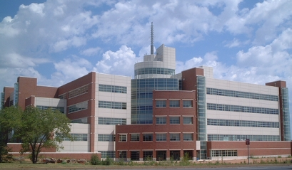
Storm Prediction Center Highlights NCEP Production Suite Review December 3, 2013 Steven Weiss, Israel Jirak, Chris Melick, Andy Dean, Patrick Marsh, and Russ Schneider Storm Prediction Center, Norman, OK
National Weather Center
National Weather Center

Slide 2
Outline
SPC mission and responsibility
Convection-allowing model (CAM) guidance for severe weather
Deterministic models: 2 cases
NAM CONUS Nest, CONUS WRF-NMM, NSSL-ARW
Ensemble systems
SSEO, SSEF, AFWA
CAM Simulated Reflectivity Verification
New SPC objective verification system
SPC “request list”

Slide 3
Good News From SPC Perspective
NCO/EMC leadership and guidance in planning/executing transition from CCS to WCOSS
Continued reliable, timely operational model production
New opportunities for enhanced collaboration
Weekly EMC Model Evaluation Group (MEG) webinars
Bi-Weekly EMC-SPC telecons/webinars focusing on convection-allowing model improvements (NAM Nest, HiResWindow)
Bi-Weekly GSD-SPC telecons/webinars focusing on RAP and HRRR development
Interactions with HWRF group to generate output fields for Tropical Cyclone tornado guidance
Closer integration of model development efforts with severe weather forecasting needs
Better alignment with NOAA/NWS strategic goals of Weather Ready Nation, Warn on Forecast, and emerging Forecasting A Continuum of Environmental Threats (FACETs)

Slide 4
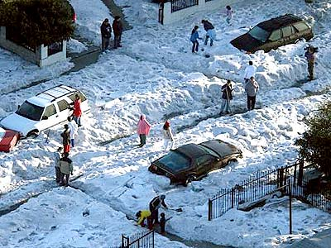
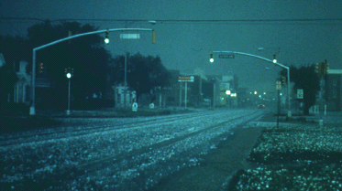
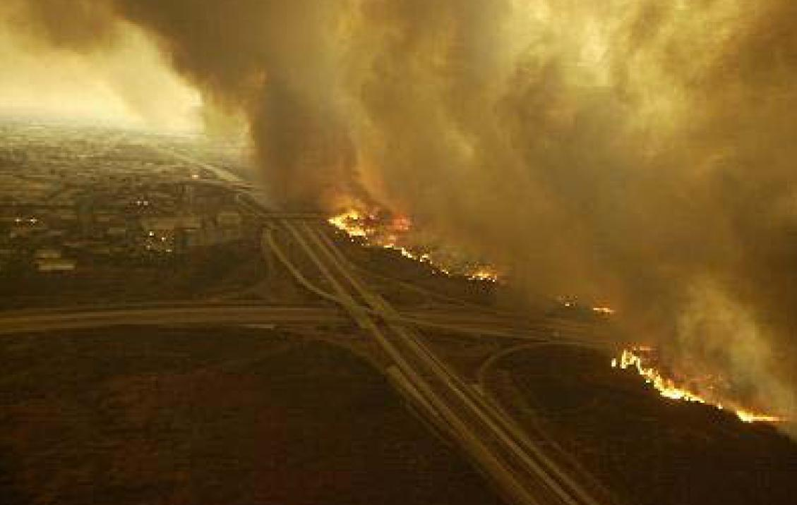
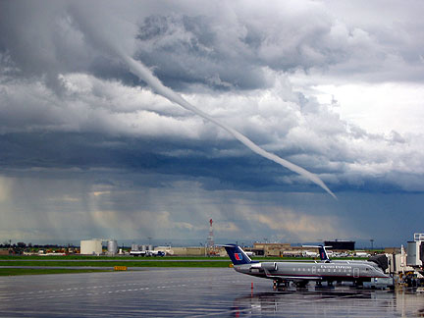
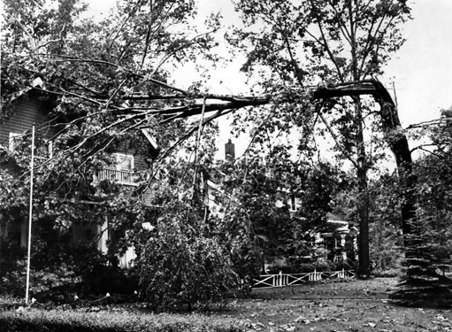
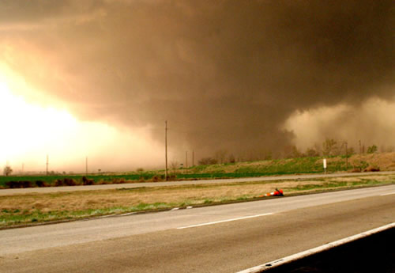
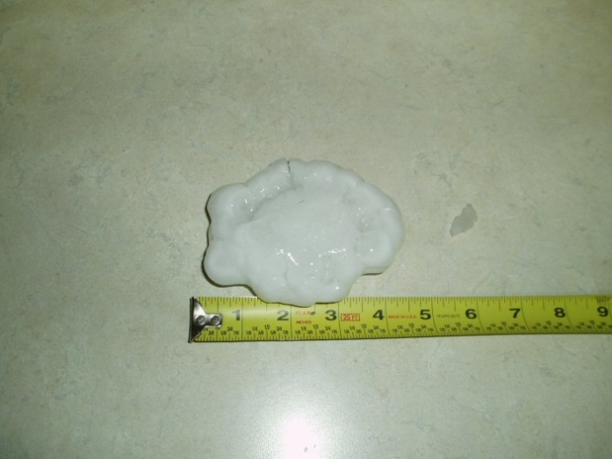
STORM PREDICTION CENTER
HAZARDOUS PHENOMENA
Thunderstorms
Hail, Wind, Tornadoes
Fire Weather
Mesoscale Winter Weather

Slide 5
SPC Mission and Responsibility
Storm Prediction Center Primary Products
Tornado and Severe Thunderstorm Watches (Event-Driven)
Watch Status Reports
Severe Weather Outlooks through Day 8
4-hr Period Enhanced Thunderstorm Outlooks for Day 1
Short-Term Mesoscale Discussions (Event-Driven)
Severe Convective Weather
Hazardous Winter Weather
Fire Weather Outlooks through Day 8
Categorical and Probabilistic Products
Severe Storm Maps, Report Listings, Event Summaries
Hourly Mesoscale Analysis; SREF & SSEO Products

Slide 6
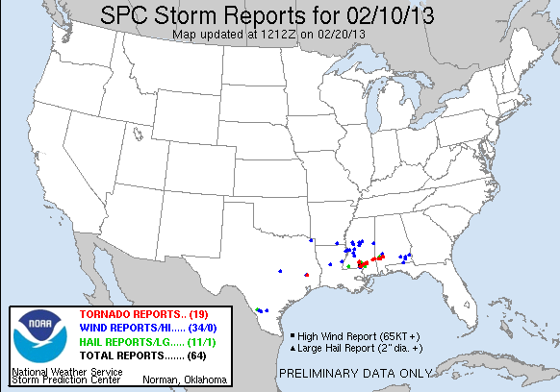
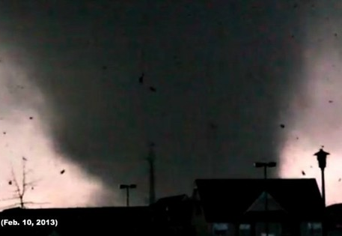
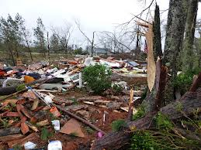
Severe Weather Case of 10 February 2013
Localized Tornado Events – EF-4 Strikes Hattiesburg, MS
21 mile path length up to 3/4 mile wide
Excellent NWS forecasts/warnings => No fatalities; 82 injuries
Nearly 200 businesses/homes destroyed and 370 damaged
Atypical convective mode transition from QLCS to series of discrete supercells
Cool season High Shear/Low CAPE environment

Slide 7
Base Reflectivity Mosaic 23z 10 Feb 2013
Hattiesburg, MS

Slide 8
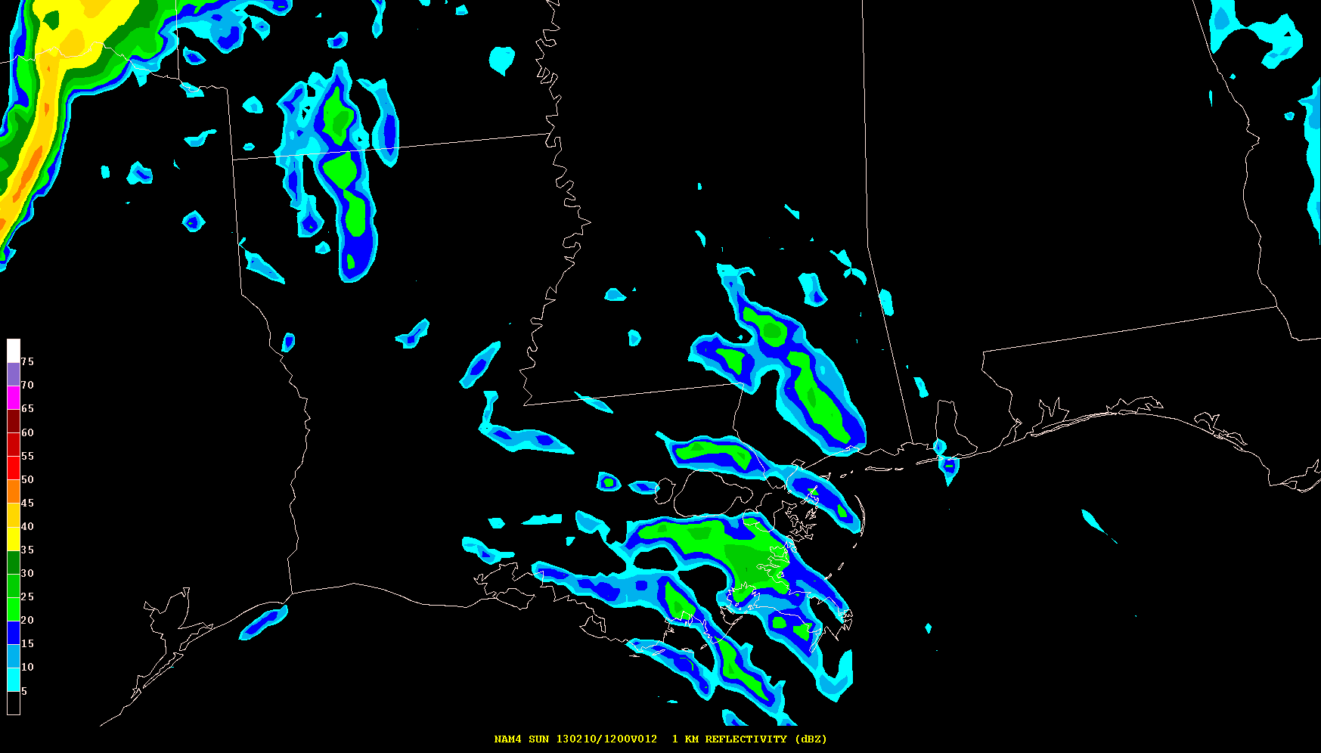
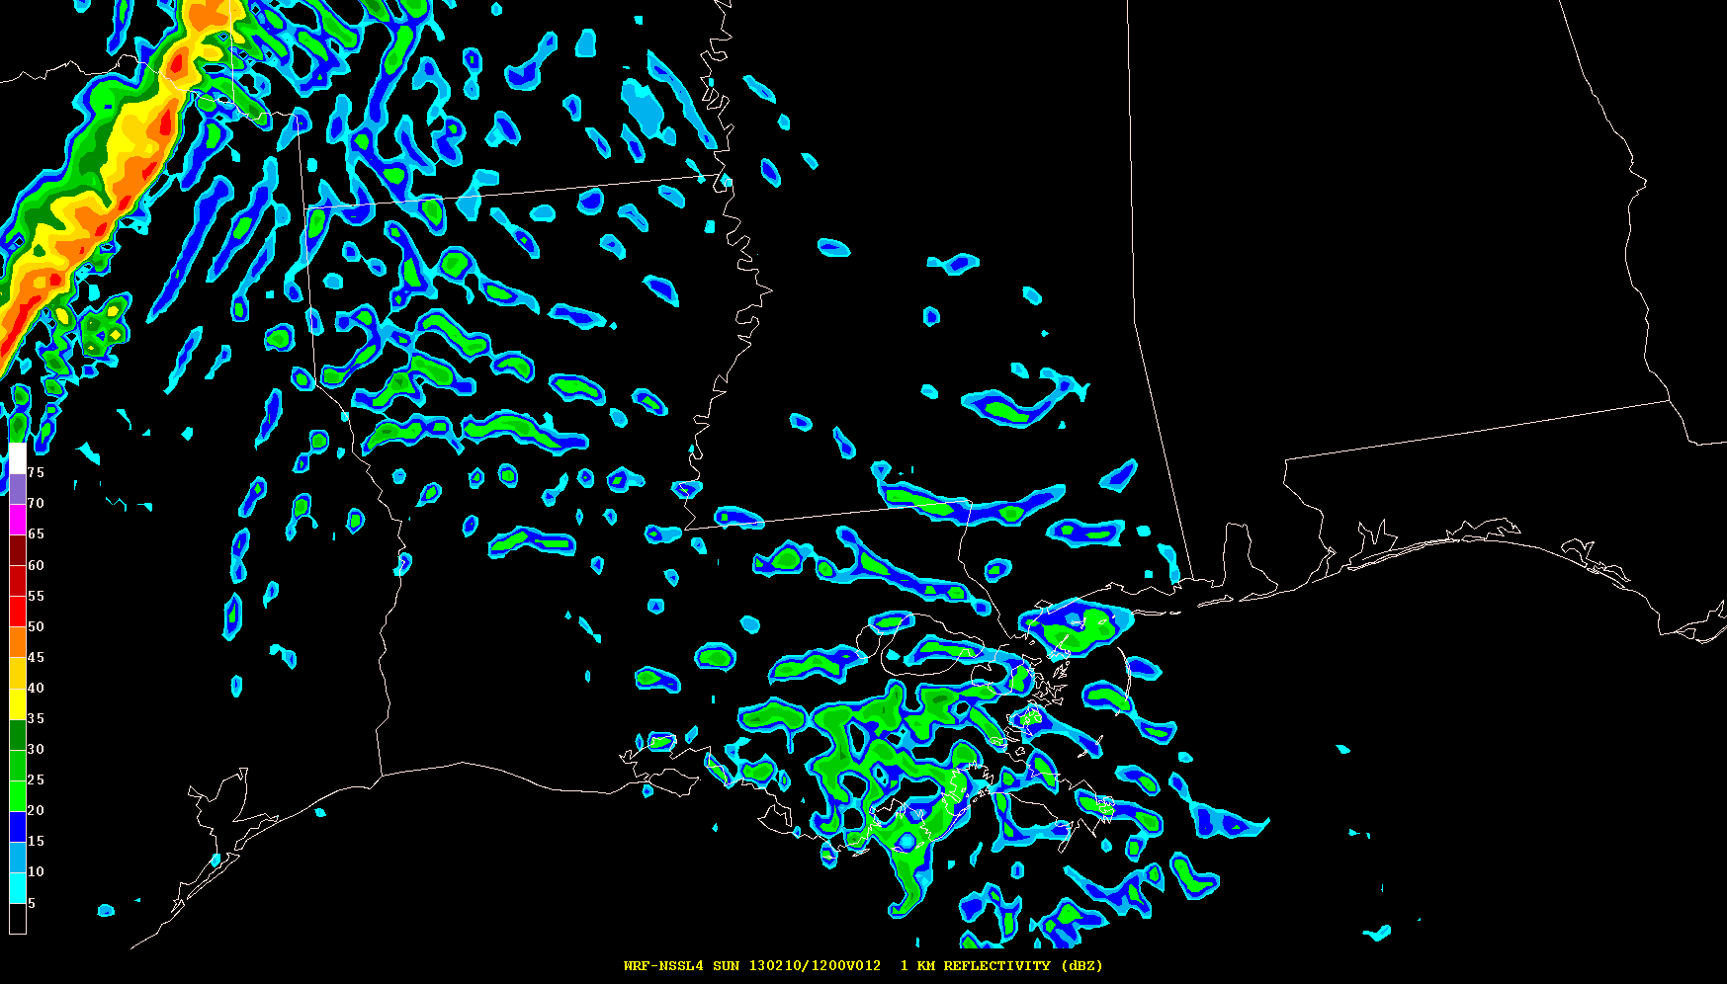
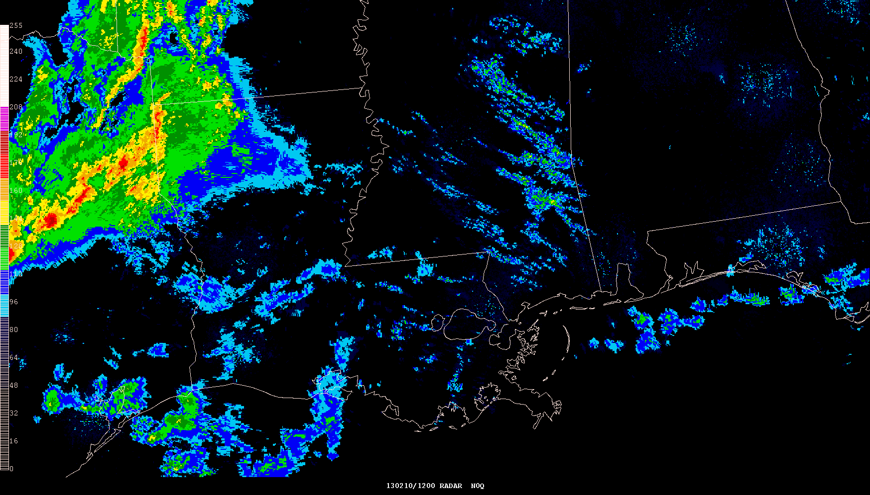
Simulated Reflectivity (1 km AGL) 12-hr Forecasts Valid 12z 10 Feb 2013
NAM 4 km CONUS Nest 4 km WRF-NMM
NSSL 4 km WRF-ARW Observed Radar Mosaic

Slide 9
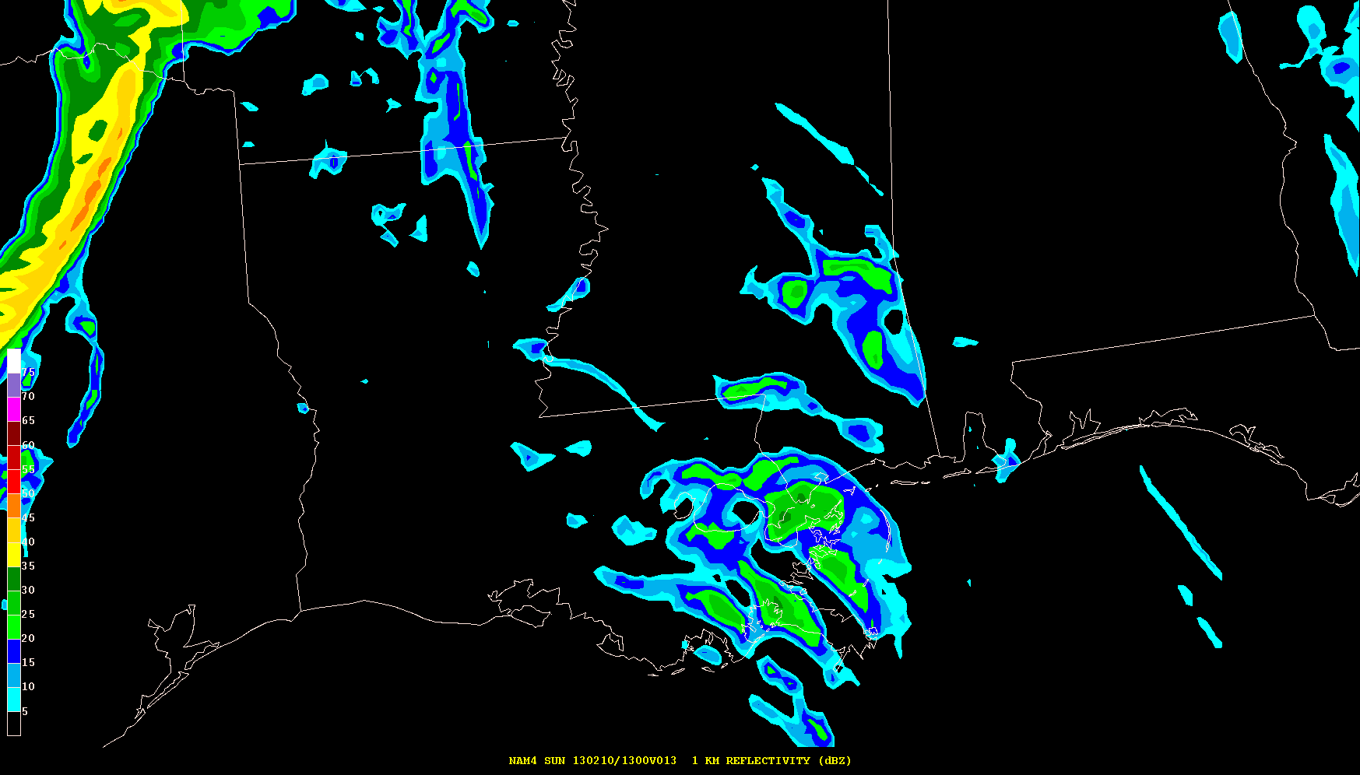
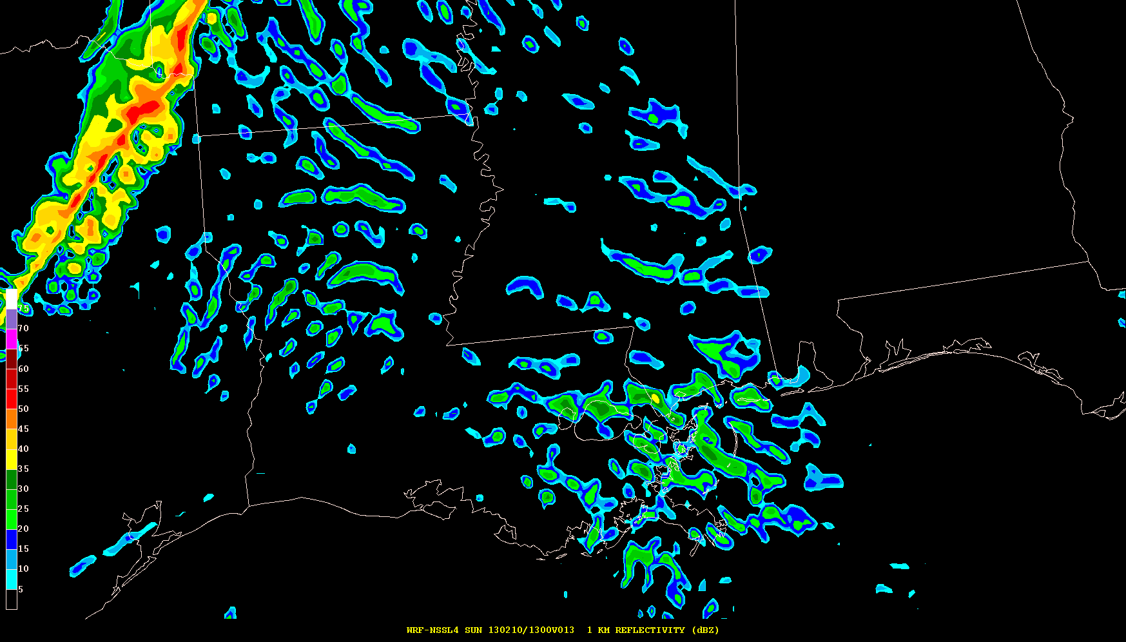
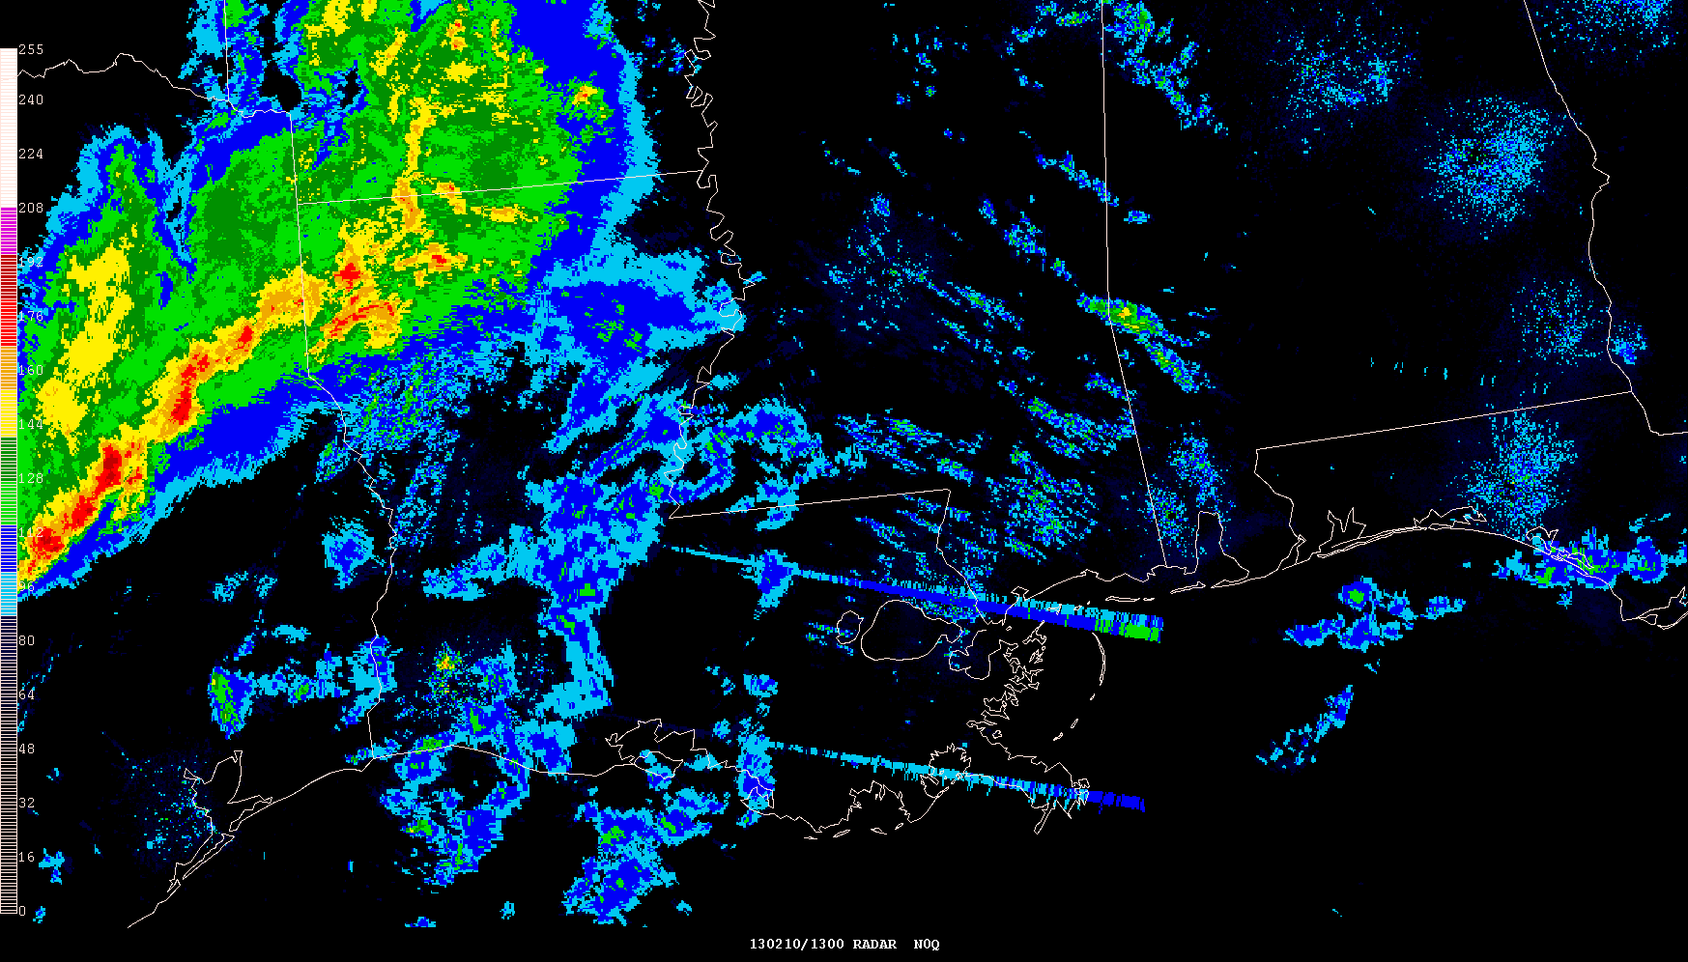
Simulated Reflectivity (1 km AGL) 13-hr Forecasts Valid 13z 10 Feb 2013
NAM 4 km CONUS Nest 4 km WRF-NMM
NSSL 4 km WRF-ARW Observed Radar Mosaic

Slide 10
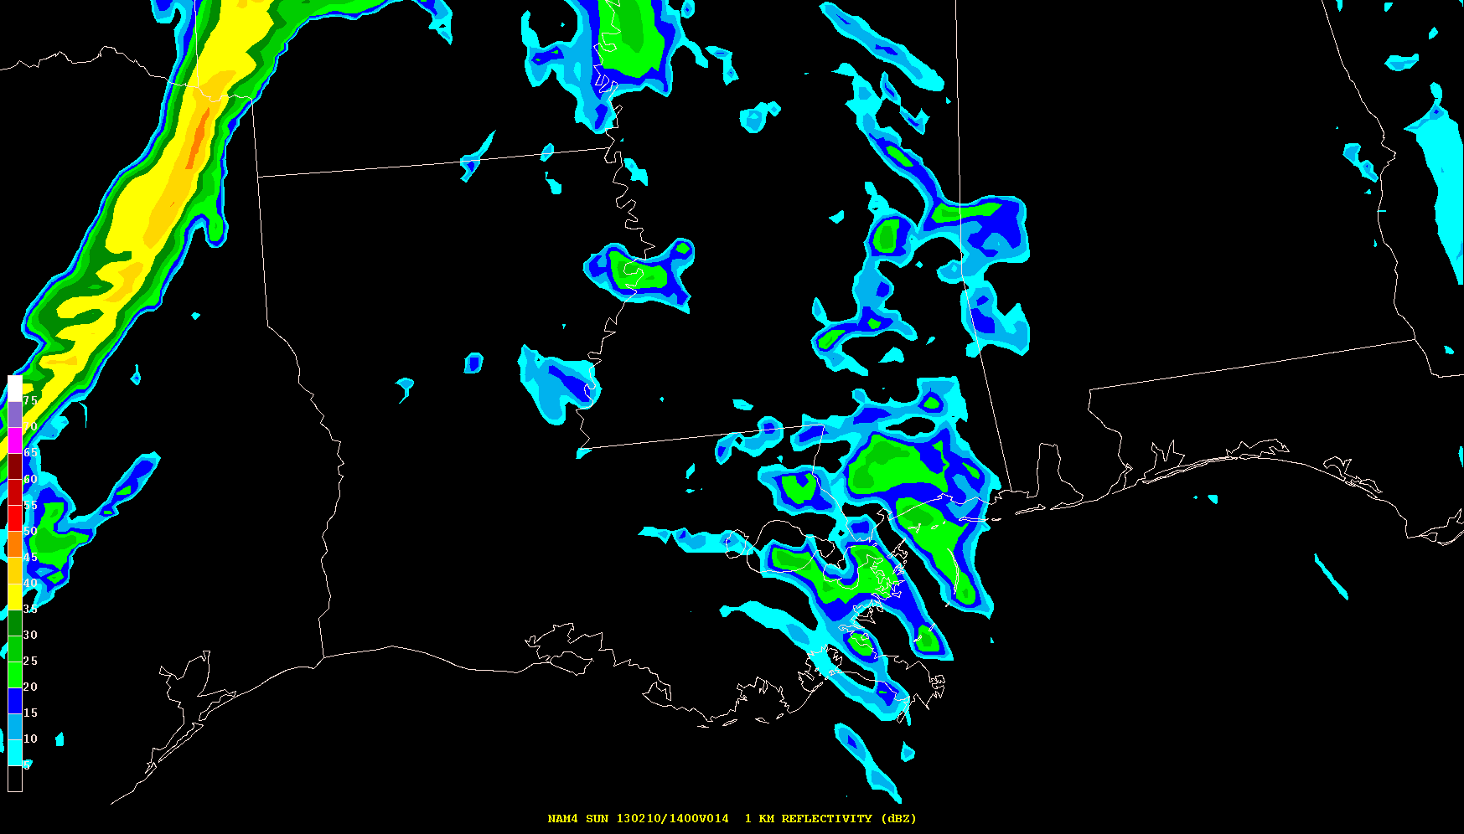
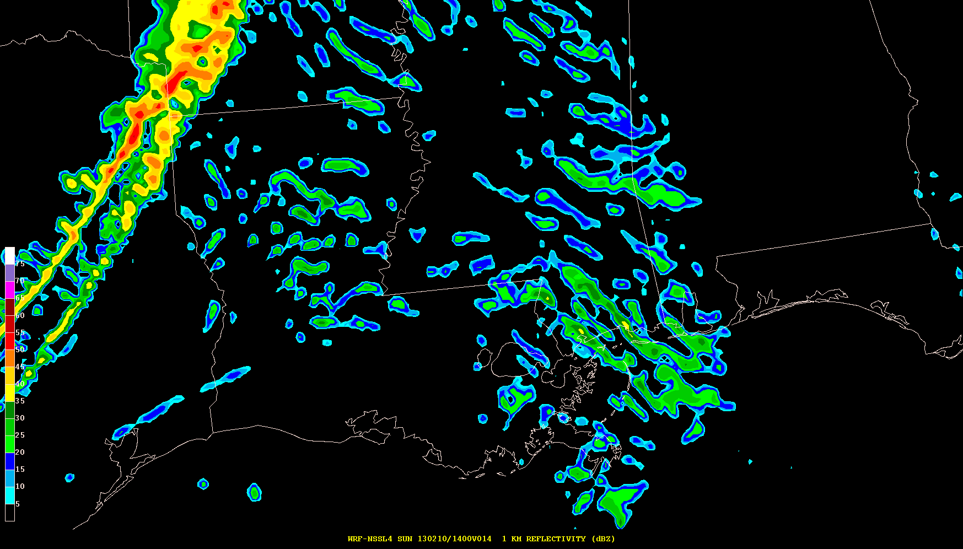
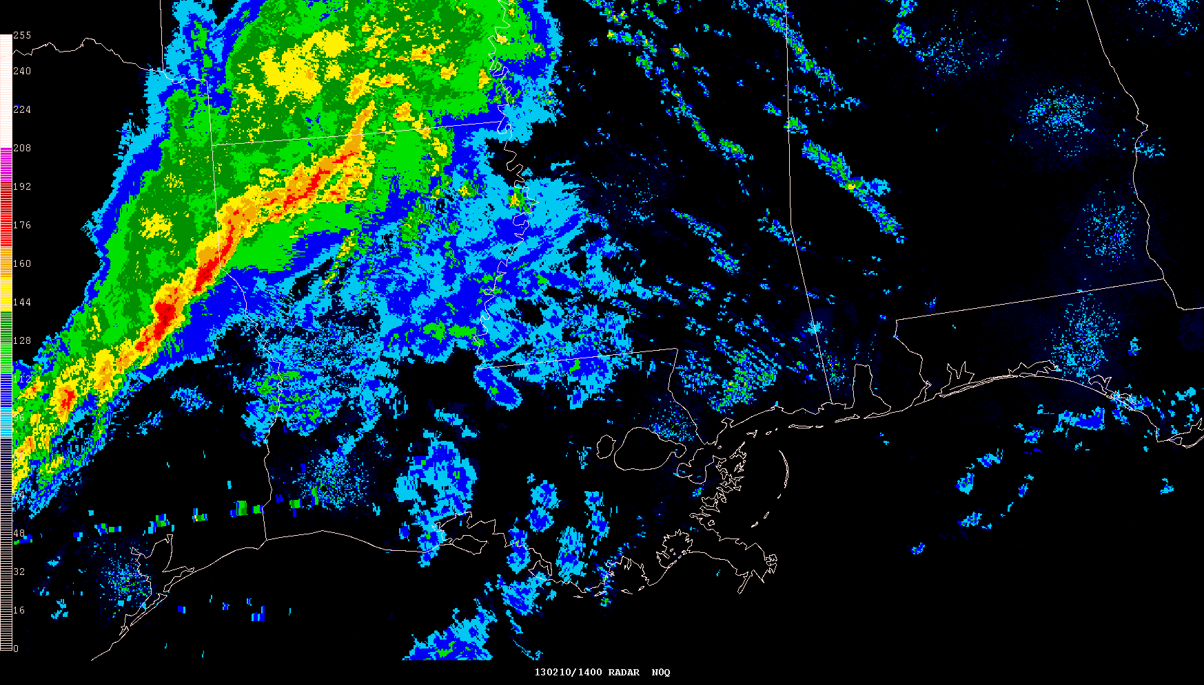
Simulated Reflectivity (1 km AGL) 14-hr Forecasts Valid 14z 10 Feb 2013
NAM 4 km CONUS Nest 4 km WRF-NMM
NSSL 4 km WRF-ARW Observed Radar Mosaic

Slide 11
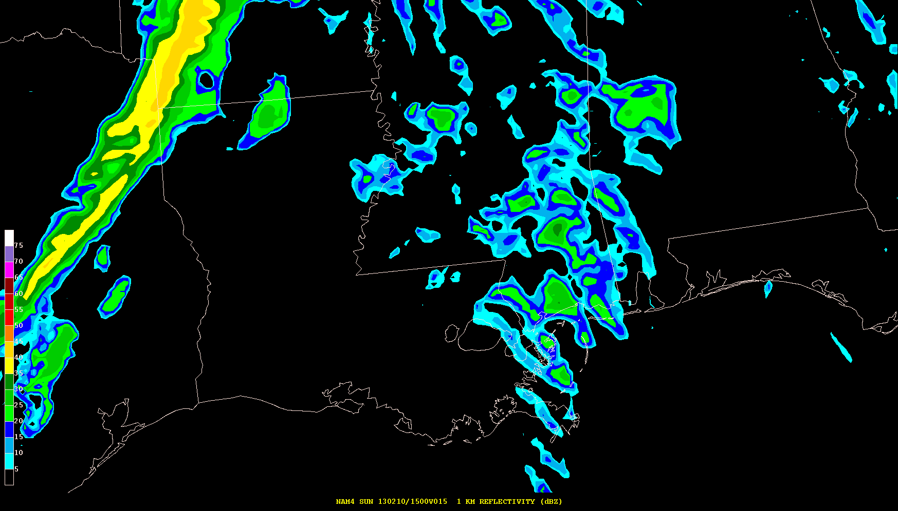
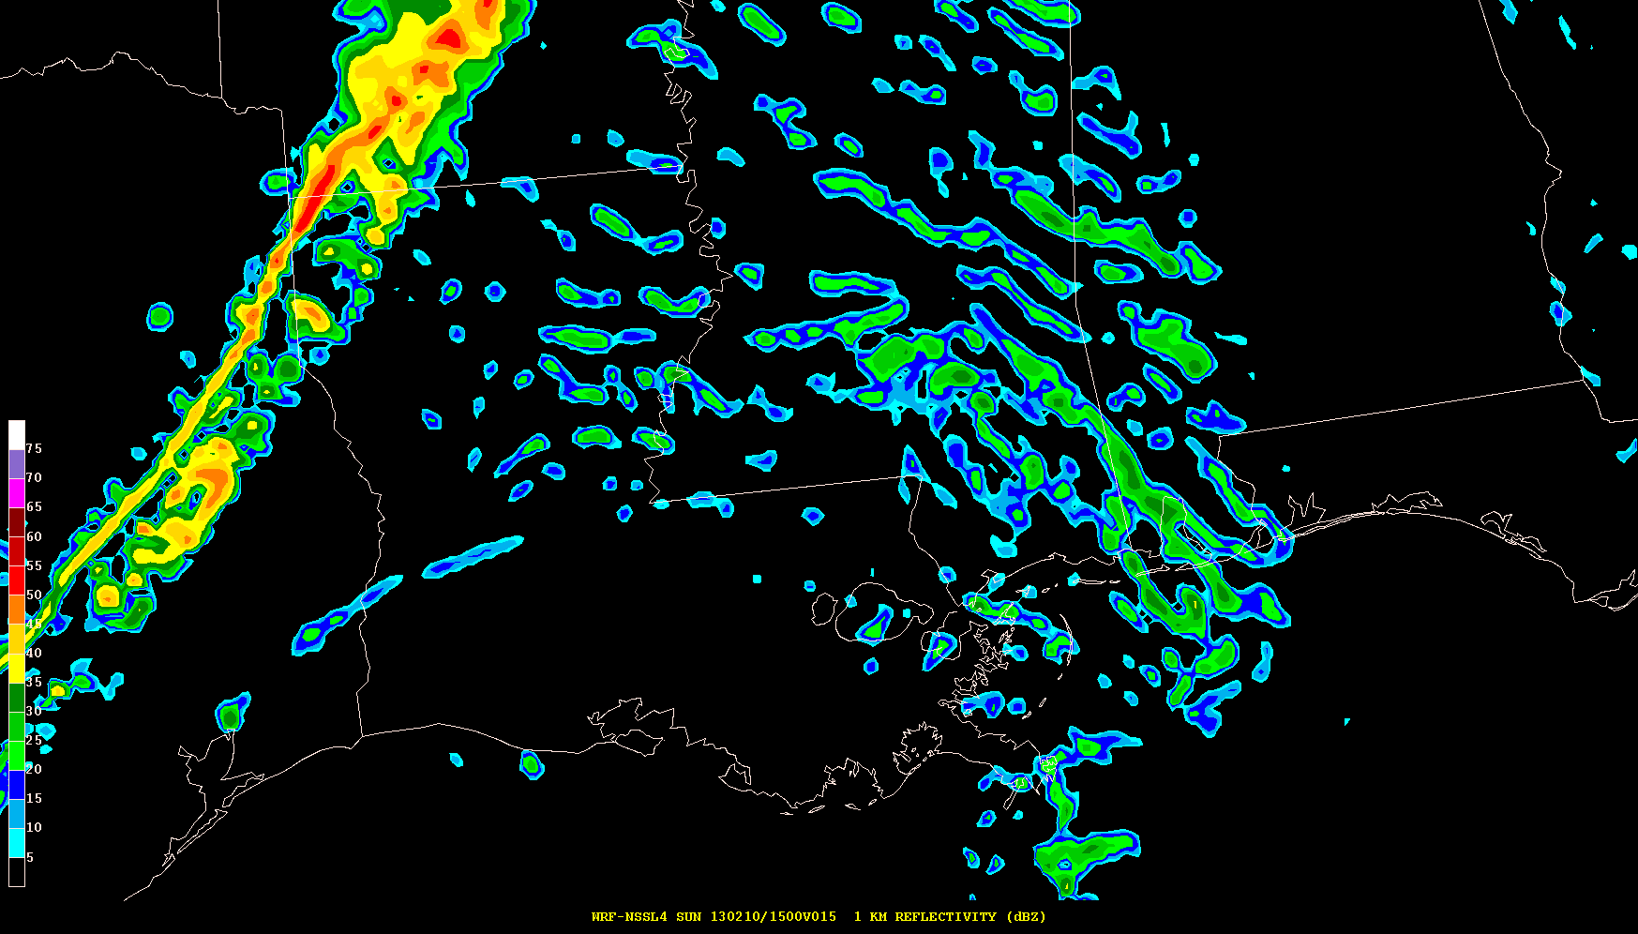
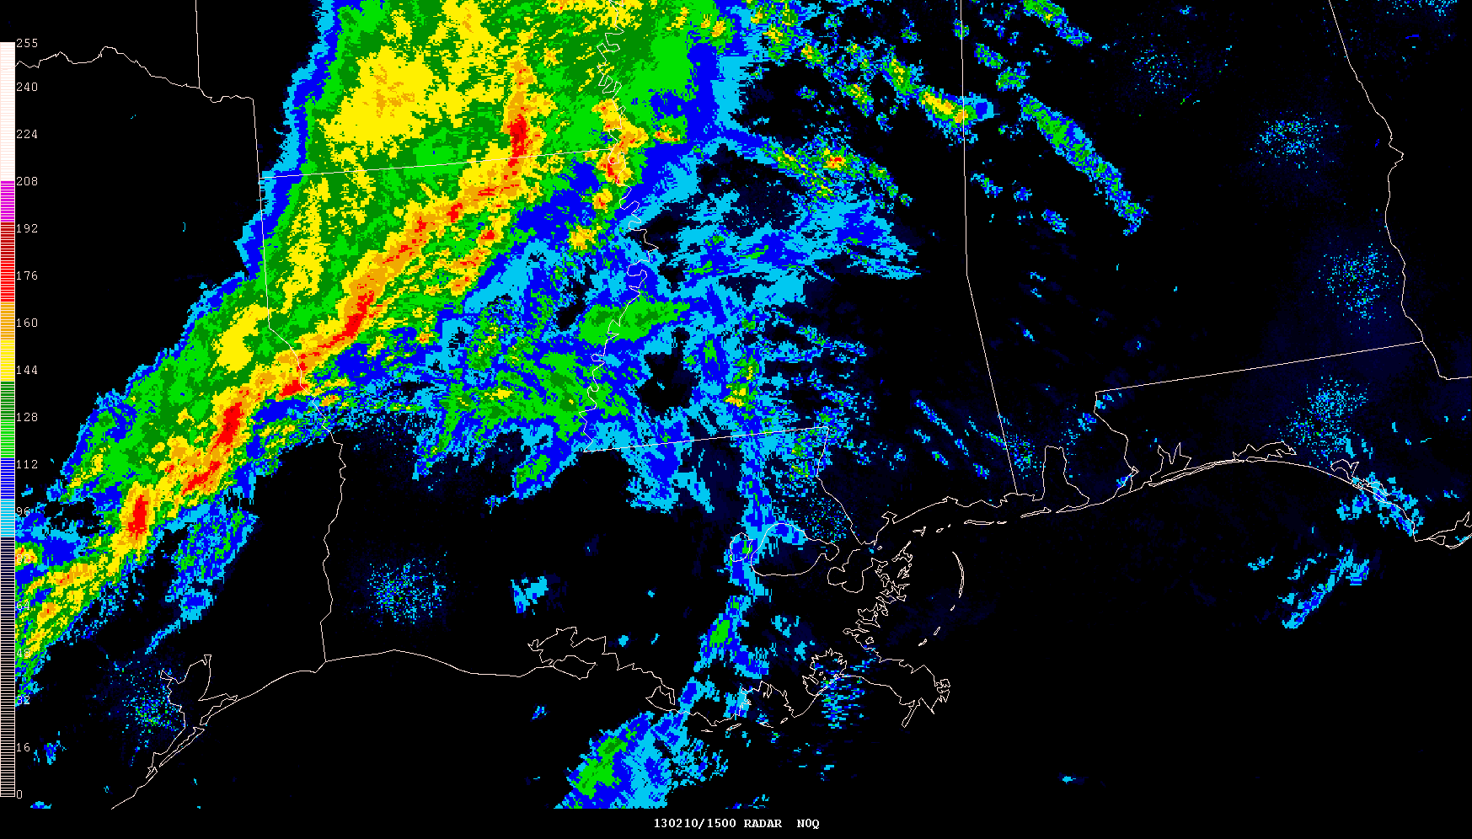
Simulated Reflectivity (1 km AGL) 15-hr Forecasts Valid 15z 10 Feb 2013
NAM 4 km CONUS Nest 4 km WRF-NMM
NSSL 4 km WRF-ARW Observed Radar Mosaic

Slide 12
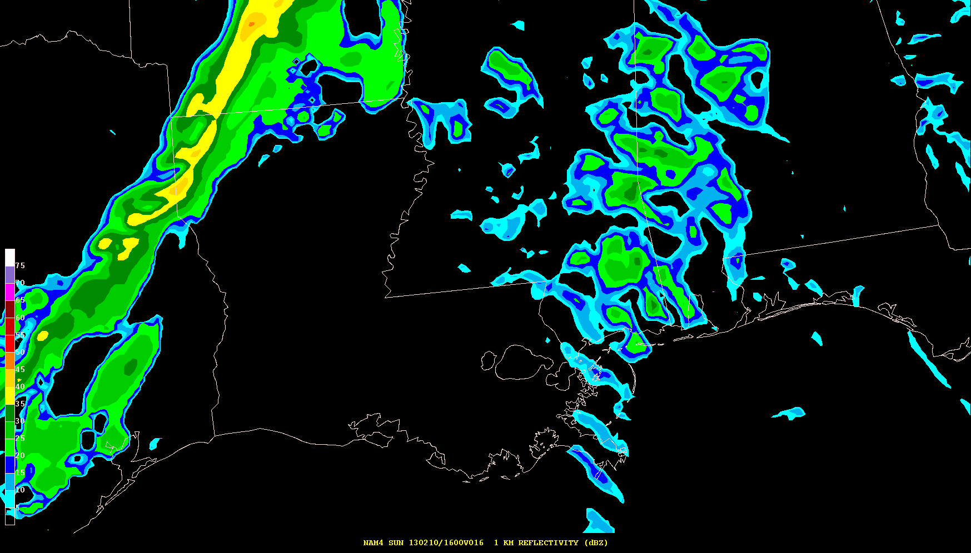
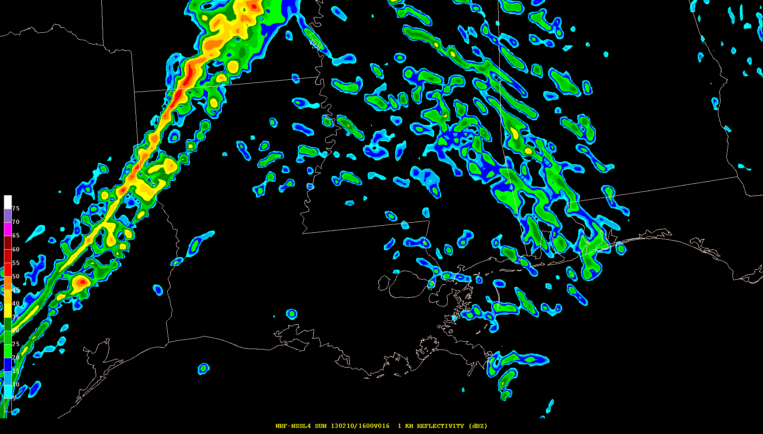
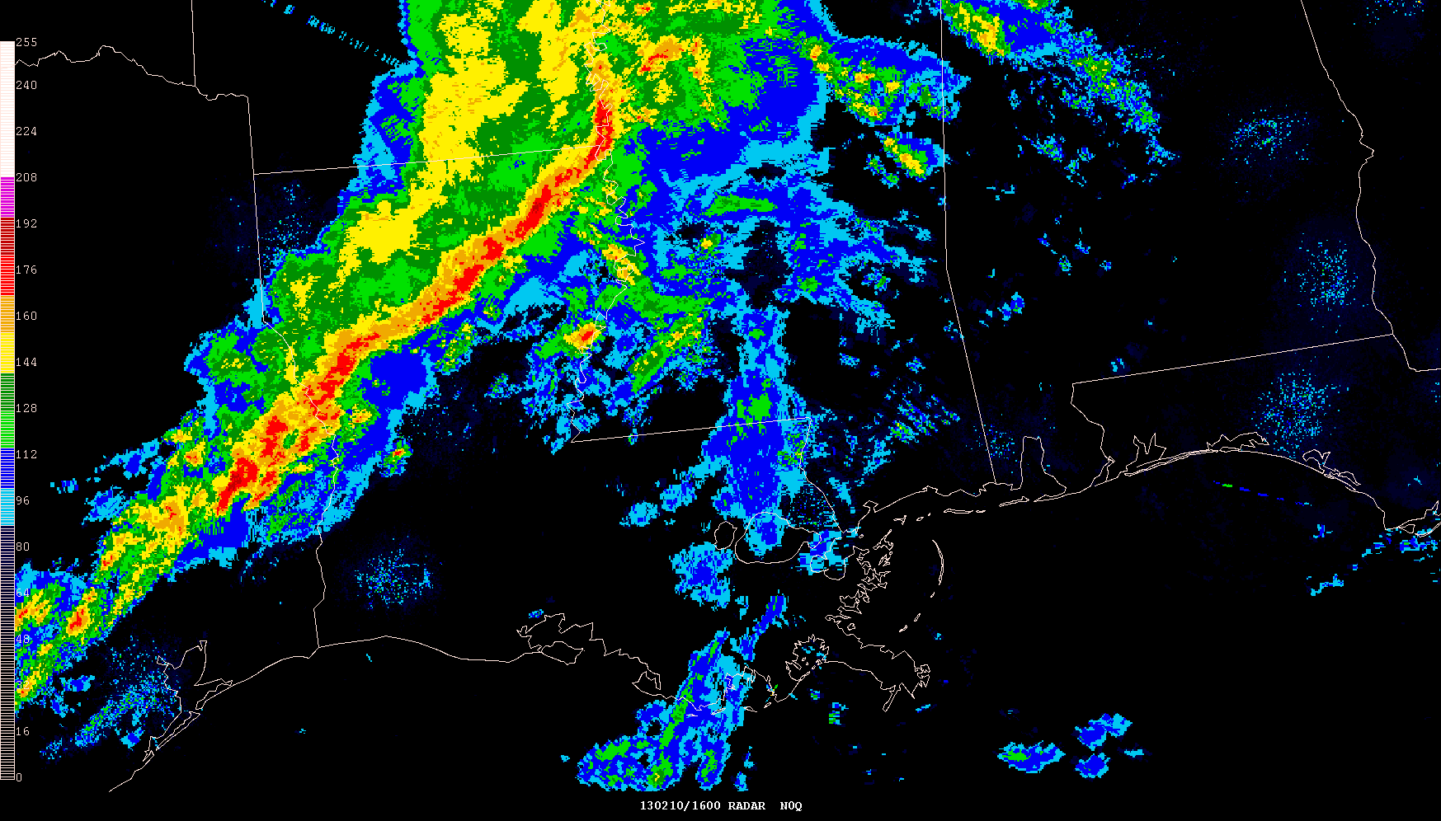
Simulated Reflectivity (1 km AGL) 16-hr Forecasts Valid 16z 10 Feb 2013
NAM 4 km CONUS Nest 4 km WRF-NMM
Models are slow with convective line from western MS into southeast TX
NSSL 4 km WRF-ARW Observed Radar Mosaic

Slide 13
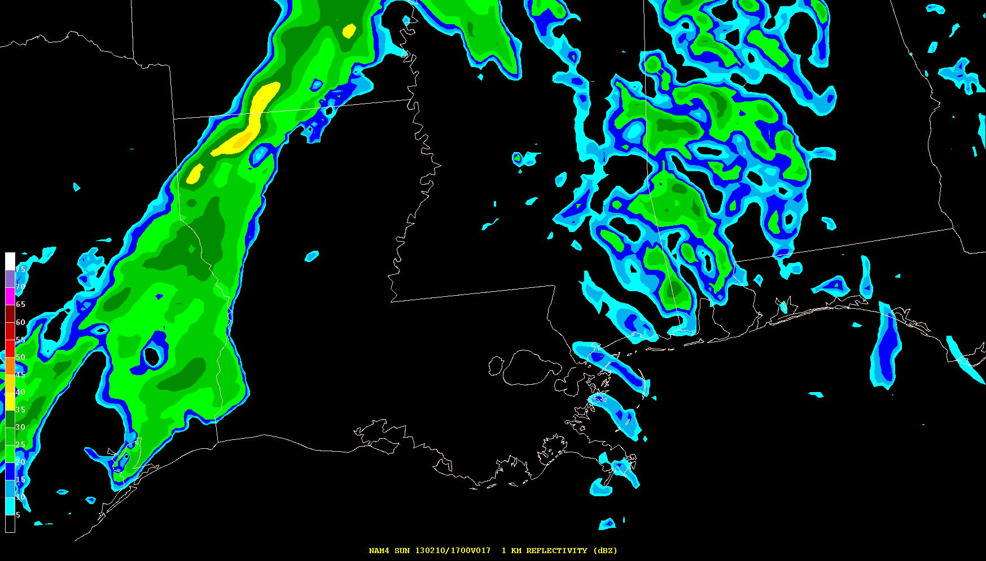
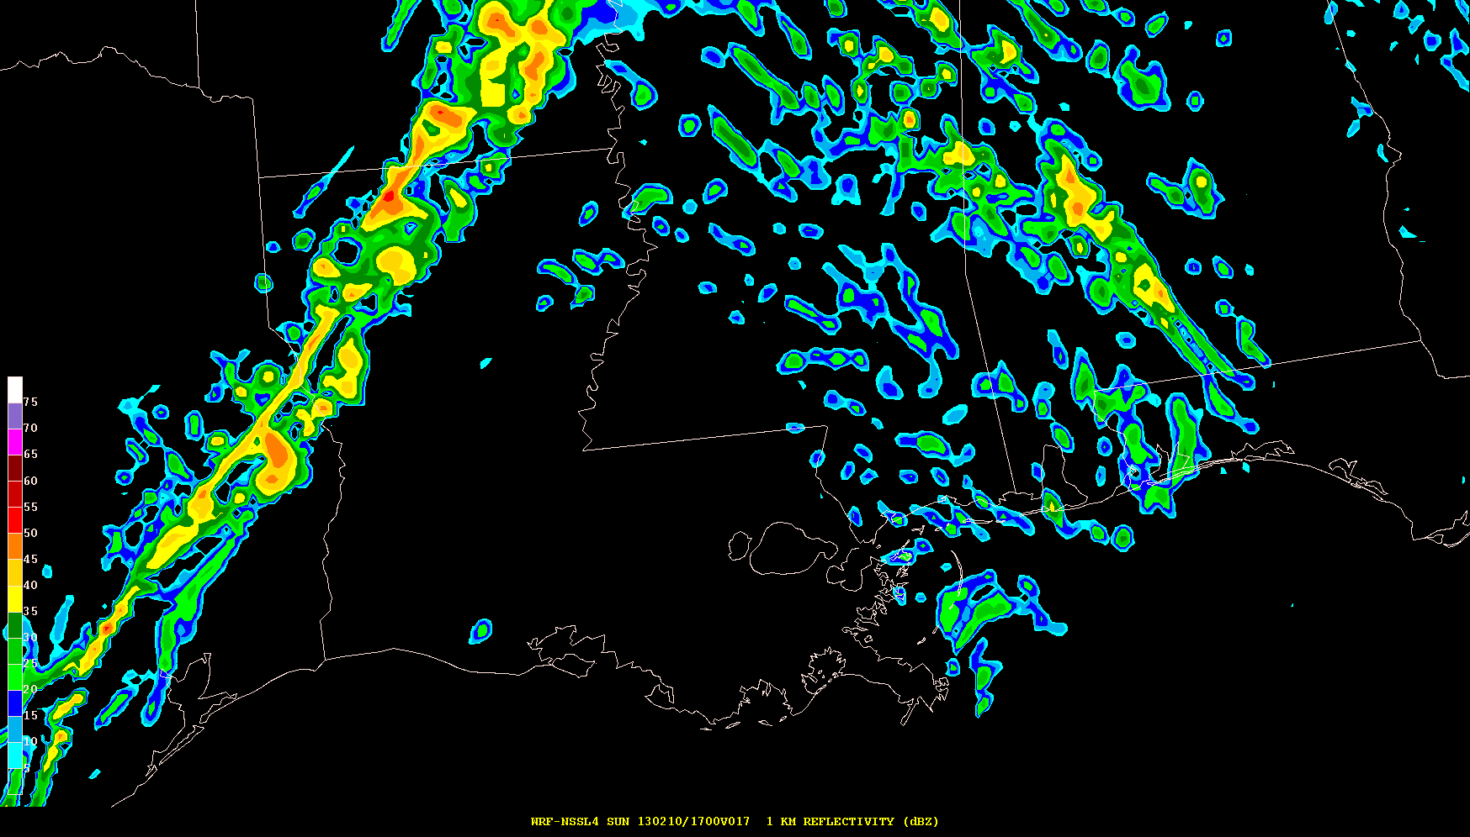
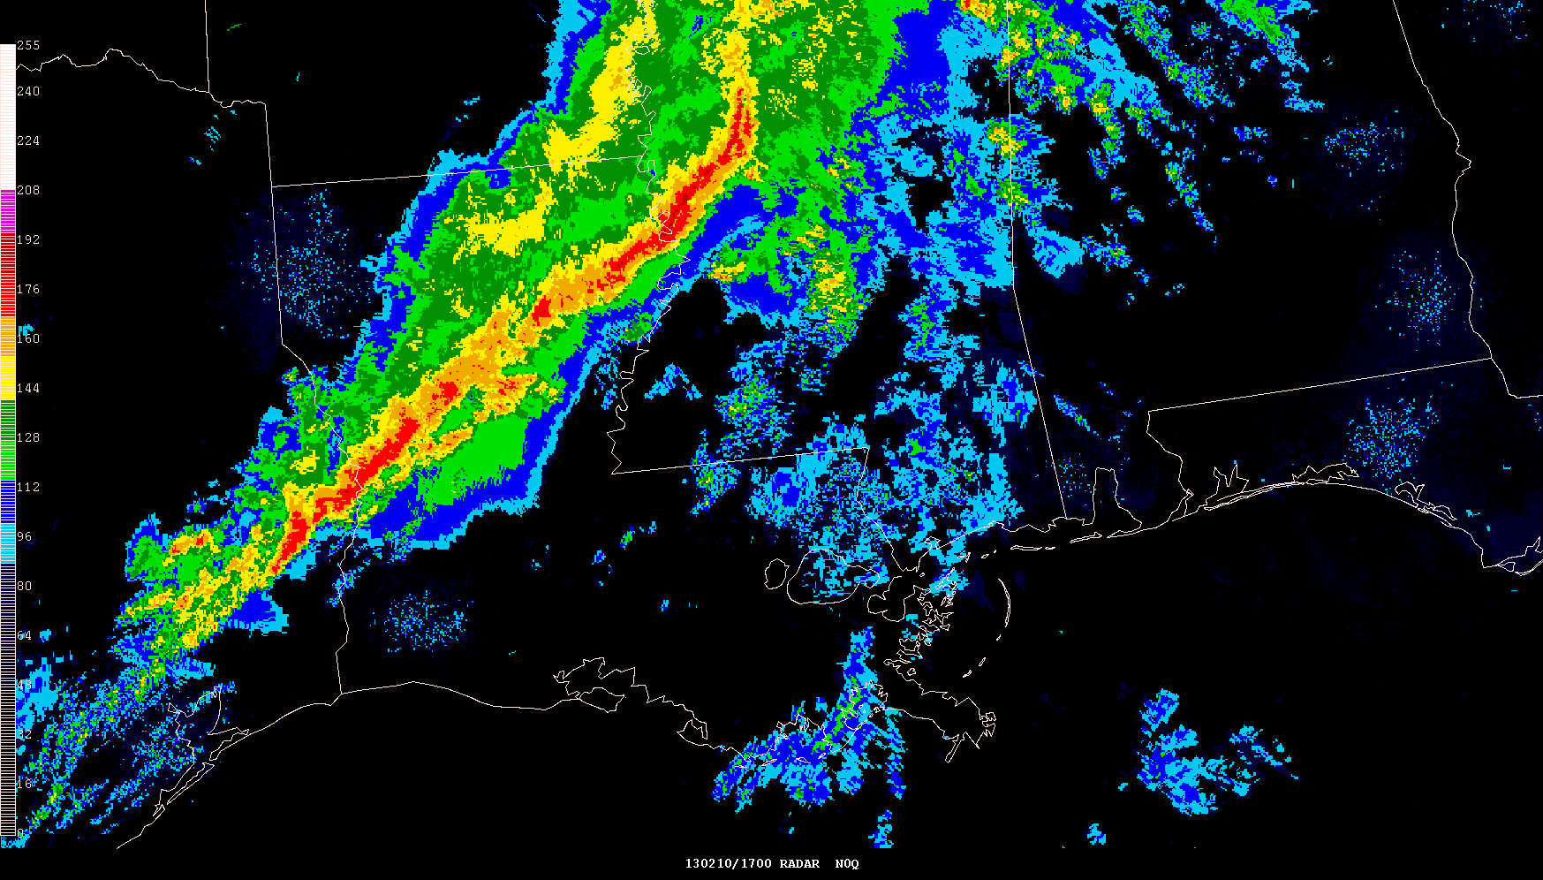
Simulated Reflectivity (1 km AGL) 17-hr Forecasts Valid 17z 10 Feb 2013
NAM 4 km CONUS Nest 4 km WRF-NMM
NSSL 4 km WRF-ARW Observed Radar Mosaic

Slide 14
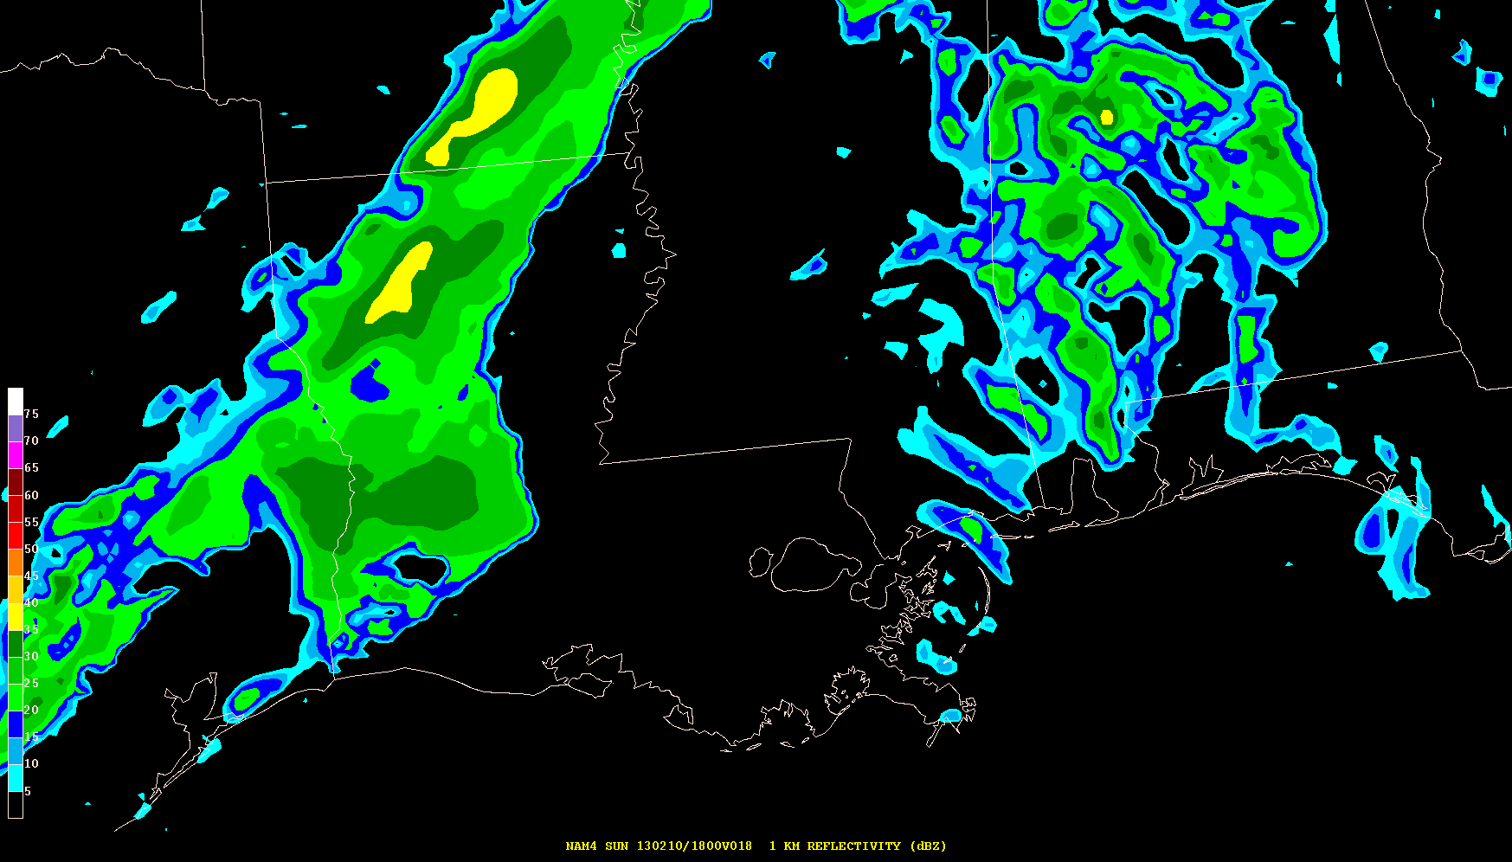
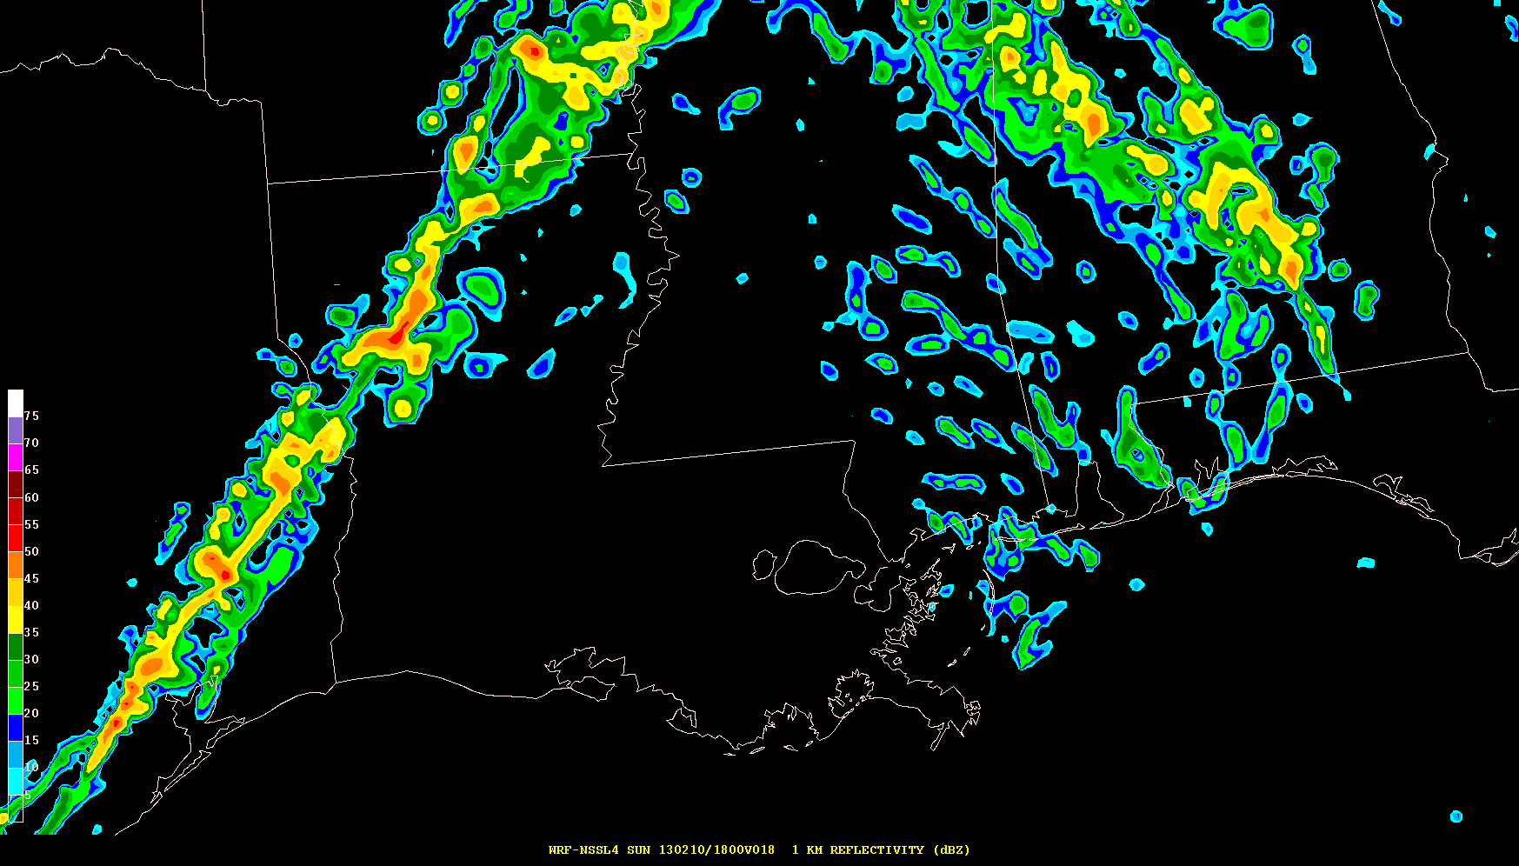
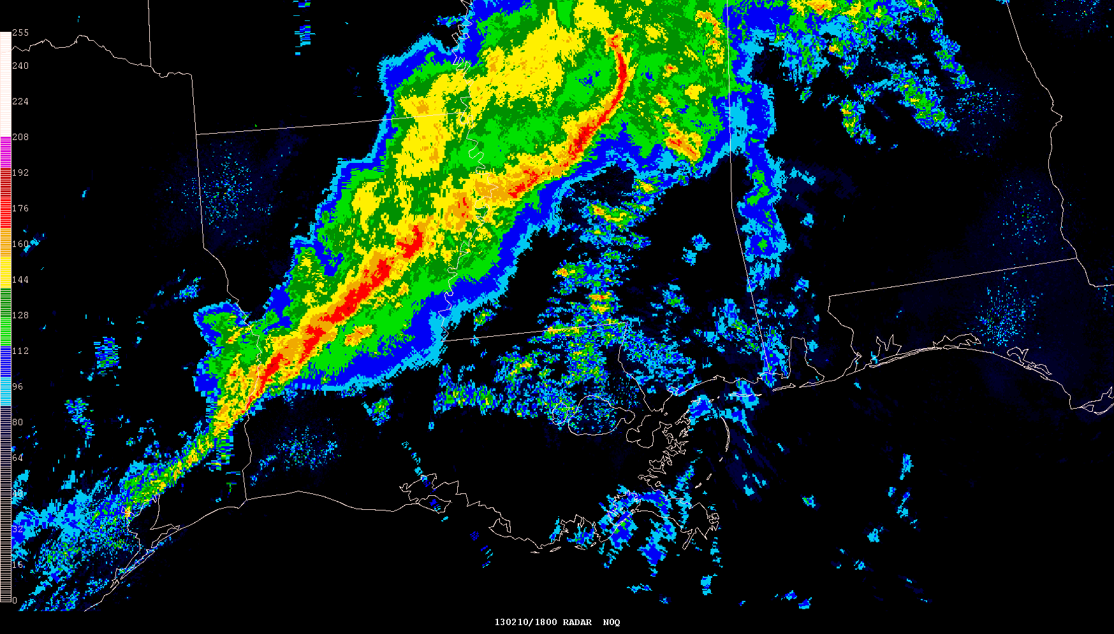
Simulated Reflectivity (1 km AGL) 18-hr Forecasts Valid 18z 10 Feb 2013
NAM 4 km CONUS Nest 4 km WRF-NMM
Radar indicates new cells forming ahead of line over southeast LA and MS
NSSL 4 km WRF-ARW Observed Radar Mosaic

Slide 15
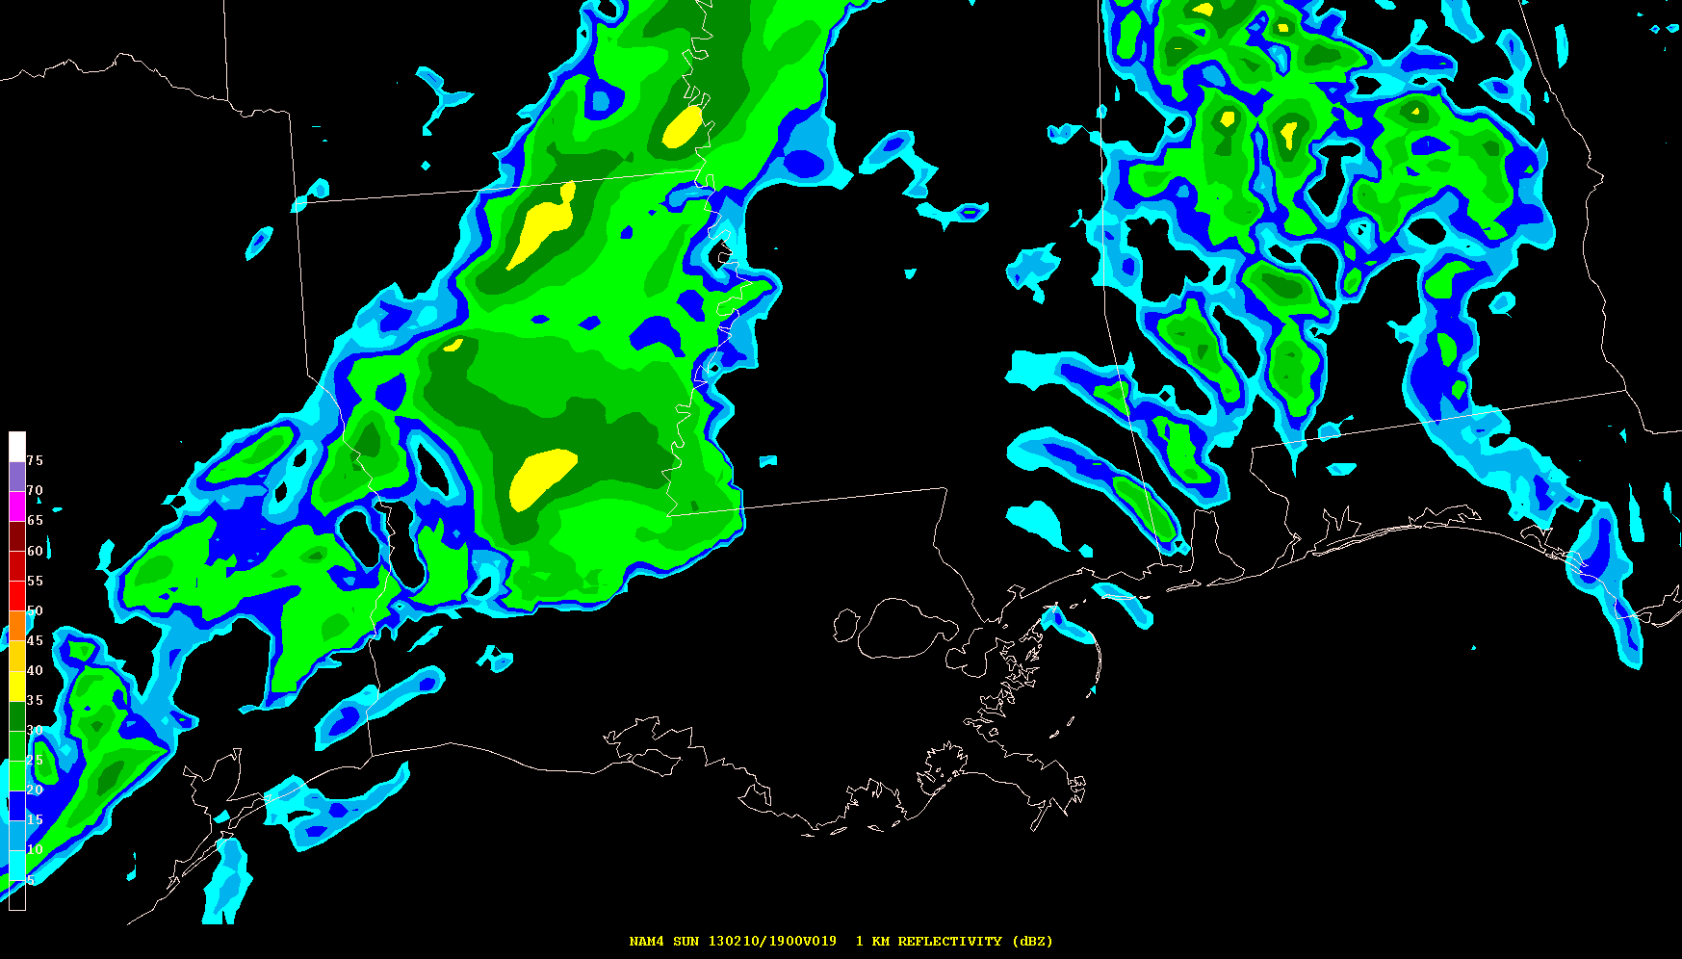
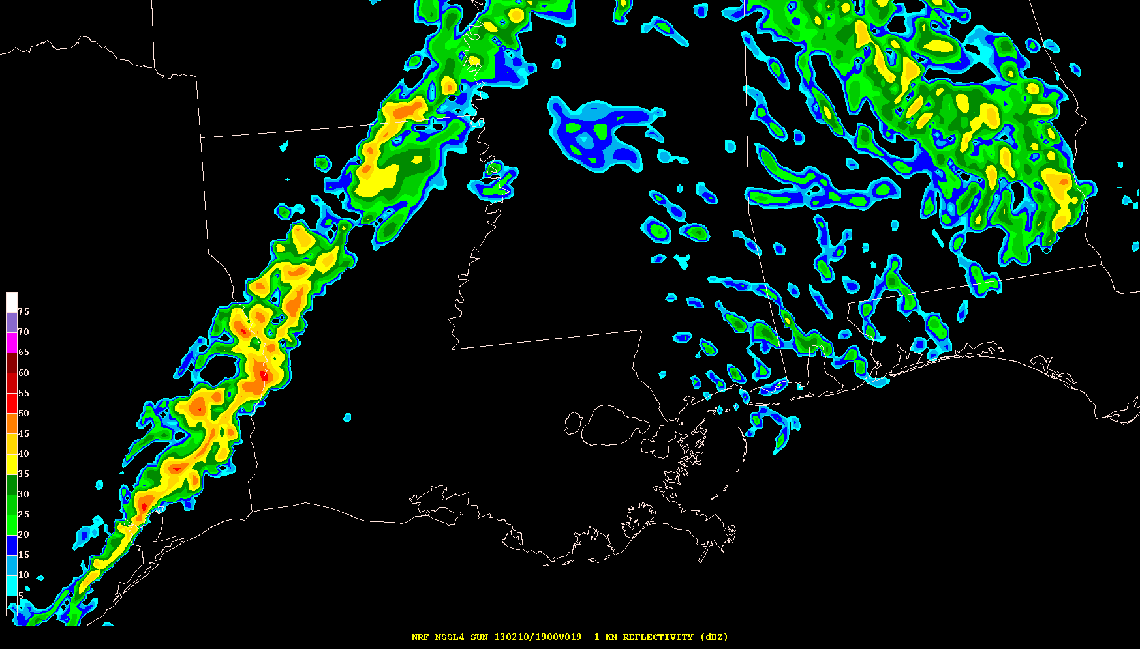
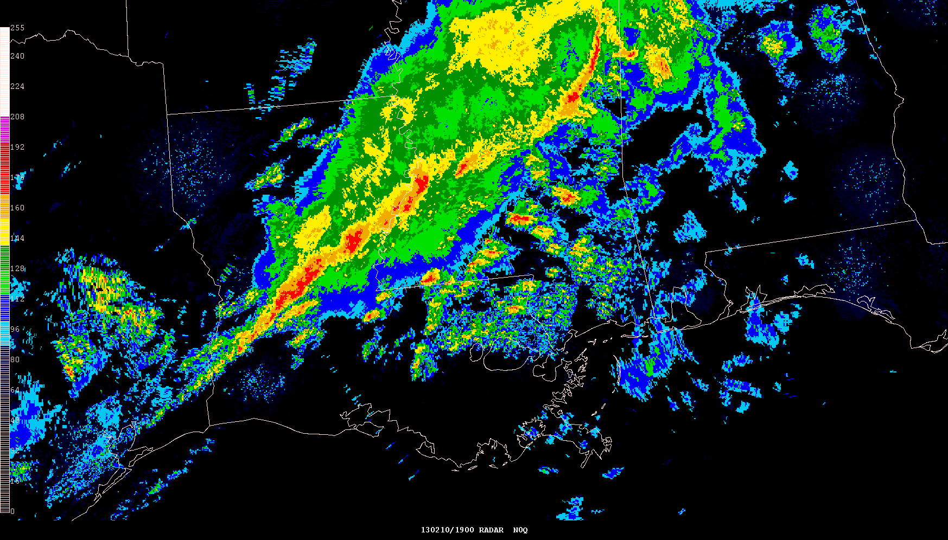
Simulated Reflectivity (1 km AGL) 19-hr Forecasts Valid 19z 10 Feb 2013
NAM 4 km CONUS Nest 4 km WRF-NMM
Linear structure is diminishing as additional discrete storms form southeast LA and MS
NSSL 4 km WRF-ARW Observed Radar Mosaic

Slide 16
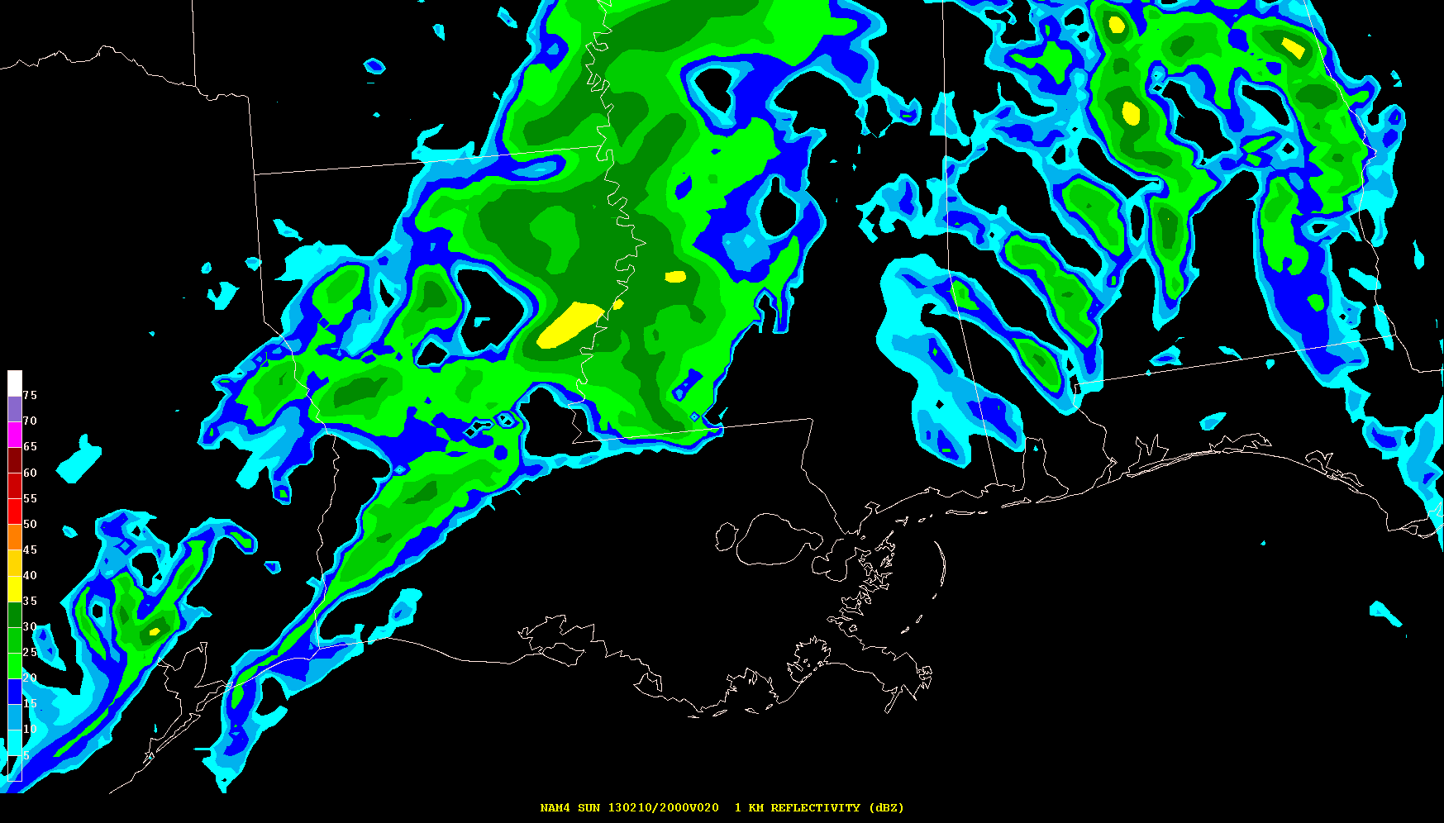
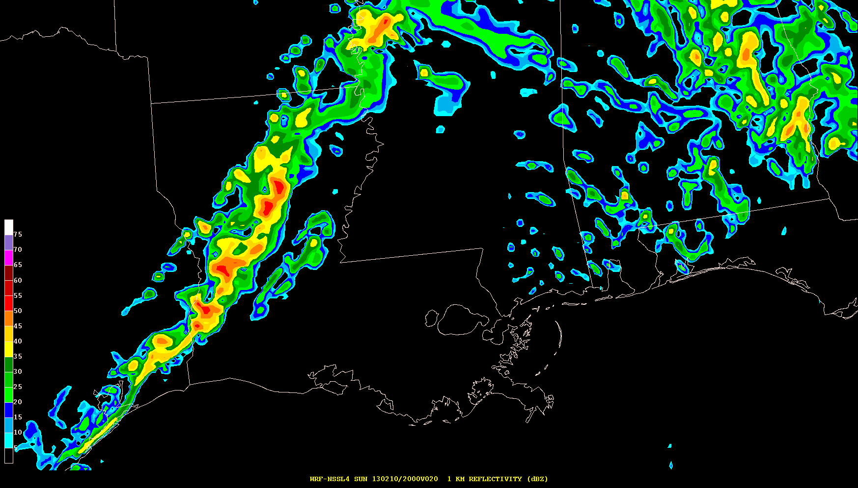
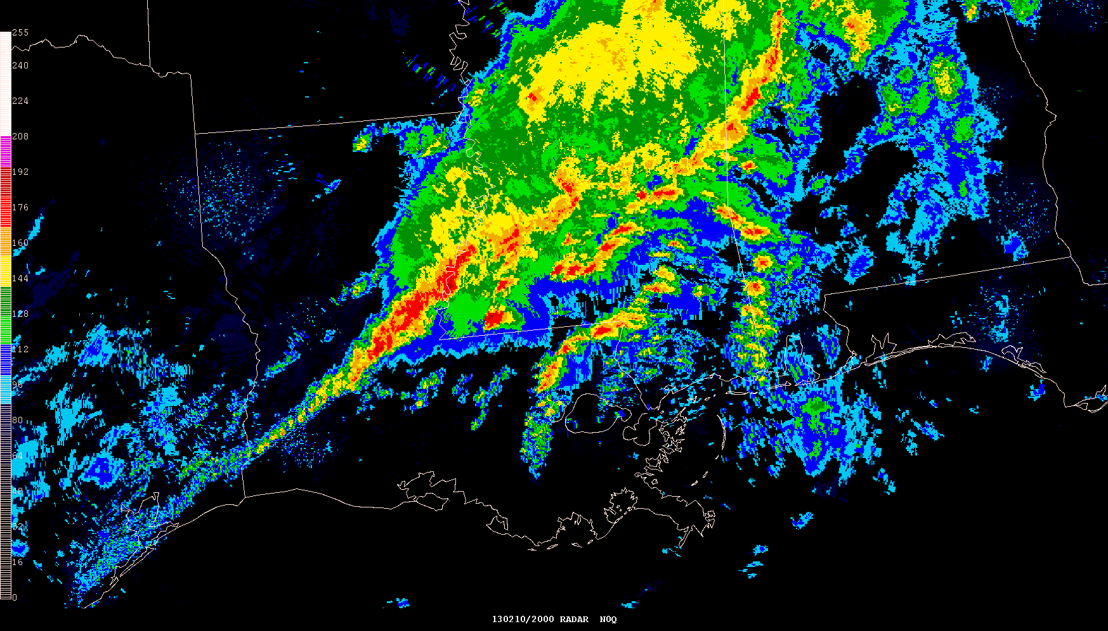
Simulated Reflectivity (1 km AGL) 20-hr Forecasts Valid 20z 10 Feb 2013
NAM 4 km CONUS Nest 4 km WRF-NMM
Models fail to predict incipient supercell storms in southern MS
NSSL 4 km WRF-ARW Observed Radar Mosaic

Slide 17
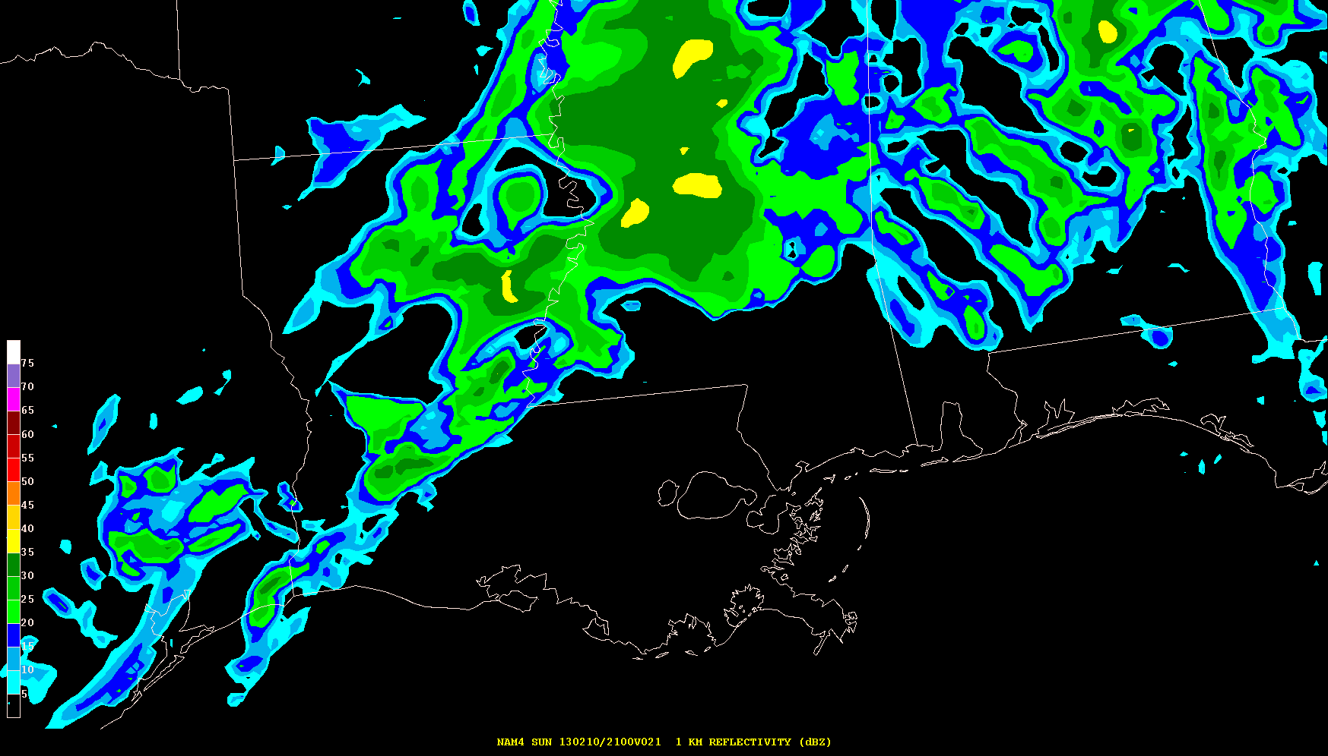
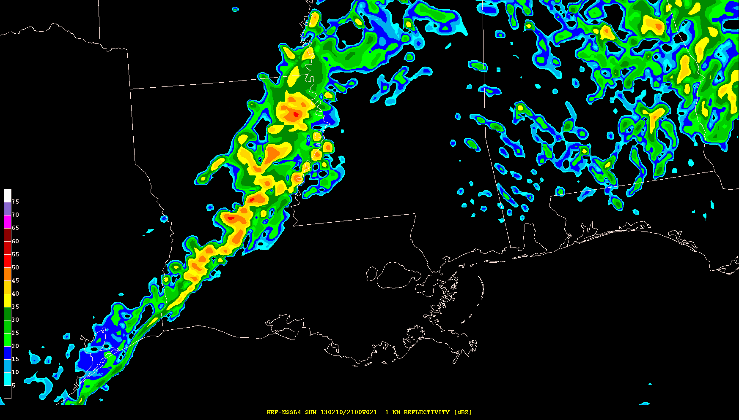
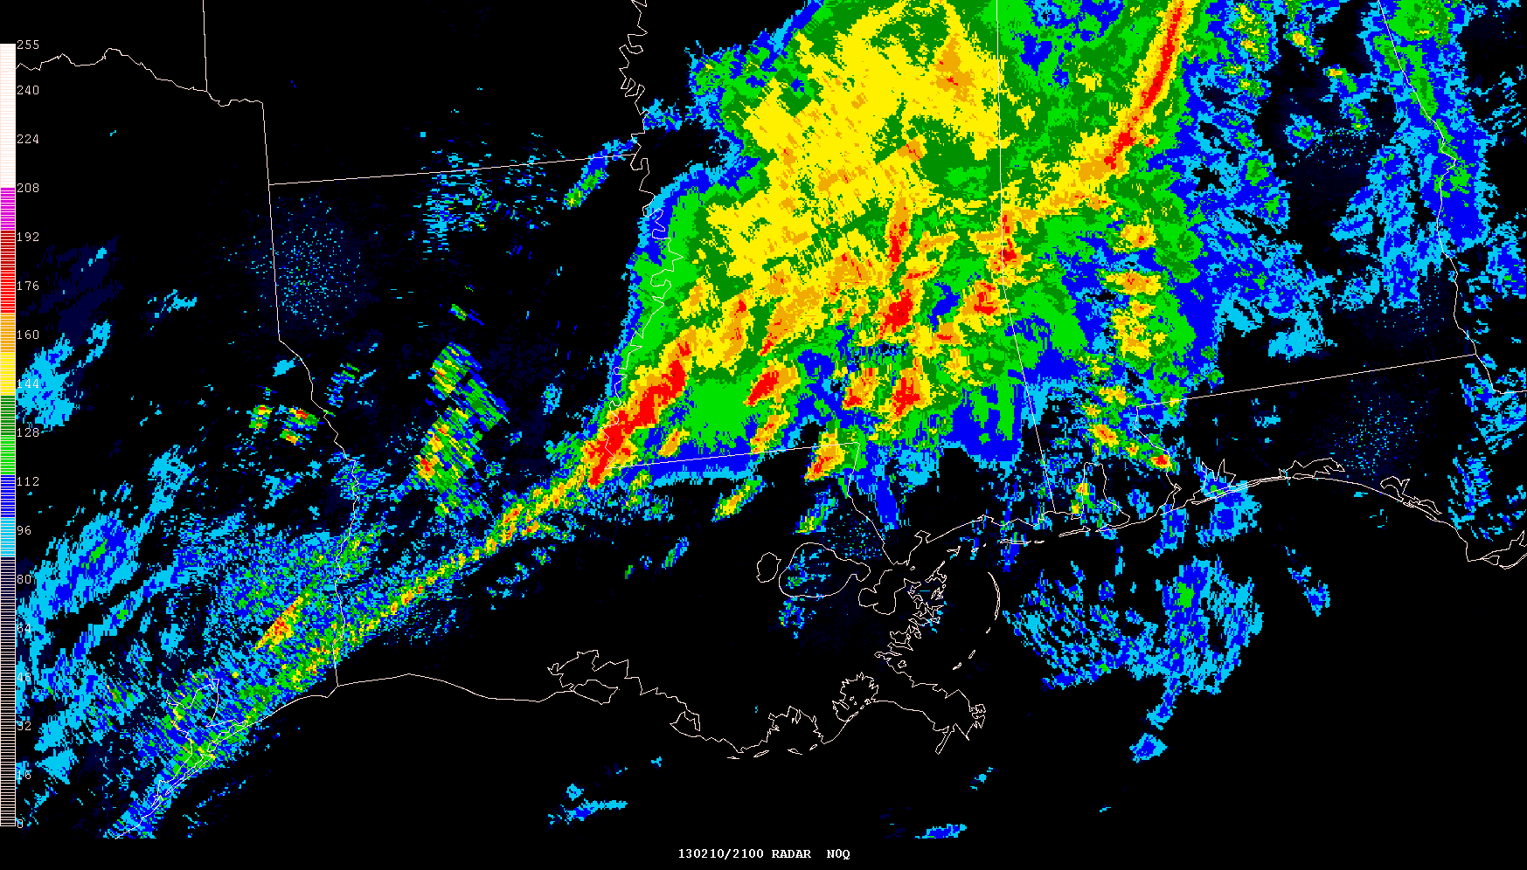
Simulated Reflectivity (1 km AGL) 21-hr Forecasts Valid 21z 10 Feb 2013
NAM 4 km CONUS Nest 4 km WRF-NMM
Tornadic supercells are imminent over southeast MS where models have few storms
NSSL 4 km WRF-ARW Observed Radar Mosaic

Slide 18
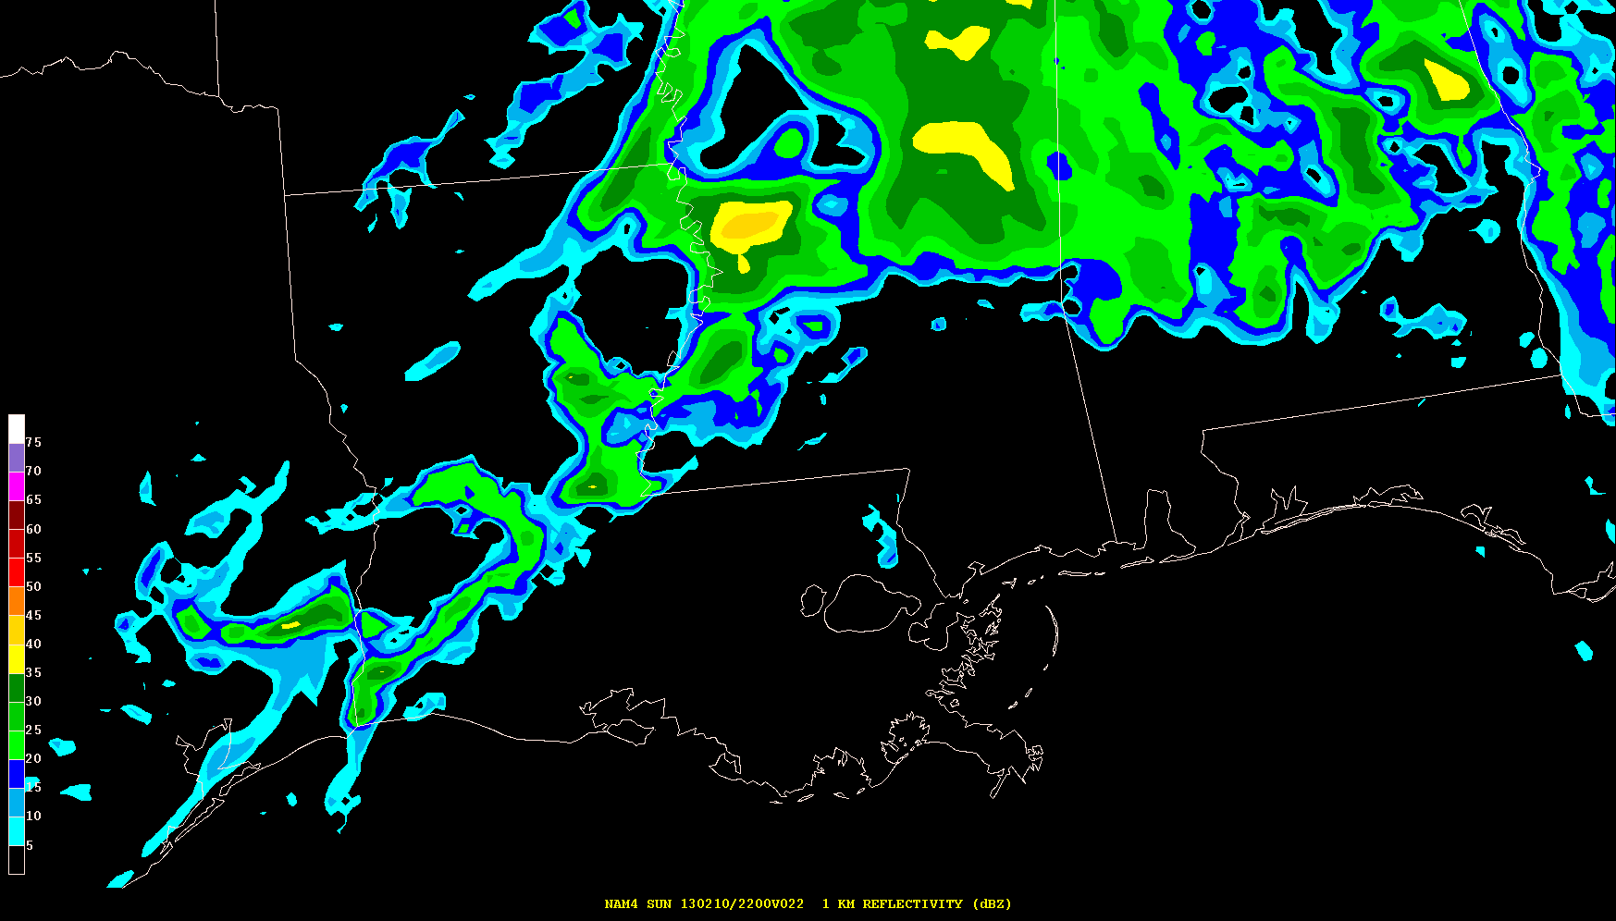
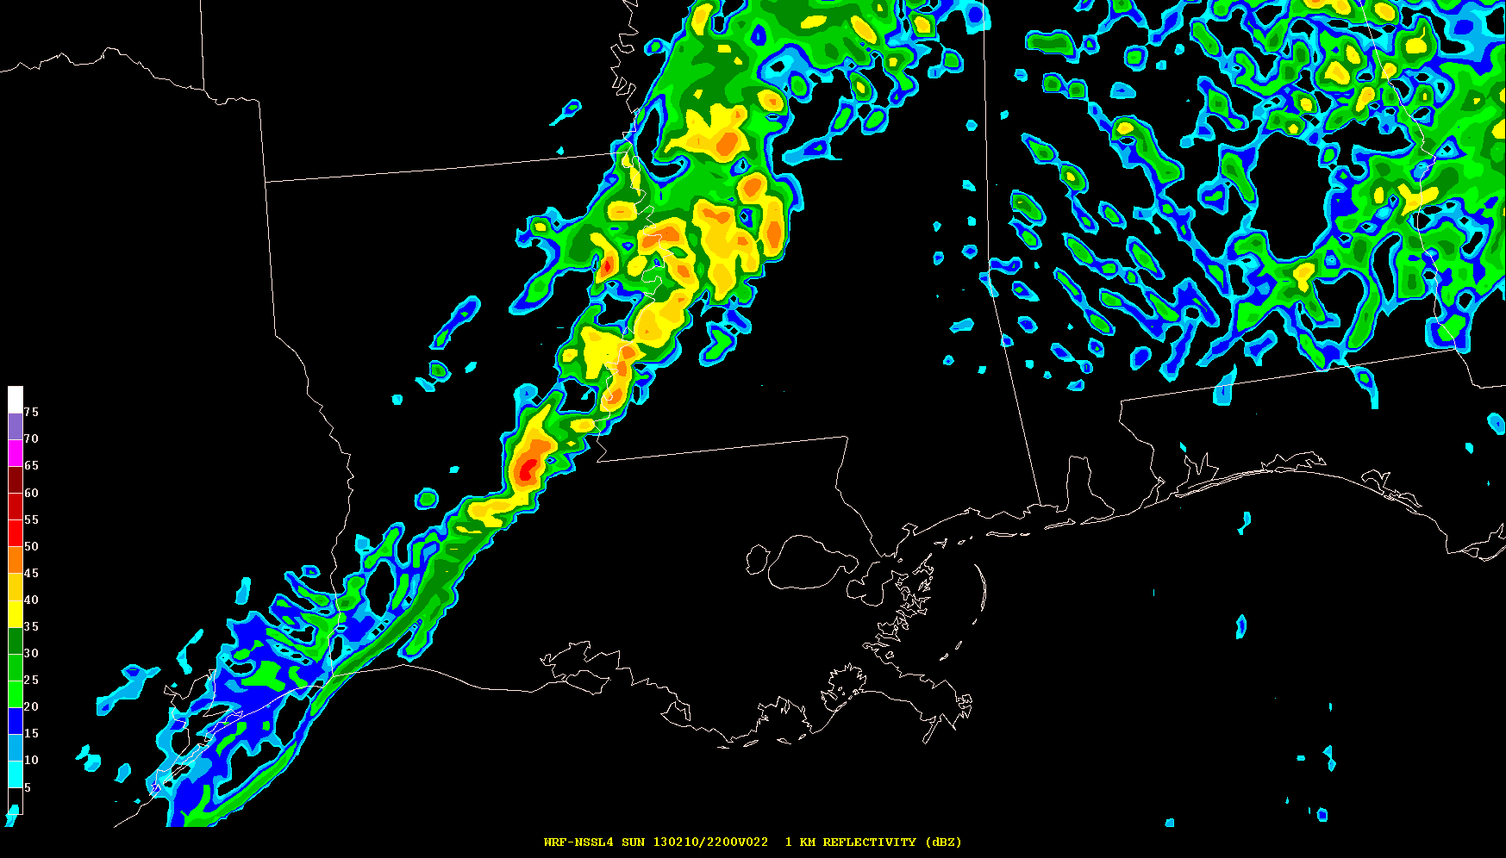
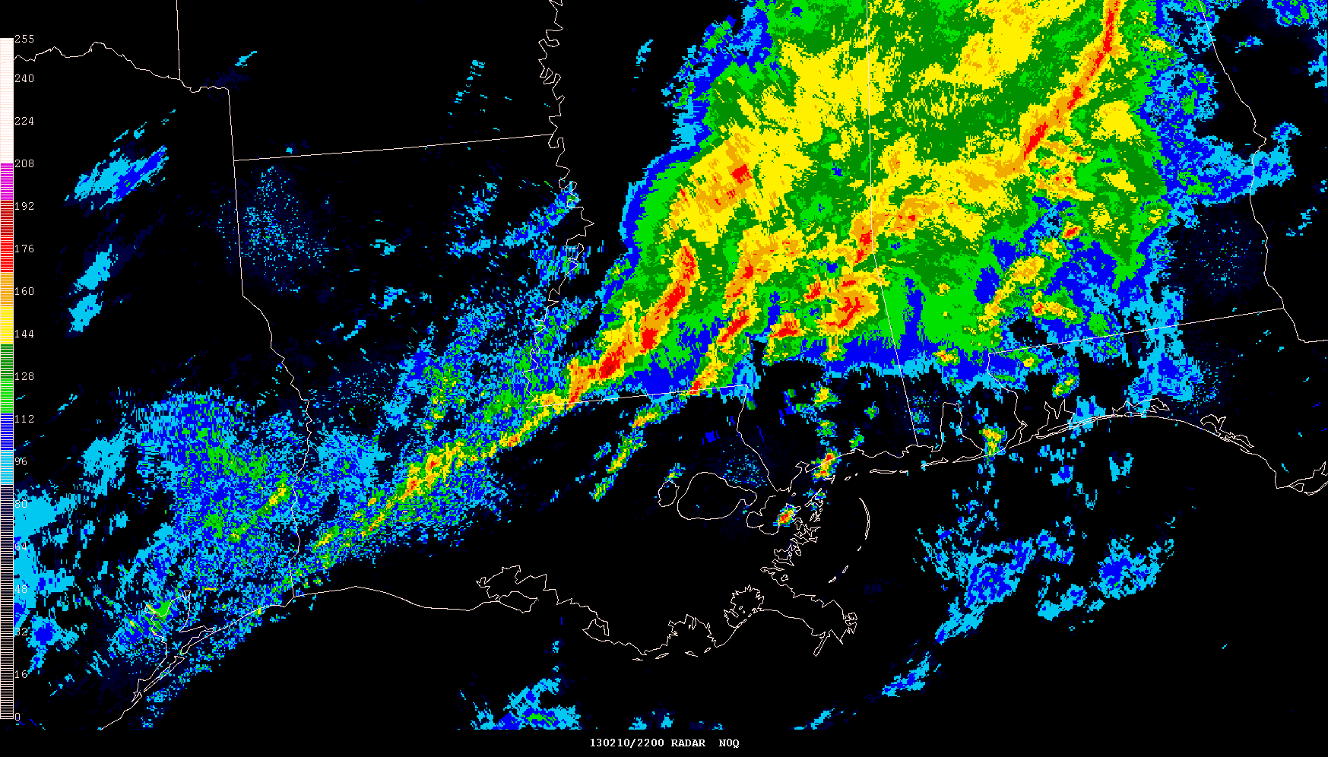
Simulated Reflectivity (1 km AGL) 22-hr Forecasts Valid 22z 10 Feb 2013
NAM 4 km CONUS Nest 4 km WRF-NMM
NSSL 4 km WRF-ARW Observed Radar Mosaic

Slide 19
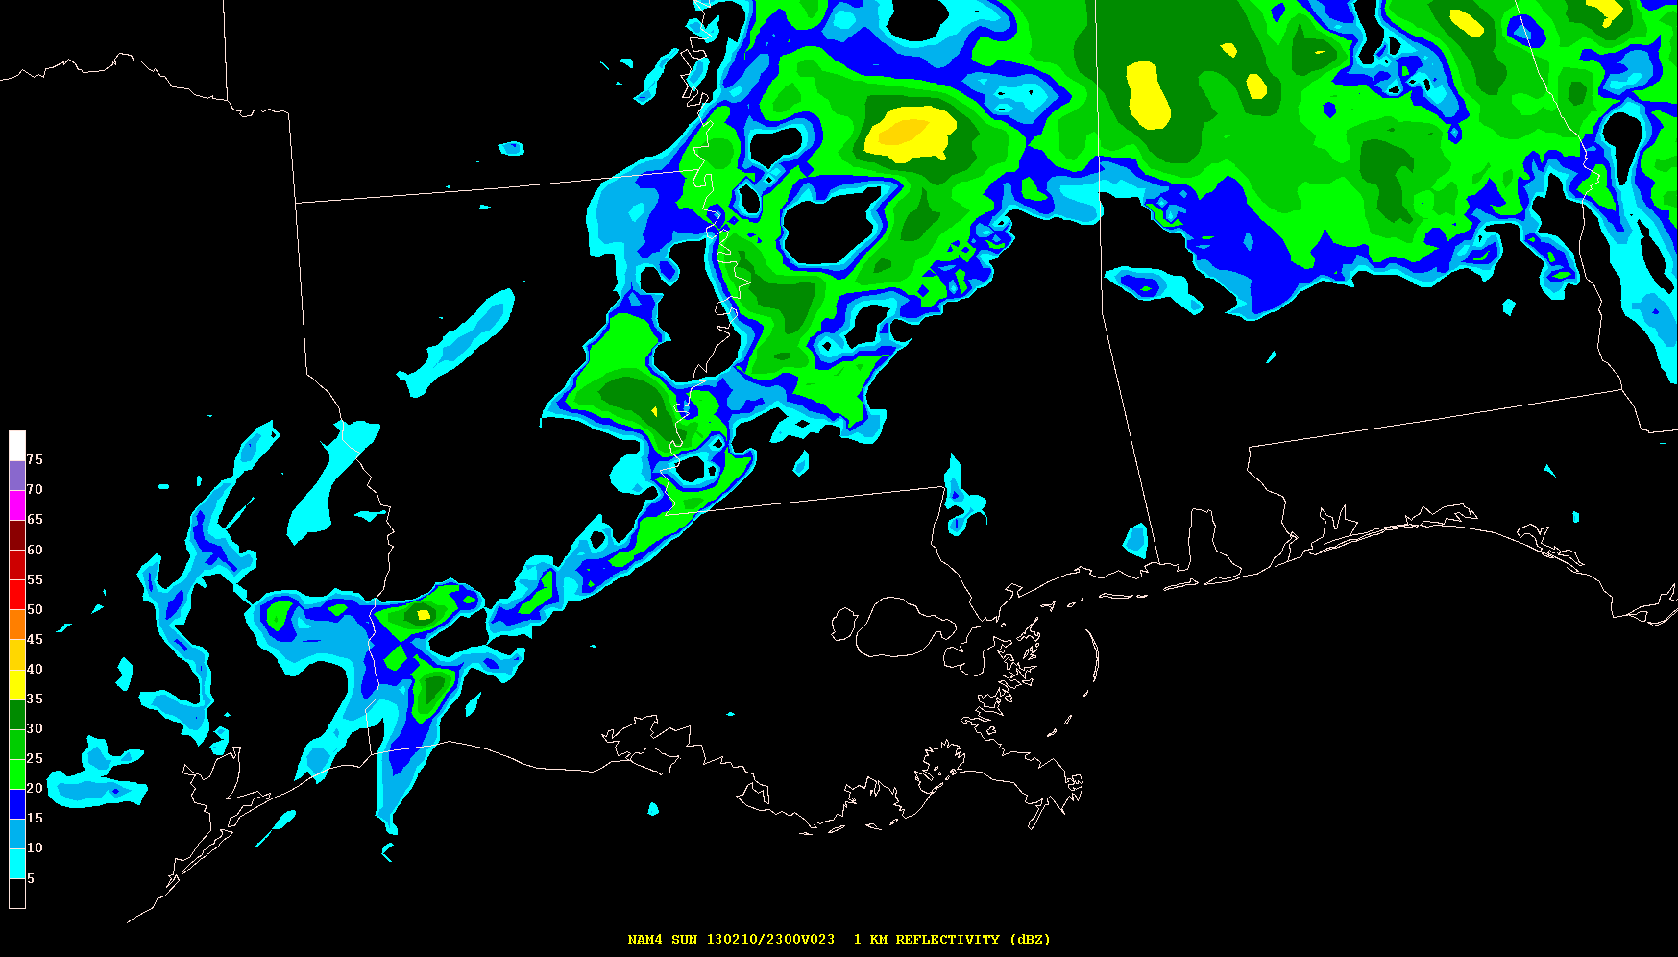
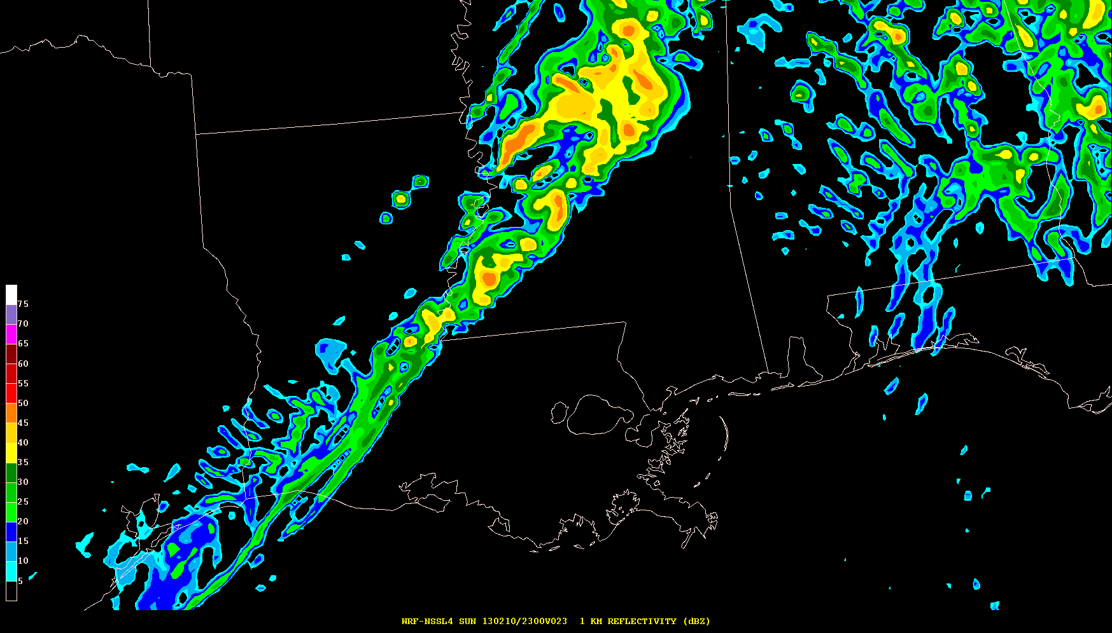
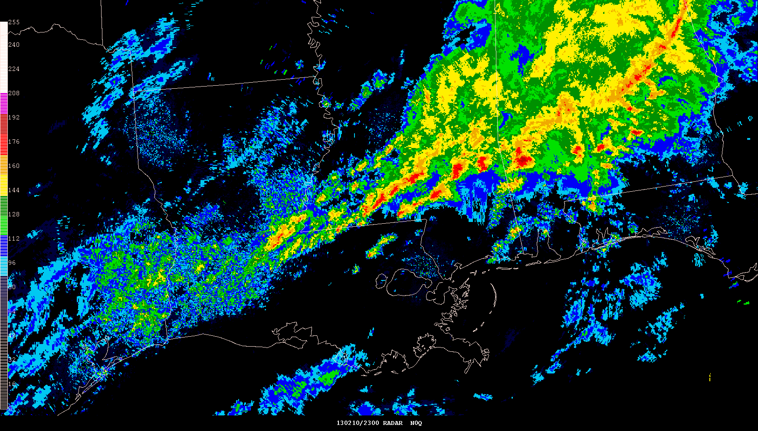
Simulated Reflectivity (1 km AGL) 23-hr Forecasts Valid 23z 10 Feb 2013
NAM 4 km CONUS Nest 4 km WRF-NMM
NSSL 4 km WRF-ARW Observed Radar Mosaic

Slide 20
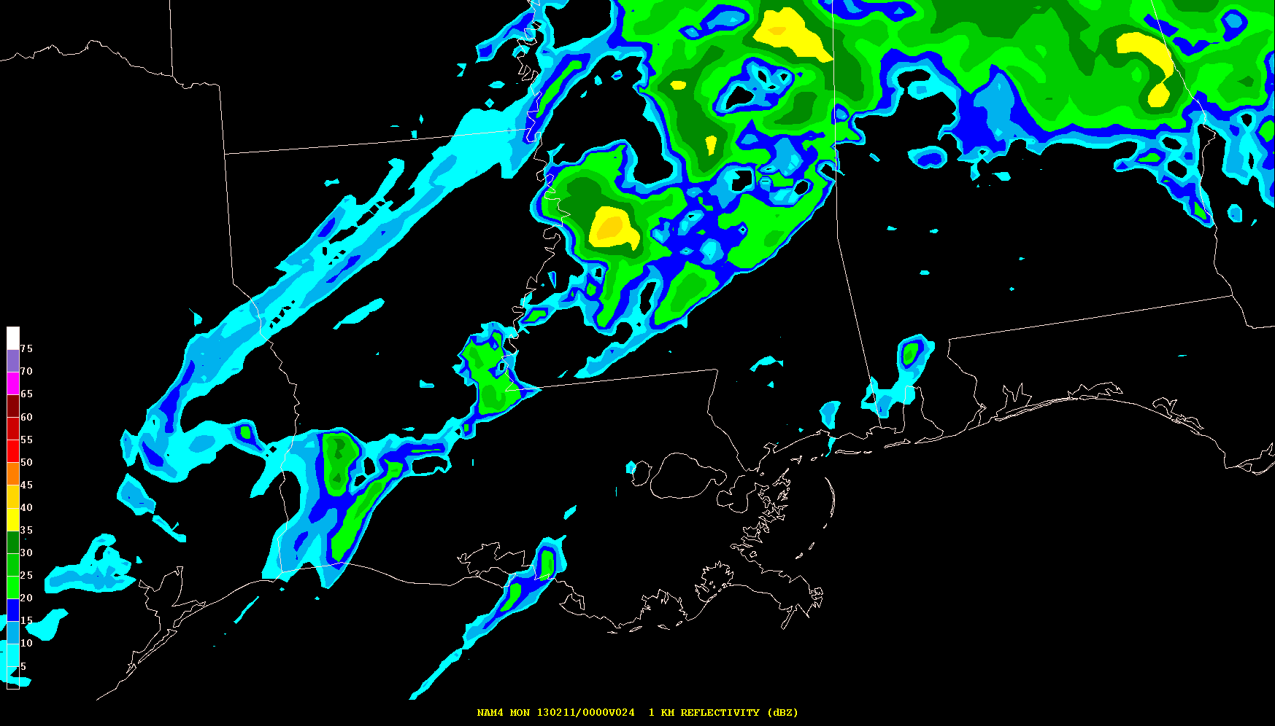
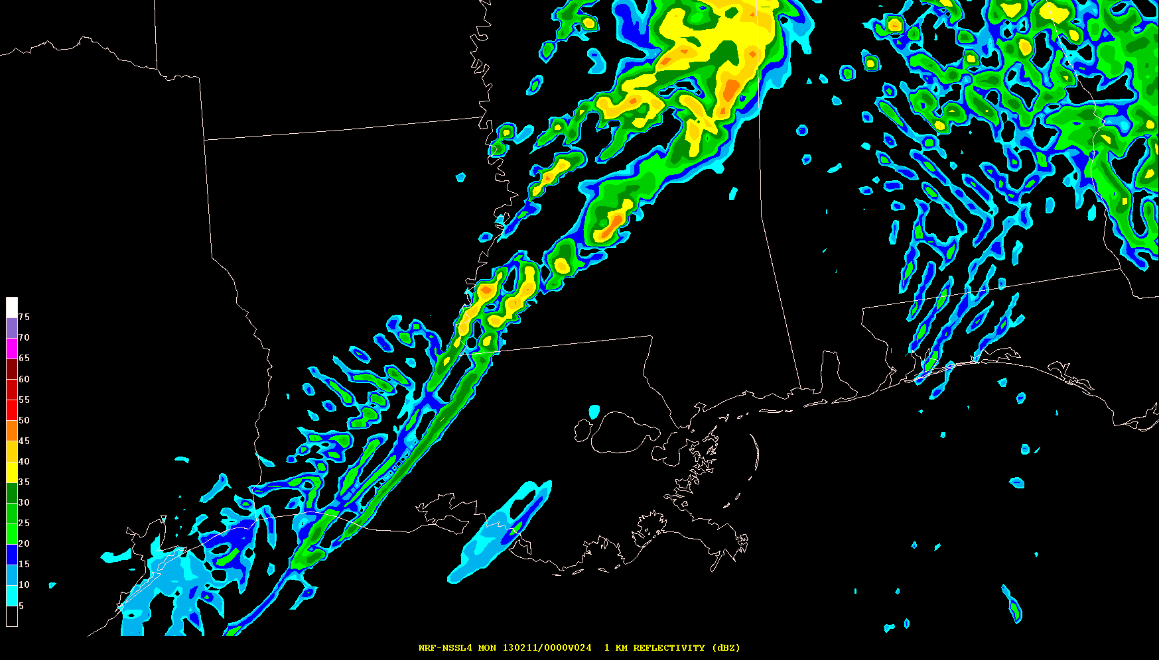
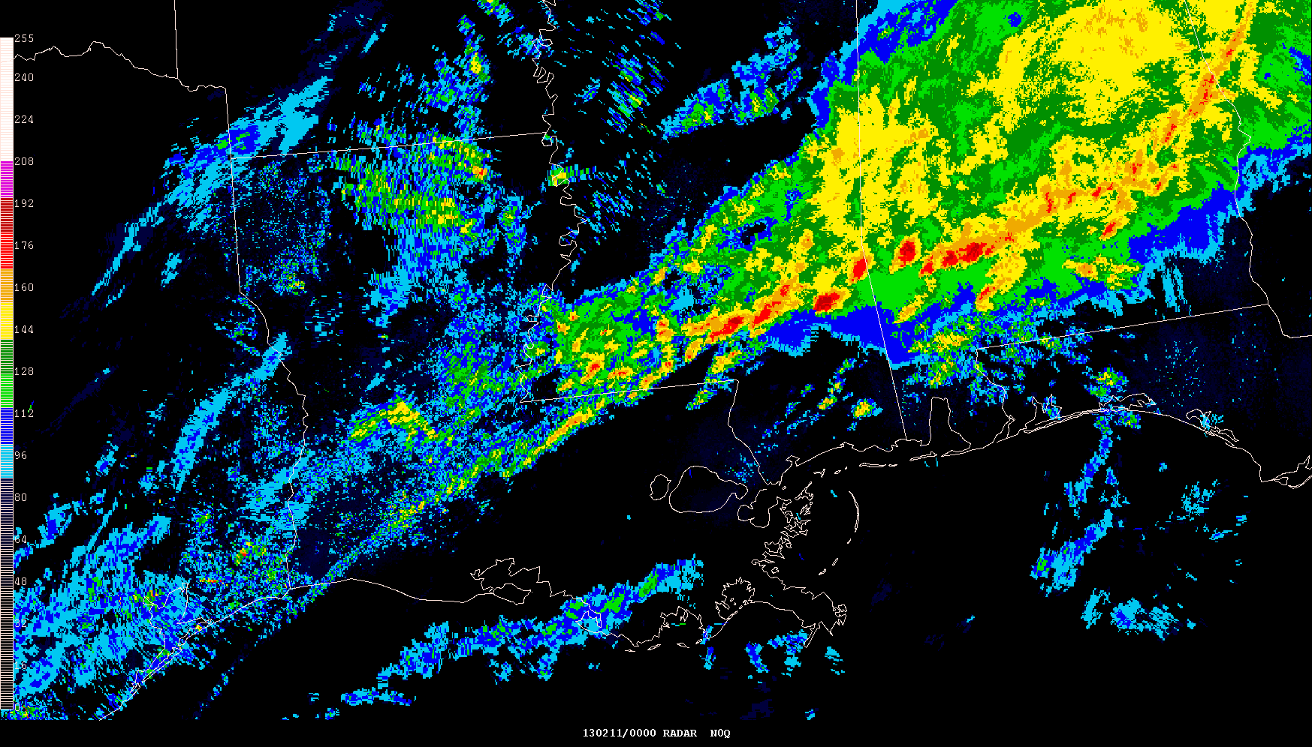
Simulated Reflectivity (1 km AGL) 24-hr Forecasts Valid 00z 11 Feb 2013
NAM 4 km CONUS Nest 4 km WRF-NMM
Tornadic supercells are continuing over southeast MS/southwest AL where models have few storms
NSSL 4 km WRF-ARW Observed Radar Mosaic

Slide 21
Did 12z Model Runs Provide Improved Forecasts?

Slide 22
Simulated Reflectivity (1 km AGL) 24-hr Forecasts Valid 00z 11 Feb 2013
NAM 4 km CONUS Nest 4 km WRF-NMM
Tornadic supercells are continuing over southeast MS/southwest AL where 00z models have few storms
NSSL 4 km WRF-ARW Observed Radar Mosaic

Slide 23
Simulated Reflectivity (1 km AGL) 12-hr Forecasts Valid 00z 11 Feb 2013
NAM 4 km CONUS Nest 4 km WRF-NMM
12z models show general improvement over earlier 00z runs with more intense QLCS
NSSL 4 km WRF-ARW Observed Radar Mosaic

Slide 24
Hourly Max Updraft Helicity(2-5 km AGL) 24-hr Forecasts Valid 00z 11 Feb 2013
NAM 4 km CONUS Nest 4 km WRF-NMM
<25 m2/s2
Max 50 m2/s2
Models have limited indications of storms with strong rotating updrafts
<25 m2/s2
NSSL 4 km WRF-ARW NSSL Radar Low-Level Rotation Tracks 23-00z

Slide 25
Hourly Max Updraft Helicity(2-5 km AGL) 12-hr Forecasts Valid 00z 11 Feb 2013
NAM 4 km CONUS Nest 4 km WRF-NMM
<25 m2/s2
Max 125 m2/s2
12z WRF-NMM and NSSL-ARW have stronger rotating updrafts compared to earlier 00z model runs
Max 50 m2/s2
NSSL 4 km WRF-ARW NSSL Radar Low-Level Rotation Tracks 23-00z

Slide 26
12z and 18z HRRR Forecasts
Was the hourly HRRR able to predict discrete cells initiating ahead of convective line?

Slide 27
Simulated Composite Reflectivity Forecasts Valid 21z 10 Feb 2013
12z HRRR 09-hr Forecast 18z HRRR 03-hr Forecast
Observed Radar Mosaic

Slide 28
Simulated Composite Reflectivity Forecasts Valid 22z 10 Feb 2013
12z HRRR 10-hr Forecast 18z HRRR 04-hr Forecast
Observed Radar Mosaic

Slide 29
Simulated Composite Reflectivity Forecasts Valid 23z 10 Feb 2013
12z HRRR 11-hr Forecast 18z HRRR 05-hr Forecast
Observed Radar Mosaic

Slide 30
Simulated Composite Reflectivity Forecasts Valid 00z 11 Feb 2013
12z HRRR 12-hr Forecast 18z HRRR 06-hr Forecast
18z HRRR has smaller phase error than 12z run although convective evolution did not match observations
Observed Radar Mosaic

Slide 31
Hourly Max Updraft Helicity (2-5 km AGL) Forecasts Valid 00z 11 Feb 2013
12z HRRR 12-hr Forecast 18z HRRR 06-hr Forecast
Max 25 m2/s2
Max 125 m2/s2
18z HRRR rotating updraft forecast is stronger with better placement compared to 12z run
Hi-Res models can provide useful guidance for forecasters even when CAM predictions are not “perfect”
NSSL Radar Low-Level Rotation Tracks 23-00z

Slide 32
Severe Weather Case of 20 May 2013
Significant Tornado Events – EF-5 Strikes Moore, OK (again)
17 mile path length; up to 1.3 miles wide
24 fatalities and hundreds injured
Most tornado deaths from a single tornado in 2013
Two schools, a hospital and hundreds of businesses/houses destroyed
Complex stormscale interactions with dryline/cold front resulted in rapid storm intensification in central Oklahoma
Unlike previous 10 February case, more widespread instability and severe storms occurred on 20 May 2013

Slide 33
Severe Weather Case of 20 May 2013
Significant Tornado Events – EF-5 Strikes Moore, OK (again)
17 mile path length; up to 1.3 miles wide
24 fatalities and hundreds injured
Most tornado deaths from a single tornado in 2013
Two schools, a hospital and hundreds of businesses/houses destroyed
Complex stormscale interactions with dryline/cold front resulted in rapid storm intensification in central Oklahoma

Slide 34
Severe Weather Case of 20 May 2013
Significant Tornado Events – EF-5 Strikes Moore, OK (again)
17 mile path length; up to 1.3 miles wide
24 fatalities and hundreds injured
Most tornado deaths from a single tornado in 2013
Two schools, a hospital and hundreds of businesses/houses destroyed
Complex stormscale interactions with dryline/cold front resulted in rapid storm intensification in central Oklahoma

Slide 35
Severe Weather Case of 20 May 2013
Significant Tornado Events – EF-5 Strikes Moore, OK (again)
17 mile path length; up to 1.3 miles wide
24 fatalities and hundreds injured
Most tornado deaths from a single tornado in 2013
Two schools, a hospital and hundreds of businesses/houses destroyed
Complex stormscale interactions with dryline/cold front resulted in rapid storm intensification in central Oklahoma

Slide 36
Base Reflectivity Mosaic 20z 20 May 2013
Moore, OK

Slide 37
Simulated Reflectivity (1 km AGL) 18-hr Forecasts Valid 18z 20 May 2013
NAM 4 km CONUS Nest 4 km WRF-NMM
Storm initiation beginning southwest OK and southeast KS; WRF-NMM4 has spurious storms MO/AR
NSSL 4 km WRF-ARW Observed Radar Mosaic

Slide 38
Simulated Reflectivity (1 km AGL) 19-hr Forecasts Valid 19z 20 May 2013
NAM 4 km CONUS Nest 4 km WRF-NMM
Models generally slow with initial severe storms southwest OK, southeast KS and southwest MO
NSSL 4 km WRF-ARW Observed Radar Mosaic

Slide 39
Simulated Reflectivity (1 km AGL) 20-hr Forecasts Valid 20z 20 May 2013
NAM 4 km CONUS Nest 4 km WRF-NMM
NAM4 weaker than NSSL-WRF and WRF-NMM with OK severe storms; EF-5 tornado now in Moore, OK
NSSL 4 km WRF-ARW Observed Radar Mosaic

Slide 40
Simulated Reflectivity (1 km AGL) 21-hr Forecasts Valid 21z 20 May 2013
NAM 4 km CONUS Nest 4 km WRF-NMM
All models poor with severe storms in southeast KS; NSSL-WRF better with new storms in TX
NSSL 4 km WRF-ARW Observed Radar Mosaic

Slide 41
Simulated Reflectivity (1 km AGL) 22-hr Forecasts Valid 22z 20 May 2013
NAM 4 km CONUS Nest 4 km WRF-NMM
WRF-NMM and NSSL-WRF indicate bowing storms into eastern OK; linear transition too fast
NSSL 4 km WRF-ARW Observed Radar Mosaic

Slide 42
Simulated Reflectivity (1 km AGL) 23-hr Forecasts Valid 23z 20 May 2013
NAM 4 km CONUS Nest 4 km WRF-NMM
NSSL-WRF has best overall location/intensity; NAM4 slowest with eastward movement in OK
NSSL 4 km WRF-ARW Observed Radar Mosaic

Slide 43
Simulated Reflectivity (1 km AGL) 24-hr Forecasts Valid 00z 21 May 2013
NAM 4 km CONUS Nest 4 km WRF-NMM
Overall, all models provided useful guidance indicating strong/severe storms developing during afternoon
NSSL 4 km WRF-ARW Observed Radar Mosaic

Slide 44
Hourly Max Updraft Helicity (2-5 km AGL) 20-hr Forecasts Valid 20z 20 May 2013
NAM 4 km CONUS Nest 4 km WRF-NMM
<25 m2/s2
Max 200 m2/s2
WRF-NMM showing intense supercell near Red River; NSSL-WRF corresponds well to observed supercells
Max 75 m2/s2
NSSL 4 km WRF-ARW NSSL Radar Low-Level Rotation Tracks 19-20z

Slide 45
Hourly Max Updraft Helicity (2-5 km AGL) 21-hr Forecasts Valid 21z 20 May 2013
NAM 4 km CONUS Nest 4 km WRF-NMM
Max 75 m2/s2
Max 200 m2/s2
By 21z models indicating strongly rotating updrafts although locations vary
Max 125 m2/s2
NSSL 4 km WRF-ARW NSSL Radar Low-Level Rotation Tracks 20-21z

Slide 46
Hourly Max Updraft Helicity (2-5 km AGL) 22-hr Forecasts Valid 22z 20 May 2013
NAM 4 km CONUS Nest 4 km WRF-NMM
Max 125 m2/s2
Max 175 m2/s2
All models develop storms with strong rotating updrafts; NSSL-WRF UH tracks better match observations
Max 125 m2/s2
NSSL 4 km WRF-ARW NSSL Radar Low-Level Rotation Tracks 21-22z

Slide 47
Hourly Max Updraft Helicity (2-5 km AGL) 23-hr Forecasts Valid 23z 20 May 2013
NAM 4 km CONUS Nest 4 km WRF-NMM
Max 125 m2/s2
Max 175 m2/s2
Max 200 m2/s2
NSSL 4 km WRF-ARW NSSL Radar Low-Level Rotation Tracks 22-23z

Slide 48
Hourly Max Updraft Helicity (2-5 km AGL) 24-hr Forecasts Valid 00z 21 May 2013
NAM 4 km CONUS Nest 4 km WRF-NMM
Max 100 m2/s2
Max 200 m2/s2
Max 200 m2/s2
NSSL 4 km WRF-ARW NSSL Radar Low-Level Rotation Tracks 23-00z

Slide 49
NAM Nest Testing – 20 May Case
EMC MMB has been conducting a series of sensitivity tests in NAM 4 km Nest to improve severe weather guidance (Brad Ferrier, Eric Aligo)
Focus has been to improve details of convective storm structure and intensity
Address concerns that NAM Nest convective storms tend to be too weak and diffuse (“do not look like storms on radar”)
Retrospective tests have been run on several severe weather cases
Primarily exploring sensitivity to microphysics and radiation parameterizations
No convective parameterization (BMJ “light” turned off)

Slide 50
Simulated Composite Reflectivity 22-hr Forecasts Valid 22z 20 May 2013 Vertical Cross-Section (top); Plan View (bottom)
Courtesy: Eric Aligo and Brad Ferrier

Slide 51
Objective Verification of CAM Reflectivity Forecasts
Spatial Neighborhood Method Applied to Real-Time Model Forecasts

Slide 52
Background
The predictability of convective storms is often low at the grid point for CAM forecasts though we know these forecasts can be quite useful (e.g., Kain et al. 2010).
Traditional grid point verification methods penalize high resolution forecasts with small phase errors
How do we quantify the perceived utility of high-resolution forecasts when the number of exact grid-point matches between forecasts and observations is relatively low?
At SPC, we have examined/applied the spatial neighborhood method owing to its straightforward interpretation and relative ease of implementation
Tested and validated in HWT Spring Experiments 2012-2013

Slide 53
Background
SPC began looking at near real-time objective verification of simulated reflectivity forecasts from convection-allowing models (CAMs) during the 2012 HWT Spring Forecasting Experiment (SFE2012).
Compared subjective impressions of forecast skill to objective grid-point and neighborhood metrics.
Neighborhood metrics were overwhelmingly favored by SFE2012 participants in agreeing with the perceived quality of reflectivity forecasts.
We wanted to develop a year-round framework to examine objective statistics in near-real time for forecaster look-back at model performance and for evaluating parallel CAMs.

Slide 54
Neighborhood Approach
NSSL-WRF
NMQ OBS
Hit = 32
@ 40 dBZ
Find the neighborhood maximum reflectivity within a 40 km radius.
Get credit for near hits
Hit = 11,555
@ 40 dBZ

Slide 55
Neighborhood Metrics
Still calculate traditional 2x2 contingency table statistics (i.e., POD, FAR, Bias, CSI, etc.) on neighborhood fields
By applying a 2-D Gaussian smoother (with σ ≈ 40 km) to both model and obs (e.g., Sobash et al. 2011, Marsh et al. 2012), get a probabilistic field (purple lines – 40 dBZ) from which fractions skill score (FSS; Roberts and Lean 2008; Schwartz et al. 2010) can be calculated.
NSSL-WRF
NMQ OBS
FSS = 0.806

Slide 56
SPC Internal Webpage (Shared with MMB) Utilizes database of gridded reflectivity forecasts and observations
Flexible menu options at top: date, region, cycle, variable, threshold, model, & metric
Multi-panel
model
display
with obs
Hourly objective metrics below images
Link to summary statistics page

Slide 57
Example: 17 Nov 2013 Tornado Outbreak
Outbreak of tornadoes and damaging wind events
20 strong/violent tornadoes; wind gusts to 86 mph
9 fatalities in Illinois and lower Michigan
Storms transitioned from discrete supercells to bowing line segments

Slide 58
Example: 17 November in Midwest
18z: NSSL-WRF and HiResW WRF-ARW better at depicting early storms across the region.

Slide 59
Example: 17 November in Midwest
00z: HiResW ARW highest scores; NAMp better than NAM depicting later linear storms.

Slide 60
Reflectivity Summary Statistics 13z Nov 17 - 12z Nov 18, 2013: Midwest Region Stats for 40-km Neighborhood
Relatively high CSI/POD scores on this day with strongly forced scenario.
NSSL-WRF (blue) has the highest POD and CSI for all thresholds; HiResW ARW has similar CSI at 40 dBZ. Although NSSL-WRF also has largest bias, the POD is much higher without an increase in FAR.
Para NAM Nest (red) has higher POD/CSI at 30-40 dBZ and lower FAR at 30 dBZ

Slide 61
Reflectivity Summary Statistics August 13 – November 22, 2013: National Stats at Grid Point
Performance diagrams can be dynamically generated with varying inputs (cycle, model, sector, date range).
Accuracy at the grid point is very low for CAM reflectivity forecasts, but we know they can still be useful…

Slide 62
Reflectivity Summary Statistics August 13 – November 22, 2013 : National Stats for 40-km Neighborhood
NSSL-WRF (blue) has the highest CSI for all dBZ thresholds. Although it also has largest bias, the POD is much higher without an increase in FAR.
Opnl NAM Nest (green) has the lowest CSI at 30 & 40 dBZ with a low bias/POD.
Para NAM Nest (red) is improved over Opnl NAM Nest (green) over the past ~3 months.

Slide 63
CAM Verification Summary
Through testing and evaluation during HWT Spring Forecasting Experiments in 2012-2013, SPC developed a framework for near real-time objective verification of reflectivity forecasts from CAMs
This system can help to objectively compare performance of multiple CAMs and assess degree of improvement in parallel systems before implementation
The neighborhood metrics tend to agree well with subjective impressions of forecast skill and provide meaningful separation among the CAMs
Over the last 3 months (13 August – 22 November) over CONUS:
NSSL-WRF had the highest CSI/POD at all dBZ thresholds (i.e., 30, 40, & 50)
Parallel NAM Nest was statistically better than the operational NAM Nest

Slide 64
Stormscale Ensemble Systems
Multiple CAM Ensembles have been tested in the HWT and are used by SPC forecasters

Slide 65
NOAA Hazardous Weather Testbed
Where practitioners and researchers work together…
NWS OUN Forecast Office:
Local CWA responsibility
Storm Prediction Center:
Nationwide responsibility
Warning
Research
Forecasting
Research
Experimental
Warning
Program
Experimental
Forecast
Program
Satellite-based
Research
Detection and prediction of hazardous weather events up to several hours in advance
Prediction of hazardous weather events from a few hours to a week in advance
Notes:
65
For picture… EFP (right side), EWP (left side) VORTEX-II/PG (center back)

Slide 66
NOAA Hazardous Weather Testbed Spring Forecasting Experiment Overview
What was new for 2013?
Forecasting emphasis on probabilistic forecasts of total severe weather valid for shorter time periods than current operational products with more frequent updates.
New model guidance available for the generation of these forecasts:
12Z convection-allowing ensembles (OU CAPS SSEF, SPC SSEO, and AFWA) in addition to 00Z runs
Hourly NSSL Mesoscale Ensemble (NME)
NSSL WRF-ARW parallel initialized from the NME
UKMET Unified Model convection-allowing runs

Slide 67
NOAA Hazardous Weather Testbed Spring Forecasting Experiment Overview
What was new for 2013?
Forecasting emphasis on probabilistic forecasts of total severe weather valid for shorter time periods than current operational products with more frequent updates.
New model guidance available for the generation of these forecasts:
12Z convection-allowing ensembles (OU CAPS SSEF, SPC SSEO, and AFWA) in addition to 00Z runs
Hourly NSSL Mesoscale Ensemble (NME)
NSSL WRF-ARW parallel initialized from the NME
UKMET Unified Model convection-allowing runs

Slide 68
2013 HWT Spring Forecasting Experiment 3 Convection-Allowing Ensembles
OU CAPS Storm-Scale Ensemble Forecast (SSEF)
25 members at 00Z with 15 core members for ensemble products and 10 members with physics-only perturbations; 8 members at 12Z; 4-km grid spacing
Single model (WRF-ARW), multi-physics, multi-initial conditions; apply SREF perturbations to NAM initial conditions
Advanced physics, 3DVAR radar data assimilation
SPC Storm-Scale Ensemble of Opportunity (SSEO)
7 members at 00Z and 12Z including 2 time-lagged members
Multi-model (WRF-ARW, WRF-NMM, and NMM-B), multi-physics; take available deterministic models and process as an ensemble
All members use NAM ICs/LBCs
Air Force Weather Agency (AFWA) Ensemble
10 members at 00Z & 12Z with 4-km grid spacing
Single model (WRF-ARW), multi-physics, multi-initial conditions; cold start from downscaled global model forecasts
No data assimilation

Slide 69
2013 HWT Spring Forecasting Experiment Display Tools to Extract and Summarize Information 24-hr UH Forecasts CAM Ensembles valid 21-00z 20 May 2013
3-hr Max Any Member 3-hr NProb>25 m2/s2 3-hr NProb >100 m2/s2
CAPS SSEF
SPC SSEO
AFWA

Slide 70
2013 HWT Spring Forecasting Experiment Display Tools to Extract and Summarize Information 12-hr UH Forecasts CAM Ensembles valid 21-00z 20 May 2013
3-hr Max Any Member 3-hr NProb>25 m2/s2 3-hr NProb >100 m2/s2
CAPS SSEF
SPC SSEO
AFWA

Slide 71
2013 HWT Spring Forecasting Experiment 00z and 12z CAM Ensembles Comparison – SSEF and SSEO Hourly Reflectivity Forecast Verification (Fractions Skill Score)
The impact of radar data assimilation in the CAPS SSEF was evident in the first 4 hours of the 12z initialized forecast.
The 12z SSEO had slightly higher FSS than the 00z SSEO after 15z
However, the 12z SSEF scores were slightly lower than 00z SSEF during 19-23z before showing slightly improved skill thereafter
Performance of SSEO was often as good or better than more formal SSEF
24 day sample M-F May 6-Jun 7

Slide 72
SPC Request List (1 of 2)
All involve large challenges with substantial computing resource dependencies
SPC future NWP model requirements are linked directly to NOAA/NWS Strategic Goals
Weather Ready Nation
Warn on Forecast
following the Forecasting A Continuum of Environmental Threats (FACETs) concept to enhance communication of risk/uncertainty progressing from days to hours before events
Mesoscale and Convection-Allowing Models (CAMs)
Continue focused efforts to improve NAM Nests and HiResWindows to simulate and predict convective storms in a more realistic manner
Data assimilation, physics, dynamic core testing
Expand deterministic approaches toward CAM ensemble system (e.g., HRRRE)
Enhance collaborations between EMC and external scientists having storm scale DA and modeling expertise, especially within (but not limited to) NOAA
OAR (ESRL, NSSL); NCAR, universities (NCEP visiting scientist program?)
Broaden objective verification metrics used in assessing model performance including parallel runs to include:
CAPE and 0-6 km bulk shear parameter analyses and forecasts to assess skill predicting the mesoscale convective environment (GFS, NAM, RAP, CAMs)
Incorporation of emerging scale-appropriate verification metrics for CAM high-res forecasts of discontinuous fields such as reflectivity, precipitation, and storm intensity attributes (e.g., new SPC CAM verification system)

Slide 73
SPC Request List (2 of 2)
Continue Efforts to Consolidate and Simplify Model Run Suite
Goal: Move toward single global, regional, and stormscale deterministic and ensemble systems that serve specific purposes
Global: 2-4 times daily out to two weeks
Regional: every 6 hrs out to Day 4
Stormscale: every hour out to 24-36 hrs (predictability dependent)
Model Evaluation Process Prior to Operational Implementation
Current 30-day pre-implementation evaluation period is necessary for final technical testing of code stability, run timeliness, product correctness, etc.
But this short period does not typically allow for in-depth assessment by user community across a range of seasons and weather regimes
Parallel model configuration largely finalized before most users first see output
Develop IT framework to give interested users earlier access to parallel runs under development
One solution would be an internal NWS NOMADS-like data distribution system for Centers/WFOs to access and display gridded datasets from operational and parallel model runs in AWIPS2 (IDP challenge)

