Slide 1
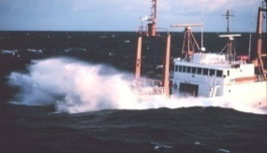
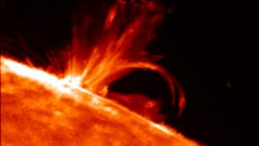
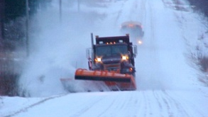
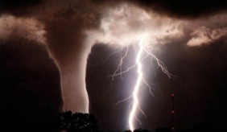
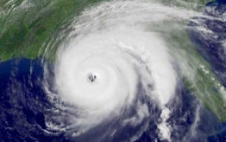
Weather Prediction Center
2013 Review
Wallace Hogsett
Science and Operations Officer
with contributions from WPC: David Novak, Mark Klein, Keith Brill, Chris Bailey, Faye Barthold, Tom Workoff, Mike Bodner, Patrick Burke, Rich Otto, Tony Fracasso, Bob Oravec, Bruce Sullivan, David Roth
2013 NCEP Production Suite Review Meeting – December 2013

Slide 2
Outline
Overview of WPC Products and GPRA Performance
Feedback on EMC guidance in support of WPC operations
QPF, Winter weather, Medium Range
High-impact events
Guidance “wish list”
Notes:
*

Slide 3
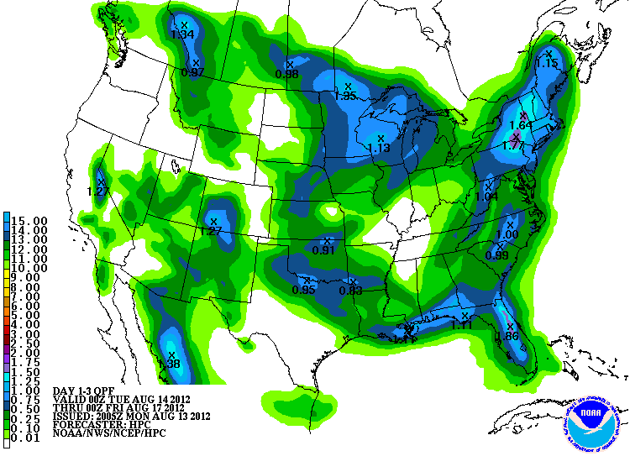
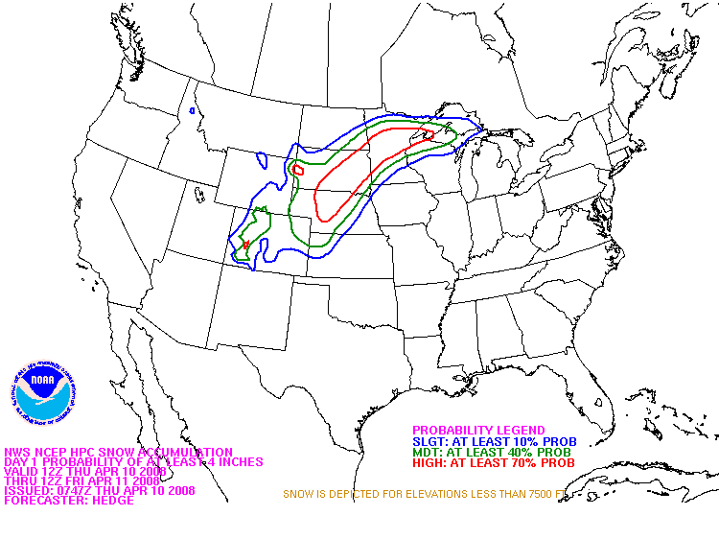
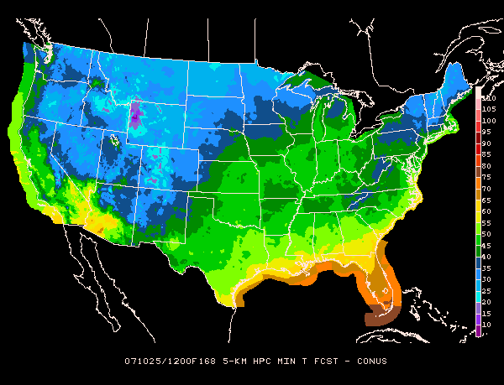
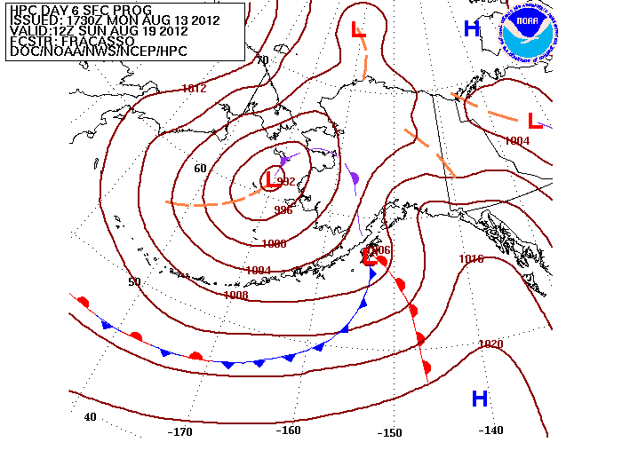
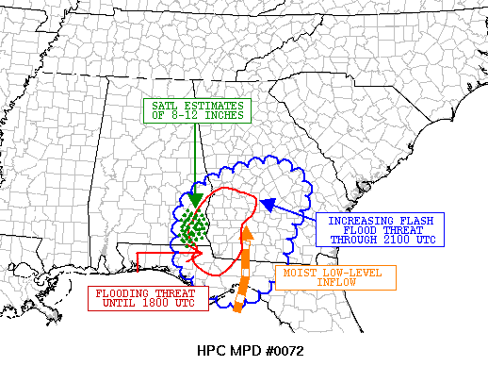
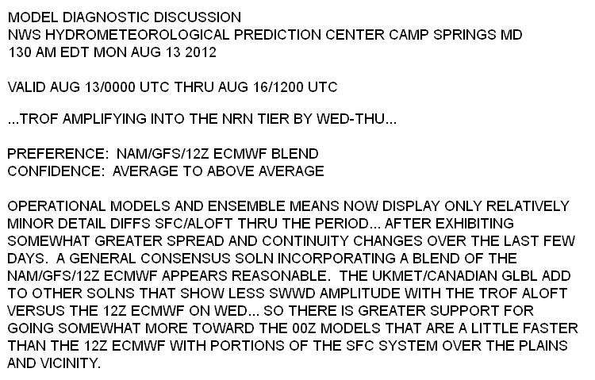
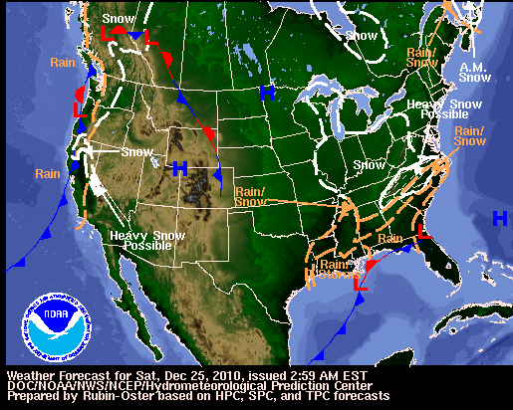
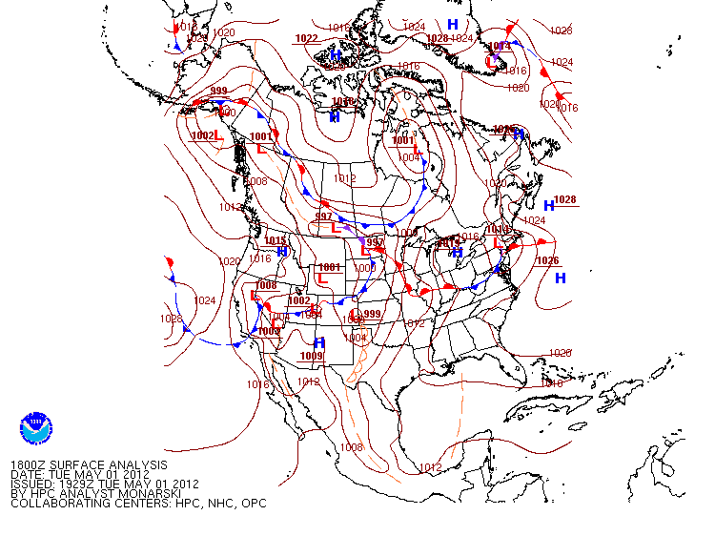
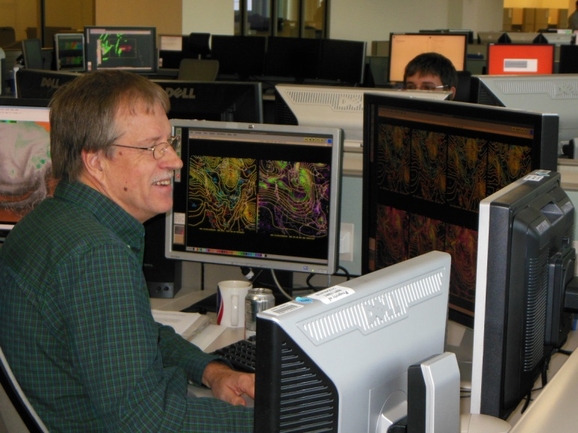
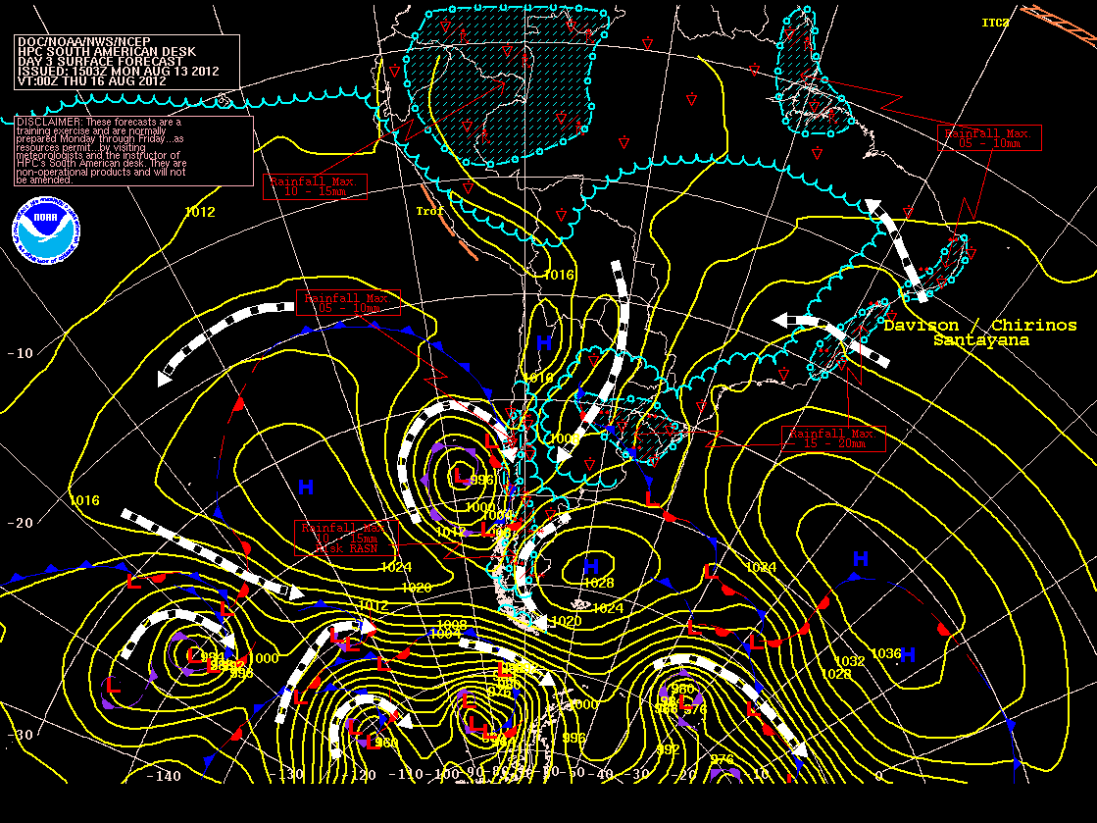
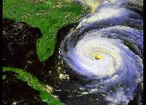
WPC Operational Desks
QPF
Winter Weather
Medium Range
Alaska Med. Range
Met Watch
Model Diagnostics
Short Range
Surface Analysis
International
Tropical

Slide 4
Thank you to EMC and NCO
Timely, reliable, and high-quality model suite
Full scale coverage: synoptic to mesoscale
Collaborative WPC-EMC/NCO interactions:
HMT-WPC Testbed activities
Model Evaluation Group (MEG) and Synergy meetings
Sandy Supplemental Activities
AWIPS2 Transition meetings
Ongoing projects: model upgrades, evaluations, etc.
WPC looks forward to continuing and expanding the interactions
4
Notes:
*

Slide 5
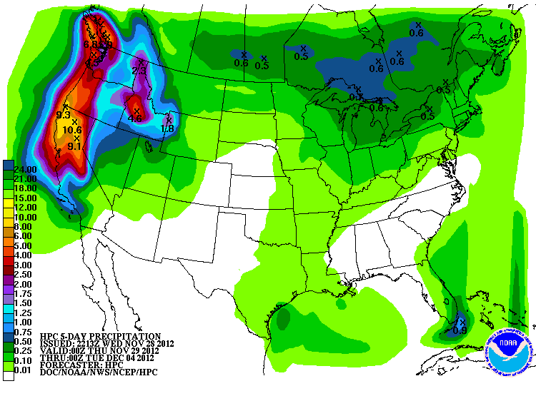
QPF

Slide 6
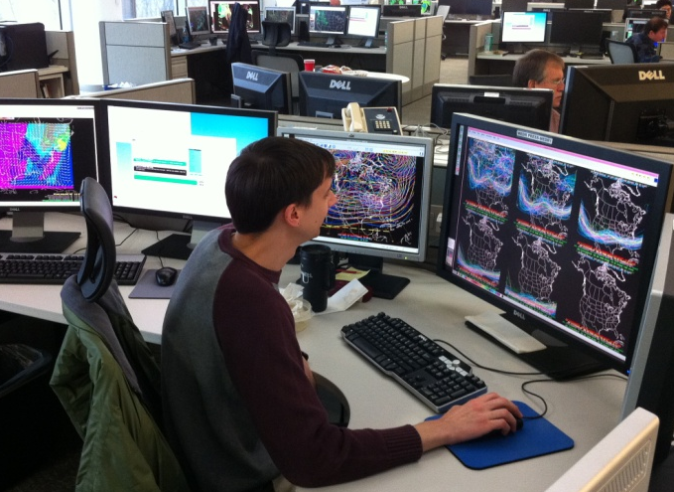
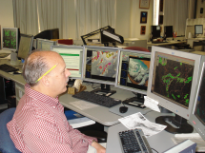
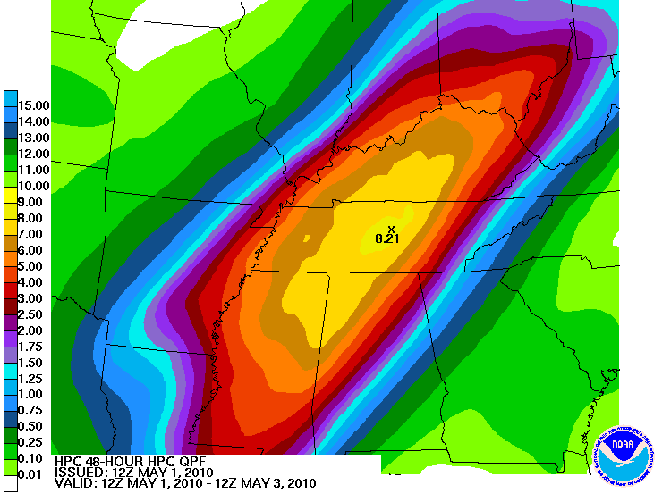
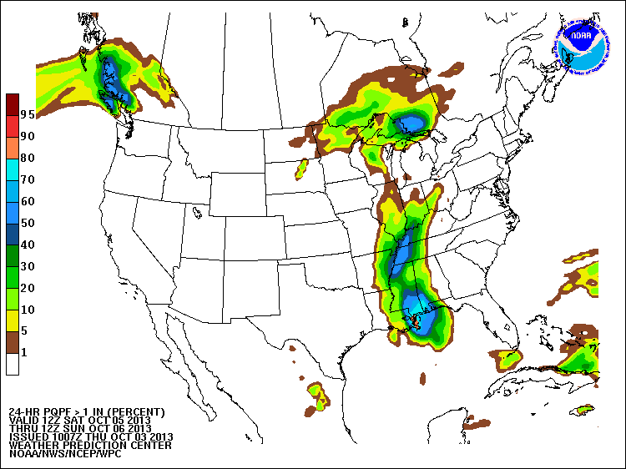
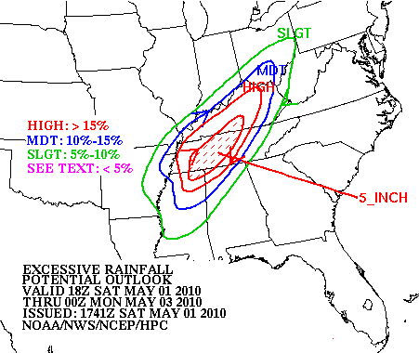
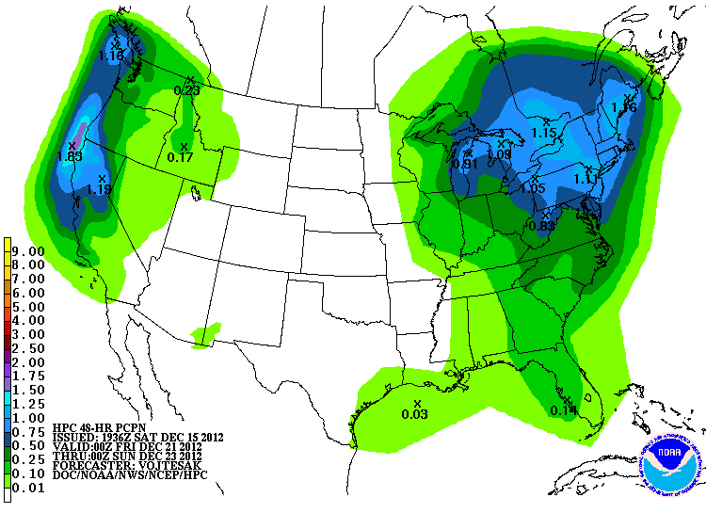
WPC QPF Services
Medium Range Desk
QPF
Desk
MetWatch
Desk
Deterministic QPF
Probabilistic QPF
Mesoscale Precipitation Discussion
Day 4-7 QPF
Excessive Rainfall
days
forecast lead time
hours

Slide 7
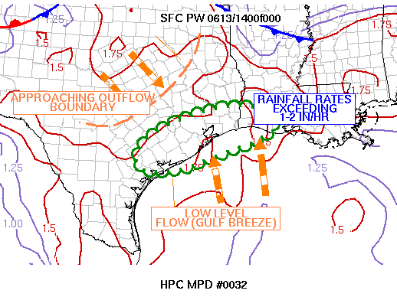
MetWatch Background
WPC provides a product similar to SPC Mesoscale Convective Discussions (MCD) focusing on heavy rainfall.
Provides enhanced situational awareness of potential flash flood events (1-6 hrs).
Requirement: high-resolution ensemble system capable of skillful and reliable short-term heavy rainfall forecasts. HRRRE?
MESOSCALE PRECIPITATION DISCUSSION 0032
NWS HYDROMETEOROLOGICAL PREDICTION CENTER CAMP SPRINGS MD
1216 PM EDT WED JUN 13 2012
AREAS AFFECTED...SOUTHEAST TEXAS...SOUTHWST LOUISIANA
CONCERNING...HEAVY RAINFALL...FLASH FLOODING POSSIBLE
VALID 131600Z - 132000Z
...SLOW MOVING CONVECTION WITH POTENTIALLY EXCESSIVE RAINFALL AMOUNTS ACROSS COASTAL AREAS IN SOUTHEAST TEXAS AND WESTERN LOUISIANA...
COMPOSITE RADAR LOOPS SHOW REGENERATING CONVECTIVE CLUSTERS ALONG THE GULF BREEZE BOUNDARY ACROSS COASTAL PORTIONS OF SOUTHEAST TEXAS...EAST OF VICTORIA...AND SOUTHWEST LOUISIANA. THESE CELLS ARE AIDED BY THE STRENGTHENING DIURNAL DESTABILIZATION...WITH THE LATEST SPC MESOANALYSIS INDICATING SURFACE-BASED CAPES BETWEEEN 3,000-4,000 J/KG...COINCIDENT WITH THE RICH...DEEP MOIST ENVIRONMENT WITH SURFACE DEWPOINTS IN THE MID 70S...K INDICES IN THE MID TO UPPER 30S...AND PWATS BETWEEN 1.75 AND 2.00 PER THE LATEST GPS AND 12Z UPPER AIR ANALYSIS.
...HURLEY.. 06/13/2012
ATTN...WFO...LCH...HGX...CRP...EWX... LAT...LON 28399668 28419704 28719735 29229718 29779637 30179525 30429385 30219268 29789250 29519279 29159377 28839481 28499573 28399668
27
Notes:
*

Slide 8
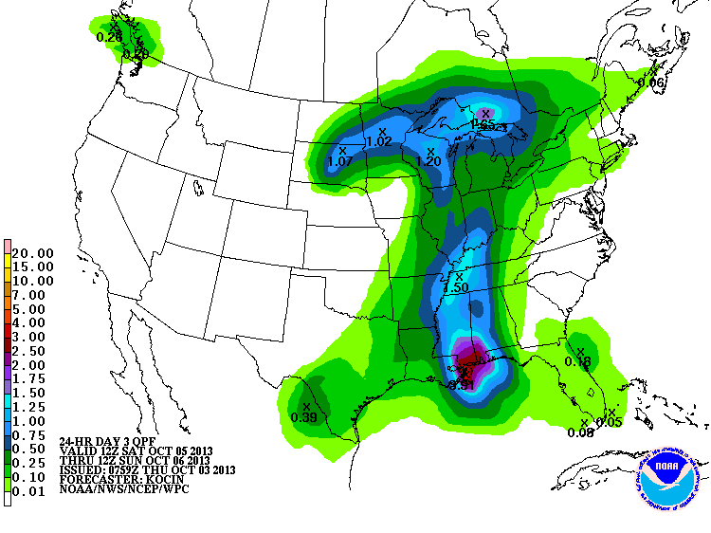
WPC QPF Products
Deterministic QPF
Probabilistic QPF
Forecaster assimilates all available guidance to determine the most likely deterministic solution
Automated process creates a PDF from a multi-model ensemble. WPC forecast is the mode.
Probabilistic QPF: http://www.wpc.ncep.noaa.gov/pqpf/conus_hpc_pqpf.php
Notes:
*

Slide 9
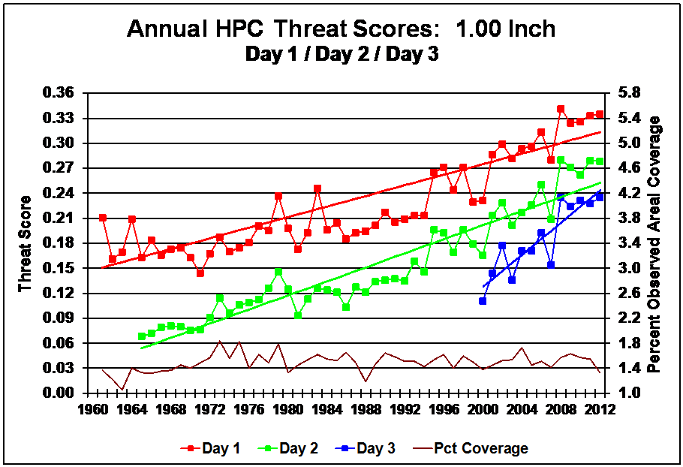
Long-Term QPF Verification
WPC
GPRA Goal: 0.31
9
Notes:
*

Slide 10
Day 1 QPF: WPC vs Guidance
FY2013
Achieved 2013 GPRA goal
WPC outperforms all individual models
WPC-generated “ENSBC” is a bias-corrected multi-model ensemble based on EMC guidance suite and is very competitive with WPC
(Novak et al. 2013)
9
Notes:
*

Slide 11
QPF Downscaled to 5km
Implemented downscaled QPF on Oct. 23, 2013 in response to WFO requests
Technique uses monthly PRISM data to downscale from 20km to 5km
Largest impact in high terrain in the Western U.S.
Notes:
*

Slide 12
High-Impact Warm-Season Events
Boulder floods (Sept 2013)
Central Texas floods (Oct 2013)
WPC contributions:
Skillful QPF products
Flash flood forecast products
12
Notes:
*

Slide 13
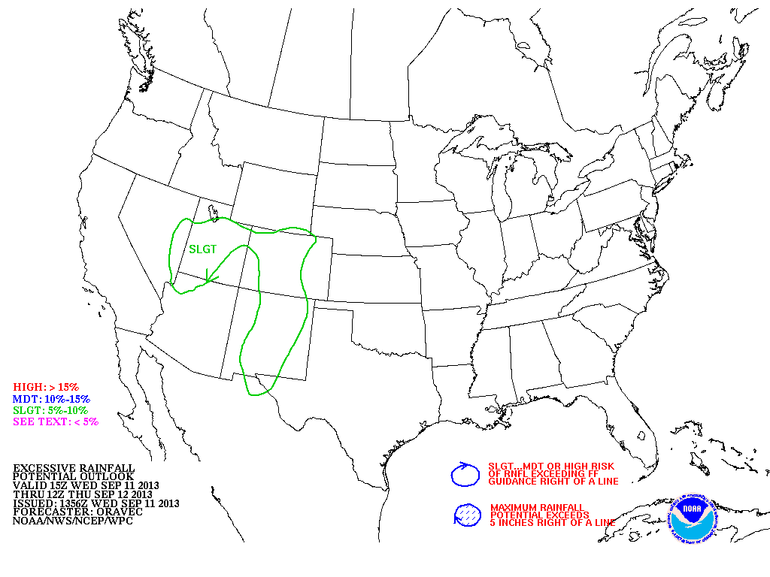
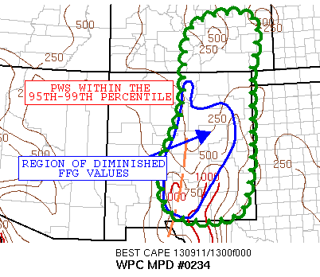
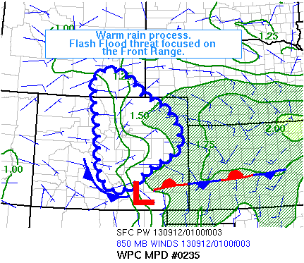
Day 1 Excessive Rainfall Outlook
Issued Sept 11 – Early Morning

Slide 14
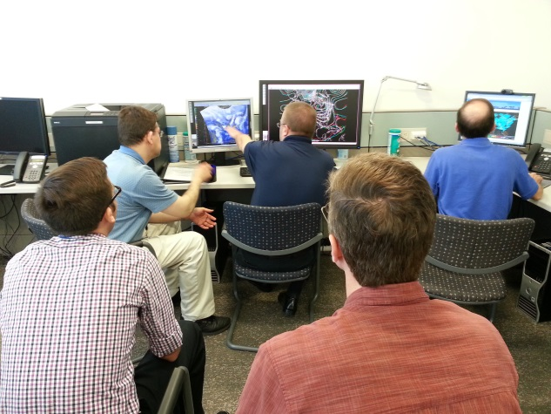
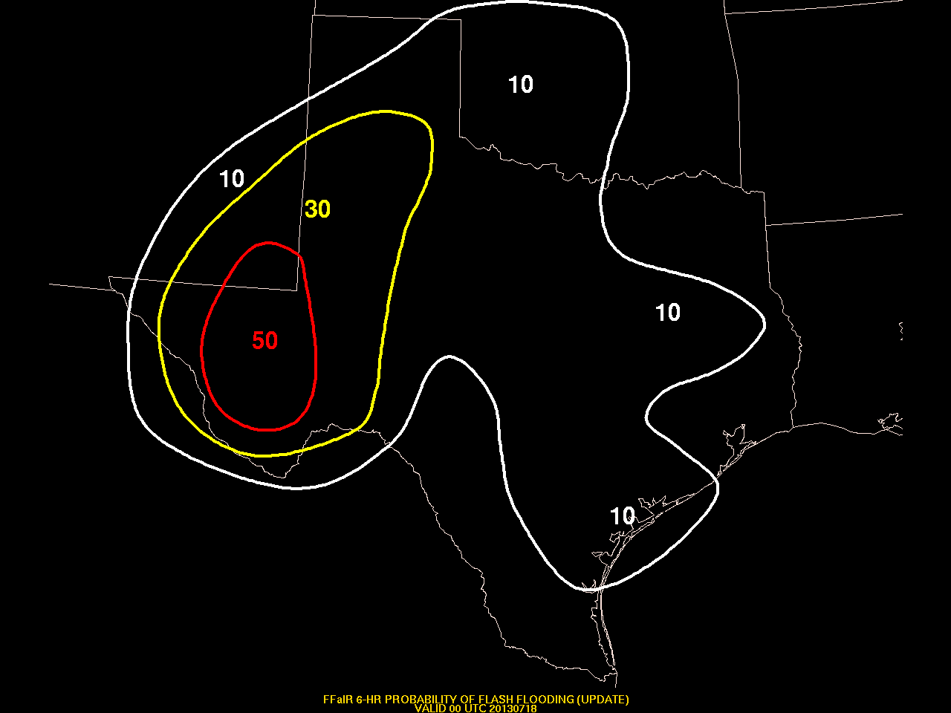
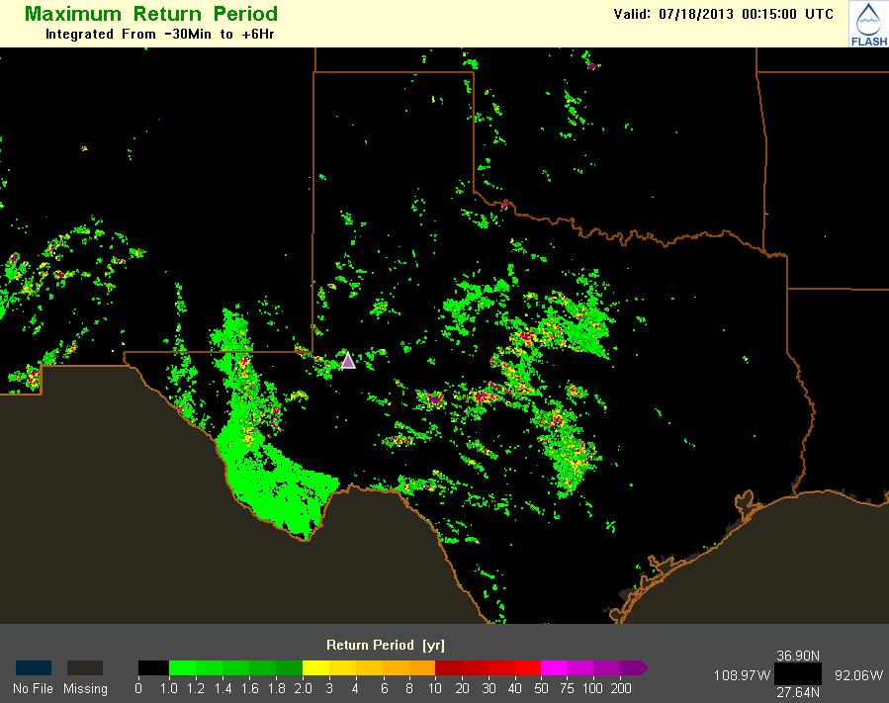
Flash Flood and Intense Rainfall (FFaIR) Experiment
Real-time forecasting experiment focusing on flash flooding in the 0-12h time frame (HMT-WPC, w/NSSL and ESRL)
Held July 2013 at WPC with 26 diverse participants
Produced probabilistic flash flood forecasts
Tools based on model QPF and RFC FFG
Tested new NWP ensemble systems
Explored flash flood verification (NSSL-FLASH)
NSSL FLASH
Probability of flash flooding
Notes:
*

Slide 15
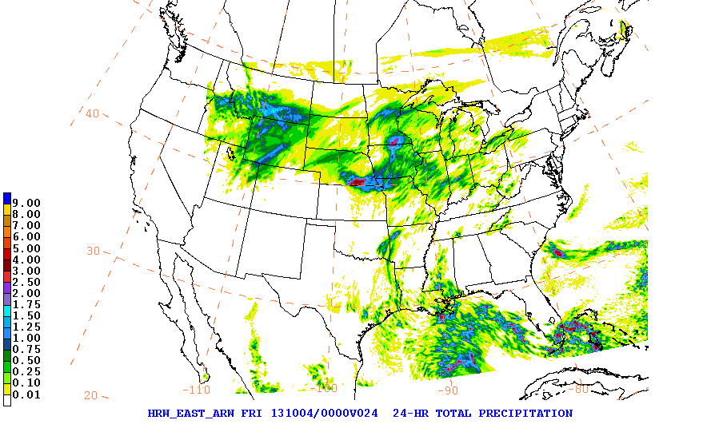
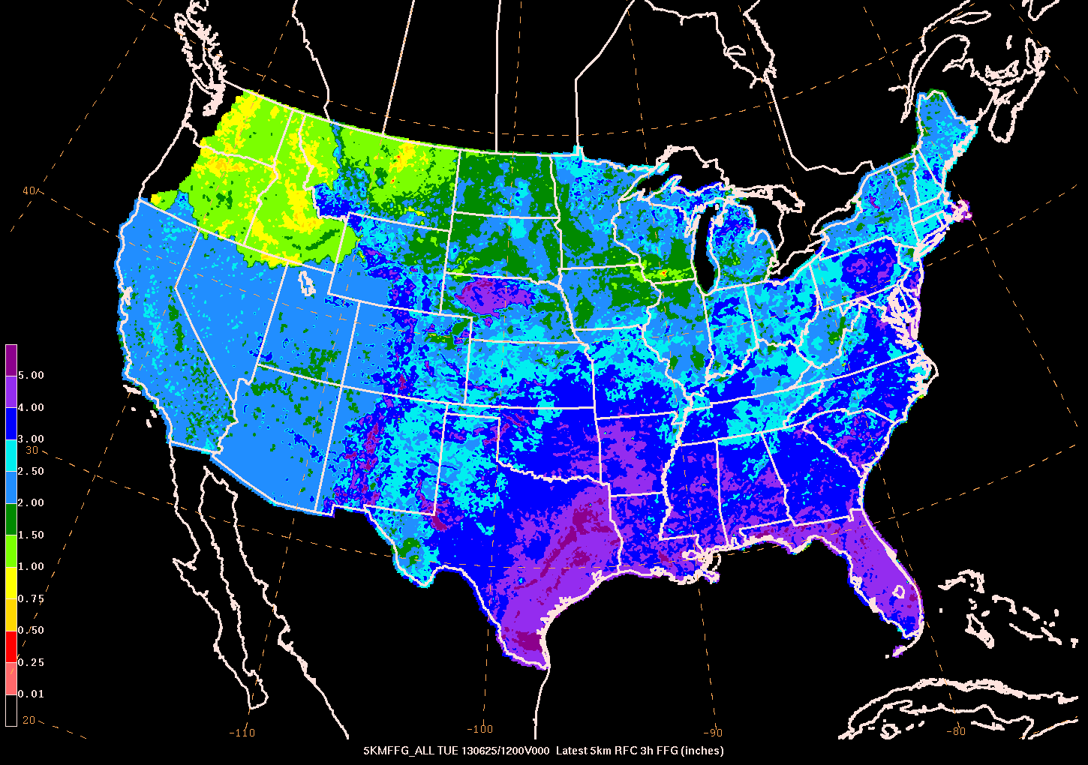
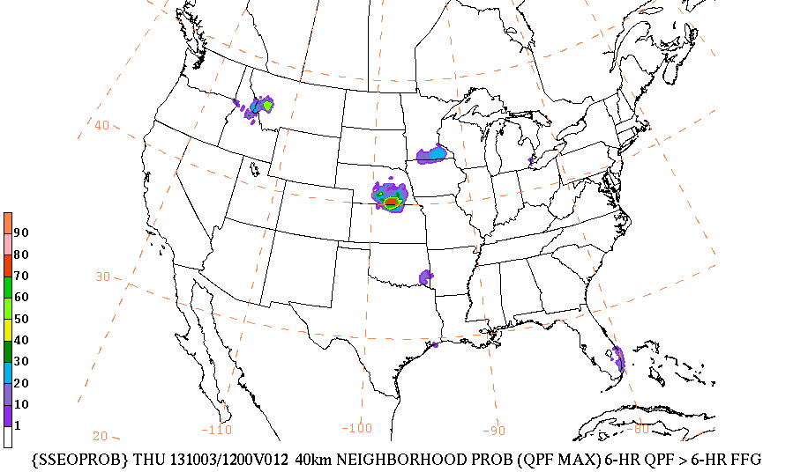
FFaIR Experiment Guidance
High-Res Ensemble QPF
Flash Flood Guidance
+
Probability of Flash Flood
Goal: Extract actionable information from ensemble guidance
Technique requires:
reliable, sufficiently diverse ensemble
unbiased precipitation forecasts
Notes:
*

Slide 16
Guidance for Boulder Floods
Leverage all high-resolution guidance (7 members) and RFC FFG,
Use neighborhood techniques to account for uncertainty in placement of precipitation,
(right) 14hr forecast, valid 02Z on Sept 12, near the time of flooding onset
“probability of flash flood”
Boulder
9
Tom Workoff, WPC
Notes:
*

Slide 17
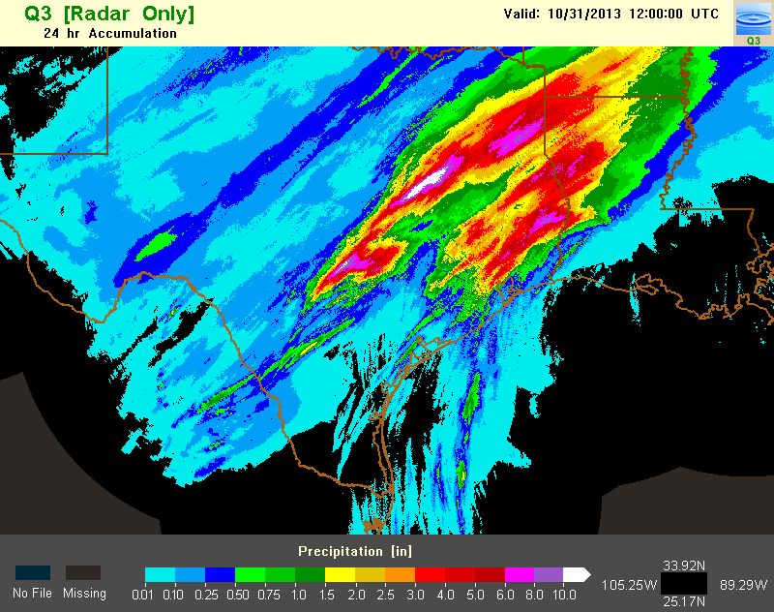
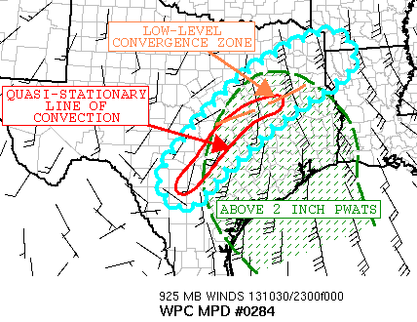
Central Texas Floods – Oct 30
>10” rainfall on Oct 30-31
Flooding threat highlighted two days in advance
Upgraded to moderate risk on Day 1
Mesoscale discussion issued prior to onset of flash flooding
Day 2 Outlook
WPC (issued 10:06pm)
Day 1 Outlook
Notes:
*

Slide 18
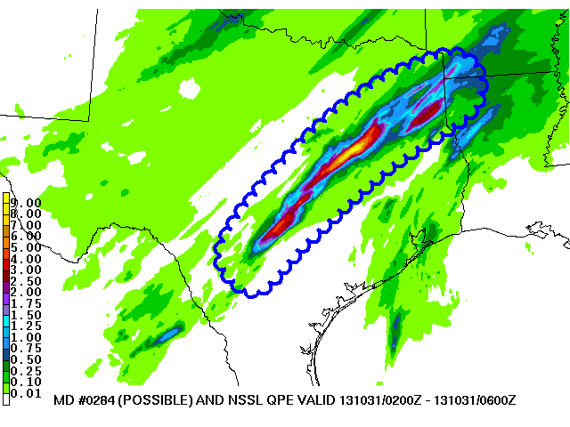
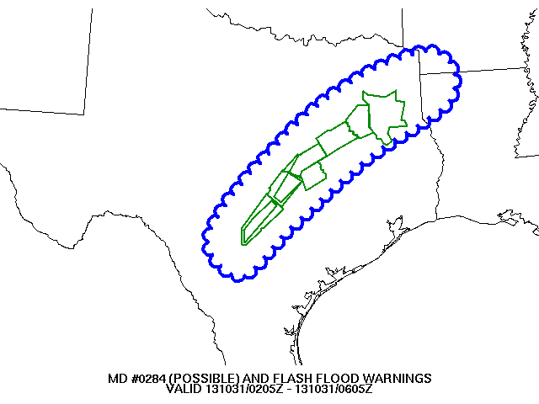
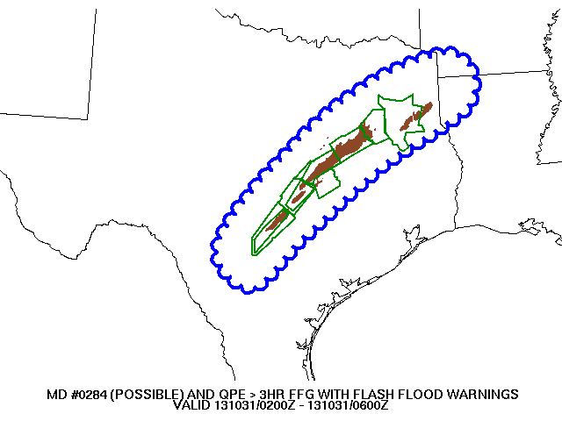
WPC
QPE
FF Warnings
QPE>Flash Flood Guidance
Faye Barthold, WPC

Slide 19
QPF Needs
Improved model bias characteristics (high-res, SREF, GFS)
Accelerate HRRRE into operations
more diverse high-res ensemble
Routine verification of probabilistic QPF
included as part of pre-implementation testing
Improved updating of Stage IV QPE
Notes:
*

Slide 20
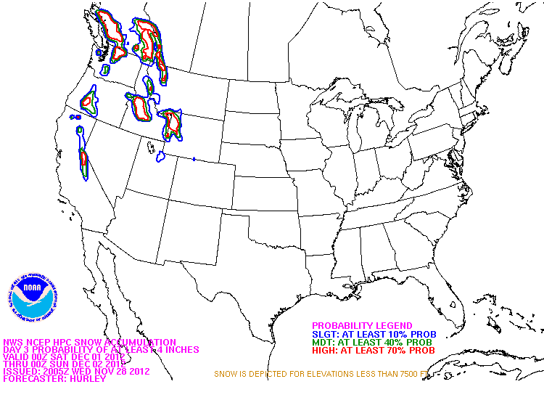
Winter Weather

Slide 21
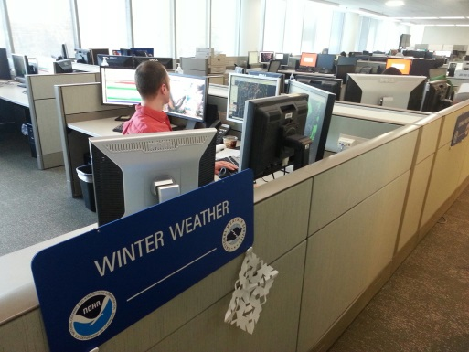
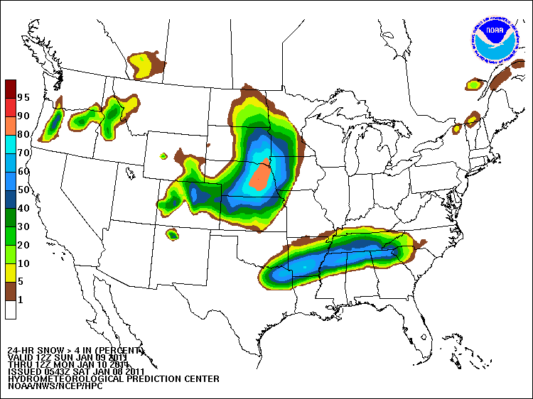
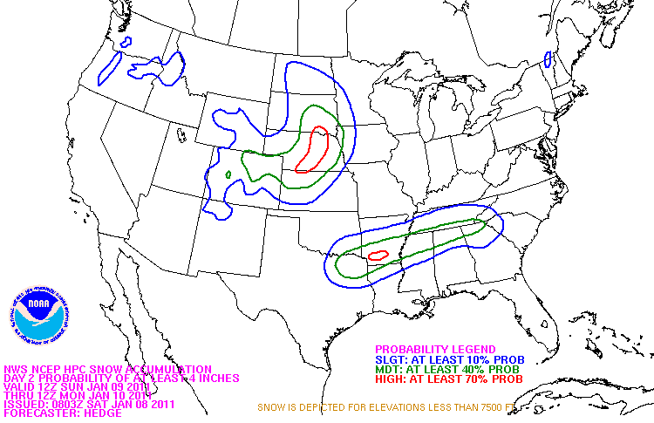
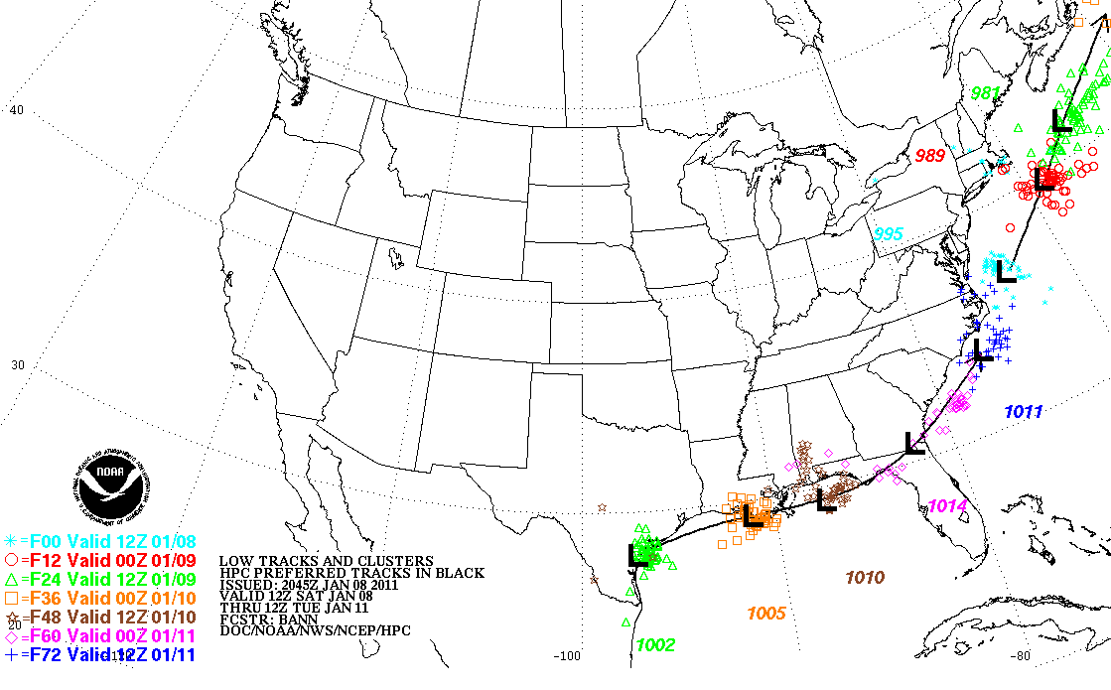
WPC’s Winter Weather Products and Services
Internal NWS collaboration
24, 48, 72 h probabilities for:
-Snow/Sleet/Freezing Rain
-Probabilities computed from deterministic forecast and ensemble spread
Track forecasts for surface lows
associated w/ significant winter weather
Heavy Snow and Ice Discussion
Notes:
21

Slide 22
Winter Weather
Deterministic Snow
Probabilistic Snow
“MODE”
“SPREAD”
Forecaster assimilates all available guidance to determine the most likely deterministic solution
Forecast process accounts for model shortcomings (bias, SLRs, etc.)
Automated process creates a PDF from a 33-member multi-model ensemble
WPC forecast is the mode of the distribution
Winter Weather Forecasts: http://www.wpc.ncep.noaa.gov/wwd/winter_wx.shtml
Notes:
*

Slide 23
WPC Deterministic Snowfall Forecast
2012-13 Day One Snow Threat Score Over the CONUS
Better
Final forecasts verify close to the Automated Ensemble
Automated Ensemble: NAM + GFS + ECMWF + SREF members + GEFS members
Deficiencies in snowfall analysis complicate verification; working with NOHRSC to address analysis shortcomings

Slide 24
WPC Deterministic Snowfall Forecast
Day Three Snow Threat Score Over the CONUS
Better
Final forecasts outperform the Automated Ensemble

Slide 25
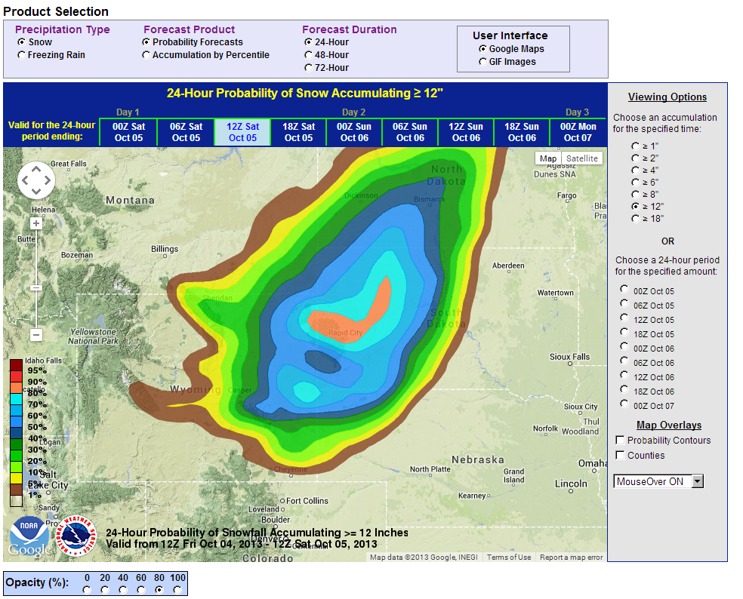
2013-14 Winter Weather Operations
New for 2013-14:
Google Maps web interface
Expanded probabilities to 6-hr time intervals for 24-and 48-hour probabilities
Additional members in ensemble (total of 33 members)
New forecast process
Day 4-7 outlook
25
Notes:
25

Slide 26
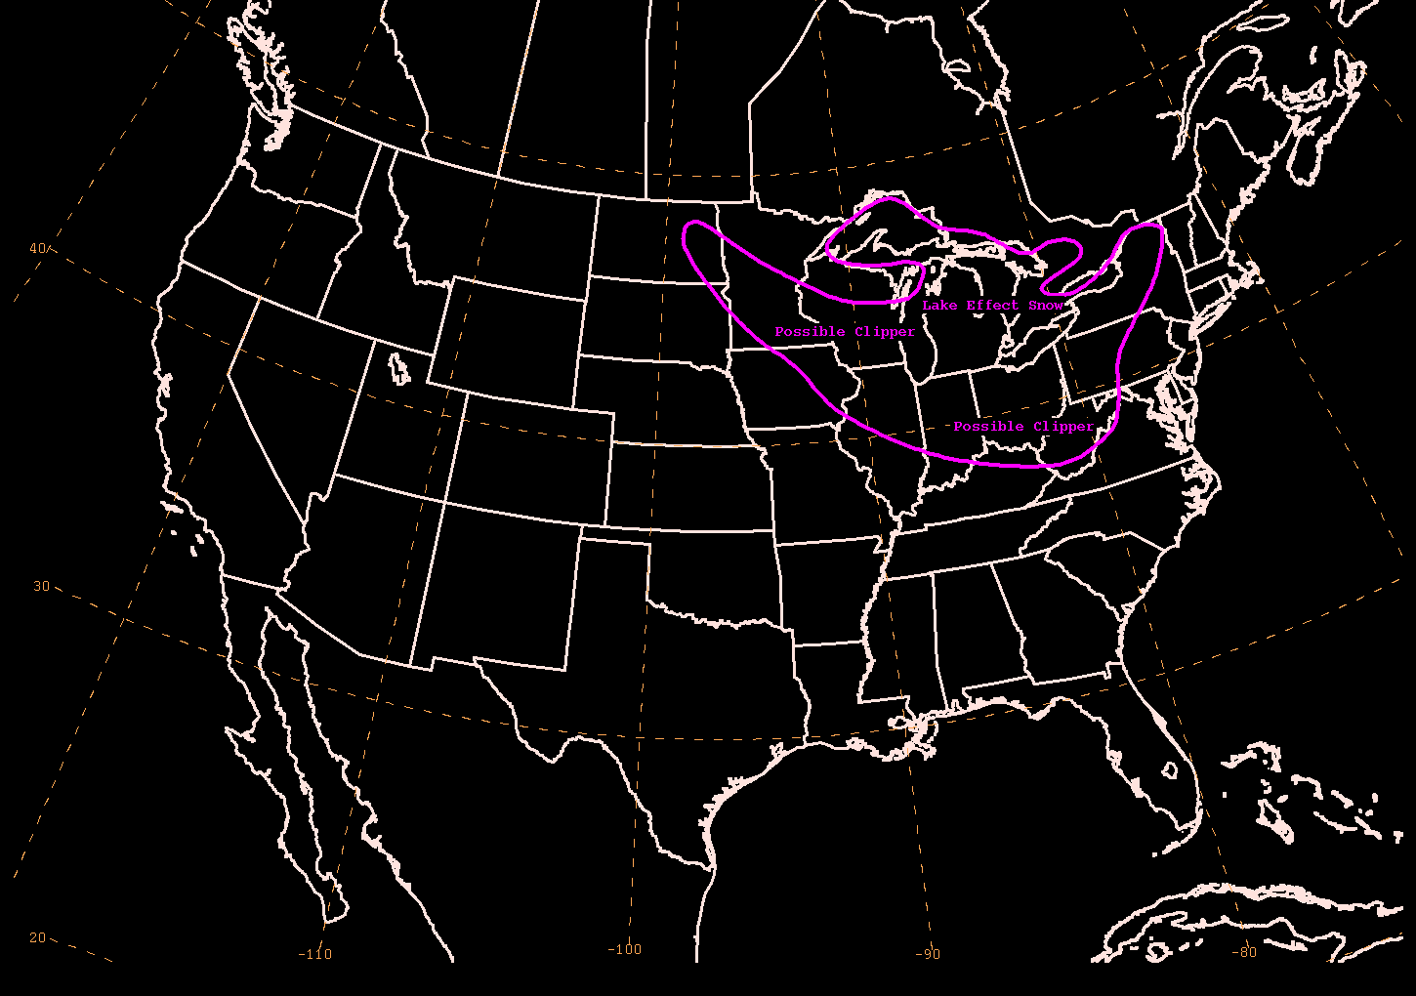
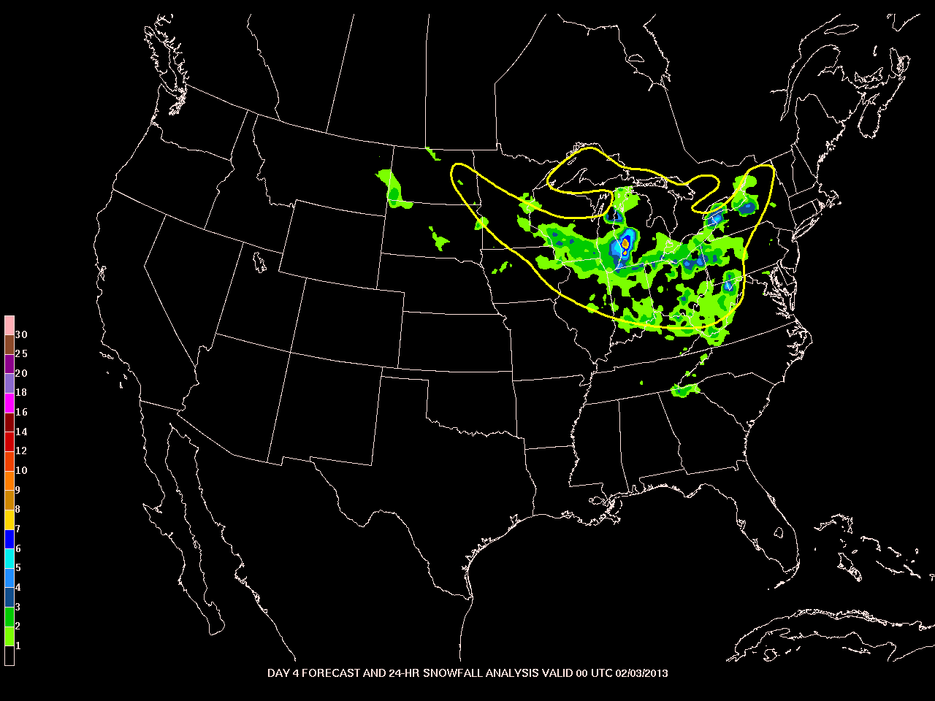
Winter Weather Experiment 2013
Explored the utility of Day 4 and Day 5 winter weather outlook
Determined winter weather outlooks could be skillful
Day 4 forecast
valid 00Z 3 February 2013
Observed 24 h snowfall ending 00Z 3 February 2013

Slide 27
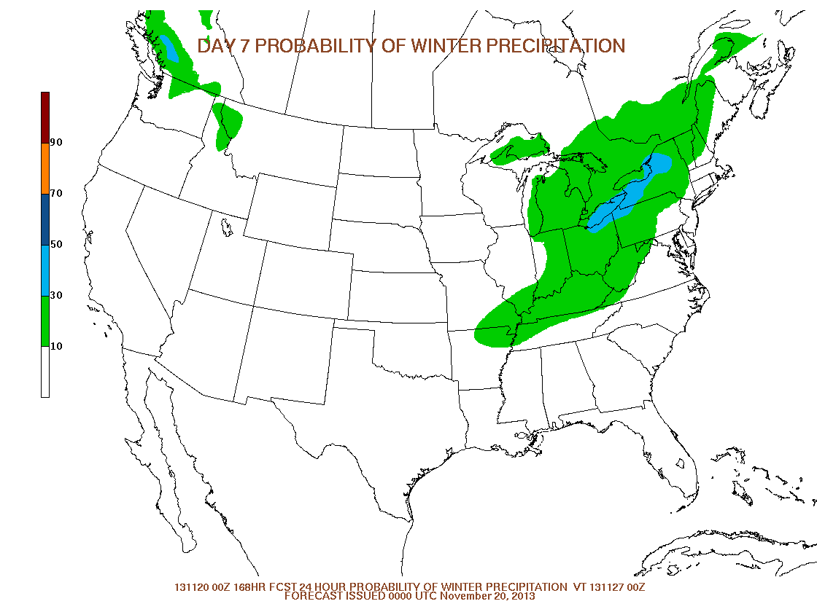
Day 4 – 7 Winter Weather Outlook Prototype
Developed objective, ensemble-based technique to provide starting point for forecasters
Internal testing this year
Aim to go experimental in 2014-15
Watch/Warning Map (Nov 26)
WPC Day 7 Outlook (issued Nov 19)
Mike Bodner, WPC

Slide 28
Advancing Snowfall Algorithms
Verification
RF Snowfall
WPC working closely with EMC on new model-implicit snowfall forecasting methods using model microphysics.
Application of NAM rime factor data to existing snow liquid ratio methods showed promise during 2013 Winter Weather Experiment (WWE).
Further testing will continue during the 2014 WWE, including land-surface coupling and the GFS and SREF.
Roebber Snowfall
Rime Factor Snowfall
Verification

Slide 29
Winter Weather Needs
Continued collaboration with EMC to implement advanced snowfall techniques, including rime factor and coupling with land surface
Routine verification of cool season phenomena
included as part of pre-implementation testing
probabilistic snowfall, low tracks
High-quality snowfall analysis
Notes:
*

Slide 30
Medium Range

Slide 31
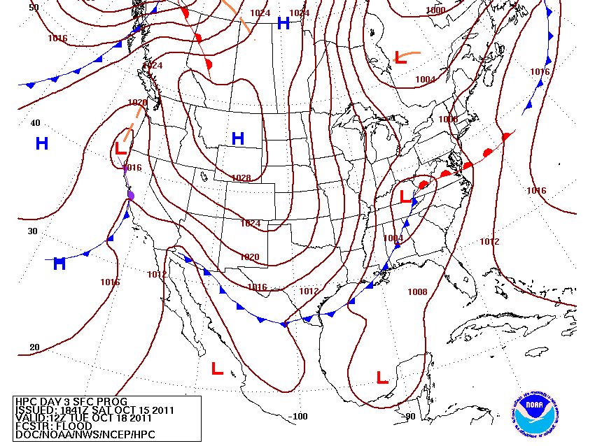
Medium-Range Grids -- An Enhanced Resource for the Field Offices
WPC provides twice-daily suite for CONUS, once-daily suite for Alaska
Available for collaboration 18hrs
More-current forecasts
Improved accuracy
Implemented Dec 18, 2012
Currently 5 km, planning for 2.5 km grids in March
Alaska Desk
Temp / PoPs
Pressure/Fronts

Slide 32
WPC Forecast Process
Forecaster evaluation of ensemble guidance
(ex., NCEP, MDL, CMC, NAEFS, ECMWF, UKMET, FNMOC)
PAST
Forecaster in the loop
Subjective “model of the day”
Manual product generation
Extensive manual edits
TARGET
Forecaster over the loop
Subjective “most likely outcome”
Automated grid generation (spatial consistency)
Limited manual edits
Forecaster weighting of ensemble guidance
Automated grid generation
Forecaster adjustment of grids

Slide 33
Medium Range Forecasting
All International Ensemble Systems
WPC “MasterBlender”
WPC operational medium range products deterministic
Plans in 2014 include initial development of probabilistic products
Sandy Supplemental will contribute new blended datasets to improve skill of blended forecasts.
Notes:
*

Slide 34
“Outside the Envelope”
GEFS
Ensemble forecasts often verify “outside the envelope”
How often do the GEFS/ECENS 7-day forecasts fail to capture the verifying 500mb height pattern?
ECENS envelope contains verifying solution more often than GEFS at Day 7.
*Inclusion of the ECENS would likely improve the reliability of bias-corrected, multi-ensemble systems (e.g., NAEFS)
ECMWF ensemble
Tony Fracasso, WPC
*
34
Notes:
*

Slide 35
Medium Range Hazards: Extreme Forecast Index (EFI)
Goal: Identify “extreme” events relative to model climatology.
Requires robust reforecast dataset.
WPC-ESRL collaboration to produce EFI using GEFS system
00Z 9/30/2013
Figure courtesy Tim Hewson, ECMWF
Notes:
*

Slide 36
WPC “Wish List”
Operationalize NAEFS bias-corrected, downscaled fields.
Inclusion of ECMWF ensemble in NAEFS is critical
Improved spread-error characteristics of GEFS
Routine reforecasts to facilitate development of ensemble-derived products: e.g., EFI, improved clusters, hazard outlooks
Accelerate implementation of HRRRE
Standard pre-implementation verification of ensemble systems
Probabilistic QPF (snow and liquid) and low tracks
Improved snowfall forecasts (microphysics, land use, ensembles)
HiRes window runs not preempted by hurricane models
Improved updating of Stage IV QPE

