Slide 1
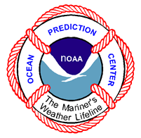
Ocean Prediction Center NCEP Production Suite Review - 2013
Joe Sienkiewicz
Ocean Applications Branch
Outline
Overview
Activities
Wish List

Slide 2
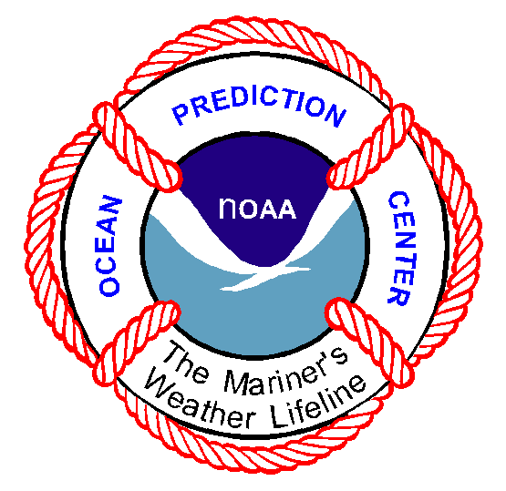
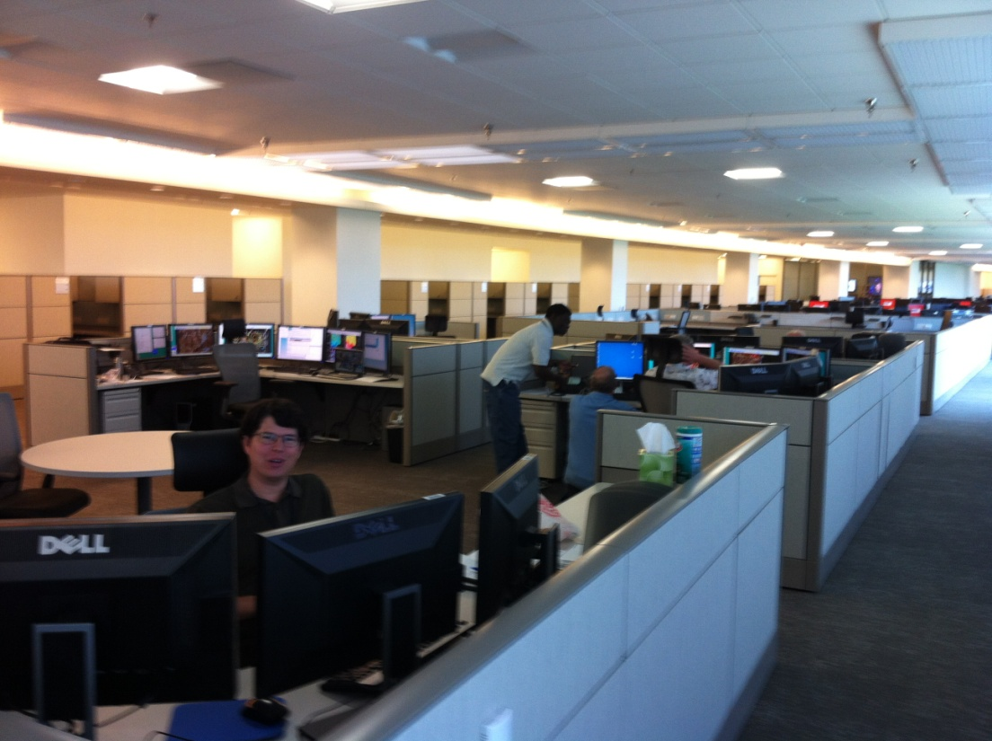
OPC Overview
Forecasts Branch– 20 Forecasters – (18)
Atlantic - High Seas and Regional
Atlantic - High Seas and Regional
Outlook Applications Branch – 5
2 FTE developers
NOAA Corp Officer
2 NOAA Affiliates Management – 3.5 (2)
Director/Operations Branch Chief
Applications Branch Chief / SOO

Slide 3
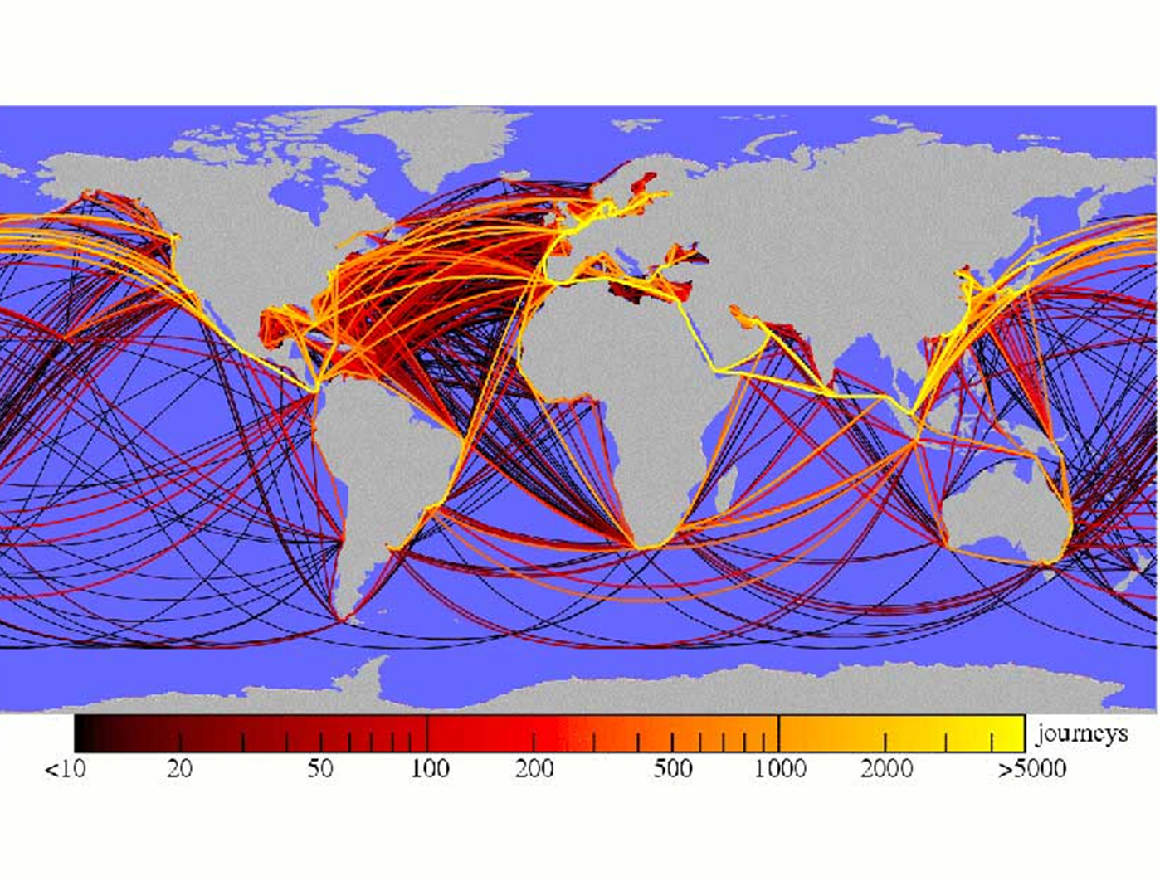
“90% of EVERYTHING”
by Rose George
“…the invisible industry…”
Notes:
A recent book by Rose George describes the shipping industry as being invisible. The is 90% of everything meaning that by weight 90% of everything is moved by ships over the highways of the global ocean. This diagram shows the shipping routes and are color coded by the number of annual voyages. The trans-Atlantic and Pacific routes are very busy with frequent transits. The white lines depict the NWS High Seas areas of responsibility. Clearly, the NWS has responsibility for some of the busiest shipping routes in the world.

Slide 4
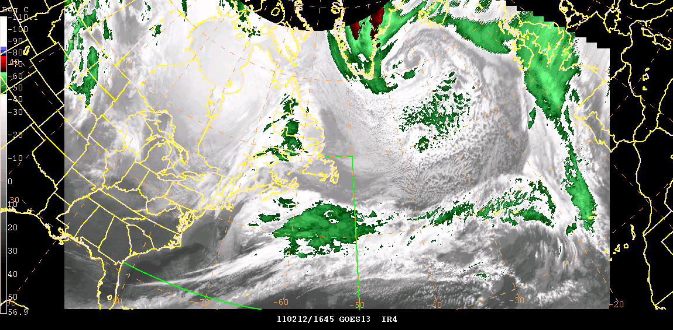
NOAA Ocean Prediction Center
North Atlantic
North Pacific
Wind Warnings - 2012
Atlantic Pacific GALE 2833 4187
STORM 981 1490
HURRICANE 218 273
FORCE
Notes:
The Ocean Prediction Center issues warnings for GALE, STORM, and HURRICANE FORCE conditions. Being 24/7 and having responsibility for the very active mid-latitude ocean areas, we issue a lot of warnings… nearly 10,000 last year. These graphs show the monthly distribution of warnings for the North Atlantic and Pacific. There is no season when the oceans are completely quiet. Also note that September through April, GALES, STORM, and HURRICANE FORCE conditions happen.

Slide 5
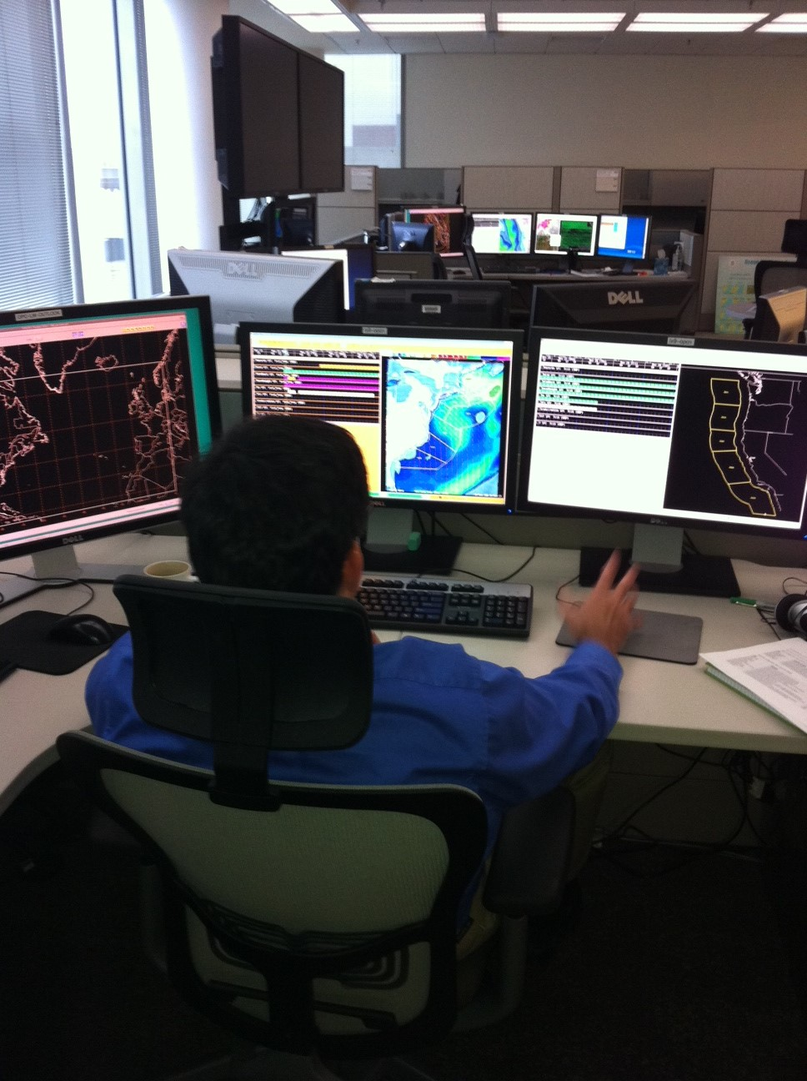
OPC Activities GFE Production for OFF waters
Operational 5/1/2013
Full Regional domains
12/2/2013
Update OFF zones
4/1/2014
Optimizing formatters
Additional sources
¼ deg ECMWF
UKMET

Slide 6
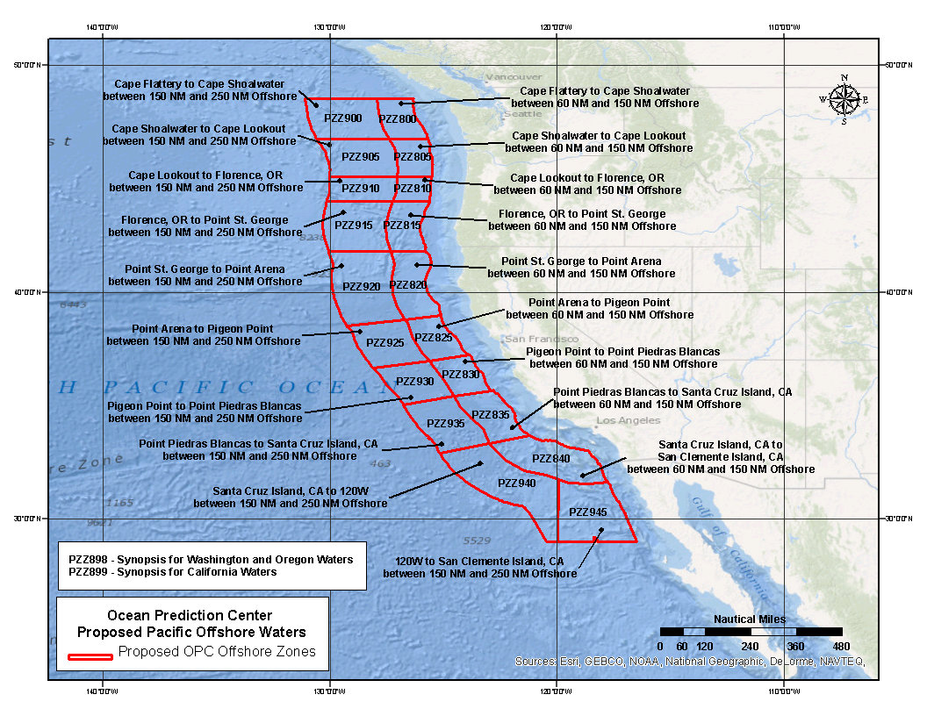

Slide 7
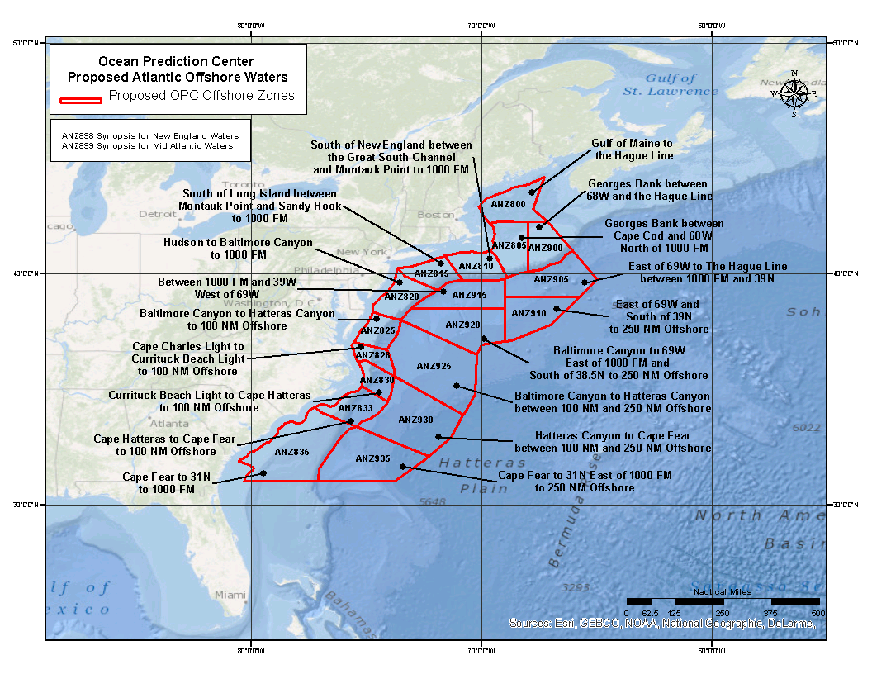

Slide 8
GFE Plans
Future steps to larger grids (full basin)
Need full gridded backup for true “Operational”
Generate graphical and gridded products
High Seas text generation
Additional parameters
SLP
Probabilistic
Large scale collaboration
Near Shore Wave Prediction System
Forecaster winds as forcing

Slide 9
OPC Activities AWIPS II
Operational for AWIPS I functionality
GFE for OFFSHORE production
Text product generation
National Centers Perspective (NCP)
Focus for FY2014
Prepare for FOTE
Training technical and forecast staffs
Adapt for NAWIPS capabilities
Developmental Environment Transition
Repurposed AWIPS-I
Will be a shared system with WPC and CPC

Slide 10
OPC Activities Ocean Winds
OceanSat-2 Scatterometer (OSCAT) available
25 km NESDIS product
Experimental http://manati.star.nesdis.noaa.gov/datasets/OSCATData.php
ASCAT_HI Coastal (KNMI) / High Wind Product (NESDIS) http://manati.star.nesdis.noaa.gov/datasets/ASCATData.php
ASCAT-B on METOP-B
Looking forward to AMSR2 (GCOM-W1) wind speeds
Talking with IFREMER - SMOS (L-band) wind speeds

Slide 11
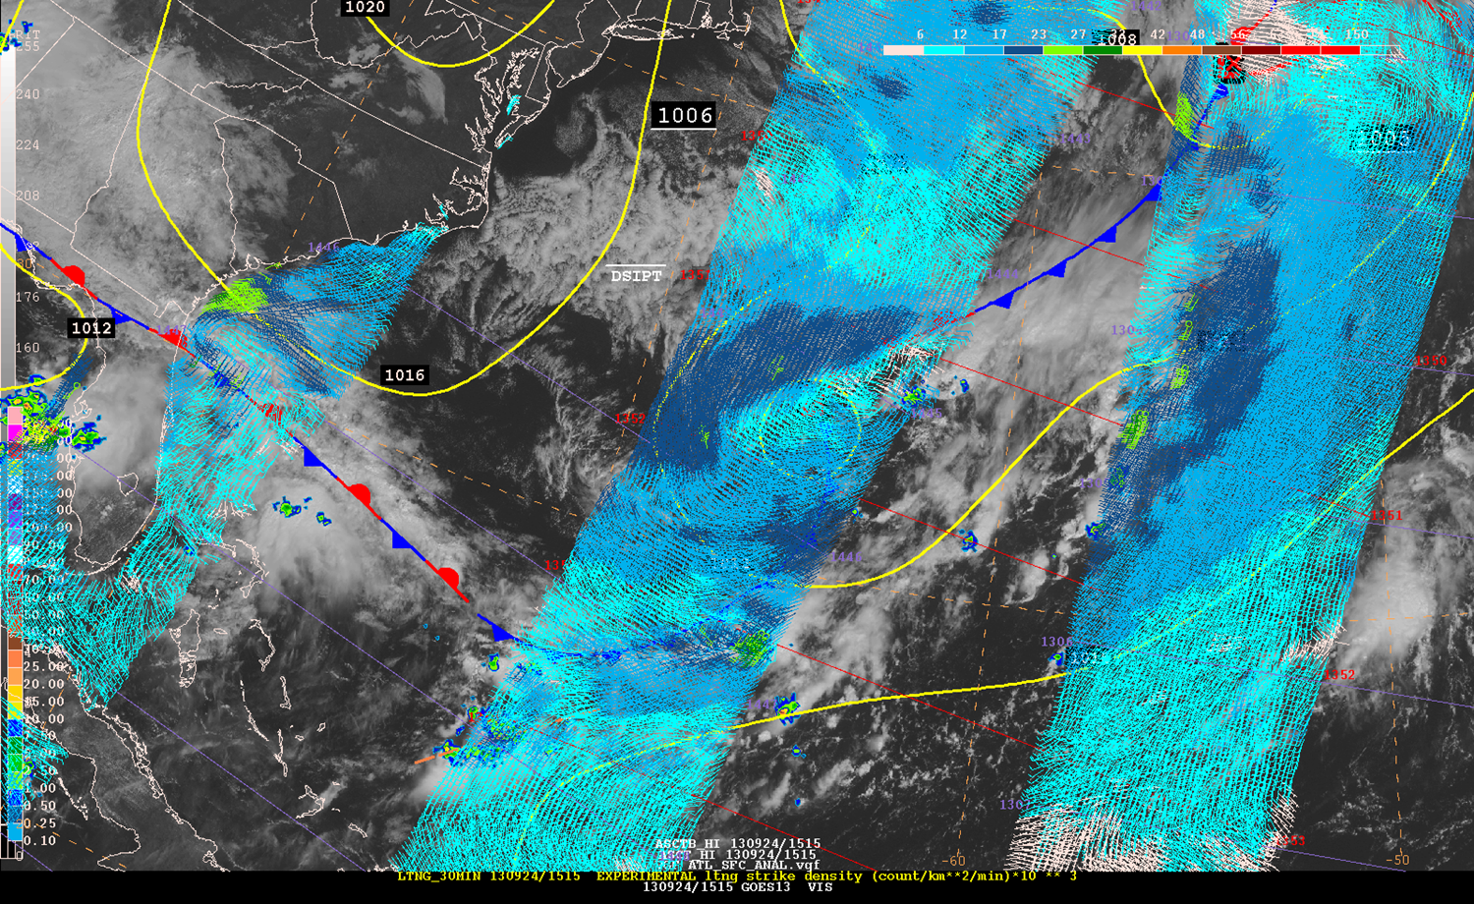
OPC Activities Ocean Winds
OceanSat-2 Scatterometer (OSCAT) available
25 km NESDIS product
Experimental http://manati.star.nesdis.noaa.gov/datasets/OSCATData.php
ASCAT_HI Coastal (KNMI) / High Wind Product (NESDIS) http://manati.star.nesdis.noaa.gov/datasets/ASCATData.php
ASCAT-B on METOP-B

Slide 12
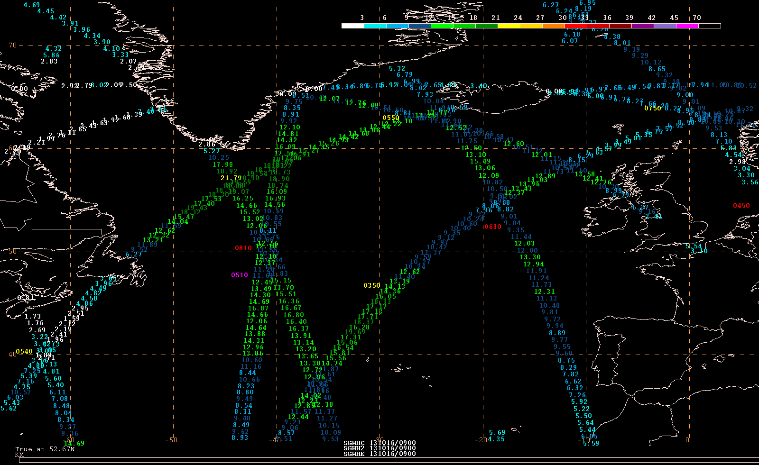
OPC Activities Ocean Waves
JASON-1 died
ENVISAT died
JASON-2 functioning
Added CRYOSAT-2
Added SARAL / AltiKA
NWS milestone – Altimeter wave heights to Alaska Region
Working to add displays of Wind Speed in NAWIPS

Slide 13
ft
m
JASON-2 – 1^{h} 53^{m}
CRYOSAT-2 – 1^{h} 39 ^{m}
ALTIKA – 1^{h} 40^{m}
1 2 3 4 5 6 7 8 9 10 11 12 13 14
Significant Wave Height
Observation time (UTC)

Slide 14
AltiKA

Slide 15
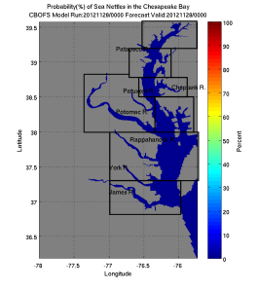
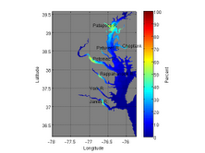
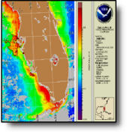
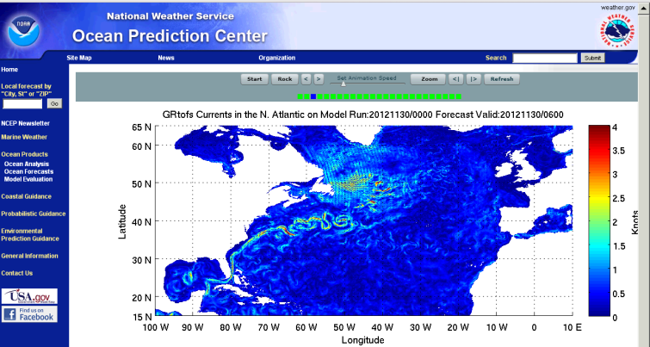
OPC Activities Enable/facilitate – Ecological and Oceanographic Prediction
Chesapeake Bay Sea Nettles http://www.opc.ncep.noaa.gov/Loops/SeaNettles/prob/SeaNettles.shtml
Vibrio Vulnificus (Pathogen)
Chesapeake, Delaware, Tampa
Working with NOS HAB efforts
Ocean Modeling
Global 1/12 deg RTOFS
End user and resource http://www.opc.ncep.noaa.gov/Current_fcasts.shtml http://www.opc.ncep.noaa.gov/SST_fcasts.shtml
Navy HYCOM (USCG SAR) and NCOM

Slide 16
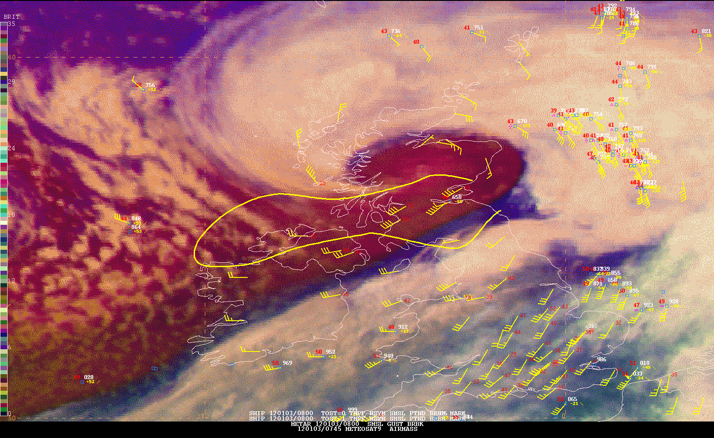
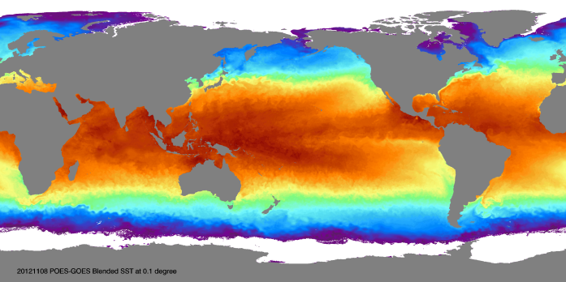
OPC Activities Satellite Readiness
Explosive Cyclogenesis
Offshore Convection
Lightning Strike Density
Low clouds and fog
Oceanographic products

Slide 17
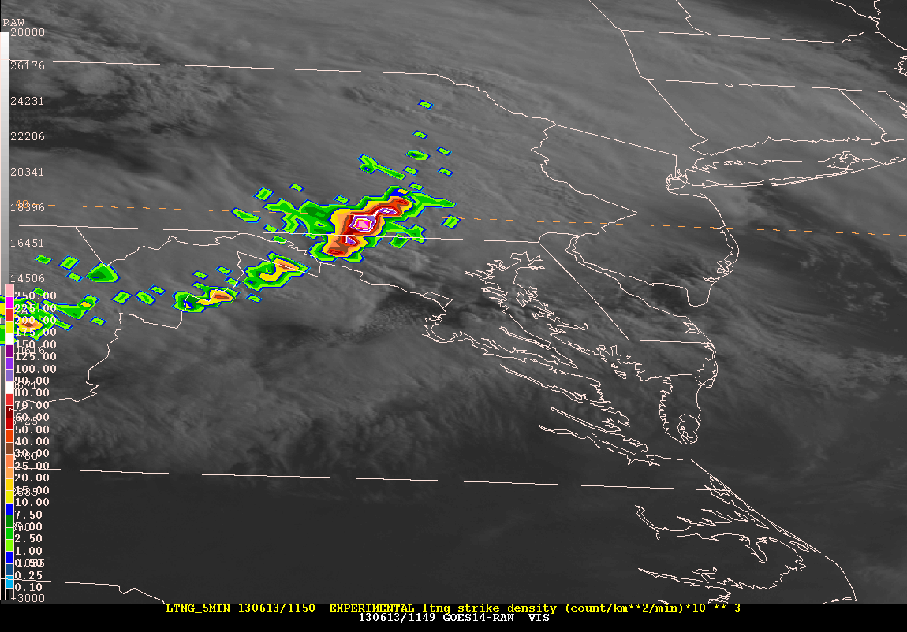
Offshore Convection
GOES-14 1 min SRO
Lightning Strike Density
Vaisala NLDN
Vaisala GLD360
Notes:
GOES-R will have a lightning detection capability. We are using a ground based source to detect lightning over the oceans and land now. This is a loop of 5 min images of lightning cloud to ground density (strikes/km**2/min) for a derecho that moved offshore. The star off of NJ show the approximate location of the Beneteau 407 Crocodile returning to MD from Newport. The next slide shows the leading edge of the derecho as it approcahed them rapidly.

Slide 18
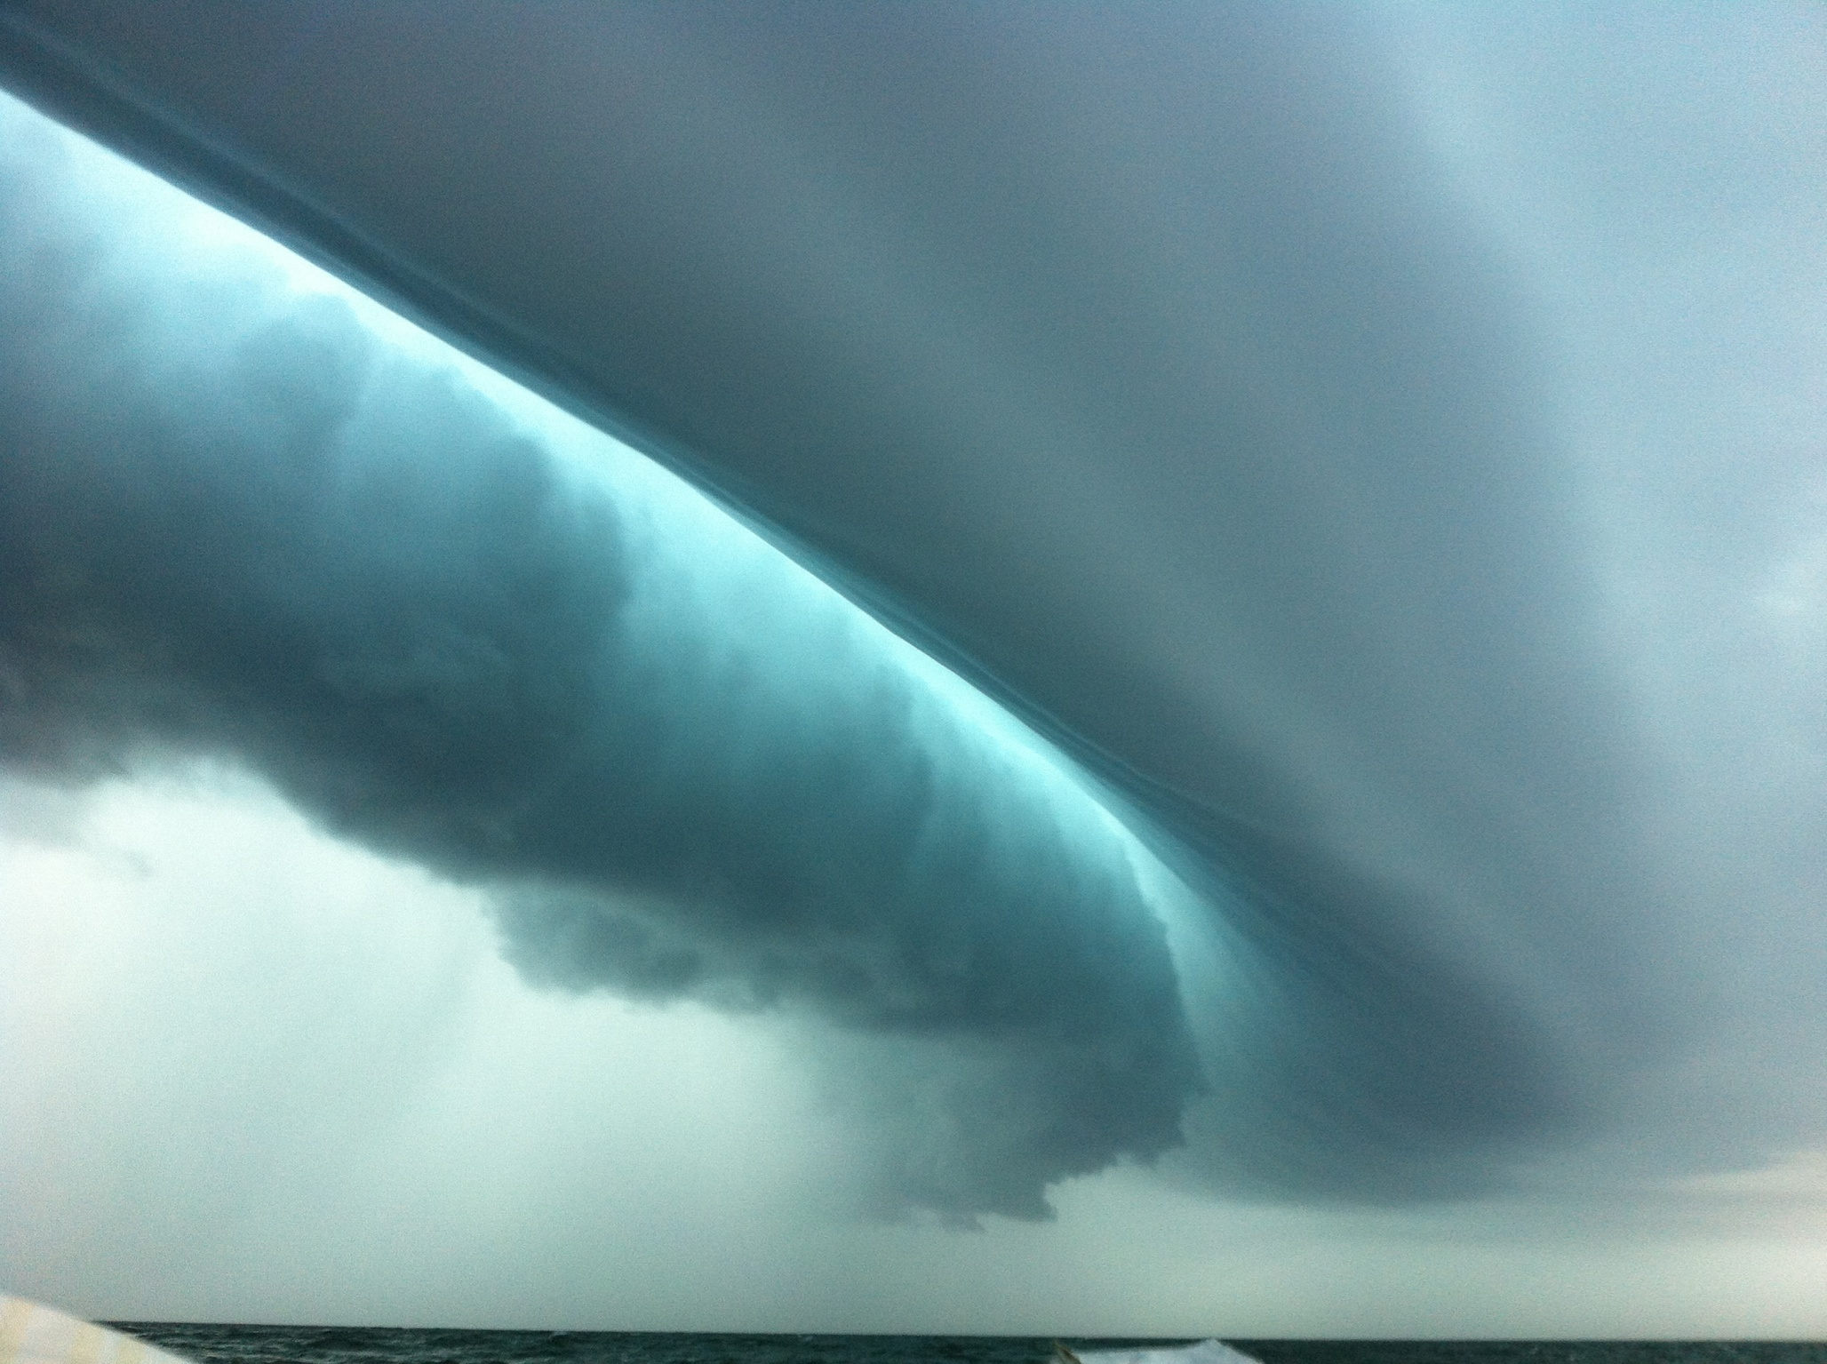
Offshore Convection
http://goesrnatcentperspective.wordpress.com/

Slide 19
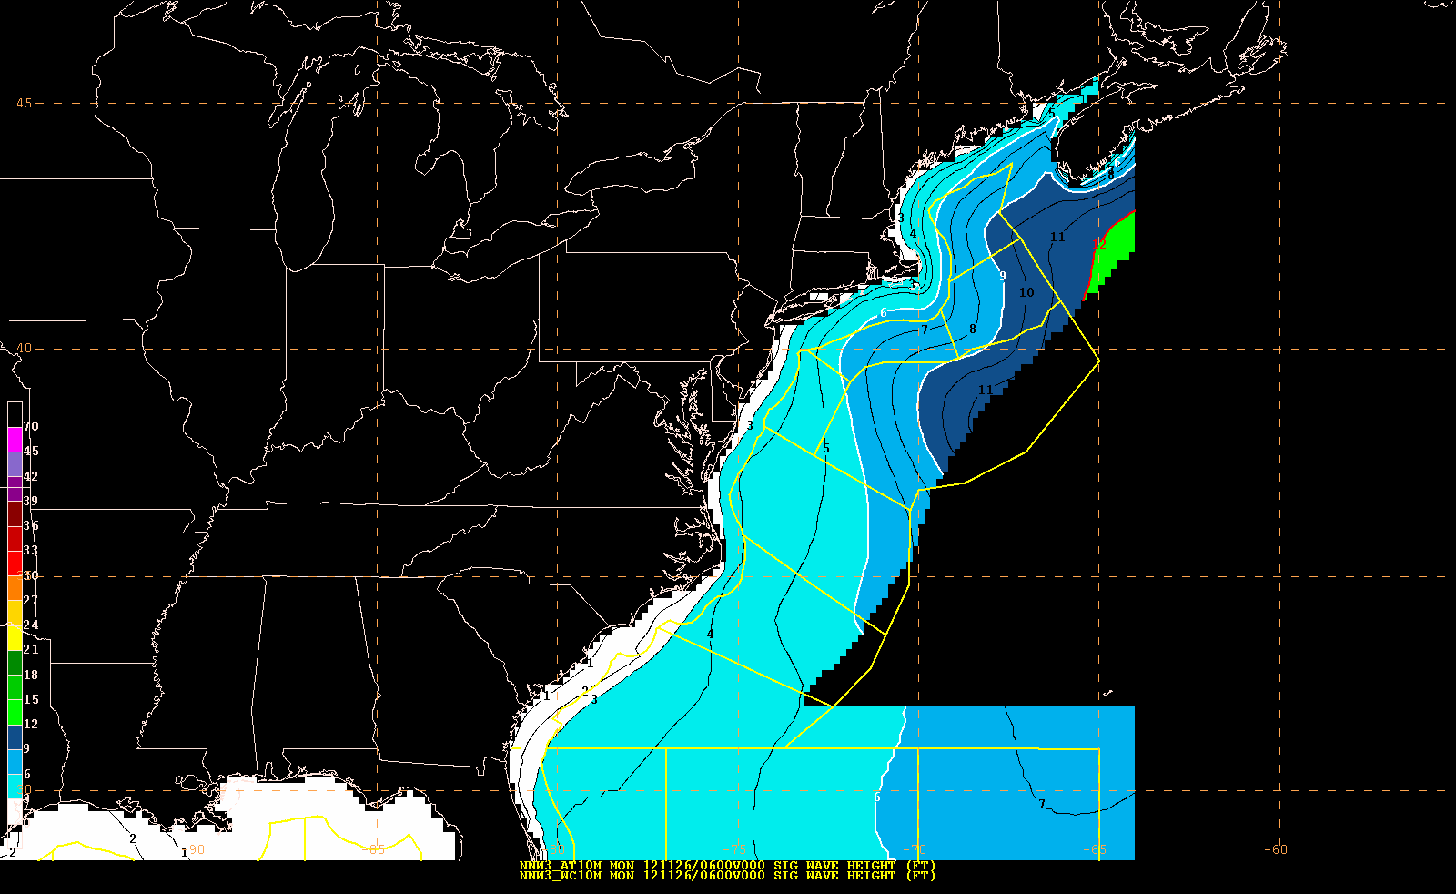
Feedback
GFE production
like to have 10 min MWW3 for OFF
gaps in coverage
in discussion to use Nearshore Wave Prediction System

Slide 20
OPC Wish List
Storm surge (non-tropical)
forcing from additional sources
on demand? …higher resolution forcing/model?
probabilistic storm surge prediction
inundation potential (datum delirium)
wave action
Availability ETSS +5h 30m ESTOFS +6h 20m
Ability to display non-standard native grids
Bay Models
Storm surge
Waves
Ensemble cyclone capability
Display (track, intensity, max wind speed, pressure, phase space)
Extreme Forecast Index
Ensemble Wind and Wave Probabilities
Verification (quantify probabilities)
MDL NDFG weather over the offshores

Slide 21
OPC Wish List
10 min MWW3 to cover OFF zones
Nearshore Wave Prediction System (OPC application)
1/12 deg Global RTOFS w/MWW3 wind / surface current impacts on waves
4 km NAM
Add GEMPAK parameters (Pryor Microburst Index)

