Slide 1

Ensemble Situational Awareness Table and Other WR UpdatesHow I Learned to Stop Worrying and Love the Global Ensembles
NAEFS
Trevor Alcott
Science and Technology Infusion Division - NWS Western Region HQ
Contributors: Andy Edman (WR-STID), Randy Graham and Nanette Hosenfeld (WFO-Salt Lake City, UT),
Chad Kahler (Western Region), Rich Grumm (WFO-State College, PA)
NCEP Production Review – 4 Dec 2013

Slide 2
Providing Tools for DSS
Using good science, our goal is to objectively answer these questions for the forecaster:
  What is significant in the forecast?
  How likely is it to happen?
  What are the potential impacts?

Slide 3
Climatological Perspectives
“R-Climate”: reanalysis-climate
  How does the model forecast compare to typical conditions at this time of year?
  “You don’t usually get a trough this deep in September”
“M-Climate”: model-climate
  How does the model forecast compare to what is typically forecast at the same lead time, and this time of year?
  “The model rarely has this much QPF at day 5”

Slide 4
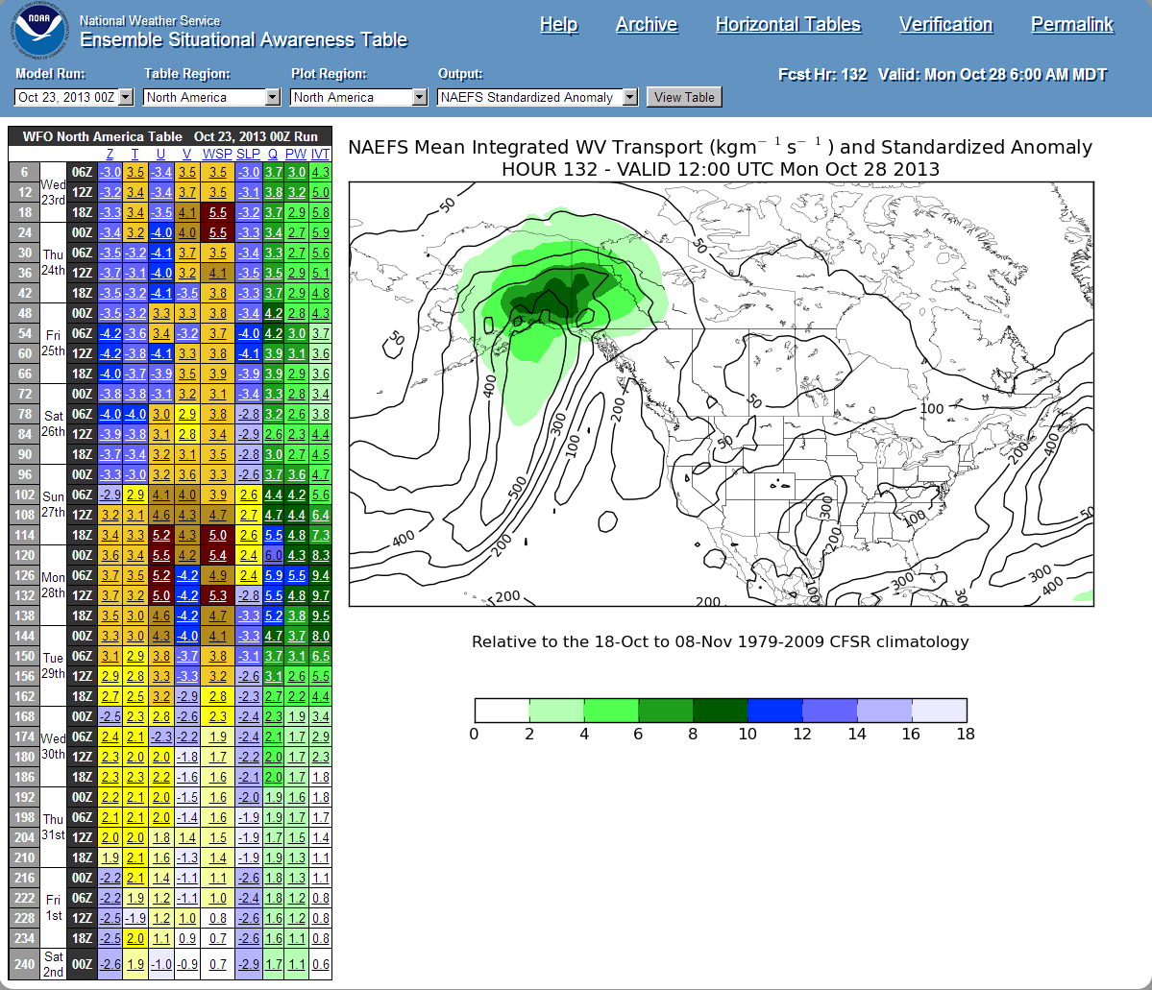
User Interface
http://ssd.wrh.noaa.gov/satable

Slide 5
R-Climate Calculations
Goal: quickly identify where/when the forecast departs significantly from climatology.
NAEFS ensemble mean is compared to the 1979-2009 Climate Forecast System Reanalysis.
  1.0x1.0-degree NAEFS interpolated to 0.5 deg
  Forecast is compared the CFSR for a 21-day window centered on the valid time.
  00Z compared only to 00Z analyses, 06Z to 06Z, etc.

Slide 6
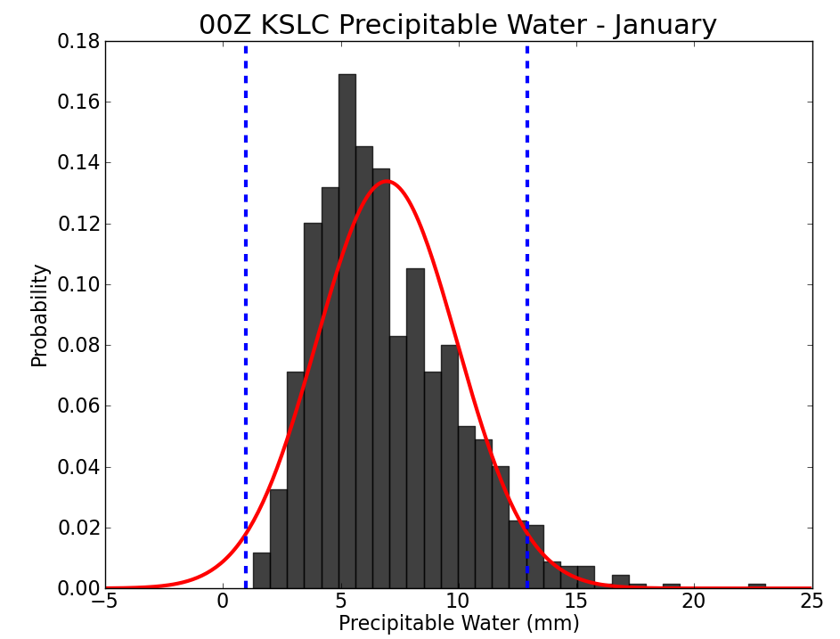



Output Types
Not all fields are normally distributed
Percentiles/return intervals help translate standardized anomalies into “where exactly does this event fall relative to climatology?”
normal distribution:
2.2%
Standardized Anomaly
–2 σ
+2 σ
Percentile
0%
Actual: 3.8%
1 day per January
Return Interval

Slide 7
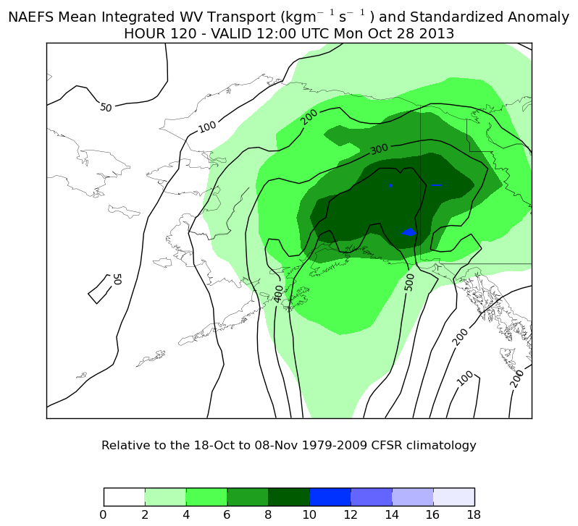
R-Climate: Standardized Anomaly

Slide 8
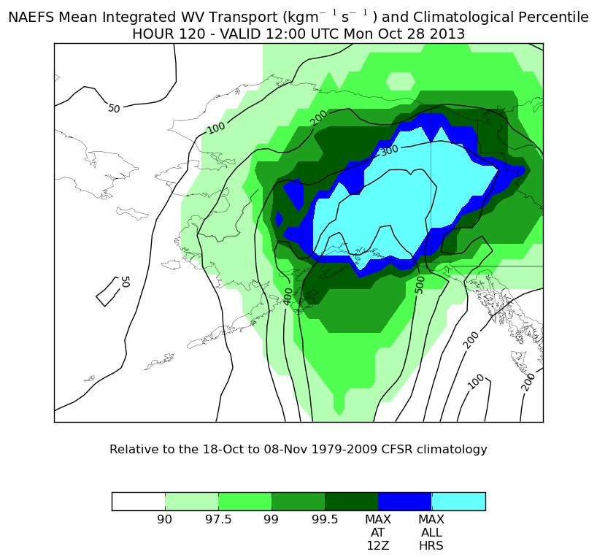
R-Climate: Percentile

Slide 9
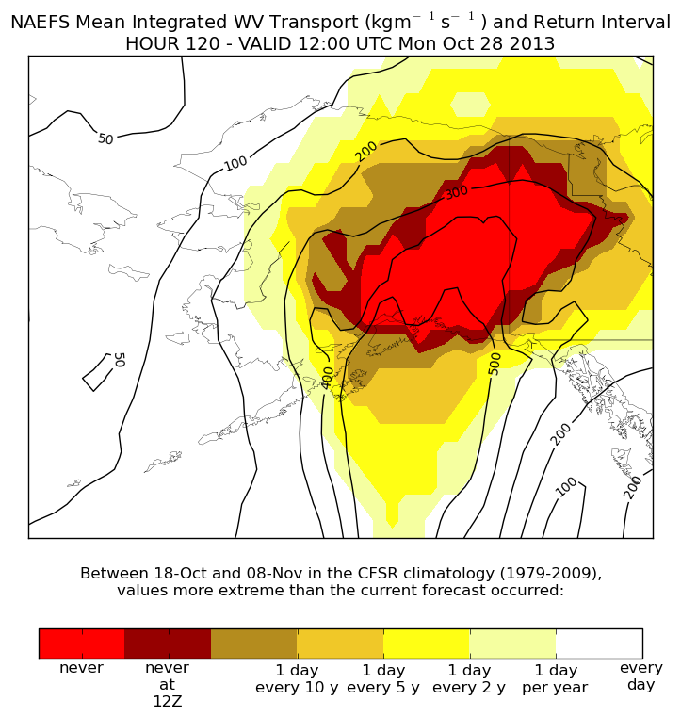
R-Climate: Return Interval

Slide 10
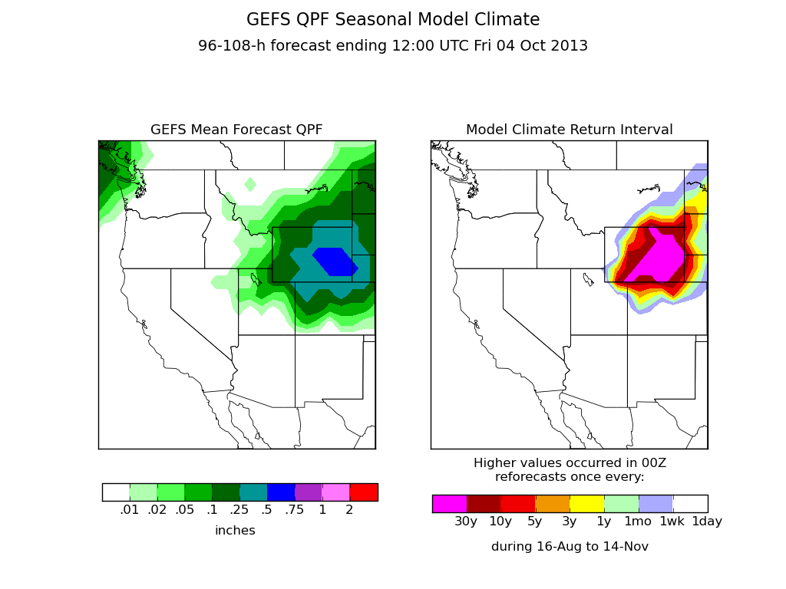
M-Climate QPF

Slide 11
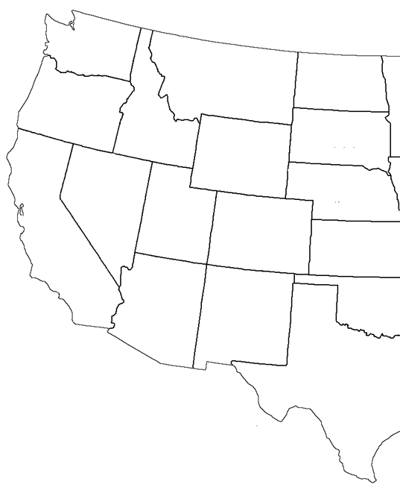
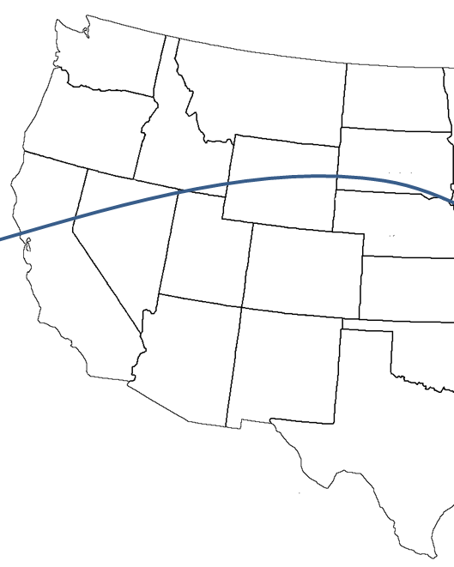
Ensemble Mean as a Confidence Tool
ensemble mean
ensemble members
climatology

Slide 12
Ensemble Mean as a Confidence Tool
ensemble mean
ensemble members
climatology

Slide 13
Ensemble Mean as a Confidence Tool
ensemble mean
ensemble members
climatology

Slide 14
Ensemble Mean as a Confidence Tool
ensemble mean
ensemble members
climatology

Slide 15
Ensemble Mean as a Confidence Tool
For a multi-model ensemble mean to depart from climatology requires that most members show a significant feature in the same location at the same time
Hypothesis: using a multi-model ensemble mean at medium to long ranges probably misses a lot of extreme events, but when it does “go big”, it’s usually right.

Slide 16
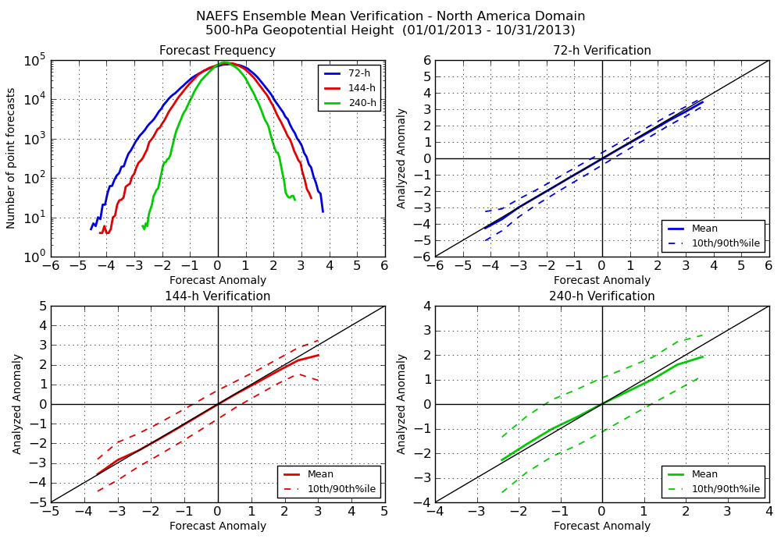
Anomaly Verification: 500-mb Height

Slide 17
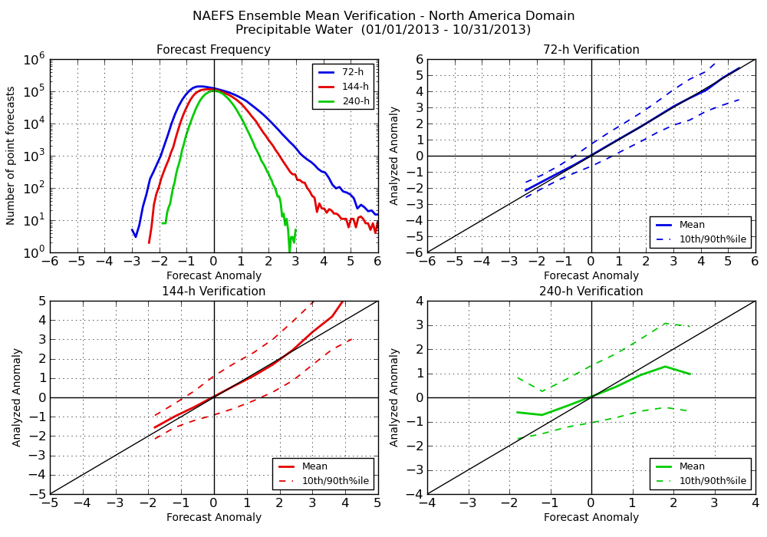
Anomaly Verification: PWAT

Slide 18
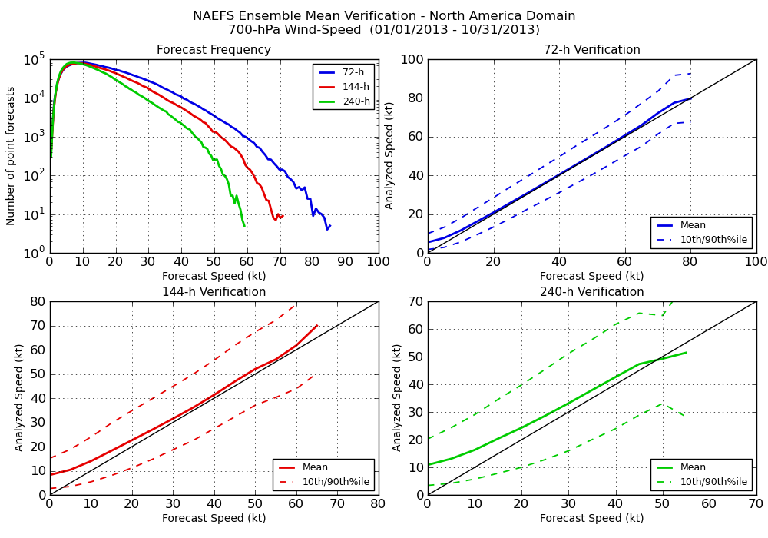
Verification: 700-mb Wind Speed

Slide 19
Defining an “extreme” event
A point with lower (or higher) values than any reanalysis valid at the same time of day, within a 21-day window, 1979-2009.
Example: at a given point, 00z 13 Aug 2013 had higher 500-mb heights than any 00z time step between 3 and 23 Aug, 1979 to 2009.
Does not mean that the heights were the lowest (or highest) ever recorded at that location -- they were the highest in 30 years at that time of year.

Slide 20
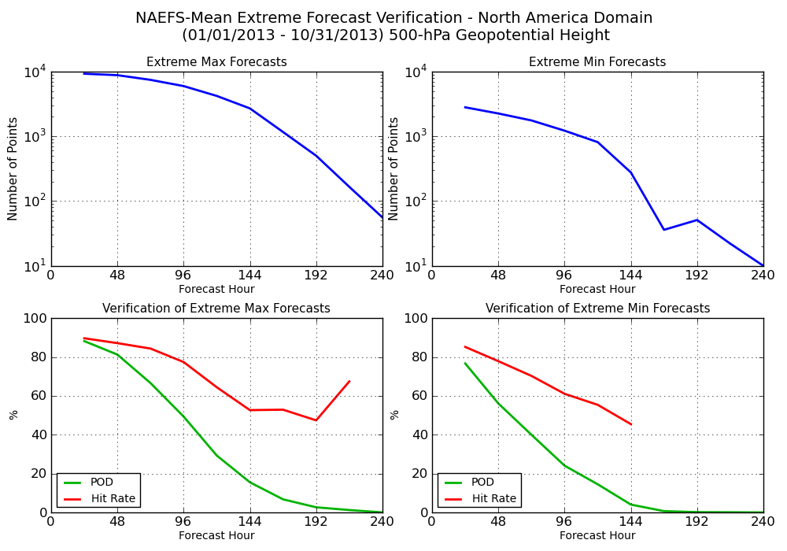
Extreme Forecasts: 500-mb Height
How many extremes were predicted, regardless of whether they were correct?
Of the extremes that were predicted, what fraction ended up verifying with the correct location/time?
What fraction of the analyzed extremes were predicted?

Slide 21
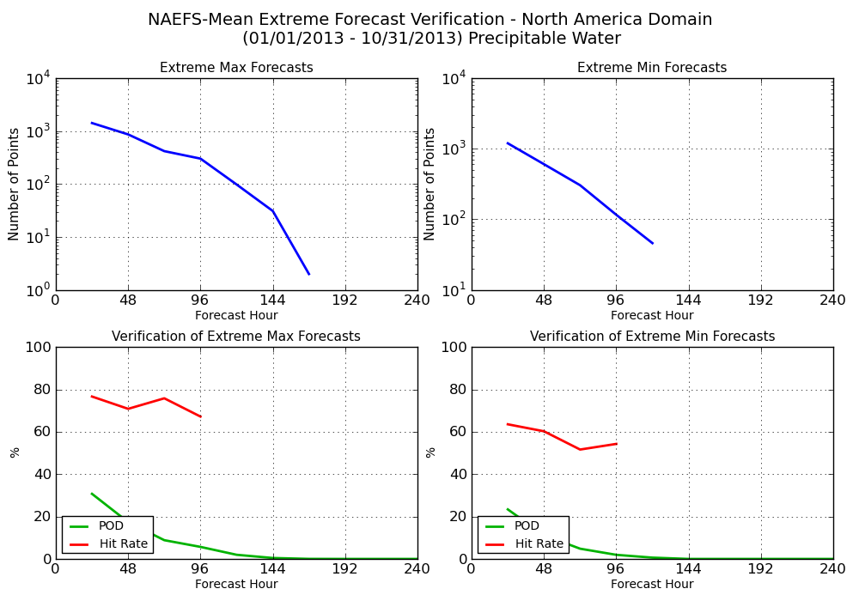
Extreme Forecasts: PWAT

Slide 22
Probabilistic Forecasts
What fraction of NAEFS members produce an “extreme” forecast?
Remember we are using “extreme” loosely
  outside the climatology for this time of year
  Not necessarily (rarely, in fact) all-time high or low
Can help identify low-probability, but potentially high-impact events

Slide 23
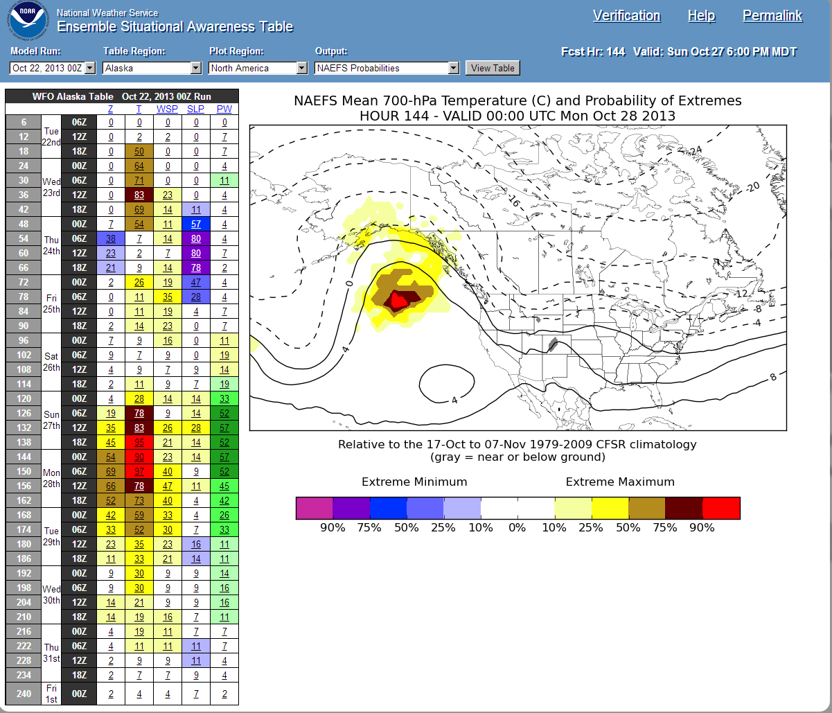
Probabilistic Forecasts

Slide 24
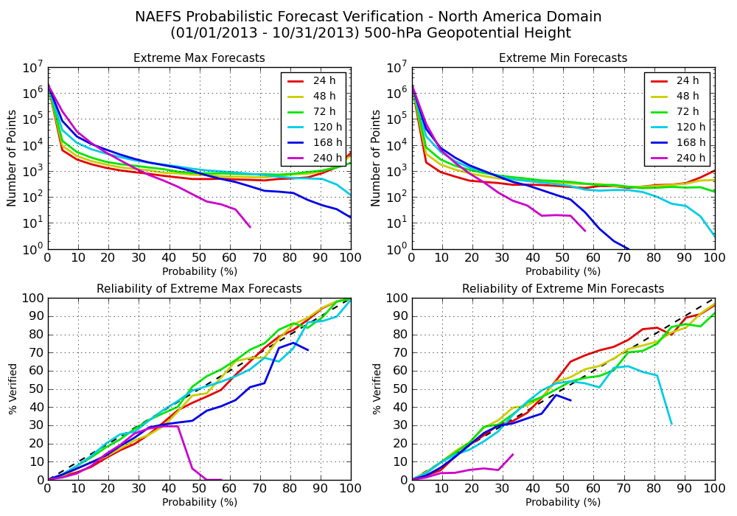
Probabilistic Forecasts: 500-mb Height

Slide 25
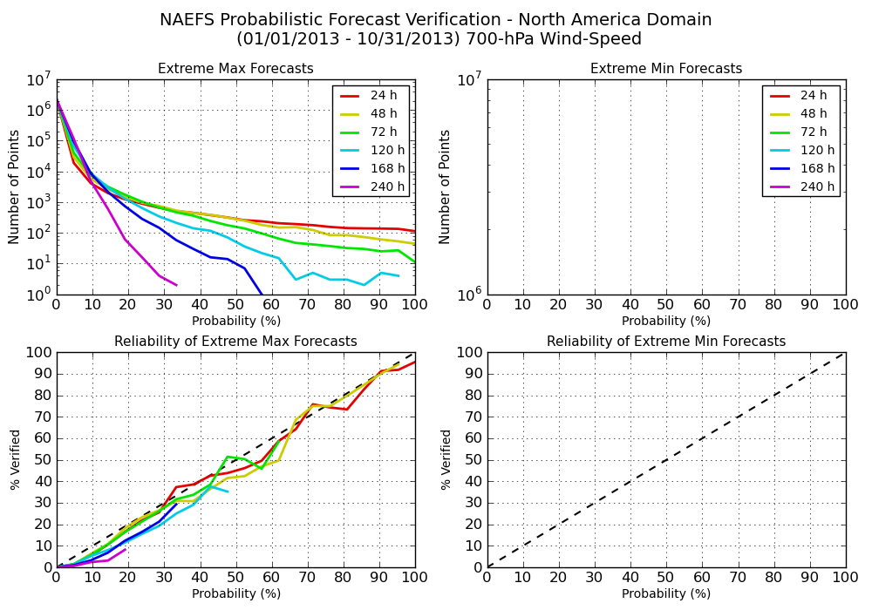
Probabilistic Forecasts: 700-mb Wind Speed

Slide 26
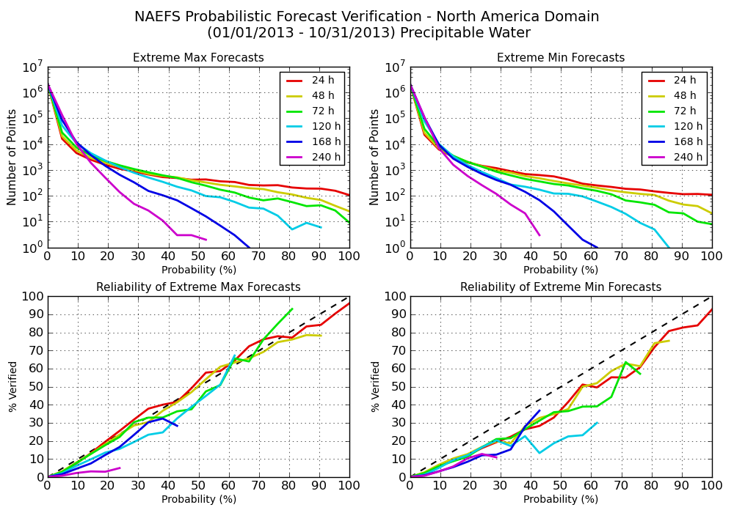
Probabilistic Forecasts: PWAT

Slide 27
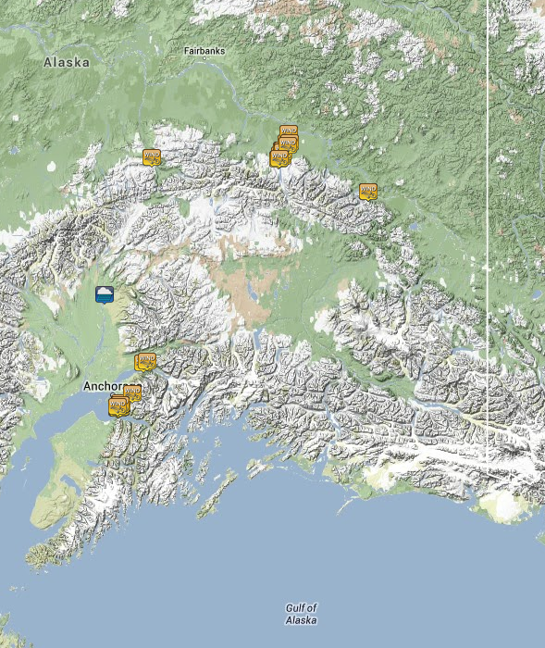
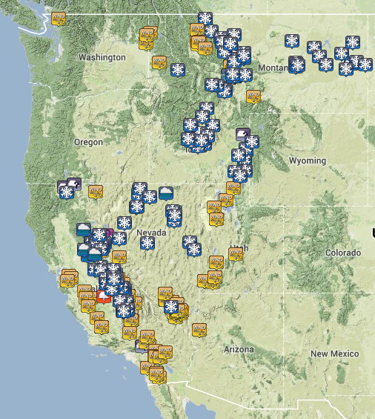
Alaska/Western US Trough
27-30 Oct 2013 Storm Reports

Slide 28
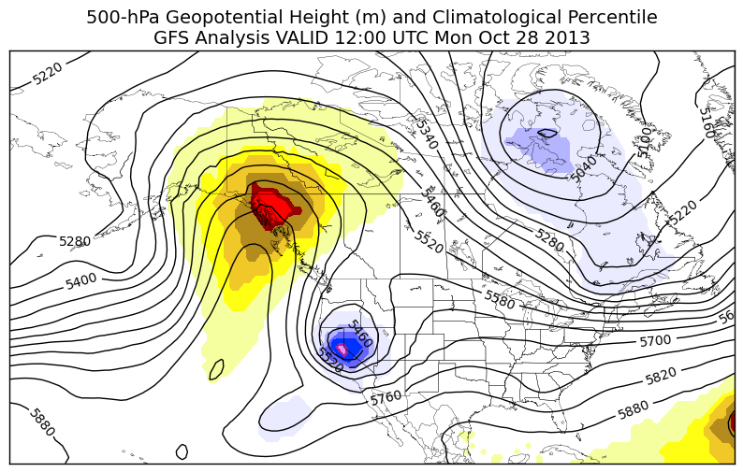
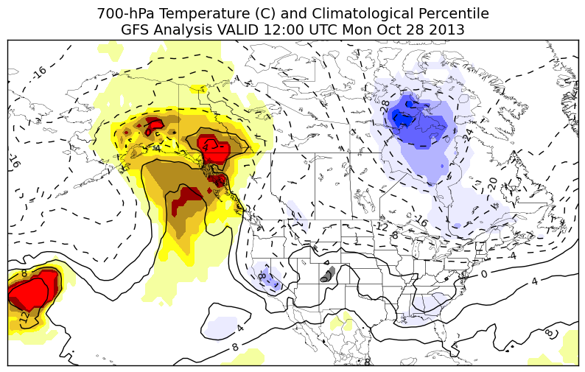

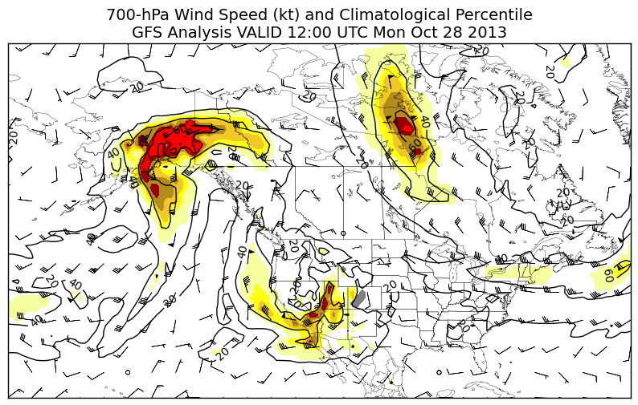
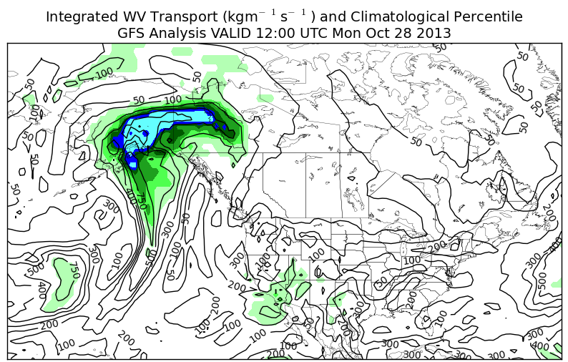
500-hPa Height
700-hPa Temperature
Analysis
700-hPa Wind Speed
Integrated WV Transport

Slide 29
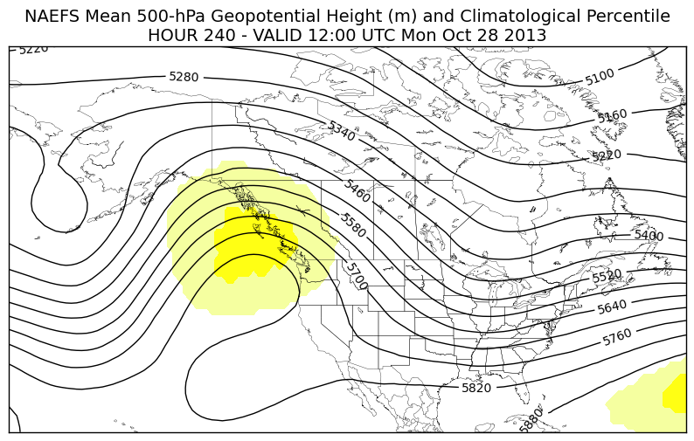
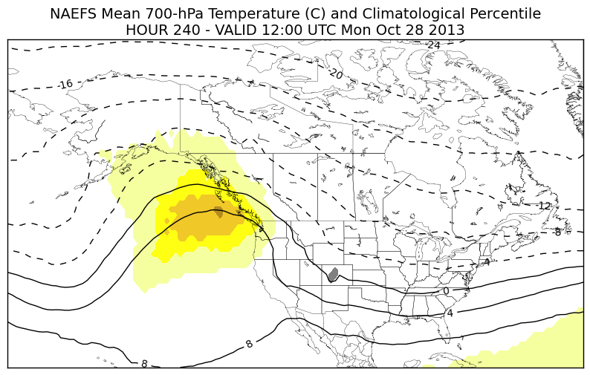
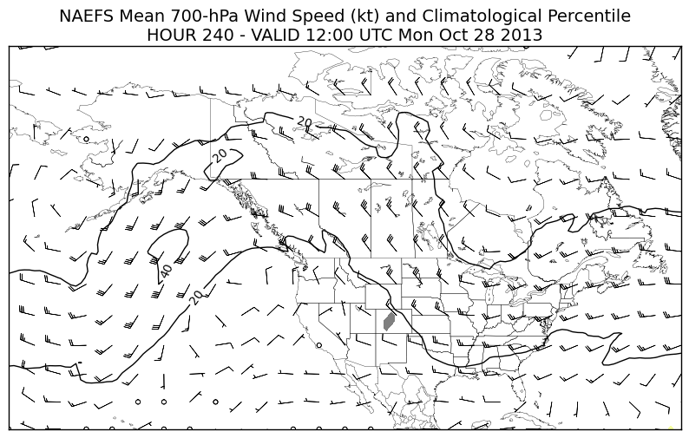
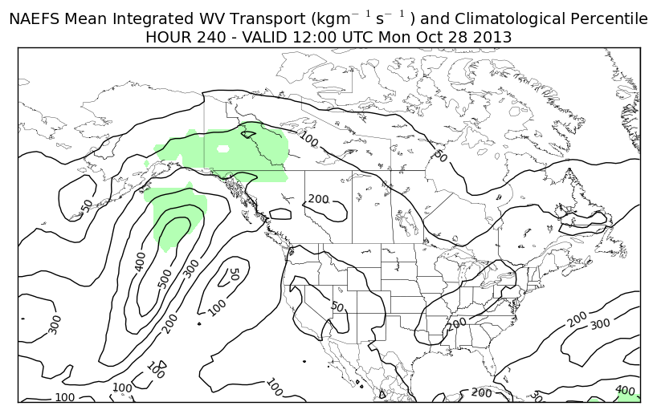
500-hPa Height
700-hPa Temperature
240-h FCST
700-hPa Wind Speed
Integrated WV Transport

Slide 30
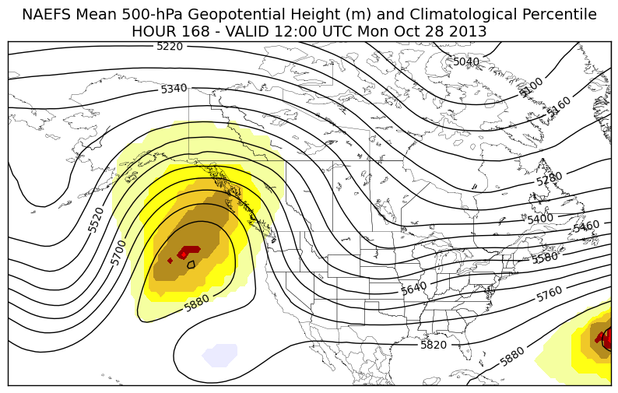
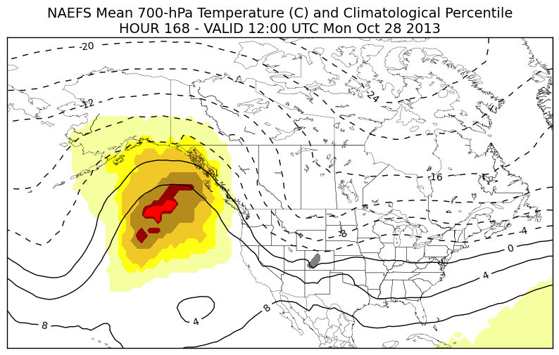
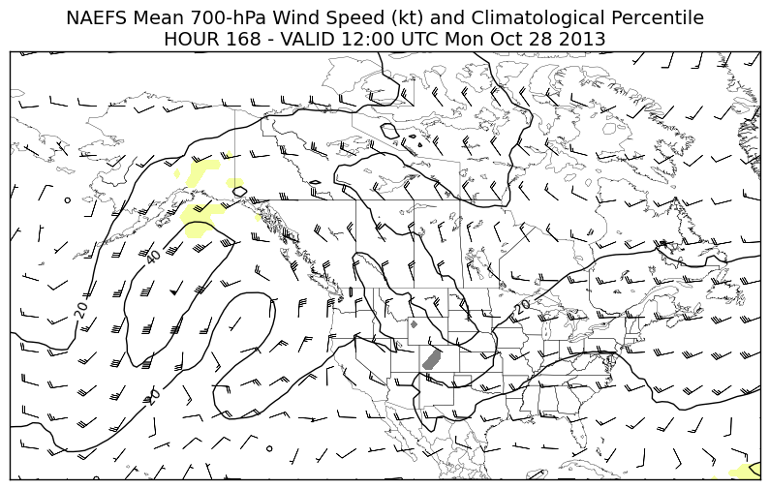
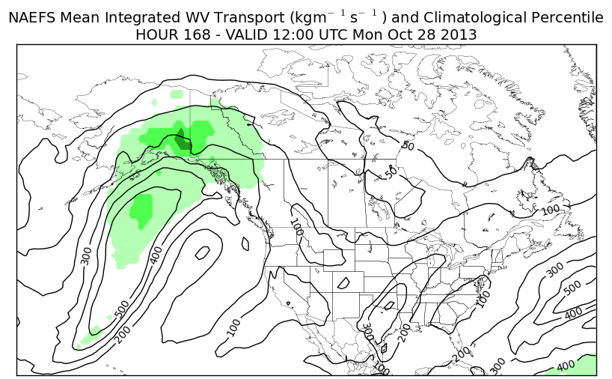
500-hPa Height
700-hPa Temperature
168-h FCST
700-hPa Wind Speed
Integrated WV Transport

Slide 31
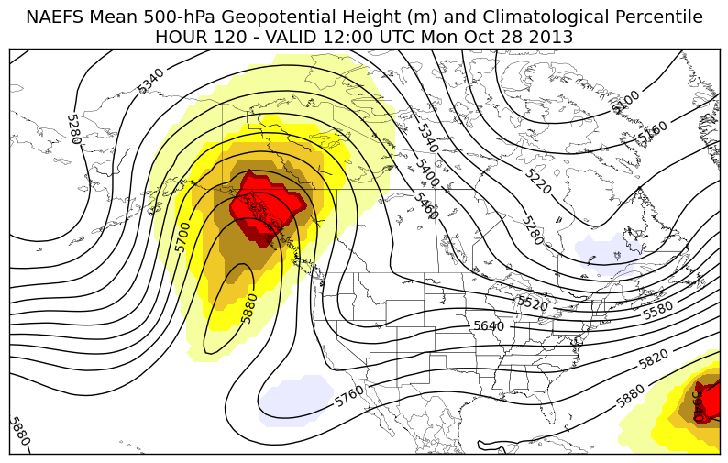
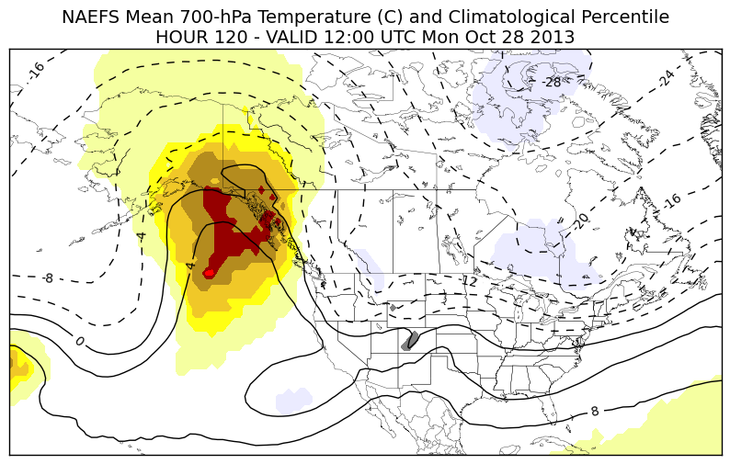
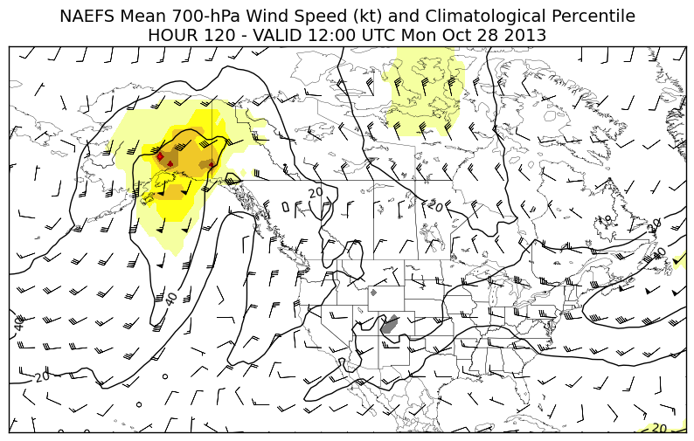
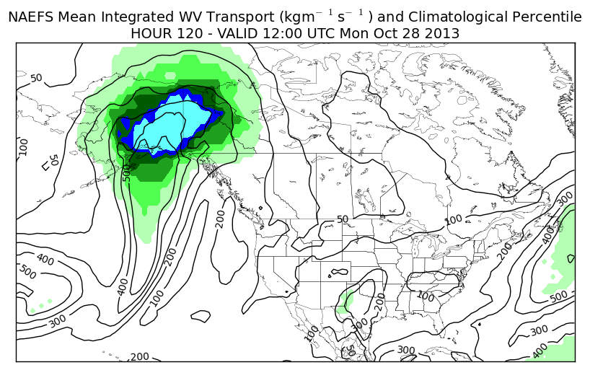
500-hPa Height
700-hPa Temperature
120-h FCST
700-hPa Wind Speed
Integrated WV Transport

Slide 32
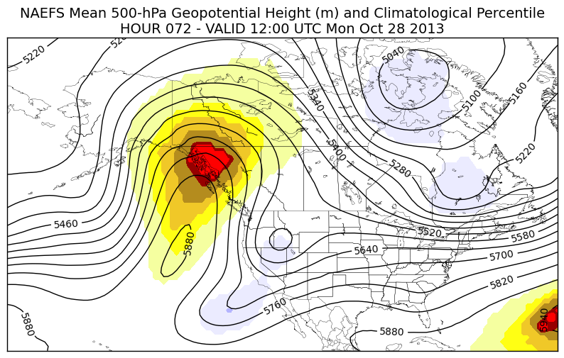
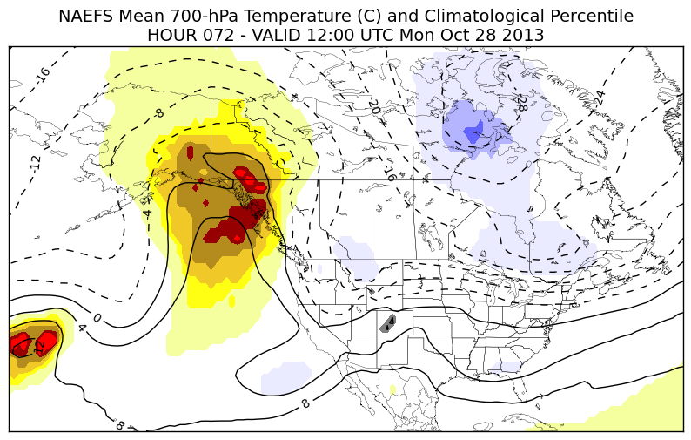
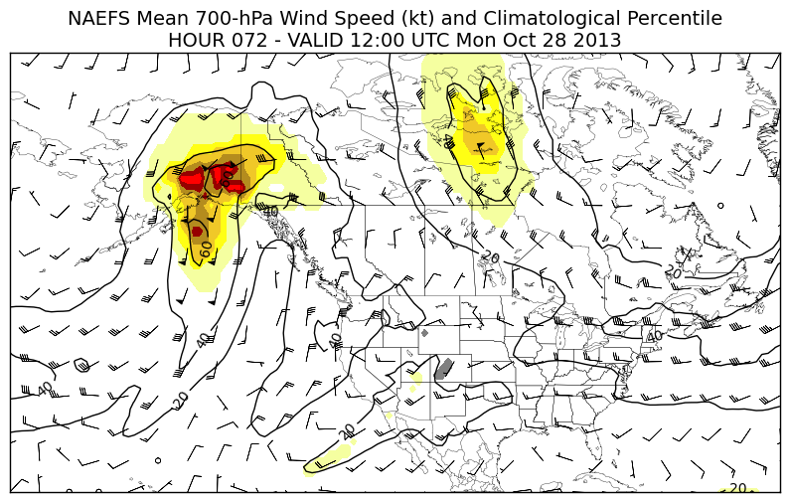
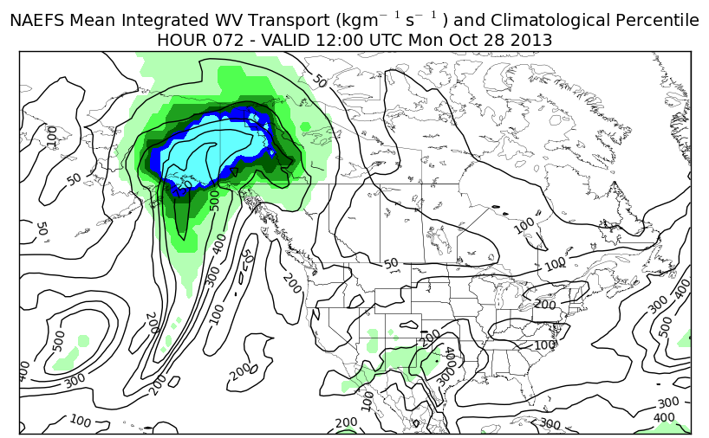
500-hPa Height
700-hPa Temperature
72-h FCST
700-hPa Wind Speed
Integrated WV Transport

Slide 33
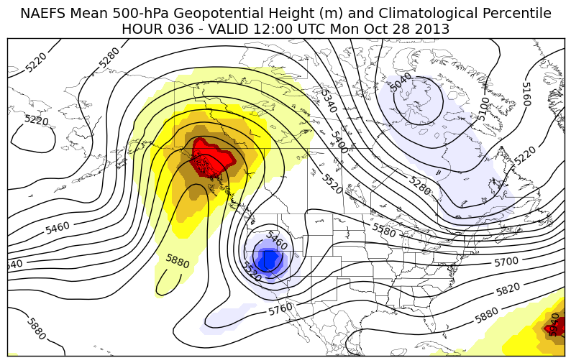
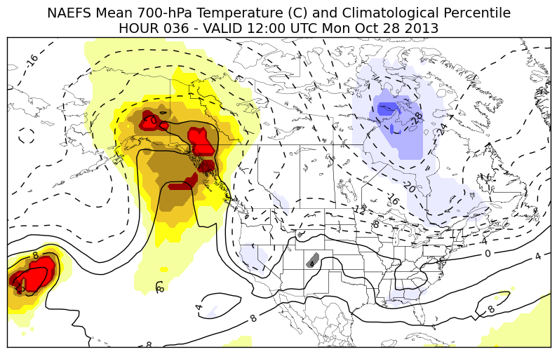
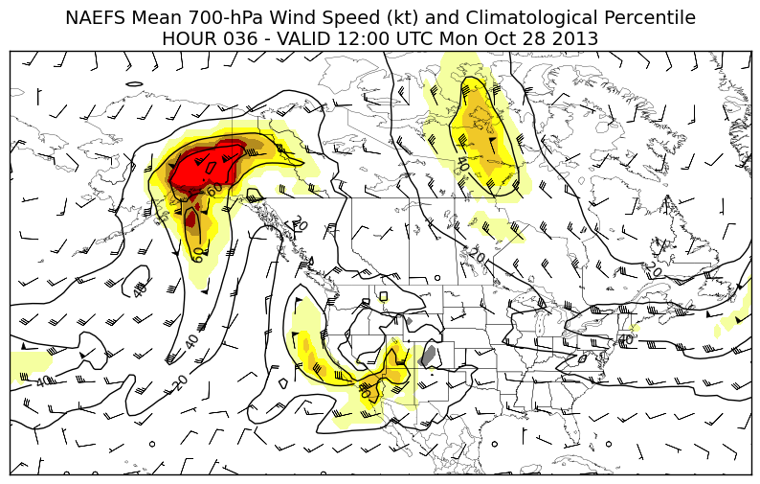
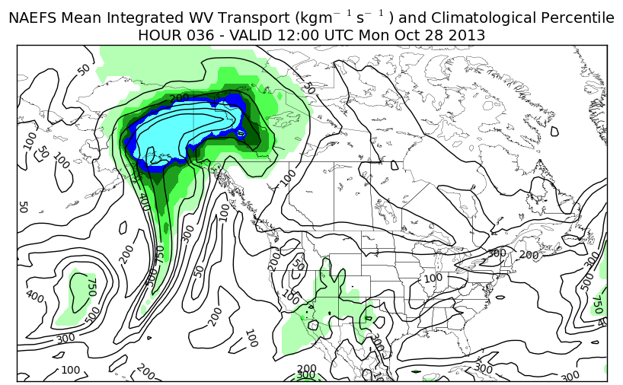
500-hPa Height
700-hPa Temperature
36-h FCST
700-hPa Wind Speed
Integrated WV Transport

Slide 34
500-hPa Height
700-hPa Temperature
Analysis
700-hPa Wind Speed
Integrated WV Transport

Slide 35
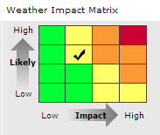

The Next Step
UK Met Office “impact matrix”
Green to red == larger anomalies / percentiles / higher probabilities of extremes
Danger colors in the SA tables depend on high “impact” and high confidence
There’s an avenue here to directly translate model information into a partner/public message.

Slide 36
Conclusions
The smoothing effect of a multi-model ensemble mean can be used to our advantage:
  the mean only differs significantly from climatology when the bulk of members from both models agree on amplitude, location and timing
  when an unusual/extreme event does show up, there is typically a high likelihood that it will verify
  “Slam dunks” may be more common than we think, and may exist at longer lead times than we’re used to.
Probabilistic information is fairly reliable in the medium range
  When reliability does break down, the ensemble tends to be overconfident.

Slide 37
Conclusions
A very rough take on NAEFS predictability limits over N America (your mileage may vary):
  Major upper-level patterns – 8-10 days
  Major surface highs/lows – 6-8 days
  Significant warmth/cold – 5-7 days
  Strong large-scale winds – 5-7 days
  Significant column moisture – 3-5 days

Slide 38
Caveats
not every high-impact event is associated with anomalous upper-level forecast fields
anomalous upper-level fields are not always associated with high-impact weather
not every high-impact event is well predicted
our tools struggle with moderate-impact, low-confidence events

Slide 39
Ongoing Work
Evaluating Ensemble Systems
Is the ensemble mean a good forecast?
Are probabilistic forecasts reliable?
Does the spread provide useful information?
  How often is the analysis “outside the envelope”
  Is there a good spread-skill relationship?

Slide 40
Forecast Dataset
500-hPa geopotential height forecasts from every member of GEFS, CMC, ECMWF
  72, 120, 168, 240-h lead times
  Jan 2008 through Nov 2013
  1.0x1.0-degrees, CONUS domain
  obtained from TIGGE archive

Slide 41
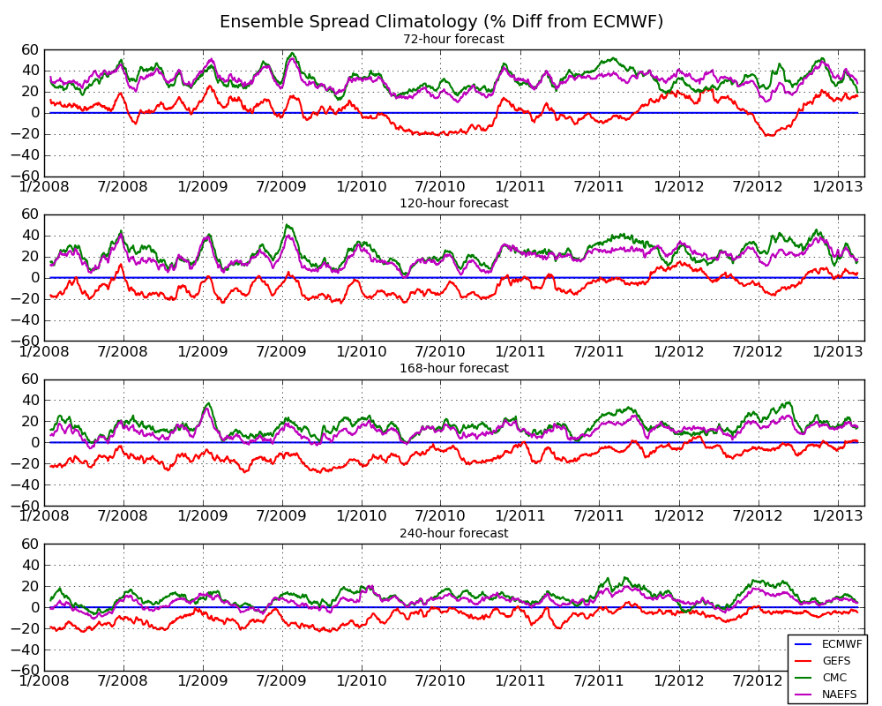

Slide 42
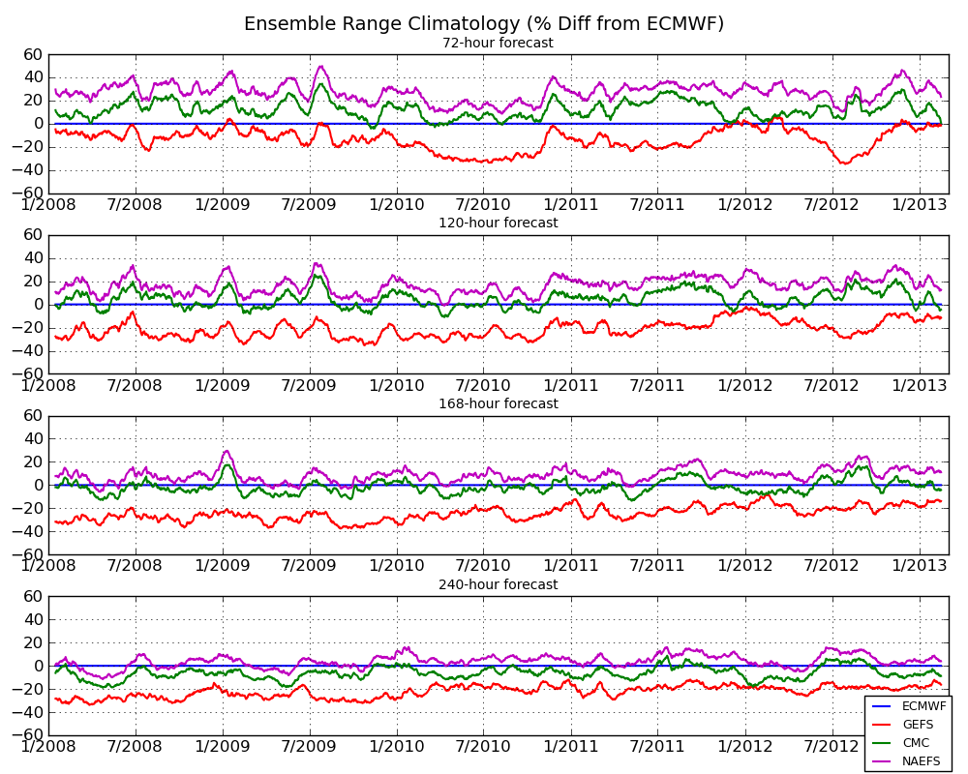

Slide 43
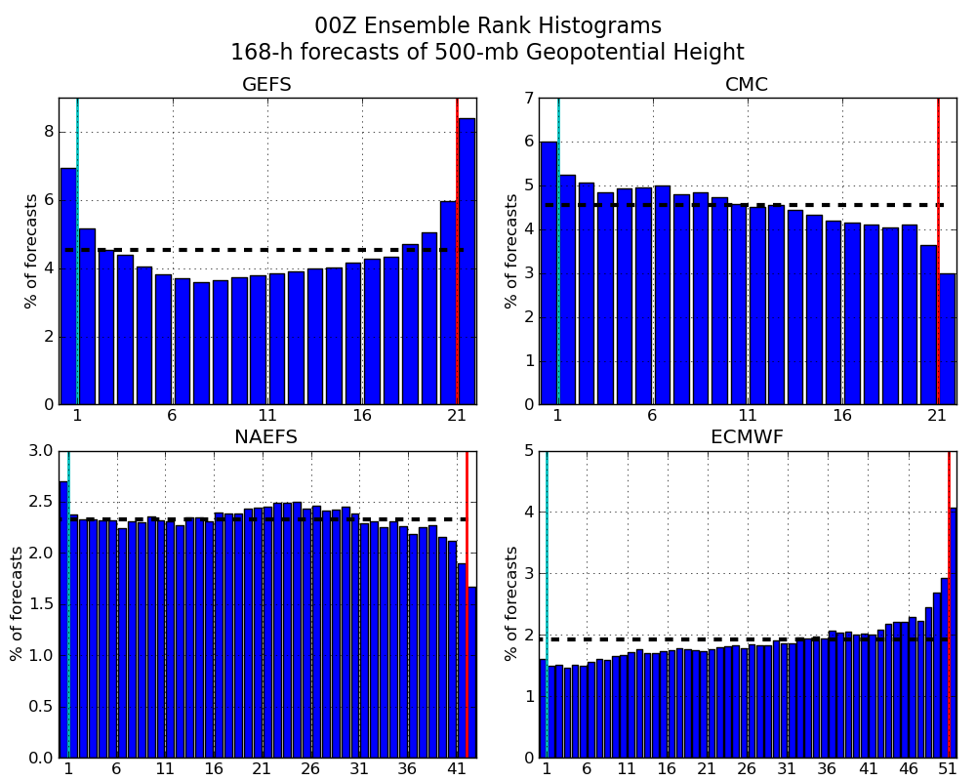
3/2011 – 3/2013

Slide 44
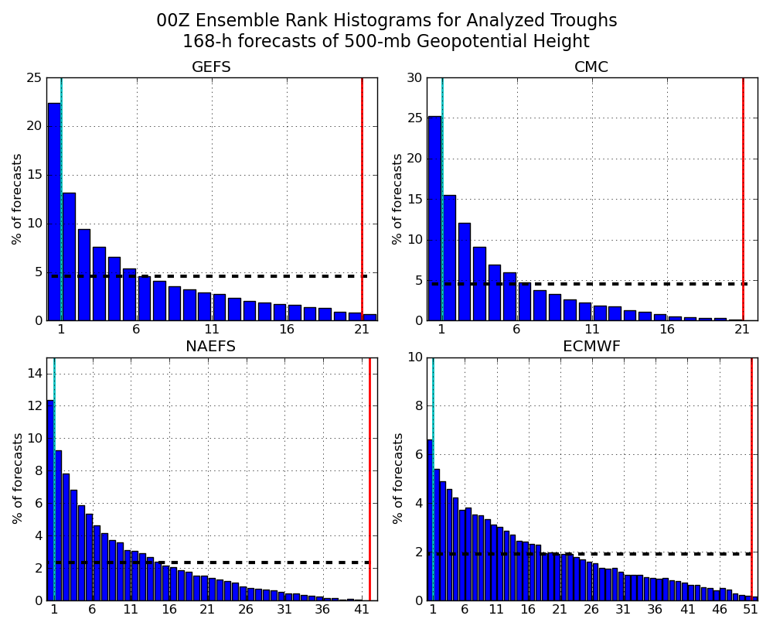

Slide 45
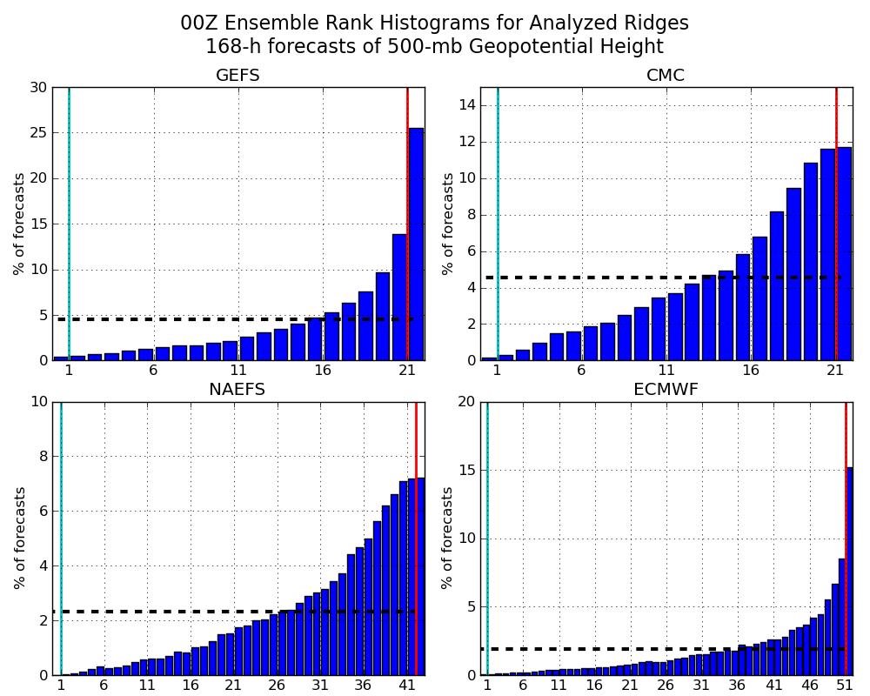

Slide 46
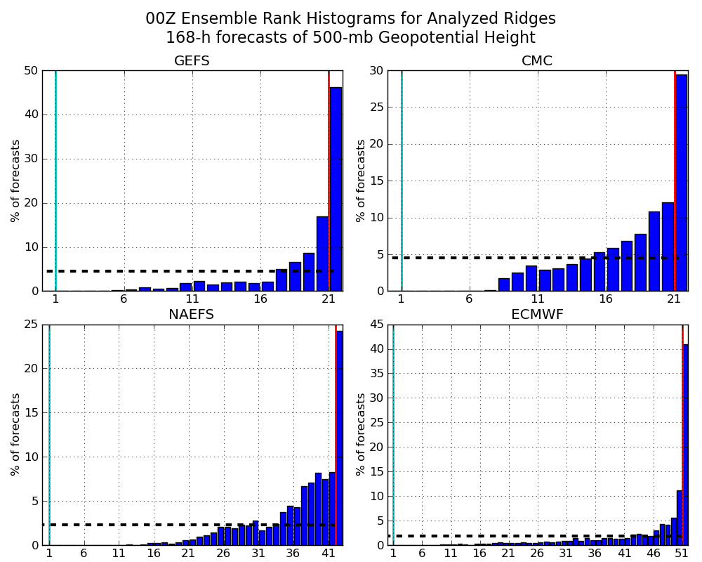

Slide 47


Slide 48


Slide 49


Slide 50


Slide 51


Slide 52


Slide 53


Slide 54


Slide 55
Questions/comments
trevor.alcott@noaa.gov
801-524-5131

