Slide 1
Images of Notable TC-related heavy rainfall events in the Northeast
ATM 401-Synoptic Meteorology II Spring 2014
Source of Images: http://www.hpc.ncep.noaa.gov/tropical/rain/tcrainfall.html

Slide 2
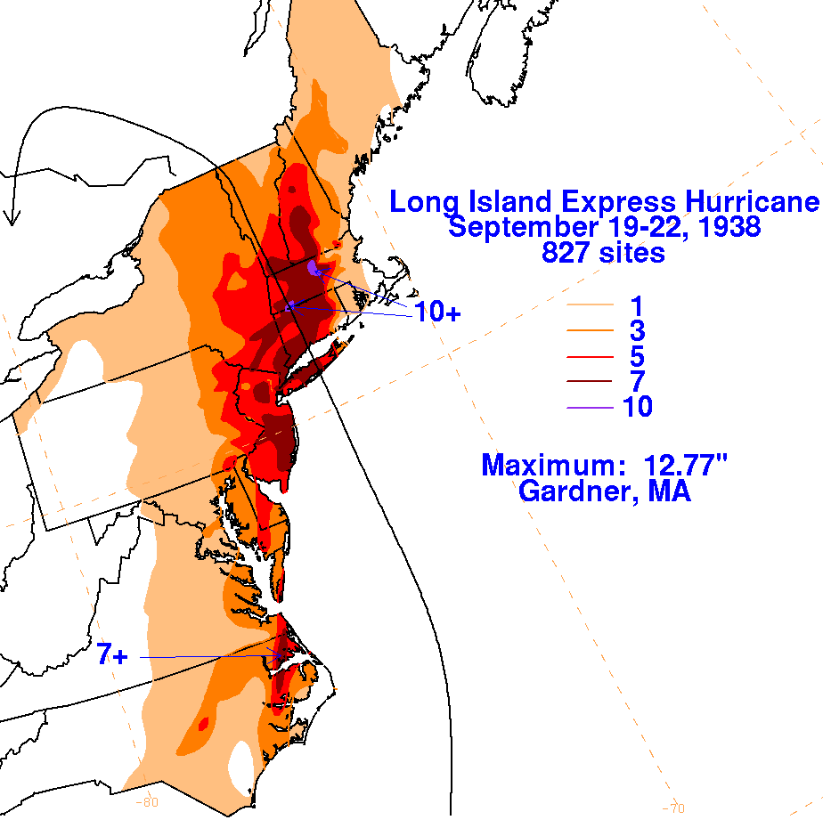
1938 New England Hurricane

Slide 3
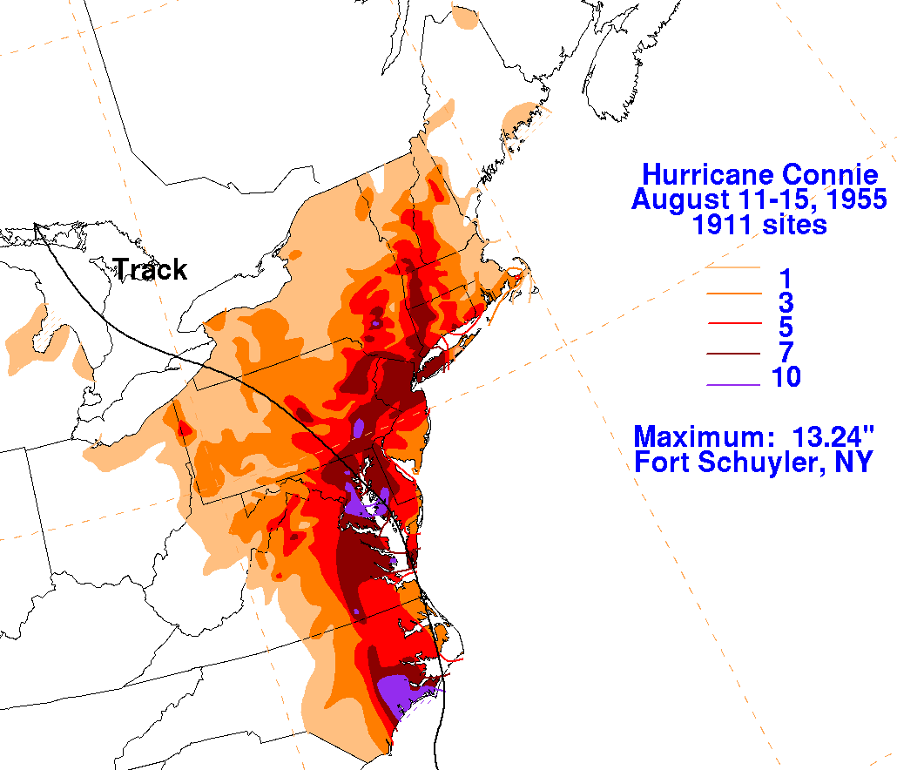
TC Connie (1955)

Slide 4
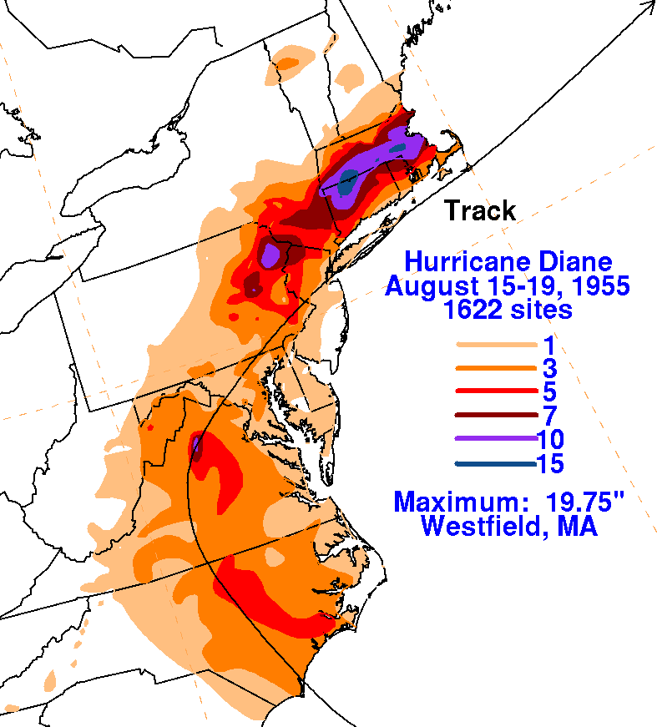
TC Diane (1955)

Slide 5
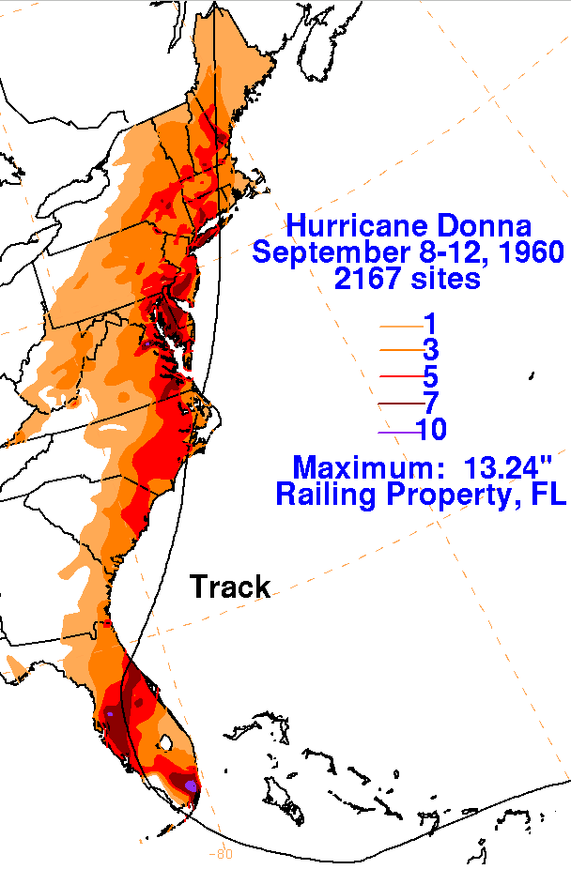
TC Donna (1960)

Slide 6
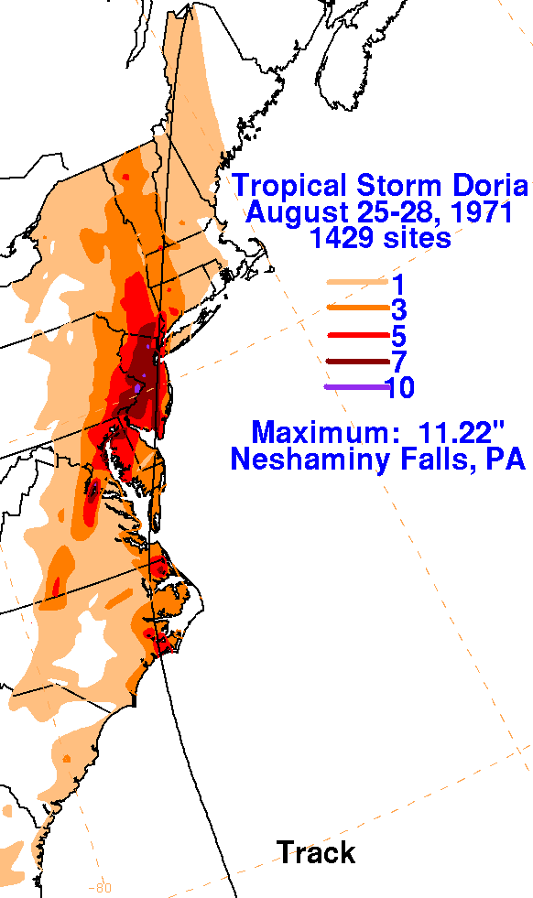
TC Doria (1971)

Slide 7
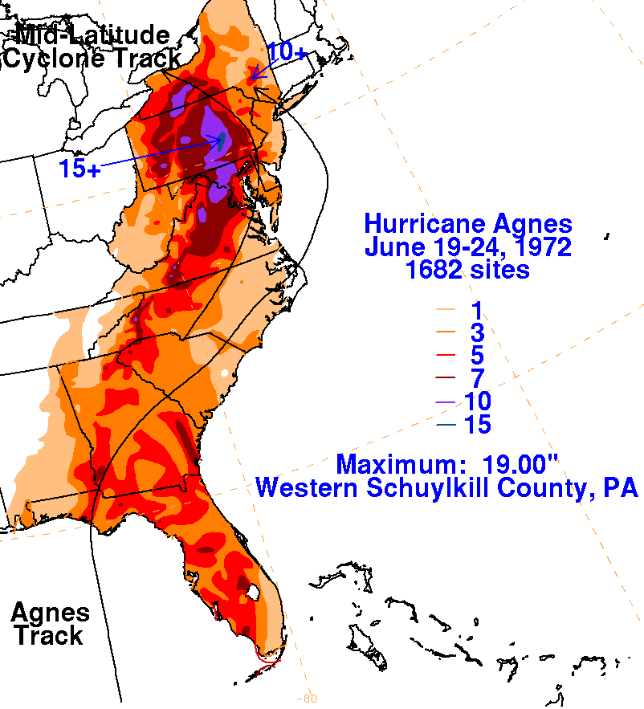
TC Agnes (1971)

Slide 8
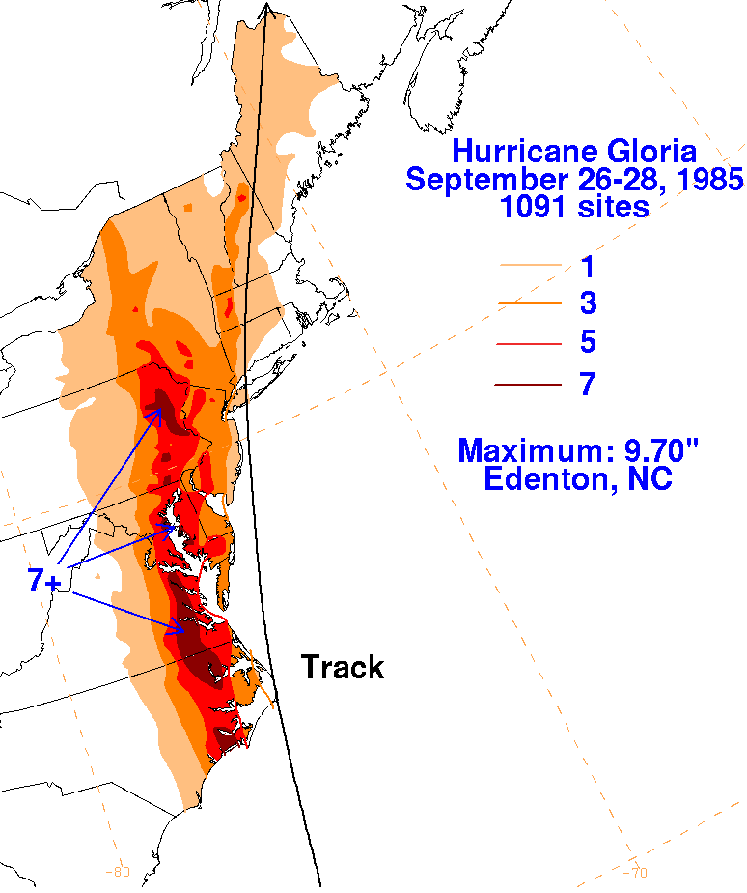
TC Gloria (1985)

Slide 9
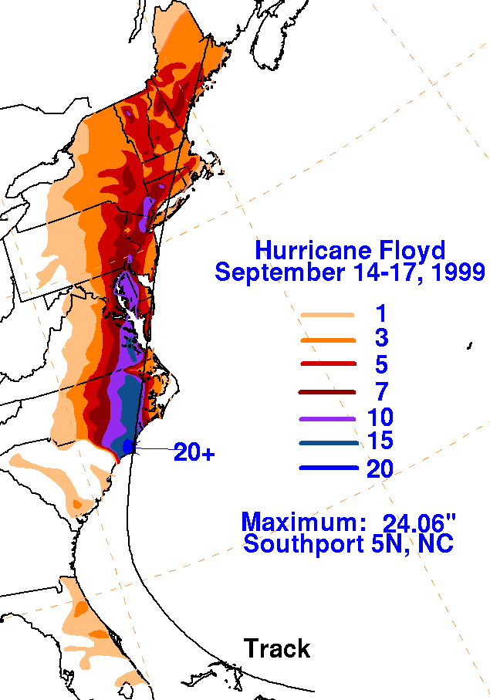
TC Floyd (1999)

Slide 10
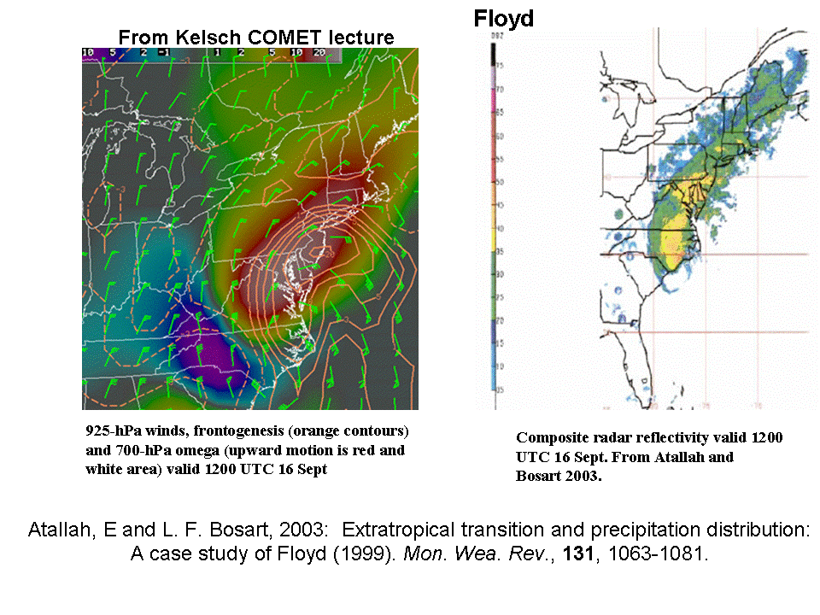
Images of Notable TC-related Heavy Rainfall Events in the Northeast
ATM 401-Stynoptic Meteorology II
Spring 2014
Compiled From: http://www.hpc.ncep.noaa.gov/tropical/rain/tcrainfall.html

Slide 11
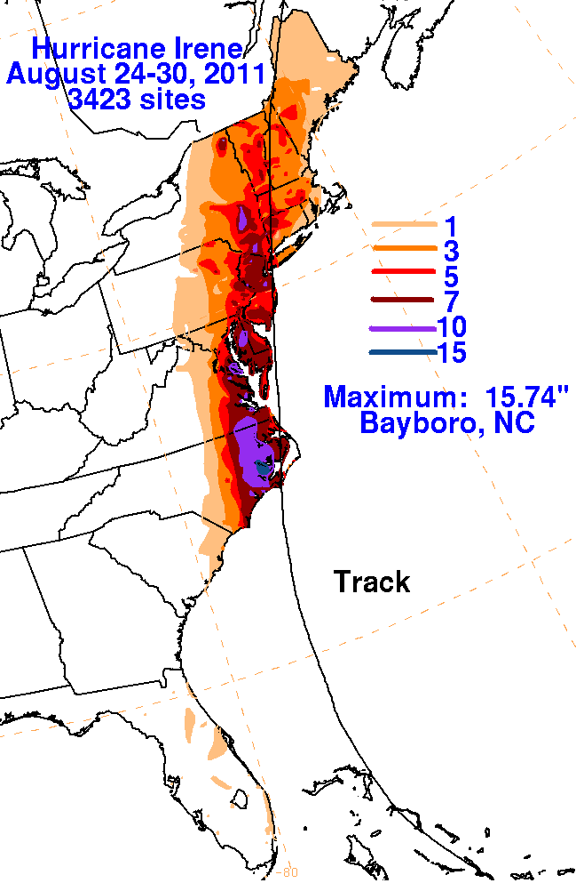
TC Irene (2011)

Slide 12
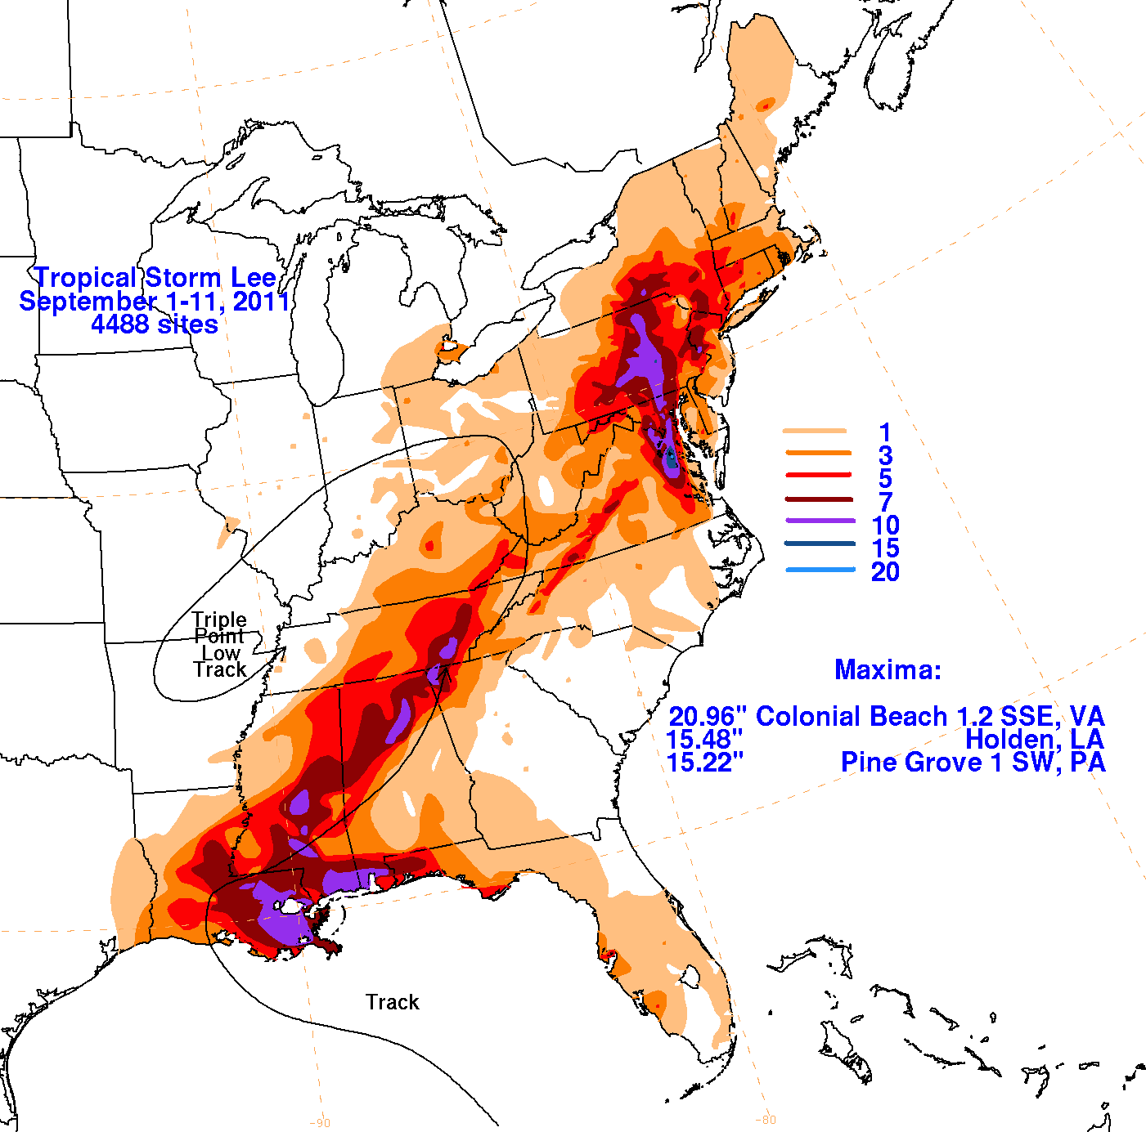
TC Lee (2011)

Slide 13
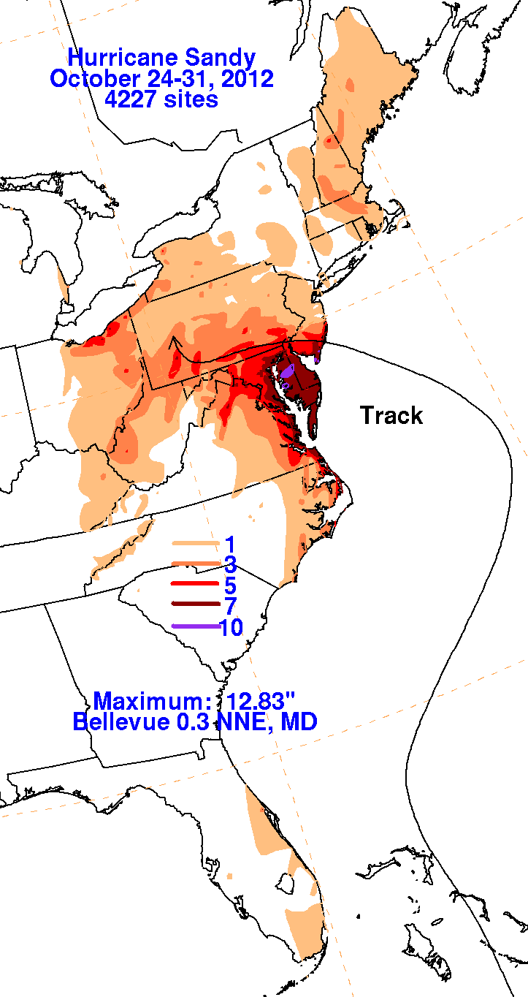
TC Sandy (2012)

Slide 14
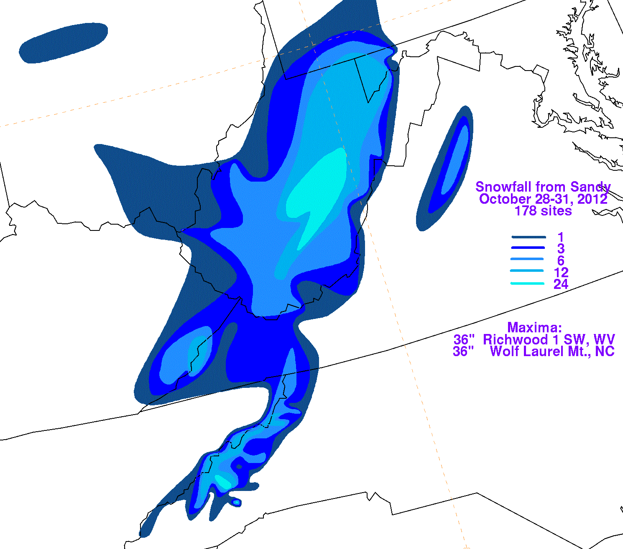
TC Sandy (2012) - Snow Accumulation

