Slide 1
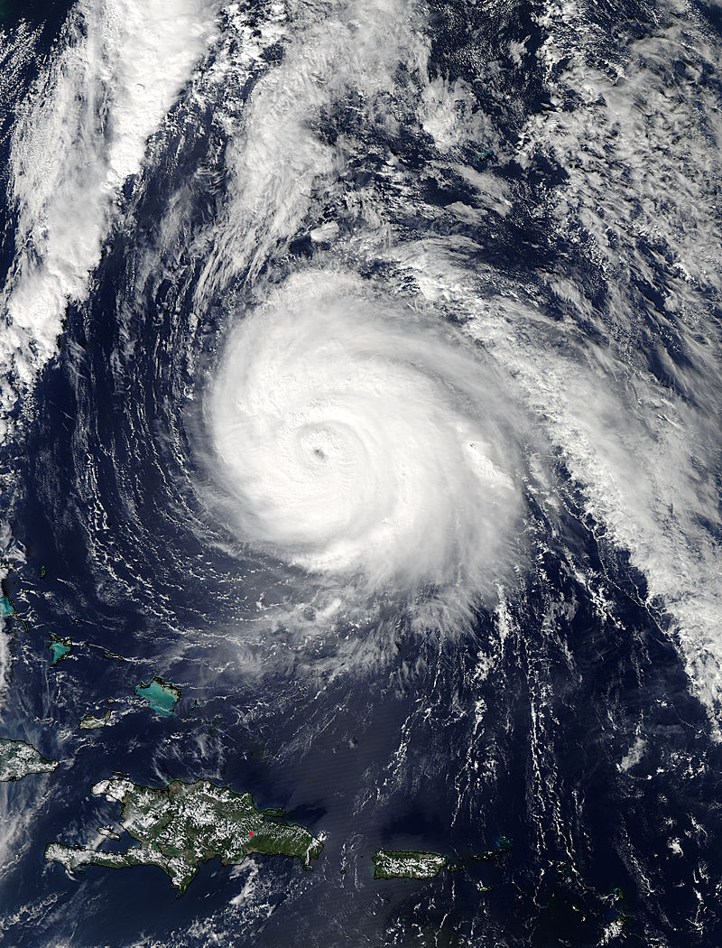

2014 Review of the NCEP Production Suite: Report from NHC
Richard J. Pasch, Eric S. Blake, & Michael J. Brennan
Hurricane Specialists
National Hurricane Center
December 3, 2014

Slide 2
Outline
Summary of 2014 hurricane season
Seasonal forecast verification
Operational highlights
TC track and intensity forecast verification
Operational forecasting issues
NHC’s “Wish List” for 2015

Slide 3
2014 Atlantic Season Facts
Below average number of named storms, 8 (fewest since 1997), but near average numbers of hurricanes and major hurricanes, 6 & 2 respectively (due to an uptick in activity in October)
Lack of activity in the deep Tropics, and only 1 tropical storm in the Gulf of Mexico
Gonzalo was the strongest Atlantic hurricane since Igor of 2010
Two landfalls in Bermuda within 6 days (Fay and Gonzalo)
One U.S. hurricane landfall, Arthur – the earliest hurricane on record to make landfall in North Carolina
Ninth consecutive year with no major hurricane landfalls in the U.S. or hurricane landfalls in Florida – both records

Slide 4
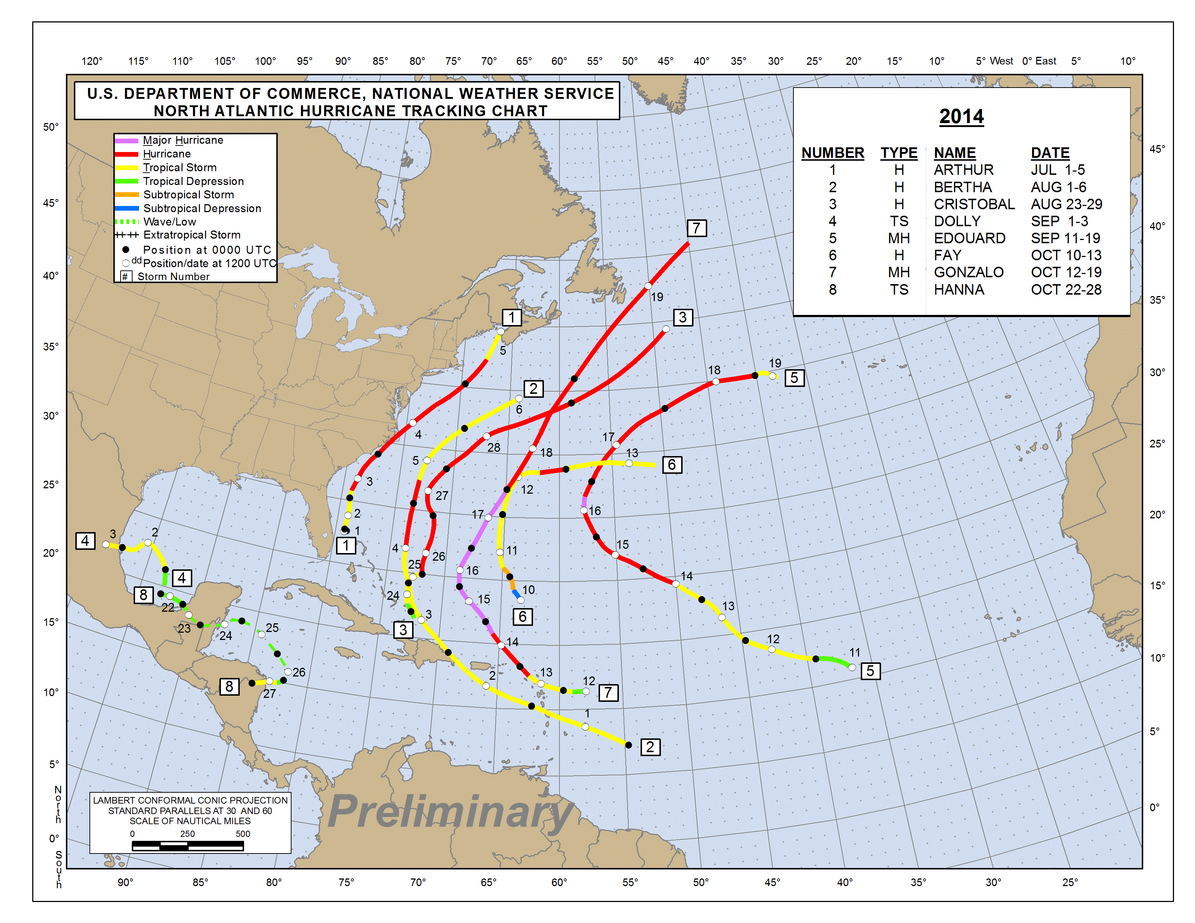

Slide 5
2014 Atlantic Basin Tropical Cyclones - Preliminary
Type/Cat | Name | Dates | Max Wind (mph) | Min Press (mb) | Deaths | Damage
H2 | Arthur | 1 – 5 Jul | 100 | 973 |  | ~$21 million
TD | Two | 21 – 23 Jul | 35 | 1012
H1 | Bertha | 1 – 6 Aug | 80 | 998 | 2
H1 | Cristobal | 23 – 29 Aug | 85 | 970 | 7
TS | Dolly | 1 – 3 Sep | 50 | 1002
H3 | Edouard | 11 – 19 Sep | 115 | 955
H1 | Fay | 10 – 13 Oct | 75 | 986
H4 | Gonzalo | 12 – 19 Oct | 145 | 940
TS | Hanna | 22 -28 Oct | 40 | 1000

Slide 6
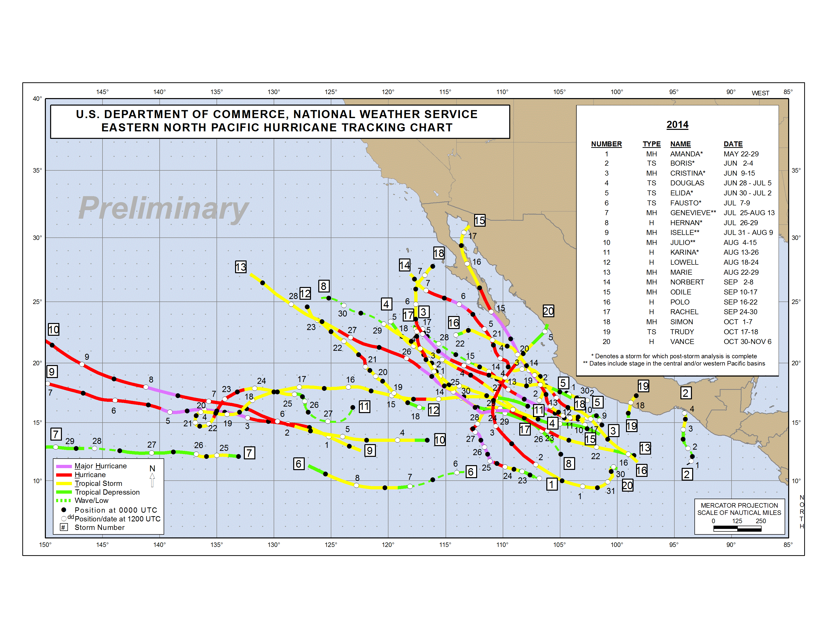

Slide 7
NOAA’s 2014 Atlantic Hurricane Outlook
Season and May 2014 Aug 2014 Observed
Activity Type Outlook Outlook Activity Climatology
Chance Above Average 10% 5% 33%
Chance Near Average 40% 25% 33%
Chance Below Average 50% 70% Below Average? 33%
Named Storms 8-13 7-12 8 12
Hurricanes 3-6 3-6 6 6
Major Hurricanes 1-2 0-2 2 3
Acc. Cyclone Energy 40-100% 40-90% 71% 100%
Photo finish on whether the ACE comes in as average or below.
Successful forecast in general
Notes:
7
Verification of the 2010 NOAA Atlantic seasonal forecast. All forecast parameters verified within ranges

Slide 8
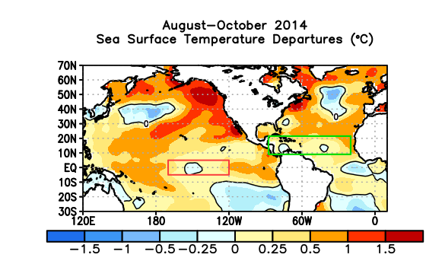
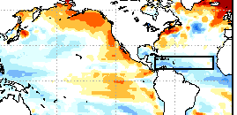
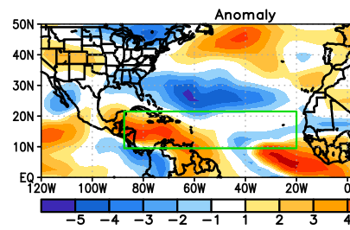
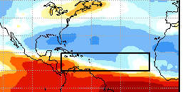
ASO 2014 CFSv3 forecast
Relatively poor El Nino and Atlantic SST forecasts
ASO Shear
ASO 2014 CFSv3 forecast
Good seasonal forecast by the high-res CFS in Atlantic basin

Slide 9
2014 Operational Highlights
Quiet Atlantic season (161 TC forecasts issued, long-term mean is ~340) - but very busy east Pacific (455 forecasts)
GFS was a mediocre performer for track in both basins
GFS ensemble was generally better than the deterministic
Good performance by the HWRF for track in the Atlantic – congratulations to the HWRF team for upgrading this model!
Third year of in-house 6- and 7-day TC track and intensity forecasts
5-day genesis probabilities in the Tropical Weather Outlook (TWO) became operational, and experimental 5-day graphical TWO introduced

Slide 10

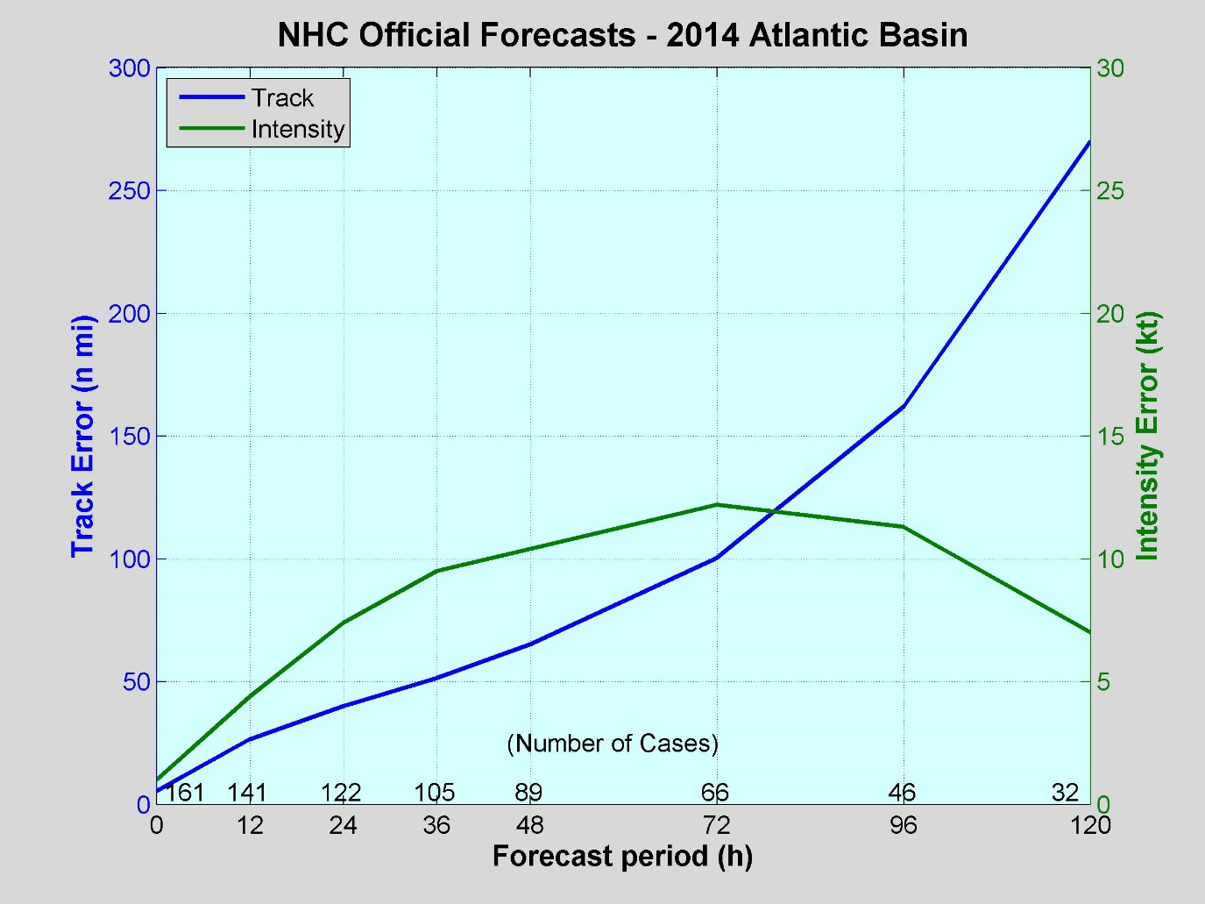
2014 Atlantic Verification
(Courtesy of John Cangialosi, NHC)
VT NT TRACK INT
(h) (n mi) (kt)
============================
000 161 5.5 1.0
012 141 26.6 4.4
024 122 40.1 7.4
036 105 51.5 9.5
048 89 65.2 10.4
072 66 100.4 12.2
096 46 162.0 11.3
120 32 270.2 7.0
Preliminary
Values in green exceed all-time records.

Slide 11
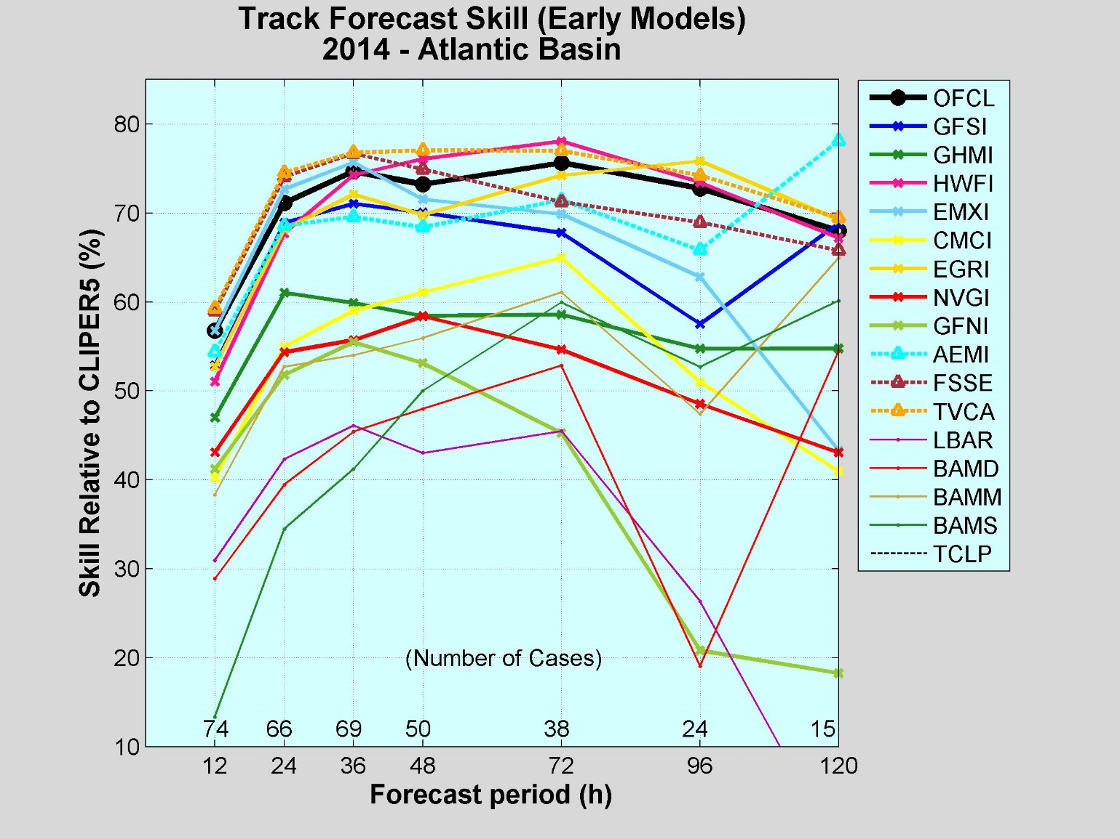
2014 Track Guidance
Official forecasts were very skillful, near the best models.
TVCA best overall model, beat FSSE at most times.
EMXI best individual model in short range, but HWFI was the overall best individual model beyond 36 h. EGRI also strong performer at the longer range.
GFS ensemble mean and GFSI next best models.
GHMI, CMCI, NVGI, GFNI trailed.

Slide 12
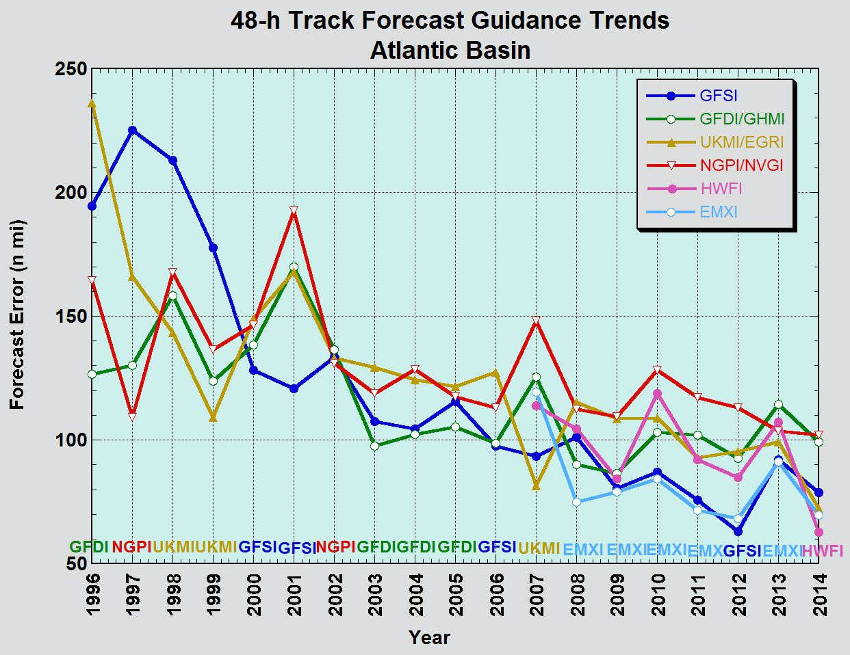
Track Model Trends
HWFI best model at 48 h in 2014.

Slide 13
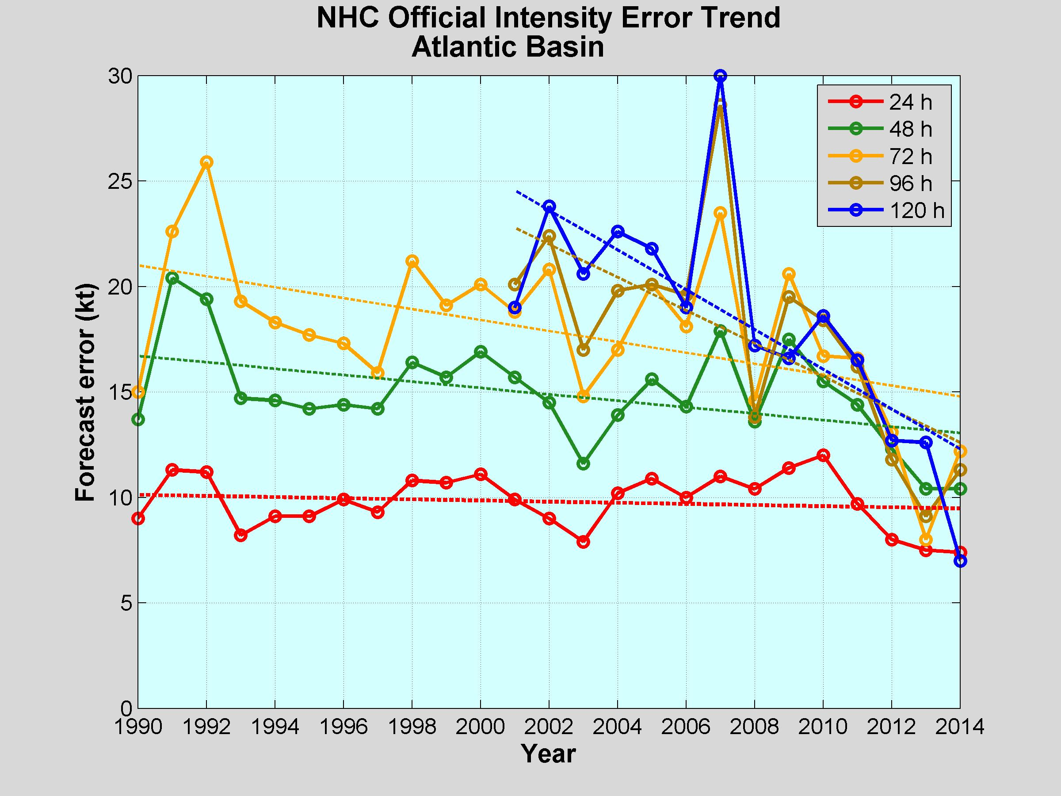
Atlantic Intensity Error Trends
Errors increased at a few forecast times in 2014, but are much lower than they were 5 years ago.

Slide 14
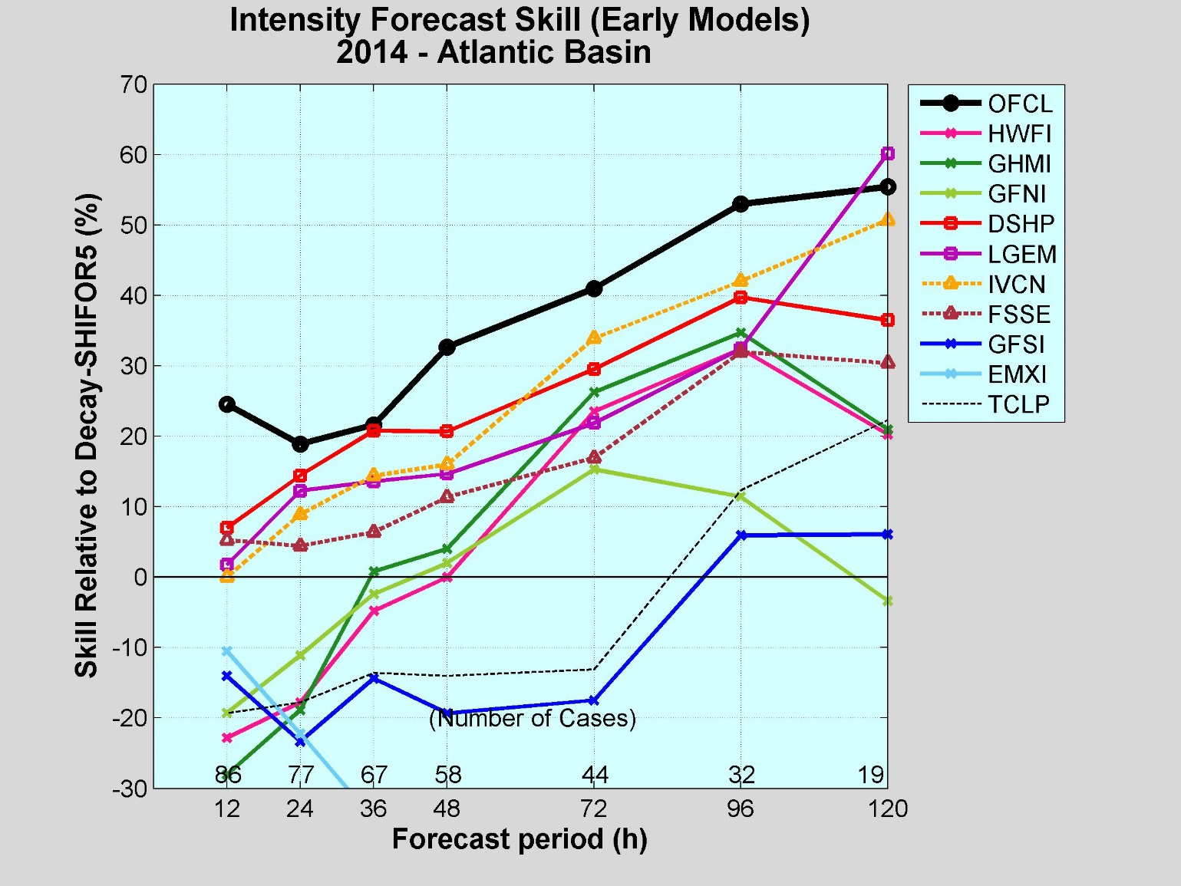
2014 Intensity Guidance
Official forecasts skill increased over time, better than all of the guidance.
IVCN better than FSSE, except at 12 h.
DSHP and LGEM were quite skillful, similar to or better than the consensus aids.
HWRF and GHMI had no skill early, but moved to middle of the pack from 72 to 120 h. GFNI not as good.
GFSI and EMXI not competitive.

Slide 15
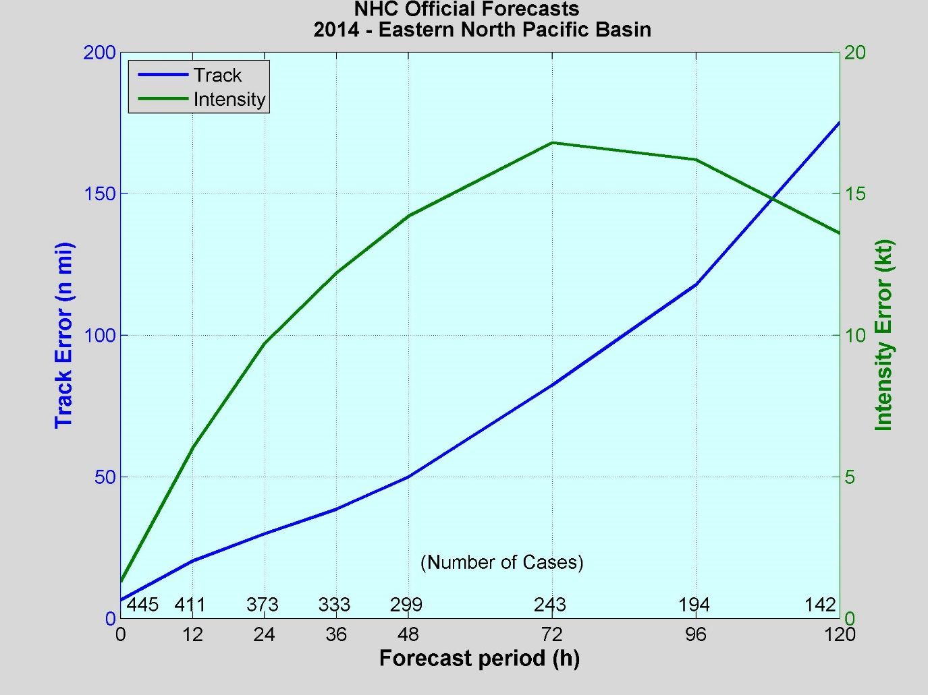
2014 East Pacific Verification
VT NT TRACK IN
(h) (n mi) (kt)
============================
000 455 6.5 1.3
012 411 20.3 6.0
024 373 29.9 9.7
036 333 38.6 12.2
048 299 49.9 14.2
072 243 82.4 16.8
096 194 117.8 16.2
120 142 175.2 13.6
Values in green exceeded all-time lows.

Slide 16
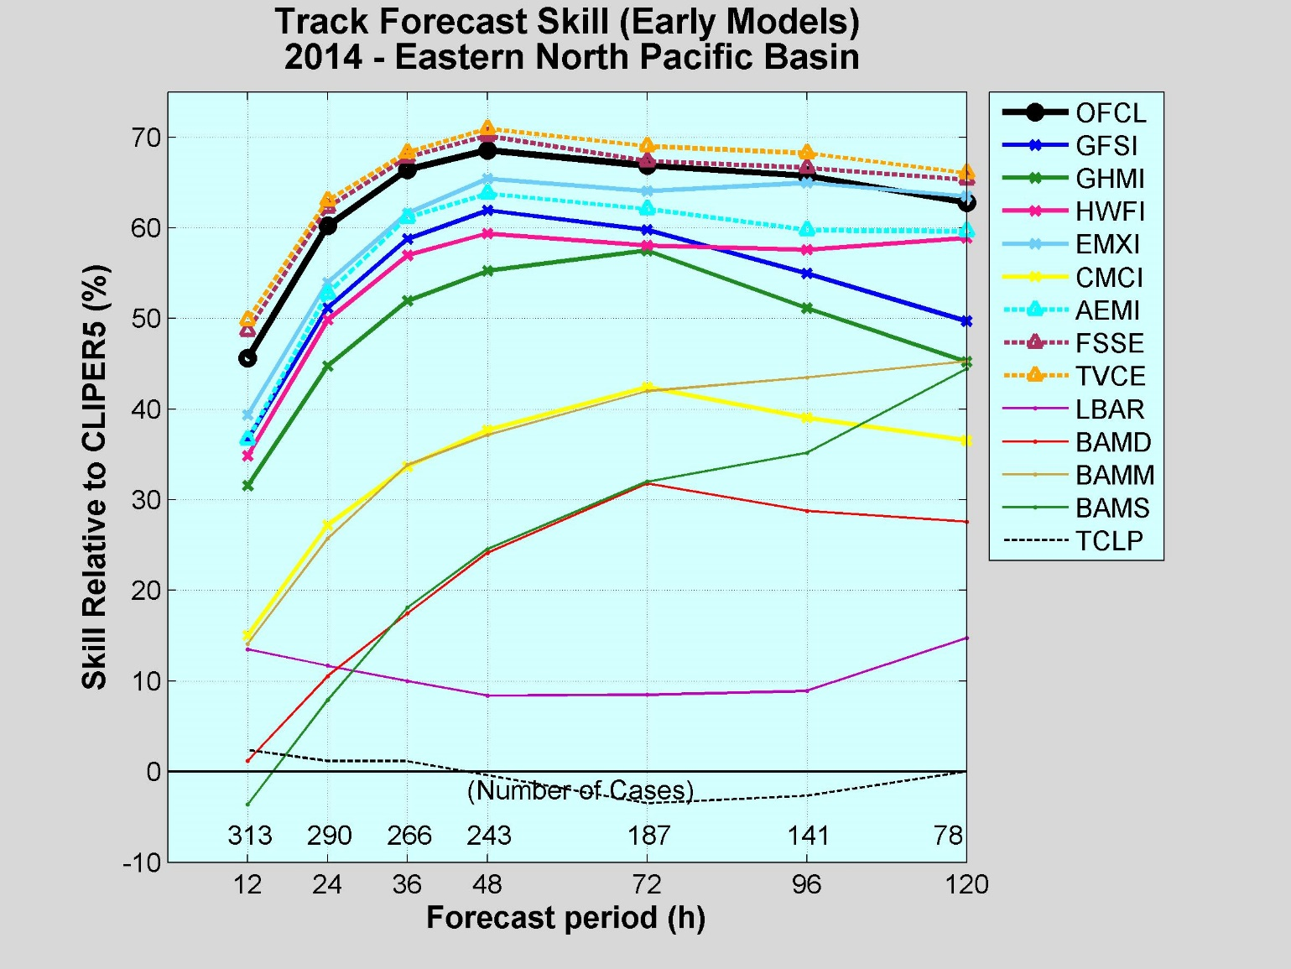
2014 Track Guidance
Official forecasts very skillful, but was bested by the consensus models, TVCE and FSSE.
EMXI best individual model, but less skill than the official forecasts.
GFS ensemble mean strong performer, better than GFSI.
HWRF, GFSI, and GHMI models were fair to good performers.
CMCI trailed.

Slide 17
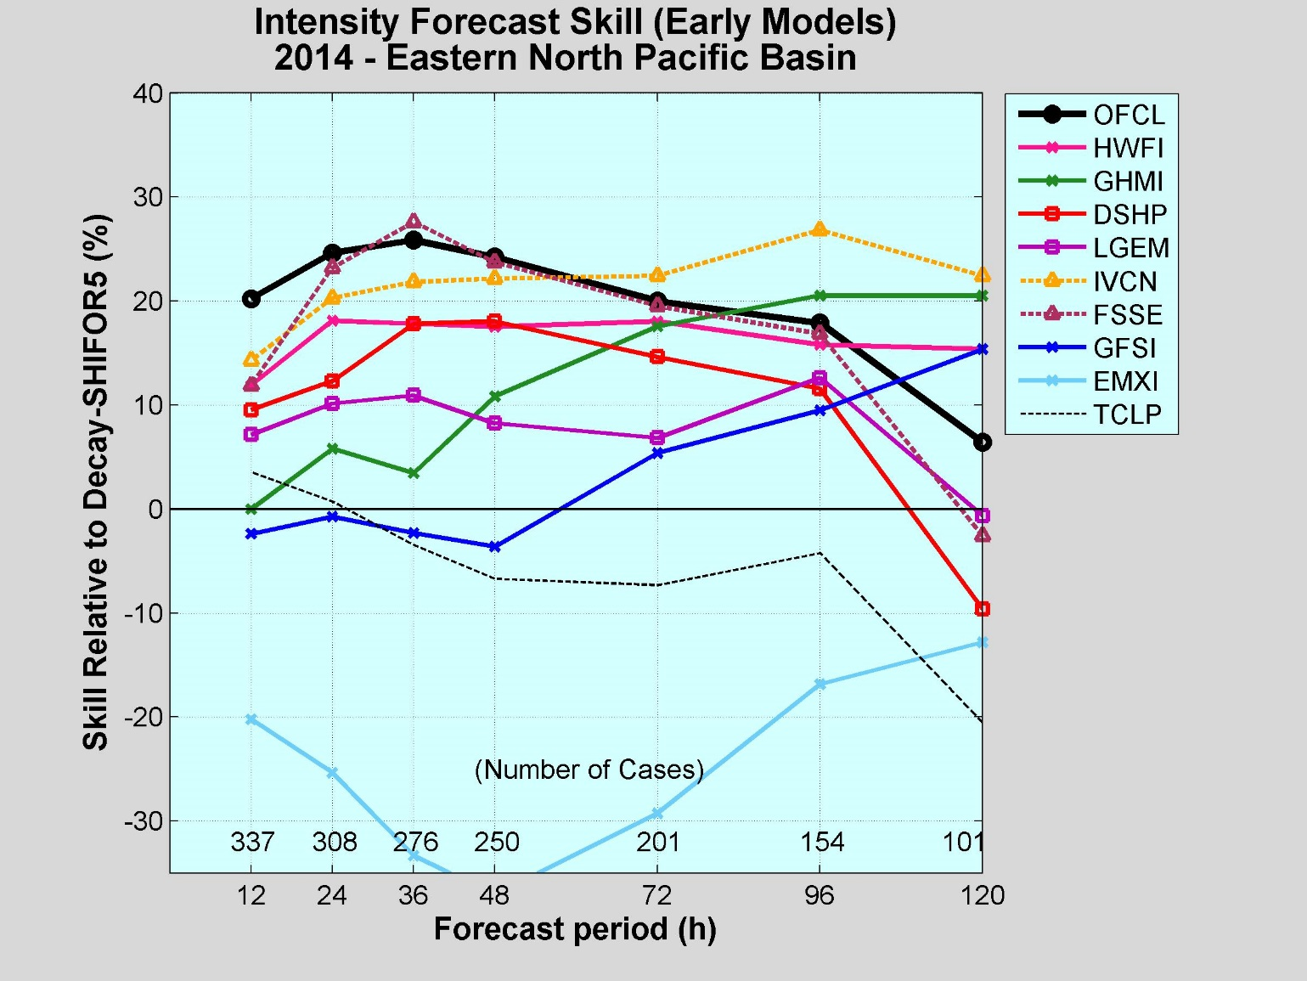
2014 Intensity Guidance
Official forecasts performed better than the guidance early, and near the best guidance from 36 to 96 h.
FSSE and IVCN best guidance through 72 h, then FSSE trails.
HWRF skillful all times, best individual model overall.
DSHP and LGEM second tier of models.
GHMI little skill early, but increases with forecast time. Best individual model at days 4 and 5.
GFSI and especially EMXI not competitive.

Slide 18
JTWC TC Track Forecasting:
Primary Guidance
Primary consensus – CONW
  NAVGEM, GFDN, COAMPS-TC, GFS, GEFS (mean), HWRF, UKMET, JGSM, JMA TC-EPS (mean), ECMWF
  GEFS and HWRF added July 2013
Other NCEP guidance
  GFDL and GFDL ensemble

Slide 19
JTWC TC Track Forecasting:
2014 YTD Western North Pacific
Cases: 87

Slide 20
JTWC TC Track Forecasting:
2014 YTD Western North Pacific
Cases: 53

Slide 21
JTWC TC Intensity Forecasting:
Primary Guidance
Consensus – S5YY
  LGEM & Decay SHIPS (w/ GFS member), HWRF, GFDN, COAMPS-TC, CHII
Consensus – S5XX
  STIPS (w/ GFS member), GFDN, COAMPS-TC, CHIPS
Additional NCEP guidance
  HWRF, GFDL, GPMN (GFDL ensemble) -> Interpolated output
  GHMI – GFDL forecast with intensity adjustment

Slide 22
JTWC TC Intensity Forecasting:
2014 YTD Western North Pacific
CASES: | 192 | 185 | 178 | 167 | 148 | 117 | 87

Slide 23
Operational Forecasting Issues
Numerous Atlantic TC genesis false alarms in the GFS, but underprediction of genesis in the east Pacific by that model (ECMWF provided better genesis guidance in that basin)
Genesis, track, and intensity of Hurricane Arthur
Rapid intensification of several eastern North Pacific TCs, especially Marie and Odile
Forecast track of Hurricane Odile and lead time for warning
Genesis and intensification of Hurricane Gonzalo
Limited real-time comparisons of operational vs. high-res (parallel) GFS

Slide 24
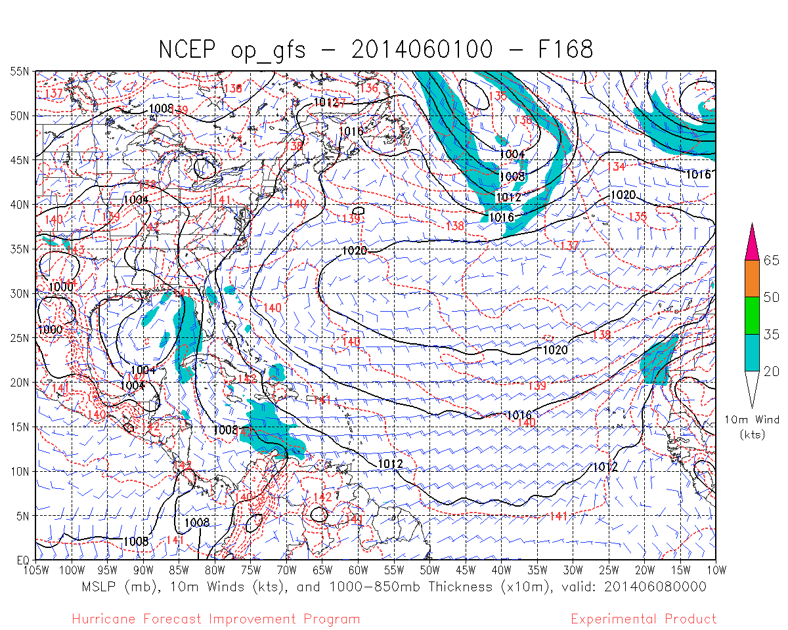
In June, the GFS persistently predicted a false alarm TC in NW Carib/SE Gulf

Slide 25
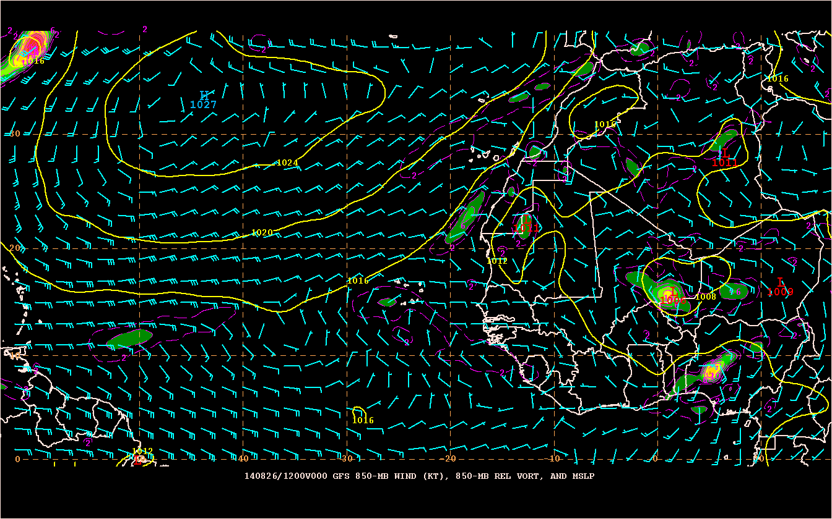
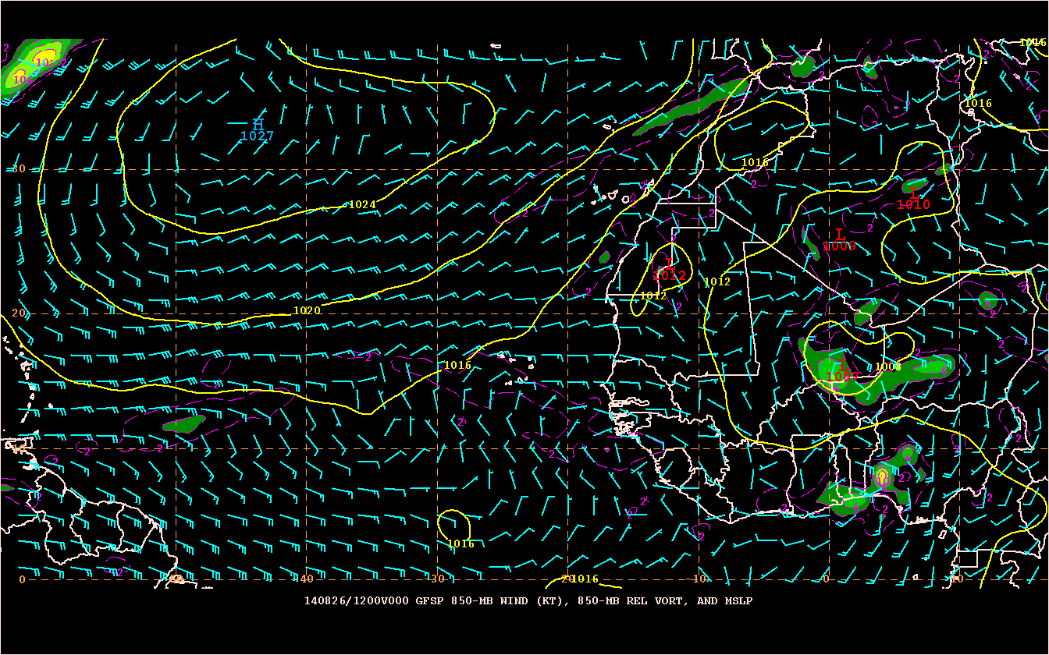
144-h operational GFS forecast of 850 mb winds, vorticity, and mslp from 1200 UTC 8/26/14
144-h parallel GFS forecast of 850 mb winds, vorticity, and mslp from 1200 UTC 8/26/14
Excerpted from the TWO at 1800 UTC 8/26/14:
“A tropical wave is forecast to move off the west coast of Africa late this week. Conditions appear to be favorable for some development thereafter while the system moves westward at 10 to 15 mph across the eastern Atlantic.
* Formation chance through 48 hours...low...near 0 percent.
* Formation chance through 5 days...medium...40 percent.”

Slide 26
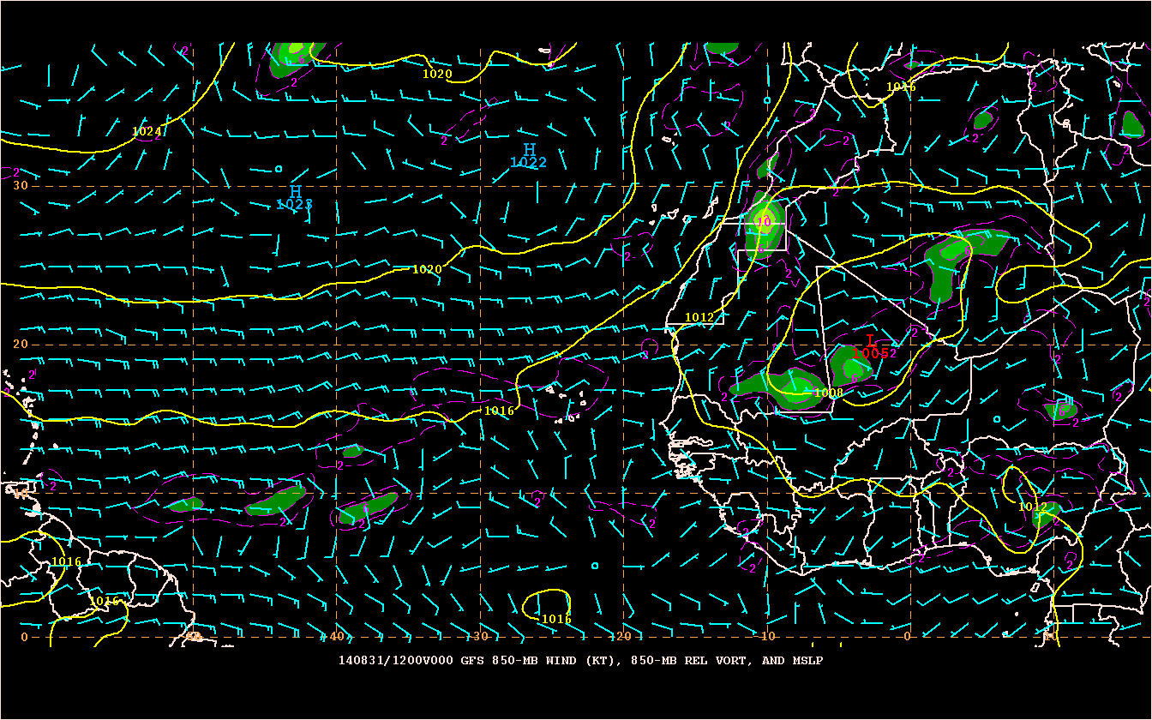
Verifying 850 mb winds, vorticity, and mslp for 120 h: nada!

Slide 27
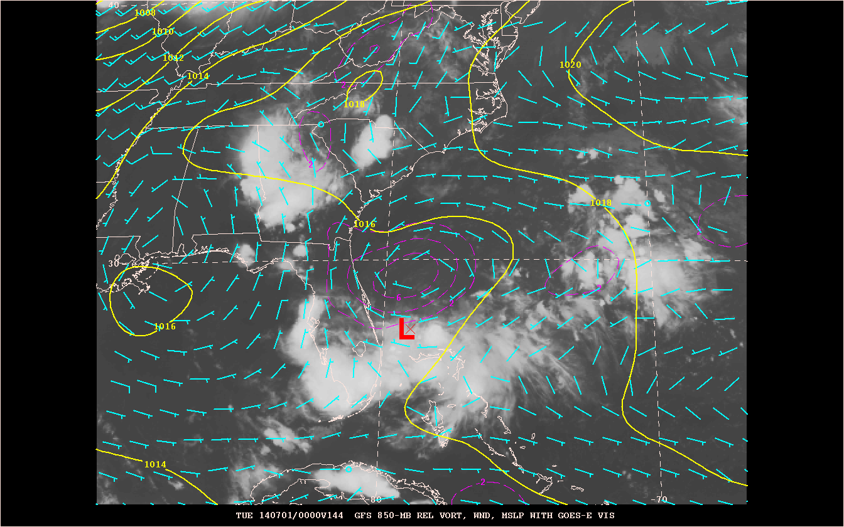
Sequence of operational GFS forecasts verifying near the time of genesis of Hurricane Arthur

Slide 28
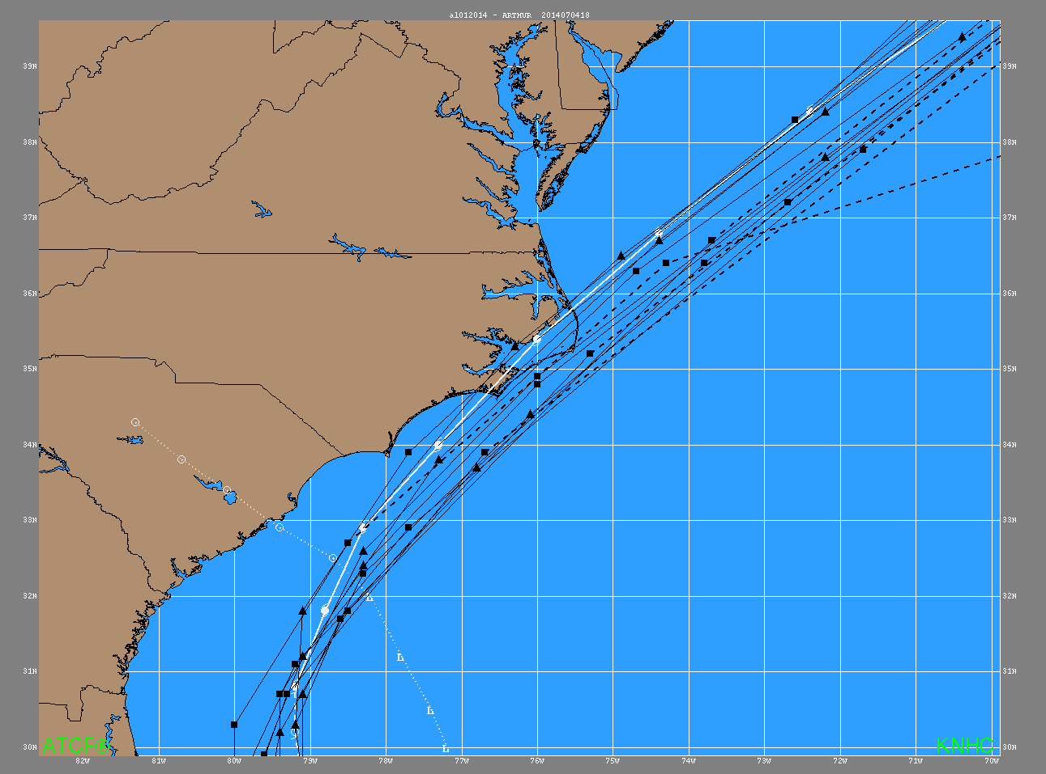
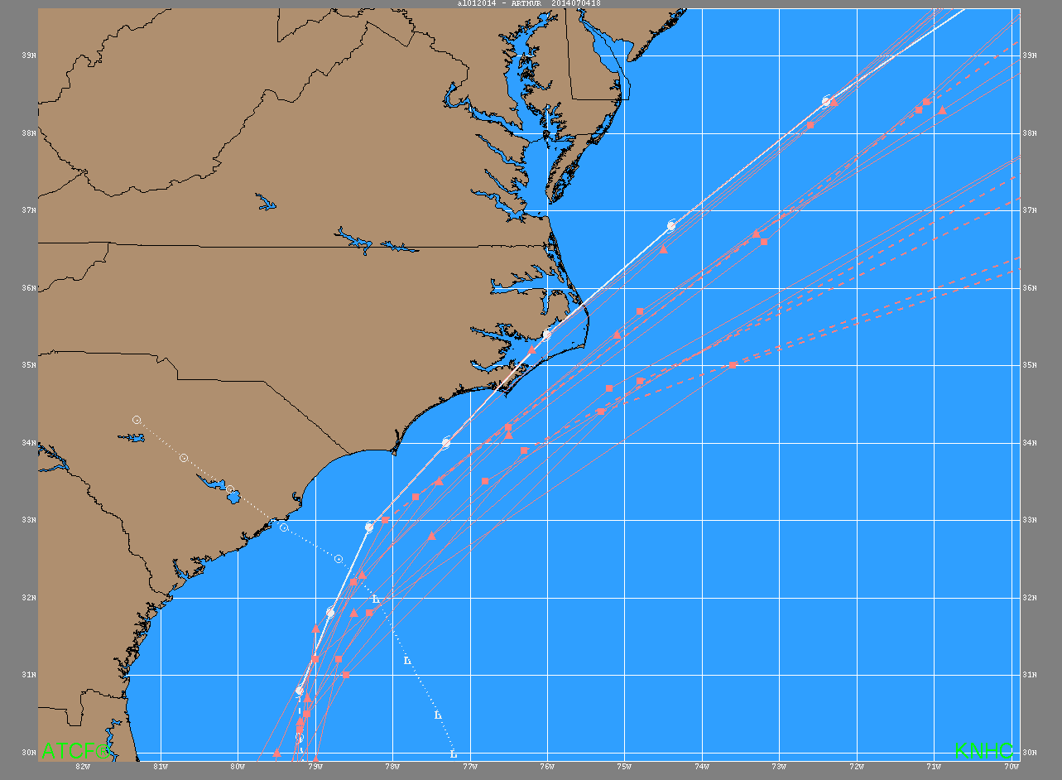
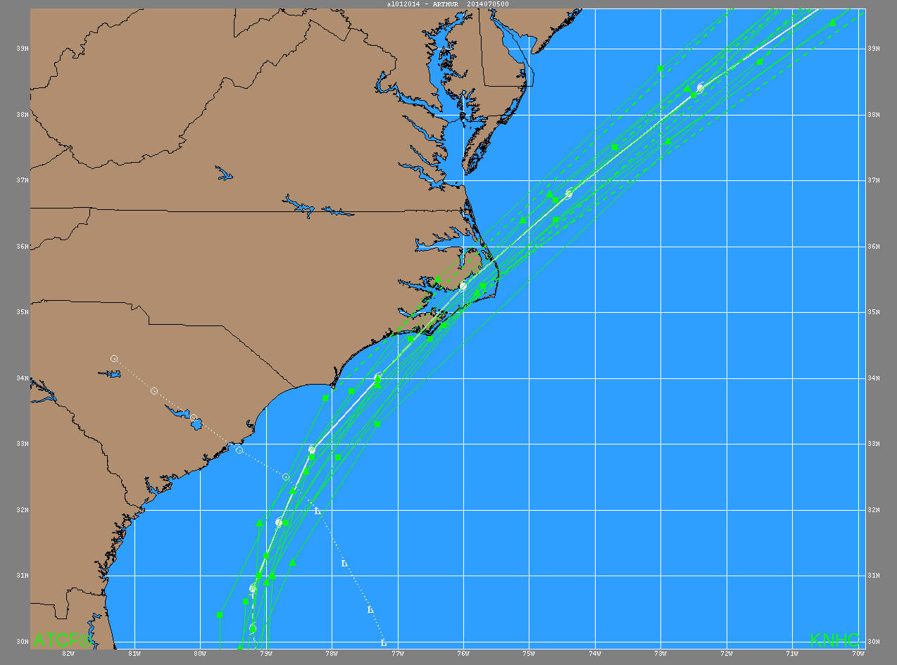
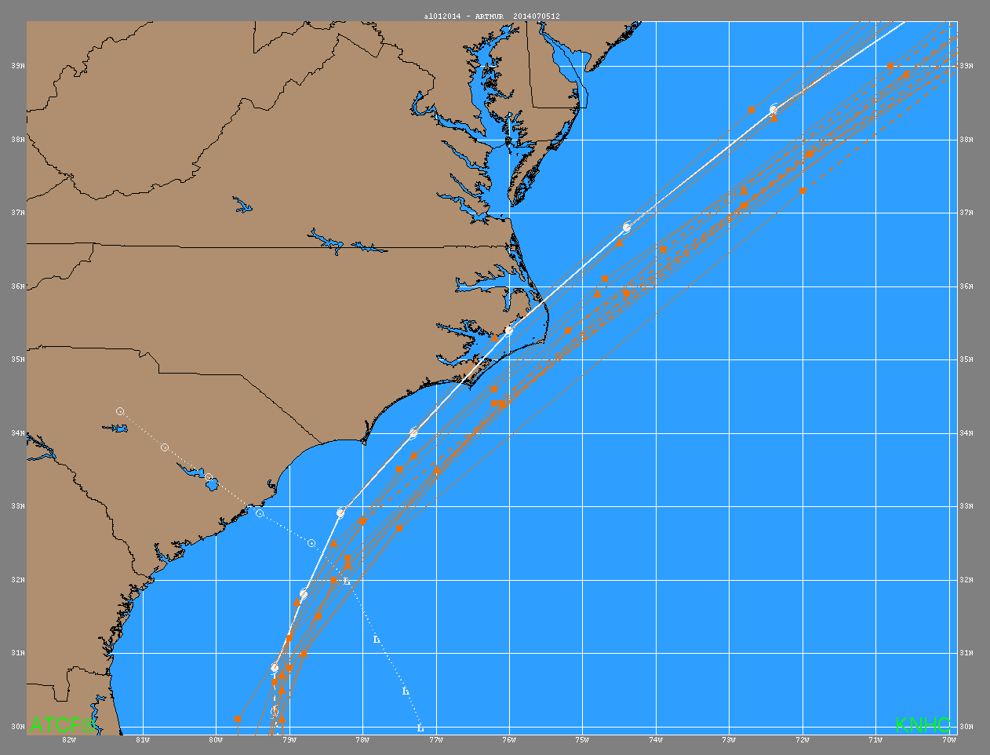
Model Track Forecasts for Arthur
GFS
ECMWF
HWRF
TVCA

Slide 29
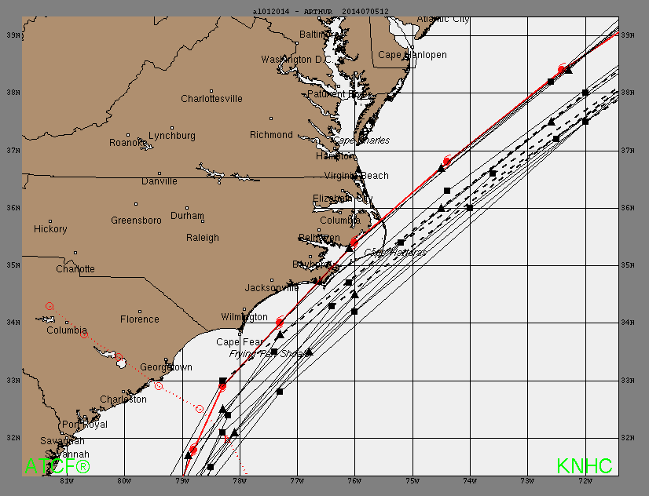
NHC Track Forecasts for Arthur

Slide 30
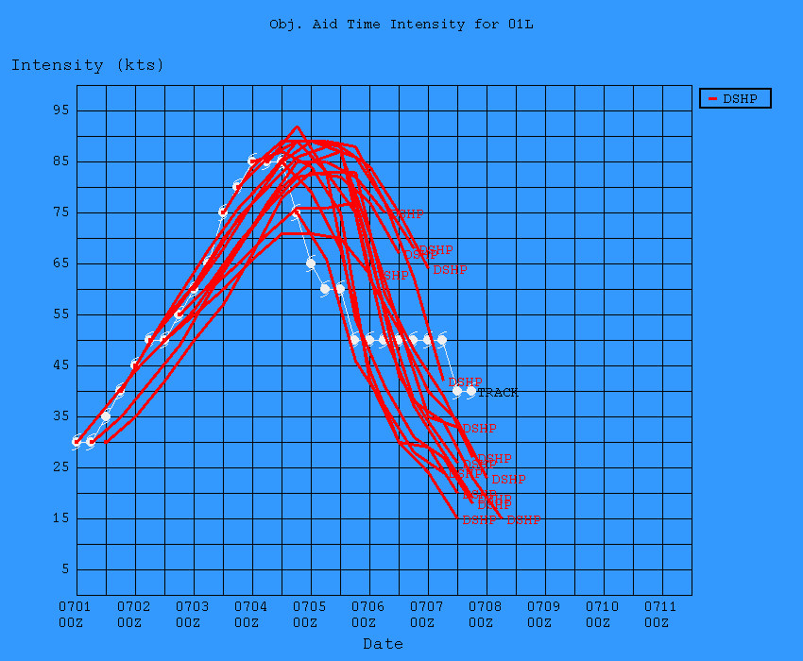
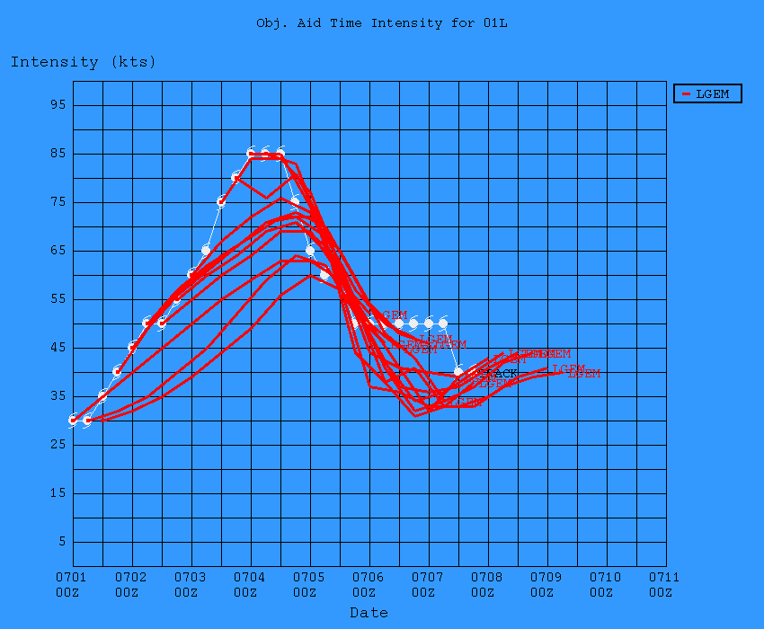
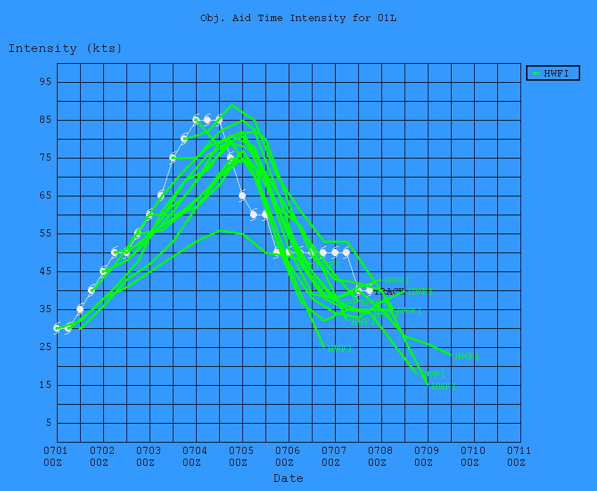
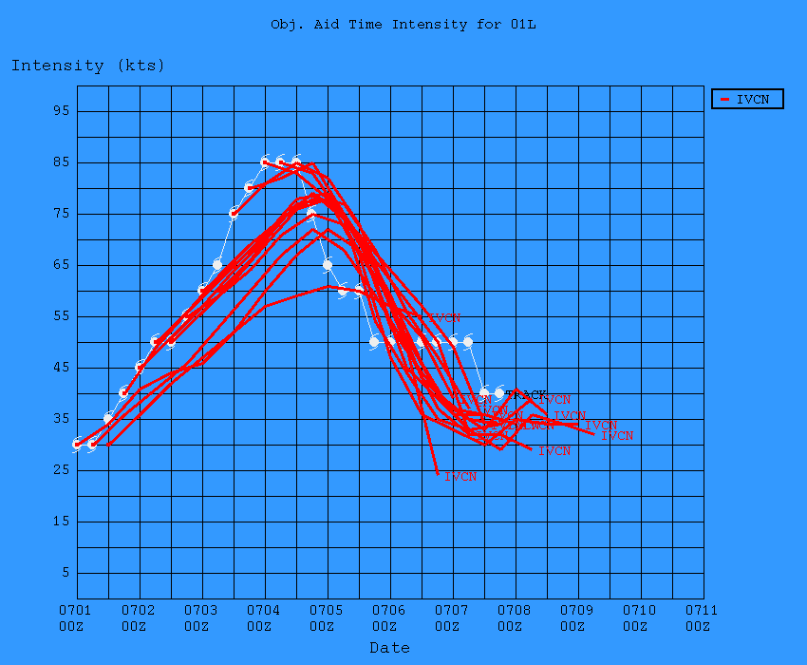
Model Intensity Forecasts for Arthur
Decay-SHIPS
LGEM
HWRF
IVCN

Slide 31
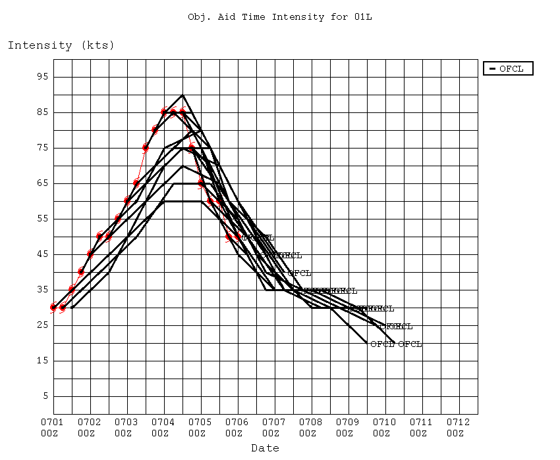
NHC Intensity Forecasts for Arthur

Slide 32
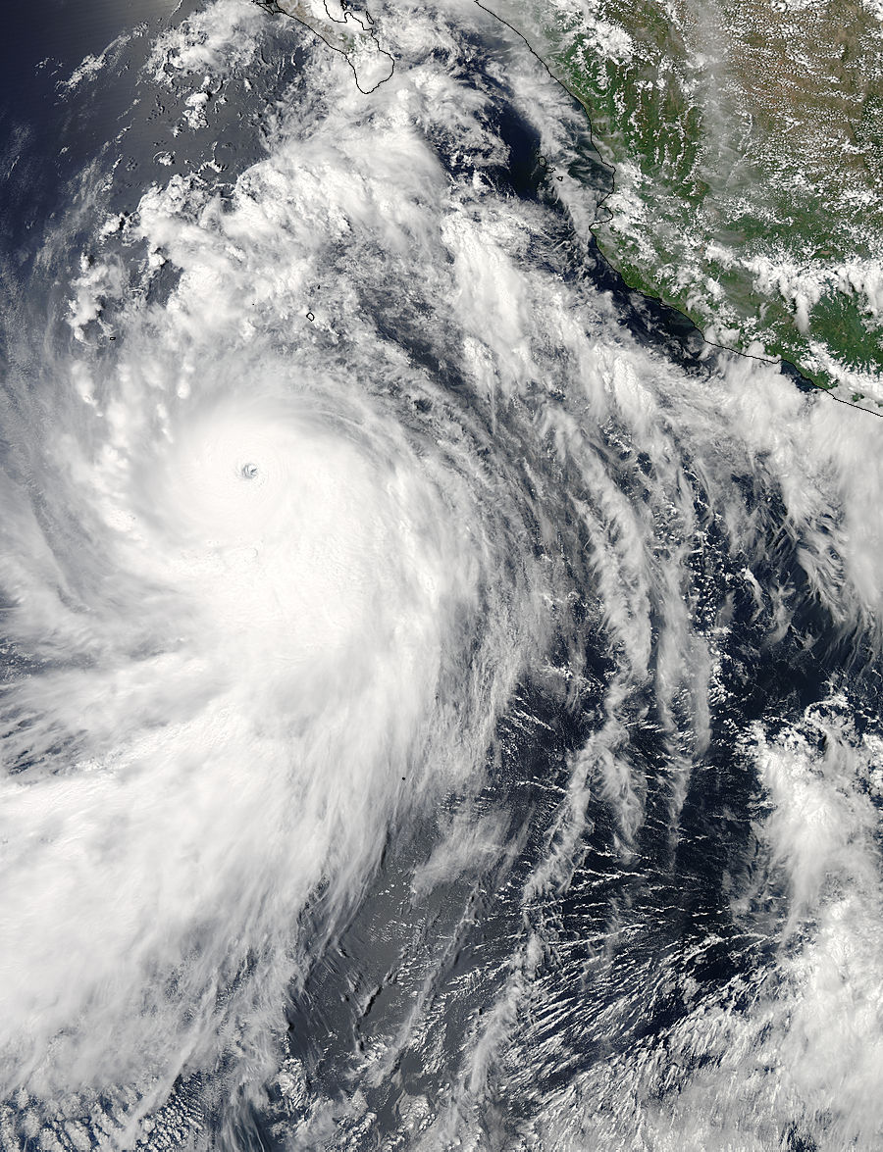
Rapid Intensification of Hurricane Marie, August 2014

Slide 33
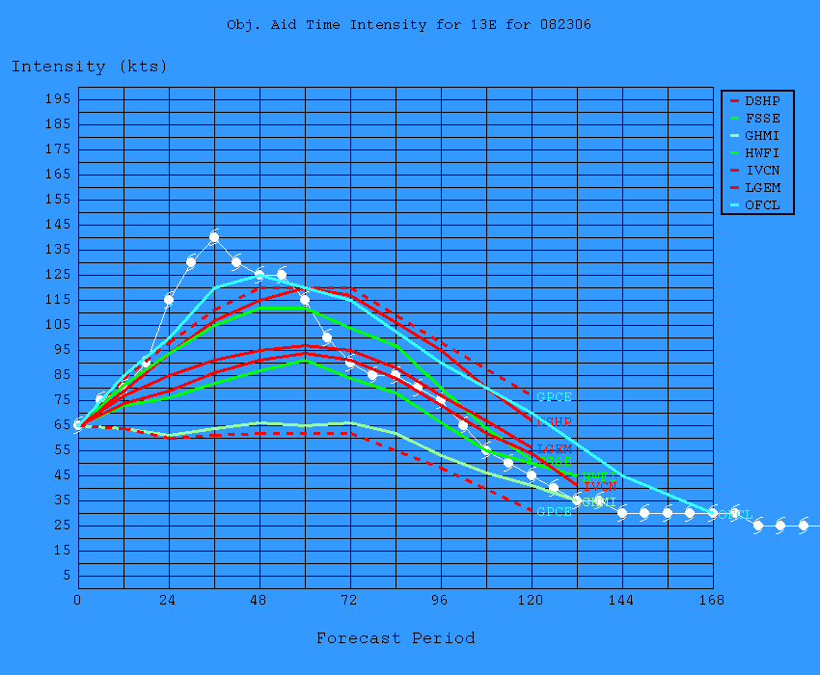
Intensity Model Guidance for Hurricane Marie, 0600 UTC 8/23/14
Prob of RI for 25 kt RI threshold= 51% is 3.9 times the sample mean(13.1%)
Prob of RI for 30 kt RI threshold= 33% is 3.8 times the sample mean( 8.7%)
Prob of RI for 35 kt RI threshold= 27% is 4.4 times the sample mean( 6.0%)
Prob of RI for 40 kt RI threshold= 23% is 5.3 times the sample mean( 4.3%)
Observed
Official Forecast

Slide 34
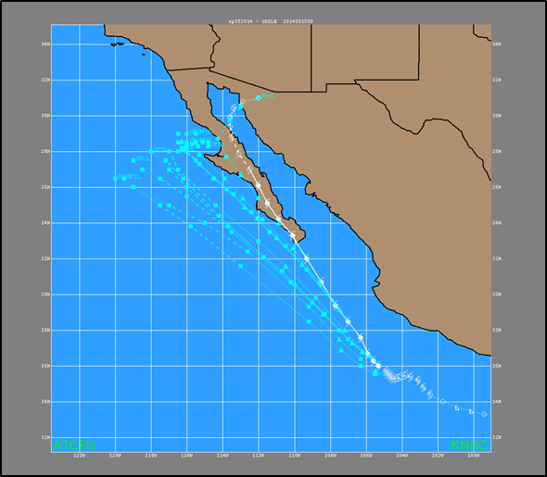
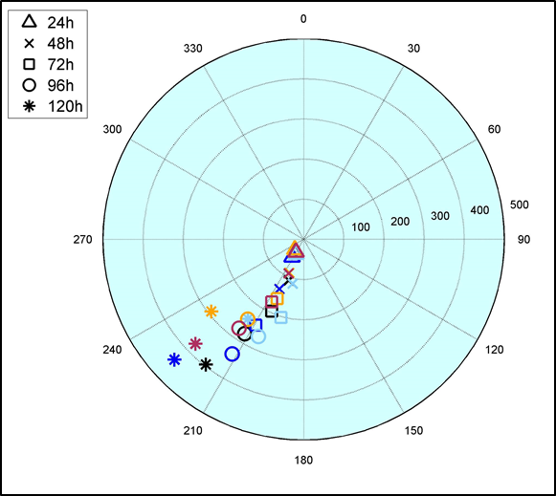
Left (westward) and slow bias of forecast for Odile resulted in less than desired warning lead time for the landfall of a major hurricane in Cabo San Lucas
(a)
(b)
(a) Selected official track forecasts (cyan lines) for Hurricane Odile, 10-18 September 2014. The best track is given by the white line with positions at 6 h intervals. (b) Polar plot of model biases of forecast track errors (in n mi) from the official forecasts (black), GFSI (dark blue), EMXI (light blue), TVCE (gold), and FSSE (red).

Slide 35
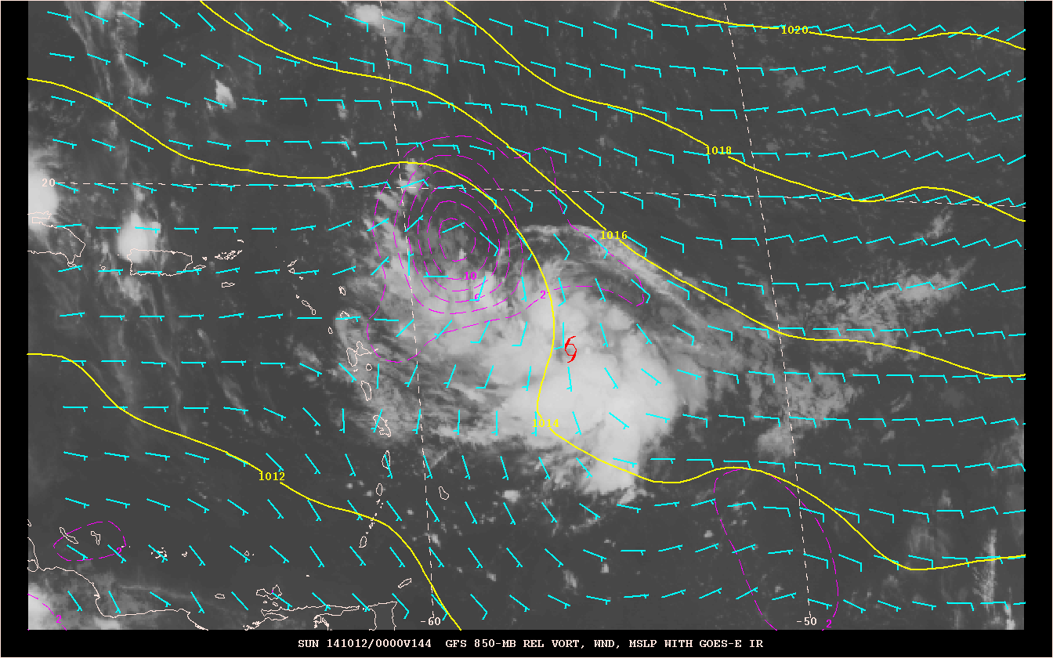
Sequence of operational GFS forecasts verifying near the time of genesis of Hurricane Gonzalo

Slide 36
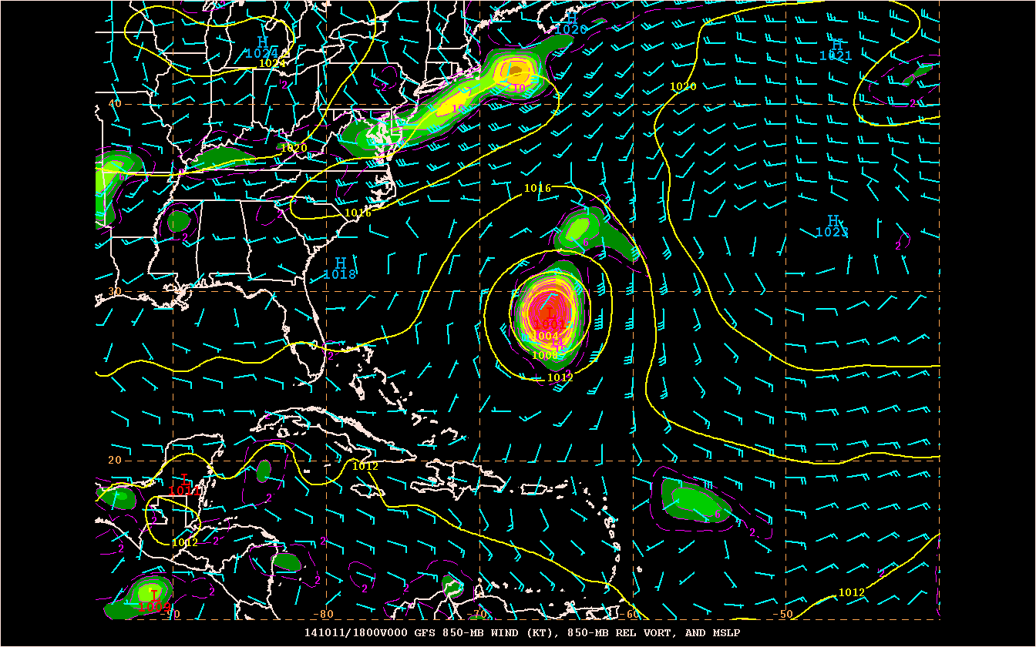
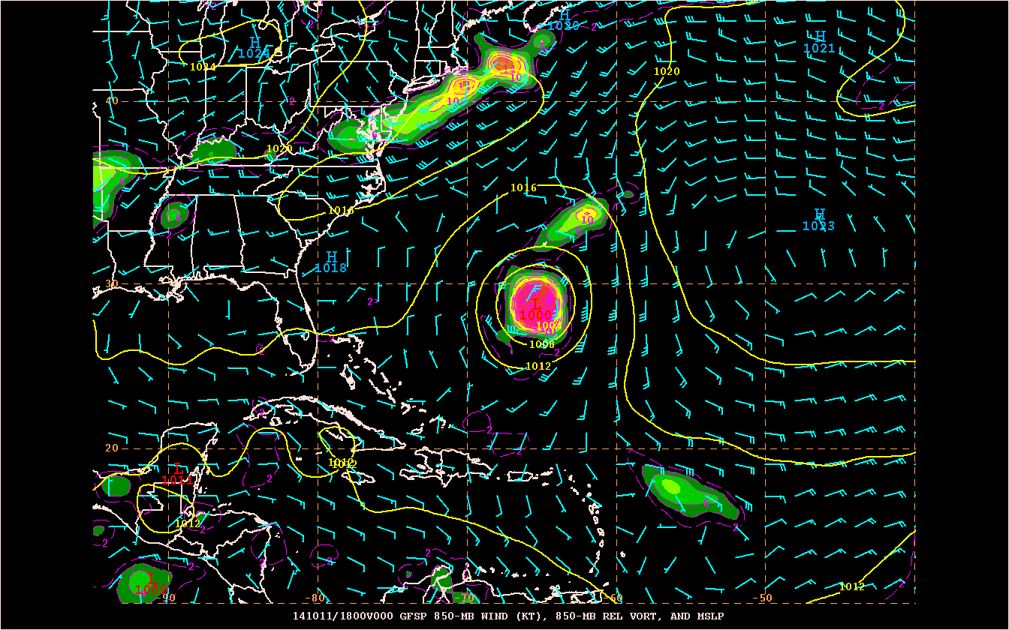
132-h operational GFS forecast of 850 mb winds, vorticity, and mslp from 1800 UTC 10/11/14, about 6 h before the genesis of Gonzalo near the Leeward Islands
132-h parallel GFS forecast of 850 mb winds, vorticity, and mslp from 1800 UTC 10/11/14

Slide 37
Some marine modeling input from the Tropical Analysis and Forecast Branch’s Scott Stripling:
In regards to my requests from last year, all points but the last have been addressed in recent MWW upgrades. However, I am unsure of the status of expanded spectral point data being made available to the field. I have remarked several times in recent years that the generation of spectral output from WW3 was one of the biggest advances in wave model guidance to the field in my career. WW3 point output is available on the EMC web site but is still not available within NMAP or AWIPS2. Older builds of AWIPS did have the ability to display point data in time series format for numerous variables, including SWH and P, but this is not longer available via the volume browser in AWIPS2. Request to restore this feature, and expand to see full spectral output for a handful of pre-determined data points across the OPC and NHC domains.

Slide 38
NHC’s Wish List for 2015
Improved guidance from the GFS (fingers crossed!)
Additional upgrades to the GFS ensemble
Probabilistic genesis guidance from global models (Peng)
Continued improvements to the HWRF (resolution, initialization, physics)
At least 1 more implementation of the GFDL Hurricane Model
6 and 7-day forecasts from HWRF and GFDL (2016?)
Implement NHC's new global version of the TC-vitals code as part of the GFS processing system
2nd run of p-surge-2 model needed on WCOSS. Currently we have one slot per synoptic time.
Provide subset of variables for large ensembles and high-resolution deterministic model output
Better timing of model implementations to reduce burden on bandwidth, storage of parallel grids, and staff. Currently NHC is participating in 3 simultaneous model evaluations (GFS, WaveWatch, Hurricane Wave).

Slide 39
Many Thanks to:
John Cangialosi & others at NHC

