Slide 1
Presented by:
Mark Iredell based on work done by Global Climate and Weather Modeling Branch
2014 NCEP Production Suite Review
GLOBAL MODELING

Slide 2
Table of Contents
The GFS is going to 13 km!
  Thank you. Questions?
Global plans for 2015+

Slide 3
The GFS is going to 13 km!
Chapter 1

Slide 4
The 13 km GFS is the biggest freaking implementation NCEP has ever done.
  Huge (almost double) resolution increase
  Also upgrades of observations, analysis, and physics
  Environmental equivalence structure overhaul
  Output format and filenames overhaul
  Almost every NCEP model and center affected
  Most testing ever (32 months 2011-2014)
  Burned through multiple supercomputers, SPA leads, post leads, parallel leads, and acting global chiefs

Slide 5
13 km GFS: Changes
Increase horizontal resolution to 13 km globally (from 23 km) using semi-Lagrangian transport
High resolution out to 10 days (from 8 days)
Higher resolution topography, improved initial snow conditions, new high resolution daily SST and sea ice analyses
New observations (METOP-B, SSM/IS UPP LAS, hourly GOES and EUMETSAT winds)
Improved satellite assimilation algorithm, particularly over southern ocean
Higher resolution EnKF with better spread due to stochastic physics
Improved cloud-radiation interaction, land characteristics, and boundary layer physics
New post-processed fields, parallel output in GRIB2

Slide 6
13 km GFS: Testing
Used both Zeus and WCOSS for parallels
Will cycle 32 simulated months covering all seasons when all is said and done
Included 4 hurricane seasons 2011-2014
Using new environmental equivalence in the NCO parallel
30-day clock restarted 20 November 2014

Slide 7
13 km GFS: Benefits
Significantly better resolution, resolving smaller scale features
Significantly better extratropical synoptic forecasts (500 mb height anomaly correlations)
Significantly and substantially better forecast fits to observed jet level winds
Significantly better precipitation forecasts
Significantly better tropical storm track and intensity in Atlantic and West Pacific
Significantly and substantially better Southern Hemisphere forecasts
Many gains are incremental; significance comes from lots of testing

Slide 8
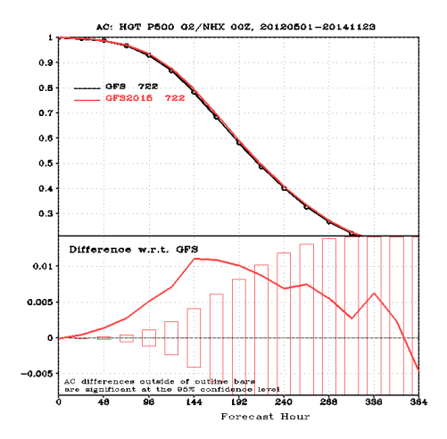
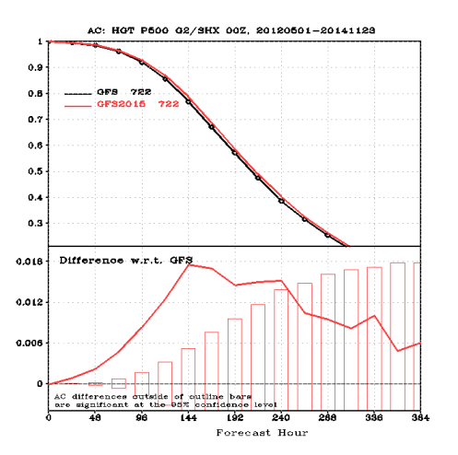
Results – Merged 2012/2013/2014
see http://www.emc.ncep.noaa.gov/gmb/wx24fy/vsdb/gfs2015/
NH 500-hPa HGT AC
SH 500-hPa HGT AC
8

Slide 9
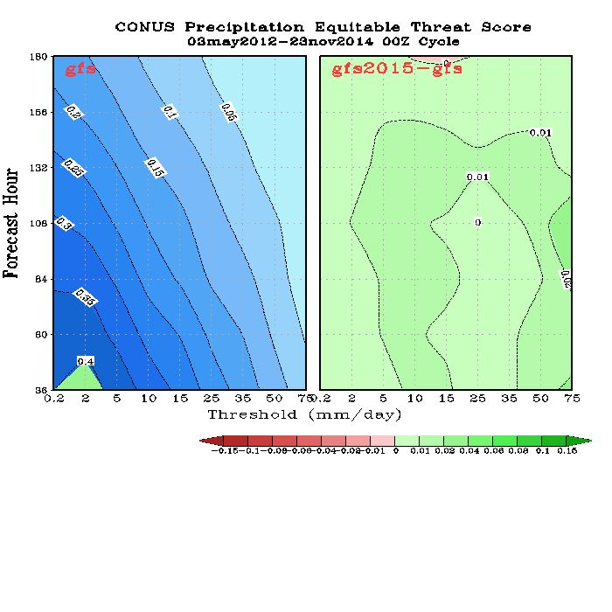
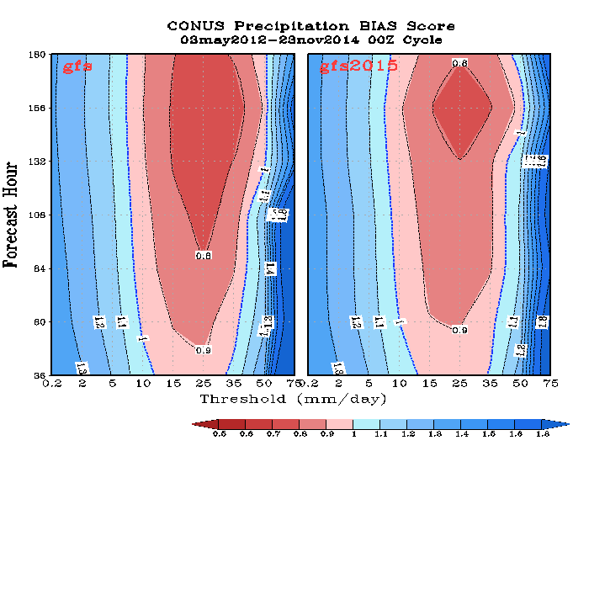
Precipitation Skill Scores, 00Z Cycle
Merged 2012/2013/2014
ETS
BIAS
Improved ETS score and reduced forecast BIAS for all intensity and forecast lead time.
9

Slide 10
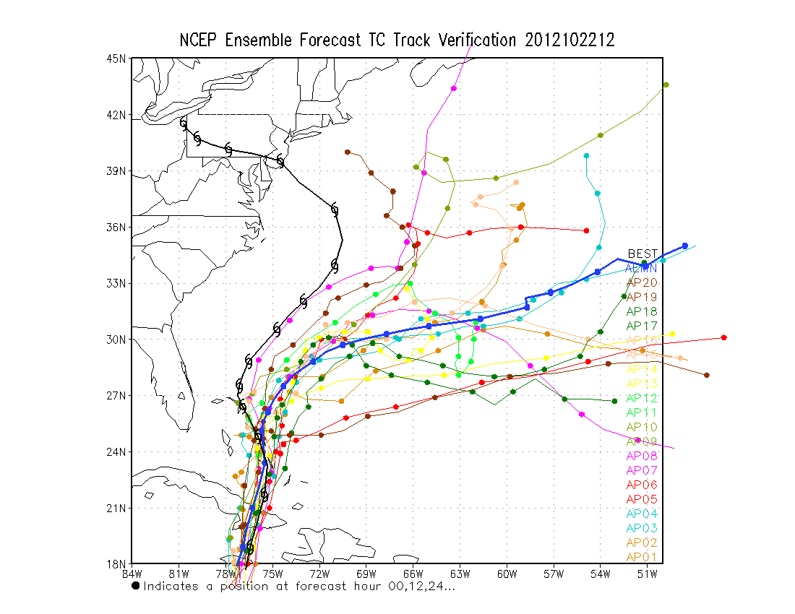
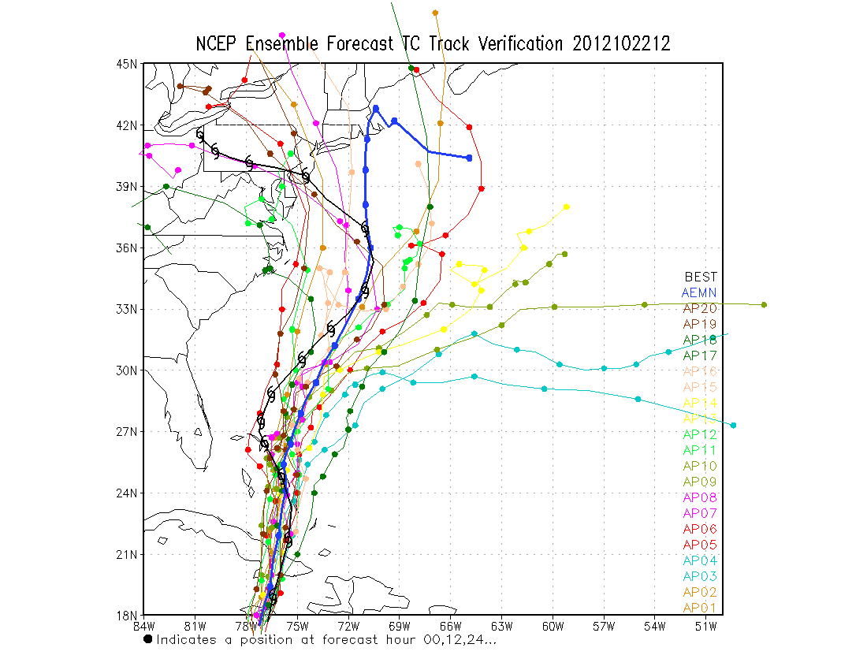
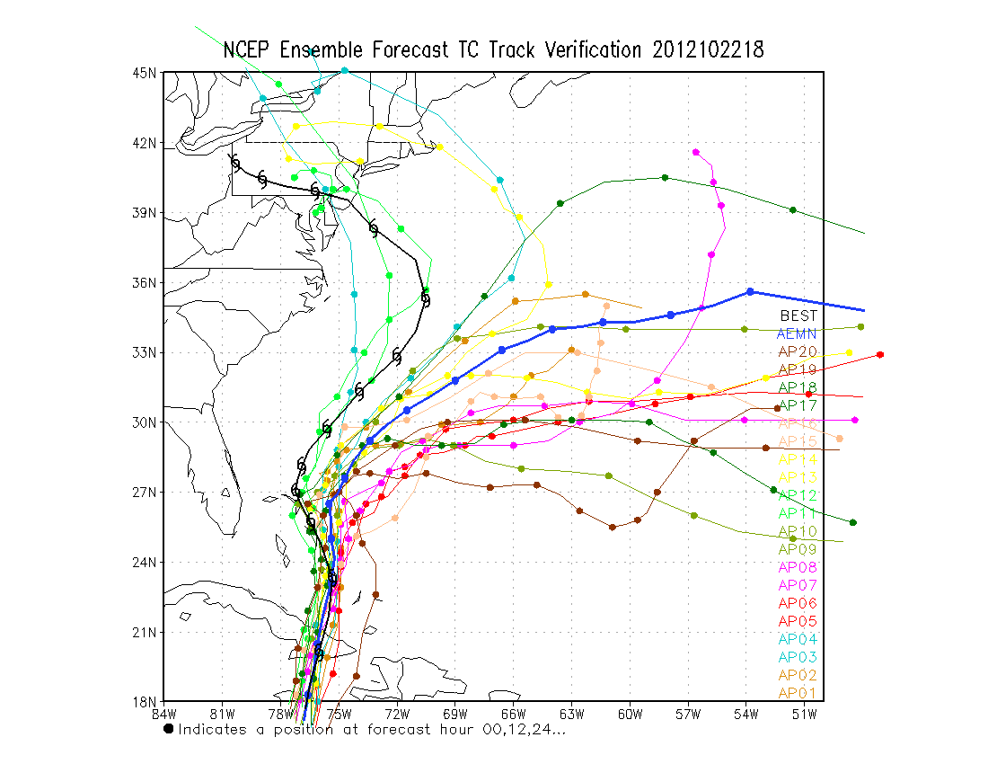
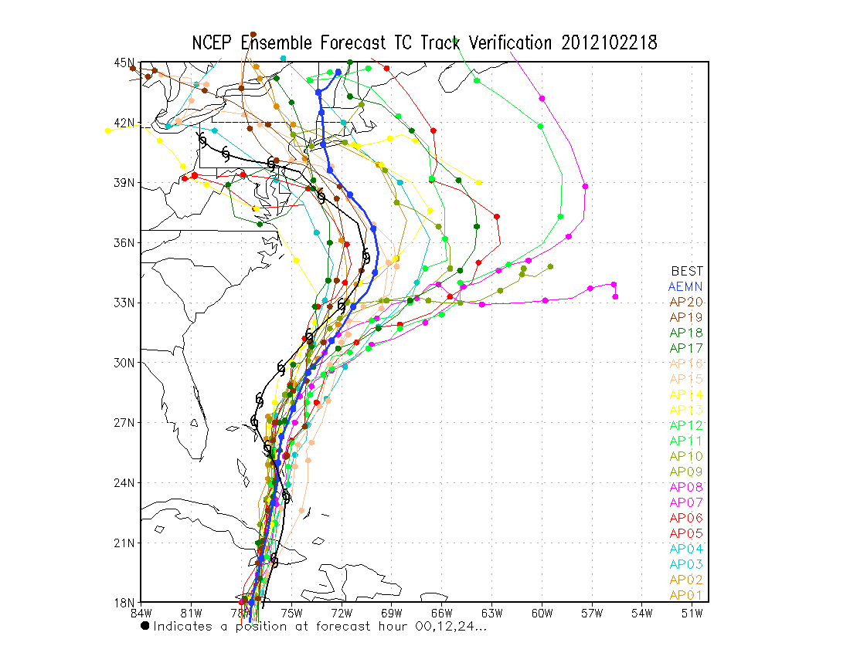
12UTC
Bimodality?
Thick blue: ensemble mean
Opr: T254L42
(55km)
Para: T574L64
(33km)
20121022 (7.5 days)
18UTC

Slide 11
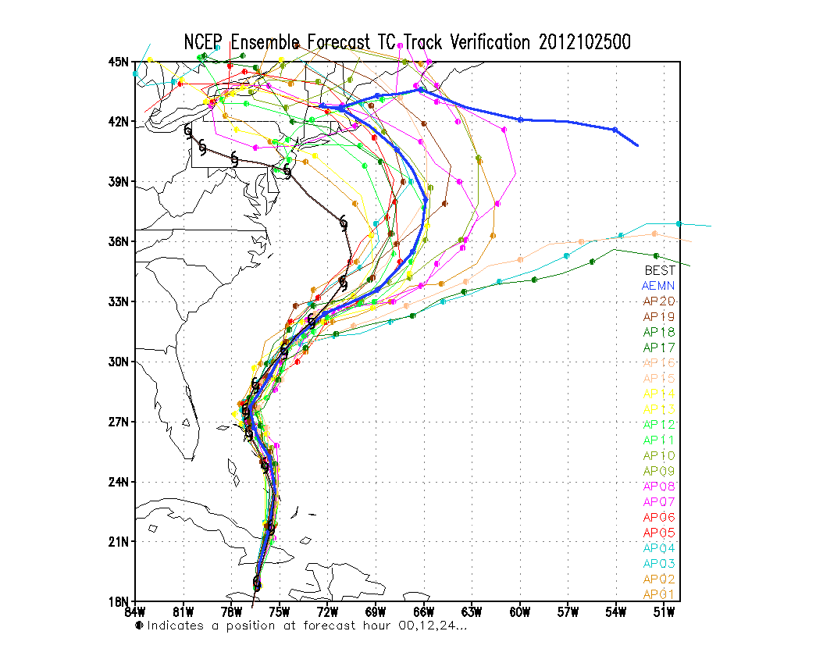
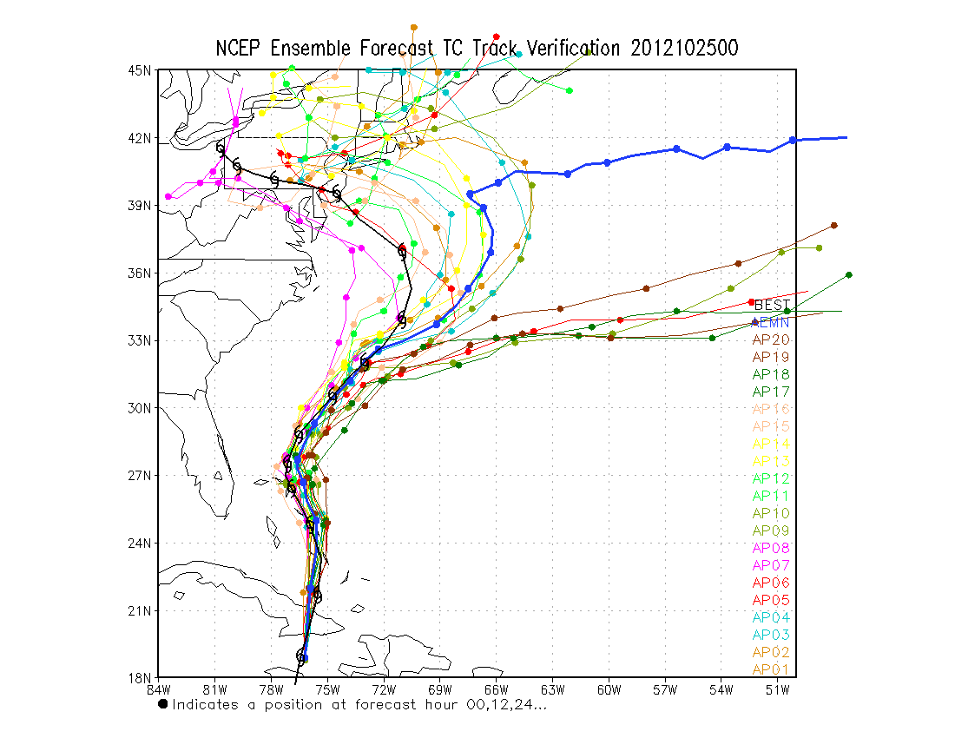
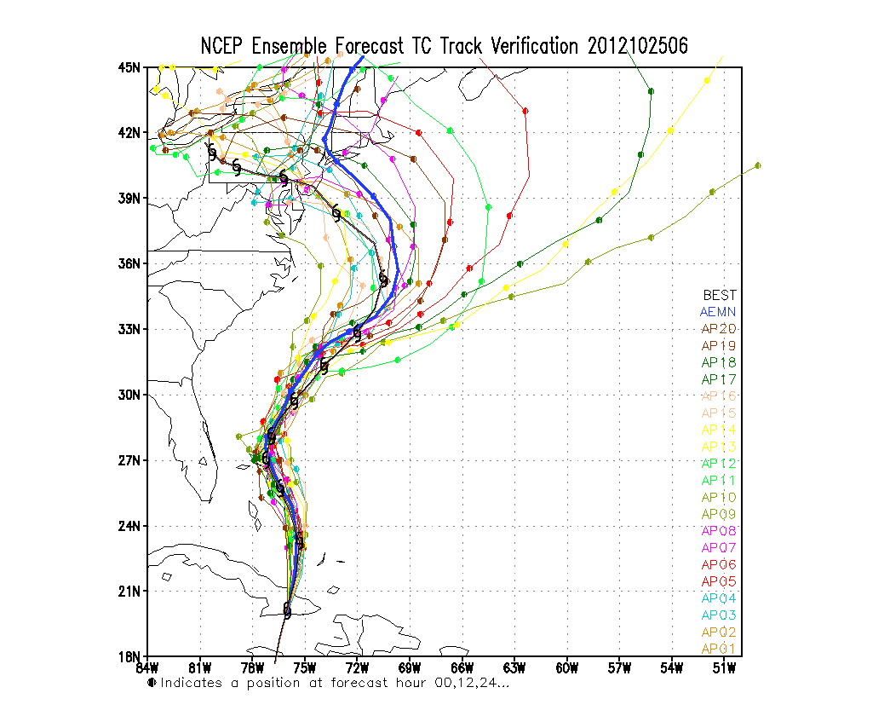
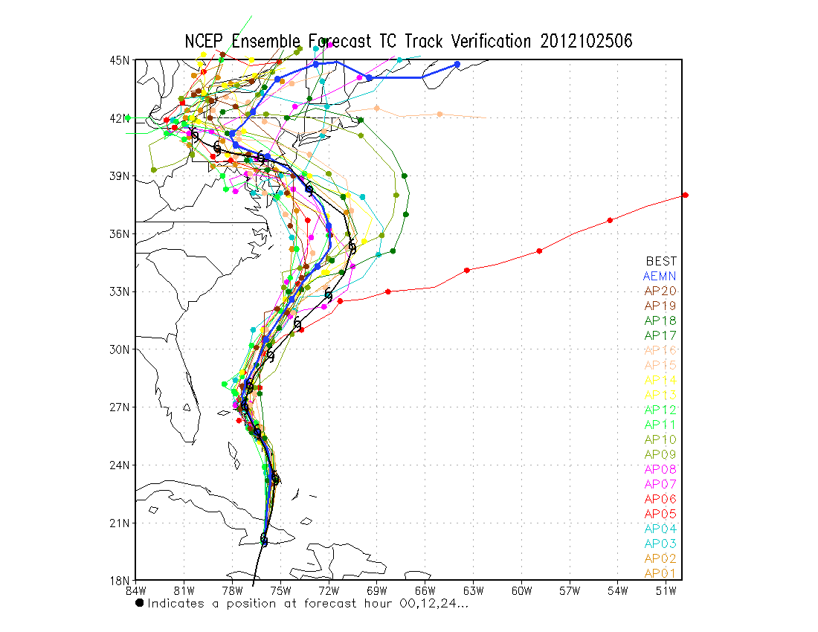
Bimodality!
00UTC
Opr: T254L42
(55km)
Para: T574L64
(33km)
20121025 (5 days)
06UTC

Slide 12
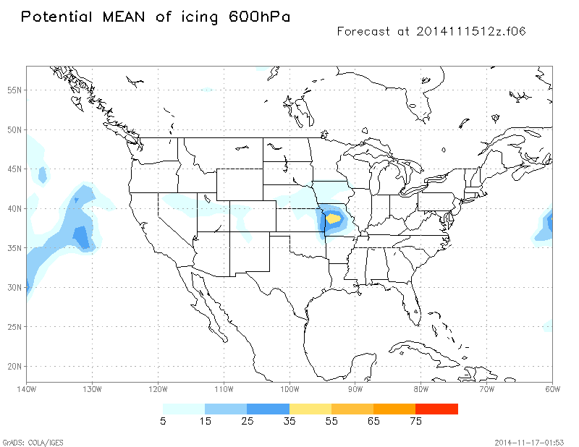
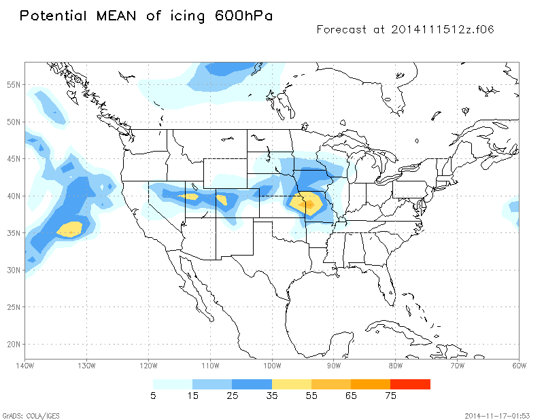
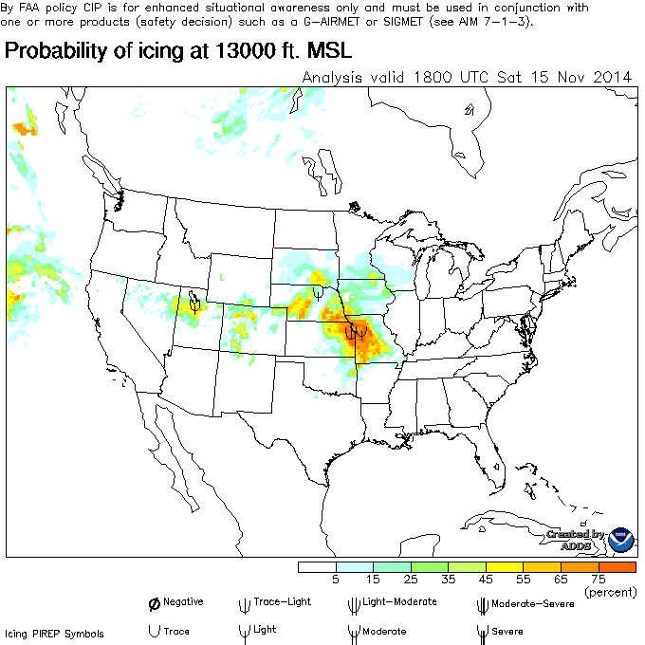
Operational(old algorithm)
Parallel (new algorithm)
Improved Icing Product in 13 km GFS post processing

Slide 13
Global plans for 2015+
Chapter 2

Slide 14
2015 global implementations
GEFS (higher resolution/new perturbations)
Yuejian Zhu
CFS (data assimilation upgrade)
Suru Saha
WAM (developmental parallel up to 600 km)
George Milward
NGAC (major aerosol upgrade)
GFS (4D hybrid and NEMS)

Slide 15
NGAC (NEMS Global Aerosol Component)
NCEP has implemented and continues to develop
global aerosol forecasting/assimilation capability
    The aerosol project builds upon extensive collaboration with NOAA labs/centers (NESDIS) and external research community (GSFC, the ICAP working group, WMO SDS-WAS program)
Phased implementation
  Phase 1: Dust-only forecasts (operational)
  * 5 aerosol species transported with Eulerian numerics
  (Implemented in Q4FY2012)
  Phase 2: Forecasts for dust, sulfate, sea salt, and carbonaceous aerosols using NESDIS’s GBBPEx smoke emissions (planned FY15 implementation)
  * 18 aerosol species transported with semi-Lagrangian numerics
        (Ongoing, Q4FY2015)
  Phase 3: NGAC with improved aerosol representation and aerosol cloud
  interaction is included
  Phase 4: Aerosol analysis using VIIRS AOD (NCEP-NESDIS-GSFC)

Slide 16
Q1FY16 GFS
NEMS (NOAA Environmental Modeling System) unifying structure, enabling coupling
4D hybrid variational EnKF
John Derber
Improved moist physics
next slides
Improved land physics
As usual, there will be new
observations, optimizations, enhancements, and products

Slide 17
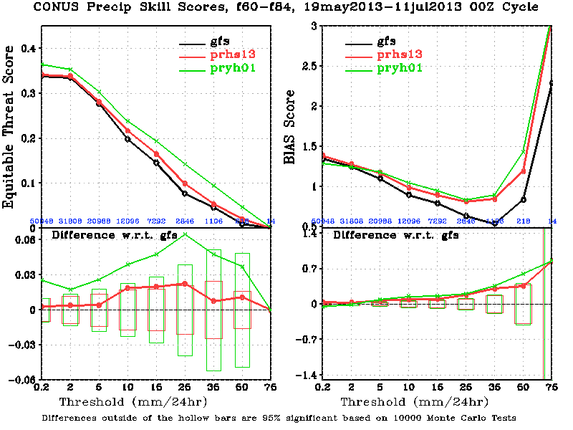

Slide 18
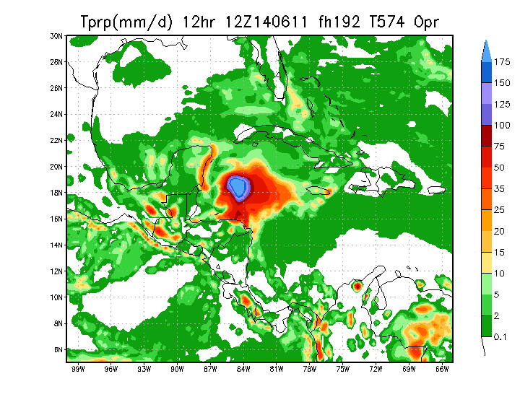
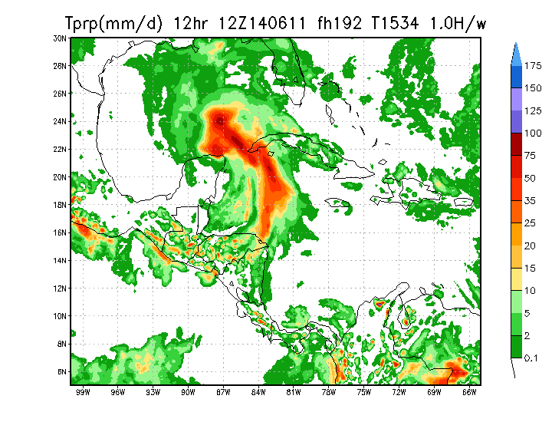
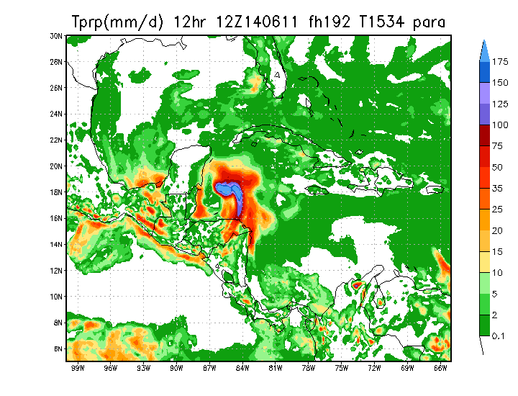
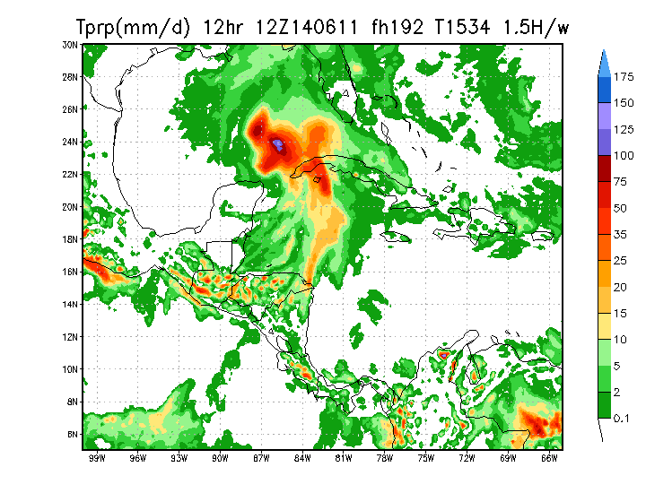
Tests for false alarm storms (8 day forecast)
Pre-operational GFS (13km) with updated convection schemes
Operational GFS (27km)
Pre-operational GFS (13km) with weaker convection in updated deep convection scheme
Pre-operational GFS (13km)

Slide 19
Future global model suite
Carry forward current requirements of
GFS, GEFS, CFS, NGAC, WAM
Keep models on same development path
Couple end-to-end seamlessly
Share information between models
Nest downscale models in NEMS
Run ensembles for all models
Create reforecast datasets for all models
Rejigger jigsaw schedule

Slide 20
Acknowledgments
  Thank you. Questions?

