Slide 1
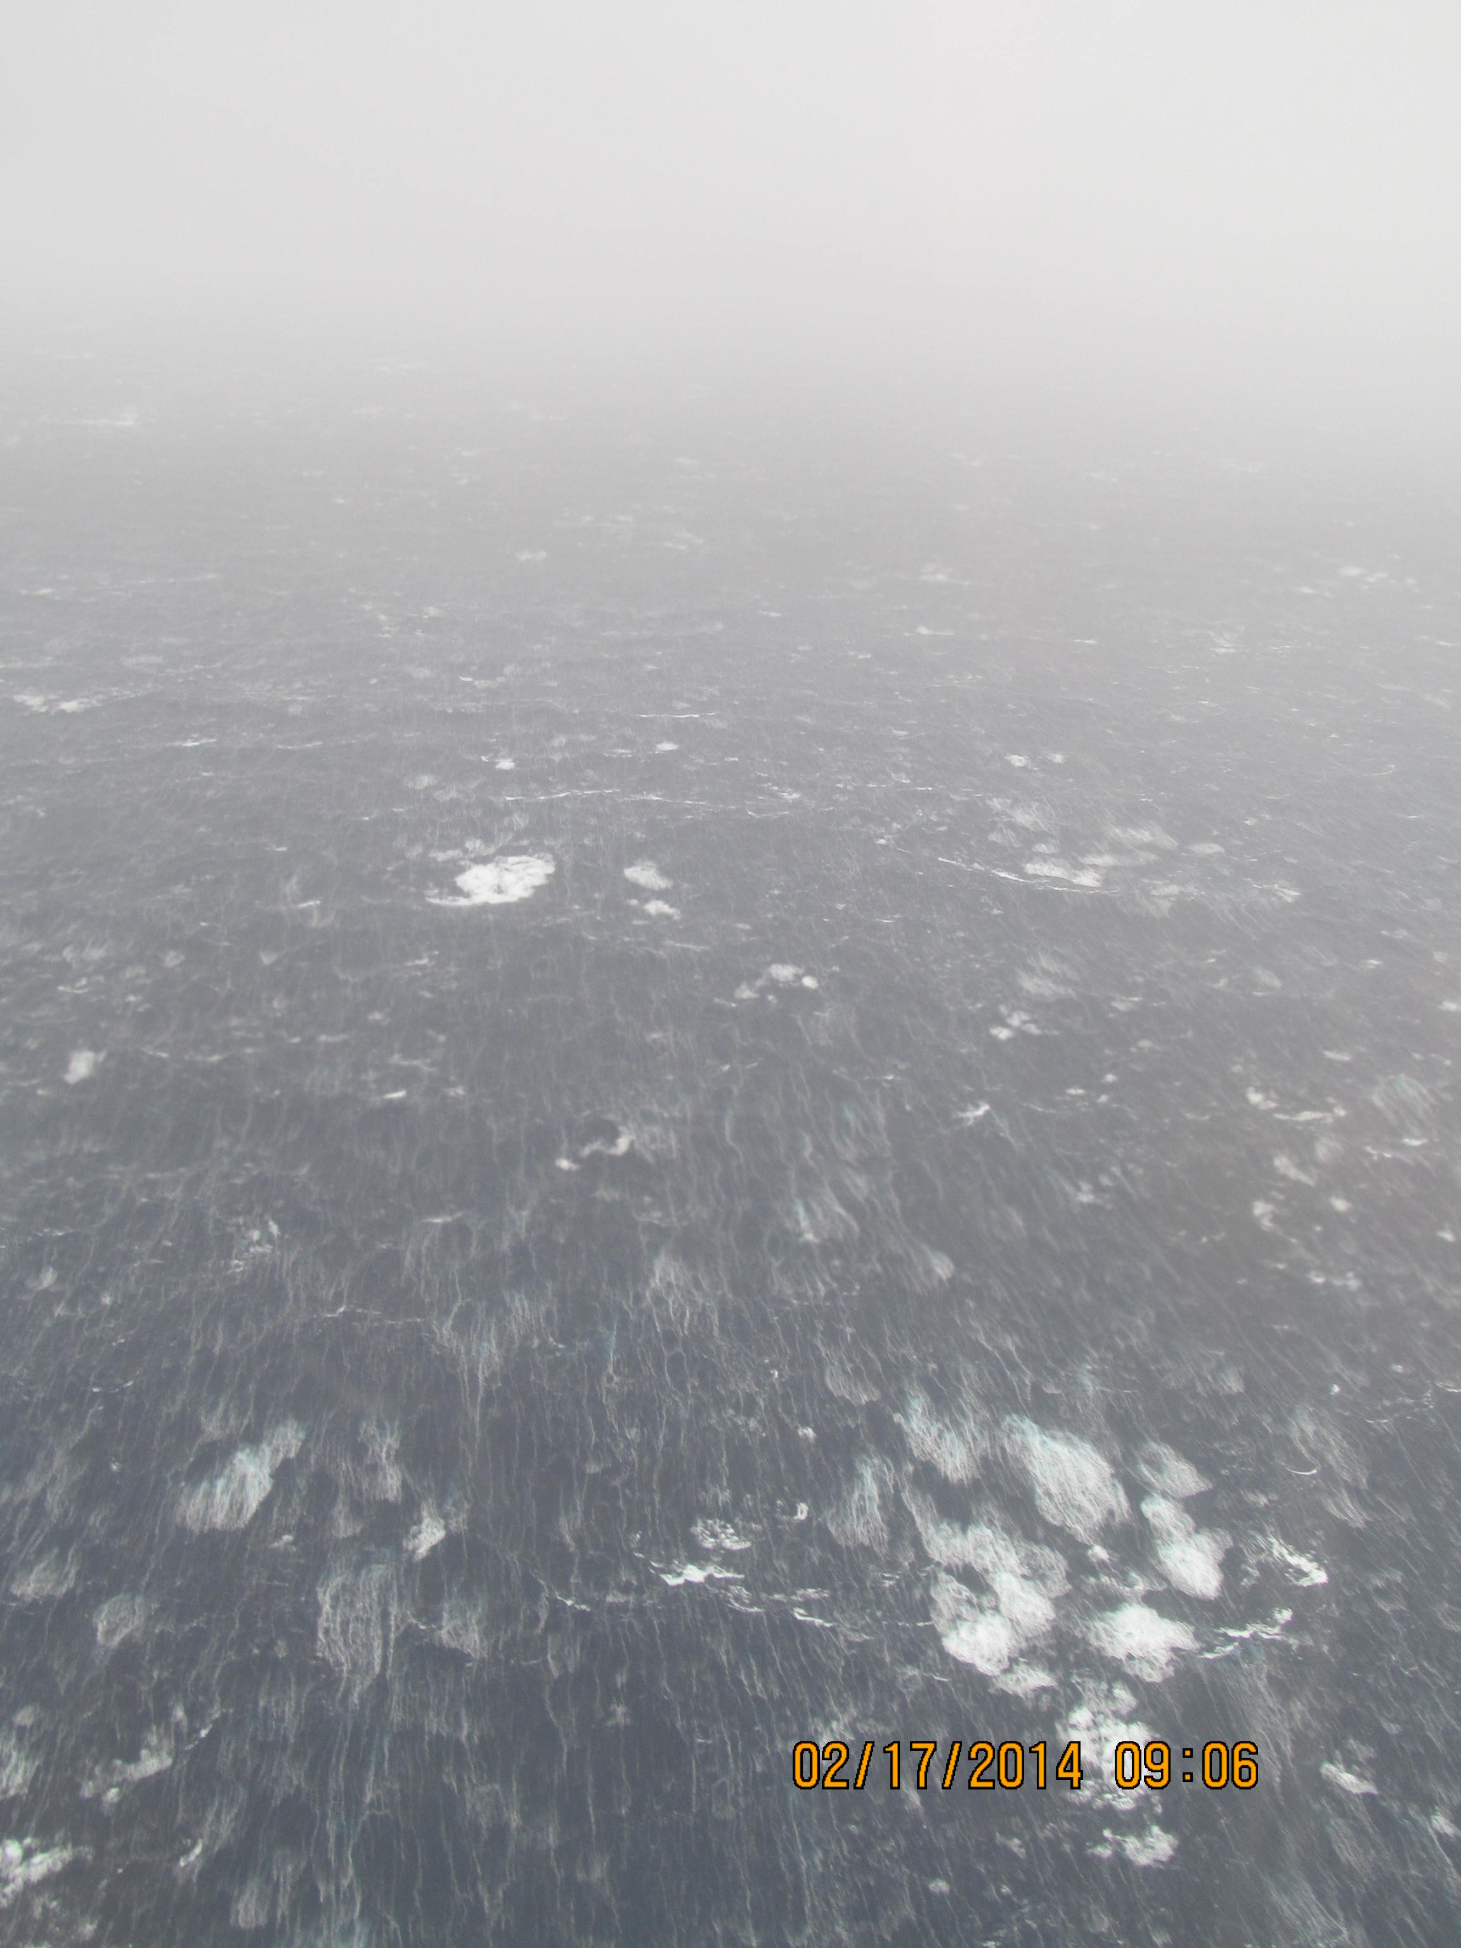



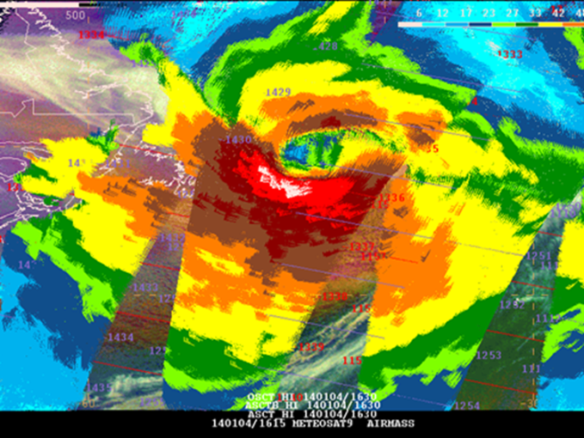
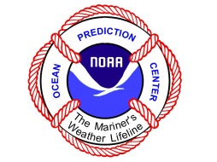
Ocean Prediction Center
Core Mission: Protection of Life and Property at Sea
Partially fulfills U.S. responsibility to Safety of Life At Sea Convention (SOLAS)
Four Mission Areas:
Marine Weather (focus on winds/waves to 5 days)
  Warning Bulletins (~20K warnings/year)
  Graphical & Gridded Products (>150 products/day)
Operational Oceanography
  SST, Currents, Salinity
Coastal Guidance
  Storm Surge (ETSS, ESTOFS)
Enabling Ecological Prediction
  HAB, pathogens, hypoxia, habitat
75
K
N
O
T
S
An extreme ocean storm, 4 January 2014
Hurricane Force winds (red 64-75 kt, white >75 kt) as retrieved from the European ASCAT-A and B scatterometers on the MetOp satellites.
Serving the Marine Transportation and Operations Sectors
Notes:
Along with NHC, Honolulu Forecast Office, and the three WFOs in Alaska, the OPC fulfills the U.S. responsibility to the International Safety At Life At Sea Convention (SOLAS). The first SOLAS was convened to improve safety after the sinking of the Titanic. Marine weather is the core focus being a 24 hour operation, 7 days a week. The OPC works within NWS and other NOAA offices and International partners to access and utilize data sets that enhance situational awareness over the oceans. Scatterometer derived ocean vector winds from satellites are a prime example… the image on the right is from the ASCAT-A and B scatterometers on the European Metop-A and B satellites over an extreme extratropical cyclone over the North Atlantic in early January 2014. The wind field is massive (winds are color coded per the scale on the left and yellow or greater requires a warning) In comparing the storm with the land mass of Newfoundland gives an idea as to how massive this cyclone was. The most severe conditions were avoided by shipping due to accurate forecasts days in advance of this storm.
As part of the marine weather focus the OPC is working with NWS and NOAA partners along with Environment Canada to improve prediction capabilities in the Arctic.
The OPC also has three additional focus areas:
Operational Oceanography – as an ocean focused center the OPC interacts with scientists developing and improving ocean models and analyses and provides feedback concerning performance and utility. The OPC web site hosts a variety of oceanographic as well as meteorological products.
Coastal Guidance - forecast area for the OPC covers an immense area – OPC forecasters are used to dealing with ocean storms and have a global perspective. The OPC through NWS chat and Marine Information Messages provides information to coastal WFOs concerning the possible threats and warnings for upcoming coastal weather events. During Sandy, OPC staff worked directly with NHC Storm Surge Unit and coastal WFOs to highlight the potential threats.
Enabling ecological prediction – NWS has a culture of timely service and operations – OPC is working with NOAA partners to bring ecological parameters into NOAA operations. Examples of this are sea nettle prediction for Chesapeake Bay, pathogen prediction for Chesapeake Bay, Delaware Bay, and Tampa Bay. The OPC is also working with NOS Harmful Algal Bloom staff to explore utilization of AWIPS II for use in future HAB prediction.

Slide 2
Ocean Prediction Center
Marine Warning Responsibility
Global Maritime Distress and Safety System
Metarea XII and IV (High Seas)
Offshore Zones to 250 nm
GMDSS NAVTEX

Slide 3
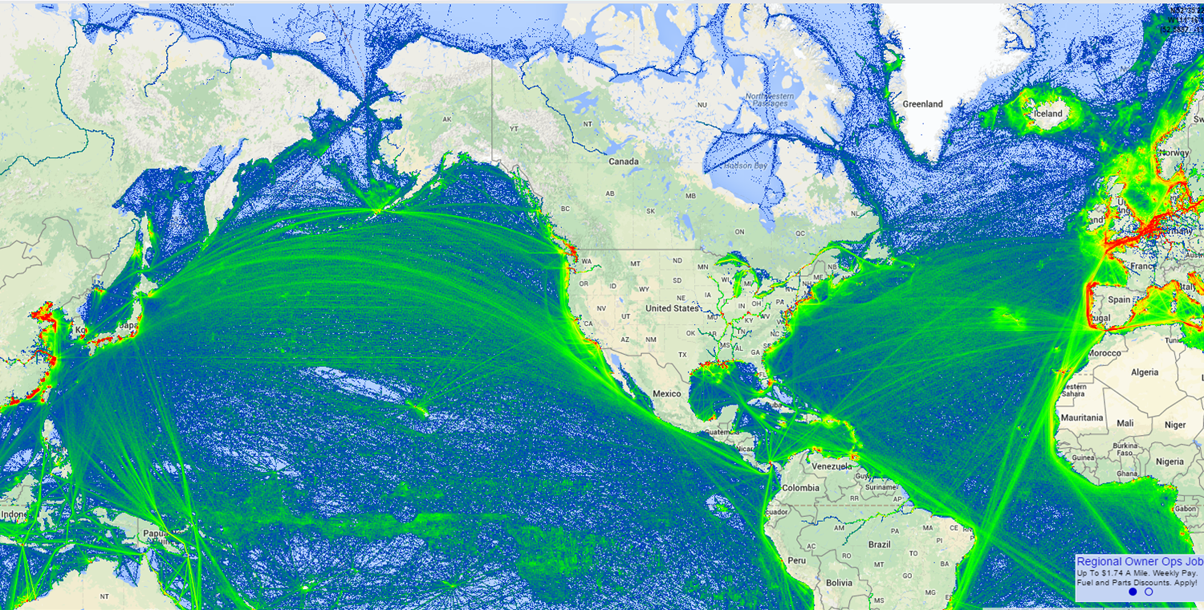
Vessel Tracks
High Seas Warning Areas

Slide 4

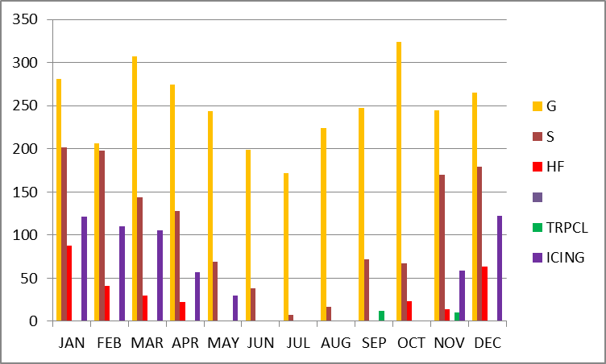
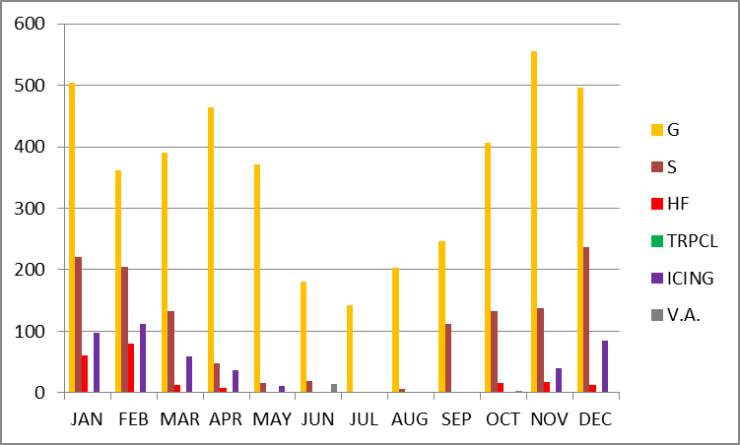
High Seas – Warnings 2013
Atlantic
Warnings
Pac Atl
4325 GALE 2988
1262 STORM 1291
207 HF 281
0 Tropical 23
440 Icing 604
17 Vol. Ash 0
Pacific
11,438 Warnings

Slide 5
High Seas – Warnings 2013
Atlantic
Warnings
Pac Atl
4325 GALE 2988
1262 STORM 1291
207 HF 281
0 Tropical 23
440 Icing 604
17 Vol. Ash 0
Pacific
GALE - most common
Warning
How many think 35 knots
is hazardous?

Slide 6
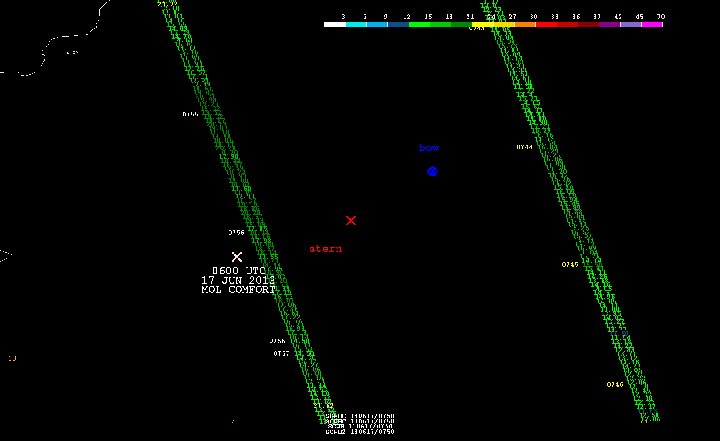
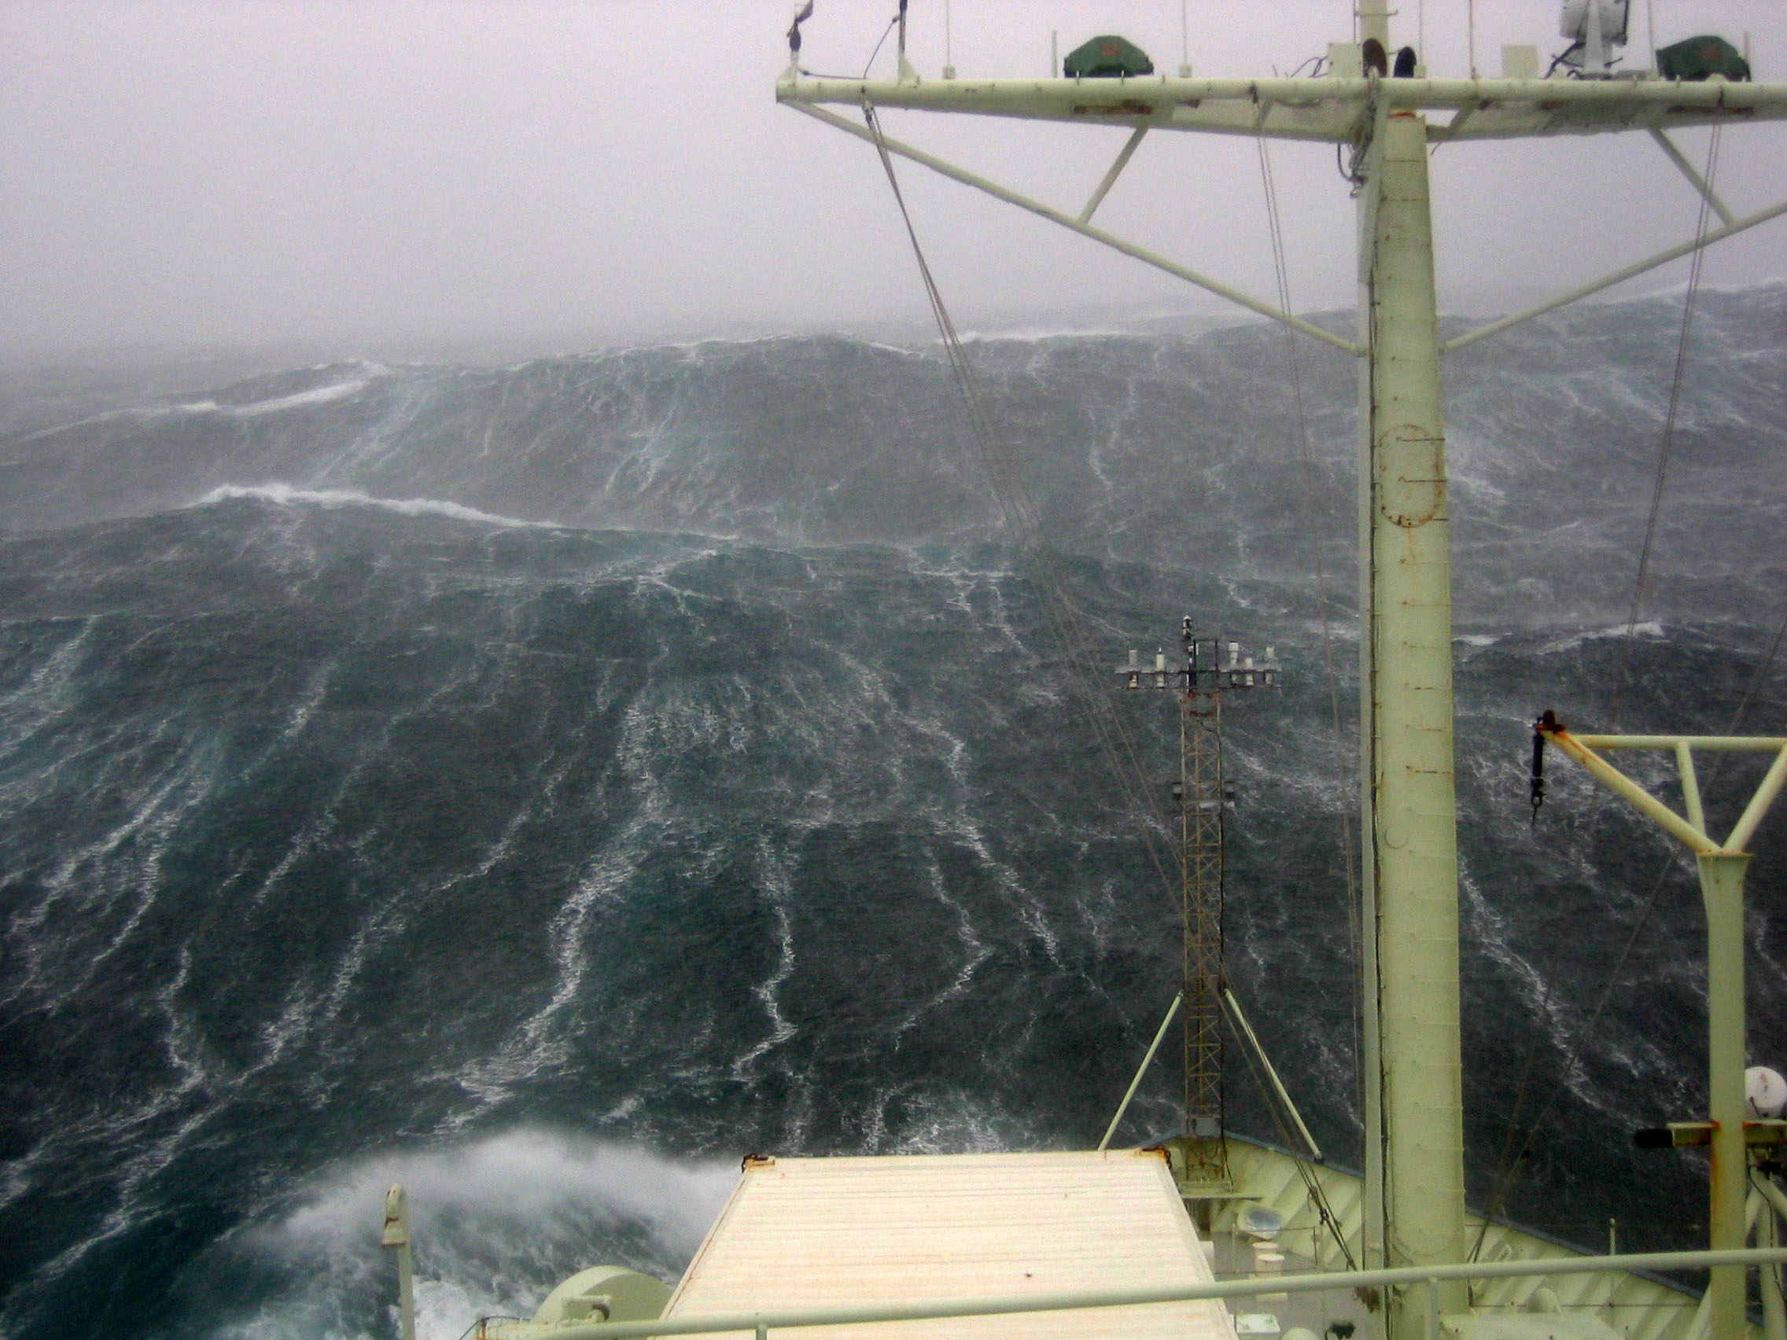
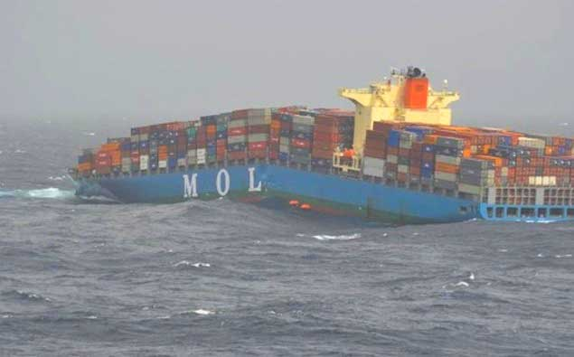
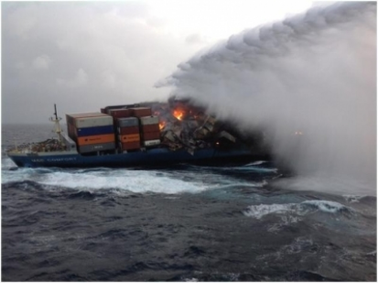
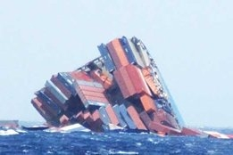
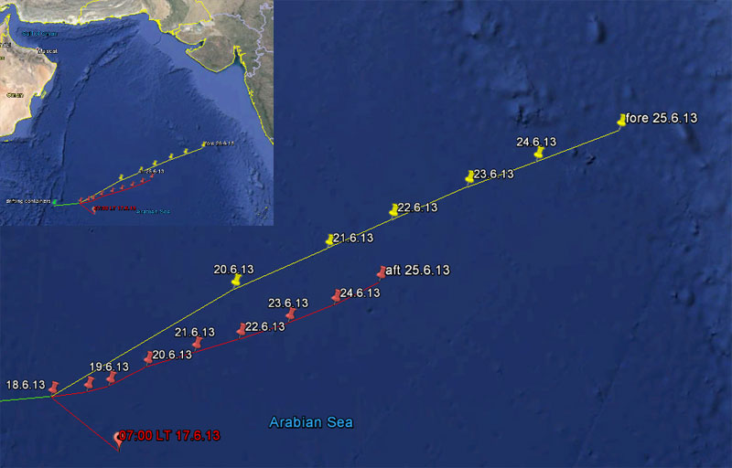
17 Jun 2013 - Arabian Sea
Southwest Asian Monsoon
17 – 20 ft SWH
Winds 35 kt
GALE Conditions

Slide 7
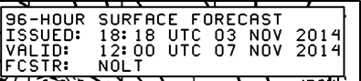
Forecast for ET Nuri
Analysis 1200 UTC 7 Nov 96 Hour Forecast from 3 Nov

Slide 8
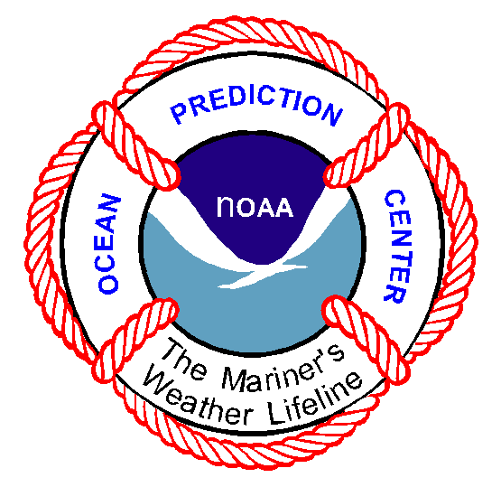
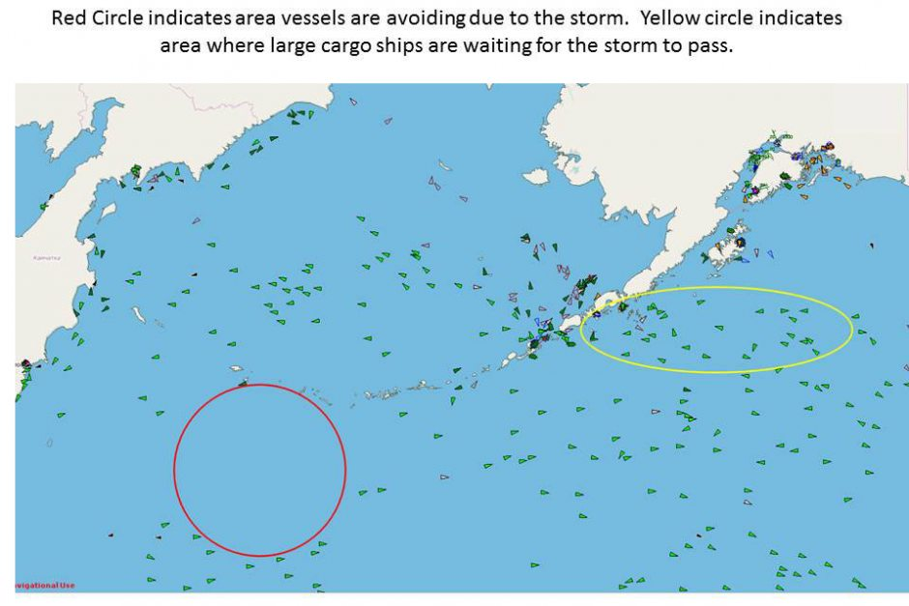
Impact of forecasts

Slide 9
GFE experience
OFF Zones reconfigured (April 1, 2014)
Tropicals are a challenge (TCM wind tool)
Future steps to larger grids (full basin)
  Need full gridded backup for true “Operational”
  Generate graphical and gridded products
  High Seas text generation (with TAFB, NHC, HFO, GSD)
Additional parameters
  SLP
  Probabilistic
Large scale collaboration
Near Shore Wave Prediction System
On hold

Slide 10
OPC Activities
AWIPS II
Operational for AWIPS I functionality
  GFE for OFFSHORE production
  Text product generation
National Centers Perspective (NCP)
  Focus for FY2015
  Prepare for FOTE (Mar 2016)
  Training technical and forecast staffs
  Adapt for NAWIPS capabilities
    Product focused project for winds / waves (w/TAFB, HFO)
    Launch scripts adapted to a unified base
Developmental Environment Transition
  Repurposed AWIPS-I (still getting there with NCO)
  Like OPCN it is a shared system with WPC and CPC

Slide 11
AOP Items
Migration to AWIPS II – 500 mb and wind wave
Improved Alaskan Arctic Ice Prediction (AR)
Demonstrate new datasets in AWIPS II for environmental prediction (NCO/OPC)
ECDIS Weather Feature Catalog
Antarctic forecasts for NMFS research
GFE backup with TAFB
OPC and HFO plan for gridded backup
Prototype offshore warning shape files

Slide 12
OPC Activities
Ocean Winds
OceanSat-2 signal generator died and secondary failed
ASCAT_HI Coastal (KNMI) / High Wind Product (NESDIS) for ASCAT-A and B
http://manati.star.nesdis.noaa.gov/datasets/ASCATData.php
AMSR2 (GCOM-W1) wind speeds, rain rate, QC flag, and SST available in gridded form in NAWIPS
NASA RapidScat data available Nov 20 in NRT from ISS
Indian Space Research Organization (ISRO) to launch ScatSat June 2015 (similar to QuikSCAT) (0630 local orbit)

Slide 13
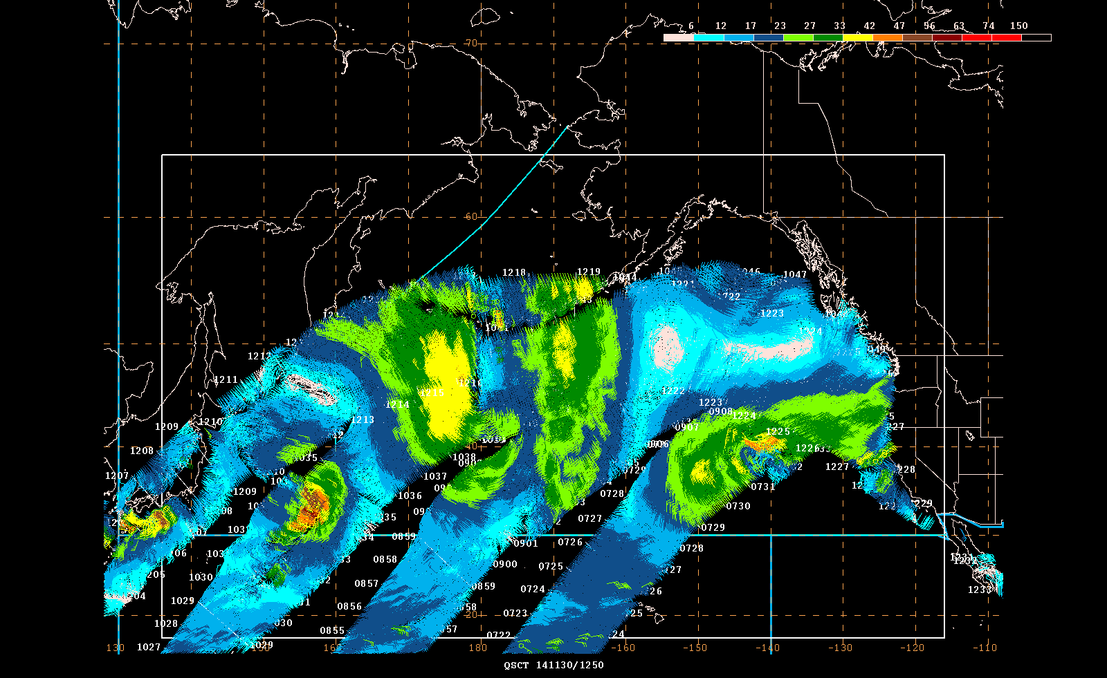
NASA RapidScat on ISS
Available to OPC and NHC 11/19/14

Slide 14
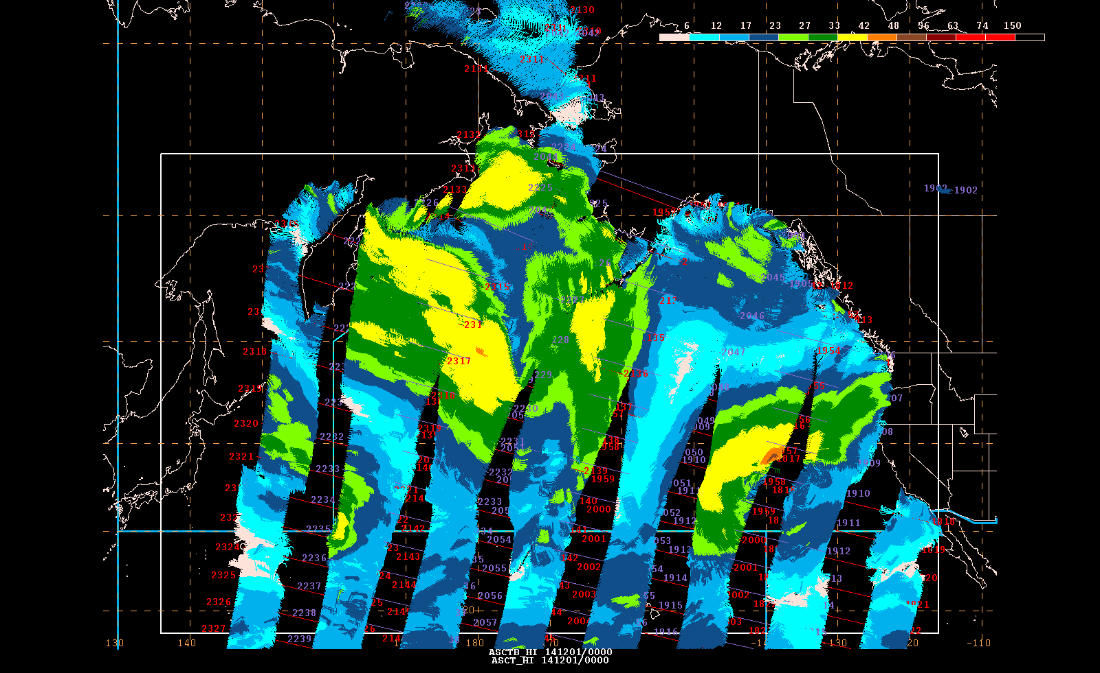
ASCAT-A and B on Metop

Slide 15
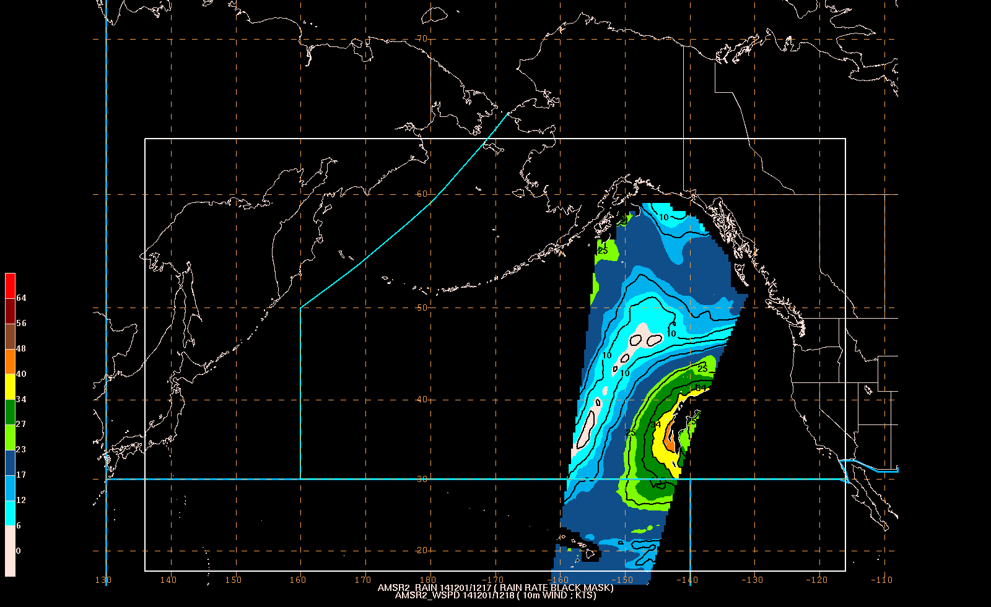
AMSR2 on GCOM-W1
Available in NAWPIS 7/17/14

Slide 16
Wind Gusts

Slide 17
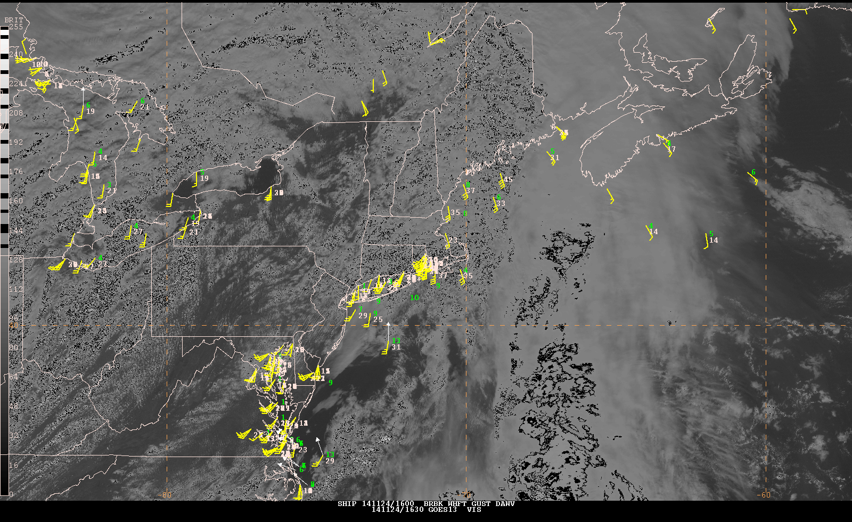
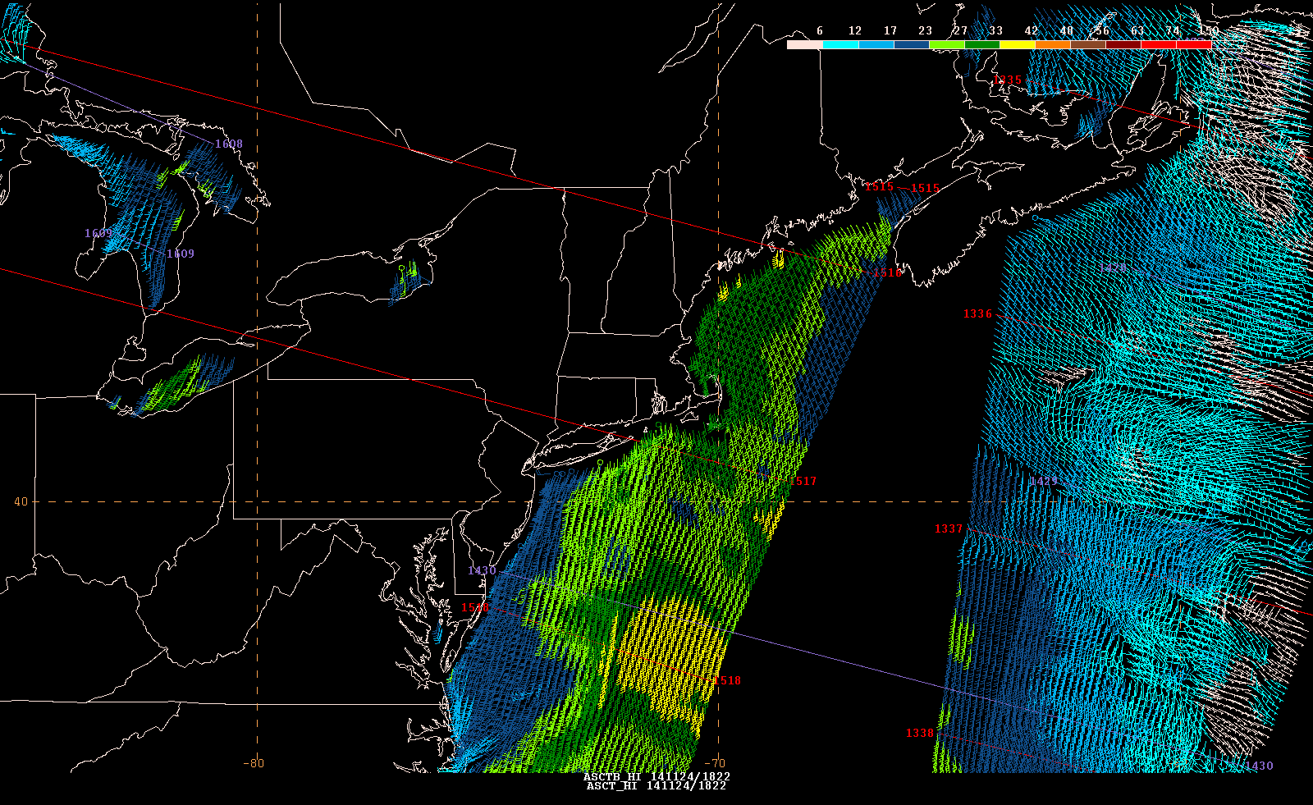
The Challenge of Southerly Flow
37
45
35
33
Wind Gusts
37
35
1600 UTC 24 Nov 2014
31
29
29
ASCAT A & B
1517 UTC 24 Nov 2014

Slide 18
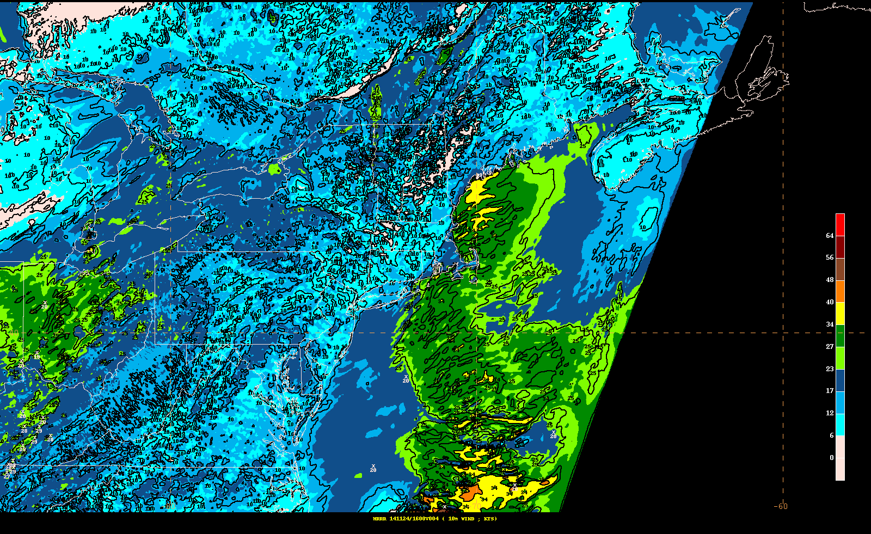
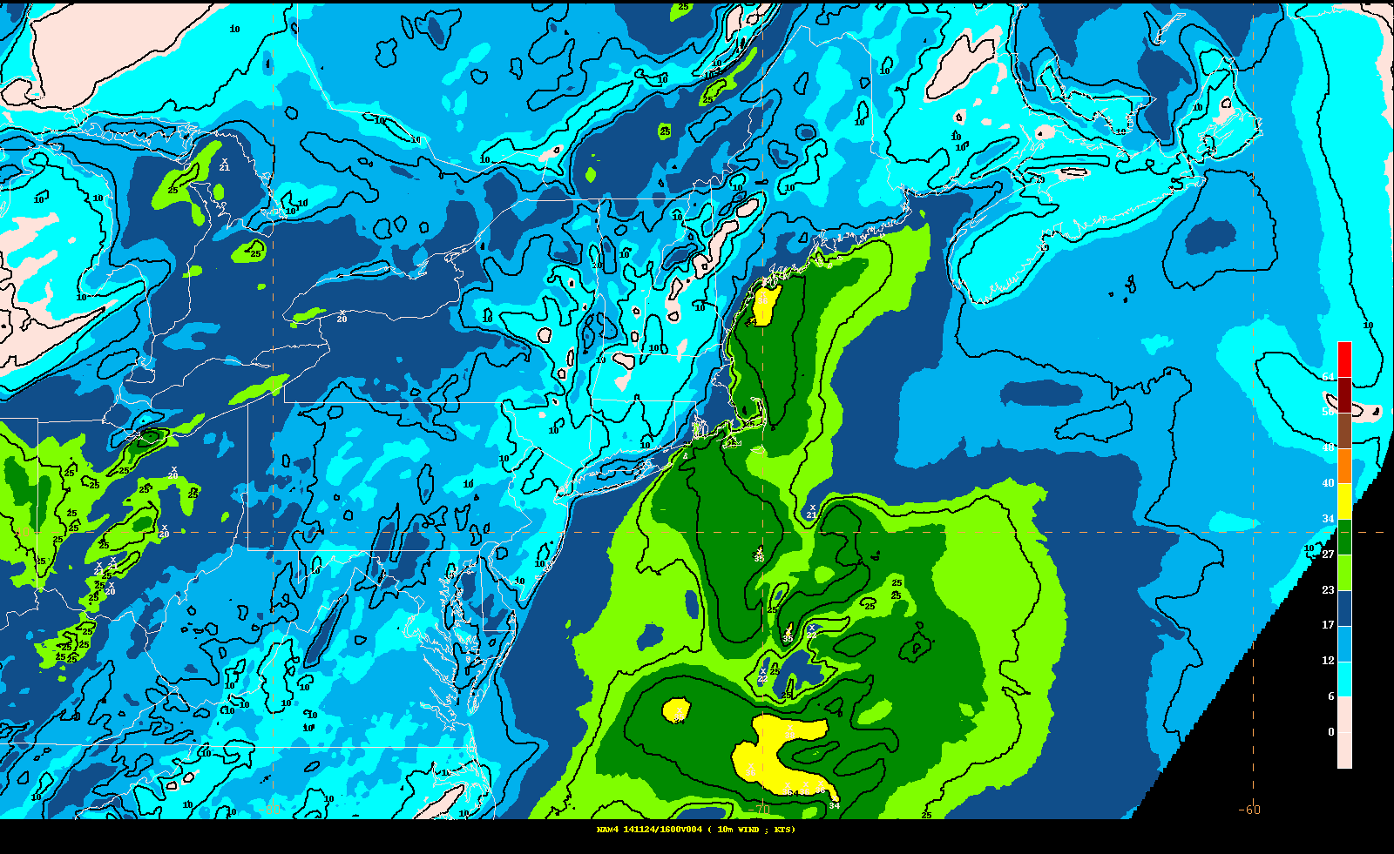
The Challenge
of Southerly Flow
1600 UTC 24 Nov 2014
HRRR 10m Wind Speed
201411241200f004
1600 UTC 24 Nov 2014
NAM4-nest 10m Wind Speed
201411241200f004

Slide 19
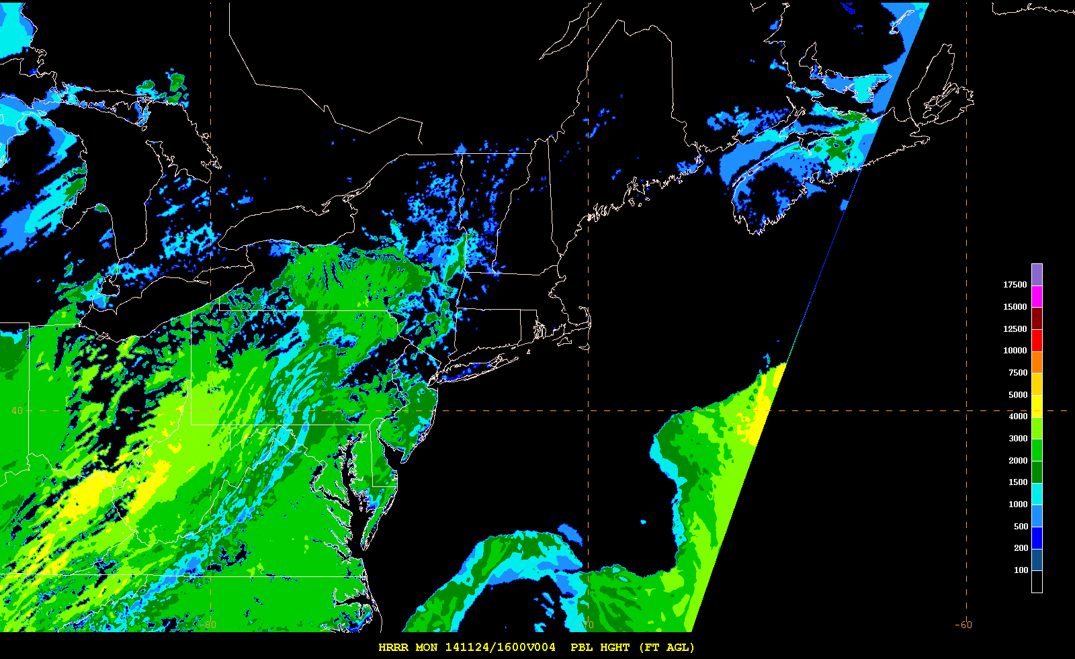
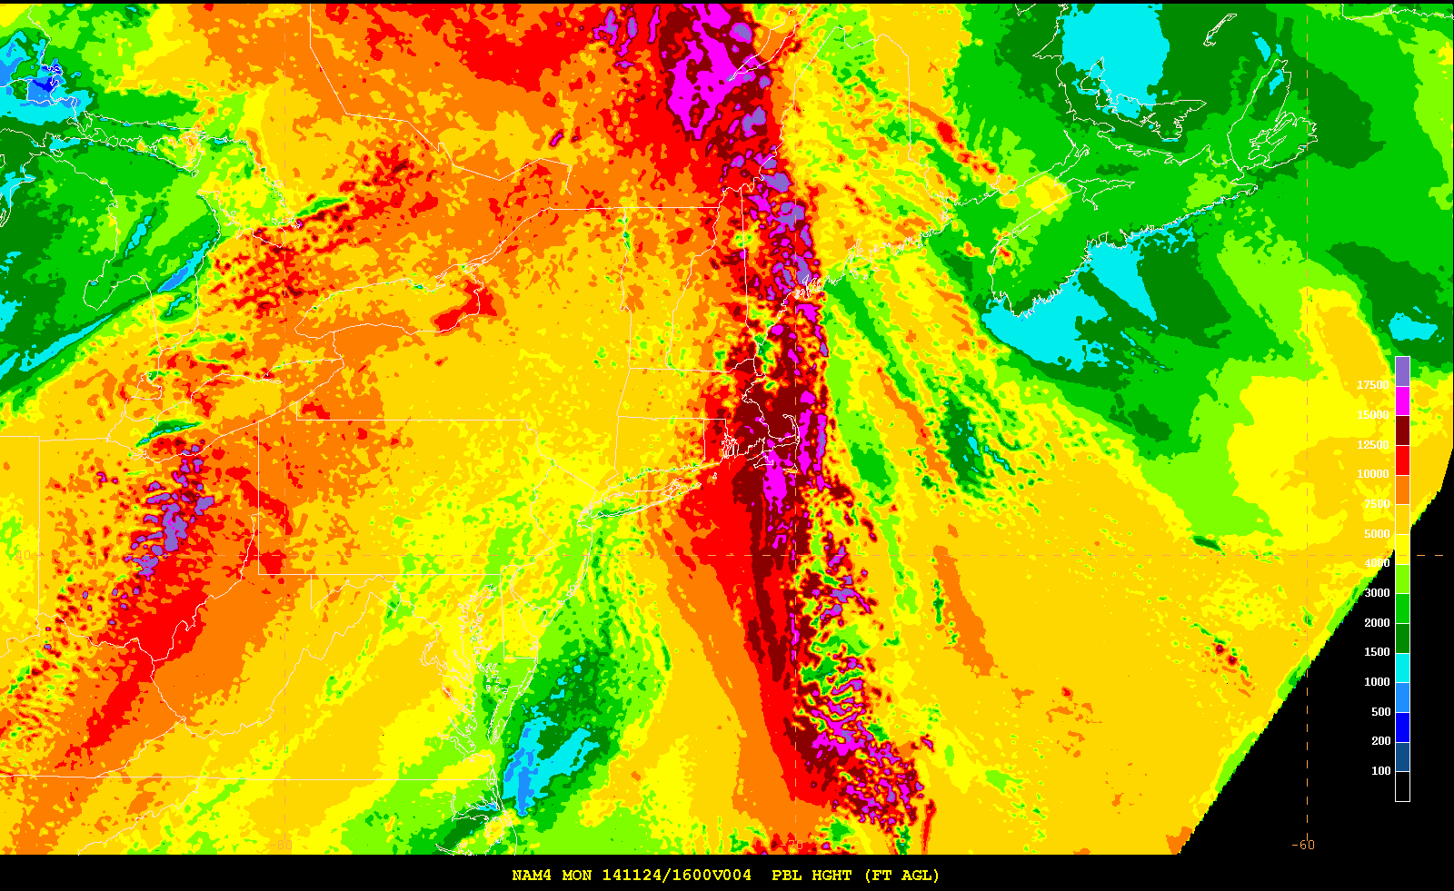
The Challenge
of Southerly Flow
1600 UTC 24 Nov 2014
HRRR 10m PBL Height (ft)
201411241200f004
1600 UTC 24 Nov 2014
NAM4-nest PBL Height (ft)
201411241200f004

Slide 20
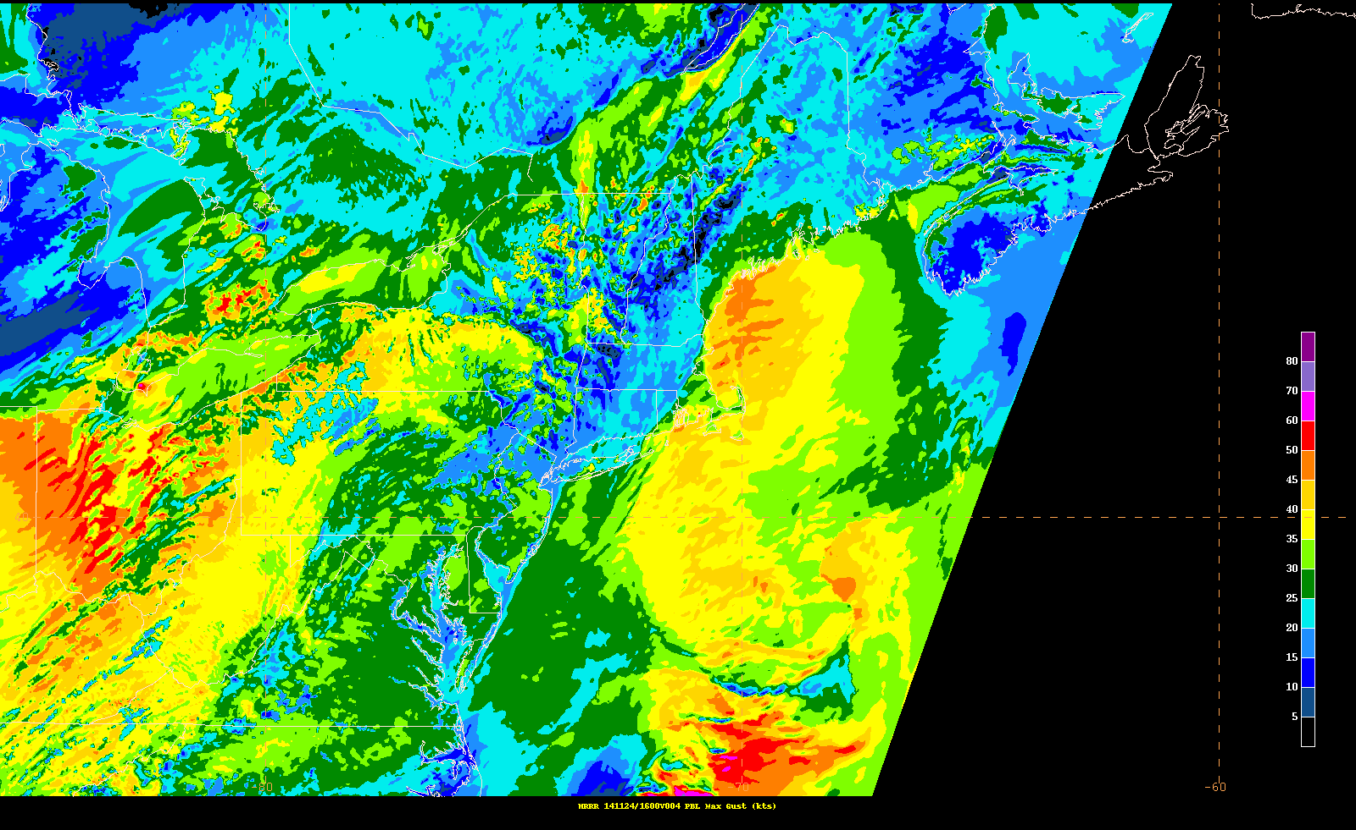
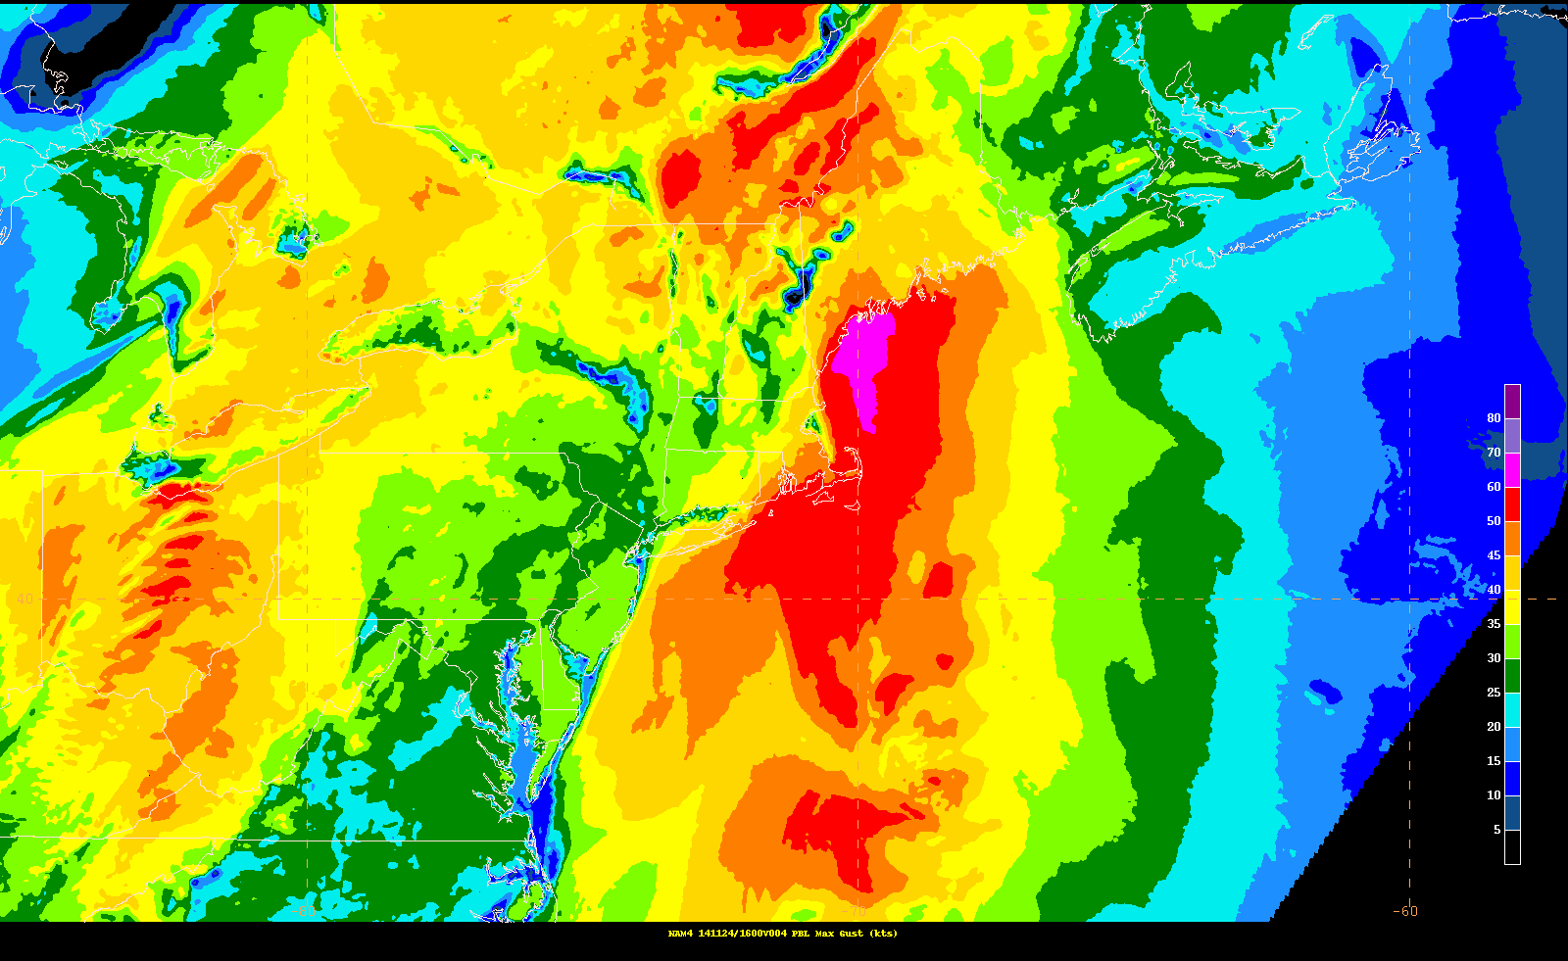
The Challenge
of Southerly Flow
1600 UTC 24 Nov 2014
HRRR 10m Max Gust (kt)
201411241200f004
1600 UTC 24 Nov 2014
NAM4-nest Max Gust (kt)
201411241200f004

Slide 21
Winds and Waves

Slide 22
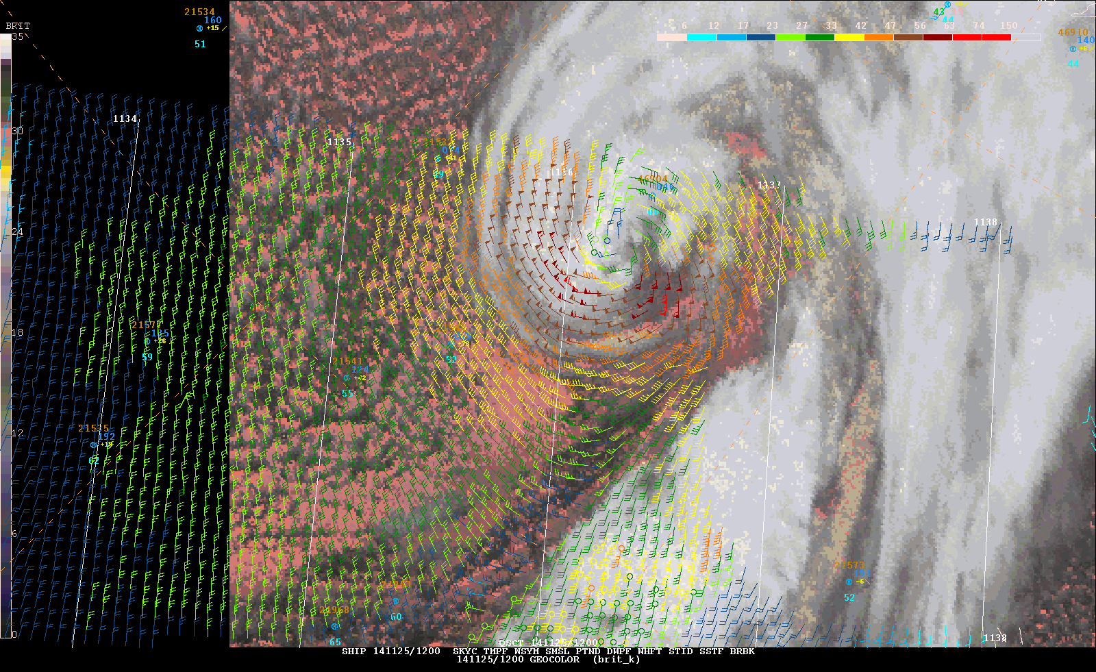
A “Pesky” NPAC Storm - 1200 UTC 25 Nov

Slide 23
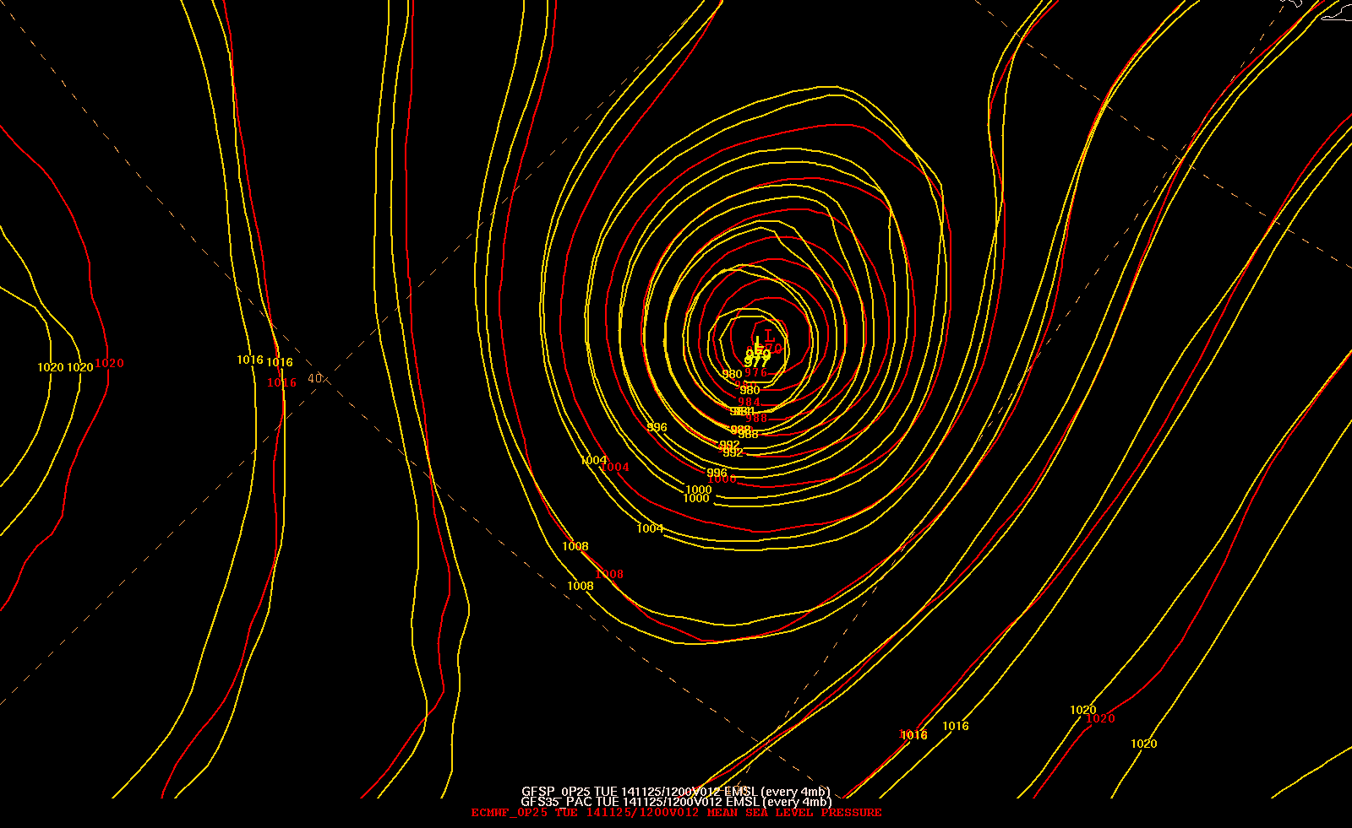
12 hr Forecasts
ECMWF ¼ deg – 970
GFS - 979
GFSp ¼ deg - 977

Slide 24
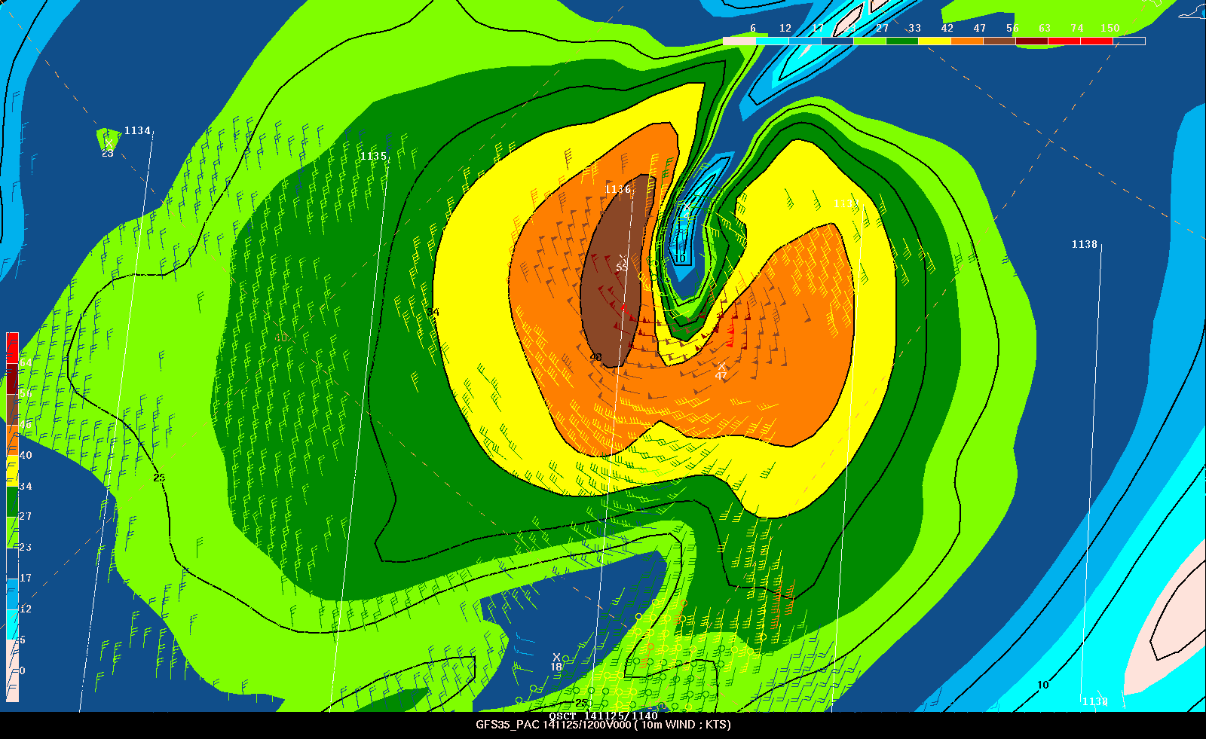
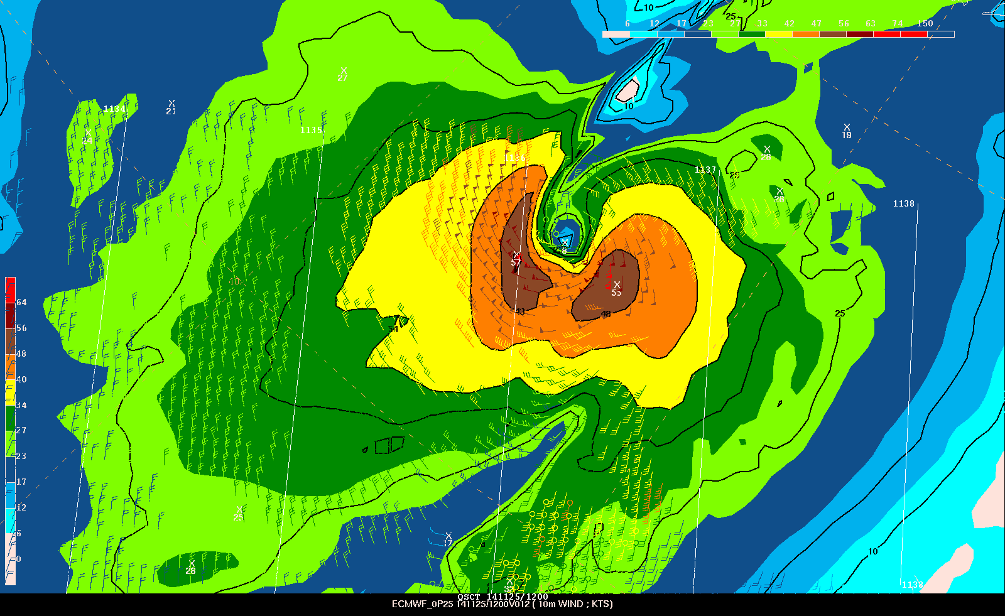
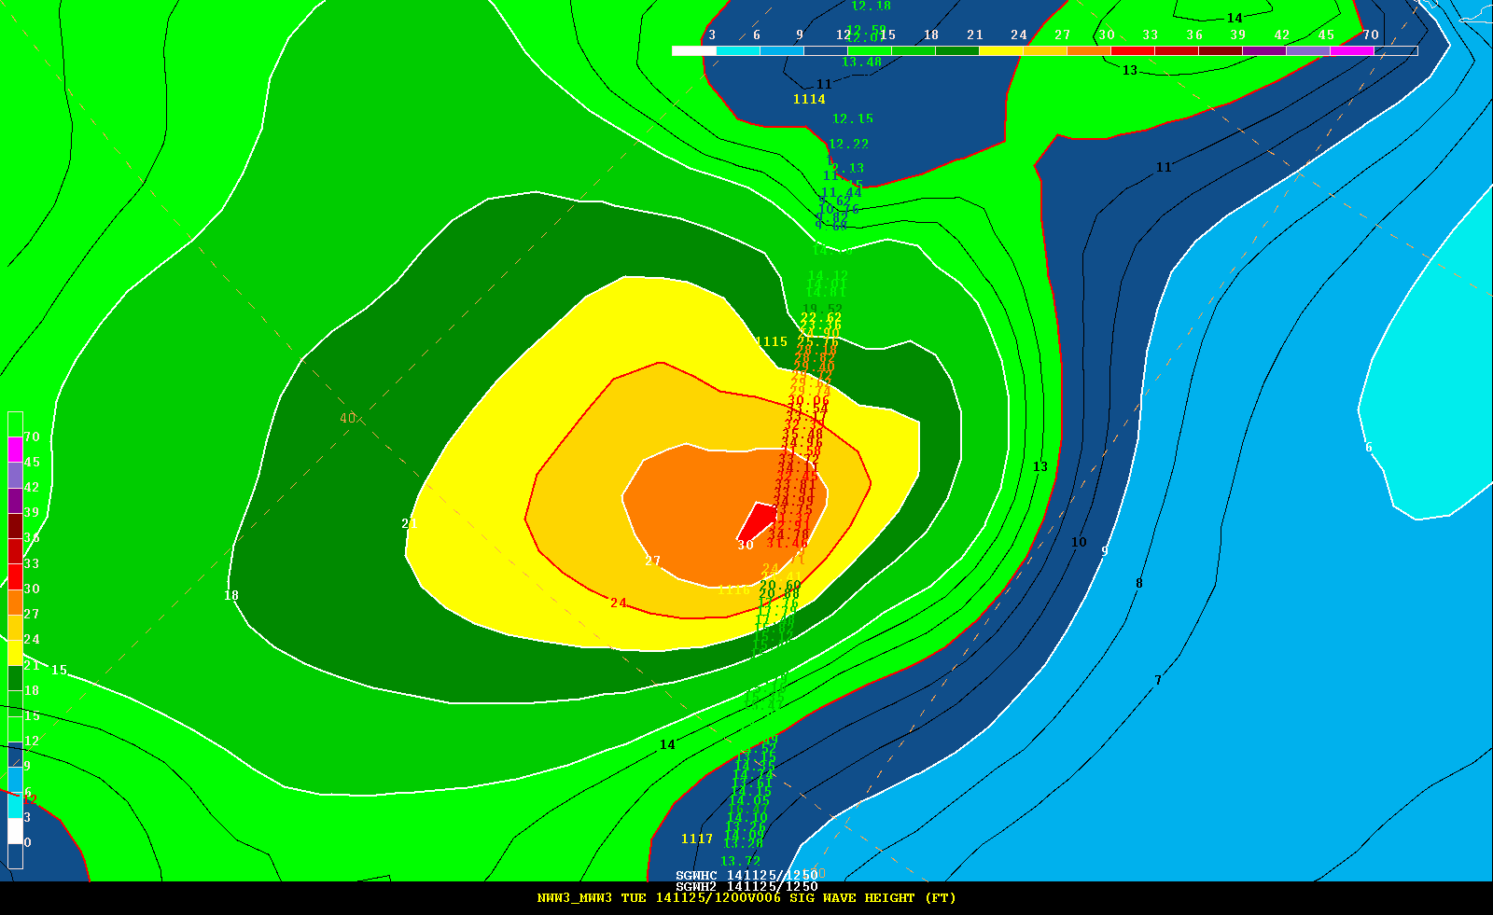
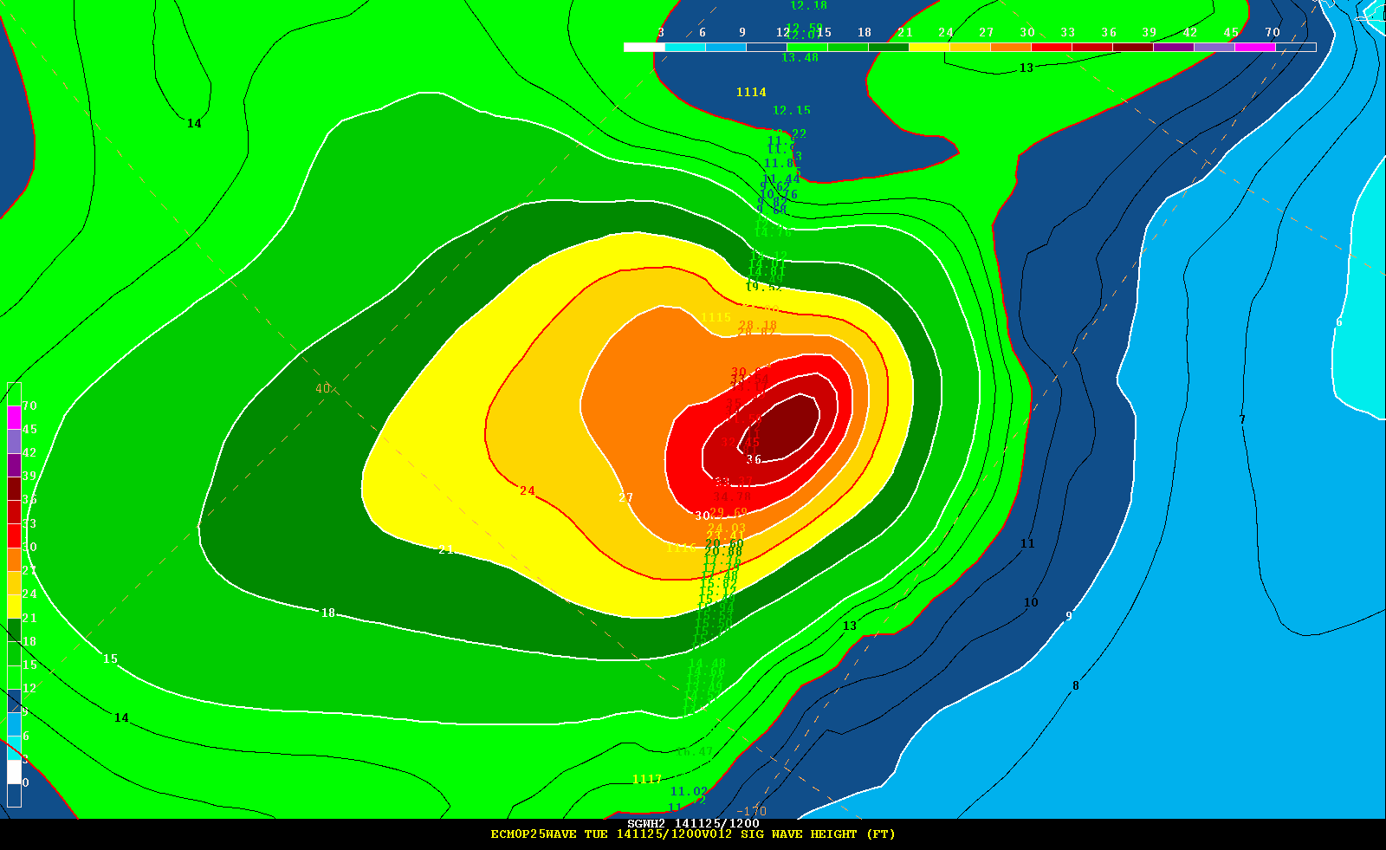
GFS ECMWF
10 WSPD 10 WSPD
MWW3 ECMWF – WAM
Hs (ft) Hs (ft)
31 ft
35 ft
35 ft
38 ft

Slide 25
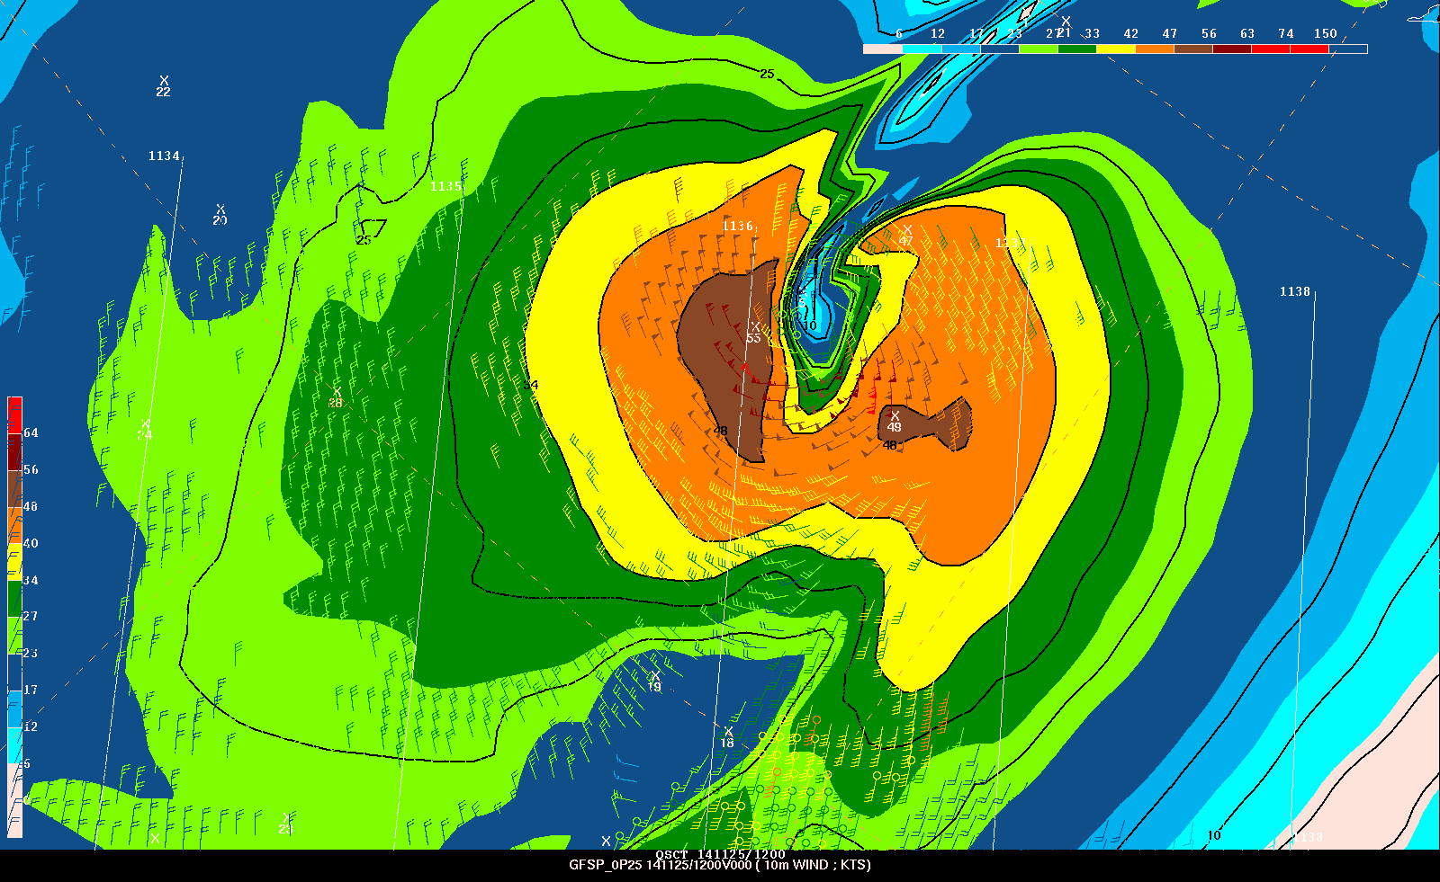
GFSp ECMWF
10 WSPD 10 WSPD
MWW3 ECMWF – WAM
Hs (ft) Hs (ft)
GFS ECMWF
10 WSPD 10 WSPD
MWW3 ECMWF – WAM
Hs (ft) Hs (ft)
31 ft
35 ft
35 ft
38 ft

Slide 26
Waves

Slide 27
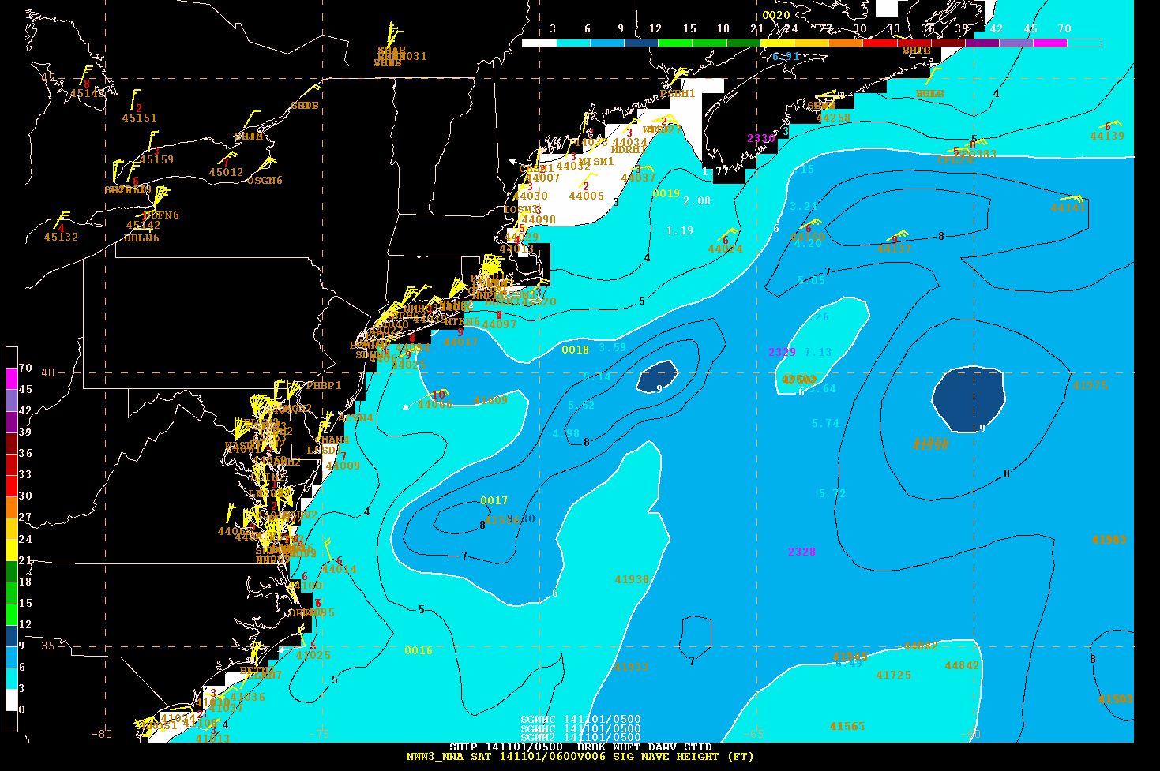
0500 UTC 01 Nov 2014

Slide 28
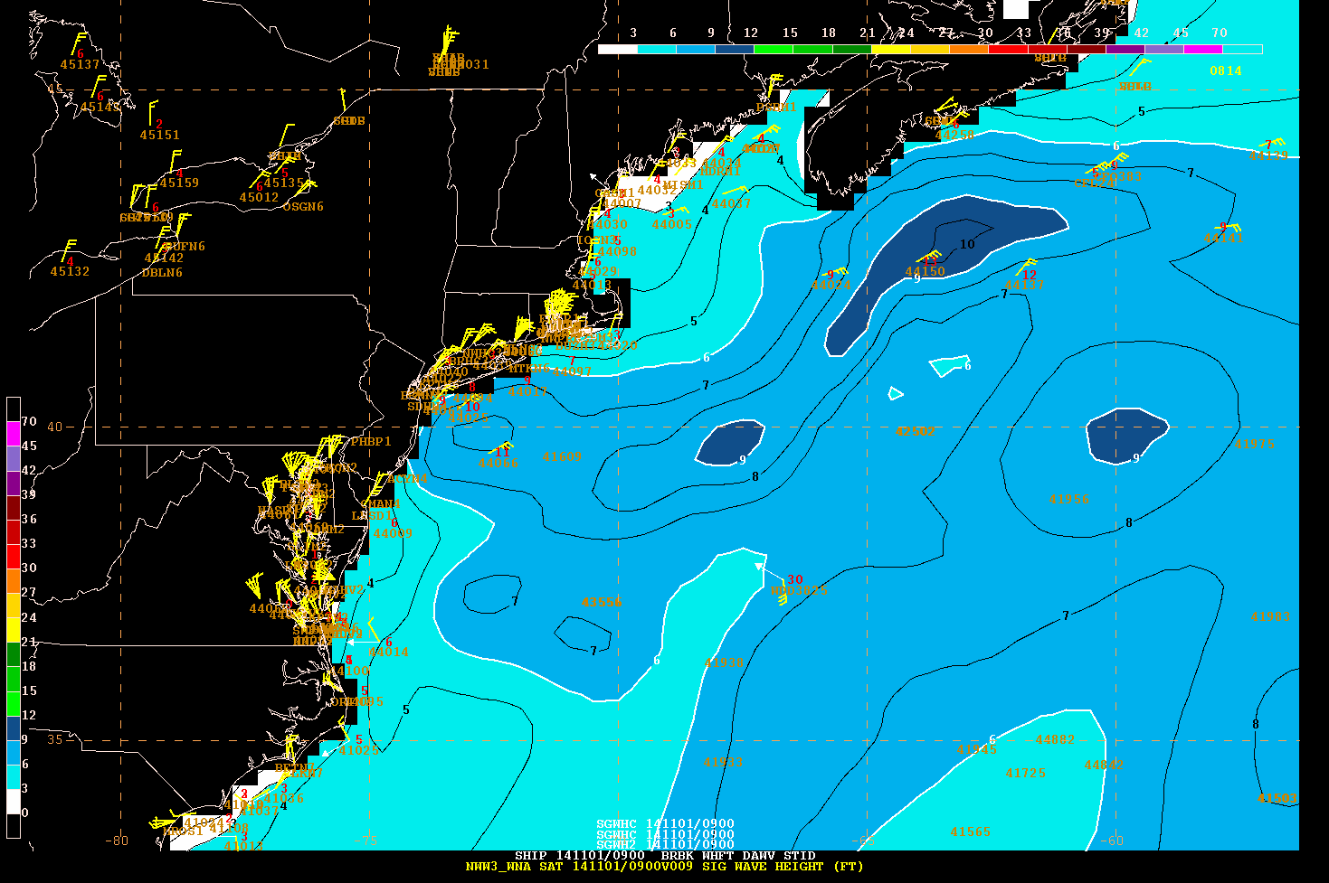
0900 UTC 01 Nov 2014

Slide 29
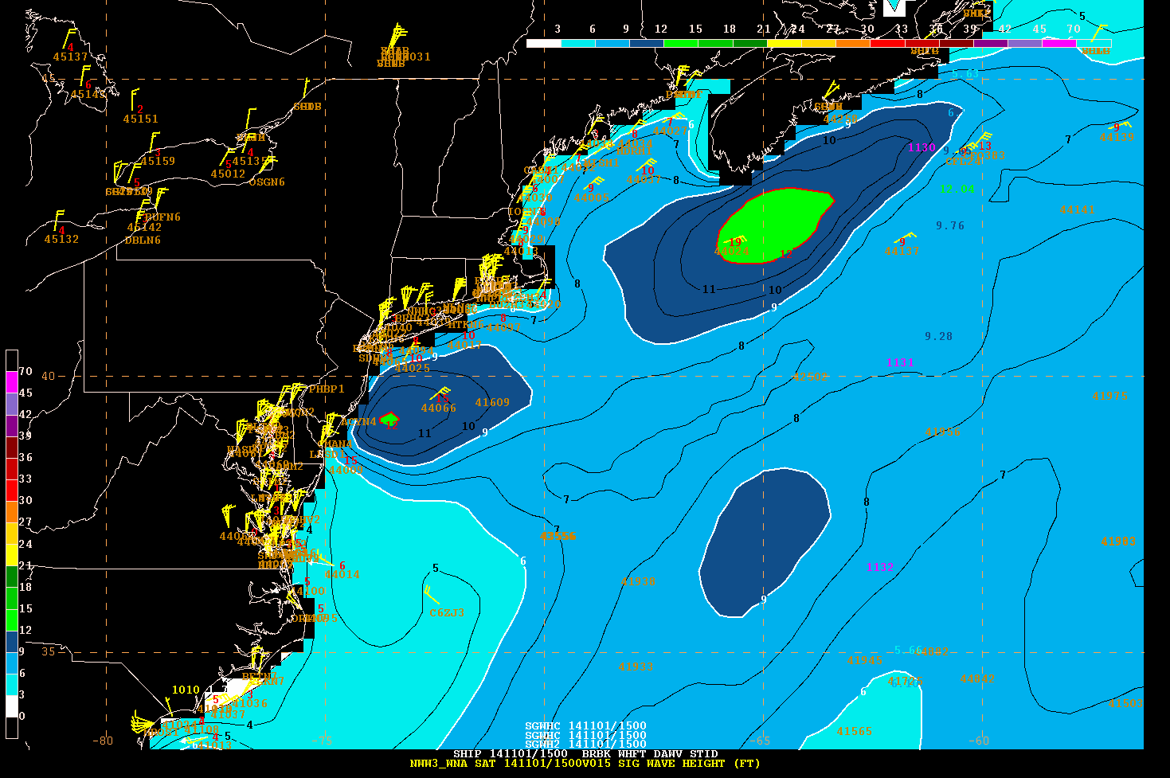
1500 UTC 01 Nov 2014

Slide 30
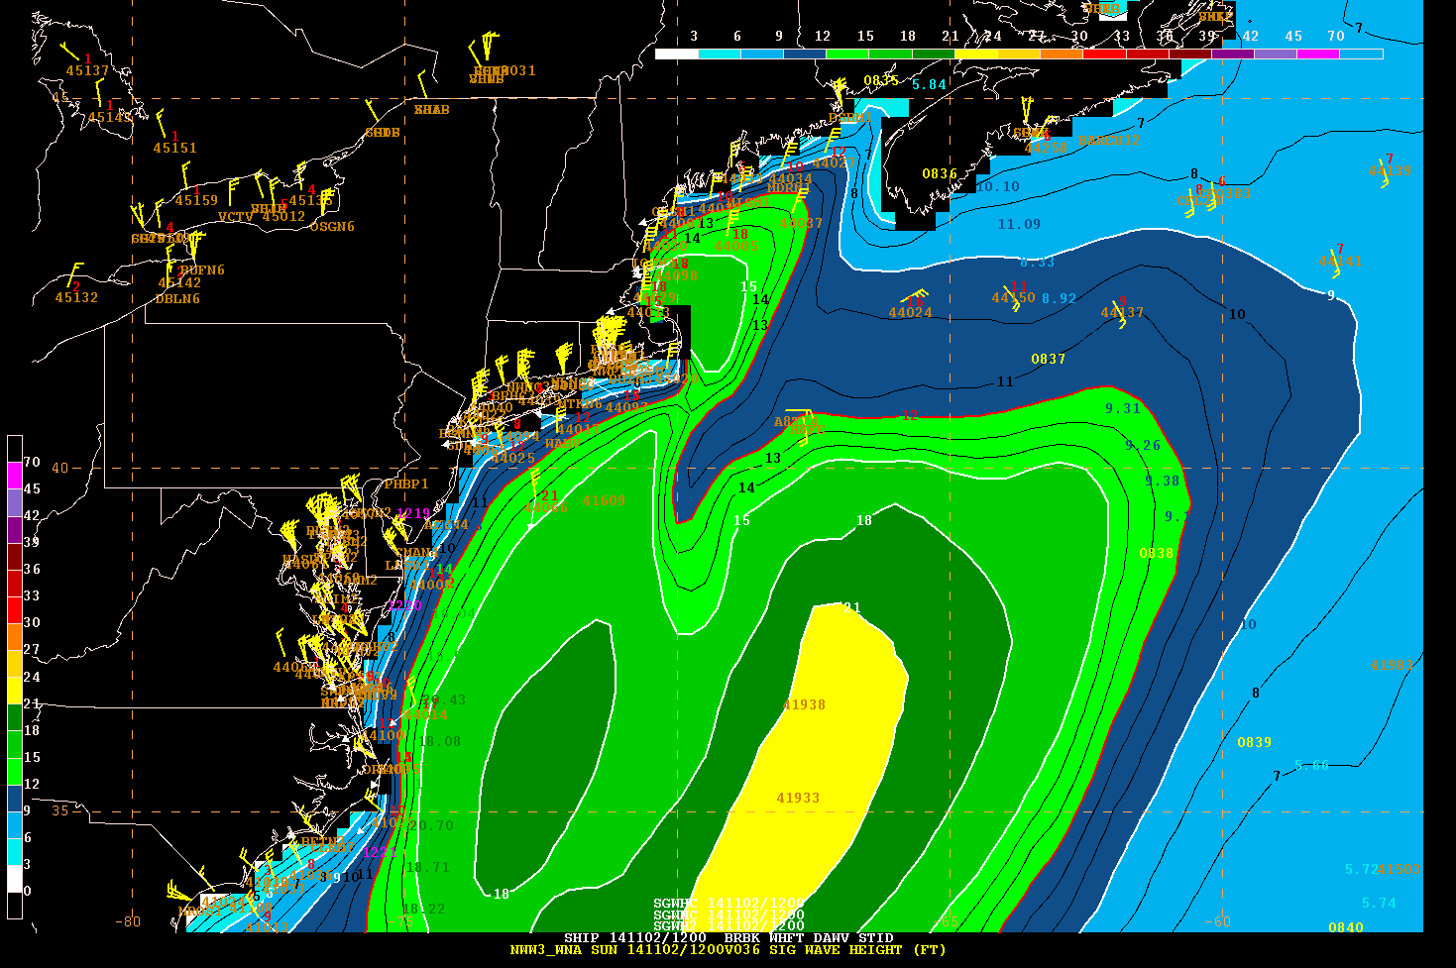
1200 UTC 02 Nov 2014

Slide 31
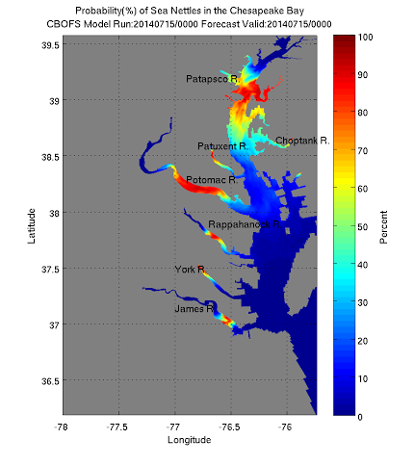
Sea Nettle Prediction
(jellyfish)
A success
Multi-line office contribution
  NWS operationalize
  NOS CBOFS
  NESDIS algorithm
A caution
River outflow turned off
Salinity drifted upward
No data assimilation
Result
Significant over prediction
Web page shut down

Slide 32
OPC
FY16 complete migration to NCP in AWIPS 2
Improvement of Sector Relevant Services
  Wind gusts
  Visibility (potential opportunity with EC (Grand Banks)
  Freezing Spray (Validation needed)
  Wave Heights – Gulf Stream
  Cyclone information in AWIPS 2 and products
    (track, intensity, max wind speed, pressure, phase space)
  Extreme Forecast Index (Hazards)
  Ensemble Probabilities of relevant parameters
    Quantified
Better utilized resource in NWS

Slide 33
