Slide 1
Climate Prediction Center
FY14 Review
Jon Gottschalck
Acting Chief, Operational Prediction Branch
NOAA / NWS / Climate Prediction Center
NCEP Production Suite Review
College Park, MD
December 2-3, 2014

Slide 2
Outline
Major climate modes overview, forecast review
Review of CPC official outlooks
Some new activities during FY14

Slide 3
Climate modes overview and forecast review

Slide 4
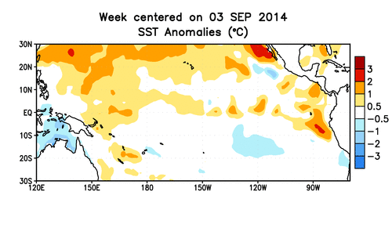
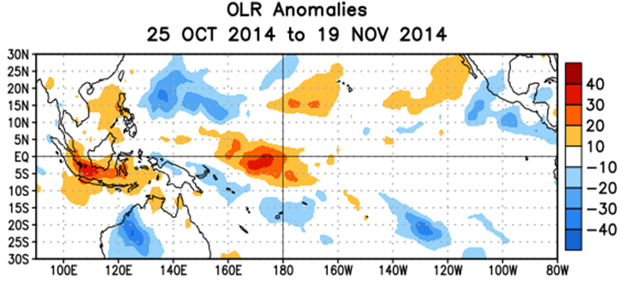
El-Nino - Southern Oscillation
El Nino development has been slow to occur
Positive SSTs have been modest although they have increased in recent weeks (Nino3.4 now near +0.8 C)
Atmospheric response across the Pacific Ocean has been lacking

Slide 5
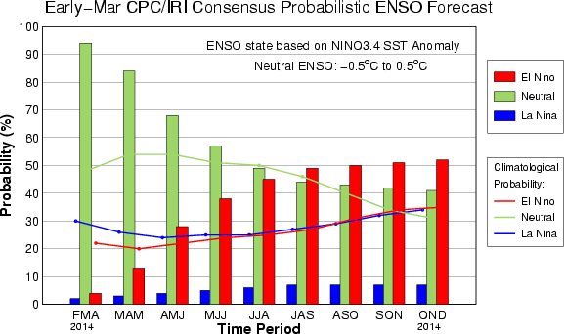
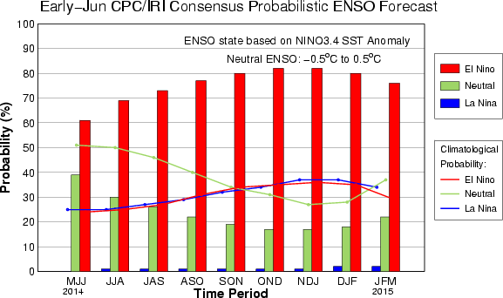
El Nino - Southern Oscillation
El Nino Watch was issued in March 2014
Forecast probabilities for the event peak were largest during summer outlooks
Strong El Nino was never forecast by CPC

Slide 6
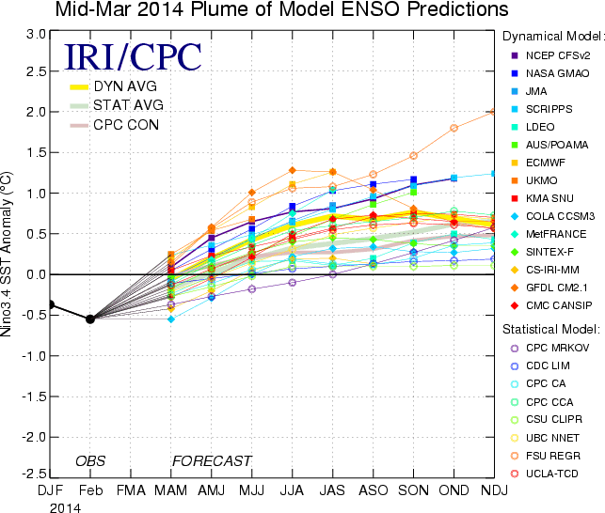
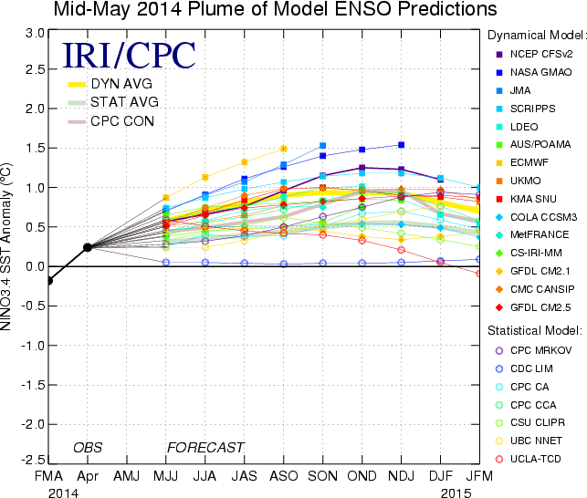
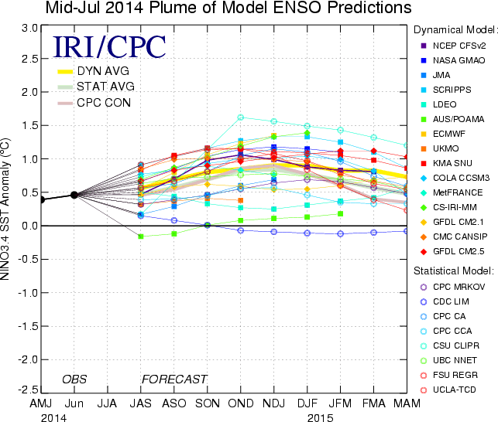
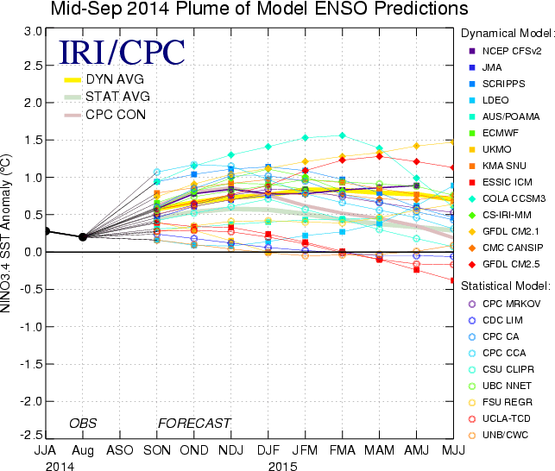
El Nino - Southern Oscillation
Courtesy: Wanqiu Wang

Slide 7
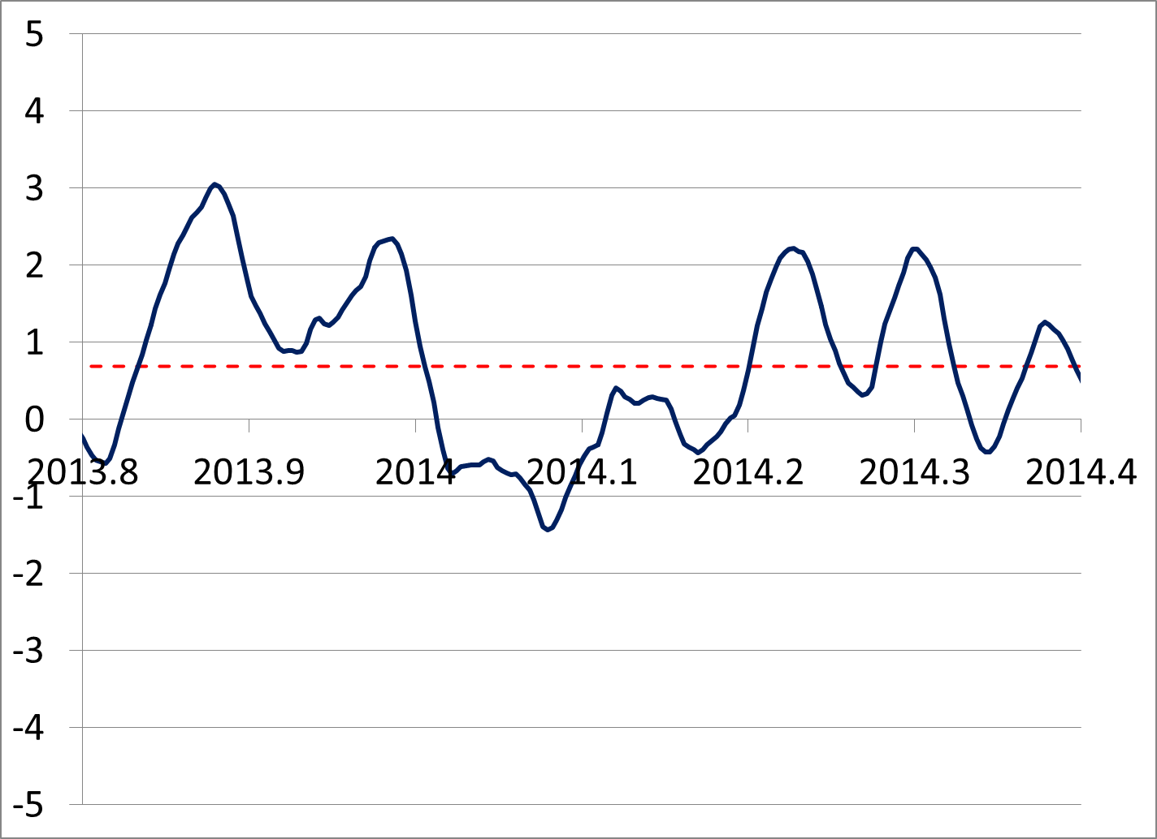
Arctic Oscillation
Standardized AO index: October 2013 - April 2014
15 day running average
Mean value: +0.70 (red line)
Zero value: Green line

Slide 8
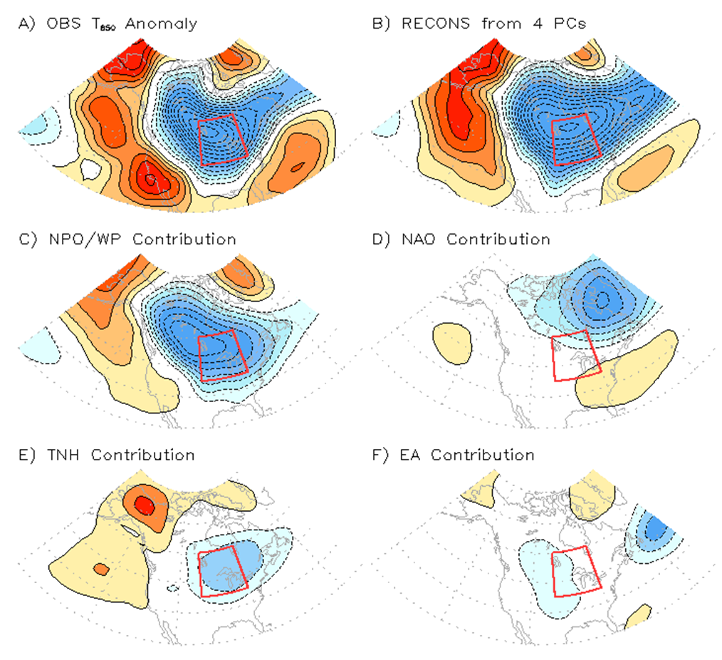
Winter 2013-2014
The North Pacific Oscillation (NPO) / Western Pacific (WP) pattern played a large role in the winter / early spring variability during 2013-14
These highly relatable patterns basically result in the north-south dipole in winter sea-level pressure over the North Pacific
DJF 200-hPa height anomalies
DJF 850-hPa temperature anomalies
ALASKA
CONUS
Courtesy: Steve Baxter

Slide 9
Review of CPC Official Outlooks

Slide 10
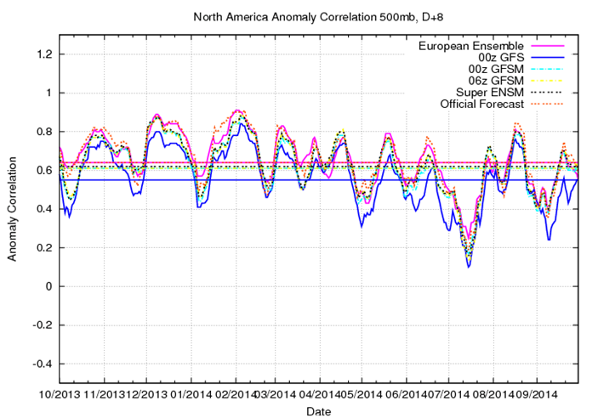
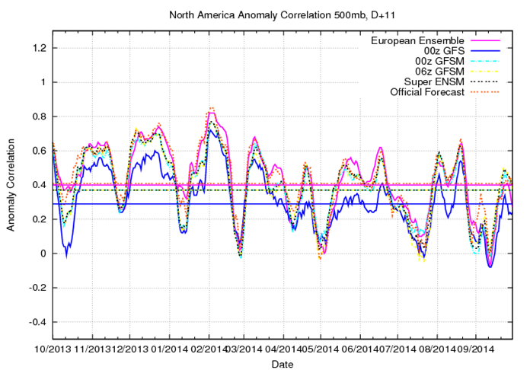
Extended Range Outlooks – 500-hPa Height
Days 6-10
Days 8-14
0z GFS: 0.55
0z GFSM: 0.61
6z GFSM: 0.61
GFS Super Ensemble: 0.62
Manual: 0.65
0z GFS: 0.29
0z GFSM: 0.36
6z GFSM: 0.36
Super Ensemble: 0.37
Manual: 0.41

Slide 11
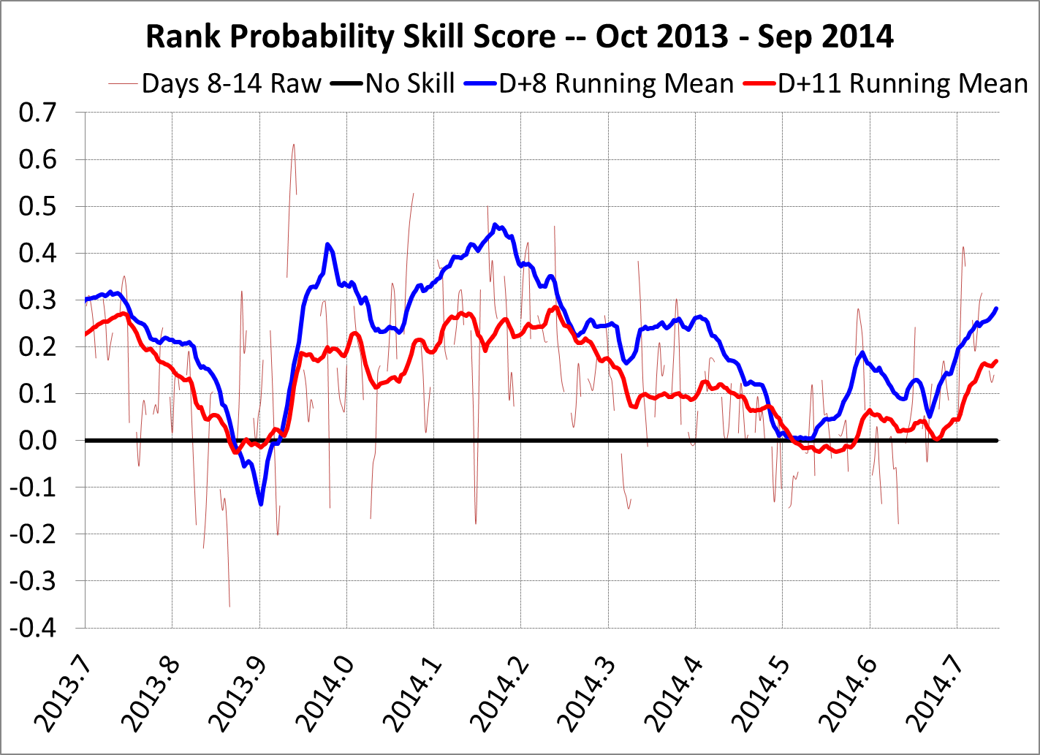
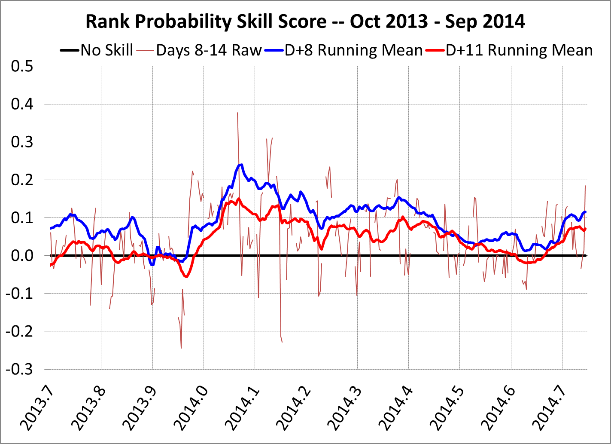
Extended Range Outlooks – T/P RPSS
Days 8-14 Temperature
Days 8-14 Precipitation
Outlook Type | Averaging Period | RPSS
Days 8-14 | Past year | 0.12
Days 6-10 | Past year | 0.21
Days 8-14 | 2008-2013 | 0.05
Outlook Type | Averaging Period | RPSS
Days 8-14 | Past year | 0.05
Days 6-10 | Past year | 0.09
Days 8-14 | 2008-2013 | 0.03

Slide 12
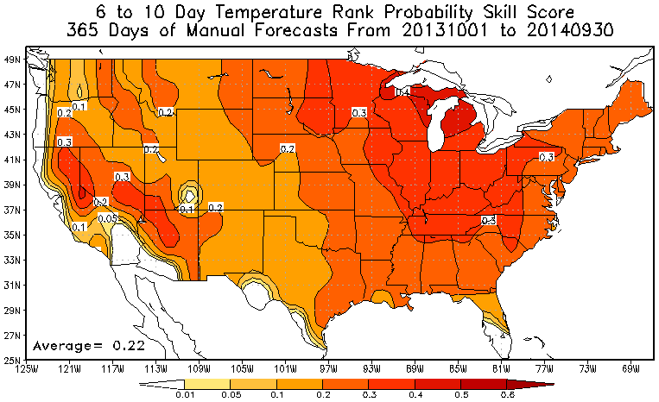
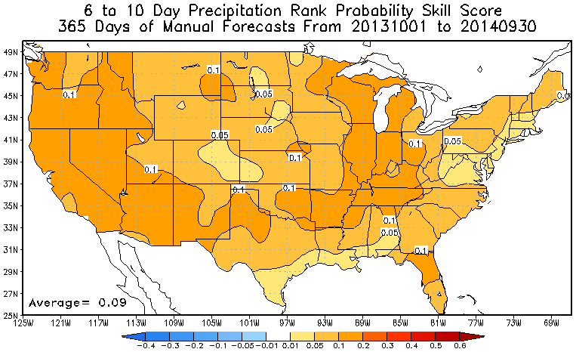
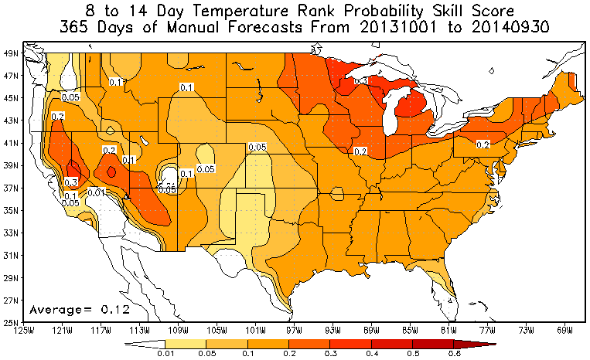
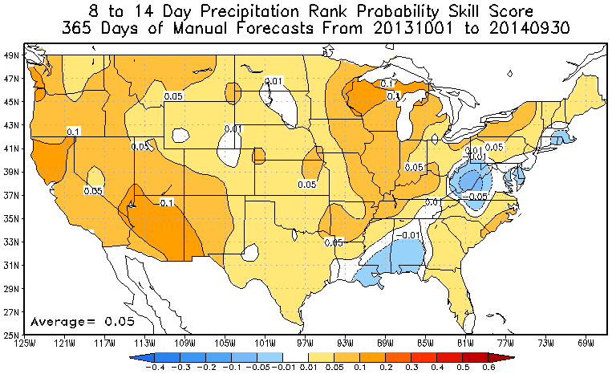
Extended Range Outlooks – T/P RPSS
Temperature
Precipitation
Courtesy: Scott Handel

Slide 13
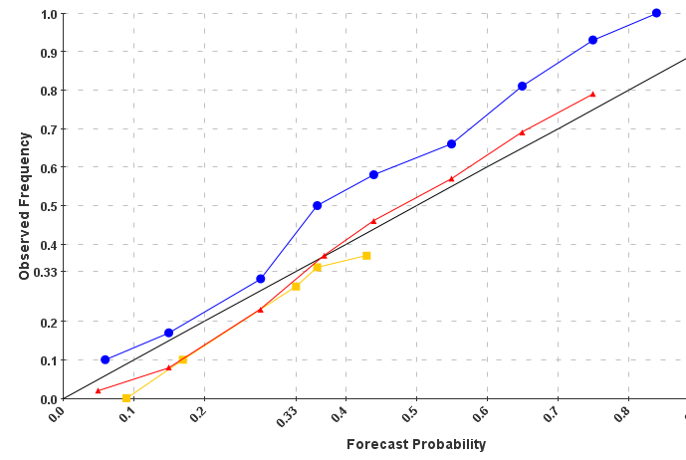
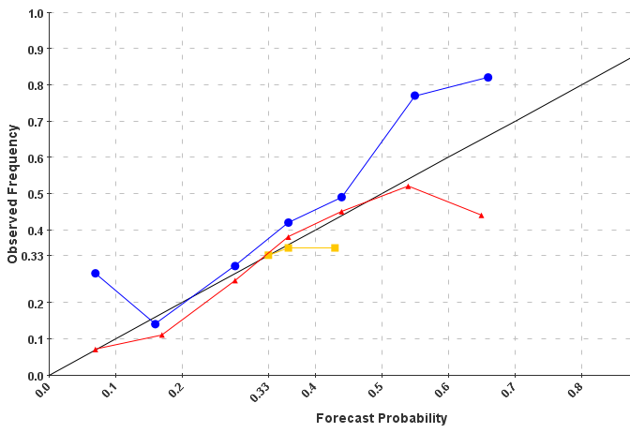
Extended Range Outlooks - Reliability
Days 8-14 Temperature
Days 8-14 Precipitation
Categories ➔ Above: Red, Below: Blue, Near: Yellow

Slide 14
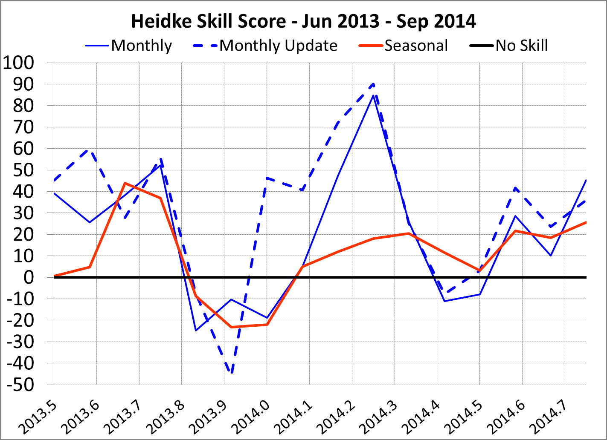
Monthly and Seasonal Outlooks – HSS
Temperature
Outlook Type | Averaging Period | HSS
Seasonal | 6/2013-9/2014 | 10.5
Monthly | 6/2013-9/2014 | 20.7
Revised Monthly | 6/2013-9/2014 | 31.7
Seasonal | 1995-5/2013 | 23.6

Slide 15
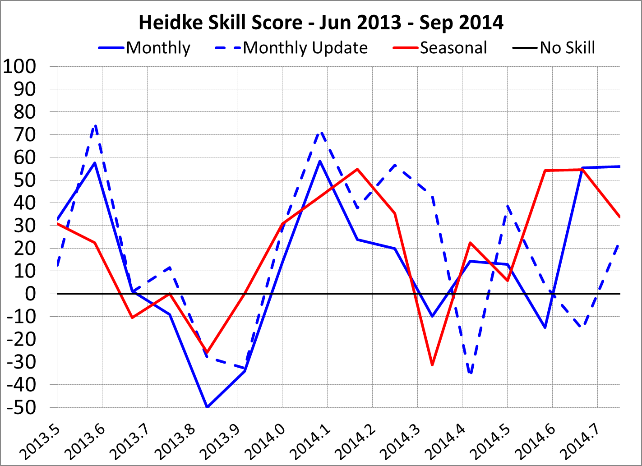
Monthly and Seasonal Outlooks – HSS
Precipitation
Outlook Type | Averaging Period | HSS
Seasonal | 10/2013-9/2014 | 20.0
Monthly | 10/2013-9/2014 | 14.3
Revised Monthly | 10/2013-9/2014 | 18.2
Seasonal | 1995-9/2013 | 13.3

Slide 16
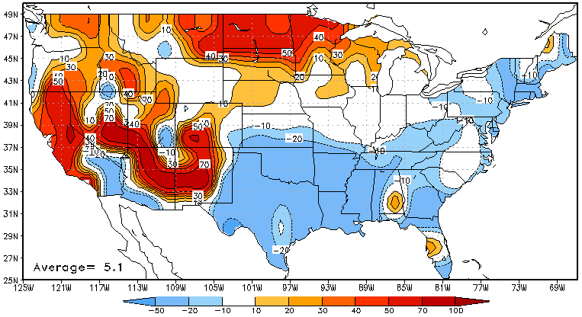
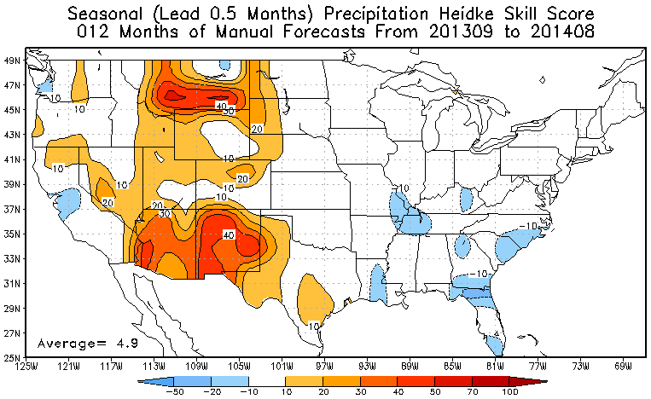
Seasonal Outlooks – Spatial Distribution
Temperature
Best forecast skill across the northern Plains and West
Poor forecasts during winter and spring months
Precipitation
Good wet season forecasts this past summer across western CONUS
Little skill in Southeast CONUS

Slide 17
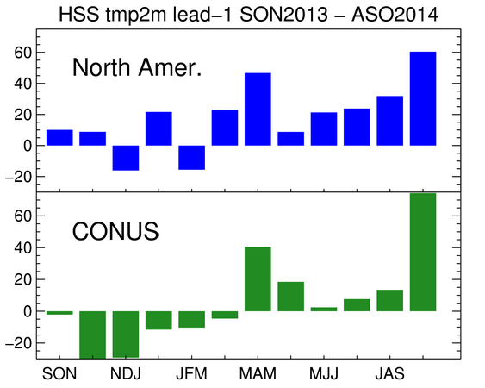
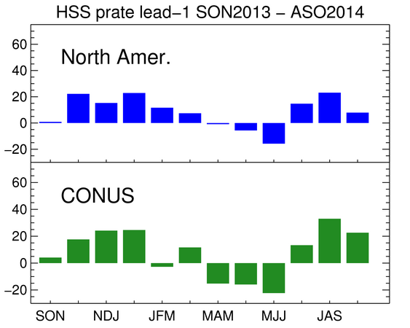
Seasonal Outlooks – NMME
Temperature
Precipitation
Courtesy: Emily Becker

Slide 18
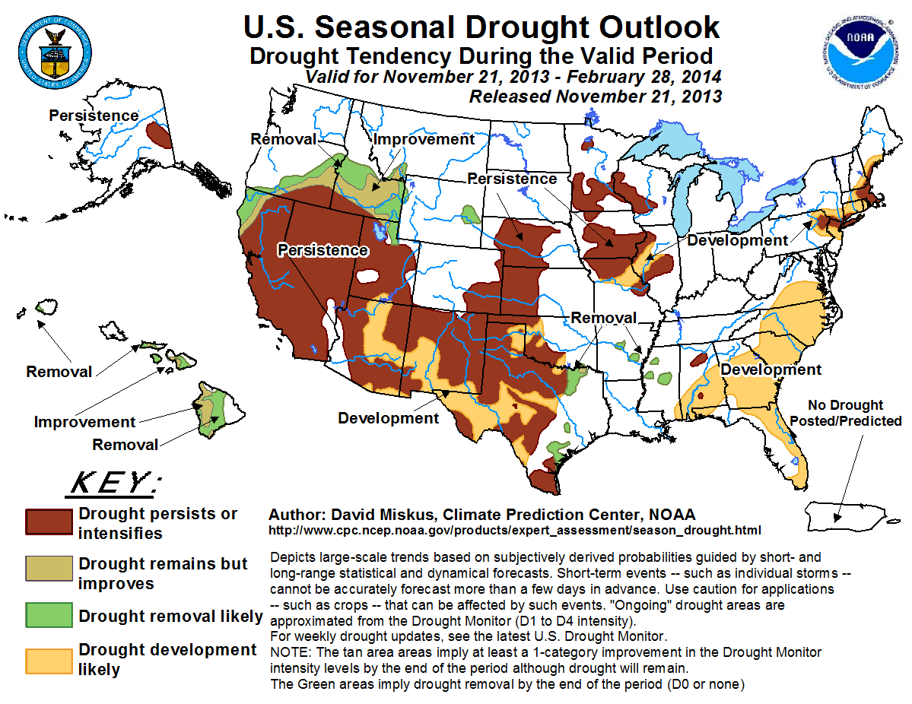
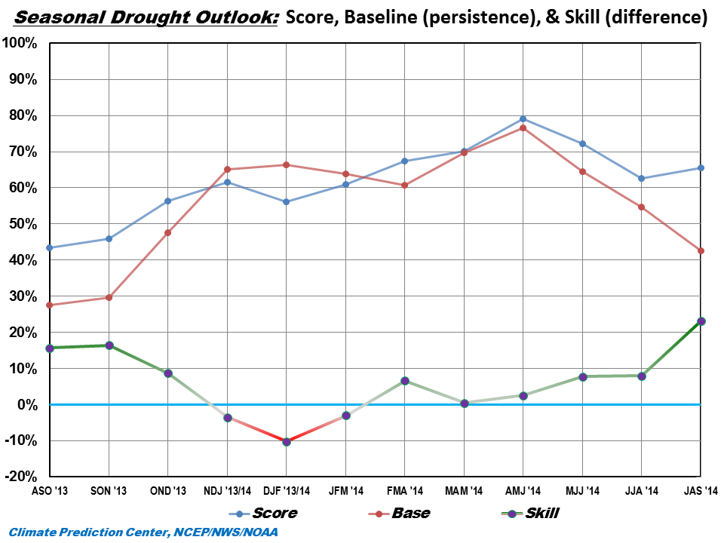
Seasonal Drought Outlook
Courtesy: Rich Tinker

Slide 19
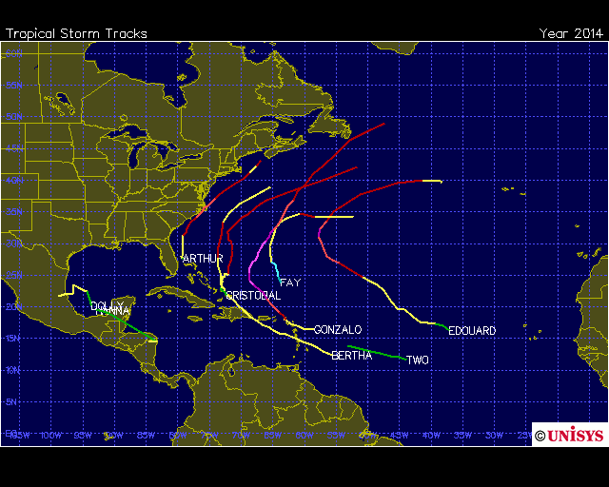
Seasonal Hurricane Outlook
Observed numbers:
Named storms: 8
Hurricanes: 6
Major Hurricanes : 2
ACE: ~67% of median
ACE: 40-100% of median / 40-90%

Slide 20
Some new activities during FY14

Slide 21
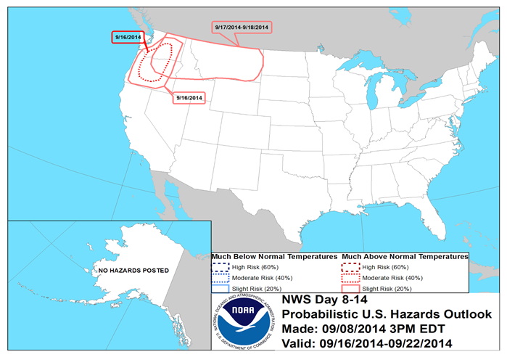
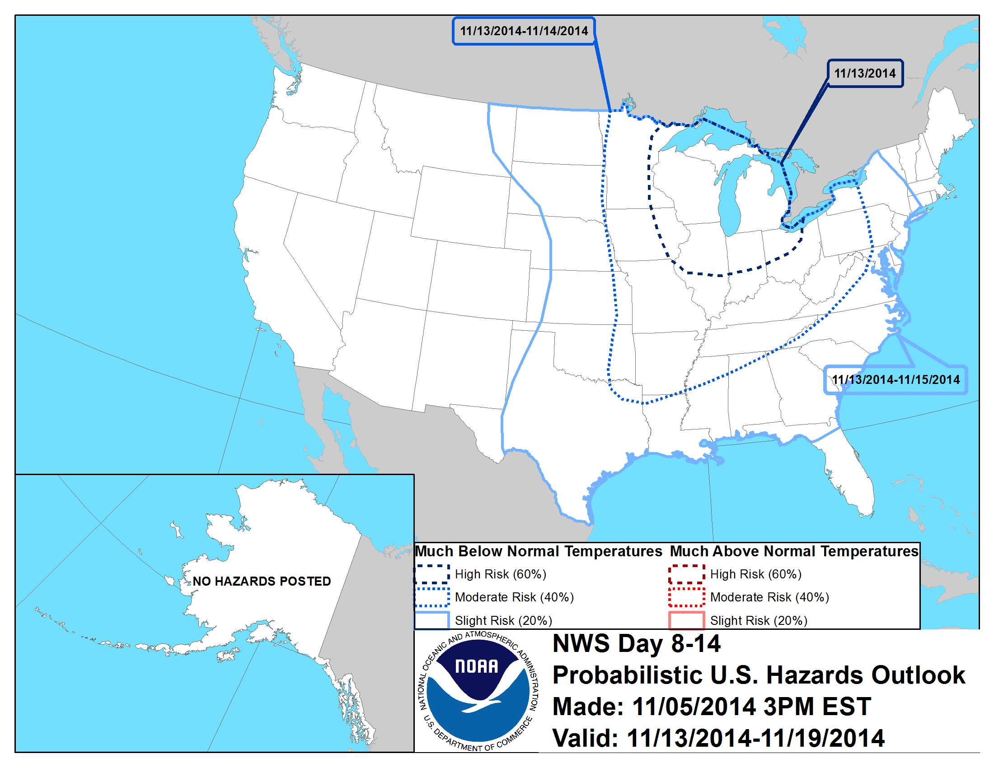
Days 8-14 U.S. Probabilistic Temperature Hazards
Systematically migrating current outlook to probabilistic form
Variable by variable approach
Started with much-above and much below normal temperatures
First released in July

Slide 22
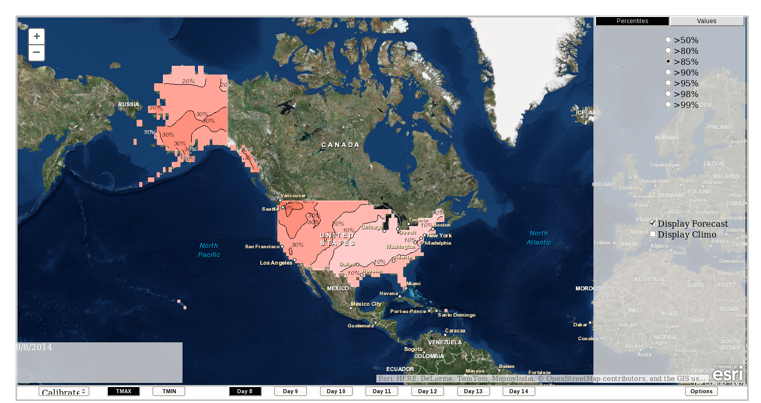
GEFS Reforecast Based Tool Display
Anchored by the GEFS Reforecast
Forecaster tool interface allows inspection by various thresholds and percentiles
Courtesy: Melissa Ou
Notes:
This is an example screenshot of what the extremes tool looks like, for daily max temperature
Web tool, displayed in GIS
Currently internal, will be available publicly in future
Some of the features/options of this web application is the ability to display ....
** ON CLICKS - Tmin, Tmax from days 8-14, percentiles and values for varying thresholds, calibrated and uncalibrated, can click anywhere on map to get a printed value of % and location
The contours on the map represent the probabilities of a location being greater than the displayed threshold (or less than, depending on what option is selected).
This is an example of forecast maximum temperature at lead day 8. These are the probabilities at each location of the percentiles being greater than the 85th percentile. The darker pink values are 30% probabilities (ie. over southern AK and the Pac NW), lighter shades are lower probabilities

Slide 23
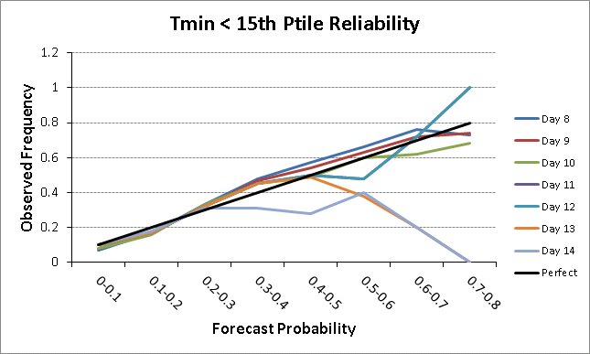
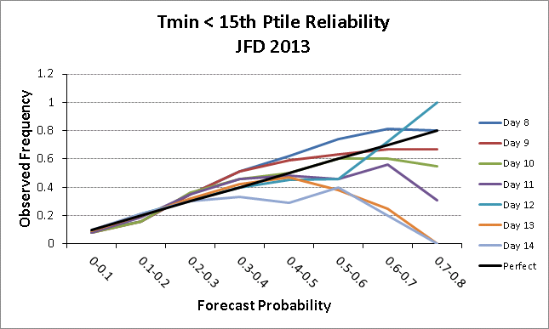
Some Tool Verification
Reliability of Tmin < 15th percentile from GEFS reforecast based forecast tool
All 2013 days (left) and Jan-Feb-Dec 2013 days (right)
Courtesy: Melissa Ou

Slide 24
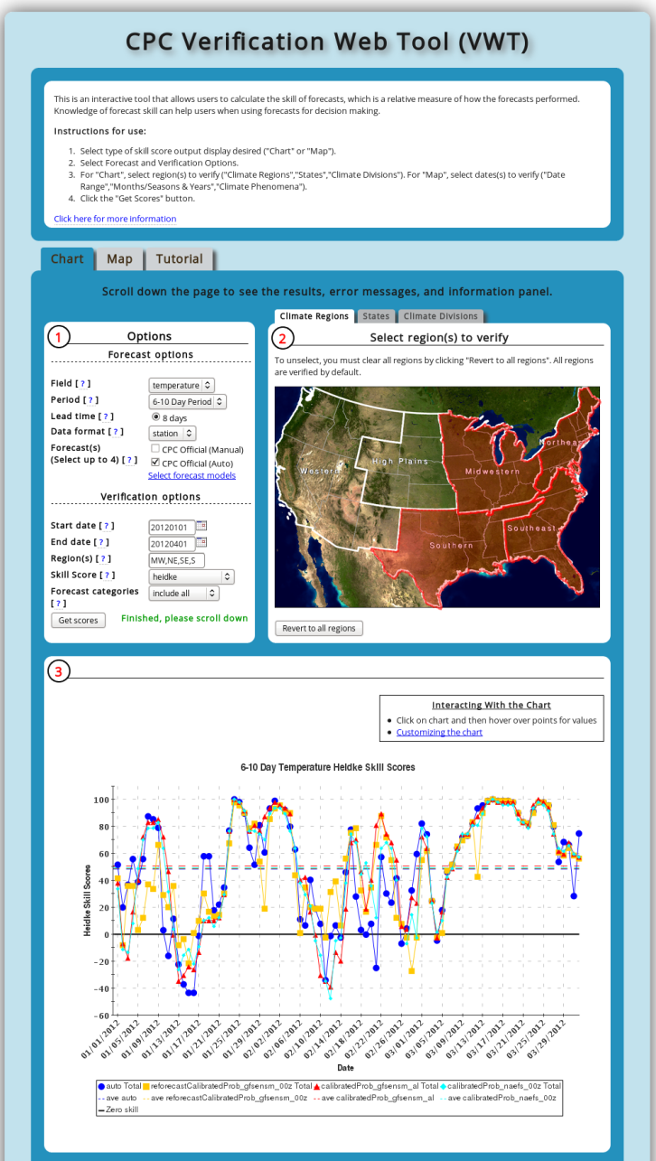
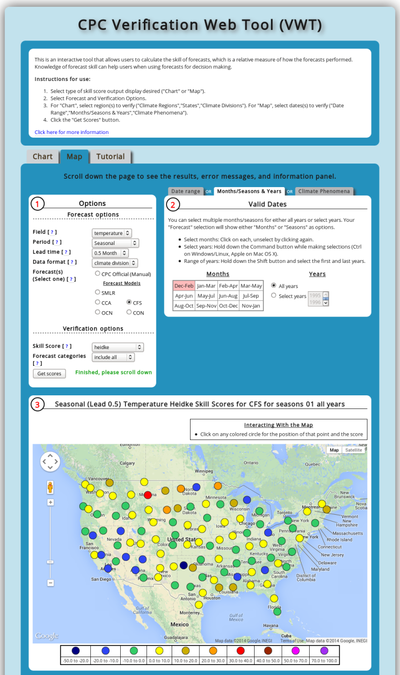
Verification Web Tool Publically Released
Dynamic web interface allowing better user access to verification info from CPC outlooks
Additional skill scores available
Regional verification and stratification by ENSO available
www.vwt.ncep.noaa.gov
www.cpc.ncep.noaa.gov/products/verification/summary

Slide 25
Toward Week 3-4 Experimental Outlooks
A major goal in the CPC 5-year strategic plan is to develop official Week 3-4 operational outlooks. An initiative to work in this direction was started in late FY14.
Many challenges to overcome over the next few years to meet this objective
➔ Assessing and documenting the scientific basis for this type of outlook?
➔ If so, would they be reliable?
What would be the frequency and format of this type of product?
CPC wide team has determined an initial inventory of information to be targeted in a Phase 1 project during FY15 with outlined requirements and deliverables and the associated project plan and timeline.
The initial experimental product is to be a combined Week 3-4 probabilistic temperature and precipitation outlook released once per week, similar in style to current CPC monthly outlook.

Slide 26
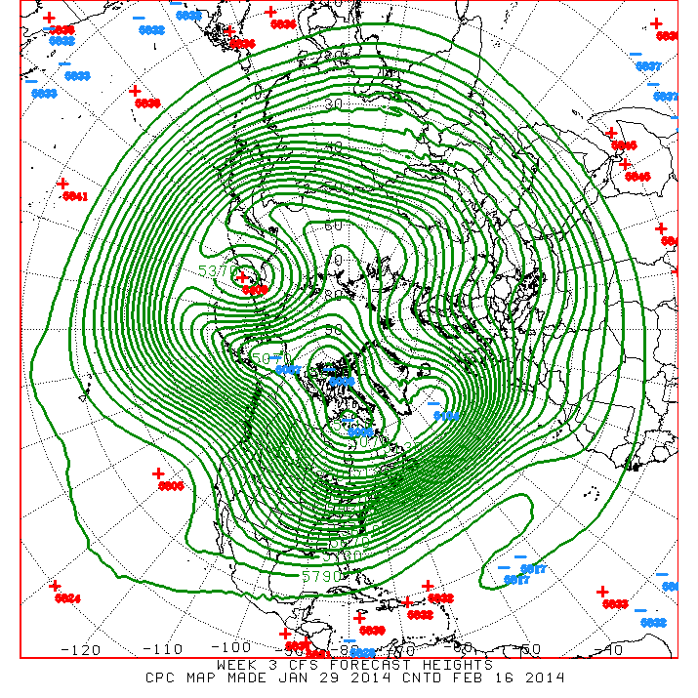
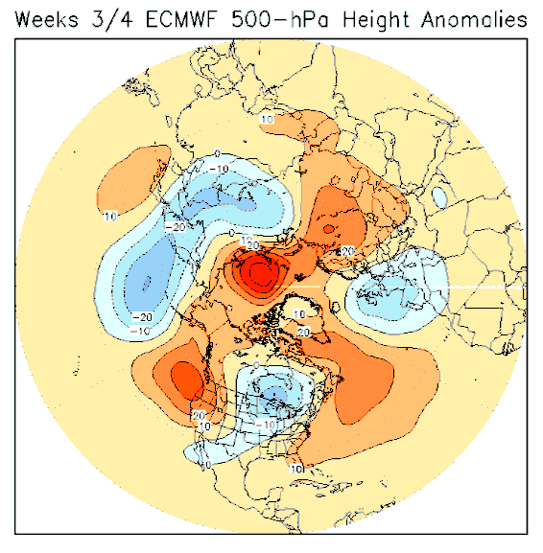
Toward Week 3-4 Experimental Outlooks
Work is currently ongoing in areas listed below:
(1) Modification, enhancement and new development of empirical techniques (i.e., constructed analogue, regression, cluster analysis, etc.) whose methodologies target MJO/ENSO, trends and blocking
(2) Analysis of dynamical model guidance from a number of operational centers including NCEP, ECMWF, JMA and Environment Canada
(3) Operational implementation at CPC of Coupled Linear Inverse Modeling (C-LIM) techniques from ESRL
Post-processing techniques and reforecast datasets with consistent reanalyses will be critical to maximize progress
Experimental outlooks will be
forecasts of opportunity

Slide 27
Toward Week 3-4 Experimental Outlooks
Links with broader initiatives are critical for CPC to deliver these services by leveraging advances in:
(1) Basic understanding and predictability research
(2) Modeling capacity
From these ongoing activities:
S2S Prediction Project
Earth System Prediction Capability
NMME subseasonal database

Slide 28
Summary
El Nino forecast has been a challenge this year, model forecasts favored event development too early and too strong
CPC FY14 extended range outlook forecast skill exceeded longer term average. Forecast reliability improving.
Rough year for seasonal temperature forecasts, primarily during the winter in the south. Monthly temperature and precipitation forecasts better. Seasonal hurricane outlooks for ATL and EPAC very good.
Initiated experimental probabilistic U.S. Hazards outlook (much above/below temperature) with encouraging early results
Set in motion an initiative that aims to work towards experimental Week 3-4 products for temperature and precipitation.

Slide 29
Thank you for your attention
Comments, questions or suggestions?
Jon.Gottschalck@noaa.gov?

Slide 30
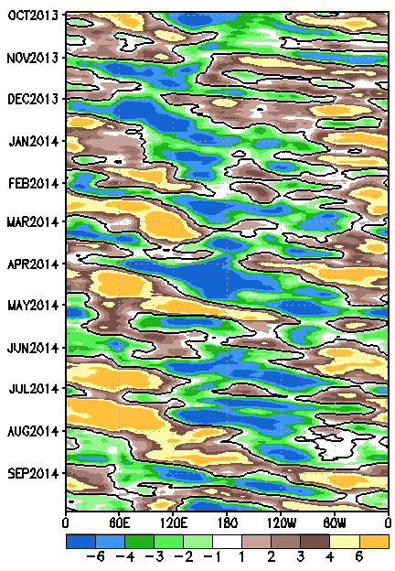
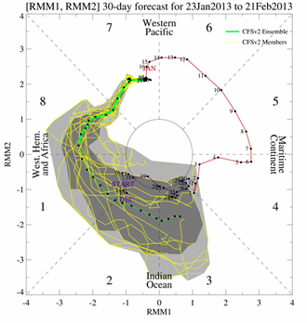
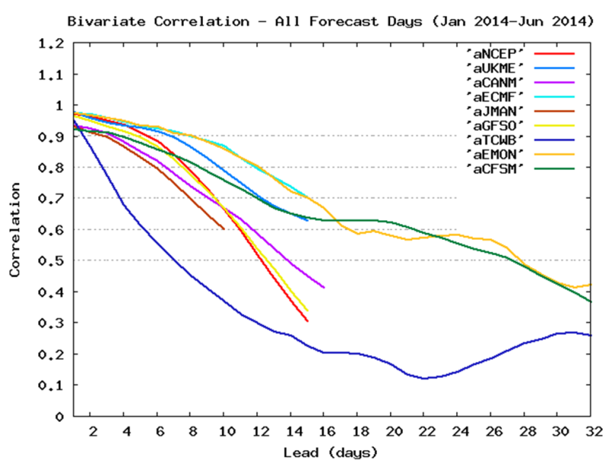
Madden-Julian Oscillation
The MJO activity was below average in 2014
When MJO was active, events were weak, non well defined and short lived (red dashed and dotted lines)
Low frequency base state (black box) more clearly visible

Slide 31
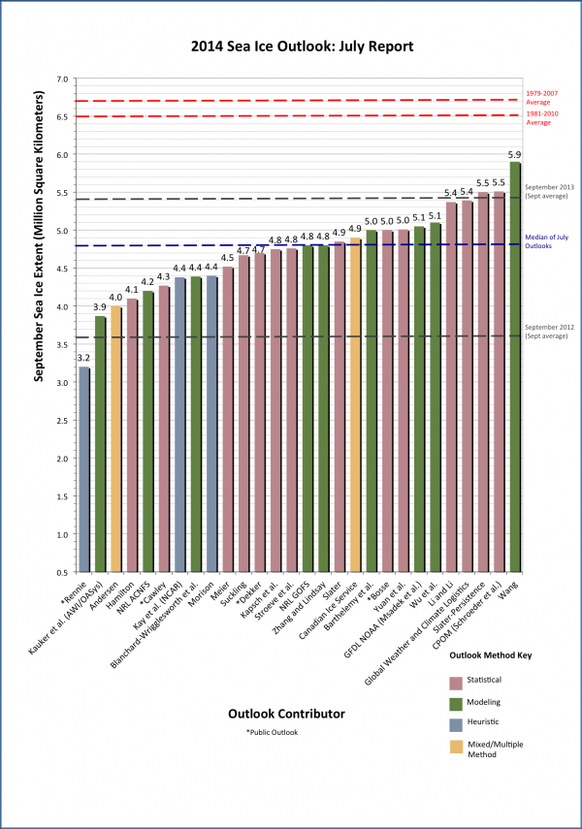
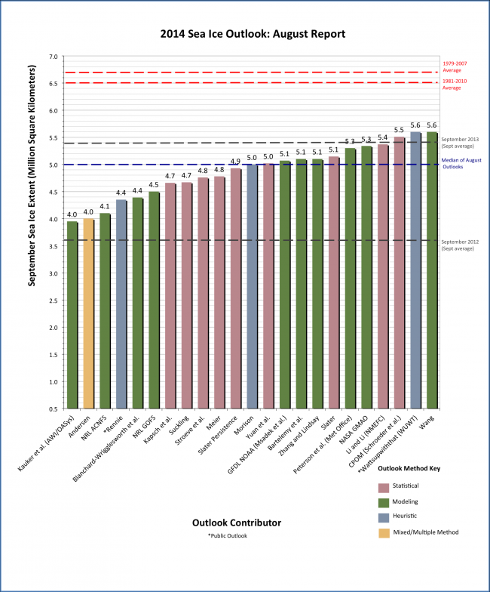
September Sea Ice Outlook
July Forecast
August Forecast
CFSv2
Obs=5.28
Obs=5.28
Courtesy: Wanqiu Wang

