Slide 1
Ensemble Forecasting
Yuejian Zhu
Ensemble & Probabilistic Guidance Team Leader
Environmental Modeling Center
December 2nd 2014
Acknowledgment for:
Members of Ensemble & Probabilistic Guidance Team

Slide 2
Responsibilities of Ensemble Team
- Assess, model, communicate uncertainty in numerical forecasts
Present uncertainty in numerical forecasting
Tasks
Design, implement, maintain, and continuously improve ensemble systems
Presents
Initial value related uncertainty
Model related forecast uncertainty
Ensemble systems
Global – GEFS / NAEFS / NUOPC
Regional – SREF / HREF / NARRE-TL / HWAF ensemble
Climate – CFS, IMME and NMME
NAEFS/GEFS downscaled
Ocean wave ensemble (MMA/EMC)
Other systems
CCPA – Climate Calibrated Precipitation Analysis
WSR – Winter Storm Reconnaissance (discontinue)
CSTAR - Collaborative Science, Technology, and Applied Research Program
Statistical correction of ensemble forecasts
Tasks
Correct for systematic errors on model grid
Downscale information to fine resolution grid (NDGD)
Combine all forecast info into single ensemble/probabilistic guidance
Probabilistic product generation / user applications
Contribute to design of probabilistic products
Support use of ensembles by
Internal users (NCEP Service Center, WFOs, OHD/RFC forecasters and et al.)
External users (research, development, and applications)

Slide 3
Coverage of This Presentation
Will mainly focus on:
GEFS upgrade and future plan
NAEFS upgrade and future plan
GEFS/NAEFS post products and future plan
CCPA – Climate Calibrated Precipitation Analysis
CSTAR - Collaborative Science, Technology, and Applied Research Program
GEFS extended forecast
IMME and NMME
Wave ensemble and its products will be reviewed by Arun Chawla (tomorrow)
Regional ensemble and related products will be reviewed by Jun Du (this afternoon)
Regional hurricane ensemble (HWRF experimentally) will be reviewed by Vijay Tallapragada (tomorrow)

Slide 4
Main Accomplishment in 2014
NAEFS upgrade – April 2014

Slide 5
SREF Upcoming Major Upgrade (~April 2015 – WCOSS Phase II)
3 model core system becomes 2 model core system (NMMB, WRF_ARW, WRF_NMM)
Vertical resolution is increased from 35 to 41 levels (horizontal resolution remains the same of 16km)
Ensemble membership is increased from 21 to 26 members
IC diversity is enhanced: (a) mix use of multiple analyses (NDAS, GFS and RAP) for each model core, and (b) blending of GEFS and SREF IC perturbations for all members
Physics diversity is enhanced: (a) more variety of physics schemes, and (b) stochastic flavor in physics parameters (GWD and soil moisture)
New variables and products are added

Slide 6
Next GEFS (V11.0.0) configuration
Model
Current: GFS Euler model (V9.0.1)
Plan: GFS Semi-Lagrangian model (V10.0.0)
Horizontal resolution
Current: T254 (55km for 0-192 hours), T190 (73km for 192-384 hours)
Plan: T574 (T382 physics - 34km for 0-192 hours), T382(T254 physics – 55km for 192-384 hours)
Vertical resolution
Current: L42 hybrid levels
Plan: L64 hybrid levels to match with GFS and DA
Computation cost:
Current: 84 nodes (+ post process) for 55 minutes
Plan: 300 nodes (first 35 minutes), 250 nodes (2nd 30 minutes)
Output:
Current: every 6-hr for 1*1 degree pgrb files
Plan: every 3-hr for 0.5*0.5 degree pgrb files
Schedule:
Jan. 2015 – deliver codes/scripts to NCO
Apr. 2015 – implementation (WCOSS-phase II)

Slide 7
Evolution of NCEP GEFS configuration (versions)
Version | Implementation | Initial uncertainty | TS relocation | Model uncertainty | Resolution | Forecast length | Ensemble members | Daily frequency
V1.0 | 1992.12 | BV | None | None | T62L18 | 12 | 2 | 00UTC
V2.0 | 1994.3 |  |  |  | T62L18 | 16 | 10(00UTC) 4(12UTC) | 00,12UTC
V3.0 | 2000.6 |  |  |  | T126L28(0-2.5) T62L28(2.5-16) |  | 10
V4.0 | 2001.1 |  |  |  | T126(0-3.5) T62L28(3.5-16)
V5.0 | 2004.3 |  |  |  | T126L28(0-7.5) T62L28(7.5-16) |  |  | 00,06,12, 18UTC
V6.0 | 2005.8 |  | TSR |  | T126L28
V7.0 | 2006.5 | BV- ETR |  |  |  |  | 14
V8.0 | 2007.3 |  |  |  |  |  | 20
V9.0 | 2010.2 |  |  | STTP | T190L28
V10.0 | 2012.2 |  |  |  | T254L42 (0-8) T190L42 (8-16)
V11.0 | 2015.04 | EnKF (f06) |  |  | T574L64 (0-8) T382L64 (8-16)

Slide 8
Next GEFS Sciences
Initial perturbations
Base: EnKF 6hr forecast
TS relocation
Centralization
Ensemble transform - un-necessary if there is no significant difference
Rescaling – un-necessary if we confirm EnKF parallels have the similar characteristics for different seasons
Stochastic perturbations
Tune STTP for model change and initial perturbation changes
Turn off stochastic perturbations for surface pressure in STTP
Expectations
Improve hurricane track forecast
Improve probabilistic forecast guidance
Improve predictability of HIW and extreme weather event

Slide 9
Preliminary results for period of May 22nd – October 31st 2013
Extended Summer Season
General stats: http://www.emc.ncep.noaa.gov/gc_wmb/xzhou/EnKF_prhs13_10.HTML
Surface against observations:
http://www.emc.ncep.noaa.gov/gmb/wx20cb/vsdb/geavg.20130601.20130831/g2o/
Precipitation:
http://www.emc.ncep.noaa.gov/gmb/yluo/tmp_dir/GEFS_PQPFvrfy_summer_test.html
TC tracks (one slide)
Note: model version may be slightly (minor) different during integration period.

Slide 10
Preliminary results for period of January 2nd – May 14 2014
Extended Winter Season
General stats: http://www.emc.ncep.noaa.gov/gmb/wd20dh/STTP2014/PROB_OoFa.HTML
Precipitation:
http://www.emc.ncep.noaa.gov/gmb/yluo/GEFS_VRFY/GEFS_PQPFvrfy_spring_test.html
Note: model version may be slightly (minor) different during integration period.

Slide 11
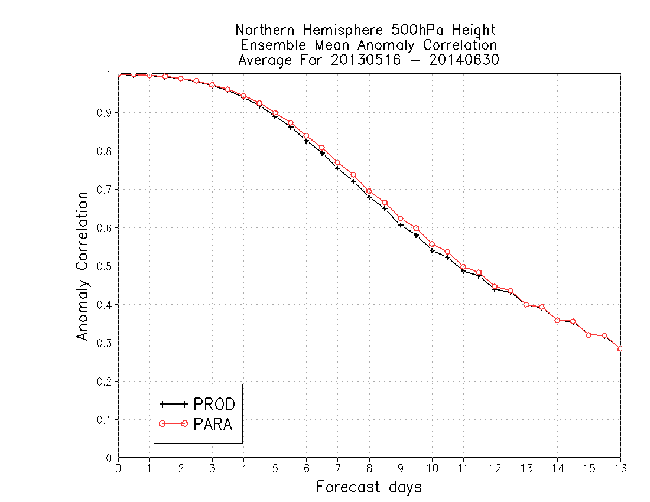
77%
2% improvement of 7-day forecast AC score
75%
9.25d
9.6d
About 8 hours improvement of skillful forecast

Slide 12
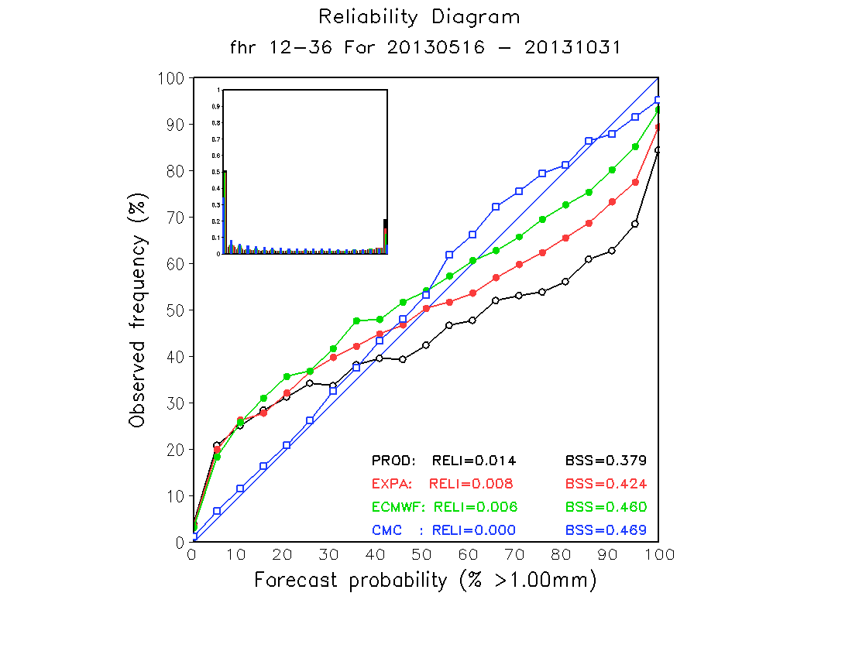
Summer 2013
Precipitation reliability for 12-36hr and greater than 1mm/day

Slide 13
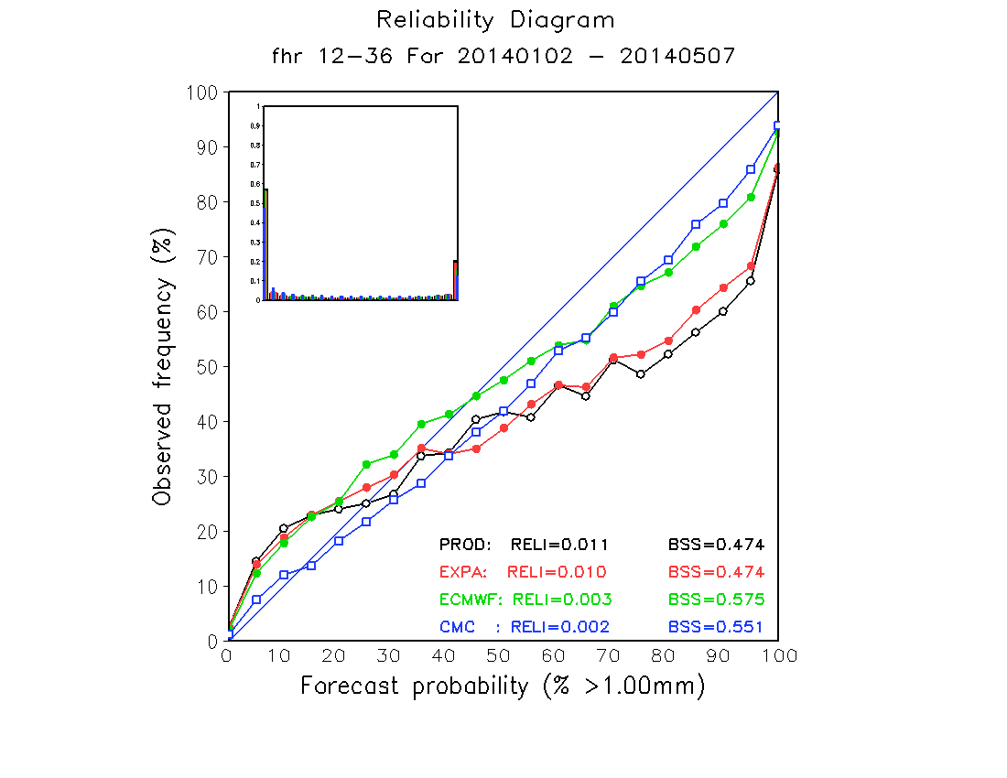
Winter + Spring 2014
Precipitation reliability for 12-36hr and greater than 1mm/day

Slide 14
May 15 – Oct. 31 2013 AL/EP/WP TC Track Verifications
Retrospective runs – once per day at 00UTC
AVNO ---- GFS prod
PRHS ---- GFS para
AEMN ----GEFS prod
T574 ---- GEFS para
Track error(NM)
Forecast hours
CASEs 236 207 185 158 133 93 61 39

Slide 15
Summary
Extended summer (05/15 – 10/31/2013)
Improvement:
Overall large scale circulation in terms of AC, RMS error, CRPS and other measures
Hurricane tracks out to 3 days (smaller sample beyond 3 days, especially for Atlantic basin)
Precipitation – improved reliability and skill
Surface temperature – improved for east CONUS
Surface wind
Neutral:
Degrade:
Surface temperature – degraded for west CONUS (large warm bias)
Extended winter (01/1 – 05/14/2014)
Improvement:
Overall for many atmospheric variables
Surface wind
Surface temperature - improved bias for short lead-time
Neutral:
Surface temperature errors
Precipitation
Degrade:

Slide 16
GEFS legacy forecast
Next GEFS implementation will be scheduled for WCOSS phase II (Q2FY15)
EMC will continue to run current operational GEFS (with BV-ETR cycling every 6 hours, but 00UTC forecast only) for one year
Current: 21 members, 00, 06, 12, 18UTC
Future: 21 members, 00UTC
Timing for legacy data delivery
Current: +4:50
Future: +8:00 (???)
Data directory for access (NCEP ftp – work with NCO)
Current directory: …/com/gefs/prod/….
future directory (???): …/com/gefs_v10/prod/….
Data names
Will be the same, but in the different directory
No statistical bias correction
Raw ensemble forecast data only
Issues for NCO:
AWIPS can not handle two GEFS data streams (???), GEFS data was already implemented to AWIPS in April 2014 from NWS ER’s request

Slide 17
Limited Reforecast (retrospective)
There is no plan for real time GEFS reforecast for next GEFS implementation.
Based on communications with WPC, CPC, SPC, OHD, MDL and other users. EMC will provide:
2-years retrospective runs (00UTC and 12UTC)
May 2013 – the time of implementation
Expect to be available: Mid of March 2015
18 years ensemble control only reforecast
Year 1995-2012
00UTC and every other day
Expect to be available: end of Jan. 2015
All data will be saved in HPSS tapes
No public ftp access
Computational resources
EMC will look for resources of development of WCOSS and research machine “zeus”
Still in the discussion with CPC to have 18 years ensemble retrospective runs

Slide 18
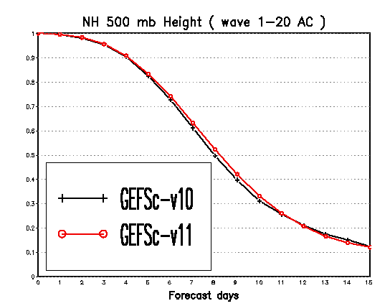
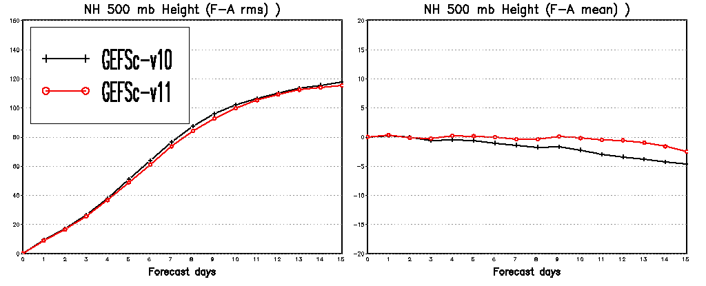
Statistical period: 01/18/1999 – 12/31/1999 (178 cases)
Ensemble control only
T574L64 (0-192h)
T382L64 (192-384h)
Anomaly correlation
RMS error
Mean error (bias)

Slide 19
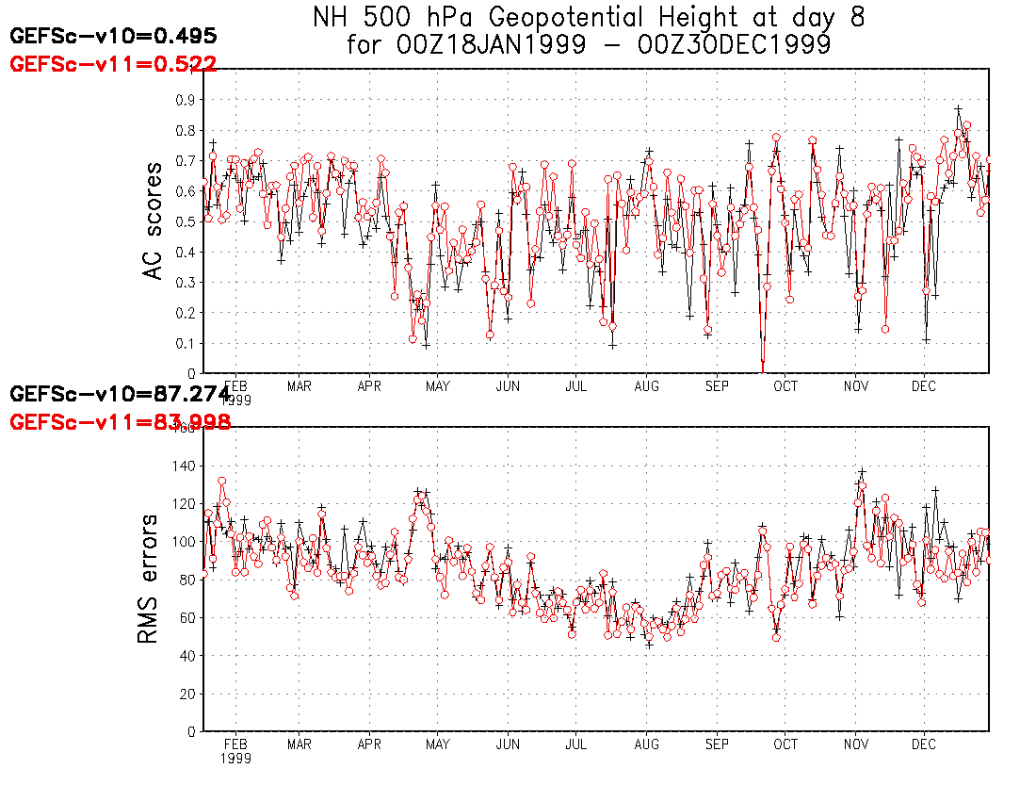
Increase AC: 2.7%
Decrease error: 3.28m

Slide 20
500hPa Anomaly Correlation for Control Only Reforecast (V10 .vs V11)
Solid – V11
Dash – V10
Years

Slide 21
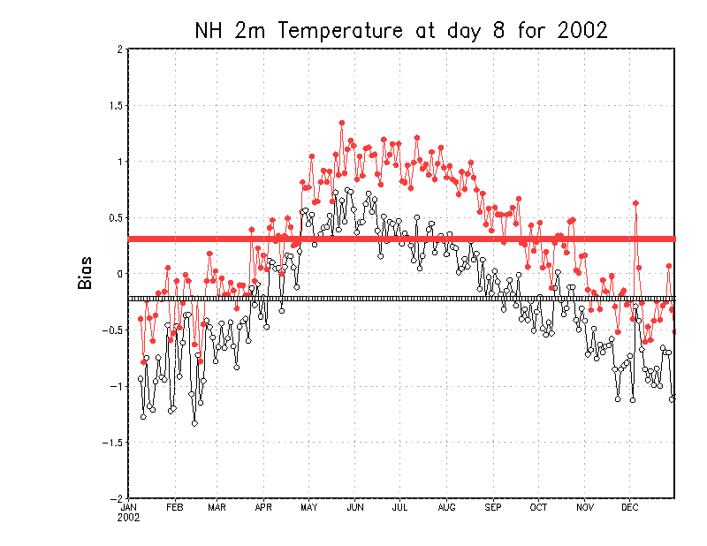
Example of 2-meter temp. bias of 2002 (fcst: 192 hours)
Warm bias
Reforecast – V11
Cold bias
Reforecast – V10

Slide 22
GEFS future

Slide 23
NH 500hPa height anomaly correlation (NCEP ensembles)
60% AC – useful skill
Forecast lead-time (days)

Slide 24
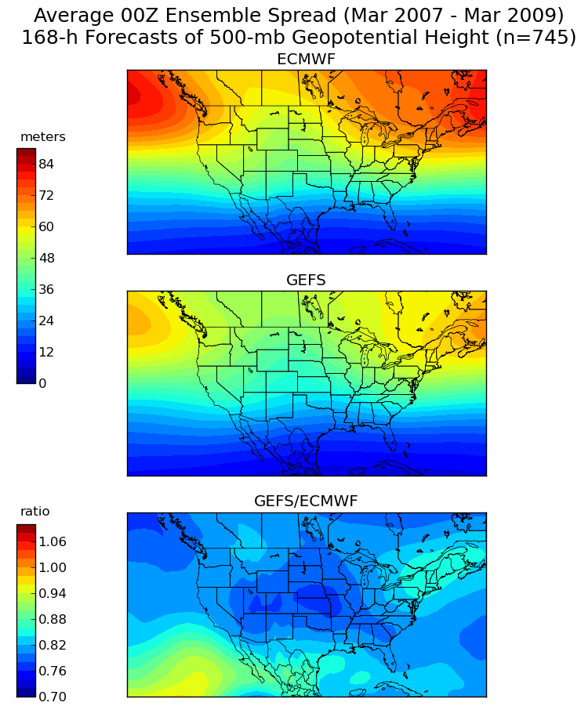
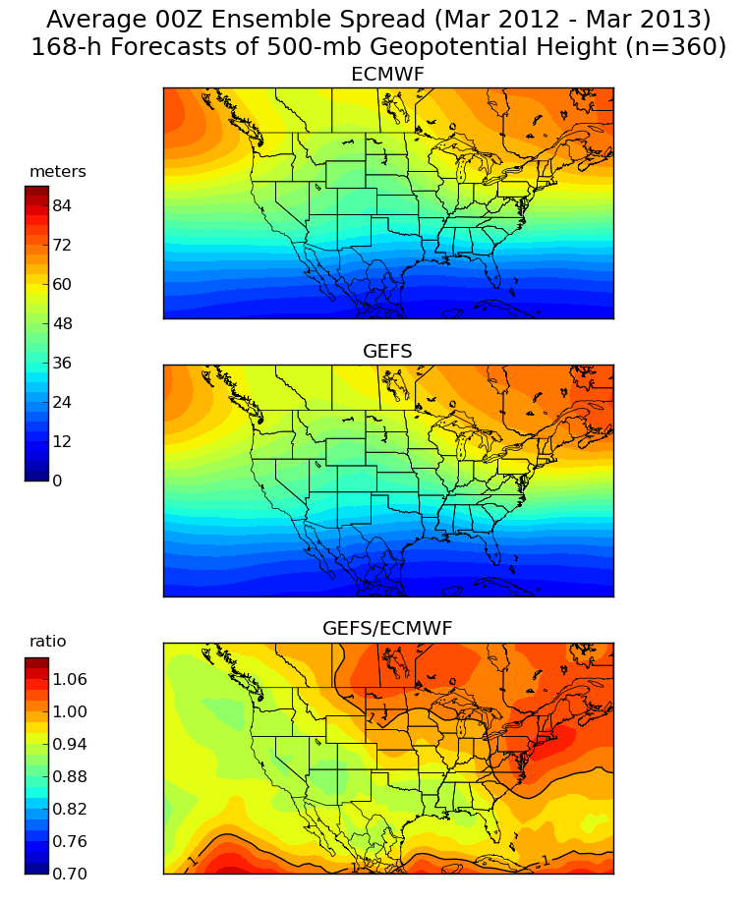
Changes of Ensemble Spread
Then
Now
Courtesy of Dr. Alcott Trevor

Slide 25
Introduce other stochastic schemes
Stochastic Kinetic Energy Backscatter (SKEB)
Represents processes absent from model
Stream function is randomly perturbed to represent upscale kinetic energy transfer (Berner et al., 2009)
Stochastic Perturbed Physics Tendencies (SPPT) – (ECWMF tech memo 598)
Designed to represent the structural uncertainty (or random errors) of parameterized physics
Multiplicative noise used to perturb the total parameterized tendencies (Palmer et al., 2009)
Biggest impact for tropics
Stochastically-perturbed boundary layer HUMidity (SHUM)
The similar formula as SPPT
Designed to represent influence of sub-grid scale humidity variability on the the triggering of convection (Tompkins and Berner 2008)

Slide 26
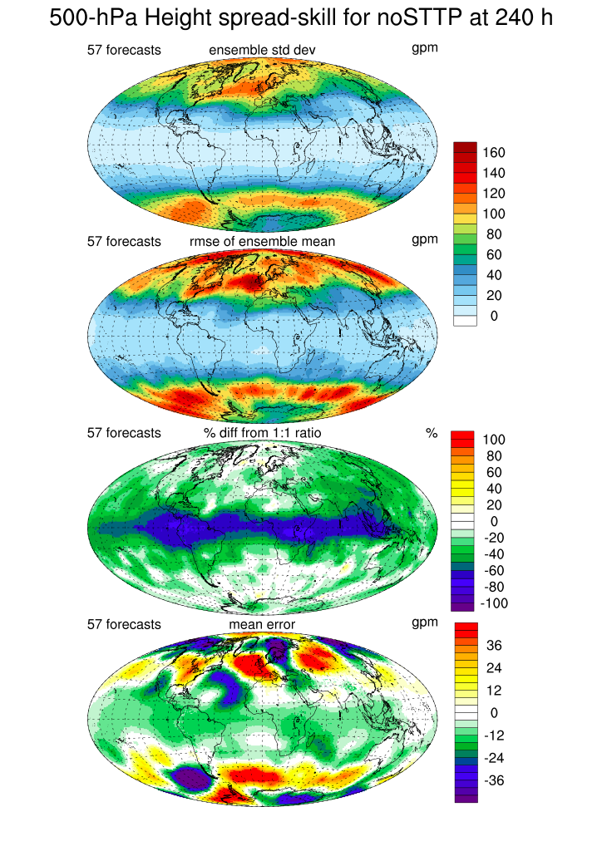
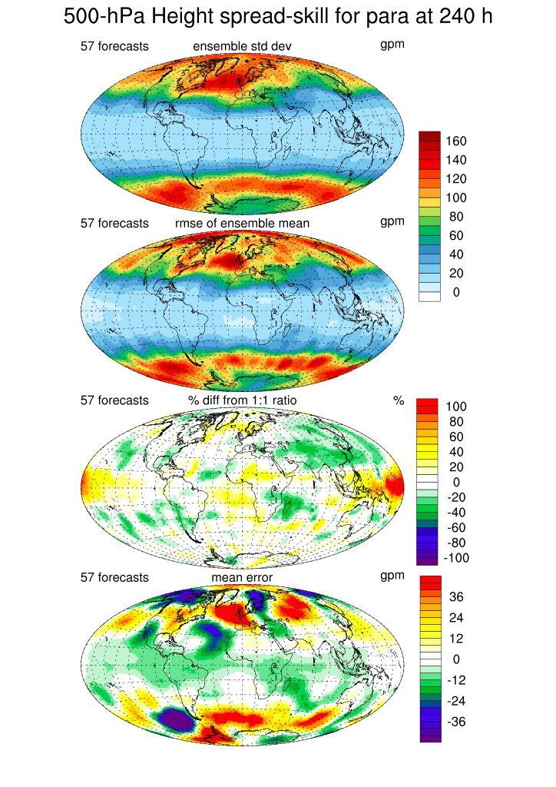
Winter 2 months

Slide 27
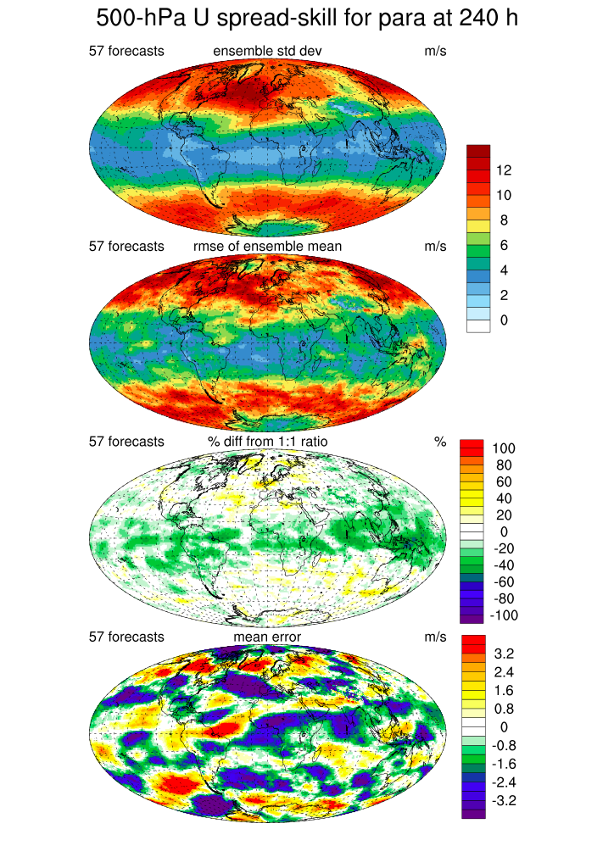
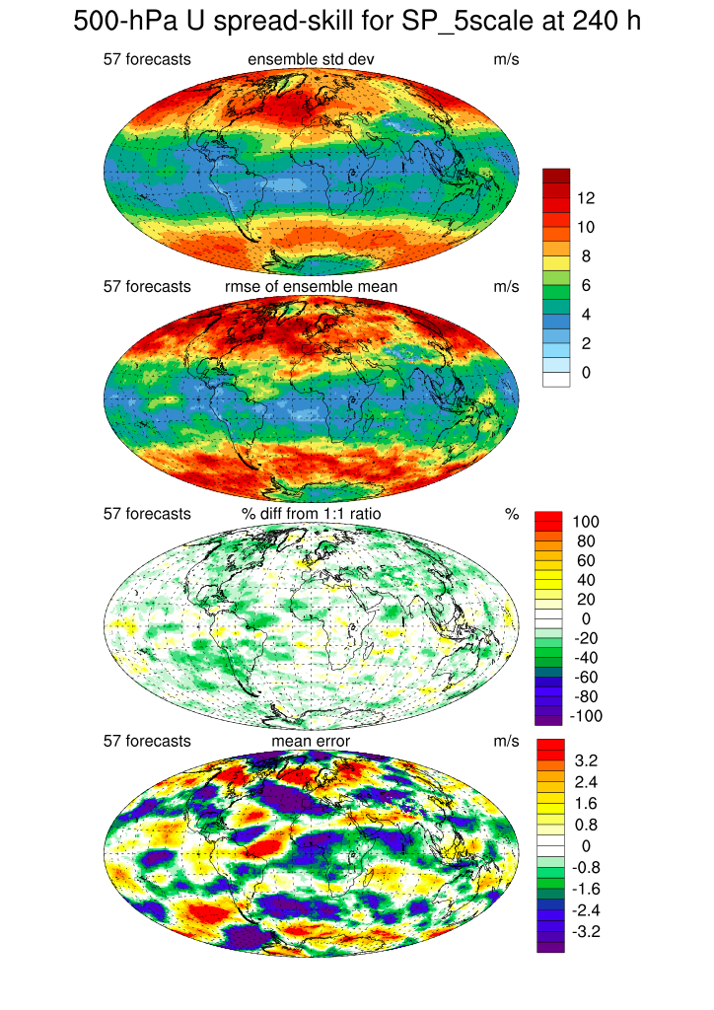

Slide 28
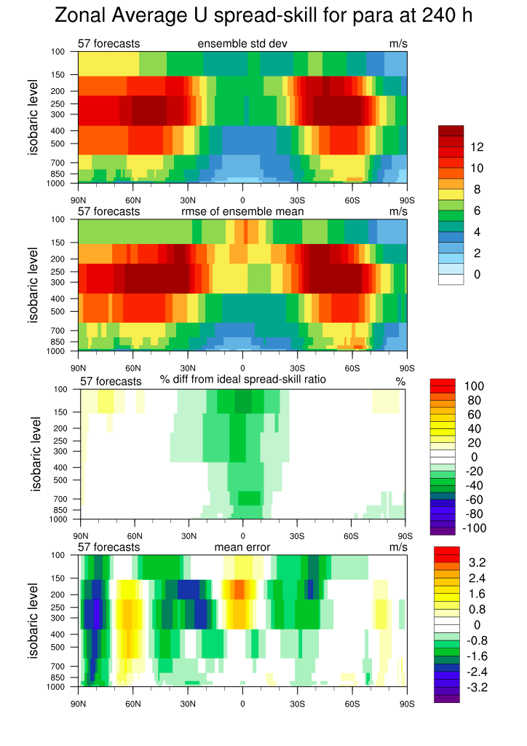
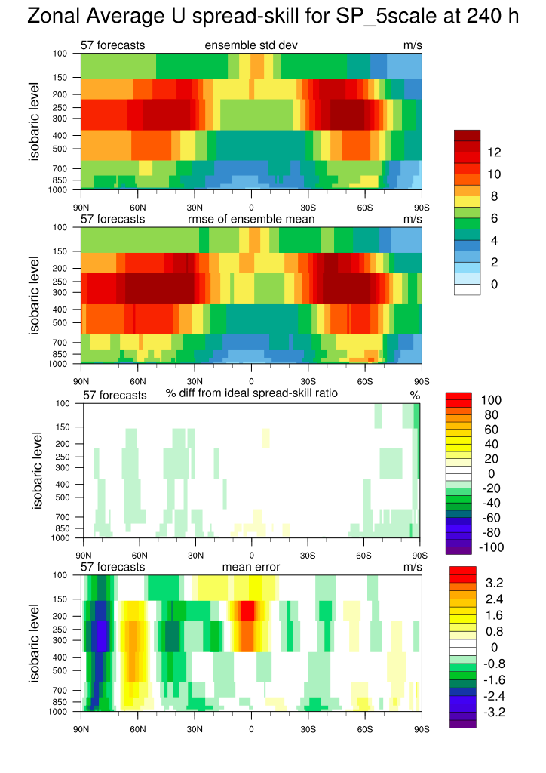

Slide 29
NAEFS Current Status
Updated: November 18th 2014
 | NCEP | CMC | NAEFS
Model | GFS | GEM | NCEP+CMC
Initial uncertainty | ETR | EnKF | ETR + EnKF
Model uncertainty/Stochastic | Yes (Stochastic Pert) | Yes (multi-physics and stochastic) | Yes
Tropical storm | Relocation | None
Daily frequency | 00,06,12 and 18UTC | 00 and 12UTC | 00 and 12UTC
Resolution | T254L42 (d0-d8)~55km T190L42 (d8-16)~70km | About 50km L72 | 1*1 degree
Control | Yes | Yes | Yes (2)
Ensemble members | 20 for each cycle | 20 for each cycle | 40 for each cycle
Forecast length | 16 days (384 hours) | 16 days (384 hours) | 16 days
Post-process | Bias correction (same bias for all members) | Bias correction for each member | Yes
Last implementation | February 14th 2012 | November 18th 2014

Slide 31
NH Anomaly Correlation for 500hPa Height Period: January 1st – December 31st 2013
GFS – 8.0d
NCEPE – 9.39d
CMCE – 9.38d
NAEFS – 9.76d

Slide 32
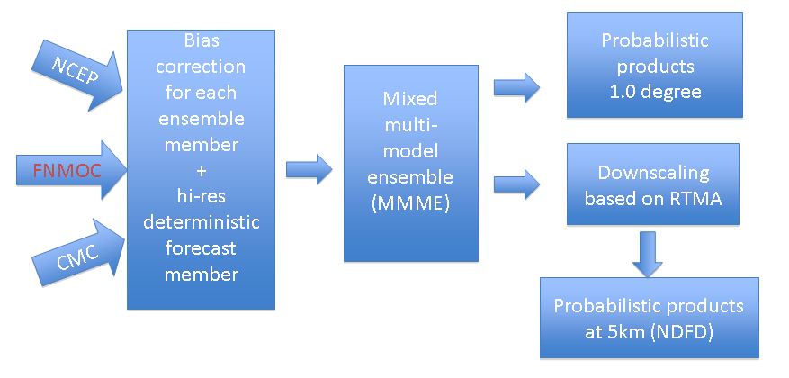
Current NAEFS SPP System
Bias corrected NCEP/CMC GEFS and NCEP/GFS forecast (up to 180 hrs), same bias correction algorithm
Combine bias corrected NCEP/GFS and NCEP/GEFS ensemble forecasts
Dual resolution ensemble approach for short lead time
NCEP/GFS has higher weights at short lead time
NAEFS products
Combine NCEP/GEFS (20m) and CMC/GEFS (20m), FNMOC ens. will be added soon
Produce Ensemble mean, spread, mode, 10% 50%(median) and 90% probability forecast at 1*1 degree resolution
Climate anomaly (percentile) forecasts also generated for ens. mean
Statistical downscaling
Use RTMA as reference - NDGD resolution (5km/6km), CONUS and Alaska
Generate mean, mode, 10%, 50%(median) and 90% probability forecasts

Slide 33
NAEFS Bias Correction Variables
Variables | pgrba_bc file | Total 49 (3)
GHT | 10, 50, 100, 200, 250, 500, 700, 850, 925, 1000hPa | 10
TMP | 2m, 2mMax, 2mMin, 10, 50, 100, 200, 250, 500, 700, 850, 925, 1000hPa | 13
UGRD | 10m, 10, 50, 100, 200, 250, 500, 700, 850, 925, 1000hPa | 11
VGRD | 10m, 10, 50, 100, 200, 250, 500, 700, 850, 925, 1000hPa | 11
VVEL | 850hPa | 1
PRES | Surface, PRMSL | 2
FLUX (top) | ULWRF (toa - OLR) | 1
New | Td2m, RH2m and Precipitation | 3
NAEFS Downscaled Variables
Variables
Variables | Domains | Resolutions | Total 10/10
Surface Pressure | CONUS/Alaska | 5km/6km | 1/1
2-m temperature | CONUS/Alaska | 5km/6km | 1/1
10-m U component | CONUS/Alaska | 5km/6km | 1/1
10-m V component | CONUS/Alaska | 5km/6km | 1/1
2-m maximum T | CONUS/Alaska | 5km/6km | 1/1
2-m minimum T | CONUS/Alaska | 5km/6km | 1/1
10-m wind speed | CONUS/Alaska | 5km/6km | 1/1
10-m wind direction | CONUS/Alaska | 5km/6km | 1/1
2-m dew-point T | CONUS/Alaska | 5km/6km | 1/1
2-m relative humidity | CONUS/Alaska | 5km/6km | 1/1
33

Slide 34
Future NAEFS Statistical Post-Processing System
NCEP
Probabilistic products at 1*1 (and/or) .5*.5 degree globally
Bias correction for each ensemble member
+
High resolution deterministic forecast
Reforecast
Mixed Multi- Model Ensembles
(MMME)
Others
Statistical
Down-scaling (based on RTMA)
CMC
RBMP
For blender
Smart
initialization
Auto-adjustment of 2nd moment
Probabilistic products at NDGD resolution
(e.g. 2.5km – CONUS)
Varied decaying weights

Slide 35
Expect new products through NAEFS (priority)
All downscaled products are finer resolution.
CONUS – 2.5km
Alaska – 3km
Extend CONUS domain
to North (part of Canada)
to South (part of Mexico)
NAEFS SPP applies to ECMWF ensemble
Bias correction and downscaling
Restrict data
Cloud cover – bias correction and downscaling
Two analysis (AFWA and CLAVR) for bias correction
Implementation time depends on RTMA upgrade
Precipitation?
Suggested to use 6hr forecast as truth for bias correction globally.
Need to find out the difference of CCPA and f06 (already have?)
For CONUS, we will have downscaling step to 2.5km.
Possible other parameters
Visibility
Wind guest
Background information
2-year retrospective runs (full size ensembles and twice per day)
18 years control only runs (every other day)

Slide 36
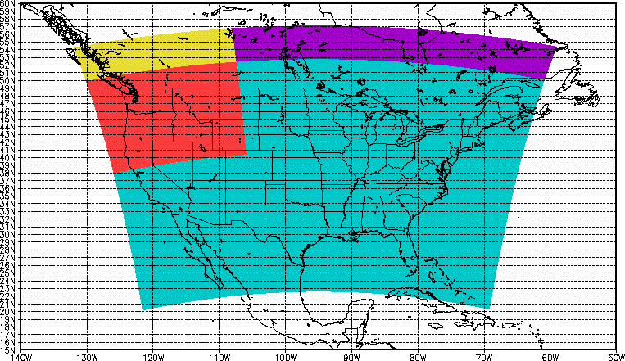
Update of RTMA/URMA
Extend CONUS-2.5km domain to provide support for Northwest River Forecast Center (NWRFC)
NWRFC
NDGD CONUS
AQUA + RED Areas: NDGD CONUS domain
RED + YELLOW Areas: NWRFC domain produced at NCEP and shipped to WFO Seattle
PURPLE: Extended area currently not disseminated
Courtesy of Manuel Pondeca

Slide 37
Climatology Calibrated Precipitation Analysis
Background - (QPF bias correction in NCEP)
Implemented on 2004 (HPC, CPC endorsed)
Bias corrected GFS/GEFS forecasts
At 2.5 degree resolution, every 24 hours, using Gauge (12UTC-12UTC)
Using decay average (or Kalman Filter) method for sampling
Using frequency match algorithm for CDF of OBS/FCST
Climatological Calibrated Precipitation Analysis (CCPA)
Use CPC unified analysis at 1/8 degree, daily, global land - reliability
Use RFC/QPE (stage IV) 5km resolution, 6-h(CONUS) – resolution
Use regression method to generate a and b from above two datasets
Produce CCPA analysis ( CCPA = a*QPErfc + b)
Resolution is 5km (NDGD) grid (and subsets) for CONUS
Update every year by apply longer stage IV to produce better regression coefficients
Important Applications
Improving QPF/PQPF bias correction – GEFS, NAEFS, SREF and etc…
Statistical downscaling QPF/PQPF forecast for GEFS, NAEFS, SREF and etc…
HPC daily precipitation analysis products – CCPA web products (2012)
Daily precipitation verifications (WPC and EMC map discussion)
Future NAM’s precipitation analysis (replaced CPC’s analysis)
Hydrological application – OHD and RFC
Research Communities
Reference
Publication: http://journals.ametsoc.org/doi/abs/10.1175/JHM-D-11-0140.1
Web display (EMC): http://www.emc.ncep.noaa.gov/gmb/yluo/CCPA.html

Slide 38
CSTAR Program
CSTAR - Collaborative Science, Technology, and Applied Research Program
Collaborate with SUNYSB, EMC, HPC, OPC of NCEP and ESRL
Predictability of high impact weather during the cool season over the eastern U.S: from model assessment to the role of the forecaster
Produce daily ensemble sensitivity analysis maps based on
NCEP GEFS
CMC GEFS
ECMWF GEFS (passwd protected)
A set of variables
MSLP and 500hPa height
CSTAR web-site: http://dendrite.somas.stonybrook.edu/CSTAR/
EMC web-site: http://www.emc.ncep.noaa.gov/gmb/yluo/CSTAR/

Slide 39
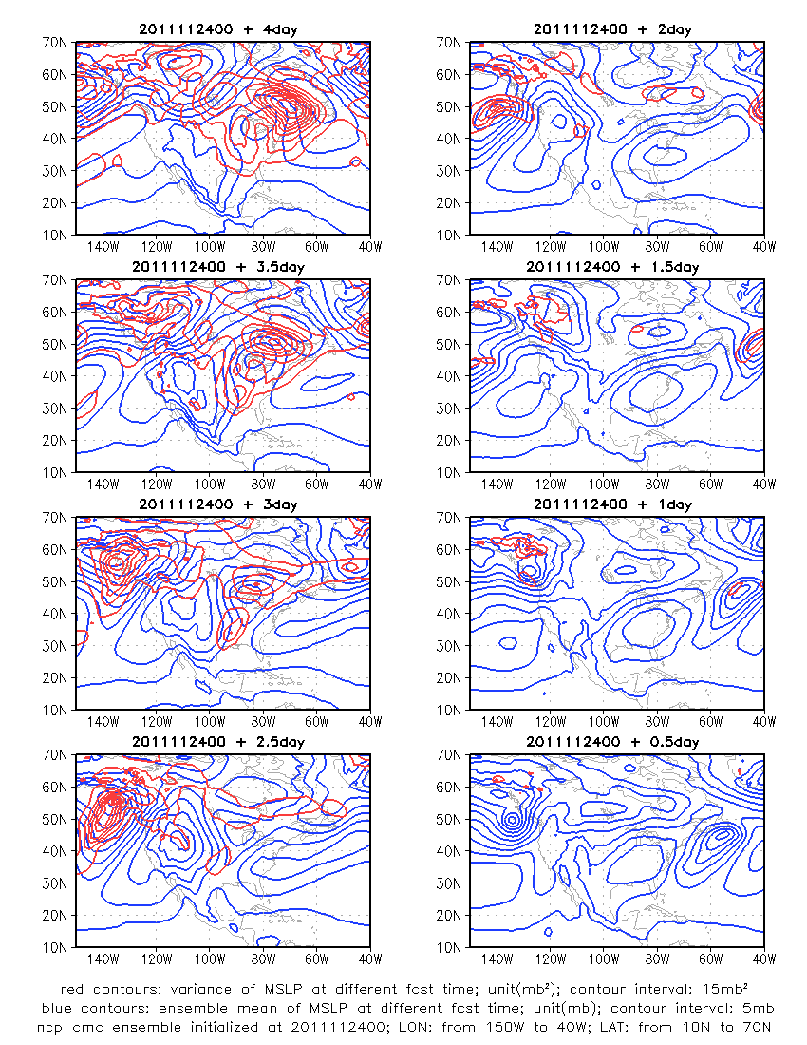
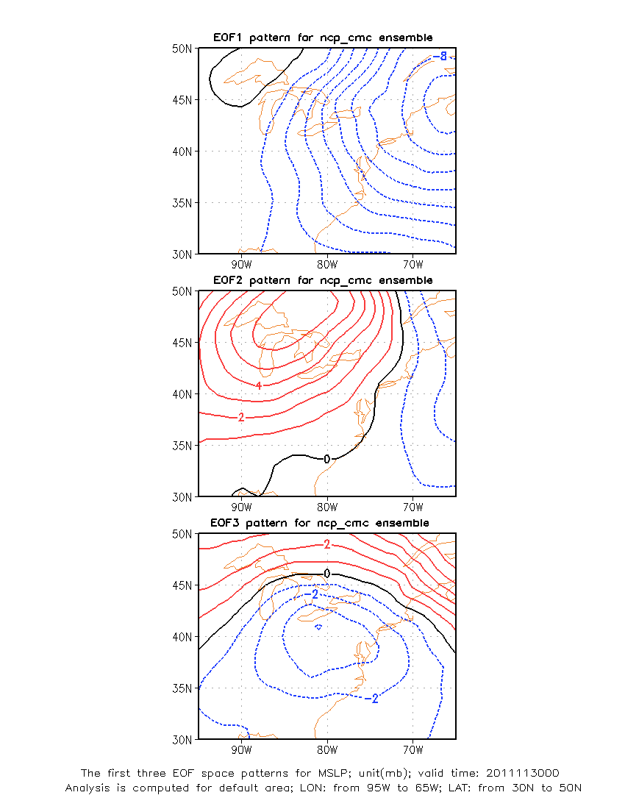
Daily maps to support CSTAR program for winter season

Slide 40
GEFS/NAEFS Product/Data Distribution
System | Current available products
Config. | deg 0-384h, every 6 hours, 20 members (NCEP) and 20 members (CMC), ens. control (NCEP and CMC)
Format | GRIB1 (and GRIB2, GIF images for web display)
CCS | NCEP: pgrba, pgrbb, pgrba_bc, pgrba_an, pgrba_wt, ensstat, ndgd CMC: pgrba, pgrba_bc, pgrba_an, pgrba_wt, ensstat NAEFS: ndgd, pgrba_an, pgrba_bc
NCEP FTPPRD | ftp://ftpprd.ncep.noaa.gov/pub/data/nccf/com/gens/prod cd gefs.${yyyymmdd} for NCEP ensemble 1. pgrb2a (00, 06, 12 and 18UTC) (1.0 degree, all lead times, 1(c) + 20 (p)) 2. pgrb2alr (00, 06, 12 and 18UTC (2.5 degree, all lead times, 1(c) +20 (p)) 2. pgrb2b (00, 06, 12 and 18UTC) (1.0 degree, all lead times, 1(c) + 20 (p)) 4. pgrb2blr (00 and 12UTC) (2.5 degree, all lead times, 1(c) + 20 (p)) 5. ensstat (00UTC) (prcp_bc, pqpf and pqpf_bc files) 6. wafs (00 and 12UTC) 7. ndgd_gb2 (00, 06, 12, 18UTC) (CONUS-5km, all lead times and all probability forecasts) ftp://ftpprd.ncep.noaa.gov/pub/data/nccf/com/gens/prod cd cmce.${yyyymmdd} for CMC ensemble 1. pgrba (00 and 12UTC) (1.0 degree, all lead times,1 control + 20 members) ftp://ftpprd.ncep.noaa.gov/pub/data/nccf/com/gens/prod cd naefs.${yyyymmdd} for NAEFS products 1. pgrb2a_an (00, 12UTC) (1.0 degree, all lead times, anomaly for ensemble mean) 2. pgrb2a_bc (00,12UTC) (1.0 degree, all lead times, probabilistic forecasts) 3. ndgd_gb2 (00,12UTC) (CONUS-5km, all lead times, probabilistic forecasts)
TOC | ftp://tgftp.nws.noaa.gov/SL.us008001/ST.opnl/ cd MT.ensg_CY.${cyc}/RD.${yyyymmdd} for NCEP only 1. PT.grid_DF.gr1_RE.high (00 and 12UTC) (Pgrba: 1.0 and 2.5 degree, 0-384 hrs, c + 10 (p)) 2. PT.grid_DF.gr1_RE.low (00 and 12UTC) (Pgrbb: 1.0 degree, 0-84 hrs, 2.5 d, 90-384 hrs, c + 10 (p)) 3. PT_grid_DF.bb
NOMADS | http://nomads.ncep.noaa.gov (click: GFS Ensemble High Resolution – html ) for NCEP, CMC and FNMOC raw and bias corrected ensemble forecast at all lead time (0-384 hours) http://nomad5.ncep.noaa.gov/pub/gens/archive/ for http: combined pgrba and pgrbb at 1 degree resolution

Slide 41
Ensemble Products on AWIPS?
Ensembles in NCEP operation
22 years anniversary of global ensemble in operation for both NCEP and ECMWF (Dec. 1992)
13 years of regional ensemble (SREF) for NCEP operation (2001)
Current status of ensemble products
NCEP service centers could use all possible ensemble products (information)
But regional office and WFO not, if they rely on AWIPS ……
For example: GEFS/NAEFS
wafs38, wafs39, wafs40 grids (3447 grid points)
00UTC and 12UTC initial forecasts
Every 6 hours out to 192 hours
GFS control + ens control + 10 ensemble members (+/- 5)
22 variables only
T2m and precipitation for all ensemble members (early this year)
What is the expectation from AWIPS II?
We have already developed functionality of probabilistic forecast
SREC - Software Recommendation and Evaluation Committee
Increase bandwidth/storage, setup priorities?
What can we do?
Can we have ensemble mean and spread first on AWIPS?

Slide 42
Extending NCEP GEFS from 16 days to 30 days
Our Strategy
To improve numerical guidance and prediction capability for week 3 & 4 and build up seamless forecast system across all time scales, NCEP is planning to accelerate the development and implementation of extending GEFS to 30 days with the inclusion of one/two way(s) coupling with a thermodynamic ocean. By contrast to NCEP Climate Forecast System (CFS), there are many advantages for extending GEFS to cover the intra-seasonal time range, including
Better initial perturbations to represent analysis errors and initial uncertainties;
Higher resolution continuously from weather to extend range to allow more interactions of different scales;
Advanced model physics with various stochastic perturbations to assimilate model uncertainties;
Large ensemble size (80+4 members for one synoptic day) to provide reliable and skillful forecast;
Acceptable configuration of reforecast/hindcast in real time for calibration;
Seamless forecasts across weather and short-term climate.

Slide 43
Science: Types of couplings for the GEFS
Type 1: Un-coupled
Short and medium range skill benchmark
Experimental runs readily available
Multi-model ensembles (NCEP, CMC, CFSv2)
Bias correction procedures
Type 2: One-way forcing
Perturbed SST – various methods
Predicted and bias corrected SST from CFSv2
Type 3: Two-ways coupling
Suitable coupled GFS model
Coupled to mixed layer model
Coupled perturbations
Coupling with ocean to take either from day-0 or day-10

Slide 44
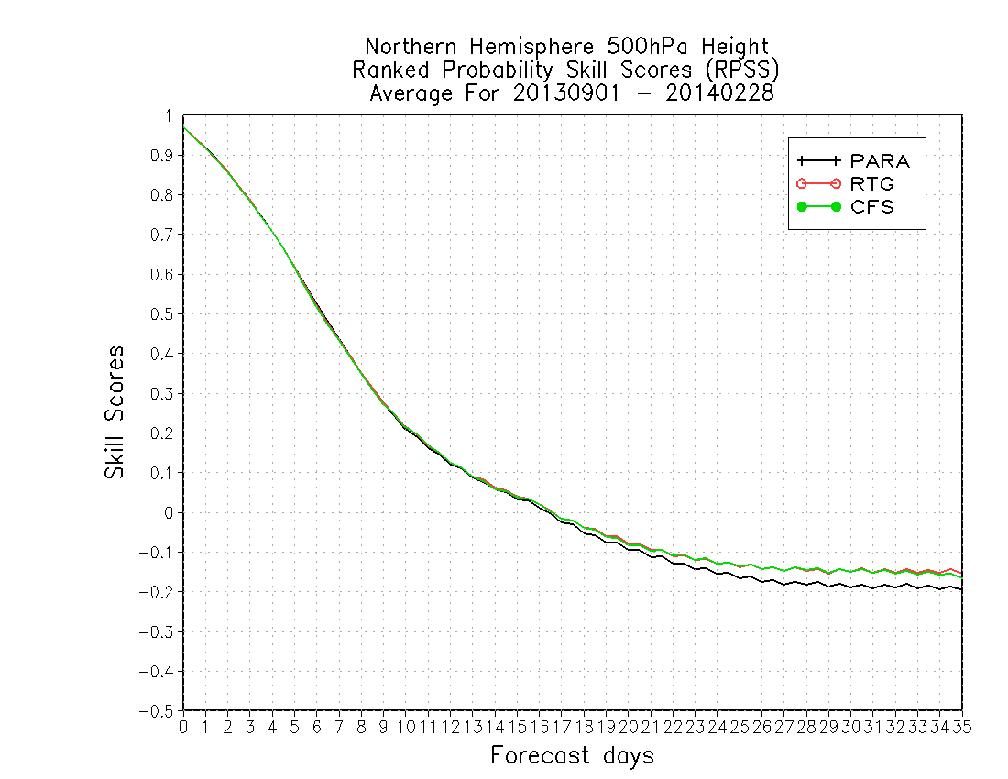
All probabilistic scores (CRPS, RPSS, ROC and etc) show the improvement for all lead time for NH 500hPa height. This is not true for southern hemisphere.
Skill line

Slide 45
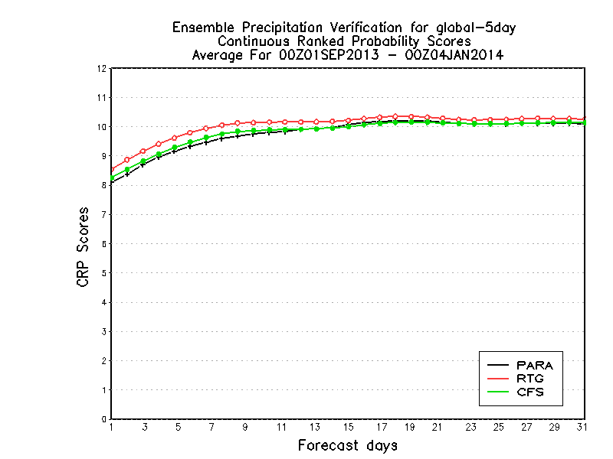
Global precipitation verification 50N-50S Global
5-day average verification - CMORPH
CRPS out to 35 days

Slide 46
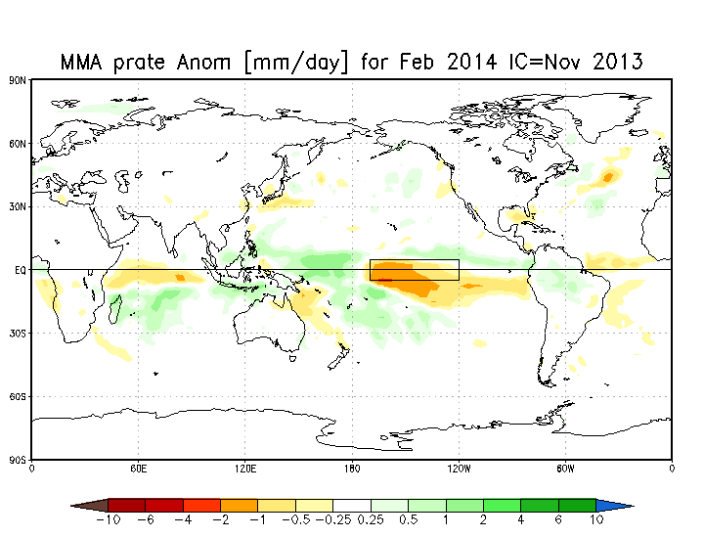
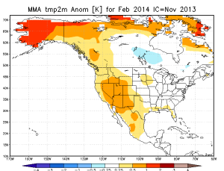
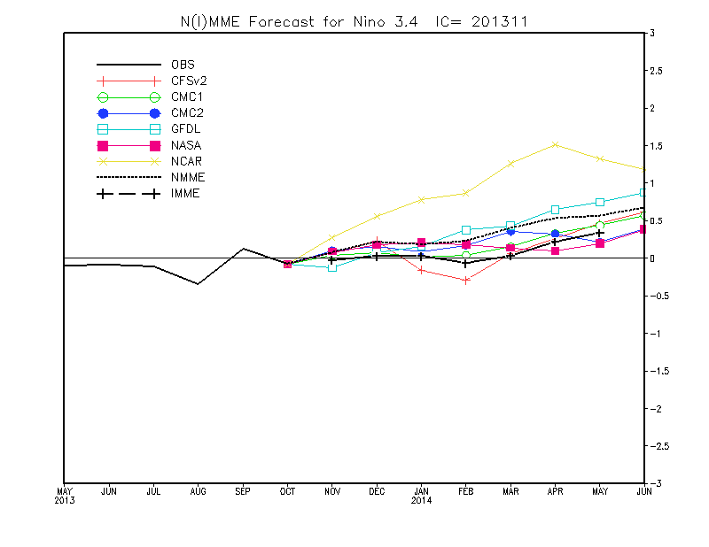
IMME Status – Malaquias Pena
Datasets:
CFSv2, ECMWF, MeteoFrance and MetOffice
Real-time forecasts and corresponding model hindcasts
Leads: 0 to 6 months. Variables: Precip Rate, 2mT, SST
Data process algorithms
Decoding, bias correction, multi-model combination and data display
Created algorithms and transitioned to WCOSS
Created algorithms for model intercomparison prediction skills
Products
Monthly mean forecasts maps: Globe and North America
Niño 3.4 forecast plumes
Posted individual model forecasts on a regular basis in a password-protected website for use by CPC’s forecasters
Developments
Probabilistic forecast products
Sophisticated multi-model combination
Potential to use for seasonal Hurricane prediction

Slide 47
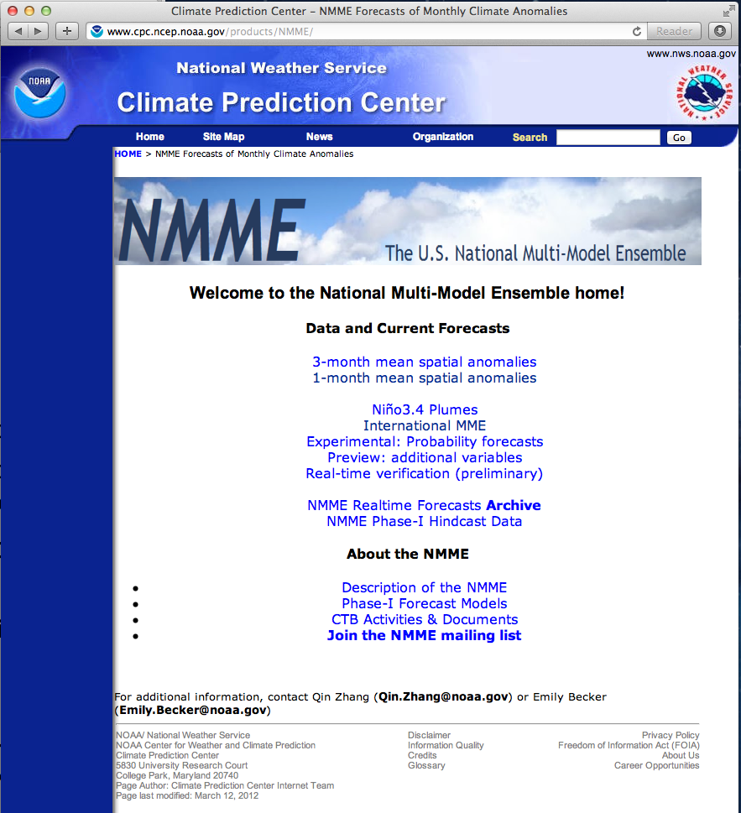
NMME Status – Malaquias Pena
Data process algorithms
Decoding and encoding into a uniform GRIB format
Transitioned algorithms to WCOSS
Forecast verification algorithms
Products are generated by CPC personnel
IMME and NMME share similar product generation strategy
Developments
CFSv2 6hr data format conversion and transfer to NCAR for NMME Phase II

Slide 48
2014 HWRF ensemble Configuration
Use 2014 operational deterministic HWRF model except for
Less vertical resolution: L43 vs. L61;
Smaller D02, D03 domains, same as H213;
No GSI due to lack of GDAS data;
IC/BC Perturbations (large scale): 20 member GEFS.
Model Physics Perturbations (vortex scale):
Stochastic Convective Trigger in SAS: -50hPa to + 50hPa white noise ;
Stochastic boundary layer height perturbations in PBL scheme, -20% to +20%;
Stochastic initial wind speed perturbations with zero mean and -3kts to +3kts.

Slide 49
NCEP Wave Ensemble Forecast System - Contributed by Henrique Alves
Latest Upgrade
July 2014
Three major changes impacting quality of output
New physics Package
Tolman & Chalikov (1996) -> Ardhuin et al (2010)
Spatial resolution increase
From 1d to 0.5d
Initialization/cycling
Effects on spread and accuracy
Longer-term upgrades to NCEP Wave ensembles
2015 and beyond
Increase resolution of forcing fields from 3h to 1h.
Introduce 20 new members: multi-model ensemble.
Downscaling: neural networks for coastal probabilistic forecasts.
Hurricane wave ensembles using HWRF ensembles.

Slide 50
Rescheduled 6th NCEP Ensemble User Workshop 25-27 March 2014, College Park, MD
The workshop brought together developers and users of ensemble forecast systems and products, as well as the research and the applications communities interested in the use of ensembles.
Following topics have been addressed to the workshop during three days course
Review progress on the generation and use of operational products since the 5th workshop that took place in 2011.
Discuss plans for future efforts and collaborations
Define actions to continue support the NWS in its transition from single value to probabilistic forecasting

Slide 51
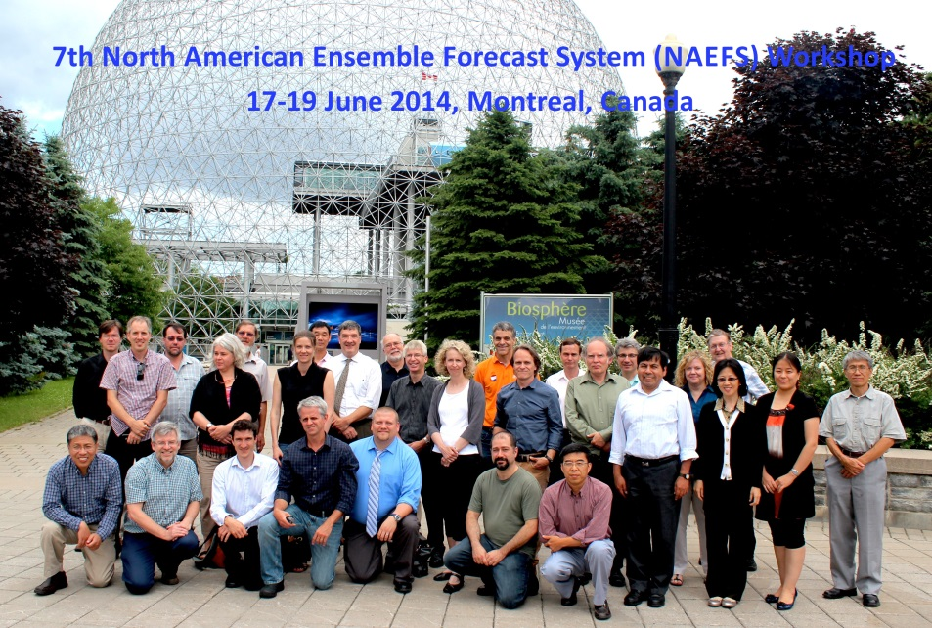
7th NAEFS Workshop in Montreal, Canada
Time: 17-19 June 2014
Locations:
17-18 June – Biosphere, Montreal, Canada
19 June – CMC, Dorval, Canada
Co-chairs: Andre Methot and Yuejian Zhu
Topics (or sessions)
Status and plan of Global ensemble forecast systems;
Operational data management and distribution;
Ensemble verification and validation metrics;
Reforecast, bias correction and post process;
Regional ensemble and data exchange;
Wave ensembles;
Integration of ensemble in forecasts: user feedback and recommendation;
Products – hazard weather, high impact weather and diagnostic variables;
Open discussion of the NAEFS research, development, implementation and operation plan

Slide 52
Background!!!

Slide 53
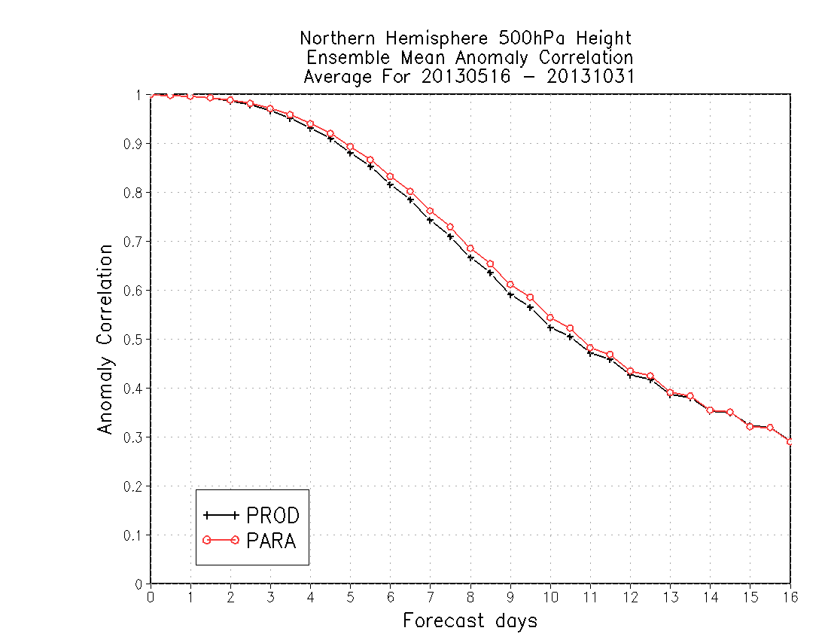
76%
2% improvement of 7-day forecast AC score
74%
9.0d
9.3d
About 8 hours improvement of skillful forecast

Slide 54
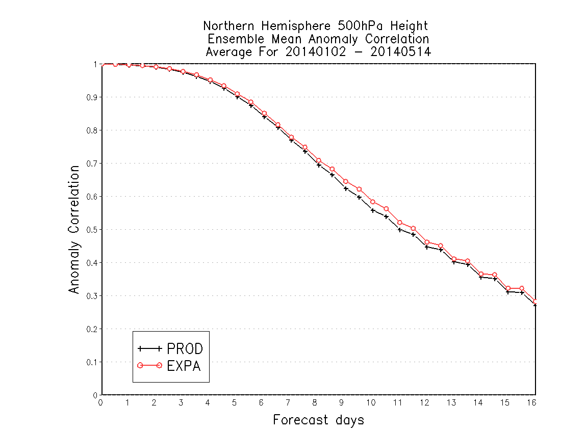
Very good for 7-day forecast AC score
77.5%
9.5d
9.8d
About 6-8 hours improvement of skillful forecast

Slide 55
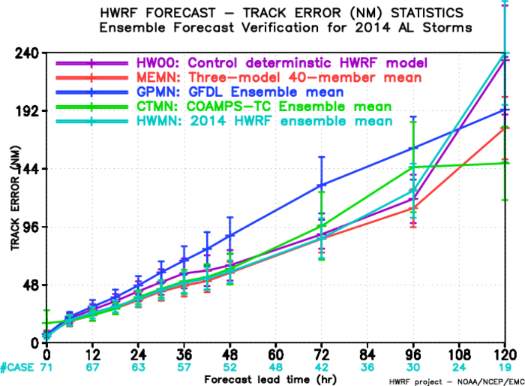
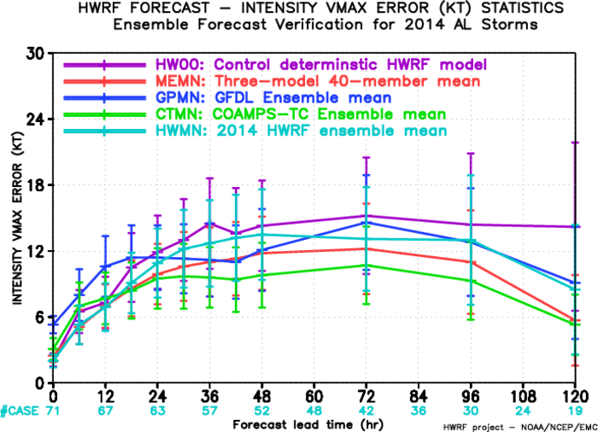
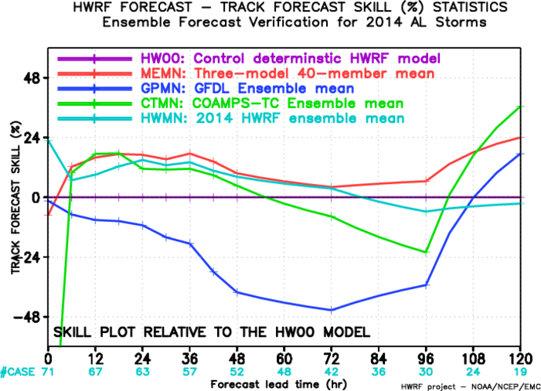
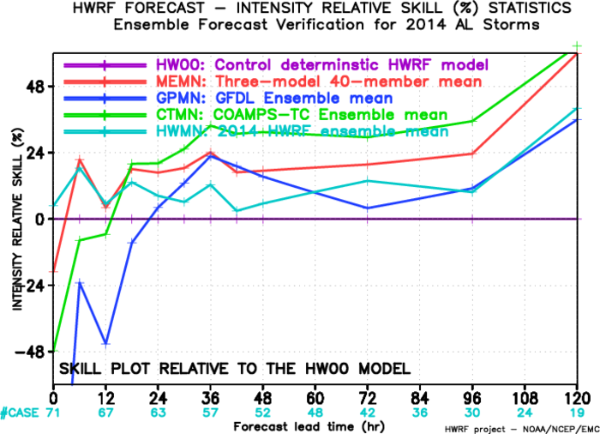
Verification for 2014 Atlantic Storms
Track
Intensity
15%-20% improvement
15%-20% improvement

Slide 56
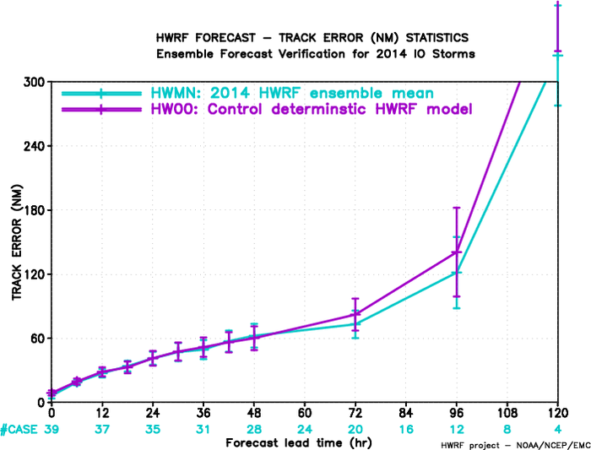
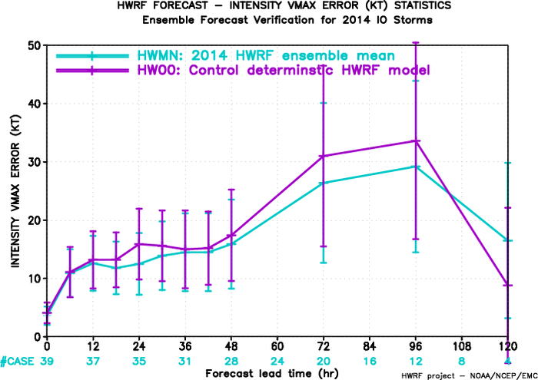
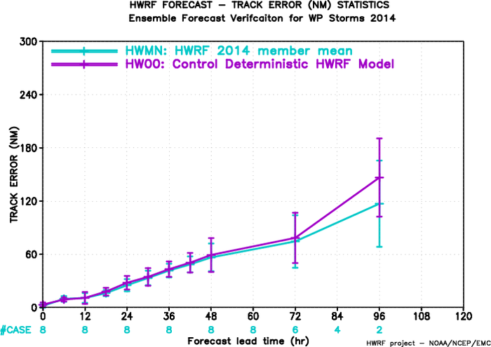
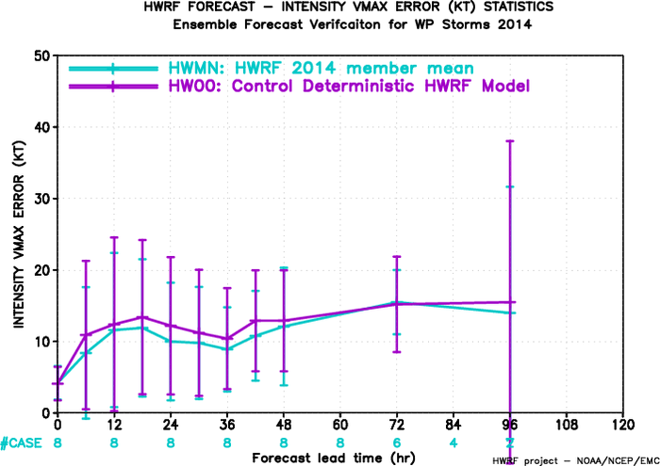
Verification for 2014 IO/WP Storms
Track
Intensity
IO
IO
WP
WP

Slide 57
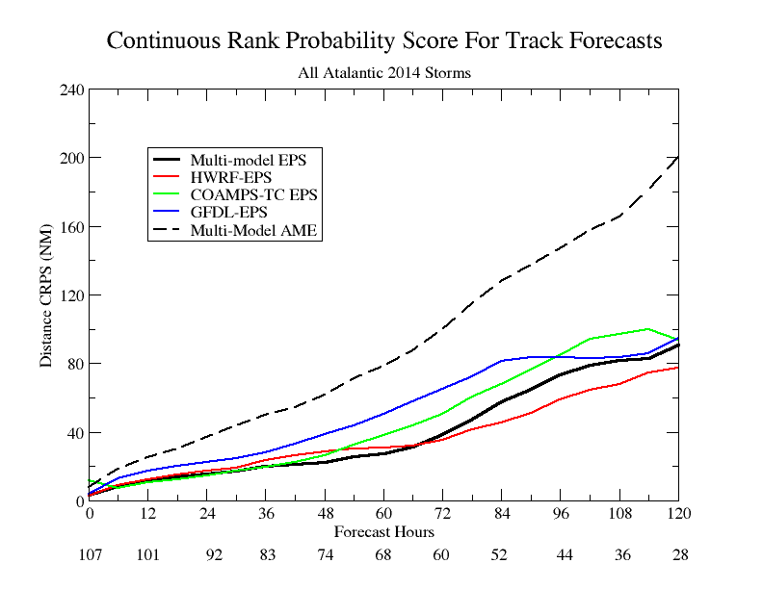
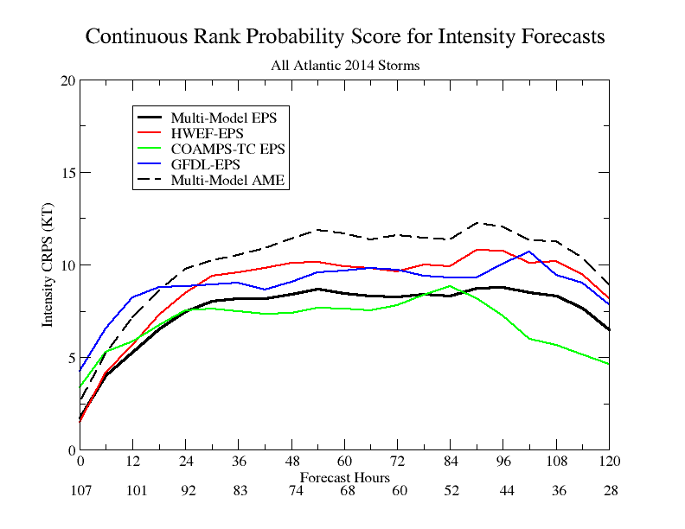
Probabilistic Verification
Continuous Rank Probability Score:
is cumulative distribution, i denotes ensemble member, N is total number of ensemble
H(x) is Heaviside function, which equals 0, when x<0, equals 1, when x>0.
Track
Intensity

