Slide 1
Unifying the global suite
Coupled modeling
Reanalysis and reforecast
Hendrik Tolman, Tom Hamill,
Yuejian Zhu, Suru Saha

Slide 2
Guiding principles
Unifying the global model suite
UCAN recommendation.
From models to application of same model.
HIWPP, R2O, NGGPS.
Reforecasting:
Established need.
New requirement.
Implementation procedure.

Slide 3
HIWPP, R2O NGGPS
Selecting a new core for global modeling
for the next few decades.
Non-hydrostatic global modeling core that will allow us to go to 3km resolution global models.
Has to be able to beat present model.
Tentative funding for dual path for 5 years.
Project over next 18 month.
Selecting new dynamic core from six candidates.
GFDL, NCAR, ERSL, Navy, EMC (2x).
Focus on global, suitable for regional.
EMC intends to put core in NEMS for use throughout suite.
YES WE WILL !!!!!
Adopting core is one thing, but
the key will be community modeling.

Slide 4
Reforecast
A recommended reforecast configuration
for the NCEP GEFS
Tom Hamill, Trevor Alcott, Mark Antolik, James Brown, Mike Charles, Dan Collins, Mark Fresch, Kathryn Gilbert, Hong Guan, Hank Herr, Wallace Hogsett, David Novak, Melissa Ou, David Rudack, Philip Schafer, Michael Scheuerer, Geoff Wagner, John Wagner, Tom Workoff, Bruce Veenhuis, and Yuejian Zhu
NOAA white paper produced in response to tasking subsequent to 2013 NPSR
[pdf here] [pptx here]

Slide 5
Reforecast
Reforecast use
CPC: 6-10 day, 8-14 day tercile forecasts of temp and precipitation over US, week +2 temperature extremes. More products in pipeline, including global products, extended hazards outlook.
OHD: for statistically post-processing of temperature and precipitation to provide input to hydrologic models. Also provides sufficient sample size for testing hydrologic models over many cases.
WPC. For calibrated PQPF. Method and verification here.
SPC. Francisco Alvarez’s (St Louis U., ESRL/GSD) experimental tornado forecast guidance.
NWS Western Region. Situational awareness tool (http://ssd.wrh.noaa.gov/satable/ )

Slide 6
Reforecast
Reforecast issues to address
Actual reforecast configuration:
Smart sampling versus “fixed matrix”.
OHD still assessing needs, will be dynamical …
Retrospective or real-time
Whitepaper says real-time, but in discussion with users we still see different opinions (OHD, EMC).
Business issue: use expensive ops compute or cheaper R&D compute, or even “the cloud”.
Compute:
Real-time ops vs off-line ops vs R&D.
Data distribution: like with CFS data, we need to address systematically how and where to distribute.
EMC in data distribution business?

Slide 7
Implementation procedure
Present approach
Ad-hoc,
Schedule based on available improvements.
Prone to delays to make plans work.
HWRF is exception:
Fixed schedule, before Atlantic Hurricane season.
Schedule driven by time line.
Well defined “gates” working backward from implementation data.
Advantages of HWRF approach:
More predictable upgrade schedule.
Clearer project management and deliverables.
Allow for closer collaboration with users.

Slide 8
Implementation procedure
“Gates” with dates
Select candidate upgrade, dedicate R2O funding.
Select successful R2O results for pre-operational testing and merging.
Freeze code for implementation.
Deliver retrospective model results.
Validate / upgrade downstream products.
Implementation
Key science / business issue to address
Retrospective vs. real-time retrospectives / reforecasts.
Do we want to do downstream together with implementation, or do we sunset old model version later?
Compute, HR, and data distribution resources.

Slide 9
Implementation procedure
Implications of fixed schedule / gated approach:
Implementation becomes continuous process:
Clear place for directed R2O funding to external collaborators.
CFS v3 and v4.
Development of next version starts before present version is implemented.
May have resource issues at EMC.
Effective use of collaboration with research community.
Better project management:
Well defined and clear deliverables.
Previous issues with code delivery.
Previous issues with adding to implementation.
Clearer path to collaborate with users.

Slide 10
Global models
Specific for global models:
GFS in December, minimize retrospectives needed downstream (HWRF).
Tentative “schedule”
TB Discussed
TB Determined
Ideally, we continuously reanalyze and reforecast.
Additional considerations
What are the target products of the three applications?
All coupled and ensemble based?
 | Update Cycle (y) | Reanalysis / reforecast
“GFS” | 1 | 2-4 year
“GEFS” | 2 | From 1999 / 20y
“CFS” | 4 | From 1979

Slide 11
Time to discuss!

Slide 12
Backup slides

Slide 13
Supporting CPC 8-14 day forecast products

Slide 14
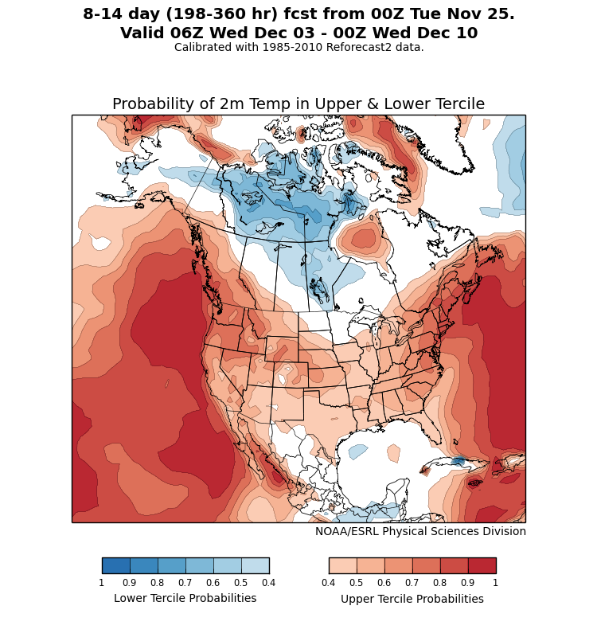
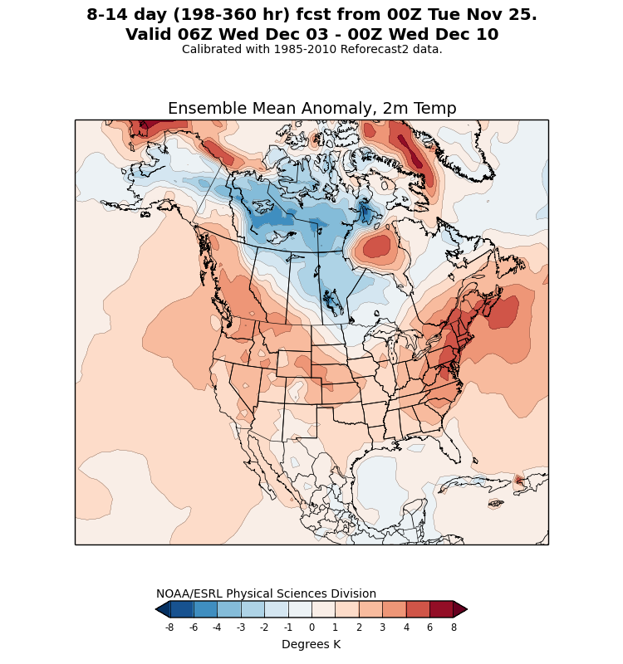
Example: 8-14 day T_{2m} forecast

Slide 15
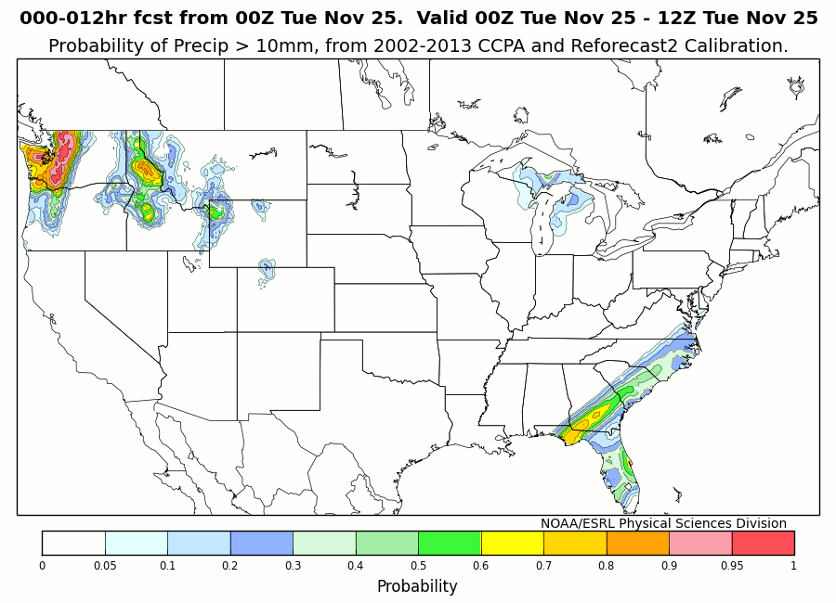
Precipitation forecast products for WPC

Slide 16
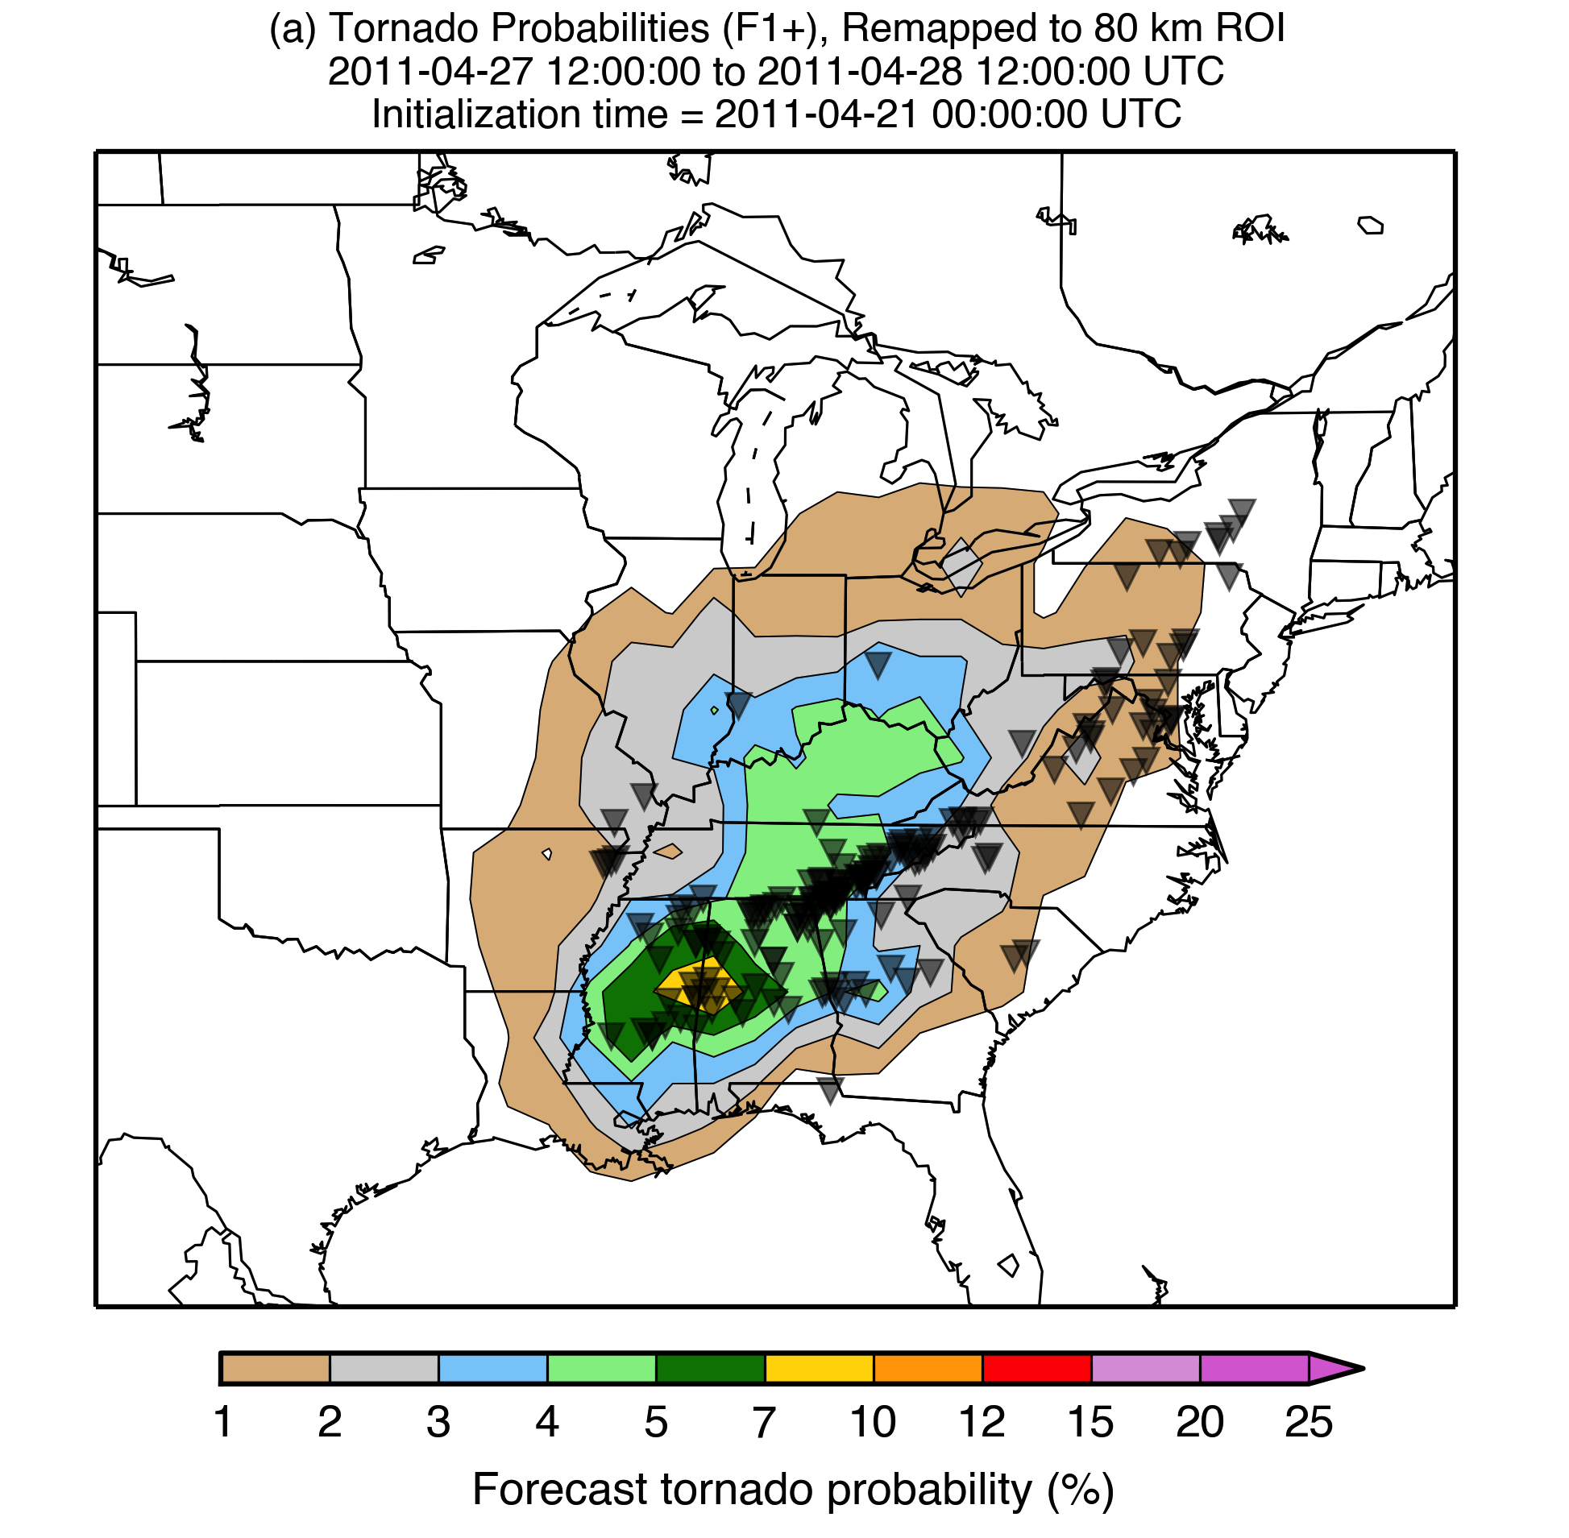
Calibrated tornado forecasts
Objective tornado probabilities for the period 12 UTC 27 April 2011 to 12 UTC 28 April 2011 for forecasts initialized 6 days earlier, based on a reforecast analog procedure
(Tuscaloosa outbreak). Observed tornado locations are shown with the grey inverted triangles.
c/o Francisco Alvarez, ESRL/GSD.

Slide 17
Recommendations
Recommendations of whitepaper
Continue real-time forecasts of 2012 GEFS till replacement reforecasts ready given 30-year, 11 member daily reforecasts exist for this version.
Begin preparations for next-gen reanalysis.
Suggested reforecast configuration:
20 years, 5 members, 2x daily, every 5th day, for 00 and 12 UTC cycle. Adds 50% to GEFS compute.
Provide 2 years of daily retro GFS forecasts also
Provide high-quality retrospective surface analyses with upgraded RTMA to support post-processing.
[link to slides with full recommendations]

Slide 18
Current status and plans
Upon the next GEFS implementation:
00Z cycle, 11 members will continue to be run in near-real time.
1 member x 20 years reforecast generated for next GEFS version in real time.
Preparation begins for a more full GEFS reforecast for the next, next version.
Ideally, we aim to provide 5 members x 20 years x 2 cycles/day x every 5th day.
New reanalysis unlikely to be available for reforecast initialization, so must deal with issues of different statistical character of old CFSR vs. real-time initial conditions.
See example next page.

Slide 19
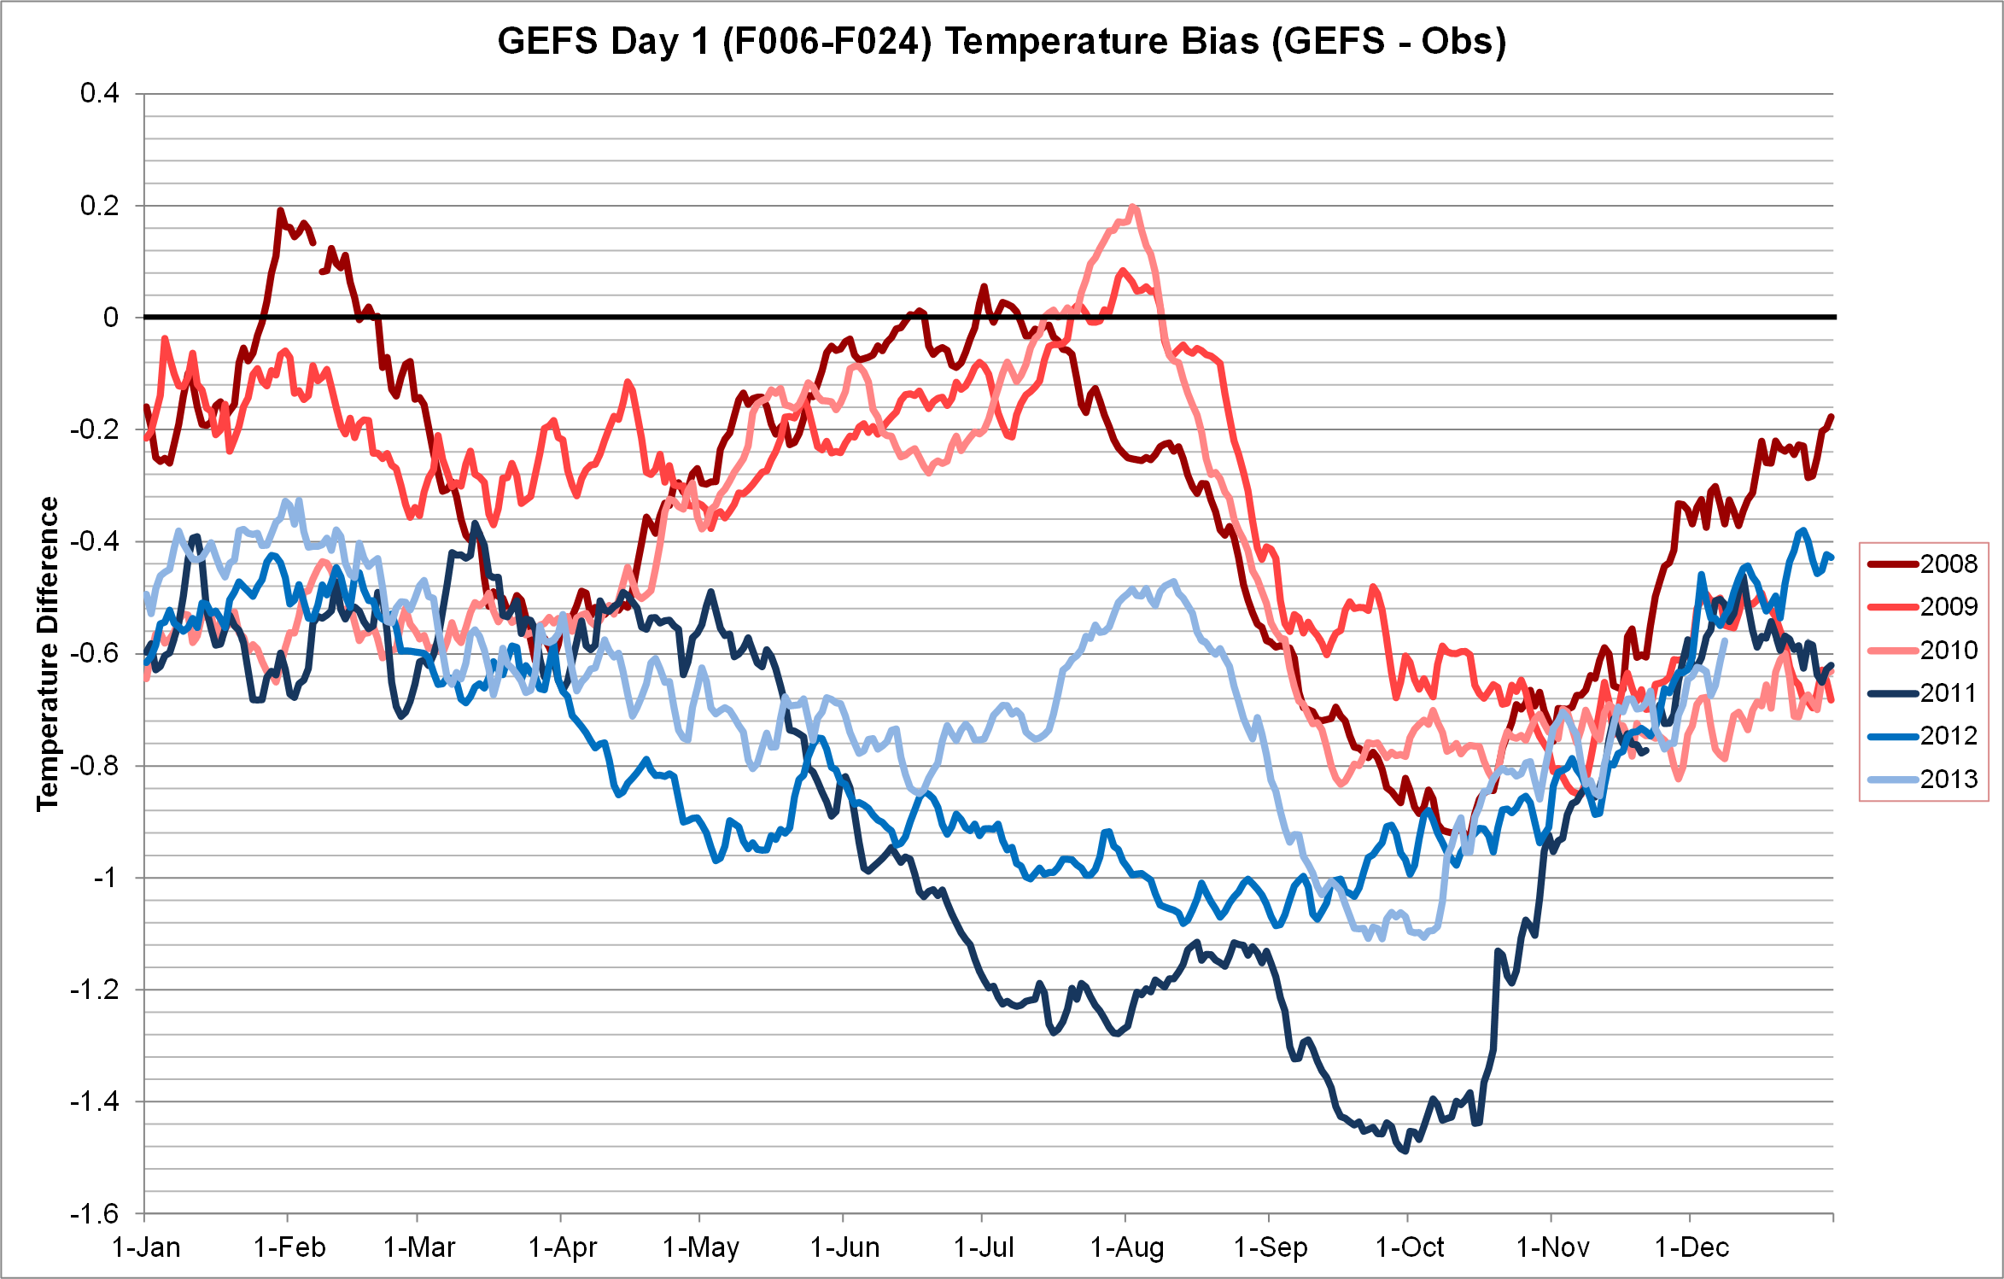
Changing short-term forecast bias due to changes in data assimilation system
c/o CPC for data in S Central US. In 2011, the reforecasts changed from CFSR initialization
to GSI initialization, which used a slightly different version of the forecast model.

Slide 20
Recommendation 1
Until a next-generation reanalysis and reforecast in place and ready for utilization, NCEP/EMC should continue the production of an 11-member GEFS ensemble for the 00 UTC cycle in its current (circa 2012) configuration. These real-time forecasts will be approximately consistent with the GEFS reforecast, so existing products can continue to be generated from them. Given the next-generation GEFS will be higher in resolution, this will be a minor computational expense.

Slide 21
Recommendation 2
NOAA should immediately begin preparations for the production of a next-generation reanalysis to support the reforecast generation process, as well as to facilitate other applications inside and outside of NOAA. The reanalysis configuration should match the operational data assimilation configuration as much as possible. The necessary preparations include determining the computational, storage, and personnel resources needed, as well as organizing the observational data that will be assimilated. The configuration details of the data assimilation system to be used in the reforecast should be decided in consultations between relevant NWS and OAR scientists. We assume that a future reanalysis will be ensemble-based, providing a number of initial analyses suitable for ensemble reforecast initialization.

Slide 22
Recommendation 3
NOAA should prepare to conduct a reforecast using the anticipated operational configuration of the GEFS. We recommend the following configuration for a GEFS reforecast: 20 years, once every 5 days, with 5 members, and twice daily, from the 00 and 12 UTC cycle. This would be an extra 200 members computed every 5 days, compared with the operational 21x4x5 = 420 members computed in those 5 days, i.e., an extra ~50% computational expense. The discussion below will include possible ways to deal with this computational burden.

Slide 23
Recommendation 4
The GFS should have at least 2 years of retrospective forecasts computed for it prior to implementation, given that it is also expected to be post-processed by MDL and used for a variety of applications such as in the blender project. Since typically 6 months of prior forecasts are already computed for quality assurance, this request is rather modest. Skipping days between retrospective samples is acceptable.

Slide 24
Recommendation 5
Given the requirements for NDFD guidance of surface weather elements at high (2.5-km) resolution, NCEP should devote the necessary resources to generate a high-quality retrospective analysis of surface weather with its Real-Time Mesoscale Analysis System.

