Slide 1
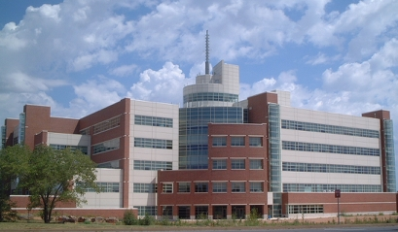
Storm Prediction Center Highlights NCEP Production Suite Review December 2, 2014 Steven Weiss, Israel Jirak, Chris Melick, Andy Dean, Patrick Marsh, and Russ Schneider Storm Prediction Center, Norman, OK
National Weather Center
National Weather Center

Slide 2
Outline
Good news and thanks from SPC
SPC mission and responsibility
Convection-allowing model (CAM) forecasts for some high-impact 2014 severe weather cases
Focus on NAM Nest and HiResW upgrades and HRRR implementation
CAM ensemble systems
How do we move forward operationally as experimental CAM ensembles continue to proliferate?

Slide 3
Thanks From SPC Perspective
Continued very reliable, timely operational model production
Forums for enhanced collaboration are paying dividends
Weekly EMC Model Evaluation Group (MEG) webinars
Bi-Weekly/Monthly EMC-SPC telecons/webinars focusing on convection-allowing model improvements (NAM Nest, HiResWindow)
Bi-Weekly GSD-SPC telecons/webinars focusing on RAP and HRRR development
Improvements in Convection-Allowing Models for severe weather forecasting support
NAM Nest, HiResW NMMB and ARW upgrades
Operational HRRR implementation
Closer integration of model development efforts with severe weather forecasting needs have been occurring – need to maintain momentum
Consistent with NOAA/NWS strategic goals of Weather Ready Nation, Warn on Forecast, and emerging FACETs (Forecasting A Continuum of Environmental Threats (FACETs)

Slide 4
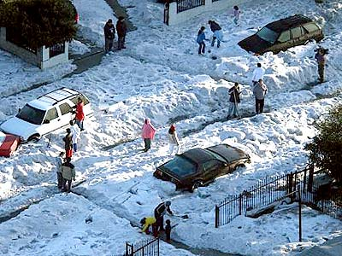
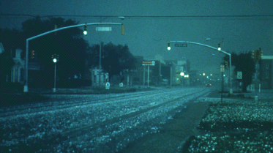
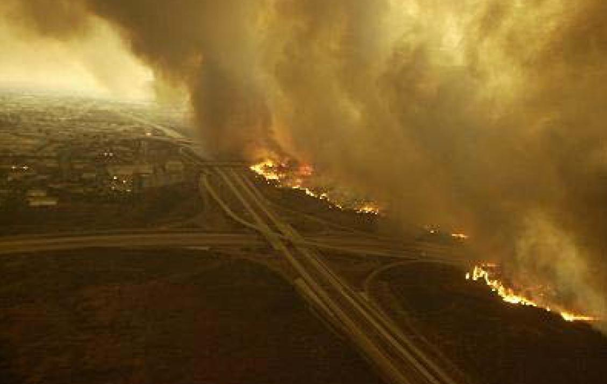
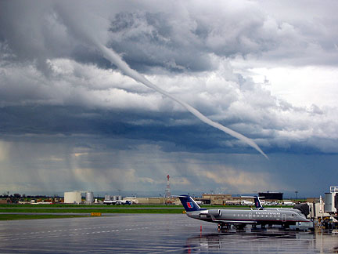
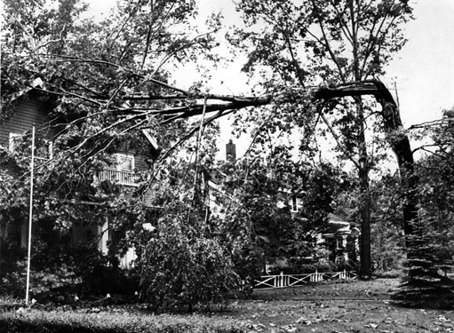
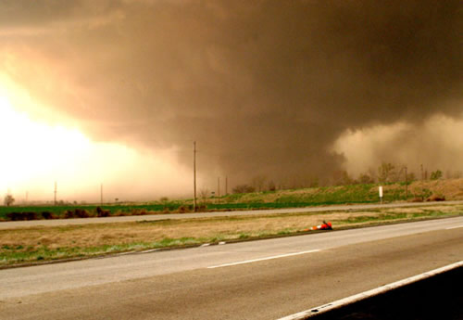
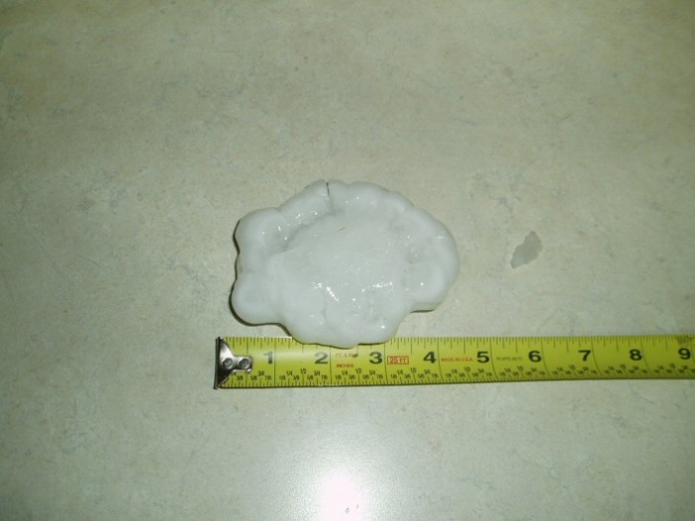
STORM PREDICTION CENTER
HAZARDOUS PHENOMENA
Thunderstorms
Hail, Wind, Tornadoes
Fire Weather
Mesoscale Winter Weather

Slide 5
SPC Mission and Responsibility
Storm Prediction Center Primary Products
Tornado and Severe Thunderstorm Watches (Event-Driven)
Watch Status Reports
Severe Weather Outlooks through Day 8
4-hr Period Enhanced Thunderstorm Outlooks for Day 1
Short-Term Mesoscale Discussions (Event-Driven)
Severe Convective Weather
Hazardous Winter Weather
Fire Weather Outlooks through Day 8
Categorical and Probabilistic Products
Severe Storm Maps, Report Listings, Event Summaries
SPC Mesoscale Analysis, SREF, SSEO, HRRR Pages

Slide 6
Convection-Allowing Model (CAM) Guidance at SPC
SPC forecasters have had access to CAM guidance since 2004
Hazardous Weather Testbed Spring Forecasting Experiment evaluations
Year-round use in SPC operational severe weather forecasting
Primary partnerships with NCEP/EMC, NSSL, ESRL/GSD, OU/CAPS, NCAR, and AFWA
Typical CAM model characteristics
Horizontal grid length ~3-4 km
No parameterized convection
Often “cold-start” from NAM or larger-scale model initial conditions
Since 2007 pioneering work on real-time CAM ensemble systems
CAMs provide unique convective storm forecast guidance
Simulated reflectivity & synthetic satellite imagery
Extraction of storm characteristics using Hourly Max Fields (HMFs)
Updraft helicity, updraft/downdraft speed, 10-m wind, vertically integrated graupel

Slide 7
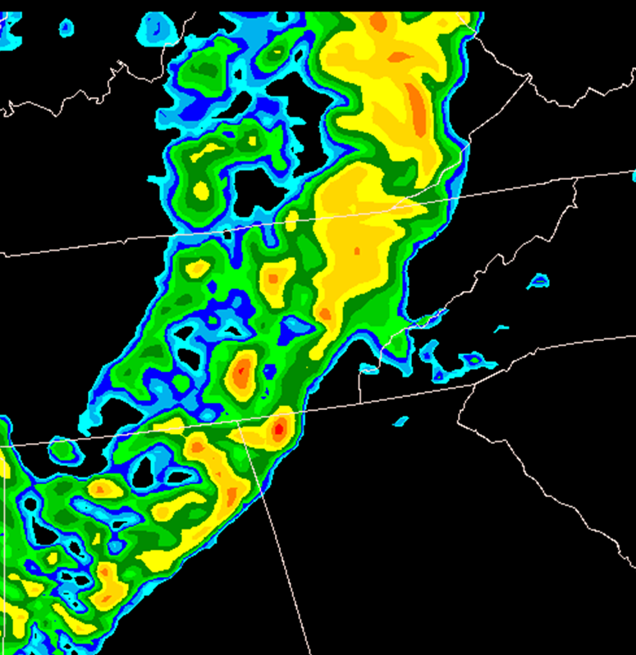
Flashback – NPSR December 2012 Super Outbreak 27-28 April 2011 Images Valid 00z 28 April
NAM 4 km Nest 24-hr forecast of 1 km AGL Simulated Reflectivity
Observed Radar Base Reflectivity Mosaic
Very few intense discrete storms predicted; model storms are too broad/weak and lack realism
Observed radar displayed numerous discrete supercells and several embedded bow echoes
Action: Started SPC-EMC bi-weekly telecons/webinars in Jan. 2013
Goal: Improve convective storm structure, mode and intensity

Slide 8
Summary of Recent EMC Convection-Allowing Model Upgrades
Characteristics | HiResW NMMB | HiResW ARW | NAM Nest
Implementation Date | 11 June 2014 | 11 June 2014 | 12 August 2014
Horizontal Grid | 3.6 km | 4.2 km | 4.0 km
Vertical Levels | 40 | 40 | 60
Initial Conditions | RAP | RAP | NAM
Microphysics | Updated Ferrier | WSM6 | Ferrier-Aligo
PBL/Turbulence | MYJ | YSU | MYJ
Radiation | RRTM | RRTM | RRTM
Conv. Param. | None | None | None
Domain | CONUS | CONUS | CONUS
Forecast Length | 48 hrs | 48 hrs | 60 hrs
Run Times | 00, 12z | 00, 12z | 00, 06,12,18z
A key goal: Improve convective storm structure, mode and intensity so simulated model storms are more similar to those observed by radar

Slide 9
Simulated Composite Reflectivity 22-hr Forecasts Valid 22z 20 May 2013 Vertical Cross-Section (top); Plan View (bottom)
Experiments with New Ferrier-Aligo Microphysics => More intense, realistic storms

Slide 10
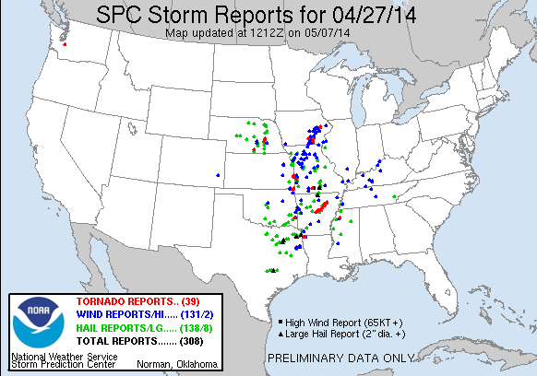
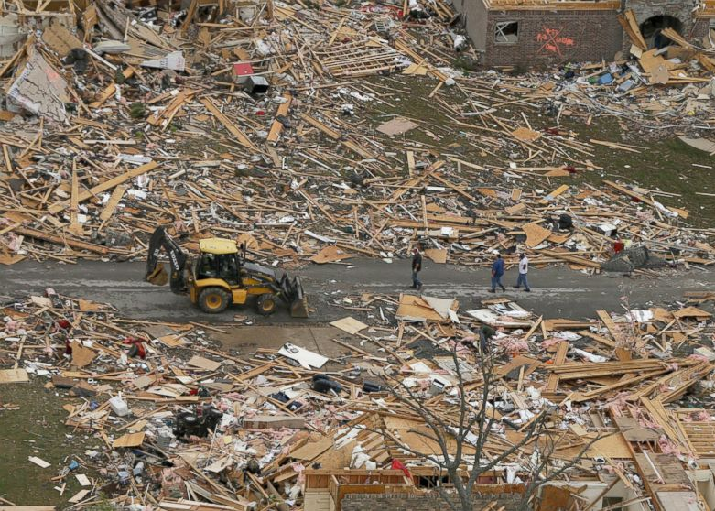
April 27, 2014
High Risk Over Parts of AR
Significant Tornadoes in AR and MS including one EF-4 tornado
19 Fatalities including 16 in Mayflower-Vilonia AR (41 mile path length)
Deadliest Single Tornado in AR Since May 15, 1968
Destroyed Homes in Mayflower, AR

Slide 11
NAM Nest Comparison 24-hr Forecast Valid 00z 28 April 2014
NAM Nest Parallel
NAM Nest Operational
Parallel NAM Nest shows more intense, smaller-scale storm details
Most intense storms correctly predicted over central AR by parallel, whereas operational run has broader region of strong storms
Observed Radar

Slide 12
HiResW NMMB Comparison 24-hr Forecast Valid 00z 28 April 2014
HiResW NMMB Parallel
HiResW WRF-NMM Operational
Neither HiResW NMMB nor WRF-NMM highlighted central AR region
Both have limited storm coverage
NMMB parallel focuses too far west
WRF-NMM operational too far east
Observed Radar

Slide 13
HiResW ARW Comparison 24-hr Forecast Valid 00z 28 April 2014
HiResW ARW Parallel
HiResW
ARW
Operational
Parallel HiResW ARW has more intense storms, especially over eastern AR (but too far east)
Parallel considered an improvement over operational, which focused weaker storms over MO
Observed Radar

Slide 14
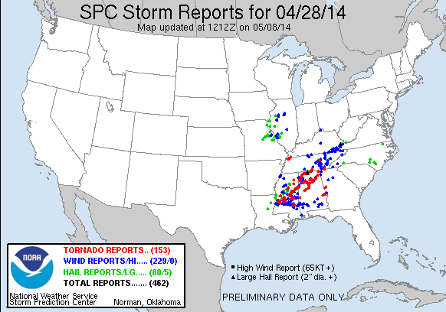
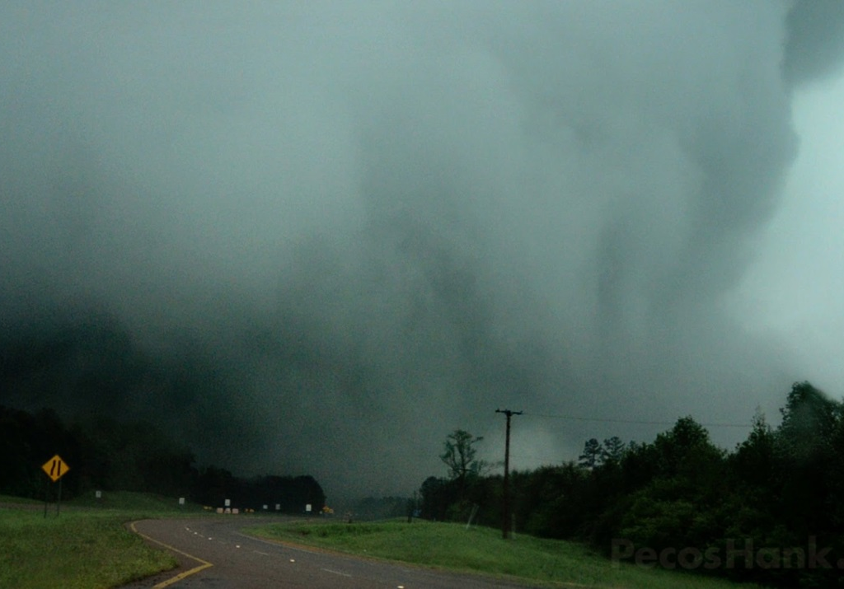
April 28, 2014
High Risk Over Parts of MS and AL
Significant Tornadoes in MS, AL and TN including EF-4 with 34 mile path length
15 Fatalities (10 in MS)
Also Hail to Baseball Size Tornado Near Louisville, MS

Slide 15
NAM Nest Comparison 22-hr Forecast Valid 22z 28 April 2014
NAM Nest Parallel
NAM Nest Operational
Parallel NAM Nest shows more intense storms and is more similar to observed radar
Both runs predict NE-SW oriented band of storms
Observed Radar

Slide 16
HiResW NMMB Comparison 22-hr Forecast Valid 22z 28 April 2014
HiResW NMMB Parallel
HiResW WRF-NMM Operational
Neither run predicts primary linear mode
Parallel HiResW NMMB has improved storm details and is better indicating threat over northern MS, but is too slow with eastward progression
Observed Radar

Slide 17
HiResW ARW Comparison 22-hr Forecast Valid 22z 28 April 2014
HiResW ARW Parallel
HiResW ARW Operational
Both runs indicate linear structure displaced to the southeast
HiResW ARW parallel appears to develop too strong a cold pool evidenced by bowing structure
Storms are more intense in parallel
Observed Radar

Slide 18
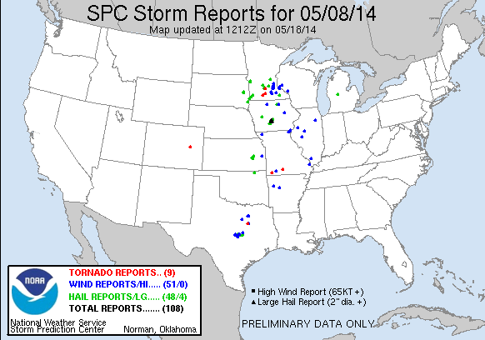
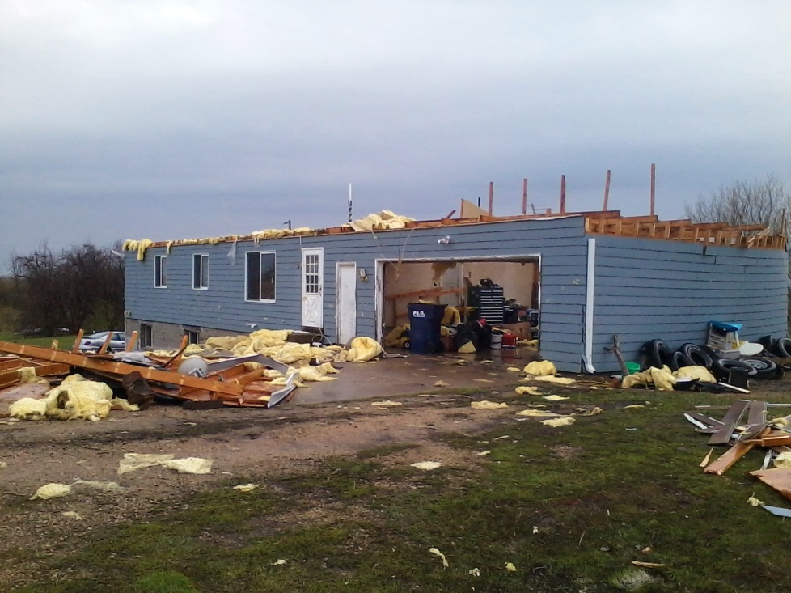
May 8, 2014
Moderate Risk Parts of MN and IA
Wind Damage, Significant Hail, and Weak Tornadoes
Case Occurred During HWT Spring Forecasting Experiment
House Damage in Red Wing, MN

Slide 19
NAM Nest Comparison 20-hr Forecast Valid 20z 8 May 2014
NAM Nest Parallel
NAM Nest Operational
Parallel NAM Nest shows more intense, smaller-scale storm details
Improved over Iowa with weaker reflectivity
Both runs predict spurious storms over eastern SD and northern WI
Observed Radar

Slide 20
HiResW NMMB Comparison 20-hr Forecast Valid 20z 8 May 2014
HiResW NMMB Parallel
HiResW WRF-NMM Operational
Parallel HiResW ARW was much better over MN than operational run
RAP initial conditions may have contributed to improved performance
Observed Radar

Slide 21
HiResW ARW Comparison 20-hr Forecast Valid 20z 8 May 2014
HiResW ARW Parallel
HiResW ARW Operational
Parallel HiResW ARW was much better over MN than operational run
RAP initial conditions may have contributed to improved performance
Observed Radar

Slide 22
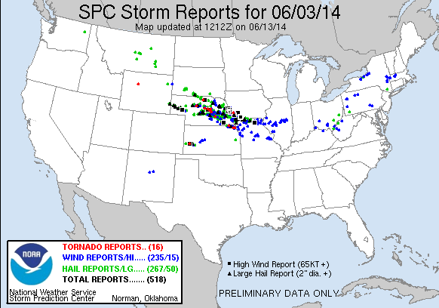
June 3, 2014
Major Severe Weather Event Over Central Plains and Lower MO Valley
Series of Severe Storms Caused Tornadoes and Significant Hail/Wind
Substantial Flooding parts of NE and IA including Omaha Metro
Hail to Softball Size and Winds to 90 mph Baseball Hail in Norfolk, NE

Slide 23
NAM Nest Comparison 24-hr Forecast Valid 00z 4 June 2014
NAM Nest Parallel
NAM Nest Operational
Parallel NAM Nest shows more intense, smaller-scale storm details, but is worse with storm coverage and NW-SE axis of observed severe storms
Observed Radar

Slide 24
HiResW NMMB Comparison 24-hr Forecast Valid 00z 4 June 2014
HiResW NMMB Parallel
HiResW WRF-NMM Operational
Parallel HiResW NMMB shows smaller-scale storms, but similar location and coverage
Neither run captures the NW-SE axis of severe storms
Observed Radar

Slide 25
HiResW ARW Comparison 24-hr Forecast Valid 00z 4 June 2014
HiResW ARW Parallel
HiResW ARW Operational
Parallel HiResW ARW is much improved with intensity, location, and coverage of storms within the severe storm axis
Observed Radar

Slide 26
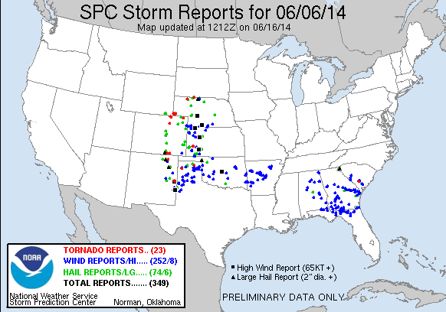
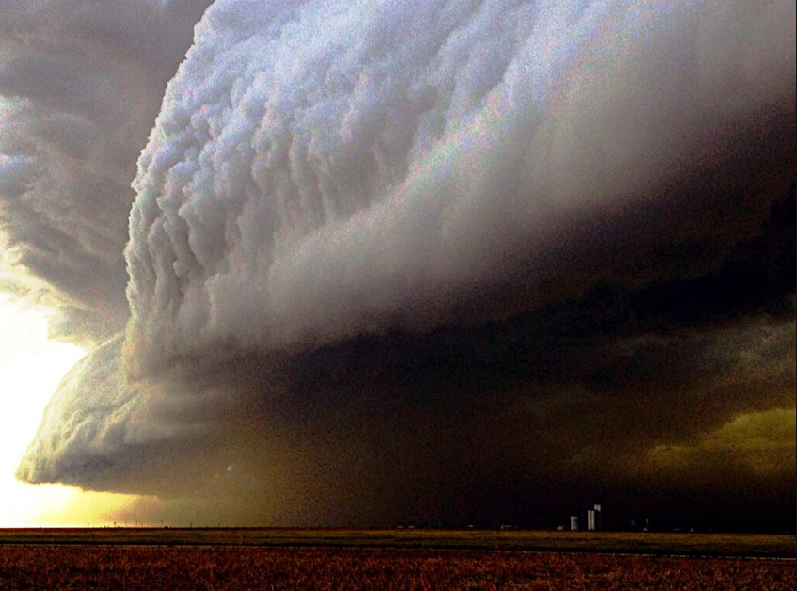
June 6, 2014
Severe Weather Event Over Central & Southern High Plains
Bowing Squall Lines Moved Eastward Producing Tornadoes and Significant Hail & Wind in CO, NM, NE, KS, and TX
Last Day of HWT Spring Forecasting Experiment
Hail to Baseball Size and Winds to 85 mph Storm near Scott City, KS

Slide 27
NAM Nest Comparison 27-hr Forecast Valid 03z 7 June 2014
NAM Nest Parallel
NAM Nest Operational
Parallel NAM Nest shows smaller-scale storm details
Parallel and operational runs show similar placement and coverage of predicted storms, with north-south extent too limited
Observed Radar

Slide 28
HiResW NMMB Comparison 27-hr Forecast Valid 03z 7 June 2014
HiResW NMMB Parallel
HiResW WRF-NMM Operational
Parallel HiResW NMMB has more limited storm coverage
Operational run provided better overall guidance despite displacement error to the west
Observed Radar

Slide 29
HiResW ARW Comparison 27-hr Forecast Valid 03z 7 June 2014
HiResW ARW Parallel
HiResW ARW Operational
Similarly, parallel HiResW ARW storm coverage was more limited in north-south extent
Operational run provided better overall guidance
Observed Radar

Slide 30
Subjective Comparison of Operational and Parallel Runs During HWT Spring Forecasting Experiment
Focusing on reflectivity and UH forecasts for severe weather guidance, parallel runs subjectively rated as good as or better than the operational model:
HiResW ARW – 18 out of 23 days
HiResW NMMB – 21 out of 23 days
NAM Nest – 17 out of 23 days
NAM Nest HiResW ARW HiResW NMMB
Parallel Better
Parallel Better

Slide 31
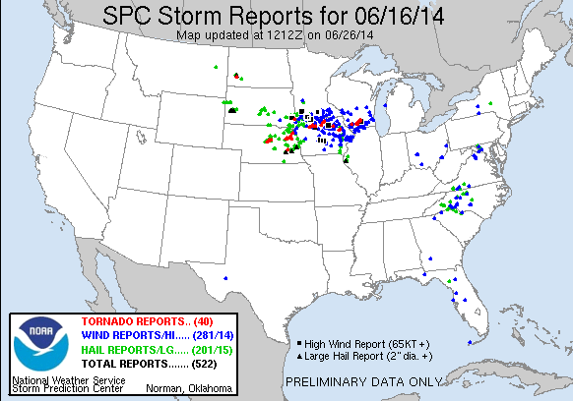
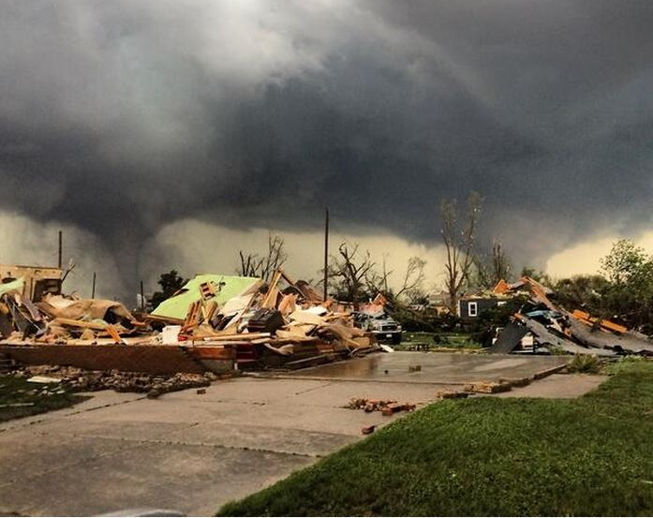
June 16, 2014
Significant Severe Weather Event Over Midwest
At least four EF-4 Tornadoes in Northeast Nebraska
Only 2 Fatalities in Sparsely Populated Area Despite Direct Hit of Pilger, NE
Hail to Softball Size and Winds to 95 mph Twin Tornadoes in Pilger, NE

Slide 32
NAM Nest and HiResW 21-hr Forecast Valid 21z 16 June 2014
NAM Nest
HiResW NMMB
Observed Radar
HiResW ARW
Pilger Storm

Slide 33
NAM Nest and HiResW 24-hr Forecast Valid 00z 17 June 2014
NAM Nest
HiResW NMMB
NAM Nest Performed Well with Primary Severe Storm Complex But Missed Pilger, NE Storm
HiResW Runs Performed Poorly and Did Not Predict Observed Convective Storm Evolution
Observed Radar
HiResW ARW

Slide 34
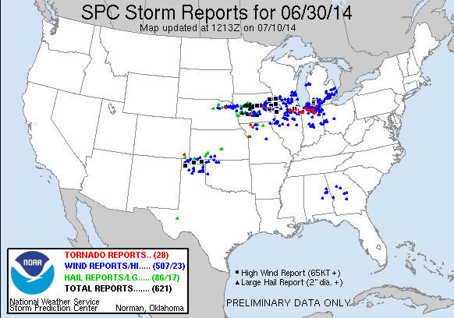
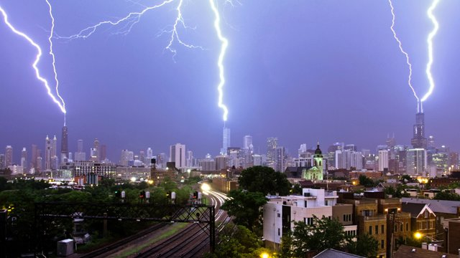
June 30, 2014
Significant Severe Weather Event Over Midwest
Two Derecho-Producing MCSs Tracked Along Similar Paths
Systems Moved at 50-60 kt Forward Speed
Widespread Wind Damage and Several EF-1 Tornadoes
Hail to Baseball Size and Winds to 90 mph Lightning Time Lapse Over Chicago

Slide 35
June 30, 2014
System 1
Chicago was hit by two derecho systems over a 4-hour period. The first struck around 00z and the second between 03-04z.
We’ll look at the 24- and 27-hr forecasts valid at 00z and 03z.
System 2

Slide 36
NAM Nest and HiResW 24-hr Forecast Valid 00z 1 July 2014
NAM Nest
HiResW NMMB
Models did not capture well Derecho 1 although NAM Nest did show a QLCS across WI
NAM Nest correctly indicated a second QLCS across eastern IA; HiResW runs were slow developing 2nd system
Observed Radar
HiResW ARW
Derecho 1
Derecho 2

Slide 37
NAM Nest and HiResW 27-hr Forecast Valid 03z 1 July 2014
NAM Nest
HiResW NMMB
NAM Nest was quite good predicting second QLCS
HiResW runs “caught up” to some extent but were slow with northern part of system
Observed Radar
HiResW ARW

Slide 38
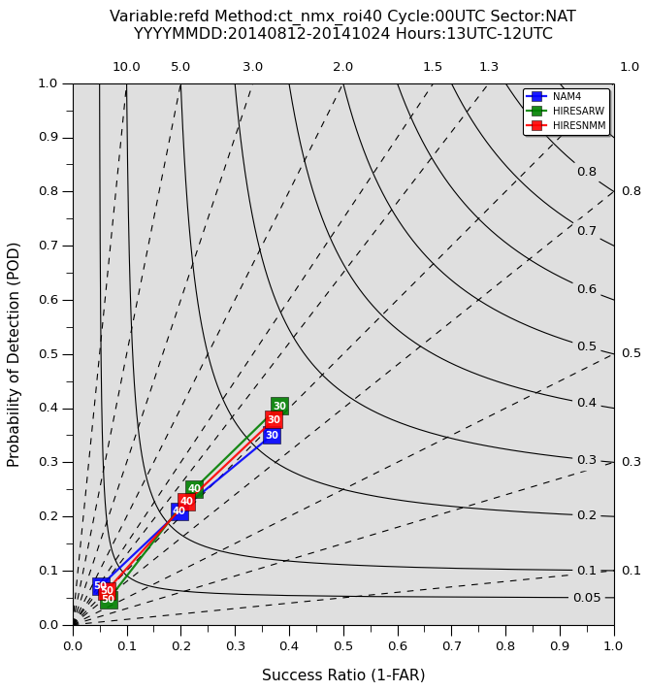
HiResW & NAM Nest Objective Verification Performance Diagram – Reflectivity
Neighborhood verification (ROI=40 km) of reflectivity (13 Aug 2014 – 22 Nov 2014)
Period after new NAM implementation
Objective verification of reflectivity forecasts using a spatial neighborhood method
Performance of NAM Nest and HiResW runs is similar
HiResW ARW has slightly higher POD/CSI and lower FAR for 30 & 40 dBZ thresholds
Bias ~1 for all models
Indicates forecasts are equally plausible in statistical sense
Useful for CAM ensemble construction (SSEO)
Higher POD
Bias = 1
CSI
Lower FAR

Slide 39
Summary: NAM Nest & HiResW
New HiResW and NAM Nest models can provide better severe storm guidance compared to previous versions
Improved storm structure, mode, and intensity
HiResW - Full CONUS domain at 00 and 12z
HiResW - Use of RAP initial conditions enhances diversity in CAM suite HiResW - Increased horizontal/vertical resolution
NAM Nest and HiResW – Updated microphysics, diffusion, radiation
But, considerable challenges remain in convective-scale prediction for high-impact weather
Convective storm prediction is very hard to do well (where, when, etc.)
Foundational for Warn on Forecast, FACETs & Weather Ready Nation
Challenges include: Observational data, DA, model dynamic core and physics, information extraction, post-processing, and display, etc.

Slide 40
Use of HRRR Model Guidance at SPC
SPC forecasters have had access to ESRL HRRR grids since April 2010
Also evaluated in HWT Spring Forecasting Experiments
No surprise – HRRR is useful for short-term forecast applications
The NCEP version of the HRRR has a higher reflectivity bias than the ESRL version, but the timeliness and reliability is much improved for the NCEP HRRR
Concept of HRRR run-to-run continuity leading to higher forecaster confidence must be used with caution
Implied spread-skill relationship is better in strongly forced situations
Issues with mixing in the warm-sector PBL lead to conditions that are too warm/dry and occasionally spurious convective initiation

Slide 41
HRRR – September 20, 2014 Strongly Forced Case in Upper Midwest Consistent Model Forecasts Over Many Cycles
Low-Topped Band of Storms in Cool, Low Dew Point Environment
Mainly Wind Damage in Minnesota Storm Clouds Near Crookston, MN

Slide 42
HRRR Run-to-Run Continuity Strongly Forced Case (“Comma Shape”) Images Valid 21z 20 September 2014
Observed Radar 12z Cycle: 9-hr HRRR Forecast Forecast

Slide 43
HRRR Run-to-Run Continuity Strongly Forced Case (“Comma Shape”) Images Valid 21z 20 September 2014
Observed Radar 13z Cycle: 8-hr HRRR Forecast Forecast

Slide 44
HRRR Run-to-Run Continuity Strongly Forced Case (“Comma Shape”) Images Valid 21z 20 September 2014
Observed Radar 14z Cycle: 7-hr HRRR Forecast Forecast

Slide 45
HRRR Run-to-Run Continuity Strongly Forced Case (“Comma Shape”) Images Valid 21z 20 September 2014
Observed Radar 15z Cycle: 6-hr HRRR Forecast Forecast

Slide 46
HRRR Run-to-Run Continuity Strongly Forced Case (“Comma Shape”) Images Valid 21z 20 September 2014
Observed Radar 16z Cycle: 5-hr HRRR Forecast Forecast

Slide 47
HRRR Run-to-Run Continuity Strongly Forced Case (“Comma Shape”) Images Valid 21z 20 September 2014
Observed Radar 17z Cycle: 4-hr HRRR Forecast Forecast

Slide 48
HRRR Run-to-Run Continuity Strongly Forced Case (“Comma Shape”) Images Valid 21z 20 September 2014
Observed Radar 18z Cycle: 3-hr HRRR Forecast Forecast

Slide 49
HRRR Run-to-Run Continuity Strongly Forced Case (“Comma Shape”) Images Valid 21z 20 September 2014
Observed Radar 19z Cycle: 2-hr HRRR Forecast Forecast

Slide 50
HRRR Run-to-Run Continuity Strongly Forced Case (“Comma Shape”) Images Valid 21z 20 September 2014
Observed Radar 20z Cycle: 1-hr HRRR Forecast Forecast
In strongly forced situations, can have more confidence in consistent solutions

Slide 51
HRRR Predicts Spurious Evening Convection over Kansas
Five Consecutive Hourly ESRL HRRR Forecasts Initialized 18-22z Valid 23-06z on 17-18 September 2014

Slide 52
HRRR Forecasts valid 23z 17 Sep 2014 Consecutive Model Runs from 18z, 19z, 20z, 21z and 22z
OBSERVED RADAR

Slide 53
HRRR Forecasts valid 00z 18 Sep 2014 Consecutive Model Runs from 18z, 19z, 20z, 21z and 22z
OBSERVED RADAR

Slide 54
HRRR Forecasts valid 01z 18 Sep 2014 Consecutive Model Runs from 18z, 19z, 20z, 21z and 22z
OBSERVED RADAR

Slide 55
HRRR Forecasts valid 02z 18 Sep 2014 Consecutive Model Runs from 18z, 19z, 20z, 21z and 22z
OBSERVED RADAR

Slide 56
HRRR Forecasts valid 03z 18 Sep 2014 Consecutive Model Runs from 18z, 19z, 20z, 21z and 22z
OBSERVED RADAR

Slide 57
HRRR Forecasts valid 04z 18 Sep 2014 Consecutive Model Runs from 18z, 19z, 20z, 21z and 22z
OBSERVED RADAR

Slide 58
HRRR Forecasts valid 05z 18 Sep 2014 Consecutive Model Runs from 18z, 19z, 20z, 21z and 22z
OBSERVED RADAR

Slide 59
HRRR Forecasts valid 06z 18 Sep 2014 Consecutive Model Runs from 18z, 19z, 20z, 21z and 22z
Summary: HRRR runs consistently predict spurious MCS rather than the elevated convective band to the northeast
OBSERVED RADAR

Slide 60
Summary: HRRR Run-to-Run Consistency and Forecaster Confidence
At times, especially during more strong forced situations, run-to-run continuity can add to forecaster confidence in the utility of the HRRR forecasts
However, there are other times when the HRRR appears to “lock in” to a solution that turns out to be erroneous
The “spread/skill” relationship of time-lagged HRRR forecasts for deep convection can vary substantially
Forecasters should be judicious when applying traditional concepts of run-to-run continuity as a measure of confidence in the forecast accuracy

Slide 61
The New Frontier: Convection-Allowing Ensembles
Lower predictability exists at the convective storm scale
Poor sampling of mesoscale environment (IC uncertainty)
Model physics errors tend to increase at smaller scales
A number of experimental convection-allowing ensemble systems have been developed in recent years
Information about range of convective storm possibilities
Probabilistic information on likelihood of convective storm occurrence, coverage, intensity, and proxy severe storm attributes
CAM ensembles are essential to support Weather Ready Nation high-impact weather needs

Slide 62
2014 Spring Forecasting Experiment Four Convection-Allowing Ensembles
OU/CAPS Storm-Scale Ensemble Forecast (SSEF) System
Since 2007; 60-hr forecasts from 00z; 12z runs began in 2013
Primarily WRF-ARW; 4-km grid spacing; forecasts to 60hrs in 2014
Multi-physics, multi-initial conditions: applies SREF perturbations to NAM ICs
Advanced physics, 3DVAR & radar data assimilation; available for HWT/SFE
SPC Storm-Scale Ensemble of Opportunity (SSEO)
Since 2011; 36-hr forecasts at 00z & 12z; 7 members (2 time-lagged)
Multi-model (ARW, WRF-NMM & NMM-B), multi-physics; ~4-km grid spacing
Uses available deterministic models at SPC to process as an ensemble
Basic data assimilation through NDAS; available year-round in SPC
Air Force Weather Agency (AFWA) Ensemble
Since 2012; 60-hr forecasts at 00z & 12z; 10 members; 4-km grid spacing
Single model (WRF-ARW), multi-physics, multi-initial conditions
Cold start from downscaled global model forecasts (GFS, UM, CMC)
No data assimilation; available year-round in SPC
National Severe Storms Laboratory (NSSL) WRF Ensemble
First year; 36-hr forecasts at 00Z; 9 members; 4-km grid spacing
Single model (WRF-ARW), single-physics, multi-initial conditions
Cold start from 3-h forecasts of selected SREF members; year-round in SPC

Slide 63
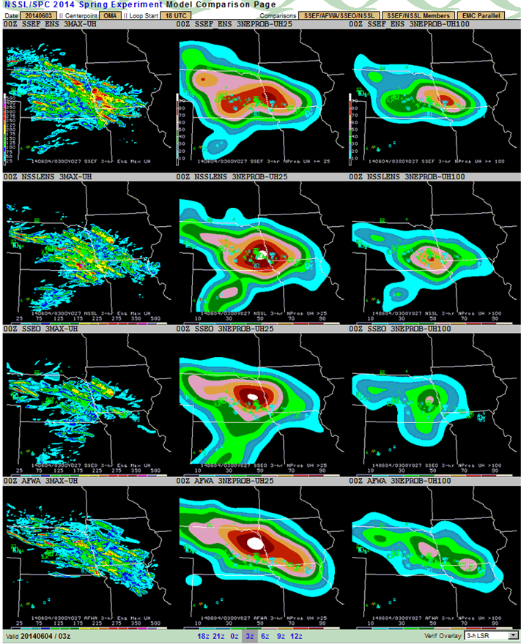
2014 HWT CAM Ensemble UH Forecasts Max; Nprob>25;Nprob>100; Valid 21-00z 3 June 2014
CAPS SSEF
NSSL Ens.
SPC SSEO
AFWA Ens.
Max From Any Member NProb UH>25 m2/s2 NProb UH>100 m2/s2
Despite differences in CAM ensemble configurations and degree of complexity in data assimilation, IC/LBC perturbations, model and physics diversity, etc., overall performance was often similar on many days

Slide 64
HWT CAM Ensemble Subjective Evaluation Hourly Probability of Reflectivity > 40 dBZ by Rating Category
SSEF: Equal number of “Poor” and “Good” forecasts
SSEO: Mostly “Fair” forecasts (middle rating category)
AFWA: Mostly “Fair” forecasts with broadest distribution of ratings
NSSL: Mostly “Fair” and “Good” ratings

Slide 65
HWT CAM Ensemble Subjective Evaluation Hourly Probability of Reflectivity > 40 dBZ by Weighted Average
Overall scores very similar when applying weighted average across the ratings
Continues to suggest that CAM ensemble performance is similar regardless of system configuration and degree of complexity

Slide 66
More Research Efforts on CAM Ensembles (But wait, there’s more)
NCAR has been developing an EnKF-based Mesoscale/CAM Ensemble System since 2011
Considerably improved by 2013 for MPEX forecasting support
Goal for 2015: CONUS 10 member, 3 km ARW Ensemble with forecasts to 48 hrs and run daily in real-time for at least 1 year
Initialized by downscaling 10 analysis members of a continuously cycling EnKF 15 km mesoscale system comprised of 50 members
Blending of ensemble DA and prediction model can result in more dynamically consistent initialization and forecast process
NCAR Ensemble expected to part of HWT Spring Experiment and available for assessment in SPC operations (pending approval of HPC request)
This will be CAM ensemble #5 - How many ensembles are too many?
Help! Organized community-wide collaboration is clearly needed

Slide 67
More Research Efforts on CAM Ensembles (But wait, there’s more)
For CAM ensembles, we are approaching where we were 5-10 years ago with deterministic CAMs
To enhance R2O/O2R process, considerable collaboration across the research and operational communities is needed to identify approaches feasible for operational implementation of CAM ensemble(s)
HWT is positioned to play a key role in the assessment process
Many key issues remain - will require sophisticated verification methods
Multi-model versus single model
Necessary horizontal and vertical resolution
Scale-appropriate sources and perturbation strategies for ICs/LBCs
Physics diversity and level of complexity
Innovative statistical approaches to extract storm-scale information
Creation of reliable probabilistic information for high-impact weather
Operational computing resources will ultimately inform CAM ensemble decision process

Slide 68
More Research Efforts on CAM Ensembles (Provocative Slide to Spur Discussion)
Effective WCOSS utilization is a key foundational component
UCACN Recommendation – Simplify operational model suite and reduce number of modeling systems
Emulate other international modeling centers that have developed a more unified modeling system
Example: As GFS and GEFS approach resolutions of NAM and SREF, are all four systems needed?
Consider creating a team composed of operational forecasters, EMC and research modelers, and stakeholders in government and private sector to discuss and help plan future modeling suite
“Think outside the box” but recognize we will always have resource limits

Slide 69
Two More Slides

Slide 70
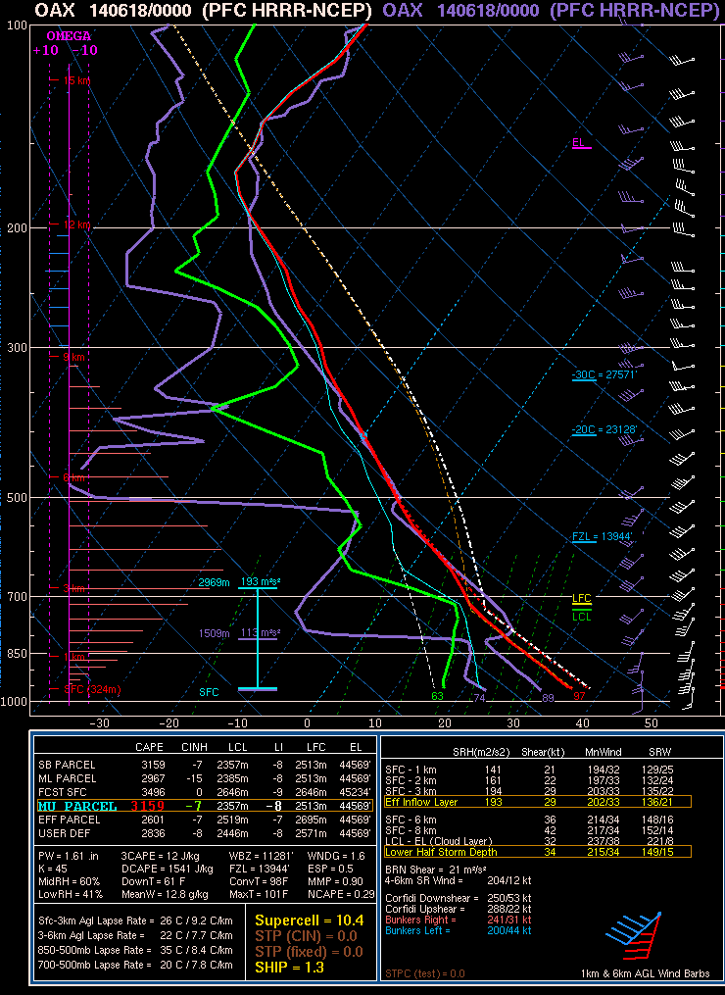
HRRR Performance: Warm-Sector PBL Mixing
The HRRR (and RAP) have a tendency to overmix the PBL, resulting in a boundary layer that is too warm and dry relative to observations.
In this example from 18 June 2014, the HRRR 6-h forecast of surface T/Td valid at 00z was 97/63 while observations showed 89/74.
The boundary layer becomes too deep/well-mixed, which can result in spurious convective initiation.
18Z NCEP HRRR, F006 Valid 00Z 06-18-14
00Z OBS SOUNDING in purple

Slide 71
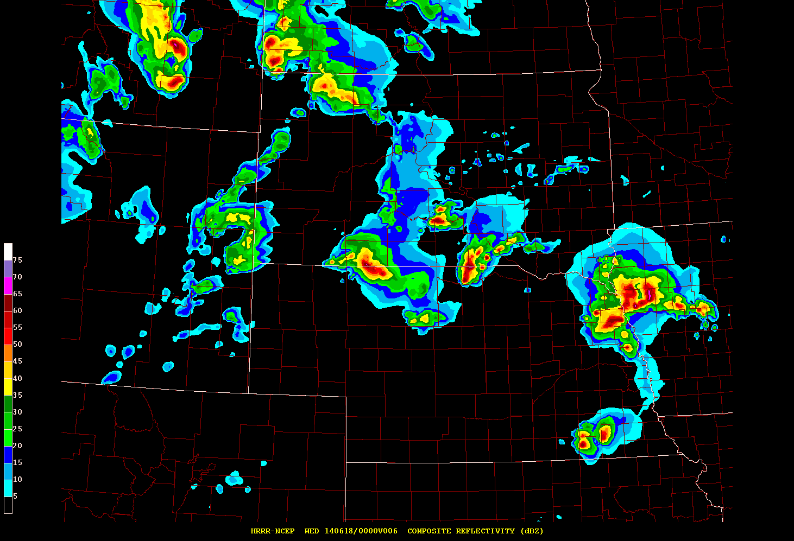
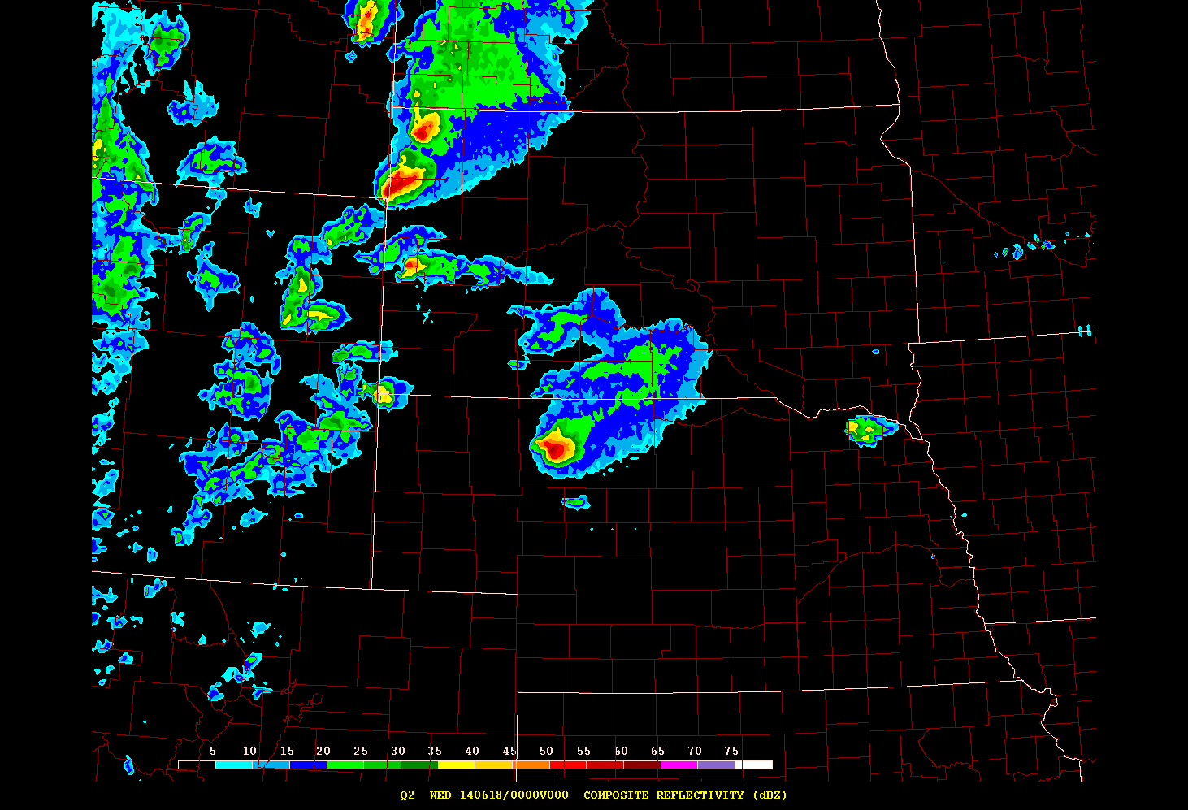
HRRR Performance Issue: Warm-Sector PBL Mixing
6-h forecast Valid 00Z June 18
Radar 00Z June 18
Overmixing in the warm sector for this case led to an area of spurious convection across western Iowa and eastern Nebraska (and it was worse in later runs).
The RAP/HRRR group at ESRL/GSD are working on solutions for this issue.

