Slide 1
NOAA ESRL GSD Earth Modeling Branch
NCEP Production Suite Review 2 -4 December 2014
Hourly updated models:
Rapid Refresh / HRRR review
Rapid Refresh version 3
Scheduled implementation Q3 2015
Upgrades: Thompson aerosol-aware MP,
G-F cum. param., MYNN PBL, RUC LSM,
sat. radiance BC, assim. mesonet, Vr, LTG
RAPv3 improvement over RAPv2
Reduced warm season afternoon/evening
low-level warm/dry bias. Improved
upper-air / storm environmental fields
High-Resolution Rapid Refresh V2
Scheduled implementation Q3 2015
Improved PBL/LSM/cloud physics
Improved radar/PBL assimilation – radial wind, lightning added
Improved storm forecasts from RAPv2/RAPv3 environment fields.
Steve Weygandt Curtis Alexander
Stan Benjamin Ming Hu
Tanya Smirnova Haidao Lin
Joe Olson Eric James
John Brown David Dowell
Georg Grell Jaymes Kenyon
Isidora Jankov Bill Moninger Tracy Smith Brian Jamison
Steven Peckham Kevin Brundage
NOAA NCEP
Geoff Manikin Geoff DiMego
Becky Cosgrove NCO staff

Slide 2
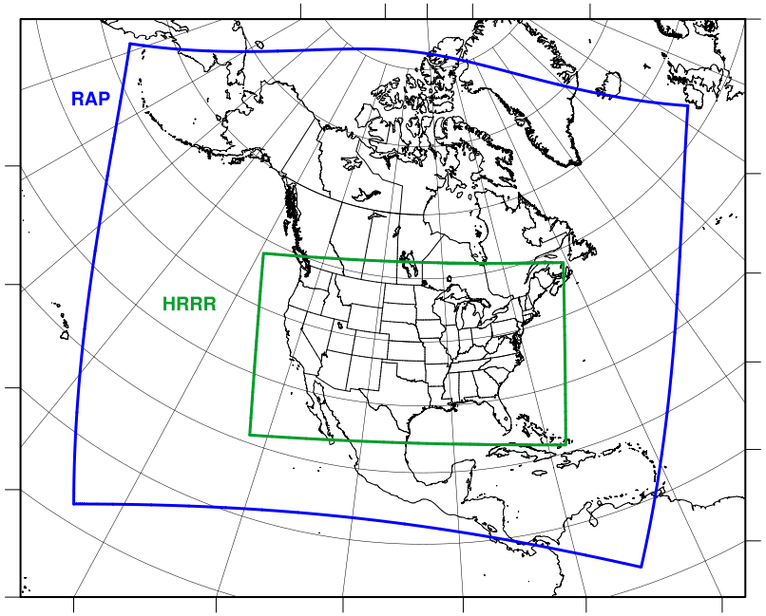
Rapid Refresh and HRRR
NOAA hourly updated models
13km Rapid Refresh (RAP) (mesoscale)
Version 2 -- NCEP implement 25 Feb 2014
Version 3 – GSD
Planned NCEP – Q3 2015
RAP
3km High Resolution Rapid Refresh (HRRR) (storm-scale)
HRRR
Initial -- NCEP
implement 30 Sept 2014
Version 2 – GSD
Planned NCEP – Q3 2015
NCEP Production Suite Review
Rapid Refresh / HRRR
2-3 December 2014

Slide 3
Likely RAP version 3 chnages
Model | Data Assimilation
WRF-ARWv3.6+ Physics changes: Grell-Freitas convective scheme Thompson MP -- Aerosol-aware MYNN PBL -- cloud/non-local mixing RUC LSM -- MODIS seasonal LAI -- improved wilting point Shallow cu parm w/rad feedback RRTMG radiation scheme Direct and diffuse GHI components | Merge with GSI trunk 75% global ensemble BEC weight Radiance bias correction, channel selection, RARS data assimilation Radial velocity assimilation Mesonet assimilation Lightning assimilation Pseudo-PBL obs for temperature Improved 2m T, Td diagnostic Low-reflectivity precip building

Slide 4
RAPv3: Observations used
Hourly Observation Type | Variables Observed | Observation Count
Rawinsonde | Temperature, Humidity, Wind, Pressure | 120
Profiler – NOAA Network | Wind | ~0
Profiler – 915 MHz | Wind, Virtual Temperature | 20-30
Radar – VAD | Wind | 125
Radar | Radial Velocity | 125 radars
Radar reflectivity – CONUS | Rain, Snow, Hail | 1,500,000
Lightning | (proxy reflectivity) | NLDN
Aircraft | Wind, Temperature | 2,000 -15,000
Aircraft - WVSS | Humidity | 0 - 800
Surface/METAR | Temperature, Moisture, Wind, Pressure, Clouds, Visibility, Weather | 2200 - 2500
Surface/Mesonet | Temperature, Moisture, Wind | ~5K-12K
Buoys/ships | Wind, Pressure | 200 - 400
GOES AMVs | Wind | 2000 - 4000
AMSU/HIRS/MHS | Radiances | 5,000
GOES cloud-top press/temp | Cloud Top Height | 100,000
GPS – Precipitable water | Humidity | 260
WindSat Scatterometer | Winds | 2,000 – 10,000
Notes:
Observations of the earth system critical to prediction…the more the better with high-density radar and stat obs

Slide 5
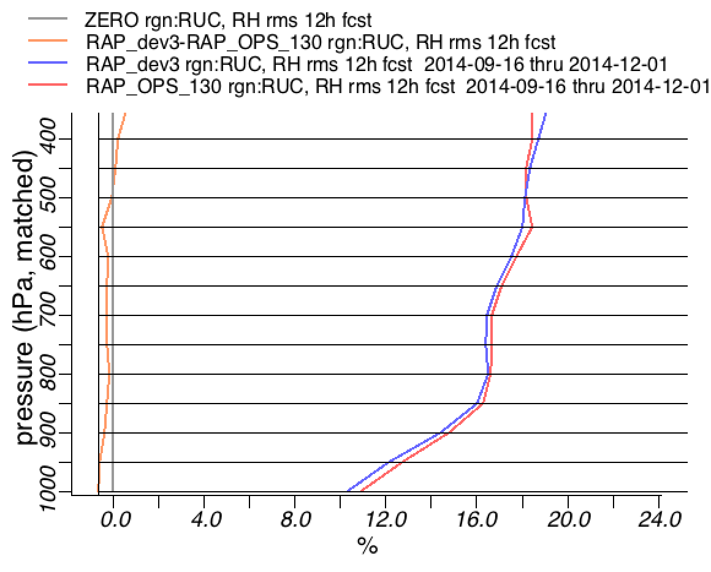
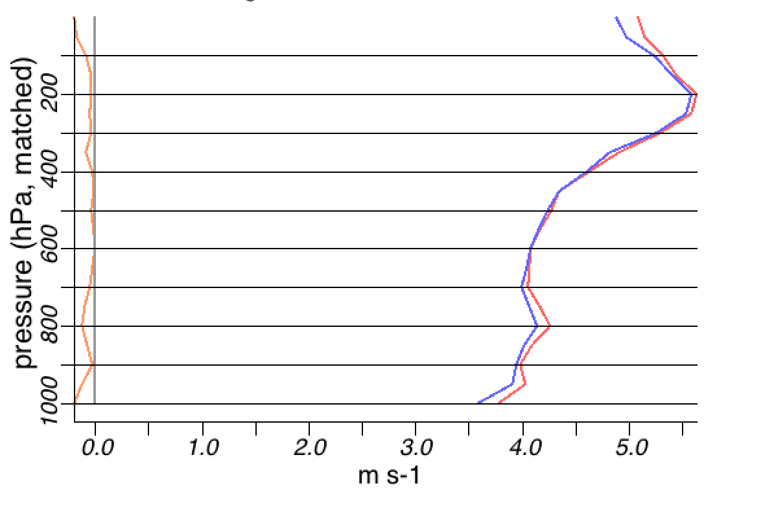
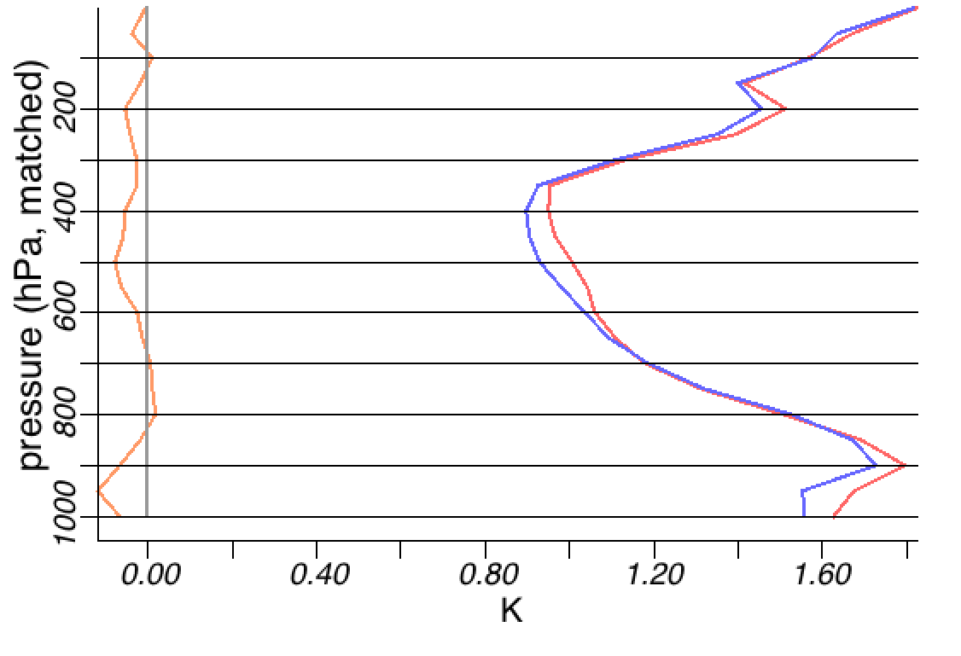
Upper-air: RAPv3 vs. oper RAPv2
Wind
Rel Hum
Better
Worse
Better
Worse
RAPv3
RAPv2
upper-air verification
+ 12 h forecast
RMS Error
Temp
15 Sept – 1 Dec 2014
Better
Worse

Slide 6
Wind RMS (m/s) [1000-1000 hPa]
RAP 2013 obs impact
-20%
RAP data impact
-- North America
-- May 2013 experiments
-- 12z and 00z combined
+3h +6h +9h +12h
Relative Humidity RMS (%) [1000-400 hPa]
-20%
Normalize: 6h Fcst – 0h Anx
V – 1.8 m/s, RH – 6%, T – 0.5K
+3h +6h +9h +12h
Aircraft – largest impact wind/RH/temp – all have up to 20% reduction forecast error, especially 6h-9h fcsts
Following in importance:
Raob, Surface,
GPS-Met, AMVs
Temperature RMS (K) [1000-100 hPa]
Airc
AMV
Raob
Sfc
GPS
-20%
+3h +6h +9h +12h
Notes:
Std atm height of 400mb is 23574 feet.

Slide 7
NCEP RAPv2 and HRRR 2014
Model | Run at: | Domain | Grid Points | Grid Spacing | Vertical Levels | Pressure Top | Boundary Conditions | Initialized
RAP | GSD, NCO | North America | 758 x 567 | 13 km | 50 | 10 mb | GFS | Hourly (cycled)
HRRR | GSD | CONUS | 1799 x 1059 | 3 km | 50 | 20 mb | RAP | Hourly - RAP (no-cycle)
Model | Version | Assimilation | Radar DA | Radiation LW/SW | Microphysics | Cumulus Param | PBL | LSM
RAP | WRF-ARW v3.4.1+ | GSI Hybrid 3D-VAR/Ensemble | 13-km DFI | RRTM/ Goddard | Thompson v3.4.1 | G3 + Shallow | MYNN | RUC 9-lev
HRRR | WRF-ARW v3.4.1+ | GSI 3D-VAR | 3-km 15-min LH | RRTM/ Goddard | Thompson v3.4.1 | None | MYNN | RUC 9-lev
Model | Horiz/Vert Advection | Scalar Advection | Upper-Level Damping | 6th Order Diffusion | SW Radiation Update | Land Use | MP Tend Limit | Time-Step
RAP | 5th/5th | Positive-Definite | w-Rayleigh 0.2 | Yes 0.12 | 10 min | MODIS Fractional | 0.01 K/s | 60 s
HRRR | 5th/5th | Positive-Definite | w-Rayleigh 0.2 | No | 5 min | MODIS Fractional | 0.07 K/s | 20 s

Slide 8
NCEP RAPv3 and HRRRv2 2015
Model | Run at: | Domain | Grid Points | Grid Spacing | Vertical Levels | Pressure Top | Boundary Conditions | Initialized
RAP | GSD, NCO | North America | 758 x 567 | 13 km | 50 | 10 mb | GFS | Hourly (cycled)
HRRR | GSD | CONUS | 1799 x 1059 | 3 km | 50 | 20 mb | RAP | Hourly - RAP (no-cycle)
Model | Version | Assimilation | Radar DA | Radiation LW/SW | Microphysics | Cumulus Param | PBL | LSM
RAP | WRF-ARW v3.6.1+ | GSI Hybrid 3D-VAR/Ensemble | 13-km DFI | RRTMG/ RRTMG | Thompson – aerosol-aware v3.6.1 | GF – v3.6.1 | MYNN v3.6.1+ | RUC 9-lev v3.6.1+
HRRR | WRF-ARW V3.6.1+ | GSI 3D-VAR/Ensemble | 3-km 15-min LH | RRTMG/ RRTMG | Thompson – Aerosol-aware v3.6.1 | None | MYNN | RUC 9-lev v3.6.1+
Model | Horiz/Vert Advection | Scalar Advection | Upper-Level Damping | 6th Order Diffusion | SW Radiation Update | Land Use | MP Tend Limit | Time-Step
RAP | 5th/5th | Positive-Definite | w-Rayleigh 0.2 | Yes 0.12 | 20 min | MODIS Fractional | 0.01 K/s | 60 s
HRRR | 5th/5th | Positive-Definite | w-Rayleigh 0.2 | Yes 0.25 (flat terr) | 15 min with SW-dt (Ruiz-Arias) | MODIS Fractional | 0.07 K/s | 20 s

Slide 9
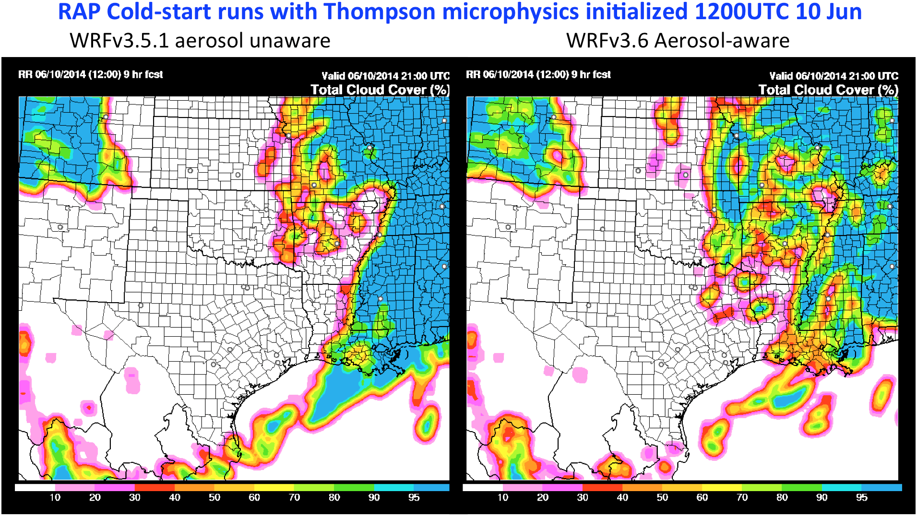
NCEP RAPv3/HRRRv2-2015 Changes
Use of forecast aerosol fields to have prognostic cloud-condensation nuclei (CCN).
Example: RAP cold-start tests without/with aerosol-aware cloud microphysics

Slide 10
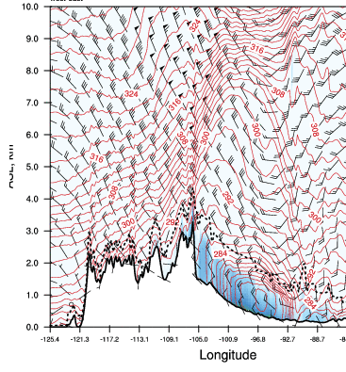
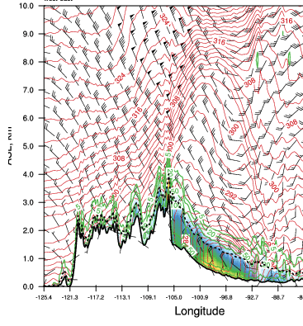
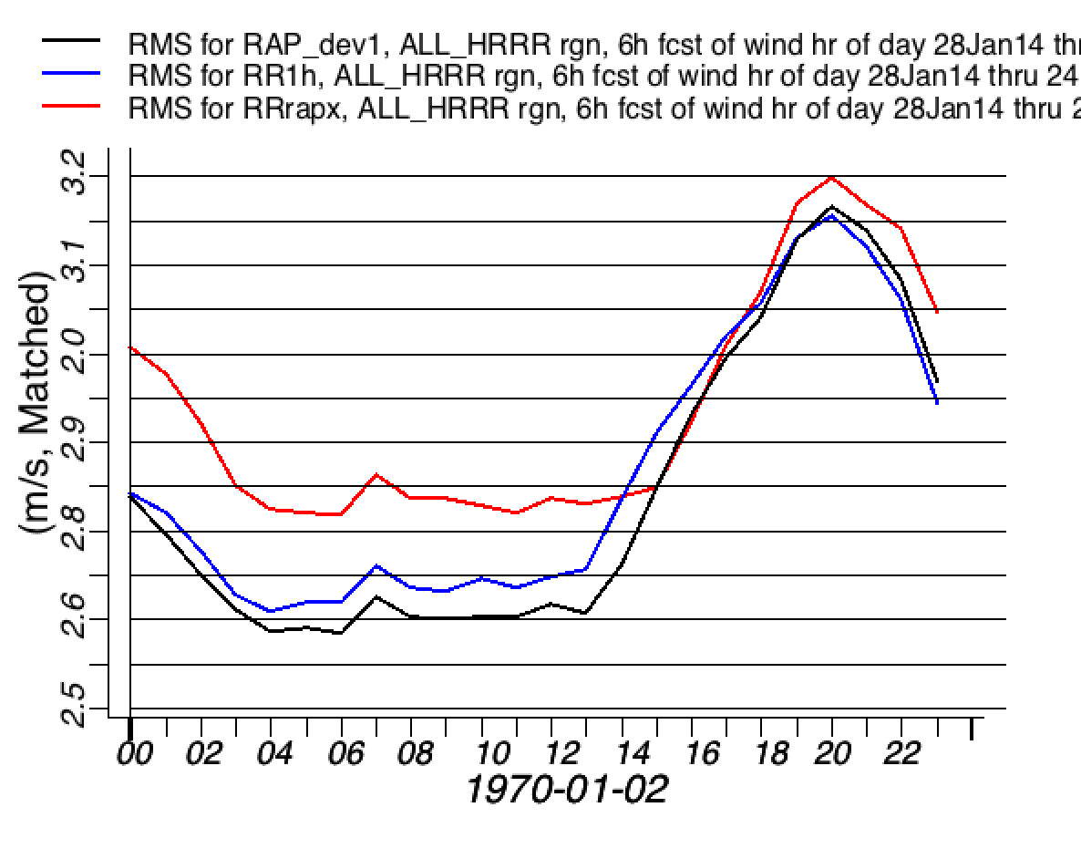
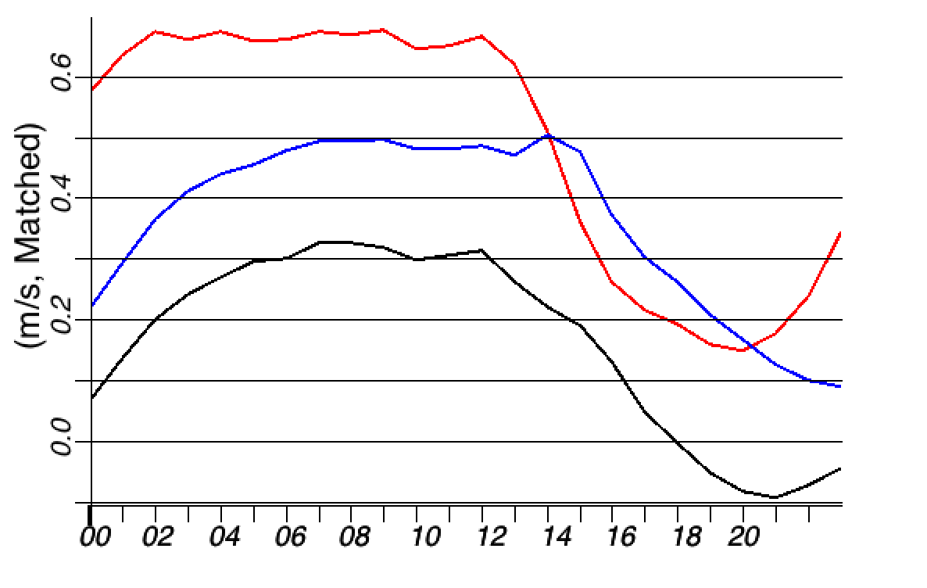
RAP / HRRR use of MYNN PBL scheme
MYJ
MYNN-modified
First implemented with RAPv2 / HRRR 2013 –
better convection, wind forecasts
Improved mixing length formulations to
flexibly change behavior across the stability spectrum
Improved surface layer scheme (customization to PBL )
Further enhancements for RAP v3 / HRRR v2 -- cloud mixing,
refined closure constants, coupling to different shallow cu schemes
TKE (color bars)
Wind speed bias (m/s)
RMS wind
vector
error (m/s)
RAPv1
RAPv2
RAPv1
RAPv3
RAPv2
RAPv3
00 02 04 06 08 10 12 14 16 18 20 22 00 UTC
00 02 04 06 08 10 12 14 16 18 20 22 00 UTC
Evening
Night
Morning
Afternoon
Evening
Night
Morning
Afternoon

Slide 11
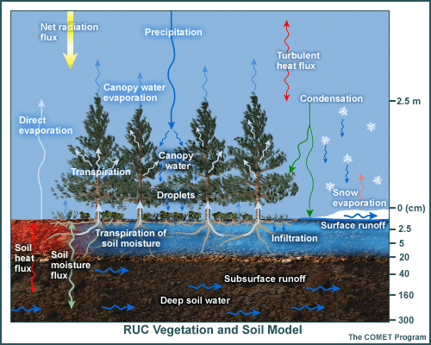
Updates to RUC Land Surface Model
RAP improvements
Version 2
Increased number of levels
in soil domain – 9 levels
Increased roughness Z₀ for forests, cropland, urban
New formulation to compute effective roughness length Z_{0eff} in the grid box (exponential)
=======================
Version 3 (partial list)
Seasonal variations of Z₀ for MODIS cropland category
Seasonal variations of LAI based on the current vegetation fraction and variability of this parameter
for different vegetation types
OLD
~ 8 m
0 (cm)
5
20
40
160
300
NEW
~ 8 m
0 (cm)
1
4
10
30
60
100
160
300
Thinner soil layer in energy / moisture budgets
Potential for increased near-surface diurnal cycle Reduced warm bias at night, cold bias in day

Slide 12
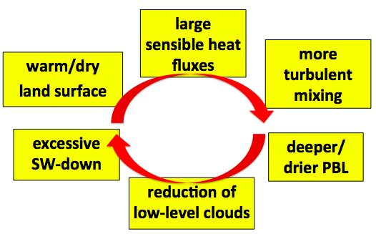
HRRR (and RAP) Future Milestones
HRRR Milestones
Physics updates to reduce warm / dry bias
Grell−Freitas “scale-aware” shallow cumulus (subgrid-scale)
Accounts for nonlocal mixing of heat & water vapor from condensed (non-precipitating) subgrid plumes
“Scale-aware” mass flux scheme
Produces subgrid cloud water & ice
➔ coupled to radiation
MYNN boundary-layer cloud fraction (subgrid-scale)
Function of local and PBL-mean RH, surface heat flux, resolution
Activates in absence of resolved / parameterized cloud fraction in column
Diagnoses subgrid cloud water & ice
(specifically for radiation coupling)
RUC-LSM
Reduced wilting points
Maintain cropland at wilting point

Slide 13
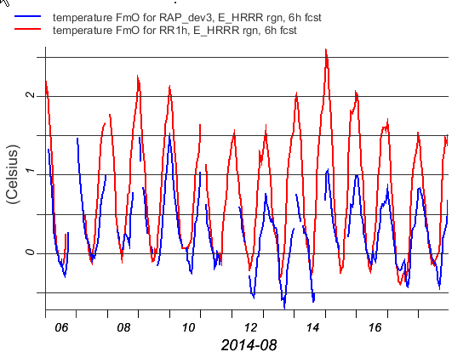
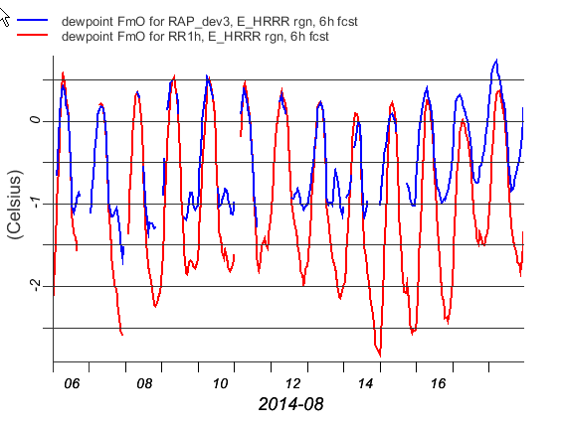
Testing RAPv3 LSM Changes
Temperature bias (K)
NCEP RAPv2
GSD test RAPv3
Warm Cold
8 Aug.2014
Reduced
wilting point
13 Aug. 2014 Change for cropland soil moisture
15 Aug. 2014
Q2 diagnostics
Dewpoint bias (k)
Moist Dry
NCEP Production Suite Review
Rapid Refresh / HRRR
2-3 December 2014

Slide 14
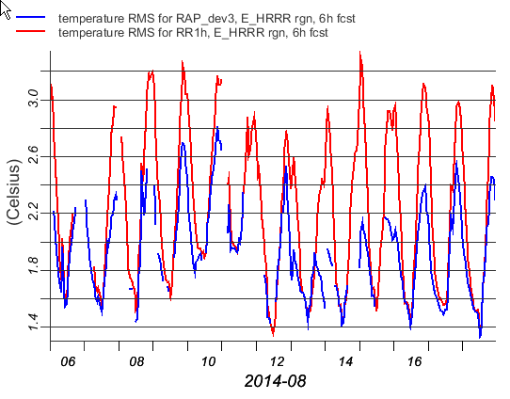
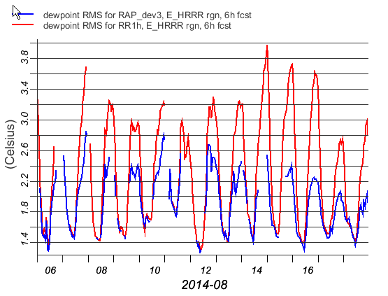
Testing RAPv3 LSM Changes
Temperature RMS (K)
NCEP RAPv2
GSD test RAPv3
8 Aug.2014
Reduced
wilting point
13 Aug. 2014 Change for cropland soil moisture
15 Aug. 2014
Q2 diagnostics
Dewpoint RMS (k)
NCEP Production Suite Review
Rapid Refresh / HRRR
2-3 December 2014

Slide 15
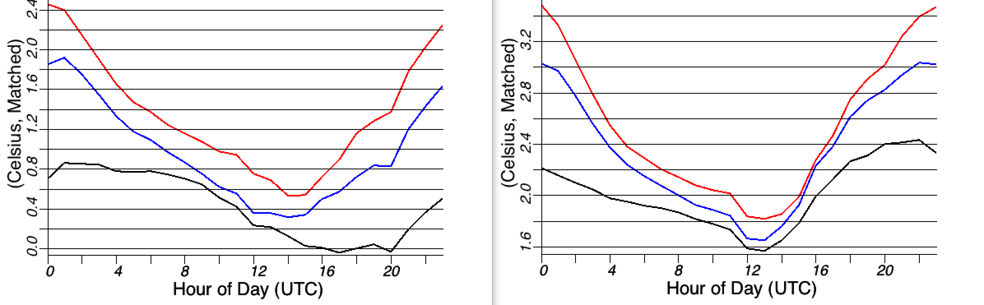
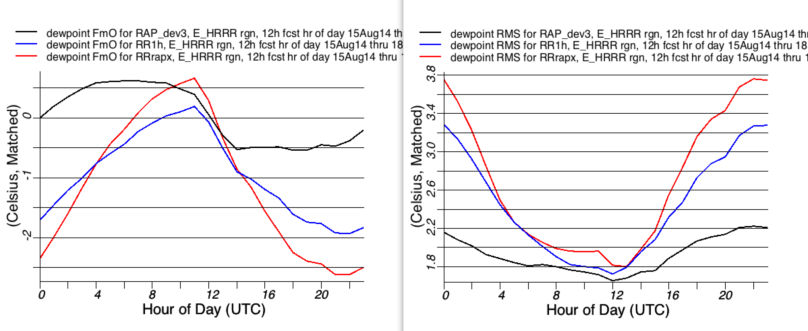
Rapid Refresh Surface verification
NCEP OPER RAPv2
GSD 2014 RAP R/T
GSD RAPv3 pre-NCEP
Temperature bias (K)
Temperature RMS (K)
Warm Cold
Evening
Night
Morning
Afternoon
Evening
Night
Morning
Afternoon
Moist Dry
Dewpoint RMS (K)
Dewpoint
bias (k)
East US
15 Aug -
18 Sep
2014
Evening
Night
Morning
Afternoon
Evening
Night
Morning
Afternoon

Slide 16
RAP
Sample
mesoscale
precipitation
type and
intensity
METAR observations
ZR
12 UTC
1 Feb
2014
Radar obs
RAP
ZR
+ 12 h fcst
Valid 12 UTC
1 Feb 2014

Slide 17
Improved RAP Precip Type
Obs Valid 17 UTC 26 Nov 2014
RAPX
18 hr Fcst
16 UTC 26 Nov 2014
RAP resolves
narrow IP band
(improved
diagnostic)
NCEP Production Suite Review
Rapid Refresh / HRRR
2-3 December 2014

Slide 18
Summary: RAPv3 vs. RAPv2
Winds -- Consistent RAPv3 improvement for both upper-air and surface, for all seasons
Temperature – Reduced low-level warm bias for warm season afternoon / evening. Improved upper-level temperature forecasts
Moisture – Reduced low-level dry bias for warm season afternoon / evening. Improved upper- level relative humidity forecast
Precipitation – Slight improvement, reduced low thresh high bias / increased high thresh low bias
NCEP Production Suite Review
Rapid Refresh / HRRR
2-4 December 2013

Slide 19
Rapid Refresh and HRRR
NOAA hourly updated models
13km Rapid Refresh (RAP)
Version 2 -- NCEP implement 25 Feb 2014
Version 3 – GSD
Planned NCEP -- 2015
RAP
3km High Resolution Rapid Refresh (HRRR)
Initial – NCEP implement 30 Sept 2014
Version 2 – GSD
Planned NCEP --2015
HRRR
GSD ➔NCEP HRRR: MORE RELIABLE (now 99+%)
AVAILABLE SOONER (1h fcst by +50 min, 15h fcst by +1:30
NCEP Production Suite Review
Rapid Refresh / HRRR
2-3 December 2014

Slide 20
HRRR Users and Applications
Example: National Weather Service including Storm and Weather Prediction Centers (SPC & WPC)
Aviation Weather Center (AWC) and FAA Command Center
National Severe Storms Laboratory (NSSL) and Air Resources Laboratory (ARL)
National Centers for Atmospheric Research (NCAR) and Lincoln Laboratory (LL)
General
Forecasting
Renewable Energy
Same-Day Decision Support
Renewable Energy
Day-Ahead Decision Support
Severe
Weather
Warn On Forecast
Severe Weather
Mesoscale Discussions, Watches,
Convective Outlooks
Severe Weather
Day 2 Outlooks
Aviation
Tactical
Planning
Aviation
Strategic
Planning
0–2 hrs 2–8 hrs 8–15 hrs 15–24 hrs 24–48 hrs
Forecast Length
Notes:
HRRR use grew out of initial aviation interest in the northeast, once eastern 2/3 of US was covered severe wx interest increased and then more recently renewable energy focus especially with day 2

Slide 21
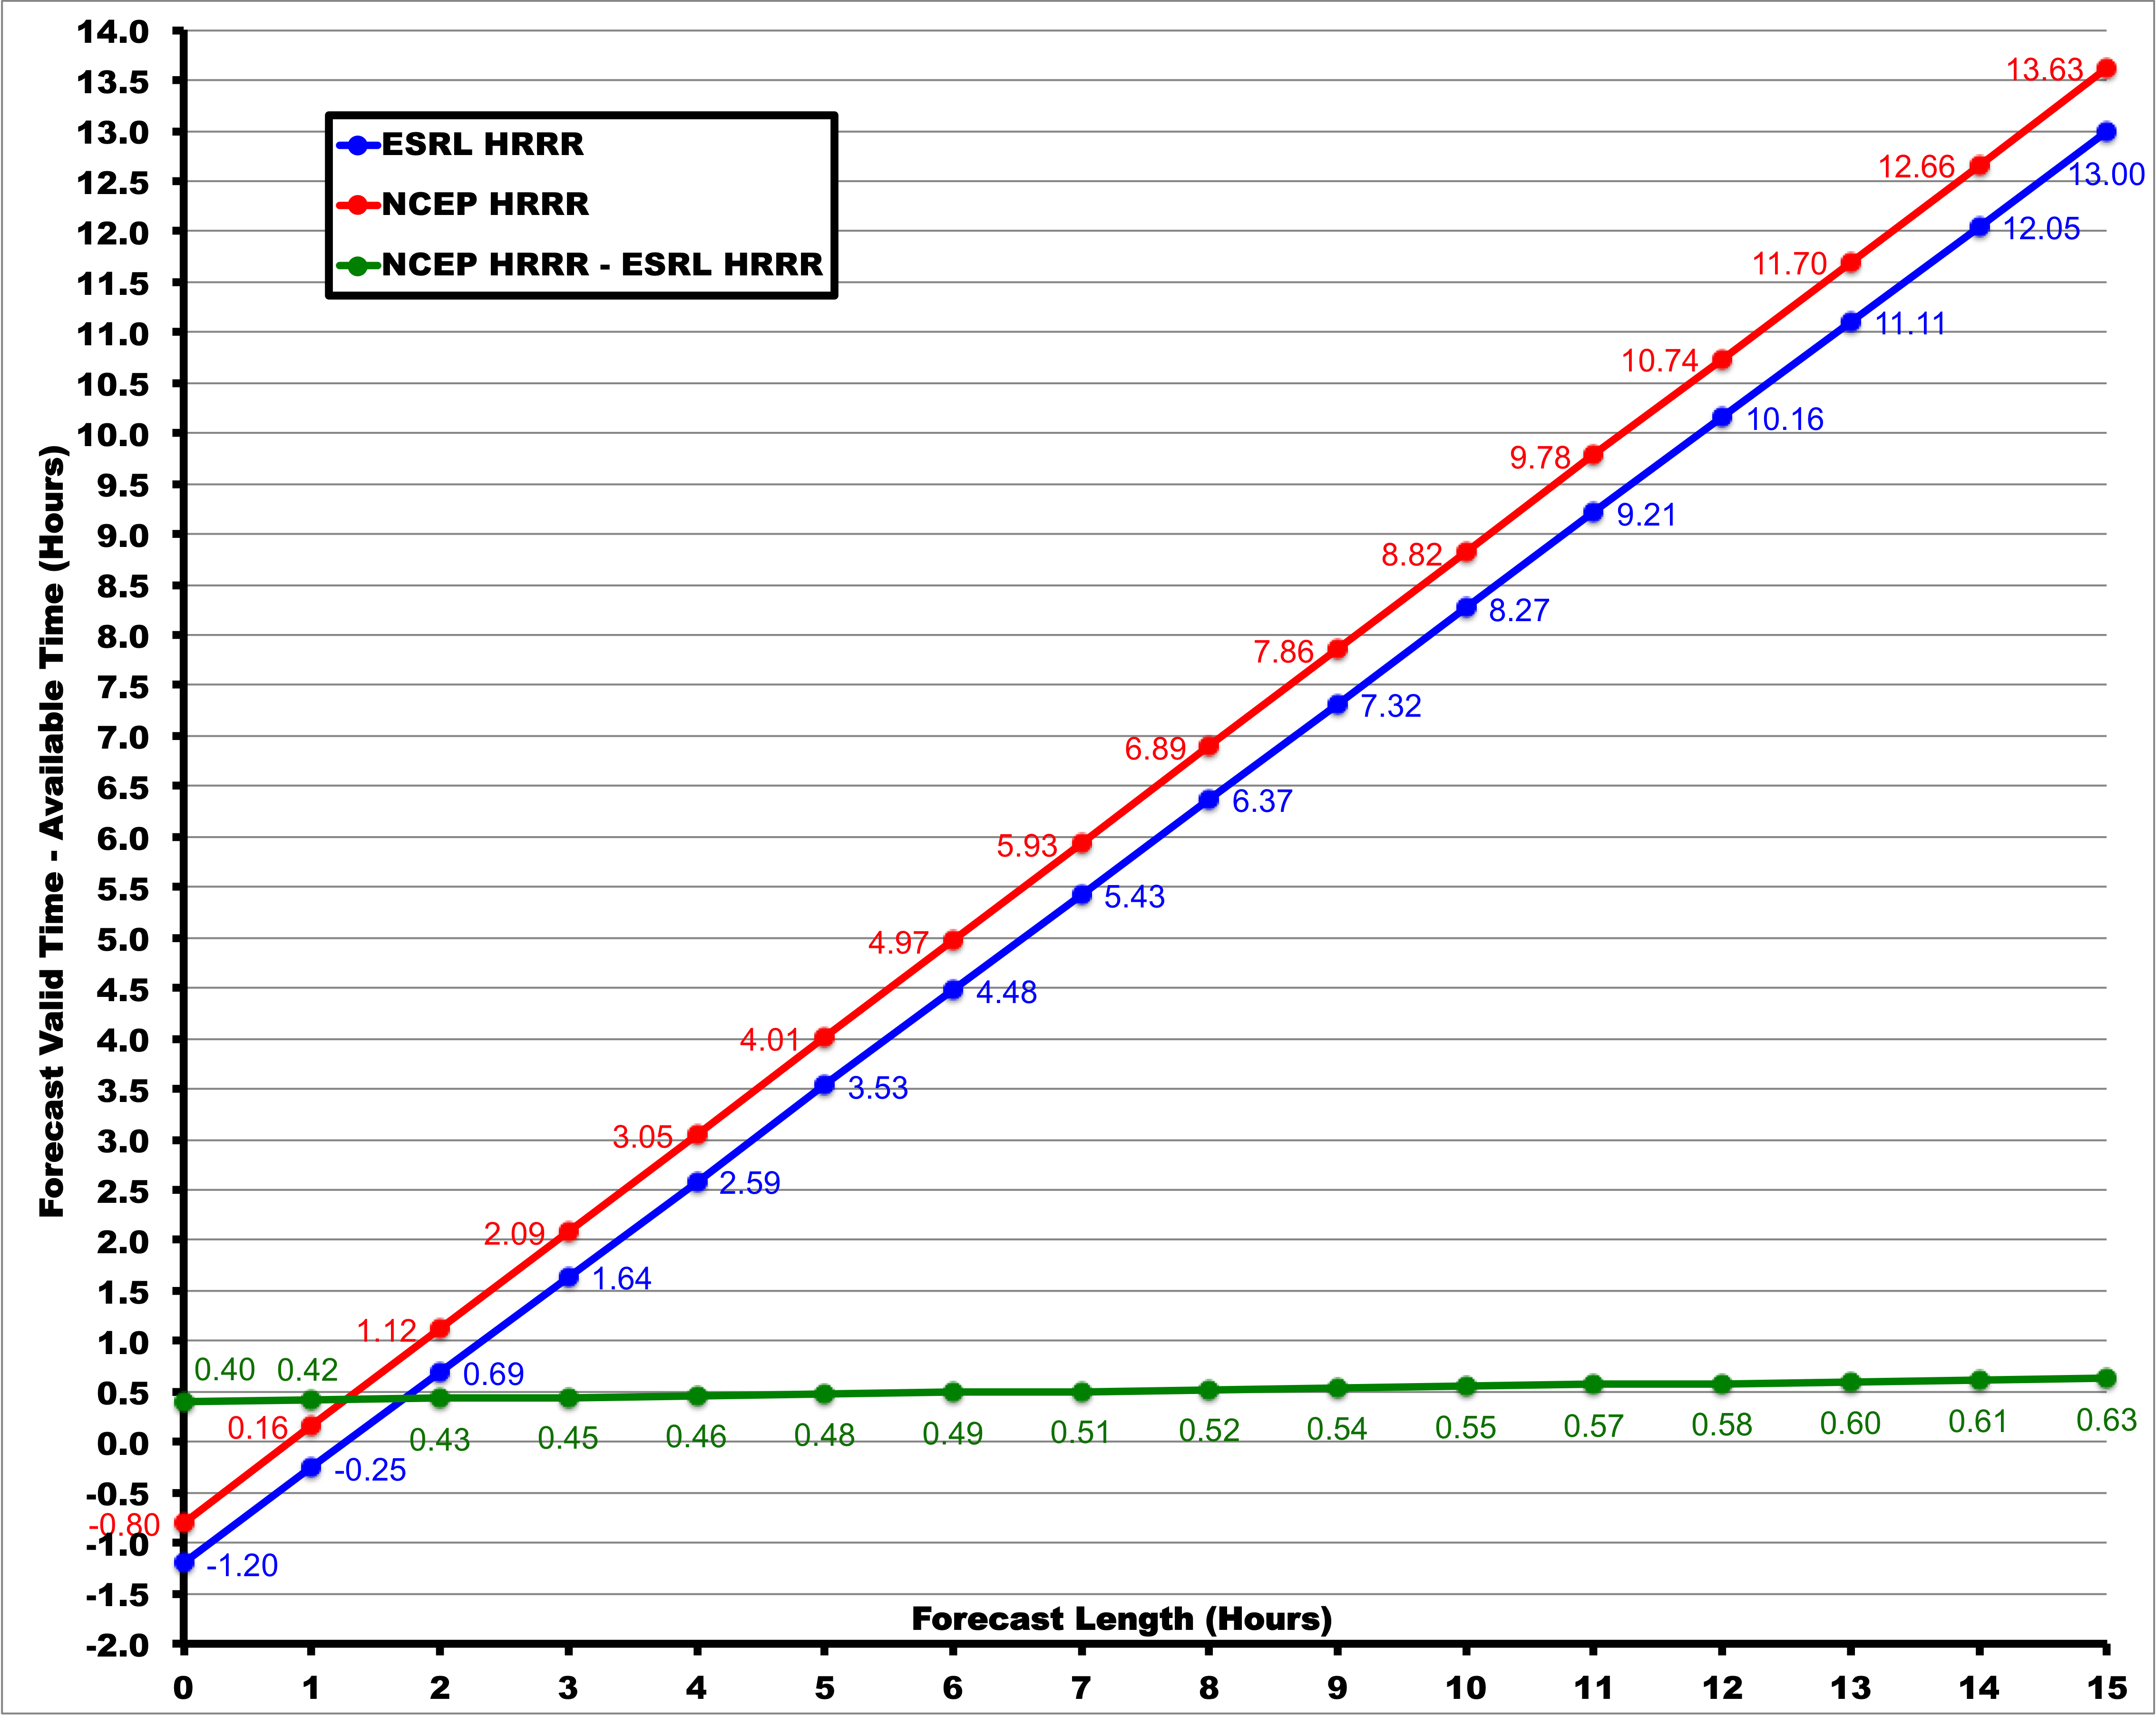
HRRR Forecast Latency
HRRR (and RAP) Future Milestones
HRRR Milestones
By the end of forecast, operational HRRR available on average ~36 min earlier than experimental HRRR
NCEP Production Suite Review
Rapid Refresh / HRRR
2-3 December 2014

Slide 22
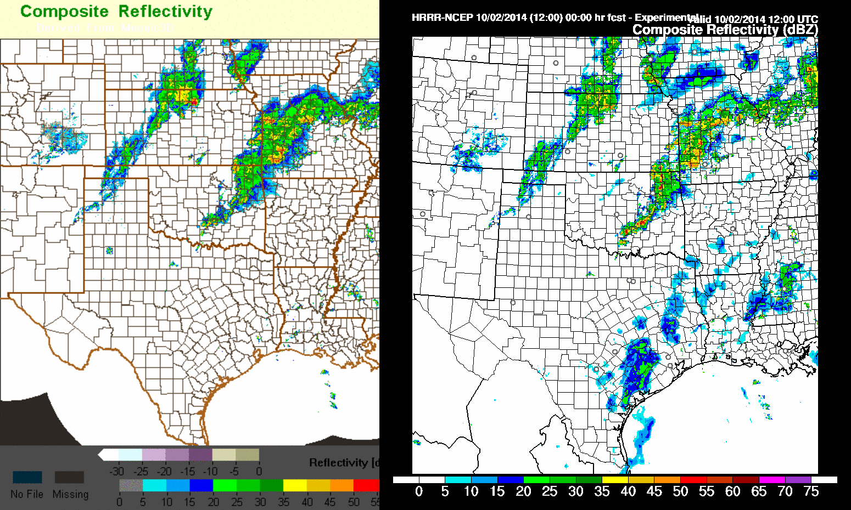
HRRR NCEP Implementation
Reflectivity Observations
Operational HRRR 12 UTC 02 Oct 2014
Valid

Slide 23
Candidate RAPv3/HRRRv2 Changes
 | Model | Data Assimilation
RAP (13 km) | WRF-ARWv3.6+ incl. physics changes Physics changes: Grell-Freitas convective scheme Thompson MP -- Aerosol-aware MYNN PBL -- cloud/non-loc mixing RUC LSM -- MODIS seasonal LAI -- Reduced wilting point Shallow cu parm w/rad feedback RRTMG radiation scheme Direct and diffuse GHI components | Merge with GSI trunk Radial velocity assimilation Mesonet assimilation RARS data assimilation Radiance bias correction Pseudo-PBL obs for temperature Improved 2m Temp/Dewpoint Background Estimate Low-reflectivity precip building
HRRR (3 km) | WRF-ARWv3.6+ incl. physics changes Physics changes: Thompson MP - Aerosol-aware MYNN PBL -- cloud/non-loc mixing RUC LSM -- MODIS seasonal LAI -- Reduced wilting point Shallow cu parm w/rad feedback RRTMG radiation scheme Direct and diffuse GHI components Numerics changes: 6th order diffusion in flat terrain | Merge with GSI trunk 3-km hybrid assimilation Hydrostatic rebalance after analysis Radial velocity assimilation Mesonet assimilation Pseudo-PBL obs for temperature Improved 2m Temp/Dewpoint Background Estimate Low-reflectivity precip building Full cloud/precip hydrometeor assim

Slide 24
NCEP RAPv2 and HRRRv1
Model | Run at: | Domain | Grid Points | Grid Spacing | Vertical Levels | Pressure Top | Boundary Conditions | Initialized
RAP | GSD, NCO | North America | 758 x 567 | 13 km | 50 | 10 mb | GFS | Hourly (cycled)
HRRR | GSD, NCO | CONUS | 1799 x 1059 | 3 km | 50 | 20 mb | RAP | Hourly - RAP (no-cycle)
Model | Version | Assimilation | Radar DA | Radiation LW/SW | Microphysics | Cumulus Param | PBL | LSM
RAP | WRF-ARW v3.4.1+ | GSI Hybrid 3D-VAR/Ensemble | 13-km DFI | RRTM/ Goddard | Thompson v3.4.1 | G3 + Shallow | MYNN | RUC
HRRR | WRF-ARW v3.4.1+ | GSI 3D-VAR | 3-km 15-min LH | RRTM/ Goddard | Thompson v3.4.1 | None | MYNN | RUC
Model | Horiz/Vert Advection | Scalar Advection | Upper-Level Damping | 6th Order Diffusion | SW Radiation Update | Land Use | MP Tend Limit | Time-Step
RAP | 5th/5th | Positive-Definite | w-Rayleigh 0.2 | Yes 0.12 | 10 min | MODIS Fractional | 0.01 K/s | 60 s
HRRR | 5th/5th | Positive-Definite | w-Rayleigh 0.2 | No | 5 min | MODIS Fractional | 0.07 K/s | 20-23 s
NCEP Production Suite Review
Rapid Refresh / HRRR
2-3 December 2014

Slide 25
NCEP RAPv3 and HRRRv2
Model | Run at: | Domain | Grid Points | Grid Spacing | Vertical Levels | Pressure Top | Boundary Conditions | Initialized
RAP | GSD, NCO | North America | 758 x 567 | 13 km | 50 | 10 mb | GFS | Hourly (cycled)
HRRR | GSD | CONUS | 1799 x 1059 | 3 km | 50 | 20 mb | RAP | Hourly - RAP (no-cycle)
Model | Version | Assimilation | Radar DA | Radiation LW/SW | Microphysics | Cumulus Param | PBL | LSM
RAP | WRF-ARW v3.6+ | GSI Hybrid 3D-VAR/Ensemble | 13-km DFI | RRTMG/RRTMG | Thompson – aerosol v3.6.1 | GF v3.6+ | MYNN v3.6+ | RUC v3.6+
HRRR | WRF-ARW v3.6+ | GSI Hybrid 3D-VAR/Ensemble | 3-km 15-min LH | RRTMG/ RRTMG | Thompson – aerosol v3.6.1 | GF shallow | MYNN v3.6+ | RUC v3.6+
Model | Horiz/Vert Advection | Scalar Advection | Upper-Level Damping | 6th Order Diffusion | SW Radiation Update | Land Use | MP Tend Limit | Time-Step
RAP | 5th/5th | Positive-Definite | w-Rayleigh 0.2 | Yes 0.12 | 20 min | MODIS Fractional | 0.01 K/s | 60 s
HRRR | 5th/5th | Positive-Definite | w-Rayleigh 0.2 | Yes 0.25 (flat terr) | 15 min with SW-dt (Ruiz-Arias) | MODIS Fractional | 0.07 K/s | 20 s
NCEP Production Suite Review
Rapid Refresh / HRRR
2-3 December 2014

Slide 26
HRRRv1 Initialization from RAPv2
13 km RAP
13z
14z
15z
Obs
GFS
Ens
Obs
GFS
Ens
Obs
GFS
Ens
GSI
Hybrid
GSI
Hybrid
GSI
Hybrid
HM
Obs
HM
Obs
HM
Obs
GSI HM Anx
GSI HM Anx
GSI HM Anx
1 hr fcst
1 hr fcst
Refl
Obs
Refl
Obs
Refl
Obs
Digital
Filter
Digital
Filter
Digital
Filter
18 hr fcst
18 hr fcst
18 hr fcst
Obs
3 km
HRRR
3-km Interp
1 hr pre-fcst
GSI
3D-VAR
HMObs
Refl Obs
GSI HM Anx
15 hr fcst

Slide 27
HRRRv2 Initialization from RAPv3
13 km RAP
13z
14z
15z
Obs
GFS
Ens
Obs
GFS
Ens
Obs
GFS
Ens
GSI
Hybrid
GSI
Hybrid
GSI
Hybrid
HM
Obs
HM
Obs
HM
Obs
GSI HM Anx
GSI HM Anx
GSI HM Anx
1 hr fcst
1 hr fcst
Refl
Obs
Refl
Obs
Refl
Obs
Digital
Filter
Digital
Filter
Digital
Filter
18 hr fcst
18 hr fcst
18 hr fcst
Obs
GFS
Ens
3 km
HRRR
3-km Interp
1 hr pre-fcst
GSI
Hybrid
HMObs
Refl Obs
GSI HM Anx
15 hr fcst

Slide 28
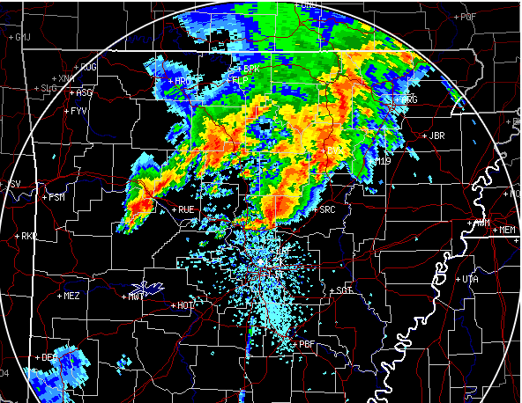
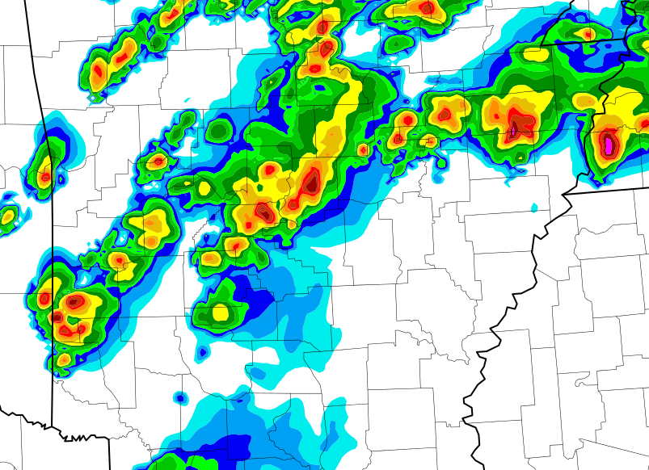
HRRR Supercell Case 27 April 2014
HRRR (and RAP) Future Milestones
HRRR Milestones
HRRR
10-hr fcst
made
at 10 AM
for 8 PM
27 April
Observed Reflectivity
Forecast Reflectivity
The 10-hour forecast captures the exact location of the storm and indicates the potential for rotation.
Tornadic
thunderstorm
Actual
tornado path
Hourly Max Updraft Helicity

Slide 29
Run-to-Run Consistency
HRRR (and RAP) Future Milestones
HRRR Milestones
HRRR Forecasts
valid at 2200 UTC
Radar Obs at 2200 UTC
15 UTC (7hr)
11 May 2014
Storm Reports
16 UTC (6hr)
Updraft Helicity
Time-Lagged Ensemble
17 UTC (5hr)
NCEP Production Suite Review
Rapid Refresh / HRRR
2-3 December 2014

Slide 30
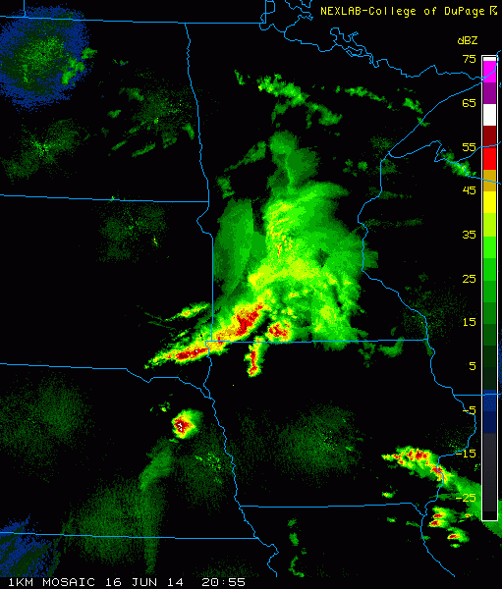
HRRR Run-to-Run Trend
HRRR (and RAP) Future Milestones
HRRR Milestones
Storm Reports
16 June 2014
Pilger, NE
14 UTC (7hr)
15 UTC (6hr)
16 UTC (5hr)
17 UTC (4hr)
HRRR Forecasts: valid at 2100 UTC
Radar Obs at 2055 UTC
NCEP Production Suite Review
Rapid Refresh / HRRR
2-3 December 2014
Notes:
Clear trend in hourly cycles for enhanced risk in northeast NE

Slide 31
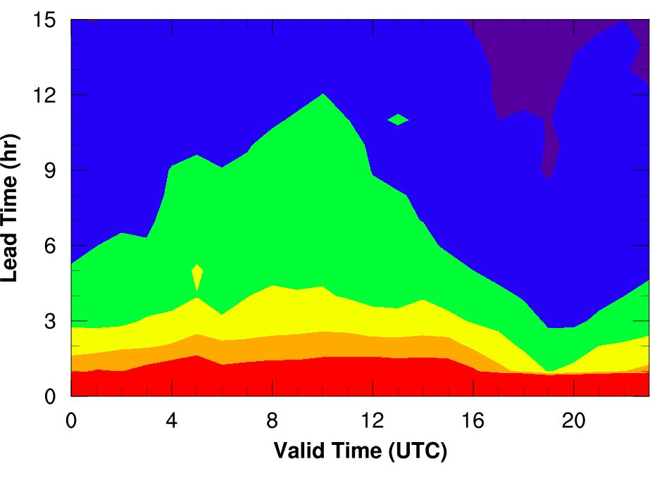
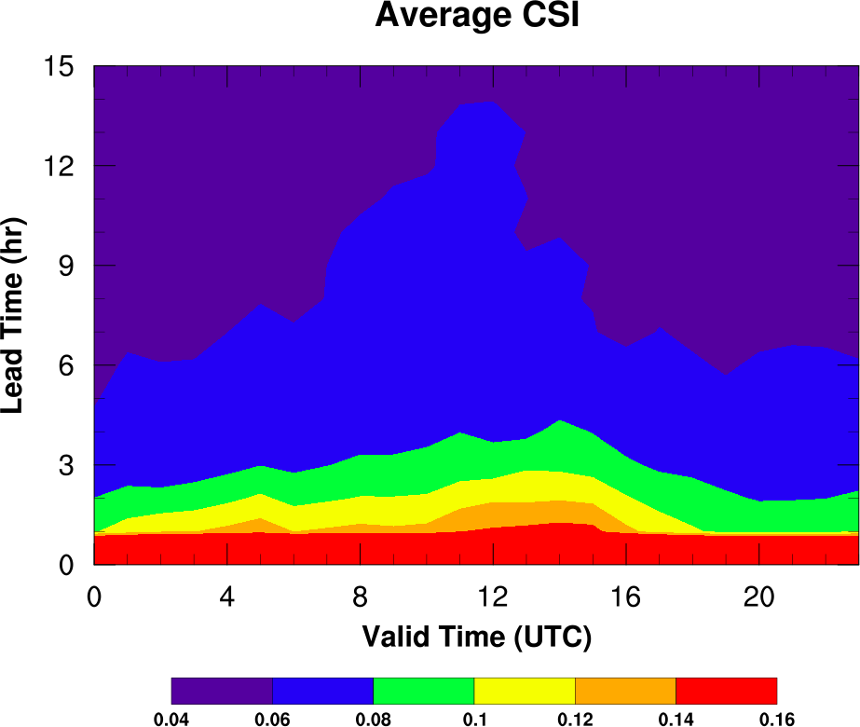
Summary of HRRR Forecast Skill
HRRR (and RAP) Future Milestones
HRRR Milestones
Average CSI for Reflectivity ≥ 35 dBZ
Stats for east of 100°W longitude
(good radar coverage for verification)
Spring (Apr-June)
Strongly forced environments
Summer (July-Sept)
Weakly forced environments
Less skill
More skill
More skill at short lead times.
More skill in evening and overnight hours.
More skill in strongly forced environments.
NCEP Production Suite Review
Rapid Refresh / HRRR
2-3 December 2014

Slide 32
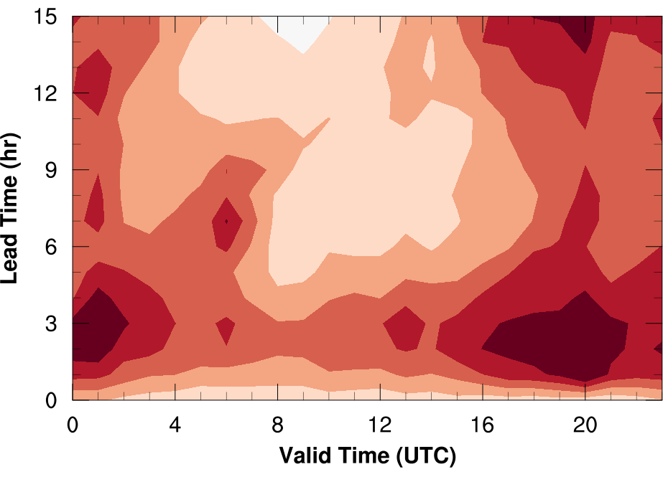
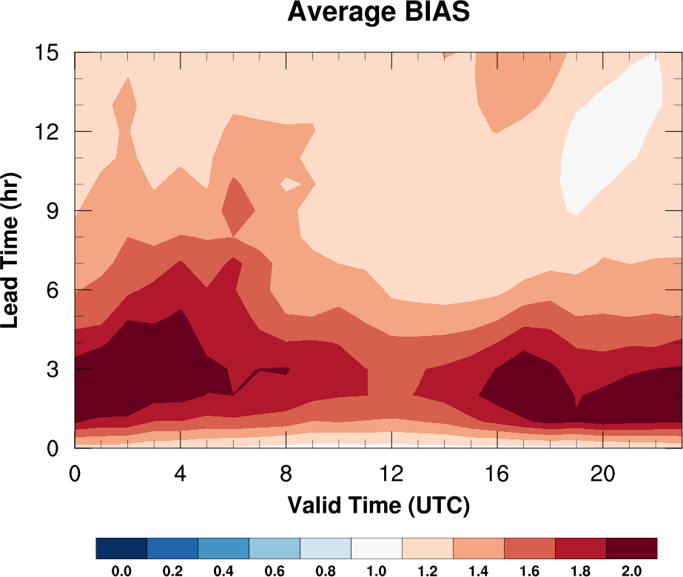
Summary of HRRR Forecast Skill
HRRR (and RAP) Future Milestones
HRRR Milestones
Average BIAS for Reflectivity ≥ 35 dBZ
Stats for east of 100°W longitude
(good radar coverage for verification)
Spring (Apr-June)
Strongly forced environments
Summer (July-Sept)
Weakly forced environments
Low Bias
High Bias
Higher bias at early lead times
NCEP Production Suite Review
Rapid Refresh / HRRR
2-3 December 2014

Slide 33
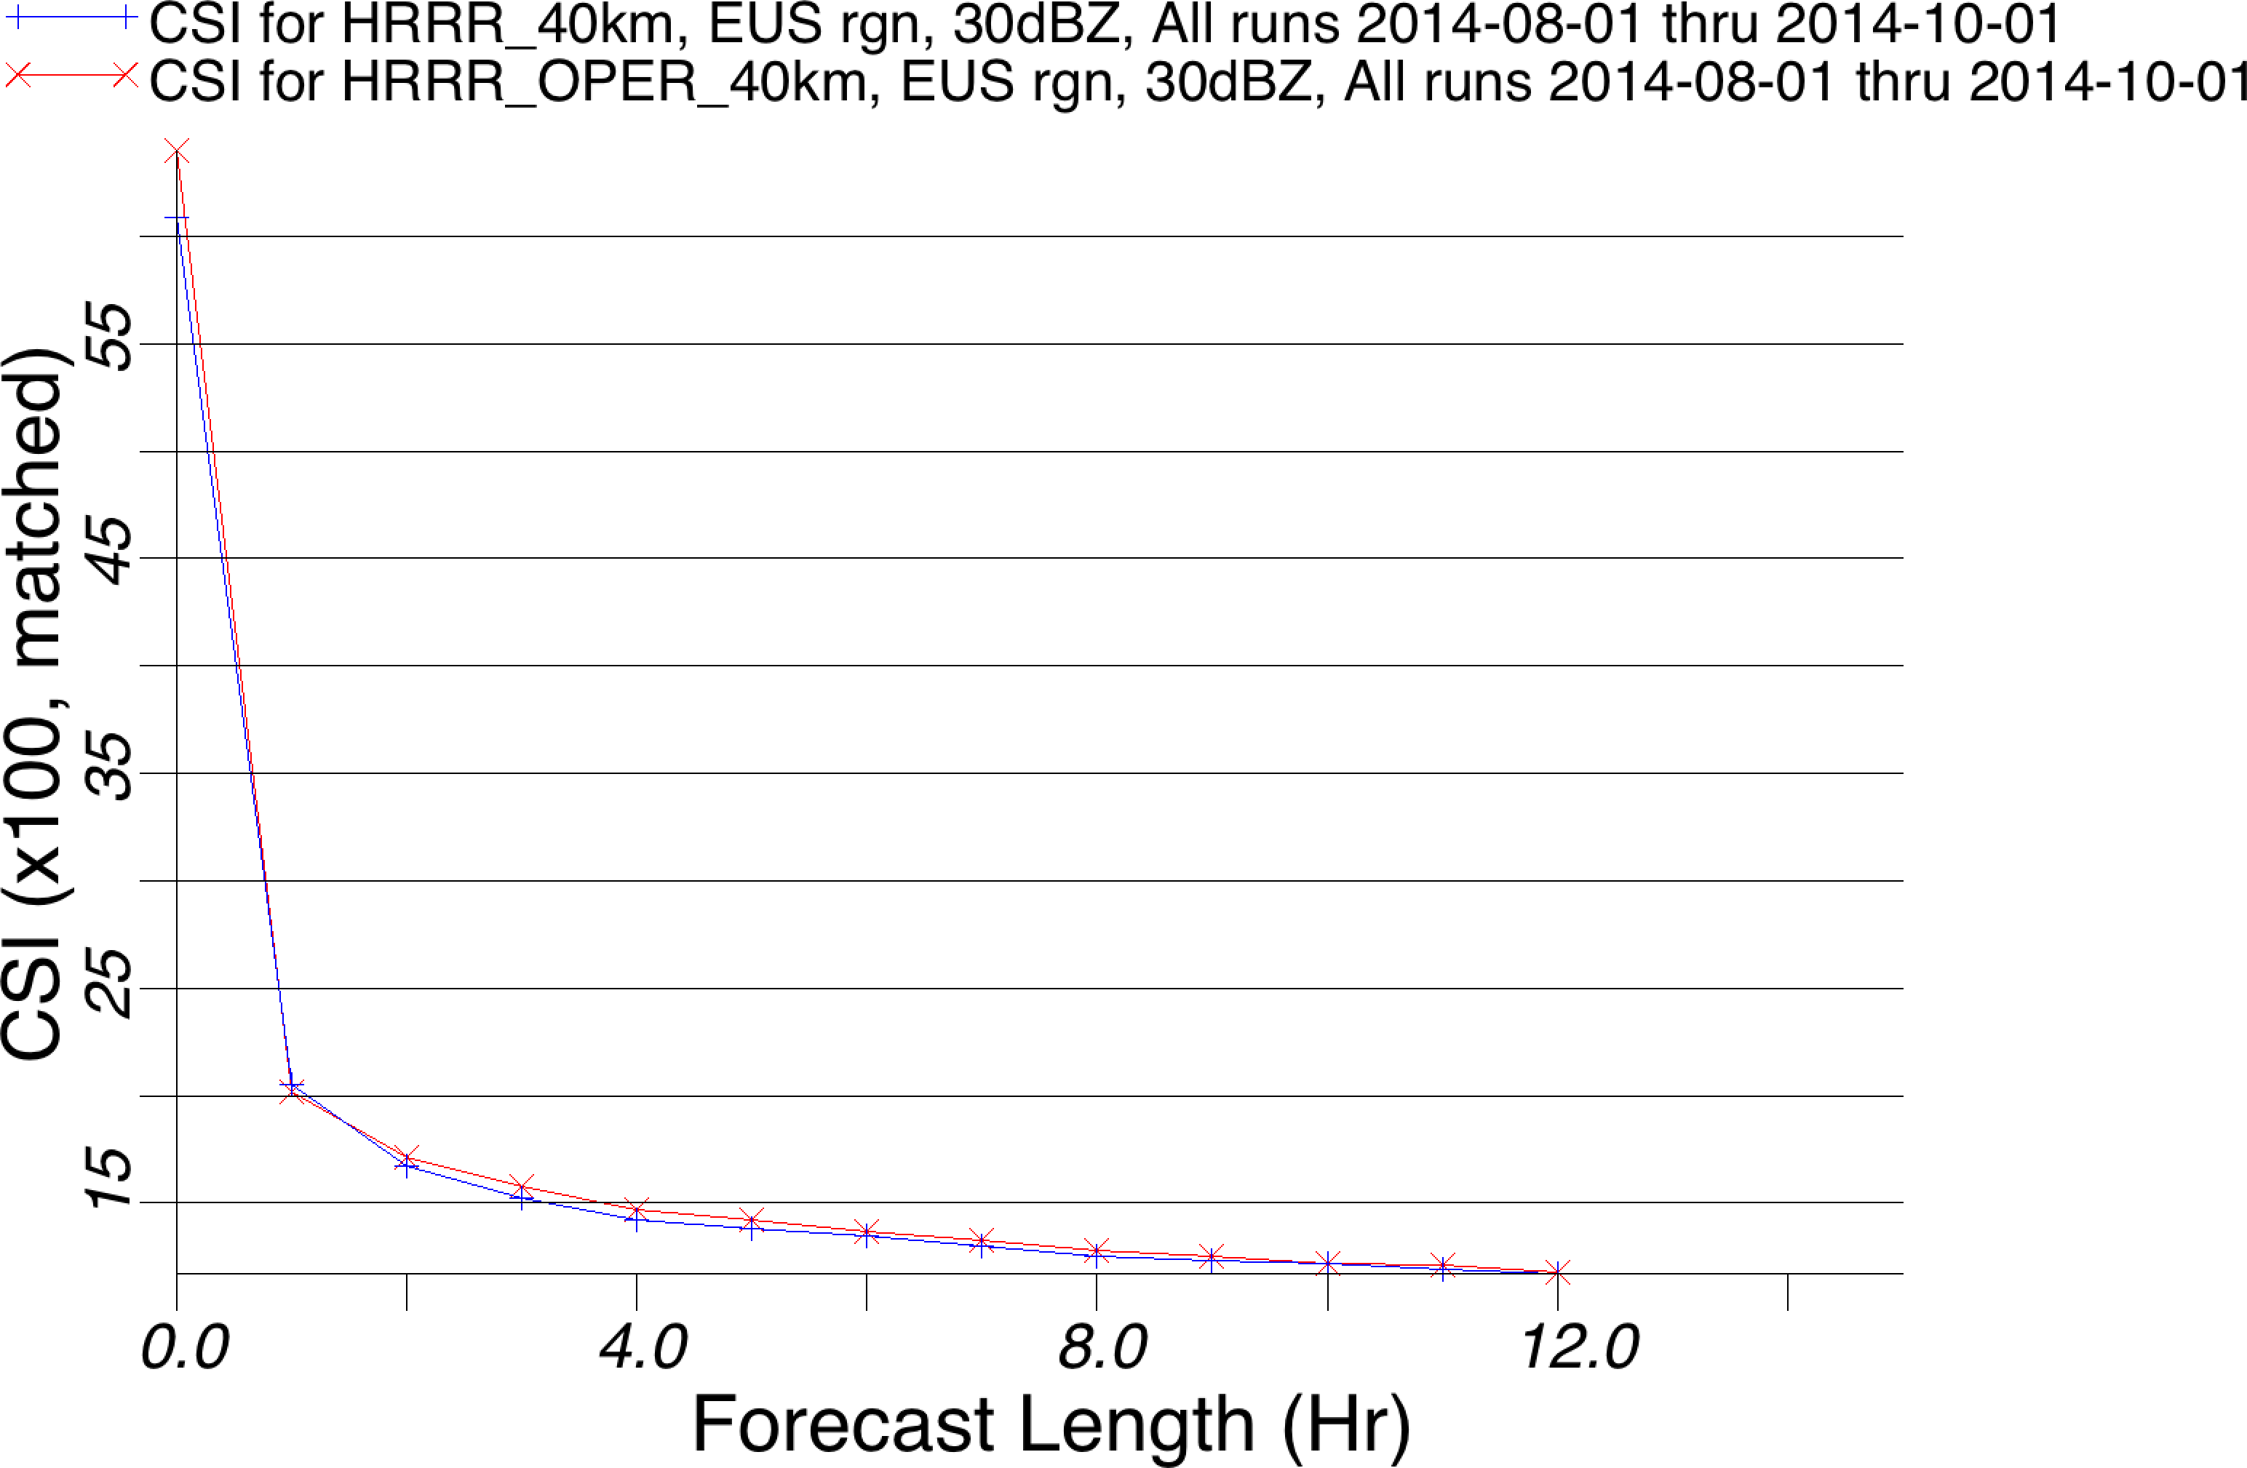
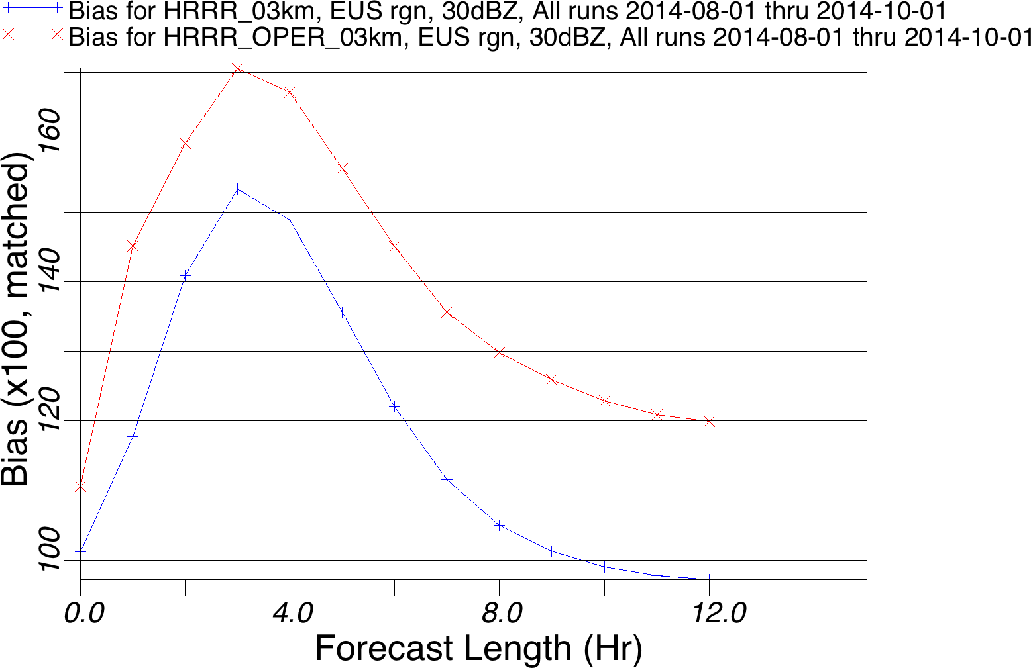
HRRRv1 vs HRRRv2
30 dBZ Composite Reflectivity
Eastern US Aug-Sep 2014
40 km CSI 03 km BIAS
HRRR-OPER (v1) HRRR-EXP (v2)
Optimal
Bias = 1.0
Improved bias at all lead times
NCEP Production Suite Review
Rapid Refresh / HRRR
2-3 December 2014

Slide 34
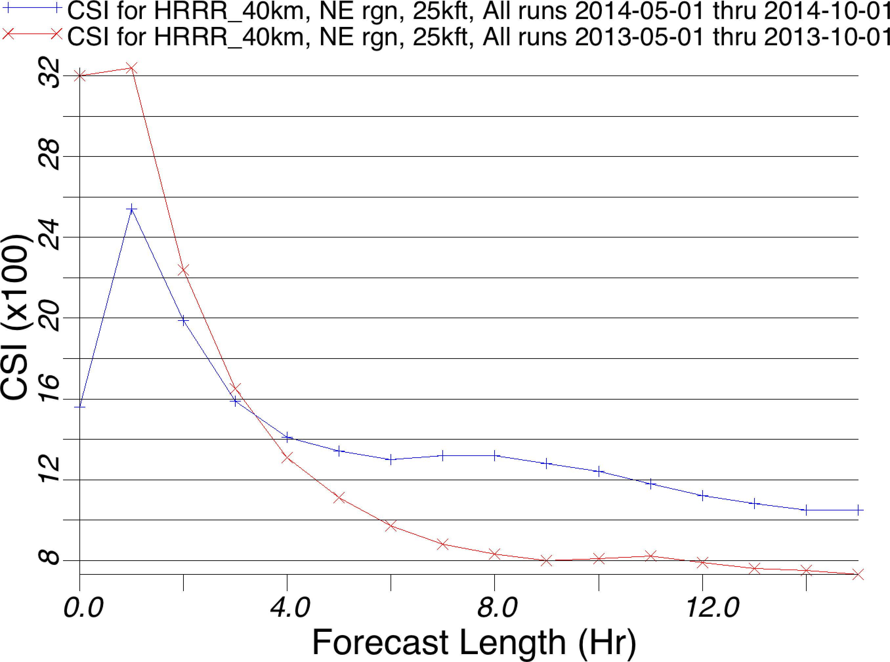
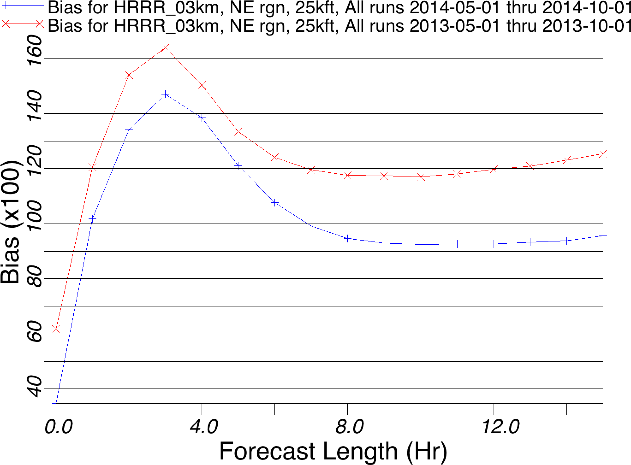
HRRR 2013 (v1) vs HRRR 2014 (v2)
25 kft 18 dBZ Echo Tops
Northeastern US May – Sept
- 2013 -2014
40 km CSI 03 km BIAS
Optimal
Bias = 1.0
Improved skill at ~2+ forecast hrs
NCEP Production Suite Review
Rapid Refresh / HRRR
2-3 December 2014

Slide 35
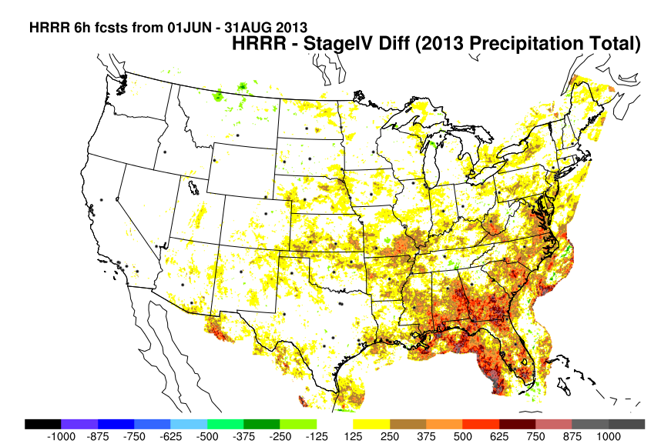
HRRR Precipitation Bias 2013 (v1)

Slide 36
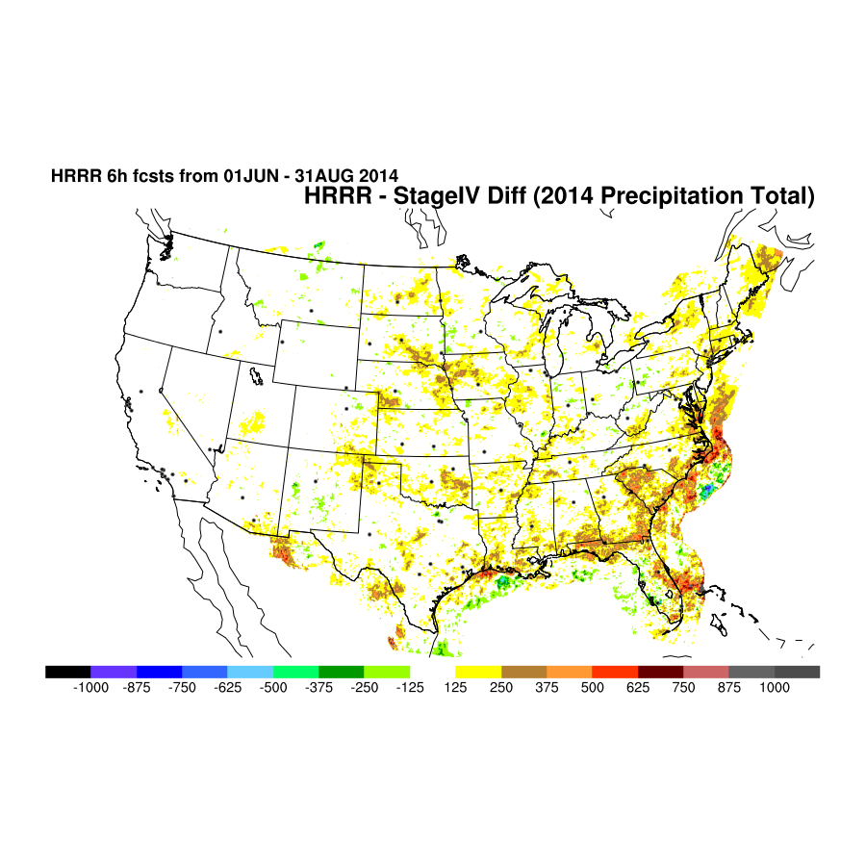
HRRR Precipitation Bias 2014 (v2)
Improved bias for 0-6 hr precip forecasts

Slide 37
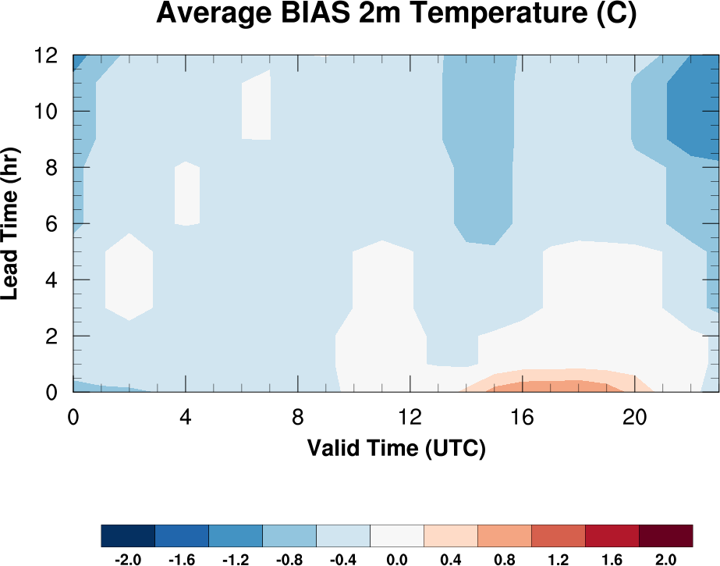
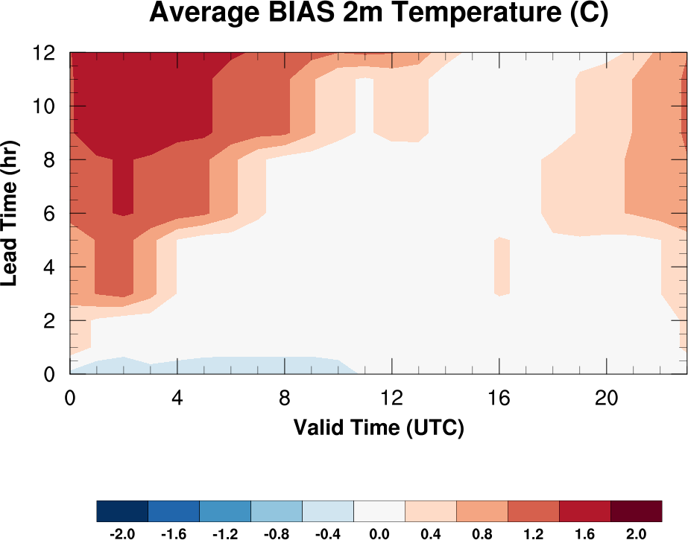
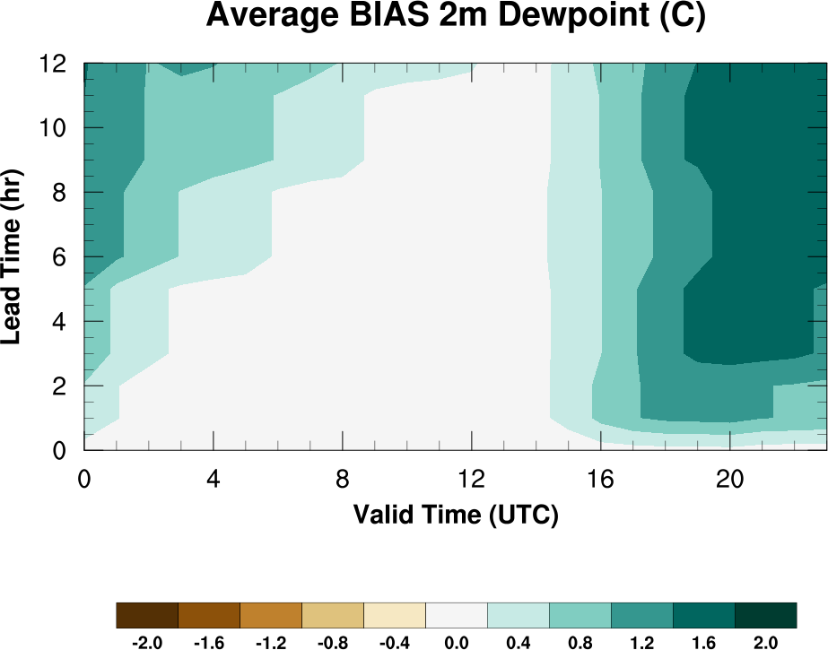
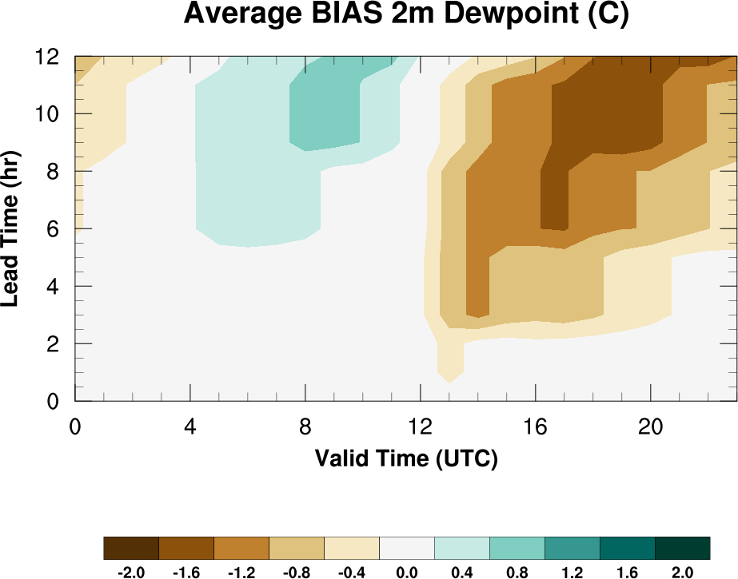
HRRR Forecast Biases
HRRR (and RAP) Future Milestones
HRRR Milestones
Winter (Jan-Mar)
Summer (Jul-Sep)
The HRRR has a daytime warm bias in the warm season.
The HRRR has a daytime dry bias in the warm season.
Experimental improvements to the model to remove bias have been made and will be implemented in a future version.
Cool
Warm
Cool
Warm
Dry
Moist
Dry
Moist
NCEP Production Suite Review
Rapid Refresh / HRRR
2-3 December 2014

Slide 38
RAP/HRRR Model Bias Feedback
HRRR (and RAP) Future Milestones
HRRR Milestones
large sensible heat fluxes
more turbulent mixing
warm/dry
land surface
excessive SW-down
deeper/drier PBL
reduction of low-level clouds
NCEP Production Suite Review
Rapid Refresh / HRRR
2-3 December 2014

Slide 39
HRRR Model Warm/Dry Bias Mitigation
HRRR (and RAP) Future Milestones
HRRR Milestones
Component | Items
GSI Data Assimilation | Canopy water cycling Temp pseudo-innovations thru model boundary layer More consistent use of surface temp/dewpoint data
GFO Convective Parameterization | Shallow cumulus radiation attenuation Improved retention of stratification atop mixed layer
Thompson Microphysics | Aerosol awareness for resolved cloud production Attenuation of shortwave radiation
MYNN Boundary Layer | Mixing length parameter changed Thermal roughness in surface layer changed Coupling boundary layer clouds to radiation
RUC Land Surface Model | Reduced wilting point for more transpiration Keep soil moisture in croplands above wilting point
Total Resource Change: Approximately ~6% increase in runtime for aerosols
NCEP Production Suite Review
Rapid Refresh / HRRR
2-3 December 2014

Slide 40
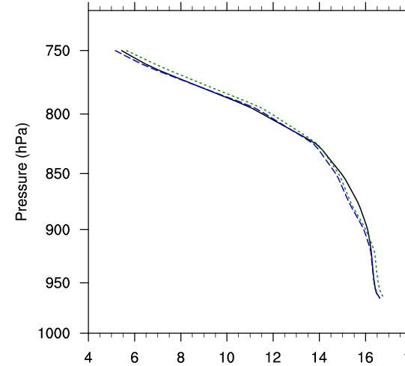
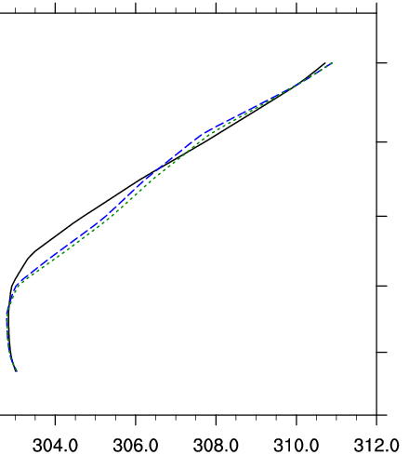
Model Warm/Dry Bias Mitigation
HRRR (and RAP) Future Milestones
HRRR Milestones
Control
area mean (437 grid points)
8-h forecasts valid 1700 UTC 20 May
Subgrid Cloud
Subgrid Cloud + LSM
Water Vapor Mixing Ratio (g kg⁻¹)
Potential Temperature (K)
Moistening
Cooling
Parameterized
Shallow
Cumulus
Drying
Warming
Increased Stratification
{ PBL }
Δ ≤ 0.6 g kg⁻¹
Δ ≤ 0.9 K

Slide 41
Convective Initiation 19 May 2013
HRRR (and RAP) Future Milestones
HRRR Milestones
Control
Subgrid Cloud + LSM
Observed
2000 UTC (11 h)
Source: UCAR
2100 UTC (12 h)
Control run depicts initiation ~1-h too late
Model Physics Changes improving timing of CI
Source: SPC
NCEP Production Suite Review
Rapid Refresh / HRRR
2-3 December 2014

Slide 42
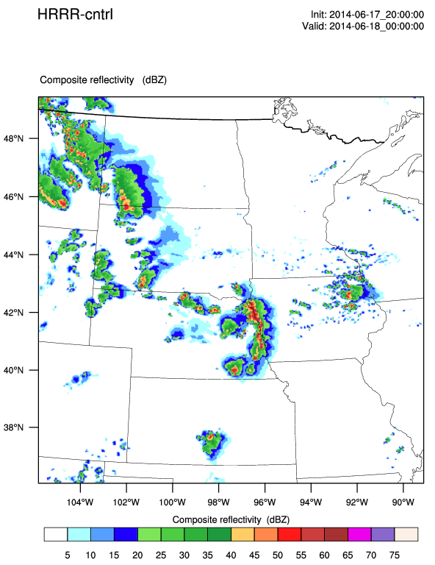
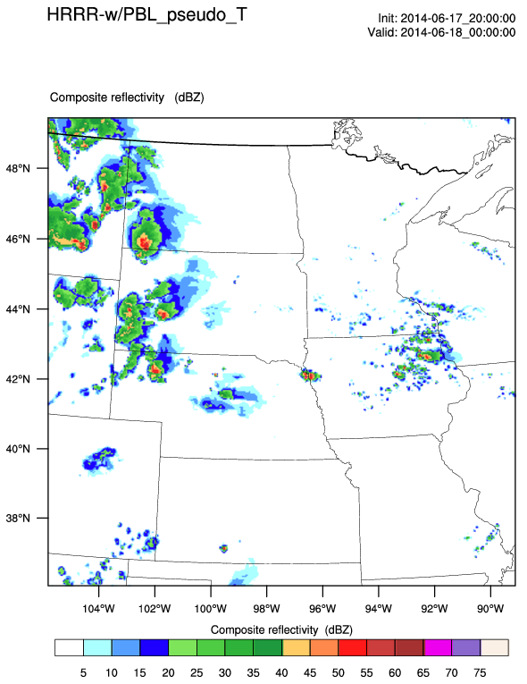
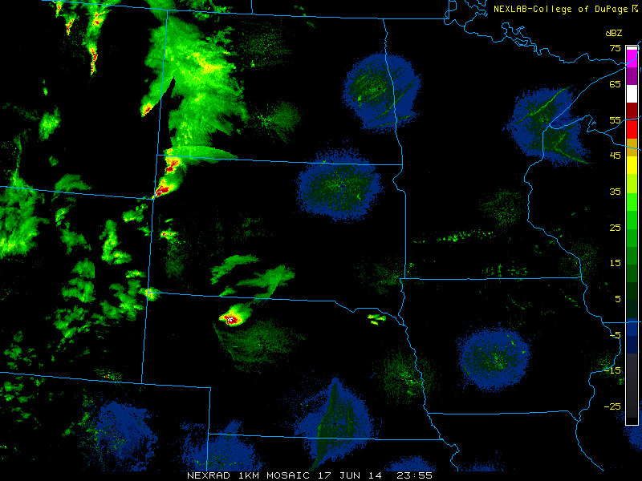
Convective Evolution 17 June 2014
4-h forecast of composite reflectivity: valid 00Z 18 Jun 2014
HRRR (and RAP) Future Milestones
HRRR Milestones
Real-Time
Forecast
00 UTC
18 June 2014
Temperature
Pseudo-Obs
Enabled
Coleridge, NE
Observations
Control run develops too much high-based convection that grows upscale
Data assimilation change improves timing and evolution of convection
NCEP Production Suite Review
Rapid Refresh / HRRR
2-3 December 2014

Slide 43
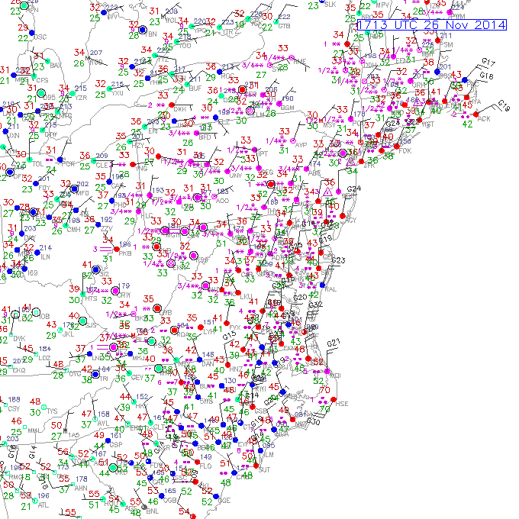
RAP and HRRR Precip Type
HRRR Oper
6 hr Fcst
17 UTC 26 Nov 2014
Obs Valid 17 UTC 26 Nov 2014
HRRRX
6 hr Fcst
17 UTC 26 Nov 2014
HRRR Resolves
Narrow Band of IP
With Improved Diagnostic
NCEP Production Suite Review
Rapid Refresh / HRRR
2-3 December 2014

Slide 44
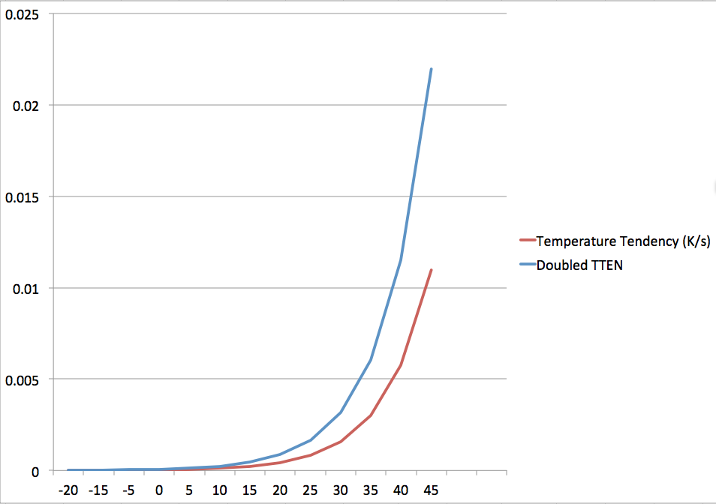
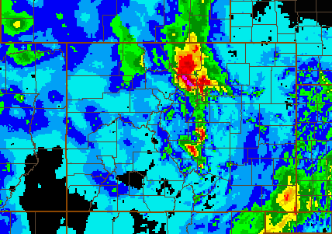
HRRR Radar DA Research
Stage IV QPE (in)
24-h Precipitation
12 UTC 11 Sep –
12 UTC 12 Sep
2x Forcing
>20 dBZ
Control Run
Init 18z 11 Sep
Valid 09z 12 Sep
“Warm Rain”
Init 18z 11 Sep
Valid 09z 12 Sep
HRRR produces more precipitation closer to observed maxima
15-h precipitation
NCEP Production Suite Review
Rapid Refresh / HRRR
2-3 December 2014

Slide 45
HRRR Radar DA Research
Stage IV QPE (in)
24-h Precipitation
12 UTC 11 Sep –
12 UTC 12 Sep
2x Forcing
>20 dBZ
Control Run
Init 18z 11 Sep
Valid 09z 12 Sep
“Warm Rain”
Init 18z 11 Sep
Valid 09z 12 Sep
HRRR produces more precipitation closer to observed maxima
15-h precipitation
NCEP Production Suite Review
Rapid Refresh / HRRR
2-3 December 2014

Slide 46
RAP/HRRR Implementation Map
HRRR (and RAP) Future Milestones
HRRR Milestones
ESRL – experimental version
NWS-NCEP - operational
RAPv3 – GSD testing in 2014
Will initialize 2014 ESRL-HRRR(v2)
Improved PBL, LSM, cu-parm, DA
WRFv3.6.1 w/ Thompson/NCAR aerosol-aware microphysics
HRRRv2 – GSD testing in 2014
Initialized by 2014 RAP (v3)
Improved radar assimilation, hybrid assimilation, PBL/cloud physics
RAPv4 – GSD testing in 2015
Hourly RAP ensemble data assimilation
HRRRv3 – GSD testing in 2015
Target: Improved 3km physics + improved data assimilation.
Implement Q3 2015
Implement Q3 2015
Implement 2016
Implement 2016
Testing of 3km ensemble DA for HRRR and later HRRRE – case studies only – 2015 onward

Slide 47
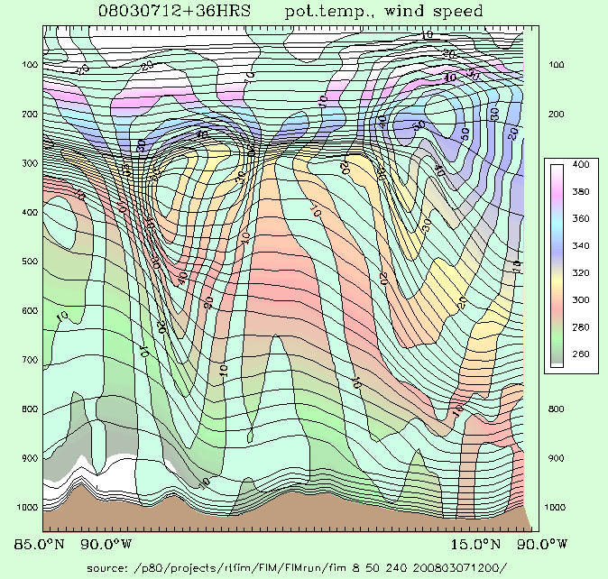
X-section location
Temp at lowest level
Sandy Supplemental funded
High-Impact Wx Pred Proj
(HIWPP) - Year 2 exp demo
Exp FIM13km, NAVGEM23, GFS13
ESRL/NCEP eval of exper multi-model ensemble -GFS and FIM (10 members each)
Note: FIM uses NEMS, GFS physics, fits within NEMS global framework.
Flow-following-
finite-volume
Icosahedral
Model FIM
http://fim.noaa.gov
Notes:
47
Two of the 3 unique aspects of the FIM are ones that you can see, for its vertical and horizontal coordinate systems.
- the isentropic-sigma hybrid vertical coordinate, which DOES adapt and generally follow air parcels up and down (Rainer in 2 talks), and
- the use of the intriguing soccer-ball like icosahedral horizontal grid (which Jin Lee will describe next).

Slide 48
Work Flow: HIWPP Hydrostatic Model Data Real-time research mode from Jan-Dec 2015
Model | Output
FIM-13km – GFS physics | 1/8 deg, hourly
FIM-13km – research (2) – GF cumulus | 1/8 deg, hourly
GFS-T1534 (1) | 1/4 deg, 3h
NAVGEM-23km-experimental - (1) | 1/4 deg, 3h
FIM-GFS experimental ensemble | Coarse res, 6-hrly, 10 FIM members
2015 evaluation and forecasts under HIWPP
Tim Schneider
48
Notes:
Version 2 of each model not yet certain

Slide 49
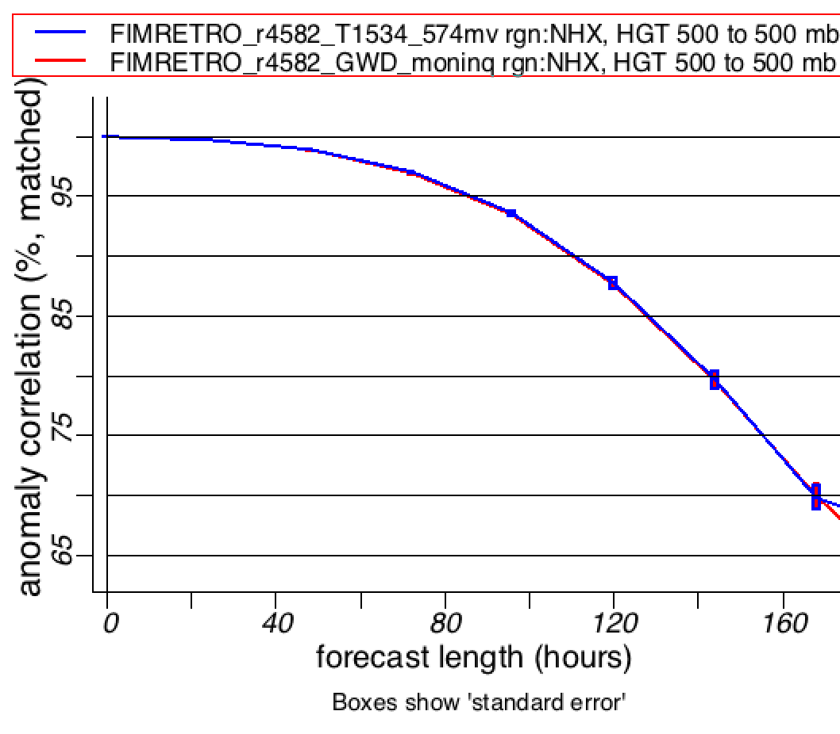
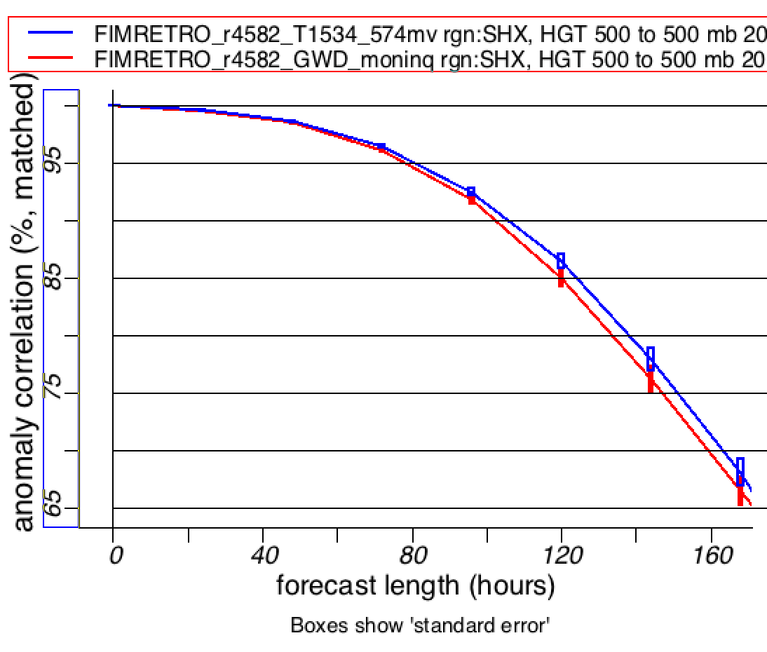
Effect of Improved GFS Initial Conditions 500-hPa Height Anomaly Correlation FIM-30km (GFS phys) GFS T574 IC vs. T1534 IC
12-month test
Oct 2013 -Sept 2014
SH, dieoff
NH, dieoff
SH, dieoff
FIM minus GFS
Aug 12 – Jul 13
SH, dieoff
Jun12 – May13
2d 5d 7d
2d 5d 7d
New T1534-GFS init conditions results in 1.5 pts better 500hPa ACC in S. Hemis, about zero impact in N. Hemis.
FIM model provides independent test to isolate analysis effect
Notes:
This result is a pretty big deal to get such improvement over the GFS for a full 1-year period.

Slide 50
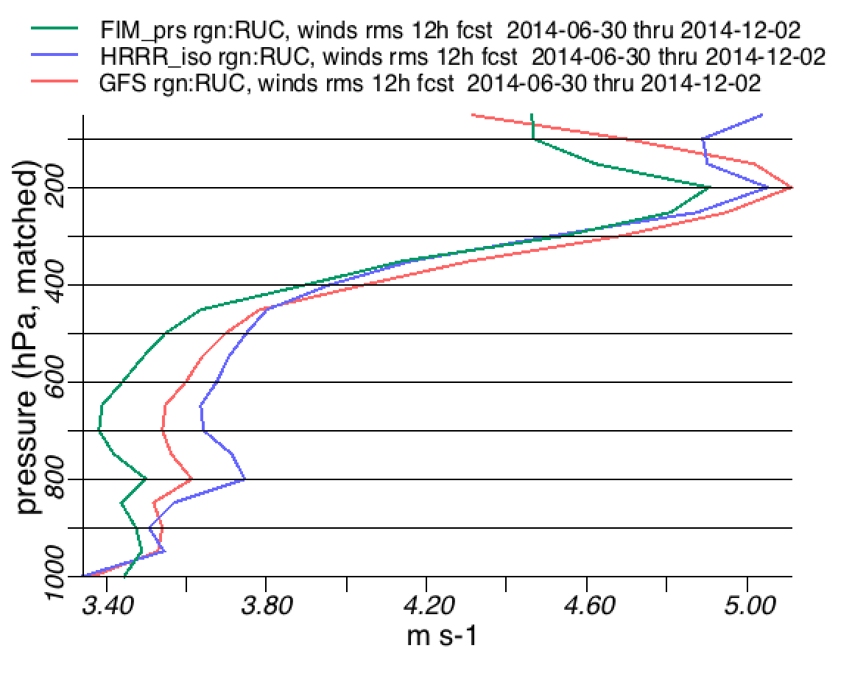
CONUS – 12h Vector Wind RMSVE
FIM vs. GFS vs. HRRR vs. raobs – Jul-Nov 2014
FIM usually better than GFS for wind forecasts in both troposphere and stratosphere from 12h out to 10+ days
Both FIM and GFS used the same hybrid initial conditions, same physics, same res
Dynamic core=main difference (quasi-isentropic vert coord, icosahedral horiz grid)
Provides baseline for future NGGPS evaluation

Slide 51
ESRL Global Model Development
HIWPP – hydrostatic real-time demo
FIM15km – 1/8 deg to 14 day, NAVGEM-23km, GFS
Ensemble – FIM40km (GFS phys + Grell-Frieitas) as experimental contribution to GEFS
HIWPP – non-hydrostatic core – NGGPS dycore candidate
NIM – ESRL icosahedral – real-data, optimization development/testing
Coupled model development
Testing of FIM-HYCOM coupled model toward experimental week 3-4 and NMME applications.
Physics
Scale-dependent Grell-Freitas conv scheme (2013, ACP) is being tested from 6-hour forecasts (part of RAPv3) through NWP application (FIM) to coupled/seasonal model application (FIM-HYCOM), also in testing in MPAS for NWP

Slide 52
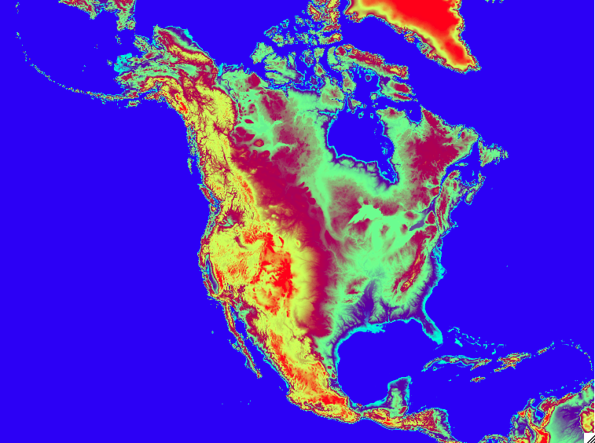
Evolution of hourly updated NOAA modeling
Feb 2014 –Rapid Refresh v2 – oper at NCEP
Sep 2014 – HRRR v1 – oper at NCEP
2015 – RAPv3 and HRRRv2 – est. June impl.
Model – improved physics – MYNN PBL / LSM/snow, aerosol-aware cloud μphysics
numerics improvements, updated WRF
Assimilation – radar assim for light precip, lightning, 2m T/Td forward model, rad wind
➔ Improved surface/lower trop forecasts, convective environment, clouds
HRRR
Rapid
Refresh ➔ NARRE
Future oper @ NCEP
North American Rapid Refresh Ensemble
2016 – RAPv4/HRRRv3
2017 – Ensemble Rapid Refresh/NAM – NARRE
(w/ hybrid 4d-ens/var DA)
2019? – Ensemble HRRR
– HRRRE – (ultimately with hourly ~3km ensemble DA)
NMMB, ARW cores
Hourly updating with GSI-hybrid EnKF (4DEnVar?)
Initially 6 members, 3 each core, physics diversity (stochastic only or with RAP/NAM/NCAR physics suites)
Hourly forecasts to 24-h
NMMB +ARW members to 84-h 4x/day

