Slide 1
Review on NCEP Regional Ensembles: 2014
Jun Du, Geoff DiMego, Binbin Zhou, Dusan Javic, Brad Ferrier, Bo Yang, Yuejian Zhu, Stan Benjamin and Isidora Jankov
EMC/NCEP/NOAA
(2014 NCEP Production Suite Review, Dec. 2-3, 2014)

Slide 2
Outline
16km SREF
(a) an interim upgrade implemented (April 2014)
(b) a major upgrade system developed and being evaluating (~April 2015)
Operational 12km NARRE-TL* and experimental 4km NCASE-TL&
* North America Rapid Refresh Ensemble – Time Lagged (RAP and NAM)
& NCEP Convection-Allowing Scale Ensemble – Time Lagged (HiresW, NAMnest and HRRR)
Experimental data exchange between NCEP SREF and CMC REPS

Slide 3
SREF Interim Package (April 2014)
Part I: Bug Fixes or improvements
Correct / improve initial conditions:
replace GFS land states with NDAS land states in NMM & ARW members;
rewrite NDAS land states in NMMB to fix a bug in NPS related to lake ice;
correct inadvertent use of global initial conditions with use of RAP for ARW members
Fix bugs in NOAH LSM:
eliminate negative soil moisture fractions for NMM and ARW members;
eliminate “urban swamp” (causing too cold surface temperature over urban regions during heat wave periods) for NMMB members
Improve cloud ceiling
correct GFS physics in 2 NMMB members to produce compatible cloud & ceiling
guidance with the rest of SREF members;
b) fix post-processor to remove use of snow in diagnosing cloud base height
Correct a mapping bug (eastward shift) in NMM member’s pressure-grib output files.
Code improvements: (a) p vs log(p), (b) NetCDF I/O for NMM and ARW

Slide 4
SREF Interim Package (April 2014)
Part II: New products
Add 4 winter weather variables:
low-level Rime Factor of 21 members;
snow depth of 21 members;
% of frozen precipitation of 21 members;
water equivalent accumulated snow of 7 ARW members
Add 2m temperature and 3-hourly accumulated precipitation of 21 SREF members from the 32km North American domain (grid 221) into AWIPS
Modify the clustering algorithm to “preserve” time-continuity within a cluster over each of the three preselected forecast periods (00-39hr, 42-63hr, 66-87hr)
Add more sites in SREF bufr sounding output by unifying the SREF bufr station list with that used in RAP and coming NAM.
Use model-lowest level fields for T2m, Q2m, U10, V10, Td2m, RH2m at f00 for NMMB

Slide 5
Feedbacks from service centers
(serving as our next upgrade targets)
To improve ensemble spread: too small IC perturbation size for ARW members, grouping by model, under-dispersion of surface variables
To increase forecast accuracy: wet and cold biases near surface
To improve probabilistic forecasts as a whole

Slide 6
SREF upcoming major upgrade
(~April 2015)
3 model core system becomes 2 model core system (NMMB, WRF_ARW, WRF_NMM)
Vertical resolution is increased from 35 to 40 layers (horizontal resolution remains the same of 16km)
Ensemble membership is increased from 21 to 26 members
IC diversity is enhanced: (a) mix use of multi analyses (NDAS, GFS and RAP) for each model core, and (b) blending of GEFS and SREF IC perturbations for all members
Physics diversity is enhanced: (a) more variety of physics schemes, and (b) stochastic flavor in physics parameters (GWD and soil moisture)
New variables and products are added

Slide 7
Physics schemes in 13 NMMB members with three flavors:
NAM1, NAM2, GFS
(Suggested by Brad Ferrier)
Mod-Mem | IC | IC pert | LBCs | Physics 1 |  |  | Physics 2 |  | GWD | Land Surface
 |  |  |  | Conv | PBL | Sfc layer | Microphys | LW, SW Rad | cleffamp | LSM | Initial | Soil pert.
nmmb_ctl | NDAS | Blending (GEFS + SREF) | GFS | BMJ old shal | MYJ | MYJ | Fer_hires | RRTM | cleffamp=1 | Noah | NAM | no
nmmb_n1 |  | same | GEFS 1 | SAS | GFS | MYJ | WSM6 | GFDL | cleffamp=0.5 | Noah | NAM | no
nmmb_p1 |  | same | GEFS 2 | BMJ new shal | MYJ | MYJ | Fer_hires | RRTM | cleffamp=2 | Noah | NAM | no
nmmb_n2 |  | same | GEFS 3 | SAS | GFS | MYJ | Fer | GFDL | cleffamp=1 | Noah | NAM | Drier soil
nmmb_p2 |  | same | GEFS 4 | BMJ old shal | MYJ | MYJ | WSM6 | RRTM | cleffamp=0.5 | Noah | NAM | Drier soil
nmmb_n3 | GFS | same | GEFS 5 | SAS | GFS | MYJ | Fer_hires | GFDL | cleffamp=2 | Noah | NAM | Drier soil
nmmb_p3 |  | same | GEFS 6 | BMJ new shal | MYJ | MYJ | WSM6 | RRTM | cleffamp=1 | Noah | NAM | Drier soil
nmmb_n4 |  | same | GEFS 7 | SAS | GFS | MYJ | WSM6 | RRTM | cleffamp=0.5 | Noah | NAM | no
nmmb_p4 |  | same | GEFS 8 | BMJ old shal | MYJ | MYJ | Fer_hires | GFDL | cleffamp=2 | Noah | NAM | no
nmmb_n5 | RAP | same | GEFS 9 | SAS | GFS | MYJ | WSM6 | RRTM | cleffamp=1 | Noah | NAM | Drier soil
nmmb_p5 |  | same | GEFS 10 | BMJ new shal | MYJ | MYJ | Fer_hires | RRTM | cleffamp=0.5 | Noah | NAM | Drier soil
nmmb_n6 |  | same | GEFS 11 | SAS | GFS | MYJ | Fer_hires | GFDL | cleffamp=2 | Noah | NAM | No
nmmb_p6 |  | same | GEFS 12 | BMJ old shal | MYJ | MYJ | WSM6 | GFDL | cleffamp=1 | Noah | NAM | No

Slide 8
Physics schemes in 13 ARW members with three flavors:
NCAR, NAM, RAP
(Suggested by Brad Ferrier)
Mod-Mem | IC | IC pert | LBCs | Physics 1 |  |  | Physics 2 |  |  |  | Land surface
 |  |  |  | Conv | PBL | Sfc layer | Microphys | LW Rad | SW Rad | Stochastic | LSM | Initial | Soil pert
arw_ctl | RAP | Blending (GEFS + SREF) | GFS | KF | YSU | MM5 | WSM6 | RRTMG | RRTMG | no | Noah | NAM | no
arw_n1 |  | same | GEFS 13 | BMJ | MYJ | MYJ | Fer | GFDL | GFDL | no | Noah | NAM | Drier soil
arw_p1 |  | same | GEFS 14 | Grell | MYNN | MYNN | Thompson | Old RRTM | GSFC | no | RUC | NAM | no
arw_n2 |  | same | GEFS 15 | KF | YSU | MM5 | Fer | GFDL | GFDL | no | RUC | NAM | no
arw_p2 |  | same | GEFS 16 | BMJ | MYJ | MYJ | Thompson | RRTMG | RRTMG | no | Noah | NAM | no
arw_n3 | GFS | same | GEFS 17 | Grell | MYNN | MYNN | WSM6 | RRTMG | RRTMG | no | Noah | NAM | Drier soil
arw_p3 |  | same | GEFS 18 | KF | YSU | MM5 | Thompson | Old RRTM | GSFC | no | Noah | NAM | no
arw_n4 |  | same | GEFS 19 | BMJ | MYJ | MYJ | WSM6 | RRTMG | RRTMG | no | RUC | NAM | no
arw_p4 |  | same | GEFS 20 | KF | YSU | MM5 | Fer | GFDL | GFDL | no | Noah | NAM | Drier soil
arw_n5 | NDAS | same | GEFS 1 | Grell | MYNN | MYNN | Fer | GFDL | GFDL | no | Noah | NAM | no
arw_p5 |  | same | GEFS 2 | KF | YSU | MM5 | WSM6 | RRTMG | RRTMG | no | RUC | NAM | no
arw_n6 |  | same | GEFS 3 | BMJ | MYJ | MYJ | Thompson | Old RRTM | GSFC | no | Noah | NAM | Drier soil
arw_p6 |  | same | GEFS 4 | Grell | MYNN | MYNN | Thompson | RRTMG | RRTMG | no | RUC | NAM | no

Slide 9
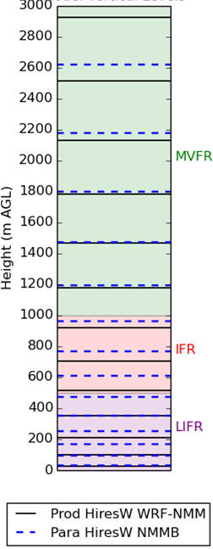
Vertical Layers: 35 to 40
Adding vertical levels to SREF members will improve models’ ability to distinguish ceiling heights at boundaries between critical flight categories

Slide 10
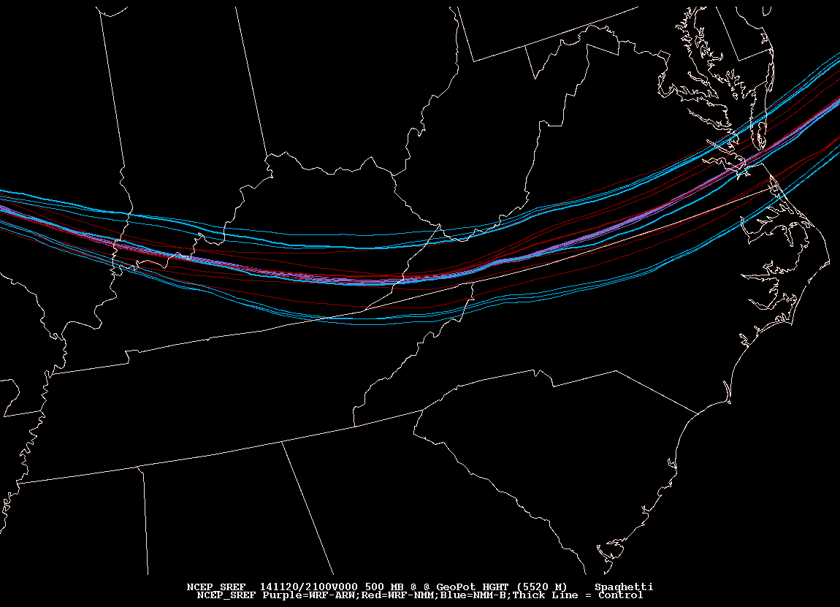
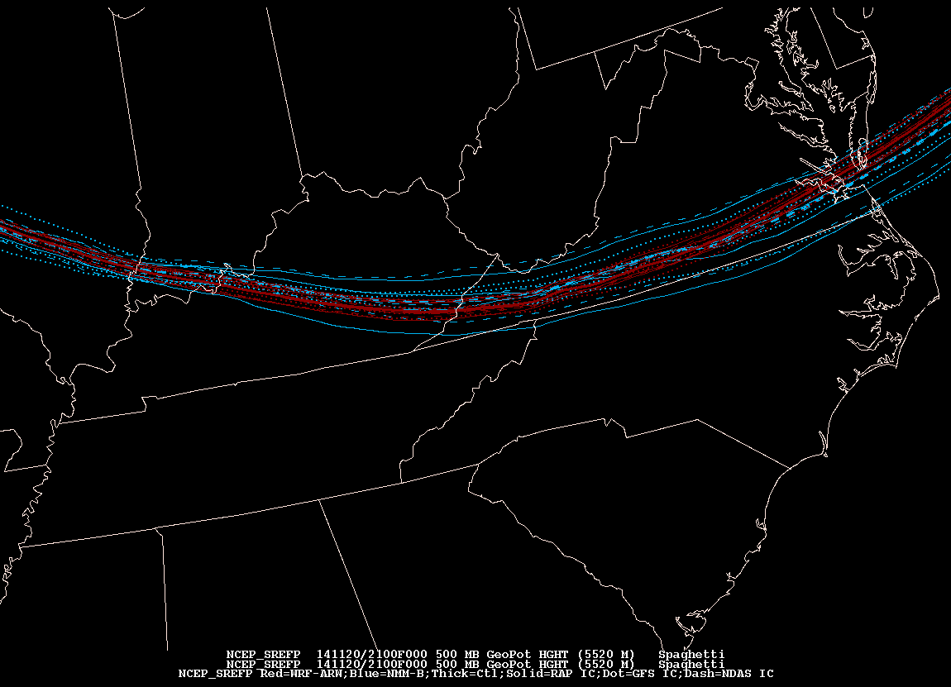
IC spread comparison: SREF vs. SREFp
(Israel Jirak, SPC)
Prod
Para
Clustering in operational by three models
Uniformly distributed across models
Almost no initial spread in operational
ARW members
Initial spread is improved in parallel ARW members
500mb heights @ 5520m
20141120/21F000

Slide 11
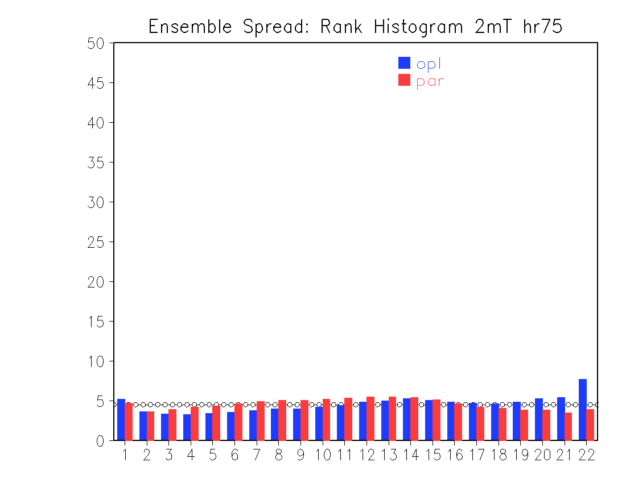
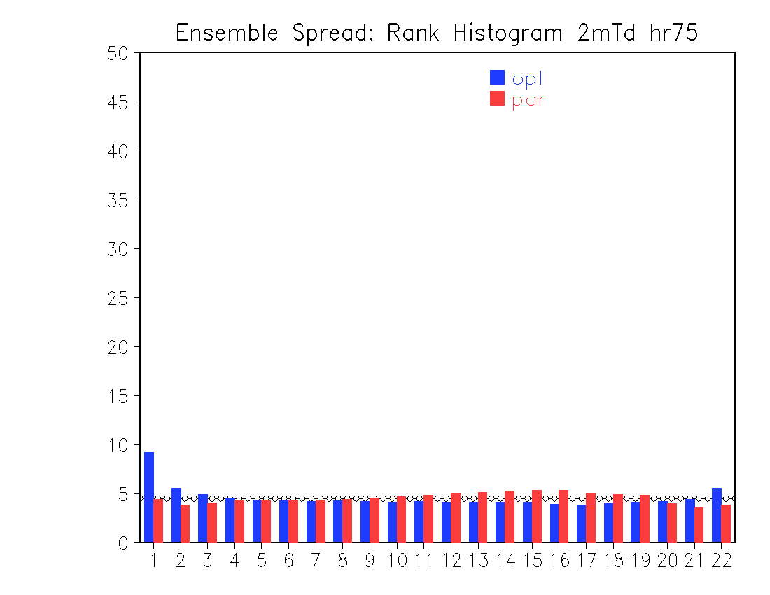
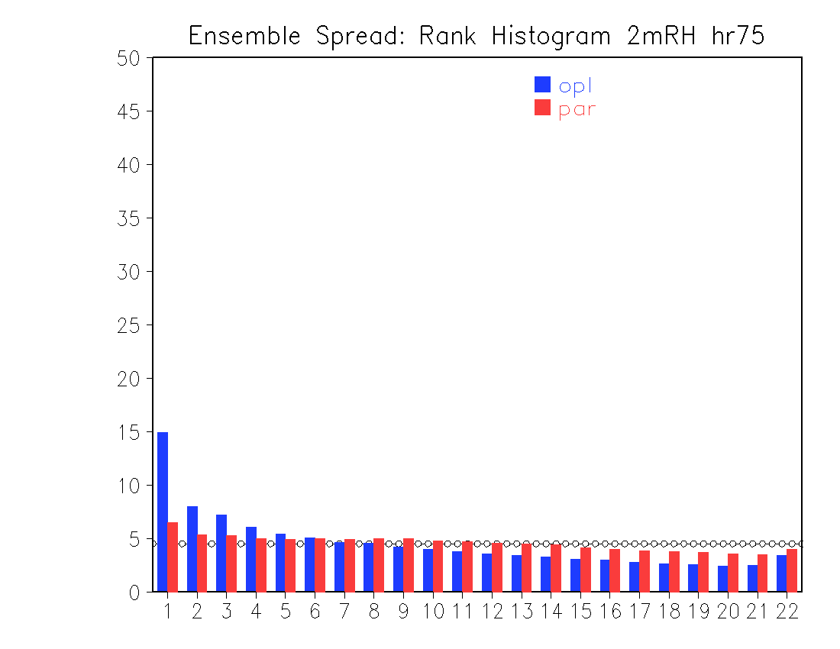
Bias reduced for surface elements
Oct. 30. – Nov. 20, 2014
2m T: cold bias reduced
2m Td: wet bias reduced
2m RH: wet bias reduced

Slide 12
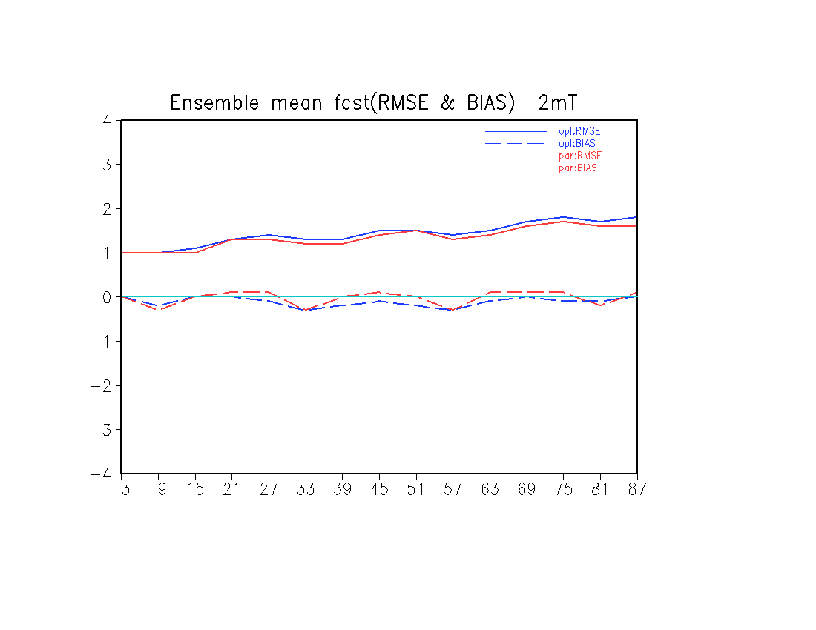
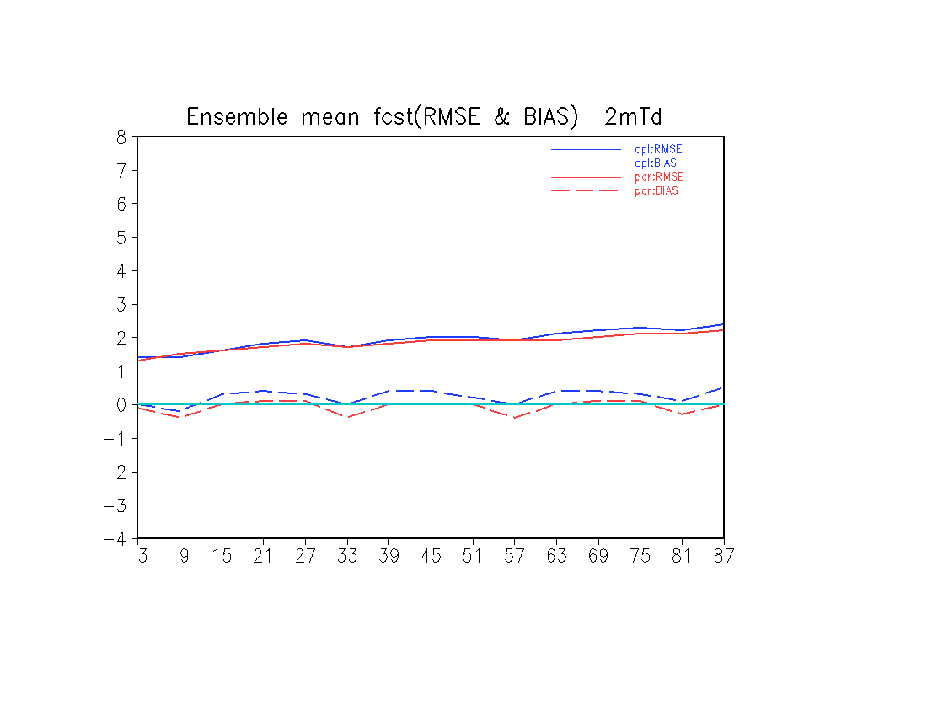
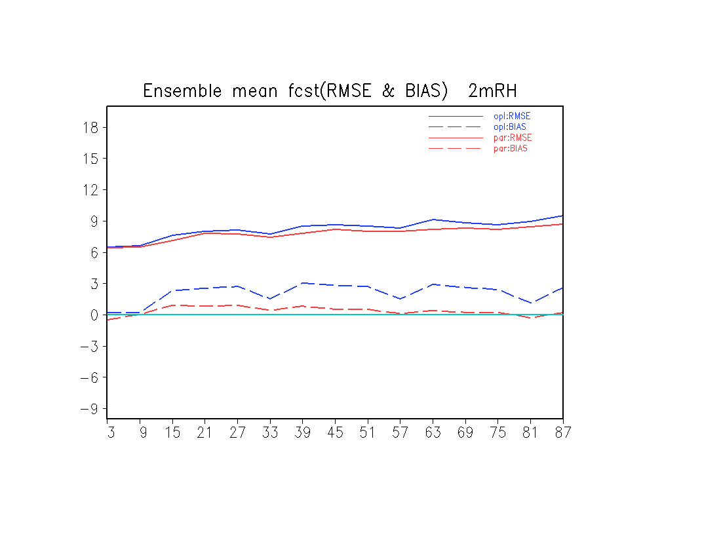
Both RMSE and Bias of ensemble mean reduced
2m T: total error as well as
cold bias reduced
2m Td: total error as well as
wet bias reduced
2m RH: total error as well as
wet bias reduced

Slide 13
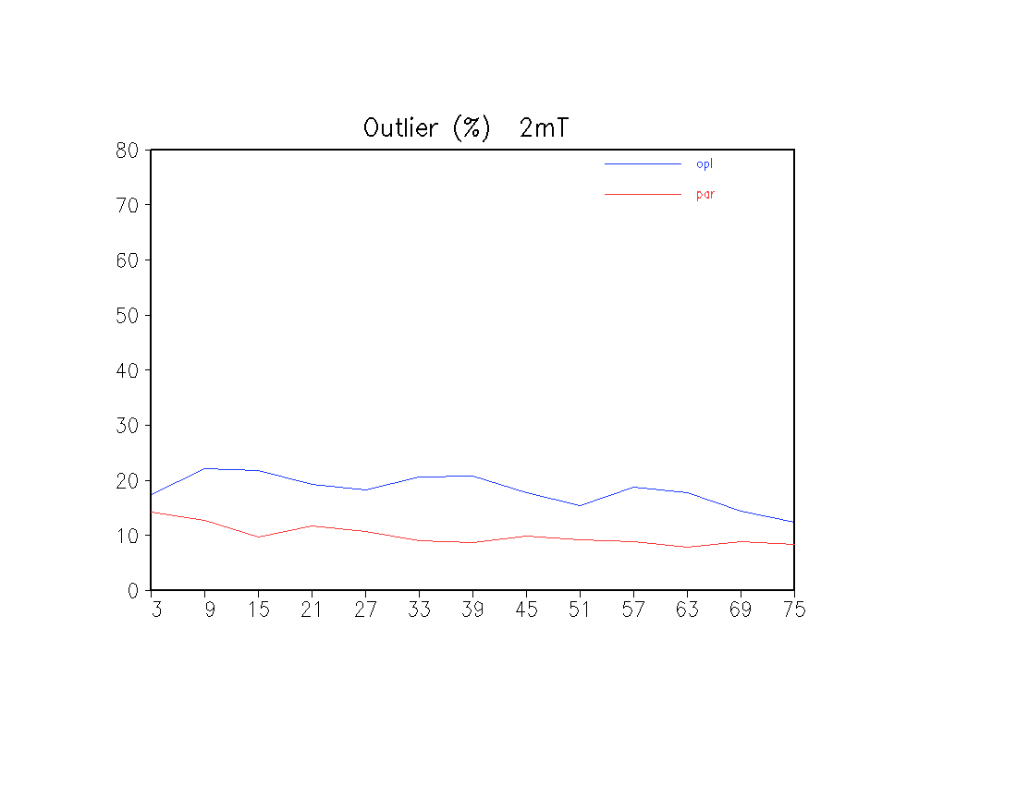
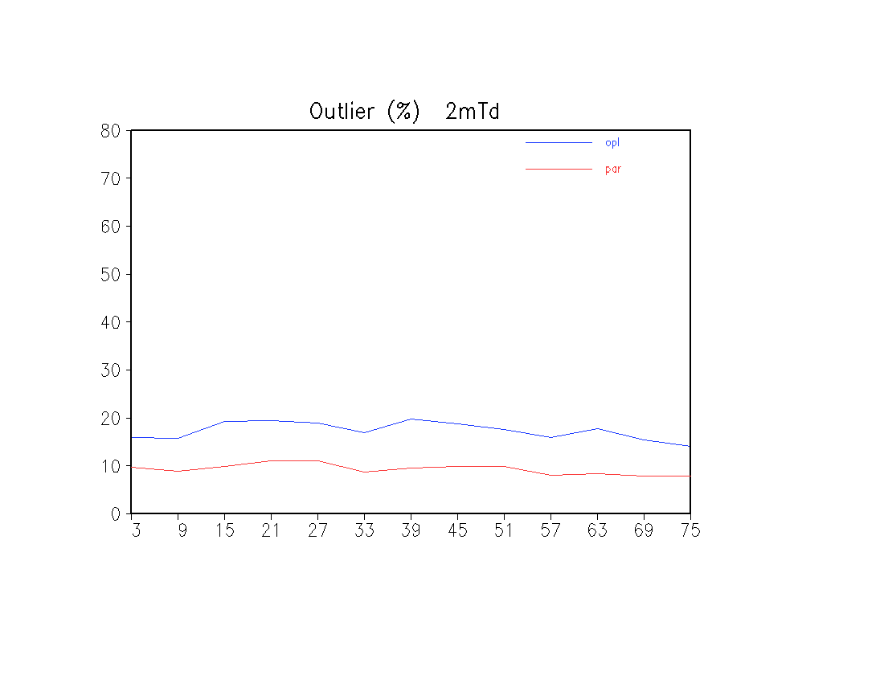
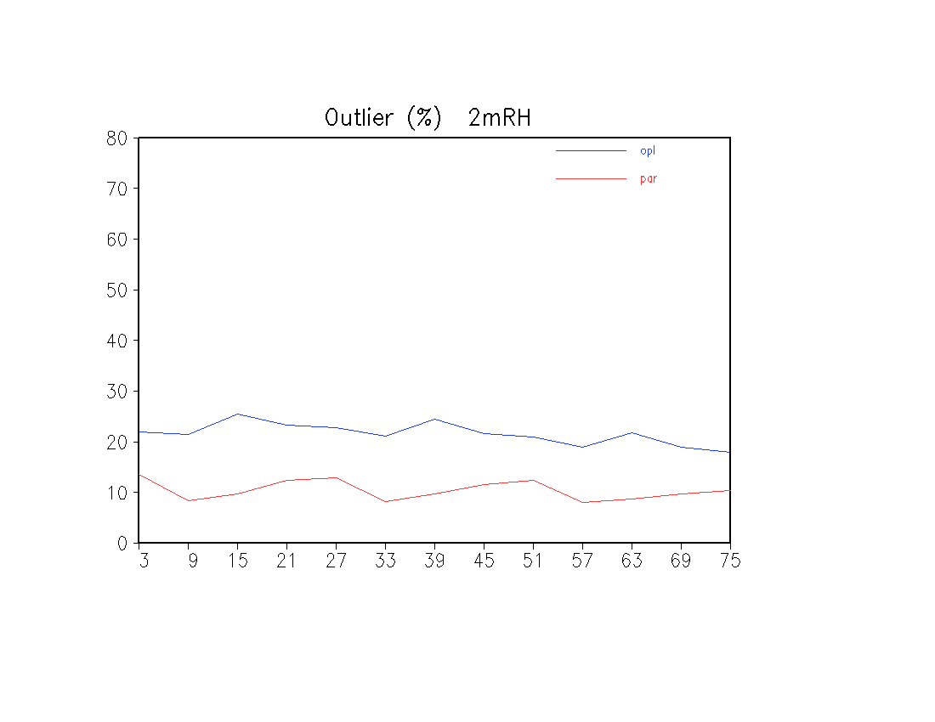
2m T
2m Td
Outlier or missing rate by ensemble range is reduced from ~20% to ~10%
2m RH

Slide 14
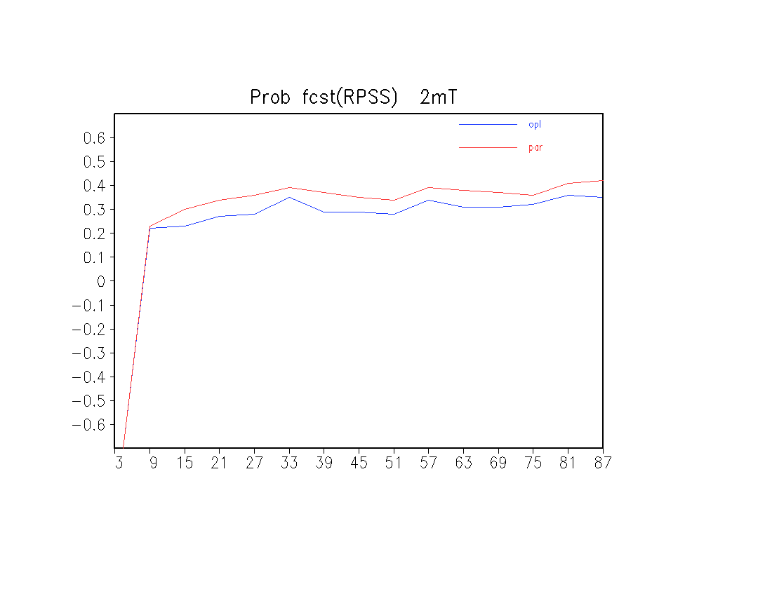
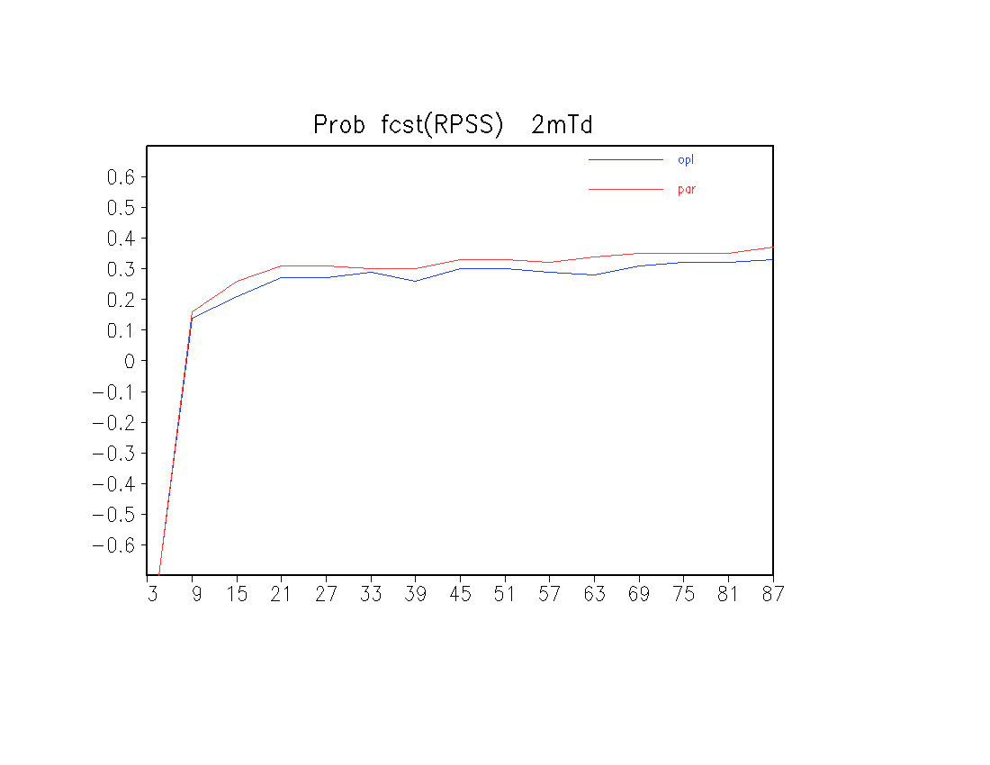
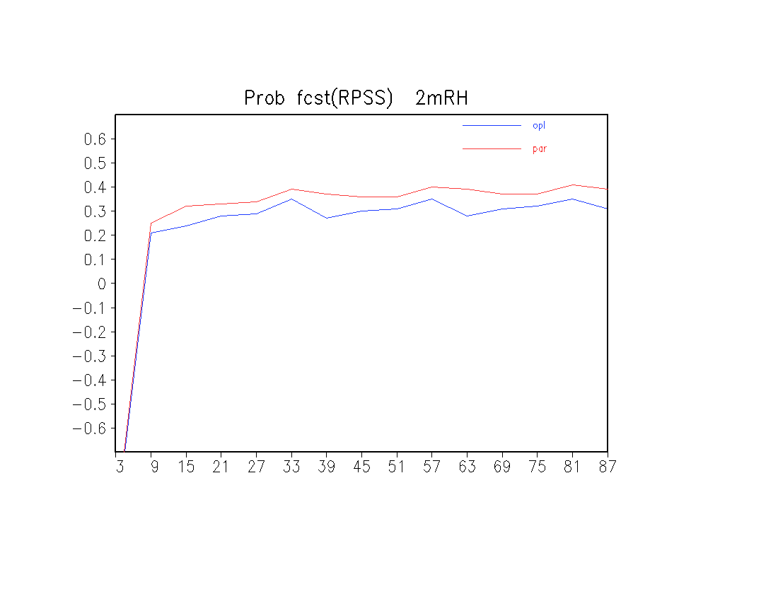
2m T
2m Td
Probabilistic forecasts improved: higher RPSS
2m RH

Slide 15
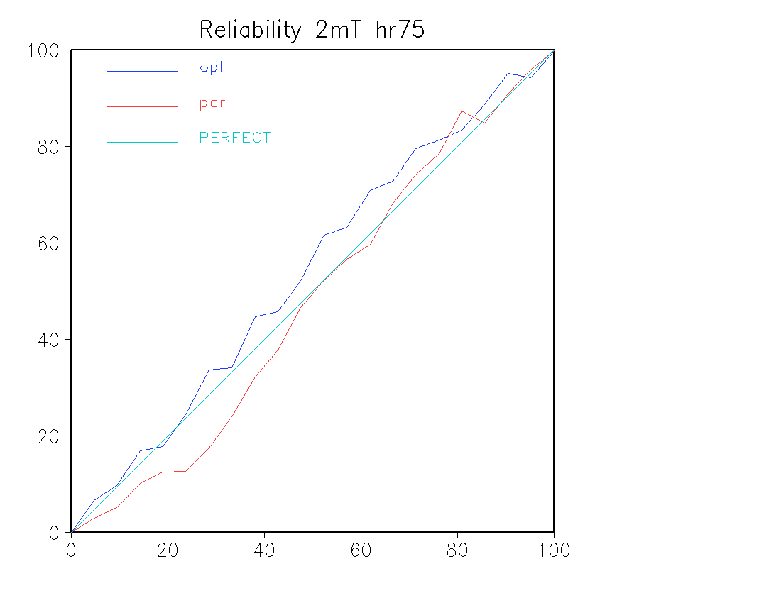
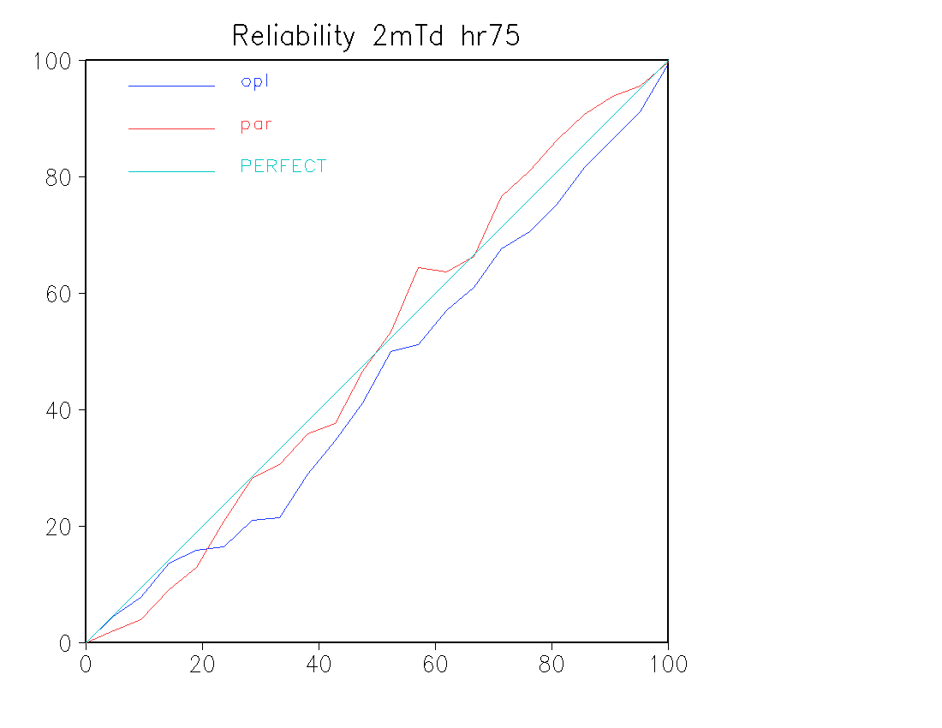
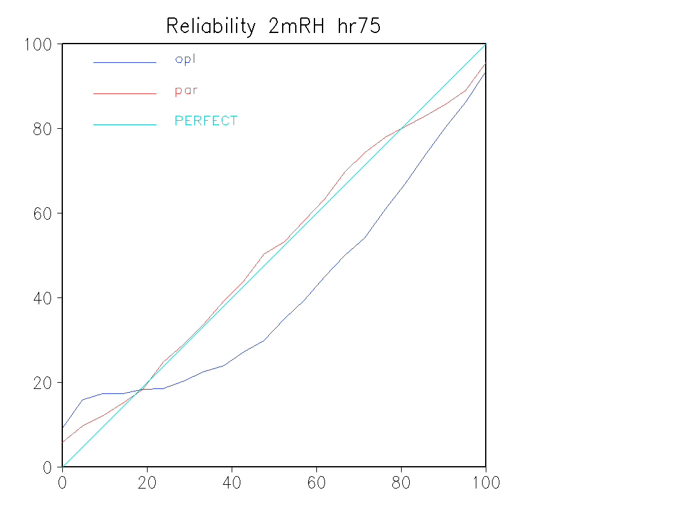
2m T
2m Td
Probabilistic forecasts are more reliable
2m RH

Slide 16
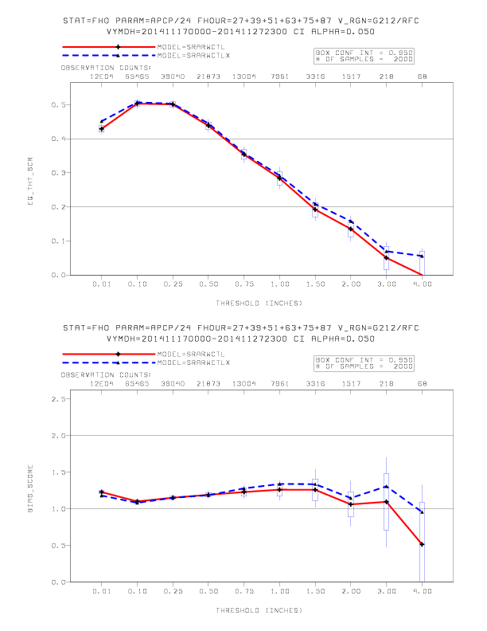
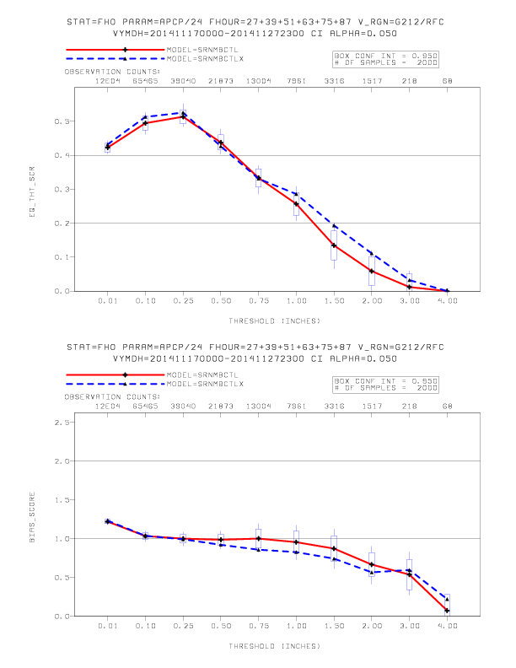
Precipitation forecasts: improvements seen especially on heavy rain end (provided by Ying Lin)
(Nov. 17 – 27, 2014)
ARW_prod
ARW_para
ETS
NMB_prod
NMB_para
ETS

Slide 17
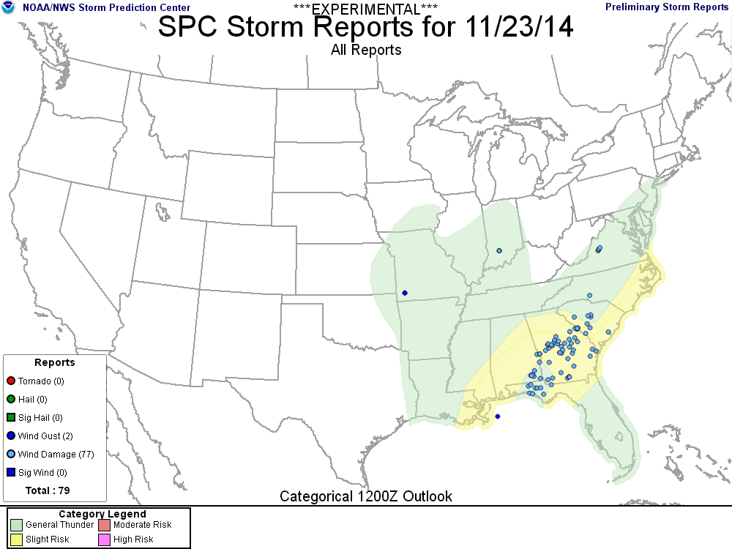
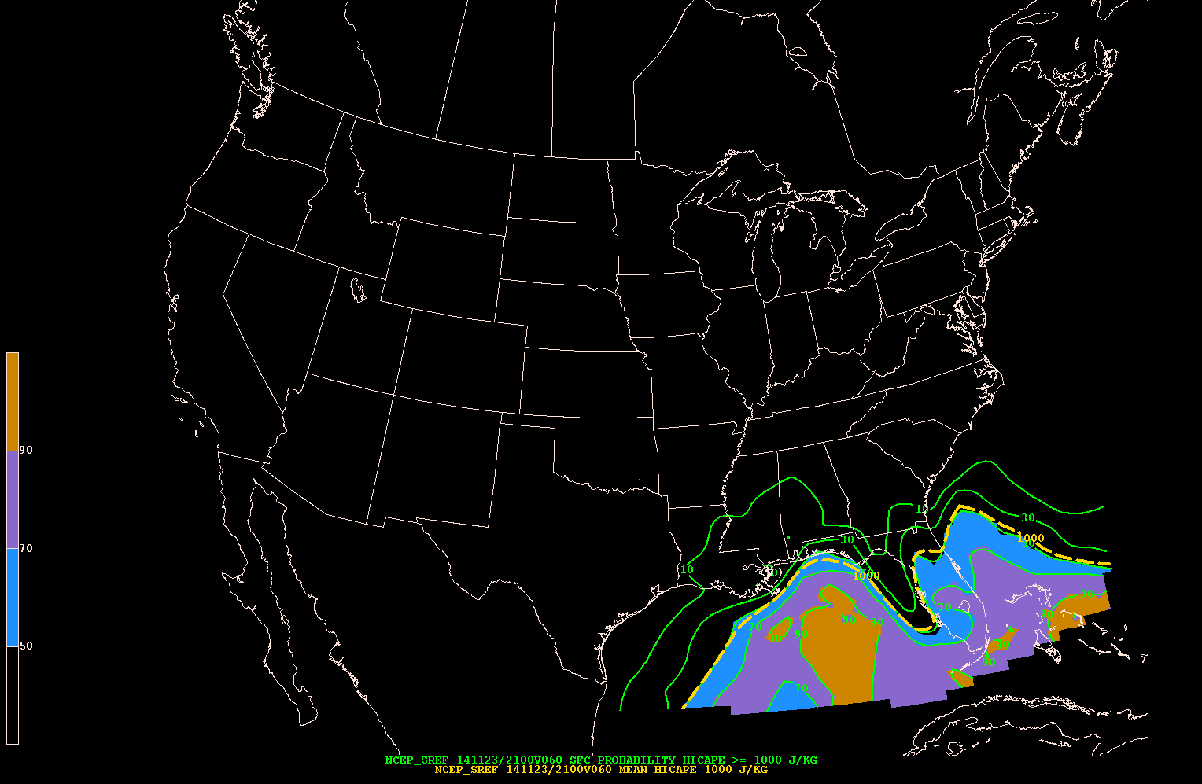
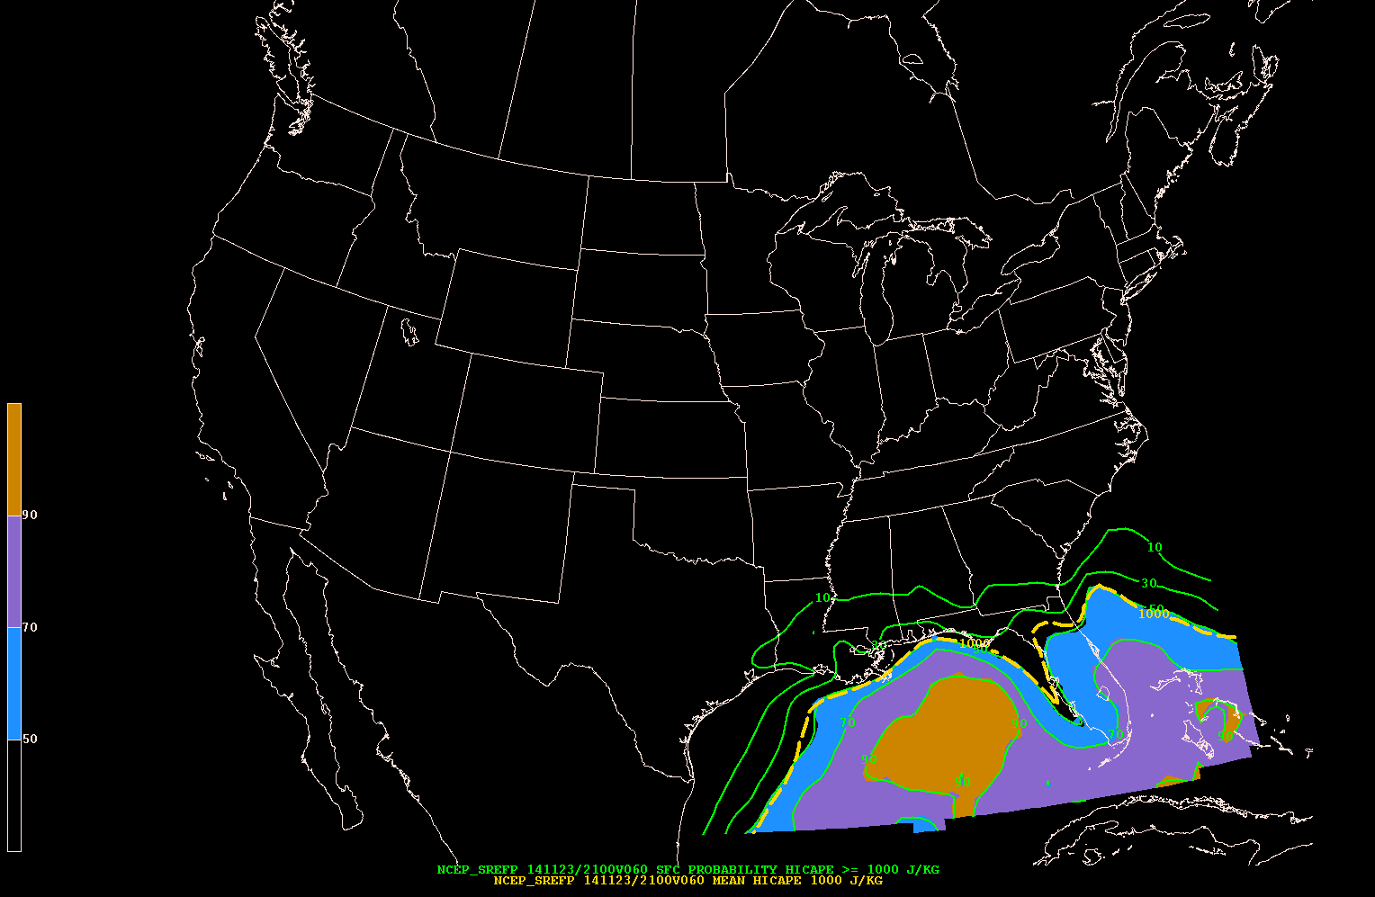
Nov. 23, 2014 severe storm outbreak in FL:
SREF vs. SREFp (Israel Jirak, SPC)
PROB MUCAPE>1000 J/kg
20141121/09F060
Prod: PROB MUCAPE>1000 J/kg
20141121/09F060
Para
Incorrect minimum in MUCAPE probability in operational SREF at 21Z on Sunday (Nov. 23, 2014) across SWRN GA into NERN Gulf

Slide 18
Status
The verification is preliminary. EMC parallel is running twice daily (00 and 21z) for more systematic evaluation by all partners (developers, forecasters and other users)
To be used by WPC for winter weather experiment (Jan. – Feb., 2015)
Implementation: ~ April, 2015

Slide 19
2014 activities of NARRE-TL and NCASE-TL
(provided by Binbin Zhou)
NARRE-TL upgraded when its base models upgraded
~After RAP upgraded to RAP-v2
~After new NAM was implemented
NARRE-TL was used during the AWC 2014 AWT Summer Experiment
NCASE-TL upgraded when its base models upgraded
~After new HiresW ARW and NMMB were implemented
~ After HRRR was implemented
NCASE-TL was used during the WPC’s 2014 summer FFaIR ( Flash Flood and Intense Rainfall)
Precipitation-related products were evaluated in FFaIR (ensemble mean is too smooth due to time-lagged members)

Slide 20
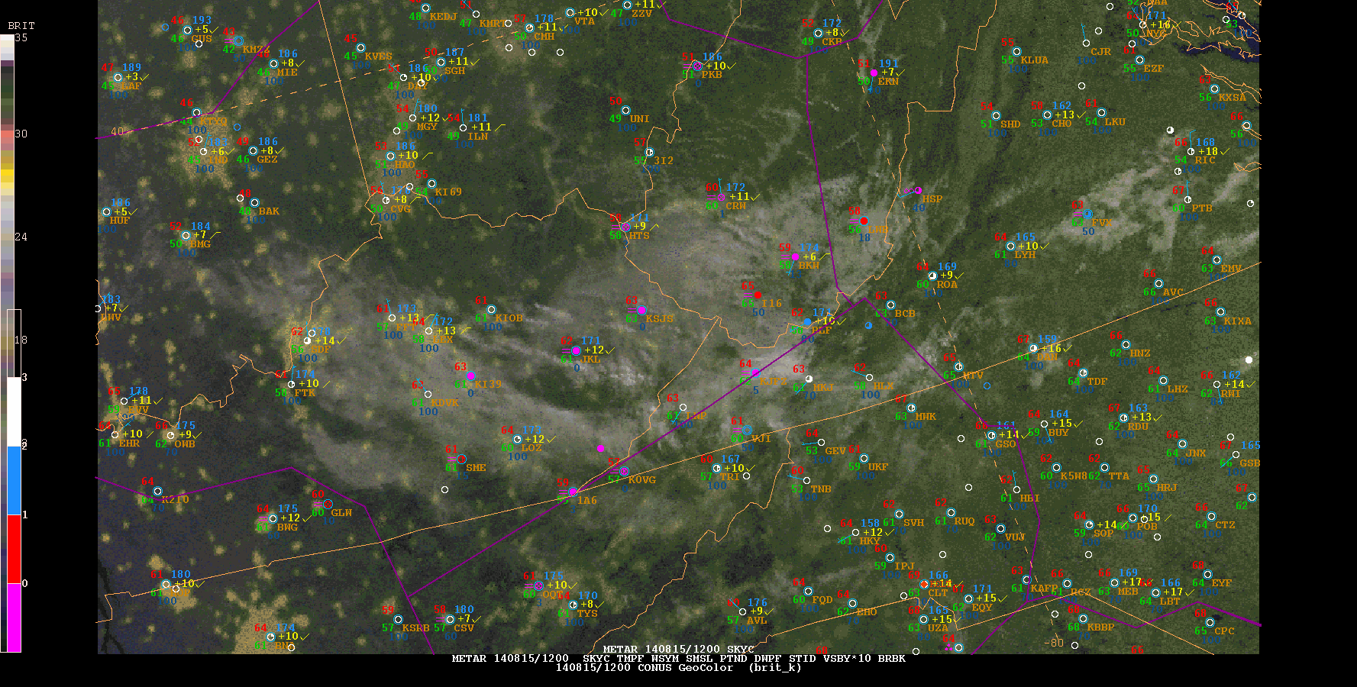
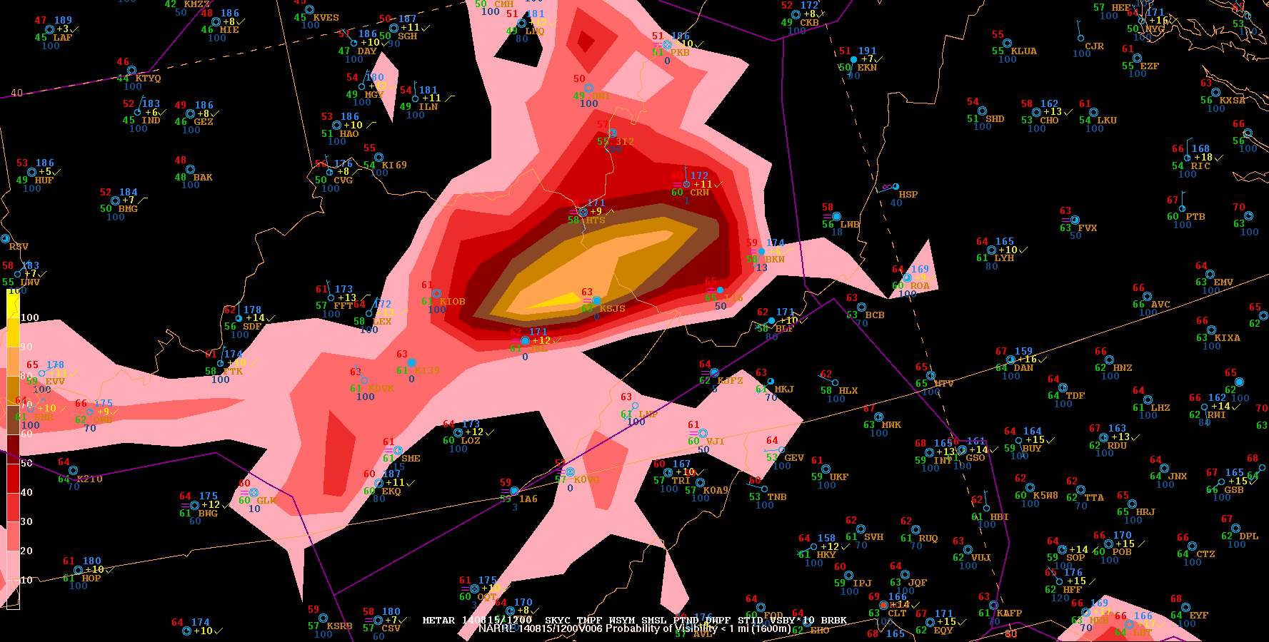
NARRE-TL for AWC 2014 AWT Summer Experiment
August 15 2014 WV-KY ground fog event: NARRE-TL showed the best
skill out of 11 participating models
Obs: 12Z 8/152014 6h prob fcst of vis < 1000m from NARRE-TL
issued at 06Z

Slide 21
2014 Jan 6 fog event forecast by NARRE-TL
Form Jeffrey Tongue about the Jan 6, 2014 dense fog event.
We were using mean visibility and probability of vsby less than 1/4 mile. I worked the evening shift yesterday. Our aviation forecasts had 3/4 mile vsby coming in after midnight (3 AM). There was not much fog over south Jersey or DelMarVa south of the warm front in the evening, so our team and surrounding WFO's were rather skeptical of dense fog (< 1/4 mile). As soon as we saw things starting to go down, we jumped on advisories, updated our terminal fcsts and alerted the FAA (thanks to the NARRE-TL guidance). We had some aircraft diverts, but air traffic was slowing down. Thus, aviation impact was not a great as it could have been. While we could have done better with the onset of fog, we did very well with the fog impacts into the morning. The forecast was spot on. There were many cancellations in the Northeast as a result and the airlines revised their schedules as much as possible. The FAA Command Center coordinated this on their 915 PM EST national telcon and planned for a special 01515 AM telcon. I was amazed to see there were no FAA programs in the Northeast this morning despite the weather. Users planned appropriately based on the NWS forecasts. The NARRE-TL was a very helpful tool for us with this event and gave us the confidence to initially issue the alerts for dense fog and continue it until FROPA this morning. This had a very significant positive impact on the National Airspace System and the economy.
Thanks to everyone at EMC for developing this product - it's making a big difference
where the "forecasts meet the users."

Slide 22
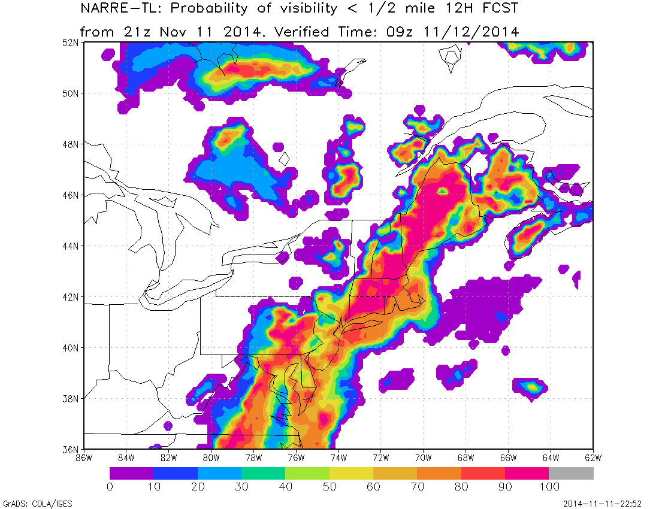
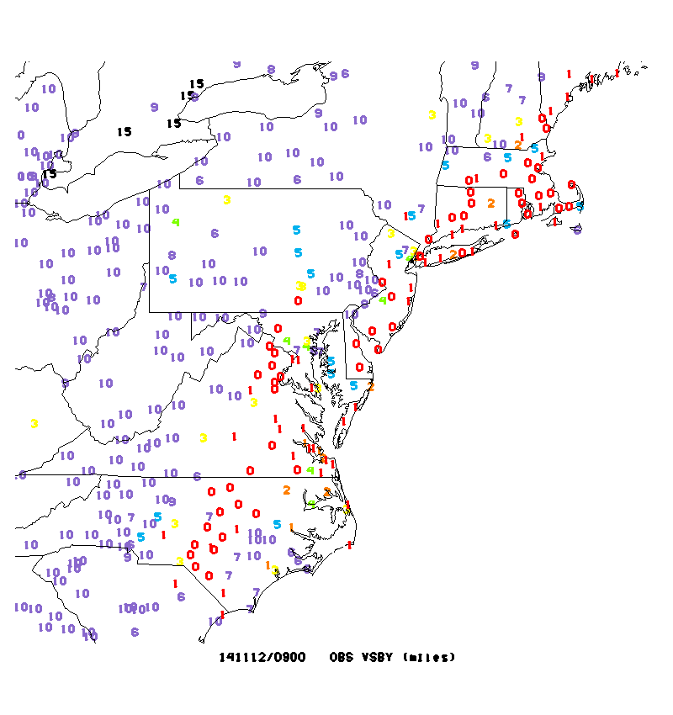
Nov 12, 2104 Mid Atlantic coast fog event

Slide 23
Form Jeffrey Tongue about the Nov 12, 2014 dense fog case
This is a First!
Geoff:
If I read the current OKX AFD correctly - the NARRE-TL was a major influence on the forecast to post a dense fog advisory well in advance. I can't remember forecasters having enough confidence this far in advance.
CONTINUED MOISTENING VIA LIGHT ONSHORE FLOW TONIGHT PLUS COOLING
BENEATH A DEVELOPING INVERSION SHOULD LEAD TO REDEVELOPMENT OF LOWCLOUDS AND SOME PATCHY FOG THIS EVENING...THEN LIKELIHOOD OF DENSEFOG AFTER MIDNIGHT ESPECIALLY NEAR THE COAST...ALSO SOME PATCHY
LIGHT RAIN OR DRIZZLE. THE 18Z NARRE-TL SHOWS INCREASING
PROBABILITIES OF VSBY 1/4 NM OR LESS TONIGHT...POSSIBLY EARLY THIS
EVENING ACROSS SE CT AND THEN EXPANDING TO MOST AREAS OVERNIGHT.
ISSUED DENSE FOG ADVY FOR MOST OF THE CWA BEGINNING AT MIDNIGHT.
THERE IS SOME UNCERTAINTY AS TO WHETHER DENSE FOG WILL DEVELOP
IN AREAS WELL NORTH/WEST OF NYC WHERE LOW CLOUDS HAVE HUNG ON INTOTHE AFTERNOON ATTM...LIMITING RADIATIONAL COOLING POTENTIAL.
….
Working Aviation Weather here in the NY Metro corner post of the NWS Golden Triangle Initiative this morning.
While a morning dense fog event in the northeast corridor used to prove a significant impact to the National AirSpace - the planning by FAA and the Commercial Airlines based on the NWS Terminal Forecasts avoided a high impact event.
Here's a comment for the National Aviation Meteorologist at the FAA Command Center:
(10:12AM) ATCSCC-NAM-brandon.smith: good updates … good comments coming my way about how well this was forecast … 24 hour lead time in the TAFs was noticed!

Slide 24
WPC FFaiR: NCASE vs. SSEO vs. ExREF
OBS
SSEO
NCASE
9km ExREF

Slide 25
Improvement of NCASE in 2015
Probably too large spread due to lagged members, leading to under-predicted probability and too smooth in ensemble mean learned from the WPC FFaiR experiment
Probability-matched approach is needed to improve ensemble mean, 2nd-moment calibration is needed to improve the reliability of probability

Slide 26
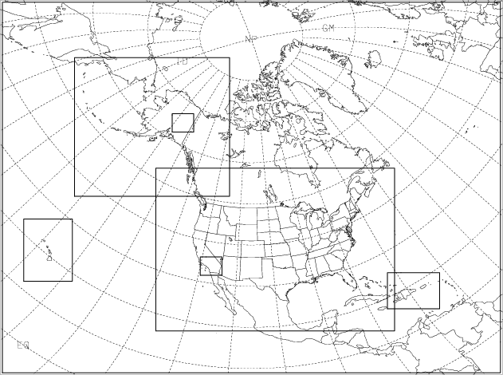
Relationship of SREF, NARRE, NCASE and NSSE
12km NARRE (first 24hr or 48h of SREF)
3km NCASE
1km NCEP Storm Scale Ensemble (NSSE)

Slide 27
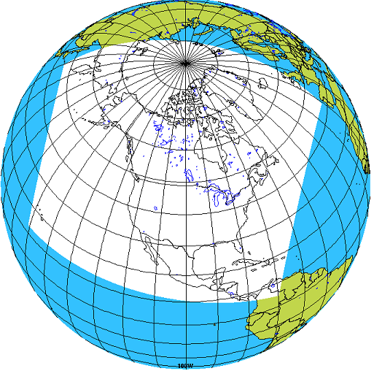
Experimental data exchange between NCEP SREF and
CMC REPS
General conclusion:
NCEP SREF is better in ensemble
spread (better dispersion and reliability)
(b) CMC REPS: better in resolution
(c) Combined ensemble: mixed results
(d) Will continue to test with the new systems

Slide 28
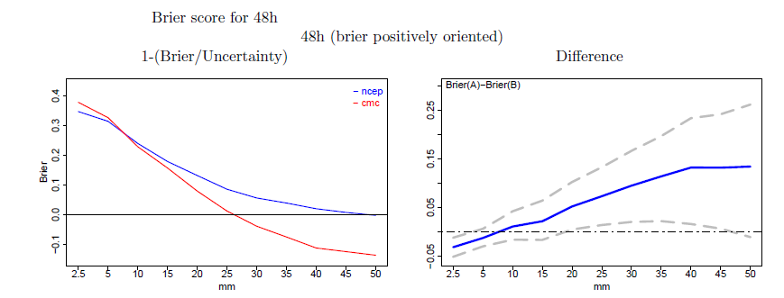
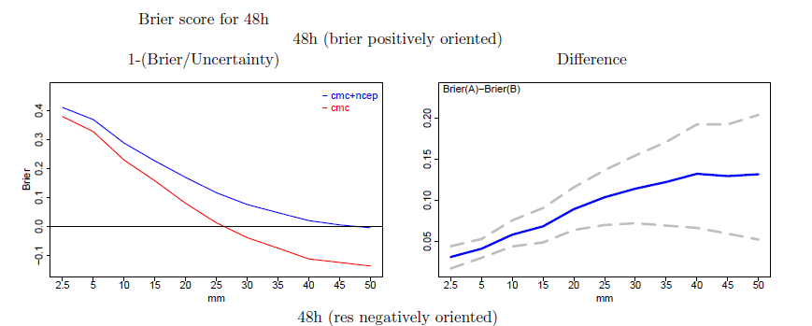
Significant improvement in precipitation amount forecasts over CMC
REPS (Summer)
(note: mixed results for some other atmospheric variables)
NCEP
vs. CMC
Higher scores better
NCEP+CMC

Slide 29
What presented
16km SREF
(a) an interim upgrade implemented (April 2014)
(b) a major upgrade system developed and being evaluating (~April 2015)
Operational 12km NARRE-TL and experimental 4km NCASE-TL
(a) upgraded in base models
(b) participated in AWC and WPC experiments
Experimental data exchange between NCEP SREF and CMC REPS

Slide 30
Questions?

