Slide 1
Transforming the
National Weather Service’s Water Services
Don Cline
Acting Director, Office of Hydrologic Development
National Weather Service, NOAA
Notes:
OUTLINE:
NEW MISSION FOCUS
TECHNICAL APPROACH
SCALE IMPLICATIONS
NATIONAL WATER CENTER (Organization, Functions, Staffing, Initial Activities, Design Tour)
SUMMARY

Slide 2
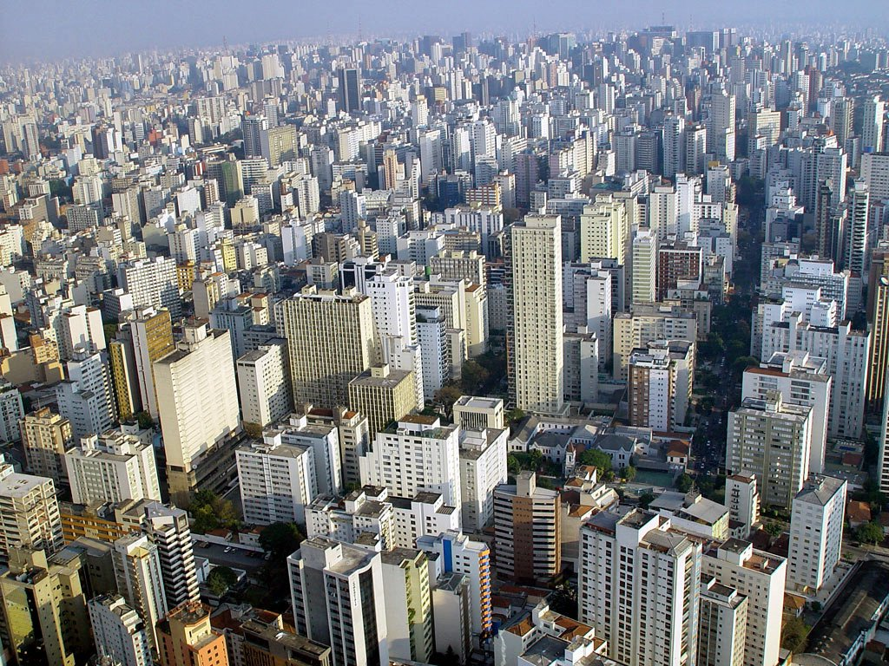
Notes:
This image is Sao Paulo, Brazil, which is experiencing their worst drought in 80 years.
Sao Paulo is Brazil’s largest city, the largest city in the America’s, and the twelfth largest city in the world with 11 million residents
Sao Paulo’s reservoir system serves 20 million residents – half of California – and are down to 3% of capacity, and devastation looms.

Slide 3
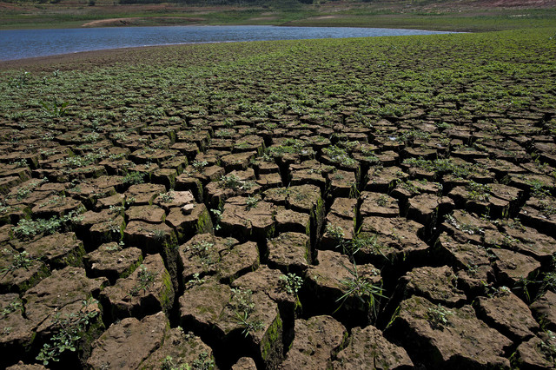
Notes:
This image is of a reservoir for Sao Paulo, Brazil, which is experiencing their worst drought in 80 years.
Sao Paulo is Brazil’s largest city, the largest city in the America’s, and the twelfth largest city in the world with 11 million residents
Sao Paulo’s reservoir system serves 20 million residents – half of California – and are down to 3% of capacity, and devastation looms.
What’s this have to to do with us?

Slide 4
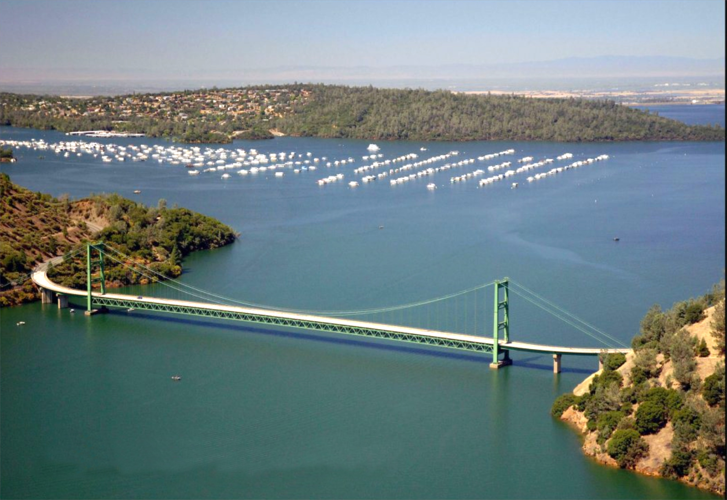
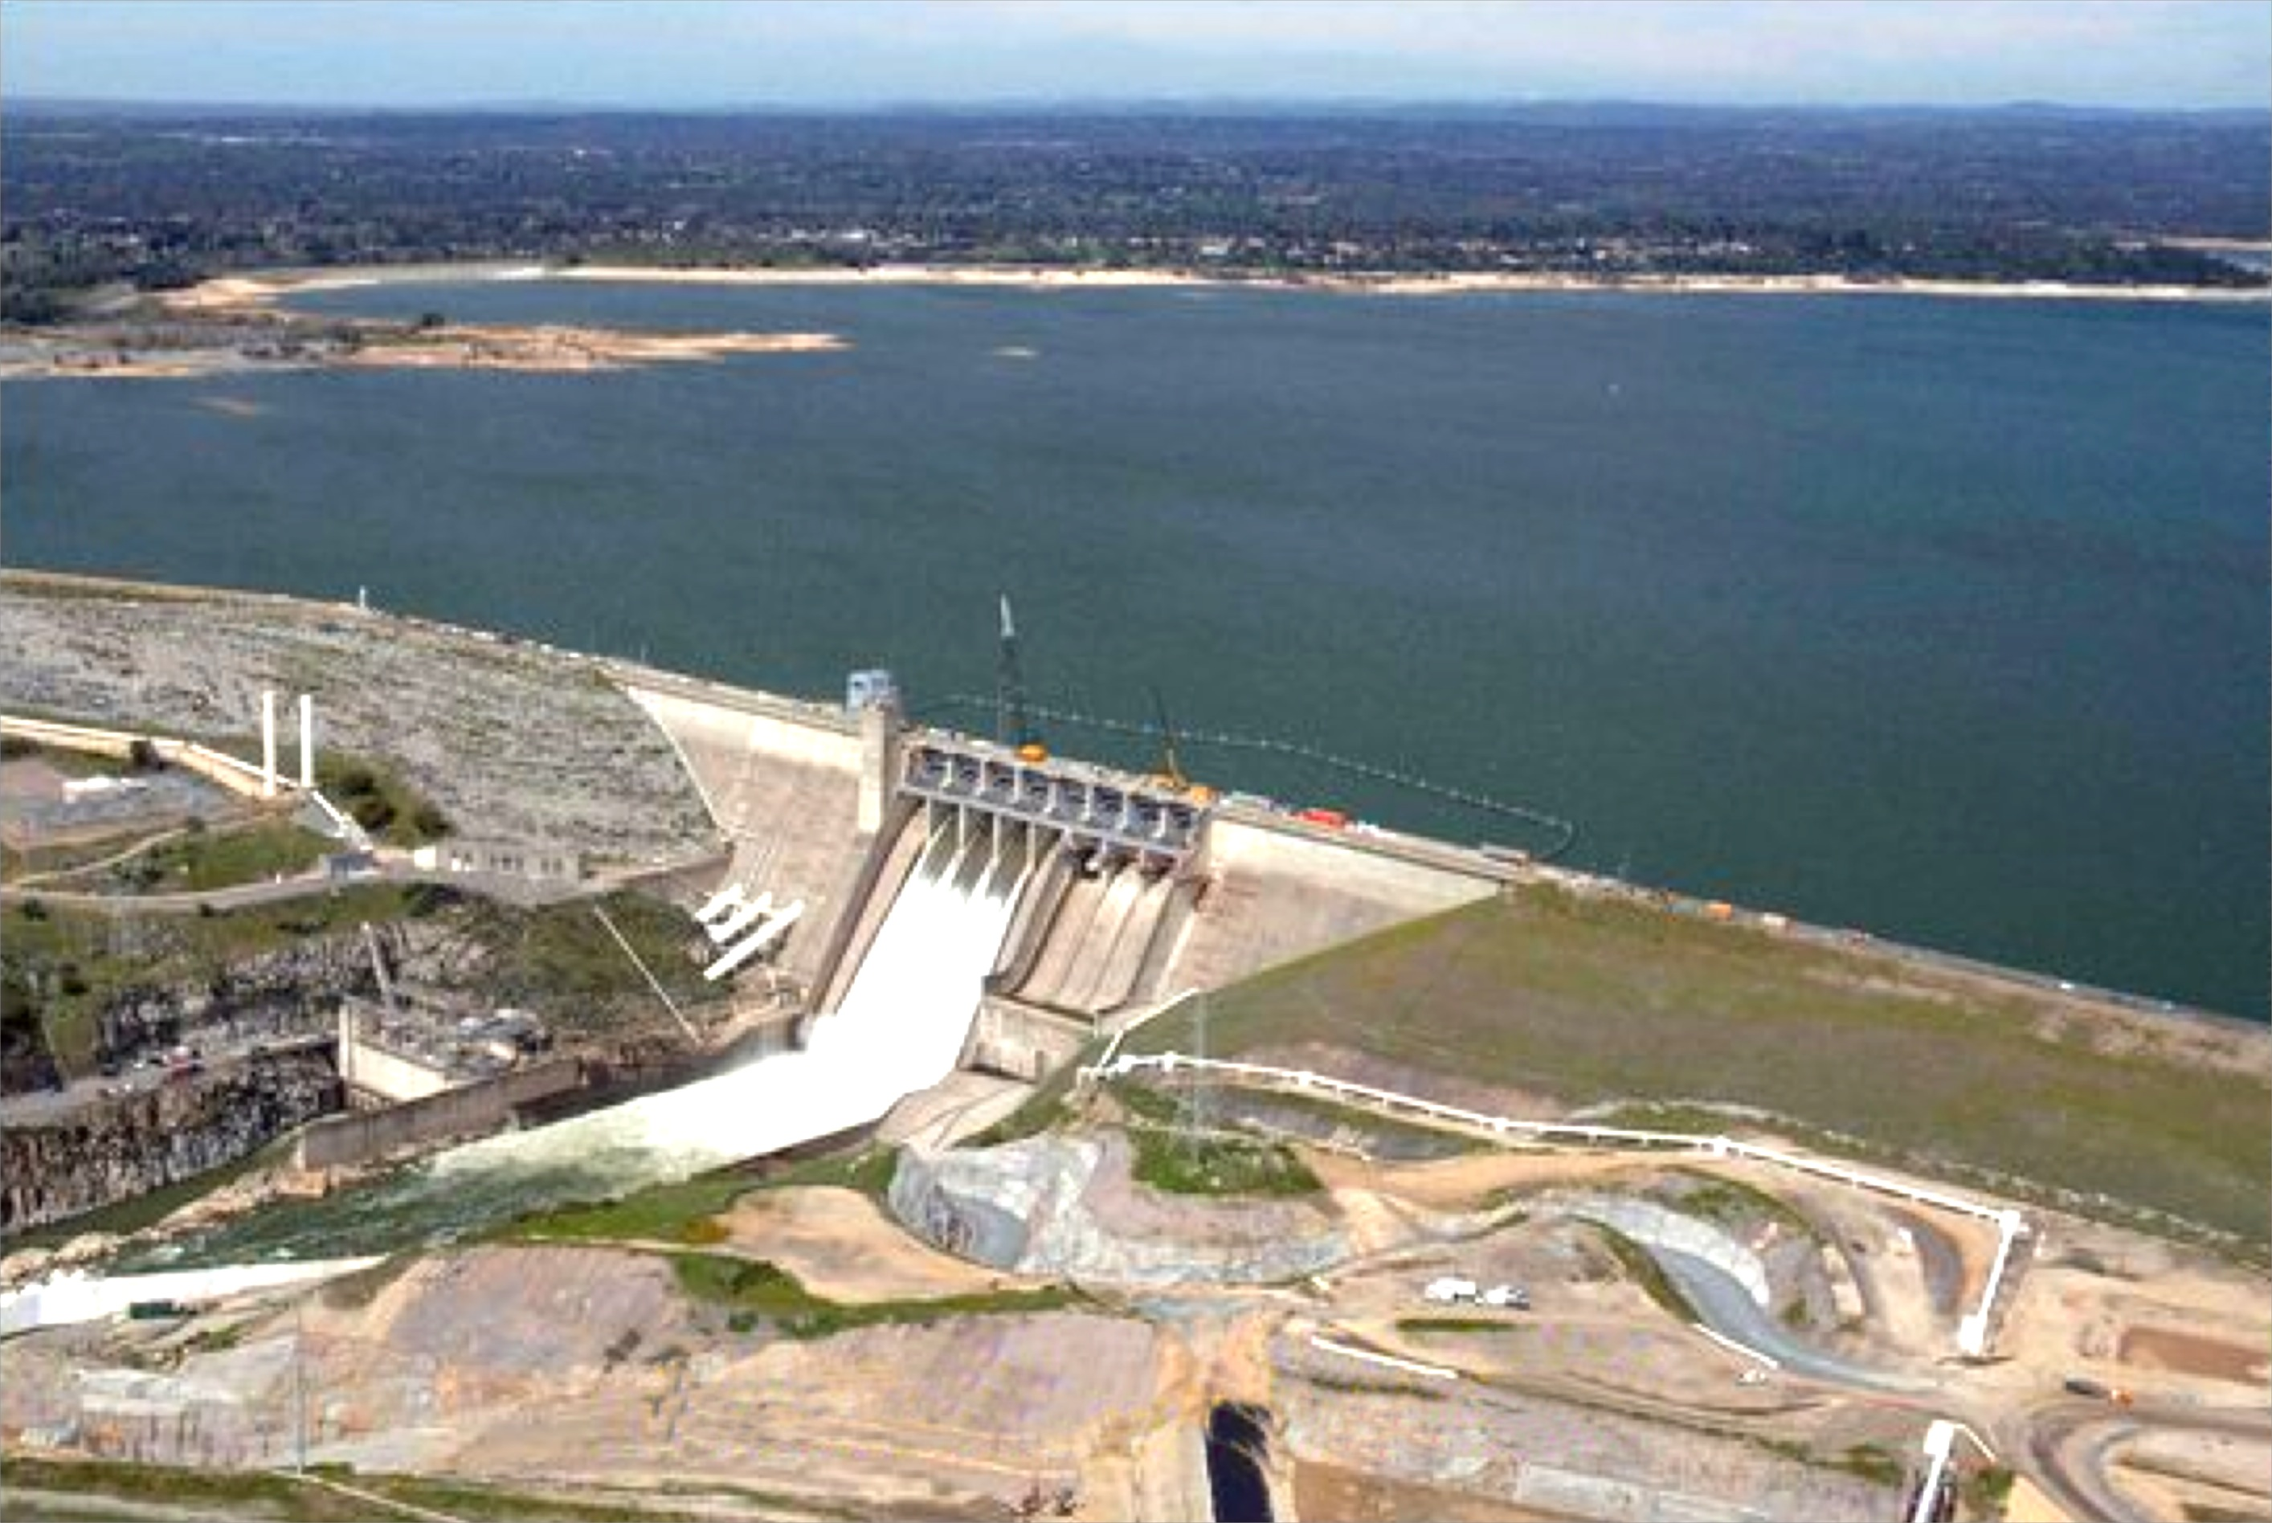
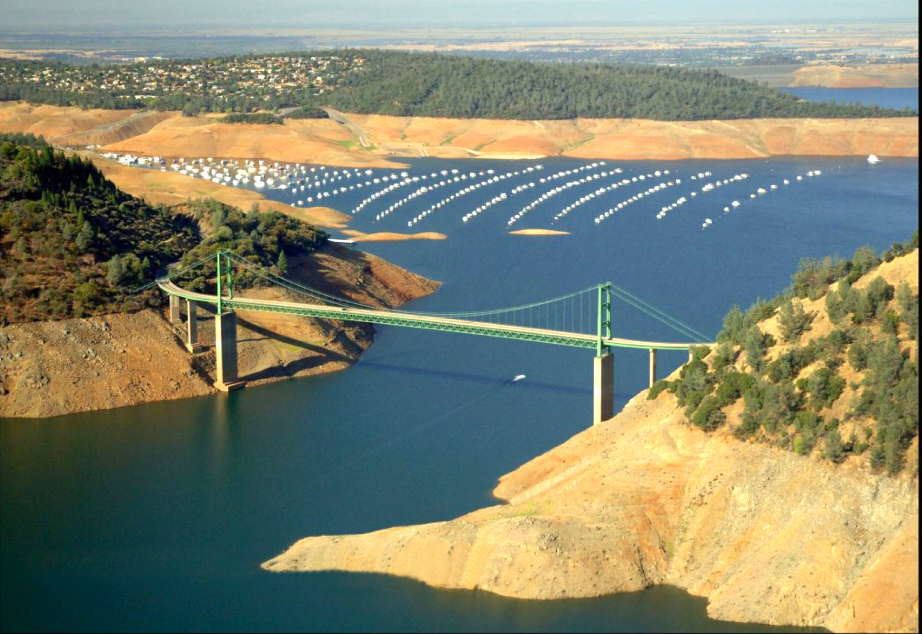
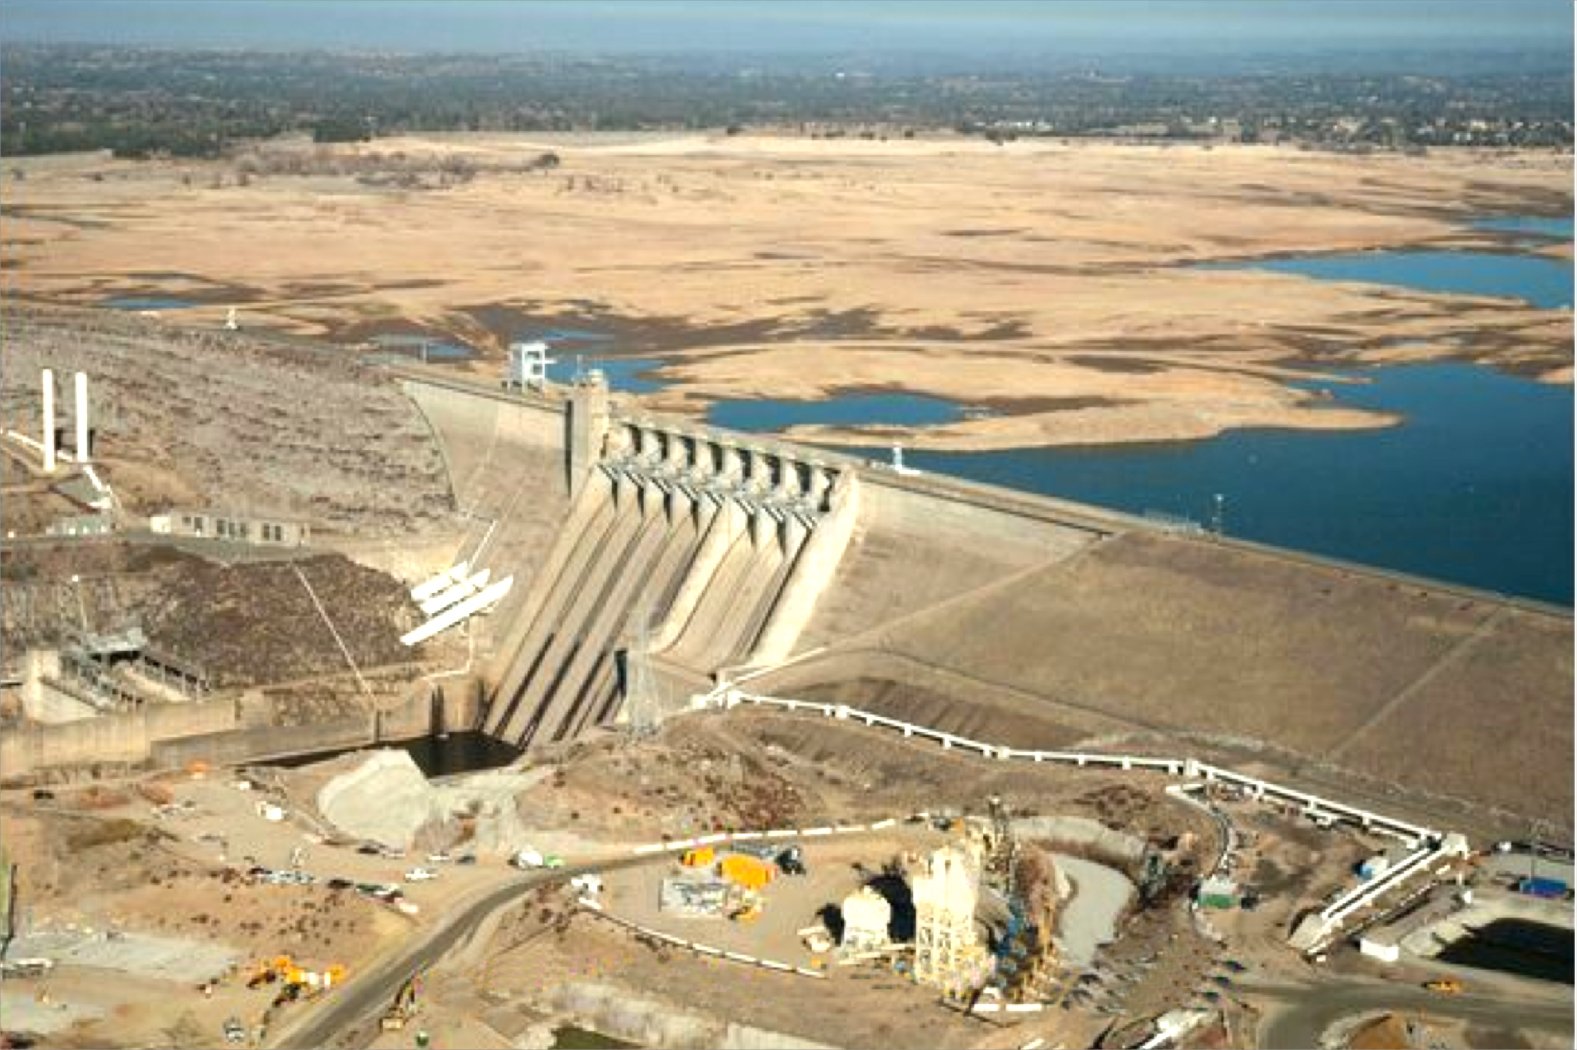
Lake Oroville, CA
Folsom Lake, CA
July 20, 2011
January 16, 2014
46% Capacity
32% Capacity
Notes:
WEST COAST – California’s Central Valley (Water-Food_Energy nexus)
Lake Oroville is currently at 46% of total capacity. It’s the second largest reservoir in California. Folsom Lake is currently at 32% of total capacity.
Both reservoirs supply water for multiple uses, including irrigated agriculture in the Central Valley, hydroelectric power, which has been reduced due to low water levels (Water-Energy Nexus), recreation.
Folsom Lake supplies fresh water to the Bay Delta, as well as San Francisco. The impacts are interdisciplinary. Scarce water supplies lead to tension between competing demands for water.
- - - - - - - - - - - - -
Lake Oroville is the centerpiece of the State of California's "State Water Project (SWP)." The project was constructed in the early 1960s (Feather River Project) and has a capacity of just over 3.5 MAF. Oroville is a multipurpose reservoir (power, water supply, flood control, environmental, recreation). Mid-winter flood control space is 750 KAF. Currently Oroville has less than 1 MAF and is nearly 2.2 MAF below top of conservation. (Top of conservation will drop as we go into winter).
Water from Lake Oroville serves a variety of customers (water contractors) as well as environmental requirements for the Sacramento - San Joaquin Delta. Water delivery contracts are in place for customers in the lower Feather River, North and South (SF) Bay counties, San Joaquin Valley, coastal counties, and Southern California. The largest contract customer is Los Angeles MWD, with nearly half of the normal annual allocation (1.9 MAF). In water year 2014, SWP forecast a delivery rate of 0% in mid-winter and eventually increased it to 20% by June 2014.
Folsom Lake is owned and operated by the USBR. It is part of the Federal "Central Valley Project" which was engineered to (1) move water from north to south, and (2) reduce dependence on groundwater in the southern San Joaquin Valley. Other components of the CVP include Shasta Lake, Trinity Lake, New Melones, Friant Lake, and 50% of San Luis Reservoir (off-channel storage shared with SWP) with a combined capacity of about 10 MAF. Some areas around Fresno, CA experienced more than 25 feet of land subsidence in the early 1900s due to groundwater pumping. CVP water replaces groundwater pumping for agriculture and is also intended to make more land in CA productive for ag purposes. Municipal uses are also supported as well as environmental considerations in the Sacramento River and the Sacramento - San Joaquin Delta.
The USBR manages Folsom Lake for multi-purposes (water supply, flood control, power, environmental, recreation). Folsom has a total capacity of 1.0 MAF with 400 to 600 KAF flood control space. Folsom is currently at 310 KAF. Average for this time of year is 500 KAF. Several cities that surround Folsom Lake rely on it for municipal use. The City of Sacramento draws primarily on the Sacramento River. Folsom Lake is vitally important for the health of the Delta where releases are used to help regulate variations in temperature an salinity in tandem with releases from Lake Shasta (5 days travel time upstream).
California is in a pickle. Surface water storage today is not adequate to support the economy and the population should another dry winter materialize. Municipal restrictions will not be effective in reducing the impacts to the economy, mostly related to agriculture. Environmental (mostly fisheries) will also suffer serious impacts should another dry winter ensue.

Slide 5
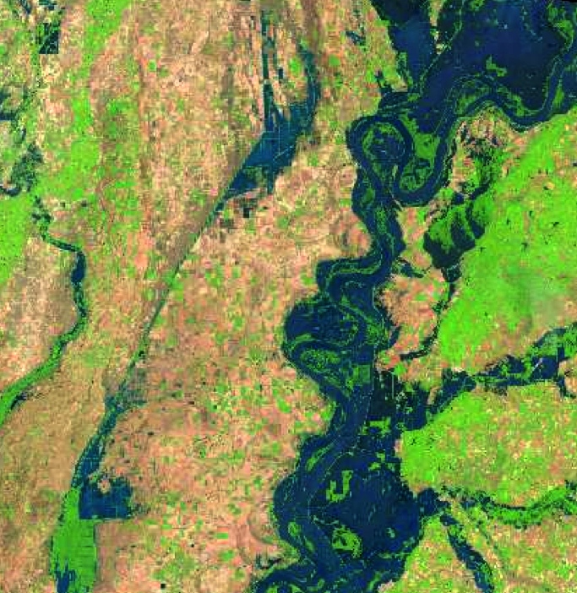
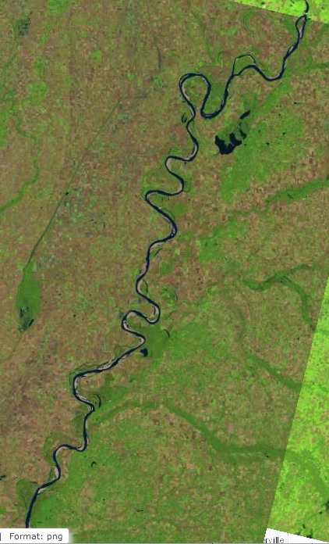
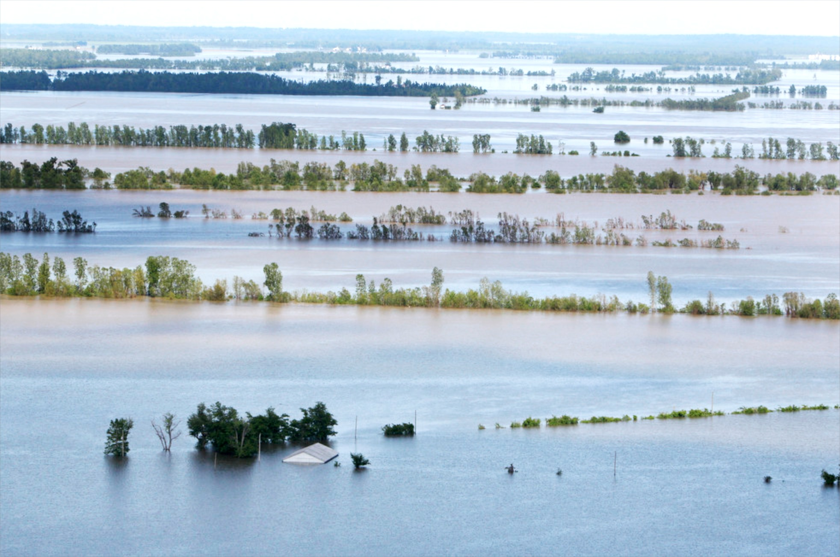
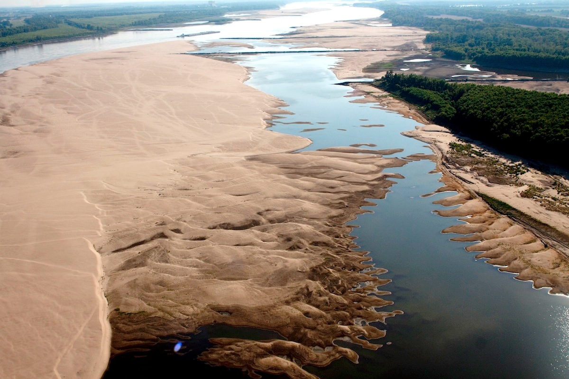
Mississippi River Above Memphis, TN
May, 10, 2011
November 28, 2012
50 km
Notes:
MIDWEST – Water-Food Nexus
USGS Landsat scenes from May 10, 2011 and November 28, 2012 illustrate extreme difference between flood and drought.
The scenes are about 100-km x 100-km.
May 10 was one week after the USACE operated the New Madrid floodway by breeching the Bird Point Levee with explosives. The operation flooded mostly agricultural land, but was deemed essential to alleviate flooding in urban areas, such as Cairo Illinois, and to reduce backwater effects on the Ohio River. The flood waters are up to 16 miles (25 km) wide in this image.
By late 2012, the drought in the midwest had brought the Mississippi R. to record lows flows. This image is just a few weeks before the USACE resorted to blowing up rock pinnabcles near Thebes, IL to allow river transportation to continue.
The 2011 flood event was expected to result in the most extensive hypoxic Dead Zone in the GOM on record, but Tropical Storm Don prevented that from happening – one more example of why interdisciplinary linkages within and Earth System modeling framework are important.

Slide 6
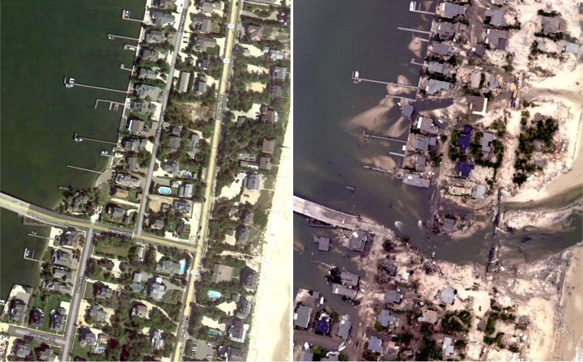
Hurricane Sandy
BEFORE
AFTER
Notes:
EAST COAST: Jersey Shore near Mantoloking
Hurricane Sandy illustrated a different threat – approximately half of the flooding damage from Sandy was caused by inland rainfall.
The combination of sources that constitute the total water level in coastal inundation – storm surge, tides, sea level rise, and inland runoff – illustrates again the need for an interdisciplinary, Earth Systems approach to water prediction.

Slide 7
CASE FOR CHANGE
Comprehensive Water Prediction
Notes:
The mission for water prediction is changing.

Slide 8
National Flood Loss¹
Water Year 1903-2013
Δ=$300 B
Δ=2538
2023
2033
2043
¹National Weather Service Hydrologic Information Center (www.nws.noaa.gov/hic/)
²Damages are adjusted for inflation to 2013. Damages are considered to be minimum estimates.
Notes:
Trends of fatalities and damages due to flooding indicate >2500 fatalities and $300B in damages over next 30 years.
Data are collected by NWS, and we know they tend to be underestimates – so likely worse than this.
Have to change the trajectory of these curves.

Slide 9
National Academy of Sciences Report Weather Services for the Nation: Second to None
Assessment of the NWS Hydrology Program
Three inter-related issues:
inadequate state of NWS hydrologic science
inefficient function and structure of the NWS’s hydrologic forecasting operations, and
lack of expertise, skill and training necessary to support a modern hydrologic program
Recommendations:
Improve pathways to accelerate research to operations
Improve RFC operational workflow to reflect state of the art science
Implement consistent framework to assess hydrologic prediction skill
National Water Center test-bed for hydrologic prediction
Enhance core competencies of hydrologic workforce
Notes:
NAS IS TELLING US WE NEED TO CHANGE

Slide 10
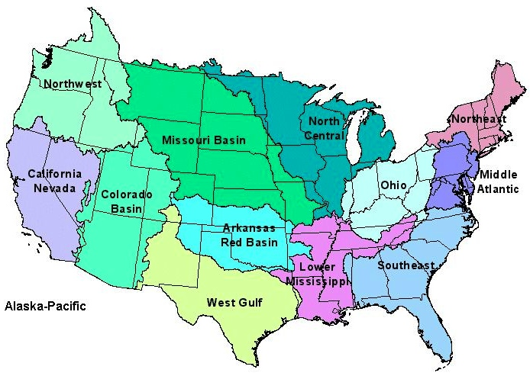
NWS River Forecast Centers (RFCs)
Prepare river and flood forecasts using models based on average basin characteristics
Provide forecast guidance to Weather Forecast Offices (WFOs)
Issue daily stage and streamflow forecasts, rainfall and drought data and information, and flash flood guidance
Work with water managers and other Federal Agencies
10
Notes:
RFC Summary

Slide 11
NWS River Forecast Centers
No River Forecast
Notes:
THERE’S A MAJOR GEOGRAPHIC GAP – WE DON’T FORECAST ALONG THE COAST

Slide 12
NWS River Forecast Centers
Seattle
Boston
New York
City
San
Francisco
Baltimore
Washington
Los Angeles
Charleston
Savannah
New Orleans
Jacksonville
Houston
12 Coastal Cities: 20 Million People
Notes:
>50% of U.S. population live within 50 miles of the coast
60% of GDP generated in coastal counties
Aging infrastructure, expensive to upgrade/replace
Rise in LOSSES of at least $1B insured damages per event
Runoff from land-falling rain often a major contribution to coastal inundation

Slide 13
WEATHER
Precipitation
Evaporation
Snowmelt
Runoff
Channel Flow
HYDROLOGY
River Flooding
Water
Prediction
Flash Flooding
Drought
Storm Surge
COASTAL
Tides
Sea Level Rise
Environmental Intelligence:
Comprehensive Water Prediction
The National Water Center and the
Transformation of NOAA’s Water Prediction Services
Notes:
POINT: THESE ARE FRAGMENTED, DISINTEGRATED TODAY. NEED TO PULL THEM TOGETHER INTO AN INTEGRATIVE FRAMEWORK
MULTIPLE ENTITIES DOING SIMILAR THINGS
Today NOAA provides many types of water prediction information, but it is fragmented across many different line offices and programs.
Moreover, our stakeholders require more comprehensive water prediction information that supports the full gamut of their decision making.
The idea of Earth Intelligence: Water 1.0 is to work towards a unified and improved water prediction capability that complements and expands our overall Earth System Prediction Capability.
NOAA’s new National Water Center is an important catalyst to make this happen.
<< CLICK ONCE TO REVEAL LIST >>

Slide 14
FOOD SECURITY
Summit to Sea
Floods to Droughts
Treetop to Bedrock
COMPREHENSIVE
WATER PREDICTION
Floods
Hazard
Mitigation
Droughts
Availability
WATER SECURITY
ENERGY SECURITY
Quality
Notes:
NOAA is worrking towards Comprehensive Water Prediction
Linking our modeling of the atmosphere to the land to the ocean…
Leveraging our data as well as our partners’
To provide water intelligence to support decision making, not just across the Water-Energy-Food Nexus, for many socioeconomic drivers (next slide)
--------
NOAA’s Water Prediction and the Water-Energy-Food Nexus
NOAA’s Water Prediction supports water, food and energy security
Pillars of Water Security:
- Availability, Quality and Hazards (e.g. Floods and Droughts)
Similarly - Pillars of Energy Security:
- Supply, Sustainability, Cost/Affordability
Similarly – Pillars of Food Security:
- Availability, Access, Stability

Slide 15
WRF-HYDRO System
VISION
Develop and implement the next generation integrated physical earth system prediction capability at weather and longer time scales, to support hours-to-seasonal global prediction including the atmosphere, ocean, land, cryosphere and space.
Notes:
EARTH SYSTEM PREDICTION CAPABILITY is a multi-agency collaboration to provide the global analyses and prediction information needed to support the Nation’s security and economic well-being.
Elements of the National ESPC vision include:
Extend predictive capability to decades using multi-model, multi-agency ensembles
Use ensembles to identify and quantify uncertainty and risk
Advance computational and environmental numerical prediction science and technology
Enhance our understanding of complex interactions of the earth environment

Slide 16
City Planners
Community Councils
Conservation Commissions
Emergency Management Services
Federal Agencies
NOAA, USGS, USACE,
FEMA, EPA, NPS, USFWS
Port Authorities
Power and Energy Administrations
Private Sector Companies and NPOs
River Basin Commissions
River Compact Associations
State Climatologists
State, County and City Agencies
Agriculture
Environment
Natural Resources
Sanitation
Water Management
Water Supply
Universities
FLOODS TO DROUGHTS
US Army Corps
of Engineers
Notes:
Three years ago NOAA joined forces with the USGS and USACE to form IWRSS – Integrated Water Resources Science and Services. We signed an MOU formalizing this agreement in 2011.
Since then, we have conducted extensive outreach with hundreds of stakeholders across the country, representing a wide range of decision makers who need water information
<< CLICK ONCE TO REVEAL LIST >>

Slide 17
Stakeholder Priorities
Flooding
Water Quality
Water Availability
Drought
Climate Change
Need integrated understanding of near- and long-term outlook and risks
Actionable Water Intelligence
Notes:
The message was loud and clear:
While flooding remains a high priority, most stakeholders are concerned about the full gamut of water
They need more, and better integrated water prediction information
They need actionable WATER INTELLIGENCE
<< CLICK ONCE TO REVEAL LIST >>

Slide 18
Stakeholder Priorities
Relevant to scales of local decision making and infrastructure
Easy Access
Broader Range of Hydrology
(Not just Floods)
Detailed Characteristics of Small Watersheds, Hillslopes
Consistent and Coherent across Large Watersheds
Examples
Total Water Level along Nation’s coasts
Climate Change
Low Flows, Droughts
Prediction Uncertainty
Risk-informed
Relevant to integrated water resource management
Need the same type of information consistently throughout domain
Notes:
The message was loud and clear:
While flooding remains a high priority, most stakeholders are concerned about the full gamut of water
They need more, and better integrated water prediction information
They need actionable WATER INTELLIGENCE
<< CLICK ONCE TO REVEAL LIST >>

Slide 19
Technical approach
Multi-Objective
Earth System Modeling
Three Phases

Slide 20
Multiple Objectives
Support high/hyper resolution over large national domain
Modular, scalable
Represent wide range of physical processes
Support linkage to coastal and estuarine models
High Performance Computing
Earth System
Maximize use of all available data
Leverage trends in data services
Everything is Geospatial
MODELING
ARCHITECTURE
DATA
Leverage significant Federal investments
Address Federal initiatives and objectives
Engage and leverage research community
Use new and emerging standards
Leverage systematic frameworks
‘Complete the forecast’ – link to impacts and risk
APPROACH
Notes:
TAKING ALL THE DRIVERS INTO CONSIDERATION, WE HAVE MULTIPLE OBJECTIVES AS WE MOVE INTO THIS NEW WATER PREDICTION PARADIGM

Slide 21
Modeling Evolution
HIGH-RESOLUTION
EARTH SYSTEM MODELS
WITH ADVANCED WATERSHED PHYSICS
(e.g. WRF-HYDRO)
More complete Lateral Hydrology
Numerous Possible Products Useful to Decision Makers:
State Variables and Fluxes, Derivatives
WE ARE GOING HERE
Single Fundamental Product:
Flow Forecast at a Point
MATURITY;
HYDROLOGIC PREDICTION SKILL
STATISTICAL/
ENGINEERING
MODELS
(e.g. NWSRFS)
ADVANCED
FULL PHYSICS
SMALL WATERSHED
MODELS
(GSSHA, PIHM)
WE ARE HERE
Simple Lateral Hydrology
LAND MODELS
(e.g. NOAH, VIC)
Column Physics
Boundary Layer
70s
80s
90s
00s
10s
20s
Notes:
BETTER, MORE INTEGRATED WATER INFORMATION -
REQUIRES BETTER, MORE INTEGRATED MODELS
Evolution of models
We’ve been on the black line for a long time. Studies show we’ve not made substantial improvements in skill over the past 20-30 years.
We’ve gotten close to all we’re going to get out of these models.
Land surface models do some things well, but are designed for other purposes and fall short on hydro prediction
Full physics models emerged in the 80s and 90s that could do nearly everything, but only in small watersheds
Now these full-physics capabilities are being incorporated into national-scale LSM style models – Earth System models
<< CLICK ONCE TO REVEAL LIST >>

Slide 22
Three Phases
Centralized Water Forecast Demonstration
Key Building Blocks
Baseline Modeling Demonstration
Nested hyper-resolution modeling demo
Enable Seamless Flash Flood Modeling
Enable Urban Hydrology/Flood Inundation
Total Water Prediction (TWP)
Link to coastal models for Total Water Level
Incorporate TWP in next-gen Earth System prediction capability
Transition to Operations
FY15 Start
FY16
Start
FY17
Start
Notes:
We have three five-year phases, staged back-to-back so that we have a comprehensive approach to build over the next 8 years or so.
These build on each other – stair-stepped – in sequence.

Slide 23
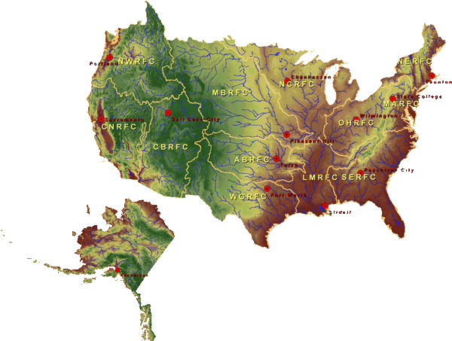
National Water Center
FY15 Centralized Water Forecasting
Centralized Data Archive – all RFC data
Modeling Evaluation Service
RFC and NWC modeling and forecasts
Modeling Testbed – new NWC capabilities
Centralized Water Forecasting Demonstration
Notes:
TRANSITION INTO METHODS
FY15 PROJECT HAS FOUR CORE COMPONENTS
RFC archive
Model evaluation service
Modeling testbed
Centralized modeling demonstration

Slide 24
Initial Prediction Framework
Short-Range Numerical Weather Prediction
HRRR-E
HRRR-E
Medium-Range Numerical Weather Prediction Ensembles
HRRR-E
HRRR-E
High-Resolution Rapid Refresh (HRRR)
GFS
Observation (and Forecast) Data
Community-based Coupling Architecture to link Hydrologic and Weather models
WRF-Hydro
Surface Water Models
Hydrologic Data Assimilation
Coastal/Estuarine Models
Ground Water Models
Land Routing Models
Total Water Level
(Coastal Inundation)
Channel Routing Models
NHD-Plus
Geospatial Infrastructure Data
HRRR-E
HRRR-E
Forecaster
Model Forecasts
HSIP, HAZUS
Notes:
TRANSITION INTO METHODS – THIS IS HOW WE ARE STARTING
FY15 CENTRALIZED MODELING FORECAST DEMONSTRATION PROJECT
Does most of these elements (not coastal piece or infrastructure yet – both of these are in FY17 - and limited assimilation).

Slide 25
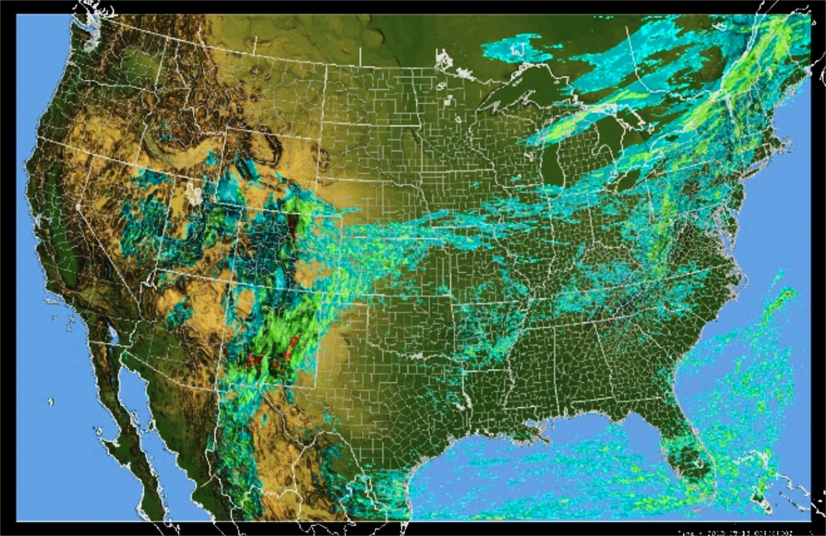
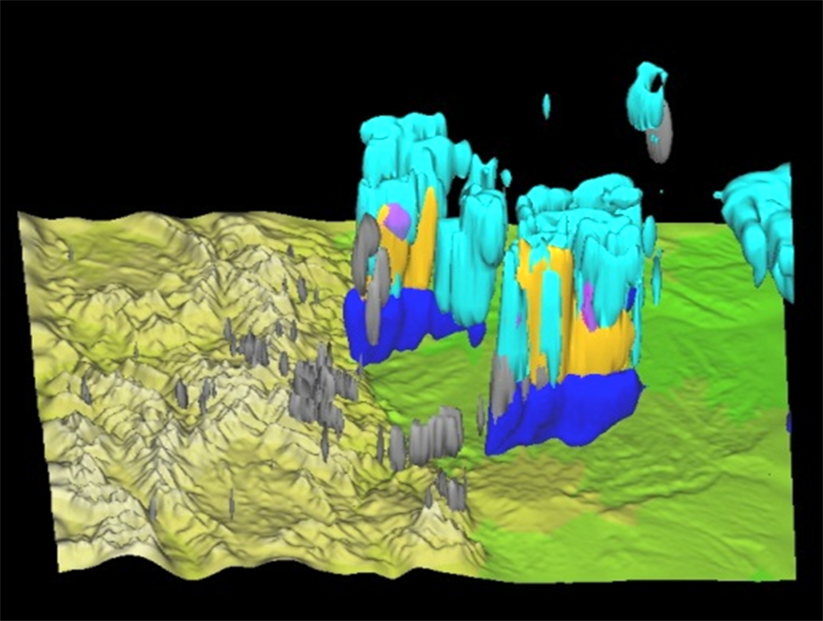
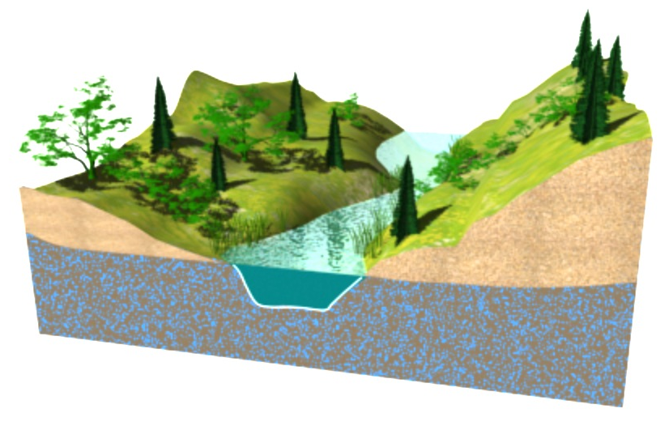
WRF-HYDRO System
Developed by National Center for Atmospheric Research (NCAR)
Community-based and supported
Architecture to couple multi-scale, multi-physics models of the atmosphere and terrestrial hydrology
10,000 m
1000 m
100 m
1 m
Notes:
STARTING POINT
To get started in this arena, we’re working with NCAR and their WRF-HYDRO system to develop and test operational capabilities
WRF-HYDRO is designed to handle the wide range of scales important to water prediction

Slide 26
WRF-HYDRO System
Strong linkages and leveraging of hydromet data infrastructure
UNIDATA, CUAHSI, NWS, USGS
Support and leveraging of existing ‘Earth System’ modeling enterprise
WRF, CESM, ESMF
Modular and extensible
Community verification and model testbedding
NCAR/NWS Development Testbed Center
Community data assimilation frameworks
e.g. NCAR Data Assimilation Research Testbed (DART)
Leveraging high-performance computing platforms
Leverage existing and emerging standards in data formats and pre-/post-processing workflows
Notes:
Several characteristics of WRF-HYDRO make it attractive as a starting point for moving into Earth System prediction for water

Slide 27
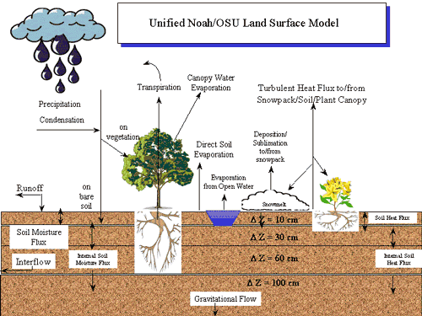
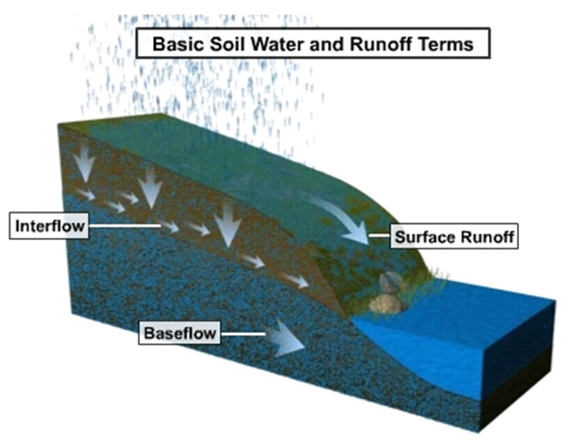
WRF-HYDRO System
Fusion of column structure of land surface models and distributed structure of hydrologic models
NOAH and NOAH-MP now supported
SAC-HTET in progress
Notes:
Several characteristics of WRF-HYDRO make it attractive as a starting point for moving into Earth System prediction for water

Slide 28
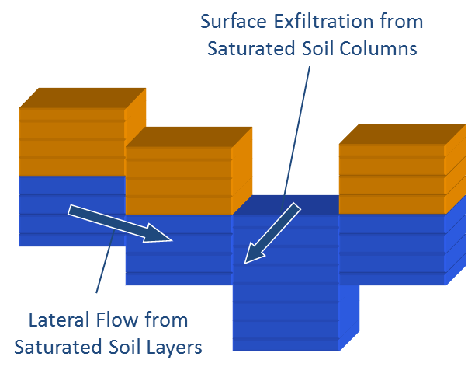
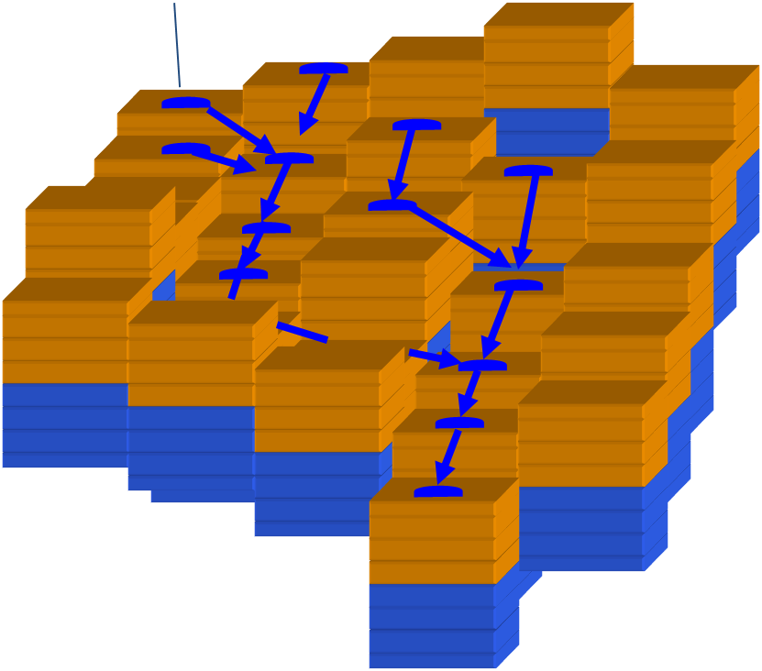
WRF-HYDRO System
Groundwater Flow:
Boussinesq Flow
Overland Flow:
Diffusive Wave (2D and 1D)
Channel Flow:
Gridded Diffusive Wave
Reach-based methods
Notes:
Model components already available within WRF-HYDRO enable surface water, groundwater and streamflow modeling.
THIS PROVIDES FLEXIBILITY ANALAGOUS TO DIFFERENT DYNAMIC CORES AND PHYSICS PACKAGES IN NWP

Slide 29
Scale implications
“Street Level” Water Prediction

Slide 30
NWS Mid-Atlantic River Forecast Center
Potomac River Basin
Sub-watersheds
CLOSER LOOK AT
SCALE DIFFERENCE
Notes:
TRANSITION TO SCALE AND MAGNITUDE – MAKE POINT OF WHAT THIS INVOLVES

Slide 31
Potomac River Basin
Forecast Points (29)
(Stream Gage Locations)

Slide 32
Potomac River Basin
NHD Plus Stream Network

Slide 33
Potomac River Basin
NHD Plus Catchments
~12,000

Slide 34
Potomac River Basin
NHD Plus Stream Network
Sterling, VA
NWS Forecast Points
10-20 Miles Away

Slide 35
Potomac River Basin
NHD Plus Catchments
Sterling, VA
NWS Forecast Points
10-20 Miles Away

Slide 36
Sterling, VA
NHD Plus Catchments and Stream Network
HSIP DATABASE
570 Layers of geospatially enabled infastructure data
Bridges, dams, levees
Manufacturing faciliites
Emergency services centers
Chemical, fuel, hazardous material storage facillities
Food processing, agricultural facilities, water treatment
etc.
Notes:
HSIP DATABASE – ALL OF THE CRITICAL INFRASTRUCTURE KNOWN

Slide 37
Sterling, VA
FEMA National Flood Hazard Layer
Notes:
Because we’re going to NHD+ scale, we can link directly to FEMA flood hazard data

Slide 38
NWS Water Prediction
TODAY
TOMORROW
Approximately 6000 forecast locations at points
Driven by large catchment “lumped” modeling
Requires:
Precipitation and Air Temperature (averaged over watershed)
Reservoir Information
River Network Topology
Hydraulic modeling for large channels
Stream Gage Data
General Impacts near Gages
Local servers and storage
Approximately 3,000,000 forecast stream catchments
Driven by high/hyper resolution Earth System modeling
Requires:
Full high-resolution meteorological suite
Reservoir Information
Stream Network Topology
Hydraulic modeling for small channels
High Resolution Terrain Data
Land Cover Change Data
Stream Gage Data (enhanced)
Reach-based Inundation Mapping and Impacts
Centralized high-performance computing
Notes:
Comparison of today and tomorrow – orders of magnitude more ‘complex’ prediction paradigm – mainly in data density

Slide 39
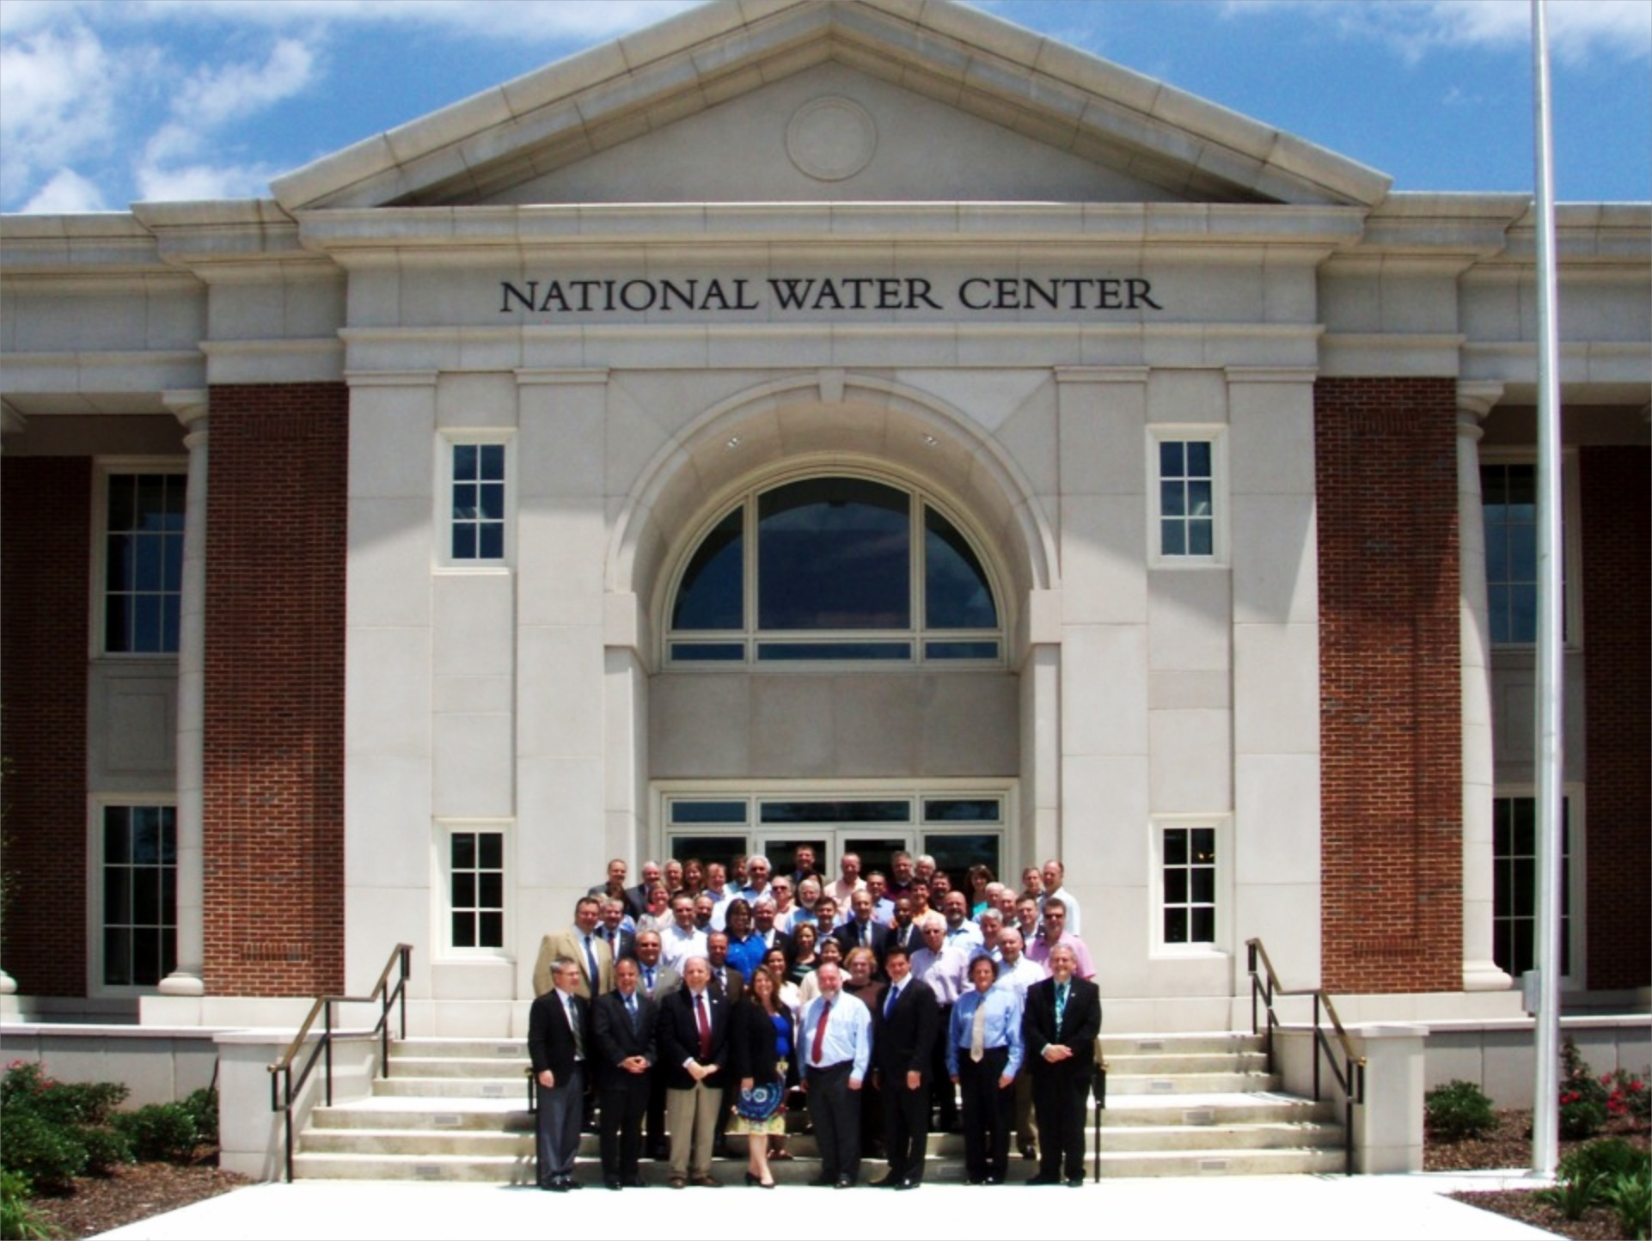
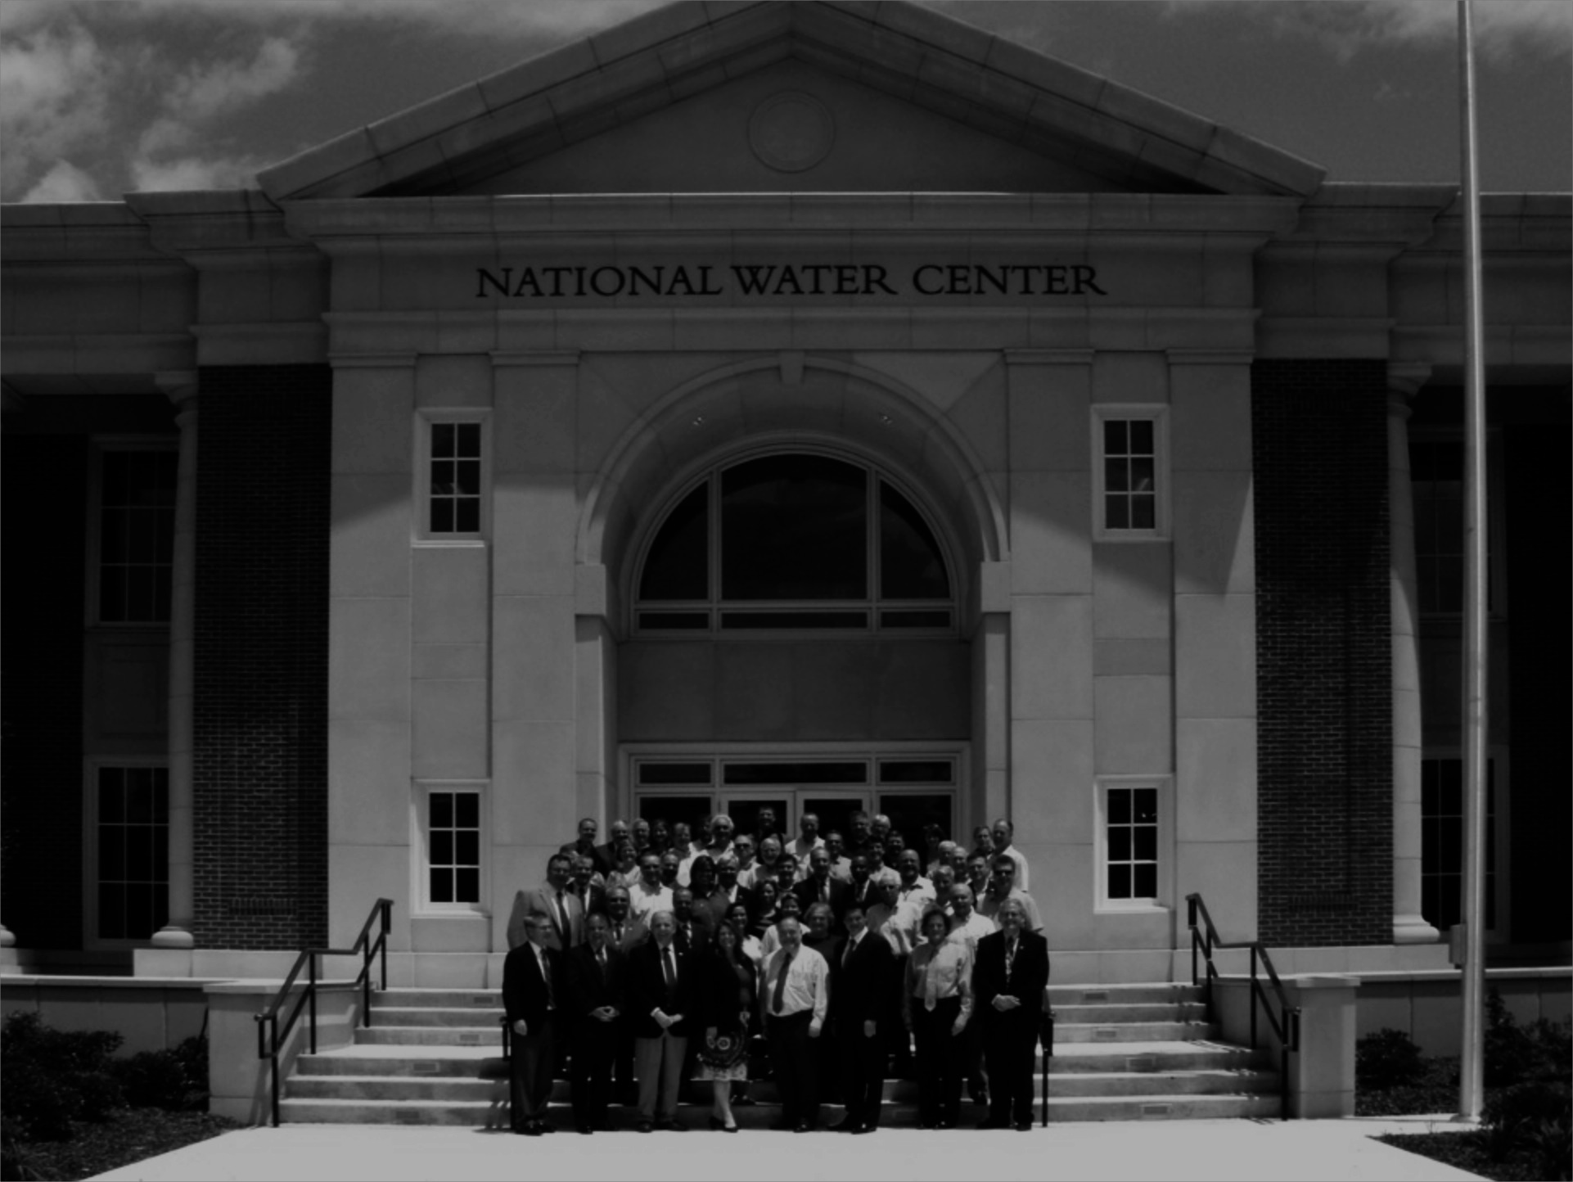
Scientific excellence and innovation driving water prediction and decisions for a water-resilient nation.
Collaborative R&D, Operations
Support mission-oriented research and development
Proving Ground Facility
Science and Technology Transition
Operations Center
Socioeconomic Sector Desks
Regional Desks
Science Desks
Interagency Staffing
RESEARCH
OPERATIONS
Notes:
Link to NOAA R2O/O2R research funnel

Slide 40
Summary
Water Mission has changed
Deliver comprehensive, integrated actionable water intelligence
Summit-to-Sea, Floods to Droughts, Treetops to Bedrock
Implementing State-of-the-Art Technical Approach:
Water prediction through Earth System modeling
Impact-based decision support underpinned by geo-intelligence
Scale Change: Orders of Magnitude More Data
Reach-based “Street Level” prediction
High Performance Computing
New organization, cornerstone facility and philosophy
National Water Center
Collaborative, cross-NOAA, interagency, academic partnerships
Incorporation of Water into fabric of NWS Enterprise
Notes:
NOAA is transforming is water prediction services to support the Nation’s need for comprehensive, integrated, actionable water intelligence
Spans floods to droughts, summit to sea, treetop to bedrock
National Water Center is a key catalyst for change
Transition research to operations
Operational water prediction
New water prediction services will align with and support Earth system prediction
Initial components of new modeling capability will include:
HRRR and GFS coupling to hydrologic models using WRF-Hydro
NHD+ national stream network
Constitutes a major shift in operational water prediction towards extensive informatics and high-performance computing
NOAA and the NWC will continue to value collaboration and work to leverage external capabilities

Slide 41
BACKUP SLIDES

Slide 42
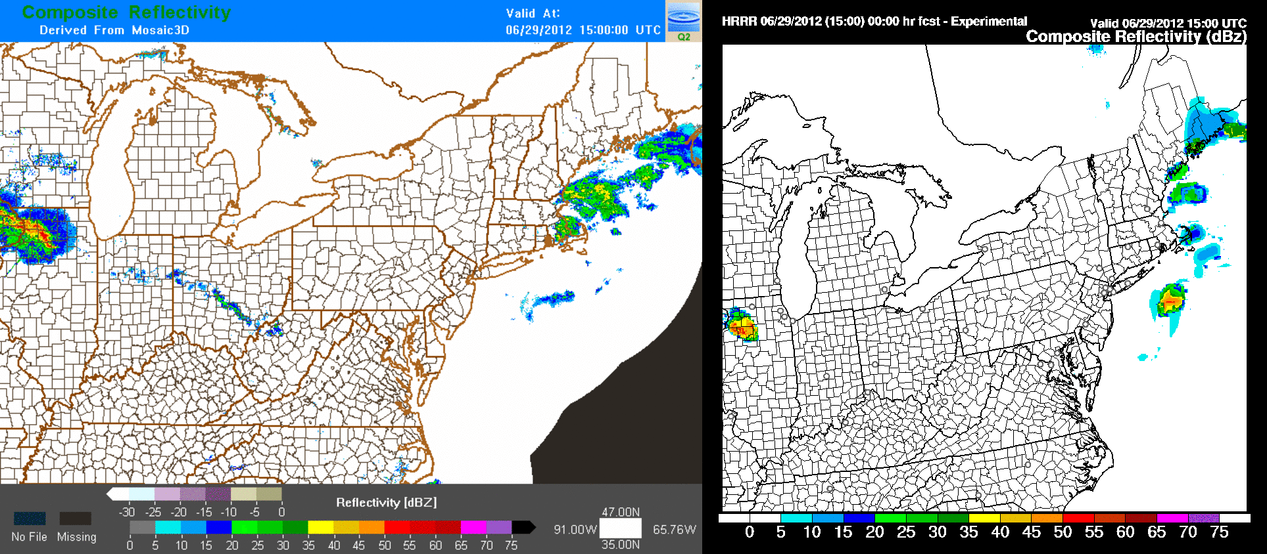
High-Resolution Rapid Refresh (HRRR)
2012 Derecho Forecast
Radar Reflectivity Observations
HRRR 15 UTC 29 June 2012
HRRR = NOAA Real-Time 3-km Hourly Updated Cloud-resolving Atmospheric Model
Notes:
Will be working on adding HRRR forcing as an option in WRF-HYDRO

Slide 43
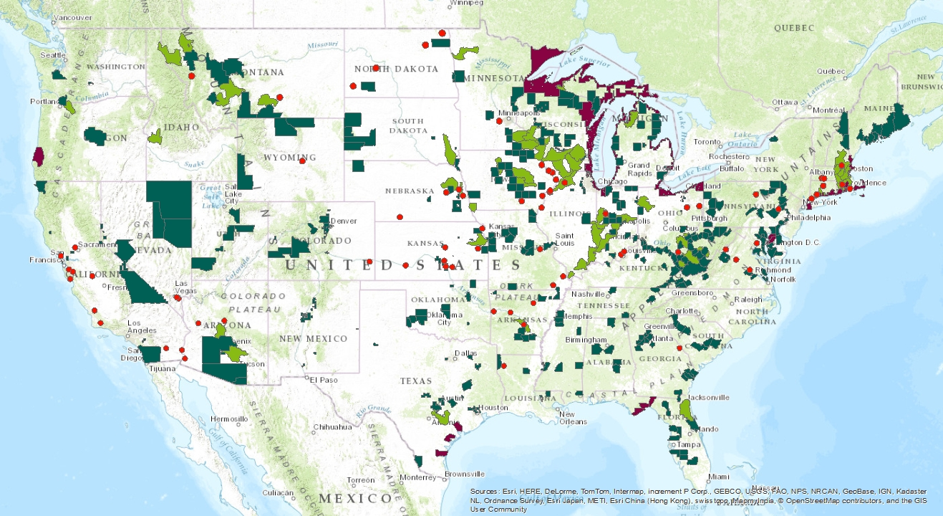
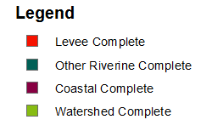
FEMA RiskMap
Projects Completed Prior to 6/30/14

Slide 44
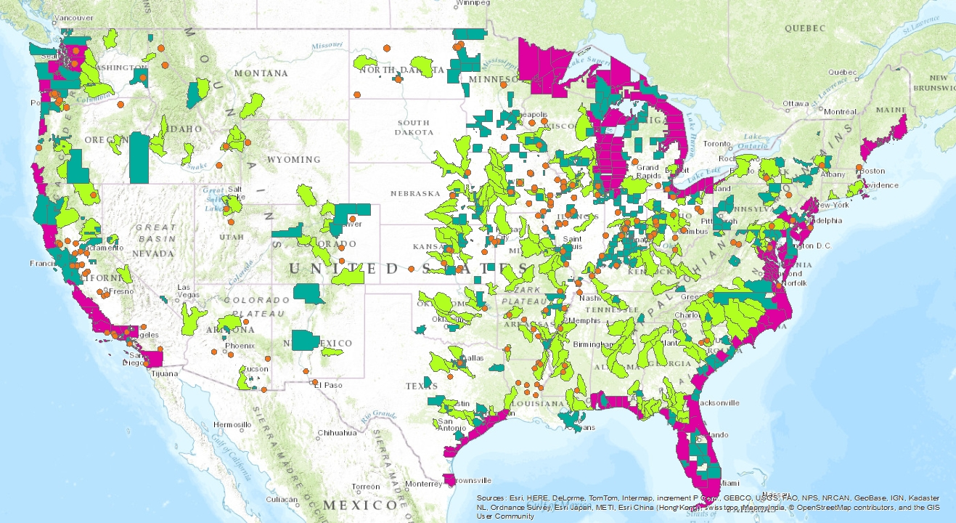
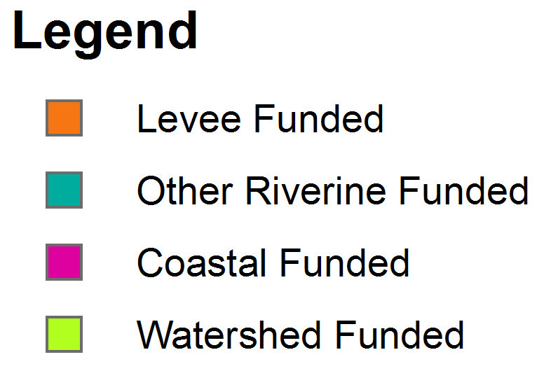
FEMA RiskMap
Projects Funded for Completion After 6/30/14
Notes:
Note coastal areas are funded for completion

Slide 45
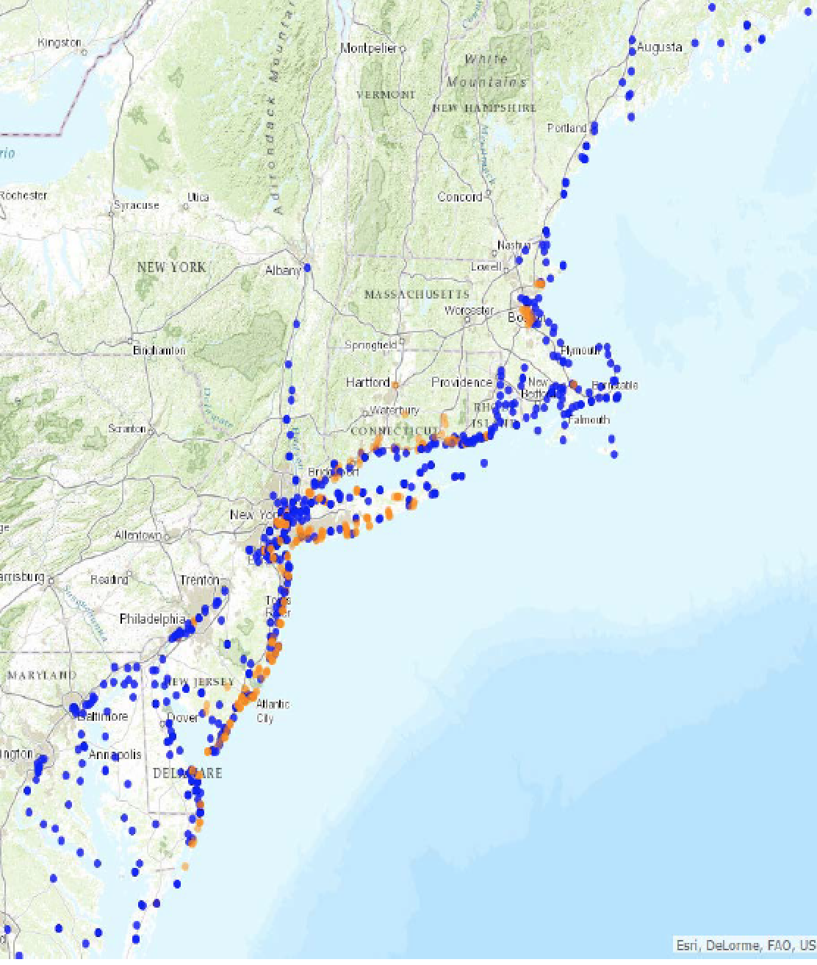
Surge, Wave and Tide Hydrodynamics Network (SWaTH)
Entire proposed network consists of about 1,000 sites:
76 non-USGS stations
162 coastal stations/tidal streams
60 rapid-deployment gages
384 temporary storm-tide sensors
217 temporary wave sensors
102 temporary barometric-pressure sensors
Pre-emptive network
Northeast Coast from Virginia to Maine
Nor’easters and tropical storms of varying magnitude
Data distributed through an online mapper termed Short-term Network
Notes:
Our river and streamflow prediction capabilities depend on a robust network of stream gages. The USGS provides the national backbone network.
As we move into modeling Total Water, the USGS will continue to be an important partner. The SWaTH network will be a valuable asset to support our modeling efforts.
SWaTH is a collaborative effort with Federal, State and local partners, emergency managers, coastal researchers and modelers
Network design can be used in support of:
Coastal elevation data and mapping resiliency
Coastal change
Coastal hydrology and storm surge
Environmental quality and contaminants
Coast ecosystem impacts
Coastal resiliency

Slide 46
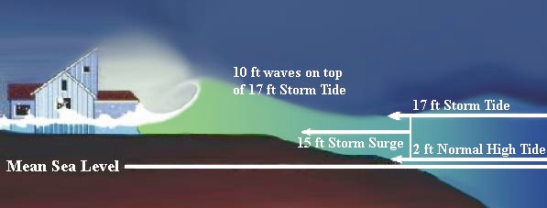
‘Total Water Level’
Integrated accounting for all sources of coastal flood inundation
Land-falling rainfall and runoff, tides, storm surge and sea level rise
Link terrestrial hydrology and coastal/estuarine modeling systems within Earth System framework
Terrestrial Hydrology
Notes:
HAVE TO BE ABLE TO CONNECT MODELING AT THE COAST

Slide 47
National Water center
Organization
Functions
Staffing
Initial Activities
Notes:
DISTRIBUTED ORGANIZATION – AL, MD, MN

Slide 48
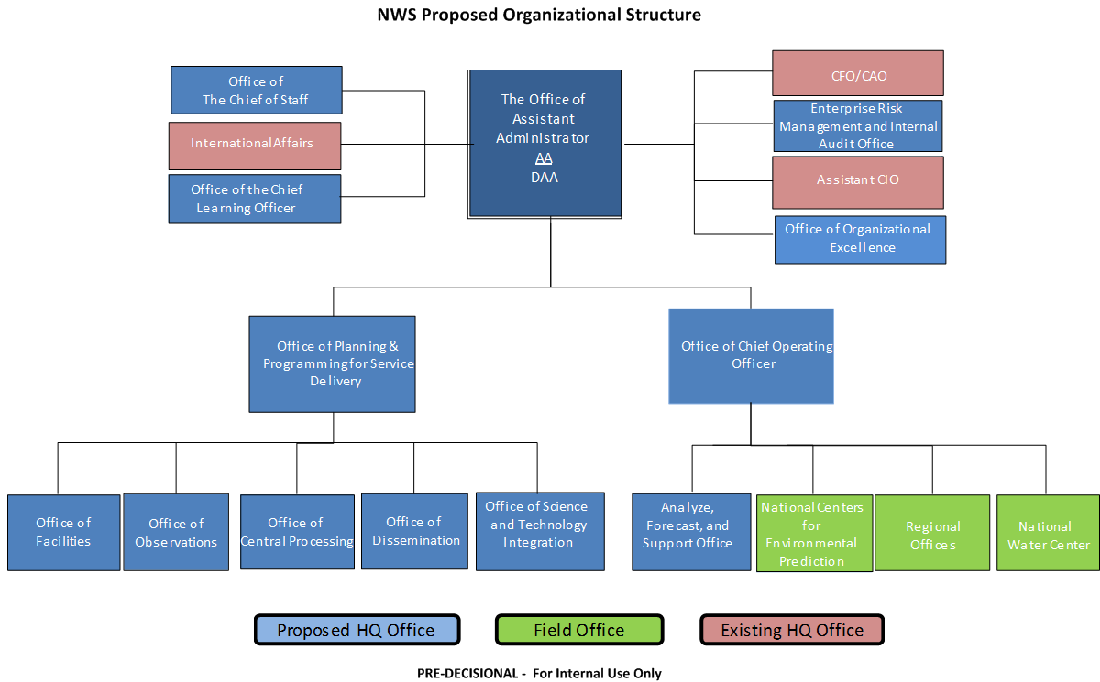
NWS Proposed Organizational Structure

Slide 49
National Water Center
VISION
Scientific excellence and innovation driving water prediction and decisions for a water-resilient nation.
MISSION
The National Water Center collaboratively researches, develops and delivers state-of-the science National hydrologic analyses, forecast information, data, decision-support services and guidance to support and inform essential emergency services and water management decisions. Through partnerships it integrates and supports consistent water prediction activities from global to local levels.
Notes:
The first facility of its kind in the world, the National Water Center (NWC) will revolutionize operational water resources analysis and forecasting by providing a central hub to efficiently manage the flow of water information, operating state-of-the-art water models in a high-performance computing environment, and producing, in partnership with NWS River Forecast Centers, a unique, comprehensive suite of new water resources information products and services. It will be the nerve center for the Nation’s water resources enterprise, informing and enabling routine high-value and high-impact decision-making across a broad range of water-management and emergency-management sectors. The NWC will produce information necessary to drive the growth of the Nation’s emerging water resources economy.
NWC Will Enhance Federal Collaboration
NOAA can’t tackle these water resources grand challenges alone. Within the framework of Integrated Water Resources Science and Services (IWRSS), the National Water Center will be a catalyst to enhance and foster new inter-agency collaboration to:
Increase efficiency, quality and timeliness of Federal water resources information
Expand water resources services beyond the capabilities of any single agency
Develop innovative, multi-disciplinary and inter-agency solutions to increasingly complex water-related challenges
Drivers Shaping the NWC
NWS Weather Ready Nation and NOAA Strategic Plans
National Academy of Science recommendations for NWS hydrology to modernize the end-to-end hydrologic forecast process
National Academy of Public Administration recommendations to realign governance and improve efficiency within NWS
IWRSS objectives and MOU:
Coordinate and improve observations and forecast operations
Deliver well-integrated water information products for enhanced decision support services
Leverage Federal research investments to expand and accelerate the transition of state-of-the-science research-to-operations
Increase scientific innovation

Slide 50
Geo Intelligence Division
(GID)
Interdisciplinary Science and Engineering Division
(ISED)
Analysis and Prediction Division
(APD)
Social Intelligence Division
(SID)
DATA/
ANALYTICS
CORE
SCIENCE
INTEGRATED
MODELING
HUMAN
FACTORS
Initial Operating Capability: May 2015
STAFFING – First 50
5 on site now
5 vacancies advertised
3 vacancies (Division Directors) announced soon
30 UCAR Visiting Scientists (150 Applications)
7 USGS staff in process
1 FEMA staff in process
Notes:
Staffing is for Tuscaloosa facility – with distributed staff in MD and MN total number will be close to 100.

Slide 51
Initial NWC Activities
Hydrology Program Senior Management Meeting (May 2014)
National Flash Flood Summit (August 2014)
National Flood Interoperability Experiment (NFIE)
Summer Institute at NWC (2015)
Academic Sabbatical Program (Fall 2015)
National Hydrology Program Managers Meeting (tent. May 2015)
Ribbon Cutting (May 2015)
Secretary of Commerce
Secretary of Interior
Senator Richard Shelby (AL)
NWC Visits the Regions: Spring 2015

Slide 52
National Flood Interoperability Experiment
Community Initiative: private sector, academia, federal agencies
Demonstrate initial set of water data services using community standards
Demonstrate real time flood simulation and mapping using cutting edge tools and techniques
Prototype a project-based interdisciplinary education model for emerging scientists and technologists
Semester curricula and NWC Summer Institute

Slide 53
National Water center
Facility Design Tour
Notes:
DISTRIBUTED ORGANIZATION – AL, MD, MN

Slide 54
National Water Center Design
6 WORKPLACE ISSUES
Generations in the Workplace
Real Estate Optimization
Enhance Collaboration
Attract, Develop and Engage
Build Brand and Culture
Wellbeing at Work

Slide 55
1
GENERATION IN THE WORKPLACE
70% of GSA workers will retire in the next 10 years.
At present, organizations are comprised largely of Baby Boomers, Born between 1946 and 1964, and a slightly smaller group of Gen Xers 1964-1977.
The smallest percentage of the workforce is distributed between the Millennials, born after 1977 and Traditionals born before 1946.
Proprietary Information

Slide 56
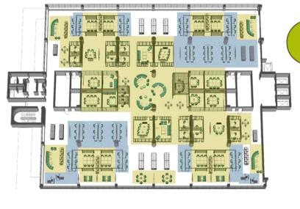
2
REAL ESTATE OPTIMIZATION
Provide a range of settings that supports a variety of workstyles and that support: collaboration, focus, learning and socialization.
Organize interrelated zones with specific intent & vibe.
Design settings for multiple functions.
Consider alternative workplace strategies
Focusing
Collaborating
Learning
Socializing
Proprietary Information

Slide 59
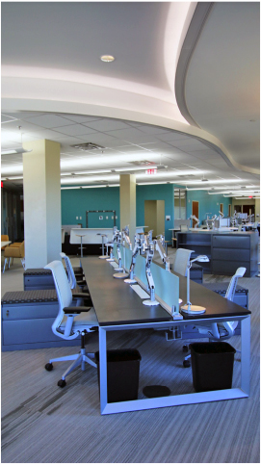
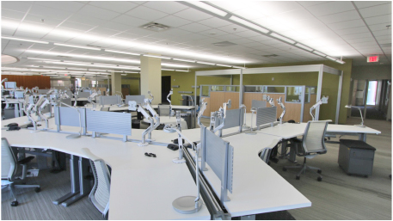

Slide 60
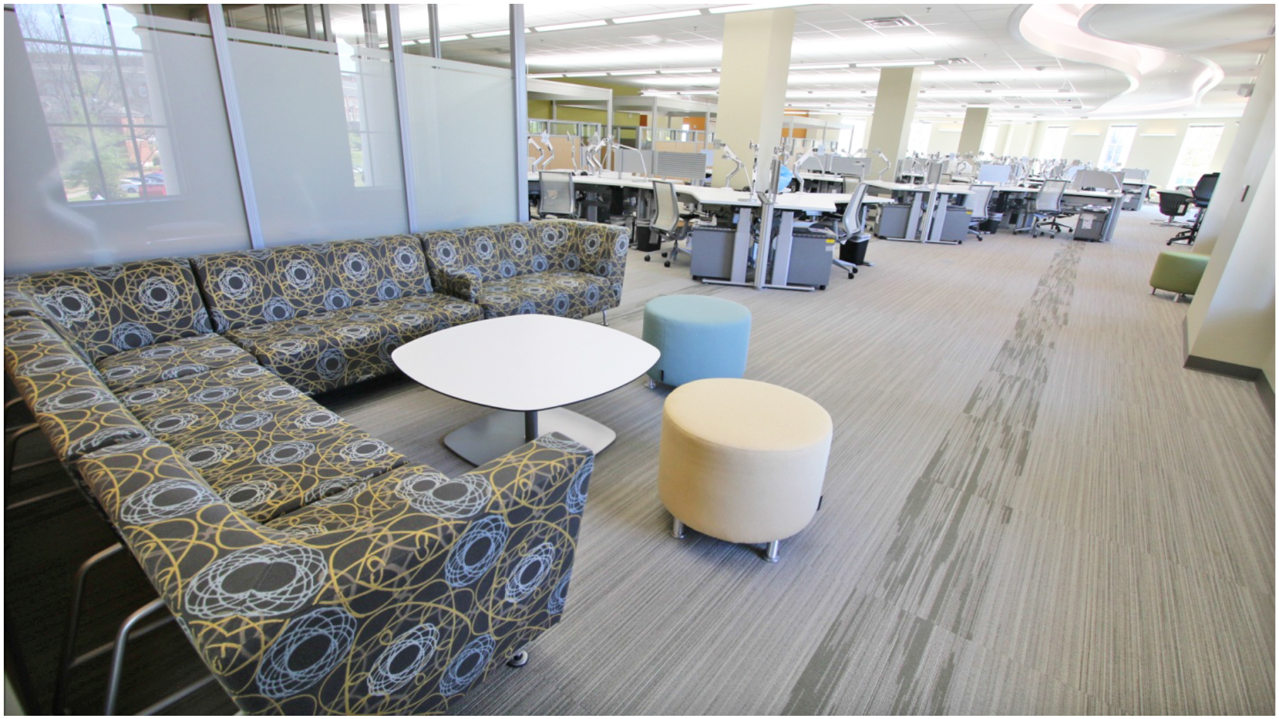

Slide 61
3
ENHANCE COLLABORATION
HOW CAN THE WORKPLACE BE DESIGNED TO TRULY ENHANCE COLLABORATION?
Proprietary Information

Slide 64
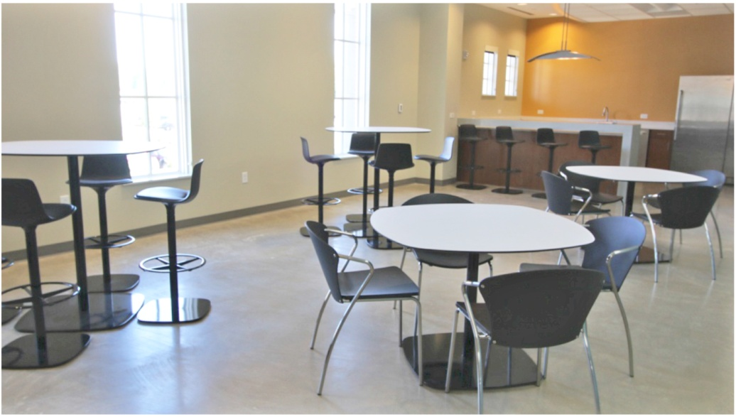

Slide 65
4
ATTRACT
DEVELOP
ENGAGE
HOW CAN SPACE ATTRACT AND ENGAGE THE RIGHT TALENT, AND HELP WORKERS DEVELOP THE SKILLS NEEDED FOR AN INTERCONNECTED WORLD?
Proprietary Information

Slide 69
Eventually, all things merge into one,
and a river runs through it.
- Norman McLean

Slide 70
NOAA Research and Development Funnel
All of atmospheric and oceanic science and technology
General Research and Development
Related to NOAA’s Mission
Research Partners
20 Years
Mission-oriented Research and Development to Improve NOAA’s Operational and Information Services
5 Years
NOAA Mission Research and Development
Science and Technology Transition
Test Beds
Requirements and Operational Concepts
Advances in Science and Technology
2 Years
Operational System Development and Implementation
Current Operations
Science and Technology Specific to NOAA Operational and Information Services
Notes:
NOAA Science Advisory Board concept of R2O.
Research structure should enhance the transfer of advances in science and technology into NOAA’s operational and information services.

Slide 71
Director
Executive Officer
(NOAA Corps)
Chief of Staff
Chief Budget Officer
Deputy Director
Chief Administrative Officer
Chief Projects, Programs and Portfolios Officer
Geo Intelligence Division
(GID)
Interdisciplinary Science and Engineering Division
(ISED)
Analysis and Prediction Division
(APD)
Social Intelligence Division
(SID)

Slide 72
Geo Intelligence Division
(GID)
Mission: GID provides centralized and consistent data services, geospatial analyses, and cartographic expertise to support science and engineering development, systems implementation, and water resources operations at local, regional, national and global scales. Supports development and operations.
Develops: Geospatial Data; Actionable Intelligence derived from Data; Geospatial Software Applications; Maps; Graphics; New Products and Product Improvements; spatial discretization techniques; analytical methods
Operates: Airborne Gamma-Survey; Geographic Information Systems; Mapping and Graphics software, systems and tools; Databases; Models; Geostatistical Analysis Software
Produces: Enterprise Geospatial Datasets, Maps, Atlases; Graphics, Documentation; Geo Intelligence
Maintains: Enterprise Geospatial Datasets, Map and Data Archives, Data Services, Product Documentation
Supports: NWC Operations; Field Operations; External Partners, Customers and Stakeholders; Knowledge Management

Slide 73
Interdisciplinary Science and Engineering Division
(SED)
Mission: ISED provides core science capacity, algorithm and software component development and operational decision support for local, regional, national and global scales. Supports development and operations.
Develops: Core Scientific Knowledge; Software Applications; Model Components; New Products and Product Improvements; Evaluation Techniques; Methodologies; Algorithms
Operates: Models; Analytical Tools; Databases; Information Systems
Produces: Scientific Publications; Software Applications; Evaluations of algorithms, techniques, tools, products and services; Product Documentation; Incremental improvements in scientific or technical maturity of algorithms, models and tools; Evaluations of skill and performance of models, products and services; new methodologies; parameterizations and calibrations
Maintains: Scientific Expertise; Product Documentation; Developmental and Operational Software
Supports: NWC Operations; Field Operations; External Partners, Customers and Stakeholders; Knowledge Management

Slide 74
Analysis and Prediction Division
(APD)
Mission: APD integrates science, software, and data components into operational water resources prediction systems for local, regional, and national and global implementation. Operates systems at national and global scales. Supports development and operations.
Develops: Integrated systems and infrastructure; Integrated Models; Modeling and Data Assimilation Tools and Systems; Model Calibrations and Parameterizations
Operates: Numerical Models; Analytical Tools; Databases; Information Systems
Produces: Systems Architecture; Decision Support Products
Maintains: Systems, Integrated Models, Databases, Records and Documents
Supports: NWC Operations; Field Operations; External Partners, Customers and Stakeholders; Web Data and Product Dissemination; Knowledge Management

Slide 75
Social Intelligence Division
(SID)
Mission: SID provides geographic and socioeconomic sector-specific water resources information, risk, impact and economic assessments and decision support services. Marshalls local, regional, and national assets to ensure effective service delivery at all scales.
Develops: Relationships with partners and stakeholders; Decision Support Services; Analyses of Impacts and Risks; Requirements for improved information and services; Training and Education Programs;
Operates: Hazards and Impacts Databases; Models; Information Systems
Produces: Economic analyses; Impact Analyses; Risk Assessments; Legal and Policy Assessments; Outreach materials; Scientific Publications
Maintains: Socioeconomic Databases; Requirements Databases;
Supports: Community Resiliency; NWC Operations; Field Operations; External Partners, Customers and Stakeholders; Training; Knowledge Management
Operations Center Desks: 10 Socio-economic Sectors
Floods, Storm Surge and Debris Flows | Agriculture | Water Quality | Weather | Transportation
Drought | Ecosystems | Climate | Water Supply | Energy

Slide 76
Stakeholder Priorities
Themes | Primary Subcomponents
Large Watershed Models | Coupled freshwater coastal model
 | Scenarios including sea level rise, climate change, storm surge
 | Reservoir and flow management
 | Low flow decision support
 | Graphics and visualization tools
 | Water supply forecasting
 | Probabilistic scenarios
 | Modeling drought and flood intensity, duration, and frequency
Flood Inundation Maps | Graphics and visualization tools
 | Probabilistic maps
Intensive Sub-watershed Models | High resolution for model
 | Ungauged watersheds
 | Provide sedimentation decision support
Data Warehouse | Connecting state databases to federal databases, supporting historical rainfall/runoff data, NWS forecasts, and climate forecasts
Water Quality Monitoring | Monitoring in critical habitats only, basic water quality parameters, and water, air, and ground temperature
Notes:
The message was loud and clear:
While flooding remains a high priority, most stakeholders are concerned about the full gamut of water
They need more, and better integrated water prediction information
They need actionable WATER INTELLIGENCE
<< CLICK ONCE TO REVEAL LIST >>

