Slide 1
Weather Prediction Center (WPC) 2014 Review
Tony Fracasso
Acting Science and Operations Officer
Contributions by Chris Bailey, Keith Brill,
Jim Hayes, David Novak, Dan Petersen
2014 NCEP Production Suite Review

Slide 2
Outline
Highlights from 2014
  QPF: Days 0-7
  Winter Weather
  Medium Range
Collaboration with Regions
Research to Operations (HMT-WPC)
WPC Requirements for EMC
2

Slide 3
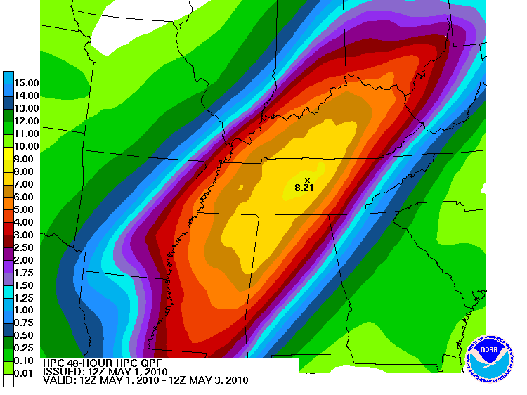
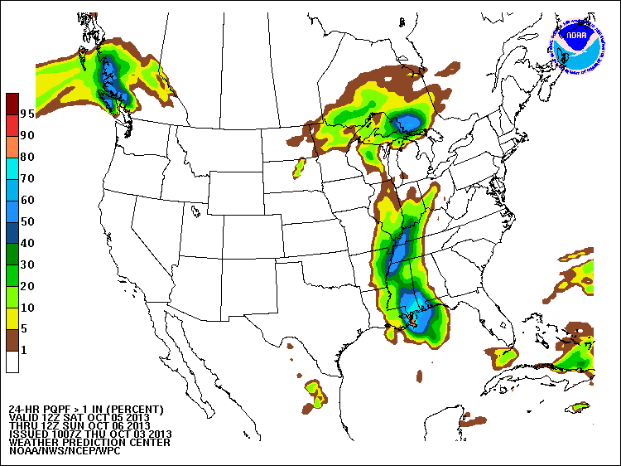
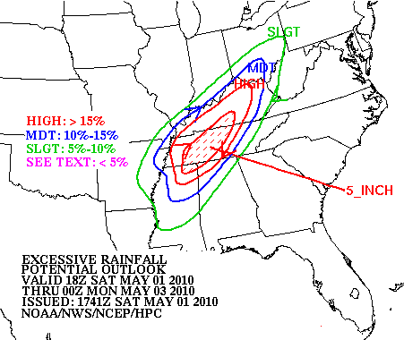
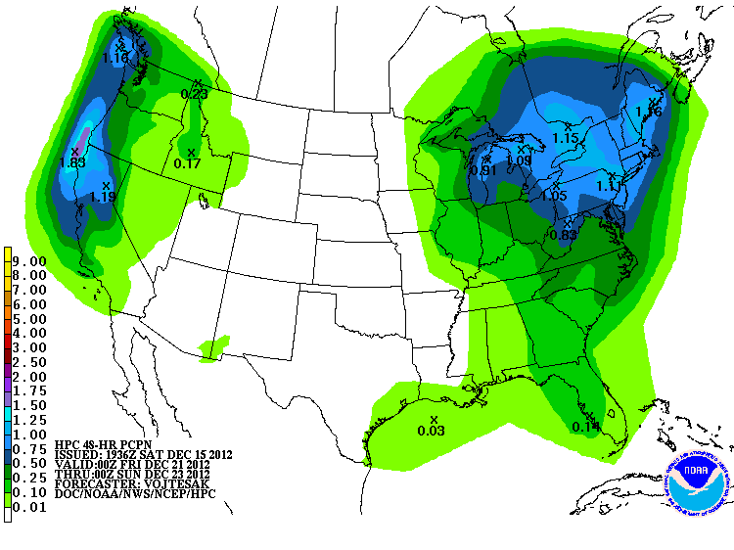
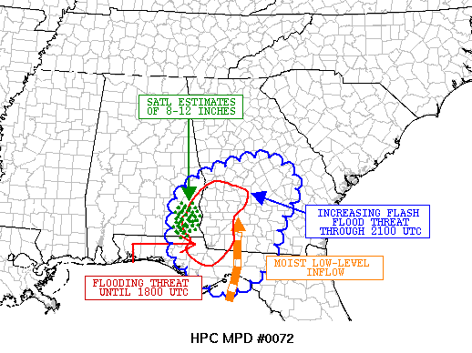
WPC QPF Services
Medium Range
Days 1-3 QPF
MetWatch
DAYS
forecast lead time
HOURS
Excessive Rainfall
Mesoscale Precipitation Discussion
Day 4-7 QPF
Deterministic QPF
Probabilistic QPF
3

Slide 4
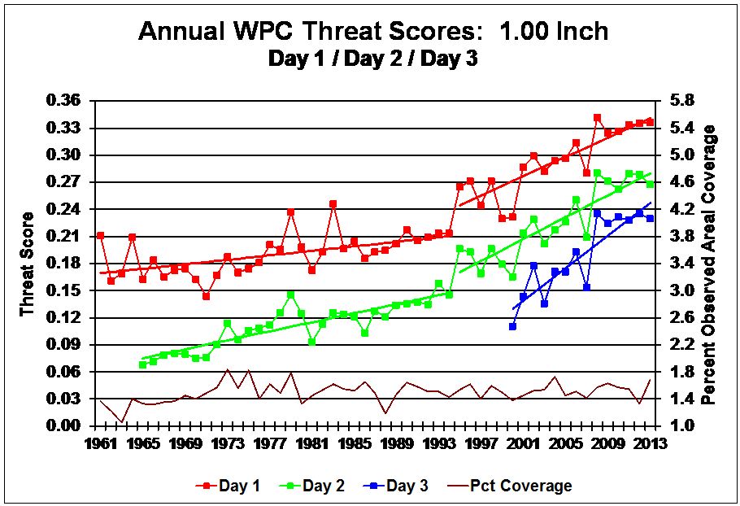
4

Slide 5
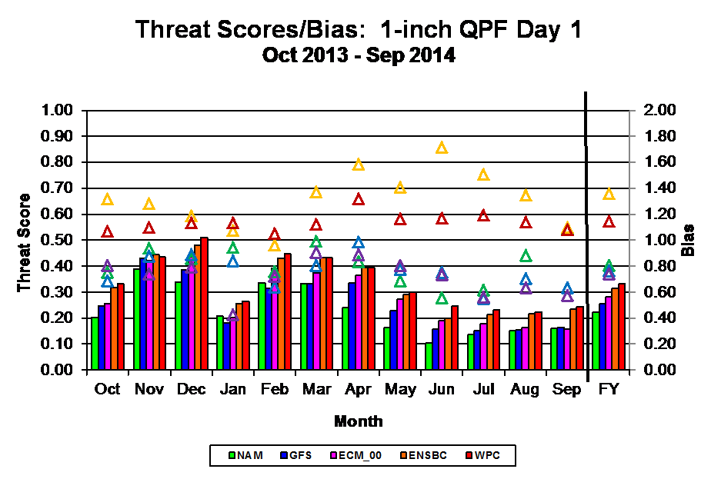
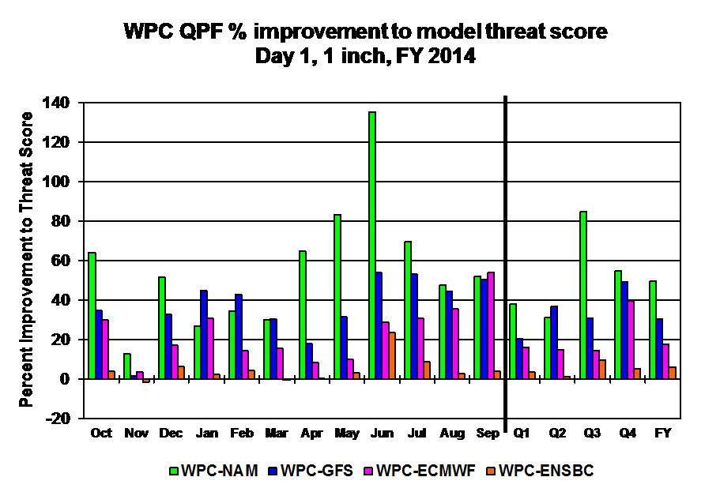
% Improvement
50% NAM
30% GFS
18% ECMWF
6% ENSBC
GPRA GOAL: 0.320
WPC FY 2014: 0.332
5

Slide 6
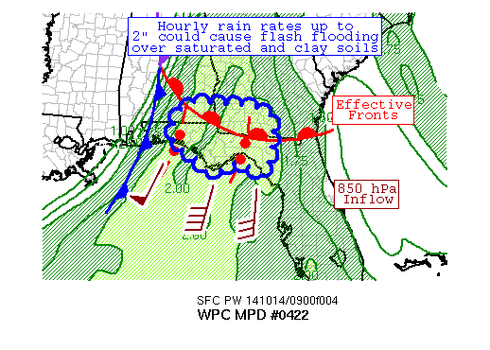
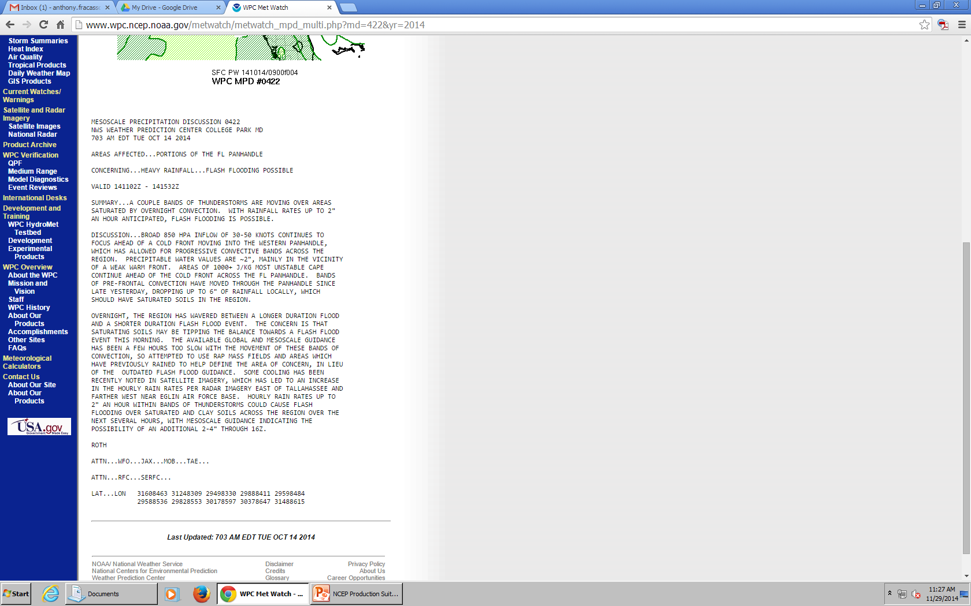
MetWatch Desk
Provides enhanced situational awareness of potential flash flood events (1-6hrs)
Similar to SPC’s MCD
Model Requirement: Storm-scale ensemble
6

Slide 7
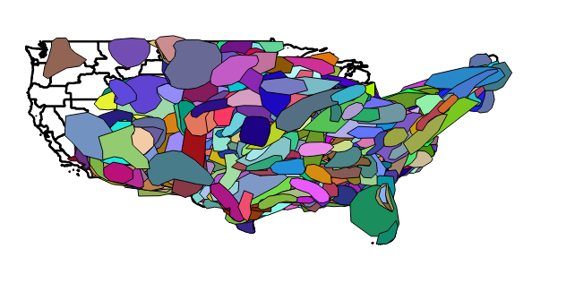
MetWatch Desk
All MPDs 2013-14
727 total
431 MPDs issued YTD
Jim Hayes (WPC)
7

Slide 8
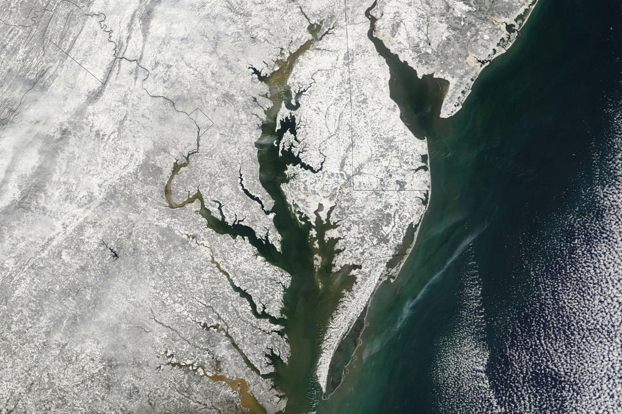
Winter Weather Desk
8

Slide 9
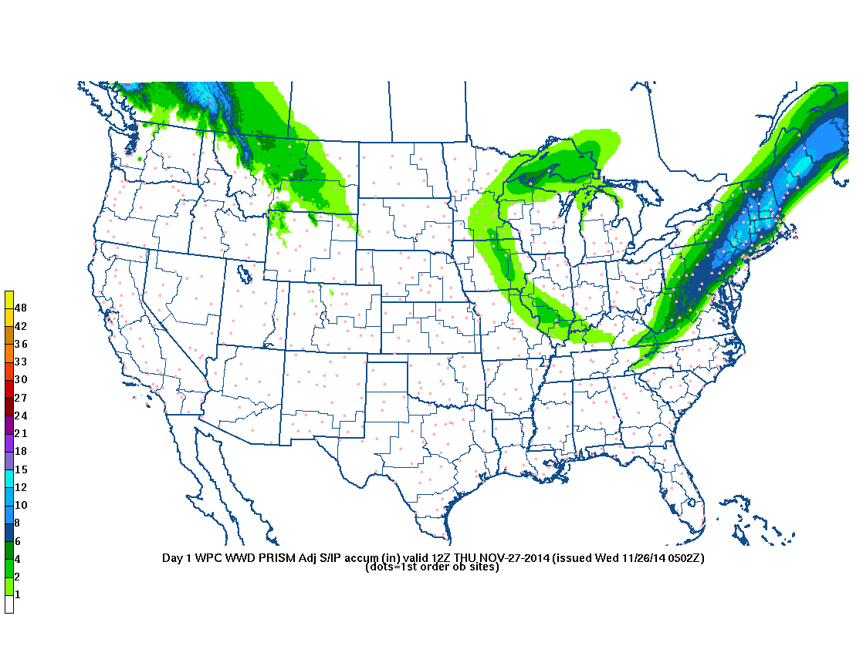
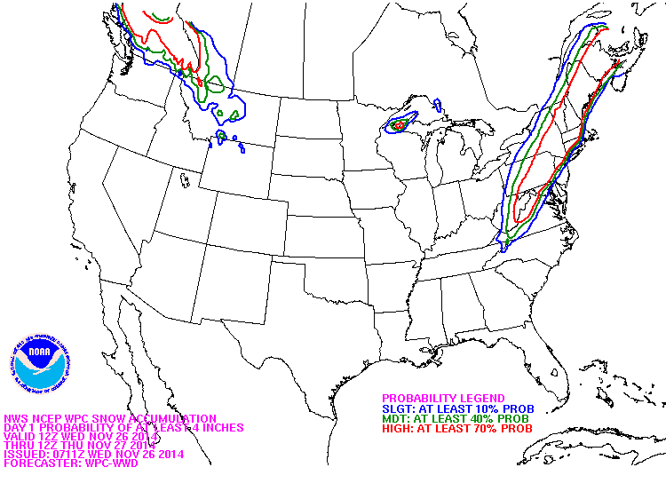
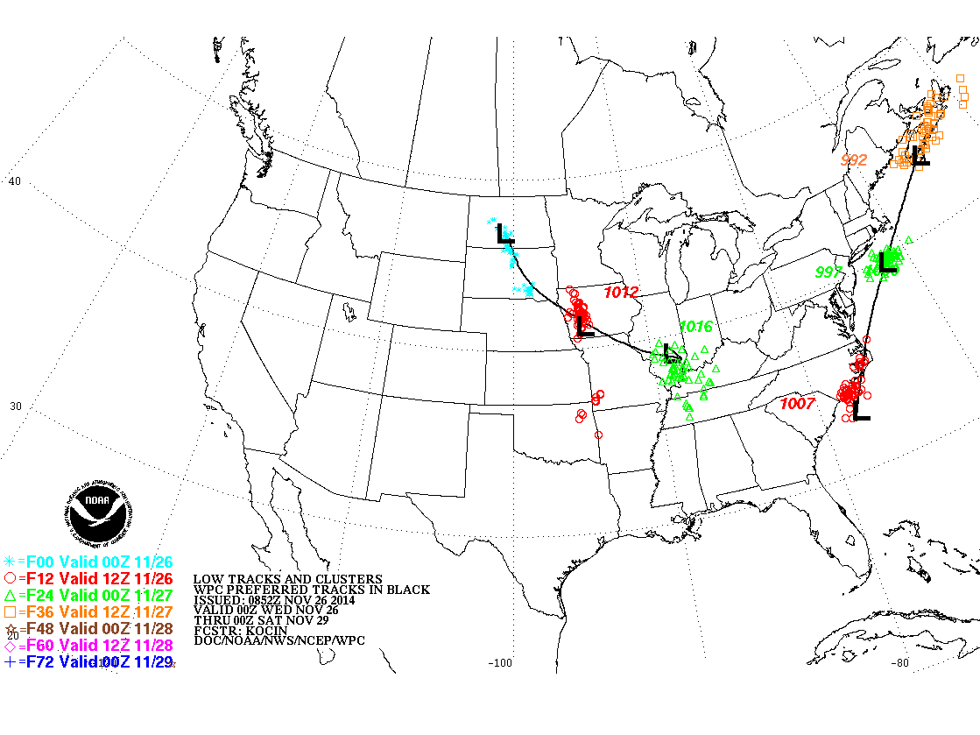
Winter Weather
Deterministic and
Probabilistic
Snowfall and Ice
Low tracks graphic
Heavy Snow Discussion
9

Slide 10
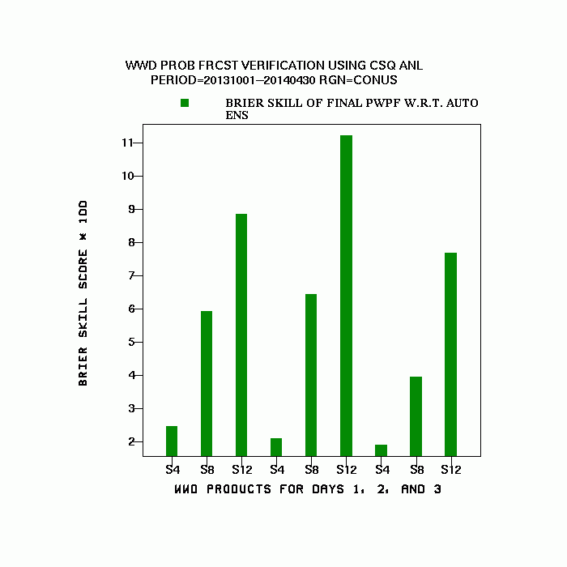
Winter Weather Desk Verification
2013-14 Season
Skill of human-influenced probabilities vs auto ensemble (4”/8”/12”)
Forecaster adds skill at all thresholds overall, especially at higher amounts
Day 1
Day 2
Day 3
12”
8”
4”
10

Slide 11
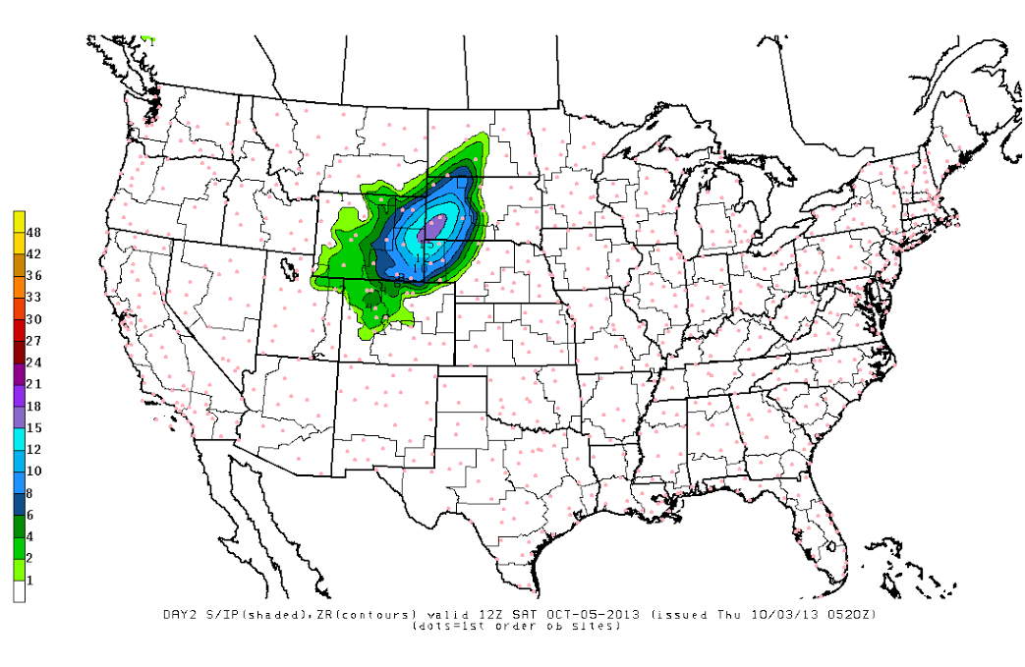
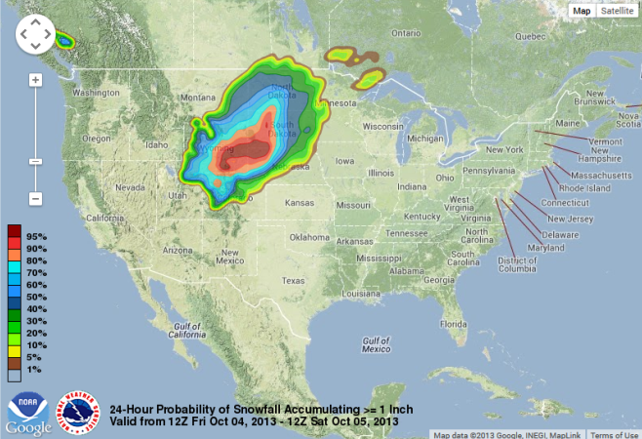
Winter Weather Desk - PWPF
WPC Deterministic Snowfall
57 member ensemble
58 member ensemble
WPC “most likely” deterministic value
Probability
Probability
Snowfall
Snowfall
11

Slide 12
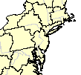
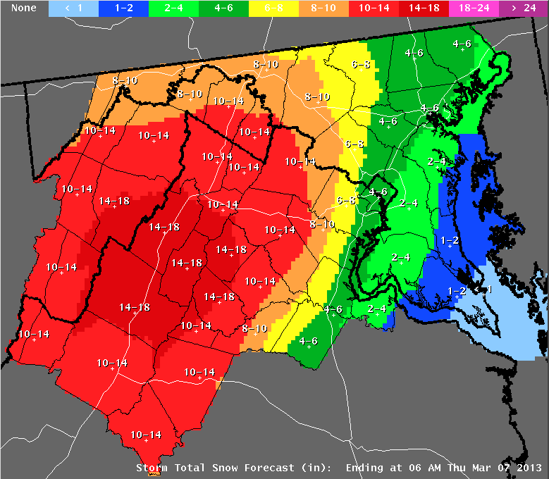
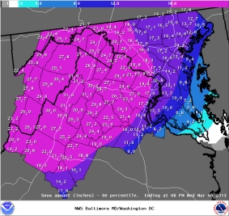
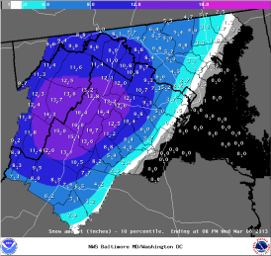
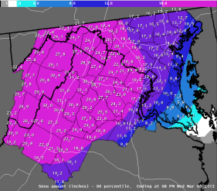
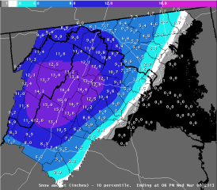
WPC Probabilistic Data Supports WFOs
X
X
BOX
OKX
PHI
LWX
X
Most Likely
X
Minimum
Maximum
Expect at least this much
Official NWS Forecast
Potential for this much
12

Slide 13
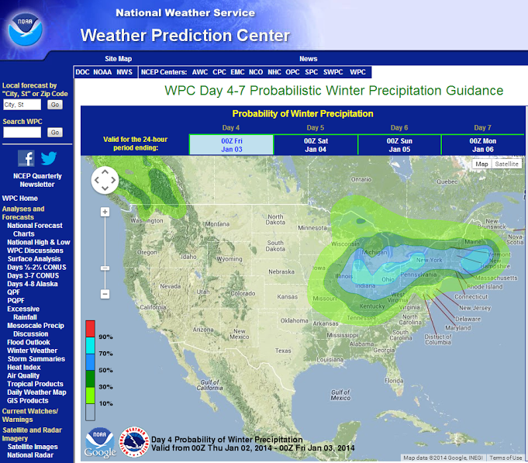
Day 4-7 Probability of Winter Weather
Issued twice daily (0900/2100Z)
NWS FOs only
Probability of >0.10” frozen QPF (~1” snow or 0.1” ice) in 24 hrs (e.g., day 4)
Started 1 December
13

Slide 14
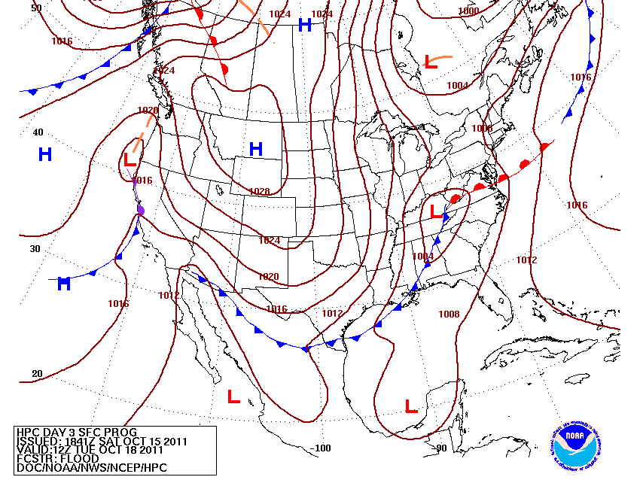
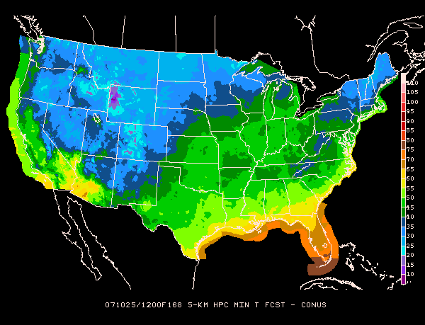
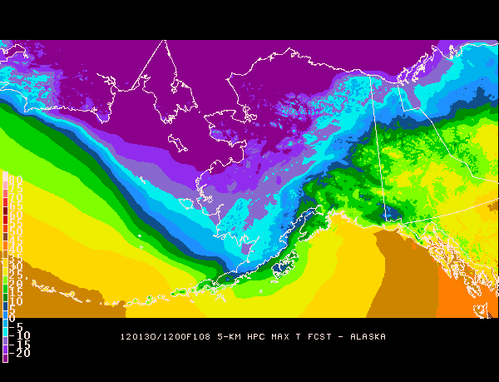
Medium Range
CONUS Sensible Wx Elements
Alaska Sensible Wx Elements
Fronts & Pressure
14

Slide 15
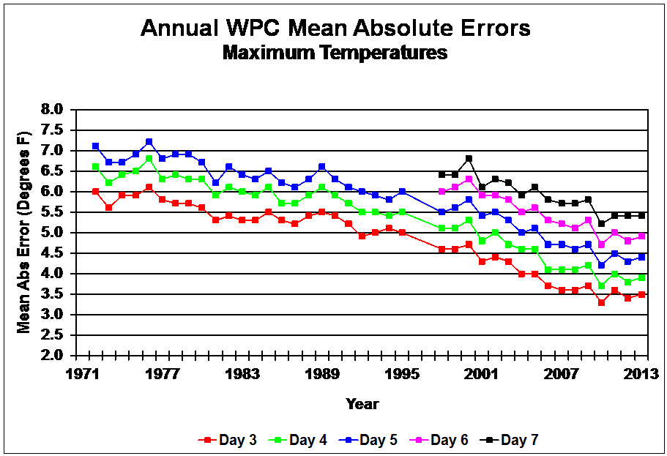
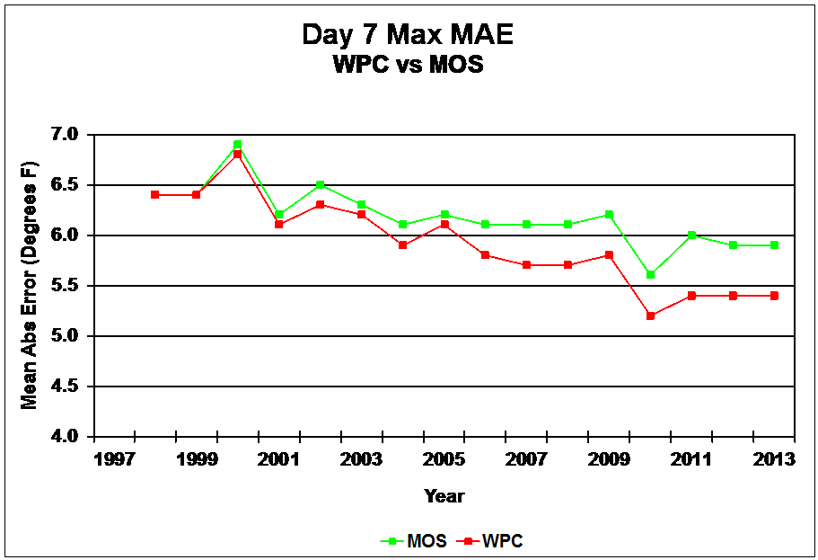
Medium Range Verification
# years to improve two forecast days was ~20 years ‘70s/’80s but was ~10 years in the 2000s
Steady the last 3-4 years?
15

Slide 16
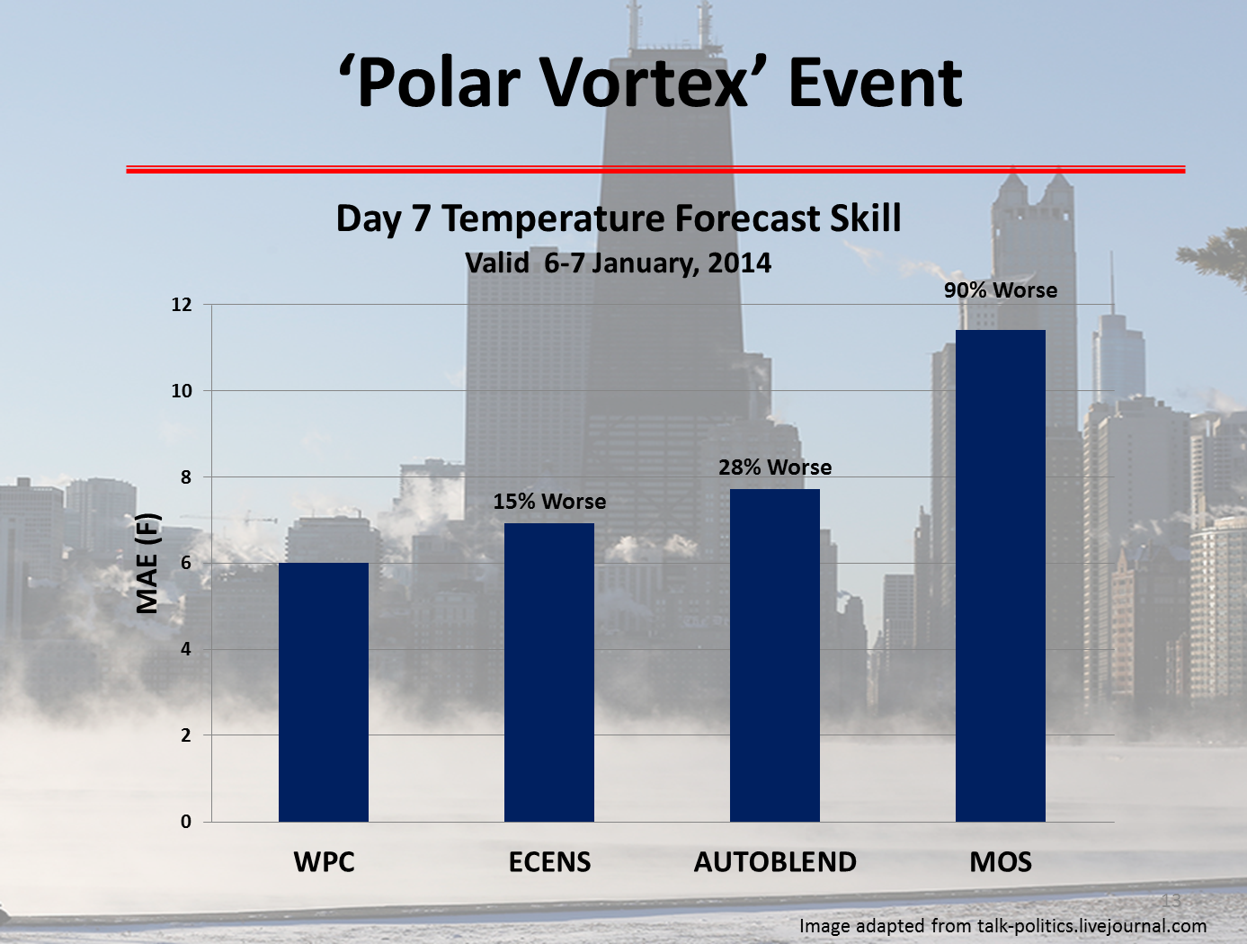
16

Slide 17
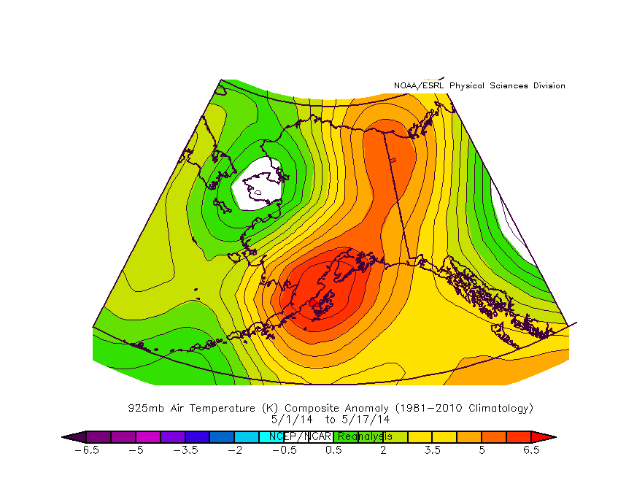
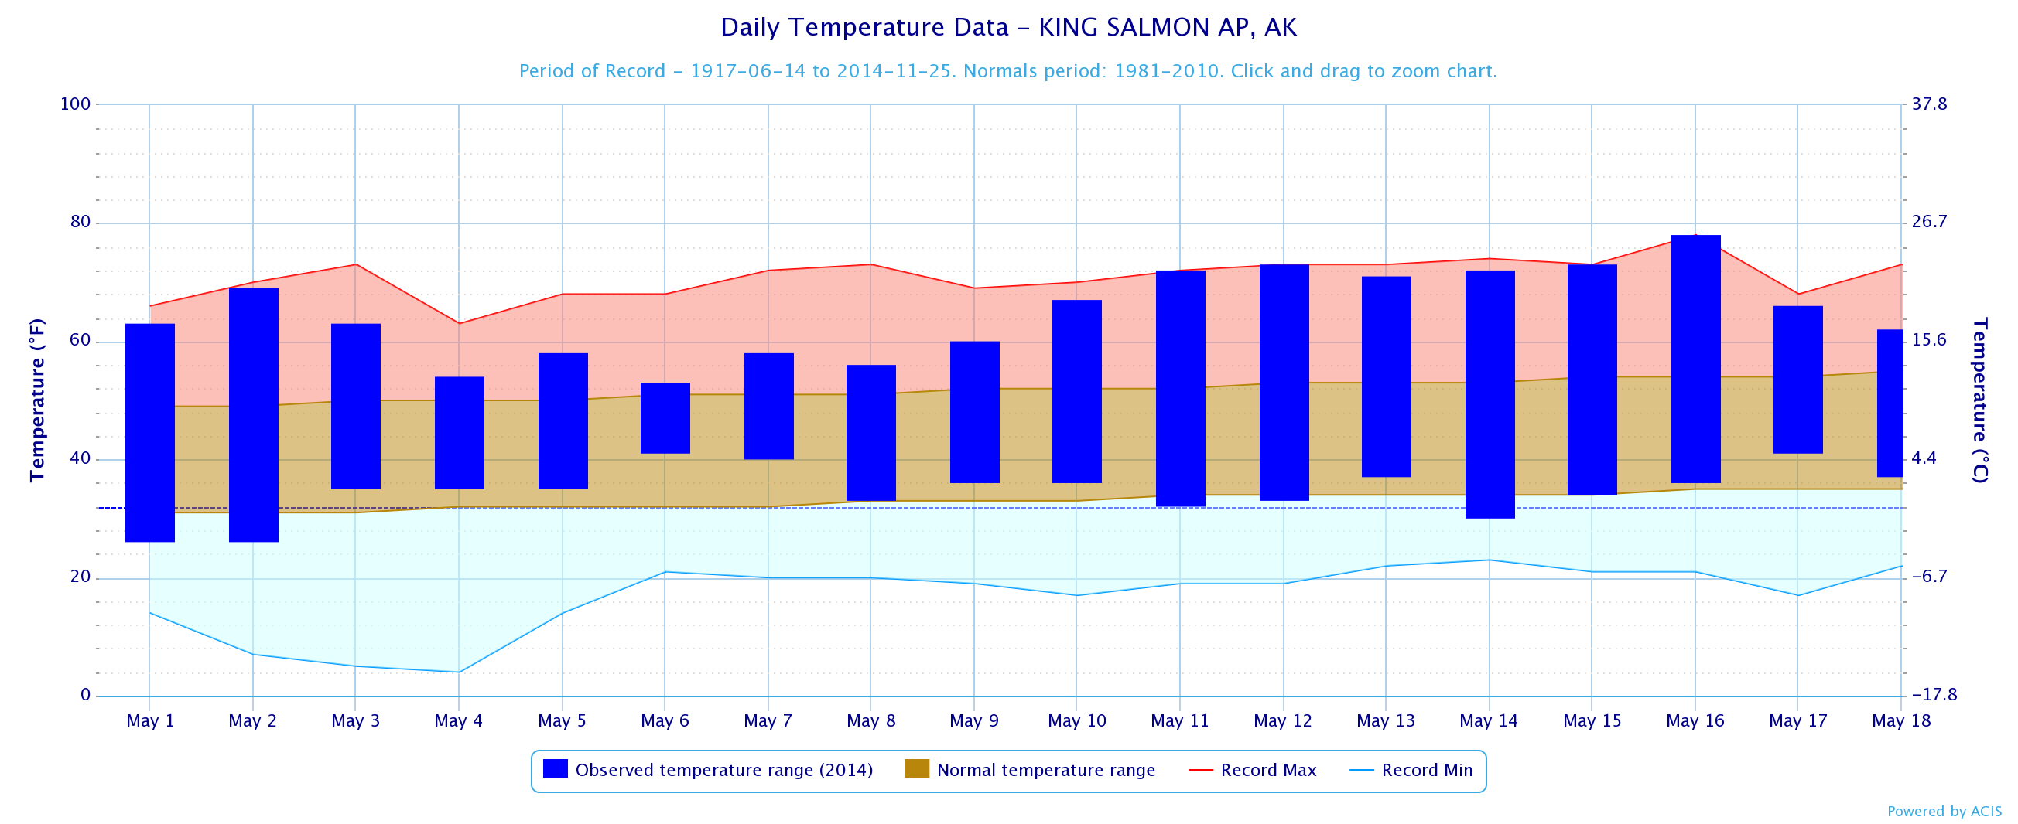
AK Record Heat - May 2014
May 1-17 Dept. from Avg. (925hPa Temperature)
King Salmon, AK
7 record or near-record highs
X
X
X
WPC AK Discussion (10 May) TEMPERATURES SHOULD BE ABOVE AVERAGE… RECORD HIGH TEMPERATURES POSSIBLE.
17

Slide 18
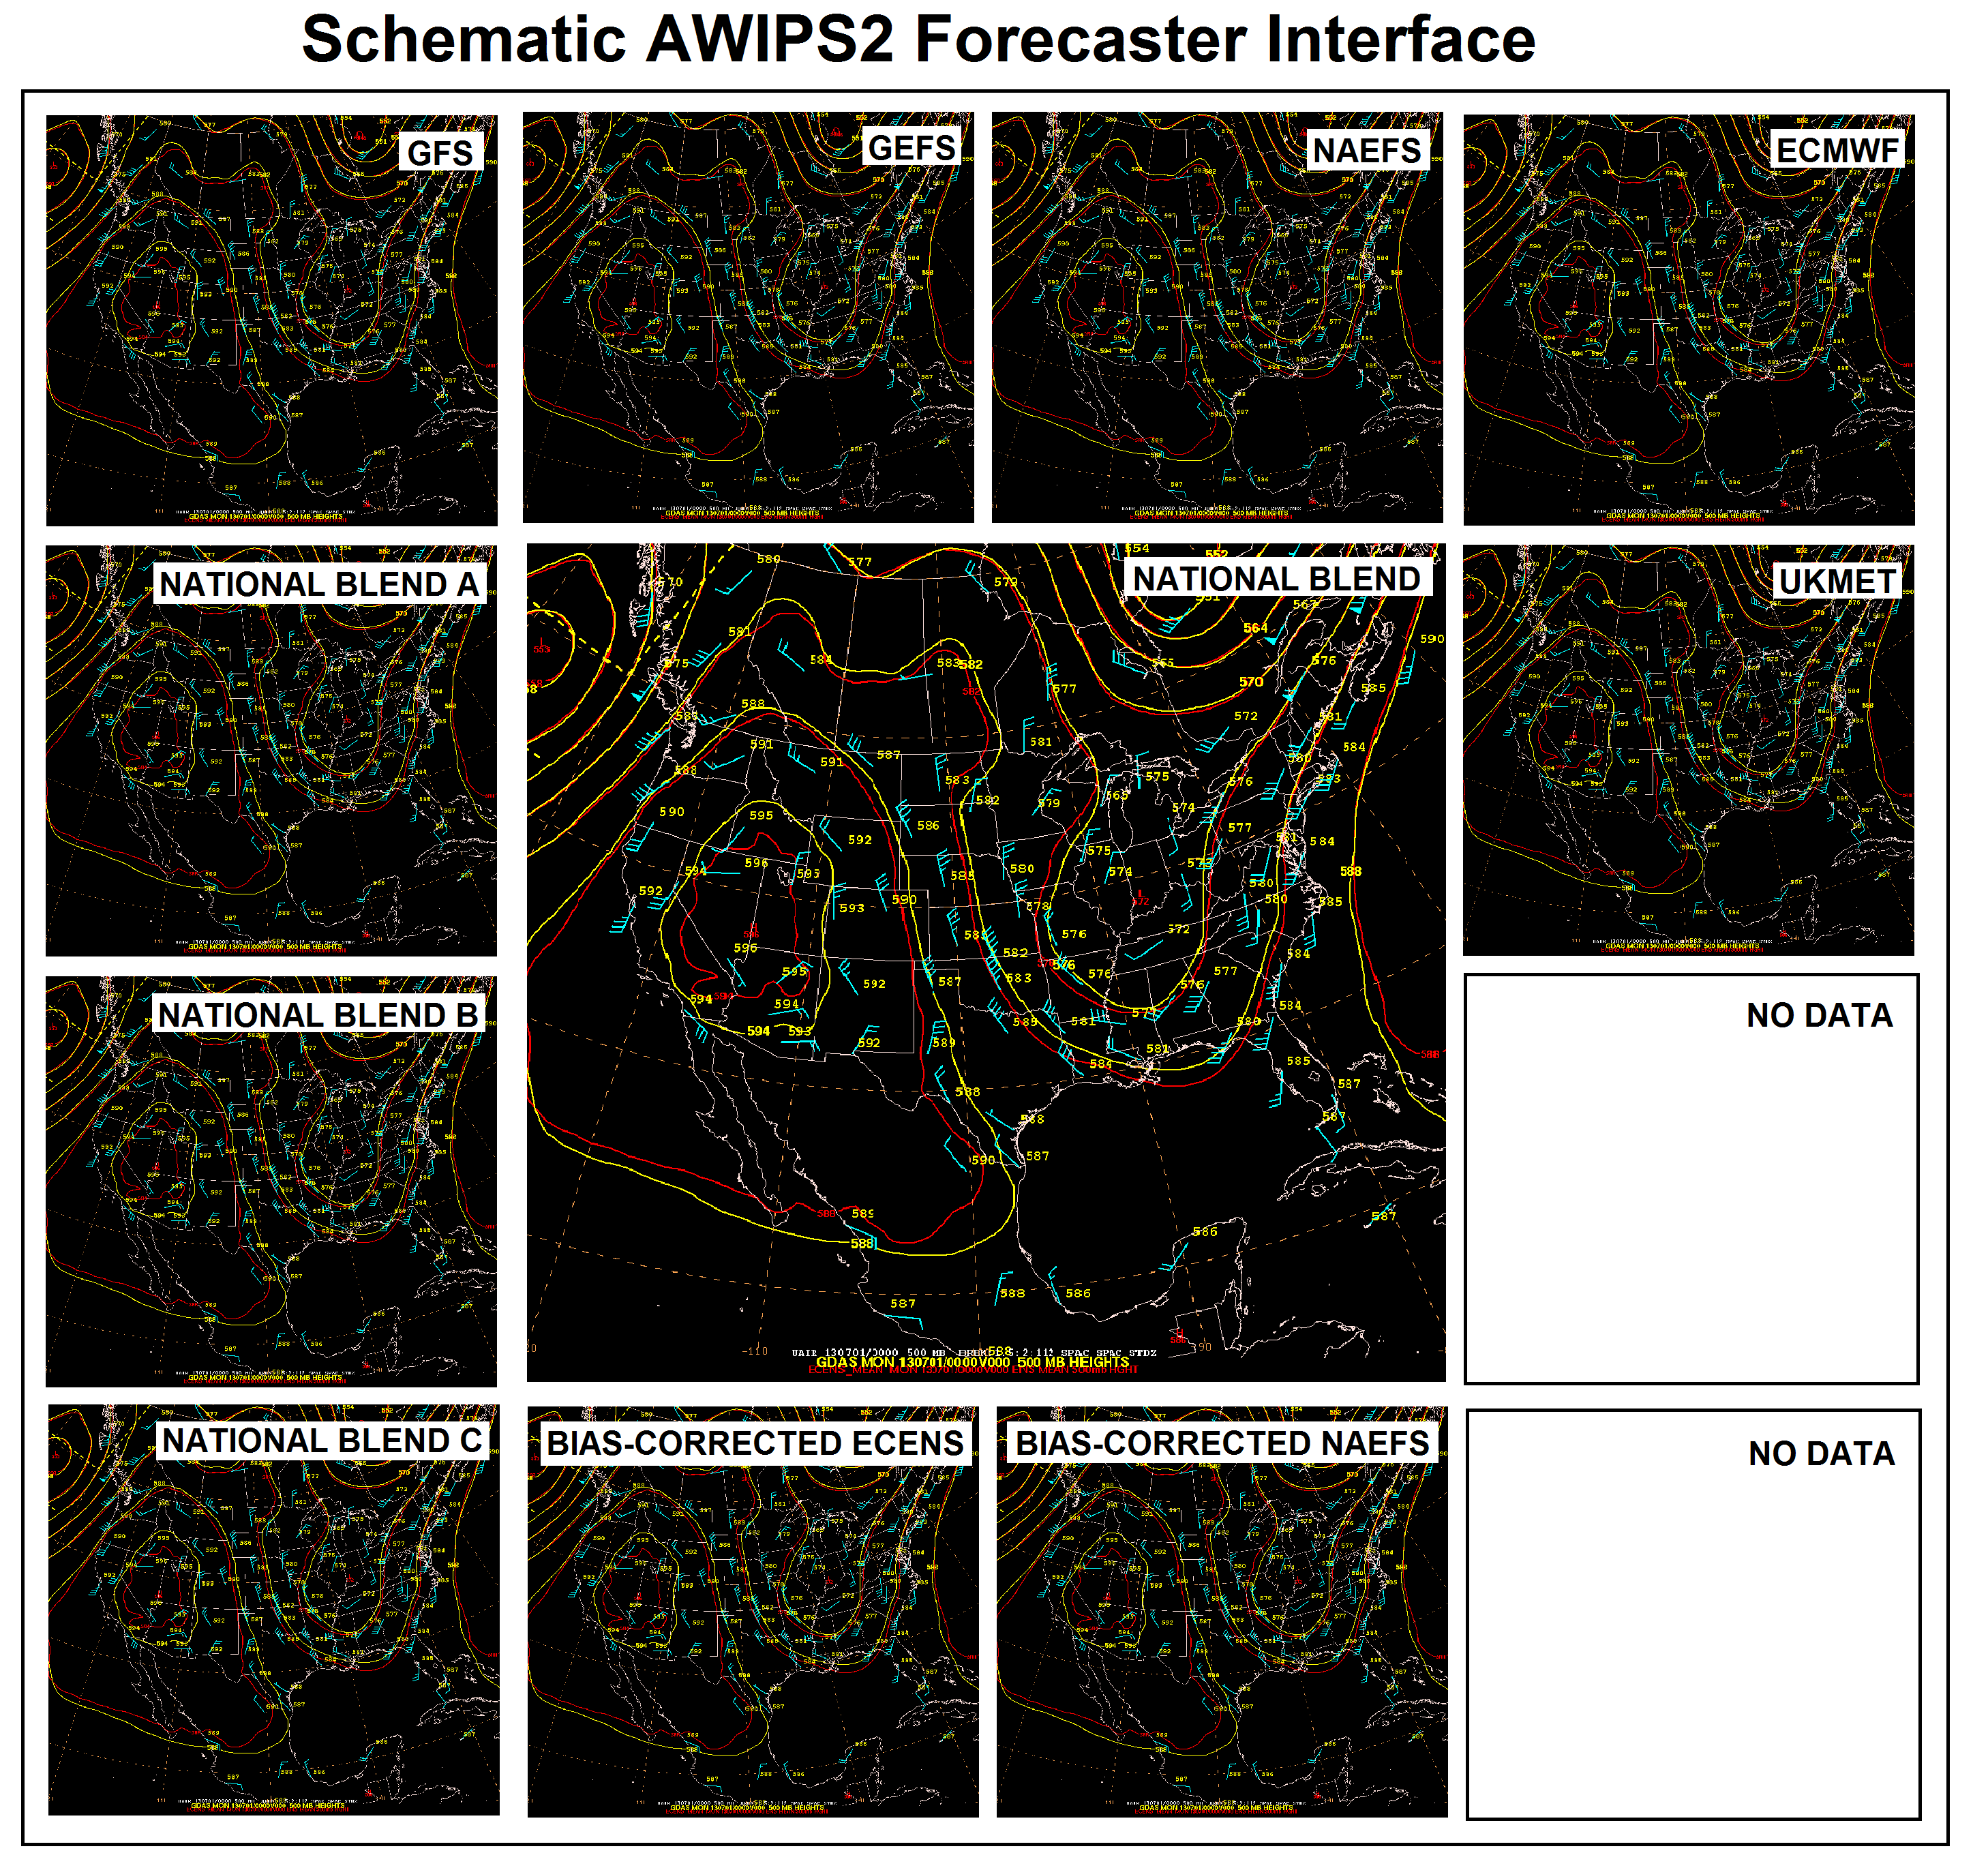
The National Blend Plan
WPC
Weather Forecast
Offices
Schematic WPC Forecaster Interface
Nationally consistent set of gridded products for NDFD weather elements
WPC applies “over-the-loop” expertise to blended grids
NATIONAL BLEND
CLUSTER 1
CLUSTER 2
18

Slide 19
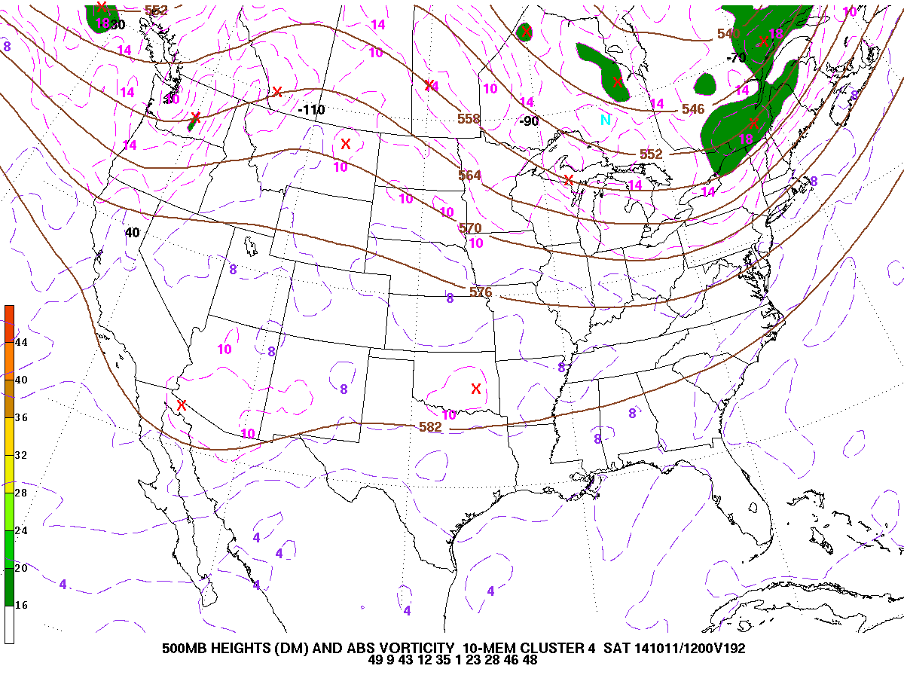
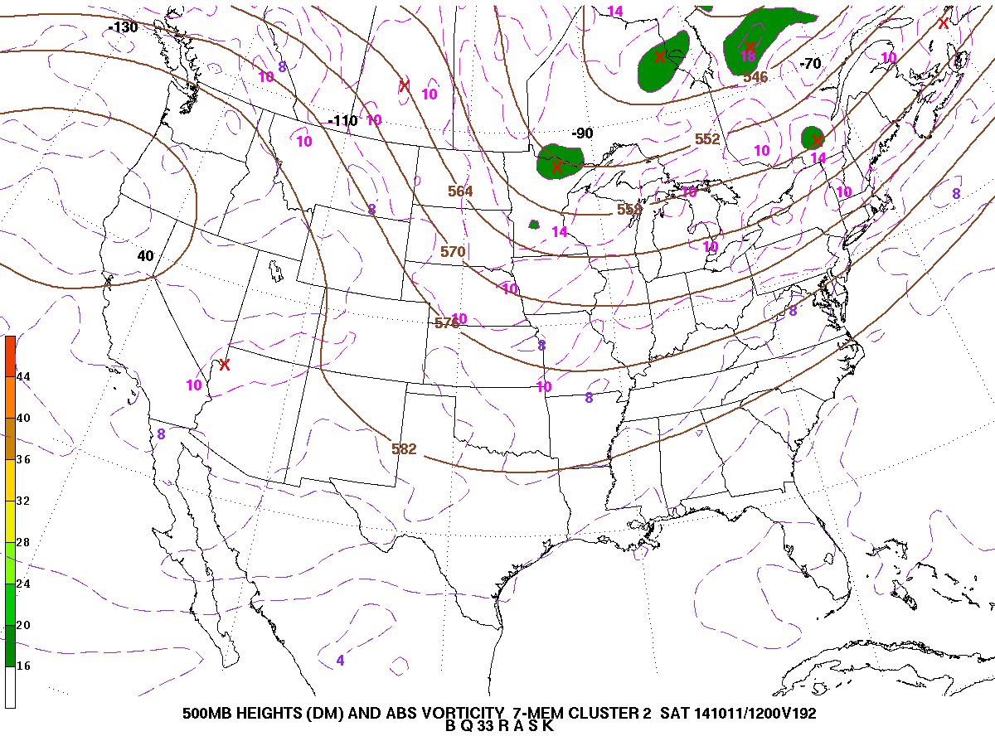
Clusters Example (Day 7)
500hPa heights/vorticity
Cluster 1 (10 members)
Cluster 2 (7 members)
H
19

Slide 20
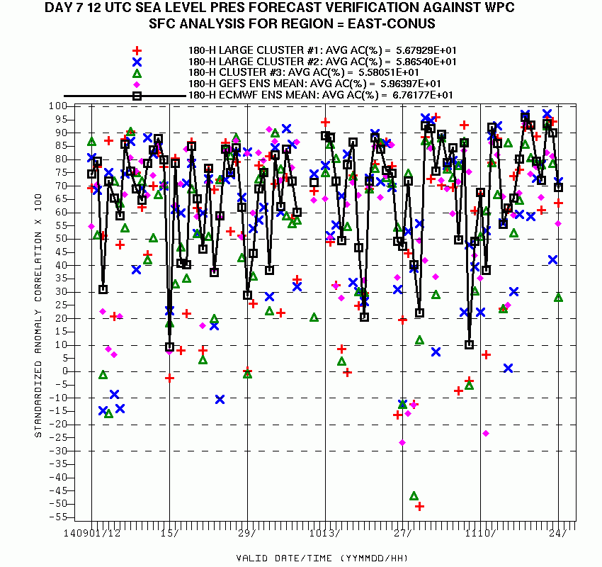
Clusters Verification (PMSL Day 7)
Cluster1
Cluster2
Cluster3
GEFS
ECENS
Better →
Given cluster(s) that beat the ECMWF ensemble mean
1 Sept - 24 Nov 2014
20

Slide 21
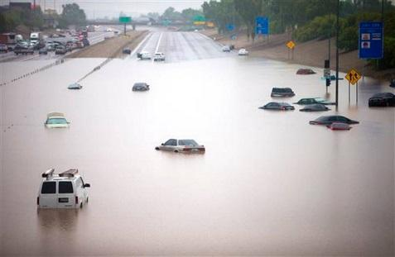
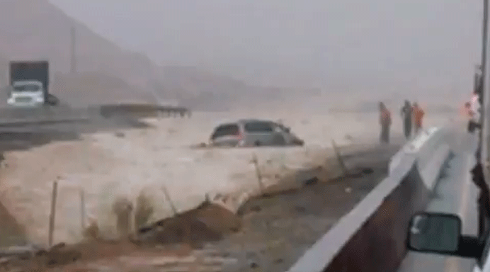
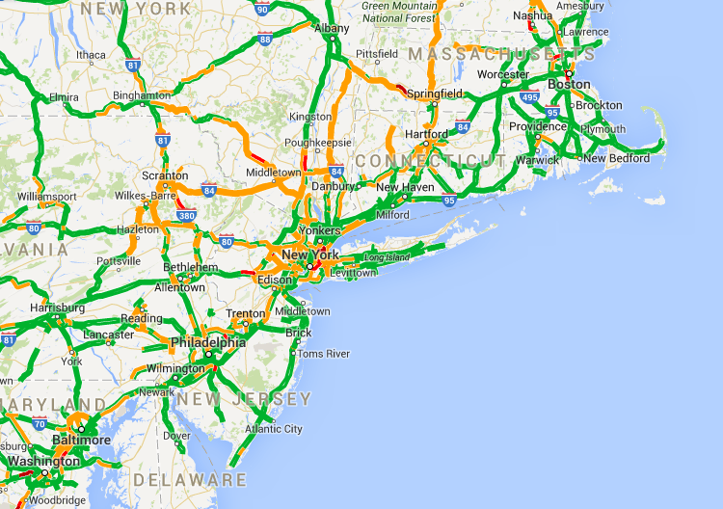
Collaboration Calls on
High-Impact Events
Facilitated by the Regional Operations Centers
- Central US (July)
- Tropical Storm Norbert, Odile (August)
- Southern/Central US heavy rain (October)
- Pre-Thanksgiving Day storm (November)
21

Slide 22
Winter Weather Desk Collaboration
2013-14 Season
254 Questions from WFOs (via 12Planet chat)
63 telephone calls
4 conference calls (33 WFOs)
3 National Go-To Meeting Winter Weather Webinars (70 WFOs, RFCs, OCCWS, regional HQ, and AWC)
Dan Petersen (WPC)
22

Slide 23
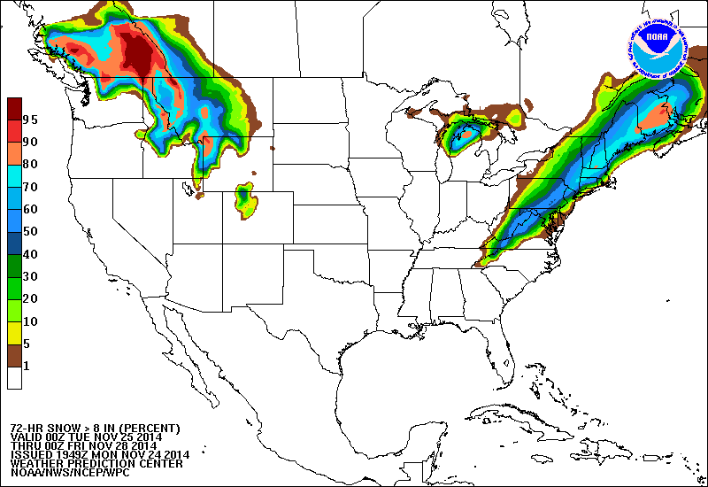
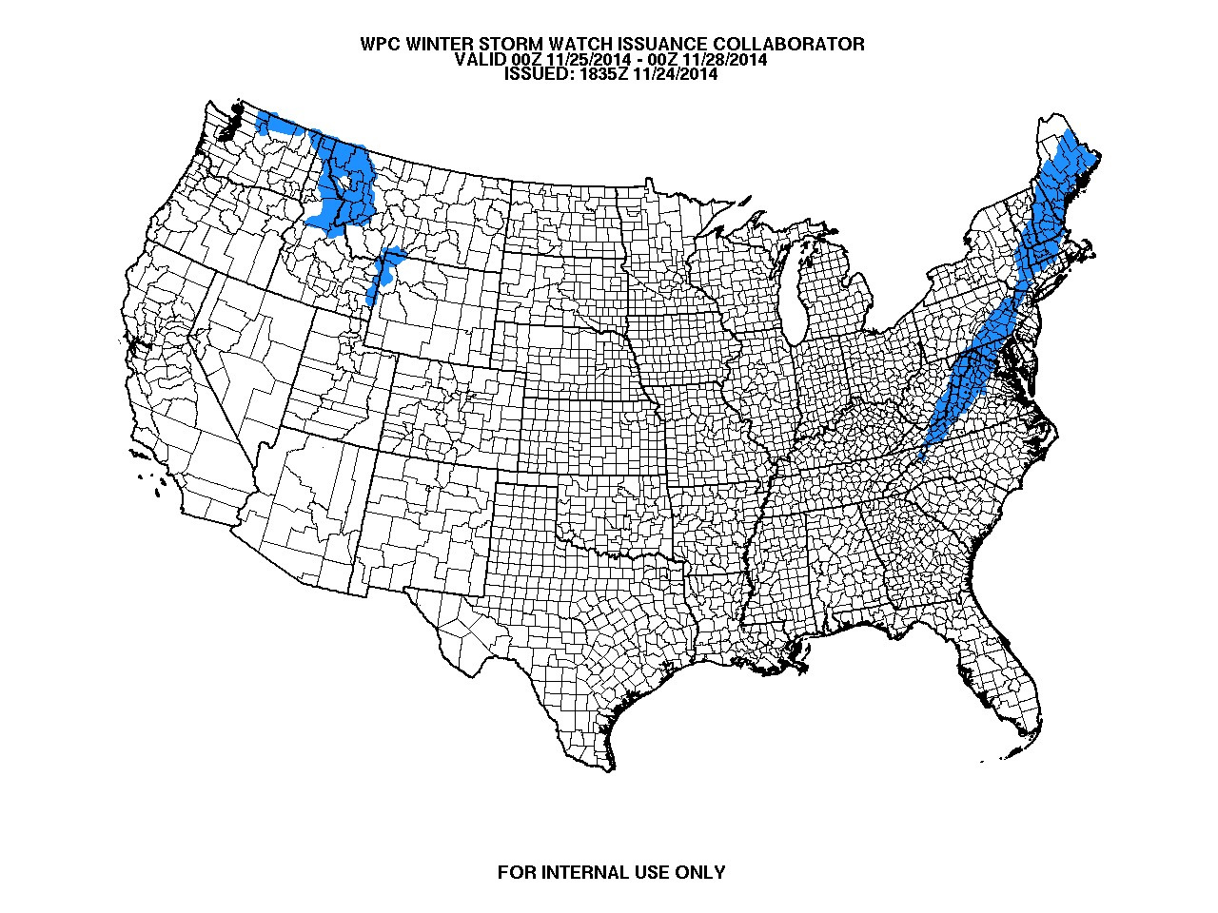
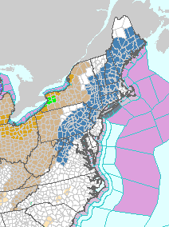
Winter Weather Watch Collaborator
WPC 72-hour Probability of >8” Snow (%)
Winter Weather Watch Collaborator Output
24 Nov 2014 20:58 UTC
weather.gov webpage
Based on 12-hr winter storm warning criteria
23

Slide 24
Hydrometeorological Testbed
Winter Weather Experiment (Jan - Feb 2014)
  Parallel SREF (with and without rime factor)
  NAM with rime factor modification
  36 participants
Flash Flood and Intense Rainfall (FFaIR) Experiment (July 2014)
  Parallel NAM (now operational)
  NCASE (NCEP Convection Allowing Scale Ensemble) - high resolution, multi-model, time-lagged ensemble
24

Slide 25
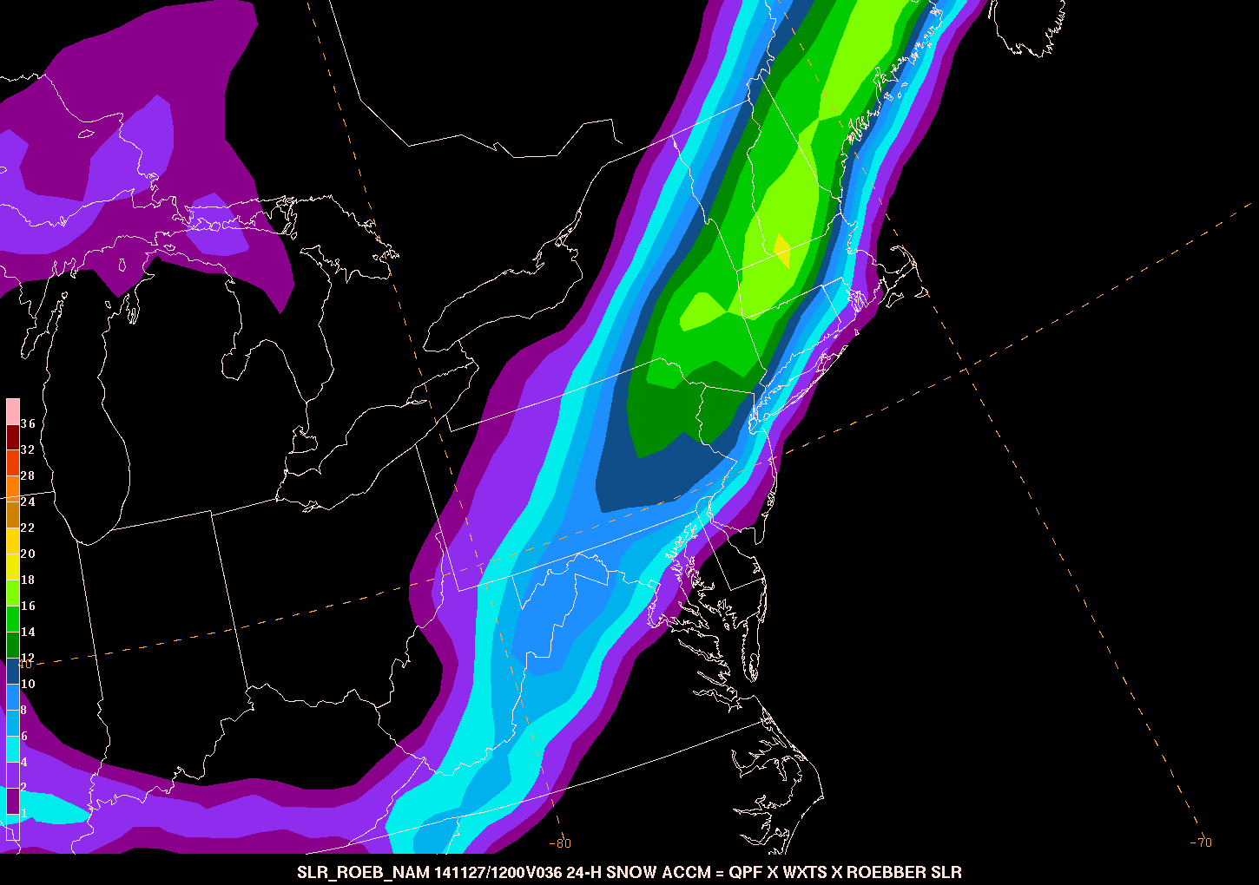
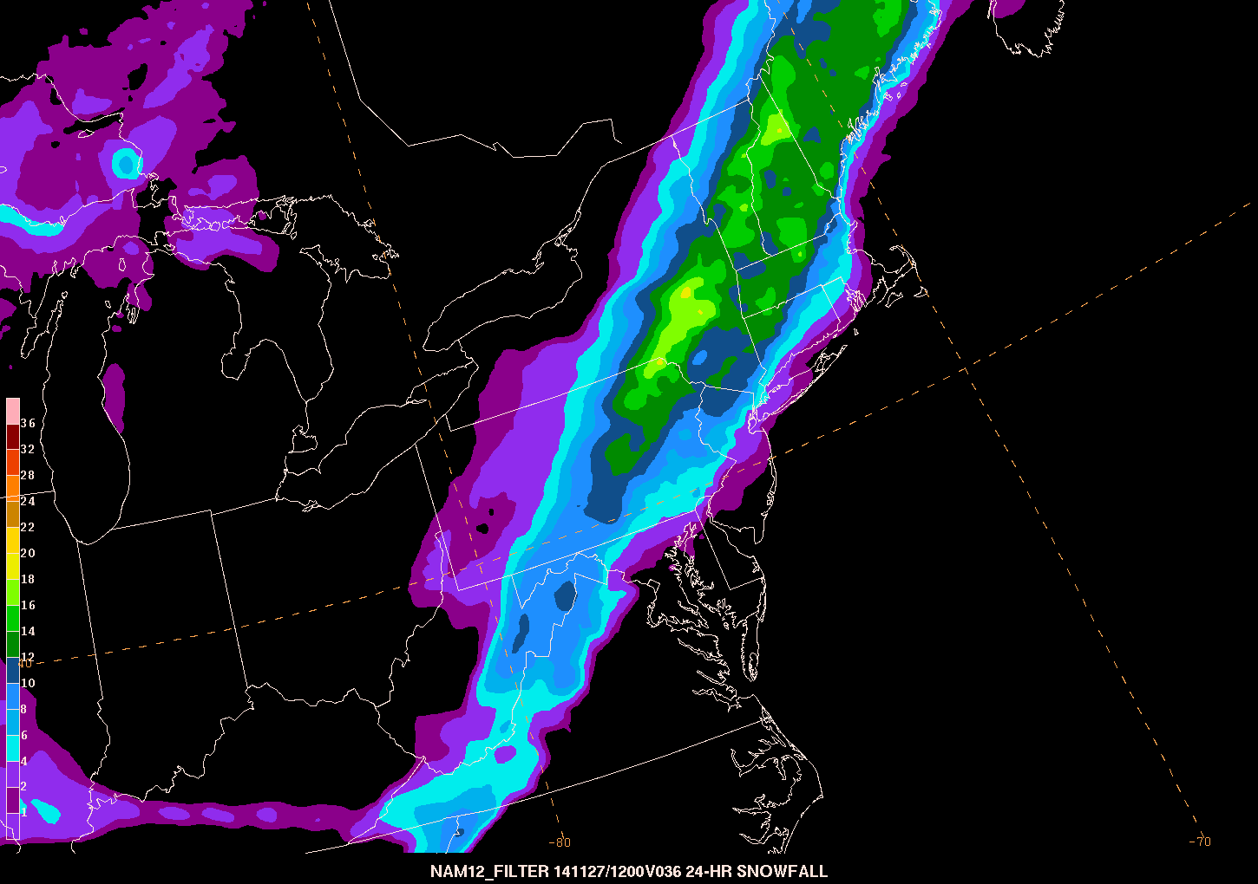
Experimental Datasets in Operations
NAM: QPF x (wx=snow) x Roebber SLR NAM Rime Filter
Pre-Thanksgiving Day Snow
00Z 26 Nov NAM
Decreased snow
- DC/NYC metro
- CT River Valley
Increased snow SW of Albany (resolution)
25

Slide 26
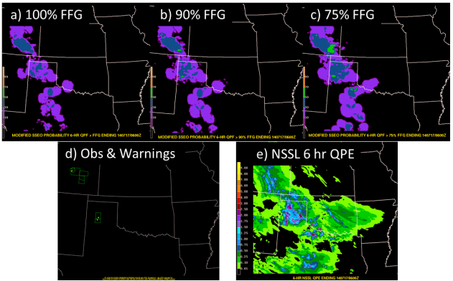
Evolving Methodologies
Ensemble approach offered best results
Use modified probabilities (X% of Flash Flood Guidance)
26

Slide 27
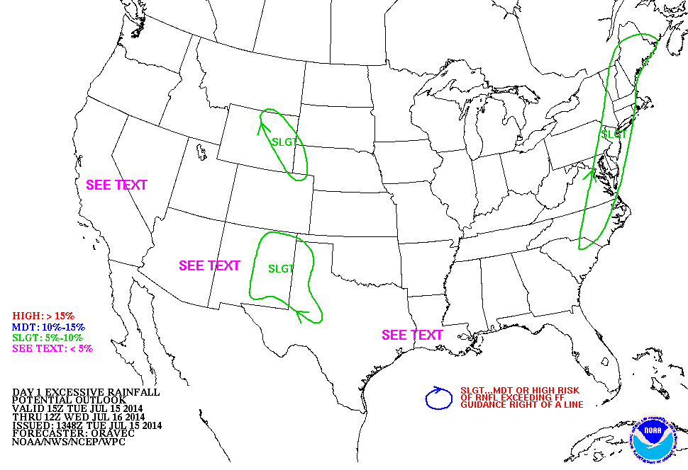
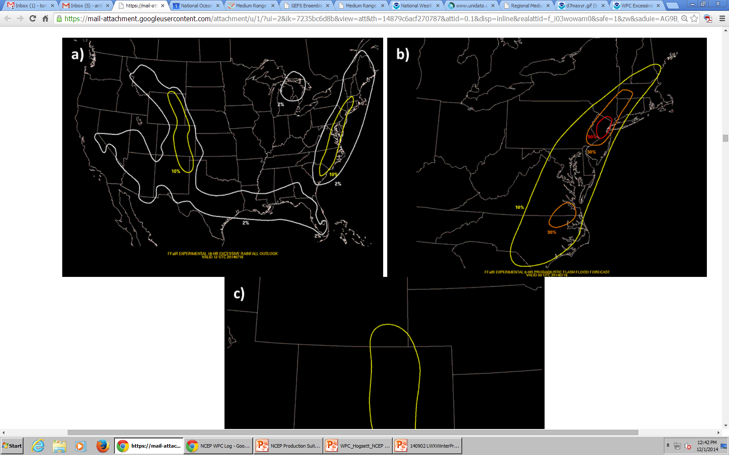
Excessive Rainfall Outlook Changes
Define Flash Flood to be within 40km of a point (consistent with SPC)
Current WPC Excessive Rainfall Outlook
Possible Future WPC Flash Flood Outlook
>10%
5-10%
<5%
>2%
<5%
27

Slide 28
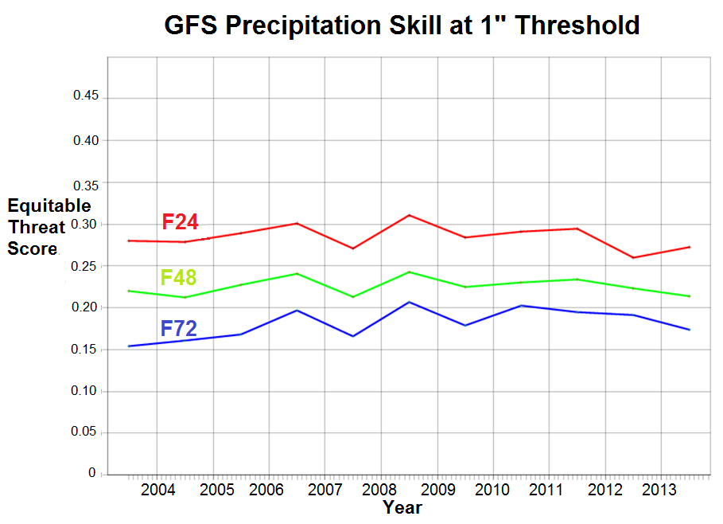
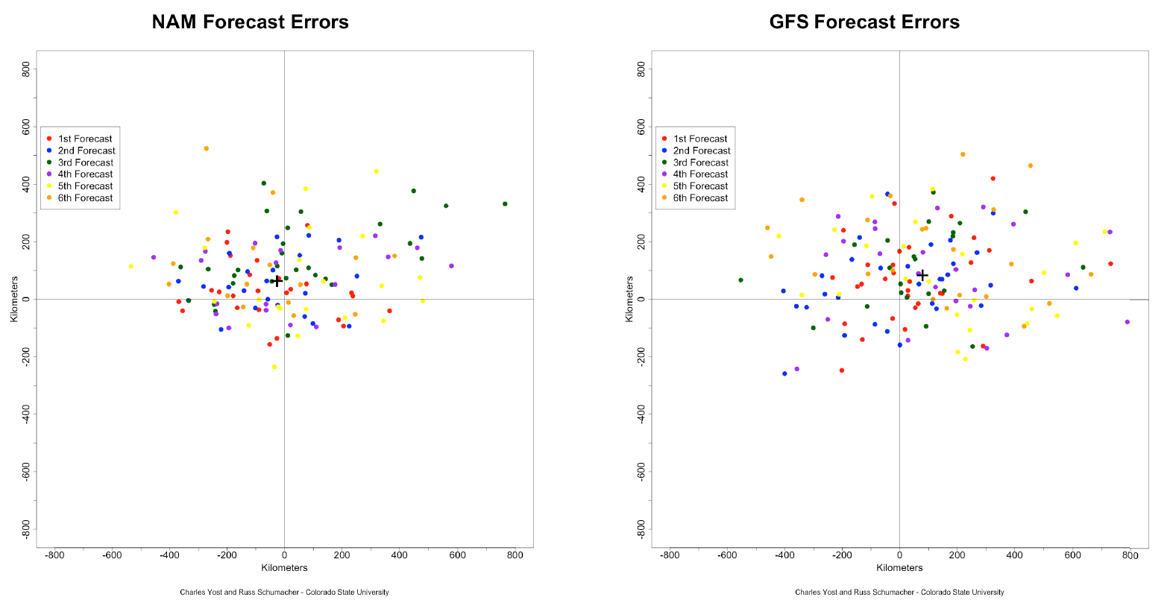
WPC Requirements
QPF
Improved skill (especially with high impact events)
More accurate placement of convective maxima
HRRRE
28

Slide 29

WPC Requirements
Winter Weather
Add rime factor and percent of frozen precipitation to GFS output (and GEFS?)
Coupling to land-surface model
Extratropical cyclone tracking displayed in AWIPS2
29

Slide 30


WPC Requirements
GEFS avg. 500hPa height error outside envelope (m)
Ensemble Systems
Increased ensemble spread in the SREF and GEFS
Bring GEFS reforecast into production
Cohesive ensemble output synthesis methods
ECENS avg. 500hPa height error outside envelope (m)
168-hr forecasts (1 August – 1 November 2014)
30

Slide 31
Extra Slides
31

Slide 32
Driest month
since
Oct 1987!
GPRA GOAL
0.320
FY14
WPC
0.332
6

Slide 33

Day 1 Day 2 Day 3

Slide 34
% Improvement
50% NAM
30% GFS
18% ECMWF
6% ENSBC

Slide 35
% Improvement
50% NAM
30% GFS
18% ECMWF
6% ENSBC
7

Slide 36




Experimental Datasets in Operations
26

Slide 37

Case: 26 November 2014
NAM: QPF x (wx=snow) x Roebber SLR NAM Rime Filter
00Z 26 Nov NAM
- Decreased snow in DC/NYC metro
- Increased snow in Catskills (resolution)

Slide 38



When does the public turn to WPC?
WPC Webpage Hits Per Day (2014)
Clearing snow at DCA
13 Feb 2014
← 11 Feb

Slide 39





T.S. Norbert - September 8, 2014
Phoenix, AZ
Day 6-7 Forecast
Day 3 Forecast
Day 0 Forecast
Wettest Day in Recorded History in Phoenix
RFC Analysis
Flash Flood Reports Reports
I-15 destroyed in spots
4

Slide 40
Quotes
“An unsophisticated forecaster uses statistics as a drunken man uses lamp posts… for support rather than illumination.” ~ Andrew Lang (1844 - 1912)
“Fate laughs at probabilities.” ~ Lytton E.G Bulwer (1803 - 1873)

