Slide 1
Figures from “The ECMWF Ensemble Prediction System”

Slide 2
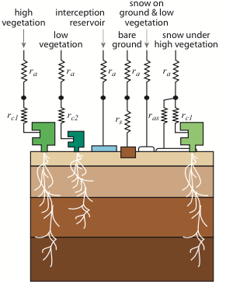
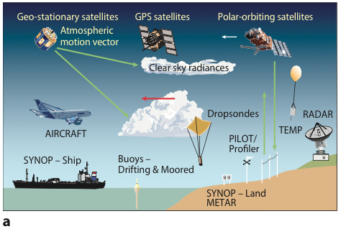
The main sources of uncertainty in numerical weather prediction arise from our incomplete knowledge of the exact state of the atmosphere (the initial conditions) and unavoidable simplifications in the representation of the complexity of nature in the numerical weather models. Despite enormous advances in the observational network (figure a), which comprises all kinds of observations ranging from satellite measurements to conventional land-based observations, it will always be impossible to describe the state of the atmosphere without any uncertainty. Similarly, the whole complexity of all atmospheric processes and their interactions with the ocean and land surface cannot be captured in a numerical model. For example, the intricate vegetation and soil moisture processes can be described only by assuming a simplified description of vegetation and soil types and the associated processes (figure b).

Slide 3
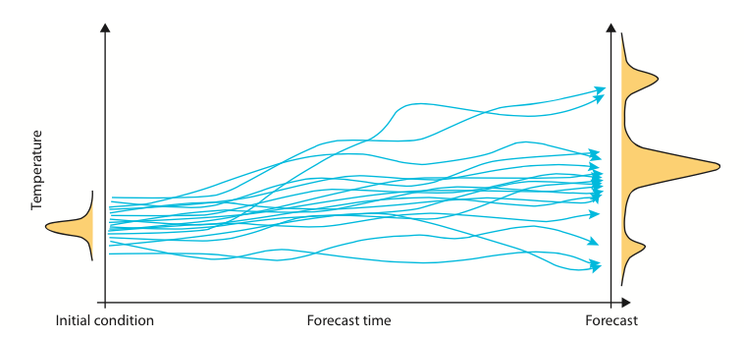
The basic principle of ensemble-based probabilistic forecasting is to make not only a single forecast from our best guess initial conditions, but also to perform a number of additional forecasts starting from slightly perturbed initial conditions, with each forecast created with a slightly perturbed model. This technique provides an estimate of the uncertainty associated with predictions from a given set of initial conditions compatible with observation errors. If the atmosphere is in a predictable state, the spread will remain small; if the atmosphere is less predictable, the spread will be larger. In a reliable ensemble prediction system, reality will fall somewhere in the predicted range. This means that users get information on the actual predictability of the atmosphere, i.e. whether a particular forecast can be expected to be certain or less certain. In addition they also get information on the range within which they can expect reality to fall.

Slide 4
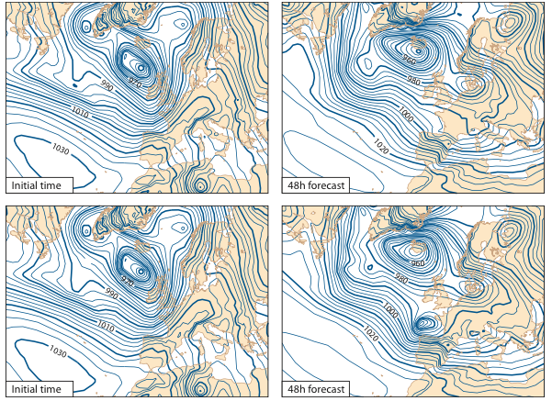
The ECMWF Ensemble Prediction System consists of one control forecast starting from the best guess initial conditions, and 50 members starting from slightly perturbed initial conditions. The left panels show the initial mean sea level pressure for the control run starting on 22 January 2009 (top left) and for one of the ensemble members (bottom left). The differences between these starting conditions are hardly visible. However, these similar initial conditions produce forecasts that are very different after only 48 hours forecast time (right panels), as seen, for example, over northern Spain and France.

Slide 5
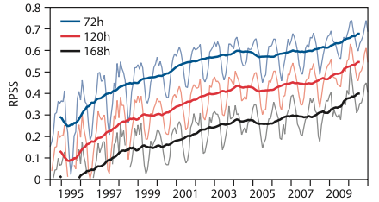
The performance of the EPS has improved steadily since it became operational in the mid-1990s, as shown by this skill measure for forecasts of the 850 hPa temperature over the northern hemisphere (20°–90°N) at days 3, 5 and 7. Comparing the skill measure at the three lead times demonstrates that on average the performance has improved by two days per decade. The level of skill reached by a 3-day forecast around 1998/99 (skill measure = 0.5) is reached in 2008–09 by a 5-day forecast. In other words, today a 5-day forecast is as good as a 3-day forecast 10 years ago. The skill measure used here is the Ranked Probability Skill Score (RPSS), which is 1 for a perfect forecast and 0 for a forecast no better than climatology.

Slide 6
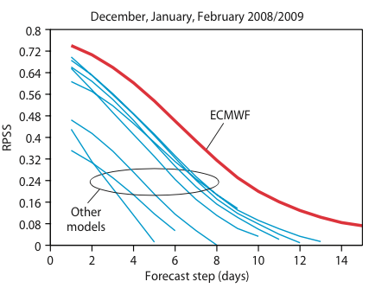
A comparison of the performance of all global ensemble prediction systems operational in the world demonstrates the leading position of the ECMWF EPS. The skill measure for the forecasts of 850 hPa temperature in the northern hemisphere (20°–90°N) for the ECMWF EPS (red line) remains above all other model systems (blue lines) at all lead times. On average, ECMWF EPS forecasts have an advantage of at least one day for the forecast at day 8. For example, the 8-day ECMWF EPS is as good as the 6-day forecast of the second best EPS. The skill measure is the same as used in the figure above.

Slide 7
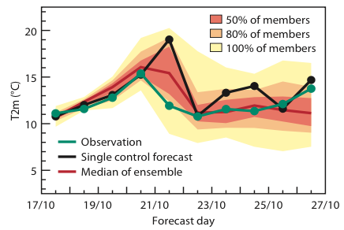
The additional information on the uncertainty of the prediction can be of high value for a number of applications. Usually, the uncertainty of a forecast grows with lead time as a function of the atmospheric flow: thus, without explicit uncertainty information from the EPS, neither the extent nor the timing of the growth of uncertainties can be estimated. For example, how long can users trust a single forecast to be close to reality? Two days, five days, seven days? In this example, showing the forecast for 2-metre temperature (T2m [C]) in Hamburg started on 17 October 2008, the spread is relatively small for the first 3–4 days, i.e. the forecast should be relatively accurate. Indeed the single control forecast (black dots) is close to the observed value (green dots) for the first four days. However, on 21 October (5-day lead time) a rapid growth of uncertainty is predicted by the EPS. If on this day users had solely trusted the control forecast, they would have based their decisions on a quite wrong forecast. However, taking into account the uncertainty information from the EPS, they would have known both how uncertain this prediction might be and what range of temperature to expect.

Slide 8
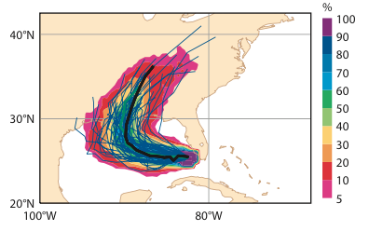
EPS-based probabilistic forecasts of tropical cyclone tracks can give decision makers extremely valuable information on the probability of occurrence of extreme weather conditions. This example shows the probability forecast issued on 26 August 2005 that the tropical cyclone Katrina will pass within a 120 km radius during the next 120 hours. The black line shows the track from the high-resolution forecast.

Slide 9
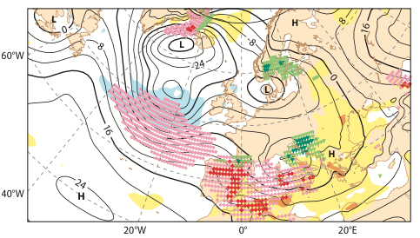
Early warnings for extreme weather conditions can be extracted from the EPS. This example shows the areas where extreme weather might be expected between the 24 and 25 January 2009, predicted by the EPS on 22 January. Different colours mark areas with high probabilities for extreme temperatures, wind or precipitation. Southern France and northern Spain were affected by a severe wind storm associated with extra-tropical depression Klaus.

