Slide 1
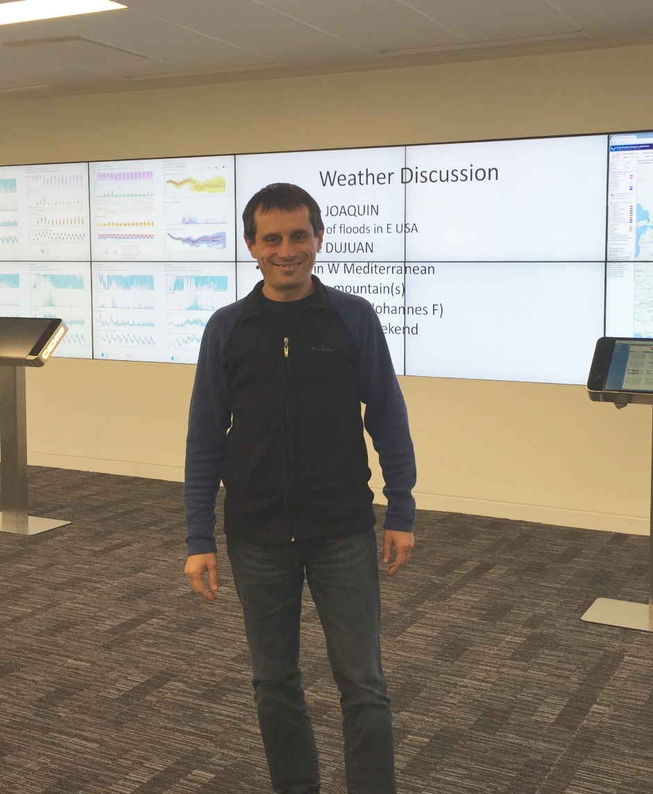
Forecasting Extreme Events
Ivan Tsonevsky, ivan.tsonevsky@ecmwf.int
Use and interpretation of ECMWF products, Feb. 2016

Slide 2
Outline
An example of severe weather – St. Jude Storm
Extreme Forecast Index (EFI) and the Model climate (M-climate)
Shift Of Tails (SOT) – an index to complement EFI
A case study: extreme cold, US
Operational products and verification
Recent development - EFI for convection

Slide 3
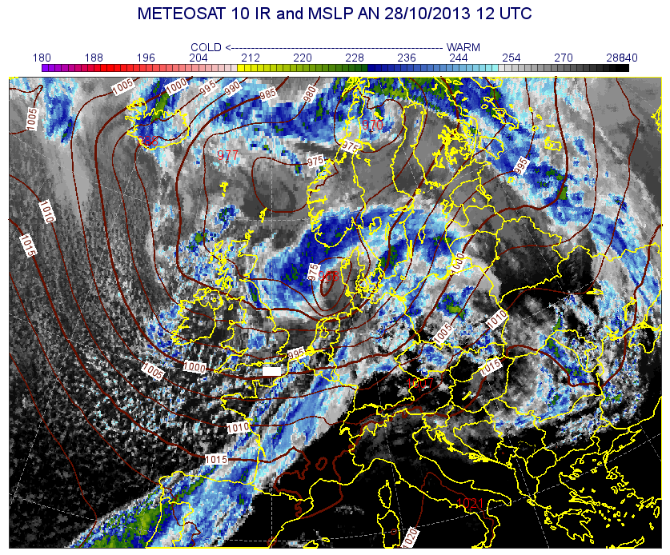
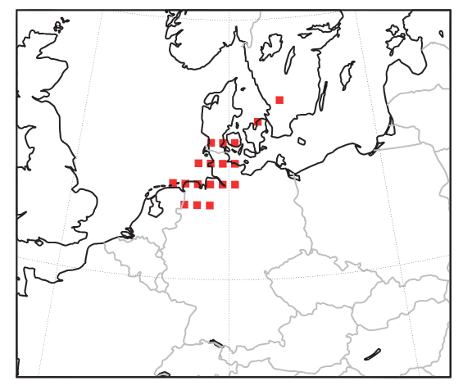
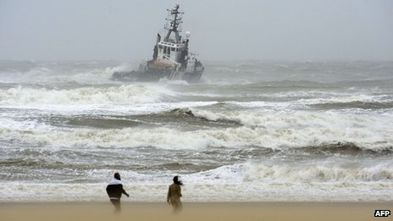
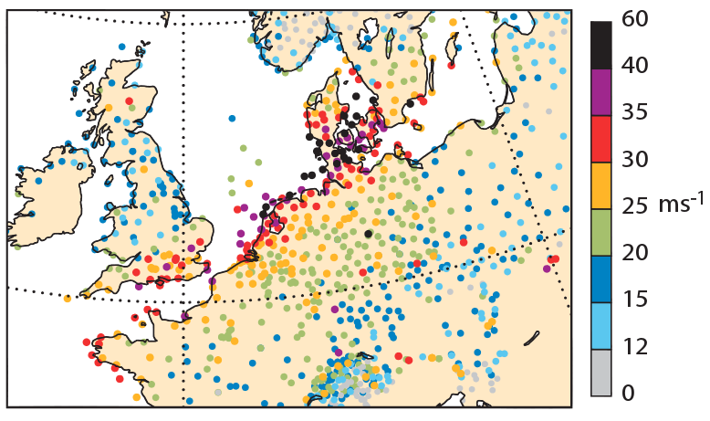
St Jude Storm, 27-28 Oct 2013
Areas exceeding the 5-year return period of 24-hour maximum wind gust diagnosed using the ERA-Interim reanalysis as a proxy for observations
Observed 24-h maximum wind gusts on 28 Oct

Slide 4
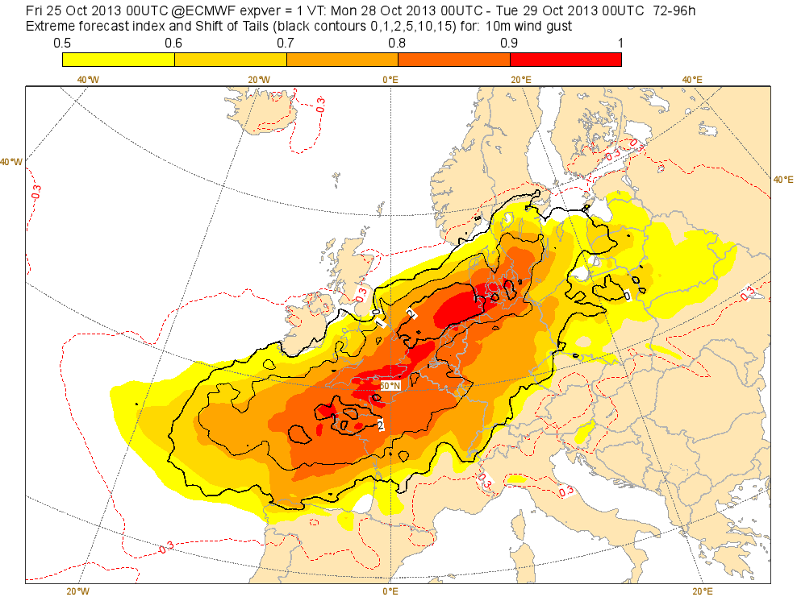
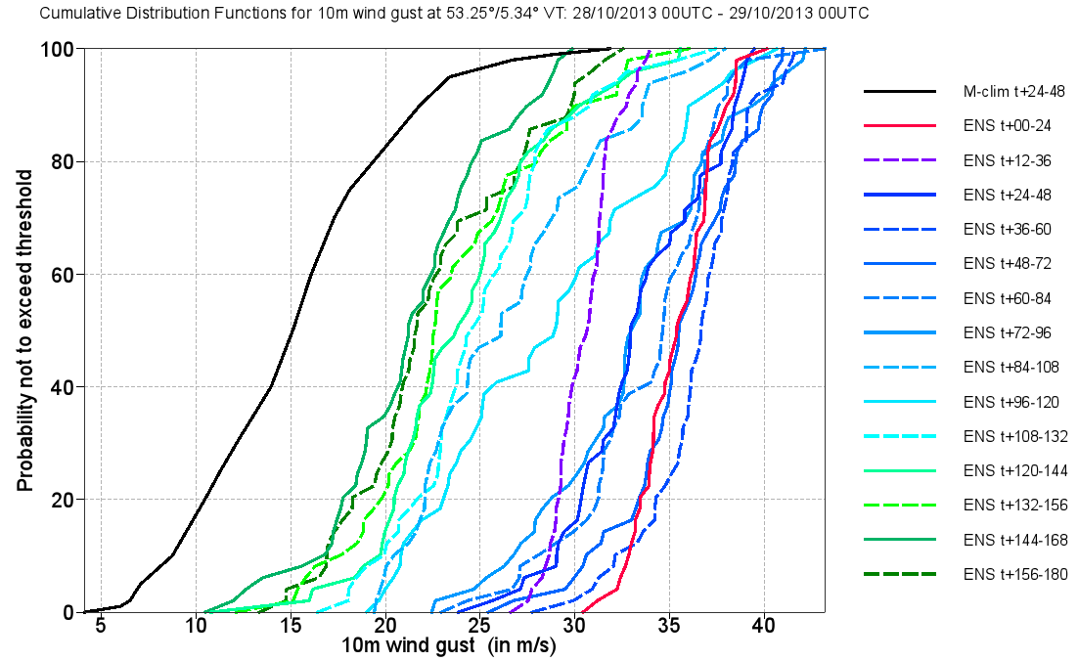
St Jude Storm, 27-28 Oct 2013
Cumulative Distribution Functions (CDF)
EFI, 10m maximum wind gusts, T+72-96h
Obs. gusts > 35 m/s
EFI indicated a risk of a windstorm in the medium range. Positive SOT (black contours) showed that an exceptionally strong windstorm was likely.
There was a sign of windier-than-normal conditions 7 days in advance with the last 7 runs predicting extreme wind (see CDF).
Windstorms in northwest Europe in late 2013, ECMWF Newsletter No. 139, 22-28

Slide 5
Extreme Forecast Index (EFI)
Extreme Forecast Index (EFI) is designed to measure how extreme a given ensemble forecast is.
EFI is a measure of the difference between the ensemble forecast distribution and a reference distribution - model climate (M-climate).
EFI delivers model-climate-related information, therefore it can be used as an “alarm bell” for extreme weather situations over any area without defining different space- and time-dependent thresholds.
Simple probabilities (eg. > 32°C) will not highlight the differences in the distributions below. EFI will, by accounting for the distribution of all the ensemble members.
20 C° (20 members)
30 C° (10 members)
35 C° (15 members)
40 C° (5 members)
20 C° (5 members)
30 C° (25 members)
35 C° (15 members)
40 C° (5 members)

Slide 6
The Model climate (M-climate)
For climate related products like the EFI a reliable model climate is essential.
Ideally the model climate (M-Climate) is a large set of ensemble re-forecasts with the latest model configuration (used operationally) for a long enough period (e.g. 30 years).
The current M-climate in use (since 12 May 2015):
Running an ensemble re-forecast suite with 10 perturbed ensemble members and the Control (was 4 perturbed member + Control)
Always for the most recent 20 years with initial conditions taken from the ECMWF global atmospheric reanalysis ERA-Interim
Re-forecast runs every Monday and every Thursday. Therefore climate files from the closest preceding run are taken. (only Thursday runs before)
Model run for 32 days, post-processed fields as for ENS (data every 6 hours)
Uses the latest model cycle (resolution/ physics / etc.)
Allows an immediate adaptation of the EFI and other model climate related products to any upgrade of ENS

Slide 7
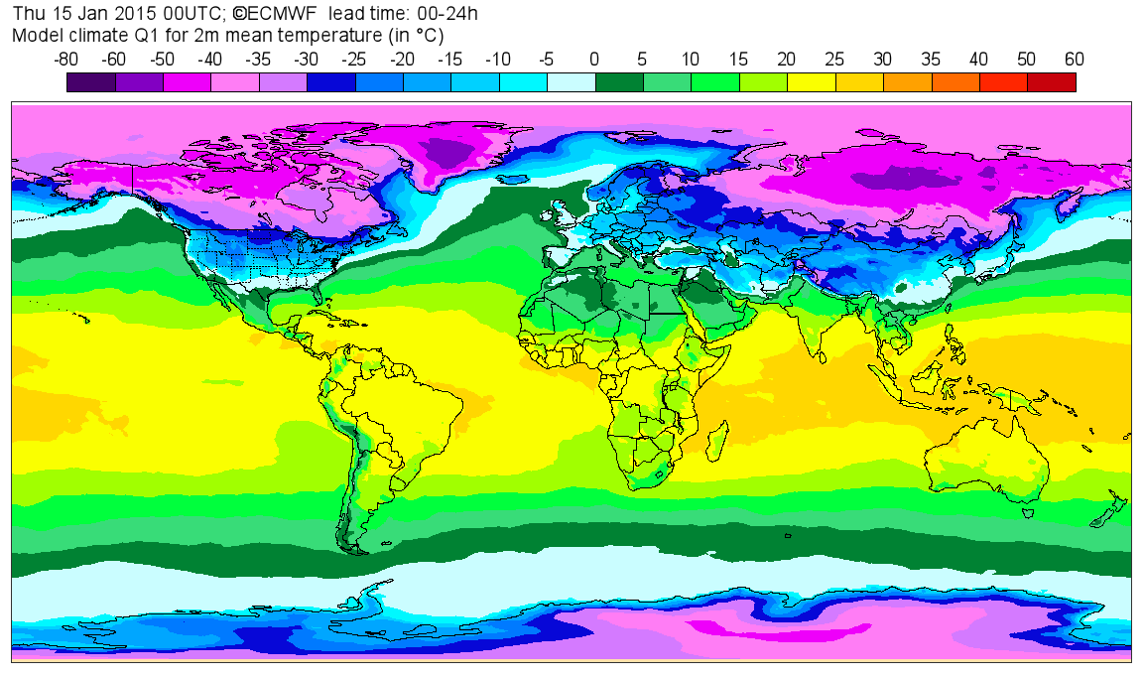
Model climate (M-climate)
To provide a robust, less noisy M-Climate, we do not use just one set of re-forecasts, but all nine sets centred on the week in question.
M-climate sample size is: 20 years * 11 ensemble members * 9 re-forecast runs = 1980 re-forecast fields (were 500)
As the M-climate consists of 1980 realisations, the M-climate extreme values correspond, approximately, to 66-year return period for month-long time windows (was 16-year return period).
Recent changes lead to:
Decrease of the noise in the tails of the M-climate distribution and considerable increase of the consistency of SOT forecasts;
Decrease of the jumpiness due to the seasonal trend.

Slide 8
Extreme Forecast Index (EFI)
The EFI is defined on the basis of the Cumulative Distribution Functions (CDF). The abnormality level in the ensemble is determined based on the position and shape of the distributions.
12 0 9 7 13 11…
0 7 9 11 12 13…
1 2 3 4 5 6…
model climate
CDF
ENS
PDF
1
1
Probability
of not
exceeding
Threshold
=RANK of
data
Density
per
threshold
Interval
(normalised)
6
5
4
3
2
0
0
1
-10
-5
0
5
10
15
20
25
-10
-5
0
5
10
15
20
25
parameter value
parameter value

Slide 9
How do CDFs and PDFs relate?
CDF
PDF (probability density function)
Prob (threshold)
Prob (interval)
Parameter value
Parameter value
The PDF (y-axis) value equals the slope of the CDF
Steeper CDF = narrower PDF = higher confidence in the forecast
A step in the CDF means a bimodal PDF

Slide 10
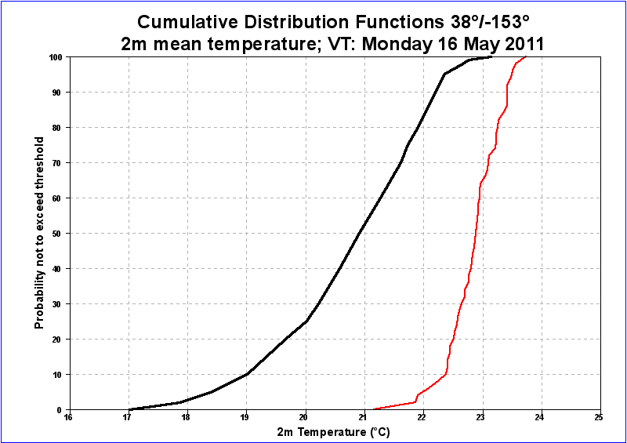
Represented by pink lines below
More weight to extremes of M-climate
EFI takes no direct account of any ENS members beyond the M-climate extremes
EFI = 78%
M-climate
ENS
p
-1 ≤ EFI ≤ 1
-100% ≤ EFI ≤ 100%

Slide 11
How ‘should’ CDFs behave in successive ENS runs?
M-climate
rank
Successive
ENS runs
value
At long lead times forecast CDF may be similar to the M-climate.
Lateral variations in CDF position between successive runs should, mostly, become less (with time).
CDF will tend to become steeper (with time), implying higher confidence.

Slide 12
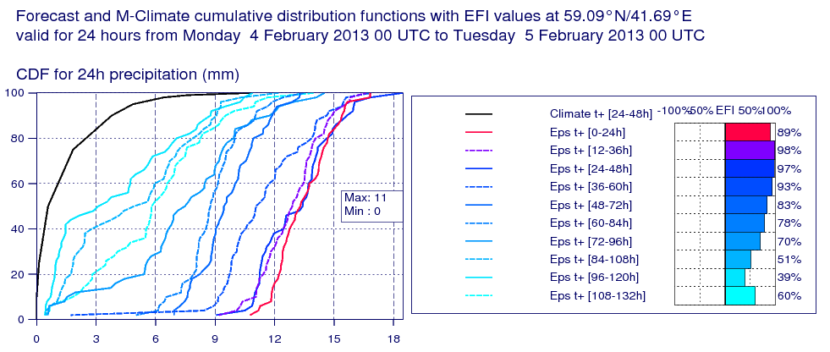
An example
The 16-year return period value of 24h precipitation for ~February is 11 mm (M-climate).
~ 95% probability of >11mm (blue line; t+24-48h)
Steeper CDF slope on more recent forecasts signifies increasing confidence

Slide 13
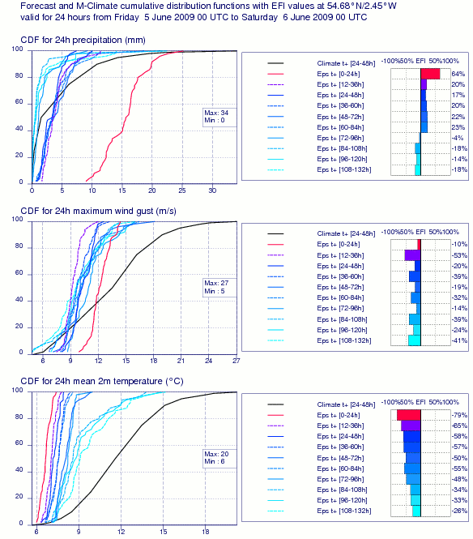
Counter example
N England rain – June’09 - low prob alternative became likely at short range.

Slide 14
Some limitations
Extreme does not necessarily mean high impact (eg 2mm rain in the desert)
Past history also important but not directly accounted for (eg heavy rain when ground saturated)
Windstorm impact can depend on whether trees are in leaf, whether ground is saturated…
Products are only as good as the model output, e.g.:
Tropical cyclone representation is limited by resolution
Threat from intense, very localised convection unlikely to be fully captured

Slide 15
Shift Of Tails (SOT)
M-climate
ENS
EFI = 1
EFI = 1
As EFI does not take direct account for members which are beyond the M-climate, once EFI reaches its maximum value of 1 or minimum value of -1, it does not provide further information about the magnitude of extremity.
Shift Of Tails (SOT) has been provided since 19 June 2012 to complement EFI by providing information about how extreme an extreme event might be.

Slide 16
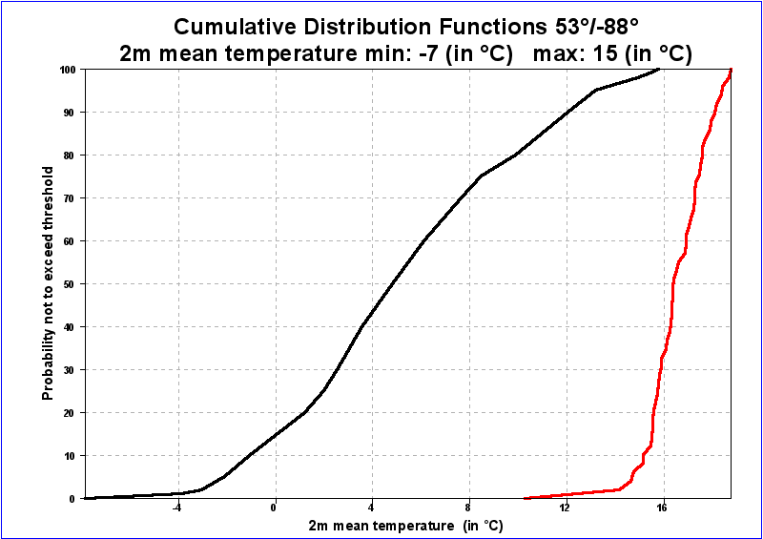
Shift Of Tails (SOT)
Qc(99)
SOT = A/B
A = Qf(90) - Qc(99)
B = Qc(99) - Qc(90)
B
A
M-Climate
ENS
SOT compares the tails of both distributions M-climate and ENS.
SOT is based on 90th (upper tail) and 10th (lower tail for temperature only) M-climate percentiles
SOT > 0 → extreme event is likely

Slide 17
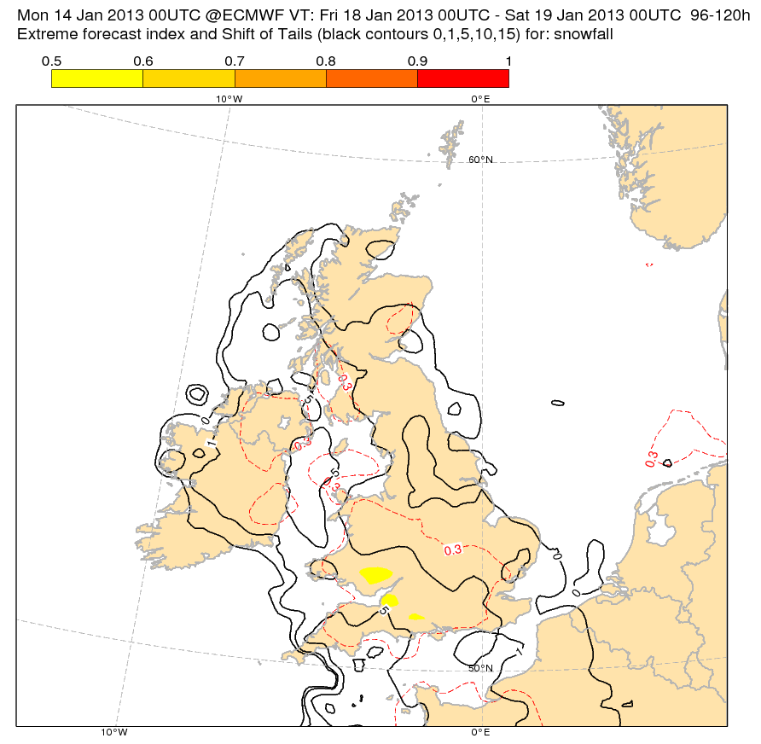
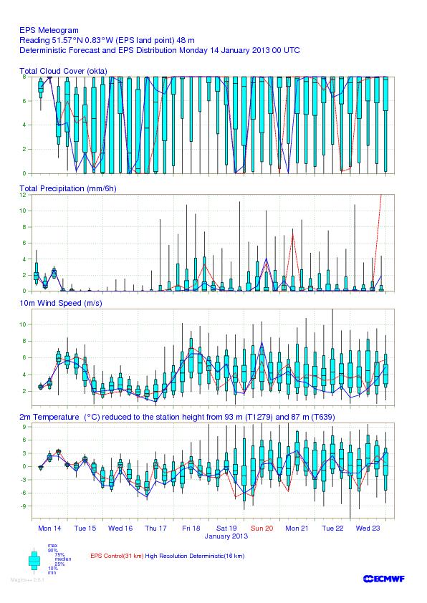
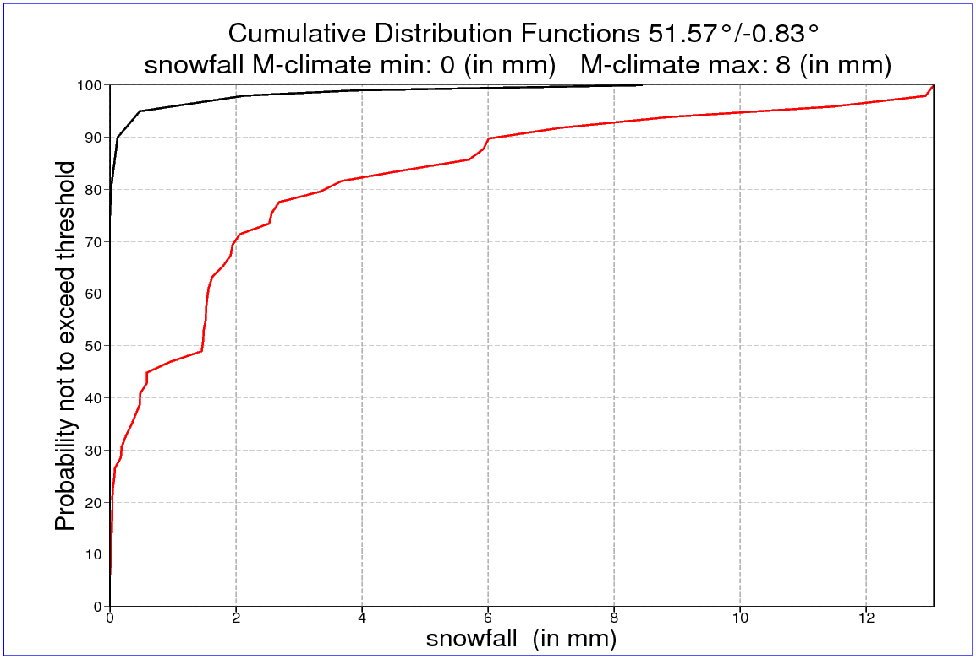
Valid for 18/01/2013
EFI&SOT; T+96-120
SOT > 0 → at least 10% of the ensemble members are above the 99th percentile M-climate
The higher the SOT value is, the further this top 10% of the ensemble forecast is beyond Q99 of the M-climate.
In the example (Reading):
EFI = 0.36
SOT = 0.8
EFI positive → forecast suggests snowy conditions
SOT >0 → there are ENS members predicting extreme snowfall (above the 99th M-climate percentile) but the forecast is still uncertain (low EFI)
B
A
M-climate
ENS
SOT = A/B

Slide 18
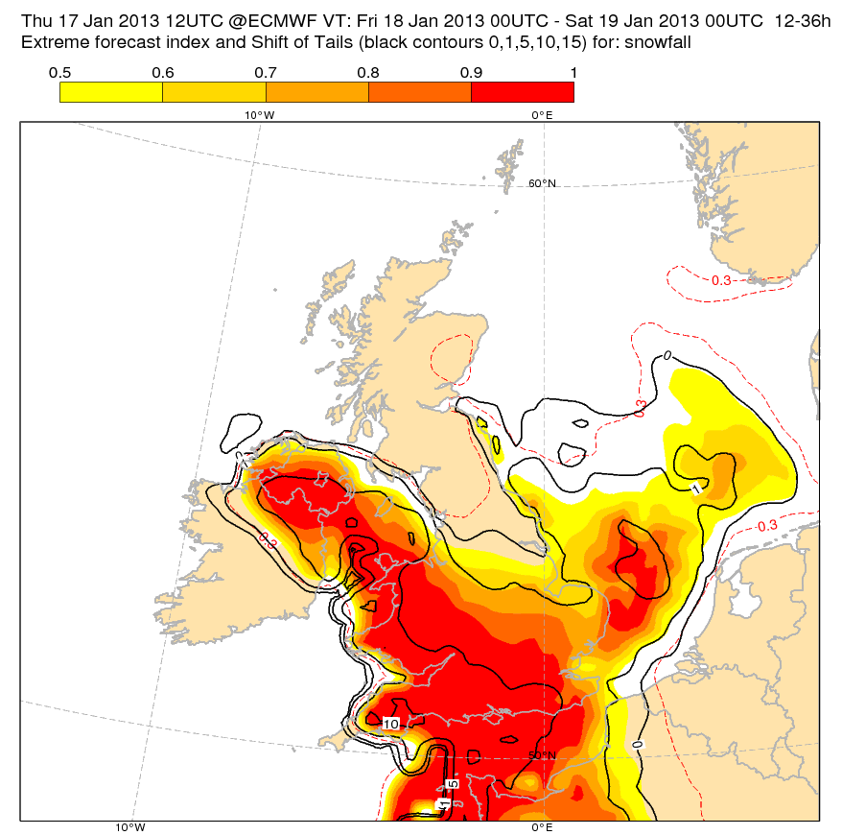
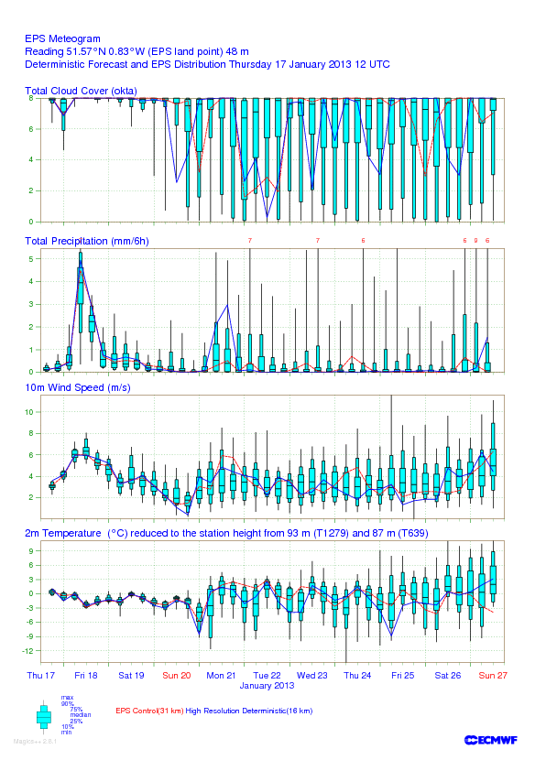
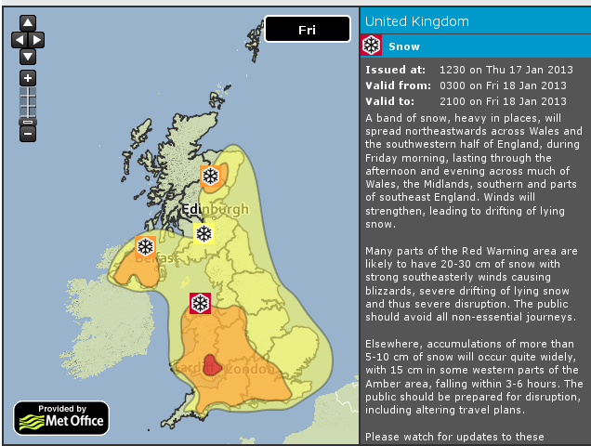
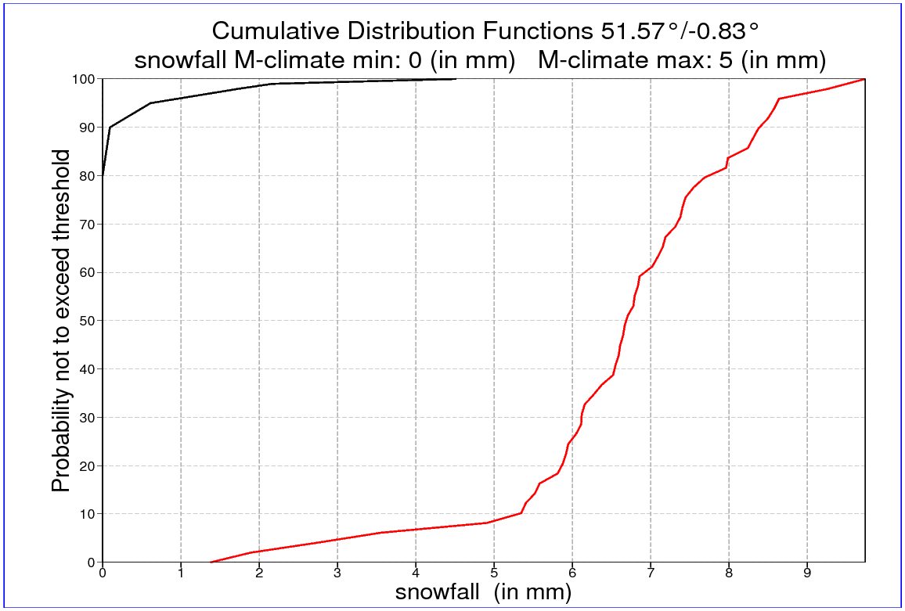
Valid for 18/01/2013
EFI&SOT; T+12-36
Forecast for Reading:
EFI = 0.96
SOT = 3.5
High values of the EFI imply high confidence that extreme snowfall may happen.
Higher SOT values indicate where the most exceptional snowfall amounts might occur (relative to climate).
B
A
M-climate
ENS
SOT = A/B

Slide 19
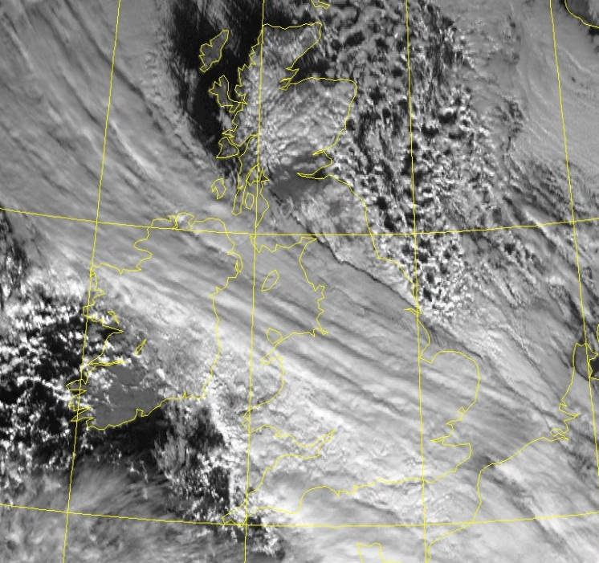
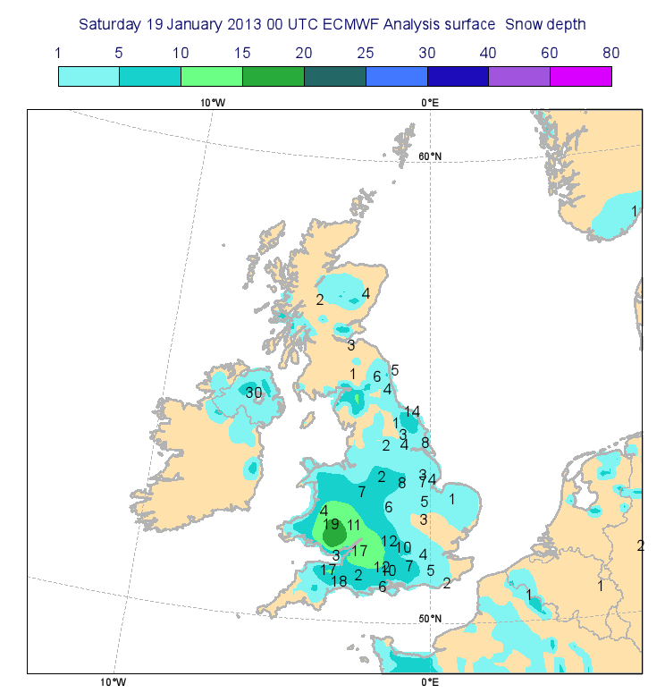
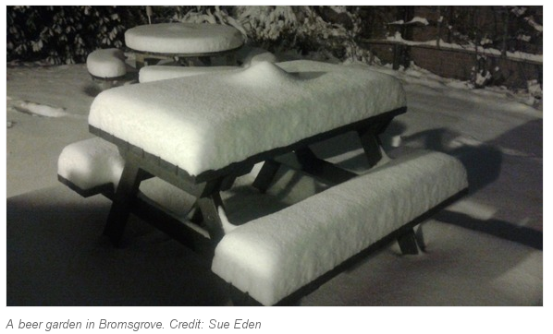
The outcome
18/01/2013 12UTC
ECMWF snow depth analysis and observations representing the new snow depth for 24-h period from 18/01/2013 00UTC to 19/01/2013 00UTC
Bromsgrove, near Birmingham, UK

Slide 20
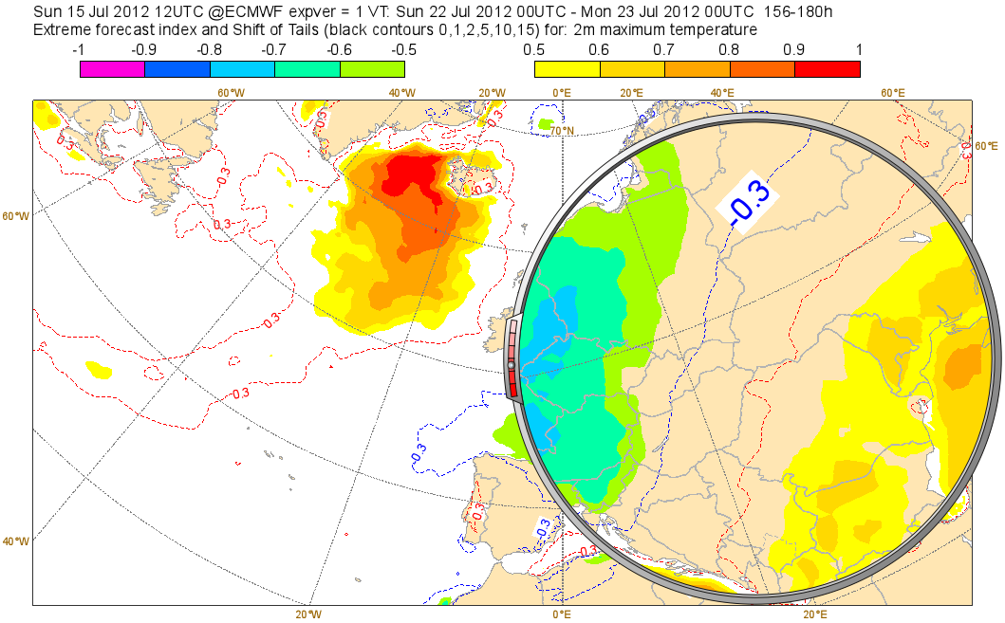
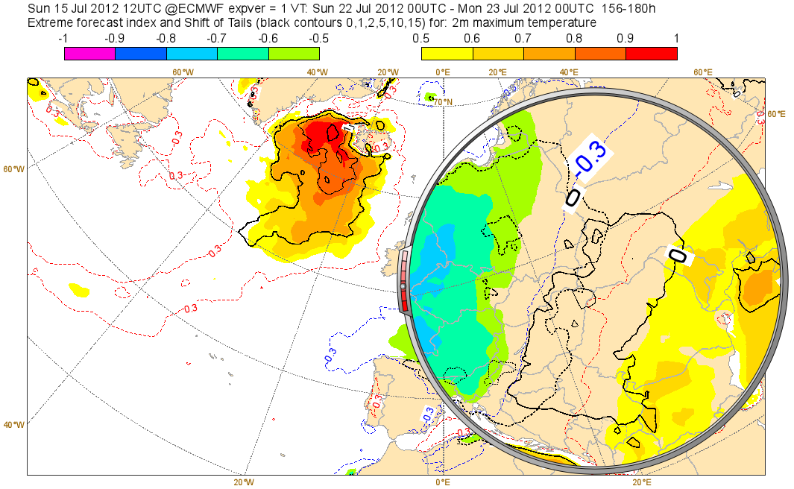
A case of large uncertainty
EFI forecast shows cold conditions over Central Europe and hot weather to the east over the Balkans.
SOT gives additional information. In the area between the cold and hot weather SOTs overlap. This is a signal of very uncertain forecast – over that area extremely low and extremely high temperatures are possible at the same time.

Slide 21
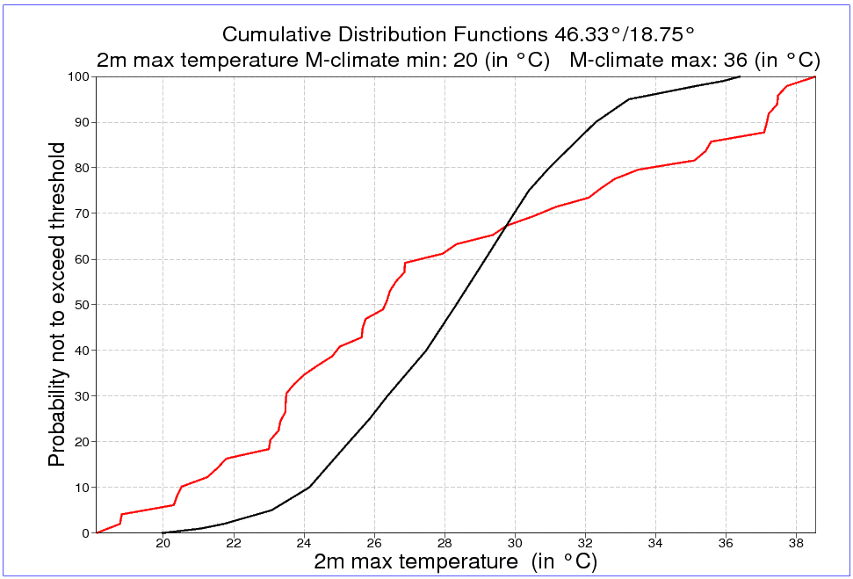
A case of large uncertainty
Some ENS members predict maximum temperature below the M-climate minimum, but some – above the M-climate maximum!

Slide 22
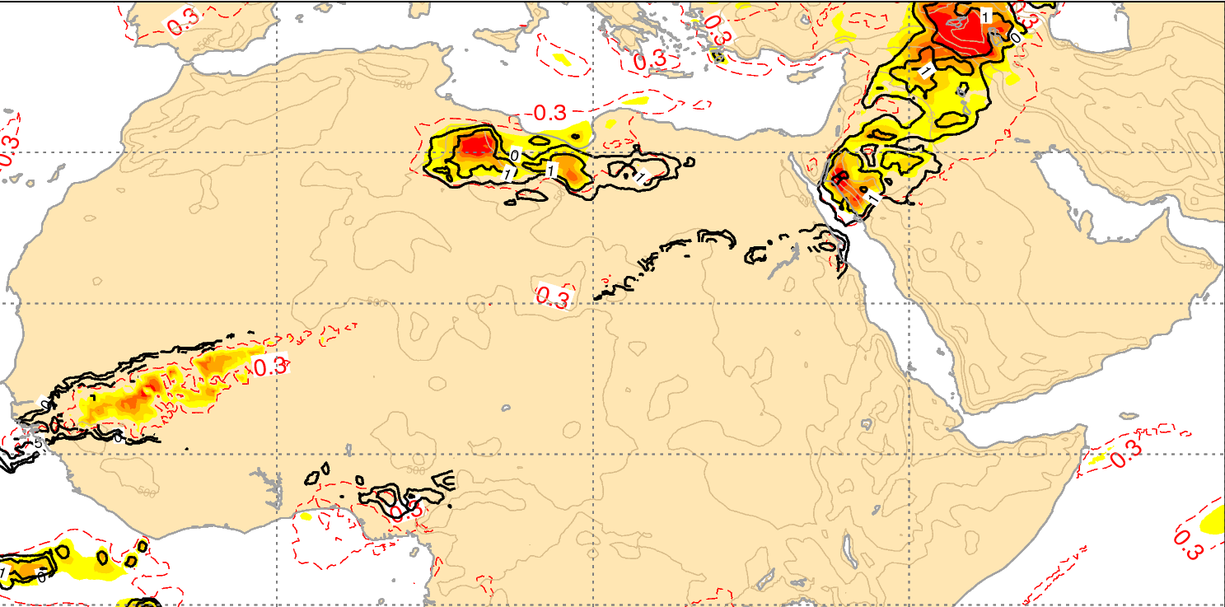
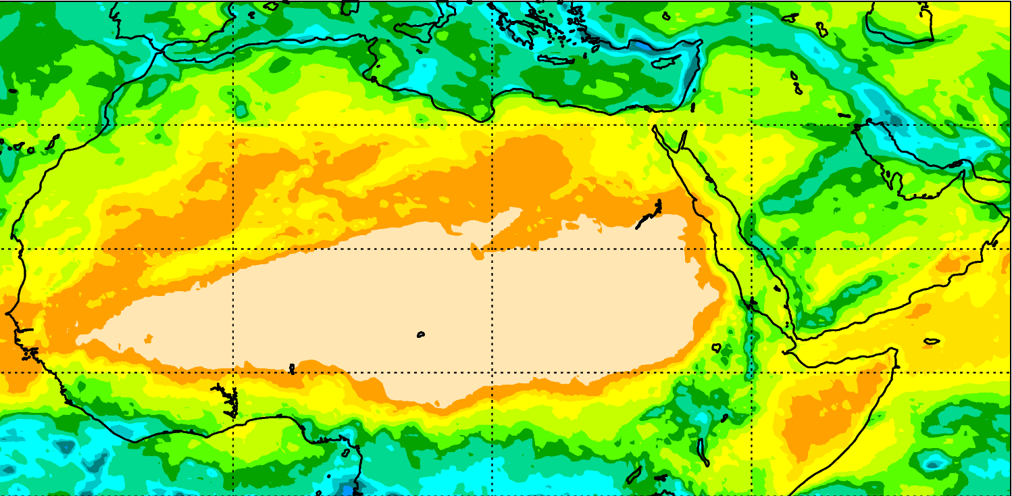
Some limitations
EFI &SOT for precipitation
M-climate Q99
SOT is not defined when M-climate Qc(90)= Qc(99) (division by 0). This leads to some noise on plots. To avoid this and to close SOT contours for snowfall, SOT is arbitrarily set to -1 where not defined only for plotting purposes.

Slide 23
Operationally available EFI fields
In the current operational system every EFI field is based on a forecast range of 24 hours or longer.
Since each meteorological parameter is valid for a period the content is either an accumulated value (e.g. precipitation), a mean over a period (e.g. temperature or mean wind) or an extremum (maximum or minimum) over that period (e.g. wind gust).
Each 24-hour period variable is worked out as a post-processed value based on four 6-hourly forecast time steps. E.g. a mean over a 00-00 UTC period is a mean of the 06-12-18 and the ending 00 UTC fields.
Importantly, for wind gusts, the 6 hourly wind gust values used are maxima within the preceding 6 hours (diagnosed by interrogating the model run at every time step).

Slide 24
Operationally available EFI fields
EFI and SOT parameters:
2-metre mean temperature index (2ti)
total precipitation index (tpi)
10-metre mean wind speed index (10wsi)
10-metre maximum wind gusts index (10fgi)
2-metre minimum temperature index (mn2ti)
2-metre maximum temperature index (mx2ti)
total snowfall index (sfi)
maximum significant wave height index (maxswhi)
CAPE (capei)
capeshear (capesi)
* Parameters in red available since 19th June 2012
* Parameters in blue available since summer 2015

Slide 25
Operationally available EFI fields
24h interval: parameters 2ti, tpi, 10swi, 10fgi, mn2ti, mx2ti, sfi, maxswhi
00 UTC: 00-24, 24-48, 48-72, 72-96, 96-120, 120-144, 144-168*
12 UTC: 12-36, 36-60, 60-84, 84-108, 108-132, 132-156, 156-180
72h interval: parameters 2ti, tpi, 10swi
00 UTC: 00-72, 24-96, 48-120, 72-144, 96-168, 120-192, 144-216
12 UTC: 12-84, 36-108, 60-132, 84-156, 108-180, 132-204, 156-228
120h interval: parameters 2ti, tpi, 10swi
00UTC: 00-120, 24-144, 48-168, 72-192, 96-216, 240-360**
12UTC: 12-132, 36-156, 60-180, 84-204, 108-228 , 240-360
240h interval: parameters 2ti, tpi, 10swi
00UTC: 000-240
12UTC: 000-240
360h interval: parameters 2ti, tpi, 10swi
00UTC: 000-360
* available since 19th June 2012
** available since 12th May 2015

Slide 26
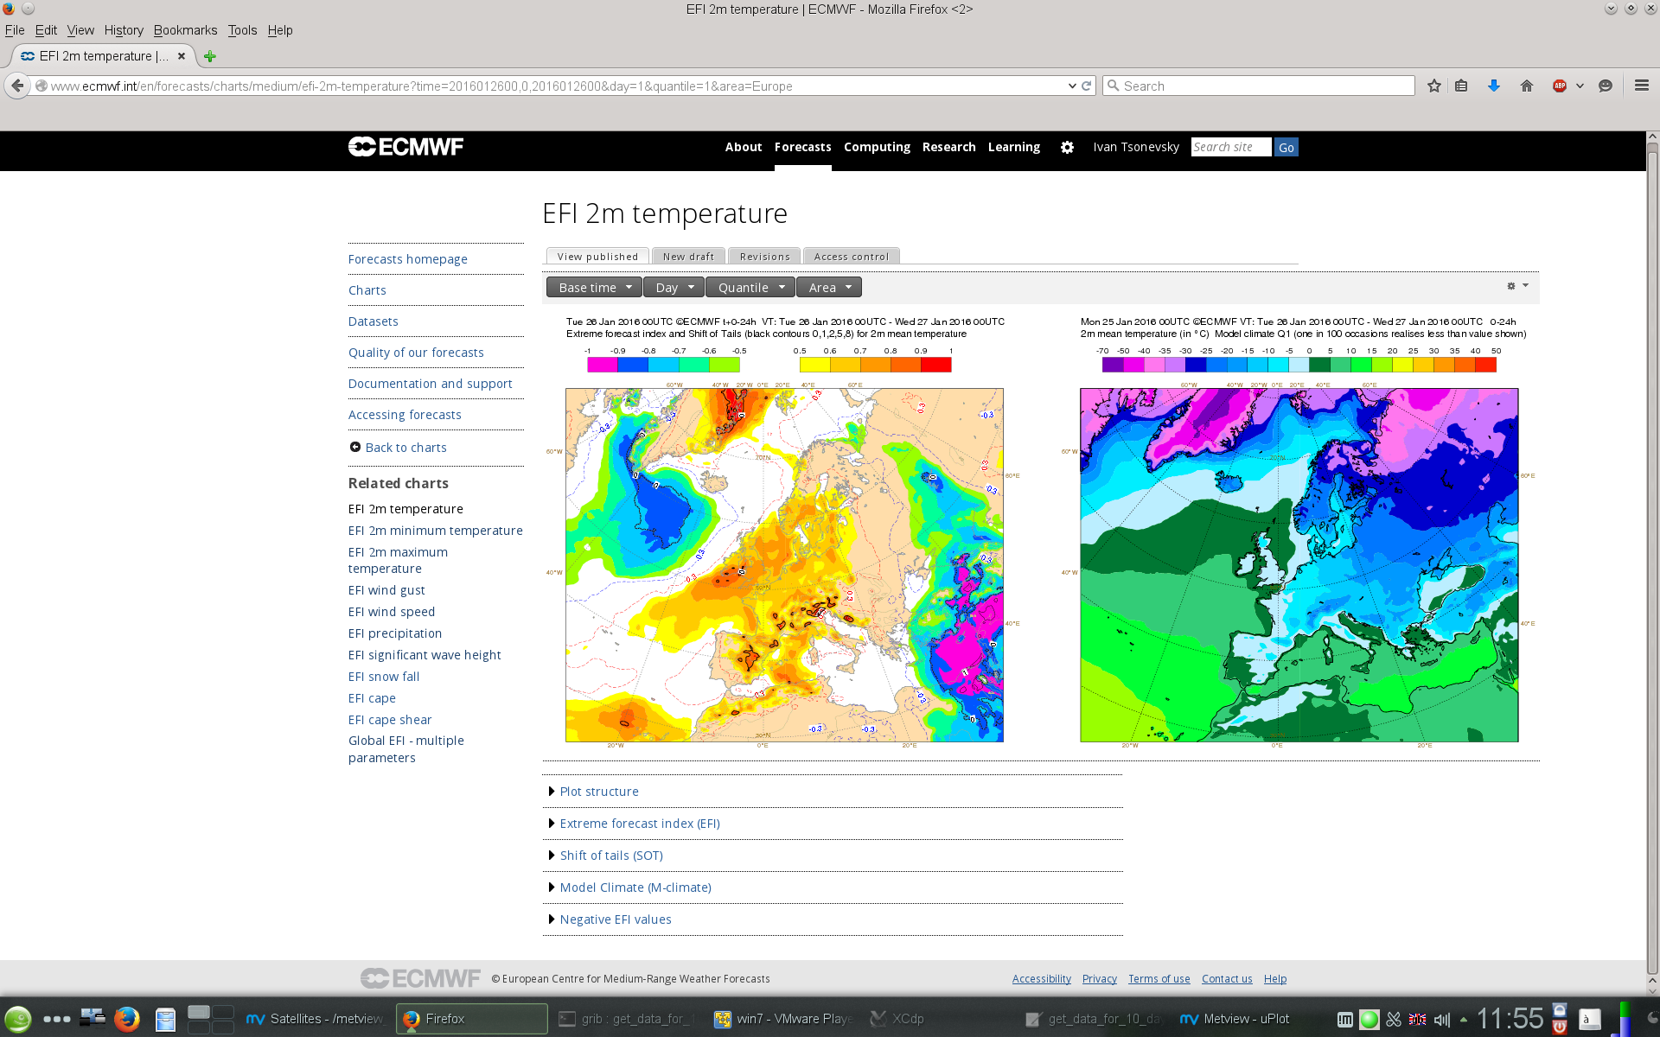
http://www.ecmwf.int/en/forecasts/charts/catalogue/efi

Slide 27
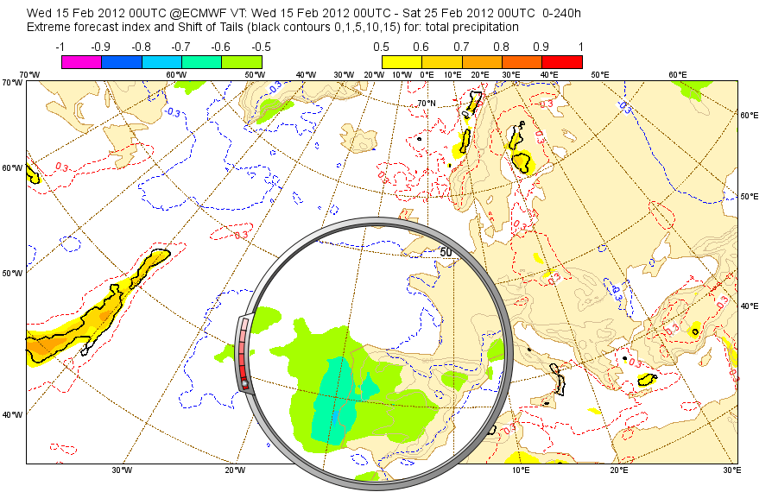
Negative EFI for precipitation
Severe drought in Portugal
For 24-hour accumulations negative EFI for precipitation does not make sense because precipitation is bounded by 0.
For accumulations over longer periods negative EFI does make sense. It shows the risk of dry weather.

Slide 28
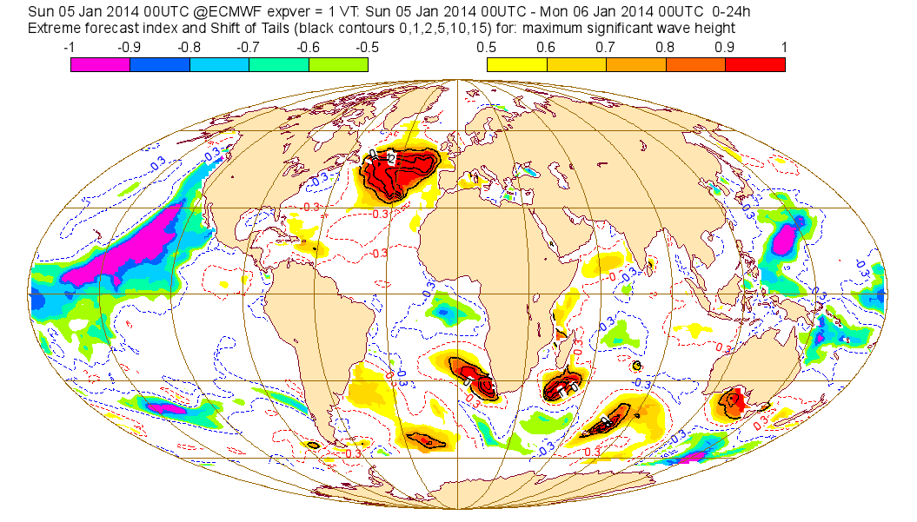
EFI for waves
Winter storm Hercules
Negative EFI (calm sea) also plotted on the web.
The winter storm Hercules generated waves up to 20 m in height on 5 and 6 January 2014.

Slide 29
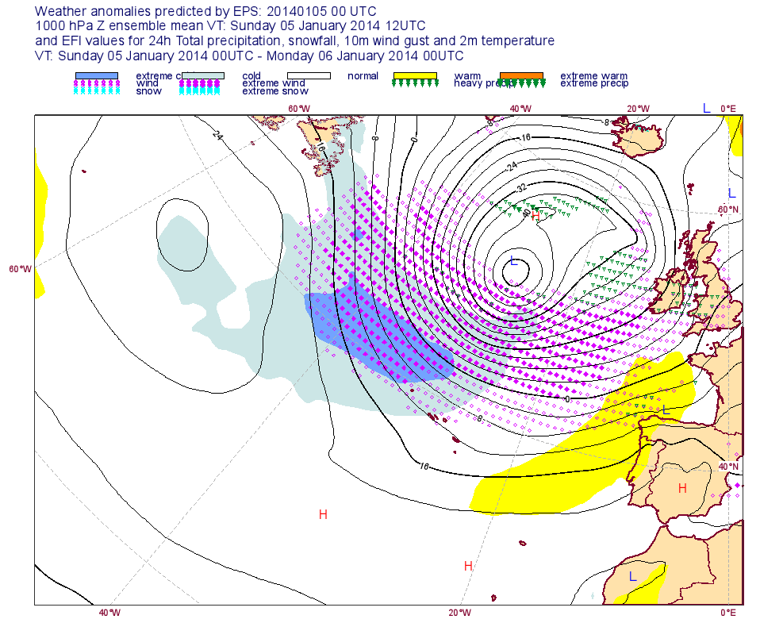
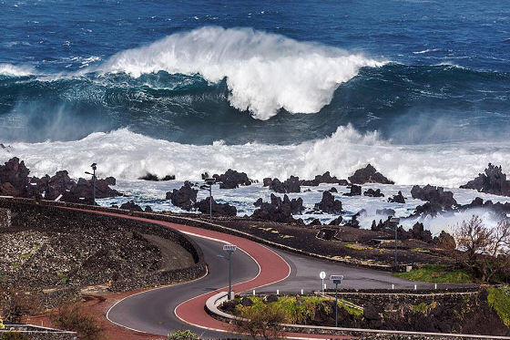
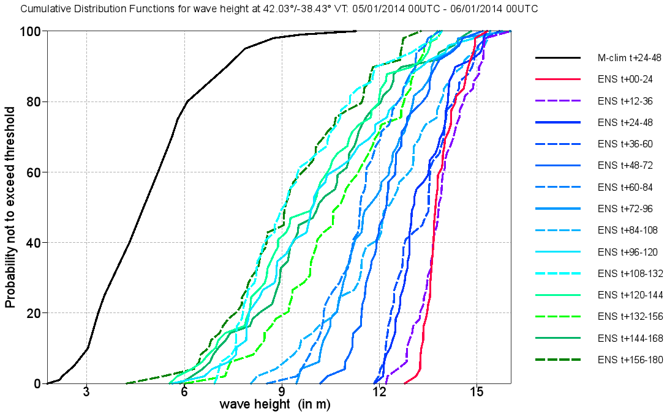
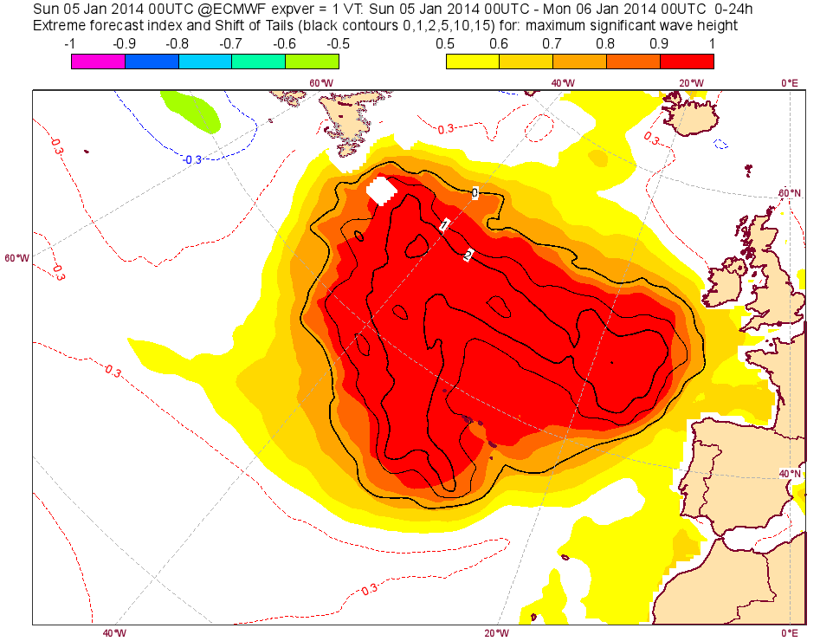
Historic swell – Storm Hercules
Winter storm Hercules
Azores
05/01/2014

Slide 30
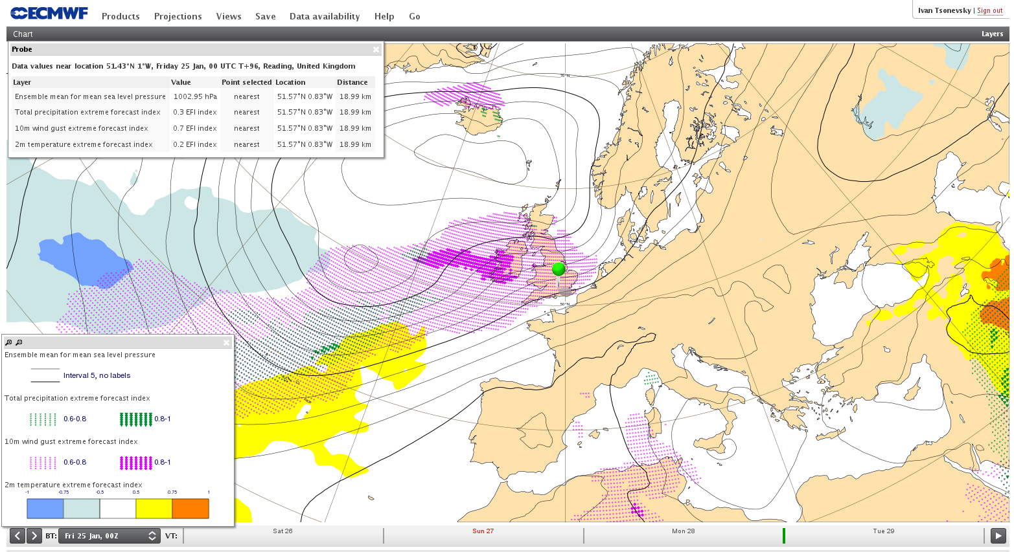
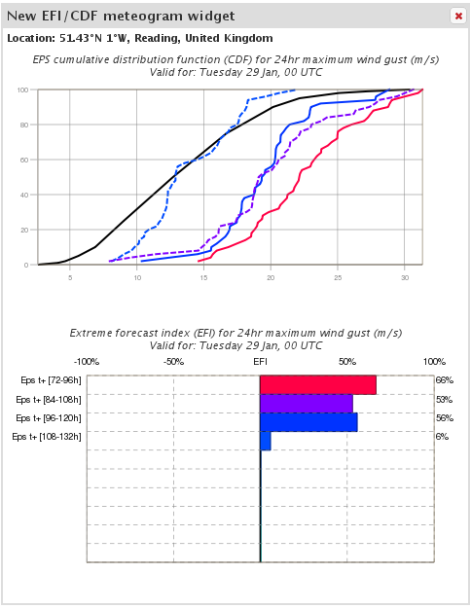
EFI on the ecCharts

Slide 31
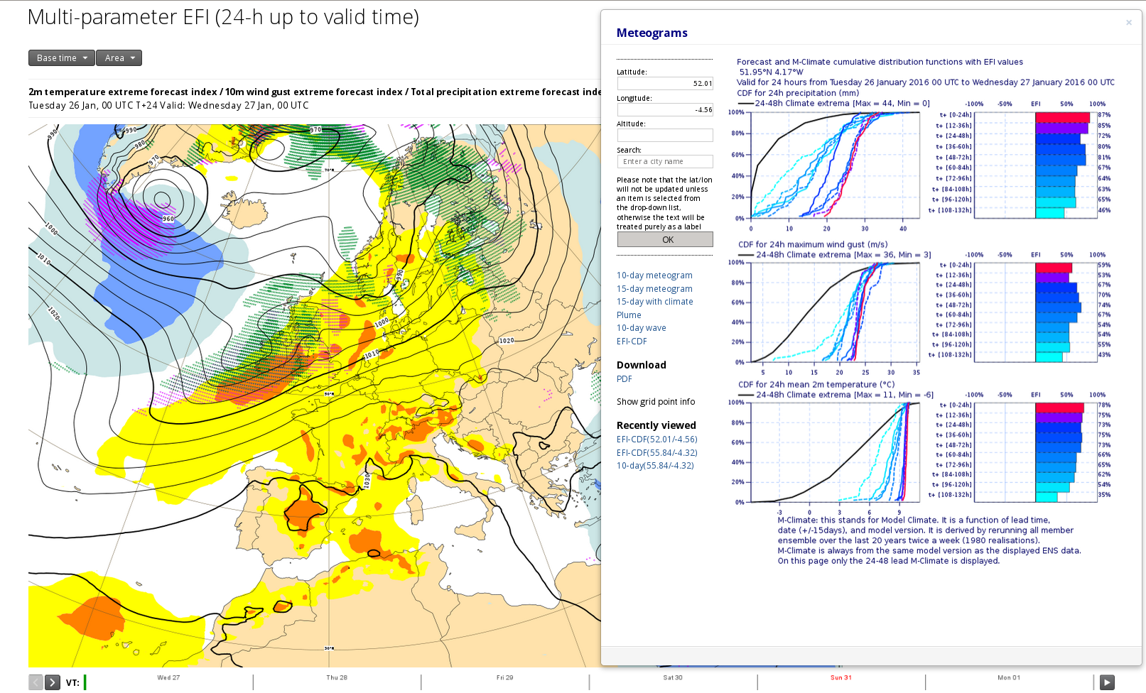
Clickable charts
http://www.ecmwf.int/en/forecasts/charts/interactive-charts
Click anywhere

Slide 32
EFI Verification
Verification of the EFI has been done using synoptic observations over Europe available on the GTS.
An extreme event is taken as occurring if the observation exceeds the 95th percentile of the observed climate for that station (calculated from a 15-year sample).
The ability of the EFI to detect extreme events is assessed using the area under the Relative Operating Characteristic (ROCA).
$EFI skill score=\frac{{score}_{forecast }−{score}_{reference}}{{score}_{perfect forecast }−{score}_{reference}}=\frac{{ROCA}_{f}−0.5}{1−0.5}=2{ROCA}_{f}−1$
0 →no skill, 1 → perfect score
The verification is done for 3 parameters: 2m mean temperature, 10m mean wind speed and total precipitation

Slide 33
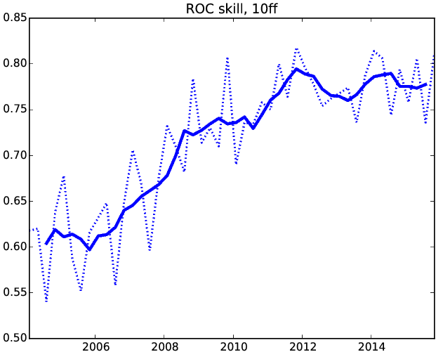
EFI Verification
EFI Skill = 2*ROCA-1
EFI Skill = 0 no skill
EFI Skill = 1 perfect score
The plot shows the skill of the EFI for 10-metre wind speed (a supplementary headline score adopted by the ECMWF Council) at forecast day 4 (t+72-96h for 00UTC).
The solid curve shows a four-season running mean.

Slide 34
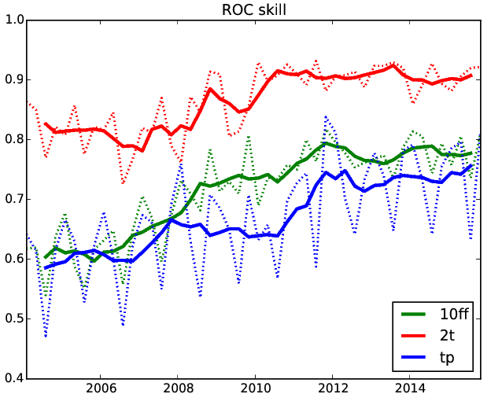
EFI Verification
Solid curves show a four-season running mean and dashed curves show seasonal EFI skill scores for 2m mean temperature (2t), 10 metre mean wind speed (10ff) and total precipitation (tp) for day 4 (t+72-96h for 00UTC).
The EFI for 2m temperature is more skilful than EFI for the other two parameters.

Slide 35
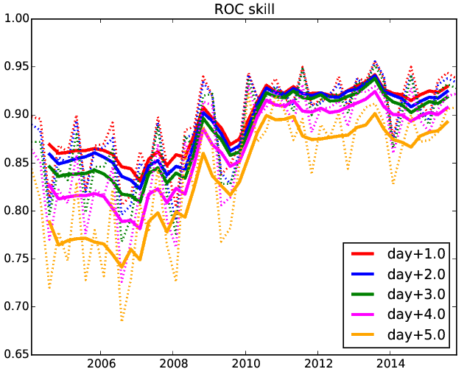
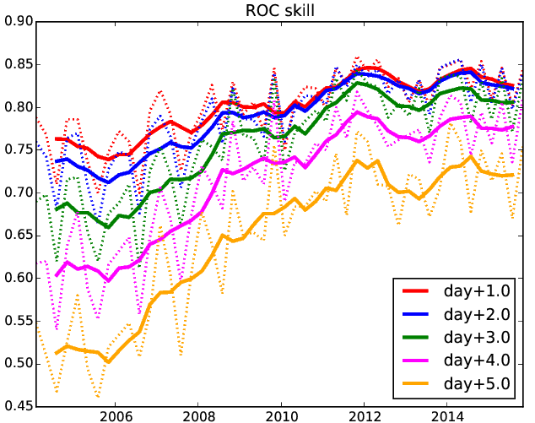
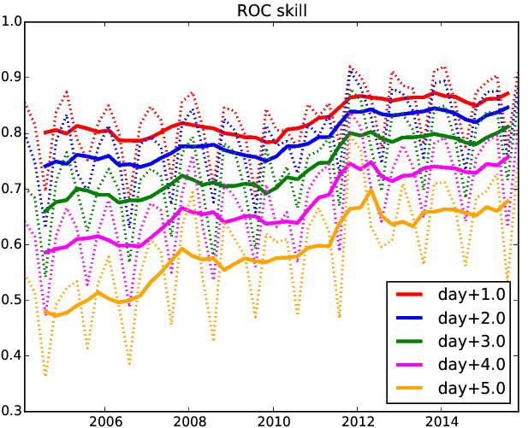
EFI Verification
2-metre mean temperature
10-metre mean wind
EFI skill as a function of the lead time
Total precipitation

Slide 36
Known issues
Re-forecast sample size is not sufficient for providing robust climate:
The increase of the sample size since May 2015 improved considerably the M-climate but still:
There is noise, especially in the tails of the climate distribution. This leads to jumpiness in the EFI and especially in the SOT.
M-climate is affected by model biases:
Jumpiness in the M-climate for different lead times
This does not affect the EFI/SOT

Slide 37
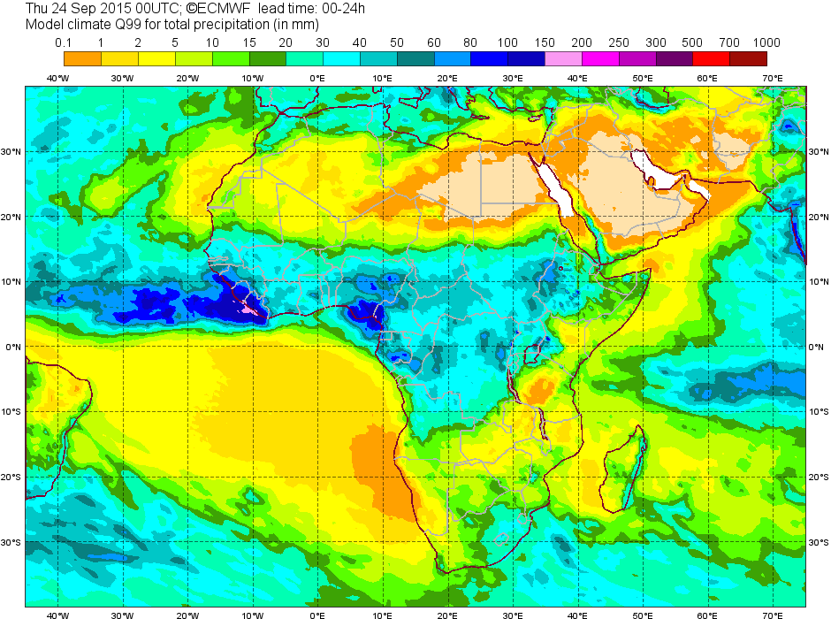
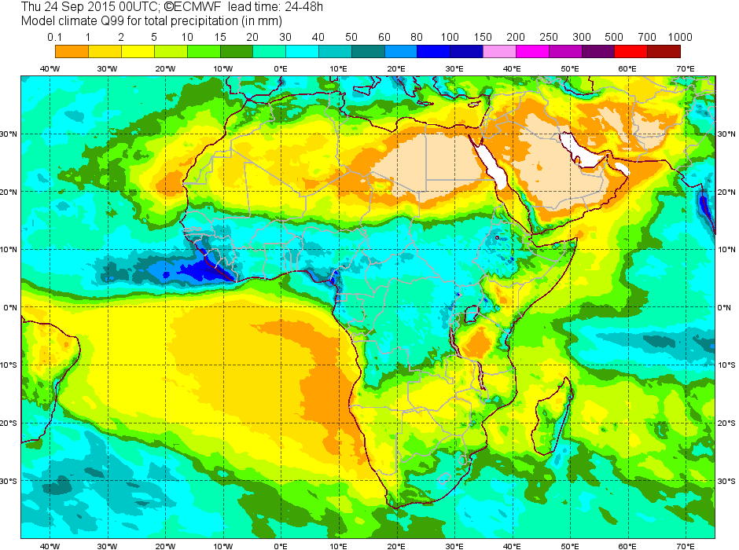
Known issues – an example, tropical Africa
T+0-24h
T+24-48h
The striking difference between t+00-24h and t+24-48h climate is noticeable on these charts which represent 99th model climate percentile. Precipitation amounts corresponding to Q99 for 00-24h are much bigger than those for 24-48h.

Slide 38
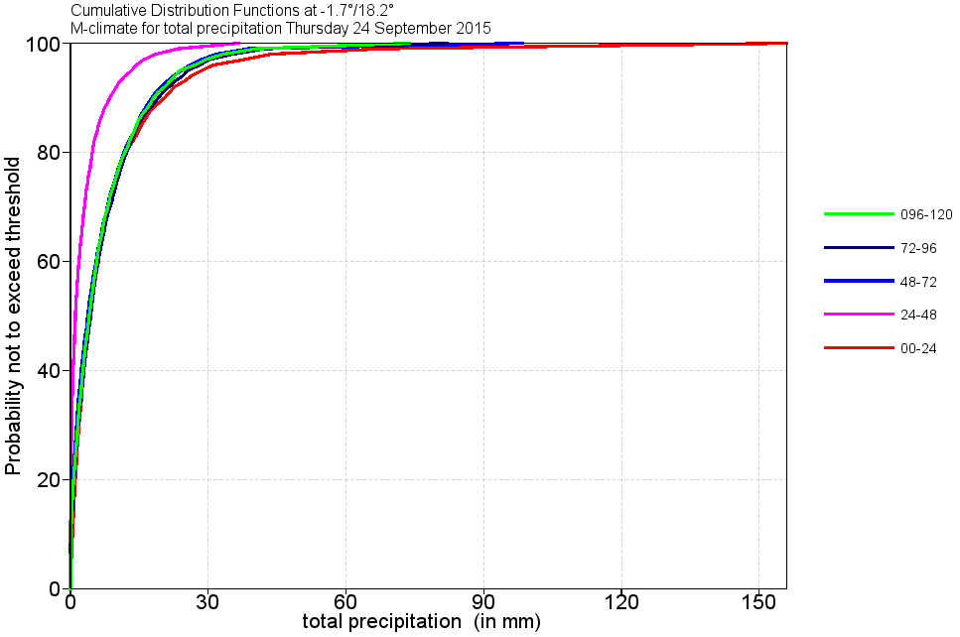
Known issues – an example, tropical Africa
Day 2 climate is much different from the rest
M-climate is not perfect. It is affected by model biases and therefore it depends on the lead time:
Jumpiness in the M-climate for different lead times
Ideally, this shouldn’t affect the EFI

Slide 39
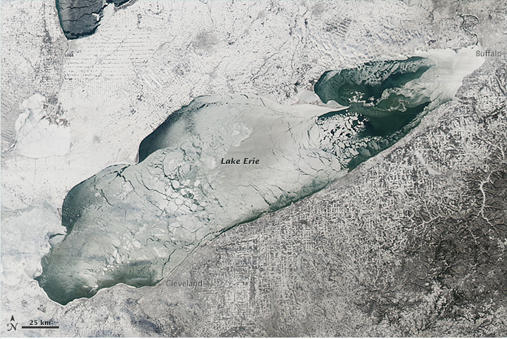
US cold snap January 2014
Great Lakes frozen

Slide 40
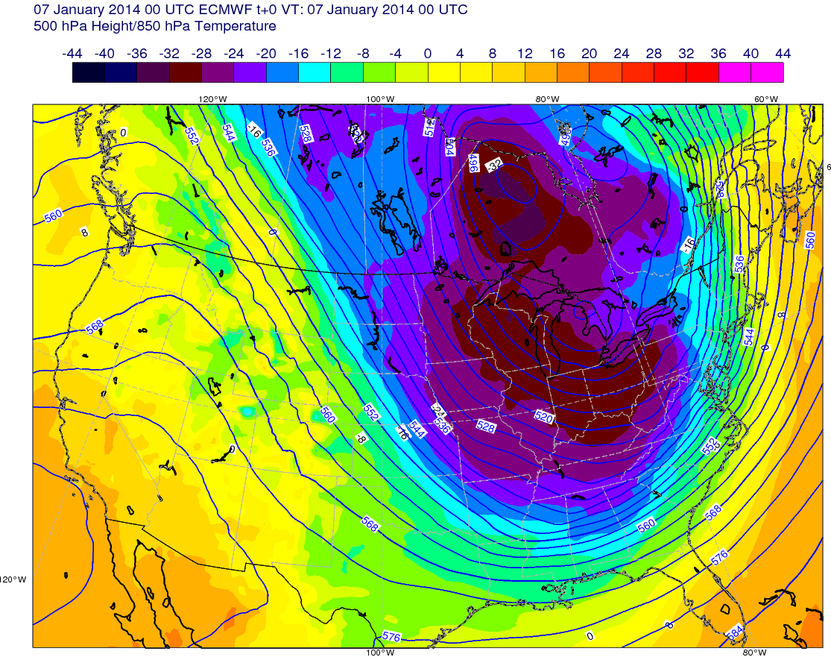
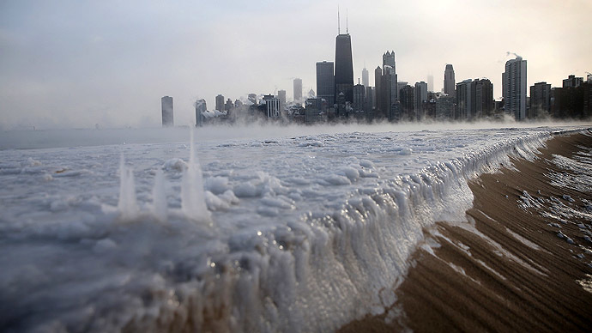
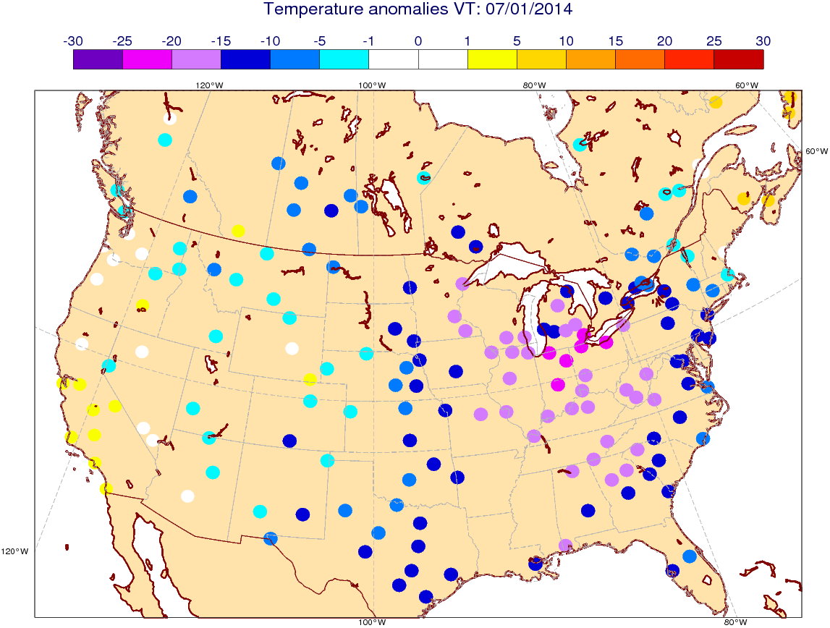
US cold snap, January 2014
Z500&T850 Analysis 07/01/2014
Chicago
An extremely cold airmass from the Arctic region dropped the temperatures in the US January 5-7, 2014.
Record freezing temperatures (15 to 22°C below normal) brought many cities to a standstill. Over a dozen deaths were attributed to the cold wave.
It was the coldest weather since early February 1996.
Temperature anomalies 07/01/2014

Slide 41
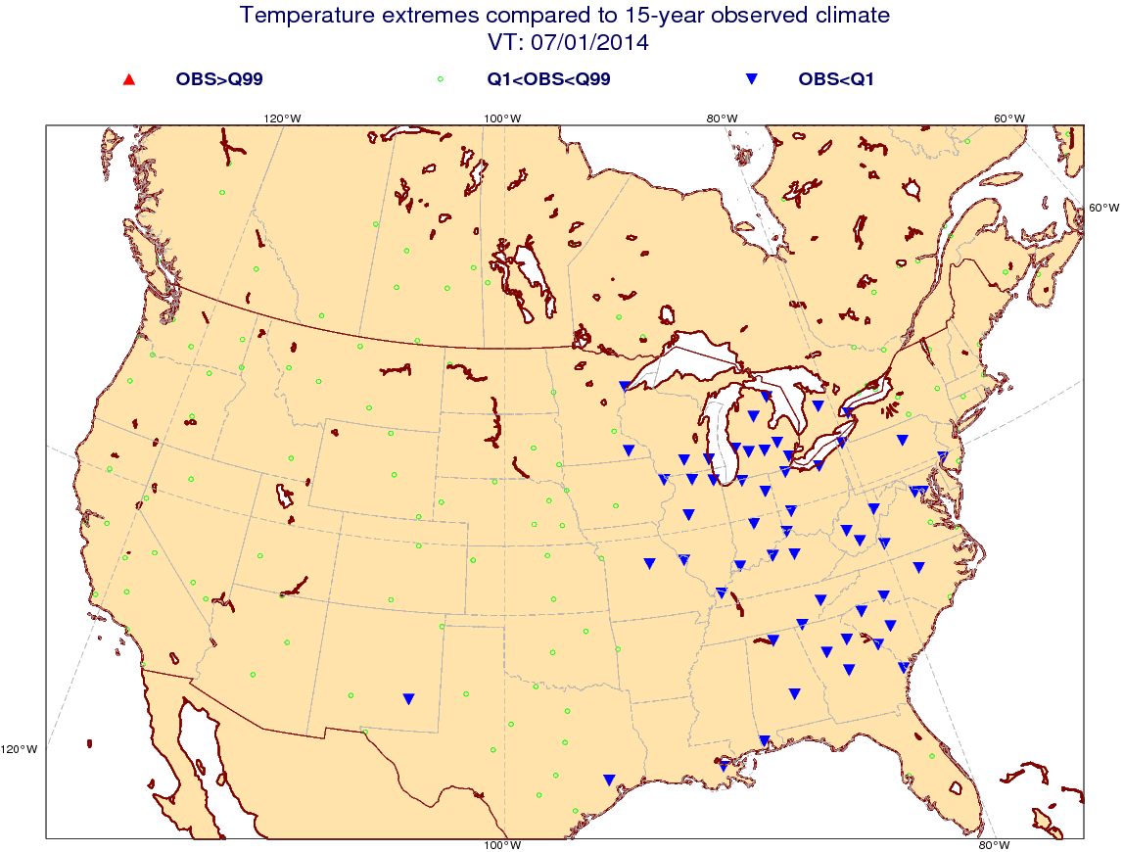
US cold snap, January 2014
T+144-168
Blue symbols denote extremely low temperatures below 1st percentile of the 15-year climatology from observations.
Positive SOT (black contours) and high negative EFI match very well the areas of extremely low temperatures even 7 days in advance.

Slide 42
US cold snap, January 2014
CDFs and EFI forecast for Chicago
All the forecast CDFs are closely packed.
Near vertical CDFs imply high confidence in the forecast.

Slide 43
Floods in Central Europe
June 2013

Slide 44
Analysis
Observed rainfall interpolated on a grid and Z700 (mean over the period) ECMWF analysis
VT: 31/05/2013 06 UTC – 03/06/2013 06UTC
INCA analysis
A quasi-stationary low pressure system brought moist, warm air from the east and northeast into Central Europe causing massive amounts of rain in southern Germany and western Austria.
Orographic enhancement of precipitation along the northern side Alps played an important role.

Slide 45
EFI & SOT, total precipitation, T+240-360
A remarkably strong signal in the EFI.
Positive SOT marks the areas where the forecast system predicts exceptionally heavy rain.

Slide 46
EFI/SOT for forecasting severe convection
Convective Available Potential Energy (CAPE) – MUCAPE in the lowest 350 hPa:
$$CAPE=\int_{z_{LFC}}^{Z_{EL}}{g\left(\frac{θ_{e,up}−{\overline{θ}}_{e,sat}}{{\overline{θ}}_{e,sat}}\right)}dz$$
CAPE-SHEAR Parameter (CSP):
$$CSP={WS}_{l_{1}}^{l_{2}}\sqrt{CAPE}$$
${WS}_{l_{1}}^{l_{2}}$ - wind shear between l₁=925 hPa and l₂=500 hPa;
$w_{max}=\sqrt{2CAPE}$ is the maximum vertical velocity in convective updraughts.
Four values for each 24-hour period are considered and the maximum of these is retained.
To avoid noise in the high latitudes, CAPE less than 10 J/kg is filtered out.

Slide 47
Severe convection, 9 June 2014
SYNOP & ESSL
Severe convection affected Western Europe on 9 June 2014.
Deep moist convection developed along the western fringe of a hot air mass.
Many weather reports of severe wind gusts and large hail.

Slide 48
Severe convection, 9 June 2014
Strong wind gusts were reported in France, Belgium, the Netherland and Germany.
The maximum wind gust at Düsseldorf airport was 42 m/s.
The EFI gave no indication of severe wind gusts even in the short range.
The EFI for CAPESHEAR reached values close to 1 six days in advance.
EFI 10fg T+0-24h
EFI CAPESHEAR T+120-144h

Slide 49
Some considerations
The EFI provides signals of anomalous weather relative to the model climatology.
very low CAPE values (<10 J/kg) are filtered out to avoid insignificant signals in the areas of low CAPE values in the M-climate (e.g. Arctic in winter)
Both convective EFIs give guidance where convection is likely to be severe if it initiates. CIN is not considered.
FC T+72-96h valid for 30 Aug 2015
EFI CAPESHEAR
EFI CAPE

Slide 50
FC T+72-96h valid for 30 Aug 2015
EFI CAPESHEAR
EFI CAPE
TP>1mm/24h

Slide 51
FC v. OBS
EFI CAPESHEAR (Prob(TP>1mm) > 5%)
EFI CAPE (Prob(TP>1mm) > 5%)

Slide 52
A squall line along a cold front
27/11/15 19UTC
A stripy structure due to:
a fast moving front
6-houly discretization in the fields from which the EFI is calculated

Slide 53
Web charts

Slide 54
EFI in the extended range

Slide 55
St. Jude storm case
T+72-96
M-climateQ99
Probability of wind gusts to exceed 99th M-climate percentile, T+72-96
M-climate can be used to compute probabilities of exceeding/not exceeding certain M-climate percentiles.

Slide 56
Further Reading:
User Guide to ECMWF forecast products, http://old.ecmwf.int/products/forecasts/guide/user_guide.pdf
Tsonevsky, I., D., Richardson, 2012: Application of the new EFI products to a case of early snowfall in Central Europe, ECMWF Newsletter, No. 133, 4.
Tsonevsky, I., 2015: New EFI parameters for forecasting severe convection. ECMWF Newsletter, No. 144, 27-32.
http://www.ecmwf.int/sites/default/files/NL-144.pdf

