Slide 1
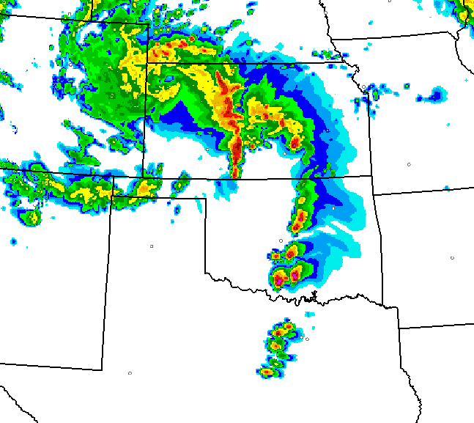
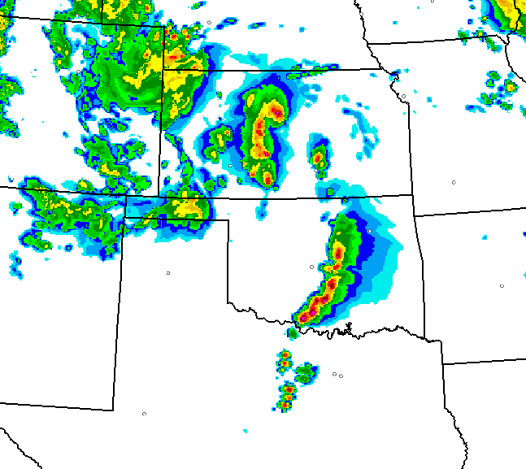
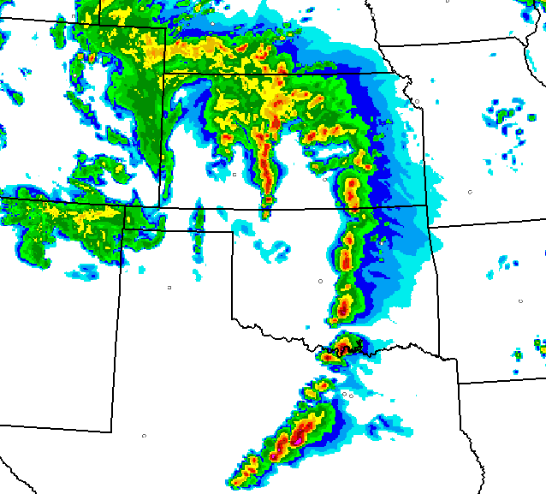
Probabilistic Hazard Prediction using a Time-Lagged Ensemble
Trevor Alcott
ESRL Global Systems Division, Boulder, CO
NCEP PSR – 8 Dec 2015

Slide 2
Time-Lagged HRRRx
2013 Colorado Flood
Composite Reflectivity (dBZ)
valid 02 UTC 12 Sep
01z
+0
+1
02z MRMS
00z
+0
+1
+2
23z
+0
+1
+2
+3

Slide 3
3-Member Time-Lagged Ensemble
with 2-hour Latency
Period
Begins
00 Z
Period
Ends
06 Z
00 Z Run (not ready)
23 Z Run (not ready)
22 Z (most recent available)
21 Z Run
20 Z Run

Slide 4
More spread
More members
Lower skill
Shorter lead time
More spread
More models
Useful spread?
Gives newest data the highest impact
Member weighting
>5 runs has little additional impact even at 100% weight

Slide 5
Model
Probability
Observations
Precipitation Amount

Slide 6
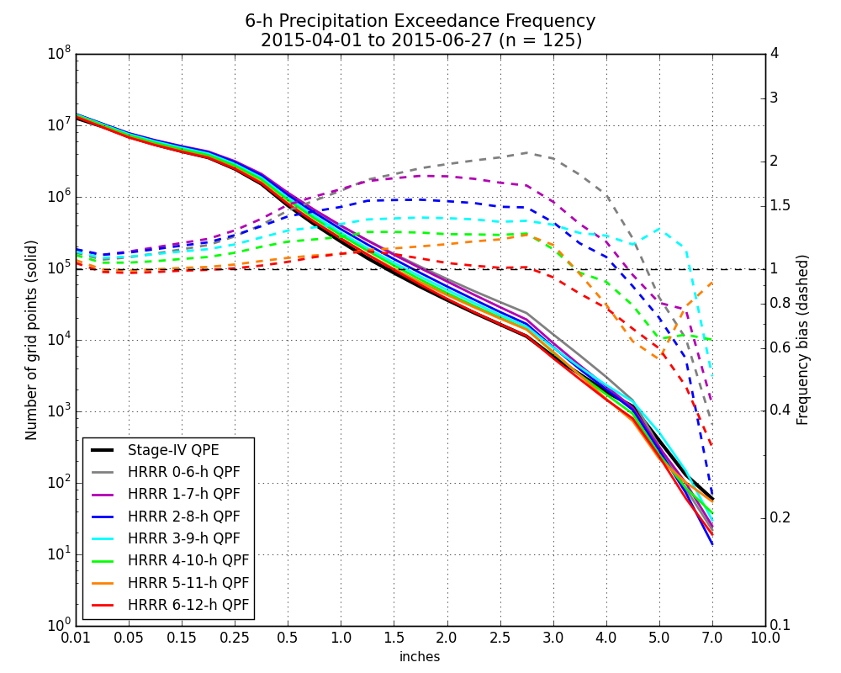
“Quantile Mapping”
Bias Correction
1.00” ≅ 99th %ile of analysis climatology
99th %ile of
model climatology
≅ 1.23”

Slide 7
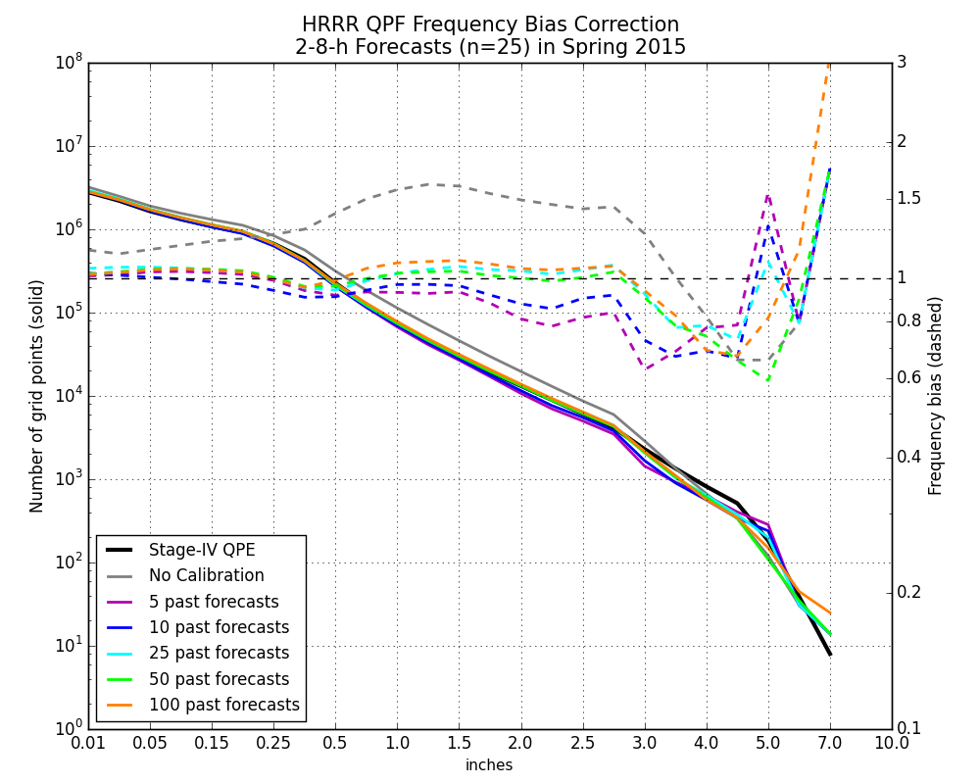
= 2 weeks
= 1 month
= 2 months

Slide 8
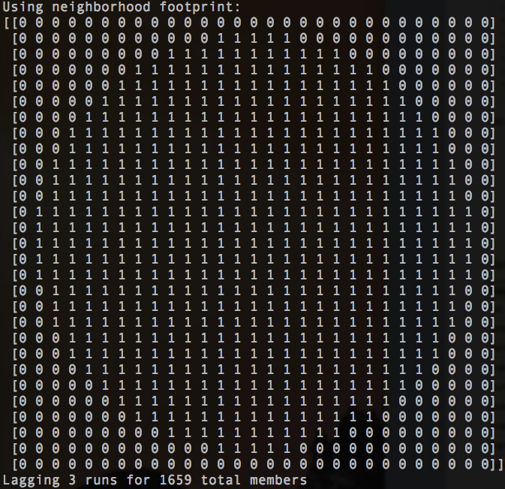
40 km ≅ 13-grid-point radius
553 points X 3 runs = 1659 ensemble “members”

Slide 9
Probability of 0.5” Precipitation in 6 hours
Ideal
Under- confident
Over- confident

Slide 10
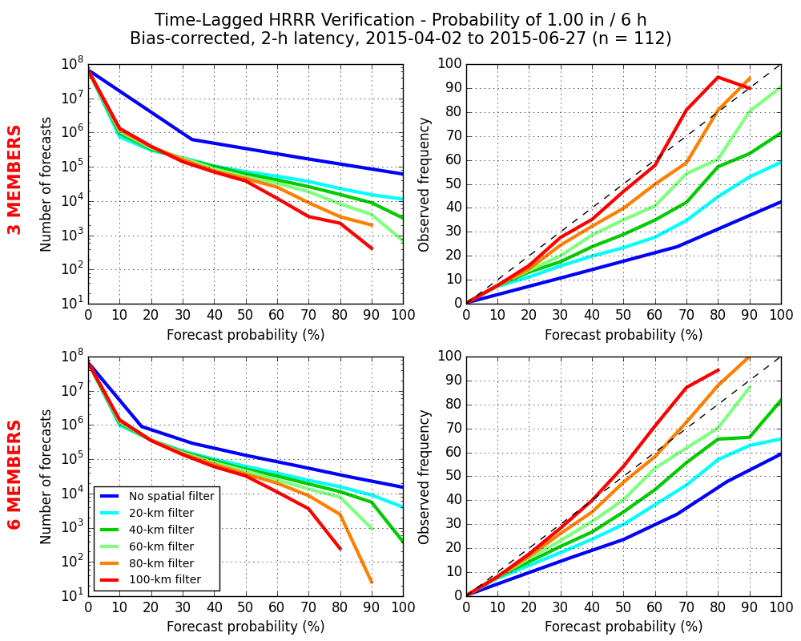
1.0”/6h in Spring
Underconfident
Overconfident
Underconfident
Overconfident

Slide 11
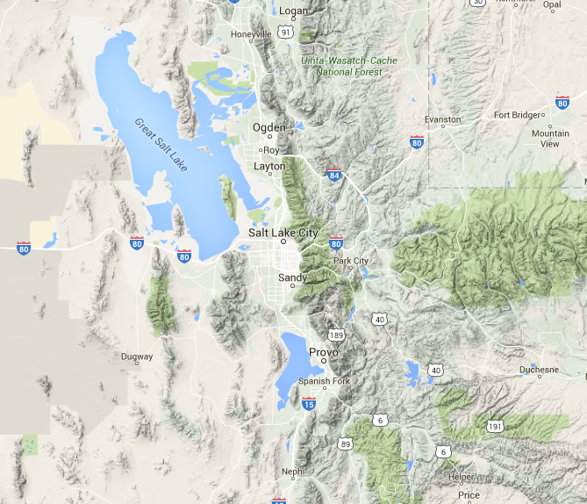
20z
Probability = 20 %
21z
22z
Probability = 20 %

Slide 12
20z
Probability = 5 %
21z
22z
Probability = 40 %

Slide 13
Complex Terrain Algorithm

Slide 14
Winter PQPF Reliability
“Flat” terrain
“Complex” terrain

Slide 18
Hazard | Proxy | Truth
Heavy rainfall | QPF | Stage-IV / MRMS
Snowfall rate | Microphysics-based | ASOS visibility
Precipitation type | Microphysics-based | ASOS type
Accum Snow | Microphysics-based | Point observations
Severe wind | 80-m hourly max wind or 10-m gust | Mesonet observations
Large hail | Column graupel, updraft speed, or ? | MESH
Tornado* | Updraft helicity | Processed MRMS rotation tracks
Visibility/Ceiling | Post-processed field in development | ASOS or future CIMSS technique

Slide 19
Proposed Timeline
Jan 2016: Initial PQPF and snowfall rate products
May 2016: Severe weather
Summer 2016: Flash flooding
Winter 2016-7: Expanded winter suite
Late 2017: Begin transition to permanent home on IDP, with dissemination to AWIPS via SBN, and D2D and GFE configured nationwide
Spring 2018: Transition complete, complete suite of products is operational

Slide 20
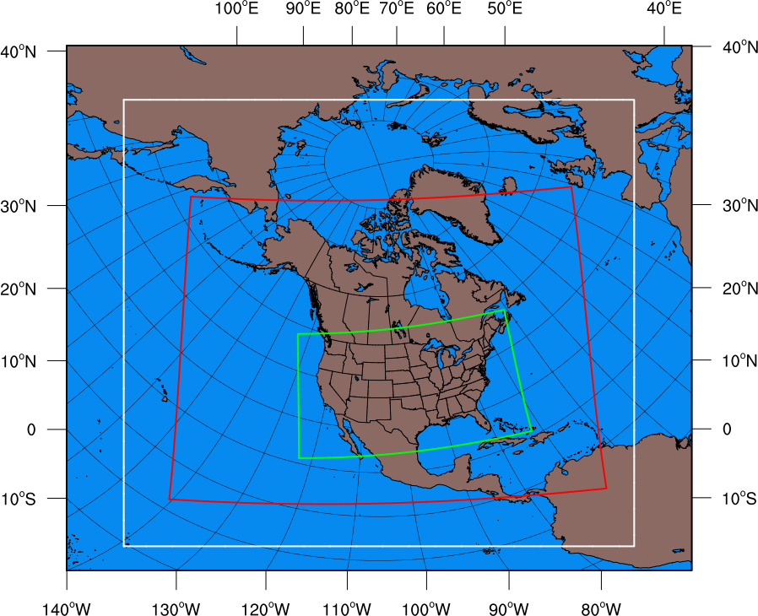
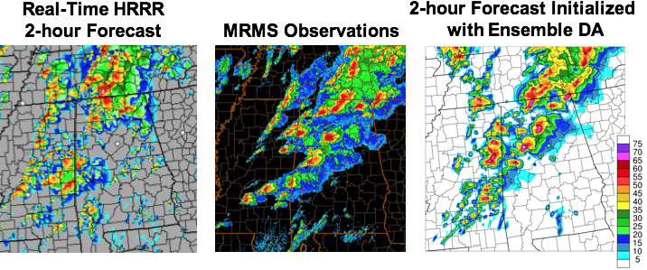
HRRR (and RAP) Future Milestones
HRRR Milestones
Possible HRRR storm-scale ensemble system
3km High-Resolution Rapid Refresh (HRRR)
Single core (ARW)
Ensemble DA
Stochastic physics
Assimilation Forecast
40 members 6 members
1 hr forecast 12 hr forecast
24 fcsts / day 24 fcsts / day
2 nodes / member 60 nodes / member
RAP v2 domain
RAP v3 expanded domain
More accurate
storm-details
from ensemble
data assimilation

