Slide 1
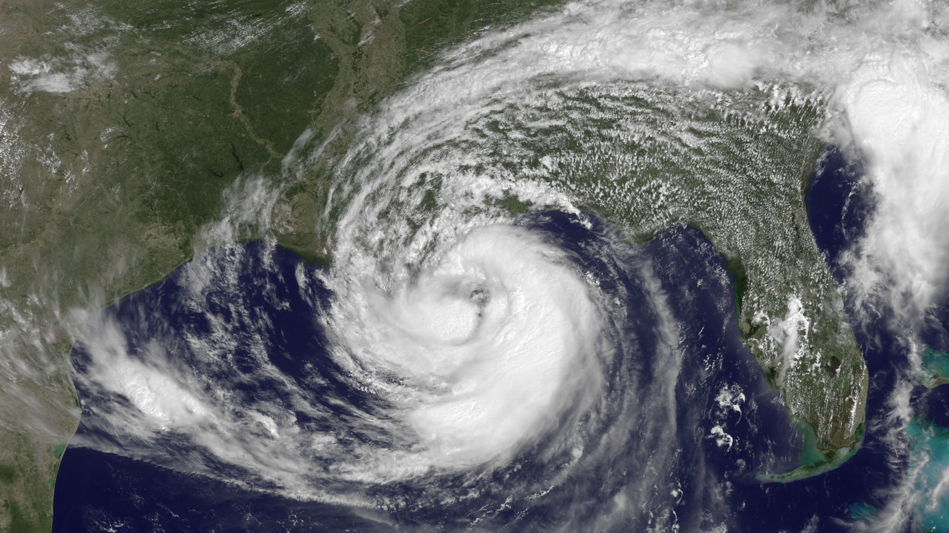

2015 Production Suite Review:
Report from NHC
Eric S. Blake, Richard J. Pasch, Andrew Penny
NCEP Production Suite
12/7/2015

Slide 2
1) Forecasting tropical cyclone (TC) intensity change
2) TC track forecasts, especially when related to storm structure
3) TC genesis prediction
What are the biggest challenges your center faces?

Slide 3
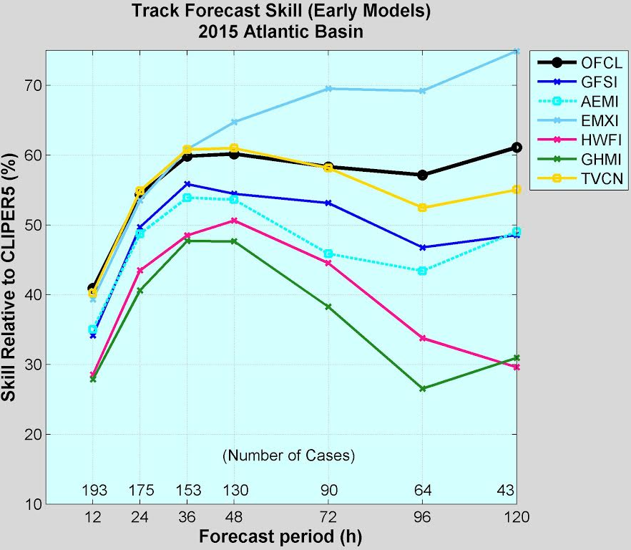
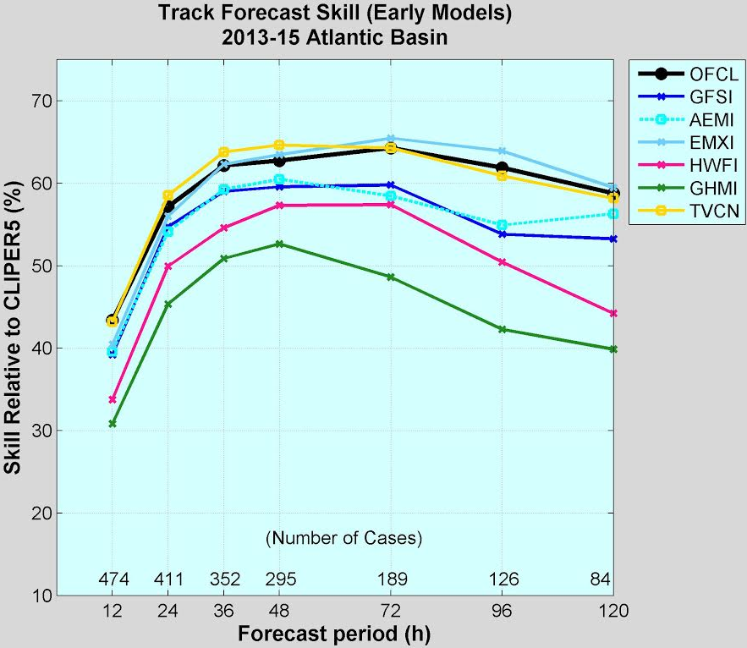
Atlantic Track skill
ECMWF best in 2015 and previous 3-year sample
GFS/GEFS similar performance, diminished skill in 2015, esp. at 3-5 days
HWRF and GFDL lag behind for track over any sample

Slide 4
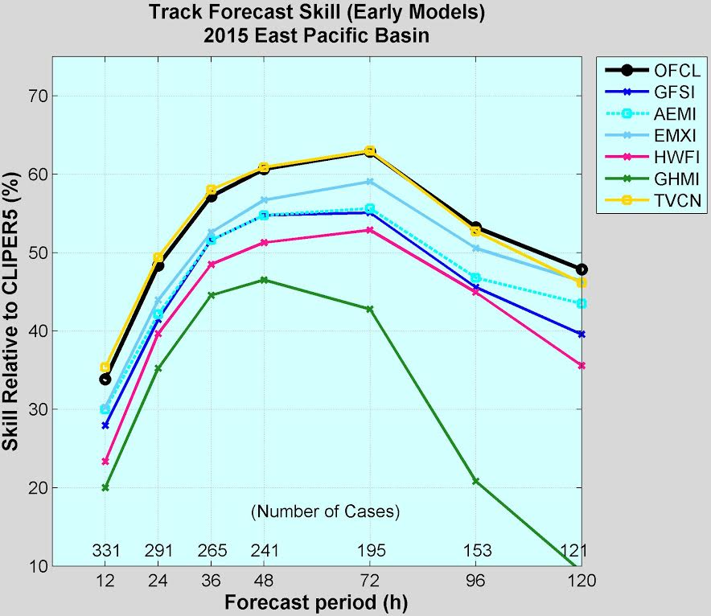
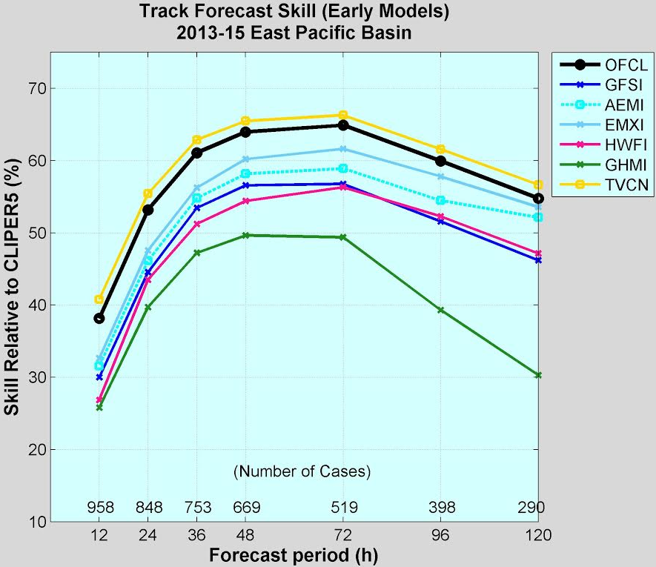
E. Pacific Track skill
ECMWF best in 2015 and previous 3 year sample, smaller lead than Atlantic however
GFS/GEFS similar performance below ECMWF
GFS and HWRF similar at days 3-5 last 3 years- unexpected
GFDL lowest skill

Slide 5
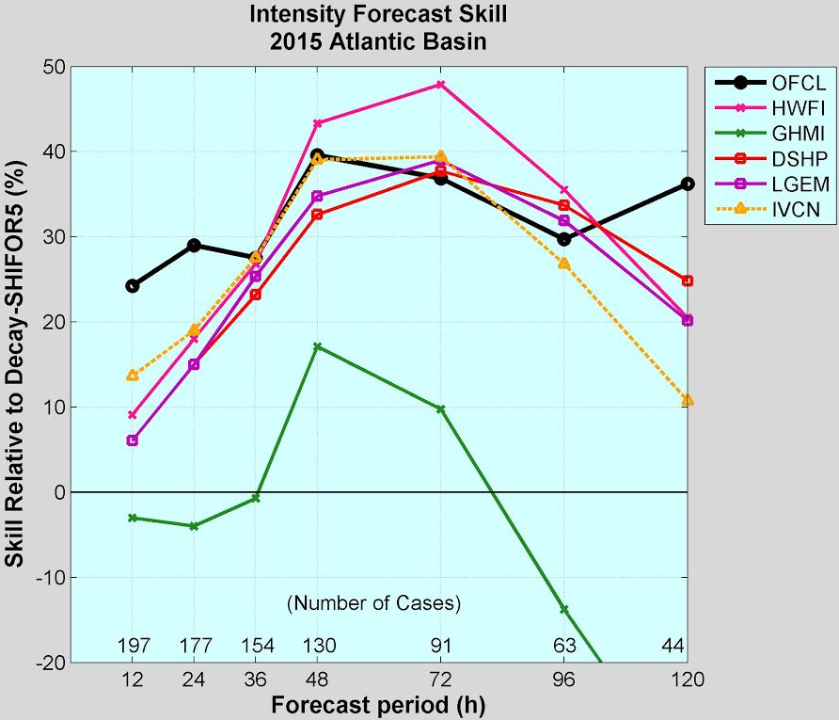
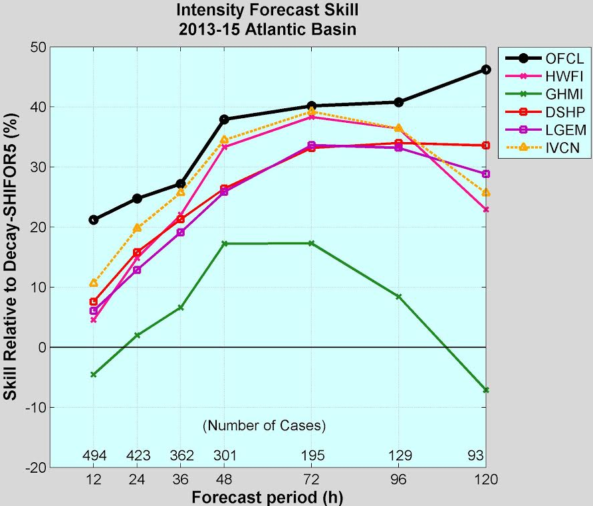
Atlantic Intensity skill
HWRF had a good year and is becoming our best Atlantic guidance over 3-year sample
GFDL consistently lags the rest of the guidance

Slide 6
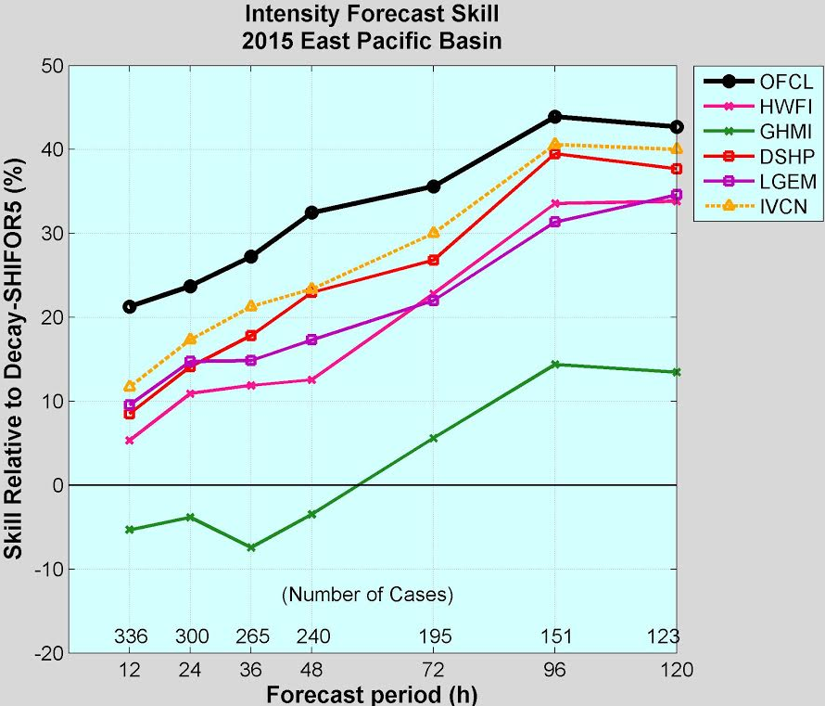
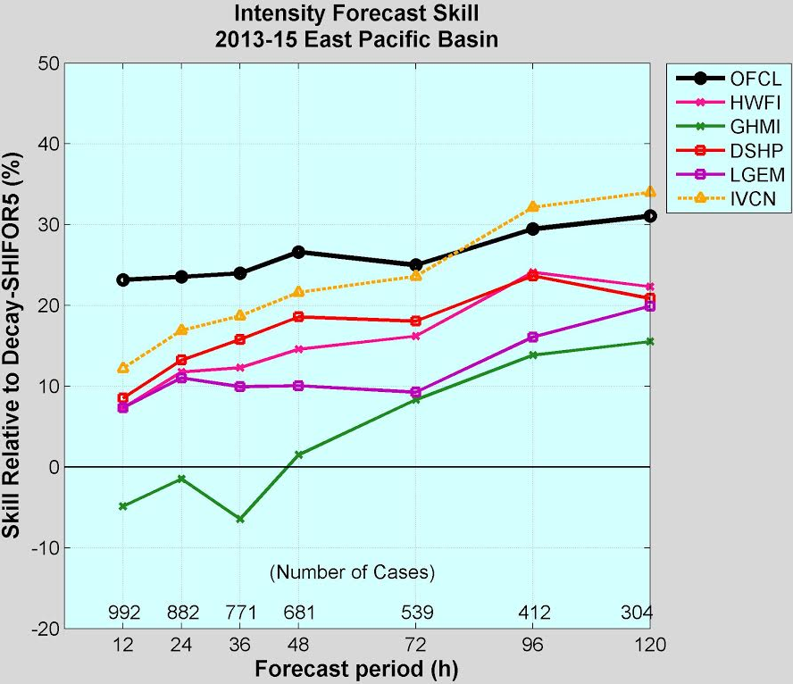
E. Pacific Intensity skill
HWRF suffered from a sizable low bias in EPac, with skill beneath the statistical models
GFDL has a larger low bias and consistently lags the rest of the guidance

Slide 7
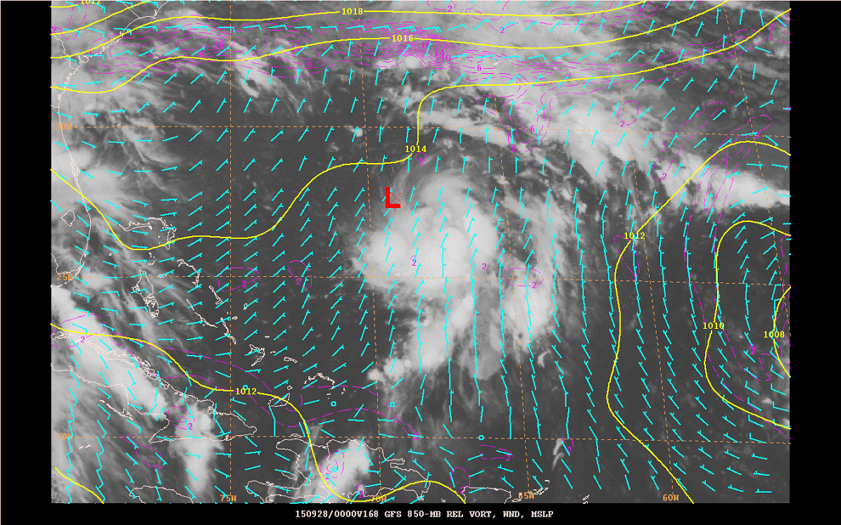
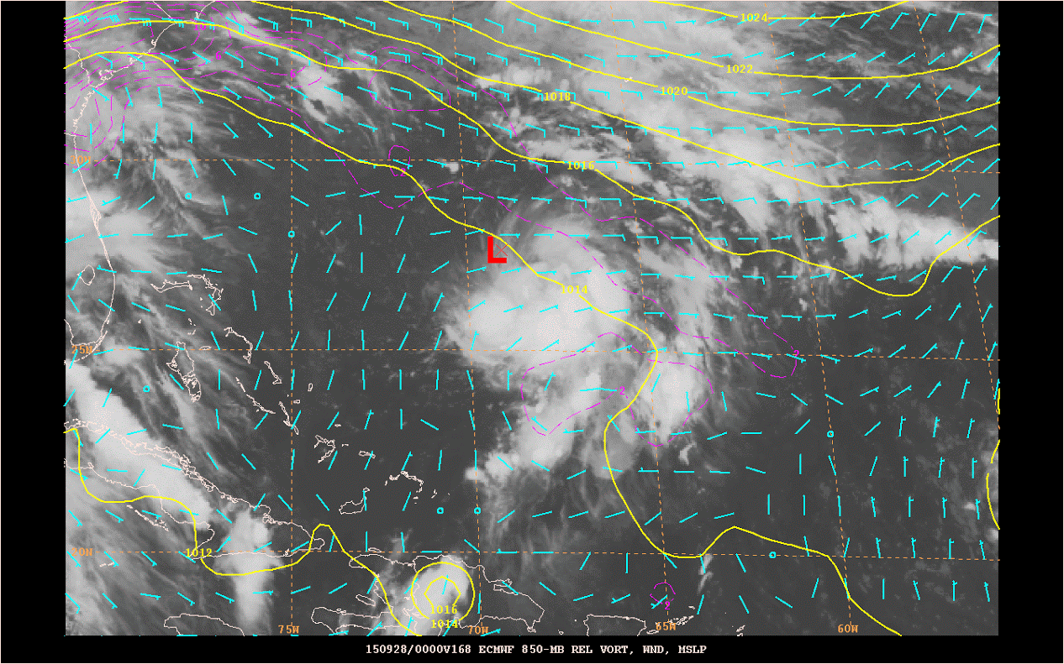
Genesis forecasts for Joaquin
GFS
ECMWF
Little signal at long-range in GFS, broad low/trough in ECMWF
ECMWF detected genesis about a day earlier than the GFS

Slide 8
-Degradation of GFS/GEFS at longer ranges for track forecasts is disappointing
- Objective verifications of genesis forecasts from 2015 GFS showed noticeable degradations
- Little improvement seen in intensity guidance, especially related to rapid changes
Does the current production suite and products adequately help you address those challenges?

Slide 9
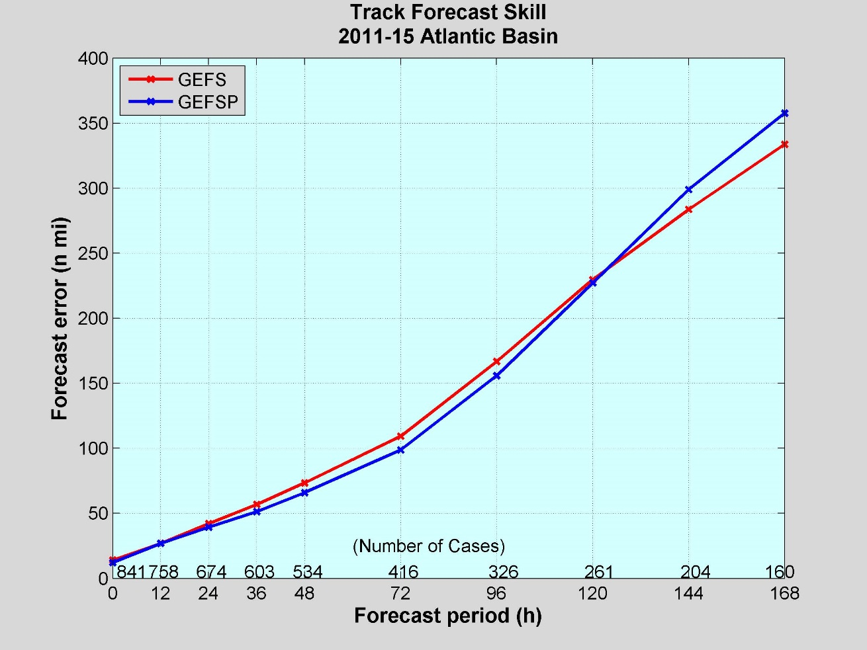
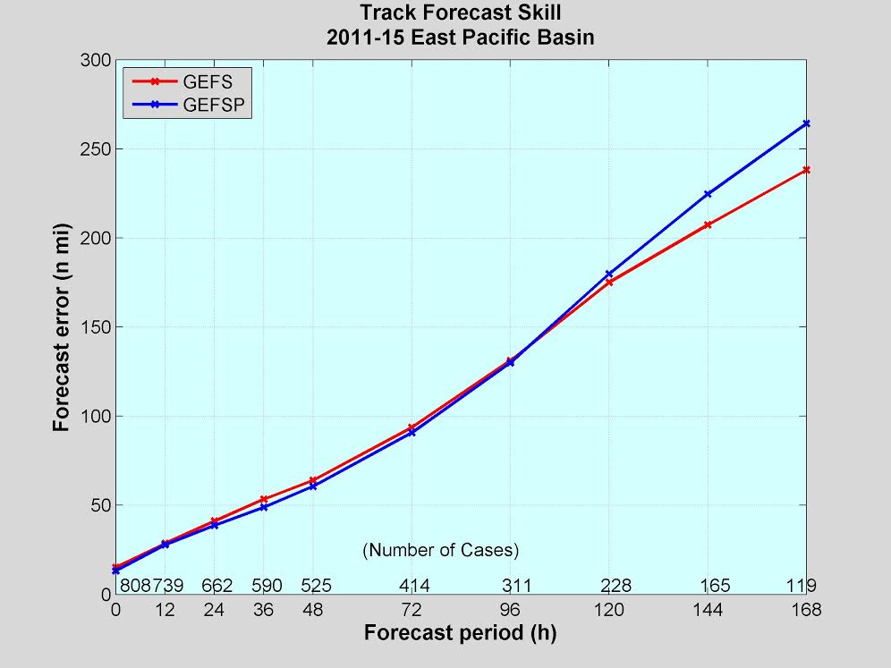
GEFS vs. GEFSP (2011-2015)
New GEFS a little better/similar through Day 3, worse beyond Day 5
Similar to GFS implementation earlier this year

Slide 10
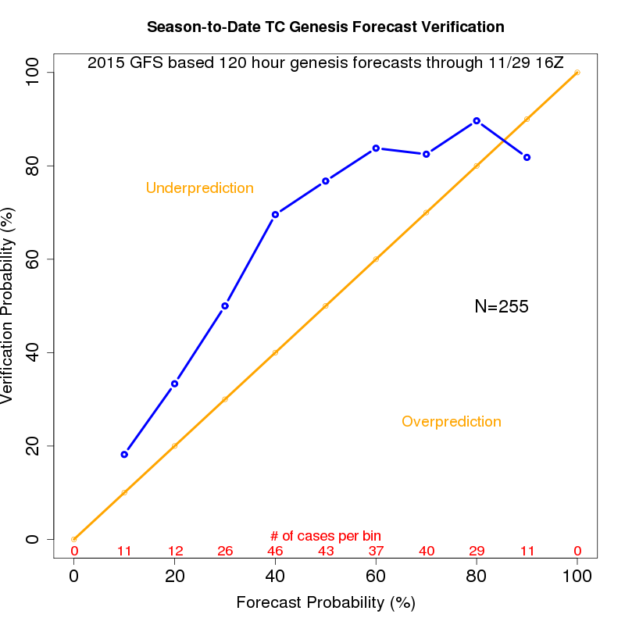
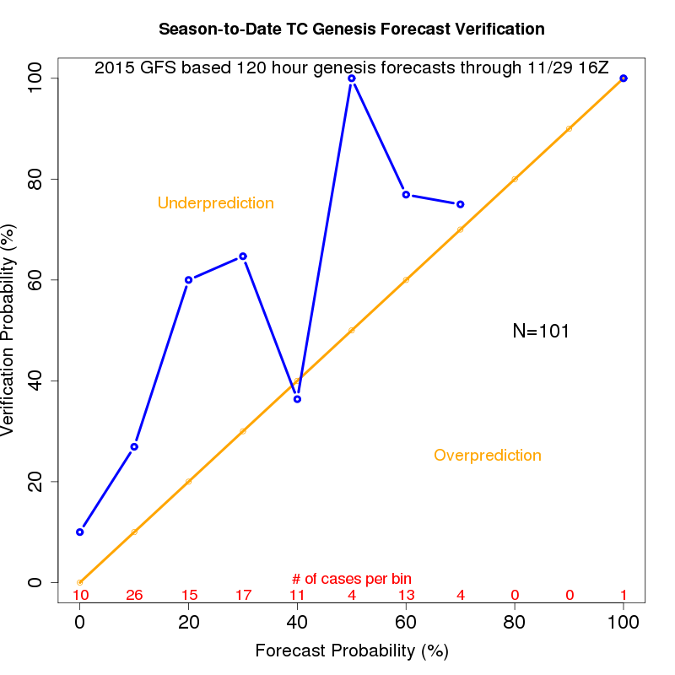
GFS genesis problems
Eastern Pacific
Atlantic
2015 GFS underpredicted genesis in both basins, and missed many systems

Slide 11
Current amount of available guidance?
Overall would say there is too little skillful guidance
More comprehensive ensemble-based guidance needed for track, intensity and genesis forecasts
Regional hurricane model (HWRF) ensemble shows some promise for hurricane intensity forecasts

Slide 12
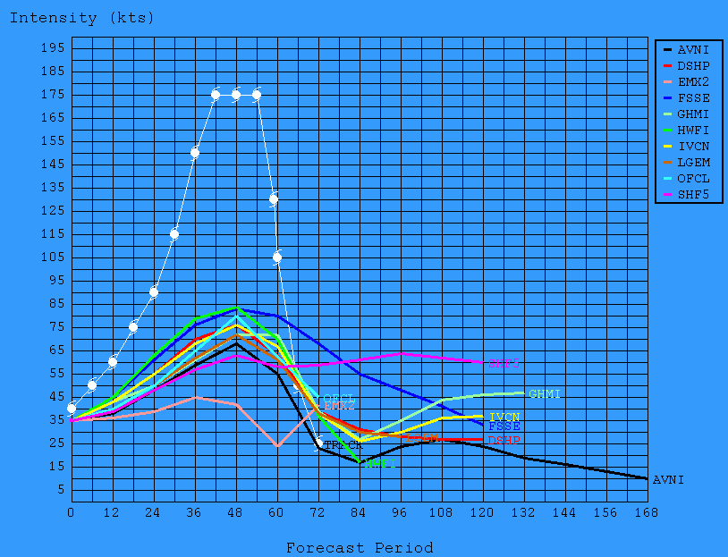
Patricia guidance before rapid intensification
Woefully underdone
Good timing of peak
Statistical models outperformed the dynamical models

Slide 13
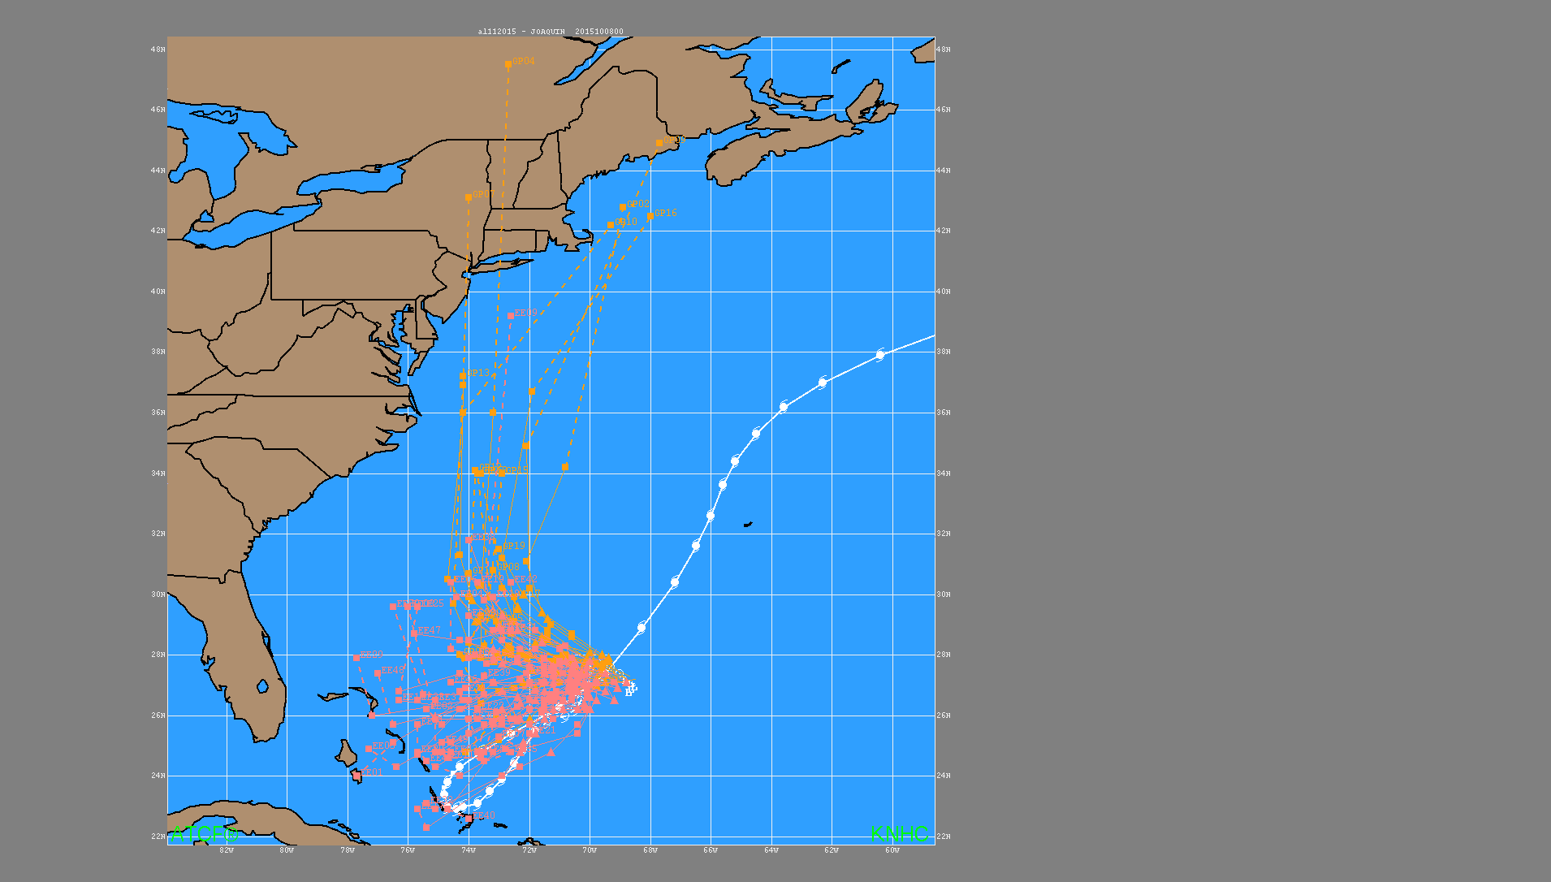
Joaquin ensemble guidance 28 Sep 1200 UTC
GEFS
EC Ensemble

Slide 14
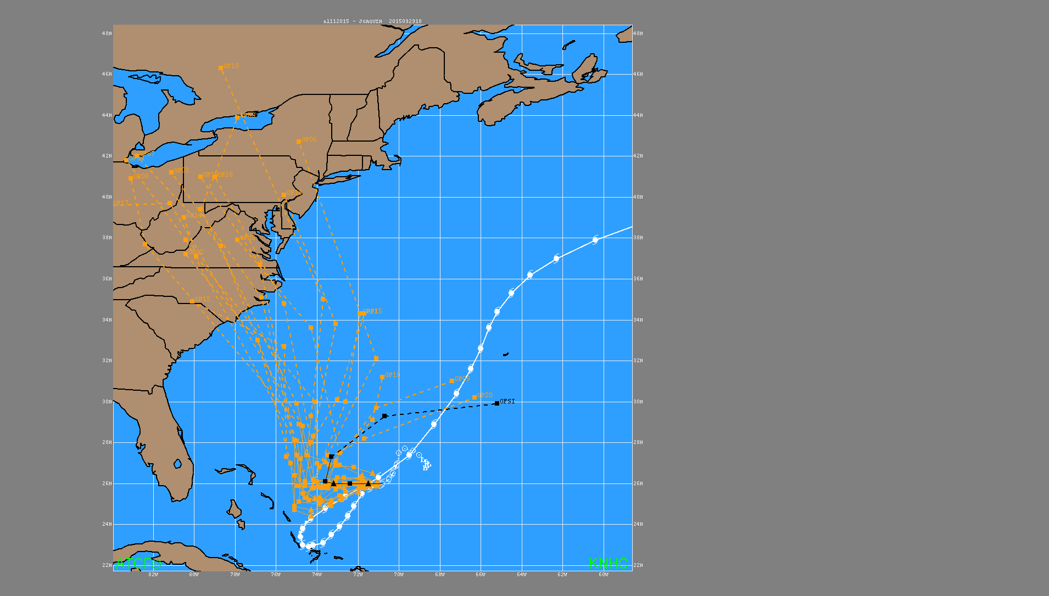
GFS Joaquin ensembles 29 Sep 1200 UTC

Slide 15

ECMWF Joaquin ensembles 29 Sep 1200 UTC
ECMWF Op

Slide 16
Needs in next 1-2 years in models/products to meet your challenges?
Adequate time for model implementation evaluation
Rigorous testing of global model implementation for downstream impacts on regional hurricane models (actually needs to be done for the next GFS implementation!)
Track/genesis forecast model improvements to support pre-tropical cyclone watches/warnings
2nd P-surge run on WCOSS to support storm surge watch/warnings
GFDL replacement (NMM version of HWRF?)
Regional hurricane models to 7.5 days to support day 6 & 7 tropical cyclone forecasts

Slide 17
What do you envision your model/products needs to be in the longer term?
Even higher resolution, non-hydrostatic, basin or global nested TC forecast model
Regional hurricane scheme that uses all data for a more realistic initialization of full TC structure
Improved model physics/parameterization
Operational HWRF ensemble
Objective verification of genesis skill (i.e. Halperin method)
Improved and unified probabilistic genesis guidance from EMC (combine Marchok/Peng methodologies)
Restoration of lost skill in longer-range track forecasts by the GFS & GEFS
Better tools for 6 and 7 day track, intensity and genesis forecasts

Slide 18
Input from the Joint Typhoon Warning Center (JTWC)

Slide 19
-Tropical cyclone intensity forecasting, particularly the onset, duration and amplitude of rapid intensification, is our toughest challenge.
-Conveying forecast confidence/uncertainty to decision makers that are typically comfortable with or require yes/no or go-no/go answers is our second toughest challenge.
-Operations tempo and dwindling human resources is our third toughest challenge.
What are the biggest challenges that JTWC faces?

Slide 20
-While there have been marked improvements in track predictions by numerical models, models, of all scales, do not perform well and often have large “busts” on rapid changes in intensity. Conversely, models can sometimes get the right intensity despite poorly predicting the track. The current production suite does not adequately address this challenge.
-Single- and multi-model track ensembles are helpful, but more reliable meso-scale ensembles are needed to accurately convey intensity forecast confidence/uncertainty. The current production suite does not adequately address this challenge.
-Operations tempo make keeping the number and types of products simple enough to be digested and understood in short amount of time, while being high quality and relevant to the forecast problem of the day. The current production suite does this adequately, but new product development should factor in forecaster operations tempo.
Does the current production suite and products adequately help JTWC address those challenges?

Slide 21
Current amount of available guidance (JTWC)?
The amount of deterministic guidance is sufficient, but the amount of ensemble guidance is insufficient, particularly in terms of tropical cyclone intensity forecast guidance, especially outside the Atlantic and eastern Pacific basins.
Needs in next 1-2 years in models/products to meet JTWC challenges?
For the short term, we need to continue receiving GFS, GEFS, GFDL, GFDL ensembles, and HWRF track, intensity, and wind distribution (radii) for tropical cyclones globally.

Slide 22
What do you envision JTWC model/products needs to be in the longer term?
For the longer term, we need to expand our receipt and use of global and meso-scale ensembles, to include probabilistic guidance with parameters binned by threshold. The ensembles need more members and more advanced perturbation methods than currently available in order to adequately reflect the range of the probability distribution.

