Slide 1
Climate Prediction Center:
Challenges and Needs
Jon Gottschalck and Arun Kumar
with contributions from Dave DeWitt and Mike Halpert
NCEP Production Review Meeting
College Park, MD
December 7, 2015

Slide 2
Background on CPC responsibility: Outlooks
NCEP CPC
Years
Forecast
Uncertainty
Outlook
Seasons
Guidance
Months
Threats Assessments
2 Week
1 Week
Temp/precip outlooks for the Week-2, monthly and seasonal time periods
Extreme outlooks for Week-2
Monthly and seasonal drought outlooks
ENSO and seasonal hurricane outlook
Forecast Lead Time
Forecasts
Days
Watches
Hours
Warnings & Alert Coordination
Minutes
Benefits
Aviation
Recreation
Health
Life & Property
Maritime
Fire Weather
Commerce
Hydropower
Agriculture
Ecosystem
Environment
Space Operations
Emergency Mgmt
Energy Planning
Reservoir Control

Slide 3
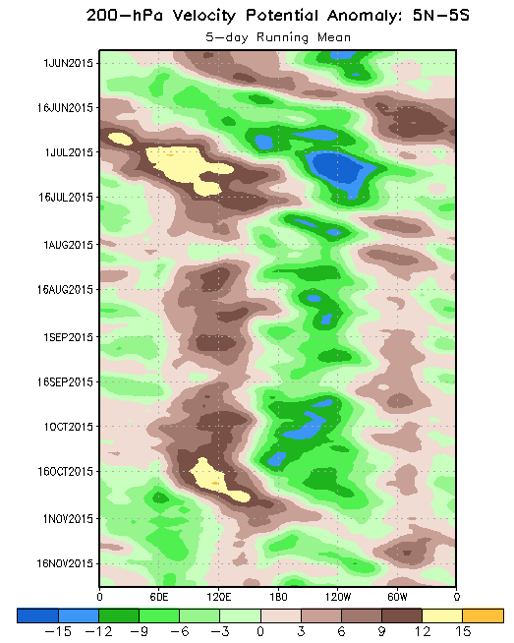
Background on CPC responsibility: Monitoring
Realtime climate monitoring from the ocean to the stratosphere is a critical function that CPC also provides
Monitor key modes of short-term climate variability and teleconnections in realtime: ENSO, MJO, PNA, AO, NAO, etc.
Realtime analysis products such as GDAS, CDAS, GODAS are critical to meet this component of CPC mission
When possible, provide attribution for causes of observed climate anomalies
CDAS
GODAS
CDAS
GEFS

Slide 4
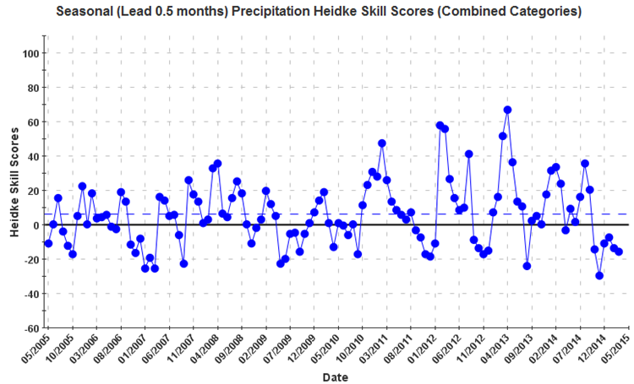
Center Challenges
Seasonal precipitation forecasting:
➔ Outside of moderate and strong ENSO events forecast skill remains quite low
➔ Little advance in skill in the past 10 years
Introduction of Week 3-4 outlooks:
➔ Experimental Week 3-4 T/P outlooks since 9/2015
➔ Forecast guidance needs

Slide 5
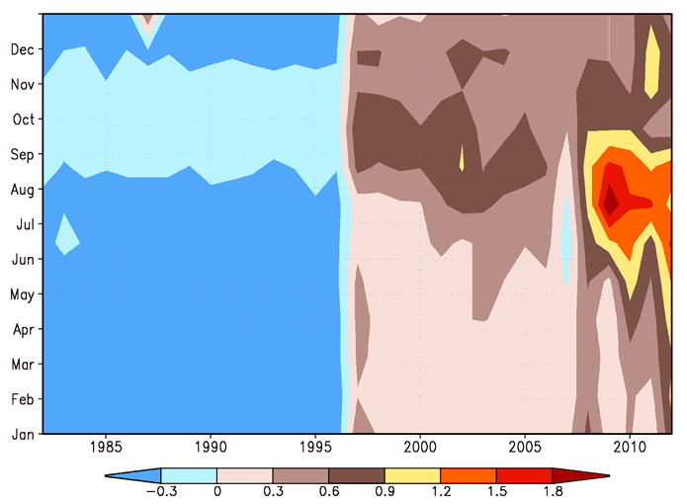
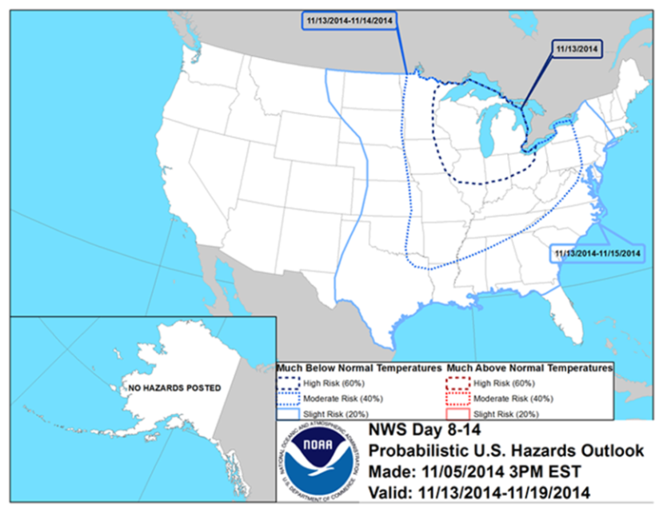
Center Challenges
Expanding outlooks from T/P only (i.e. extremes)
➔ Examples:
Odds for top 10% winter seasonal precip?
Probability of # excessive heat events?
Odds Week 3-4 cold air outbreak?
➔ Guidance to support this emerging area / need
Mitigation of analysis discontinuities
Analysis jumps influence hindcasts, bias correction for real-time forecasts is a challenging issue
Differences in sea ice extent between CFSR and NSIDC. Two significant jumps: One in 1997 and the other in 2008.

Slide 6
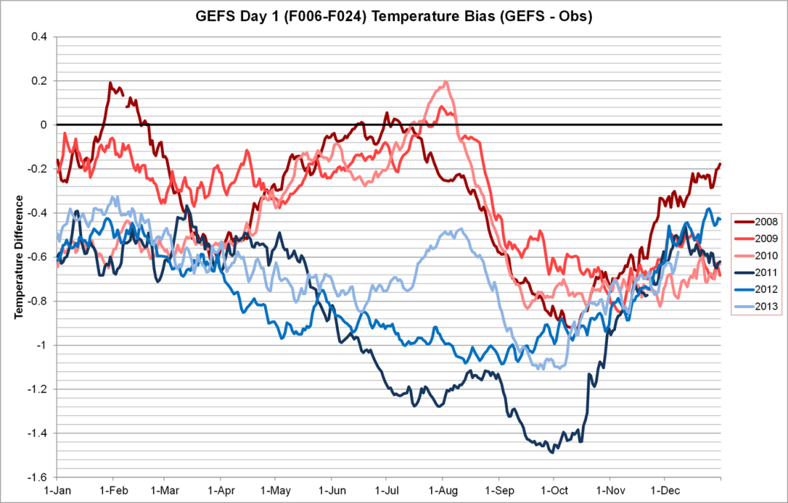
Center Needs: Week-2 Related
Make reforecasts available at each GEFS update cycle with the following specific minimum requirements:
(1) At least 20 years
(2) At least 5 members per cycle
(3) At least 2 cycles per week (i.e., 2 separate days during a week)
Critical for extremes and proper forecast reliability
Model consistency in initialization system critical and required
Influencing:
(1) Week-2 predictions of temperature probabilities in the Southeast U.S. during summer
(2) Development of a Week-2 excessive heat outlook

Slide 7
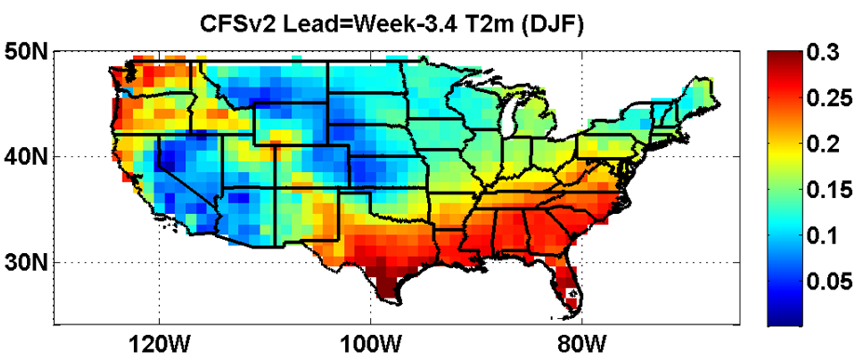
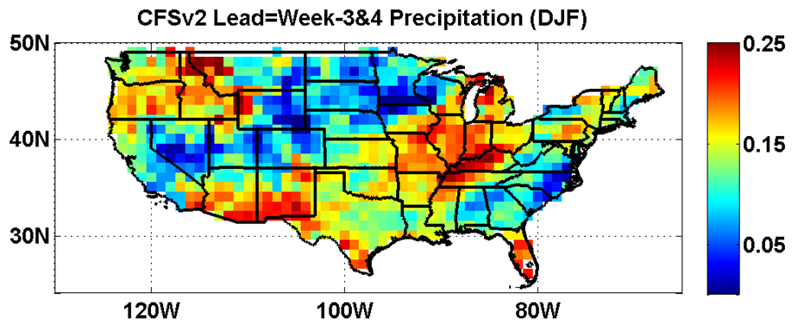
Center Needs: Week 3-4 Related
Operational extension of the GEFS to at least 35 days to support Week 3-4 experimental outlooks (at least once per week)
Complementary to the currently available CFS 45-day runs
GEFS may provide more rapid model upgrade cycle, larger ensemble size, higher resolution, alternative initialization strategies, etc.)
Reforecast requirement consistent with Week-2 request

Slide 8
Center Needs: Seasonal related
More rapid update cycle of the CFS to keep up with advances in models (every 7 years limits seasonal prediction progress)
To the extent possible, minimize jumps in the analysis of slowly varying components of the Earth System used to initialize reforecasts
To completely serve CPC operational outlook horizon of 13 forecast seasons, a seasonal forecast system out to 15 months is required
Forecast frequency of at least every five days
CFS reforecast and realtime model need to be identical
Reforecast period required to span at least 30 years (1981-present preferred) to follow NMME protocol

Slide 9
Center Needs: Seasonal related
Maintain a dialog on the decisions related to forecast system infrastructure for climate scale predictions, e.g.,
(1) Model resolution
(2) Ensemble size
(3) Realtime and reforecast run frequency
(4) Output frequency and variables
Maintain a set of model scripts that can be used for model integrations over extended period of time (e.g., 50 years) to understand sources of predictability and provide attribution
Support real-time climate monitoring requirements
Support drought monitoring requirements (based on NLDAS)

Slide 10
Center Needs: Experimental / Future products related
Improved sea ice related forecast guidance (and better continuity in the sea ice analysis used in CFS reforecasts)
Guidance to support monthly/seasonal severe weather outlooks
Extend subseasonal configured CFS 45 day runs to 105 days to provide additional support for requests for Month 2 and Month 3 T/P outlooks
From:
CPC Strategic Plan

Slide 11
Thanks for your attention
Comments and Questions?
Jon.Gottschalck@noaa.gov

