Slide 1
Weather Prediction Center
2015 NCEP Production Suite Review
December 7, 2015
Mark Klein
Science and Operations Officer
Contributions by David Novak, Kathy Gilbert, Patrick Burke, Tony Fracasso, Rich Otto, Marc Chanard, and Mike Bodner

Slide 2
What are WPC’s biggest challenges?
QPF
NWP QPFs have shown very slow improvement for the last decade
Forecasting placement of high-impact precipitation events, particularly in the warm season
Medium range
Under-dispersive ensemble guidance (GEFS)
Winter weather
Prediction of precipitation type and snowfall accumulations in transition zones
Mesoscale snow banding
Mining relevant information from an expansive model suite
Communications between operational forecasters and modelers
Information about the models, such as biases, how upgrades will affect sensible weather
Difficulty evaluating parallel model guidance
Evaluation period too short and lack of time on shift to adequately perform an evaluation
Notes:
So, start out the presentation by reviewing the purpose of the review...to answer the 5 questions posed. And we’ll launch right into each one.
WPC’s largest roles are forecasting QPF, winter weather and the medium range Day 3-8. Most of our product suite revolves around these 3 main areas. For QPF, there hasn’t been much improvement in NWP for a decade or more. In particular, getting the placement (and timing) of high-impact precipitation events that may lead to flash flooding.
At medium range, the GEFS...at least up to this last implementation...has proven to be underdispersive in the mid-latitudes. Probabilistic forecasting is a role that is increasing for WPC, and an under-dispersive ensemble will lead to over-confident forecasts and more solutions falling outside of the solution envelop.
At winter weather...our biggest challenges are mesoscale snow banding...which we will be investing in this years WWE...and prediction of precipitation type and accumulation in transition zones.
Other challenges - there’s a large product suite. How do we successfully get what we need from it to make deadlines. Then some issues that have been brought up before like at the SOO meeting, including communications between forecasters and modelers...and the difficulty properly evaluating parallel guidance. The latter I know is being addressed.

Slide 3
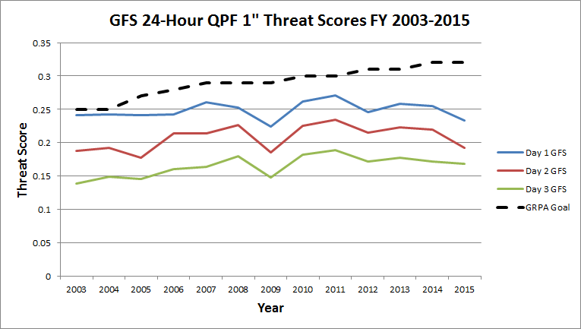
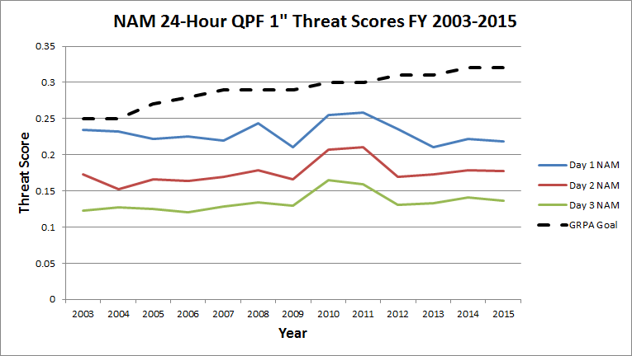
Slow NWP QPF improvement for the past decade
Verification: WPC’s QC’d manual analysis
Data sources: CPC ¼ º analysis, Stage IV data, METAR, COOP, HADS, CoCoRaHS
Notes:
Here are a couple of plots of 24-hour QPF threat score at the 1” threshold from the NAM and GFS since 2003. The verifying analysis is WPC’s QC’d, which incorporates multiple data sources as listed. One could question the use of WPC’s analysis, but Ying Lin’s plots reveal the same trends...and the WPC analysis methodology has been consistent for this entire period.
Also plotted is WPC’s GRPA goal, 1” threat score of 24-hour QPF.
Basically...there hasn’t been much improvement in the QPFs. The GFS shows a general climb for Days 2-3, but not Day 1. And then NAM has remained pretty flat throughout. Unfortunately our GRPA goal steadily rises, and while we’ve reached or exceeded it every year, this lack of improvement makes it increasingly difficult to do so.

Slide 4
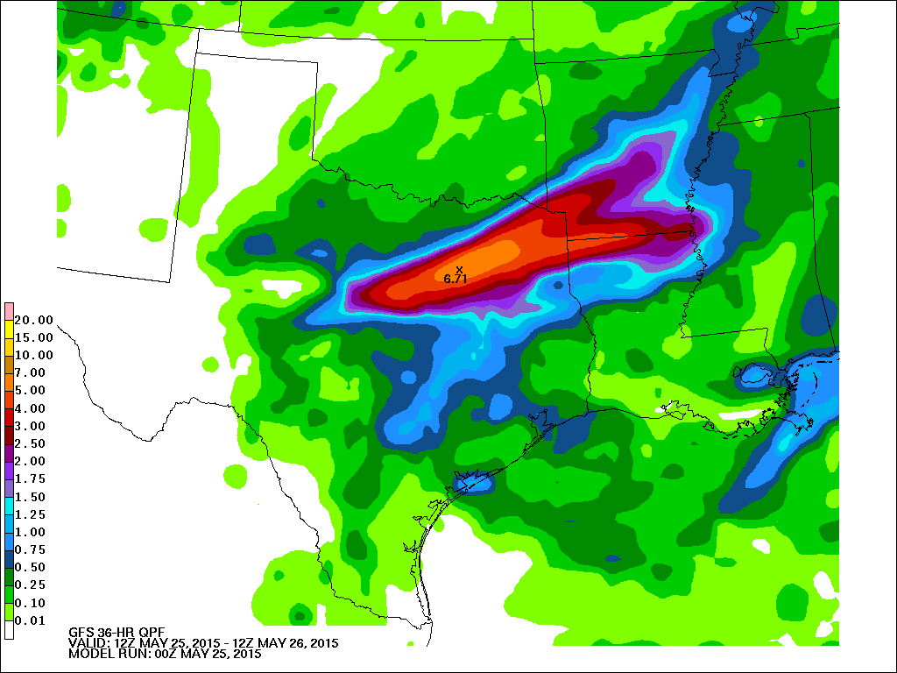
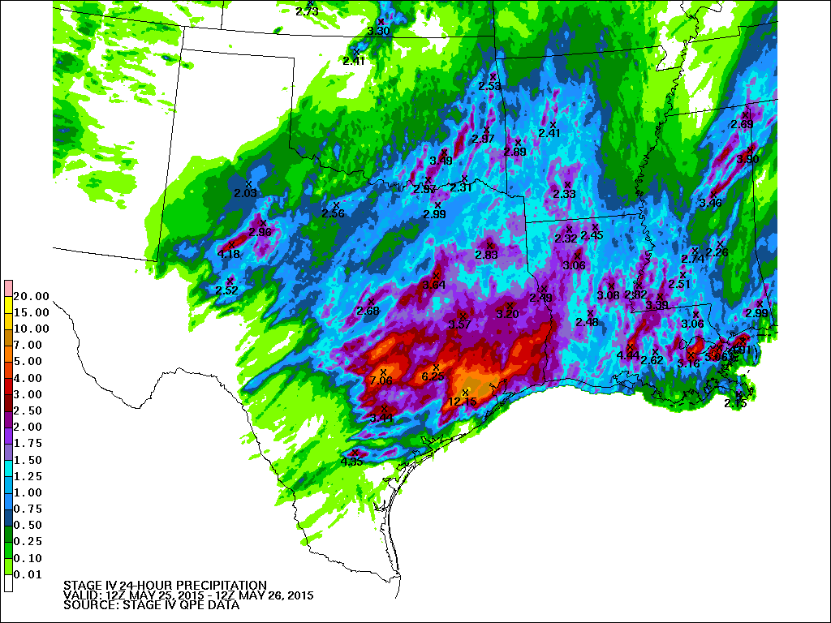
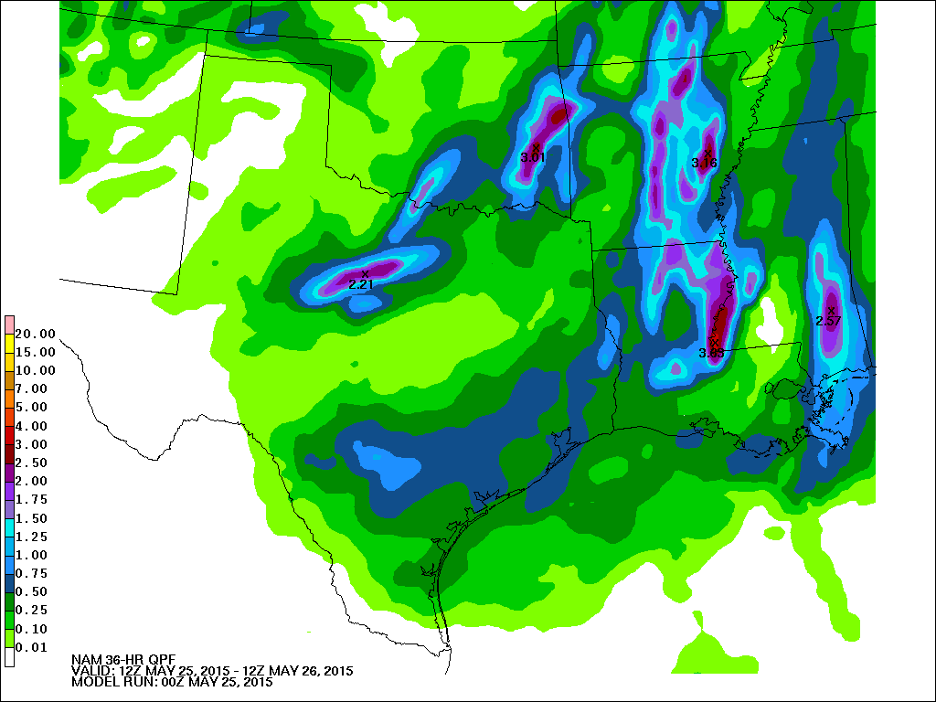
Example - high impact heavy rain event
Houston Flood - May 25-26, 2015
GFS 24-hour QPF from 00Z 5/25/15 (36-hour forecast)
24-hour Stage IV QPE - valid 12Z 5/26/15
12 km NAM 24-hour QPF from 00Z 5/25/15 (36-hour forecast)
Notes:
The first example is from this spring. A significant flood event took place in and around Houston in late May. Stage IV analysis verifying at 12Z on the 26th is on the left, while the 36-hour forecasts from the 00Z runs on May 25th (36-hour forecasts) is on the right. The GFS mostly captured the magnitude, but was considerably too far north. The 12km NAM essentially missed it completely.

Slide 5
Under-dispersive ensemble guidance
“Outside the envelope” verification Jan 1 - Apr 30, 2015
Percent occurrence of 500 mb heights that verified higher or lower than any ensemble member 168-hour forecast
GEFS
ECMWF EFS
Notes:
In the medium range...as I mentioned, there’s not enough spread in the guidance. These figures show “outside the envelope” verification from the GEFS and EC ensembles for the first 4 months of this year. Displayed is the percent occurrence where the observed 500mb heights (using the GDAS analysis) verified higher or lower than any of the ensemble members at the grid point.
So basically, the max and min 500mb forecasts are collected from each member for each grid point. This will show the percent of forecasts where the 500mb height didn’t verify in that range. This occurred 20-30% of the time across the southern U.S. and along the Pacific coast in the GEFS. For the EC, this rarely exceeded 10% throughout the domain.

Slide 6
Does the current production suite and products adequately help you address those challenges?
To some extent, yes!
Convection-allowing models (CAMs) have become an invaluable tool for our QPF and Metwatch functions
Looking forward to increasing use of the HREF
But…
Lack of model improvement at QPF hinders ability to accurately predict high-impact events with adequate lead time
Under-dispersive ensemble guidance leads to over-confidence and an over-forecast bias in our probabilistic QPF and winter weather forecasts
Use of precipitation-type algorithms is outdated
Easy-to-digest training materials/documentation on models does not exist; for example:
Changes with new parallels and their impact on sensible weather elements
Model biases and simplified material about model physics
Notes:
So, does the current production suite address those challenges. Yes, to a point. Our QPF and Metwatch desk (which write MPDs for heavy rain events that may lead to flash flooding) have found this resource invaluable. Nearly every MPD written references one or more of the CAMs as supplying guidance and support for their forecasts.
But...as pointed out in the challenges, the lack of QPF improvements and under-dispersiveness of the ensembles l Also...the current precipitation type algorithms are outdated, and there’s not more widespread use of model explicit schemes to predict frozen precip accumulation.
Finally...training on new or existing guidance is difficult. It may be available, but each time there’s an upgrade, I can’t quickly locate a brief discussion on how the model changes will impact sensible weather or a quickl look at verification scores. What does x change do to QPF, CAPE, winds, etc..?

Slide 7
Is the current amount of available guidance too much, too little, or the right amount?
The quality of the guidance matters more than the amount
Does the NWP help the forecaster make the right key decision as fast as possible?
Generally endorse the “DiMego plan” - consolidation of the model suite into 3-4 ensemble systems
GEFS
SREF
HREF
Includes HRRR, HiRes windows, NAM nest
Run hourly with hourly (or sub-hourly) output to 18-24 hours
Extend to 84 hours at 00/06/12/18 UTC with 3-hourly output
SSEF (Storm-scale)
Control runs serve as the “deterministic”
Notes:
Is the amount of guidance in the Goldilocks range? Hard to say, because the real issue is quality versus amount. Question: Does the NWP help the forecaster make the RIGHT key decision as quickly as possible?
In general, though...looking at the guidance profiles, we basically endorse Geoff DiMego’s plan of having 3-4 primary ensemble systems...with the “deterministic” forecast falling out of the control member. For the high-res, ideally running this out to 18-24 hours on an hourly basis and extending to 84 hours at the synoptic times.

Slide 8
What does WPC need in terms of products or models to address challenges over next 1-2 years?
Advancements to the quality of existing product suite
Improve QPF
Increasing role in IDSS for high-impact precipitation events
Promote greater ensemble dispersion in both the SREF and GEFS
SREF is a primary driver for our PQPF and PWPF
Other improvements
Add probabilistic forecasts of precipitation types over time intervals (1-h , 3-h depending on frequency of data output)
Continued improvement of land surface modeling of snow depth.
Notes:
What does WPC need in terms of models or products to address short-term challenges. Well, this breaks down into 2 components. The first is advancing the quality of the existing product suite.
#1 - Improve the QPF. Our ability to satisfy customers in increasing role providing impact based decision support will rely heavily on improving QPF in the model suite. Consider adding bias-corrected QPF to more guidance, especially high-resolution.
Secondly, increase the dispersion of the ensemble guidance. This applies to our PQPF and PWPF and medium range. The SREF is currently a major driver of WPC’s PQPF and PWPF product suite. While we can modify the deterministic products, the quality of the post-processed probability guidance depends on a quality of the ensemble...and based on our scores on reliability diagrams from the last winter season where there was a significant over-forecast bias, there’s room for improvement.
Other ideas. We’d like a continued focus on improving land surface models. This will help with the snow accumulation, particularly in scenarios with borderline surface temperatures (differing degrees of melting)...and improve dew point/2m temps. And something that may be more related to the next slide...adding probabilistic precipitation type accumulated over model time steps in addition to the binary 1/0 instantaneous determination.

Slide 9
What does WPC need in terms of products or models to address challenges over next 1-2 years?
Additional post-processing
QPF
Probability matched mean QPF from GEFS, SREF, HREF
Improve intensity forecasts while maintaining the forecast spatial extent of the precipitation
Medium range
Ensemble cluster output
Winter Weather
Expand the use of POFP in deterministic/ensemble systems.
Additional probabilistic output from ensemble guidance
Neighborhood probability fields from ensembles
HREF: 6- and 24-hour QPF probabilities and winter weather parameters
Notes:
The second component to address challenges is adding new post-processing.
For QPF, this might include probability-matched precipitation in the post...and more easily viewing soundings from hi-res guidance. This can be particularly useful both to our QPF and winter weather desks. At medium range, create ensemble clusters. WPC currently does some of its own post-processing to create clusters. It would be ideal to move that into the production suite.
For winter weather, consider expanding the fraction of frozen precipitation in the snow-water equivalent paramter to the GFS, GEFS. This might involve either transfering Ferrier micro physics into the GFS and ARW, or much better, further developing the Thompson and other microphysics schemes to be applicable in a non-instantaneous way.
In addition, neighborhood probabilistic fields from the ensembles. We’ve worked with post-processing this for QPF from the SSEO for our flash flood experiment. Adding these fields to the HREF and SREF would be useful to support redesigning our excessive rainfall forecasts to display probabilities of exceeding flash flood guidance within 40km of a point versus at a grid point. And now that the HREF is out...I know there’s a document with the end-goal parameters from the HREF...and 3-hour QPF is there, but really need the 6- and 24-hour.

Slide 10
What are WPC’s expected model/product needs for the longer term?
Drive toward more probabilistic output and products
Extreme Forecast Index (EFI) products
Day 8-10 temperature and precipitation outlooks
Dispersive and reliable ensemble guidance
Increased focus on IDSS
Tools to measure uncertainty/predictability
Tools to synthesize the output of model data
Coupling of atmospheric and hydrologic models to improve forecasting of flash flood potential
Improved and focused nowcasting guidance (0-6 hour time frame)
Fusion of advanced remote sensing data with HREF (e.g. GOES-R)
Notes:
Looking at WPC’s product suite beyond 1-2 years, our focus will continue to shift more probabilistically, so improving and advancing the ensemble model suite and post-processing tools is key. Perhaps at some point, WPC will produce operational Day 8-10 forecasting...which will almost certainly be probabilistic and strive to provide longer lead forecasts of higher impact events, hence the EFI.
Speaking of high impact, as I’ve mentioned...our focus on IDSS will be increasing. So tools to measure uncertainty...and tools to synthesize model data into formats so that forecasters don’t get data overload. And increase work in improving the nowcasting period...the 0-6-hour time frame. How can we improve forecast of short-term evolution of flash flood events...or where mesoscale snow bands (and no snow-areas) may form. This was brought up in this year’s WWD meeting at NCWCP.
Finally...work toward coupling atmospheric and hydro models to more accurately depict the entire water cycle...and improve forecasts of flash floods.

Slide 11
Extra Slides

Slide 12
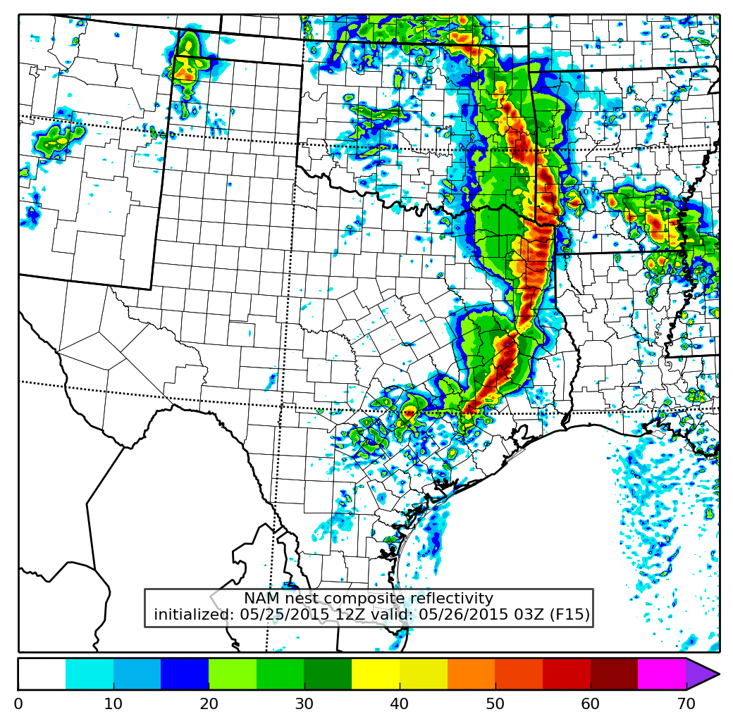
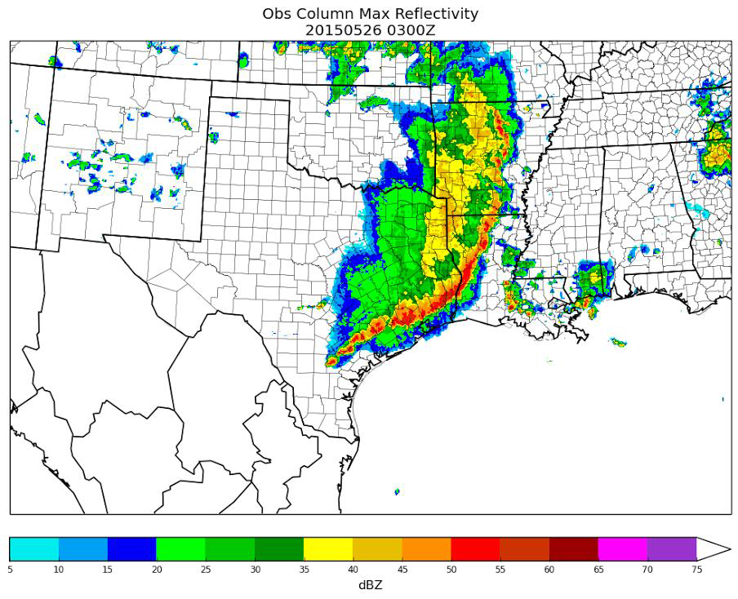
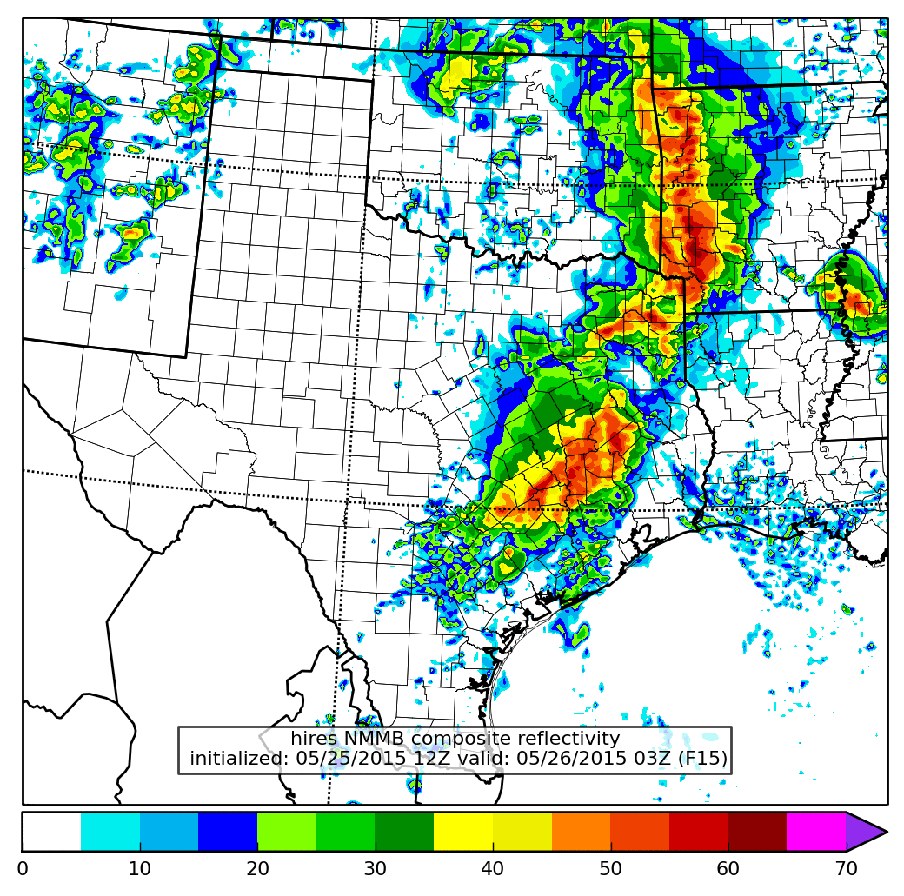
CAM bias - Too slow with forward-propogating MCSs
15-hour forecast reflectivity from NAM CONUS nest and Hi-RES NMMB
Observed reflectivity - 03Z 5/26/15

Slide 13
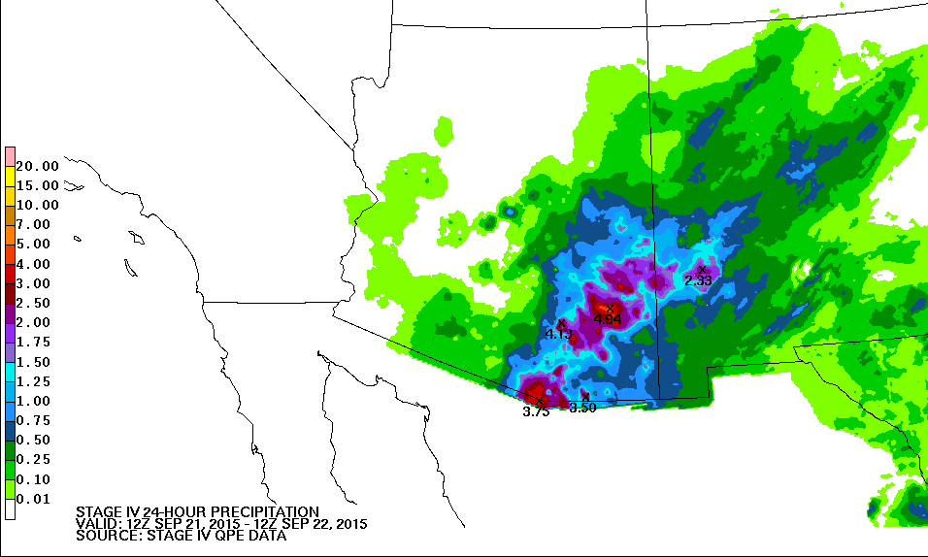
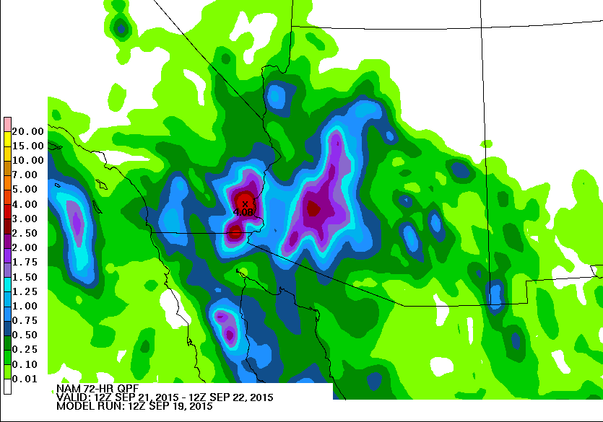
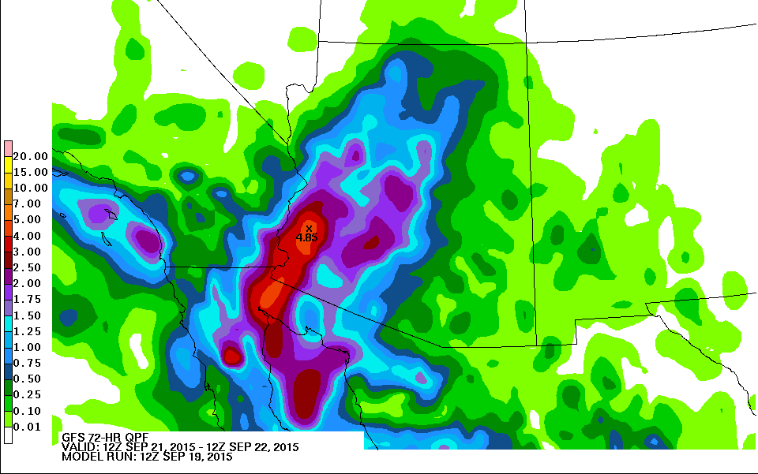
QPF associated with East Pacific tropical cyclones

Slide 14
Subjective observed model biases
NAM, GFS, and to a lesser extent the Hires Windows, displacing heaviest QPF too far to the north/west away from the best instability during the warm season
During events with strong synoptic forcing (cool season), the HiRes Windows have a wet bias in the cool sector due to over-forecast of CAPE.
CAM guidance tends to be slow with forward-propagating convective systems
Warm low-level temperature bias in the HRRR allows this model to break the cap too soon; initiates convection too early
NAM CONUS nest has a high bias with precipitation maxima, but coverage is too low

Slide 15
Mesoscale snow banding features - looking at this for next WWE

