Slide 1
Evolving the NCEP Production Suite
Dr. William M. Lapenta
Director, National Centers for Environmental Prediction
NOAA/National Weather Service
NCEP Production Suite Review
07 December 2015

Slide 2
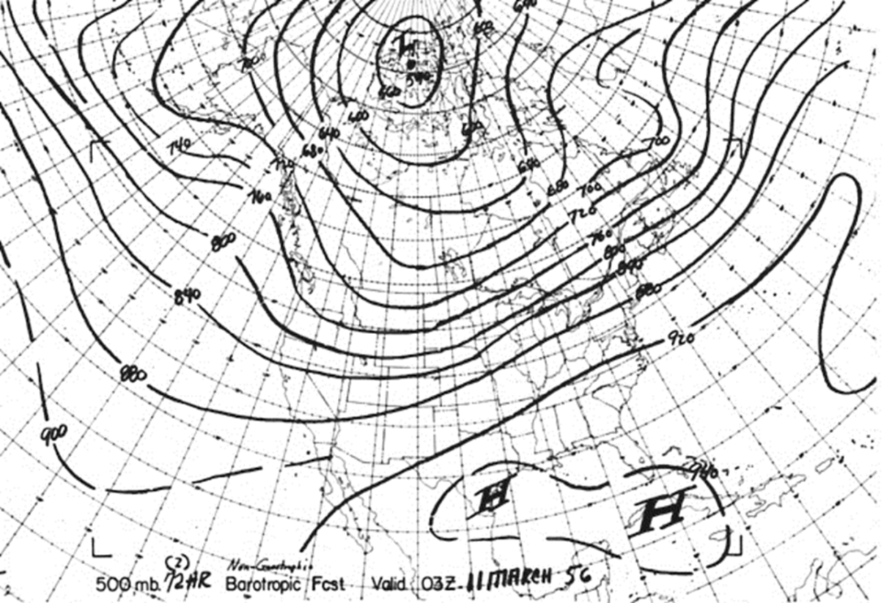
1955 - US Weather Bureau First Operational Production Suite
Baroclinic:
300 km / 3-layer CONUS to 36 hr
1500z run
Started 2100z
Finished 2230z
Thermotropic:
375 km / 2 layer No. Am to 36 hr
0300z run
Started 1000z
Finished 1230z
Barotropic:
600 km / 1 layer ~NHemis to 72 hr
0300z run
Started 1230z
Finished 1300z
500mb Height
72h Forecast Valid 03Z 11 March 1956

Slide 3
Seamless Suite of Operational Numerical Guidance Systems
Spanning Weather and Climate
Years
Forecast
Uncertainty
Outlook
Seasons
Months
Climate Forecast System
Guidance
North American Multi-Model Ensemble System
Threats Assessments
2 Week
North American Ensemble Forecast System
Global Ensemble Forecast System
1 Week
Global Forecast System
Global Dust
Forecast Lead Time
Forecasts
Short-Range Ensemble
Land DA
Wave Ensemble
Days
North American Mesoscale
Waves
Global Ocean
Bays
Watches
Fire Wx
Regional Hurricane
Space Weather
Storm Surge
Hours
Rapid Refresh
HRRR
Ozone
Tsunami
Warnings & Alert Coordination
Minutes
Dispersion (smoke)
Benefits
WAM
NSWPS
WRF-HYDRO
Aviation
Recreation
Health
Life & Property
Maritime
Fire Weather
Commerce
Hydropower
Agriculture
Ecosystem
Environment
Space Operations
Emergency Mgmt
Energy Planning
Reservoir Control
3

Slide 4
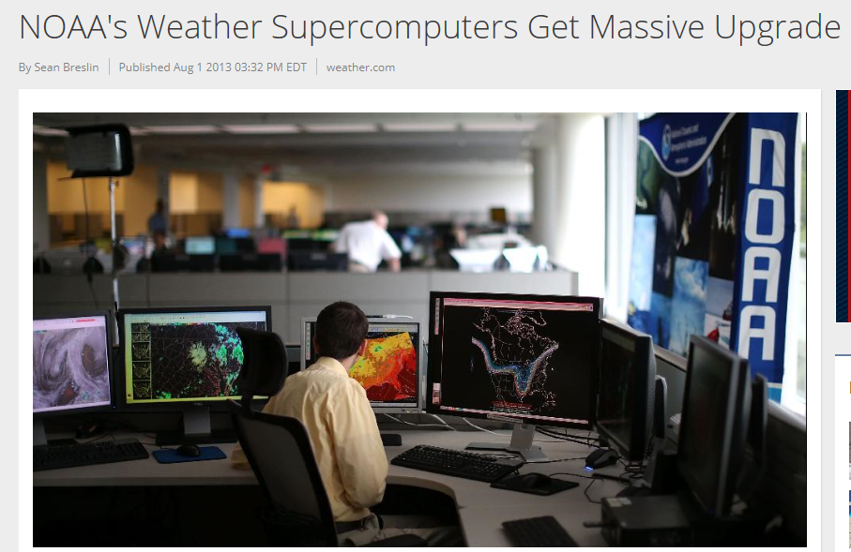
NOAA Operational Computer Upgrade in 2015
Petaflop = 1000 Trillion Floating Point Operations per Second
1 trillion = 1x10¹² = 1,000,000,000,000
Capacity per cluster
Dec 2014 = 0.28 Pf
Jan 2015= 0.77 Pf
Dec 2016= 2.80 Pf

Slide 5
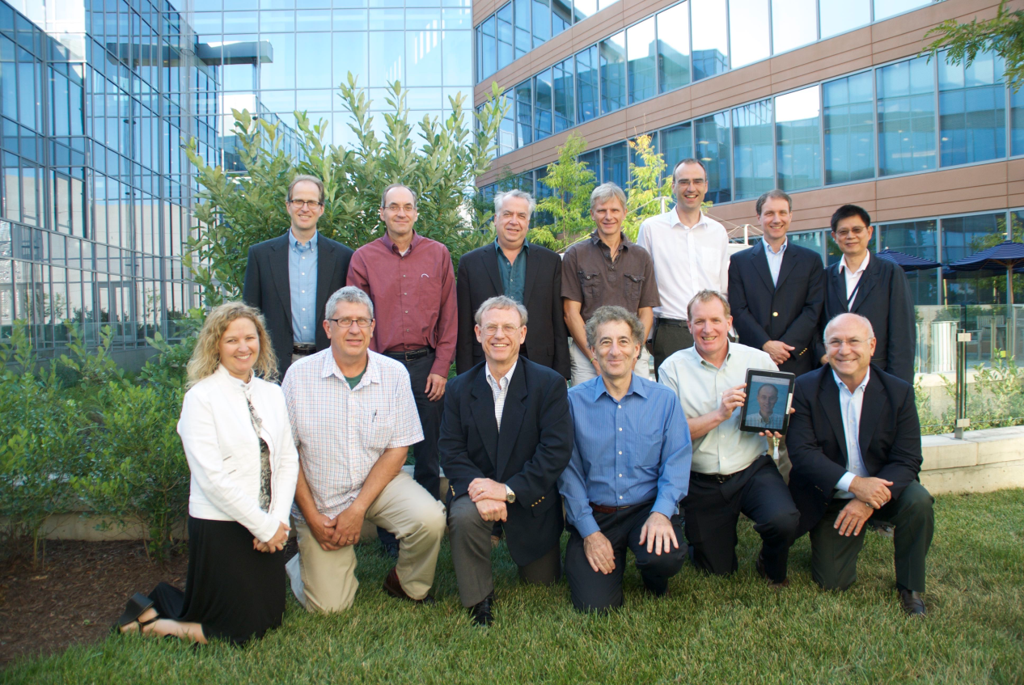
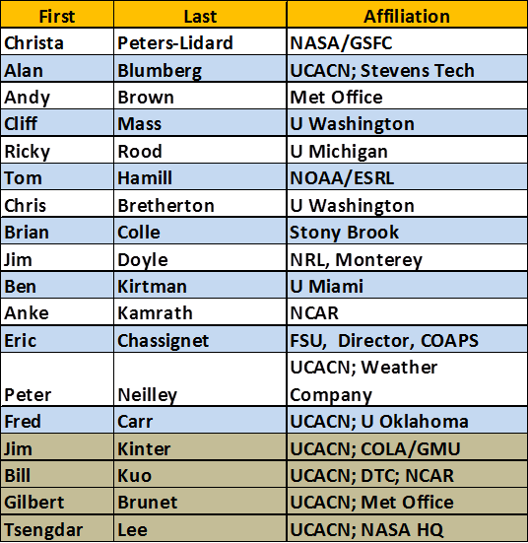
UMAC Membership
Meeting 4-7 August 2015 in College Park
90 Participants across the community
Preliminary findings and recommendations briefed to NOAA leadership
Report to be published by the end of October 2015
Materials available at:
https://www.earthsystemcog.org/projects/umac_model_advisory/

Slide 6
UMAC Preliminary Findings and Recommendations

Slide 8
Executive Council
Portfolio Integration Council
Mission Delivery Council

Slide 9
High-level Requirements Process Overview CaRDS
To PIC (as validated field requirement)
Approved
or
Tier 4 – MDC Validation
To AFS (if contained within Portfolio)
Tier 3 – AFS Director Review/Validation
A Mandate (e.g., executive order, public law, etc.) would enter Cards at Tier 2
To NSP Team (for execution)
Not Approved - Feedback to Originator
Integrate with SD
Portfolios
Tier 2 – National Service Program (NSP) Team Review
CaRDS Submission
Tier 1 – First Level (Local) Review (MIC/HIC, MSD, NC Director, etc. with visibility to FMC Director)
Submit Request
(short template)
Needs/
Requests
Request Originator
Pre-decisional
9

Slide 10
Thoughts for the Meeting….
Integrated NWS Field (WFO, RFC, CWSU, Regions, National Centers) is a priority driver for numerical guidance requirements
Requirements (NOT SOLUTIONS) will be solicited, vetted and validated through the 11 NWS National Service Programs and the Integrated Field
Model development organizations responsible for developing solutions to validated requirements
The model implementation process needs revision
NCO 30-day parallel insufficient for adequate field assessment
Develop capability for model developers to interact with field during development cycles
Think strategically this week…

