Slide 1
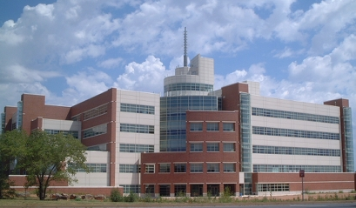
Storm Prediction Center NCEP Production Suite Review December 7, 2015 Steven Weiss, Russell Schneider, Israel Jirak, Chris Melick, Andy Dean, and Patrick Marsh Storm Prediction Center, Norman, OK
National Weather Center
National Weather Center

Slide 2
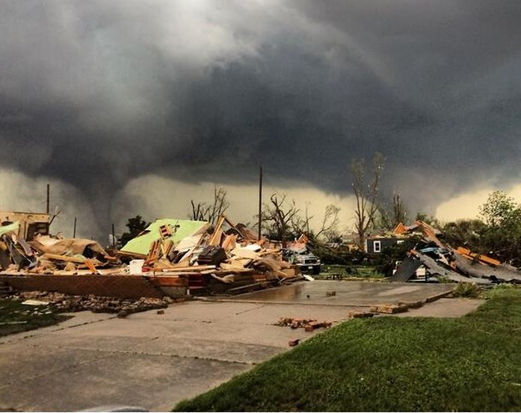
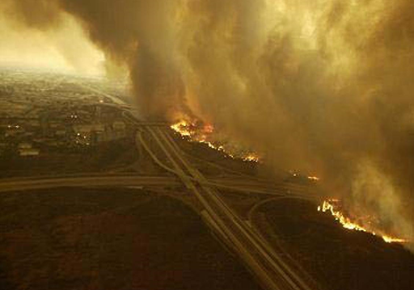
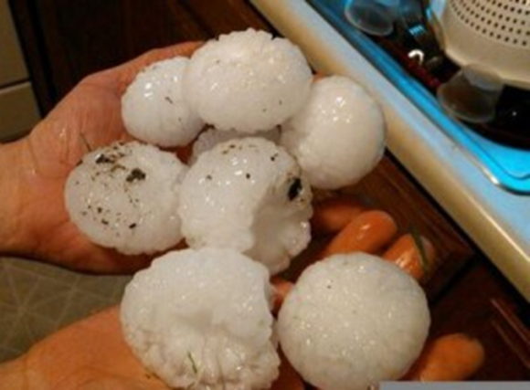
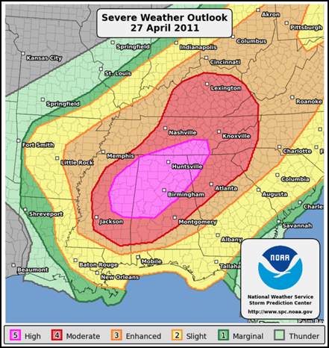
Question 1
What are the Biggest Challenges Your Region/Center Faces?

Slide 3
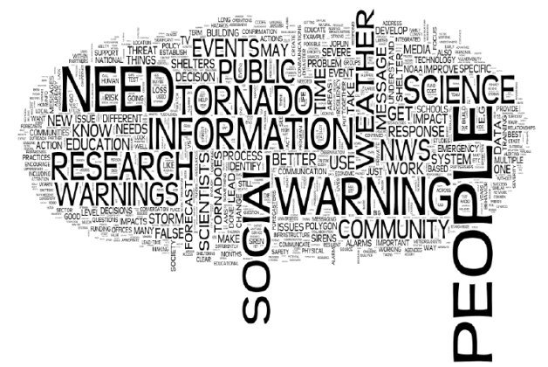
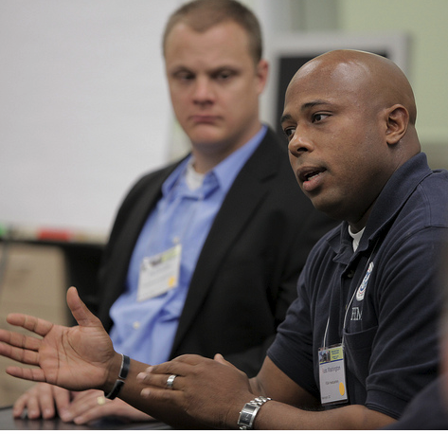
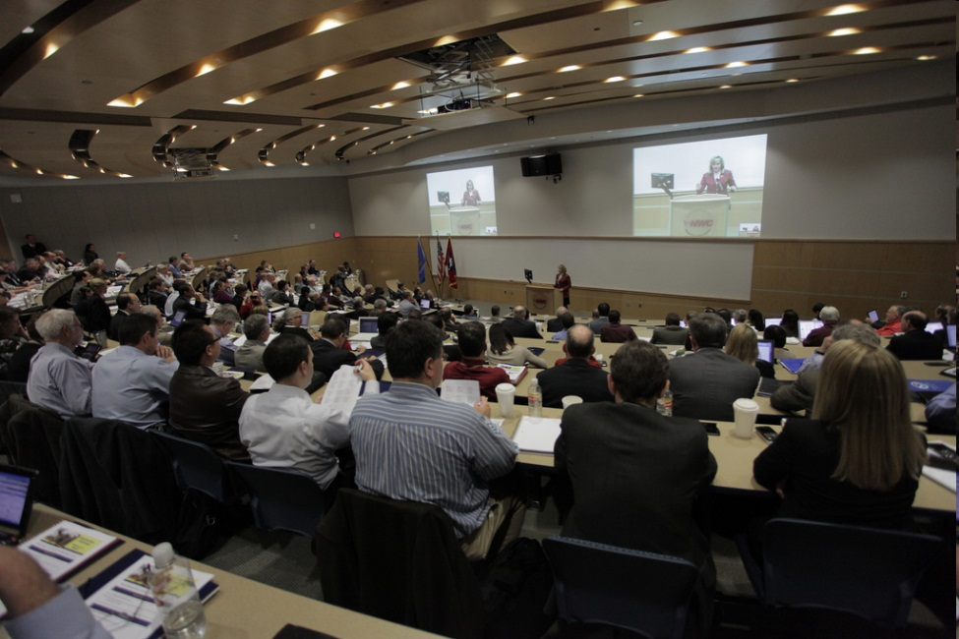
Goal: reduce the loss of life and mitigate the social and economic impacts of severe weather
This is a multi-dimensional Science and Service problem
Physical Science and Social Science Factors
Hazard Prediction, Risk Quantification, and Communication Issues
http://www.joss.ucar.edu/events/2011/weather_ready/

Slide 4
1. What are the Biggest Challenges Your Region/Center Faces?
How do we effectively blend science advancements (R2O) into an increasingly service-based NWS (IDSS)?
Blending SPC expert knowledge of severe storm storm environments with emerging CAM ensembles
Both a forecaster and a post processing challenge
Integrating emerging short-range CAM ensembles with forecaster expertise to create frequently updated probabilistic information in the 1-15 hour range
Support hour-to-hour emergency decision making (FACETs)
Handling data volume rates that continue to expand exponentially
Effective specialized post-processing and information extraction tools are essential
Extending Day 1 CAM-driven individual hazard forecast skill out to Days 2 & 3
Requires effective forecast of convective mode and cascading influence of previous day's convection
Translating quantitative hazard forecasts into probabilistic impact forecasts

Slide 5
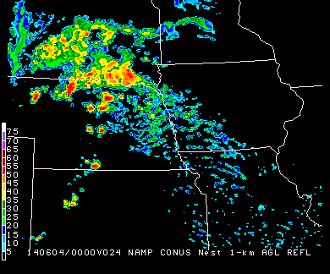
Questions 2 and 3
Does the Current Production Suite and Products Adequately Help You Address Those Challenges?
Is the Current Amount of Available Guidance Too Much, Too Little, or the Right Amount? (Goldilocks Dilemma)
GFS
NAM
RAP
SPC

Slide 6
2. Utility of Production Suite Products 3. Too Much, Too Little, Just Right?
In early September 2015, SPC forecasters were surveyed on numerical models used in SPC operations
21 of 22 full time forecasters (95%) completed the survey
They provided ratings and comments on specific global, regional, and convection-allowing models and ensembles
Global: GFS, GEFS, ECMWF, ECMWF Ensemble (4)
Regional: NAM, RAP, SREF (3)
CAM: NAM Nest, HiResW NMMB & ARW, HRRR, NSSL-WRF, SSEO, NSSL Ensemble (7)
They were also asked several questions about simplifying the modeling suite

Slide 7
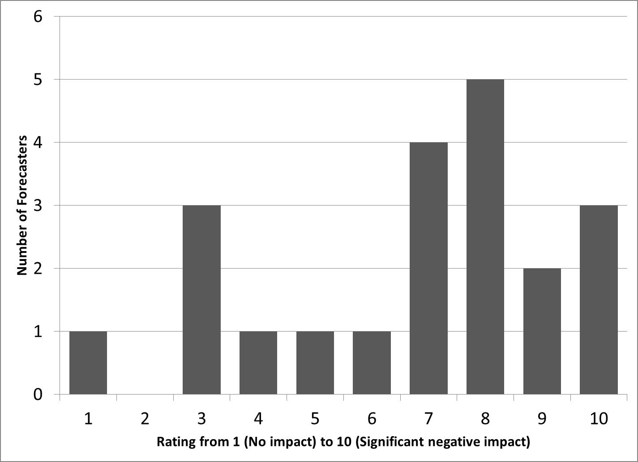
If the parent NAM were eliminated from operations, and you were left with the GFS for guidance on pattern, environment, precipitation, etc., how would that impact your operational outlooks and products?
67% said replacing NAM with GFS would have a noticeable negative impact on forecasts
Common themes in forecaster comments:
Receipt of the NAM is more timely than the GFS
NAM generally provides more useful guidance for mesoscale features (e.g., fronts, drylines, outflows) and convective precipitation than the GFS
Thermodynamic profiles from the GFS, especially in the boundary layer, are often incorrect

Slide 8
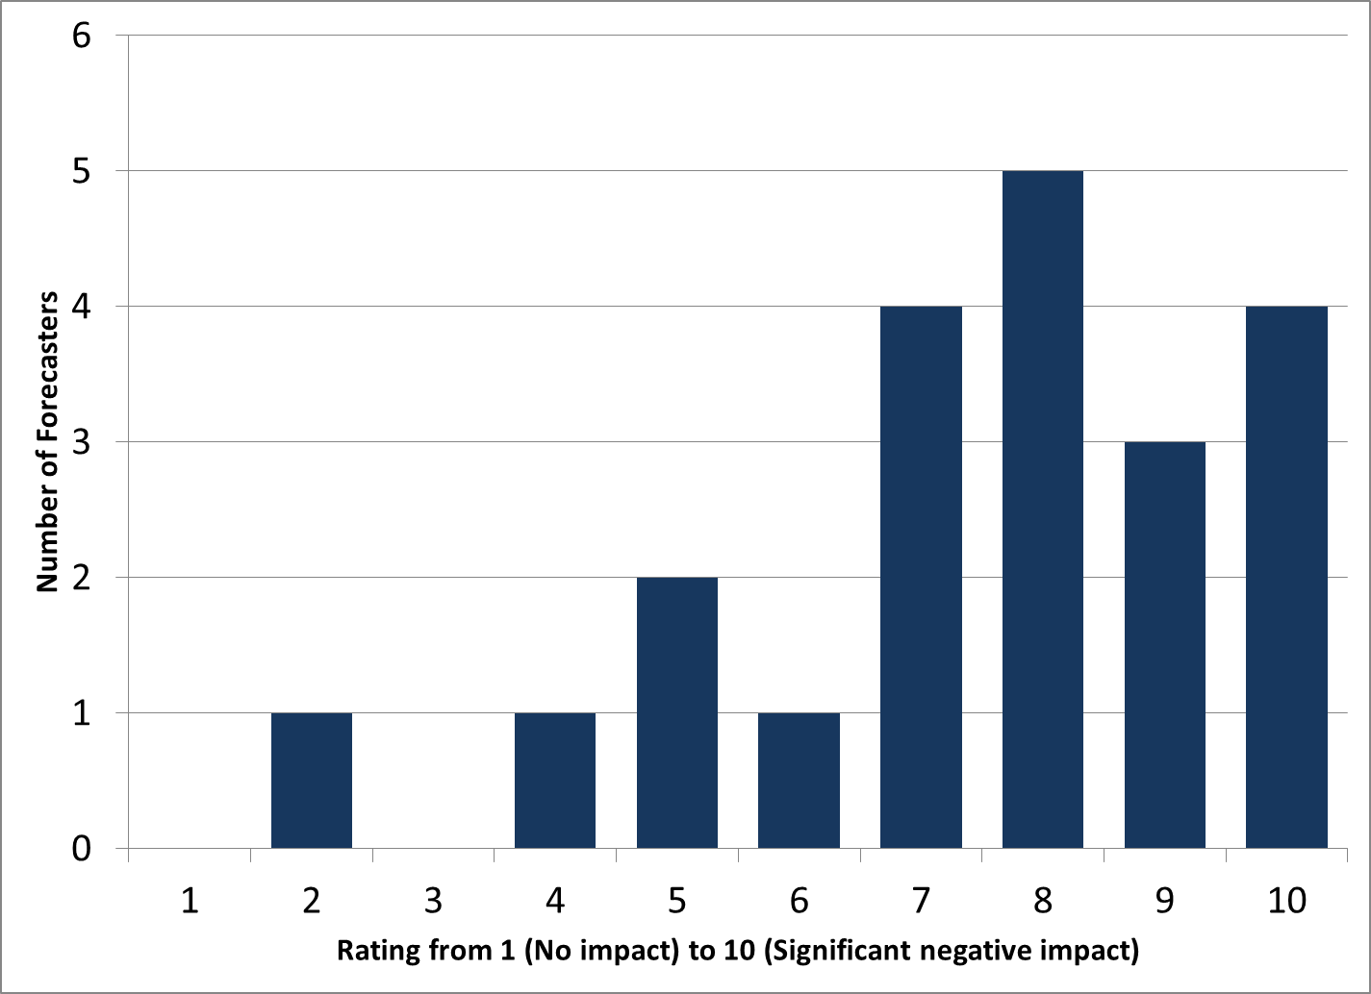
Similarly, if the SREF were eliminated from operations, and you were left with the GEFS for ensemble guidance on pattern, environment, precipitation, etc., how would that impact your operational outlooks and products?
76% said replacing SREF with GEFS would have a noticeable negative impact on forecasts
Common themes in forecaster comments:
Timeliness and resolution are better for the SREF than the GEFS
Post-processed and calibrated fields for the SREF are helpful and widely used
Do not look at GEFS (insufficient spread, poor thermodynamic fields)

Slide 9
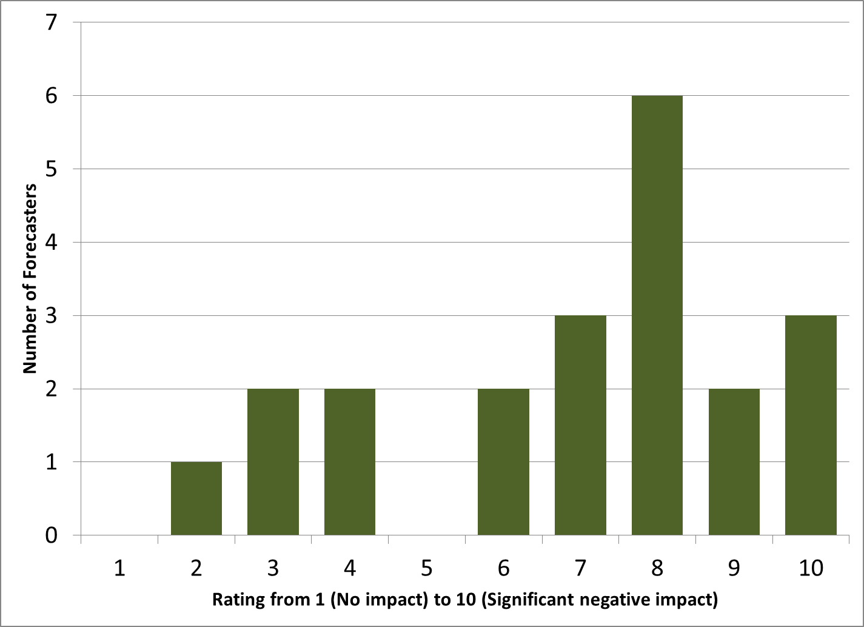
Similarly, if the parent NAM and RAP were eliminated from operations, and you were left with the NAM Nest and HRRR for regional guidance on pattern, environment, precipitation, etc., how would that impact your operational outlooks and products?
67% said replacing NAM/RAP with NEST/HRRR would have a noticeable negative impact on forecasts
Common themes in forecaster comments:
Higher resolution fields from NAM Nest and HRRR take longer to load in workstations
Details in the high-resolution nests can be noisy, misleading, difficult to interpret, etc.

Slide 10
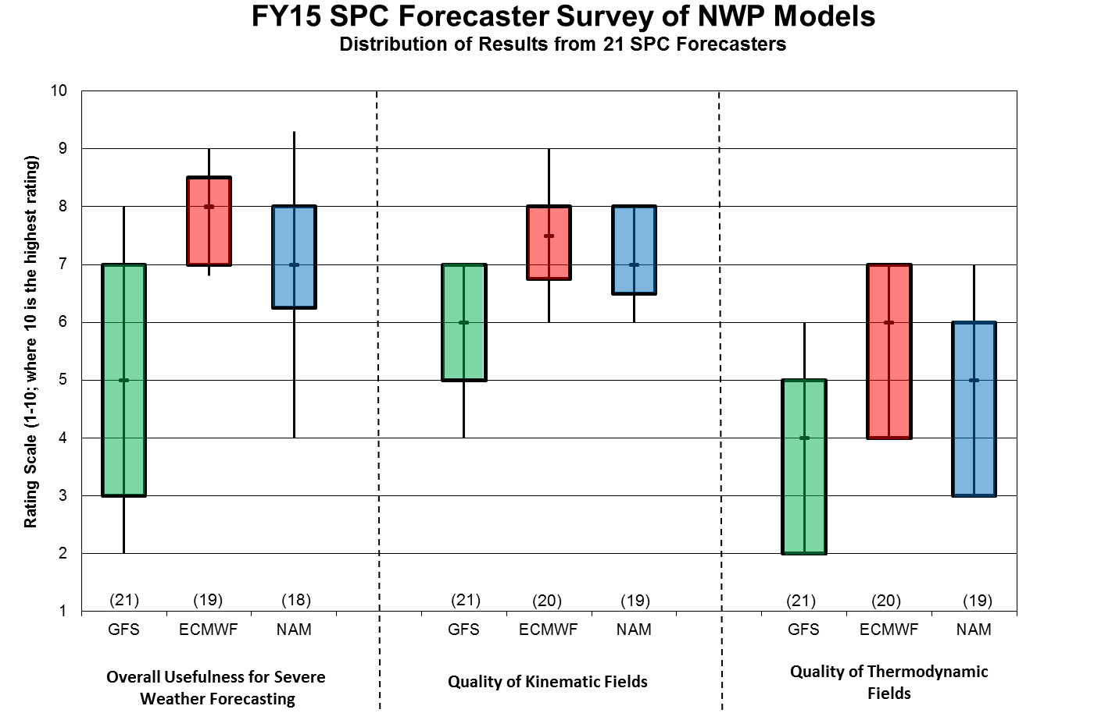
Deterministic Models: Days 1-3+
Overall Usefulness Kinematic Fields Thermodynamic Fields
EC
EC
NAM
NAM
GFS
EC
GFS
NAM
GFS
Common themes in forecaster comments:
GFS: Mass fields are good on synoptic scale, but thermodynamic fields are generally in error
ECMWF: Model of choice for synoptic-scale pattern, precipitation, and consistency beyond Day 1
NAM: PBL moisture and buoyancy overestimated

Slide 11
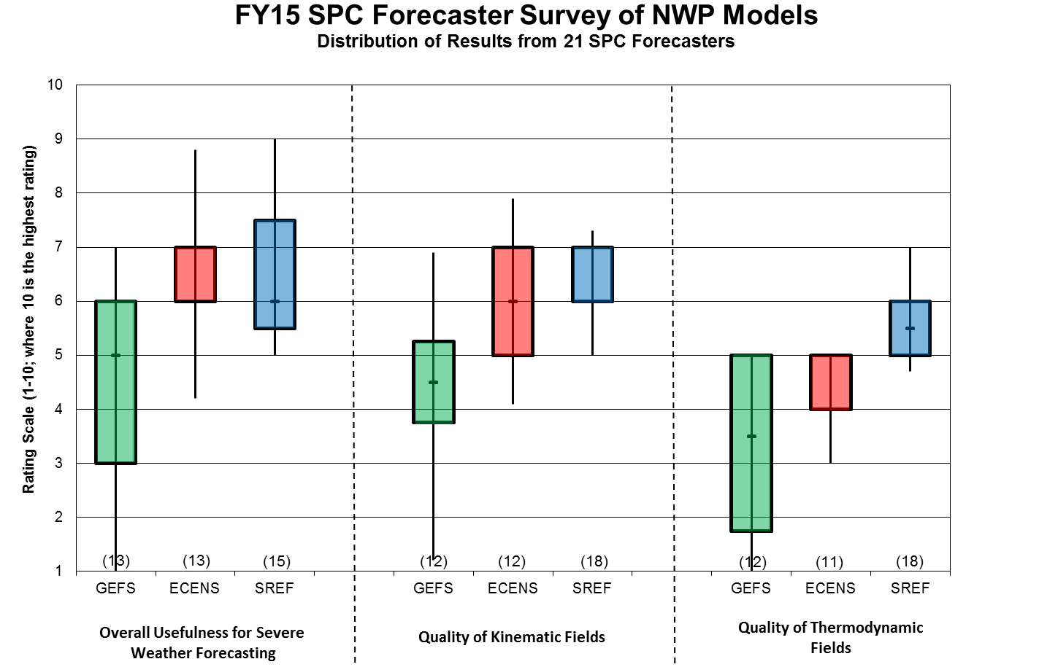
Ensembles: Days 1-3+
Overall Usefulness Kinematic Fields Thermodynamic Fields
EC ENS
SREF
SREF
EC ENS
SREF
GEFS
EC ENS
GEFS
GEFS
Common themes in forecaster comments:
GEFS: Similar issues to GFS (useful synoptic scale mass fields but thermodynamic fields often poor)
ECENS: Used for evaluating spread/predictability
SREF: Post-processed and probabilistic guidance useful

Slide 12
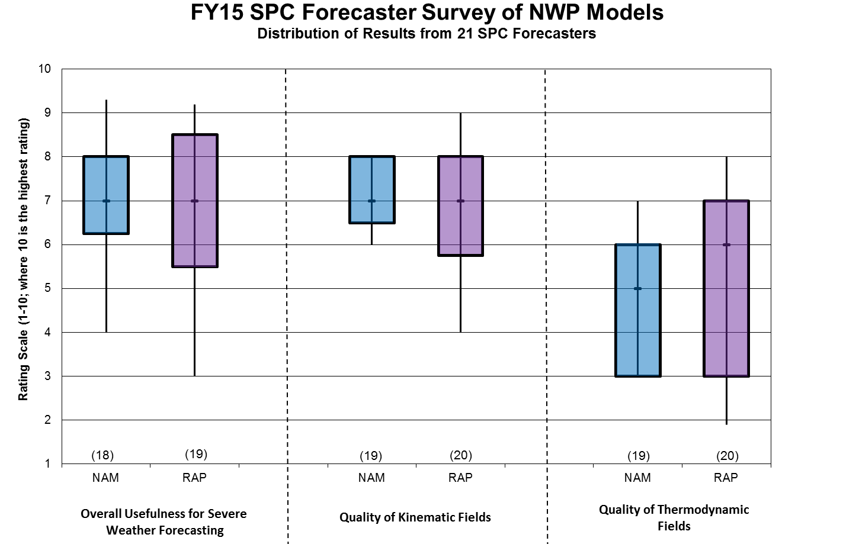
Deterministic Models: Day 1
Overall Usefulness Kinematic Fields Thermodynamic Fields
NAM
NAM
RAP
RAP
NAM
RAP
Common themes in forecaster comments:
NAM: PBL moisture and buoyancy often overestimated
RAP: Notable overmixing of the PBL in the afternoon; advantage is hourly frequency

Slide 13
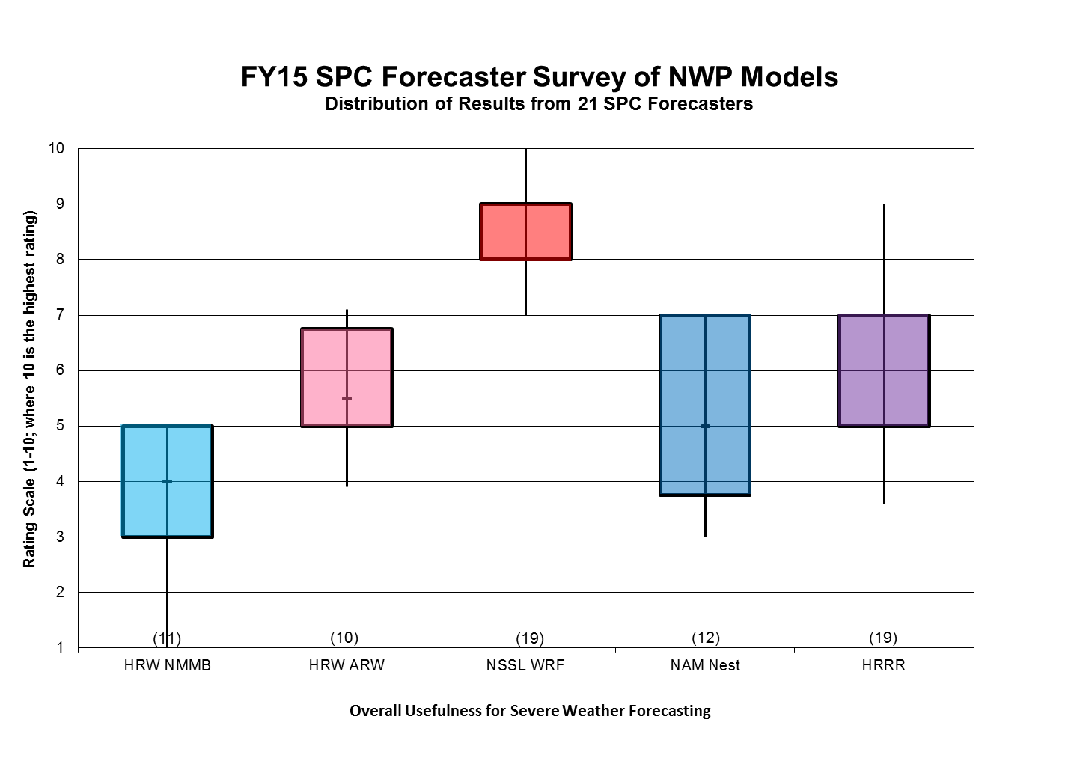
Deterministic CAMs: Day 1
Overall Usefulness in Severe Weather Forecasting
NSSL
HRW ARW
HRRR
NAM NEST
HRW NMMB
Common themes in forecaster comments:
NSSL-WRF: “gold standard” and best performing CAM; static configuration for several years
NCEP HRRR: Run-to-run inconsistency; Overforecast of convection in the warm season; ESRL HRRR is an improvement over the NCEP HRRR

Slide 14
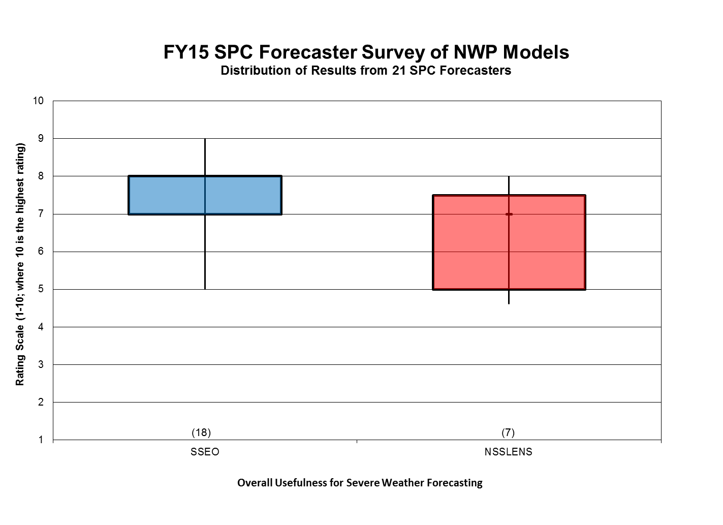
Ensemble CAMs: Day 1
Overall Usefulness in Severe Weather Forecasting
SSEO
NSSL Ens
Common themes in forecaster comments:
SSEO: whole is greater than the sum of its parts; provides confidence in location, timing, and intensity of severe weather threat

Slide 15
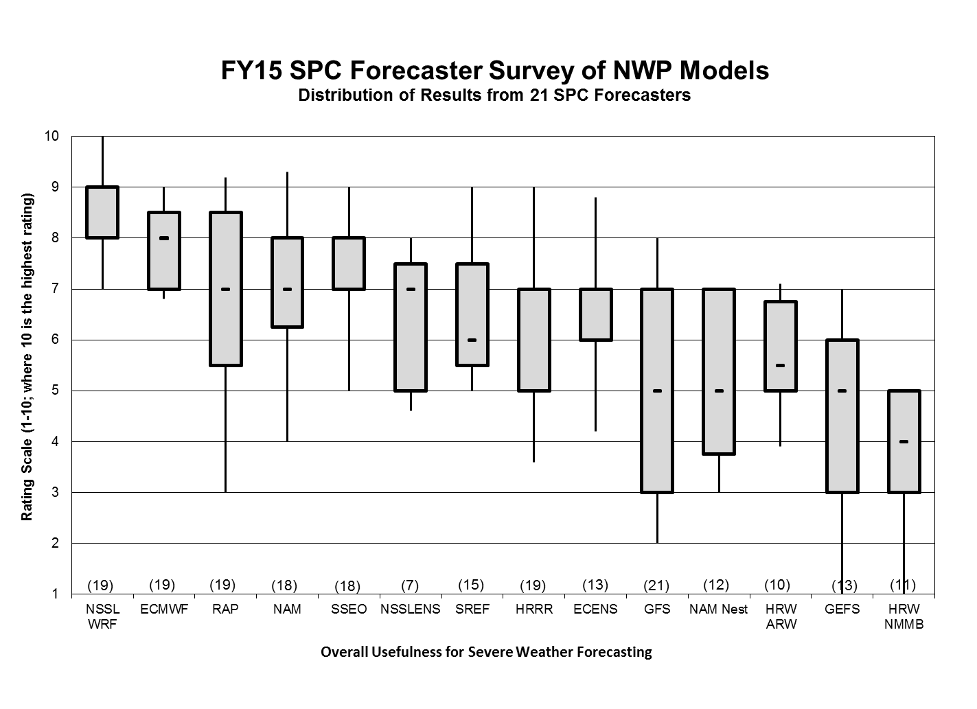
All Models
(14)
Overall Usefulness in Severe Weather Forecasting
NSSL
EC
SSEO
NAM
EC ENS
RAP
SREF
Common themes in forecaster comments:
Forecast accuracy of thermodynamic profiles in the boundary layer has degraded over the years
Too many models (many of them less useful); makes it difficult to track biases and changes
Room for improvement!

Slide 16
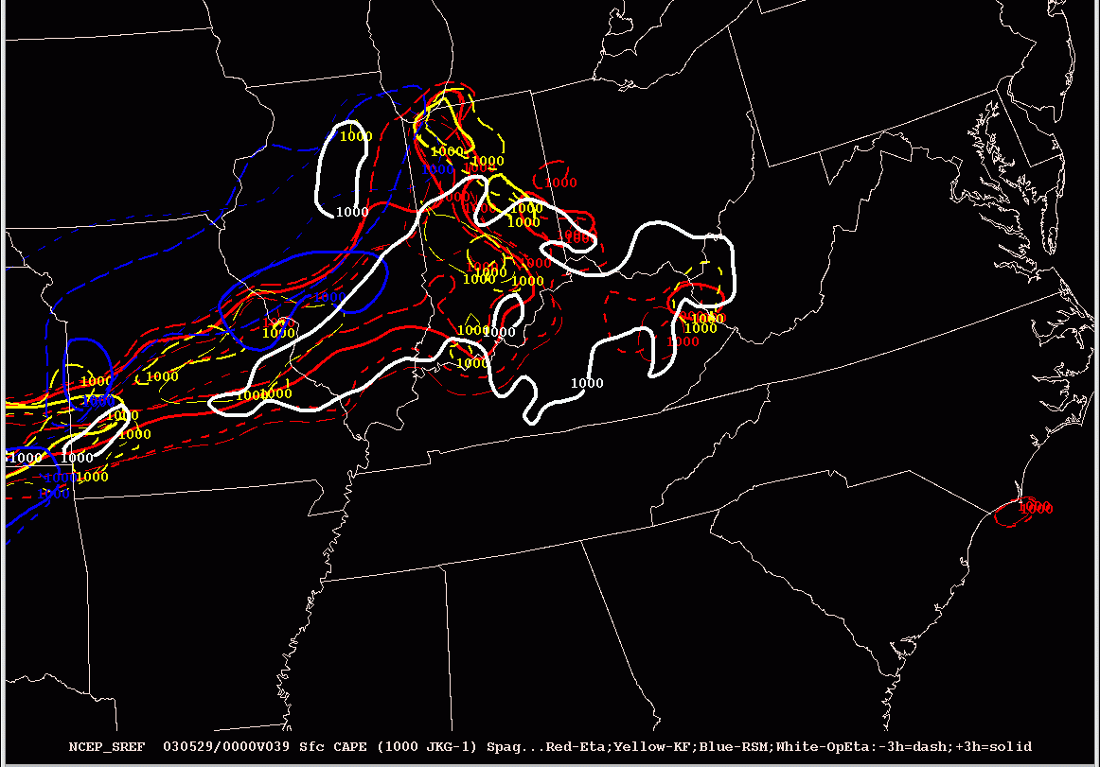
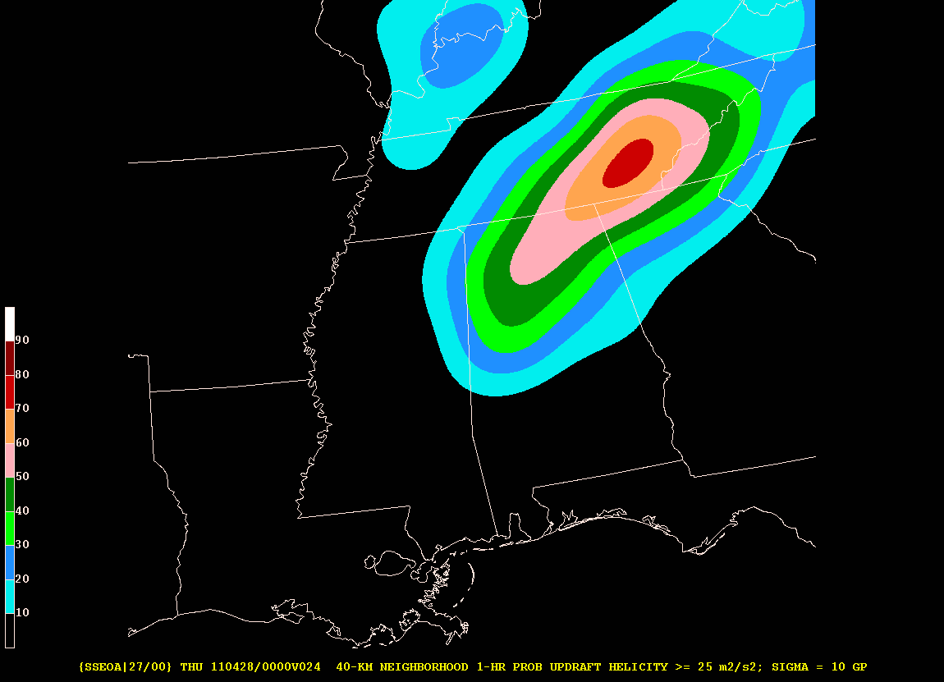
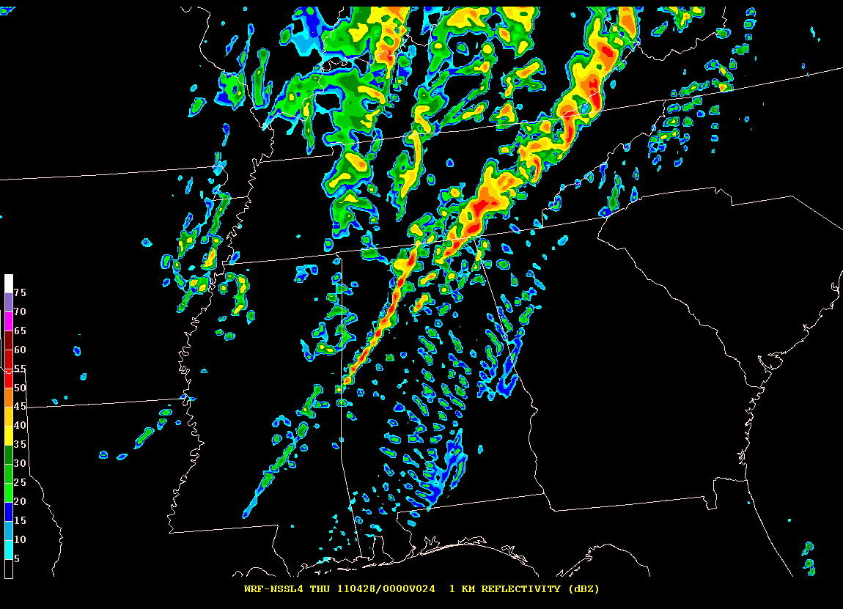
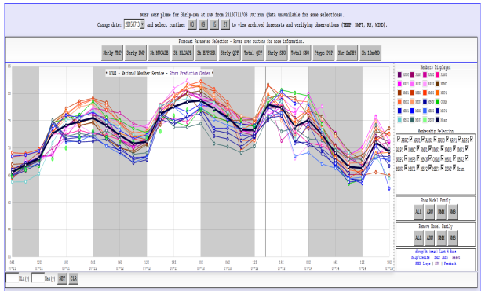
Question 4
What Do You Need in Terms of Models or Products to Meet Your Challenges in the Next 1-2 Years?

Slide 17
4. What Do You Need in Terms of Models or Products to Meet Your Needs in the Next 1-2 Years?
Improved model representations of thermodynamic profiles
PBL structure (depth, moisture, capping inversions)
GFS/GEFS too warm/dry/deeply mixed in warm season (MEG discussions)
GFS can have noticeable low-level errors at 00-h time (starts out poorly)
Data assimilation and LSM issues
Conversely NAM can be too moist and too unstable
NAM can exhibit physically unrealistic sounding structures
MAUL-like profiles in pre-convective/near-storm model environment
Not unusual to see large differences in GFS and NAM CAPE, RH, etc.
Errors in base models feed directly into ensembles
You help build better ensembles by building better models

Slide 18
4. What Do You Need in Terms of Models or Products to Meet Your Needs in the Next 1-2 Years?
Community development of operational convection-allowing model (CAM) ensemble
High resolution model community is coalescing around plans to systematically test CAM ensemble design and configuration
Goal: Better inform operational development of HREF
HWT 2016 Spring Forecasting Experiment
NSSL, GSD, OU/CAPS, NCAR (perhaps EMC?) have agreed to contribute ARW and NMMB members to test sensitivities, such as:
Number of members, multi-core/single core, DA/IC perturbation strategies, physics diversity and radar assimilation
Common grid/domain, model version, configuration, time step, etc.
Real-time subjective evaluations during HWT; post-experiment objective verification (DTC); STI-MEG team involvement
SSEO used as performance baseline for comparison

Slide 19
4. What Do You Need in Terms of Models or Products to Meet Your Needs in the Next 1-2 Years?
Progress on Rapidly Updating Analysis (RUA)
Improved diagnostic assessment of mesoscale/storm-scale environment is critical for forecaster short-term decision-making
Underlying premise
RUA requires high degree of fidelity with actual observations
Best “Analysis” for diagnostic purposes is not the same as Best ICs for model forecasts (at this time)
RUA should use the power of advanced data assimilation to incorporate traditional observations and remote sensing data
Long-term goal is to provide fully integrated and dynamically consistent real-time view of the mesoscale/storm scale environment
Including storm attribute fields themselves and feedback from convective storms to the near-storm environment

Slide 20
Question 5
What Do You Envision Your Model/Product Needs to be in the Longer Term?

Slide 21
~2020: Potential SPC Products/Services and Attributes of Operational Supporting NWP
Probabilistic Outlooks of Tornado, Severe Hail, and Severe Wind Hazards extended to Day 3
Probabilistic Outlooks of Tornado, Severe Hail, and Severe Wind Hazards for 4-h periods for Days 1 and 2
Frequently Updated, Short Term Probability Forecasts for Tornado, Severe Hail, Severe Wind, and Significant Severe Hazards to support transition to continuously evolving public severe weather watches (Day 1)
Week 2 and Monthly/Seasonal Severe Weather Outlooks (with CPC)
* NWP capabilities are dependent on improvements in NOAA high performance computing resources and advances in data assimilation, physics, ensemble perturbation strategies, etc. For Warn on Forecast vision to progress, organized community development & testing is needed
Global Ensemble Forecast*: ~12 km ~40 member ensemble with EnKF/hybrid or newer-state-of-the-art DA, run every 6h with forecasts to at least Day 10
CONUS High Resolution Ensemble Forecast*: ~3 km CONUS ~15 member storm scale ensemble with EnKF/hybrid or newer state-of-the-art hourly DA, forecasts to 18-24h every hour and to 48-60h every 6h.
WoF Prototype*: ~1 km CONUS or movable regional domain 10-15 member storm scale ensemble with EnKF/hybrid or newer state-of-the-art DA, run hourly with forecasts to 12-18h (If movable, focused on “severe weather of the day” areas)
Stormscale 3D Analysis (RUA)*: ~1 km EnKF/hybrid or newer state-of-the-art DA, CONUS storm scale analysis updated every 15 min
CFS capacity to support Extended Outlooks
Simplified Model Suite!

Slide 22
Supplemental Slides

Slide 23
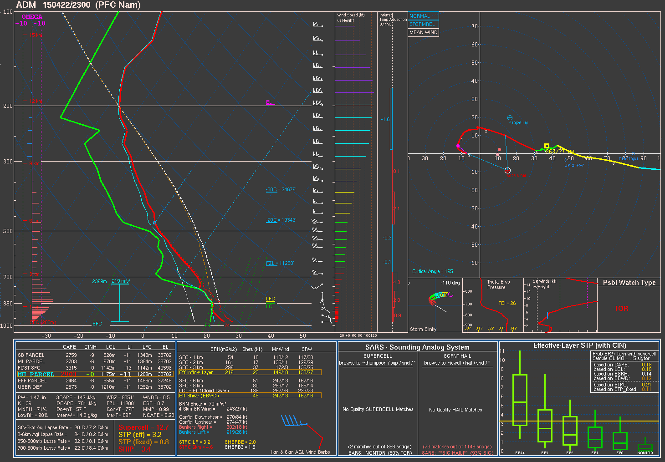
4. What Do You Need in Terms of Models or Products to Meet Your Needs in the Next 1-2 Years?
Improved model representations of thermodynamic profiles
NAM 59-h forecasting sounding @ADM
Immediate pre-convective environment
MUCAPE 2903 J/kg
MAUL-like structure

Slide 24
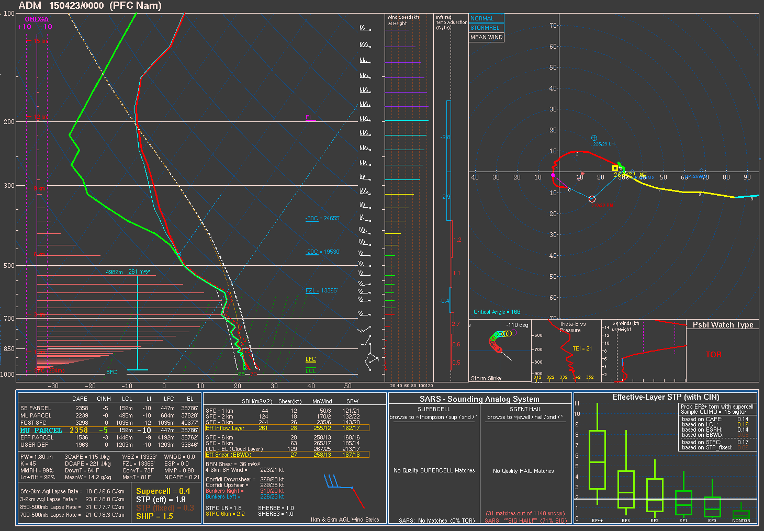
4. What Do You Need in Terms of Models or Products to Meet Your Needs in the Next 1-2 Years?
Improved model representations of thermodynamic profiles
NAM 60-h forecast sounding @ADM
Deep convection occurring with saturated dry-adiabatic lapse rate 600-500 mb
MUCAPE 2358 J/kg

Slide 25
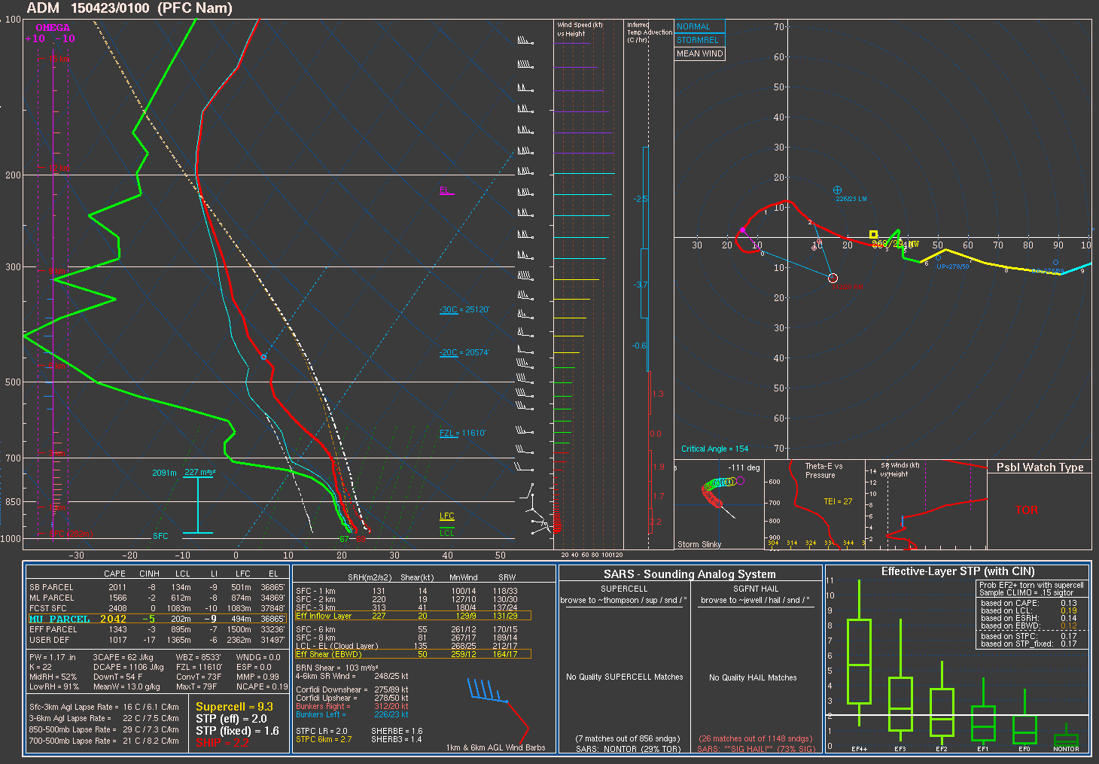
4. What Do You Need in Terms of Models or Products to Meet Your Needs in the Next 1-2 Years?
Improved model representations of thermodynamic profiles
NAM 61-h forecast sounding @ADM
Deep convection ended but little indication of traditional BMJ adjustment with high RH and near-moist adiabatic profile
MUCAPE 2042 J/kg

