Slide 1
NPSR MEG Review
12/8/15
EMC Model Evaluation Group
Geoff Manikin
Glenn White
Corey Guastini

Slide 2
Concerning the Amount of Guidance
Among our event recaps in 2015, the MEG reviewed the January New England blizzard, including a careful examination of all precip guidance
The next slide shows the precip guidance available during 1/26, the period leading up to the start of the event and the first few hours of the snow

Slide 3
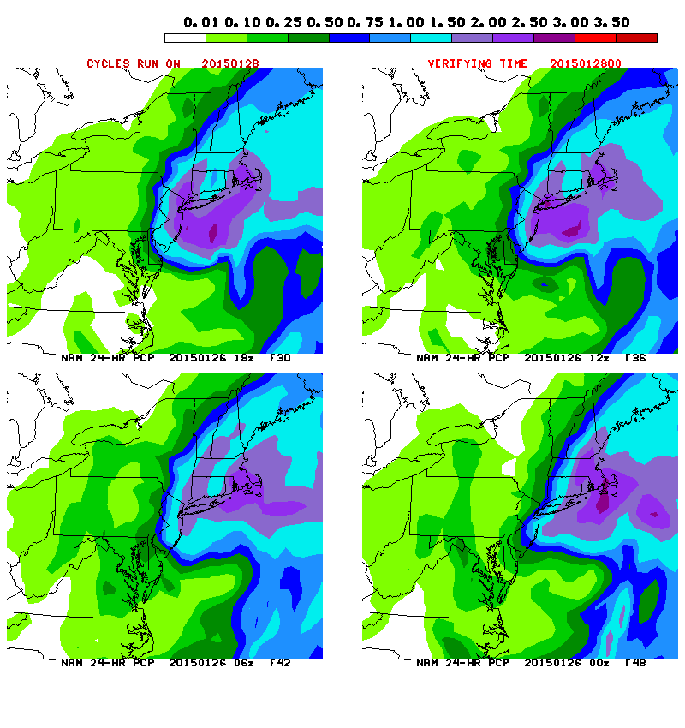
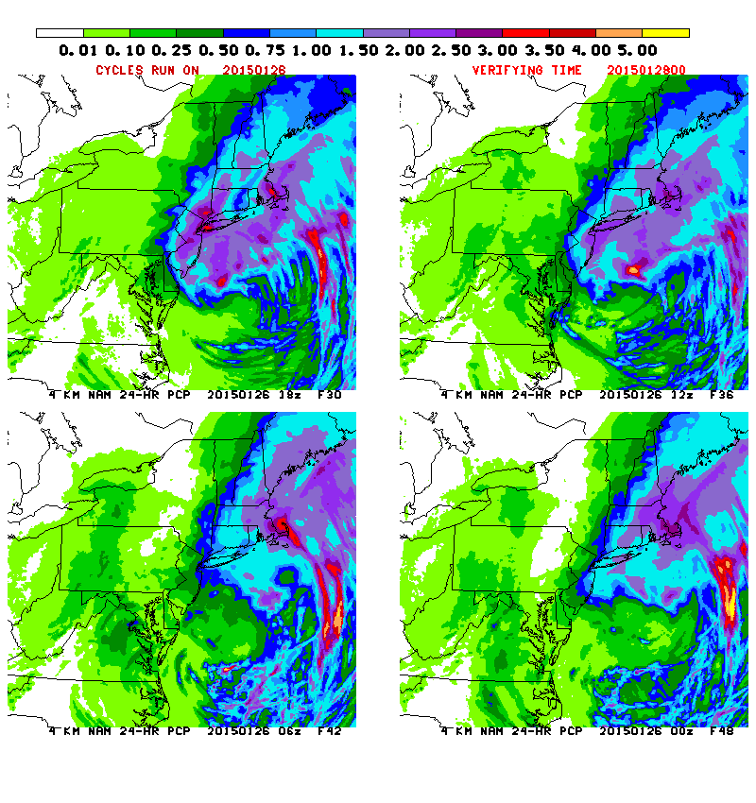
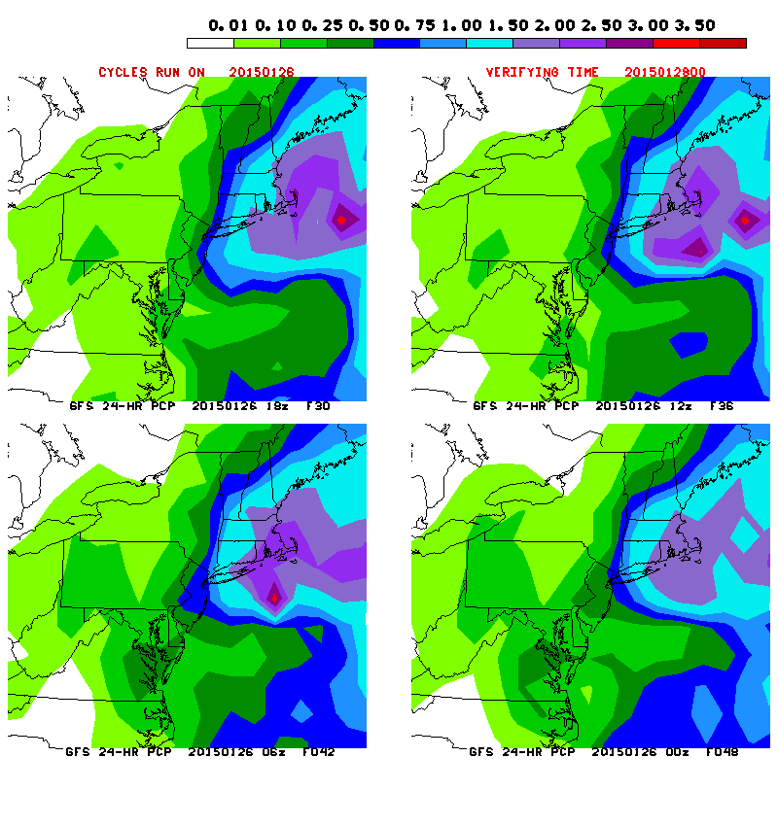
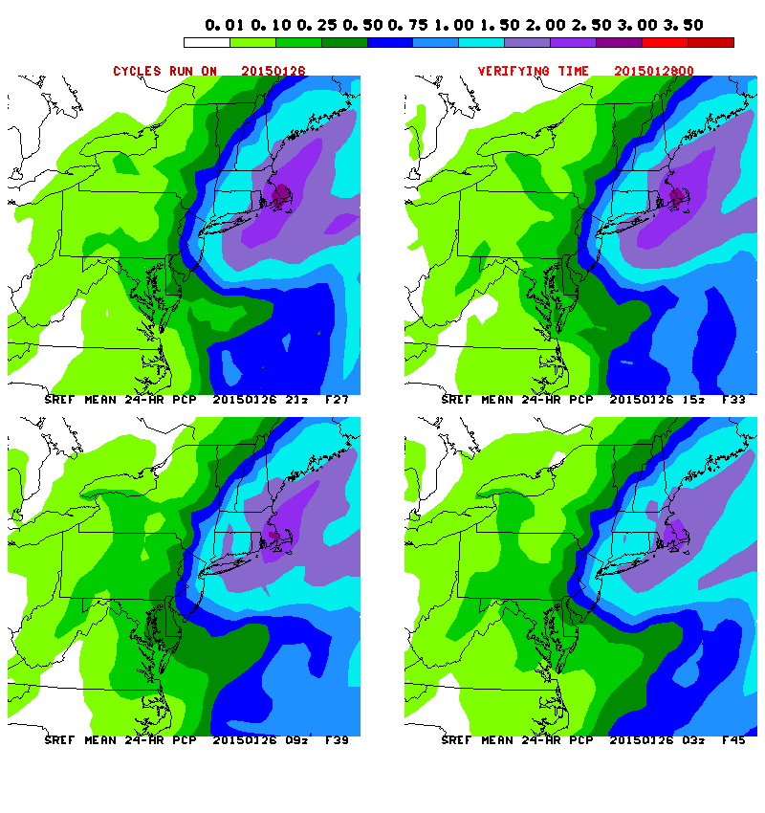
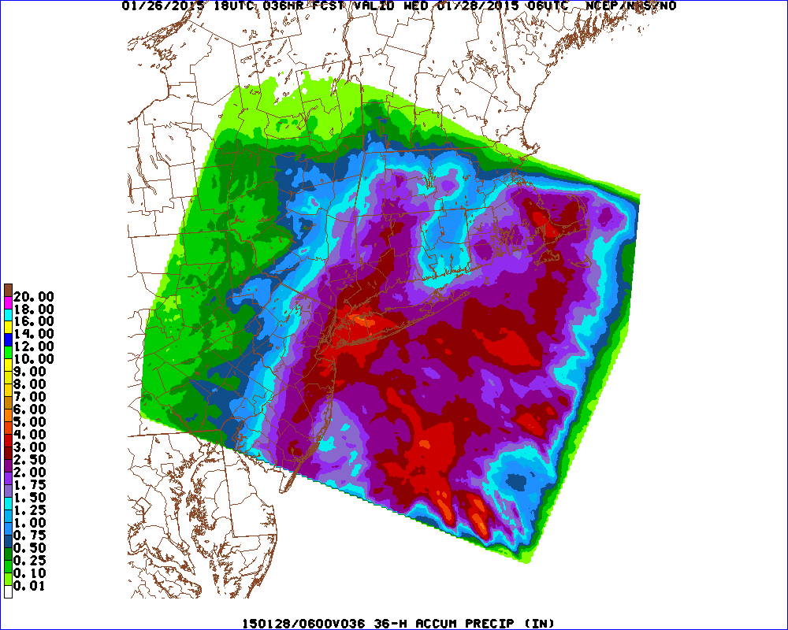

Slide 4
The amount of guidance to review after an event makes our heads spin; we can’t fathom what it’s like to be a forecaster dealing with it in real time.
SIMPLIFY!!!

Slide 5
Our Assessment of the Most Pressing Model Issues

Slide 6
Initializing GFS Moisture
No attempt to match F00 2-m meter dew points to obs
Moisture profiles first guesses are sometimes so far off from the observed raobs that there is little fit to the data

Slide 7
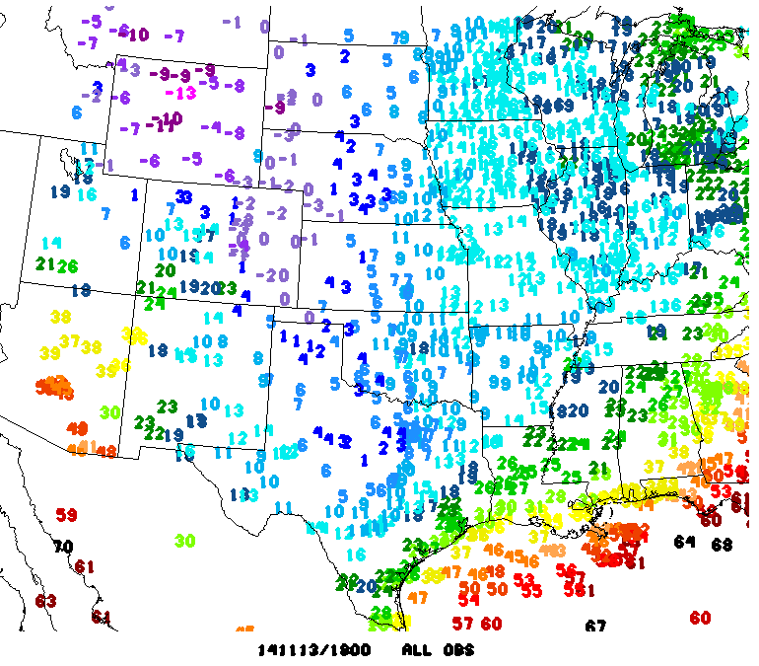
Initializing GFS Dew Points

Slide 8
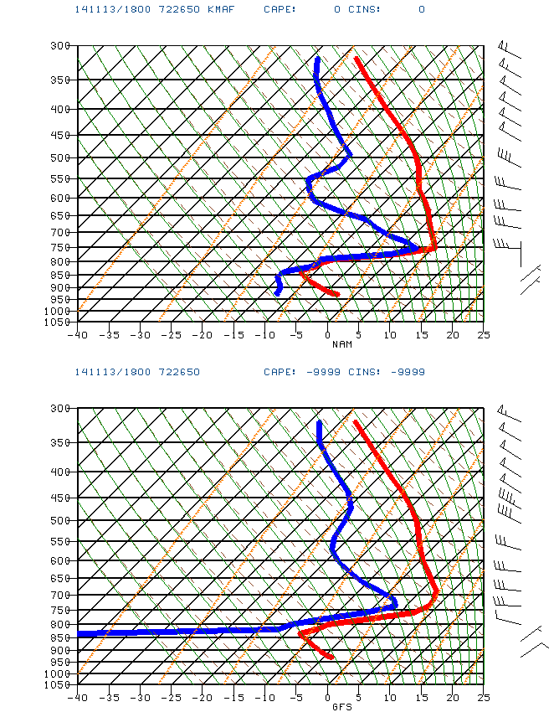
NAM
F00 Soundings
for Midland, TX
GFS

Slide 9
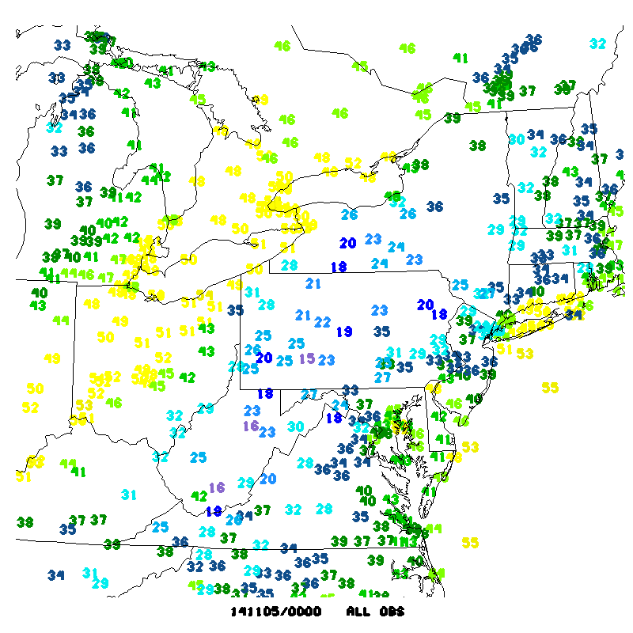

Slide 10
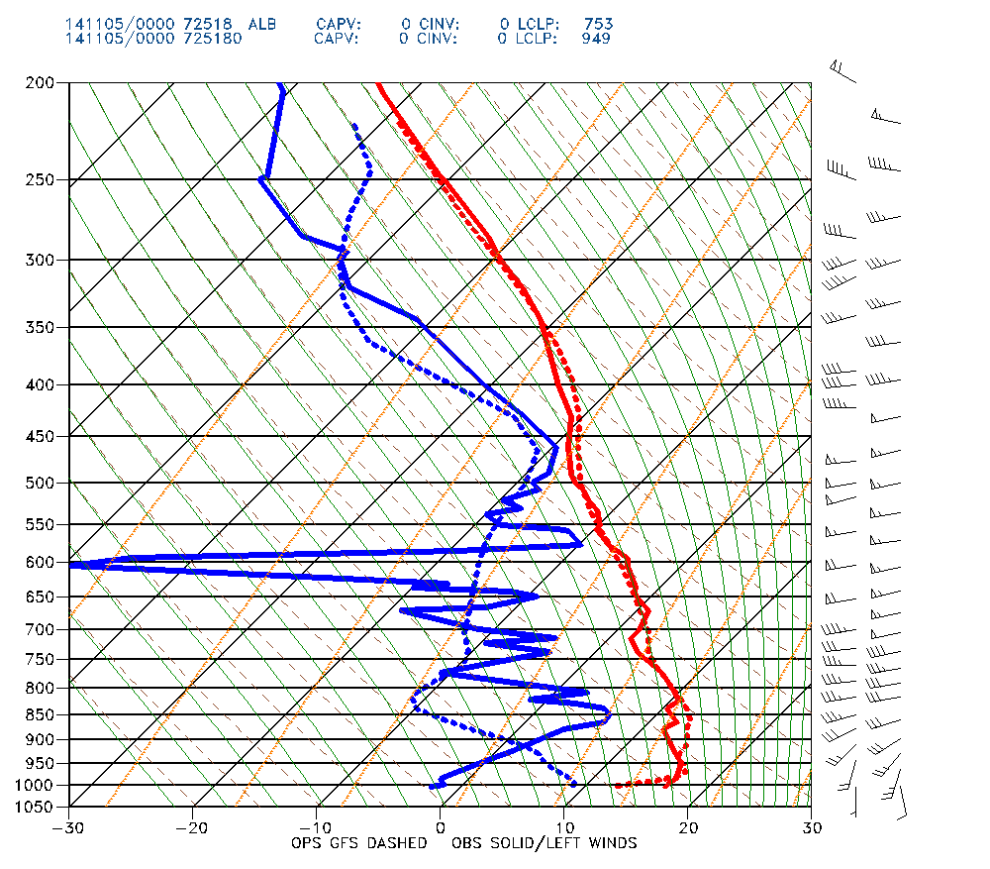
GFS 00-hr Forecast Sounding vs Obs for Albany, NY

Slide 11
Inversions
GFS doesn’t make them strong enough
NAM sometimes makes them too strong
GFS tends to make low-level winds too strong
Implications for precip type forecasting in strong warm advection events

Slide 12
06z F06 MAF
GFS
NAM

Slide 13
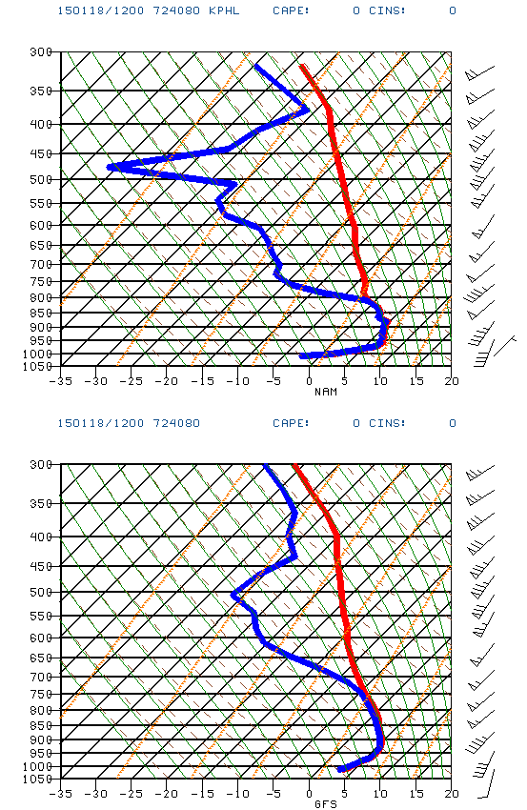
NAM
12-hr FCST SOUNDINGS for PHILADELPHIA,PA
VALID 12z 1/18 – when
ice was accumulating
on overpasses and
elevated surfaces,
causing many serious
crashes
GFS

Slide 14
Low QPF Bias in Warm Sector in NAM
Insufficient convection along southern end of cold front where forcing is weaker, but instability, deep moisture, and low-level convergence are good
Moisture in the model is able to stream further to the north and west, leading to a wet bias in the cool sector
NAM nest is often superior to the parent in this type of event

Slide 15
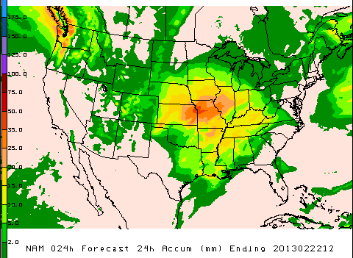
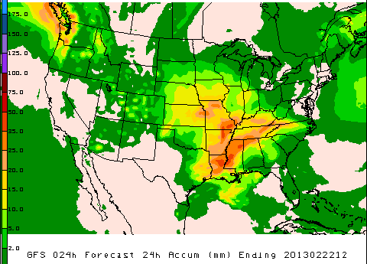
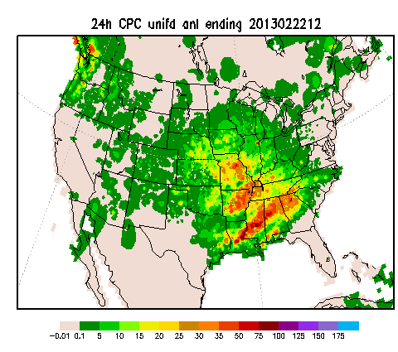

Slide 16
NAM nest tends to allow instability to recover WAY too fast after active convection stabilizes the atmosphere
Common occurrence in hi-res guidance??

Slide 17
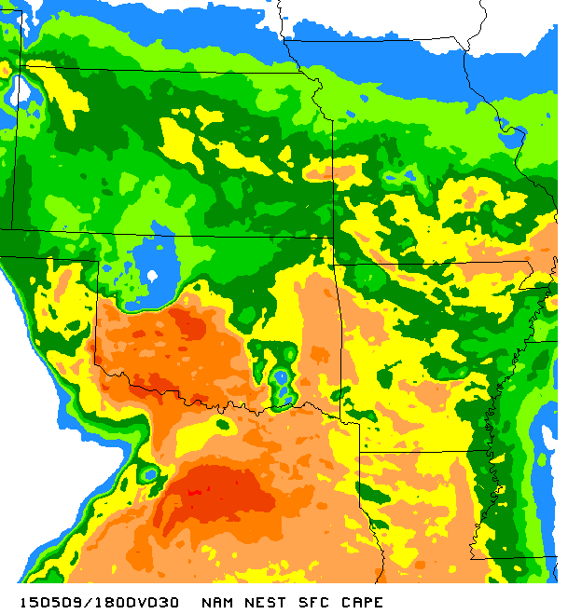
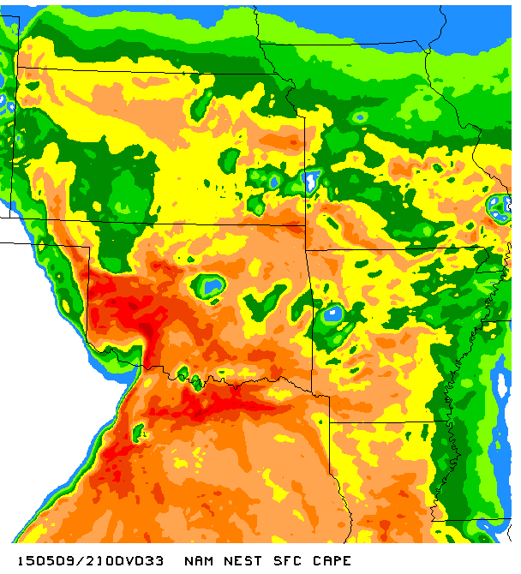
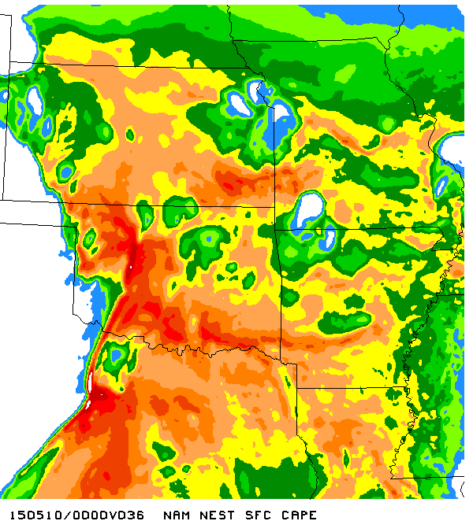
EVOLUTION OF NAM4 SFC CAPE
18-00z 5/9/15

Slide 18
Warm, Dry Biases in GFS/RAP/HRRR
RAPv2 and HRRRv3 will significantly mitigate these biases
Next version of GFS also shows healthy improvement

Slide 19
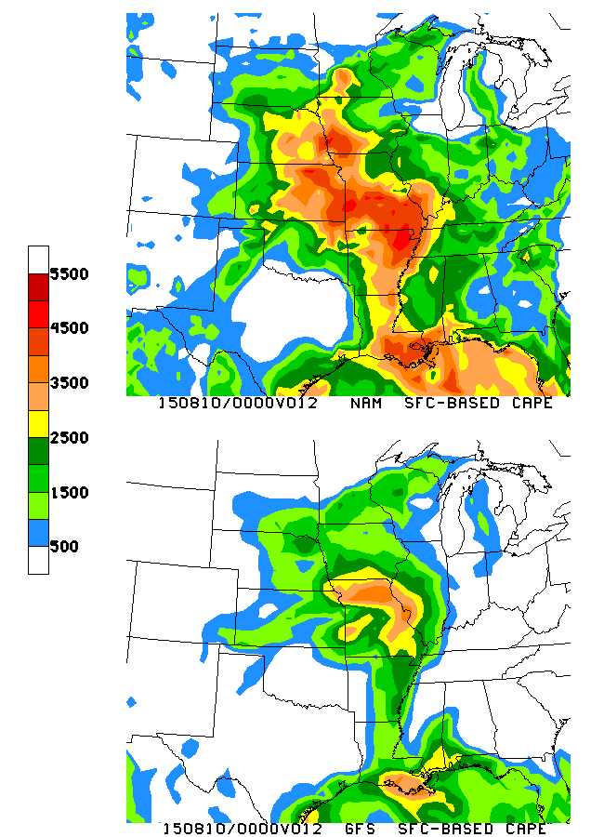
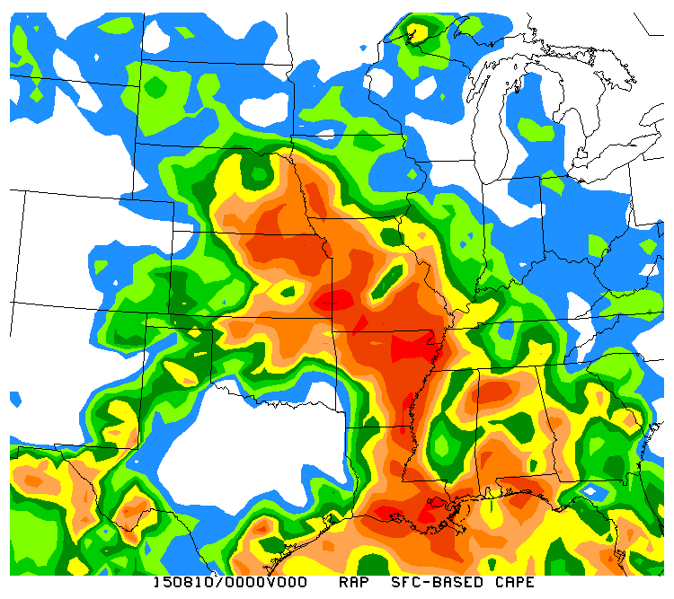
Sample 12-hr NAM/GFS forecasts
of sfc-based cape
ANL

Slide 20
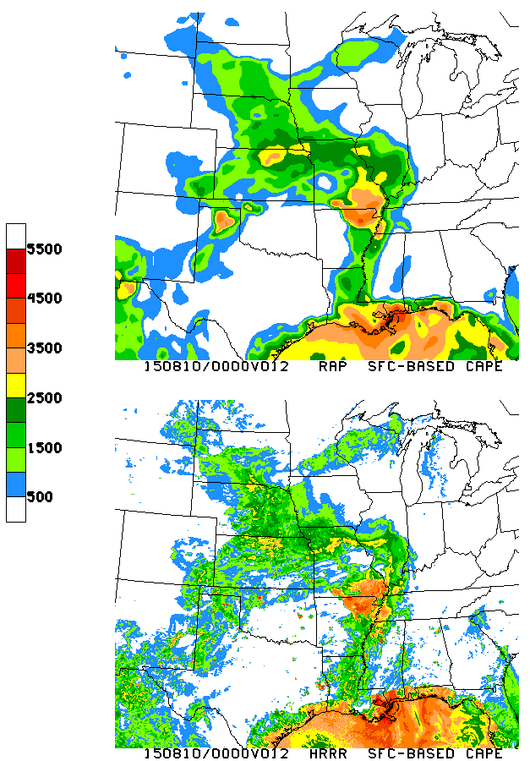
RAP/HRRR have similar issues as GFS
… but parallels show huge improvement

Slide 22
Cases in which other deterministic models lock in to solution before GEFS
Ensemble does not generate sufficient spread

Slide 23
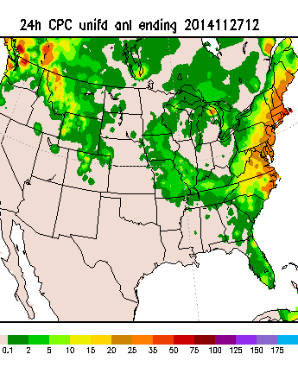
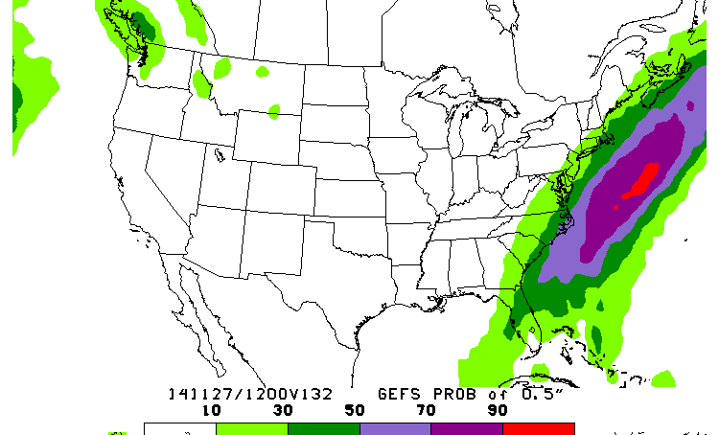

Slide 24
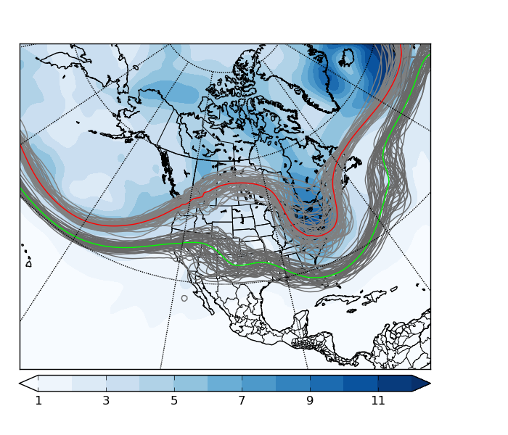
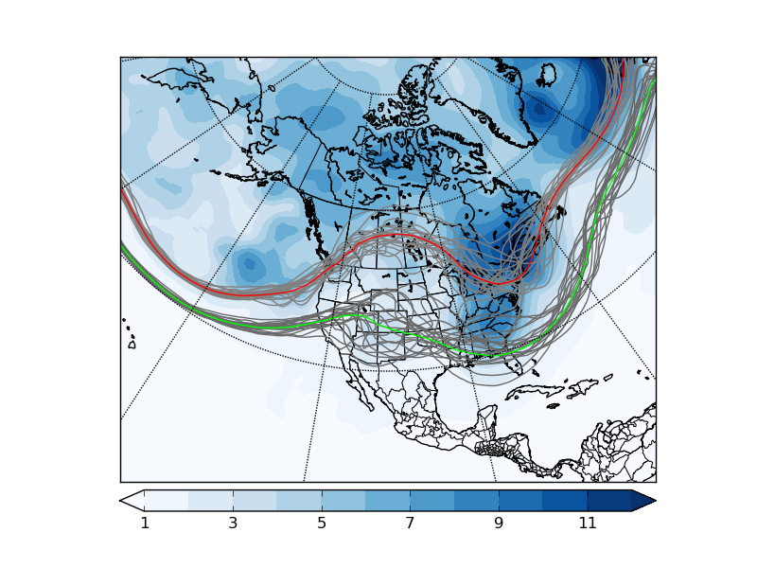
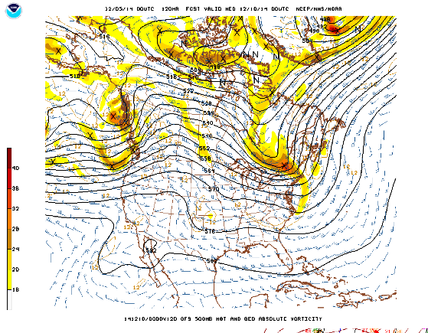
F120 00Z/05 cycle verifying 00Z/10
552 dam
EC
576 dam
GEFS
Too many GEFS
members look
like ops GFS

Slide 25
SREF BI-MODAL CLUSTERING

Slide 26
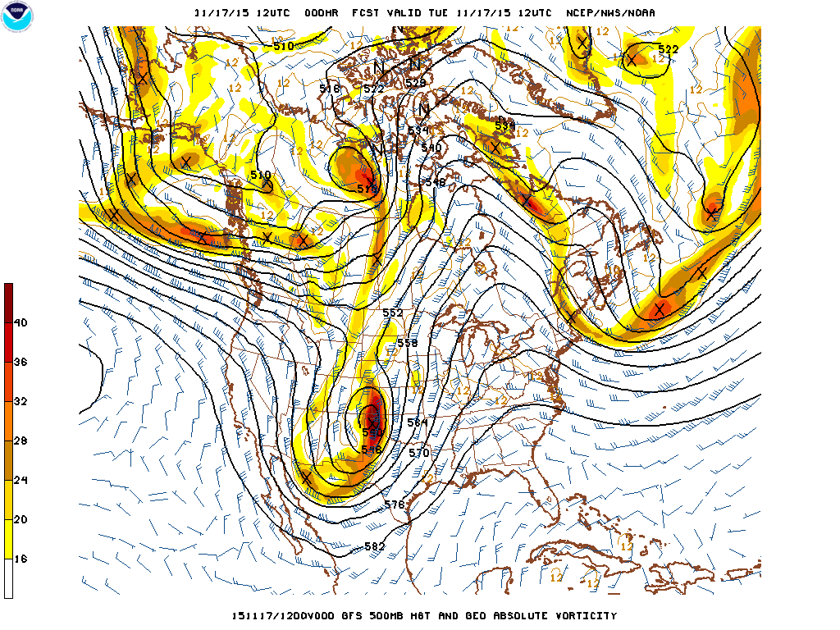

Slide 27
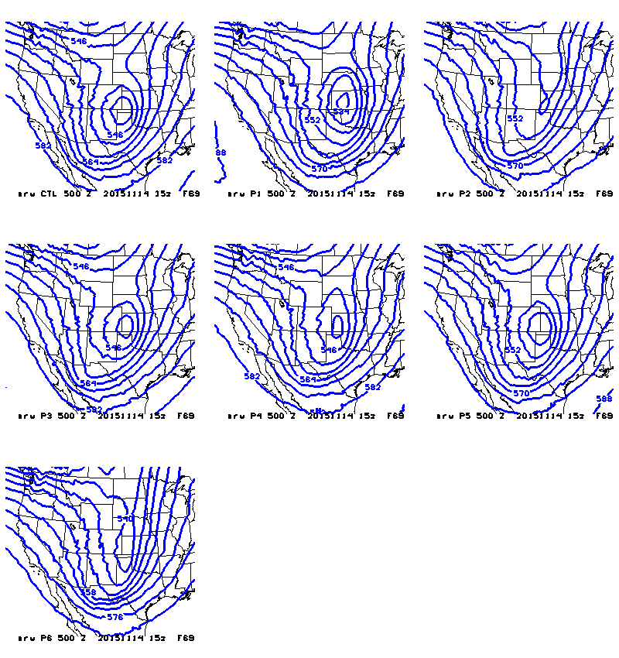
Sample of 15z 11/14 ARW F69
500 mb Heights

Slide 28
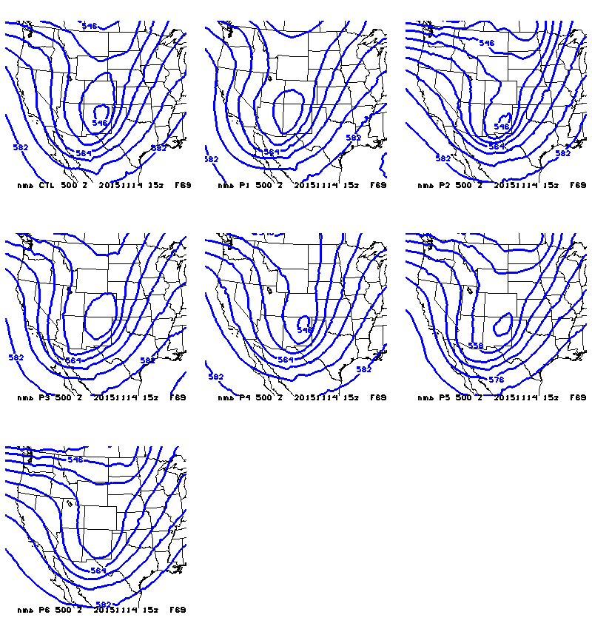
Sample of 15z 11/14 NMMB F69
500 mb Heights

Slide 29
Future Needs
A few quick thoughts on some issues we envision as critical to a successful evolution of the production suite in the years ahead

Slide 30
The MEG strongly supports the push to get a high-resolution ensemble into production in 2017 but believes that there is insufficient evidence to make a single core vs dual core decision at this time
Eventually, as resources permit, there will be a need to add convection-permitting ensemble data assimilation (costly!)
Regarding the call by some to have the GFS take over NAM duties, despite overall GFS synoptic superiority at longer ranges, the NAM handles certain critical short-range elements much better (mostly related to low-level T/q profiles)
The MEG believes that it is crucial to implement GFS and GEFS upgrades simultaneously

Slide 31
Shameless Self-Promotion
The MEG meets each Thursday at 11:30 AM EST at the NCWCP
Webinar access is available, and all presentations are recorded and available on Google Drive (shout-out to SR!)
Contact mary.hart@noaa.gov for MEG announcements/agendas

Slide 32
EXTRA SLIDES

Slide 33
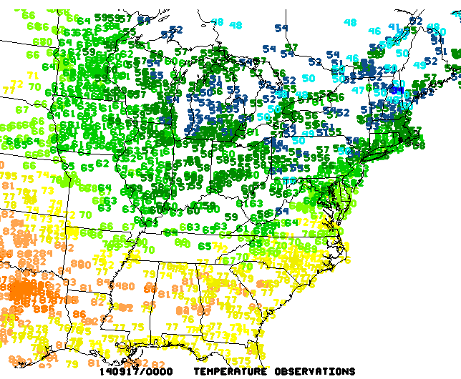

Slide 34
SREF CAPE plumes for Wichita, KS
NAM is often more unstable than any SREF member

Slide 35
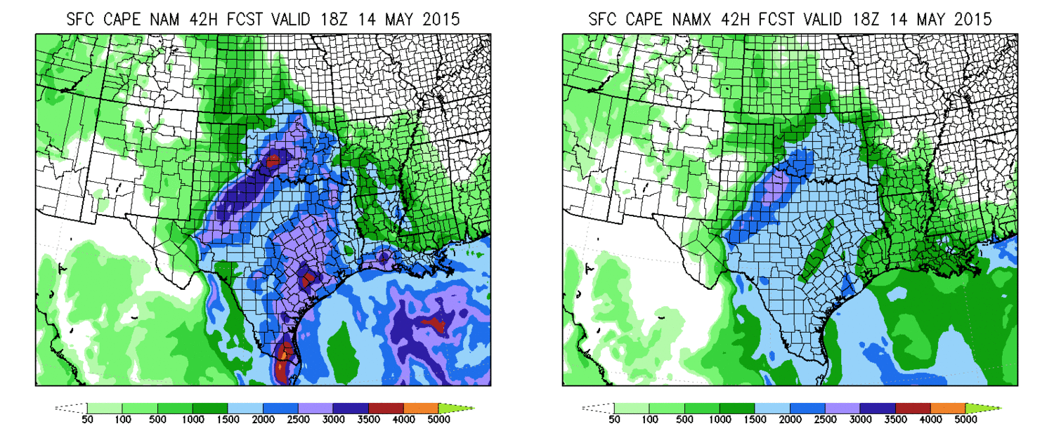
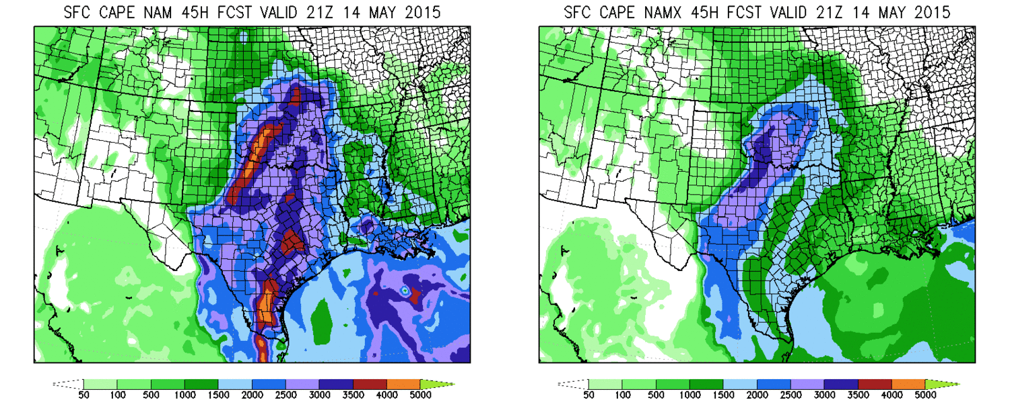

Slide 36
