Slide 1
Verification and Reliability of the TIGGE Multi-Center Grand Ensemble (MCGE)
Slides obtained from:
http://gpvjma.ccs.hpcc.jp/TIGGE/A_brief_description.pdf

Slide 3
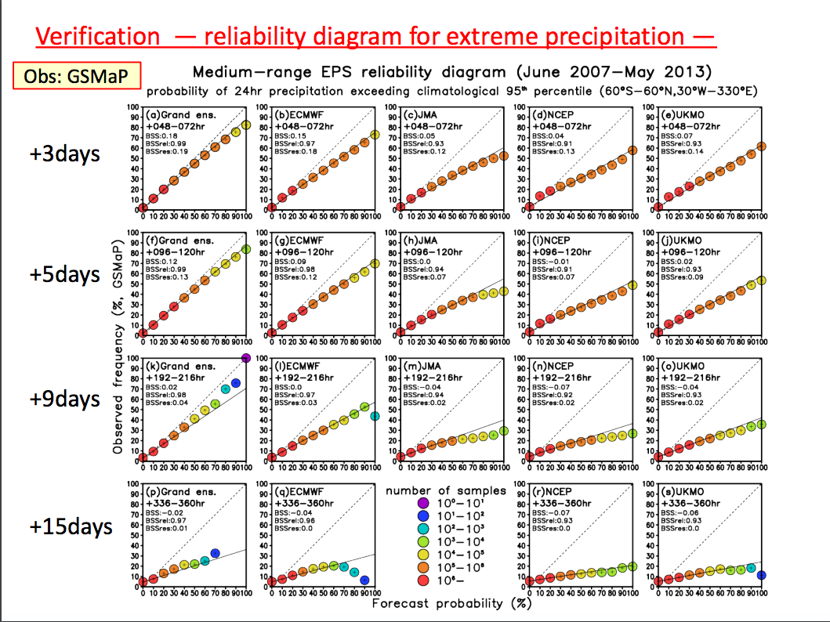

Slide 4
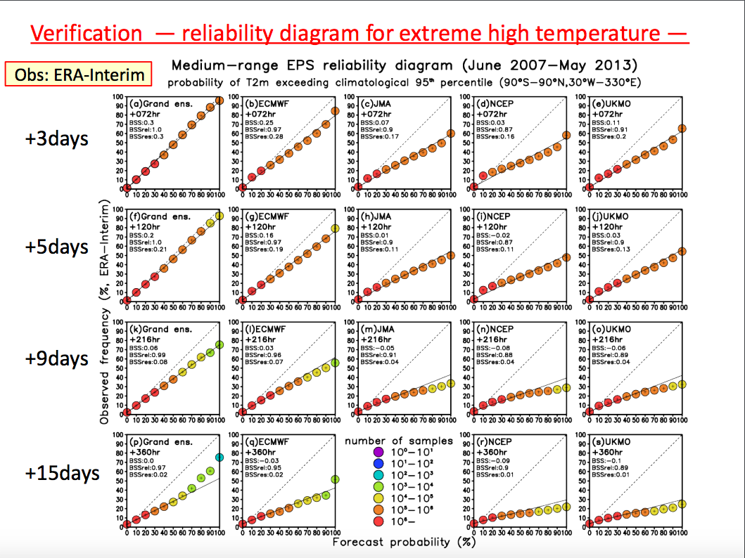

Slide 5
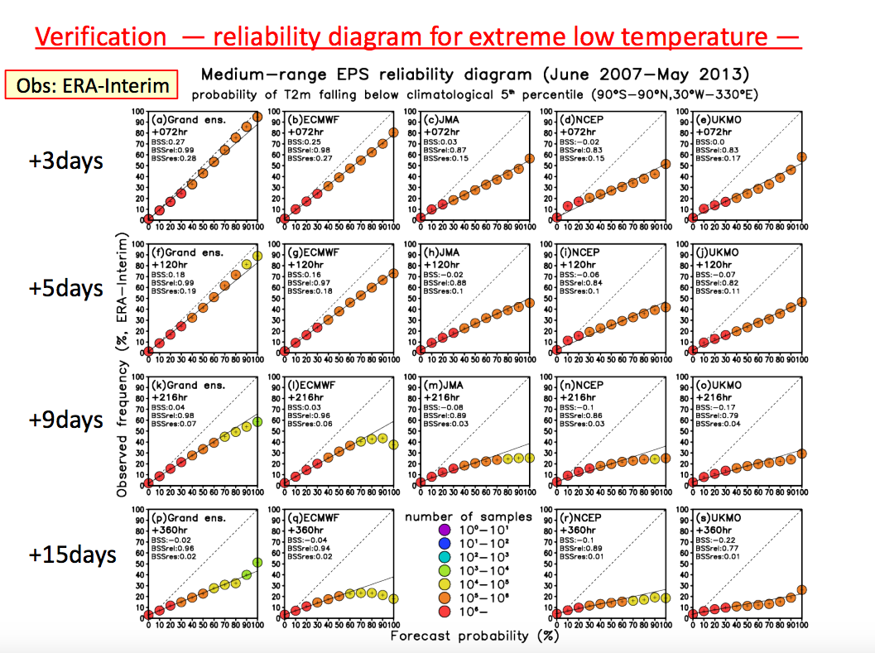

Slide 6
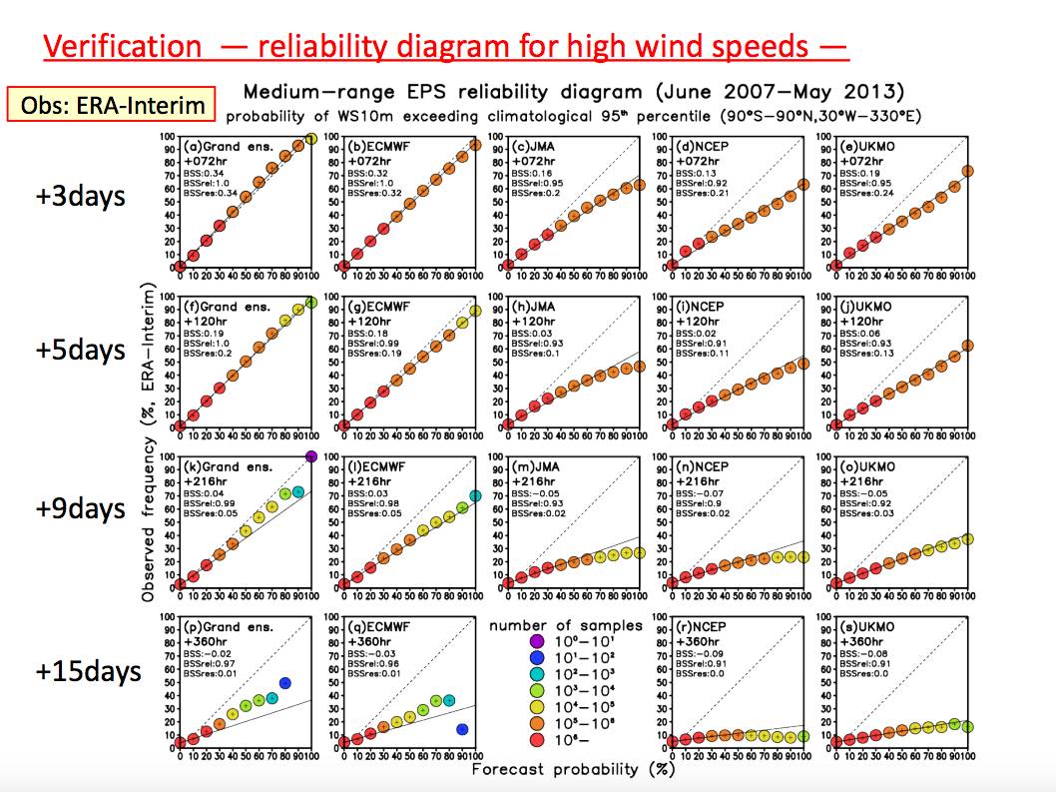

Slide 9
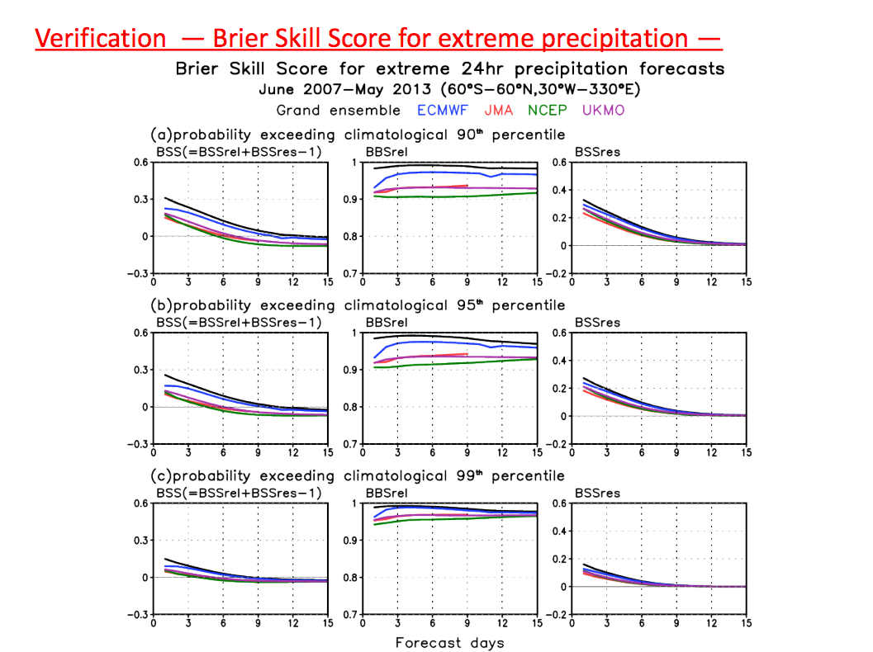

Slide 10
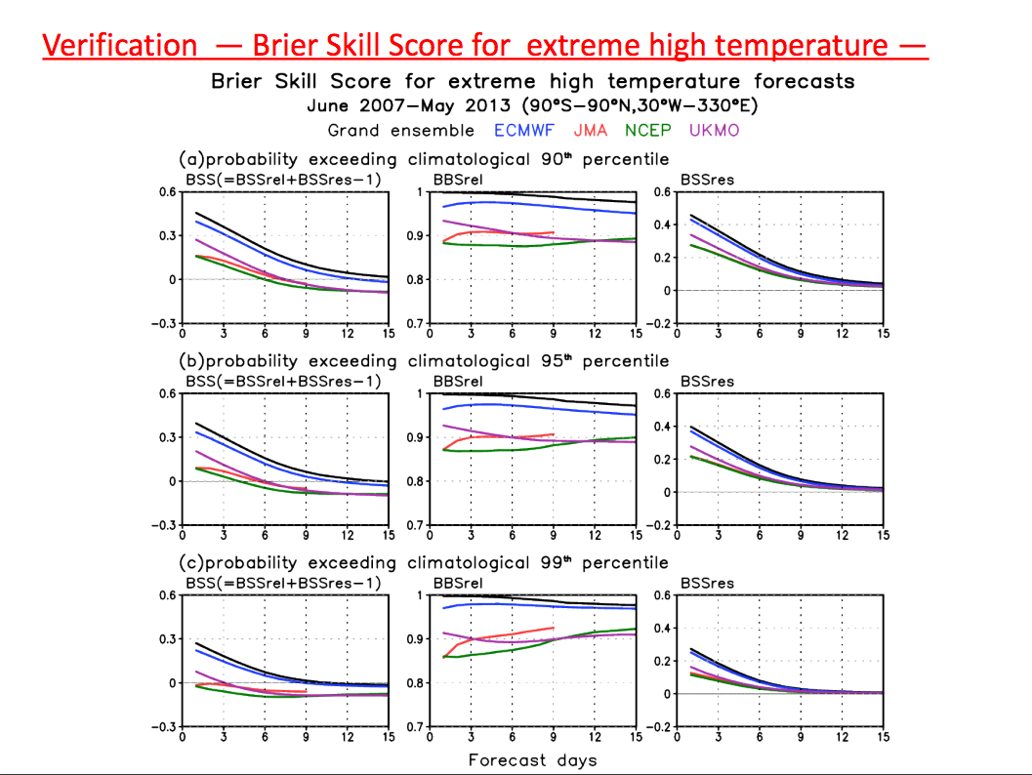

Slide 11
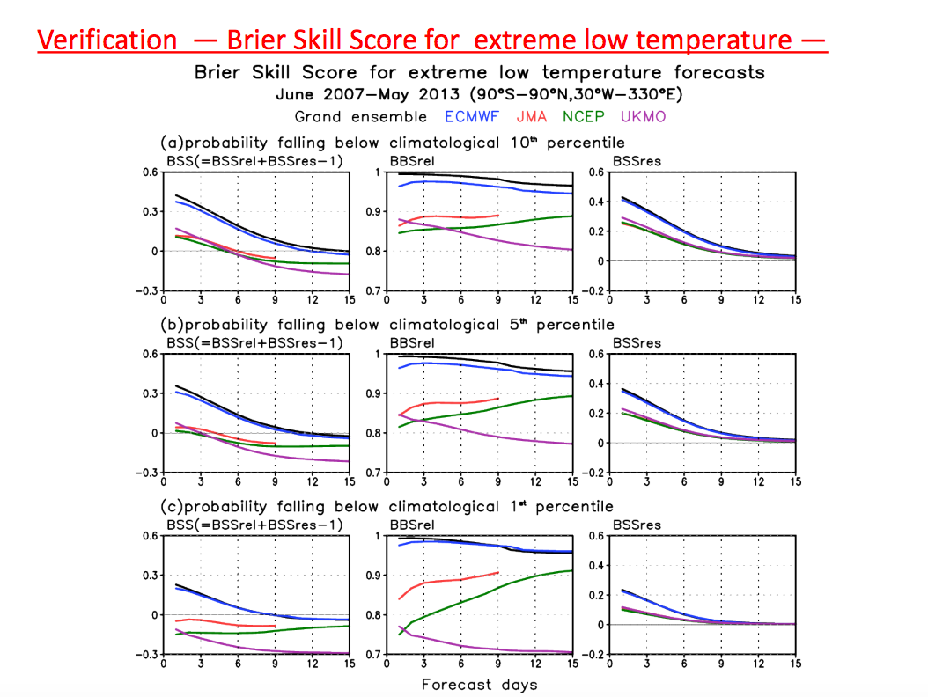

Slide 12
