Slide 1
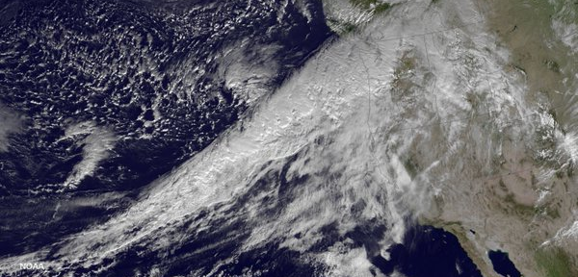
Mid-Latitude Dynamics and Atmospheric Rivers
Session: Theory, Structure, Processes 1
Wednesday, 10 August 2016
Jason M. Cordeira
Plymouth State University, CW3E/Scripps
Contribution from:
Heini Werni
Peter Knippertz
Harold Sodemann
Andreas Stohl
Francina Dominguez
Huancui Hu
2016 International Atmospheric Rivers Conference
8–11 August 2016
Scripps Institution of Oceanography

Slide 2
Objective and Outline
Objective
What components of midlatitude circulation support formation and structure of atmospheric rivers?
Outline
Part 1: ARs, midlatitude storm track, and cyclogenesis
Part 2: ARs, tropical moisture exports, and warm conveyor belt

Slide 3
Objective and Outline
Objective
What components of midlatitude circulation support formation and structure of atmospheric rivers?
Outline
Part 1: ARs, midlatitude storm track, and cyclogenesis
Part 2: ARs, tropical moisture exports, and warm conveyor belt

Slide 4
Mimic TPW (SSEC/Wisconsin)
Global water vapor distribution is concentrated at lower latitudes owing to warmer temperatures
Observations illustrate poleward extrusions of water vapor along “tropospheric rivers” or “atmospheric rivers”

Slide 5
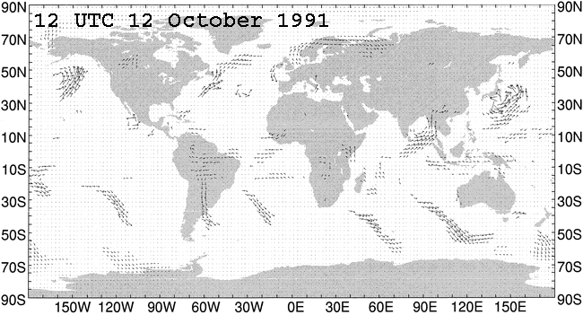
Zhu and Newell (MWR-1998)
>90% of meridional water vapor transports occurs along ARs
ARs part of midlatitude cyclones and move with storm track

Slide 6
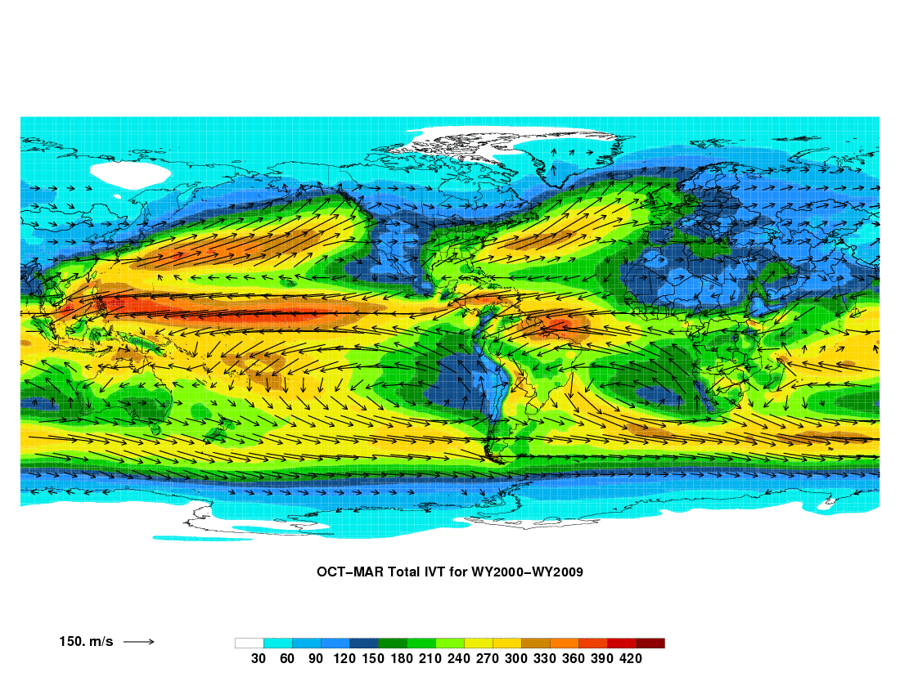
Climatology of Water Vapor Transport
Global mean IVT
AK
Russia
U.S.
EU
Asia
Africa
S.Amer
AU
150 kg m⁻¹ s⁻¹
ECMWF ERA Interim Reanalysis
Oct–Mar 99/00 to 08/09 (i.e., ten winters)
IVT calculated for isobaric layers between 1000 and 100 hPa

Slide 7
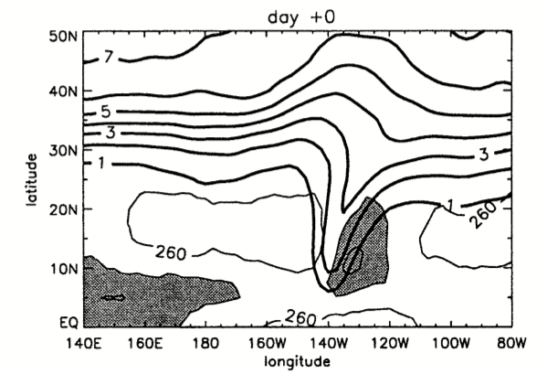
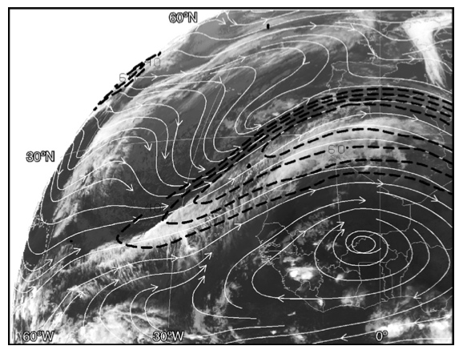
Tropical–Extratropical Interactions
Waugh and Fanutso (2003-JAS)
Knippertz (2005-MWR)
WA
OR
CA
MX
Africa
Composite 350-K PV and negative OLR anomalies for “trough intrusions” at low latitudes
Case study 345-k streamlines and isotachs for low-latitude trough over eastern North Atlantic
Initiation of water vapor transport along ARs linked to occurrences of upper-tropospheric troughs at lower latitudes, changes in static stability, and downstream southerly flow
TCs may also contribute to poleward heat/moisture flux

Slide 8
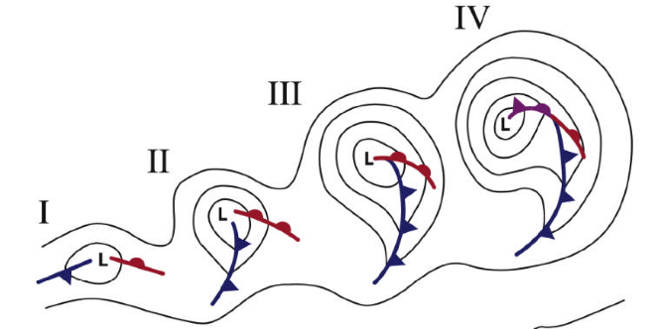
Midlatitude cyclogenesis
Upper-level disturbance (X) embedded within a Rossby wave initiates cyclogenesis → southerly flow aids in development of poleward water vapor transport
L
L
L
X
L
20°N
Norwegian Cyclone Model / Polar Front Theory
Bjerknes and Solberg (1922)

Slide 9
Midlatitude cyclogenesis
Upper-level disturbance (X) embedded within a Rossby wave initiates cyclogenesis → southerly flow aids in development of poleward water vapor transport
Diabatic processes contribute to modification of Rossby wave structure that favors further cyclogenesis, stronger cyclone, additional poleward water vapor transport
L
L
X
L
L
20°N
Norwegian Cyclone Model / Polar Front Theory
Bjerknes and Solberg (1922)

Slide 10
Midlatitude cyclogenesis
Upper-level disturbance (X) embedded within a Rossby wave initiates cyclogenesis → southerly flow aids in development of poleward water vapor transport
Diabatic processes contribute to modification of Rossby wave structure that favors further cyclogenesis, stronger cyclone, additional poleward water vapor transport
Frontogenesis along frontal features favors aggregation of water vapor
L
L
L
X
L
20°N
Norwegian Cyclone Model / Polar Front Theory
Bjerknes and Solberg (1922)

Slide 11
Midlatitude cyclogenesis
Upper-level disturbance (X) embedded within a Rossby wave initiates cyclogenesis → southerly flow aids in development of poleward water vapor transport
Diabatic processes contribute to modification of Rossby wave structure that favors further cyclogenesis, stronger cyclone, additional poleward water vapor transport
Frontogenesis along frontal features favors aggregation of water vapor
L
Norwegian Cyclone Model / Polar Front Theory
Bjerknes and Solberg (1922)
L
L
L
20°N

Slide 12
Ralph et al. (2004-MWR, 2005-MWR, 2006-GRL)
cold air
Enhanced vapor flux
in Atmos. river
warm air
cold
air
Warm,
Humid
IWV > 2 cm
Atmos. river
400 km
ARs situated near leading edge of cyclone cold front
75% of water vapor flux occurs below 2.25 km near LLJ

Slide 13
ARs and the midlatitude cyclone
AR resembles tropical moisture export (TME)
Located in region of warm conveyor belt (WCB)
3D kinematic and thermodynamic processes involved in simultaneously maintaining/removing IWV
Cold conveyor
belt
L
hPa
Location of AR
hPa
Warm conveyor belt
250 kg m^{–1} s^{–1}
500 kg m^{–1} s^{–1}
750 kg m^{–1} s^{–1}
1000 kg m^{–1} s^{–1}
Image adapted from Carlson (1980)

Slide 14
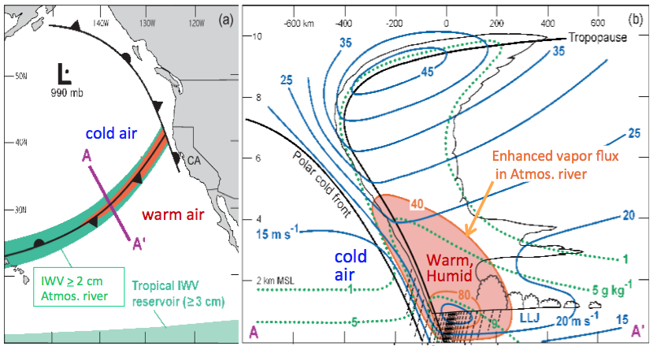
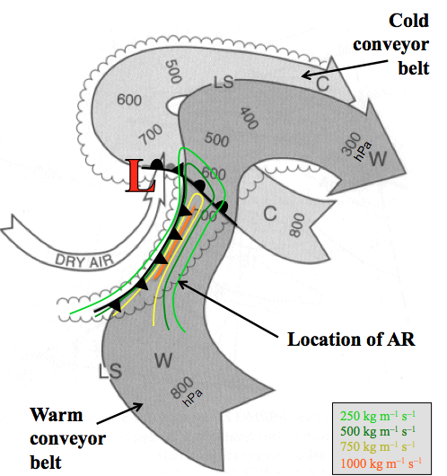
ARs and the midlatitude cyclone
Negative contribution (IWV removal): Frontal circulations and isentropic ascent are regions of vertical motion that favor removal of IWV
Positive contribution (IWV maintenance): Kinematic frontogenesis may lead to water vapor flux convergence, evaporation into dry air on back edge
Can offset

Slide 15
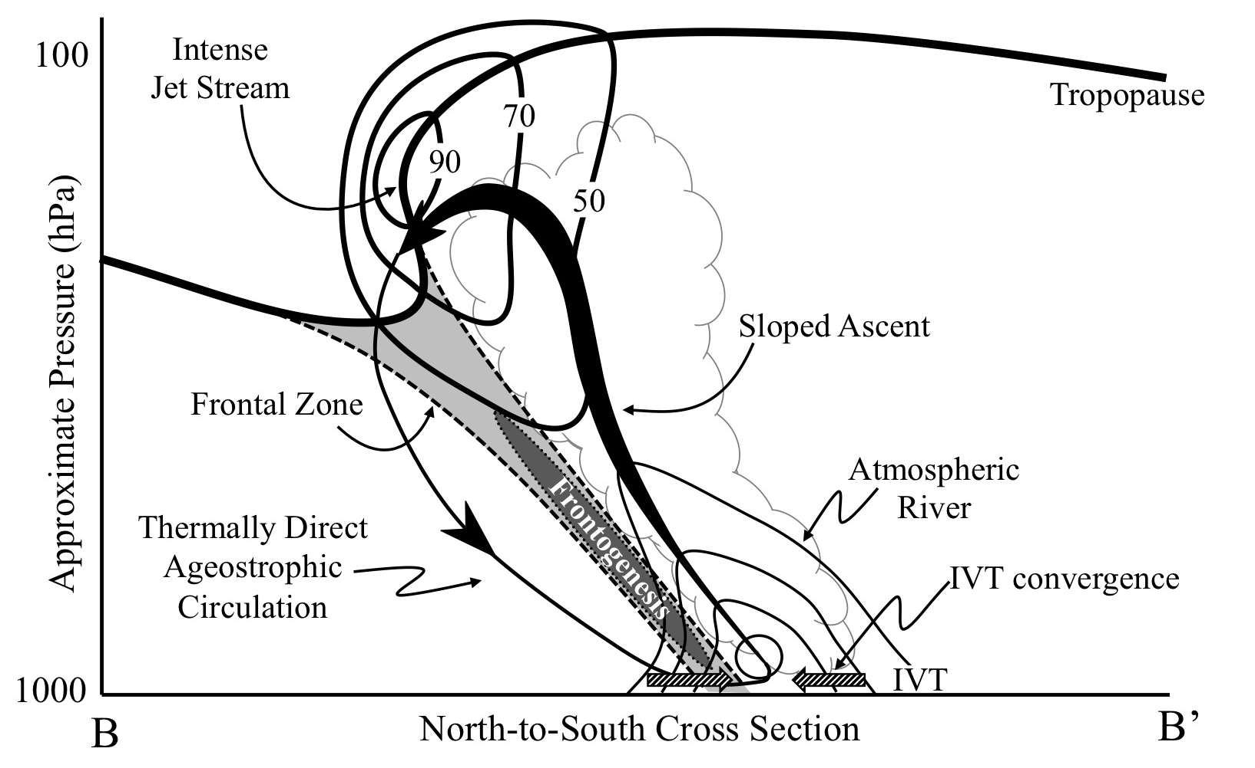
ARs and the midlatitude cyclone
Cordeira et al. (2013-MWR)

Slide 16
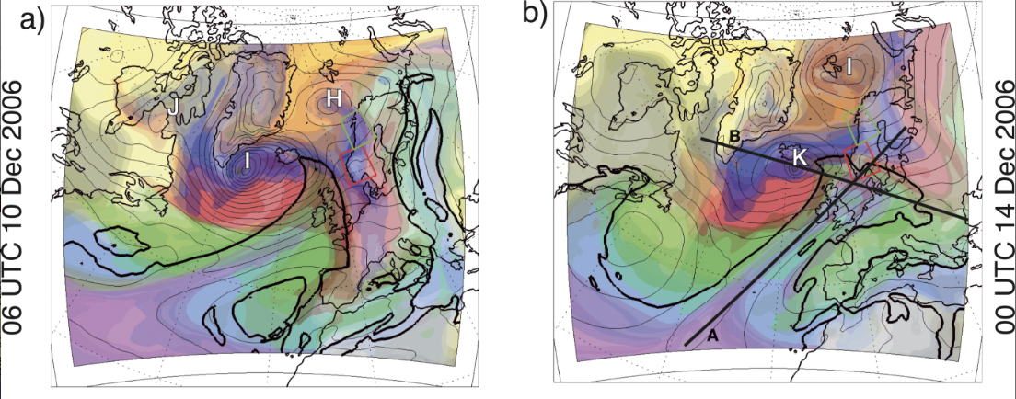
ARs and the midlatitude cyclone
Fig. 6a,b from Sodemann and Stohl (2013, MWR): Moisture origin and meridional transport in atmospheric rivers and their association with multiple cyclones
Summary provided by Sodemann and Stohl (2013-MWR)
Formation of ARs tightly coupled to circulation at tropopause level
Individual cyclones contribute to formation and maintenance of ARs at trailing end by adding moisture accumulated at their cold fronts
Cyclones use a part of ARs as a reservoir to feed their WCB
Individual ARs maintained or depleted by several cyclones in sequence

Slide 17
Objective and Outline
Objective
What components of midlatitude circulation support formation and structure of atmospheric rivers?
Outline
Part 1: ARs, midlatitude storm track, and cyclogenesis
Part 2: ARs, tropical moisture exports, and warm conveyor belt

Slide 18
Part 2 - ARs, TMEs, and WCBs
Can we quantitatively identify spatial correspondence between ARs, TMEs, and WCB?
How are these three processes related?
How can we rectify the difference between Lagrangian and Eulerian perspectives?
Cold conveyor
belt
L
hPa
Atmospheric rivers
Location of AR
hPa
Warm conveyor belt
250 kg m^{–1} s^{–1}
500 kg m^{–1} s^{–1}
750 kg m^{–1} s^{–1}
1000 kg m^{–1} s^{–1}
Image adapted from Carlson (1980)

Slide 19
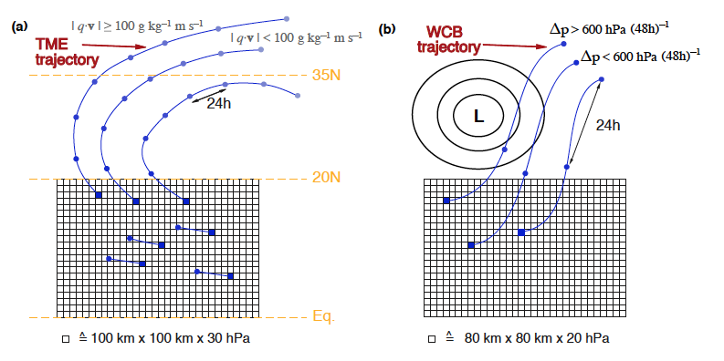
Part 2 - ARs, TMEs, and WCBs
Atmospheric rivers
Lagrangian definitions of air parcel characteristics
TMEs related to water vapor transport out of tropics
WCBs related to ascent of air parcels in cyclone warm sector

Slide 20
Part 2 - ARs, TMEs, and WCBs
L
L
H
Atmospheric rivers
Methodology
Define an AR based on threshold values of IVT and IWV

Slide 21
Part 2 - ARs, TMEs, and WCBs
L
L
H
Methodology
357 points identified on grid in AR conditions with IVT>250 kg m^{–1} s^{–1} and IWV>20 mm

Slide 22
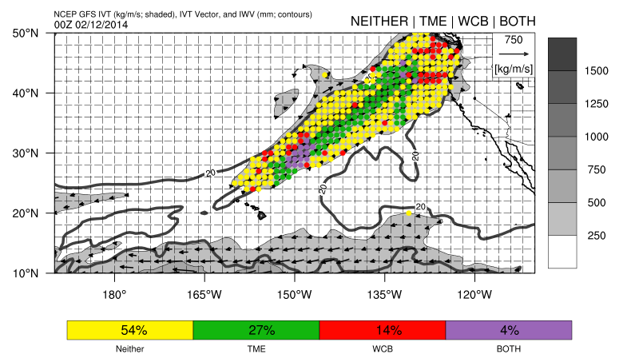
Part 2 - ARs, TMEs, and WCBs
Lagrangian analysis at 900 hPa

Slide 23
Part 2 - ARs, TMEs, and WCBs
Repeat for DJF 1979–2014 for troposphere >20°N
→Wernli and Knippertz

Slide 24
Part 2 - ARs, TMEs, and WCBs
TMEs
ARs
WCBs
Average DJF Frequency
Next step: Identify geographic coverage and spatial overlap of AR, TMEs, and WCBs

Slide 25
Part 2 - ARs, TMEs, and WCBs
6.7%
11.7%
5.8%
ARs
TMEs
WCBs
Percentage of area poleward of 20ºN that is on average covered by ARs, TMEs, and WCBs only

Slide 26
Part 2 - ARs, TMEs, and WCBs
6.7%
11.7%
5.8%
ARs
TMEs
WCBs
3.3%
3.3÷6.7=49% →
% AR grids also TME
ARs+TMEs

Slide 27
Part 2 - ARs, TMEs, and WCBs
6.7%
11.7%
5.8%
ARs
TMEs
WCBs
3.3%
1.55%
3.3÷6.7=49% →
% AR grids also TME
← 1.55÷6.7=23%
% AR grids also WCB
ARs+TMEs
ARs+WCBs

Slide 28
Part 2 - ARs, TMEs, and WCBs
6.7%
11.7%
5.8%
ARs
TMEs
WCBs
3.3%
1.55%
3.3÷6.7=49% →
% AR grids also TME
← 1.55÷6.7=23%
% AR grids also WCB
ARs+TMEs
ARs+WCBs
11% of AR grids both TME+WCB

Slide 29
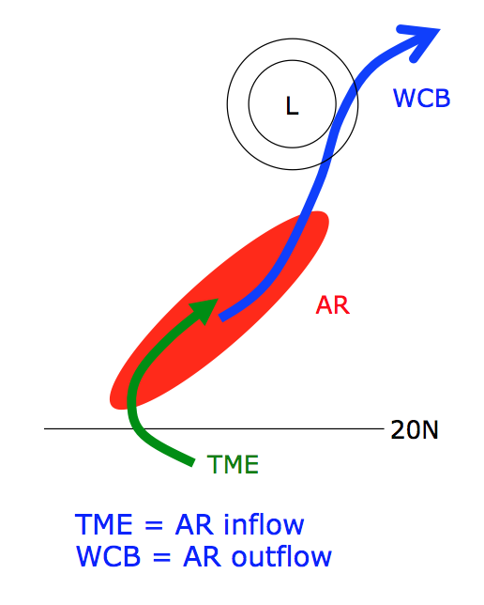
Part 2 - ARs, TMEs, and WCBs
ARs are relatively “small” spatial features on a global scale (~6%)
~50% of spatial area defined as an AR also TME
~25% of spatial area defined as AR also part of WCB
Note that using thresholds of IVT=250 kg m^{–1} s^{–1} and IWV=20 mm resulted in a null overlap of 40%

Slide 30
Part 2 - ARs, TMEs, and WCBs
Some ARs in midlatitudes contain:
An “inflow region” of TME air parcels
An “outflow region” of WCB air parcels
A region that is neither TME or WCB!
250 hPa
Ascending
trajectory paths
500 hPa
Descending
trajectory paths
WCB and TME
250 hPa
950 hPa
500 hPa
Precipitation
Evaporation
Atmospheric River
Neither WCB/TME
950 hPa
TME

Slide 31
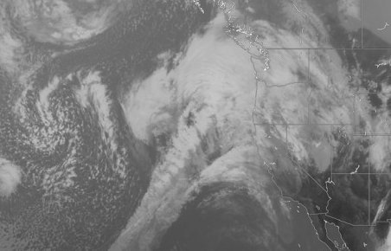
Part 2 - ARs, TMEs, and WCBs
Schematic representation:
Upper-Level Jet
WCB
X
L
Upper-Level
Trough
LLJ
AR
TME

Slide 32
Summary
ARs result from poleward water vapor transport that may develop in concert with changes in midlatitude storm track and cyclogenesis
ARs propagate as storm track and cyclones evolve, contributing water vapor to dynamical processes
ARs are terminated in presence of moist ascent/precipitation, but may be sustained in presence water vapor flux convergence and evaporation
TMEs comprise a large portion of some ARs, whereas WCBs comprise a small portion of some ARs
TMEs may give rise to [some] ARs, whereas WCBs lead to their demise

