Slide 1
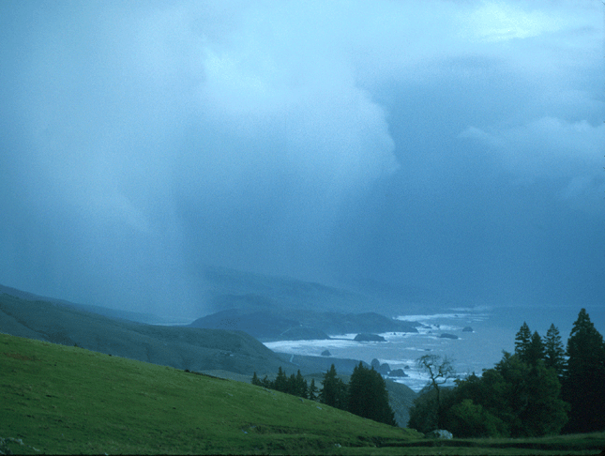


Emergence of the Concept of Atmospheric Rivers
F. Martin Ralph
UC San Diego/Scripps Institution of Oceanography
International Atmospheric Rivers Conference (IARC)
Keynote Presentation
8 August 2016, La Jolla, CA

Slide 2
Outline
Purpose: Describe major milestones in development of the AR concept
1970s and 1980s: Underlying concepts established
1990s: Global perspectives lead to the term “atmospheric river” (AR)
2000s: U.S. West Coast experiments, forecasts and practical goals focus on ARs
2010-2015: The concept matures, science and practical applications grow
2016 and beyond: A diverse community exists and is pursuing a range of promising science and application directions

Slide 3
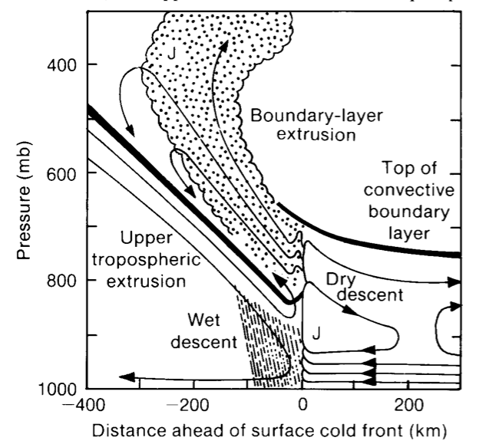
The low-level jet
Browning described the LLJ in the region of the polar cold front as a cork-screw like motion that can advance warm moist air both poleward and upward
Browning and Pardoe (1973-QJRMS)
Slide courtesy of J. Cordeira

Slide 4
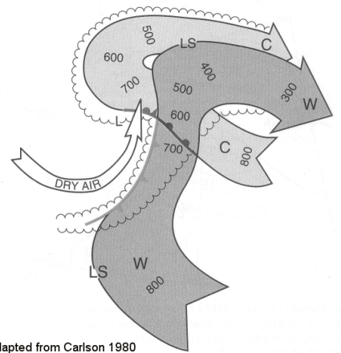
Warm and Cold Conveyor Belt Concepts
3D kinematic and thermodynamic schematic
Warm conveyor belt
  Ahead of cold front
  Ascends over warm front
  Represents sensible and latent heat
Cold conveyor belt
L
hPa
Image adapted from Carlson (1980)
hPa
Warm conveyor belt
Slide courtesy of J. Cordeira

Slide 5
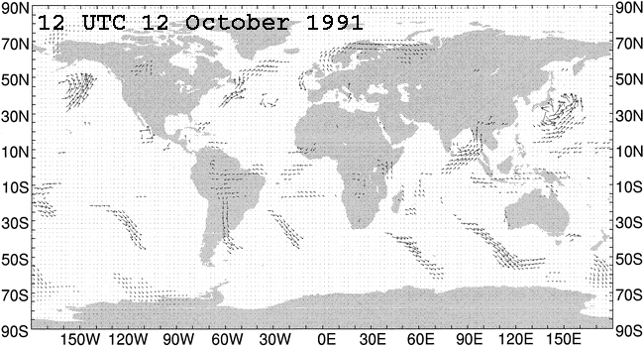
Zhu & Newell (1998) concluded in a 3-year ECMWF model diagnostic study:
95% of meridional water vapor flux occurs in narrow plumes in <10% of zonal circumference.
There are typically 3-5 of these narrow plumes within a hemisphere at any one moment.
They coined the term “atmospheric river” (AR) to reflect the narrow character of plumes.
ARs are very important from a global water cycle perspective.

Slide 6
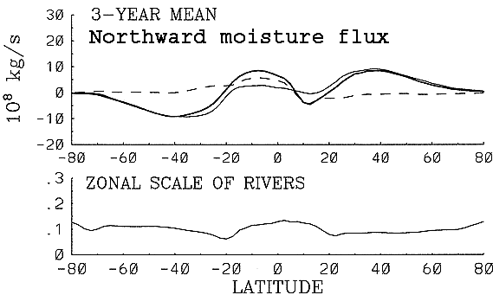
Atmospheric Rivers are responsible for 90 - 95% of the total global meridional
water vapor transport at midlatitudes, and yet constitute <10% of the Earth’s
circumference at those latitudes. (Zhu and Newell 1998)
ARs carry 95%
of total flux
35S
35N
ARs cover <10% of
zonal circumference

Slide 7
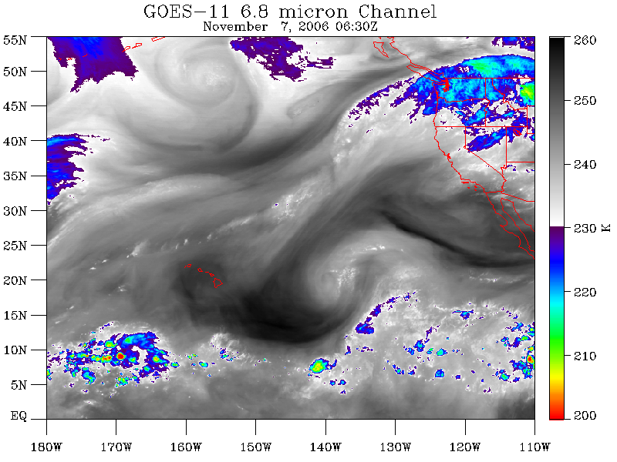
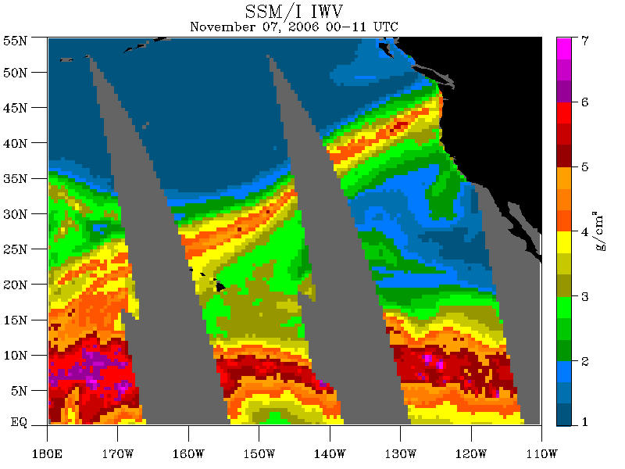
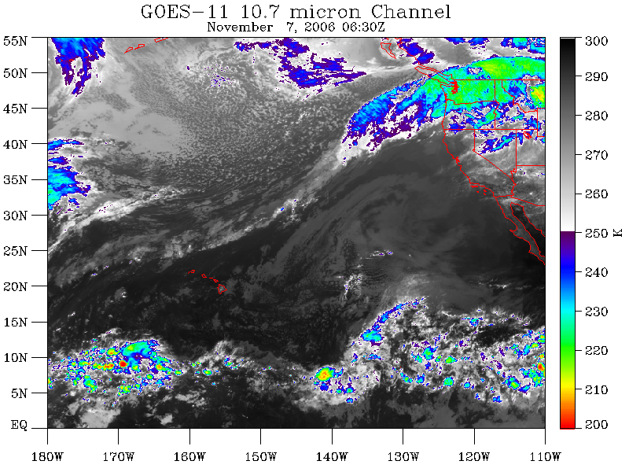

Slide 8
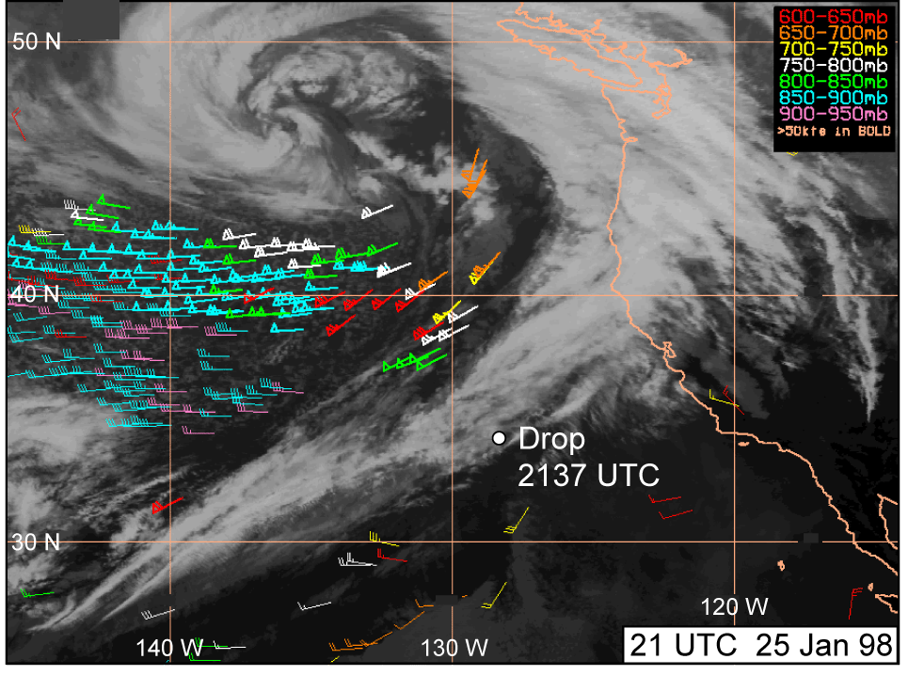
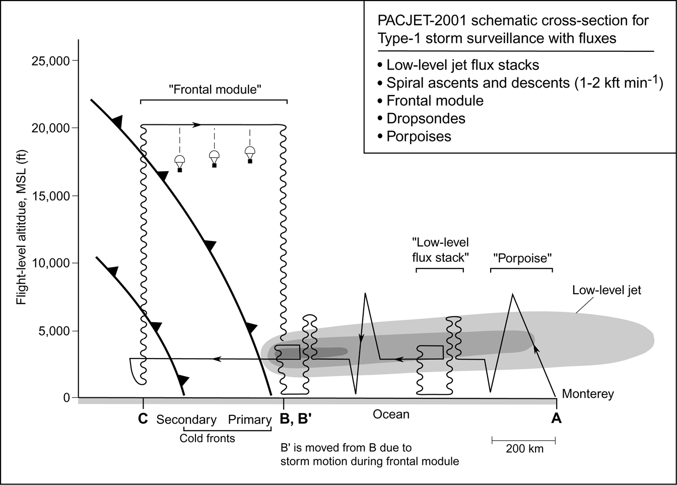
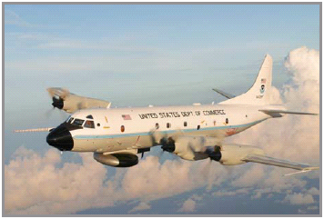
Offshore Structure Diagnosed with Aircraft and Satellite Observations
Ralph et al. 2004, 2005 (MWR)
Low-level jet (LLJ) airborne P-3
observing strategy used in CALJET (1998)
and PACJET (2001)
Notes:
In each case, satellite imagery shows the location of the dropsonde in the vicinity of the cold-frontal comma-cloud tail.

Slide 9
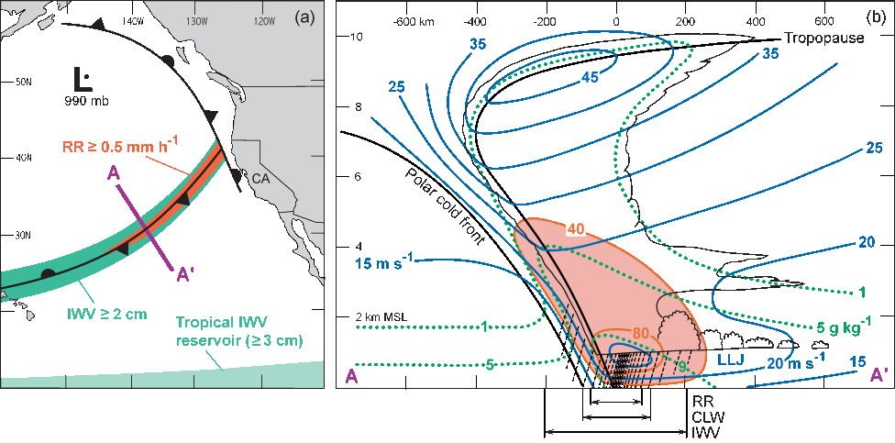
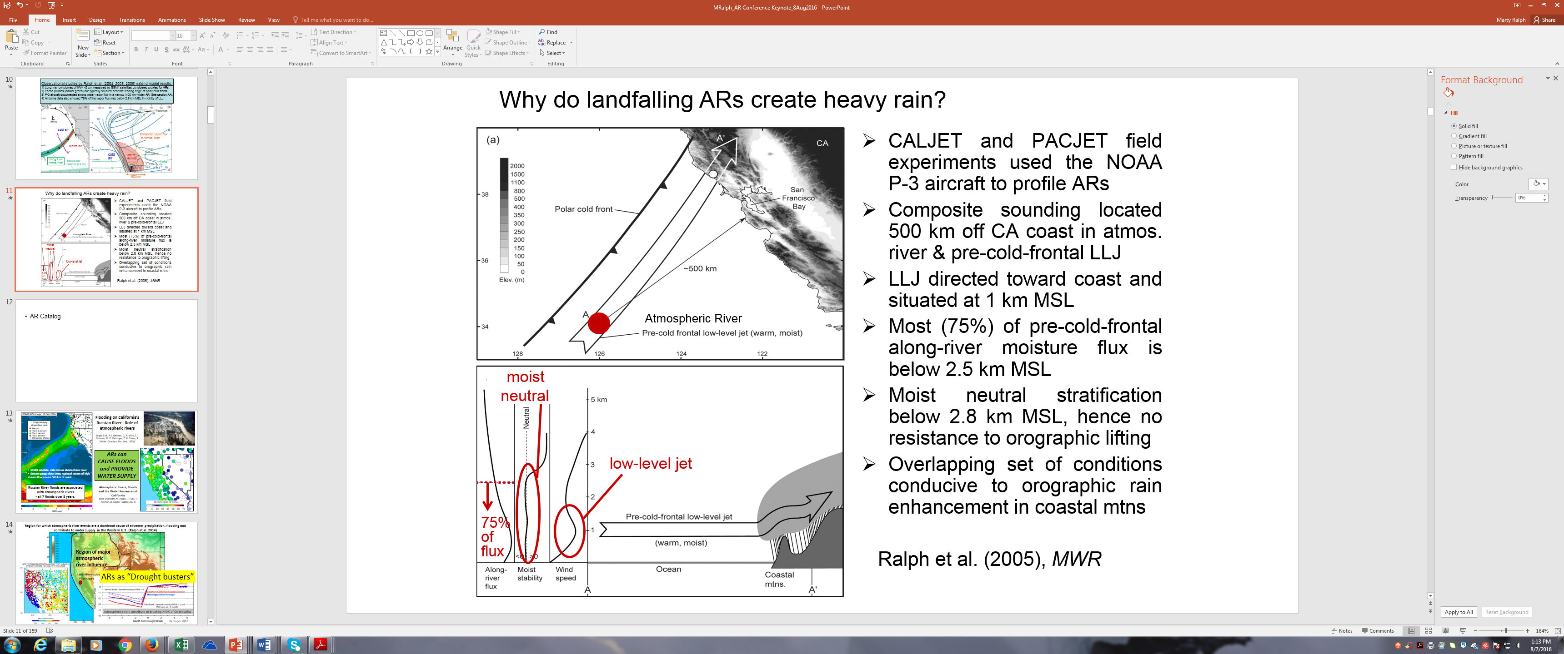
Airborne observational studies extended model results:
Ralph, Neiman, Wick 2004 (RNW-2004) created first obs’-based AR detection method: used IWV >2 cm from satellite.
These plumes, had to be >2000 km long and <1000 km wide, are situated near the leading edge of polar cold fronts.
P-3 aircraft documented strong water vapor flux in a narrow (400 km-wide) AR; See section AA’.
17 airborne cases showed 75% of the vapor flux was below 2.5 km MSL in vicinity of LLJ (Ralph Neiman Rotunno 2005).
cold air
Enhanced vapor flux
in Atmos. river
warm air
cold
air
Warm,
Humid
IWV > 2 cm
Atmos. river
400 km

Slide 10
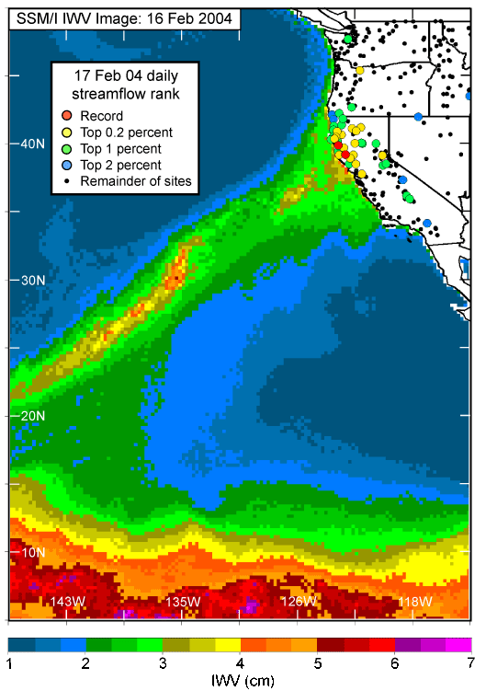
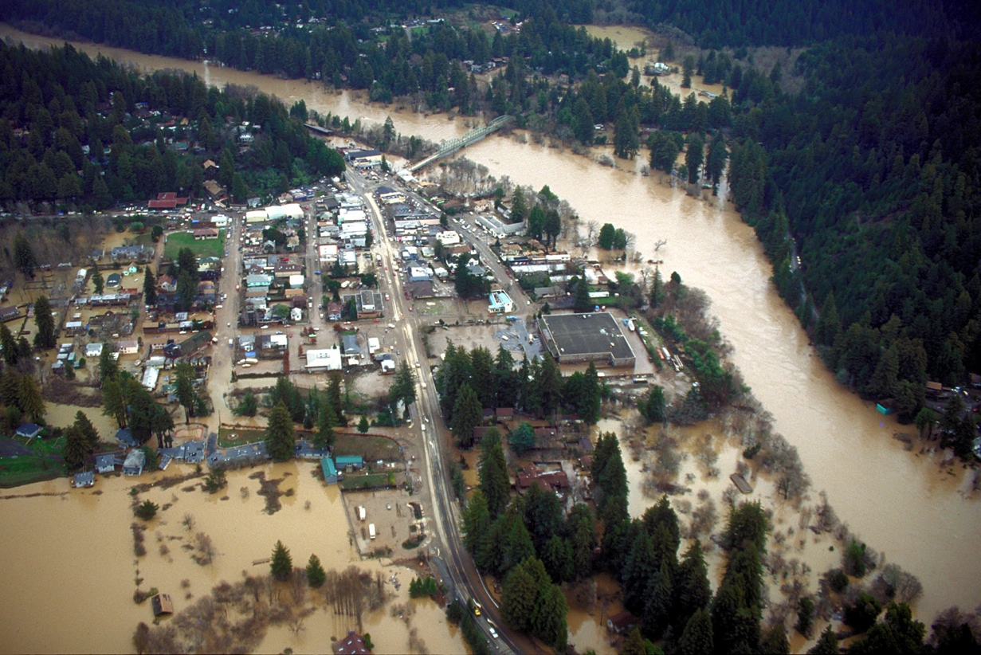
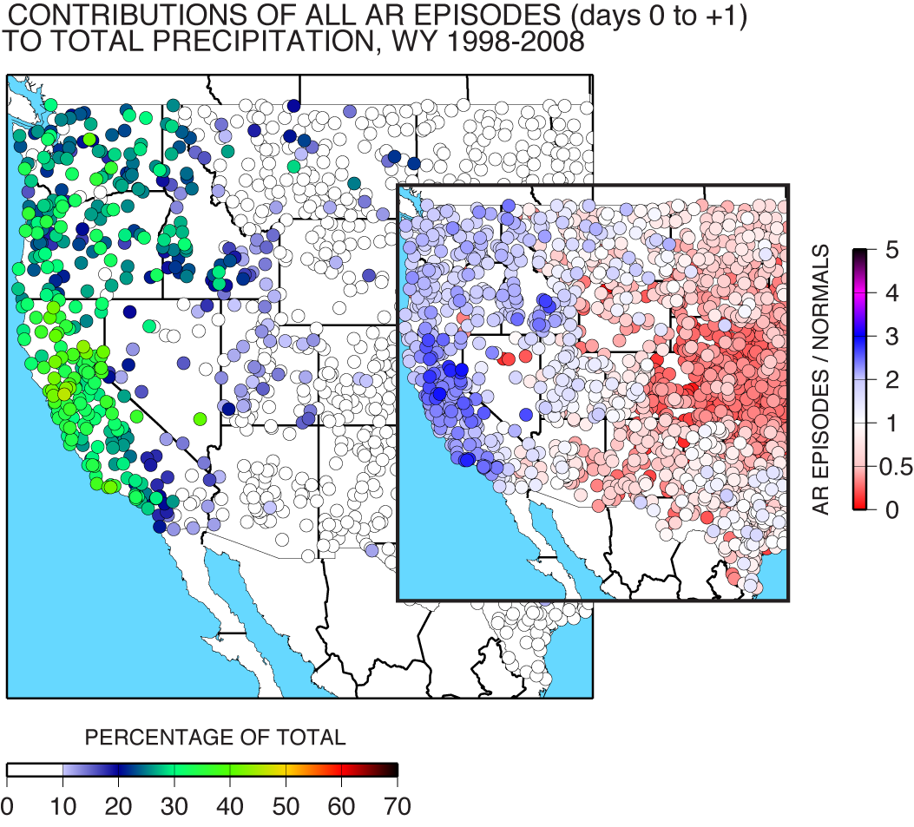
Flooding on California’s Russian River: Role of atmospheric rivers
Ralph, F.M., P. J. Neiman, G. A. Wick, S. I. Gutman, M. D. Dettinger, D. R. Cayan, A. White (Geophys. Res. Lett., 2006)
ARs can
CAUSE FLOODS and PROVIDE WATER SUPPLY
SSM/I satellite data shows atmospheric river
Stream gauge data show regional extent of high stream flow covers 500 km of coast
Russian River floods are associated with atmospheric rivers
- all 7 floods over 8 years.
Atmospheric Rivers, Floods and the Water Resources of California
Mike Dettinger, M. Ralph, , T. Das, P. Neiman, D. Cayan (Water, 2011)

Slide 11
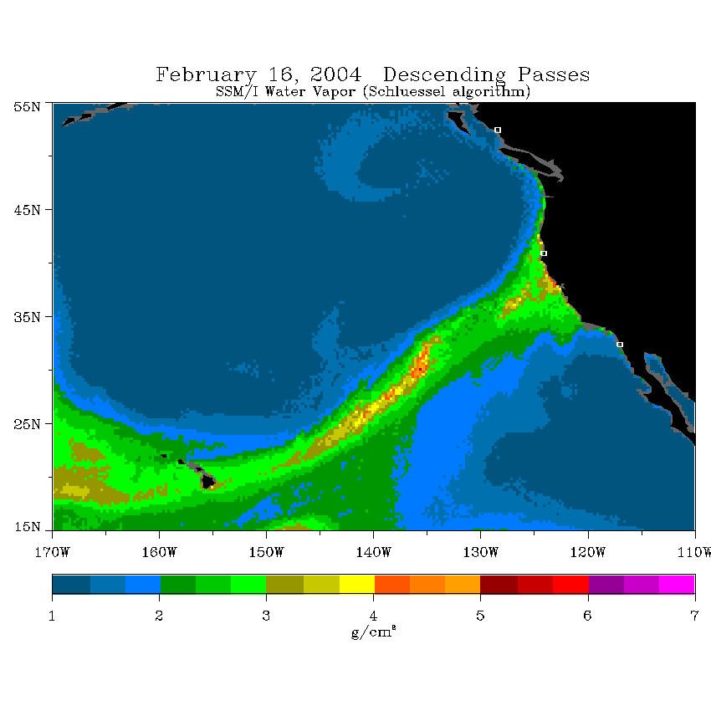
First Multi-year Catalog of AR Events Created: Used RNW 2004 Method & Satellite IWV Data
Long, narrow plume of enhanced atmospheric water vapor in warm sector of winter storms
Identified via integrated water vapor (IWV) in numerical models or observed in SSMI/S Satellite estimates
Example from 2014 illustrates AR landfall in California
16-Feb-04
North coast
IWV >2cm:
>2000 km long
South coast
IWV >2cm:
<1000 km wide
Method from F.M. Ralph, P. Neiman, G. Wick (2004), Mon. Wea. Rev. (“RNW method”)
Neiman, P.J., F.M. Ralph, G.A. Wick, J. Lundquist, and M.D. Dettinger (2008), J. Hydrometeor.
SSM/I Integrated Water Vapor (cm)

Slide 12
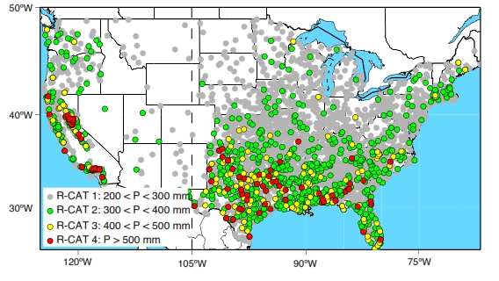
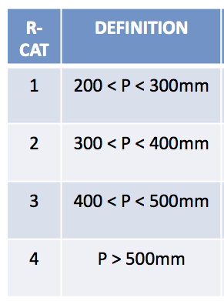
LARGEST 3-DAY PRECIPITATION TOTALS, 1950-2008
Primarily due to Atmospheric River events
Ralph, F.M., and Dettinger, M.D., Historical and national perspectives on extreme west-coast precipitation associated with atmospheric rivers during December 2010: Bulletin of the American Meteorological Society, (2012)

Slide 13
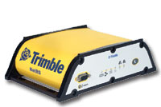
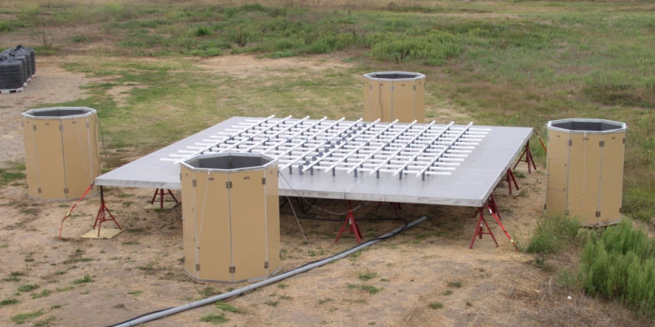
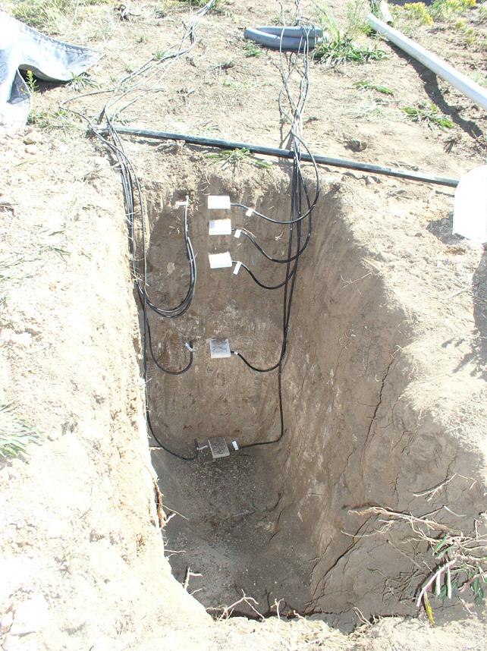
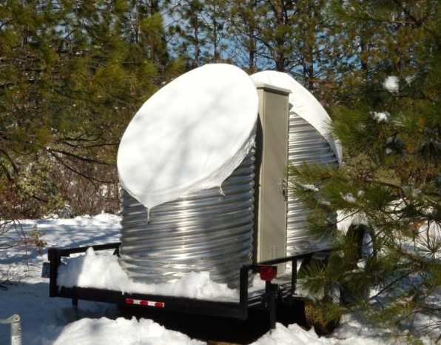
California Extreme Precipitation Network
An Atmospheric River-focused long-term observing network is being installed in CA as part of a 5-year project between CA Dept. of Water Resources (DWR), NOAA and Scripps Inst. Of Oceanography
Installed 2008-2015
>100 field sites
GPS receiver for
integrated water vapor
¼-scale 449-MHz wind profiler with RASS
FM-CW snow-level radar
Soil Moisture and Temperature Probes
White et al. 2013 (J. Atmos. Oceanic Tech.)

Slide 14
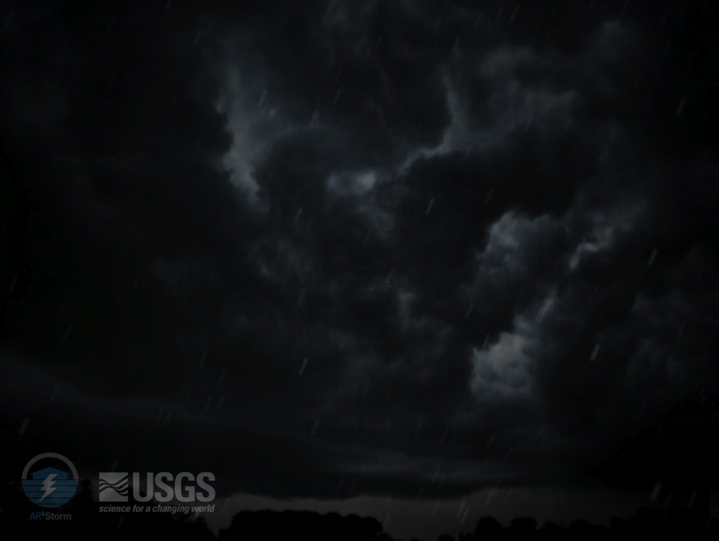
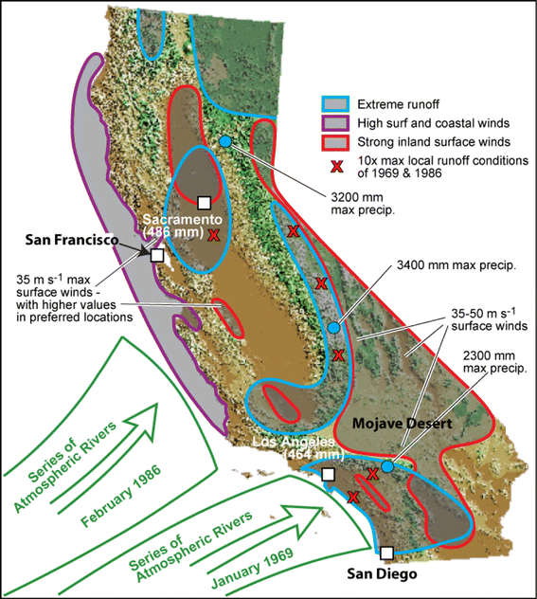
ARkStorm: An emergency preparedness scenario for California
USGS organized a large team of experts.
A meteorology team was formed and built a plausible physical scenario. Back-to-back extreme AR events (mostly based on actual 1969 and 1986 storms) struck over about 3 weeks . Considers the 1861/82 floods as an example.
The meteorological scenario was then given to follow-on groups of experts in damage assessment and economic disruption estimation and has become the basis for emergency preparedness exercises.
Dettinger et al. 2011 (Natural Hazards)
Projected damage and economic losses exceed $500 Billion
Special Issue in ASCE Journal “Natural Hazards Review” in 2016 presents key engineering and impact analysis papers.
Dale Cox (USGS) – ARkStorm lead

Slide 15
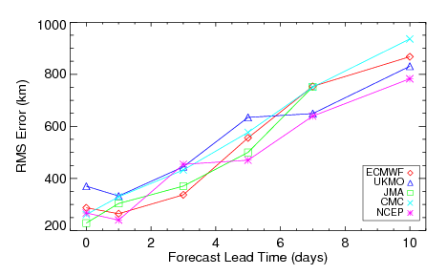
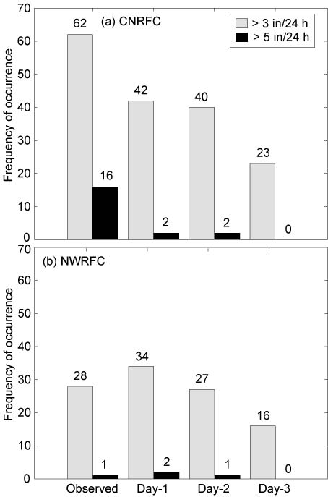
The Forecasting Challenge
Forecasting large precipitation amounts is difficult
Forecasting AR landfall includes position errors larger than watersheds
RMS Error in Forecast AR Landfall Location
500 km forecast error at 5-day lead time
Of the 20 dates with >3 inches of precipitation in 1 day, 18 were associated with ARs.
Ralph et al. 2010
Wick et al. 2013

Slide 16
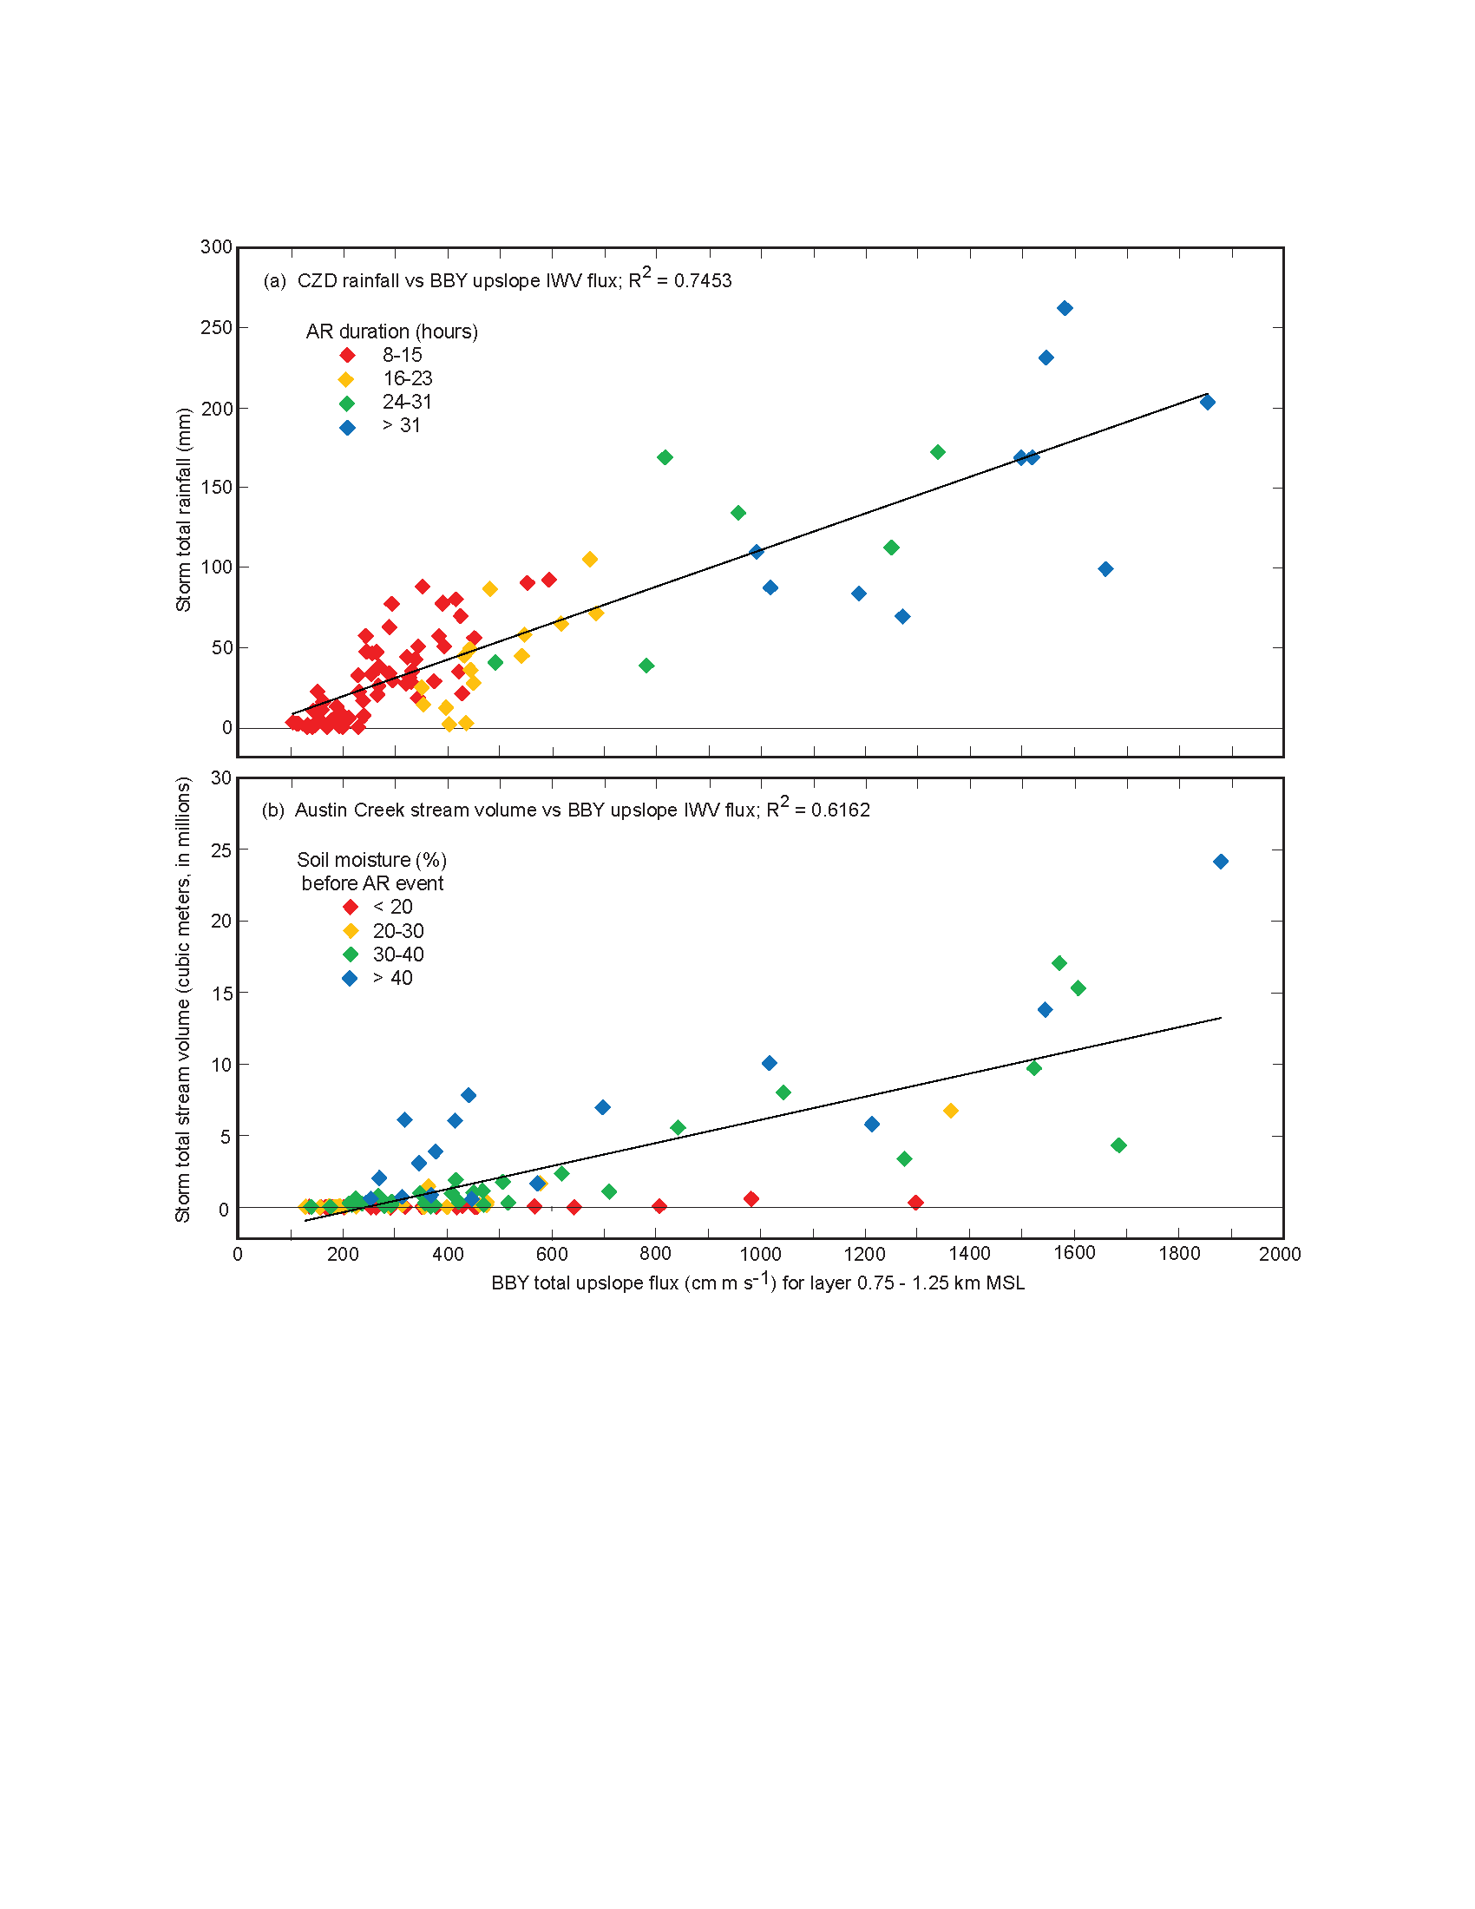
Observed impacts of duration and seasonality of atmospheric-river landfalls on soil moisture and runoff in coastal northern California
Ralph, F. M., T. Coleman, P.J. Neiman, R. Zamora, and M.D. Dettinger, J. Hydrometeorology, 2013
Other factors involved
e.g., frontal circulations, aerosols, etc…
Storm-total rainfall at CZD
(mm)
The greater the precipitation
Storm-total upslope water vapor flux at BBY (cm m/s)
The greater the AR strength and duration

Slide 17
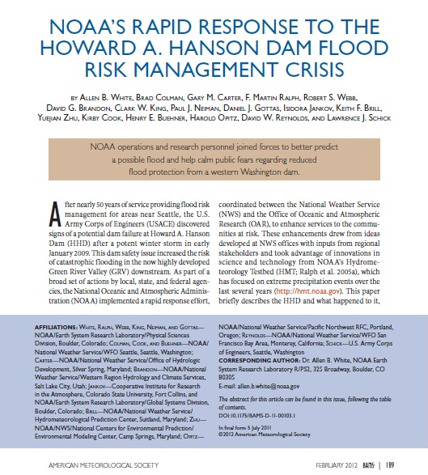
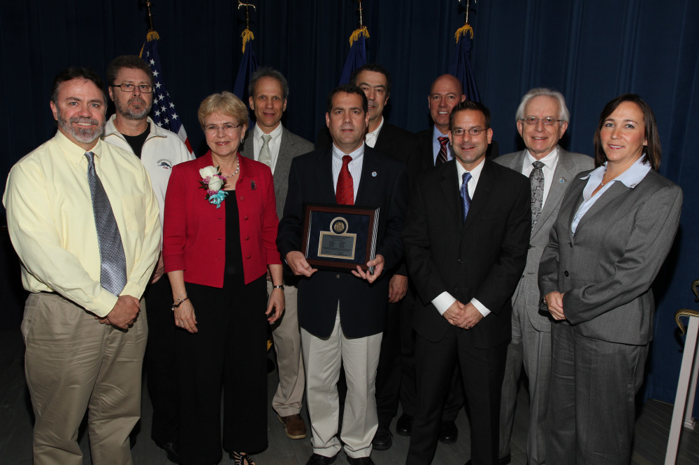
Atmospheric River concepts and tools developed in California were key components of NOAA’s rapid response to the Howard Hanson Dam flood risk crisis that affected the Seattle area from 2009-2012
As research showed predictability in the medium range lead times, NWS’ Hydromet Prediction Center extended the lead time of their QPF an additional 2 days, i.e., added days 6 and 7 for the first time. This started in the West, and then became national.
USACE was considering taking over operation of a dam in Washington State during a recent storm.
Using the HMT ARO at the coast and NWS forecasts, USACE saw the back edge of the AR was coming ashore and thus heavy rain was about to end, so they did not take over operation from the local water agency.
Case study and statistics on forecaster use of AR data are presented in White et al. 2012 (Bulletin of the American Meteorological Society).
Dept. of Commerce
Bronze Medal 2012

Slide 18
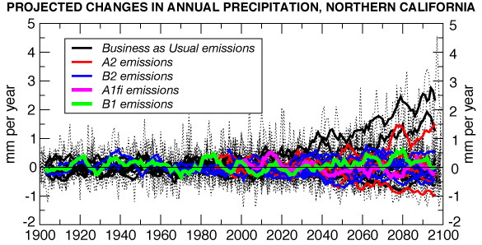
A Key Challenge: Changing Climate
Guerneville
19 of 23 in this range
cm/month
cm/month
Dettinger, 2005
Annual precipitation projections vary mostly due to how extreme precipitation events are handled (in CA this means ARs).
Pierce et al 2013 (J. Clim.): Model disagreements in the projected change in occurrence of the heaviest precipitation days (>60 mm day⁻¹) account for the majority of disagreement in the projected change in annual precipitation, and occur preferentially over the Sierra Nevada and Northern California.
Notes:
The Sonoma County Water Agency faces many challenges in an era of increasing government regulation, declining fish populations and climate uncertainty.
The Russian River Watershed is one of the most flood prone regions in the nation.
Sonoma County receives more FEMA flooding assistance that any other county in California.

Slide 19
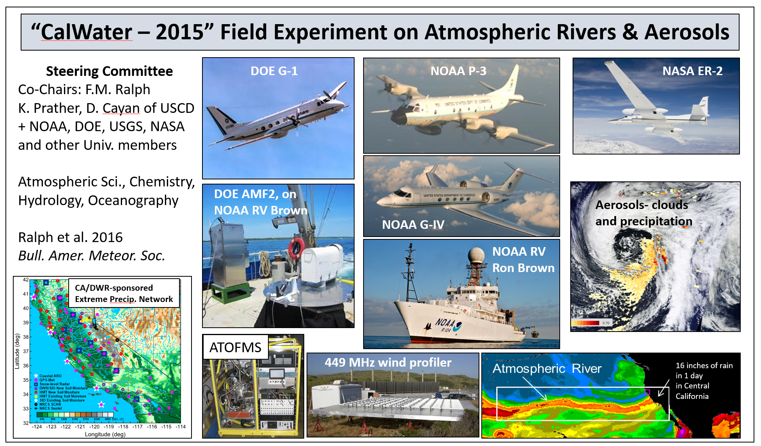
CalWater Field Studies Designed to Quantify the Roles of Atmospheric Rivers and Aerosols in Modulating U.S. West Coast Precipitation in a Changing Climate
Ralph F.M., K. A. Prather, D. Cayan, J.R. Spackman, P. DeMott, M. Dettinger, C. Fairall, R. Leung, D. Rosenfeld, S. Rutledge, D. Waliser, A. B. White, J. Cordeira, A. Martin, J. Helly, and J. Intrieri, 2016, Bull. Amer. Meteor. Soc.
Field seasons
CalWater-1: 2009-2011
CalWater-2: 2014-2016
Locations
California
Eastern Pacific Ocean
Sponsors
DOE, NOAA
California Energy Commission
California Dept. of Water Resources
NSF, NASA, ONR

Slide 20
Emergence of the Concept of Atmospheric Rivers
F. Martin Ralph
UC San Diego/Scripps Institution of Oceanography
International Atmospheric Rivers Conference (IARC)
Keynote Presentation
8 August 2016, La Jolla, CA

Slide 21
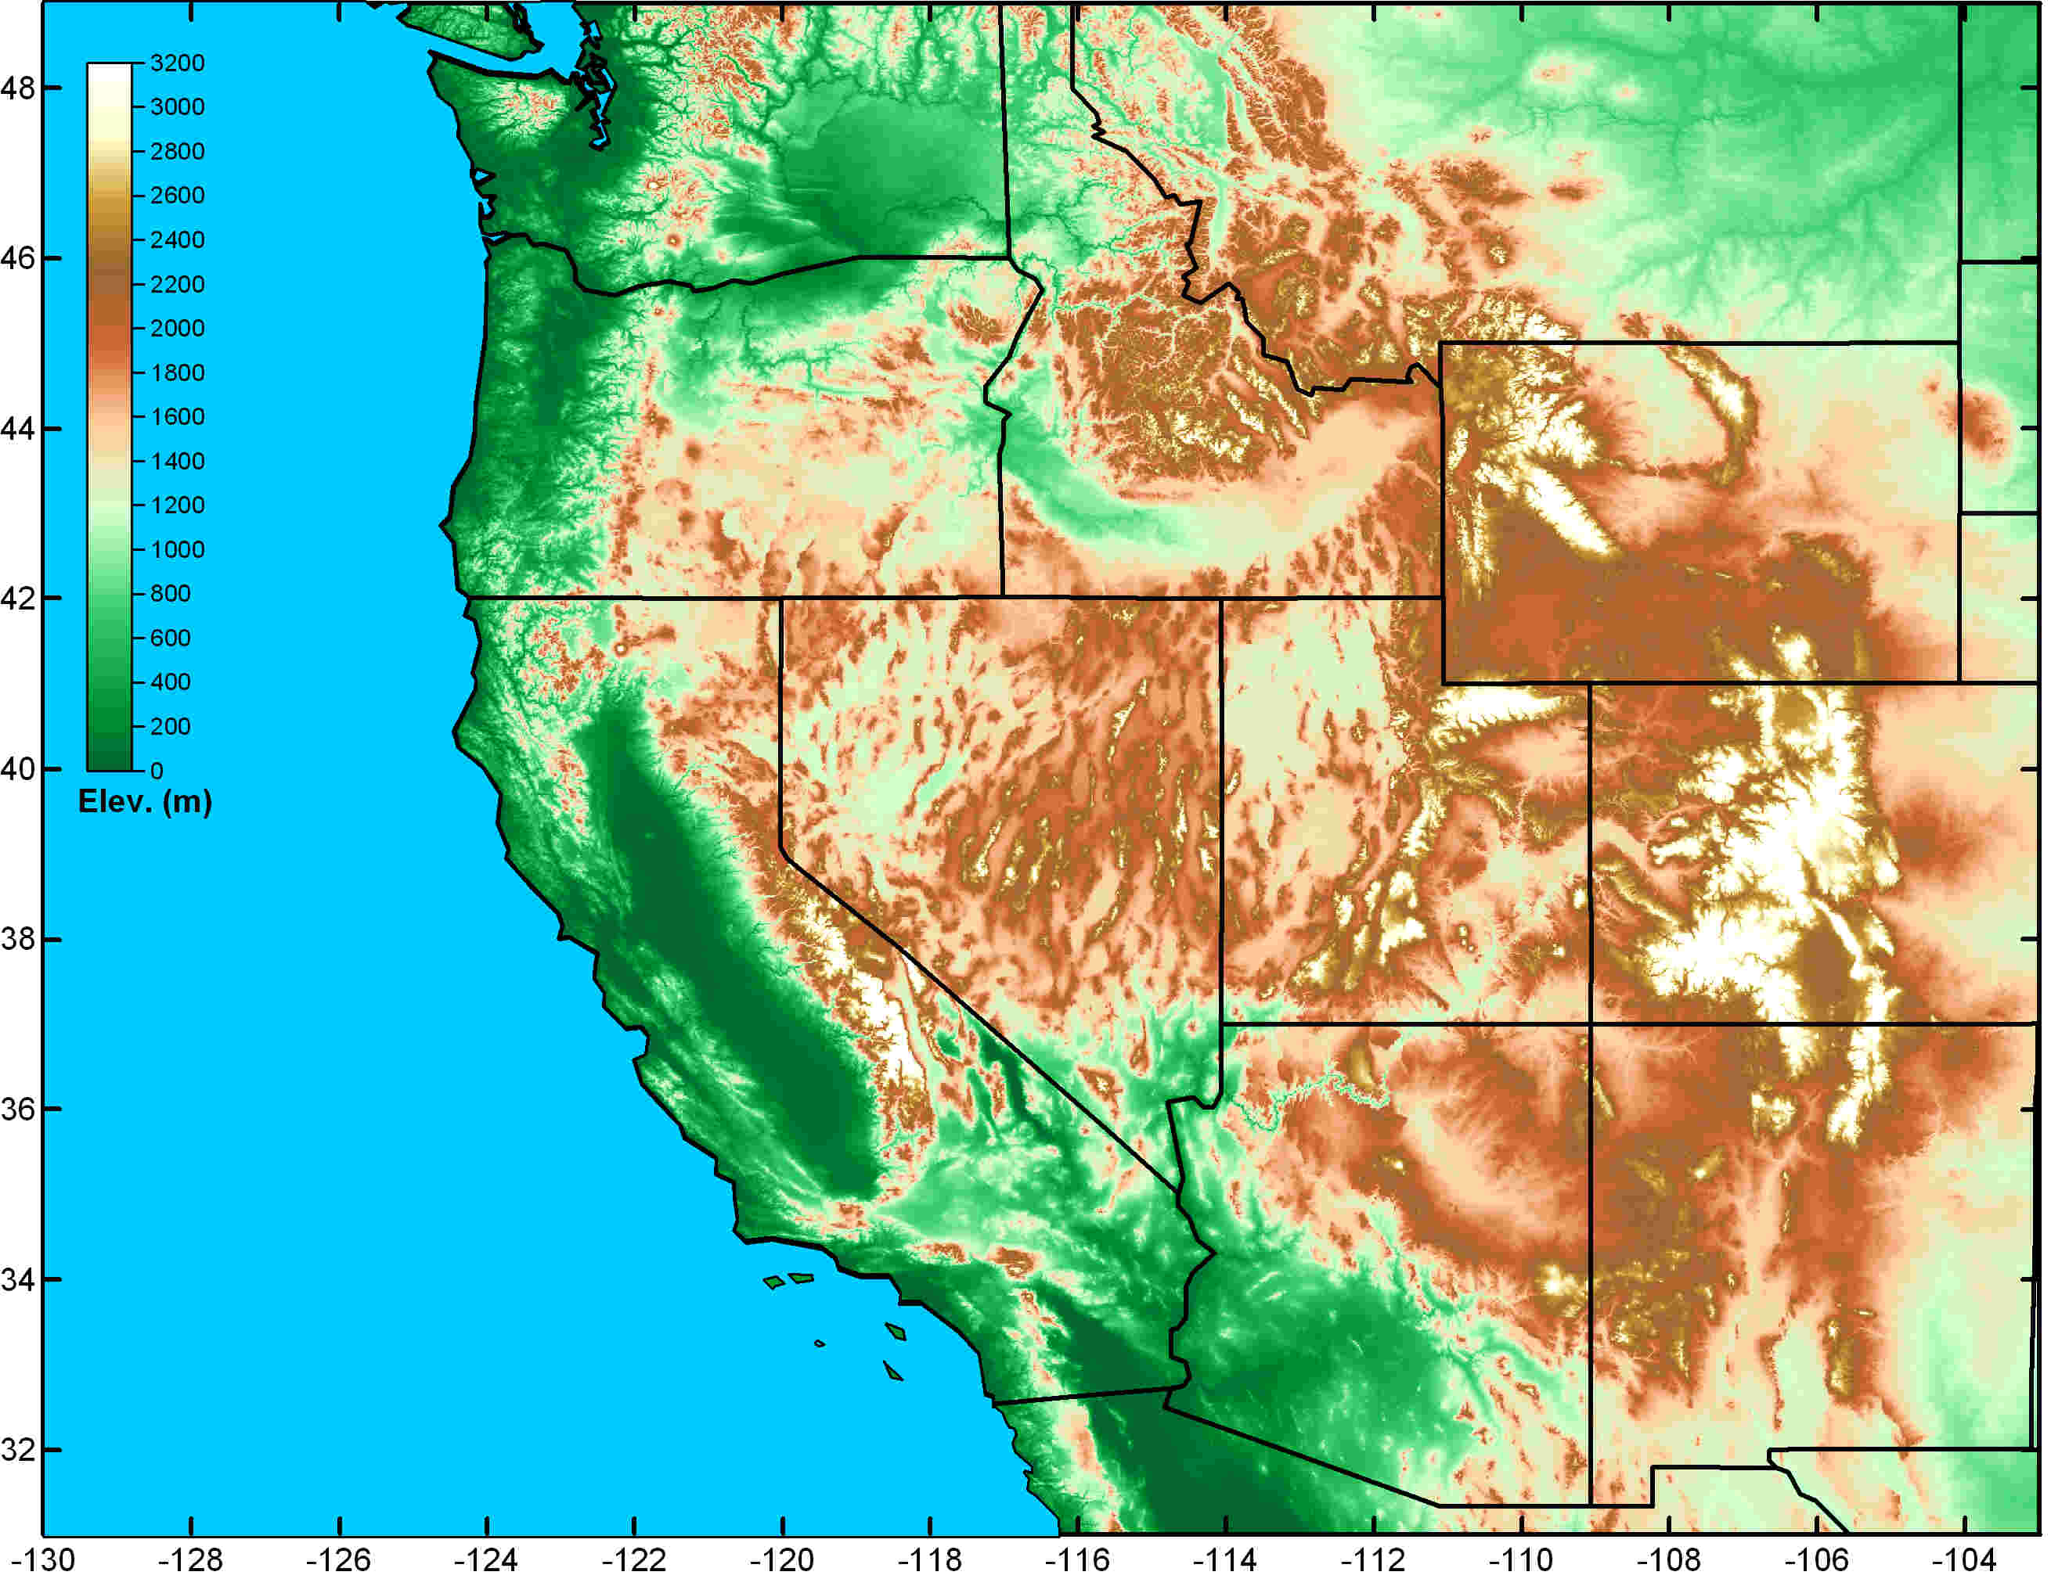


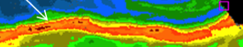

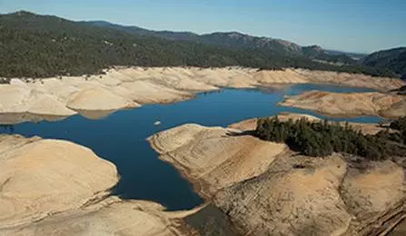


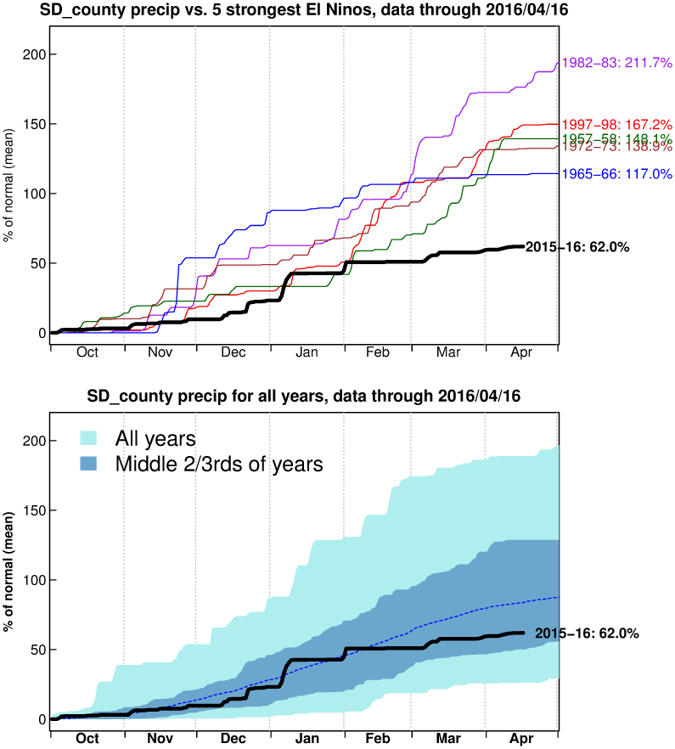
Great Plains Convection
(spring and summer)
Atmospheric Rivers
(fall and winter)
Front Range Upslope (rain/snow)
CW3E-North
at Sonoma County Water Agency
Director: F. Martin Ralph, Ph.D. Website: cw3e.ucsd.edu
Strategies: Observations, physical processes, modeling, decision support
Scope: A group of roughly 25 people with 10 major projects
Partners: California DWR, Sonoma County Water Agency, CNAP, USGS San Diego Supercomputing Center
Sponsors: CA DWR, USACE/ERDC, NOAA, SCWA, NASA, USBR
Funded collaborations
Southwest Monsoon (summer & fall)
CW3E
Based at UCSD/Scripps Oceanography
Key Phenomena Causing Extreme Precipitation in the Western U.S. (Ralph et al. 2014)
Mission
Provide 21st Century water cycle science, technology and outreach to support effective policies and practices that address the impacts of extreme weather and water events on the environment, people and the economy of Western North America
Goal
Revolutionize the physical understanding, observations, weather predictions and climate projections of extreme events in Western North America, including atmospheric rivers and the North American summer monsoon as well as their impacts on floods, droughts, hydropower, ecosystems and the economy
Atmospheric Rivers
CW3E’s Core Efforts
Tools for California Water Extremes
Climate Science
“West-WRF” Weather Model
Subseasonal-to-Seasonal Outlooks

Slide 22
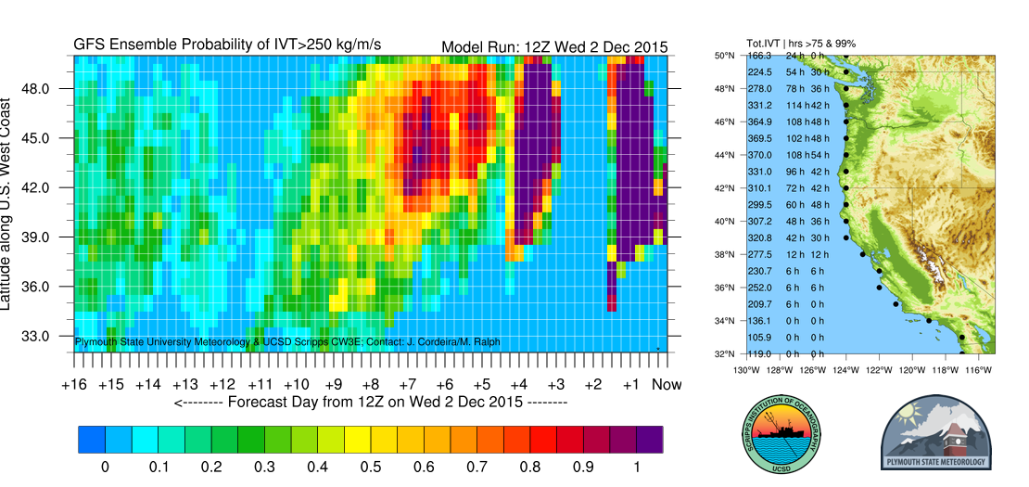
Forecast chances of landfall of at least WEAK Atmospheric River conditions on the U.S. West Coast from 2-18 Dec 2015 - updates available at cw3e.ucsd.edu (Cordeira et al. BAMS 2016, in press)
10-16-day forecast
Shows chance of
AR landfalls (but forecasts this far ahead are highly uncertain)
5-10 day forecast shows growing
chance of
AR landfalls
0-5 day forecast shows
two AR landfalls on US west coast
12 Dec to 18 Dec
7 Dec to 12 Dec
2 Dec to 7 Dec
What does this diagram show? The main diagram (left display) is read from *right* to *left* at a given latitude in order to indicate how many days from today AR conditions are likely at the coast. By plotting the display from *right* to *left*, the display shows you "what is in the pipeline" as storm systems generally move from west to east. This diagram shows the chances (i.e., probability) of having at least weak "atmospheric river" conditions (i.e., strong horizontal water vapor transport, called “IVT” exceeding 250 kg/m/s) at different latitudes along the U.S. West Coast from "today" through the next 16 days at 6-hour increments. It uses a threshold of IVT>250 kg/m/s as the threshold for AR conditions based on years of study. The landfall locations are the black dots in the right-most panel. The probability is based on 21 different forecasts run simultaneously with slightly different starting conditions (which simulates the “butterfly effect”). The forecasts are from the NOAA/NWS’ “GFS” global weather forecast model. The probability is shaded on a scale from 0% (blue) to 100% (purple). The landfall locations are the black dots in the right-most panel. The right map-panel shows the total 16-day time-integrated IVT (Tot.IVT) for that location in millions of kg/m (left column of numbers). The diagram also shows the number of hours a location along the coast may expect to see AR conditions along with uncertainty. These hours are drawn in the region next to the U.S. West Coast in the right-most panel. These numbers represent the number of hours (over the next 16 days) a location has a 75% chance of AR conditions (middle column of numbers) or a 99% chance of AR conditions (right column of numbers). The higher this number, the longer AR conditions are likely and the more precipitation may be expected!

Slide 23
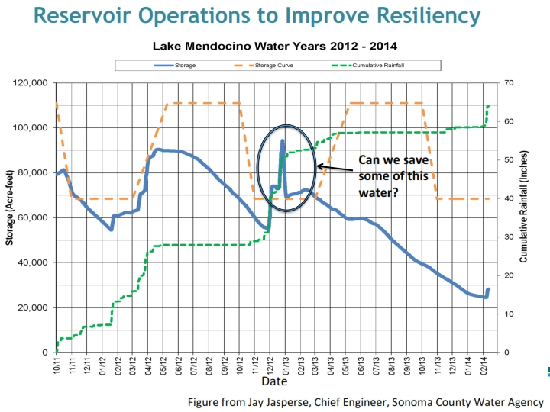
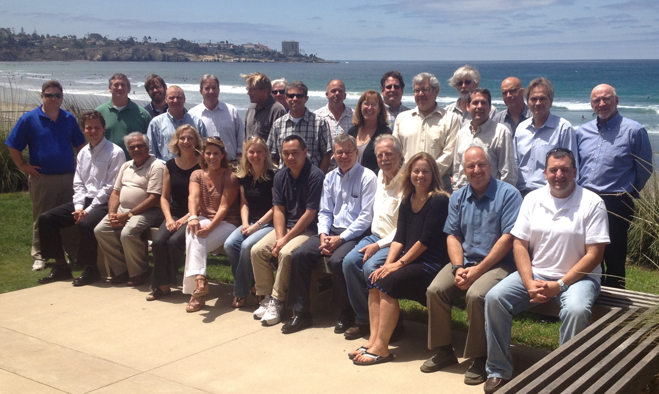
Forecast-Informed Reservoir Operations
FIRO Steering Committee
Sonoma County Water Agency
Scripps CW3E
U.S. Army Corps of Engineers
CA Dept. of Water Resources
NOAA, USGS, US BurRec
Meteorologists, climatologists, hydrologists Civil Engineers, biologists, economists

Slide 24
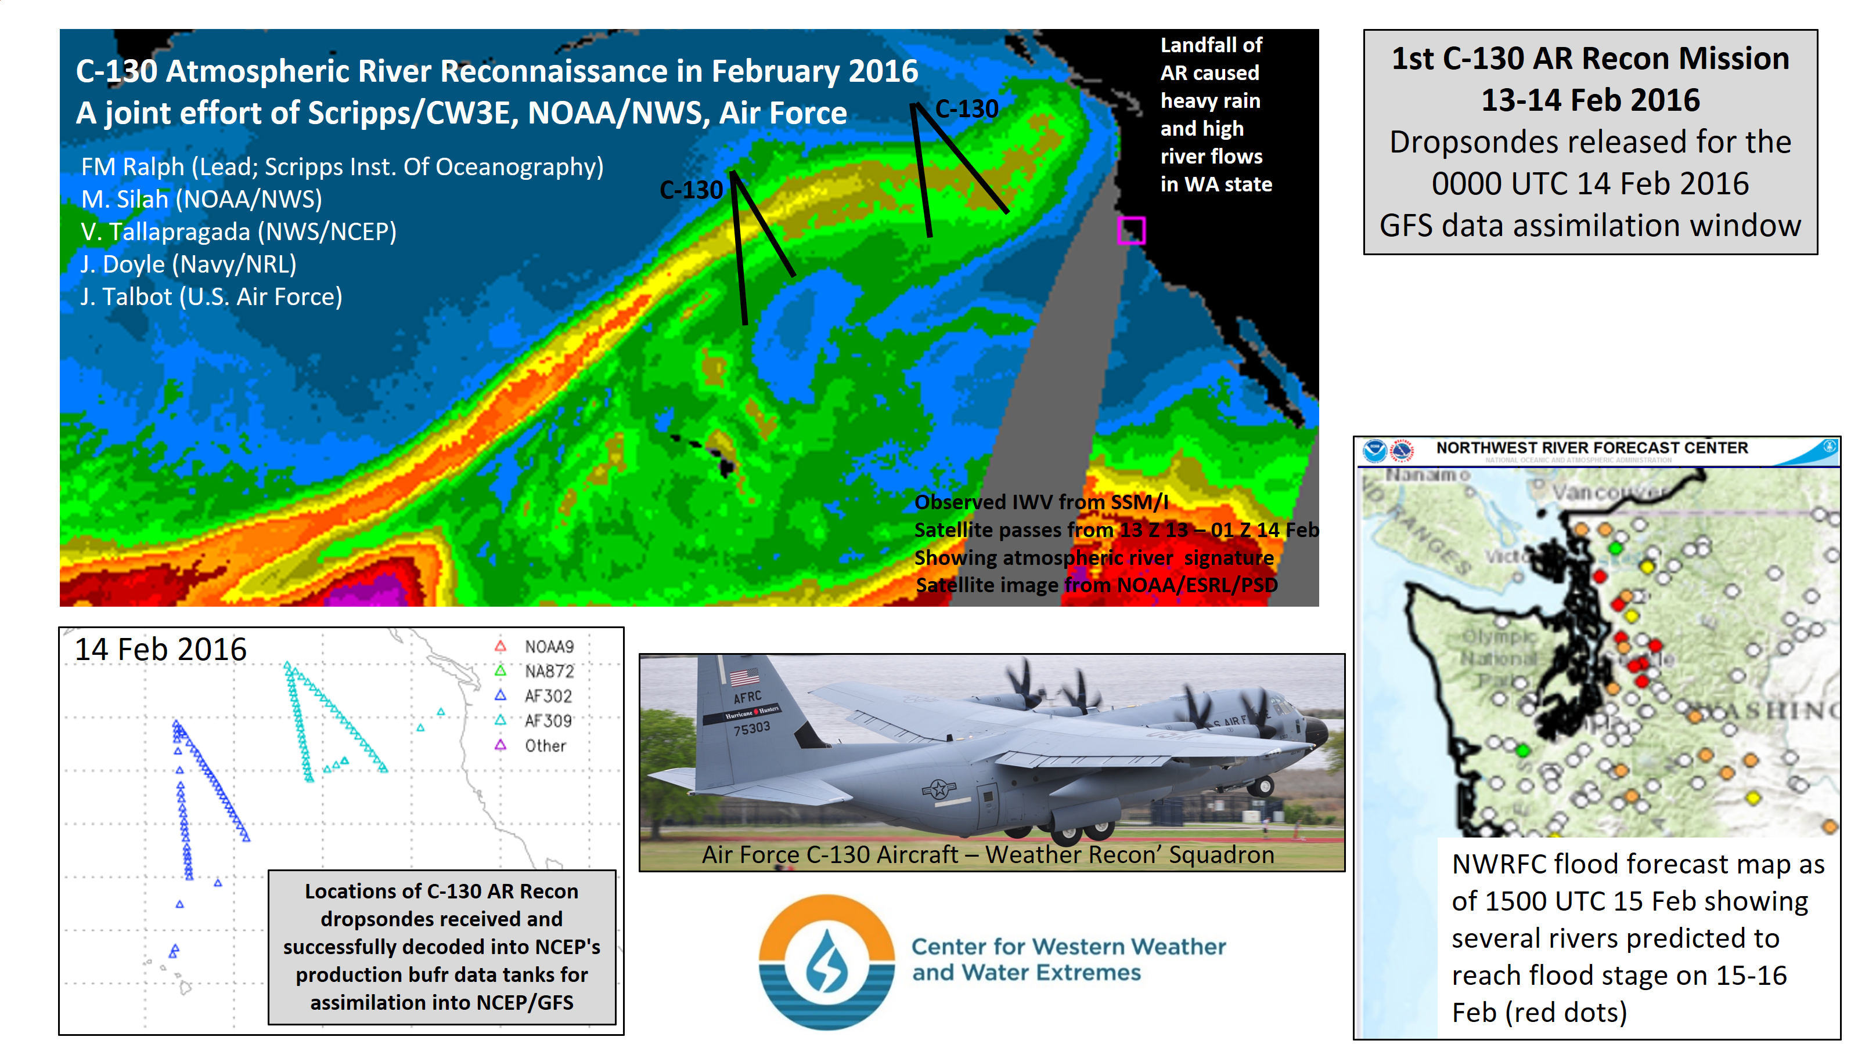

Slide 25


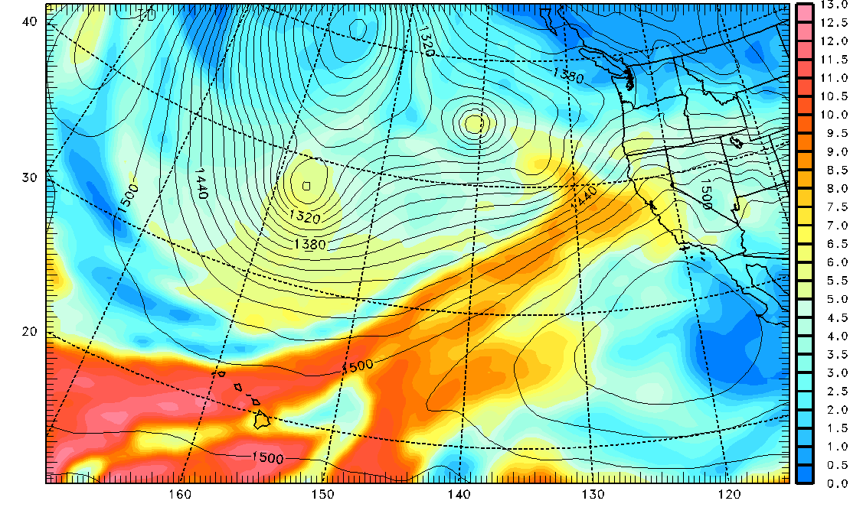
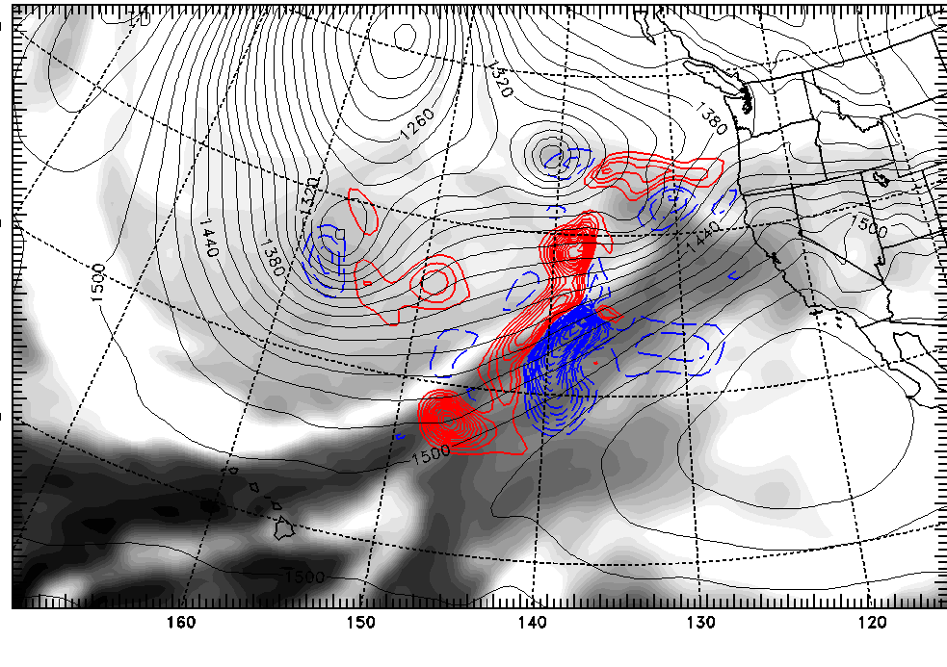
Nested Adjoint Sensitivity
36-h Sensitivity (Analysis)
12Z 8 February 2014 (Final Time 00Z 10 February)
Jim Doyle - NRL
Geopotential Heights and Water Vapor
850 hPa
36-h Water Vapor Sensitivity
850 hPa (q_{v} shown in gray)
36-h forecast sensitivity calculations for 12Z 8 February 2014 case
Moisture sensitivity is a maximum along the atmospheric river and just to the north of the AR.
Moisture sensitivity is 2X larger than the temperature and 3X larger than the wind component sensitivity (assume analysis errors are ~1 K, 1 m/s, 1 g/kg)

Slide 26
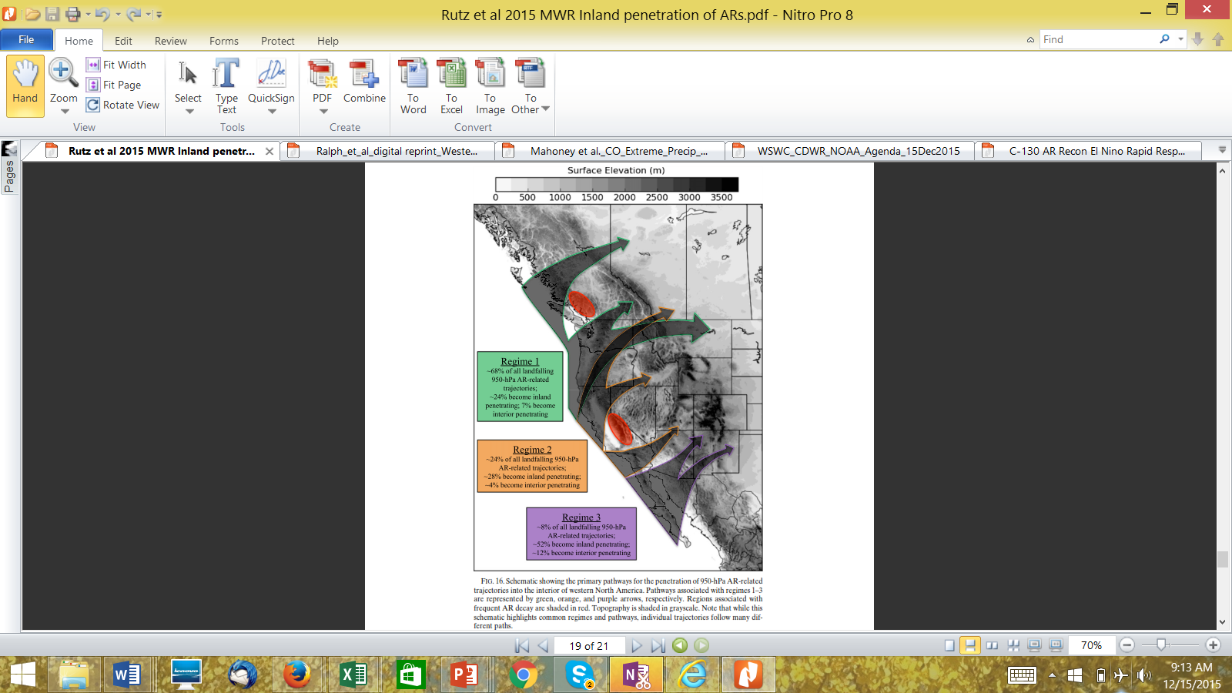
The Inland Penetration of Atmospheric Rivers over Western North America:
A Lagrangian Analysis
J.J. Rutz, J. W. Steenburgh and F.M. Ralph
Mon. Wea. Rev., 2015

Slide 27
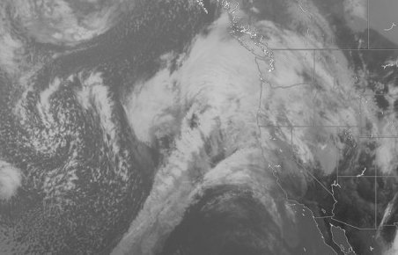
AR Workshop June 2015: Compared TMEs, ARs, the LLJ, and WCBs
Schematic representation:
Upper-Level Jet
WCB
X
L
Upper-Level
Trough
LLJ
AR
TME
Slide courtesy of J. Cordeira, derived from AR (Cordeira), WCB (Wernli), TME (Sodemann) presentations at the AR Workshop in June 2015

Slide 28
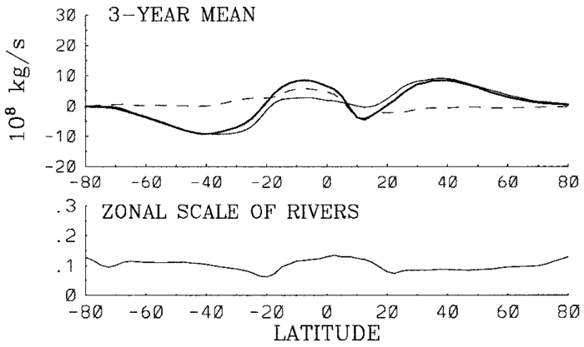
Poleward Water Vapor Transport: Modern tool and global landfall map
Zhu and Newell (1998)
Guan and Waliser (2015)
AR fractional poleward IVT and integrated zonal scale using Guan and Waliser (2015) AR detection algorithm applied globally largely consistent with original estimate by Zhu and Newell (1998)

Slide 29
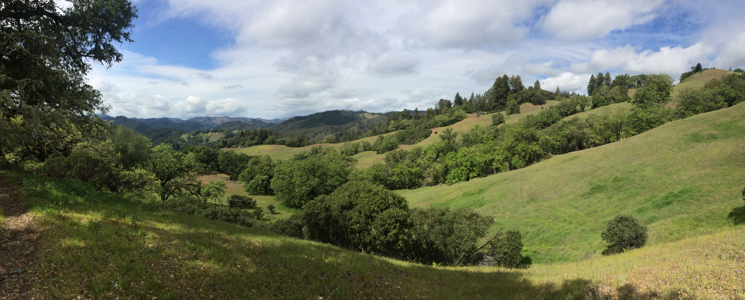
Summary
The emergence of the atmospheric river concept represents an example of the complex and often circuitous route that major new research directions take before maturing and having impact through applications.
The path provides a telling example of the importance of sustained basic research, and of connecting researchers with people in operational or application-oriented roles.

