Slide 1
Sandy (2012), Hazel (1954) and the 1938 New England Hurricane: A Perspective

Slide 2
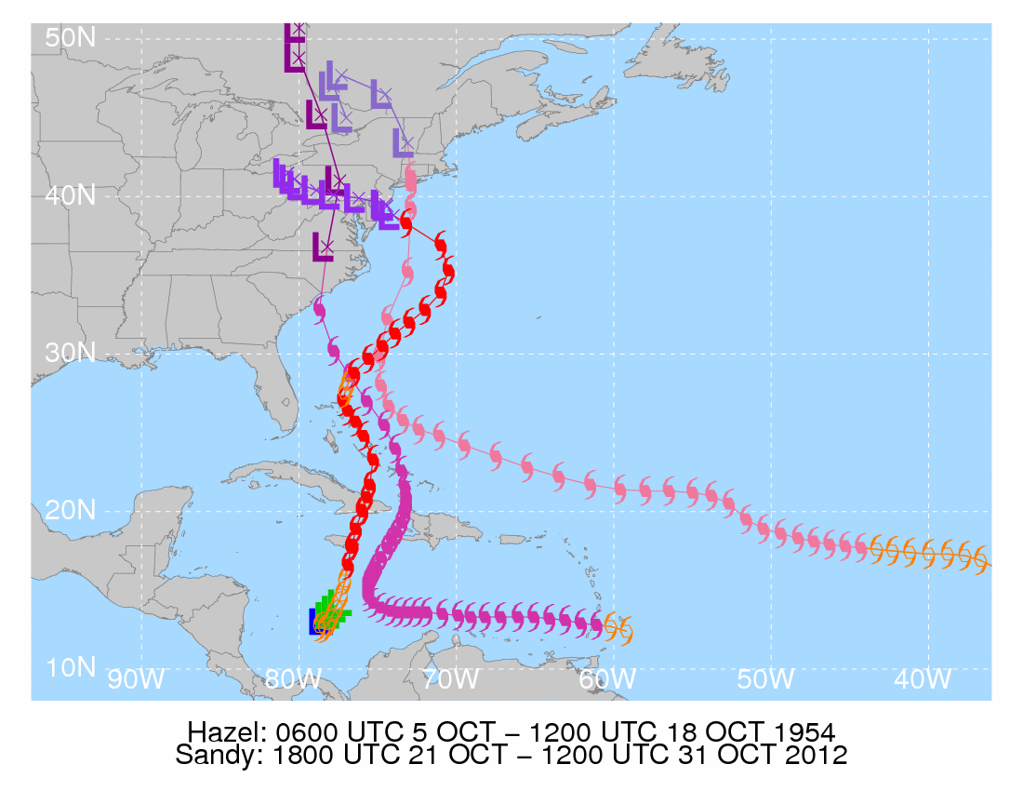
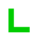
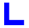

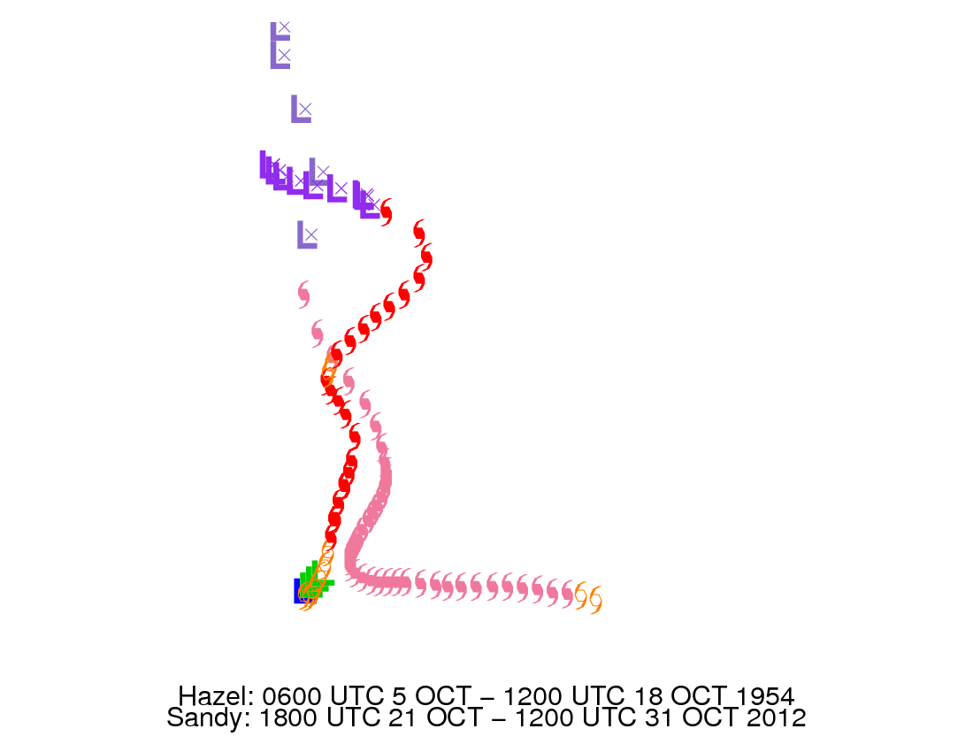
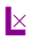

Low pressure
Tropical depression
Tropical storm
Hurricane (Sandy)
Hurricane (Hazel)
Hurricane (38-Hurr)
Extratropical (Sandy)
Extratropical (Hazel)
Extratropical (38-Hurr)
Sandy: 1800 UTC 21 October – 1200 UTC 31 October 2012
Hazel: 0600 UTC 5 October – 1200 UTC 18 October 1954
1938 New England Hurricane: 1200 UTC 9 September – 0000 UTC 23 September 1938

Slide 5
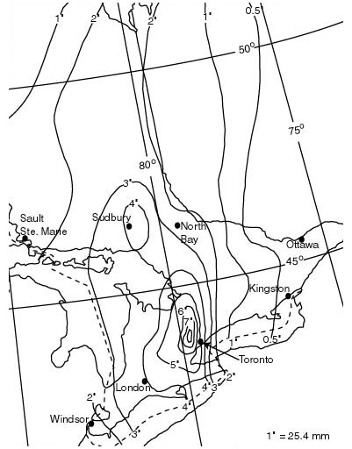
Hazel (1954) Rainfall: Canada

Slide 7
http://noaa.maps.arcgis.com/apps/StorytellingTextLegend/index.html?appid=f8c2910c358e47d98ea2bdb03903462
Hurricane Hazel first developed on October 5, 1954, and moved westward through the Caribbean without striking land. Instead of continuing its predicted track towards Jamaica, Hazel made a sharp turn north, striking Haiti. Forecasters believed that the storm would lose power over the cooler waters north of Florida and drift eastward into the Atlantic. Again, contrary to predictions, Hazel turned northward to make landfall in the Carolinas as a Category 4 hurricane and then traveled up the East Coast into Canada. Hazel finally moved offshore on October 18.

Slide 9
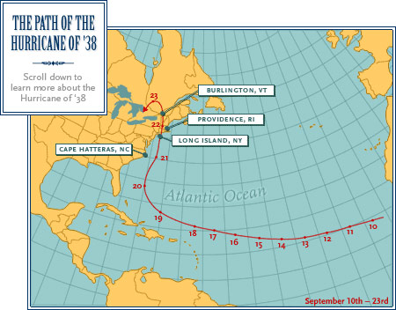

Slide 10
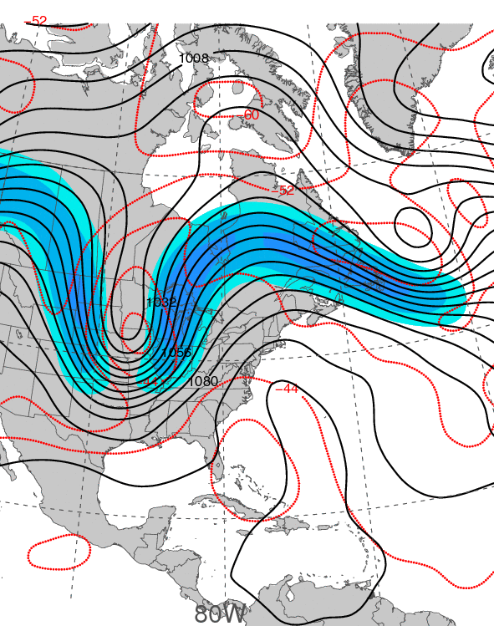
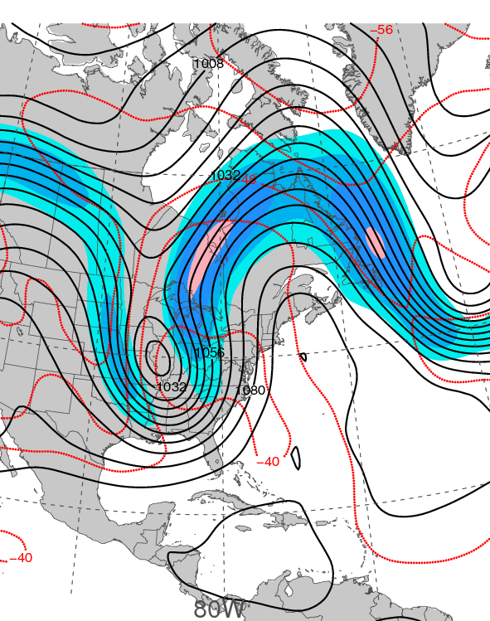
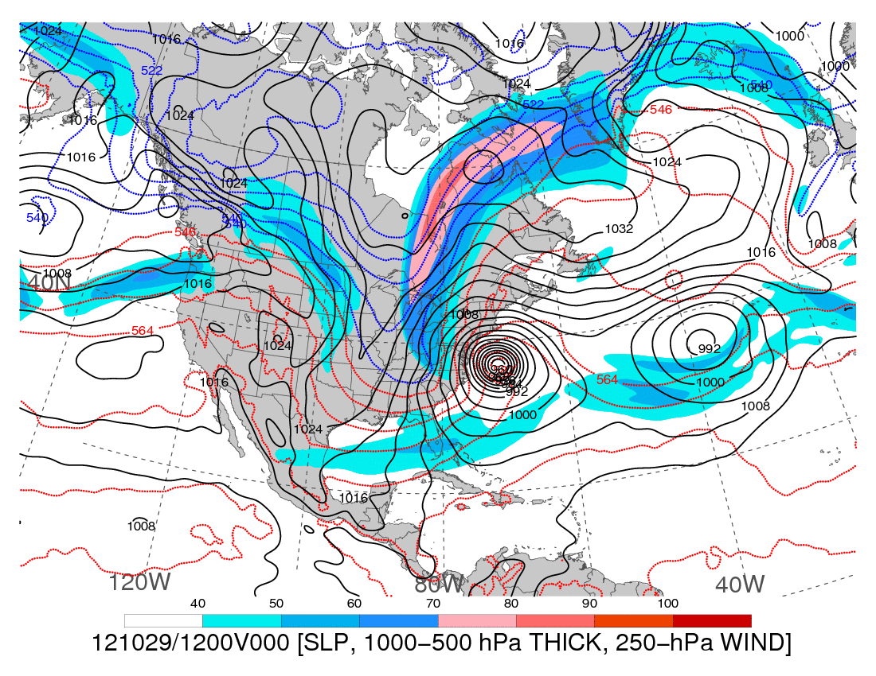
0000 UTC 15 October 1954
0000 UTC 16 October 1954
250-hPa wind speed (shaded, m s⁻¹), temperature (dashed red contours, °C),
and geopotential height (black solid contours, dam)

Slide 11
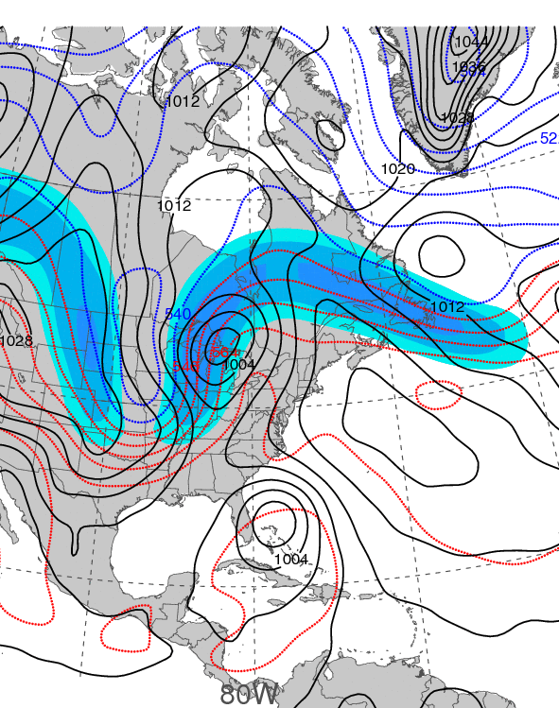
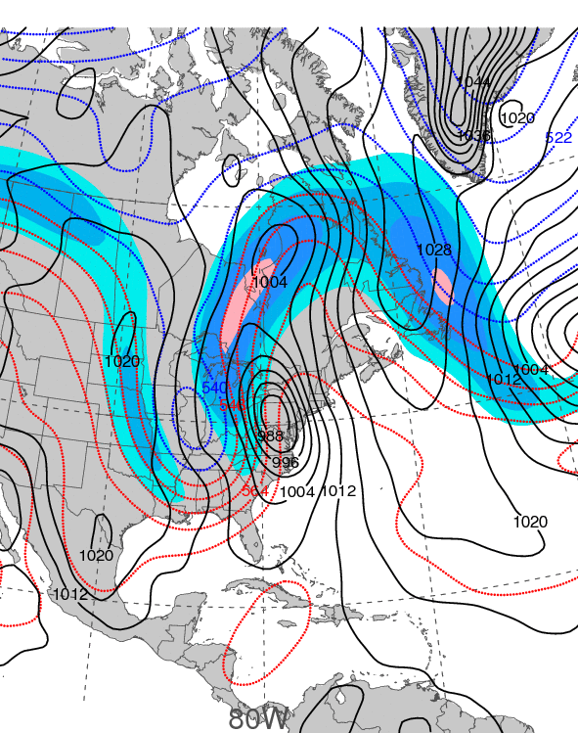
0000 UTC 15 October 1954
0000 UTC 16 October 1954
250-hPa wind speed (shaded, m s⁻¹), 1000–500-hPa thickness (dashed red/blue contours, dam), and mean sea level pressure (black solid contours, hPa)

Slide 12
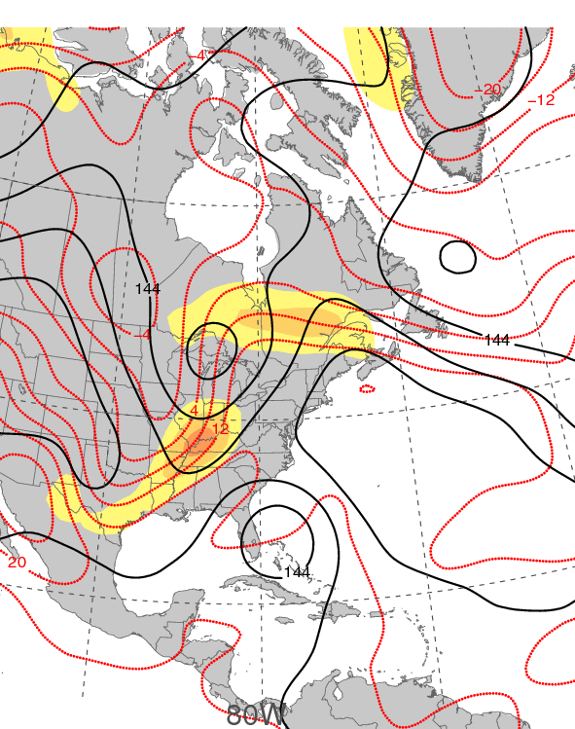
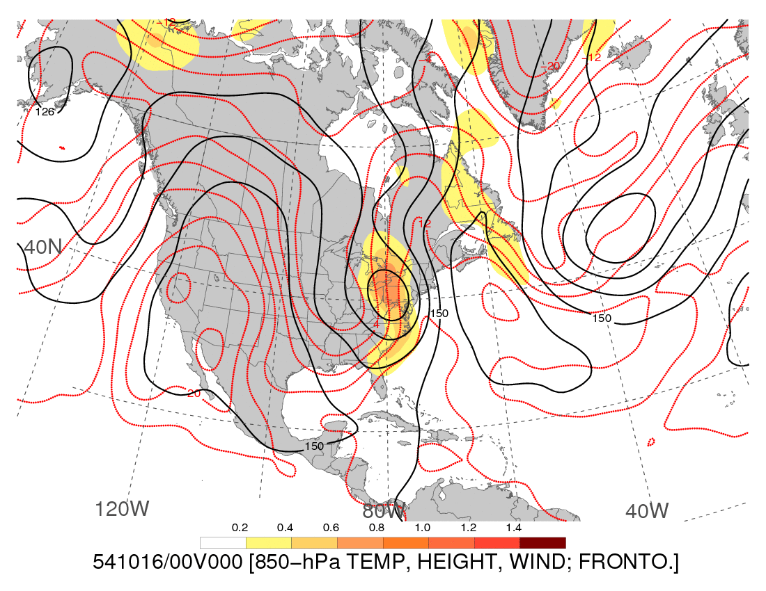
0000 UTC 15 October 1954
0000 UTC 16 October 1954
850-hPa frontogenesis [shaded, K (100 km) ⁻¹ (3 h) ⁻¹], temperature (dashed red contours, °C), and geopotential height (black solid contours, dam)

Slide 14
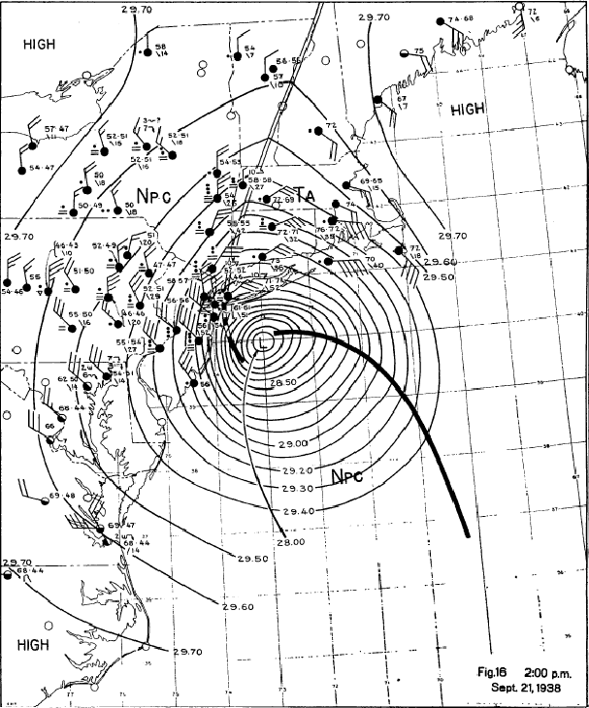

Slide 15
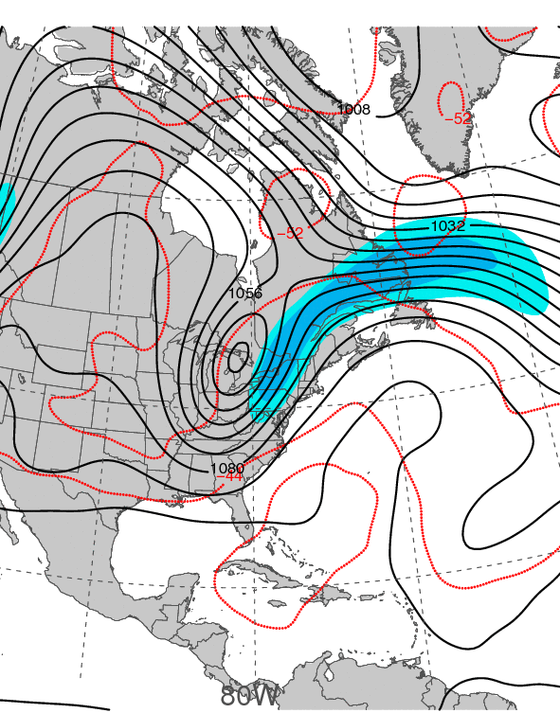
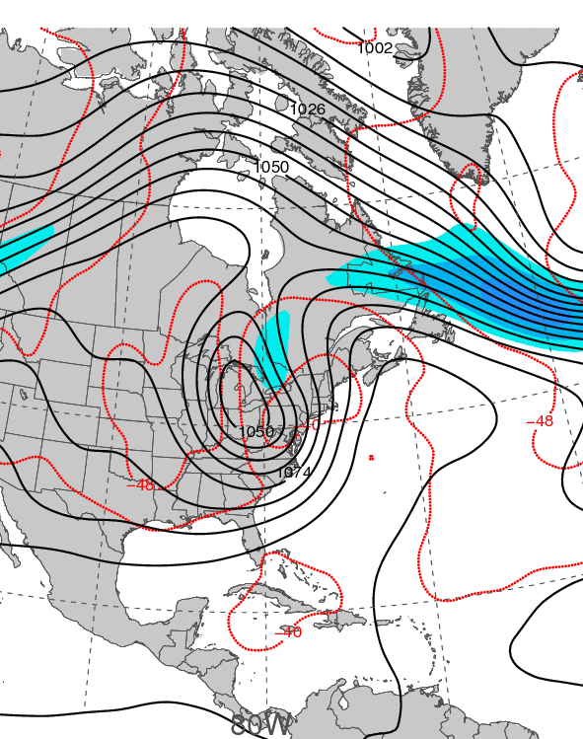
0000 UTC 21 September 1938
0000 UTC 22 September 1938
250-hPa wind speed (shaded, m s⁻¹), temperature (dashed red contours, °C),
and geopotential height (black solid contours, dam)

Slide 16
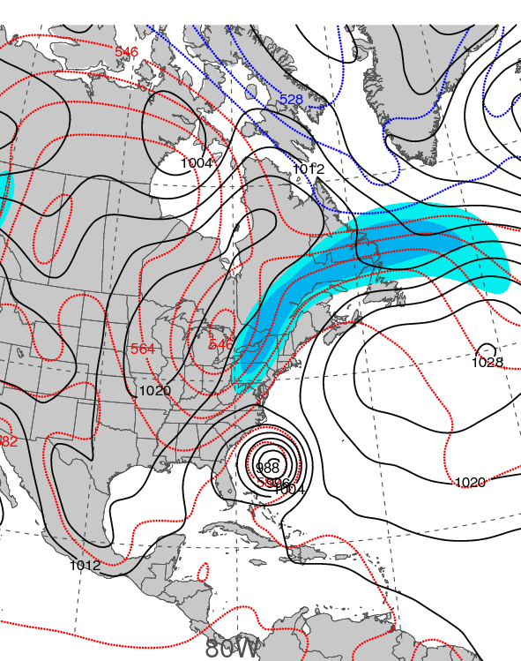
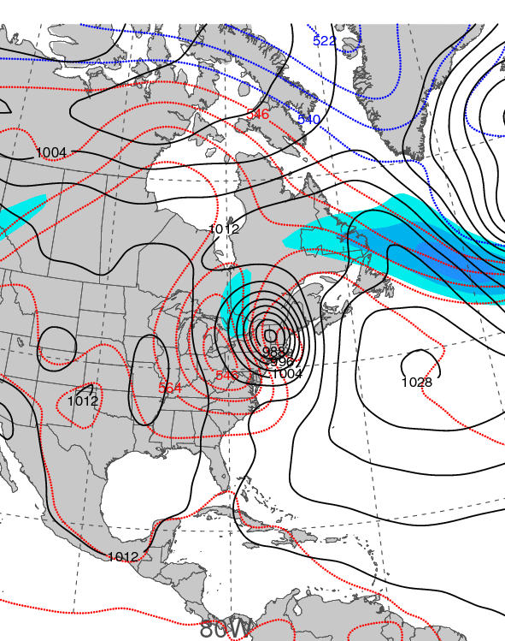
0000 UTC 21 September 1938
0000 UTC 22 September 1938
250-hPa wind speed (shaded, m s⁻¹), 1000–500-hPa thickness (dashed red/blue contours, dam), and mean sea level pressure (black solid contours, hPa)

Slide 17
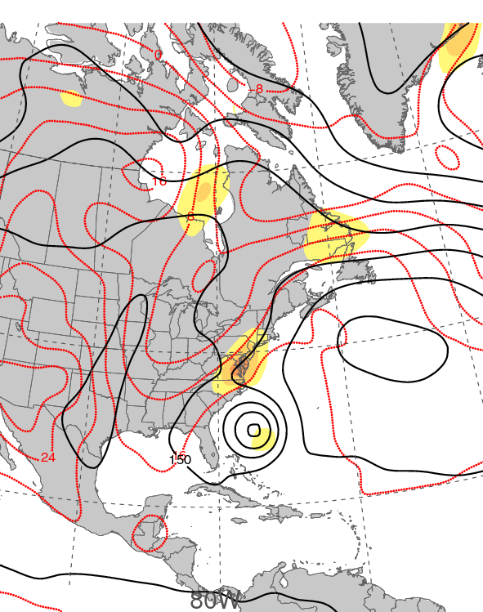
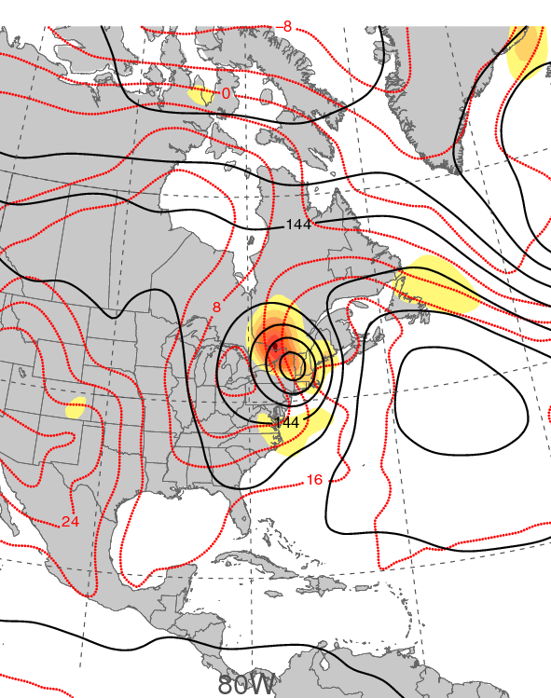
0000 UTC 21 September 1938
0000 UTC 22 September 1938
850-hPa frontogenesis [shaded, K (100 km) ⁻¹ (3 h) ⁻¹], temperature (dashed red contours, °C), and geopotential height (black solid contours, dam)

Slide 18
Post Landfall: The Snowy Side of Sandy

Slide 20
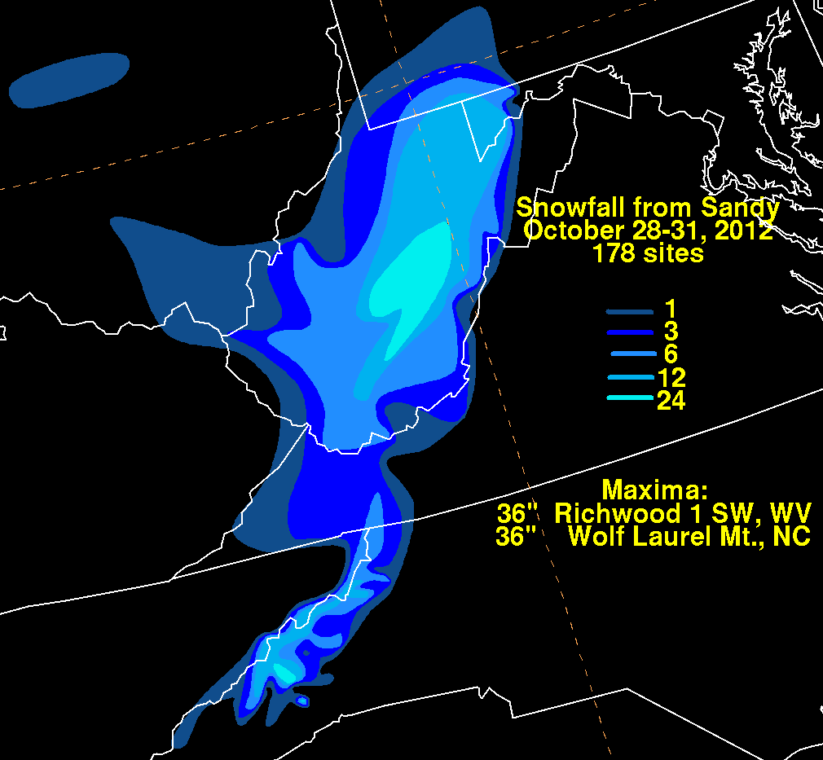
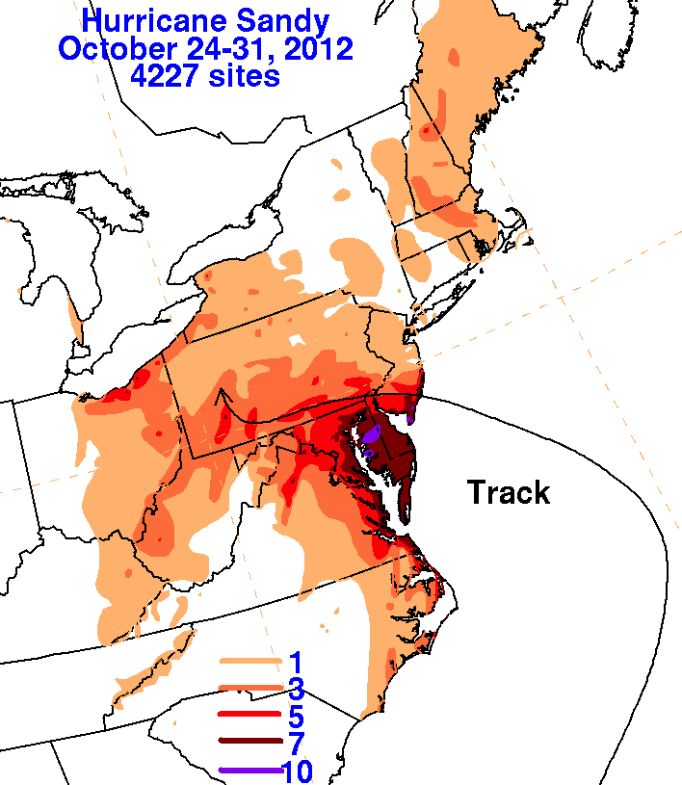
Total Precipitation
Observed snowfall (in, shaded)
Observed precipitation (in, shaded)
Downslope drying
Image Source: Weather Prediction Center

Slide 21
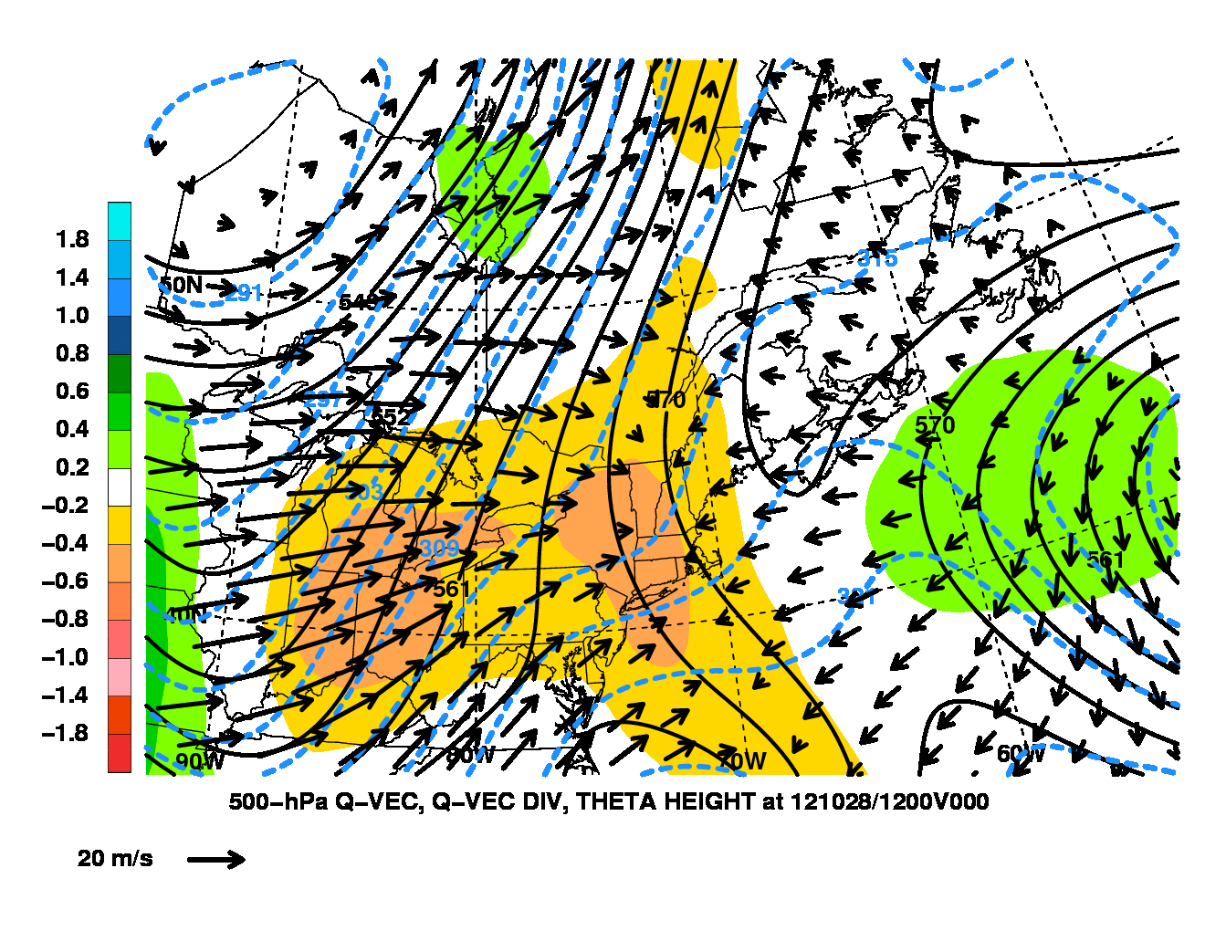
Quasi-Geostrophic Forcing
500-hPa heights (dam, solid), temperature (°K, dashed), Q-vectors (Pa m⁻¹ s⁻¹,
arrows), Q-vector forcing (Pa m⁻² s⁻¹, shaded)
1200 UTC 28 October 2012
Forcing for ascent in the snowfall region originated downstream of an upper-level trough at 1200 UTC 28 October

Slide 22
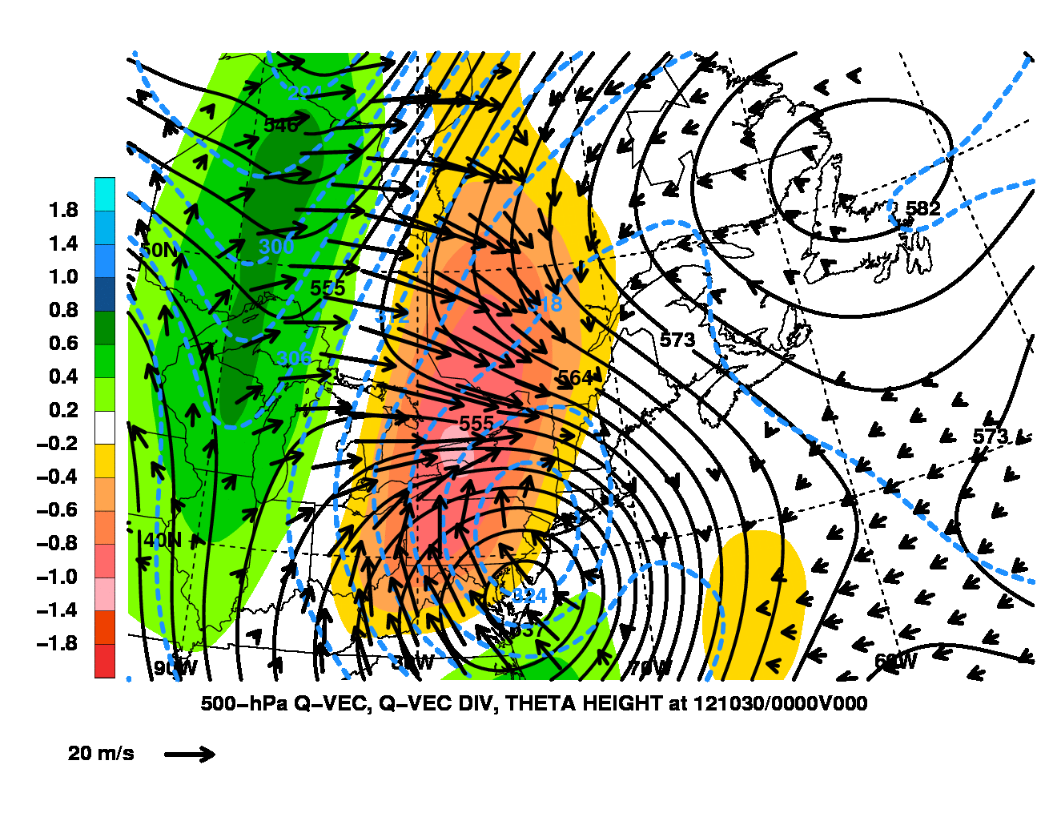
Quasi-Geostrophic Forcing
500-hPa heights (dam, solid), temperature (°K, dashed), Q-vectors (Pa m⁻¹ s⁻¹,
arrows), Q-vector forcing (Pa m⁻² s⁻¹, shaded)
0000 UTC 30 October 2012
500 hPa Q-vector convergence increased over West Virginia as forcing for ascent wrapped around the poleward and western side of the cyclone

Slide 23
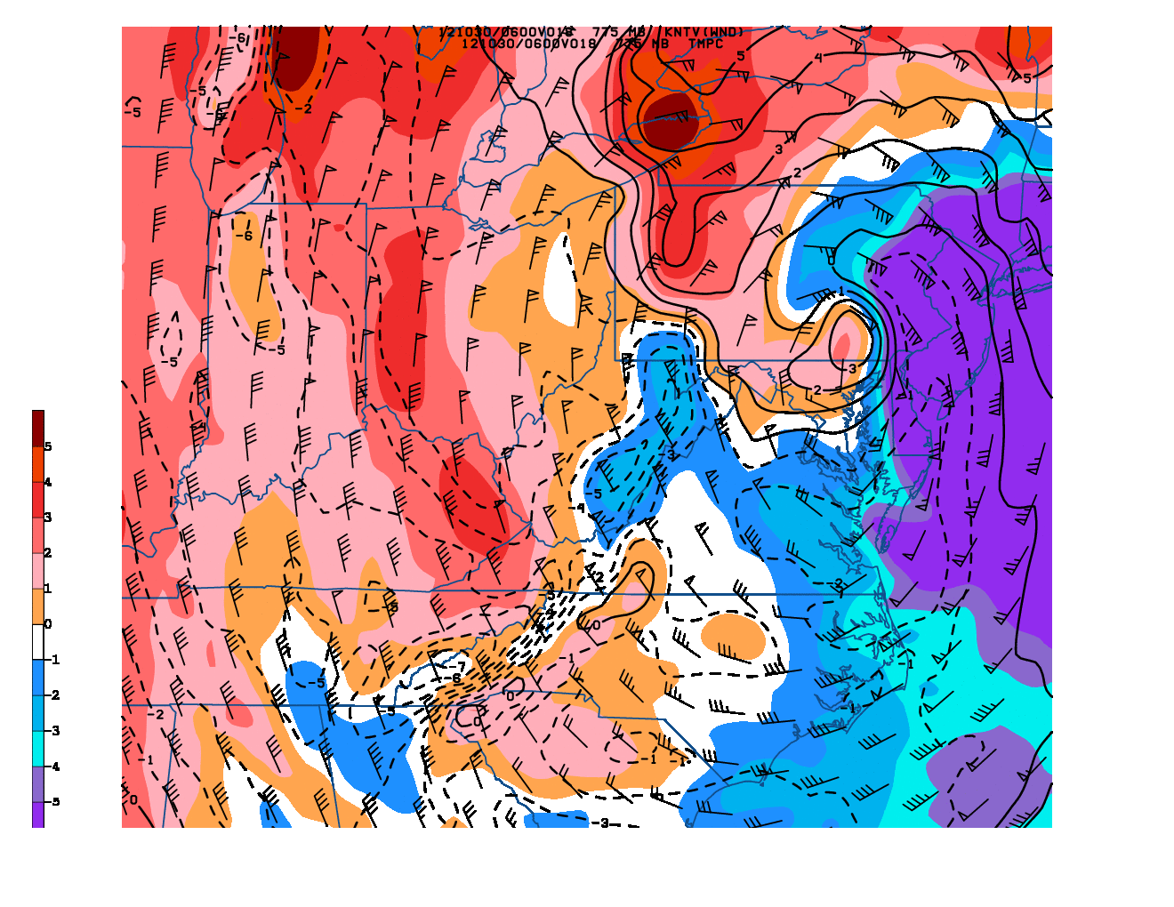
Low-Level Warm-Air Advection
800-hPa temperature change (°C 6h⁻¹, shaded), temperature (solid > 0 °C, dashed < 0 °C), wind (kt, barbs)
0600 UTC 30 October
Northerly and northwesterly low-level warm-air advection upwind of the Appalachian Mountain spine increased the stability in this region
ILN

Slide 24
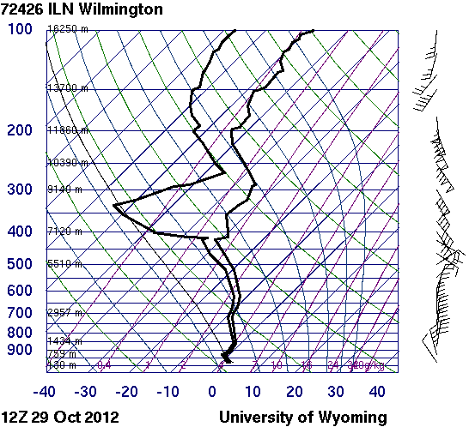
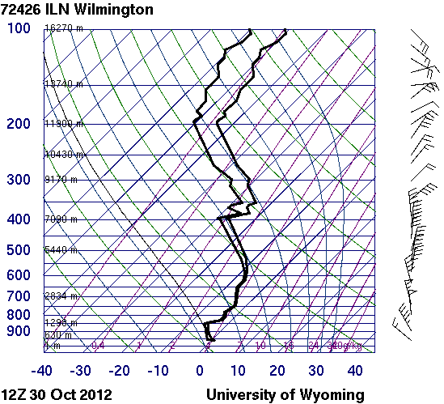
Wilmington, OH (ILN) Soundings
1200 UTC 29 October 2012
1200 UTC 30 October 2012
Inversion strengthens
12-km NAM forecast soundings for ILN match observed soundings

Slide 25
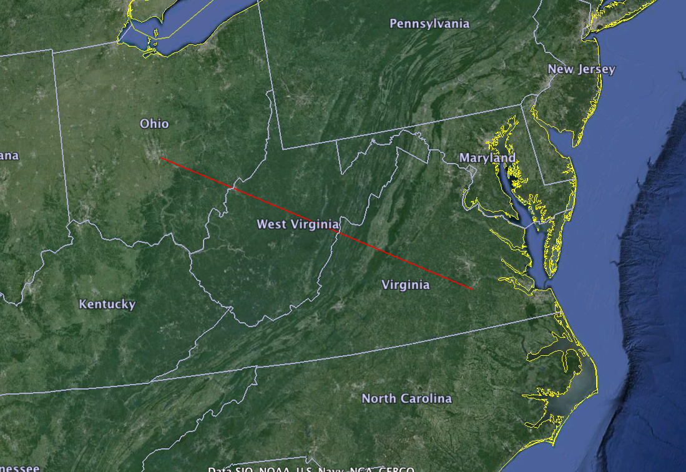
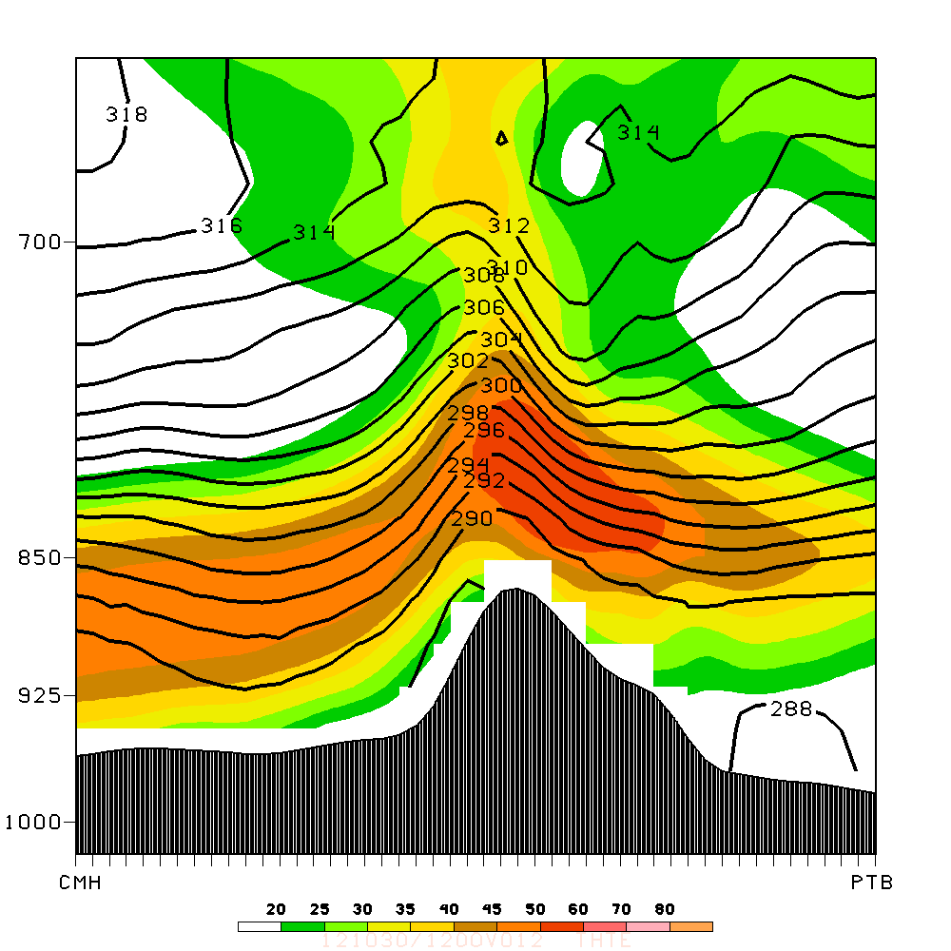
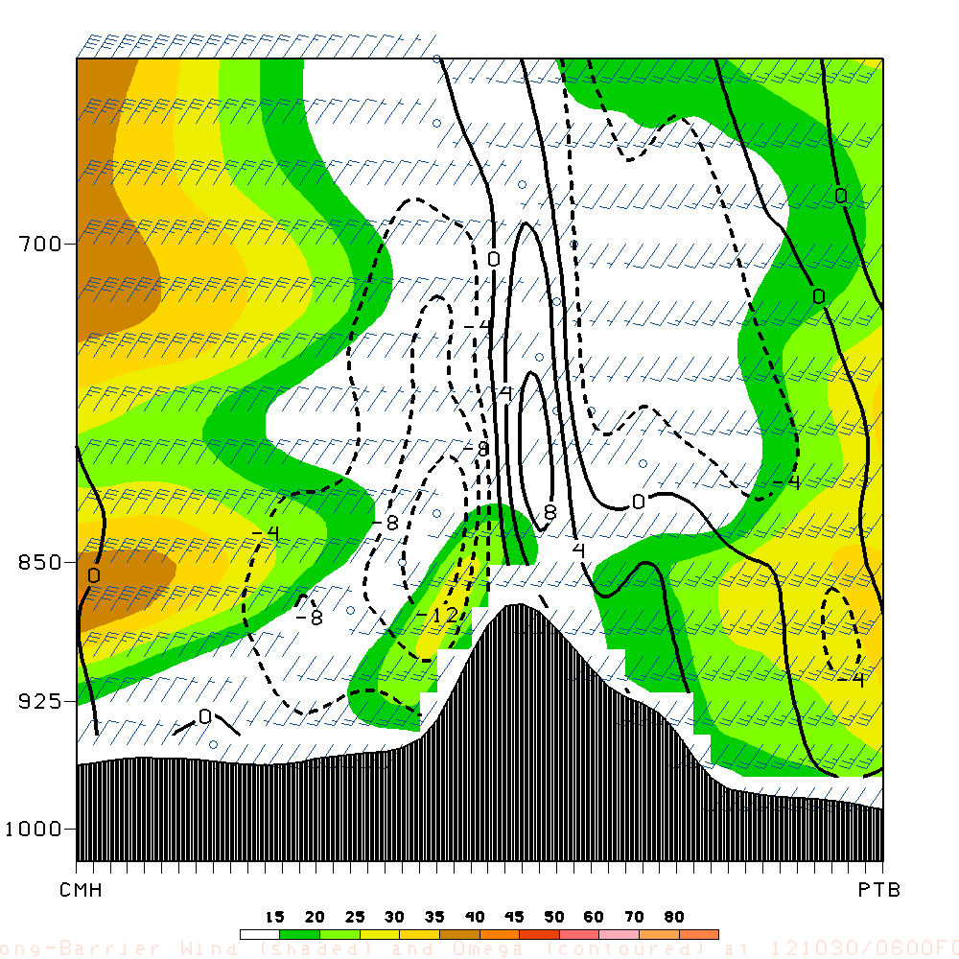
Blocked Flow
Along-barrier wind (kt, shaded), omega (Pa s⁻¹, dashed contours-upward, solid contours-downward)
Cross-barrier wind (kt, shaded), theta-e (K, solid)
Upstream lifting
Barrier jet
Decrease in cross-barrier wind speed
0600 UTC 30 October 2012
0600 UTC 30 October 2012
12-km NAM analyses

Slide 26
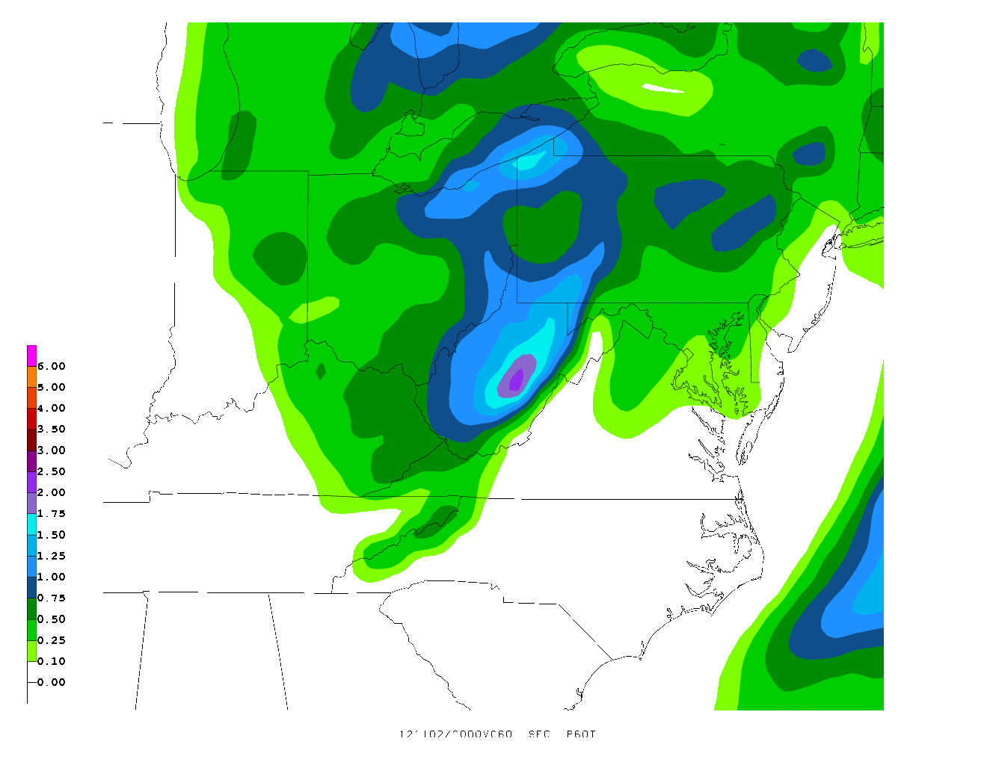

Upwind Precipitation Enhancement
NAM forecast precipitation (in, shaded) after inversion development

Slide 27
Low pressure
Tropical depression
Tropical storm
Hurricane (Sandy)
Hurricane (Hazel)
Hurricane (38-Hurr)
Extratropical (Sandy)
Extratropical (Hazel)
Extratropical (38-Hurr)
Sandy: 1800 UTC 21 October – 1200 UTC 31 October 2012
Hazel: 0600 UTC 5 October – 1200 UTC 18 October 1954
1938 New England Hurricane: 1200 UTC 9 September – 0000 UTC 23 September 1938

