Slide 1
The “Pi-Day” Coastal Storm of 14 March 2017
Lance F. Bosart,
Alicia M. Bentley, Tomer Burg, and Andrew C. Winters
National Weather Association
43rd Annual Meeting
Wednesday 29 August 2018
St. Louis, Missouri 63101
Support Provided by: NSF AGS-1355960 and NSF AGS-0935830

Slide 2
Motivation
“Pi-Day” Storm of 14 March 2017:
Limited synoptic-scale predictability horizon (3–6 days)
Restricted subsynoptic-scale storm track predictability (36–72 h)
Dumped heavy snow farther inland than anticipated
Resulted in less snow and more rain near the coast than expected
Linked to the structure and evolution of the North Pacific jet (NPJ)

Slide 3
Outline
Observational overview
Synoptic overview
Large-scale GEFS d(prog)/dt analysis for 0000 UTC 15 March
CONUS GFS d(prog)/dt analysis for 1800 UTC 14 March
NPJ regimes favorable to eastern CONUS cold/storminess

Slide 4
Observational Overview: Snowfall and Peak Winds

Slide 5
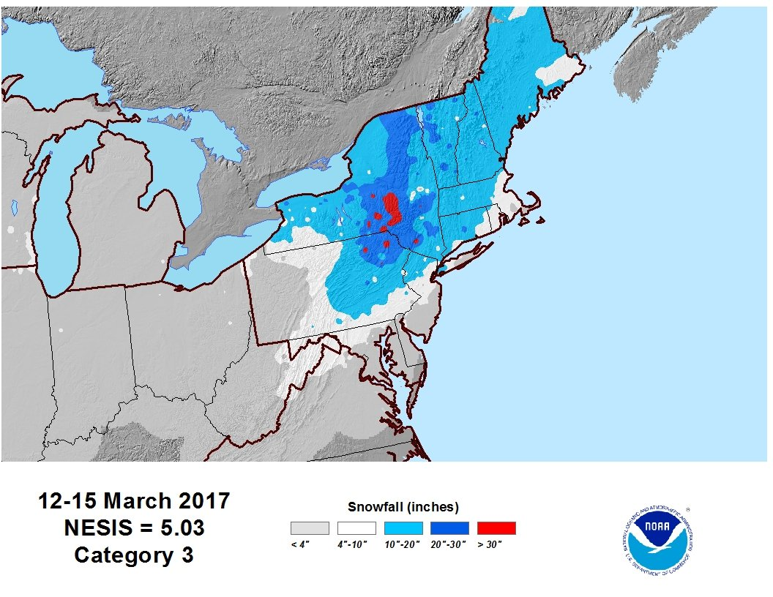
Winter Storm Stella
Source: weather.com

Slide 6
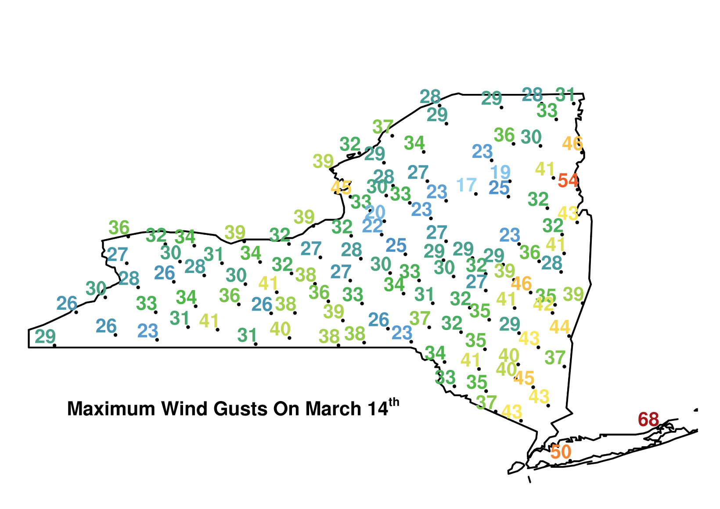
NYS Mesonet Maximum Wind Gusts (mph)
14 March 2017

Slide 7
Synoptic Overview: 500-hPa Height, Winds and Vorticity for 12–15 March 2017
Troughs of Pacific and Arctic origin interact over the eastern CONUS
Stronger Arctic trough rotates cyclonically around weaker Pacific trough as they partially phase
Strong cyclogenesis occurs closer to the coast than initially forecast at lead times < 60–72 h

Slide 8
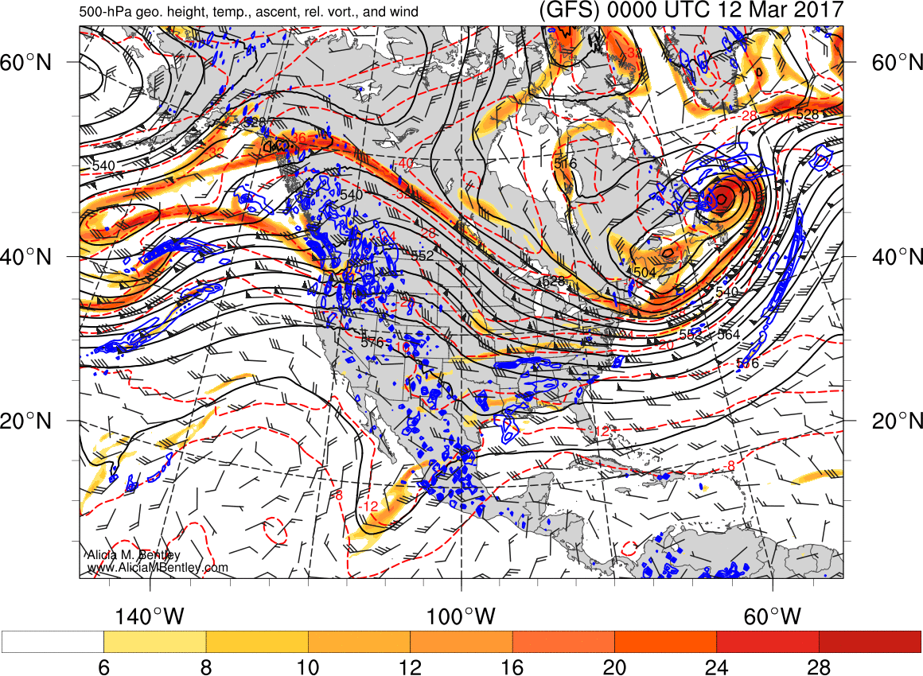

Slide 9
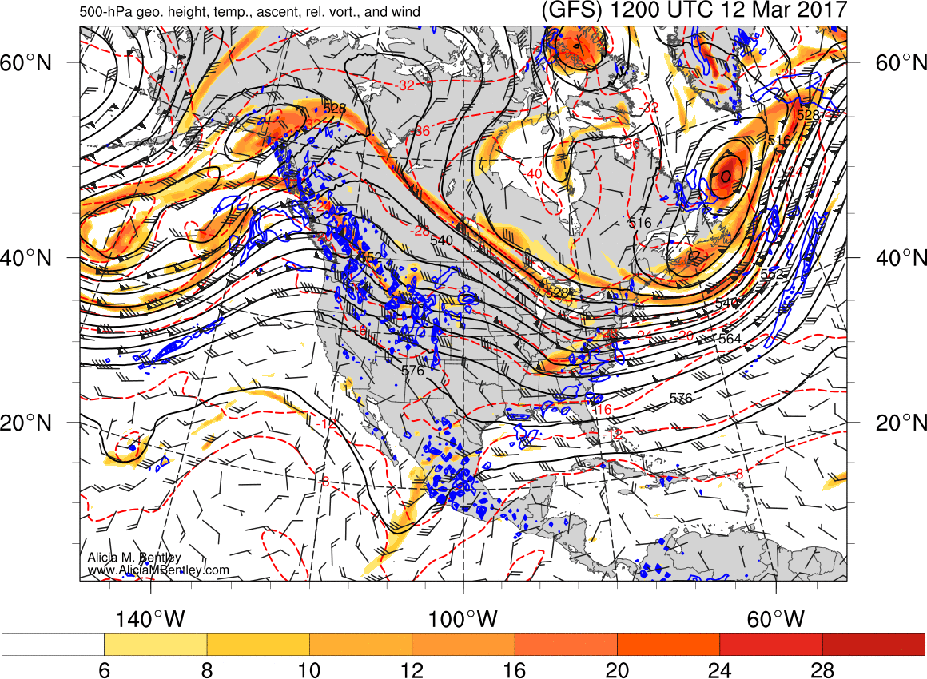

Slide 10
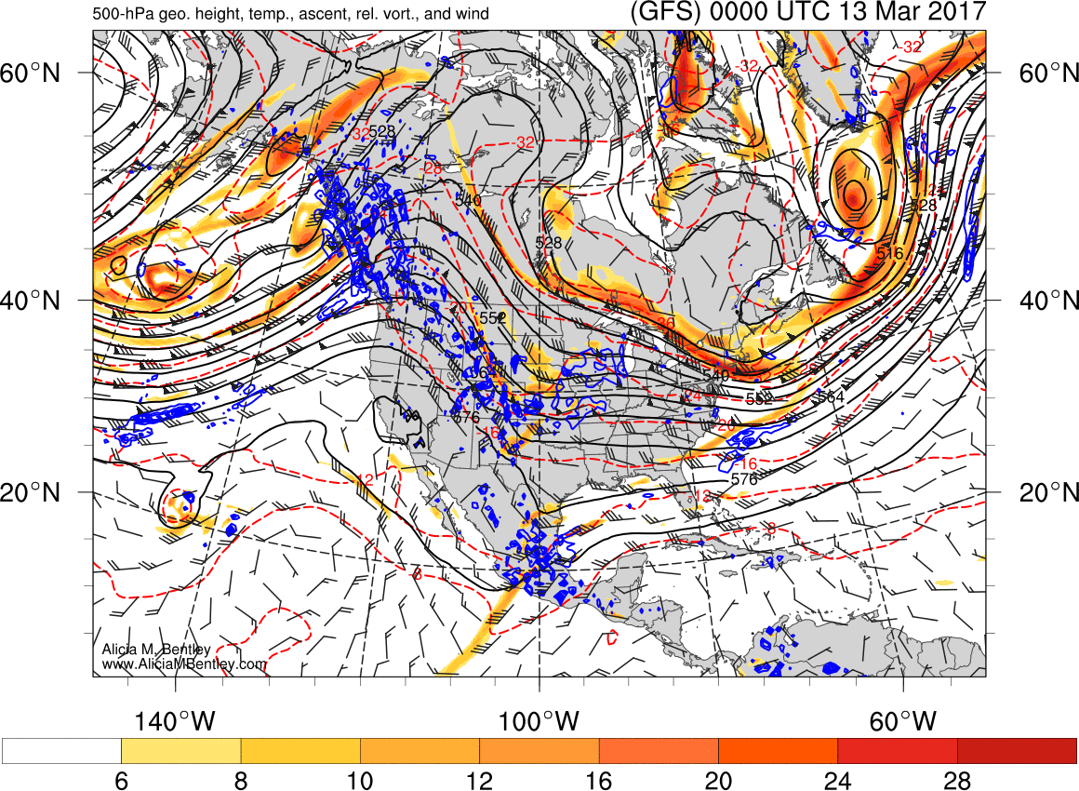

Slide 11
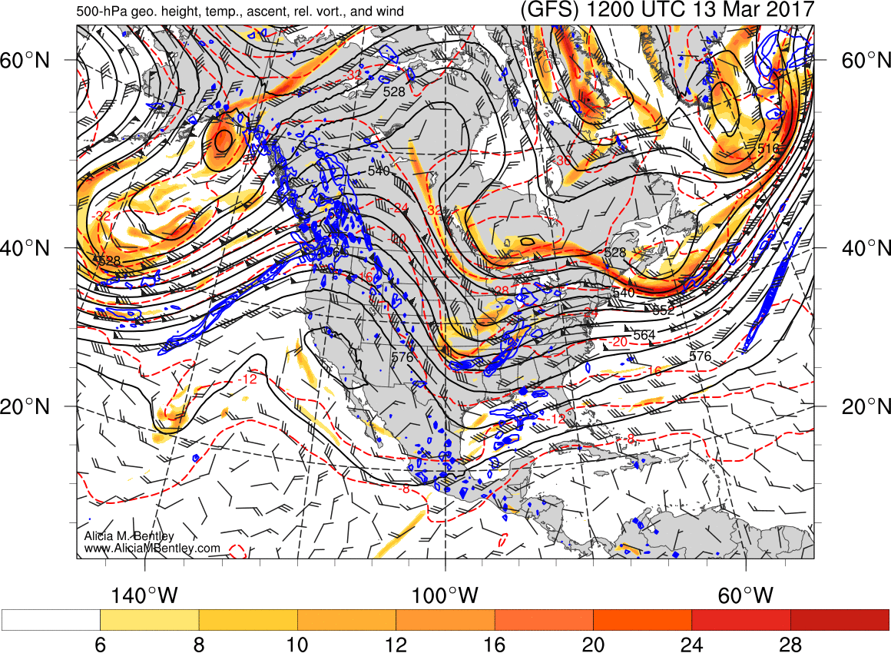

Slide 12
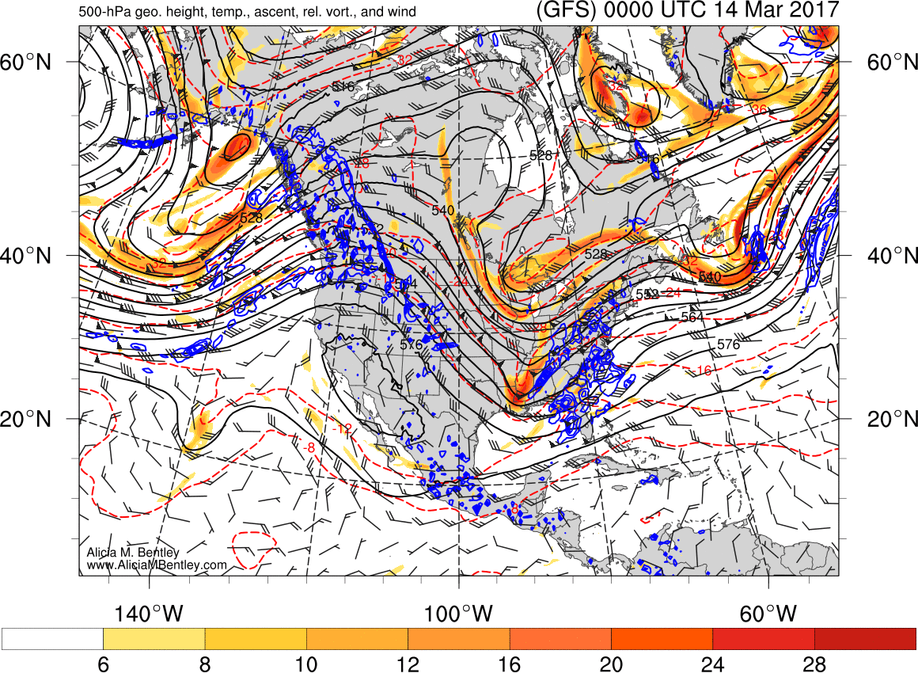

Slide 13
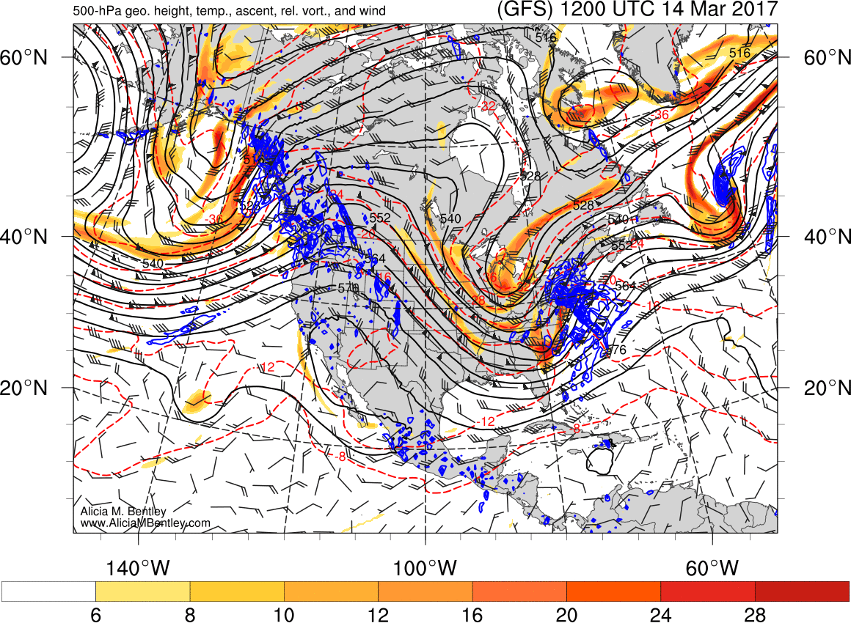

Slide 14
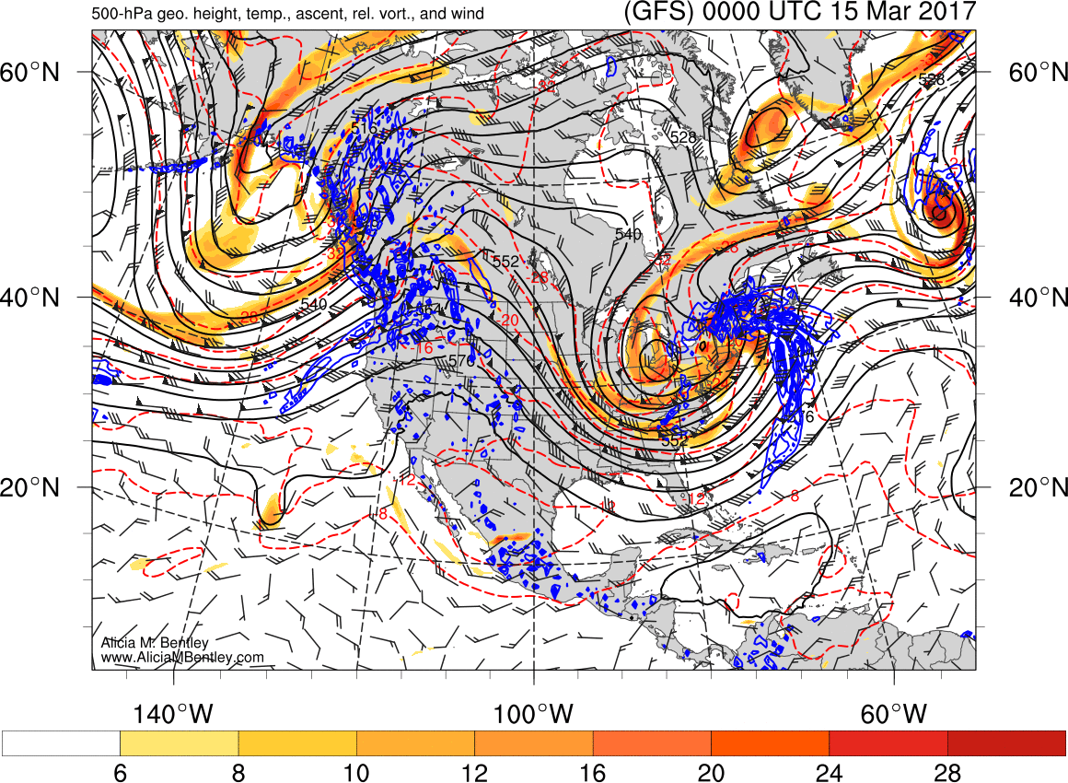

Slide 15
Large-Scale d(prog)/dt Analysis: GEFS Ensemble Mean Forecasts Verifying 0000 UTC 15 March 2017

Slide 16
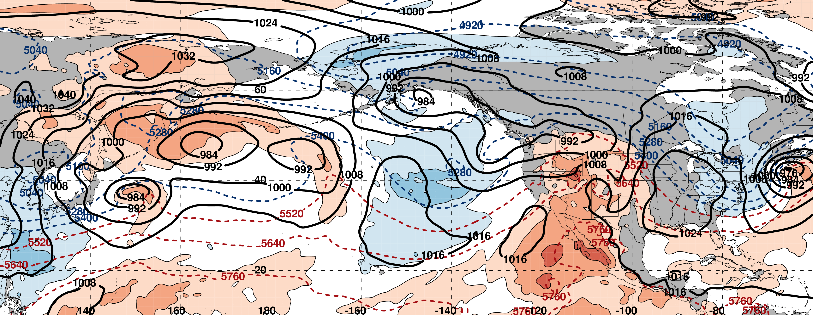
250-hPa Geo. Height (black contours)
250-hPa Standardized Geo. Height Anomalies (red contours: positive / blue contours: negative)
250-hPa Wind Speed (purple fill)
Mean Sea Level Pressure (black contours)
850-hPa Standardized Temperature Anomalies (red fill: positive / blue fill: negative)
1000–500-hPa Thickness (dashed red/blue contours)

Slide 17
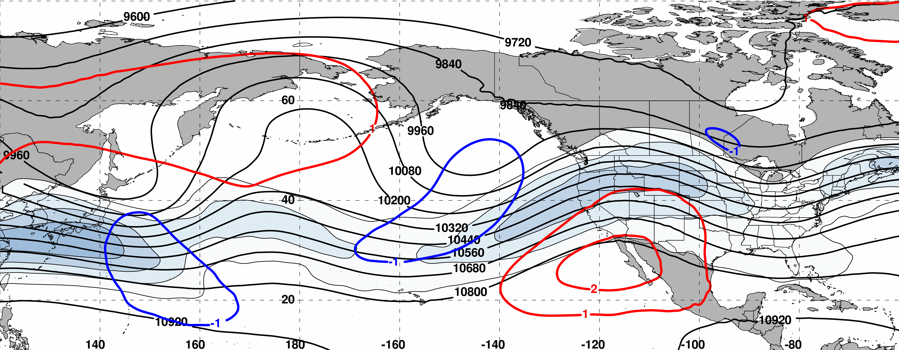
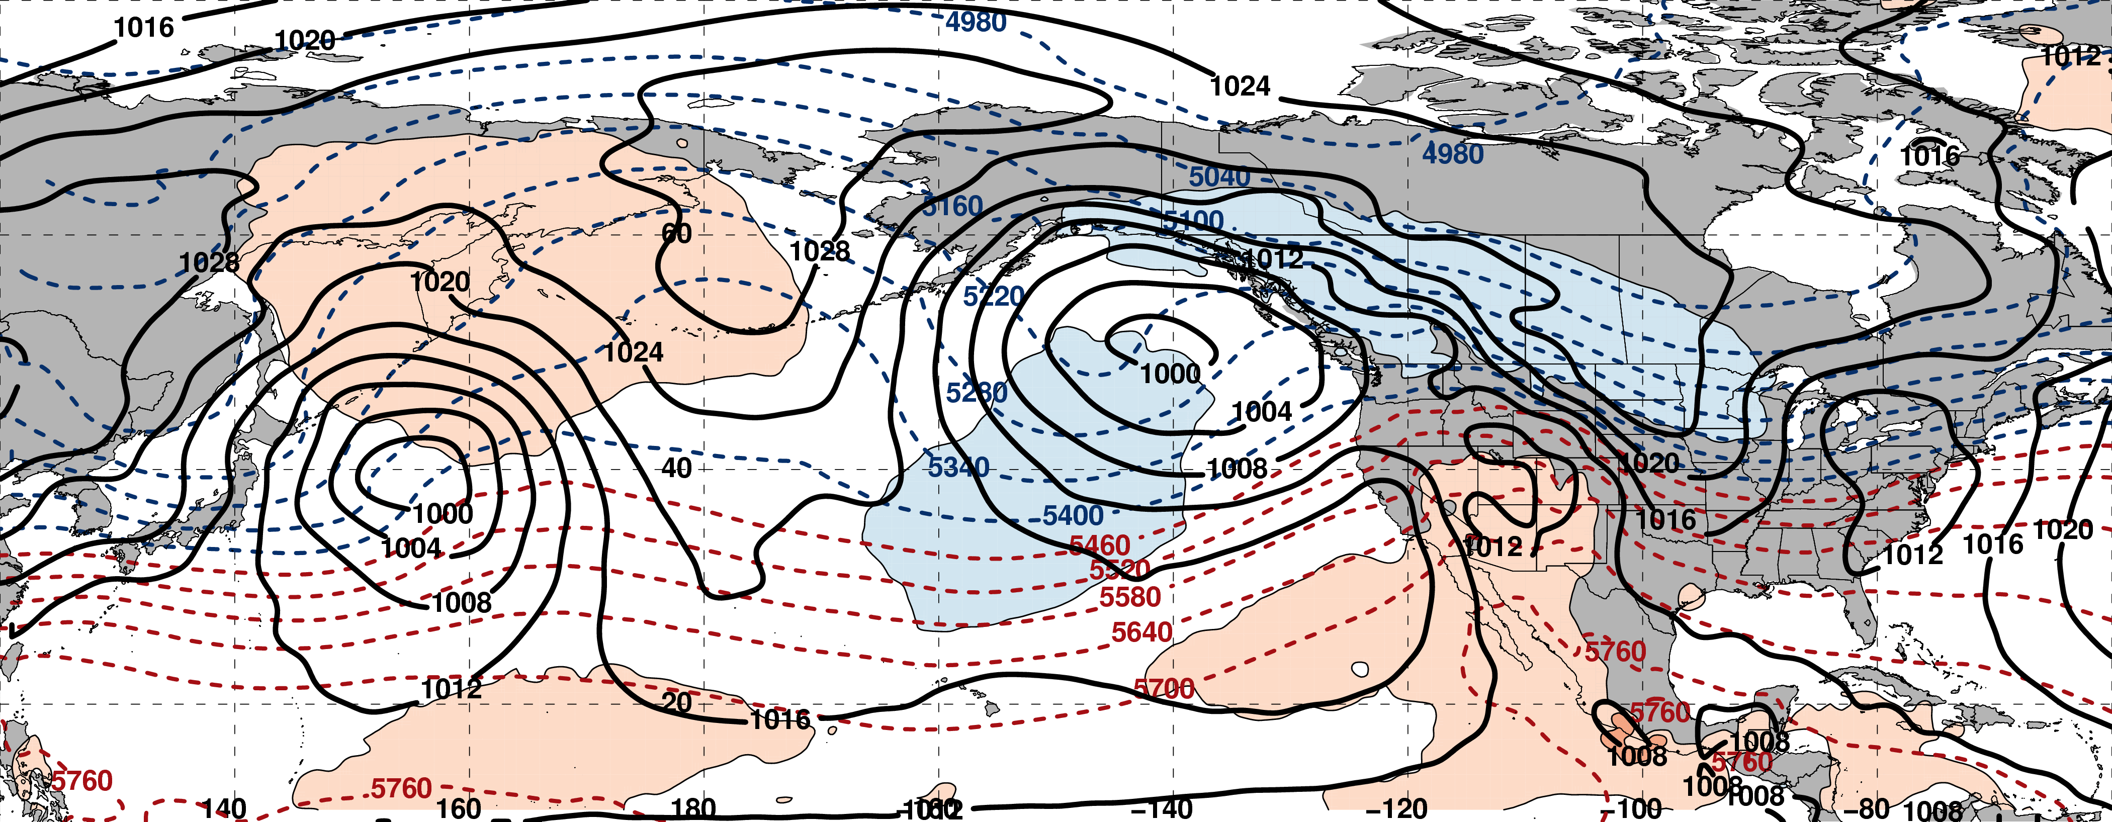
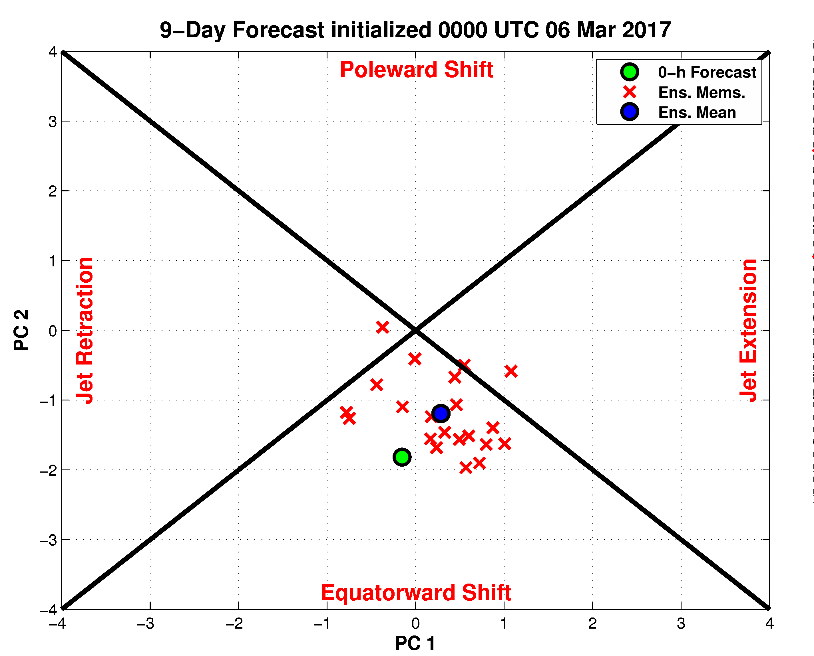
216-h Forecast: 250-hPa Jet (shading), Geo. Hght (contours), Std. Hght Anom. (contours)
m s^{–1}
216-h Forecast: MSLP (contours), Thick. (contours), 850-hPa Temp. Anom. (shading)
σ

Slide 18
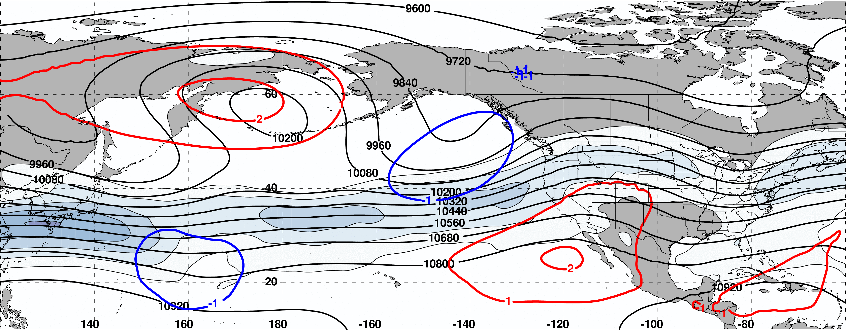
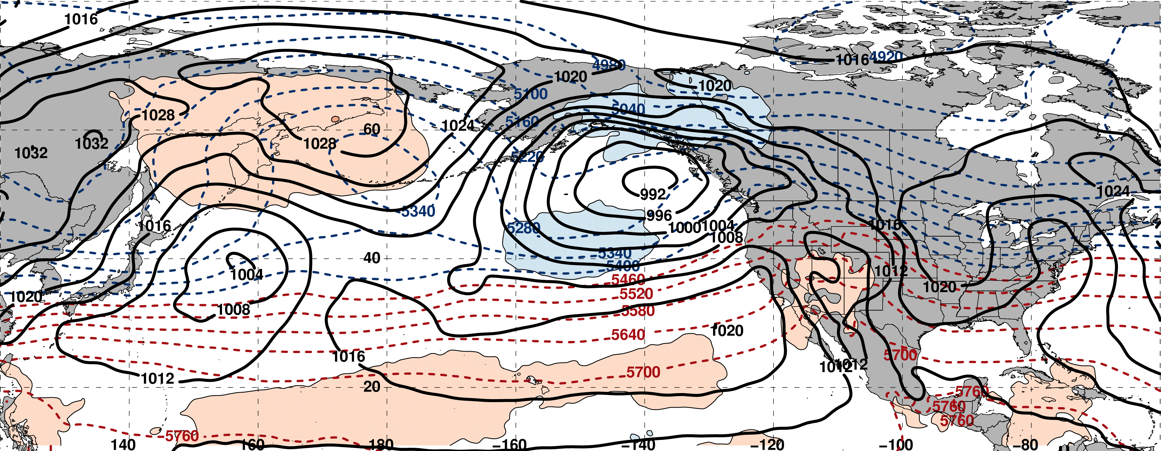
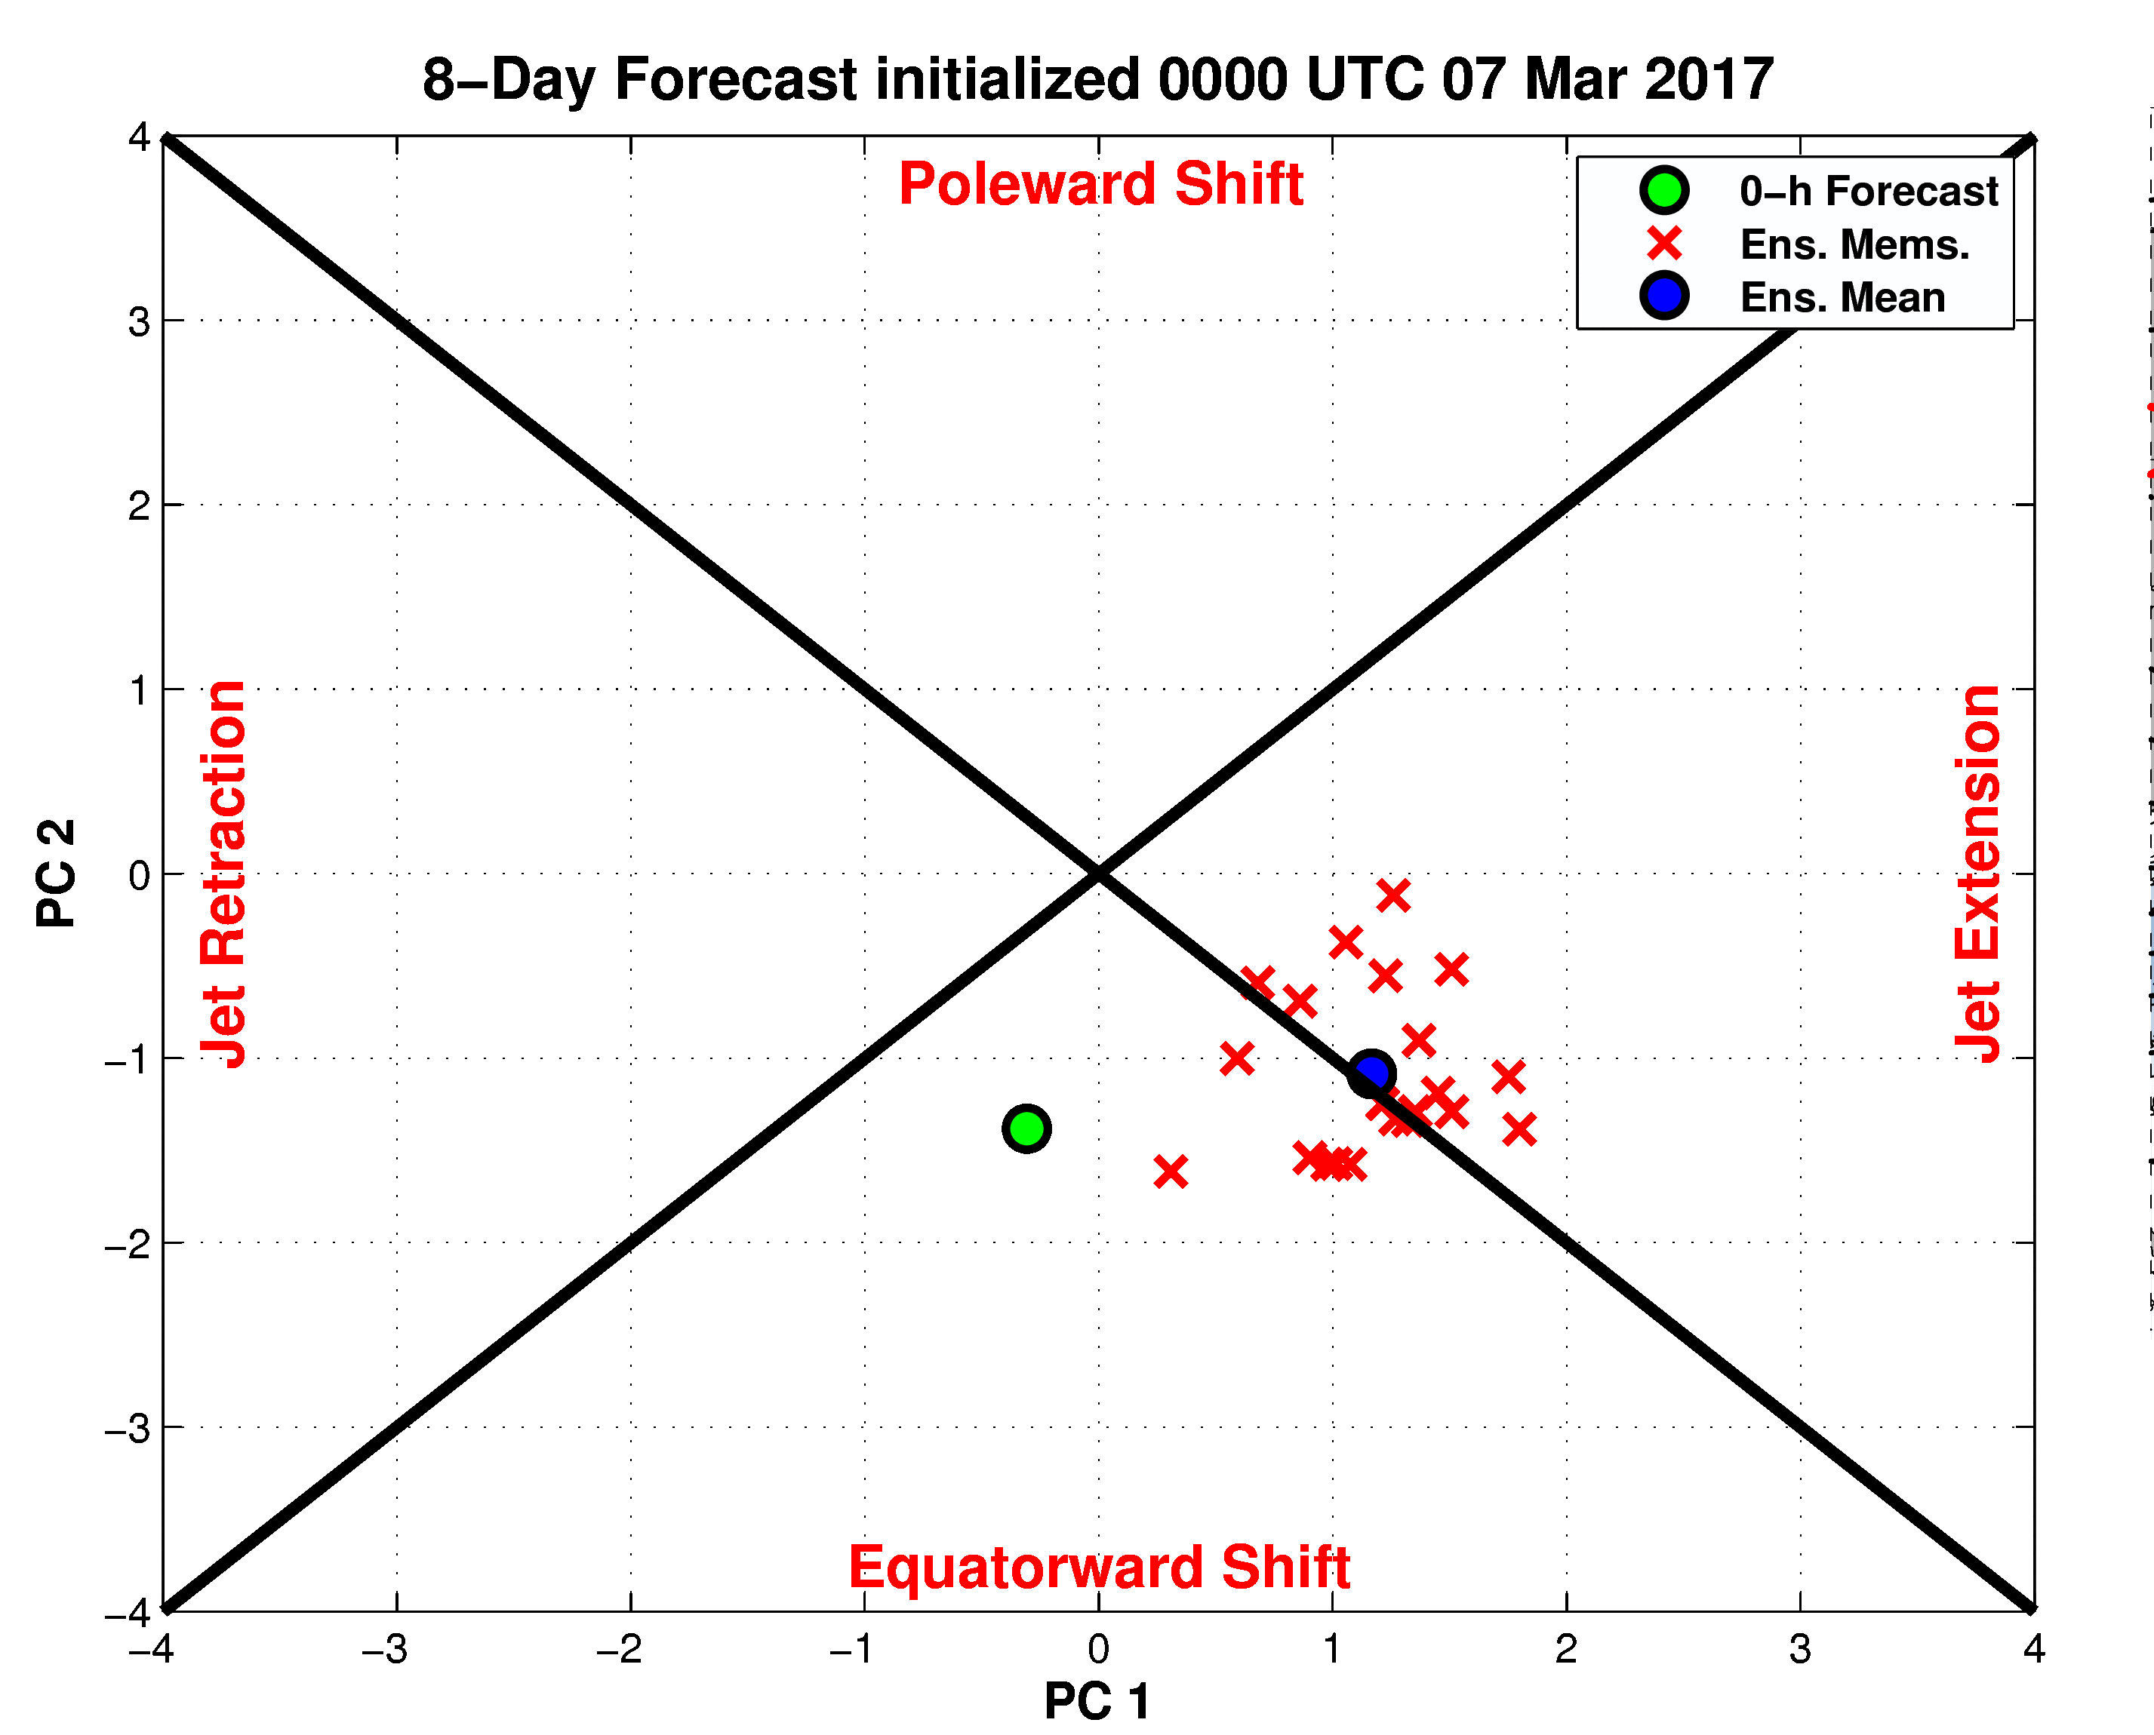
192-h Forecast: 250-hPa Jet (shading), Geo. Hght (contours), Std. Hght Anom. (contours)
m s^{–1}
192-h Forecast: MSLP (contours), Thick. (contours), 850-hPa Temp. Anom. (shading)
σ

Slide 19
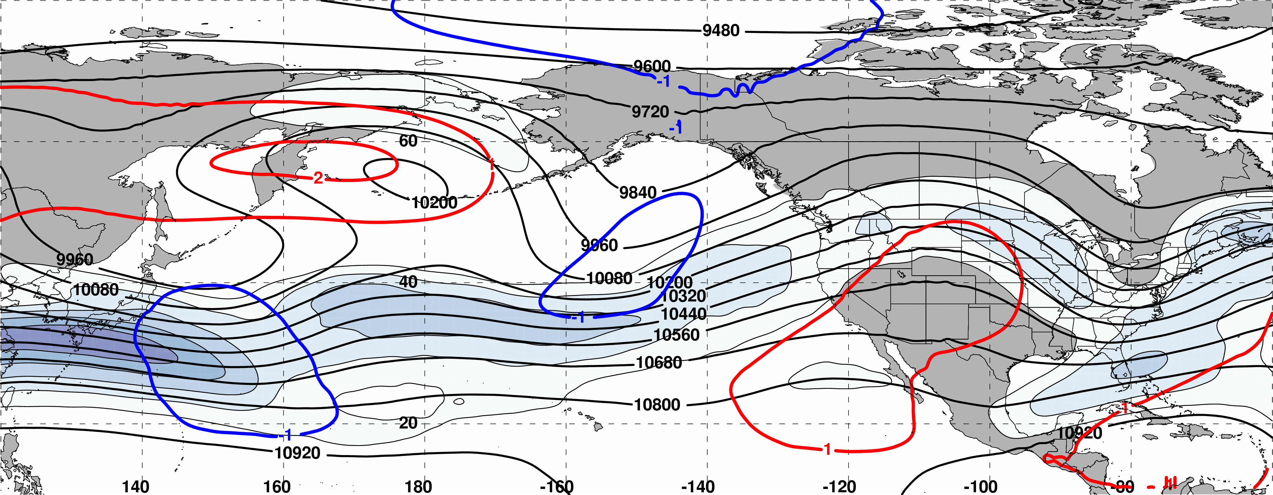
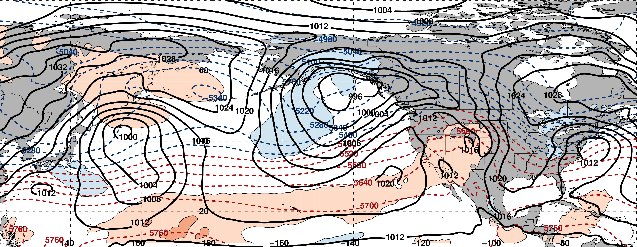
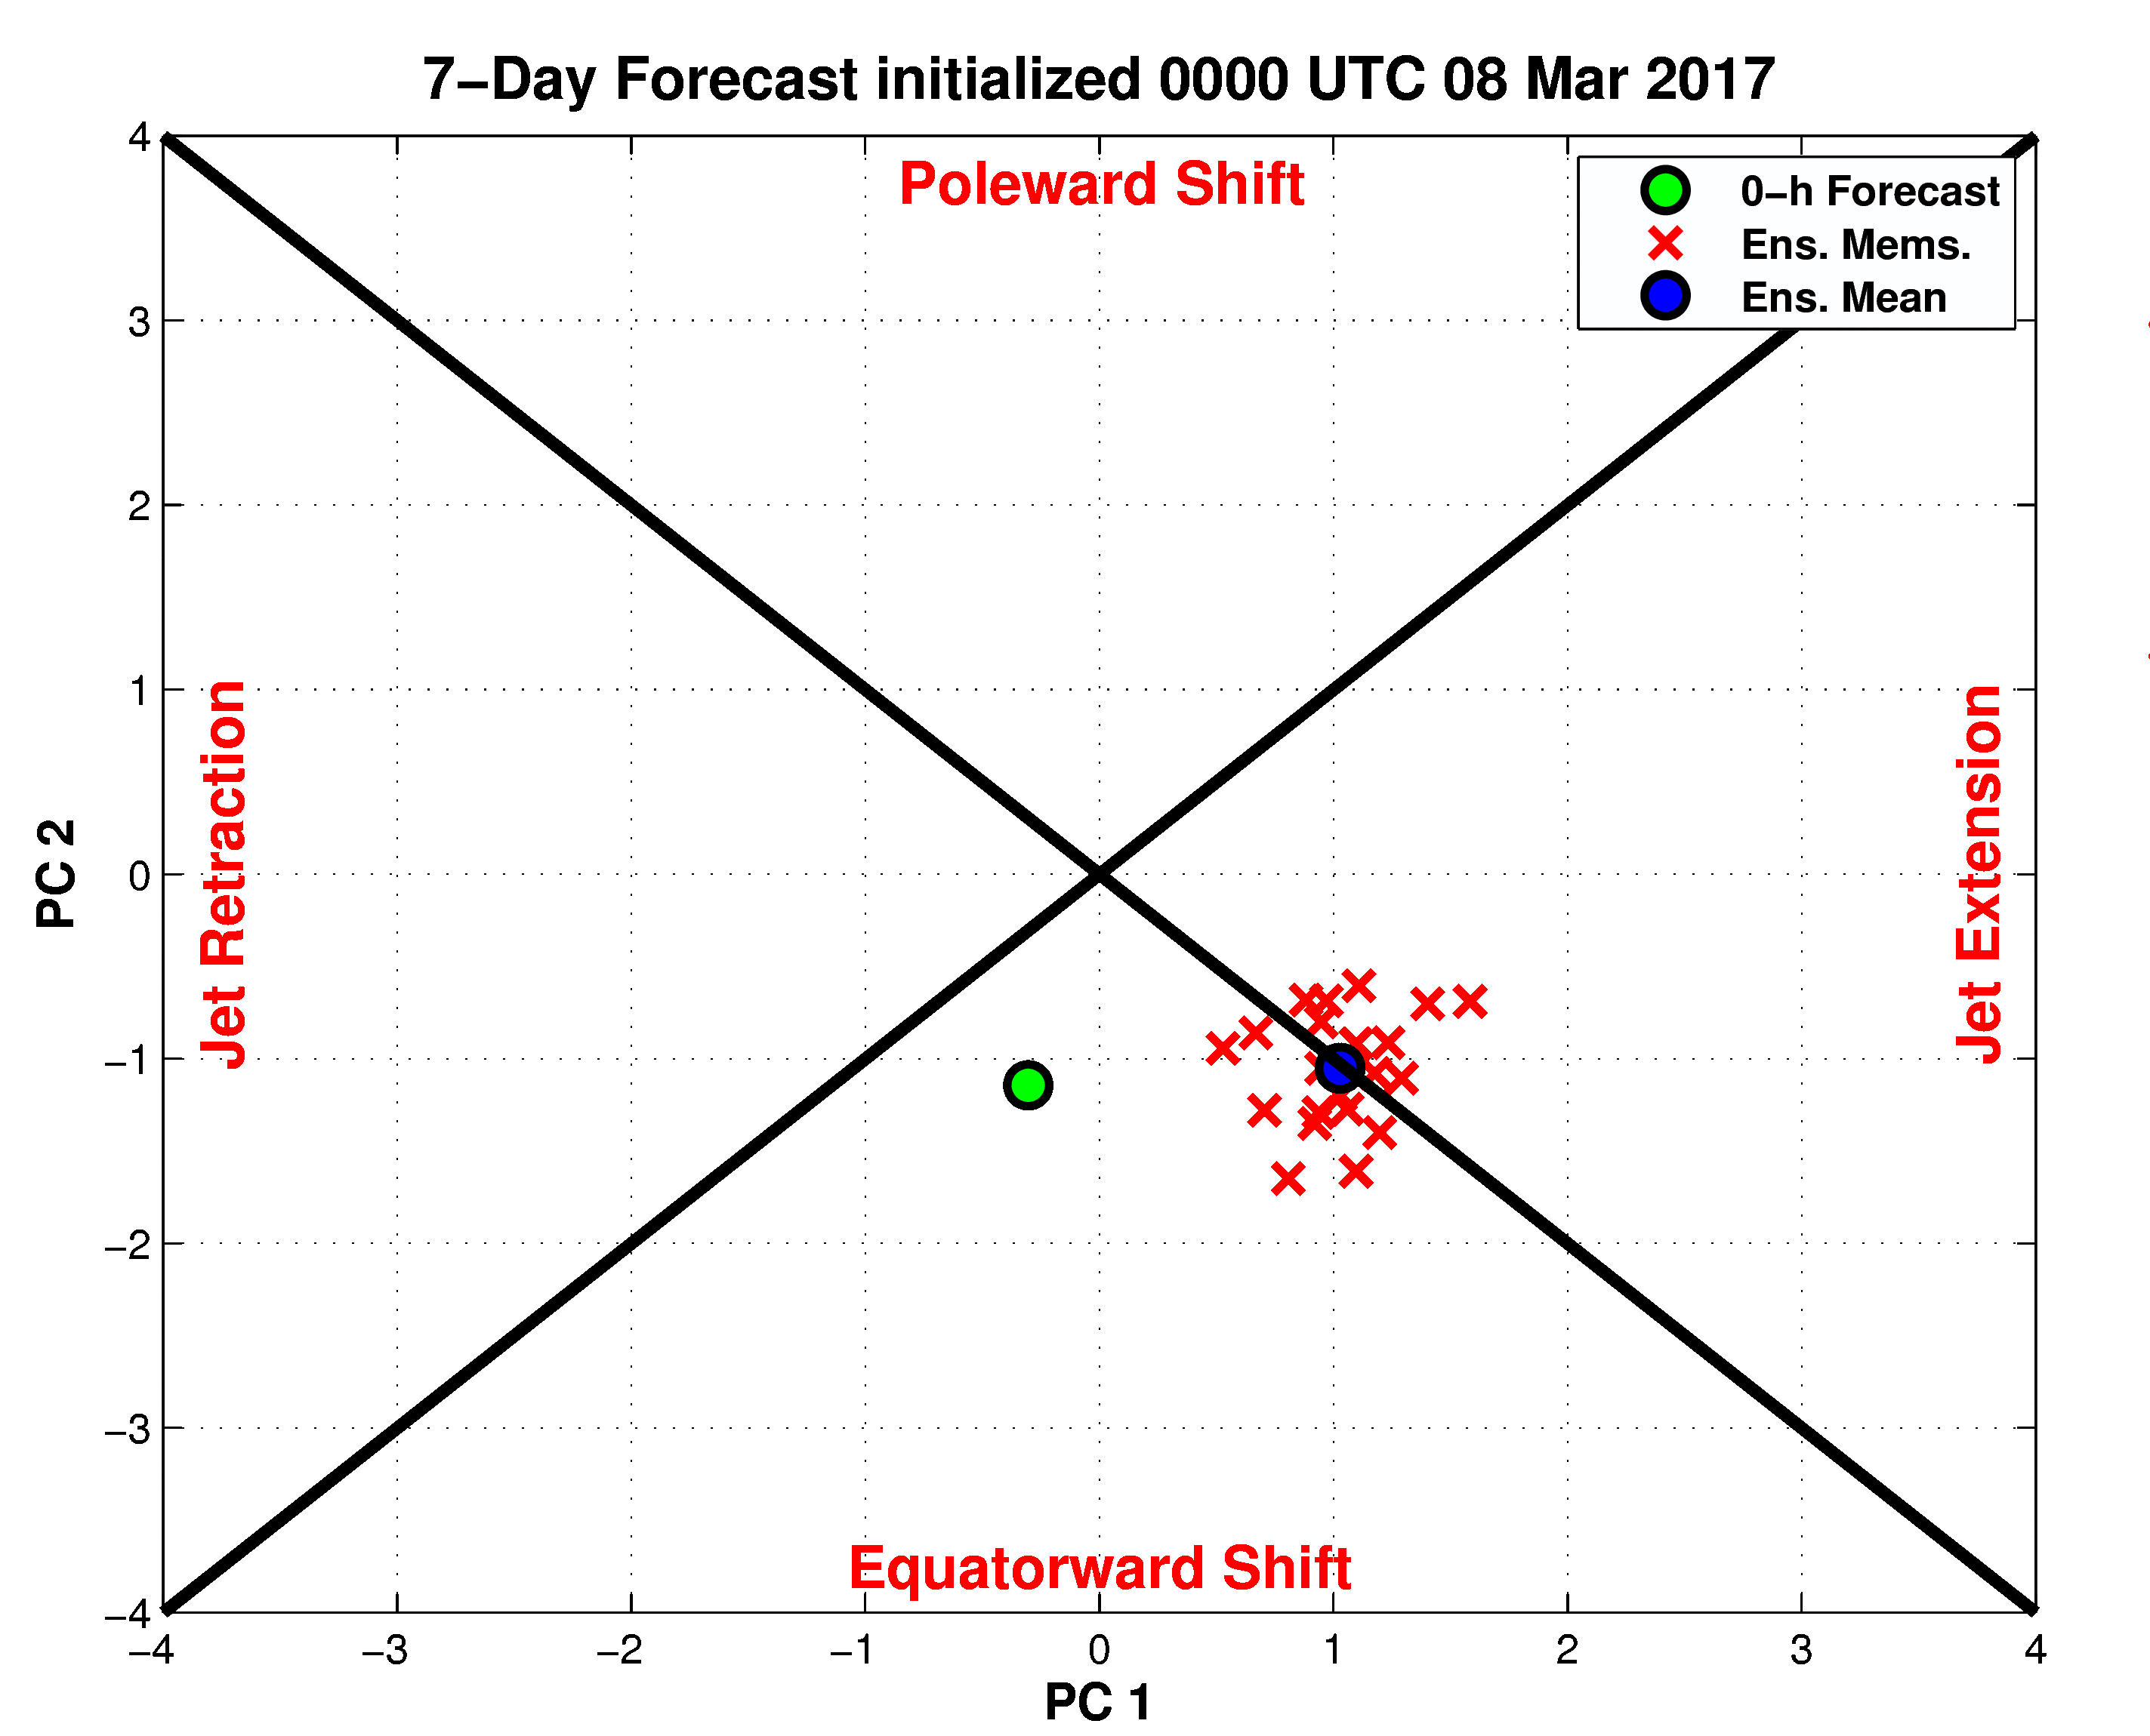
168-h Forecast: 250-hPa Jet (shading), Geo. Hght (contours), Std. Hght Anom. (contours)
m s^{–1}
168-h Forecast: MSLP (contours), Thick. (contours), 850-hPa Temp. Anom. (shading)
σ

Slide 20
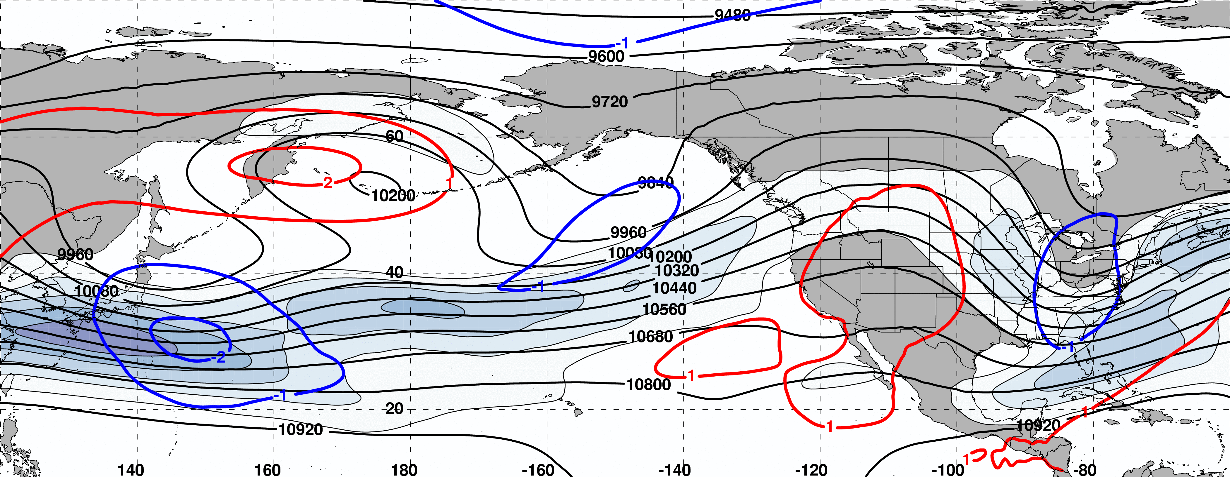
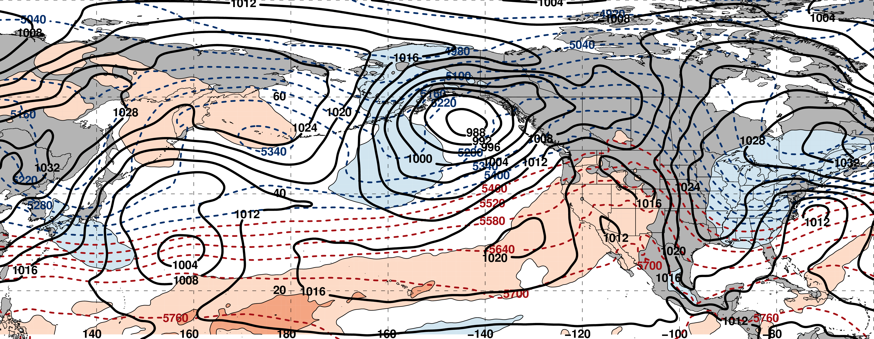
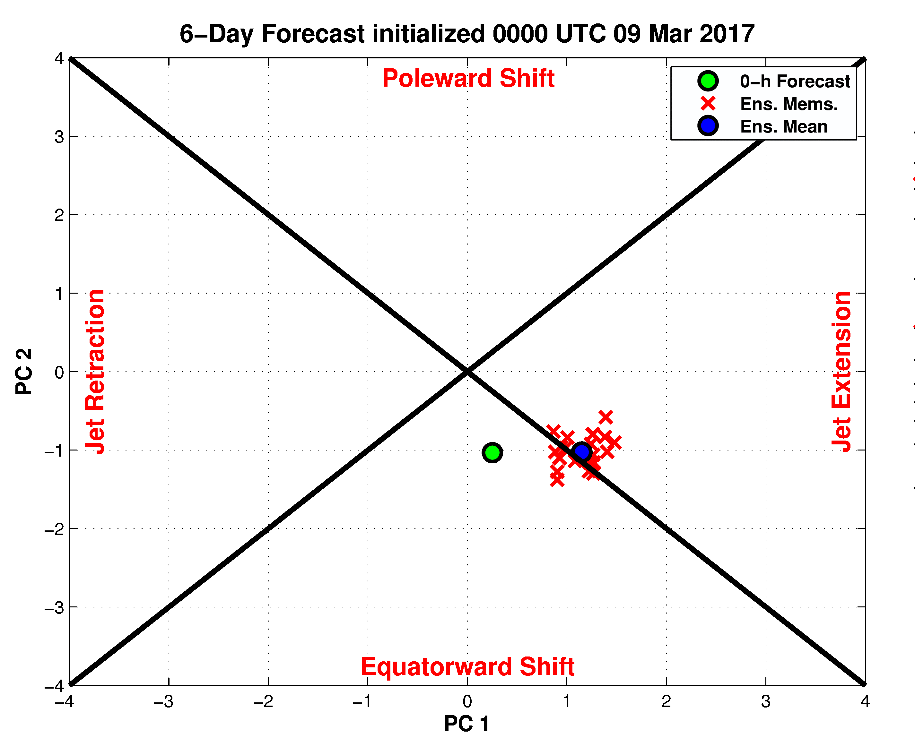
144-h Forecast: 250-hPa Jet (shading), Geo. Hght (contours), Std. Hght Anom. (contours)
m s^{–1}
144-h Forecast: MSLP (contours), Thick. (contours), 850-hPa Temp. Anom. (shading)
σ

Slide 21
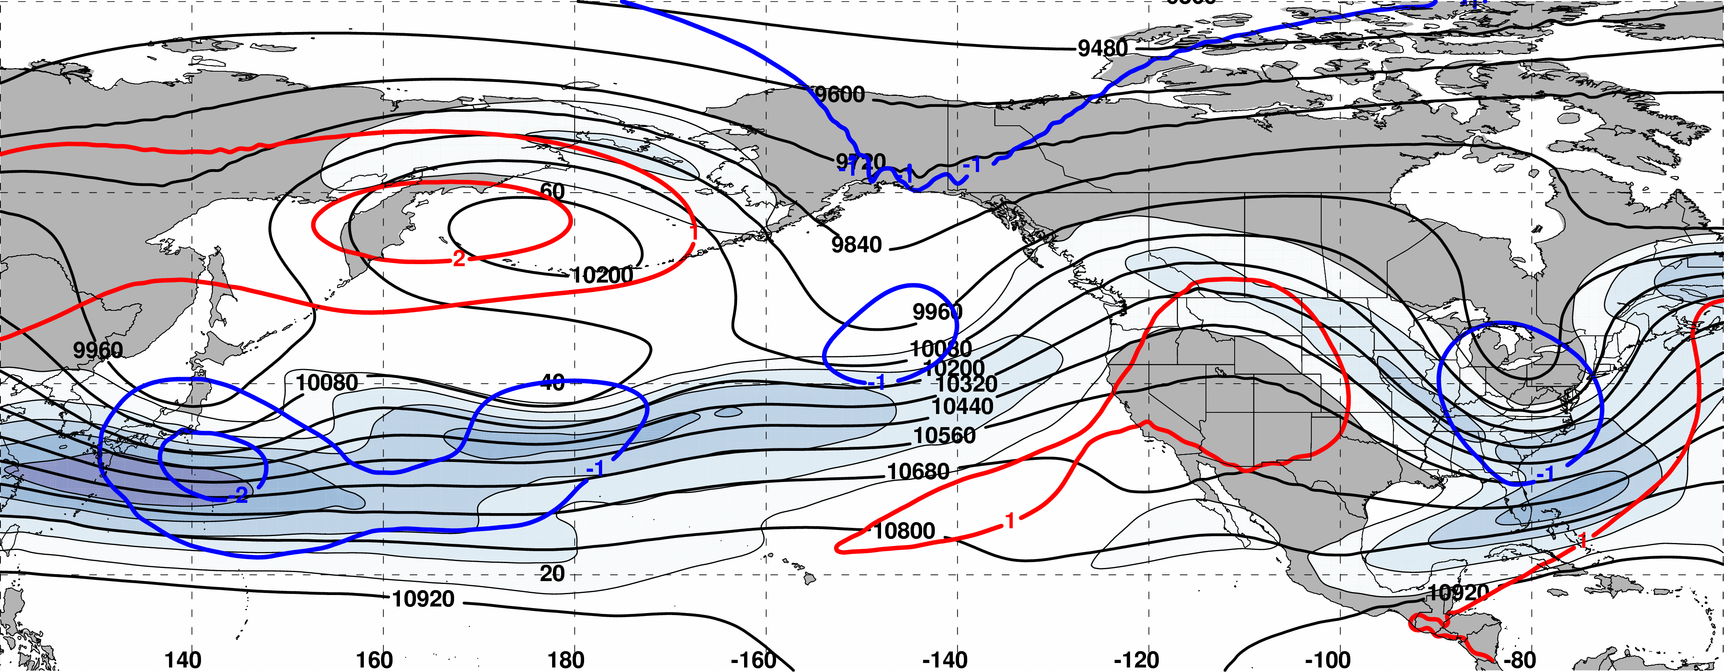
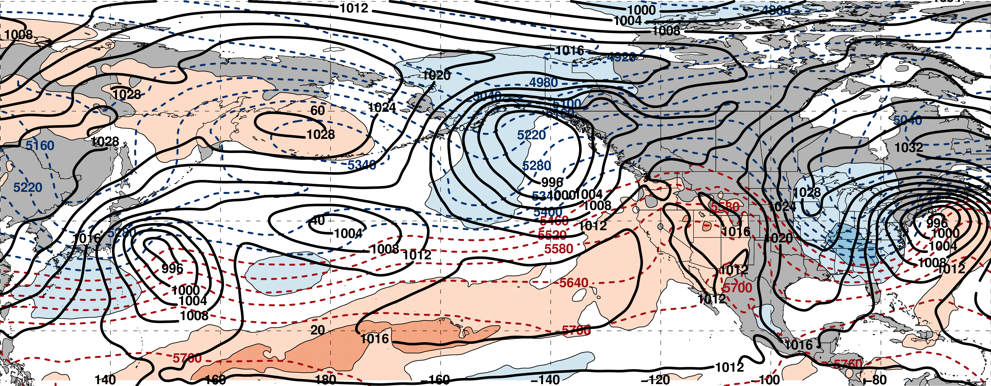
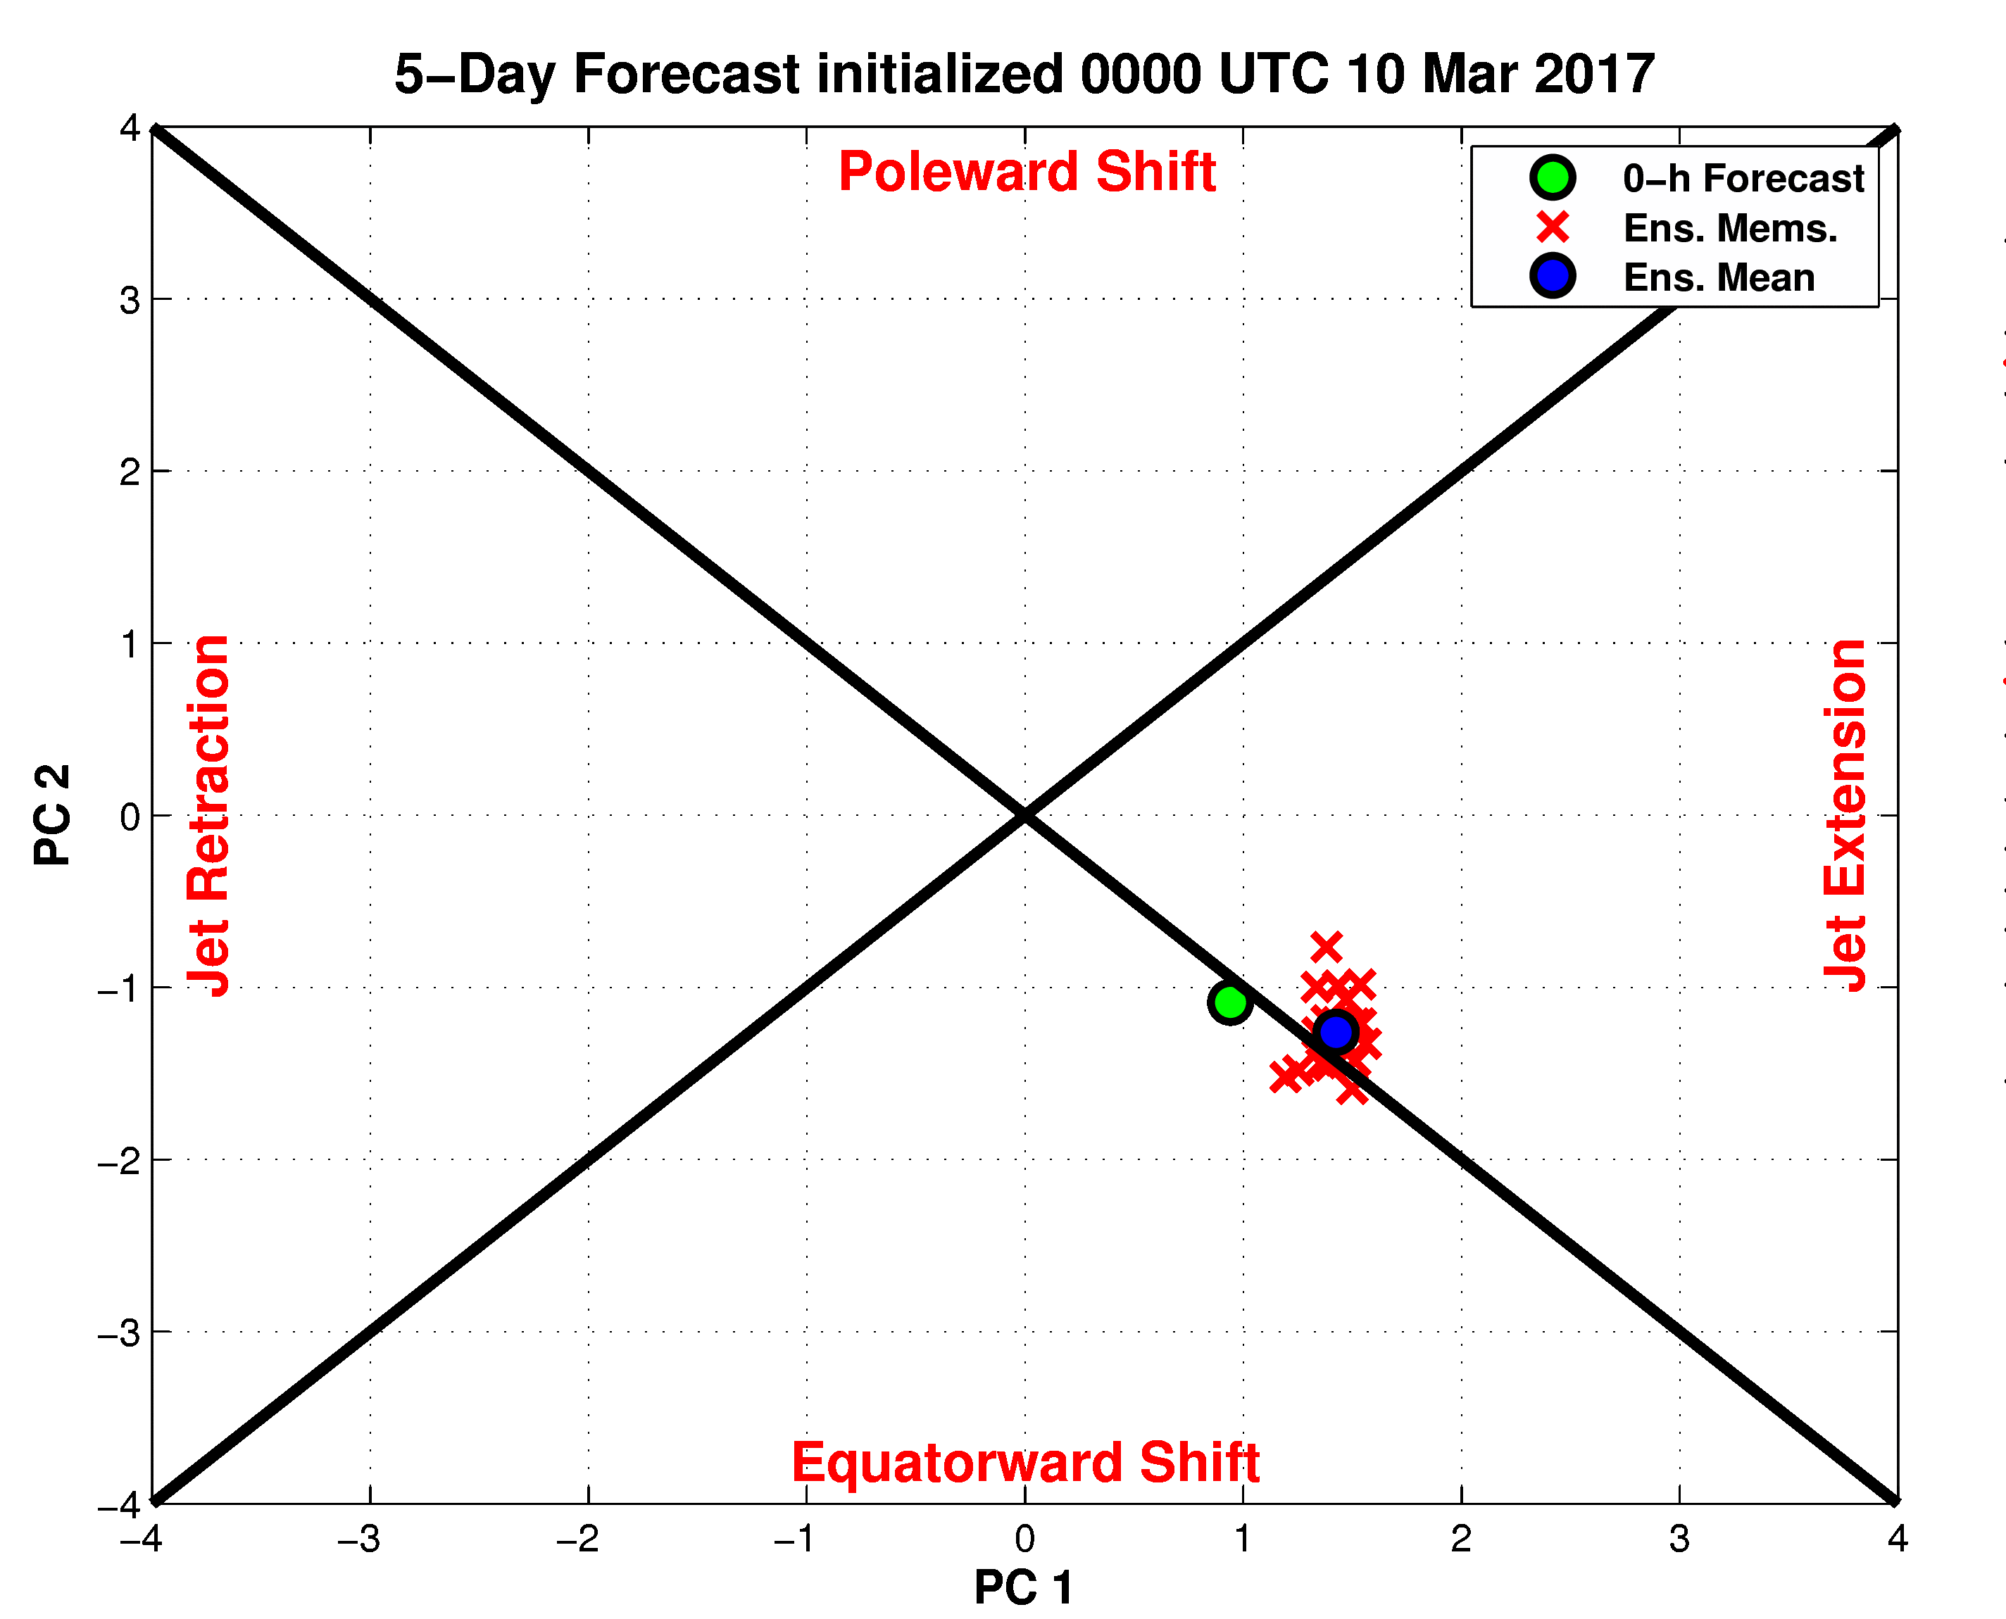
120-h Forecast: 250-hPa Jet (shading), Geo. Hght (contours), Std. Hght Anom. (contours)
m s^{–1}
120-h Forecast: MSLP (contours), Thick. (contours), 850-hPa Temp. Anom. (shading)
σ

Slide 22
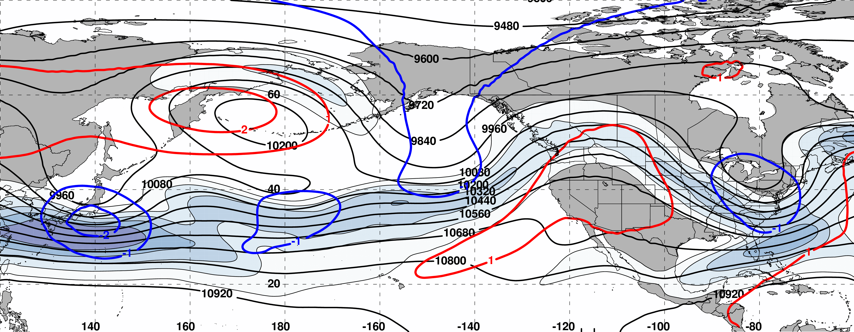
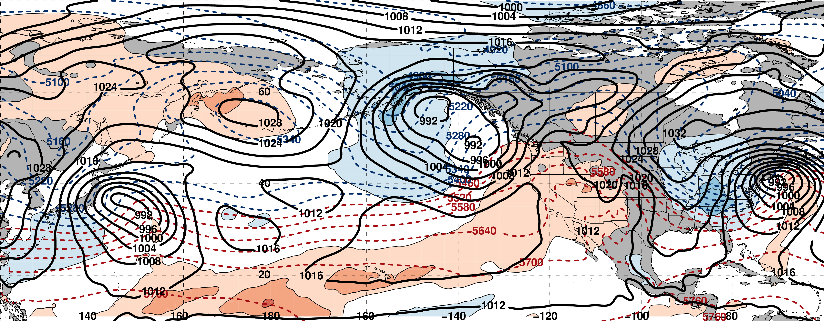
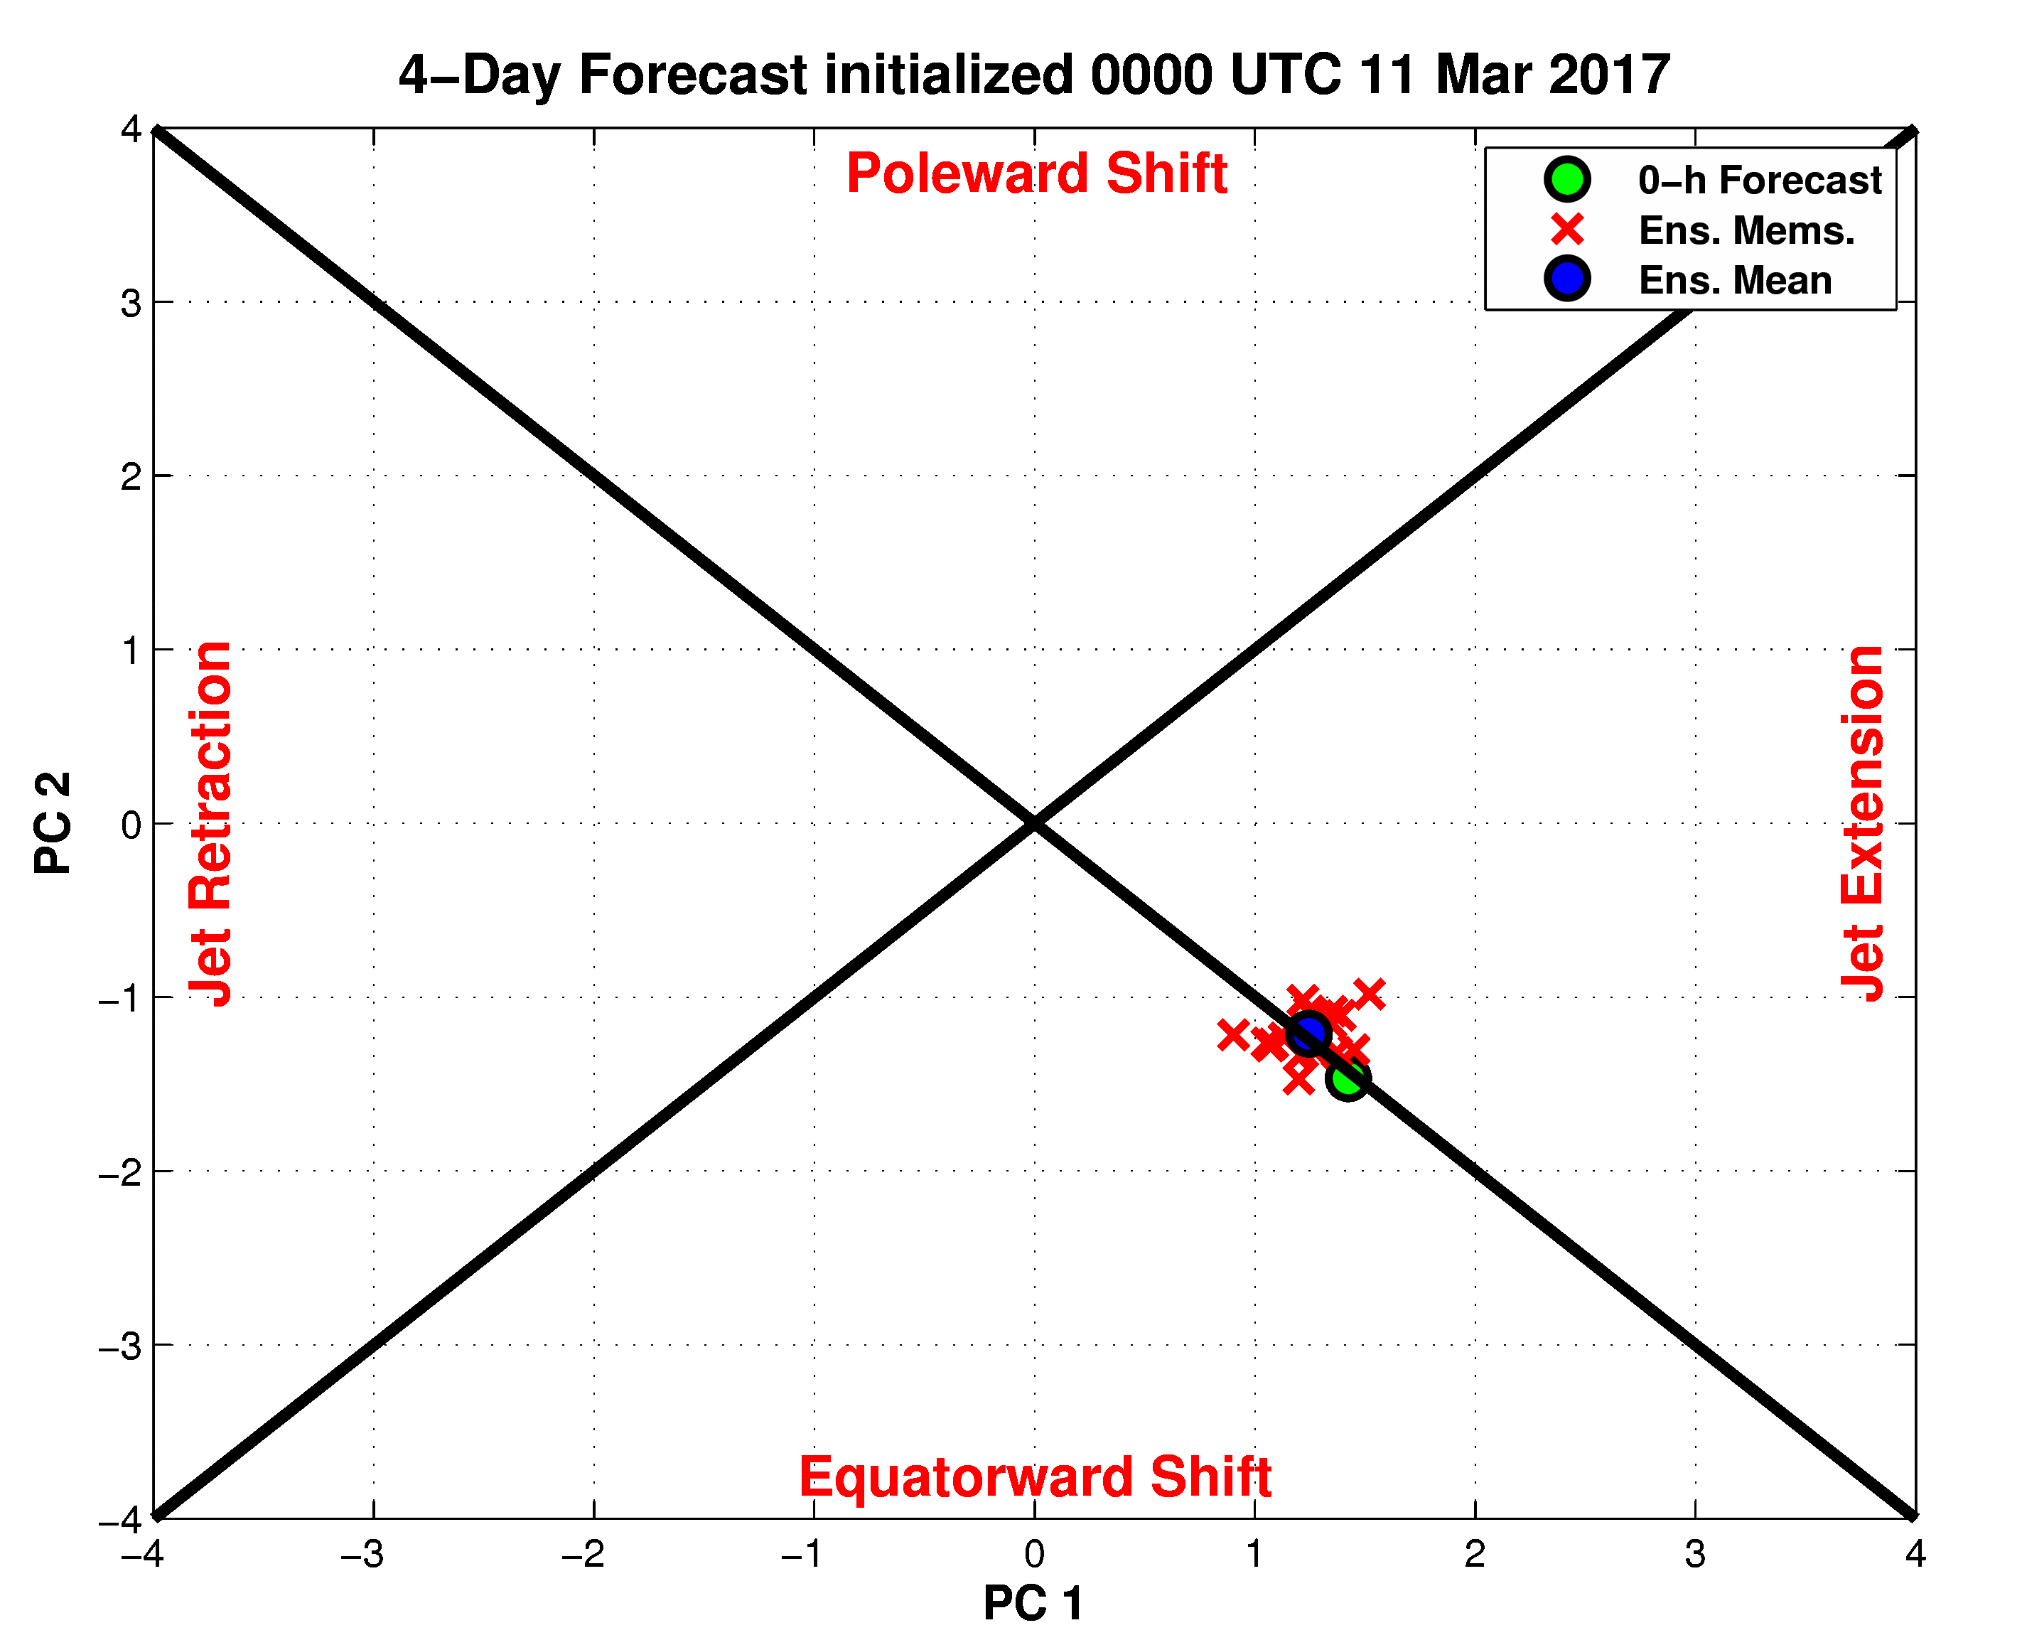
96-h Forecast: 250-hPa Jet (shading), Geo. Hght (contours), Std. Hght Anom. (contours)
m s^{–1}
96-h Forecast: MSLP (contours), Thick. (contours), 850-hPa Temp. Anom. (shading)
σ

Slide 23
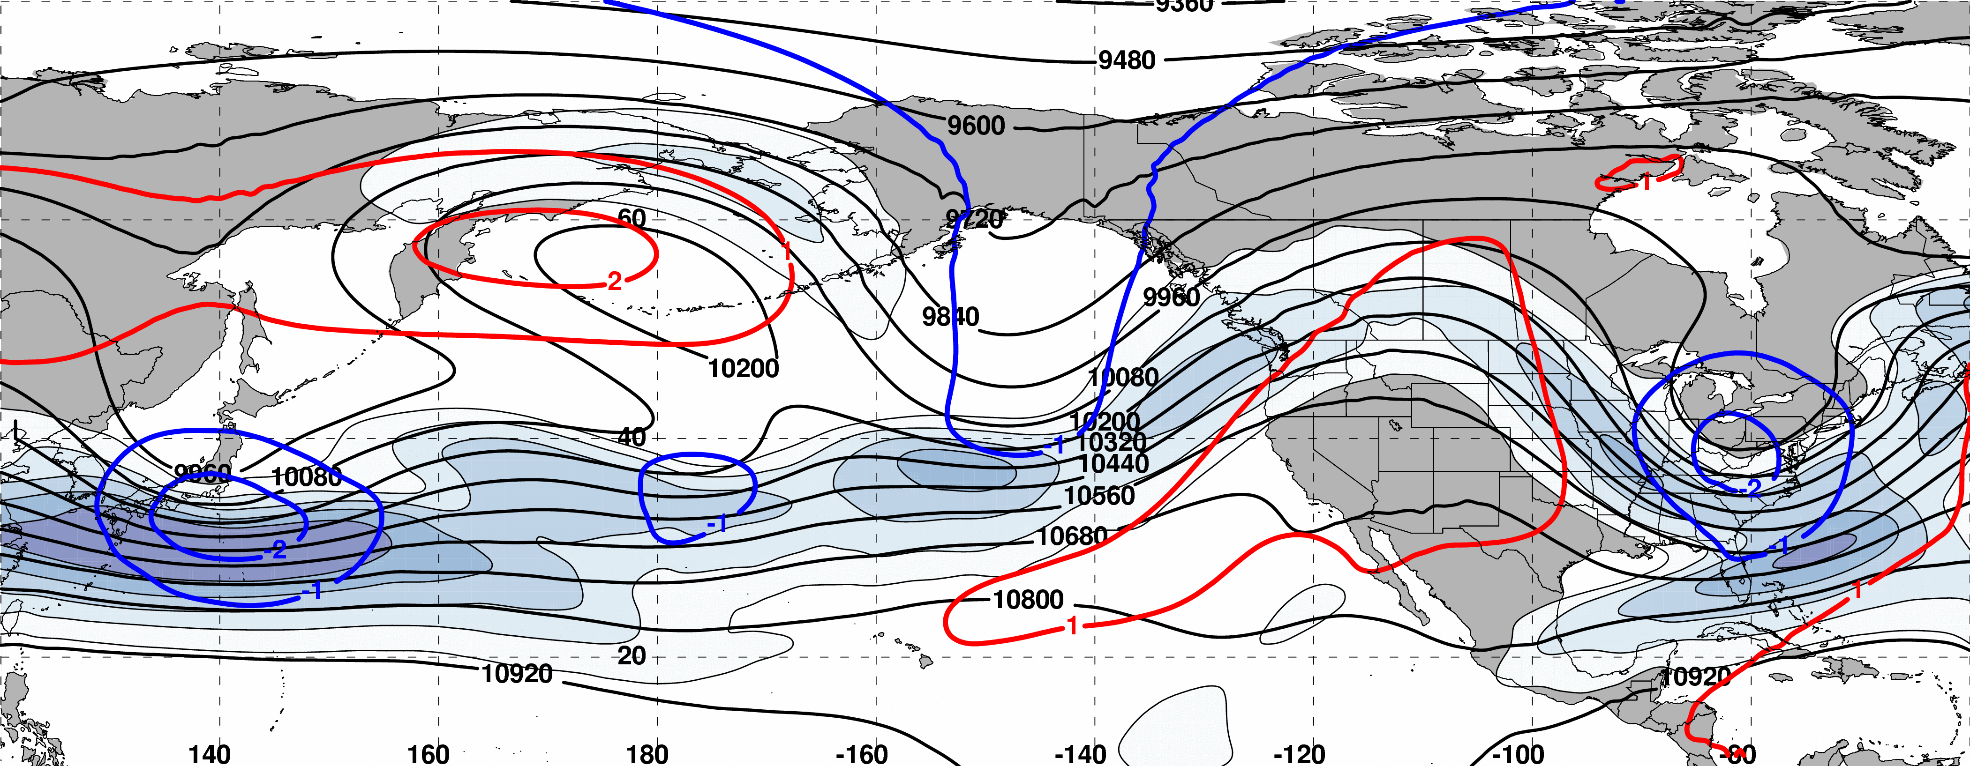
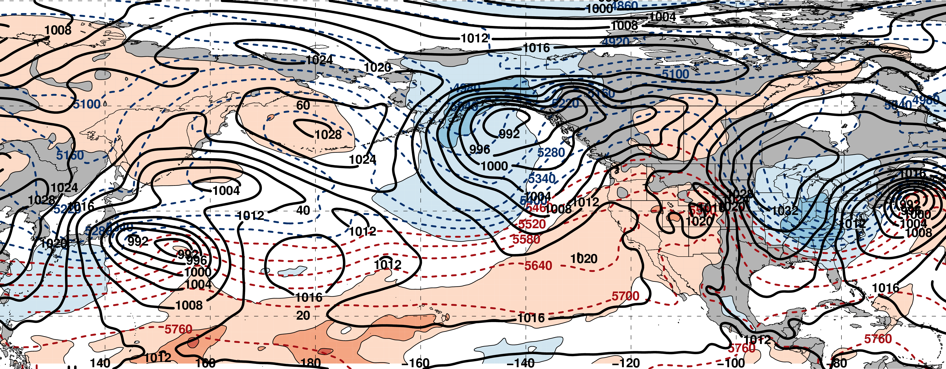
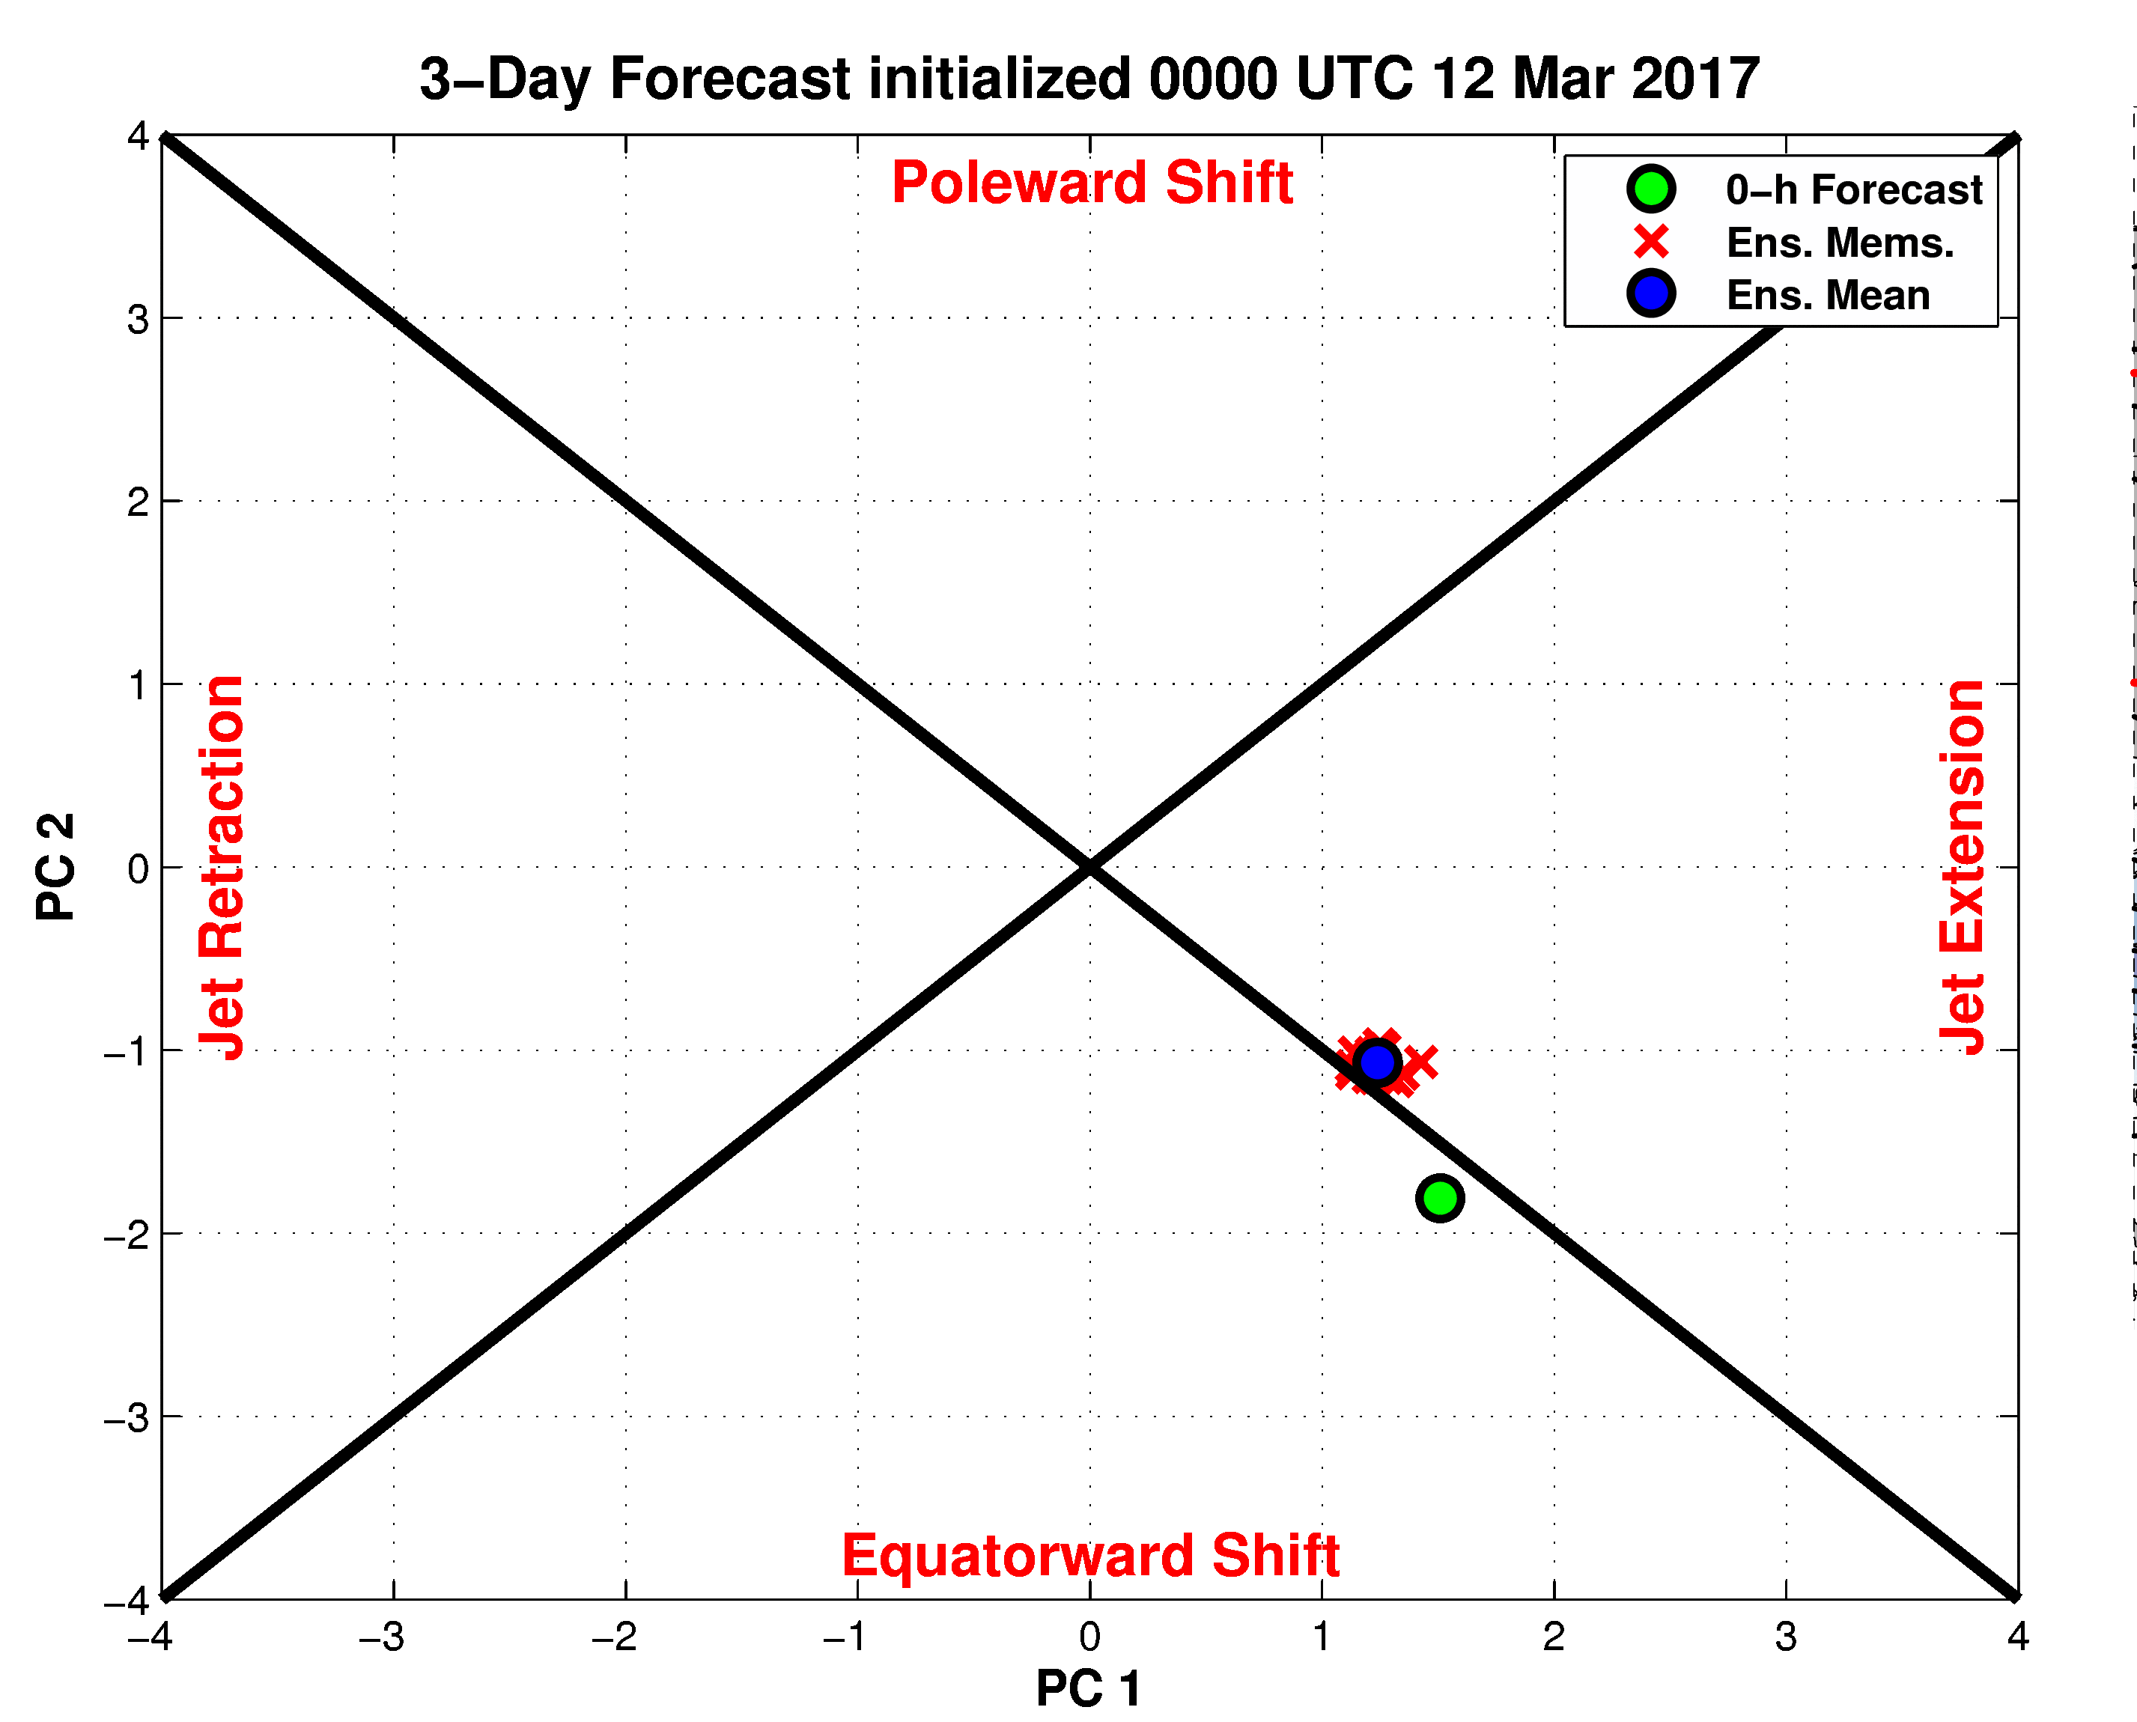
72-h Forecast: 250-hPa Jet (shading), Geo. Hght (contours), Std. Hght Anom. (contours)
m s^{–1}
72-h Forecast: MSLP (contours), Thick. (contours), 850-hPa Temp. Anom. (shading)
σ

Slide 24
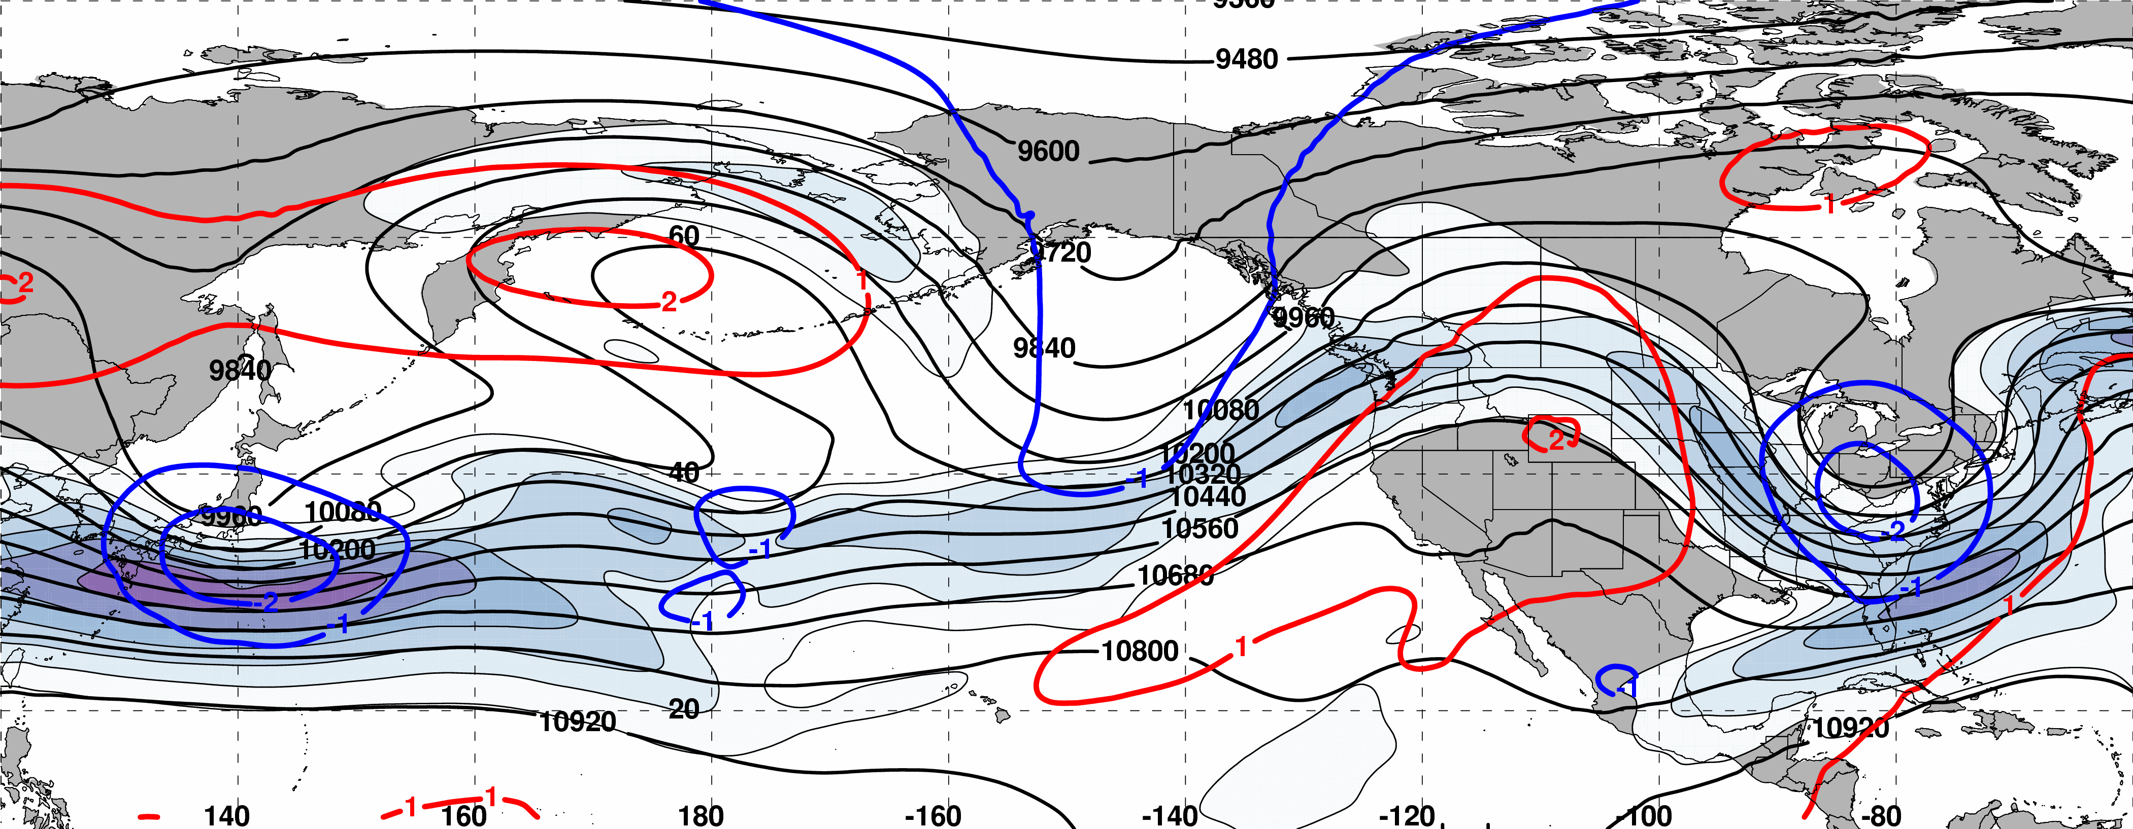
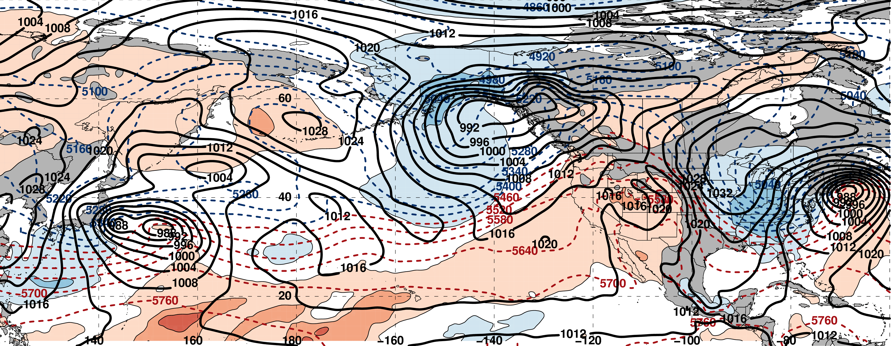
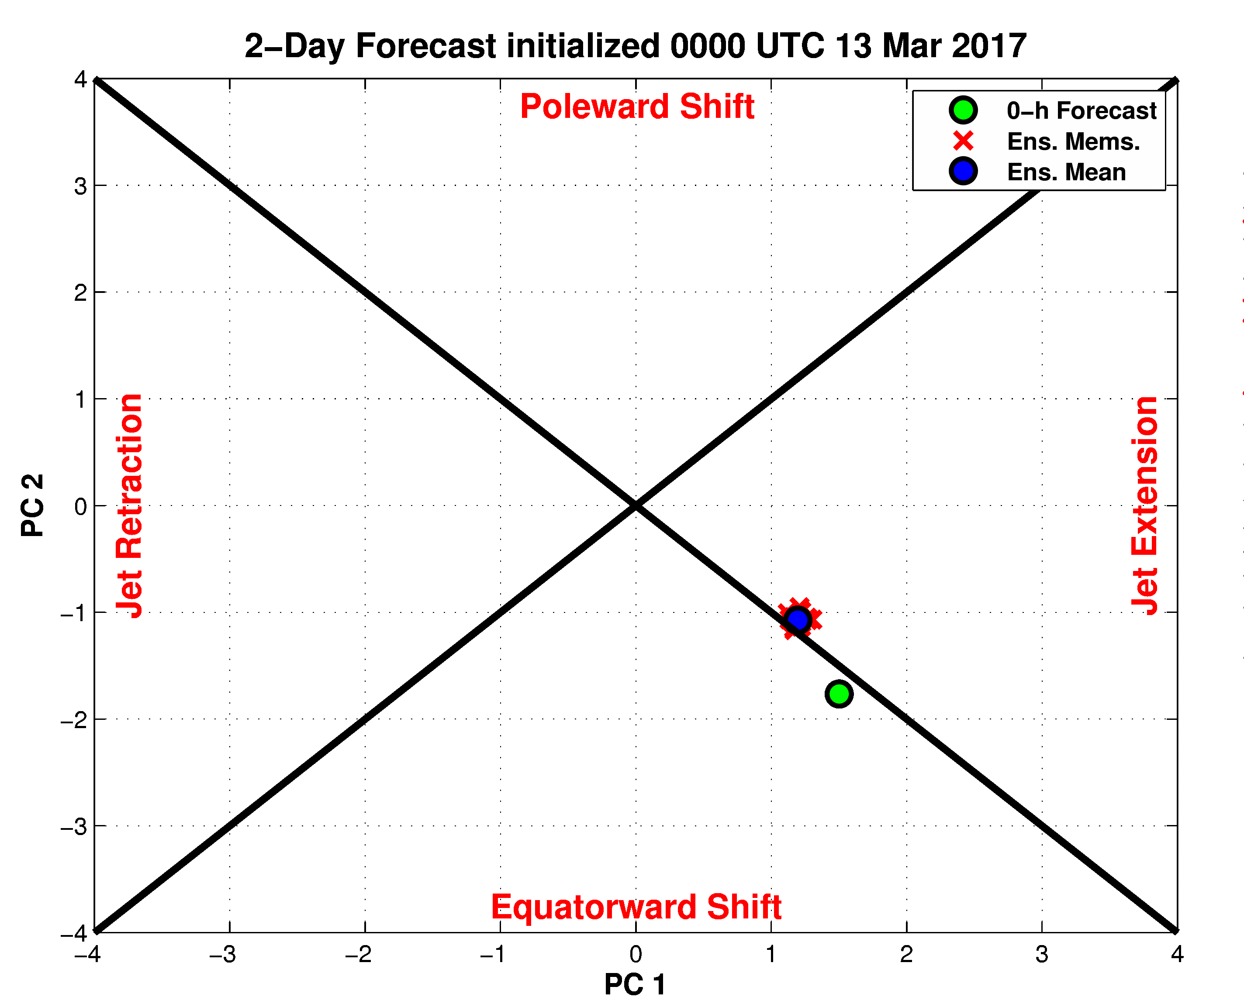
48-h Forecast: 250-hPa Jet (shading), Geo. Hght (contours), Std. Hght Anom. (contours)
m s^{–1}
48-h Forecast: MSLP (contours), Thick. (contours), 850-hPa Temp. Anom. (shading)
σ

Slide 25
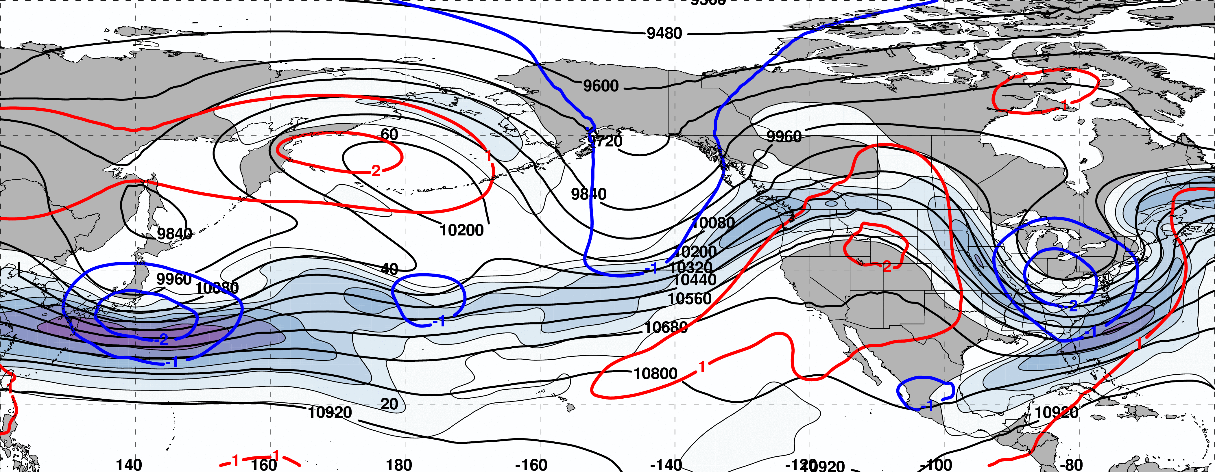
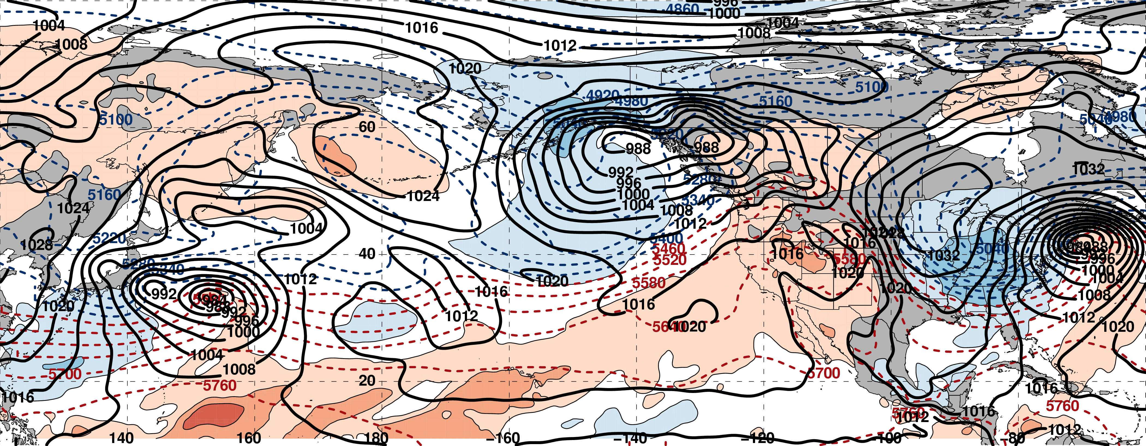
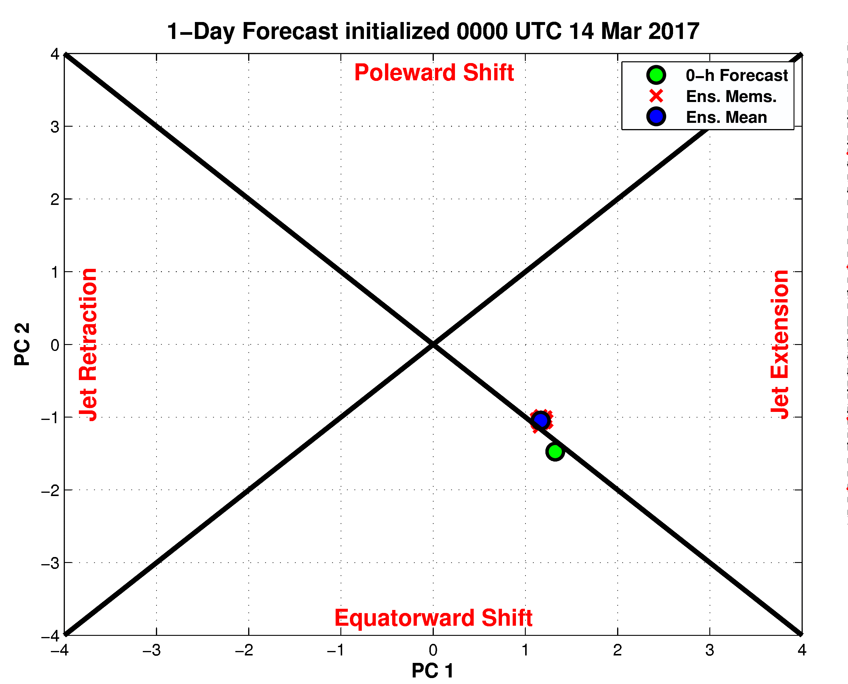
24-h Forecast: 250-hPa Jet (shading), Geo. Hght (contours), Std. Hght Anom. (contours)
m s^{–1}
24-h Forecast: MSLP (contours), Thick. (contours), 850-hPa Temp. Anom. (shading)
σ

Slide 26
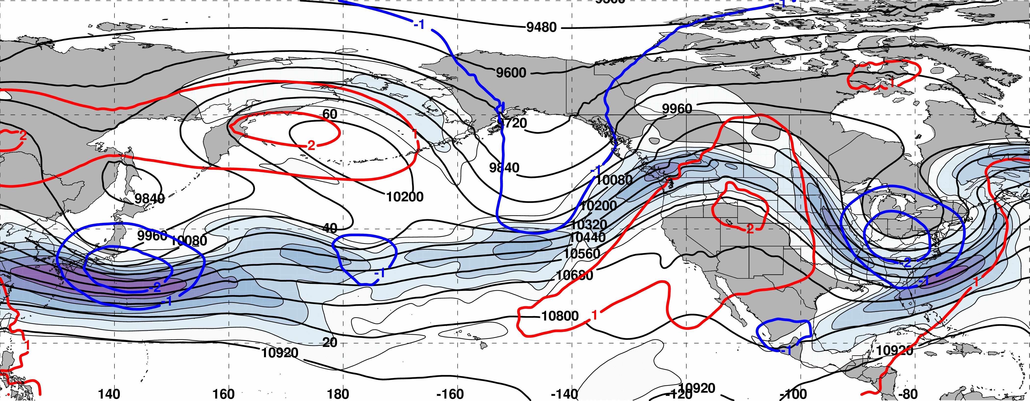
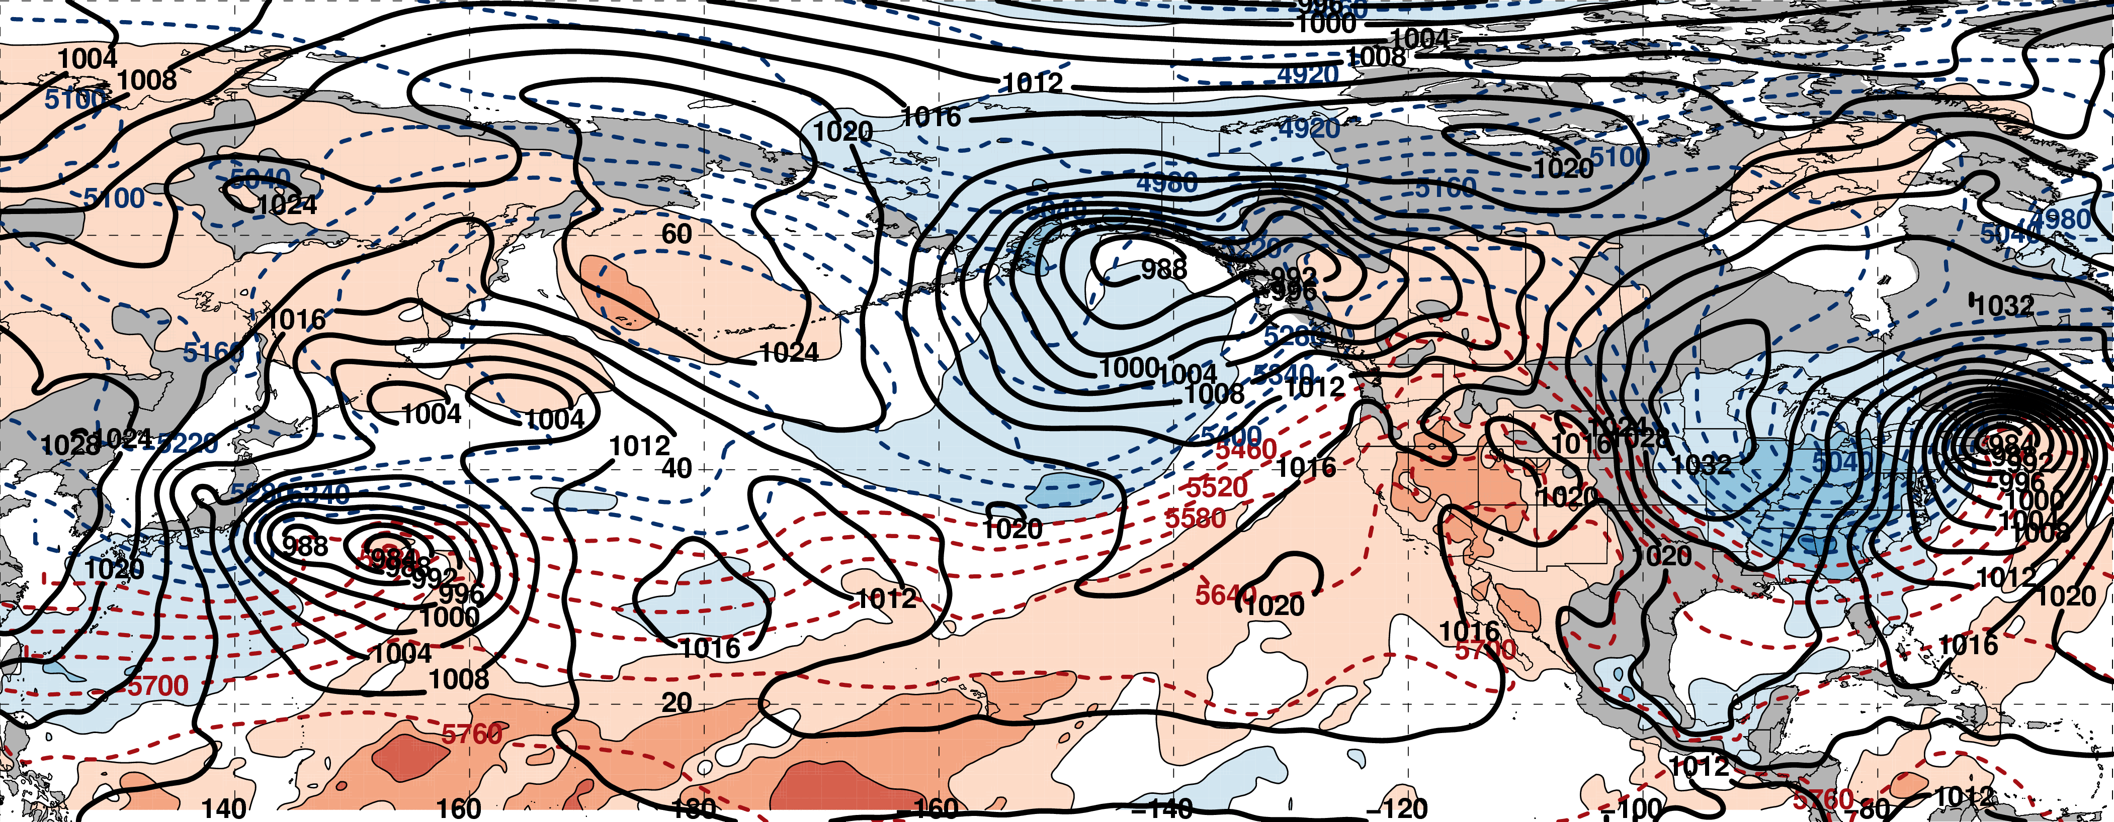
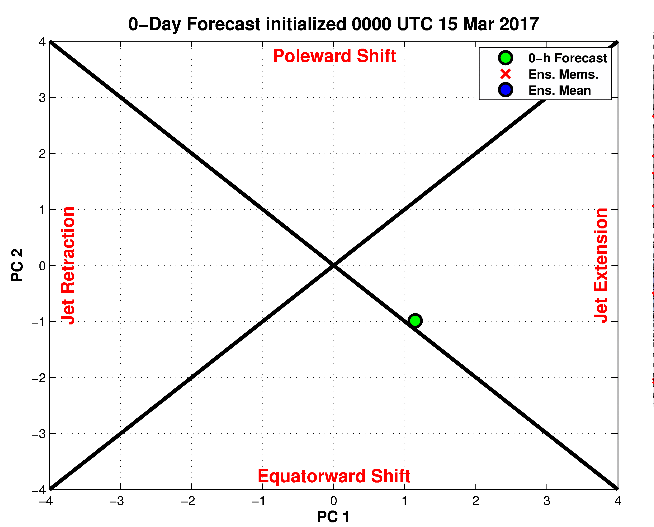
00-h Forecast: 250-hPa Jet (shading), Geo. Hght (contours), Std. Hght Anom. (contours)
m s^{–1}
00-h Forecast: MSLP (contours), Thick. (contours), 850-hPa Temp. Anom. (shading)
σ

Slide 27
Selected Large-Scale Analyses at Peak Storm Intensity: 1800 UTC 14 March 2017

Slide 28
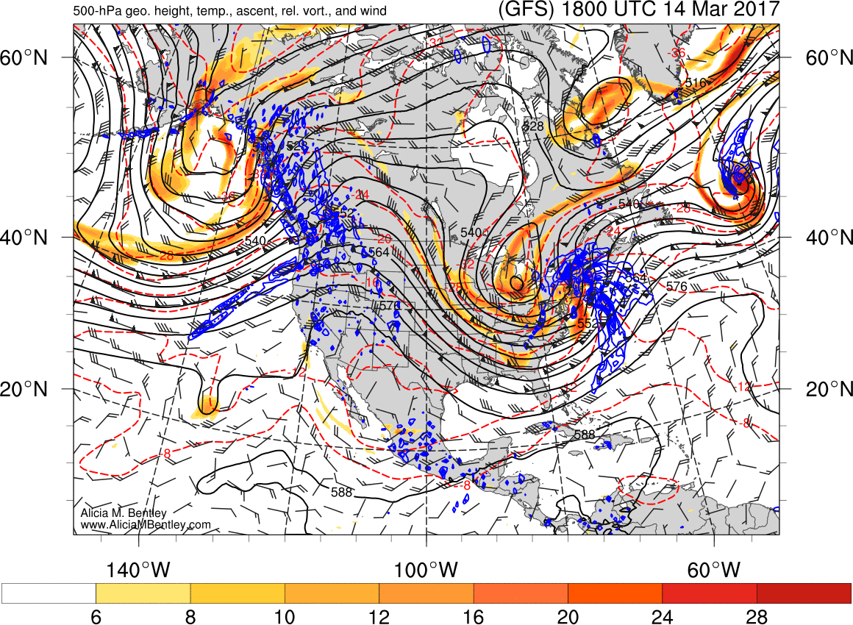

Slide 29
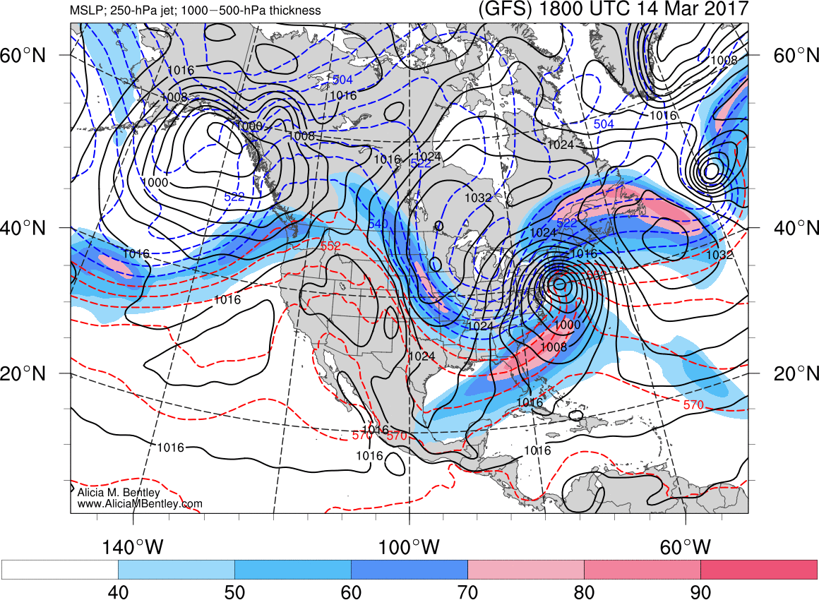

Slide 30
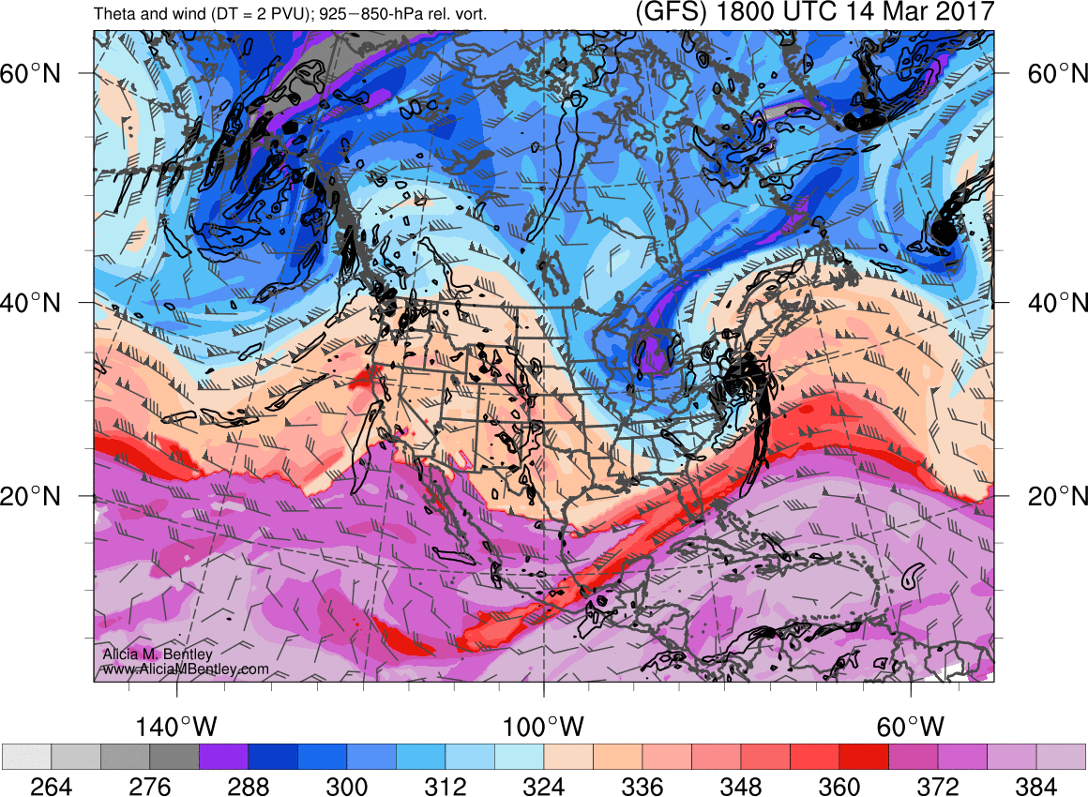

Slide 31
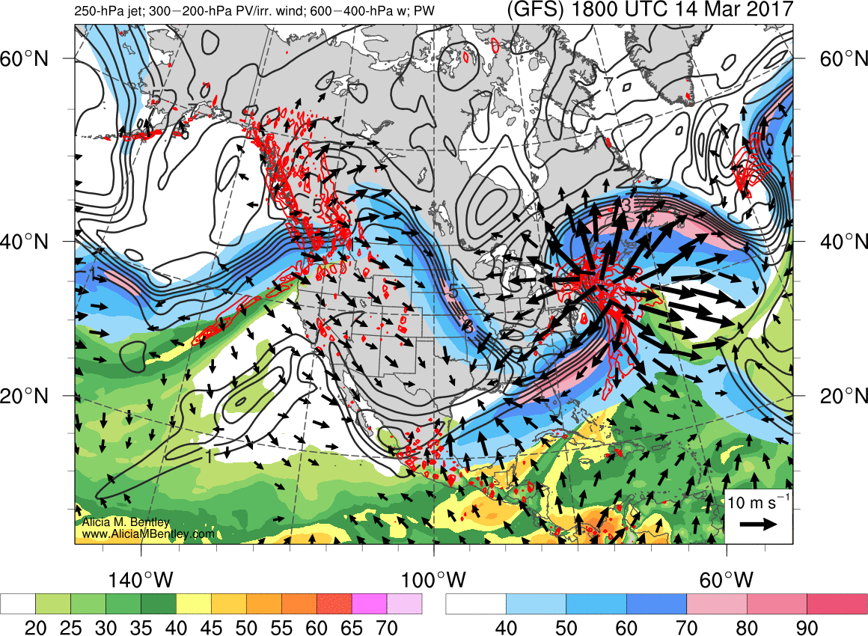

Slide 32
CONUS d(prog/dt) Analysis:
1800 UTC 14 March 2017
Potential temperature (K) and winds (kt) on the 2 potential vorticity unit (PVU) surface
SLP (hPa), 1000–500-hPa thickness, and GFS precipitation rate (mm h⁻¹)

Slide 33
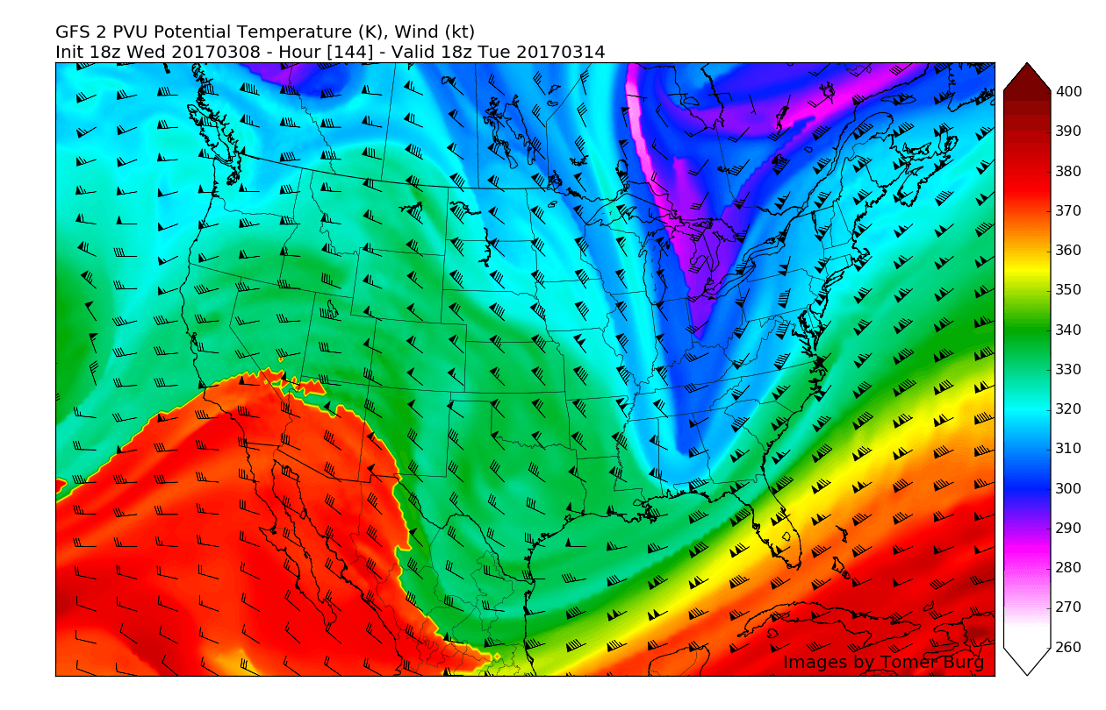

Slide 34
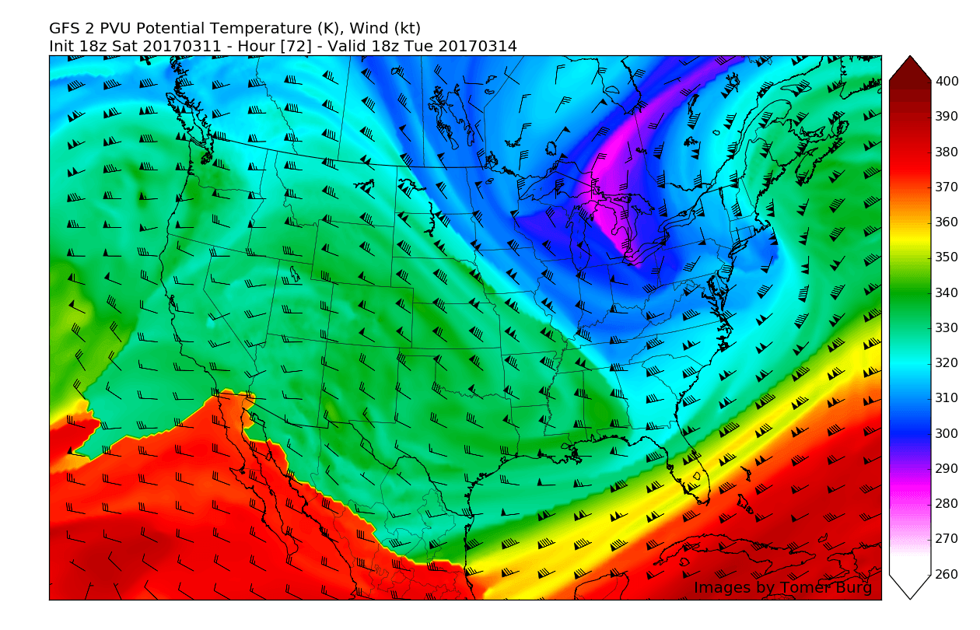

Slide 35
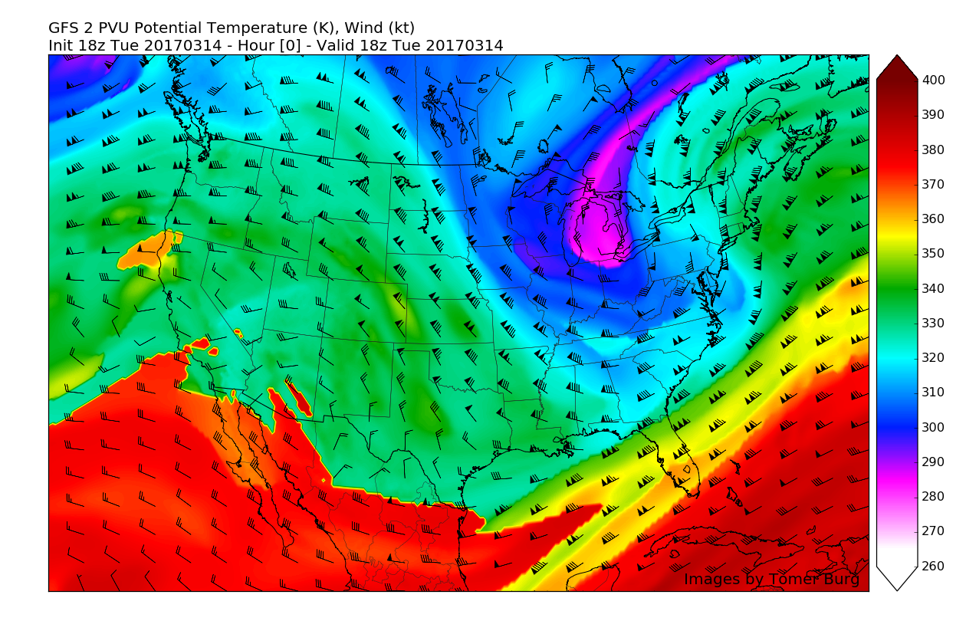

Slide 36
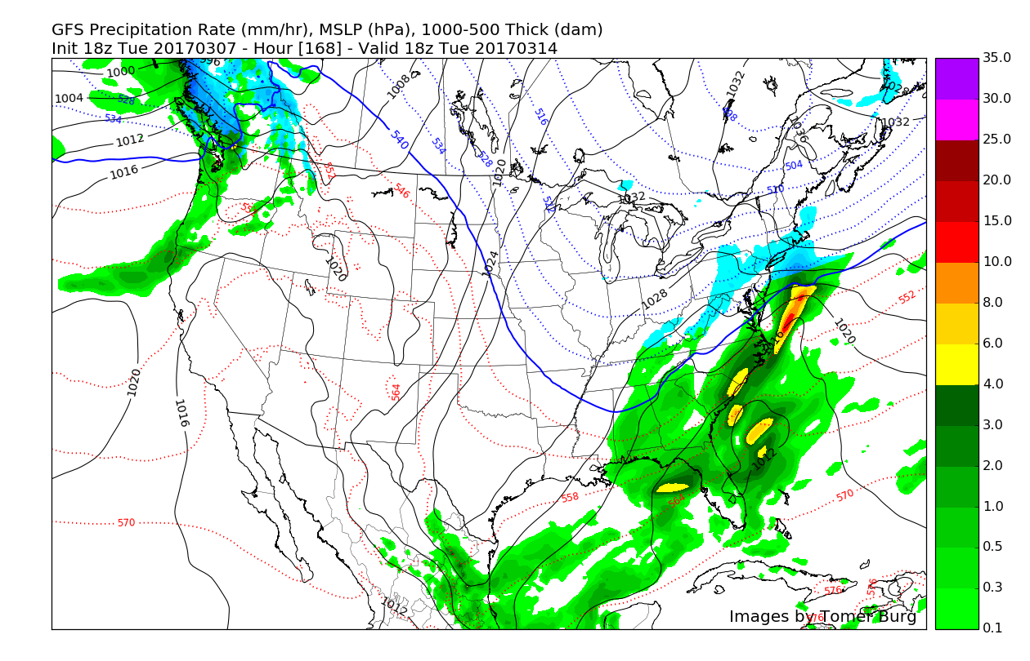

Slide 37
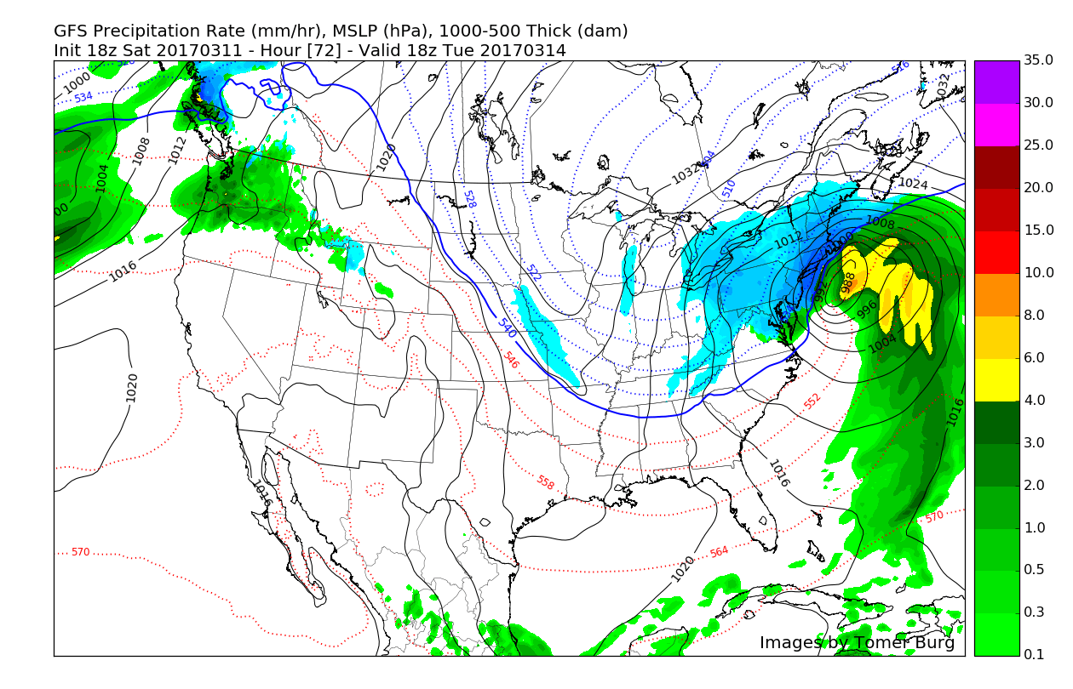

Slide 38
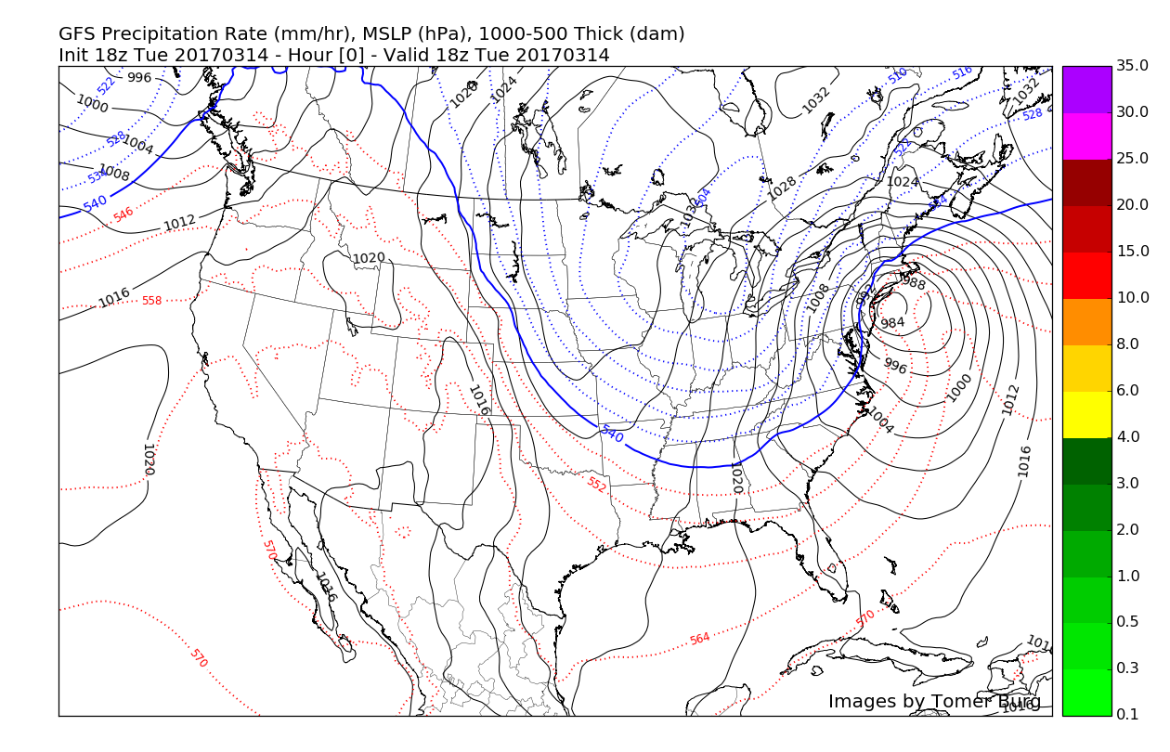

Slide 39
Precipitation Type and Snowfall Amount Forecast Challenges and Uncertainty Along the I-95 Corridor

Slide 41


NCAR Ensemble Total Snowfall (inches) Forecasts from 0000 UTC 13 March (left) and 0000 UTC 14 March (right) 2017

Slide 42

29 h Fcst NCAR 850-hPa ensemble mean wind speed (kt), heights (m), and winds (barbs, kt)
Verifying 1700 UTC 14 March 2017

Slide 43

29 h Fcst ensemble mean SLP (hPa), ensemble spread (hPa), and 10-m winds (kts)
Verifying 1700 UTC 14 March 2017

Slide 44
An Antecedent North Pacific Jet (NPJ) Flow Pattern Associated with Poor Downstream GEFS Forecasts

Slide 45

NPJ Extension: Worst – Best Forecasts
250-hPa Geo. Height Anom. Composite Difference: [Worst Forecast (N=90) – Best Forecast (N=77)] at 192 h
m
99% Conf. Interval
The worst NPJ phase diagram forecasts initialized during a jet extension are frequently associated with significantly higher heights over the North Pacific and significantly lower heights over North America 8 days after forecast initialization
Notes:
Start end labels in box. Change to 8 day trajectories.

Slide 46

250-hPa Geo. Height Anom. Composite Difference: [Worst Forecast (N=90) – Best Forecast (N=77)] at 192 h
m
99% Conf. Interval
0000 UTC 26 February: 250-hPa Jet (shading) and Precipitable Water Anom. (shading)
m s^{–1}
σ
Notes:
Start end labels in box. Change to 8 day trajectories.

Slide 47
Conclusions: “Pi-Day” Storm
Cyclonically rotating and interacting troughs drove Pi-Day storm
Coupled jets favored a stronger storm closer to the coast
GEFS predictability horizon was < 3–6 days
P-type forecast uncertainty was maximized along the I-95 corridor
Antecedent Gulf of Alaska blocking can reduce predictability range

Slide 48
“Animal Farm” Meteorology
All weather impacts are equal, but some weather impacts are more equal than other weather impacts
Cyclone track uncertainty impacts are amplified in the densely populated I-95 corridor
“Cranky” I-95 corridor residents are very sensitive to precipitation type, amount, and intensity impacts
Should standard statistical forecast skill metrics be augmented by population-weighted weather impacts?

Slide 49
North Pacific Jet (NPJ) Regimes
Griffin and Martin (2017) highlight synoptic-scale flow evolution patterns associated with NPJ regimes
Winters et al. (2018) identified four NPJ regimes: (1–2) zonal jet extension and retraction and (3–4) poleward and equatorward jet shift
Composite upper-tropospheric flow patterns associated with these four NPJ regime four days after the development of that NPJ regime are shown next
Griffin, K. S. and J. E. Martin, 2017: Synoptic features associated with temporally coherent modes of variability of the North Pacific jet stream. Mon. Wea. Rev., 30, 39–54. https://journals.ametsoc.org/doi/abs/10.1175/JCLI-D-15-0833.1
Real-Time NPJ Phase Diagram
http://www.atmos.albany.edu/facstaff/awinters/realtime/About_EOFs.php
(Contact Andrew Winters: acwinters@albany.edu)
Notes:
Day + 4 is chosen because it generally features the maximum response over North America.

Slide 50
Extra Slides

Slide 51
Motivation: North Pacific Jet Phase Diagram
The North Pacific Jet (NPJ) phase diagram serves as an objective tool to characterize the instantaneous state and evolution of the upper-tropospheric flow pattern over the North Pacific
The previous presentation indicated that jet retractions and equatorward shifts are generally characterized by reduced forecast skill in comparison to jet extensions and poleward shifts
The prevailing NPJ regime, as determined by the NPJ phase diagram, has important implications for the character of the downstream upper-tropospheric flow pattern over North America

Slide 52
NPJ Phase Diagram Web Interface
A web interface has been developed and implemented at WPC that offers real time NPJ phase diagram forecasts and NPJ regime composites.
http://www.atmos.albany.edu/facstaff/awinters/realtime/About_EOFs.php
Contact: acwinters@albany.edu
Collaborators: Mike Bodner (WPC), Arlene Laing (NOAA), Dan Halperin (WPC), Bill Lamberson (WPC), Josh Kastman (WPC), and Sara Ganetis (WPC)

Slide 53
250-hPa North Pacific Zonal Wind Variability
EOF 1 – Jet Extension/Retraction
Sept.–May mean 250-hPa zonal wind: black contours
Sept.–May 250-hPa zonal wind EOF 1 pattern: shading
+ EOF 1: Jet Extension
– EOF 1: Jet Retraction

Slide 54
250-hPa North Pacific Zonal Wind Variability
EOF 1 – Jet Extension/Retraction
Hypothetical Zonal Wind
Sept.–May mean 250-hPa zonal wind: black contours
Sept.–May 250-hPa zonal wind EOF 1 pattern: shading
+ EOF 1: Jet Extension
– EOF 1: Jet Retraction
Notes:
The outermost green contour is 20 m/s and contour interval for green contours is every 10 m/s. The green contours are calculated by adding the EOF patterns to the mean zonal wind. The resultant wind distribution would project onto the point (1,0) on the N. Pacific Jet phase diagram.

Slide 55


250-hPa Wind Speed, Geo. Heights, Geo. Height Anom.: Jet Retraction D+4
m s^{–1}
Mean SLP, 1000–500-hPa Thick., 850-hPa Temp. Anom.: Jet Retraction D+4
K

Slide 56


250-hPa Wind Speed, Geo. Heights, Geo. Height Anom.: Poleward Shift D+4
m s^{–1}
Mean SLP, 1000–500-hPa Thick., 850-hPa Temp. Anom.: Poleward Shift D+4
K

Slide 57


0000 UTC 02 March: 250-hPa Jet (shading) and Precipitable Water Anom. (shading)
m s^{–1}
σ
0000 UTC 02 March: MSLP (contours), Thick. (contours), 850-hPa Temp. Anom. (shading)
L
σ

Slide 58
NPJ Regime Change Leading to “Pi-Day” Storm
9-day Probabilistic Forecast Trajectory Initialized at 0000 UTC 02 March 2017
02 Mar. 2017
11 Mar. 2017
GEFS Mean
GFS Analysis

Slide 59
NPJ Regime Change Leading to “Pi-Day” Storm
9-day Probabilistic Forecast Trajectory Initialized at 0000 UTC 02 March 2017
02 Mar. 2017
The GEFS underestimated the equatorward shift and extension of the NPJ at the end of the forecast period
An equatorward-shifted and extended NPJ is often associated with below-normal temperatures in the Eastern U.S.
11 Mar. 2017
GEFS Mean
GFS Analysis

Slide 60
A North Pacific Jet (NPJ) Perspective
EOF analyses of 250-hPa zonal winds are used to identify characteristic NPJ regime phase spaces*
Four NPJ regimes are identified: extended and retracted; poleward- and equatorward-shifted
*Andrew Winters Real-Time NPJ Phase Diagram (Real-Time NPJ Phase Diagram
http://www.atmos.albany.edu/facstaff/awinters/realtime/About_EOFs.php)

Slide 61
NPJ Flow Regimes Favorable for Eastern CONUS Troughs, Cold, and Storminess
Eastward jet extension
Equatorward jet shift
Construct composite analyses of these two flow regimes four days after regime onset

Slide 62


250-hPa Wind Speed, Geo. Heights, Geo. Height Anom.: Jet Extension D+4
m s^{–1}
Mean SLP, 1000–500-hPa Thick., 850-hPa Temp. Anom.: Jet Extension D+4
K

Slide 63


250-hPa Wind Speed, Geo. Heights, Geo. Height Anom.: Equator. Shift D+4
m s^{–1}
Mean SLP, 1000–500-hPa Thick., 850-hPa Temp. Anom.: Equator. Shift D+4
K

