Slide 1
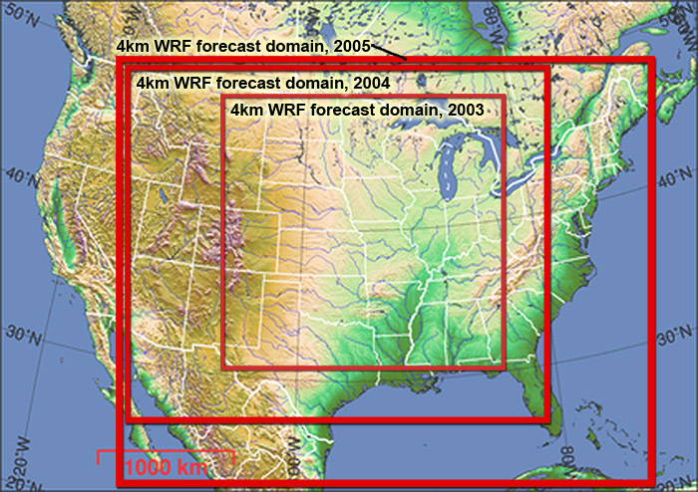
WRF Realtime Convective Forecasting
36 h forecasts, 3-4 km grid resolution, Initialized at 00 UTC from 40 km NAM

Slide 2
WRF Model Physics
“Plug-compatible” interface defined for physics modules
Physics options implemented in WRF:
Microphysics: Kessler-type (no-ice)
Lin et al. (graupel included),WSM6
NCEP Cloud3, Cloud5, Ferrier
Cumulus Convection: New Kain-Fritsch, Grell Ensemble
Betts-Miller-Janjic
Shortwave Radiation: Dudhia (MM5), Goddard, GFDL
Longwave Radiation: RRTM, GFDL
Turbulence: Prognostic TKE,
Smagorinsky, constant diffusion
PBL: MRF, MYJ, YSU
Surface Layer: Similarity theory, MYJ
Land-Surface: 5-layer soil model, RUC LSM
Noah unified LSM, HRLDAS

Slide 3
RESOLUTION
What does does it take to represent convective processes?
It depends on the phenomena:
convective initiation
updrafts, downdrafts, cold pools
rain, hail, surface winds
supercell processes (e.g. rotating updrafts)
tornadoes (supercell, non-supercell, QLCS, etc..)
bow echoes, squall lines, MCCs

Slide 4
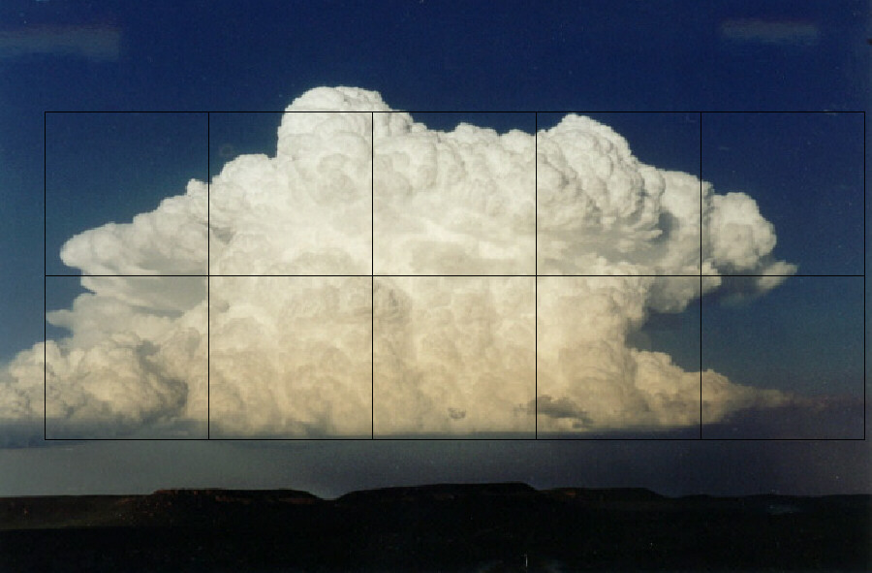
6 km Resolution

Slide 5
1 km Resolution

Slide 6
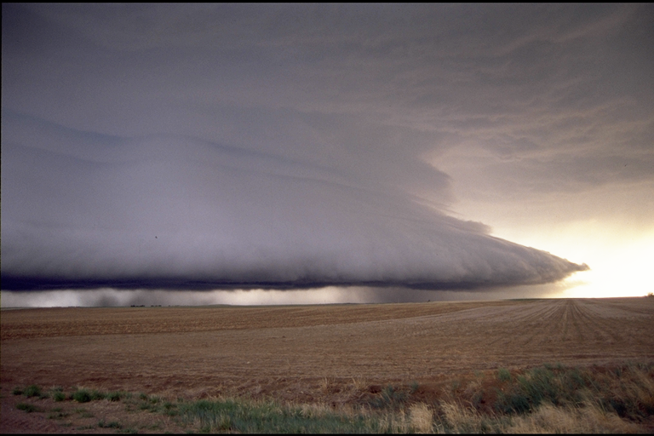
How much resolution does it take to simulate squall lines and bow echoes?

Slide 7
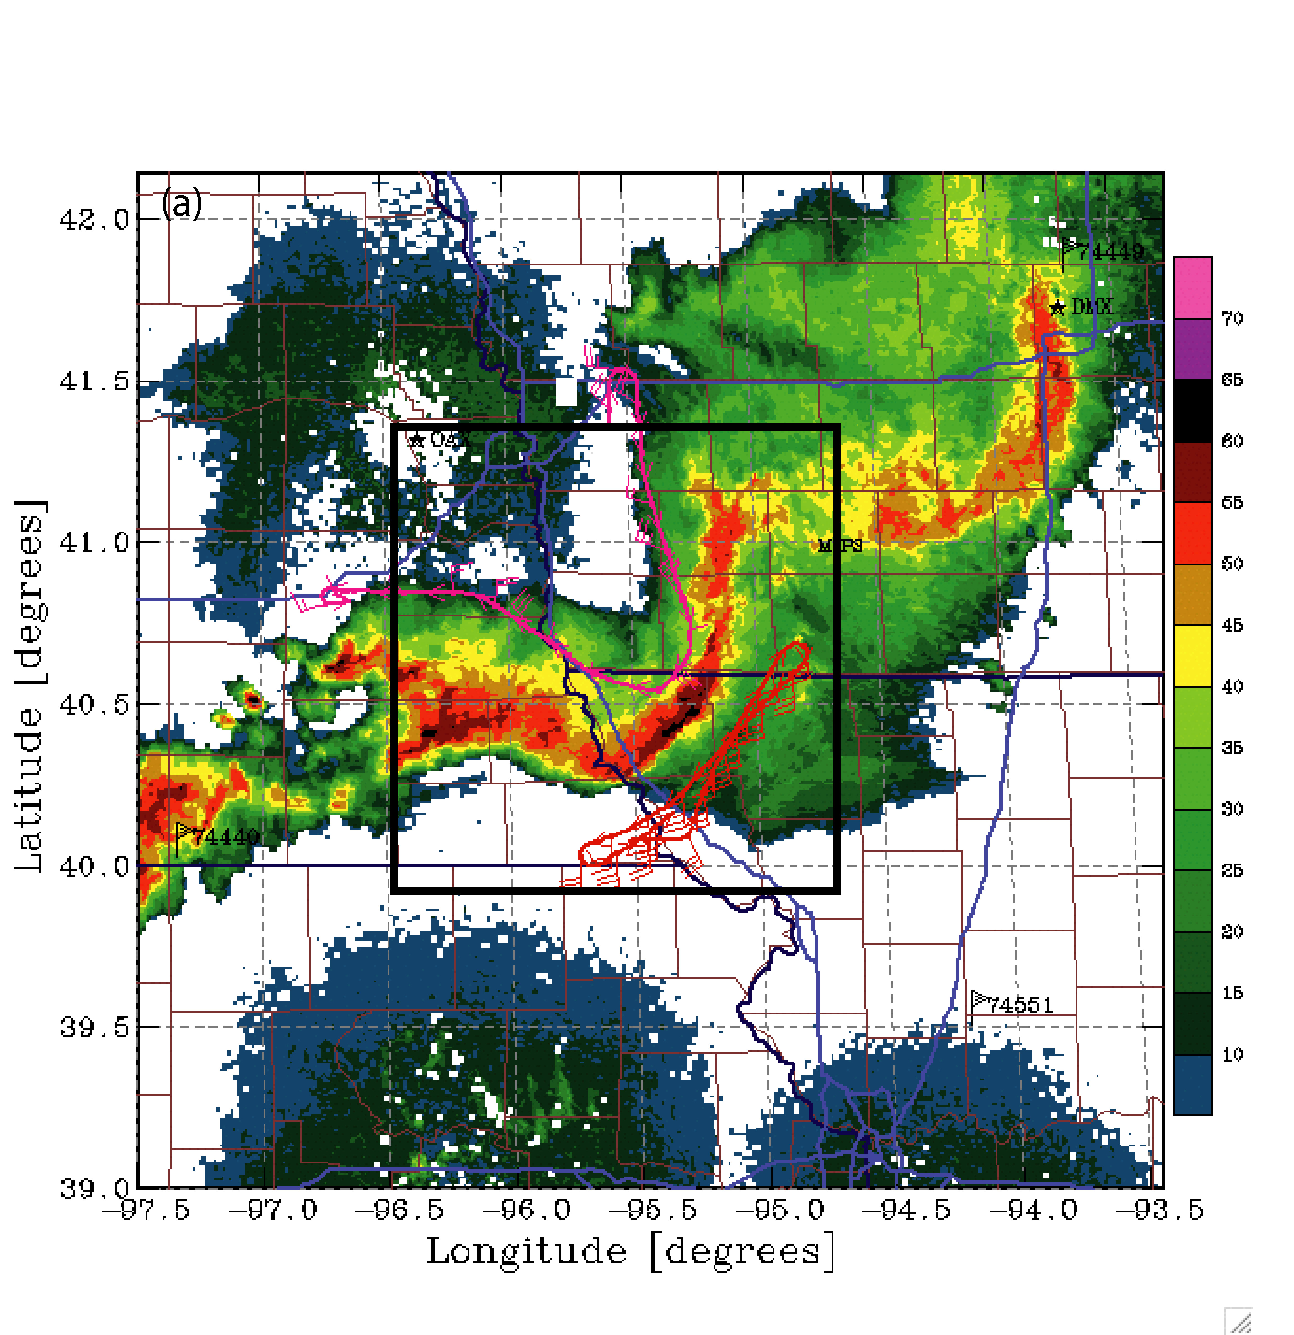
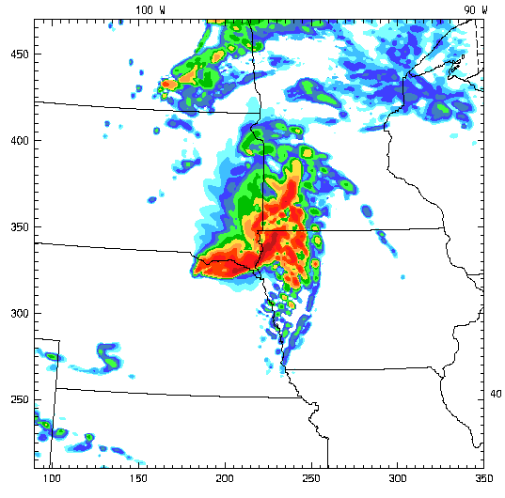
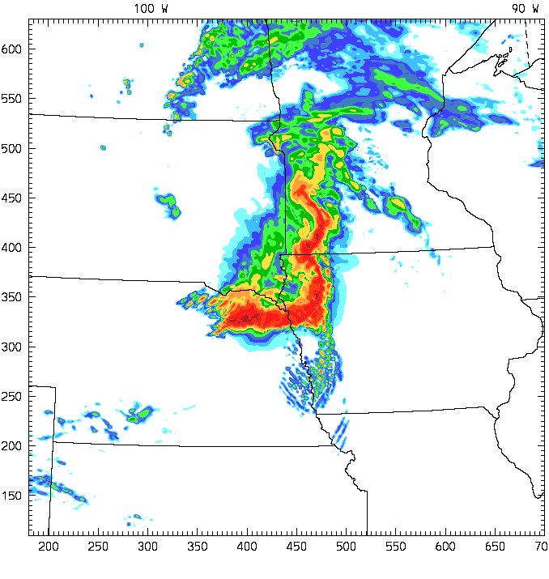
BAMEX Bow Echo: 10 June 2003
BAMEX OBS, Reflectivity
4 km?
2 km?
WRF-ARW Forecasts

Slide 8
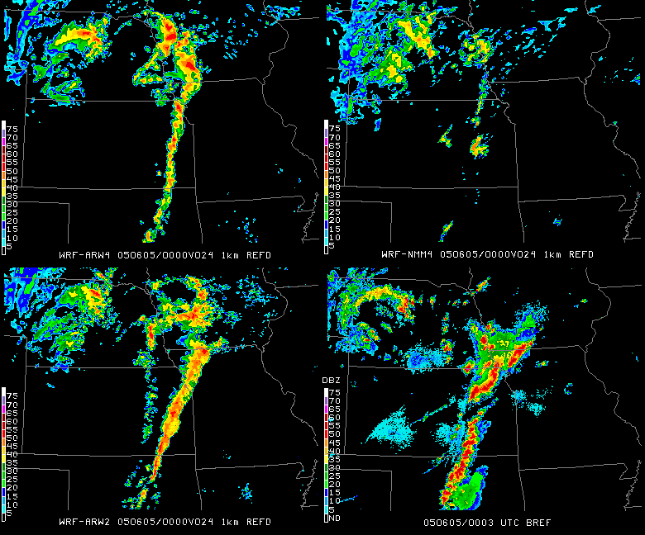
24 h forecast Valid 00 UTC 06/05/05
4-km NMM
4-km ARW
2-km ARW
Nexrad

Slide 9
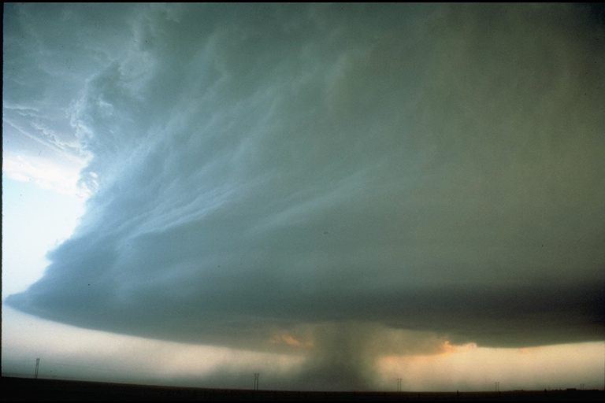
How much resolution to simulate a supercell?

Slide 10
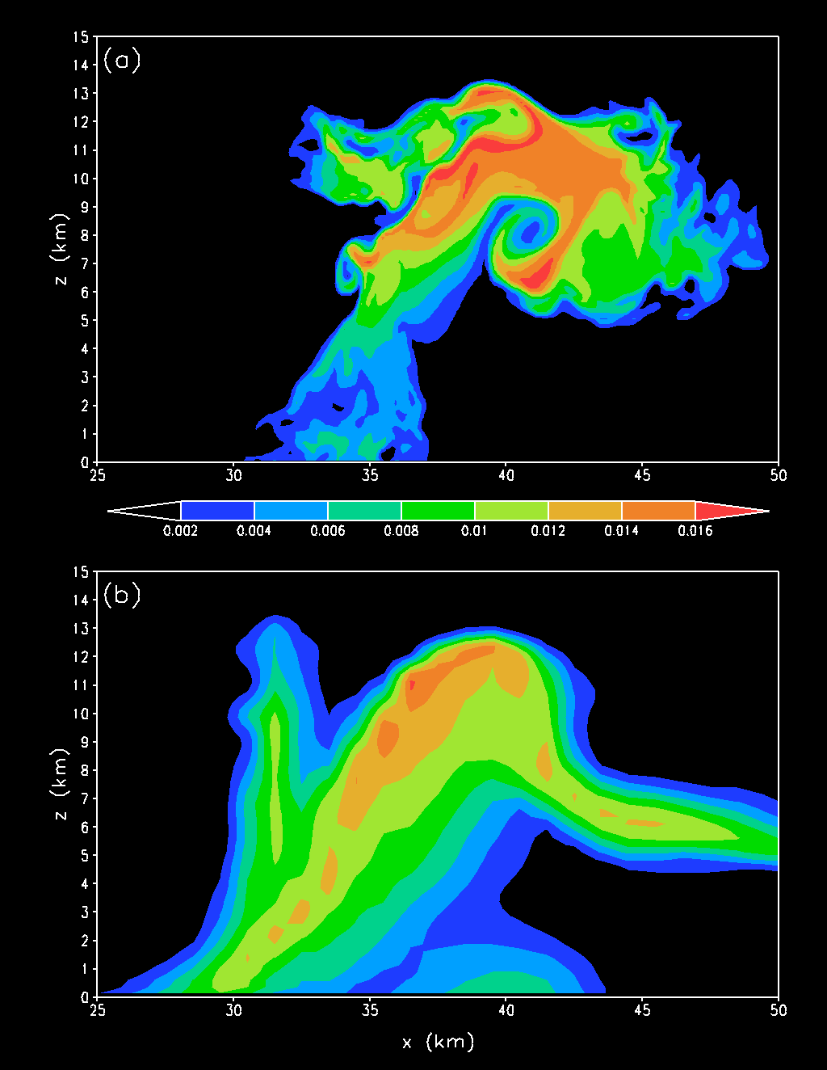
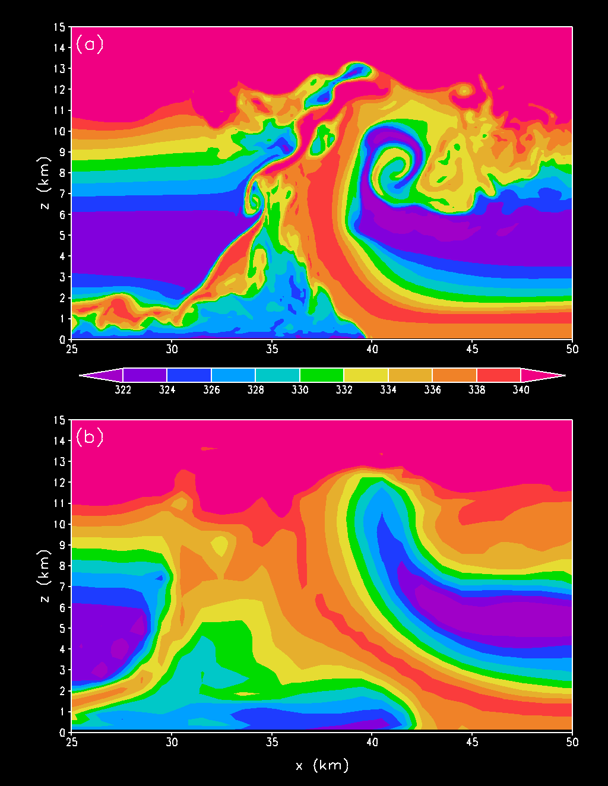
OK, how much resolution do we really need?? e.g., Bryan and Fritsch….
125 m:
1000 m:
Rainwater mixing ratio
with “strong” shear
θ_{e}, with “strong” shear

Slide 11
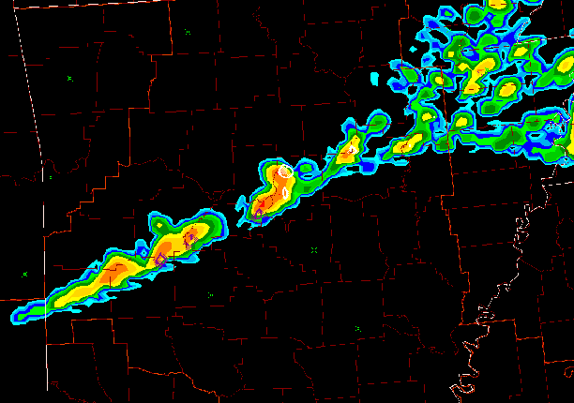
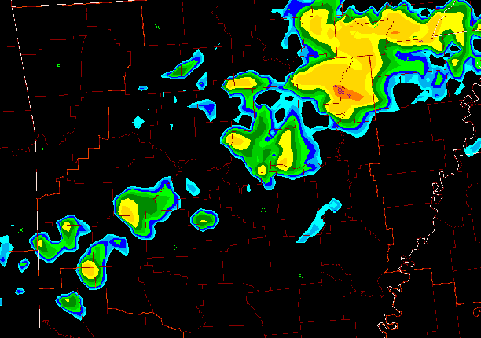
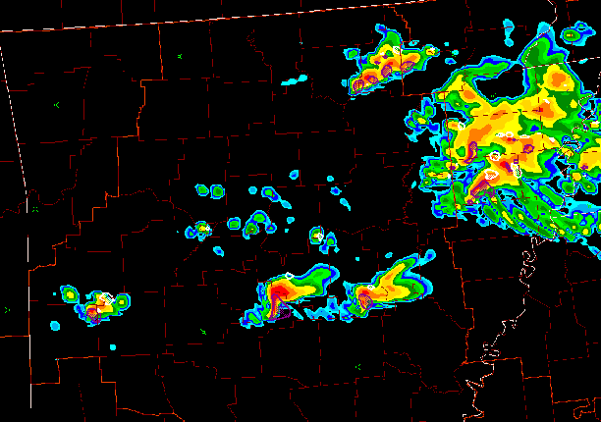
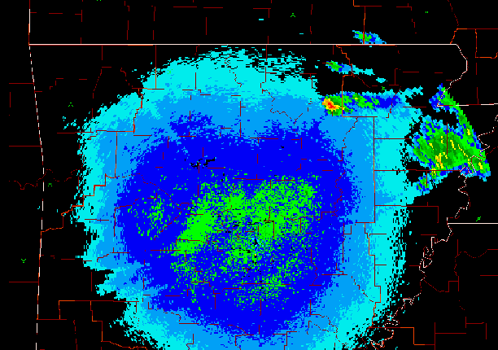
0500 UTC 29 April 2005: 1 km model reflectivity, NEXRAD BREF
ARW4
NMM4
ARW2
BREF

Slide 12
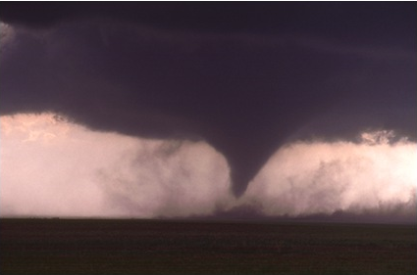
….How much resolution for a tornado??
~ 50 - 100 m

Slide 13
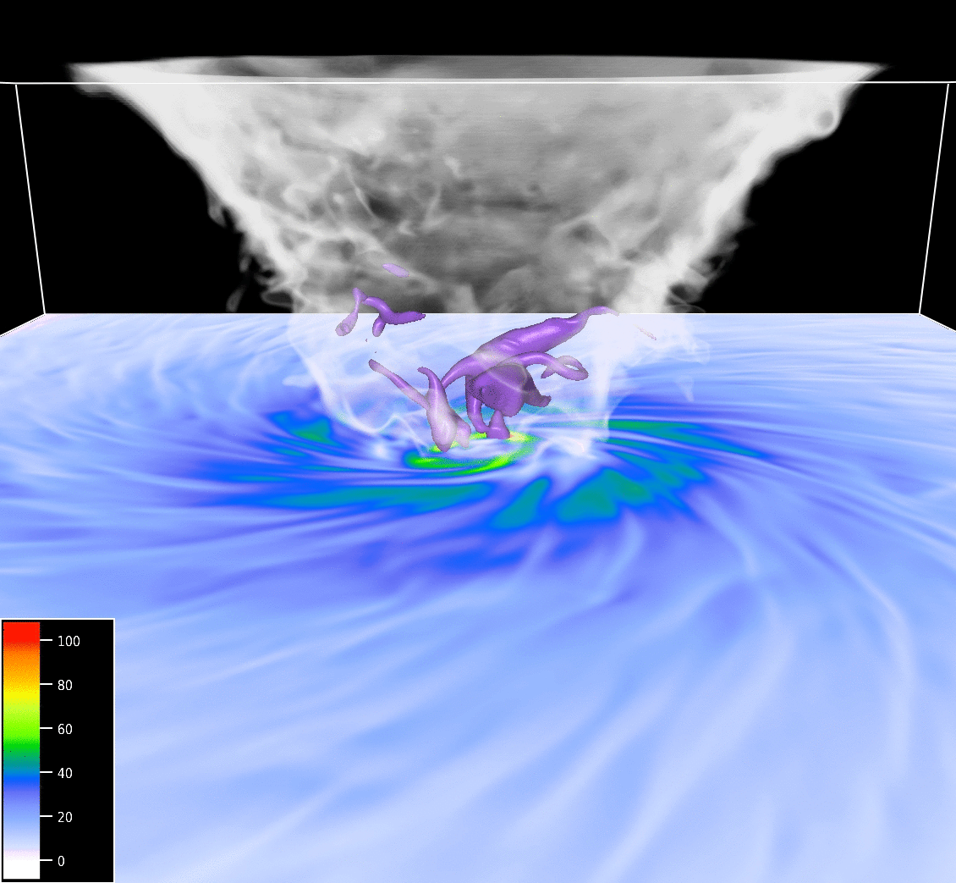
High swirl:
Details:
Δx, Δy = 5 m
Δz = 2.5 m
10 s animation,
image every 0.1 s
2 km
500 m
Wind speed (m s⁻¹)
at 1 m AGL
White/gray shading:
analogous to cloud

Slide 14
Model Physics in High Resolution NWP
Physics
“No Man’s Land”
1 10 100 km
Resolved Convection
Cumulus Parameterization
3-D Radiation
Two Stream Radiation
LES
PBL Parameterization

Slide 15
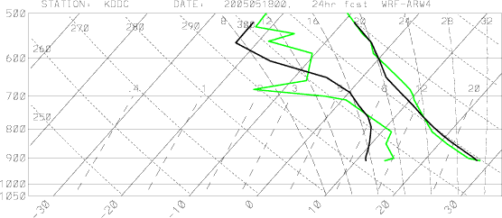
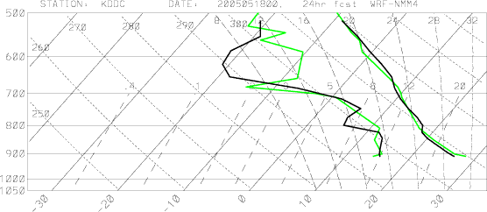
Sounding comparison: 24h forecast valid 00Z 18 May at DDC
ARW4
YSU
Too dry in PBL, too moist above; Where is the PBL top?
Model
Raob
MYJ
NMM4
Good forecast…
Raob
Model
(Jack Kain, NSSL)

Slide 16
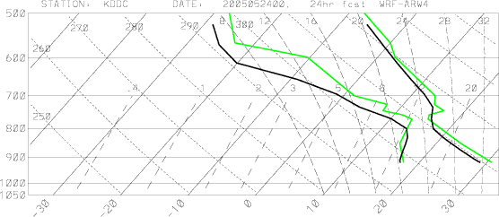
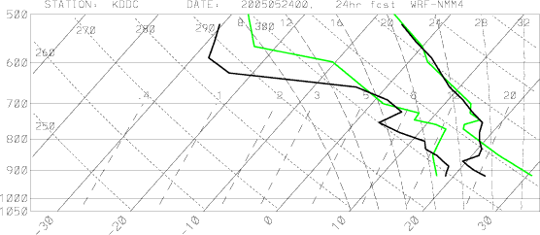
Sounding comparison: 24h forecast valid 00Z 24 May at DDC
ARW4
YSU
Good forecast…
Model
Raob
MYJ
NMM4
PBL too shallow, cold, & moist…
clouds just broke up!
Model
Raob
(Jack Kain, NSSL)

Slide 17
Predictability:
What can we hope to do?

Slide 18
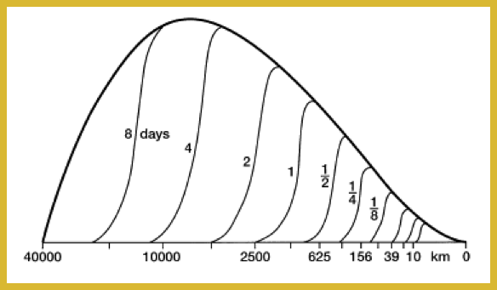
Theoretical Predictability Limits??
Atmos. Energy Spectrum
Lorenz, 1969
Predictability Limit for given scale
Error spectrum at given time
Scale (km)
Subsynoptic waves (~1200 km): ~1.5 days
Convective Systems (~300 km): ~12 h
Thunderstorms (~10 km): ~ 1h

Slide 19
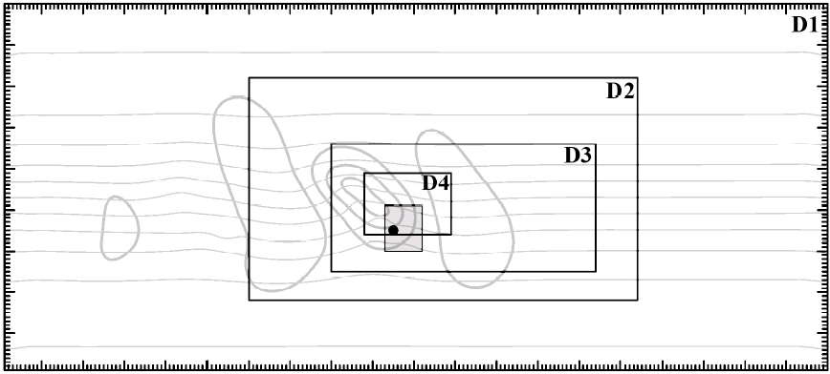
Baroclinic Waves / Moist Convection
white noise added to D2 at t = 36h
Zhang et al. (2006)
Notes:
More systematic approach considers a growing baroclinic wave in a channel / moist instability.

Slide 20
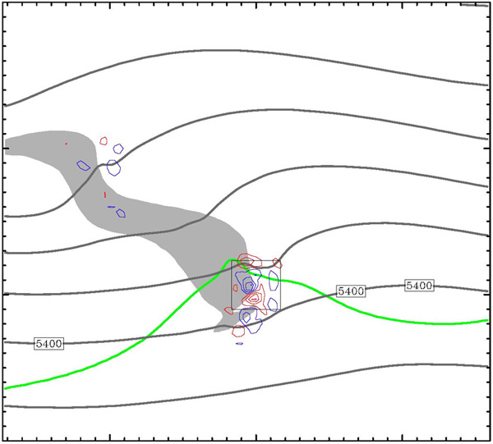
Evolution of Difference Field
500 hPa height (solid), v’ (color, c.i.=2m/s), 3h precip (shaded > 3mm)
CAPE > 50J/Kg
Zhang et al. (2006)

Slide 21
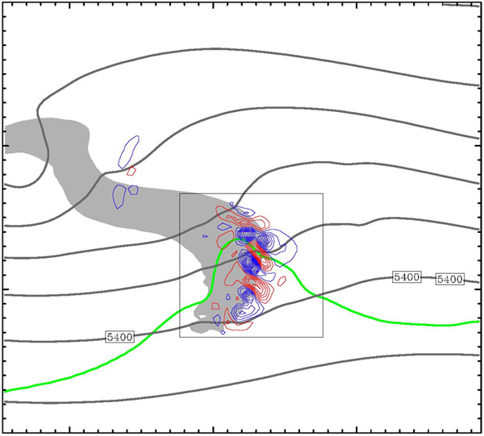
Evolution of Difference Field
500 hPa height (solid), v’ (color, c.i.=2m/s), 3h precip (shaded > 3mm)
CAPE > 50J/Kg
Zhang et al. (2006)

Slide 22
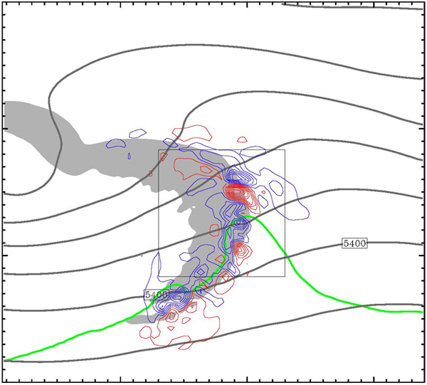
Evolution of Difference Field
500 hPa height (solid), v’ (color, c.i.=2m/s), 3h precip (shaded > 3mm)
CAPE > 50J/Kg
Zhang et al. (2006)

Slide 23
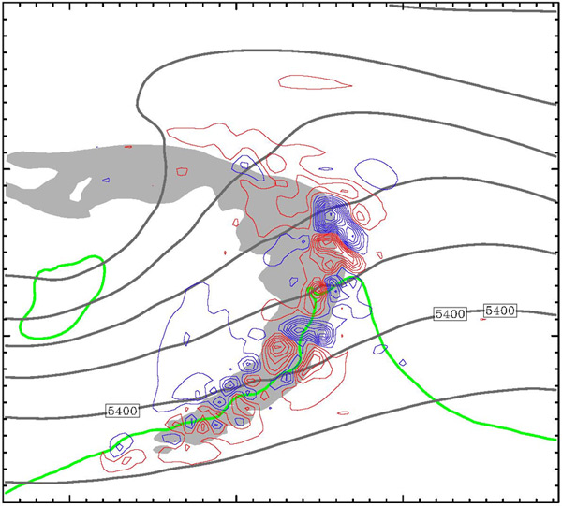
Evolution of Difference Field
500 hPa height (solid), v’ (color, c.i.=2m/s), 3h precip (shaded > 3mm)
CAPE > 50J/Kg
Zhang et al. (2006)

Slide 24
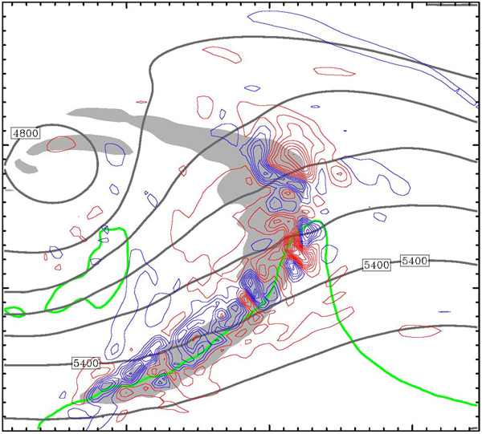
Evolution of Difference Field
500 hPa height (solid), v’ (color, c.i.=2m/s), 3h precip (shaded > 3mm)
CAPE > 50J/Kg
Zhang et al. (2006)

Slide 25
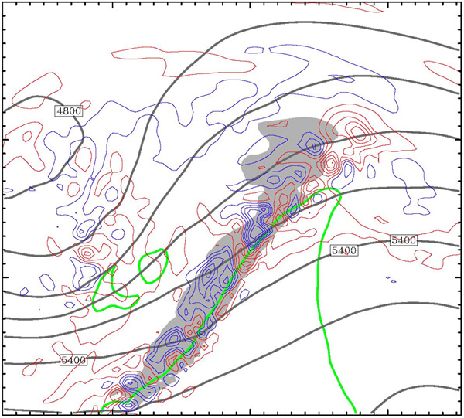
Evolution of Difference Field
500 hPa height (solid), v’ (color, c.i.=2m/s), 3h precip (shaded > 3mm)
CAPE > 50J/Kg
Zhang et al. (2006)

