Slide 1
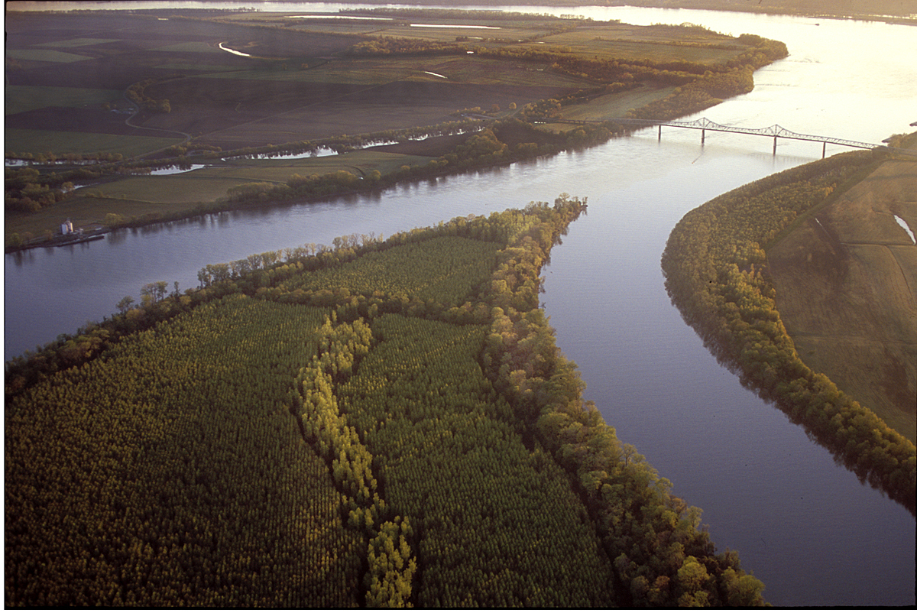
A Review of Research on Upper-Level Jet-Front Systems
Andrew C. Winters
ATM 619
28 January 2016

Slide 2
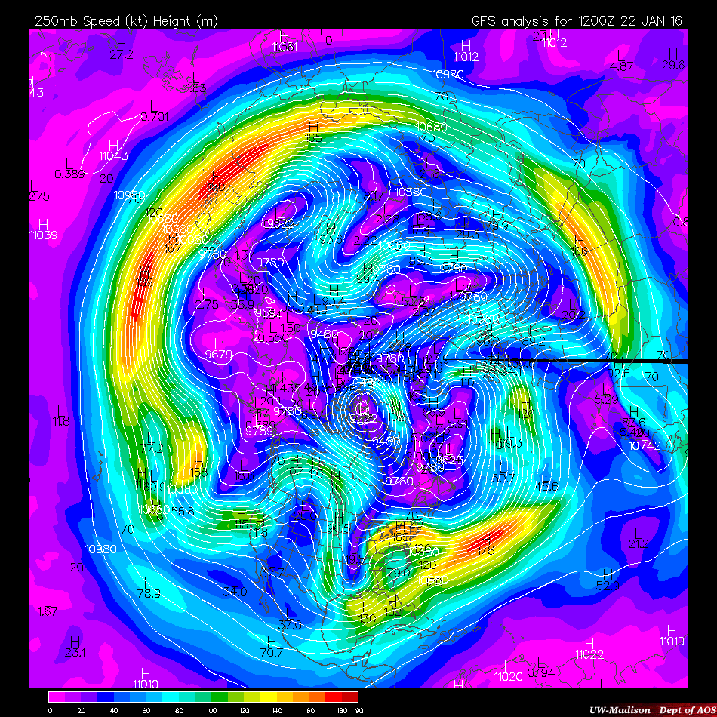
250 hPa Wind Speed
1200 UTC 22 Jan 2016
UW-Madison AOS
Notes:
Jet streaks can extend on the order of 1000s of km, while their width is only on the order of 100s of km. Considerable lateral shear. Jets circumnavigate the globe and exhibit substantial meridional meanders.

Slide 3
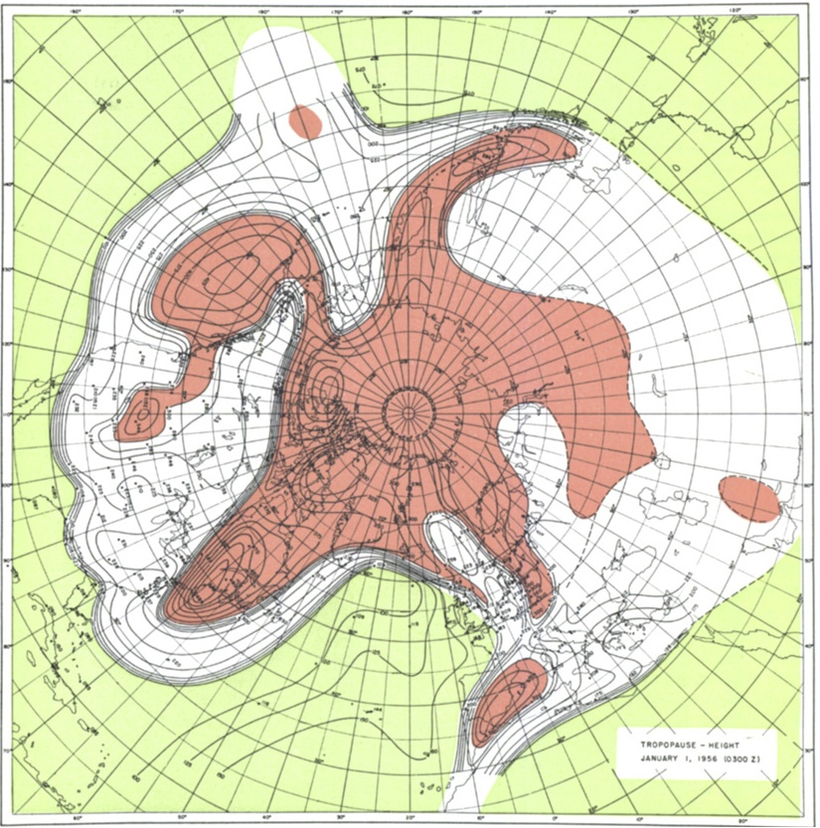
Modified from Defant and Taba (1957)
Tropical Tropopause
Subtropical Tropopause
Polar Tropopause
STJ
POLJ
Notes:
Tropopause height is useful in identifying the locations of the jets, as they sit in the breaks in the tropopause height.
Jet streaks can extend on the order of 1000s of km, while their width is only on the order of 100s of km. Considerable lateral shear. Jets circumnavigate the globe and exhibit substantial meridional meanders.

Slide 4
Modified from Defant and Taba (1957)
Tropical Tropopause
Subtropical Tropopause
Polar Tropopause
STJ
POLJ
Notes:
Tropopause height is useful in identifying the locations of the jets, as they sit in the breaks in the tropopause height.
Jet streaks can extend on the order of 1000s of km, while their width is only on the order of 100s of km. Considerable lateral shear. Jets circumnavigate the globe and exhibit substantial meridional meanders.

Slide 5
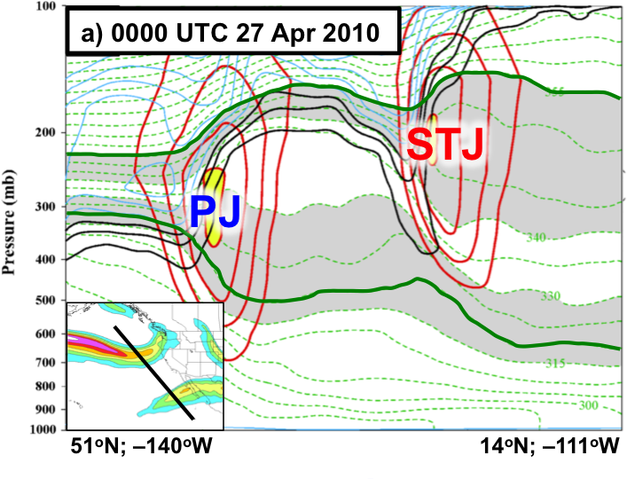
A
A’
Modified from Winters and Martin (2014)
Notes:
And when you take a cross section you’ll notice that the jets are characterized by substantial baroclinicity in the upper-troposphere and lower stratosphere. As well as strong vertical shear.

Slide 6
Building Blocks to Jet Stream “Discovery”
Ferrel (1878) – a direct proportionality exists between the magnitude of the column-averaged horizontal temperature gradient and the vertical shear of the geostrophic wind (Kutzbach 1979, p. 110).
Notes:
Ferrel’s relationships are now commonly known as the thermal wind relationship.. Underpins the existence of an upper-level wind speed maximum near the tropopause.
Margules provided the theoretical link between Earth’s general circulation and the development of midlatitude disturbances capable of producing sensible weather.

Slide 7
Building Blocks to Jet Stream “Discovery”
Ferrel (1878) – a direct proportionality exists between the magnitude of the column-averaged horizontal temperature gradient and the vertical shear of the geostrophic wind (Kutzbach 1979, p. 110).
Margules (1903) – the pole-to-equator temperature gradient represents a reservoir of potential energy from which midlatitude disturbances could draw kinetic energy.
Notes:
Ferrel’s relationships are now commonly known as the thermal wind relationship.. Underpins the existence of an upper-level wind speed maximum near the tropopause.
Margules provided the theoretical link between Earth’s general circulation and the development of midlatitude disturbances capable of producing sensible weather.
Bjerknes and Solberg implied that the polar front was a continuous boundary at midlatitudes that encircled the globe and separated warm, moist tropical air from cold, dry polar air masses. Much of the pole-to-equator temperature gradient was focused into a single

Slide 8
Building Blocks to Jet Stream “Discovery”
Ferrel (1878) – a direct proportionality exists between the magnitude of the column-averaged horizontal temperature gradient and the vertical shear of the geostrophic wind (Kutzbach 1979, p. 110).
Margules (1903) – the pole-to-equator temperature gradient represents a reservoir of potential energy from which midlatitude disturbances could draw kinetic energy.
Bjerknes and Solberg (1922) – “Polar Front Theory”.
Notes:
Ferrel’s relationships are now commonly known as the thermal wind relationship.. Underpins the existence of an upper-level wind speed maximum near the tropopause.
Margules provided the theoretical link between Earth’s general circulation and the development of midlatitude disturbances capable of producing sensible weather.
Bjerknes and Solberg implied that the polar front was a continuous boundary at midlatitudes that encircled the globe and separated warm, moist tropical air from cold, dry polar air masses. Much of the pole-to-equator temperature gradient was focused into a single

Slide 9
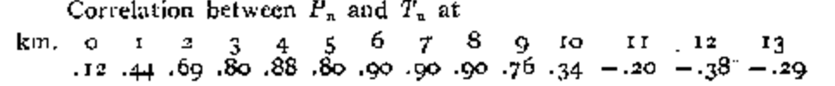
Building Blocks to Jet Stream “Discovery”
Dines (1925) – Cyclones were characterized by cold (warm) column-averaged temperatures below (above) ~9 km.
Notes:
- Growing numbers of surface and upper-air observations followed World War I and accelerated interest in the the temperature stucture of the midlatitude atmosphere.
-The opposite held true for anticyclones. Consequently the juxtaposition of a cyclone and anticyclone resulted in a column-averaged horizontal temperature gradient between the cyclone and anticyclone, which reversed at higher altitudes.
- Dines also suggested that the tropopause sloped downward towards higher latitudes.

Slide 10
Building Blocks to Jet Stream “Discovery”
Dines (1925) – Cyclones were characterized by cold (warm) column-averaged temperatures below (above) ~9 km.
Horizontal circulations associated with cyclones were maximized near the tropopause.
Notes:
- Growing numbers of surface and upper-air observations followed World War I and accelerated interest in the the temperature stucture of the midlatitude atmosphere.
-The opposite held true for anticyclones. Consequently the juxtaposition of a cyclone and anticyclone resulted in a column-averaged horizontal temperature gradient between the cyclone and anticyclone, which reversed at higher altitudes.
- Dines also suggested that the tropopause sloped downward towards higher latitudes.

Slide 11
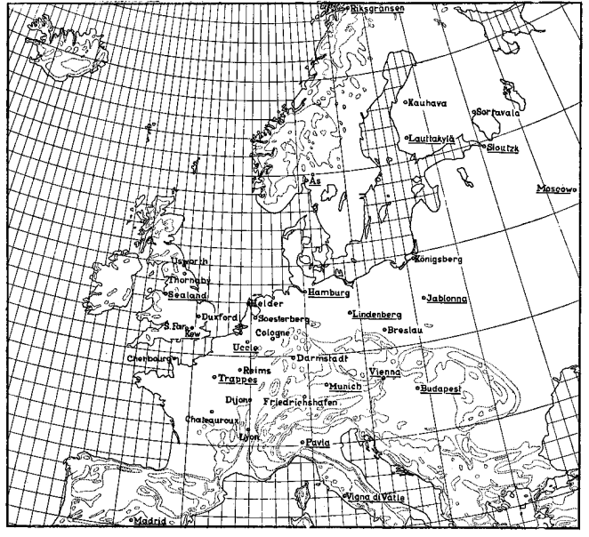
Building Blocks to Jet Stream “Discovery”
Bjerknes and Palmén (1937)
Coordinated “swarm ascents” at 18 different locations across Europe.
Notes:
Meteorgraphs. Coordinated international effort to launch balloon soundings at 18 diff. locations across Europe. Wanted to capture the horizontal and vertical temperature structure throughout Europe.

Slide 12
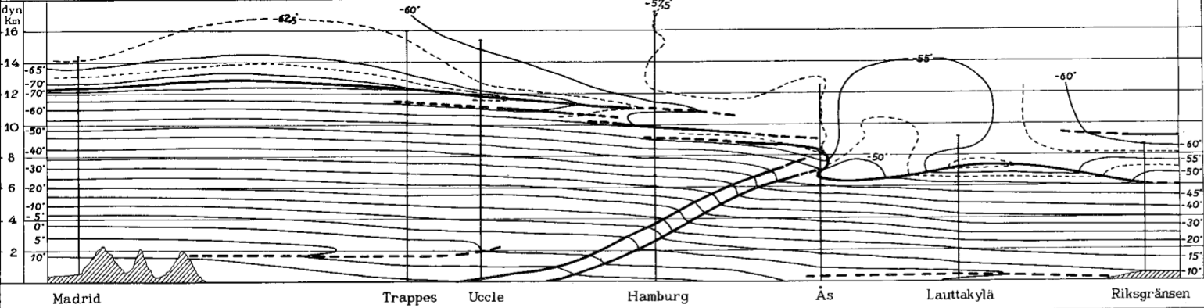
Building Blocks to Jet Stream “Discovery”
Bjerknes and Palmén (1937)
The front is a transition zone across which the temperature gradient, not the temperature itself, is discontinuous.
Note that the tropopause abruptly lowers at the location where the polar front intersects the tropopause.
Reversal in the sign of the meridional temperature gradient above the tropopause break.
Notes:
Also noted that areas characterized by a strong horizontal temperature gradient exhibited stronger vertical wind shear.

Slide 13
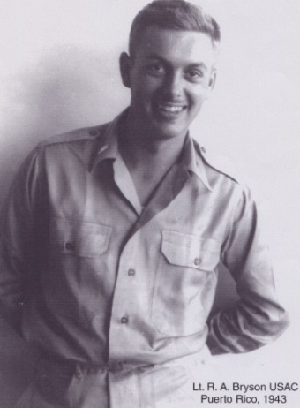
“Discovery” of the Jet Stream
Reid Bryson and Bill Plumley – Weather Officers in the Pacific during World War II (1944)
(Bryson 1994).
CCR
Notes:
Use dissertation here for notes on the full story!

Slide 14
“Discovery” of the Jet Stream
Reid Bryson and Bill Plumley – Weather Officers in the Pacific during World War II (1944)
(Bryson 1994).
Heinrich Seilkopf – “die Strahlströmung”,
Which translates to “jet flow” (1939)
(Reiter 1963, p. 3).
Notes:
Use dissertation here for notes on the full story!

Slide 15
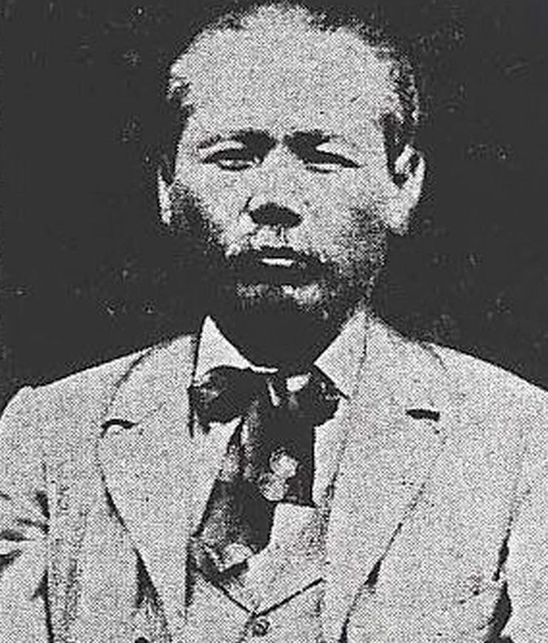
“Discovery” of the Jet Stream
Reid Bryson and Bill Plumley – Weather Officers in the Pacific during World War II (1944)
(Bryson 1994).
Heinrich Seilkopf – “die Strahlströmung”,
Which translates to “jet flow” (1939)
(Reiter 1963, p. 3).
Wasaburo Ooishi – observed and
documented large climatological wind
speeds over Japan (1926).
Cliff Mass
Notes:
Use dissertation here for notes on the full story!

Slide 16
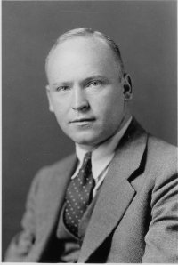
“Discovery” of the Jet Stream
Reid Bryson and Bill Plumley – Weather Officers in the Pacific during World War II (1944)
(Bryson 1994).
Heinrich Seilkopf – “die Strahlströmung”,
Which translates to “jet flow” (1939)
(Reiter 1963, p. 3).
Wasaburo Ooishi – observed and
documented large climatological wind
speeds over Japan (1926).
Carl-Gustaf Rossby – First to refer to the phenomenon as the “jet stream” (1947).
MIT
Notes:
Use dissertation here for notes on the full story!

Slide 17
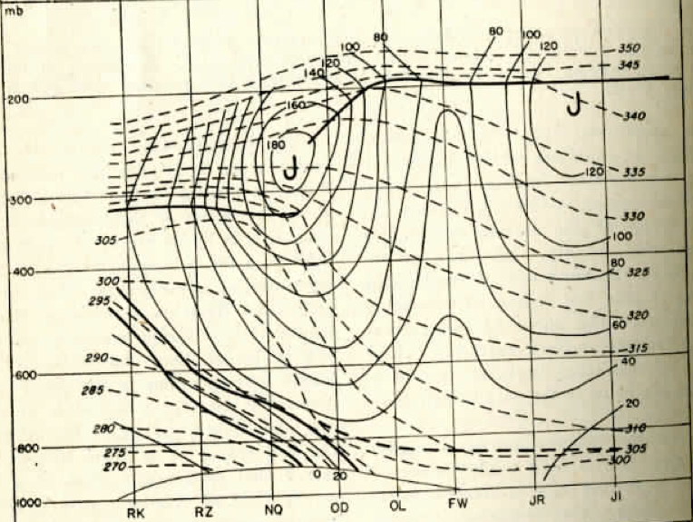
“Discovery” of the Jet Stream
University of Chicago (1947)
One of the first hemispheric examinations of the midlatitude circulation in the literature.
1) A nearly continuous band of strong zonal wind speeds.
2) Sat atop the strongly baroclinic polar front.
3) The jet was nestled squarely in a tropopause break.
Notes:
Use dissertation here for notes on the full story!

Slide 18
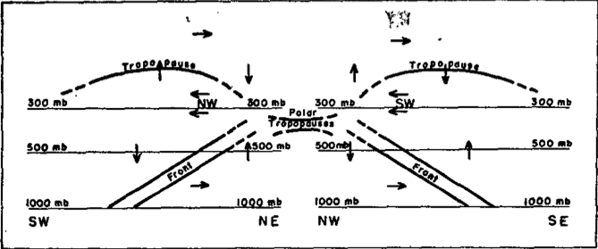
Cross-Stream Vertical Circulations
Cross-stream vertical circulations were proposed as a dynamical mechanism that could support the characteristic distribution of temperature and vorticity in the vicinity of the jet.
Palmén and Nagler (1948)
Notes:
Focus transitioned towards understanding the formation and structure of the jet stream. Horizontal divergence operating alone at the level of maximum wind was not enough to generate the characteristic relative vorticity observed there. Cross-stream vertical circulations provided the dynamical link between UTLS baroclinicity and the jet itself. Parcels accelerated into the trough and decelerated out of it – motivated the PN49 study.

Slide 19
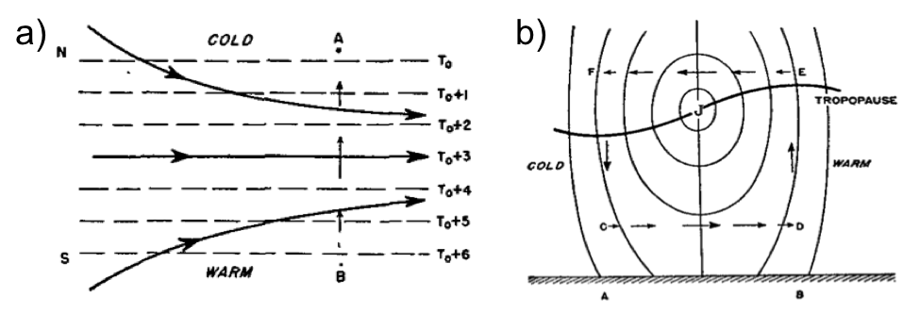
Cross-Stream Vertical Circulations
Cross-stream vertical circulations were proposed as a dynamical mechanism that could support the characteristic distribution of temperature and vorticity in the vicinity of the jet.
Namias and Clapp (1949)
Notes:
Attempted to provide an explanation for a process that would facilitate the development of transverse circulations. Confluence of two separate air streams that strengthened the tropopspheric temperature gradient. This resulted in an increased pressure gradient and the circulation was a dynamical mechanism that responded to this imbalance between the PGF and the flow itself. This circulation also accounted for the characteristic tropopause structure in the vicinity of the jet.

Slide 20
Cross-Stream Vertical Circulations
The Geostrophic Paradox
Notes:
Go to the board and just draw example of how transverse circulations satisfy the tendency for the geostrophic flow to destroy the thermal wind.

Slide 21
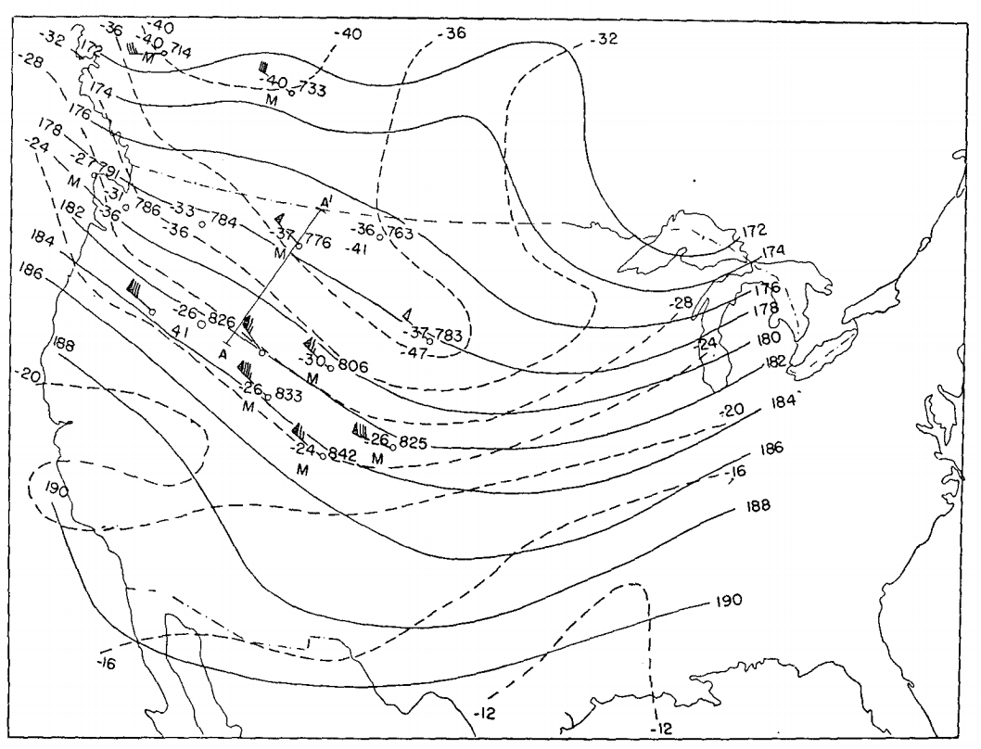
Cross-Stream Vertical Circulations
Reed and Sanders (1953)
1500 UTC 27 January 1953
Notes:
An increase in observational capabilities in the 1950’s, including an expansion of the N. American radiosonde network, provided additional opportunities to acquire observations that had the potential to validate the aforementioned conceptual models.

Slide 22
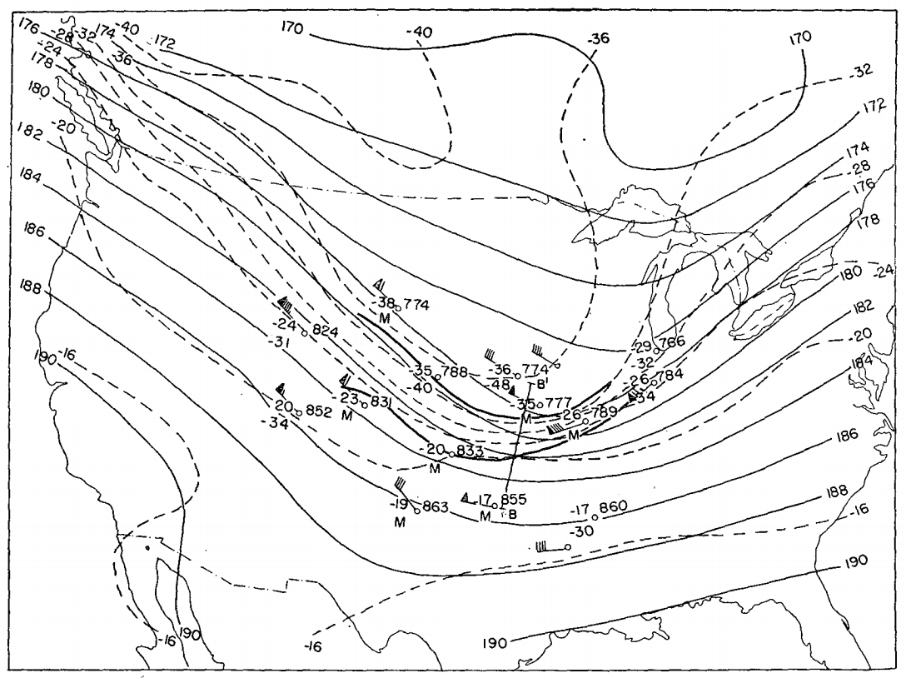
Cross-Stream Vertical Circulations
Reed and Sanders (1953)
0300 UTC 28 January 1953
Notes:
An increase in observational capabilities in the 1950’s, including an expansion of the N. American radiosonde network, provided additional opportunities to acquire observations that had the potential to validate the aforementioned conceptual models.

Slide 23
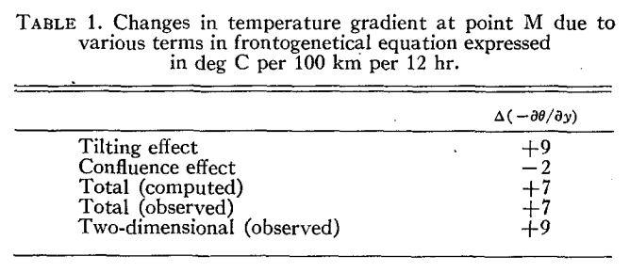
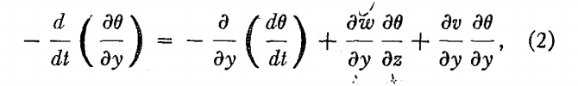
Cross-Stream Vertical Circulations
Reed and Sanders (1953)
Notes:
An increase in observational capabilities in the 1950’s, including an expansion of the N. American radiosonde network, provided additional opportunities to acquire observations that had the potential to validate the aforementioned conceptual models.

Slide 24
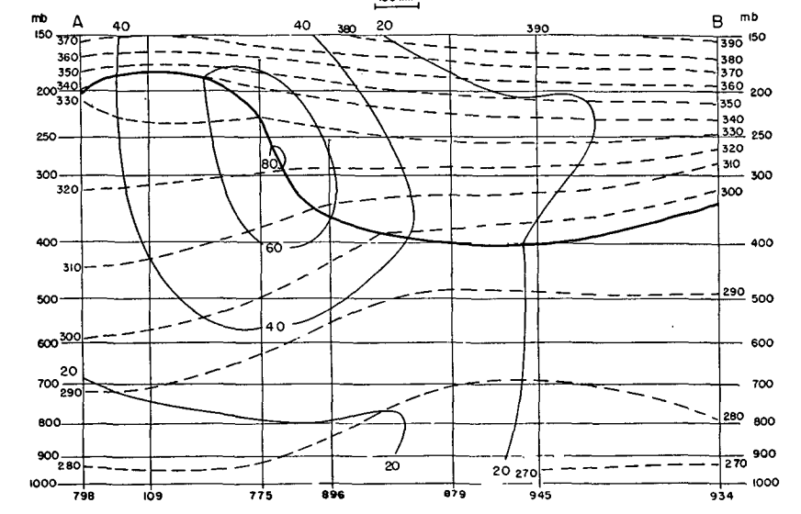
Cross-Stream Vertical Circulations
Reed (1955)
Notes:
An increase in observational capabilities in the 1950’s, including an expansion of the N. American radiosonde network, provided additional opportunities to acquire observations that had the potential to validate the aforementioned conceptual models.

Slide 25
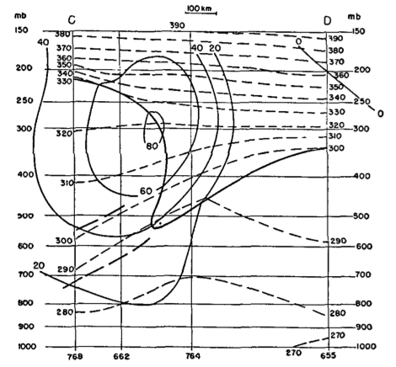
Cross-Stream Vertical Circulations
Reed (1955)
Notes:
An increase in observational capabilities in the 1950’s, including an expansion of the N. American radiosonde network, provided additional opportunities to acquire observations that had the potential to validate the aforementioned conceptual models.

Slide 26
Cross-Stream Vertical Circulations
Only ageostrophic motions can account for the production of convergence and vorticity characteristic of a front.

Slide 27
Cross-Stream Vertical Circulations
Only ageostrophic motions can account for the production of convergence and vorticity characteristic of a front.
The Sawyer (1956)–Eliassen (1962) Circulation Equation retains across-front ageostrophic advections of temperature and momentum and provides a way to diagnose the transverse circulations associated with active fronts.

Slide 28
Cross-Stream Vertical Circulations
Only ageostrophic motions can account for the production of convergence and vorticity characteristic of a front.
The Sawyer (1956)–Eliassen (1962) Circulation Equation retains across-front ageostrophic advections of temperature and momentum and provides a way to diagnose the transverse circulations associated with active fronts.
Notes:
Neglects along flow ageostrophy. Derived from the thermodynamic equations and from the geostrophic momentum approximation. Semi-geostrophic theory. We’ll revisit this more in detail when we discuss this particular paper.

Slide 29
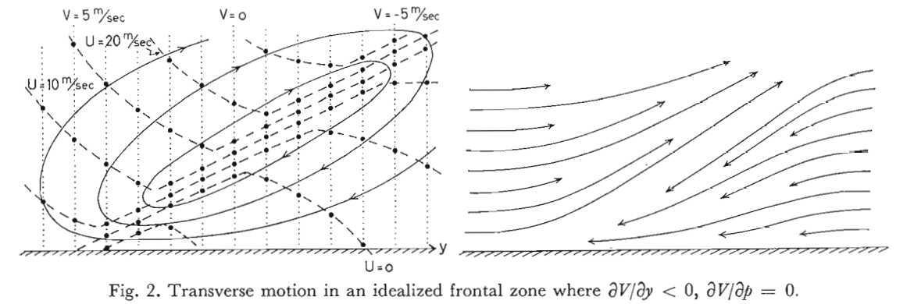
Cross-Stream Vertical Circulations
Eliassen (1962)
Notes:
Neglects along flow ageostrophy. Derived from the thermodynamic equations and from the geostrophic momentum approximation. Semi-geostrophic theory. We’ll revisit this more in detail when we discuss this particular paper.

Slide 30
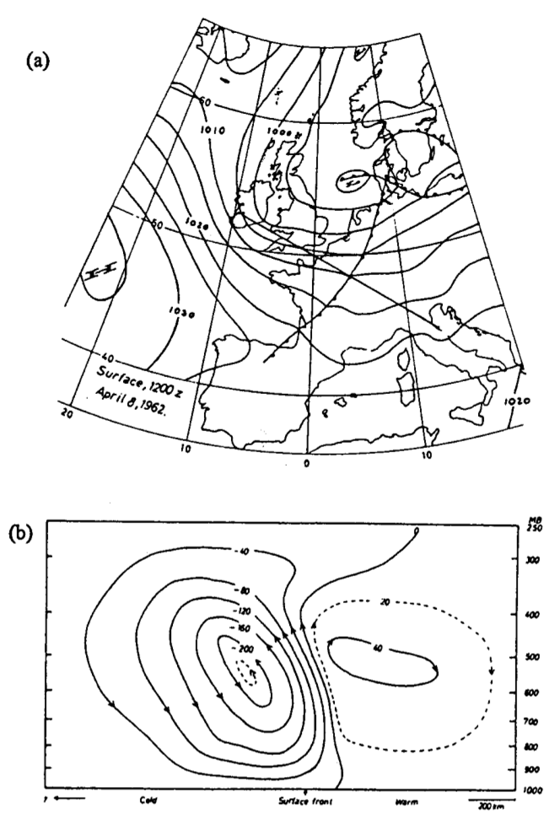
Cross-Stream Vertical Circulations
Solution of the Sawyer–Eliassen Circulation Equation
Todsen 1964
Notes:
Using high-resolution field data Shapiro was able to provide further evidence for subsidence as a mechanism for upper-level frontogenesis.

Slide 31
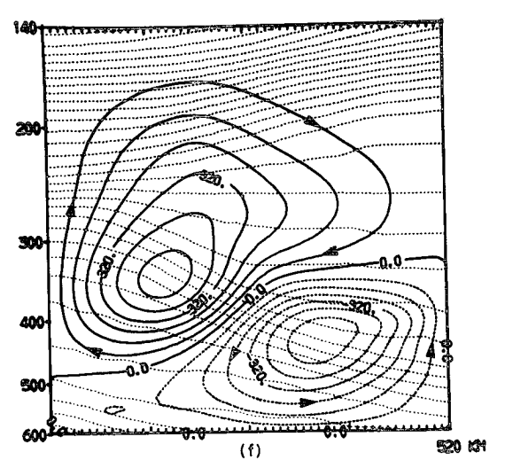
Cross-Stream Vertical Circulations
Solution of the Sawyer–Eliassen Circulation Equation
Shapiro 1981
Todsen 1964
Notes:
Using high-resolution field data Shapiro was able to provide further evidence for subsidence as a mechanism for upper-level frontogenesis.

Slide 32
Cross-Stream Vertical Circulations
Solution of the Sawyer–Eliassen Circulation Equation
Shapiro 1981
Lang and Martin 2012
Notes:
Conceptual models developed in 1982. The shift of the circulations has since been referred to as the “Shapiro Effect”

Slide 33
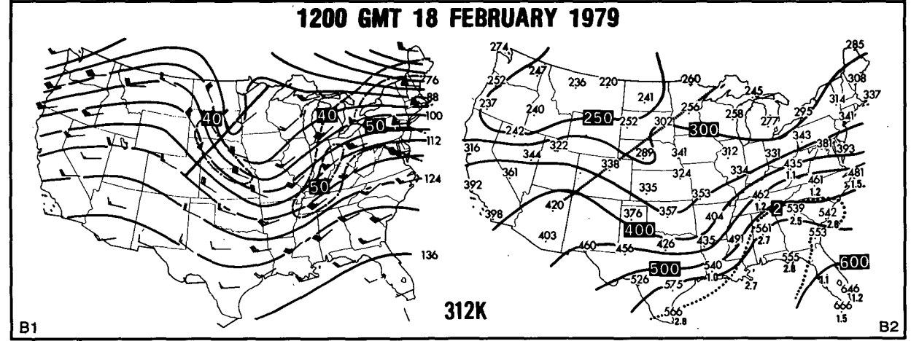
Cross-Stream Vertical Circulations
Impacts of Transverse Circulations on the Production of Sensible Weather
The Presidents’ Day Storm
Uccellini et al. 1985
Notes:
Role of subsidence in the development of the strong positive PV anomaly that aided in the development of the surface cyclone.

Slide 34
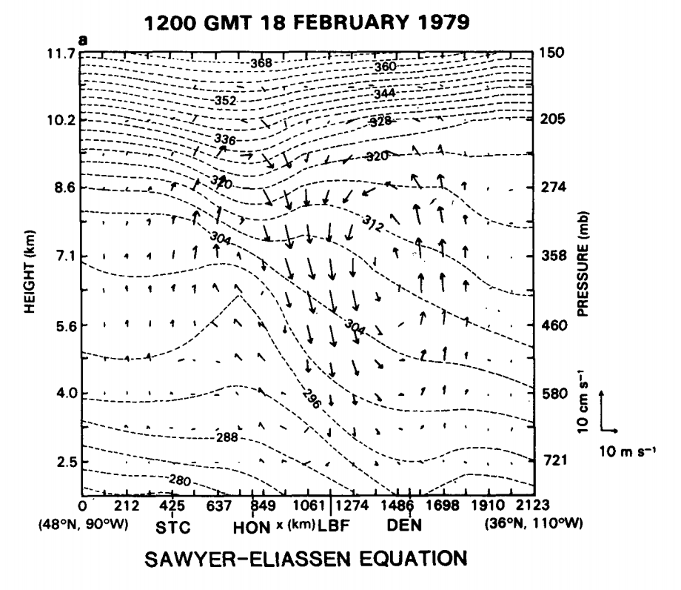
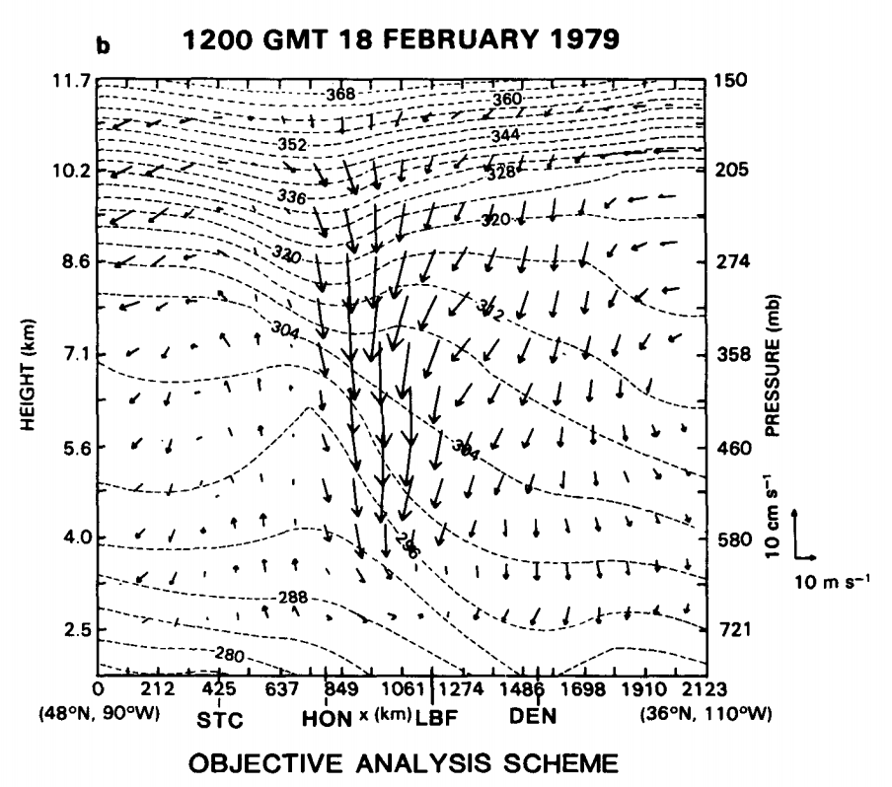
Cross-Stream Vertical Circulations
Impacts of Transverse Circulations on the Production of Sensible Weather
The Presidents’ Day Storm
Uccellini et al. 1985
Notes:
Role of subsidence in the development of the strong positive PV anomaly that aided in the development of the surface cyclone.

Slide 35
Cross-Stream Vertical Circulations
Impacts of Transverse Circulations on the Production of Sensible Weather
– Severe Weather Outbreaks
(e.g., Omoto 1965; Uccellini and Johnson 1979; Hobbs et al. 1990; Martin et al. 1993)
Notes:
Examples of ways that jet circulations can impact the production of sensible weather.

Slide 36
Cross-Stream Vertical Circulations
Impacts of Transverse Circulations on the Production of Sensible Weather
– Severe Weather Outbreaks
(e.g., Omoto 1965; Uccellini and Johnson 1979; Hobbs et al. 1990; Martin et al. 1993)
– Cyclogenesis
(e.g., Uccellini et al. 1984; Uccellini and Kocin 1987; Whitaker et al. 1988; Barnes and Colman 1993; Lackmann et al. 1997)

Slide 37
Cross-Stream Vertical Circulations
Impacts of Transverse Circulations on the Production of Sensible Weather
– Severe Weather Outbreaks
(e.g., Omoto 1965; Uccellini and Johnson 1979; Hobbs et al. 1990; Martin et al. 1993)
– Cyclogenesis
(e.g., Uccellini et al. 1984; Uccellini and Kocin 1987; Whitaker et al. 1988; Barnes and Colman 1993; Lackmann et al. 1997)
– Moisture Transport
(e.g., Uccellini and Johnson 1979; Uccellini et al. 1984; Uccellini and Kocin 1987; Winters and Martin 2014)

Slide 38
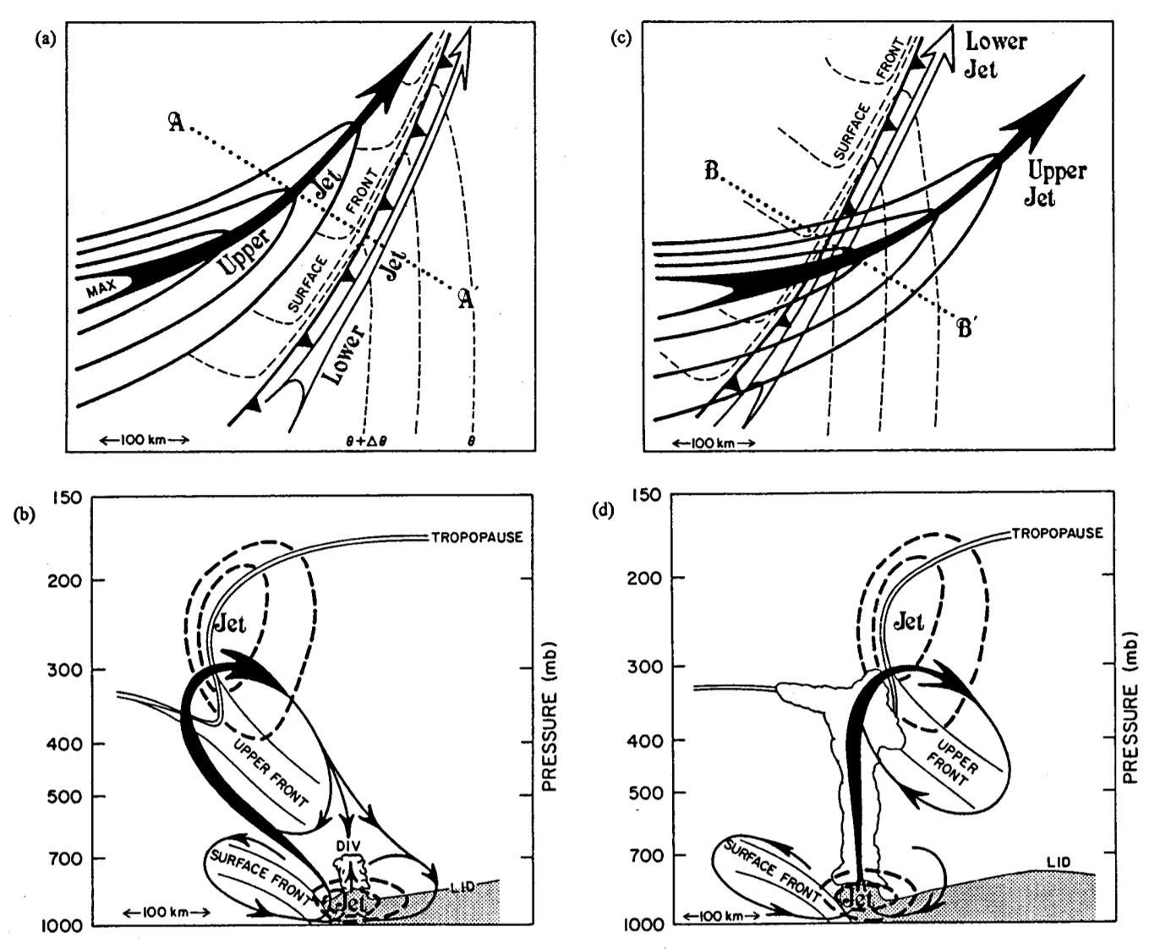
Cross-Stream Vertical Circulations
Shapiro 1982
Notes:
Ways that upper level and lower level transverse circulations can couple favorably. Tie to convective events.

Slide 39
Three-Dimensional Vertical Circulations
Recall that the Sawyer–Eliassen Circulation Equation neglects the along-flow component of the ageostrophic wind.

Slide 40
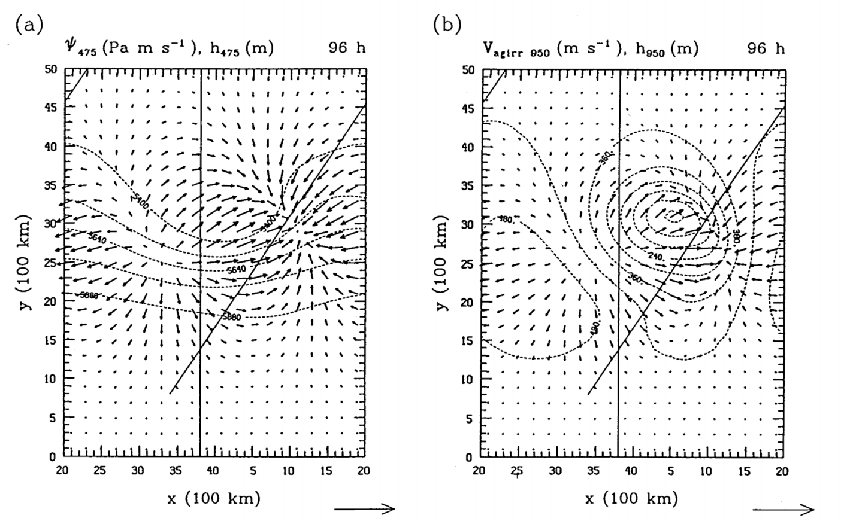
Three-Dimensional Vertical Circulations
Recall that the Sawyer–Eliassen Circulation Equation neglects the along-flow component of the ageostrophic wind.
Keyser et al. 1989
Notes:
Explain the psi vector convergence is a diagnostic of vertical motion. You can see the low –level convergence in the right panel. Keyser et al. used a primitive equation model to simulate cyclogenesis.

Slide 41
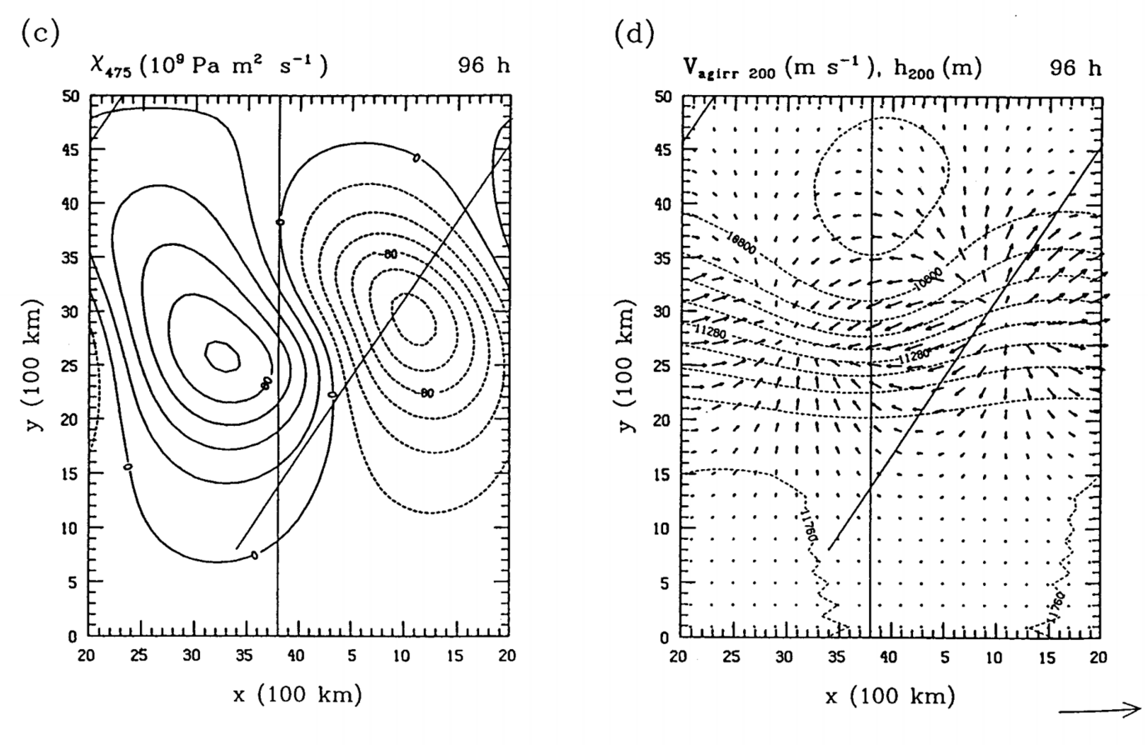
Three-Dimensional Vertical Circulations
Recall that the Sawyer–Eliassen Circulation Equation neglects the along-flow component of the ageostrophic wind.
Keyser et al. 1989
Notes:
Velocity potential and upper level divergence.

Slide 42
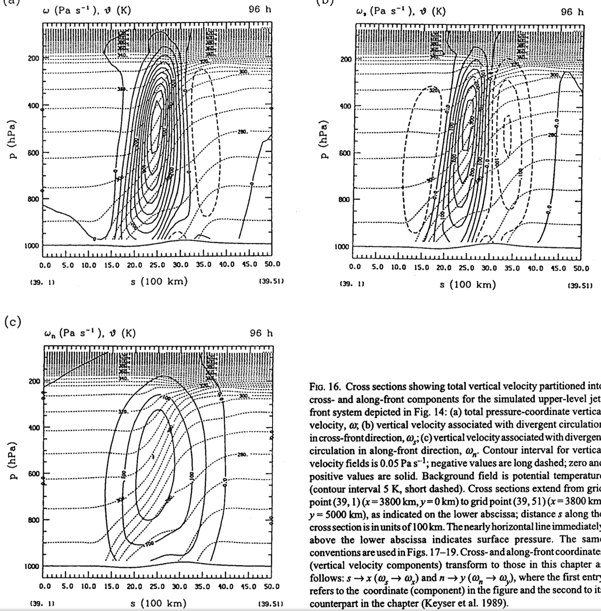
Three-Dimensional Vertical Circulations
Full omega
Transverse omega
A majority of the vertical motion is of the transverse variety.
Though there are important contributions from the along-flow direction, as well.
Shearwise omega
Keyser et al. 1989

Slide 43
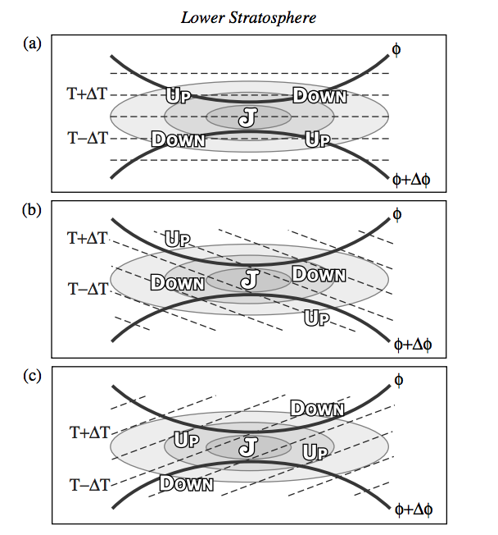
Recent Upper-Level Jet–Front Research
Lower Stratospheric Fronts
Lang and Martin 2012; 2013
Notes:
Climatology of jet events.

Slide 44
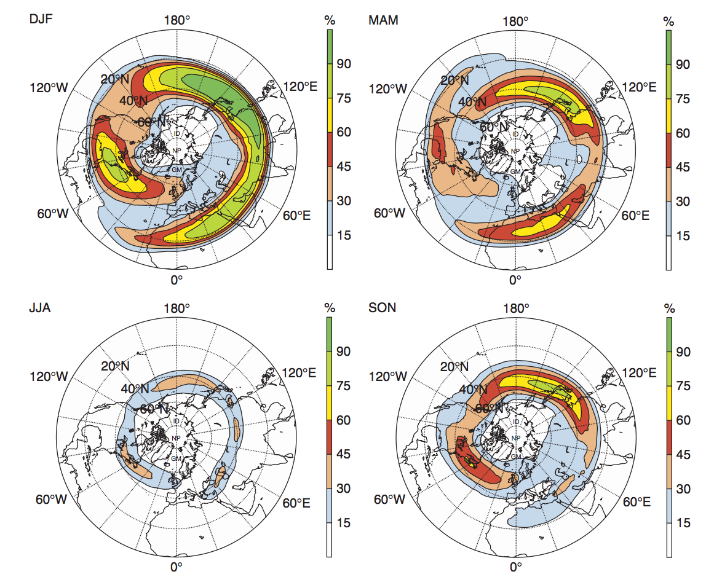
Recent Upper-Level Jet–Front Research
Jet Stream Climatologies
Koch et al. 2006
Notes:
Climatology of jet events.

Slide 45
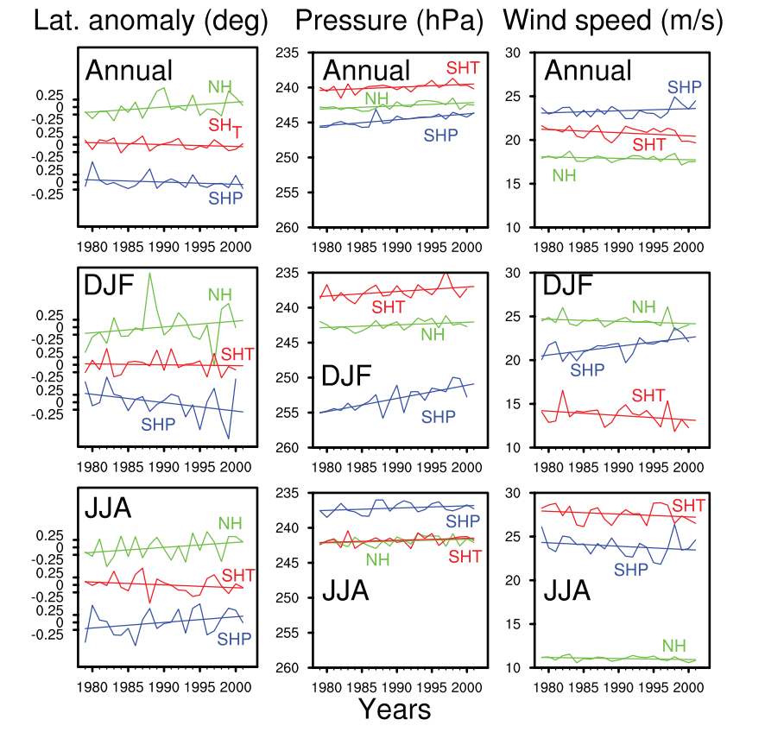
Recent Upper-Level Jet–Front Research
Jet Stream Climatologies
Koch et al. 2006
Archer and Caldeira 2008
Notes:
Trends in jet stream identifications

Slide 46
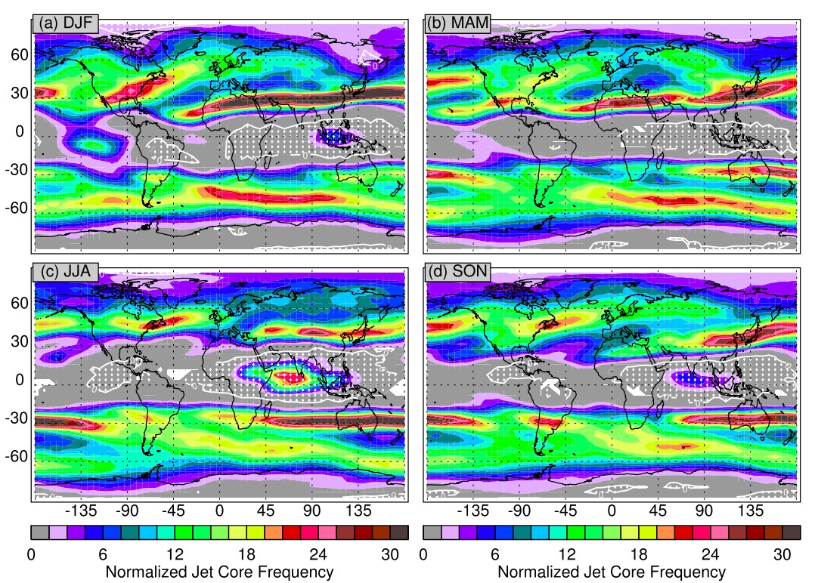
Recent Upper-Level Jet–Front Research
Jet Stream Climatologies
Koch et al. 2006
Archer and Caldeira 2008
Manney et al. 2014

Slide 47
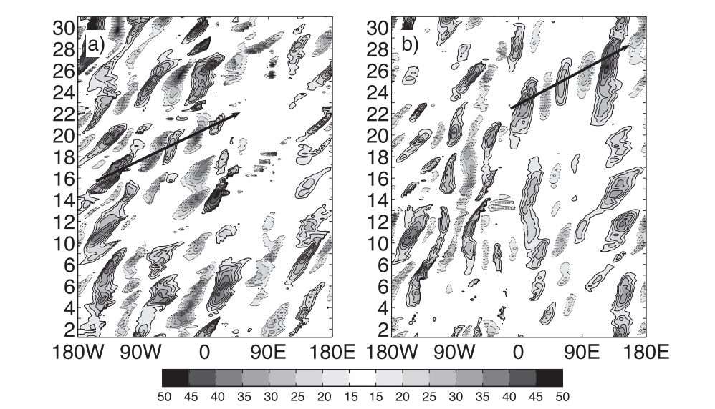
Recent Upper-Level Jet–Front Research
Jet Stream Interactions
Martius et al. 2010
Notes:
Interaction between PJ and STJ

Slide 48
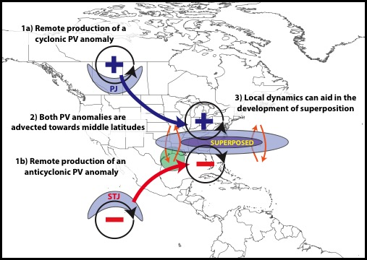
Recent Upper-Level Jet–Front Research
Jet Stream Interactions
Martius et al. 2010
Winters and Martin 2016

Slide 49
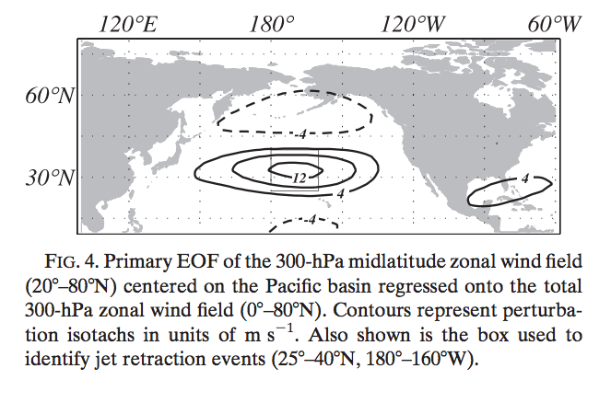
Recent Upper-Level Jet–Front Research
Jet Stream Variability
Jaffe et al. 2011

Slide 50
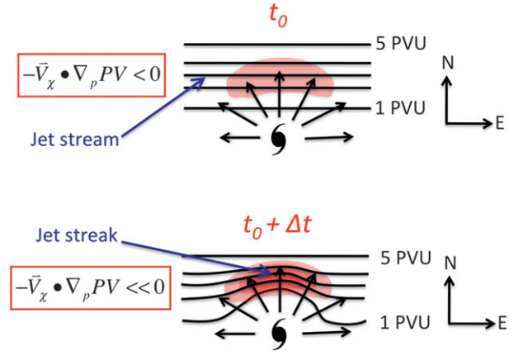
Recent Upper-Level Jet–Front Research
Tropical–Extratropical Interactions
Archambault et al. 2013; 2015

Slide 51
References
Archambault, H. M., L. F. Bosart, D. Keyser, and J. M. Cordeira, 2013: A climatological analysis of the extratropical flow response to recurving western North Pacific tropical cyclones. Mon. Wea. Rev., 141, 2325−2346.
________, D. Keyser, L. F. Bosart, C. A. Davis, and J. M. Cordeira, 2015: A composite perspective of the extratropical flow response to recurving western North Pacific tropical cyclones. Mon. Wea. Rev., 143, 1122–1141.
Archer, C. L., and K. Caldeira, 2008: Historical trends in the jet streams. Geophys. Res. Lett., 35, L08803.
Barnes, S. L., and B. R. Colman, 1993: Quasigeostrophic diagnosis of cyclogenesis associated with a cutoff extratropical cyclone – The Christmas 1987 storm. Mon. Wea. Rev., 121, 1613-1634.
Bjerknes, J. and H. Solberg, 1922: Life cycle of cyclones and the polar front theory of atmospheric circulation. Geofys. Publika., 3 (1), 1-18.
________, and E. Palmén, 1937: Investigations of selected European cyclones by means of serial ascents. Geofys. Publika., 12 (2), 1-62.
Bryson, R., 1994: Discovery of the Jet Stream. Wisconsin Academy Review 40 (3) Madison, Wisconsin: Wisconsin Academy of Science, Arts, and Letters, Summer 1994.
Defant, F., and H. Taba, 1957: The threefold structure of the atmosphere and the characteristics of the tropopause. Tellus, 9, 259-275.

Slide 52
References
Dines, W. H., 1925: The correlation between pressure and temperature in the upper air with a suggested explanation. Quart. J. Roy. Meteor. Soc., 51, 31-38.
Eliassen, A., 1962: On the vertical circulation in frontal zones. Geophys. Publ., 24, 147-160.
Hakim, G. J., and D. Keyser, 2001: Canonical frontal circulation patterns in terms of Green’s functions for the Sawyer–Eliassen equation. Quart. J. Roy. Meteor. Soc., 127, 1795–1814.
Hobbs, P. V., J. D. Locatelli, and J. E. Martin, 1990: Cold fronts aloft and forecasting of precipitation and severe weather east of the Rocky Mountains. Wea. Forecasting, 5, 613-626.
Jaffe, S. C., J. E. Martin, D. J. Vimont, and D. J. Lorenz, 2012: A synoptic climatology of episodic, subseasonal retractions of the Pacific Jet. J. Climate, 24, 2846-2860.
Keyser, D., B. D. Schmidt, and D. G. Duffy, 1989: A technique for representing three-dimensional vertical circulations in baroclinic disturbances. Mon. Wea. Rev., 117, 2463-2494.
Koch, P., H. Wernli, and H. C. Davies, 2006: An event-based jet-stream climatology and typology. Int. J. Climatol., 26, 283-301.
Kutzbach, G., 1979: The Thermal Theory of Cyclones: A History of Meteorological Thought in the Nineteenth Century. Amer. Meteor. Soc., 255 pp.
Lackmann, G. M., D. Keyser, L. F. Bosart, 1997: A characteristic life cycle of upper-tropospheric cyclogenetic precursors during Experiment on Rapidly Intensifying Cyclones of the Atlantic (ERICA). Mon. Wea. Rev., 125, 2729-2758.

Slide 53
References
Lang, A. A., and J. E. Martin, 2012: The structure and evolution of lower stratospheric frontal zones. Part I: Examples in northwesterly and southwesterly flow. Quart. J. Roy. Meteor. Soc., 138, 1350-1365.
________, and ________, 2013: The structure and evolution of lower stratospheric frontal zones. Part II: The influence of tropospheric convection on lower stratospheric frontal development. Quart. J. Roy. Meteor. Soc., 139, 1798-1809.
Manney, G. L., M. I. Hegglin, W. H. Daffer, M. J. Schwartz, M. L. Santee, and S. Pawson, 2014: Climatology of upper tropospheric/lower stratospheric (UTLS) jets and tropopauses in MERRA. J. Climate, 27, 3248-3271.
Margules, M., 1903: Über die energie der stürme. Jahrb. Zentralanst. Meteorol. Wien., 1-26.
Martin, J. E., J. D. Locatelli, and P. V. Hobbs, 1993: Organization and structure of clouds and precipitation on the mid-Atlantic coast of the United States. Part VI: The synoptic evolution of a deep tropospheric frontal circulation and attendant cyclogenesis. Mon. Wea. Rev., 121, 1299-1316.
Martius, O., C. Schwiertz, and H. C. Davies, 2010: Tropopause-level waveguides. J. Atmos. Sci., 67, 866-879.
Namias, J., and P. F. Clapp, 1949: Confluence theory of the high tropospheric jet stream. J. Meteor., 6, 330-336.

Slide 54
References
Omoto, Y., 1965: On pre-frontal precipitation zones in the United States. J. Meteor. Soc. Japan, 43, 310-330.
Ooishi, W., 1926: Raporto de la Aerologia Observatorio de Tateno (in Esperanto). Aerological Observatory Rep. 1, Central Meteorological Observatory, Japan, 213 pp.
Palmén, E., and K. M. Nagler, 1948: Formation and structure of a large-scale disturbance in the westerlies. J. Meteor., 6 (4), 227-242.
Reed, R. J., 1955: A study of a characteristic type of upper-level frontogenesis. J. Meteor., 12, 226-237.
________, and F. Sanders, 1953: An investigation of the development of a mid-tropospheric frontal zone and its associated vorticity field. J. Meteor., 10, 338-349.
Reiter, E., 1963: Jet Stream Meteorology. University of Chicago Press, 515 pp.
Sawyer, J. S., 1956: The vertical circulation at meteorological fronts and its relation to frontogenesis. Proc. Roy. Soc. London, 234A, 346-362.
Shapiro, M. A., 1981: Frontogenesis and geostrophically forced secondary circulations in the vicinity of the jet stream-frontal zone systems. J. Atmos. Sci., 38, 954-973.
________, 1982: Mesoscale weather systems of the central United States. CIRES, 78 pp.
Todsen, M., 1964: A computation of the vertical circulation in a frontal zone from the quasi-geostrophic equations. Air Force Cambridge Laboratories Tech. Note 4, OAR Contribution AF 61(052)-525, 23 pp.

Slide 55
References
Uccellini, L. W., and D. R. Johnson, 1979: The coupling of upper and lower tropospheric jet streaks and implications for the development of severe convective storms. Mon. Wea. Rev., 107, 682-703.
________, and P. J. Kocin, 1987: The interaction of jet streak circulations during heavy snow events along the East Coast of the United States. Wea. Forecasting, 2, 289-308.
________, ________, R. A. Petersen, C. H. Wash, and K. F. Brill, 1984: The Presidents’ Day cyclone of 18-19 February 1979; Synoptic overview and analysis of the subtropical jet streak influencing the pre-cyclogenetic period. Mon. Wea. Rev., 112, 31-55.
________, D. Keyser, K. F. Brill, and C. H. Wash, 1985: The Presidents’ Day cyclone of 18-19 February 1979: Influence of upstream trough amplification and associated tropopause folding on rapid cyclogenesis. Mon. Wea. Rev., 113, 962-988.
University of Chicago, Department of Meteorology, 1947: On the general circulation of the atmosphere in middle latitudes. Bull. Amer. Meteor. Soc., 28, 255-280.
Whitaker, J. S., L. W. Uccellini, and K. F. Brill, 1988: A model-based diagnostic study of the rapid development phase of the Presidents’ Day cyclone. Mon. Wea. Rev., 116, 2337-2365.
Winters, A. C., and J. E. Martin, 2014: The role of a polar/subtropical jet superposition in the May 2010 Nashville Flood. Wea. Forecasting, 29, 954-974.
_________, and _________, 2016: Synoptic and mesoscale processes supporting vertical superposition of the polar and subtropical jets in two contrasting cases. Quart. J. Roy. Meteor. Soc., 142, (in press).

