Slide 1
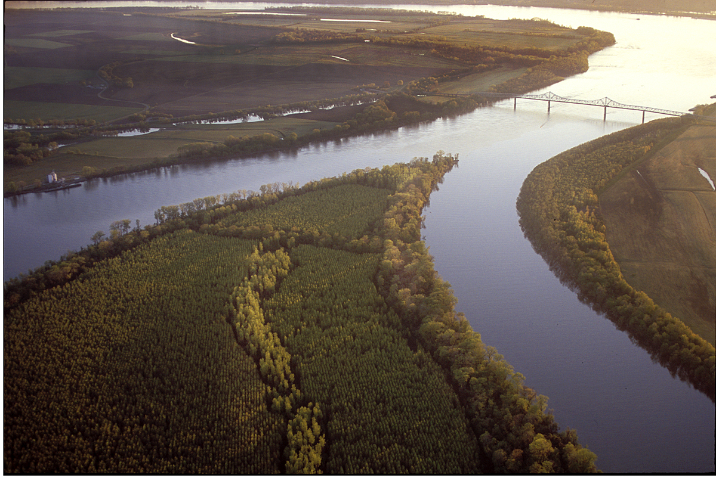
Antecedent Remote and Local Synoptic Environments Most Conducive to North American Polar/Subtropical Jet Superpositions
Andrew C. Winters
ATM 621
14 February 2017

Slide 2
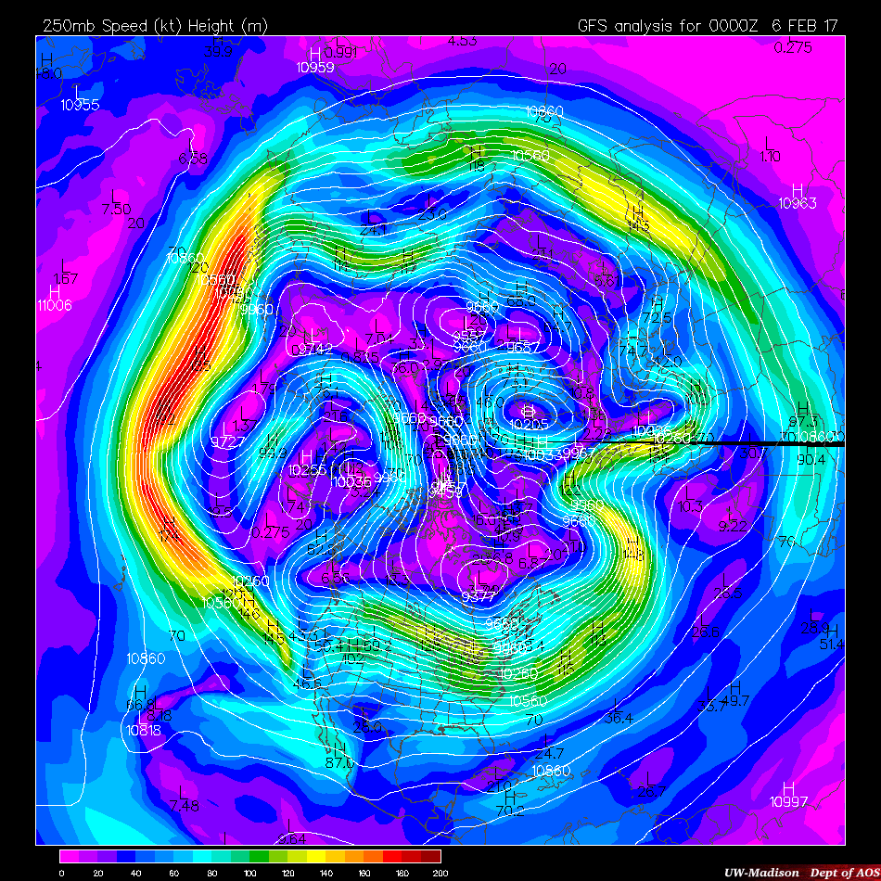
250-hPa Wind Speed
0000 UTC
6 Feb 2017
NP
Albany, NY
NP North Pole
UW-Madison AOS
Notes:
Jet streaks can extend on the order of 1000s of km, while their width is only on the order of 100s of km. Considerable lateral shear. Jets circumnavigate the globe and exhibit substantial meridional meanders.

Slide 3
250-hPa Wind Speed
0000 UTC
6 Feb 2017
NP
Jet Streaks
Albany, NY
NP North Pole
UW-Madison AOS
Notes:
Jet streaks can extend on the order of 1000s of km, while their width is only on the order of 100s of km. Considerable lateral shear. Jets circumnavigate the globe and exhibit substantial meridional meanders.

Slide 4
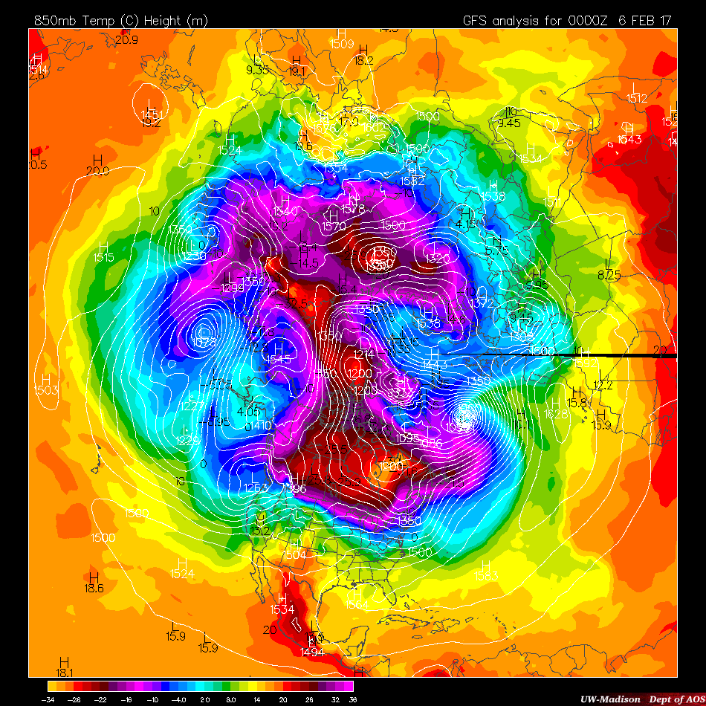
850-hPa Temperature
0000 UTC
6 Feb 2017
NP
Jet Streaks
Albany, NY
NP North Pole
UW-Madison AOS
Notes:
Jet streaks can extend on the order of 1000s of km, while their width is only on the order of 100s of km. Considerable lateral shear. Jets circumnavigate the globe and exhibit substantial meridional meanders.

Slide 5
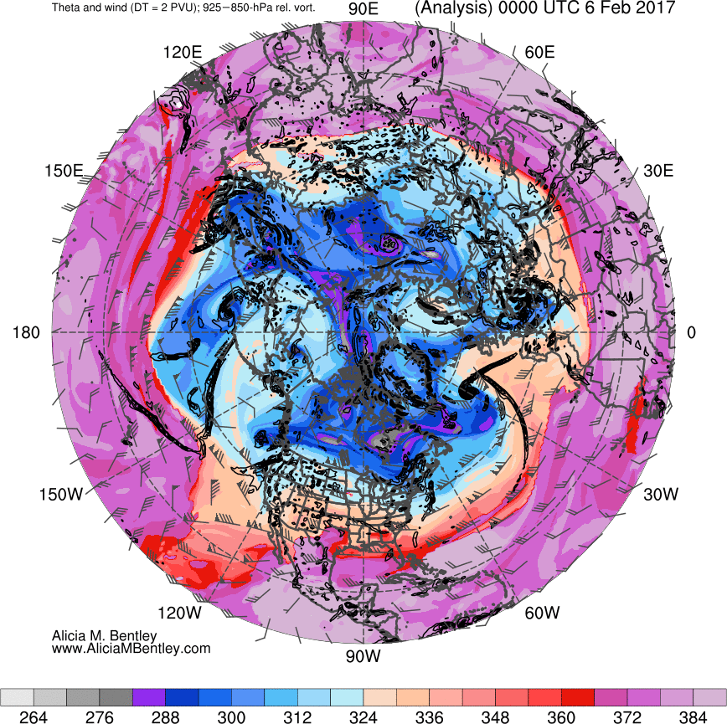
Potential Temperature on the DT
0000 UTC
6 Feb 2017
NP
Jet Streaks
Albany, NY
NP North Pole
Notes:
Jet streaks can extend on the order of 1000s of km, while their width is only on the order of 100s of km. Considerable lateral shear. Jets circumnavigate the globe and exhibit substantial meridional meanders.

Slide 6
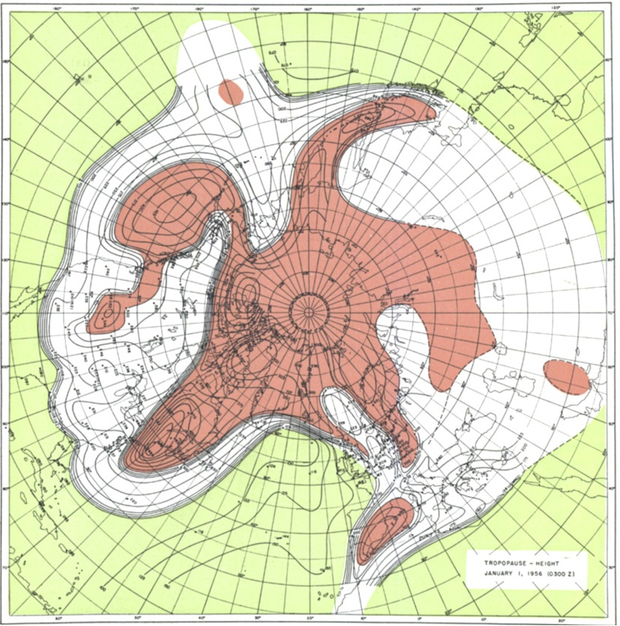
Defant and Taba (1957)
Tropical Tropopause
Subtropical Tropopause
Polar Tropopause
Maps of tropopause pressure help to identify the location of jets.
STJ
POLJ
Modified from Defant and Taba (1957)

Slide 7
Defant and Taba (1957)
Tropical Tropopause
Subtropical Tropopause
Polar Tropopause
Maps of tropopause pressure help to identify the location of jets.
While each jet occupies its own climatological latitude band – substantial meanders are common.
STJ
POLJ
Modified from Defant and Taba (1957)

Slide 8
Defant and Taba (1957)
Tropical Tropopause
Subtropical Tropopause
Polar Tropopause
Maps of tropopause pressure help to identify the location of jets.
While each jet occupies its own climatological latitude band – substantial meanders are common.
STJ
POLJ
Modified from Defant and Taba (1957)

Slide 9
Defant and Taba (1957)
Modified from Defant and Taba (1957)

Slide 10
Defant and Taba (1957)
Tropical Tropopause
Subtropical Tropopause
Polar Tropopause
Maps of tropopause pressure help to identify the location of jets.
While each jet occupies its own climatological latitude band – substantial meanders are common.
STJ
POLJ
Modified from Defant and Taba (1957)

Slide 11
Defant and Taba (1957)
Tropical Tropopause
Subtropical Tropopause
Polar Tropopause
Maps of tropopause pressure help to identify the location of jets.
While each jet occupies its own climatological latitude band – substantial meanders are common.
Occasionally, latitudinal separation between the jets can vanish → vertical superposition.
STJ
POLJ
Modified from Defant and Taba (1957)
Notes:
Only flash to the tropopause temperature once to show the intensified frontal structure.

Slide 12
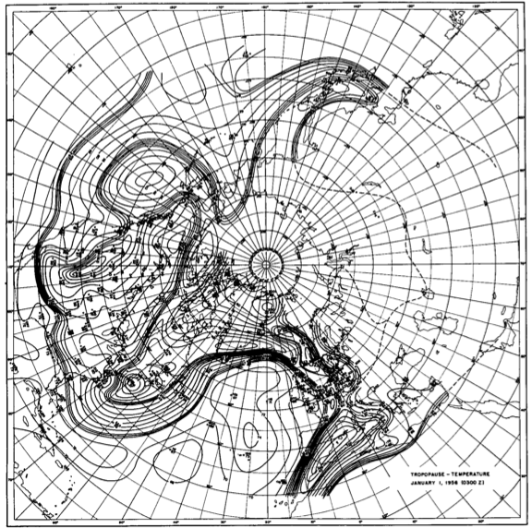
Defant and Taba (1957)
POLJ
STJ
In the vicinity of a superposition, the pole-to-equator baroclinicity is combined into a much narrower zone of contrast.
Modified from Defant and Taba (1957)

Slide 13
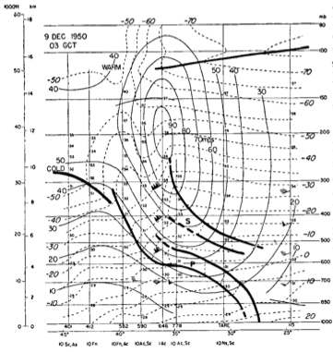
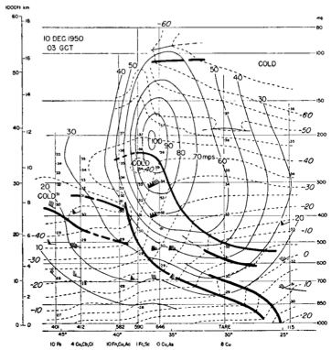
Mohri (1953)
0300 UTC 9 Dec. 1950
0300 UTC 10 Dec. 1950
J
J
Modified from Mohri 1953
Mohri (1953) clearly illustrated this consolidation of baroclinicity.

Slide 14
Mohri (1953)
0300 UTC 9 Dec. 1950
0300 UTC 10 Dec. 1950
J
J
Modified from Mohri 1953
Mohri (1953) clearly illustrated this consolidation of baroclinicity.
Intensified frontal structure is often attended by a strengthening of the jet’s transverse circulation.

Slide 15
Characteristics of a Superposition
The development of a two-step tropopause structure.
The consolidation of upper-tropospheric and lower-stratospheric baroclinicity into a single zone of contrast.
The development of anomalously strong upper-tropospheric wind speeds.

Slide 16
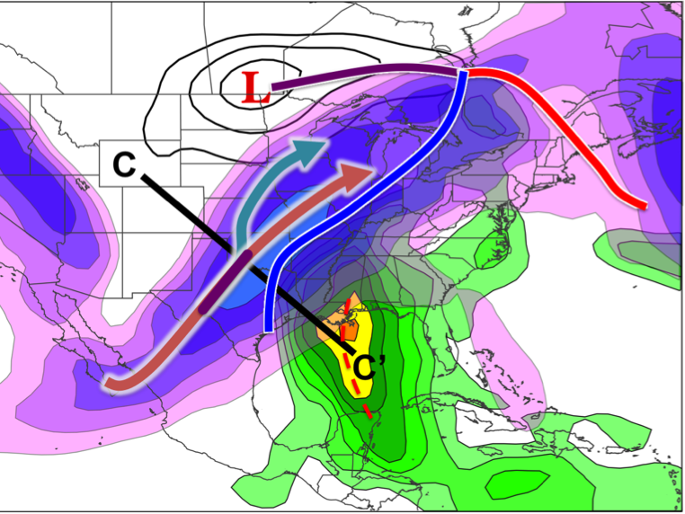
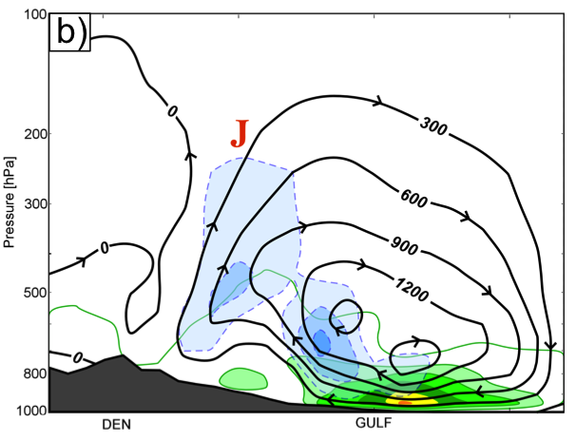
Superpositions and High-Impact Weather
Superposed jets can be an element of high-impact weather events
1–3 May 2010 Nashville Flood
- Superposed jet’s ageostrophic circulation helped to enhance poleward moisture transport (Winters and Martin 2014; 2016)
C
C’
Notes:
Go through these more quickly. Don’t need to include as many details.

Slide 17
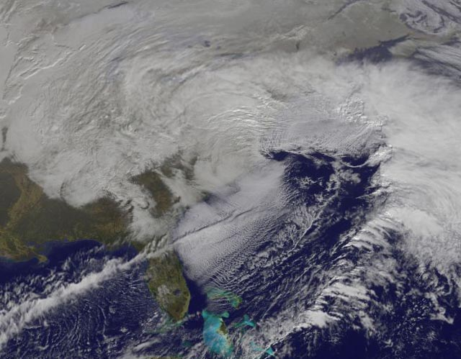
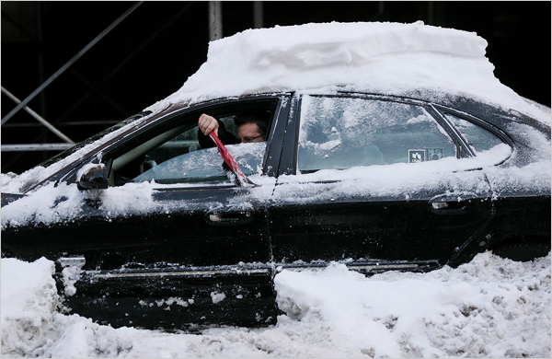
Superpositions and High-Impact Weather
Superposed jets can be an element of high-impact weather events
1–3 May 2010 Nashville Flood
- Superposed jet’s ageostrophic circulation helped to enhance poleward moisture transport (Winters and Martin 2014; 2016)
18–20 December 2009 Mid-Atlantic Blizzard
- Superposed jet was associated with a rapidly deepening cyclone (Winters and Martin 2016; 2017)

Slide 18
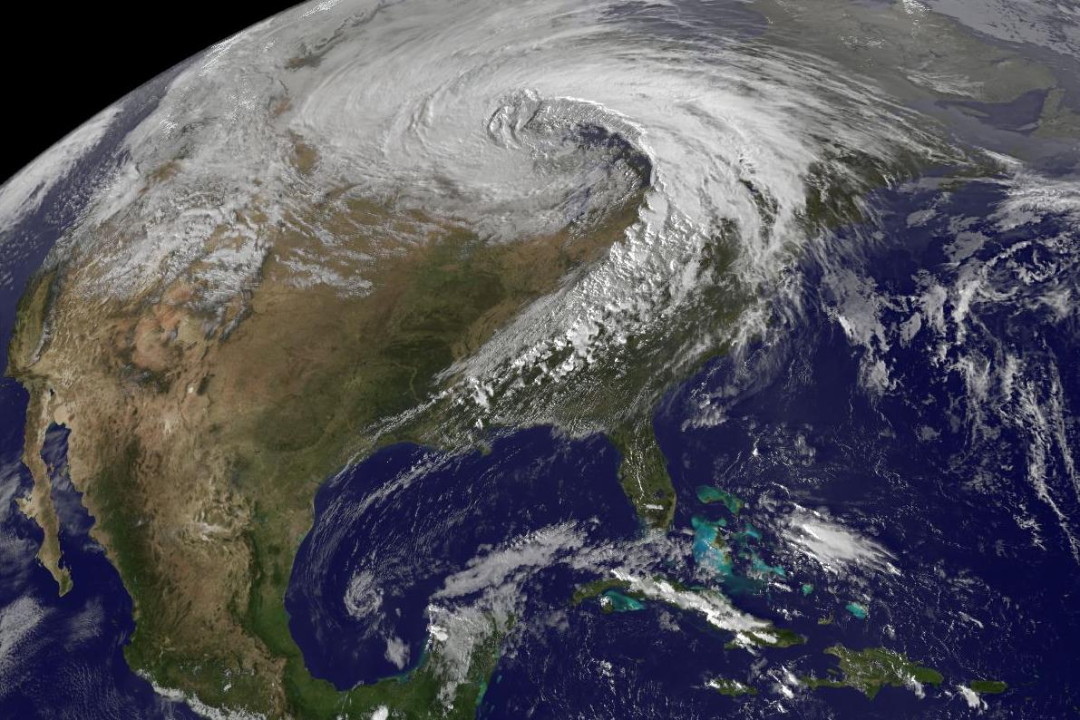
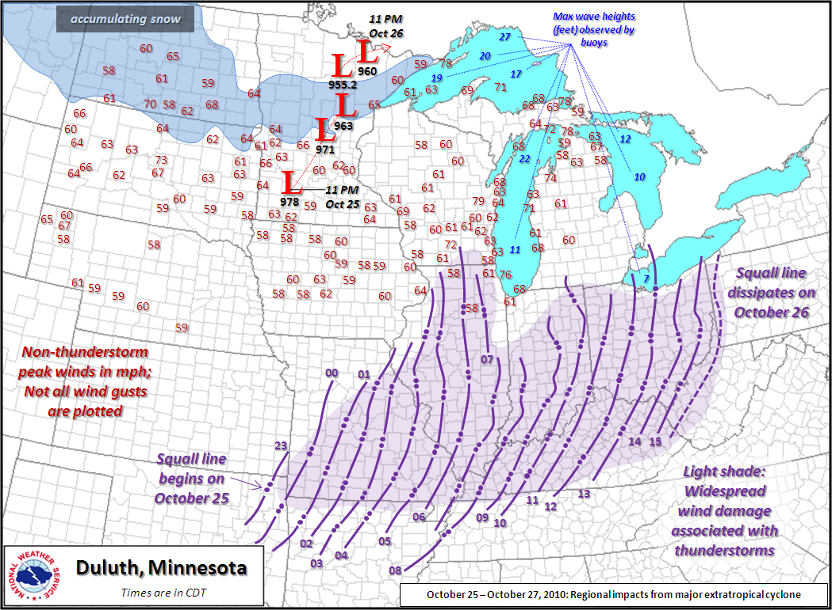
Superpositions and High-Impact Weather
Superposed jets can be an element of high-impact weather events
1–3 May 2010 Nashville Flood
- Superposed jet’s ageostrophic circulation helped to enhance poleward moisture transport (Winters and Martin 2014; 2016)
18–20 December 2009 Mid-Atlantic Blizzard
- Superposed jet was associated with a rapidly deepening cyclone (Winters and Martin 2016; 2017)
26 October 2010: Explosive Cyclogenesis Event
- Cyclone was associated with the development of superposed jet over the West Pacific.

Slide 19
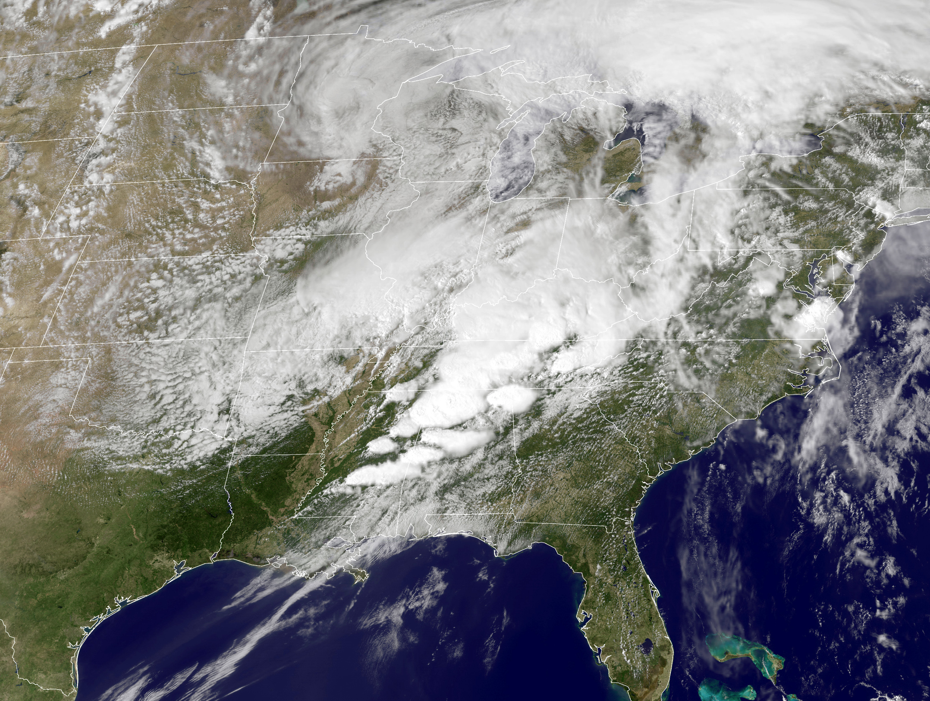
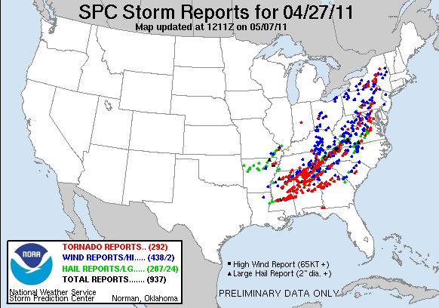
Superpositions and High-Impact Weather
Superposed jets can be an element of high-impact weather events
1–3 May 2010 Nashville Flood
- Superposed jet’s ageostrophic circulation helped to enhance poleward moisture transport (Winters and Martin 2014; 2016)
18–20 December 2009 Mid-Atlantic Blizzard
- Superposed jet was associated with a rapidly deepening cyclone (Winters and Martin 2016; 2017)
26 October 2010: Explosive Cyclogenesis Event
- Cyclone was associated with the development of superposed jet over the West Pacific
25–28 April 2011 Tornado Outbreak
- Superposed jet developed over the West Pacific prior to the outbreak (Knupp et al. 2014; Christenson and Martin 2012)

Slide 20
Superpositions and High-Impact Weather
Superposed jets can be an element of high-impact weather events
1–3 May 2010 Nashville Flood
- Superposed jet’s ageostrophic circulation helped to enhance poleward moisture transport (Winters and Martin 2014; 2016)
18–20 December 2009 Mid-Atlantic Blizzard
- Superposed jet was associated with a rapidly deepening cyclone (Winters and Martin 2016; 2017)
26 October 2010: Explosive Cyclogenesis Event
- Cyclone was associated with the development of superposed jet over the West Pacific
25–28 April 2011 Tornado Outbreak
- Superposed jet developed over the West Pacific prior to the outbreak (Knupp et al. 2014; Christenson and Martin 2012)
How do these structures develop??

Slide 21
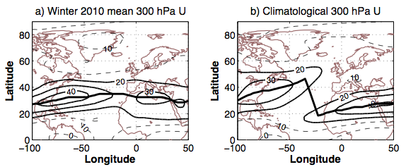
Jet “Mergers”
Much of the relevant literature that addresses the topic of jet “mergers”…
Considers interannual or climate time scales (e.g. Eichelberger and Hartmann 2007; Harnik et al. 2014)
Harnik et al. 2014
Notes:
Jets become vertically indistinguishable.. Harnik looks at being horizontally indistinguishable. Don’t need Martius…take this out.

Slide 22
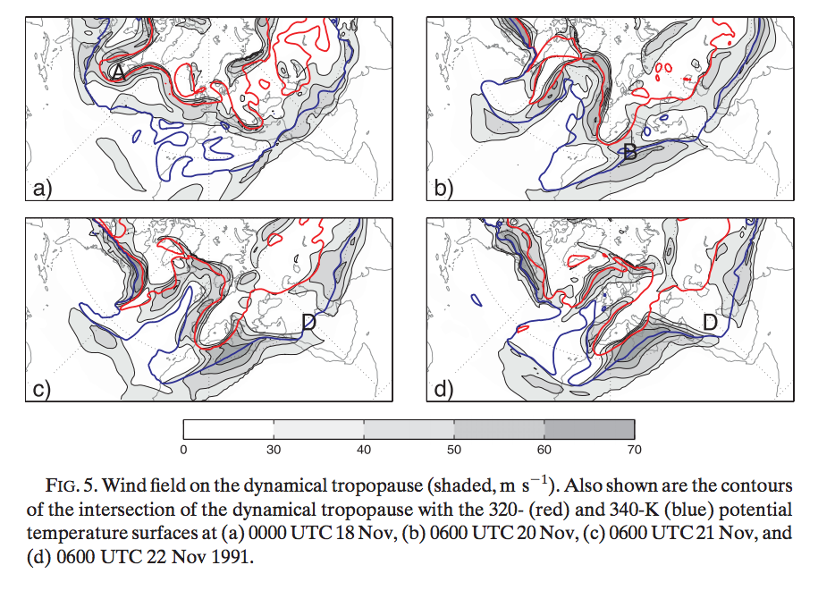
Jet “Mergers”
Martius et al. 2010
Much of the relevant literature that addresses the topic of jet “mergers”…
Considers interannual or climate time scales (e.g. Eichelberger and Hartmann 2007; Harnik et al. 2014)
Is strongly based on wave-wave interaction (e.g. O’Rourke and Vallis 2013; Martius et al. 2010)
Notes:
Jets become vertically indistinguishable.. Harnik looks at being horizontally indistinguishable. Don’t need Martius…take this out.

Slide 23
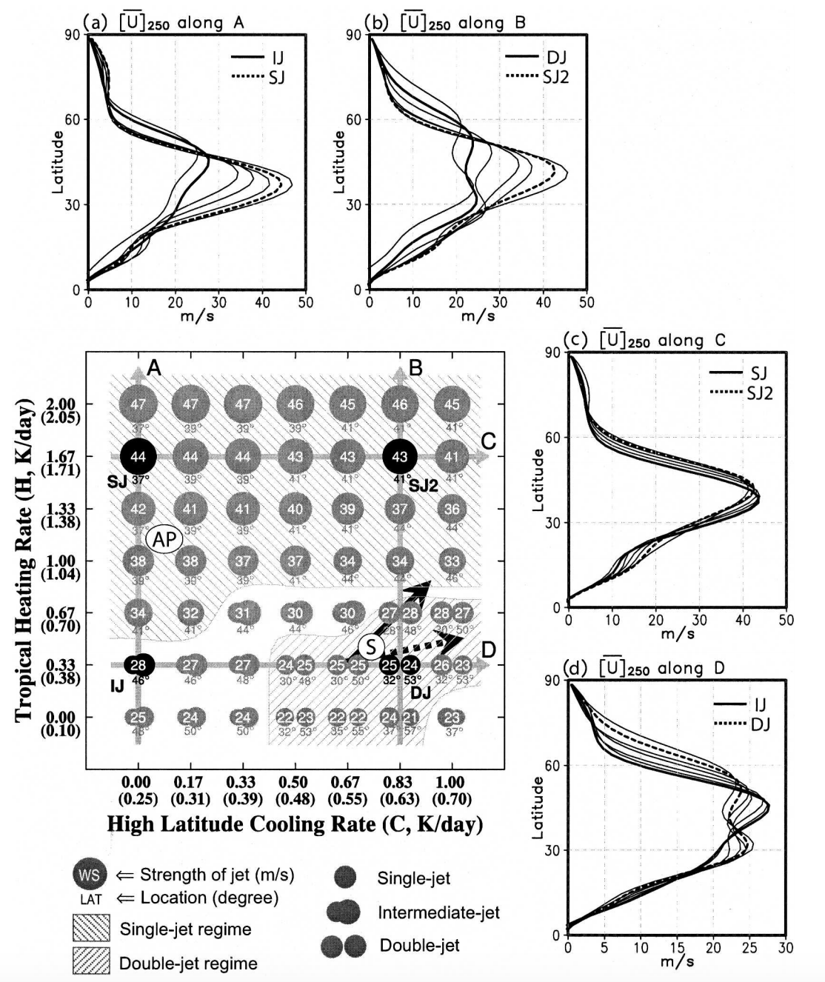
Jet “Mergers”
Son and Lee 2005
Much of the relevant literature that addresses the topic of jet “mergers”…
Considers interannual or climate time scales (e.g. Eichelberger and Hartmann 2007; Harnik et al. 2014)
Is strongly based on wave-wave interaction (e.g. O’Rourke and Vallis 2013; Martius et al. 2010)
And/or is performed within an idealized model environment (e.g. Lee and Kim 2003; Son and Lee 2005)
Notes:
Jets become vertically indistinguishable.. Harnik looks at being horizontally indistinguishable. Don’t need Martius…take this out.

Slide 24
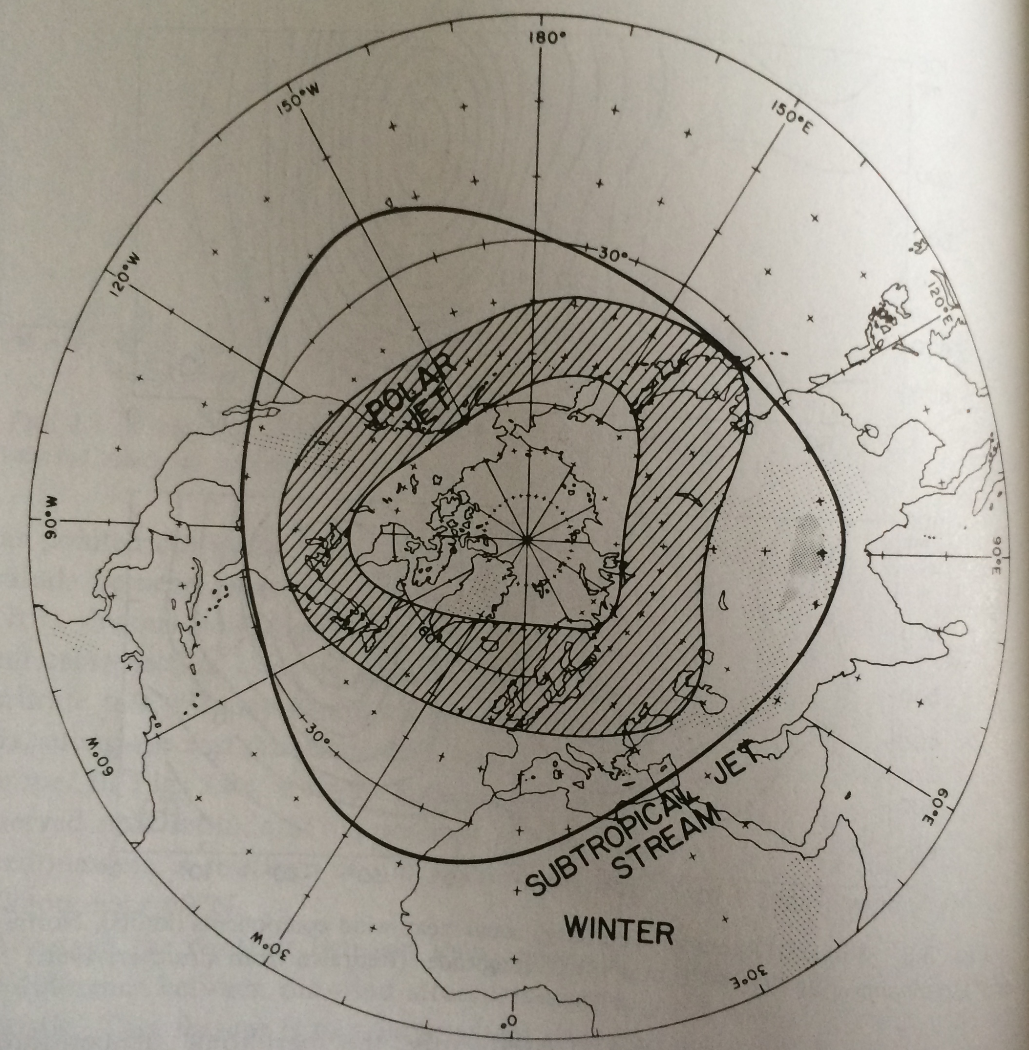
A Superposition Conceptual Model
Riehl 1962
Krishnamurti (1961) demonstrated that there are three areas where the polar and subtropical jets are typically found in close proximity.
Western Pacific
North America
Northern Africa

Slide 25
A Superposition Conceptual Model
Riehl 1962
Krishnamurti (1961) demonstrated that there are three areas where the polar and subtropical jets are typically found in close proximity.
Western Pacific
North America
Northern Africa

Slide 26
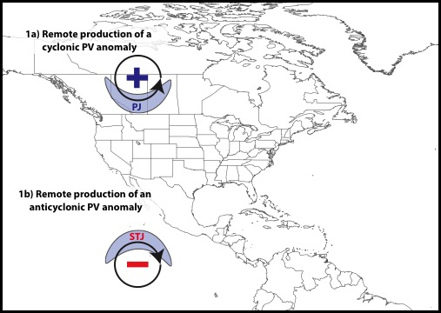
A Superposition Conceptual Model
Winters and Martin 2017

Slide 27
A Superposition Conceptual Model
Winters and Martin 2017

Slide 28
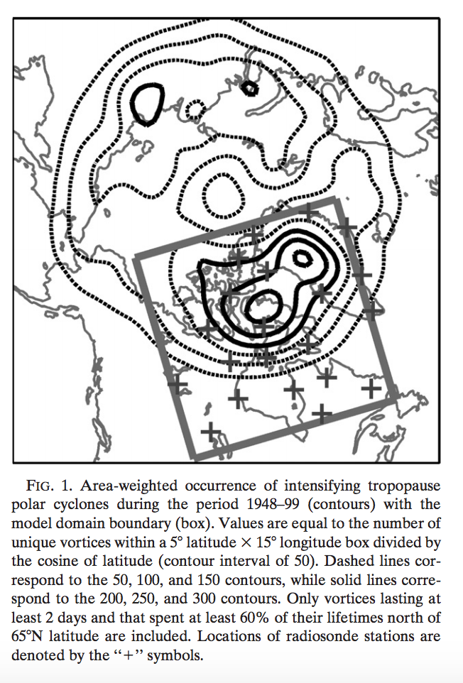
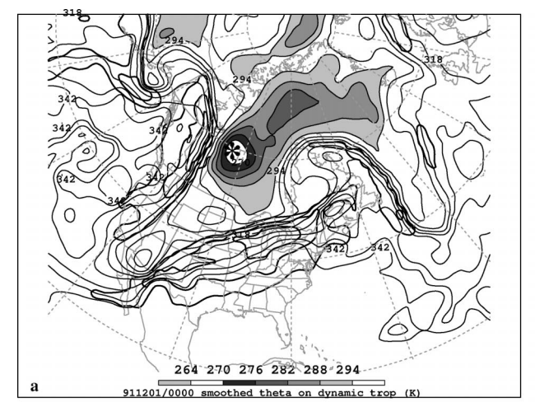
Polar Cyclonic PV Anomalies
Cavallo and Hakim 2010:
Tropopause Polar
Vortices
Pyle et al. 2004:
Coherent Tropopause
Disturbances

Slide 29
A Superposition Conceptual Model
Winters and Martin 2017

Slide 30
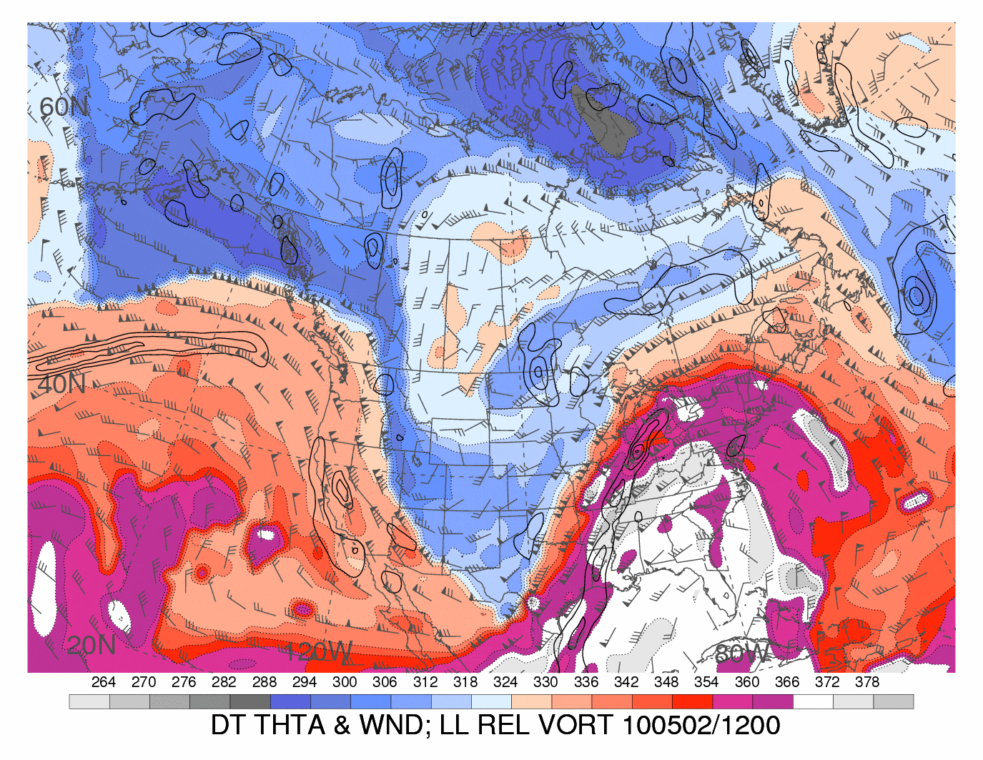
Tropical Anticyclonic PV Anomalies
Heather Archambault

Slide 31
Tropical Anticyclonic PV Anomalies
Heather Archambault

Slide 32
Tropical Anticyclonic PV Anomalies
Heather Archambault
Several studies document the mechanisms through which low PV air can be transported poleward:
Liebmann and Hartmann 1984
Iskenderian 1995
Roundy et al. 2010
Fröhlich et al. 2013
Archambault et al. 2013; 2015

Slide 33
Tropical Anticyclonic PV Anomalies
Heather Archambault
Tropical anticyclonic PV anomalies typify a thermodynamic environment characterized by:
Weak upper-tropospheric static stability
Atmospheric rivers within the poleward-directed branch of their circulation, on occasion

Slide 34
A Superposition Conceptual Model
Winters and Martin 2017

Slide 35
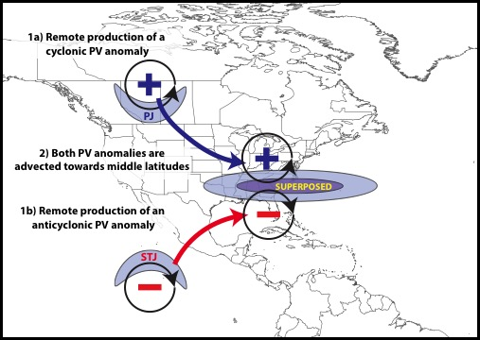
A Superposition Conceptual Model
Winters and Martin 2017

Slide 36
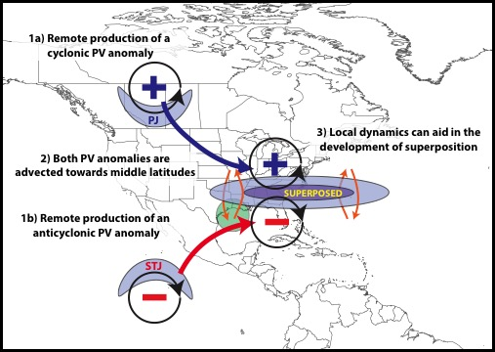
A Superposition Conceptual Model
Winters and Martin 2017

Slide 37
The Process of Superposition (WM17)
Winters and Martin 2017

Slide 38
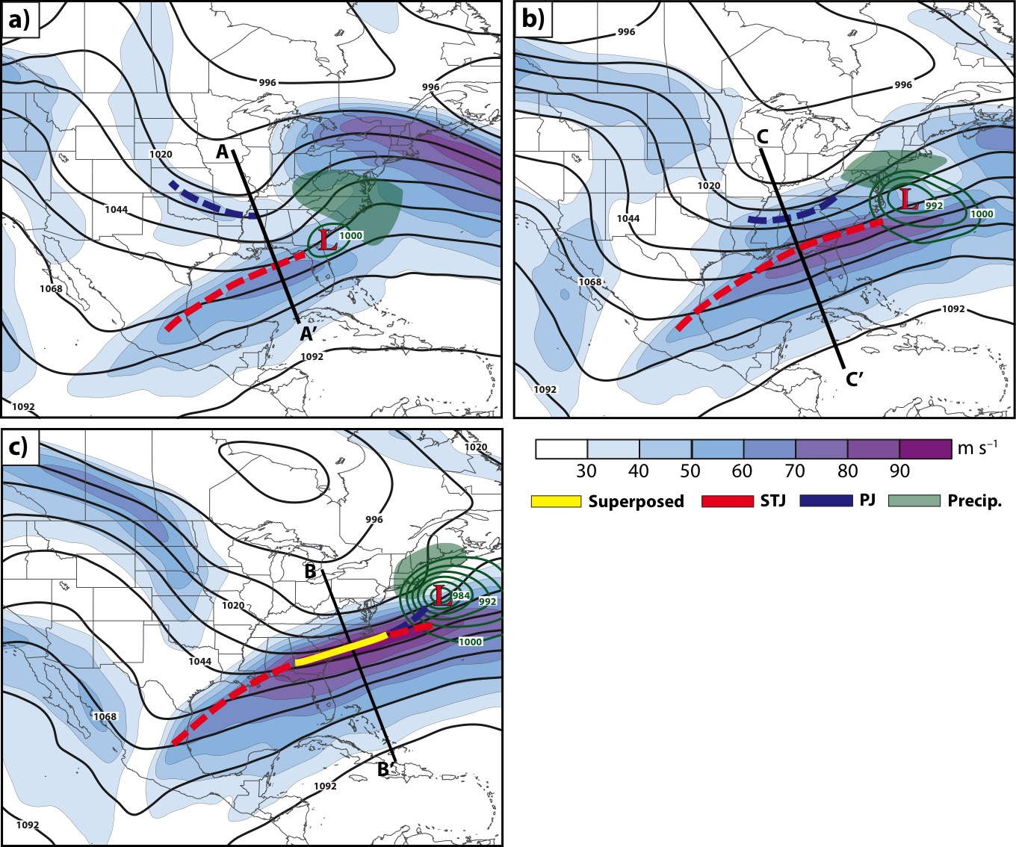
The Process of Superposition (WM17)
0000 UTC 19 Dec 2009
1800 UTC 19 Dec 2009
1200 UTC 20 Dec 2009
18–20 December 2009
Mid-Atlantic Blizzard

Slide 39
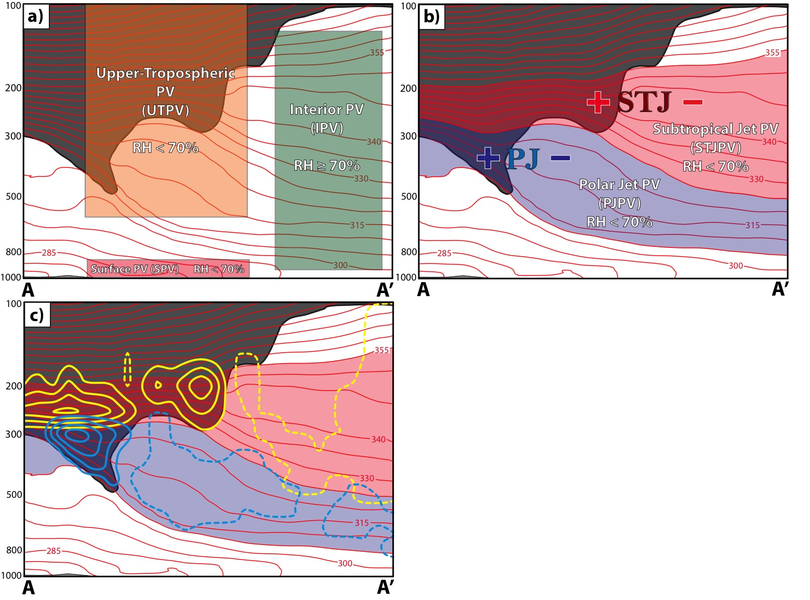
The Process of Superposition (WM17)
Employed piecewise PV inversion (Davis and Emanuel 1991) to diagnose the development of a superposition during the blizzard.

Slide 40
1800 UTC
19 December
Non-divergent wind associated with the Mean PV and the Upper-tropospheric PV has the dominant impact
Net effect is to promote a differential horizontal displacement of both tropopause breaks that favors superposition
Polar Trop. Break
Subtropical Trop. Break

Slide 41
1800 UTC
19 December
Non-divergent wind associated with the Mean PV and the Upper-tropospheric PV has the dominant impact
Net effect is to promote a differential horizontal displacement of both tropopause breaks that favors superposition
Polar Trop. Break
Subtropical Trop. Break

Slide 42
1800 UTC
19 December
The Polar Jet and Subtropical Jet PV non-divergent wind contribute equally to advection along the polar tropopause break
The Subtropical Jet PV non-divergent wind is primarily responsible for all advection diagnosed along the subtropical tropopause break
Polar Trop. Break
Subtropical Trop. Break

Slide 43
The Process of Superposition (WM17)
Winters and Martin 2017

Slide 44
The Process of Superposition (WM17)
Winters and Martin 2017

Slide 45
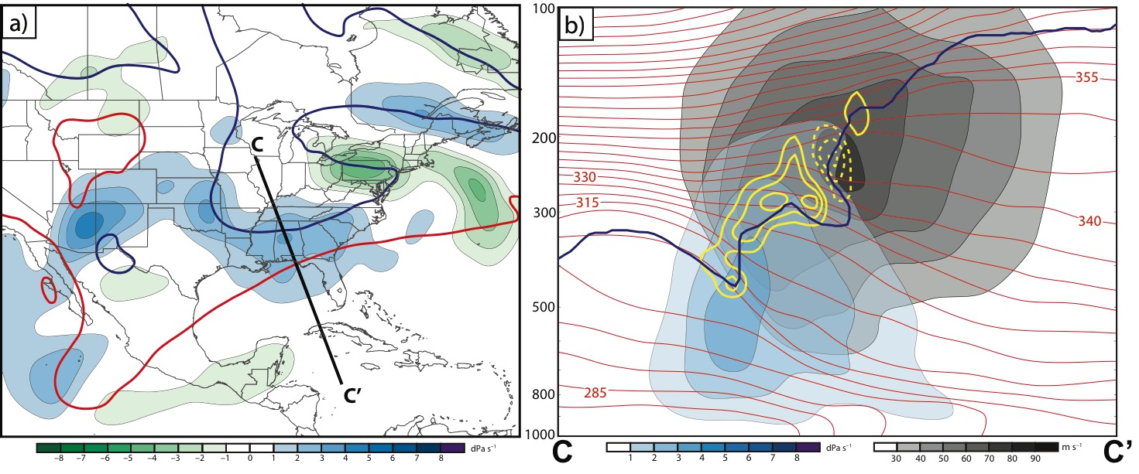
1800 UTC 19 December
Subsidence is favorably located to promote a downward displacement of the subtropical tropopause step

Slide 46
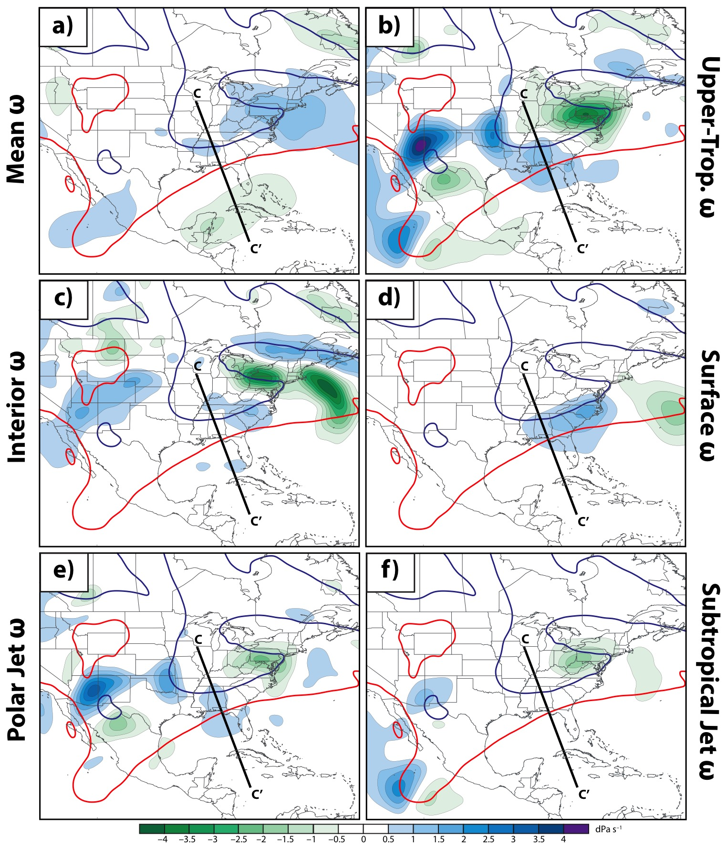
1800 UTC
19 December
Subsidence is primarily associated with the Upper-Tropospheric, Interior, and Surface PV
The Polar Jet PV is associated with stronger subsidence than the Subtropical Jet PV

Slide 47
Sawyer–Eliassen Circulation Equation
Static Stability
Across-Front Baroclinicity
Horizontal Relative Vorticity
Geostrophic and Diabatic Forcing
Frontal Characteristics
Where:
X
Y
Shearing
Stretching
Notes:
Vertical relative vorticity. Maybe don’t need the coefficients.

Slide 48
Piecewise Sawyer–Eliassen Circulation
Static Stability
Across-Front Baroclinicity
Horizontal Relative Vorticity
Geostrophic and Diabatic Forcing
Frontal Characteristics
Where:
X
Y
Shearing
Stretching

Slide 49
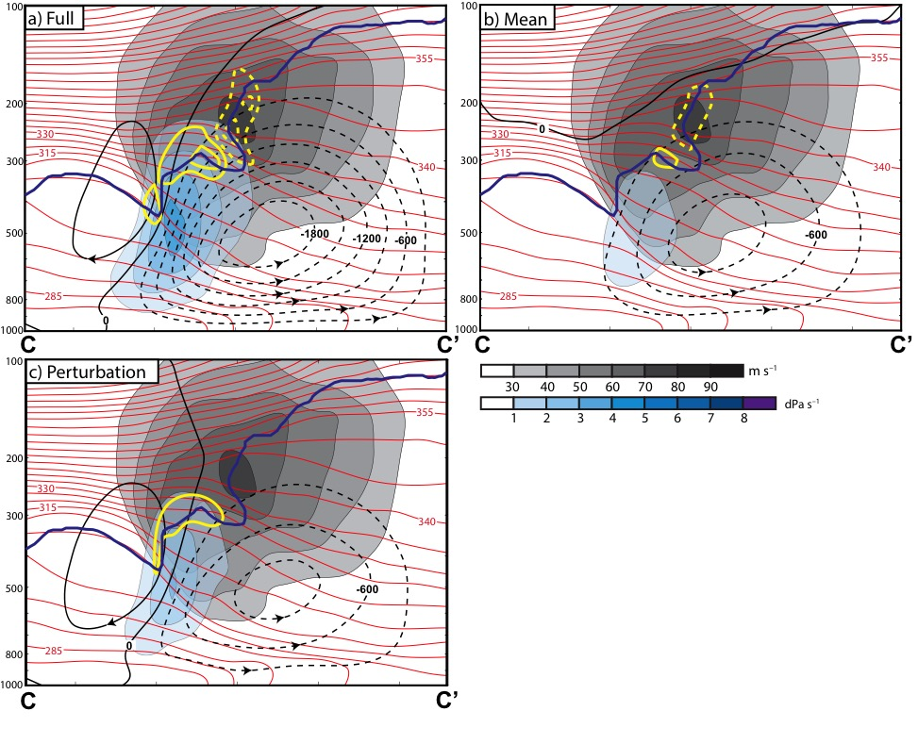
The geostrophic wind associated with each subset of the PV distribution was used to force the piecewise Sawyer–Eliassen Circulation Equation (Sawyer 1956; Eliassen 1962; Morgan 1999)

Slide 50
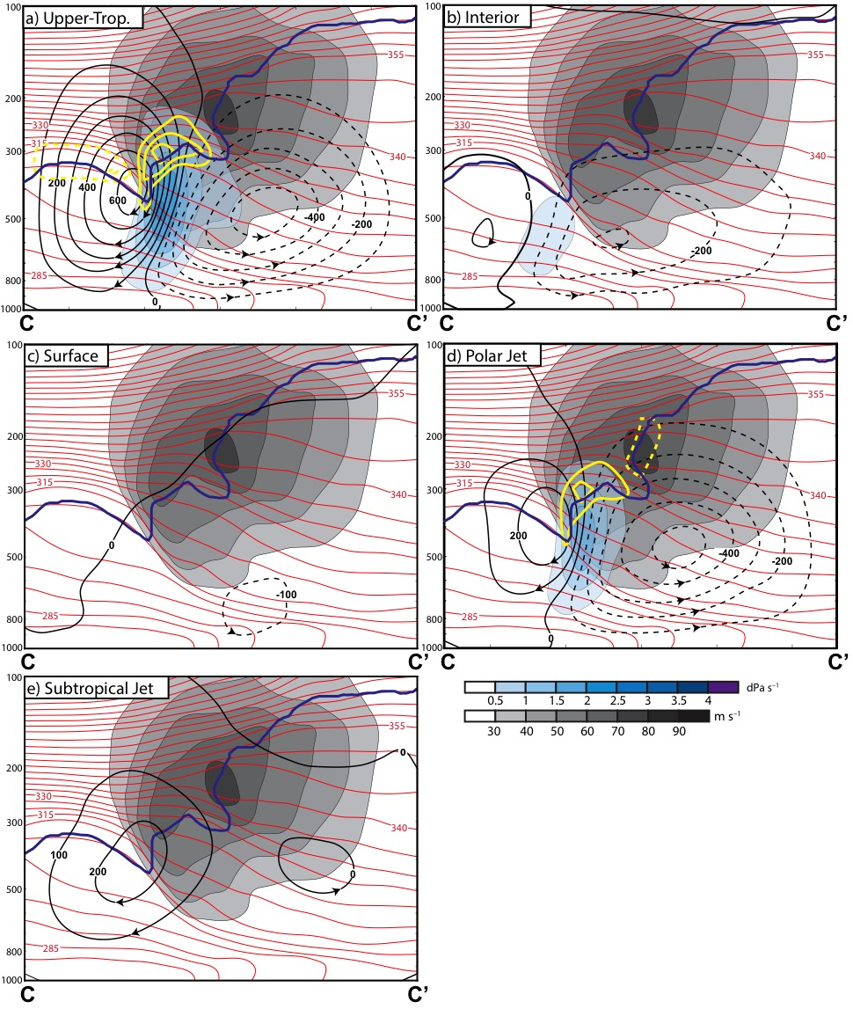
1800 UTC
19 December
Strongest circulation was driven by the Upper-Tropospheric PV geostrophic wind
The Polar Jet PV geostrophic wind forced a stronger circulation than the Subtropical Jet PV geostrophic wind

Slide 51
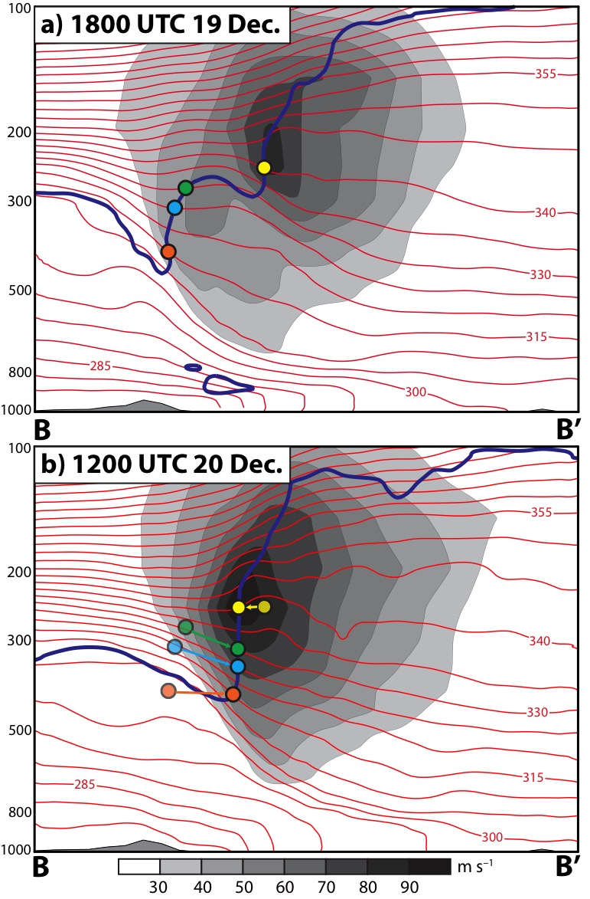
Synthesis (WM17)
Both the differential horizontal displacement and vertical displacement of the tropopause are evident
Considerable variability characterizes the environments associated with jet superpositions (e.g., 2010 Nashville Flood)

Slide 52
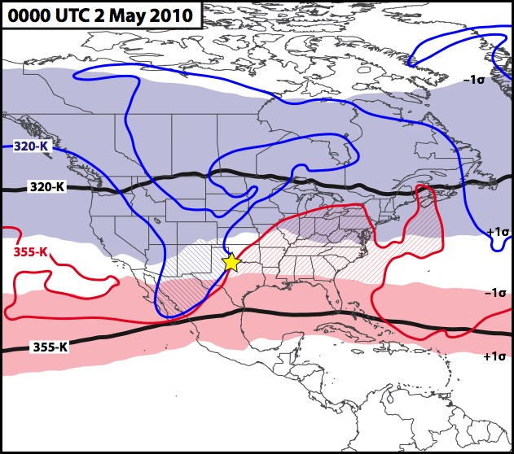
Future Work
Categorize and composite North American Jet Superposition Events
Determine the preferred mode of jet superposition
Differentiate between jet superposition and “null events”

Slide 53
References
Archambault, H. M., L. F. Bosart, D. Keyser, and J. M. Cordeira, 2013: A climatological analysis of the extratropical flow response to recurving western North Pacific tropical cyclones. Mon. Wea. Rev., 141, 2325–2346.
_________, D. Keyser, L. F. Bosart, C. A. Davis, and J. M. Cordeira, 2015: A composite perspective of the extratropical flow response to recurving western North Pacific tropical cyclones. Mon. Wea. Rev., 143, 1122–1141.
Cavallo, S. M., and G. J. Hakim, 2010: Composite structure of tropopause polar cyclones. Mon. Wea. Rev., 138, 3840–3857.
Christenson, C. E., and J. E. Martin, 2012: The large-scale environment associated with the 25−28 April 2011 severe weather outbreak. 16th NWA Severe Storms and Doppler Radar Conference, Des Moines, IA, National Weather Association, 31 March 2012.
Davis, C. A., and K. E. Emanuel, 1991: Potential vorticity diagnostics of cyclogenesis. Mon. Wea. Rev., 119, 1929–1953.
Defant, F., and H. Taba, 1957: The threefold structure of the atmosphere and the characteristics of the tropopause. Tellus, 9, 259–275.
Eichelberger, S. J., and D. L. Hartmann, 2007: Zonal jet structure and the leading mode of variability. J. Climate, 20, 5149–5163.
Eliassen, A., 1962: On the vertical circulation in frontal zones. Geophys. Publ., 24, 147–160.
Fröhlich, L., P. Knippertz, A. H. Fink, and E. Hohberger, 2013: An objective climatology of tropical plumes. J. Climate, 26, 5044–5060.

Slide 54
References
Harnik, N., E. Galanti, O. Martius, and O. Adam, 2014: The anomalous merging of the African and North Atlantic jet streams during the Northern Hemisphere winter of 2010. J. Climate, 27, 7319–7334.
Iskenderian, H., 1995: A 10-year climatology of Northern Hemisphere tropical cloud plumes and their composite flow patterns. J. Climate, 8, 1630–1637.
Knupp, K. R., T. A. Murphy, T. A. Coleman, R. A. Wade, S. A. Mullins, C. J. Schultz, E. V. Schultz, L. Carey, A. Sherrer, E. W. McCaul Jr., B. Carcione, S. Latimer, A. Kula, K. Laws, P. T. Marsh, and K. Klockow, 2014: Meteorological overview of the devastating 27 April 2011 Tornado Outbreak. Bull. Amer. Meteor. Soc., 95, 1041–1062.
Krishnamurti, T. N., 1961: The subtropical jet stream of winter. J. Meteor., 18, 172−191.
Lee, S., and H.-K. Kim, 2003: The dynamical relationship between subtropical and eddy-driven jets. J. Atmos. Sci., 60, 1490–1503.
Liebmann, B., and D. L. Hartmann, 1984: An observational study of tropical–midlatitude interaction on intraseasonal time scales during winter. J. Atmos. Sci., 41, 3333–3350.
Martius, O., C. Schwiertz, and H. C. Davies, 2010: Tropopause-level waveguides. J. Atmos. Sci., 67, 866–879.
Mohri, K., 1953: On the fields of wind and temperature over Japan and adjacent waters during winter of 1950–1951. Tellus, 5, 340–358.
Morgan, M. C., 1999: Using piecewise potential vorticity inversion to diagnose frontogenesis. Part I: A partitioning of the Q vector applied to diagnosing surface frontogenesis and vertical motion. Mon. Wea. Rev., 127, 2796–2821.

Slide 55
References
O’Rourke, A. K., and G. K. Vallis, 2013: Jet interaction and the influence of a minimum phase speed bound on the propagation of eddies. J. Atmos. Sci., 70, 2614–2628.
Pyle, M. E., D. Keyser, and L. F. Bosart, 2004: A diagnostic study of jet streaks: Kinematic signatures and relationship to coherent tropopause disturbances. Mon. Wea. Rev., 132, 297–319.
Roundy, P. E., K. MacRitchie, J. Asuma, and T. Melino, 2010: Modulation of the global atmospheric circulation by combined activity in the Madden–Julian Oscillation and the El Niño/Southern Oscillation during boreal winter. J. Climate, 23, 4045–4059.
Sawyer, J. S., 1956: The vertical circulation at meteorological fronts and its relation to frontogenesis. Proc. Roy. Soc. London, 234A, 346–362.
Son, S.-W., and S. Lee, 2005: The response of westerly jets to thermal driving in a primitive equation model. J. Atmos. Sci., 62, 3741–3757.
Winters, A. C., and J. E. Martin, 2014: The role of a polar/subtropical jet superposition in the May 2010 Nashville Flood. Wea. Forecasting, 29, 954–974.
_________, and _________, 2016: Synoptic and mesoscale processes supporting vertical superposition of the polar and subtropical jets in two contrasting cases. Quart. J. Roy. Meteor. Soc., 142, 1133–1149.
_________, and _________, 2017: Diagnosis of a North American polar/subtropical jet superposition employing potential vorticity inversion. Mon. Wea. Rev., 145, (in review).

Slide 56
Supplementary Slides

Slide 57
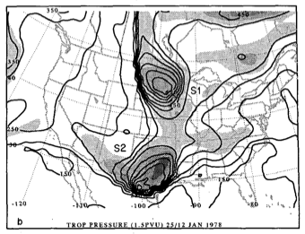
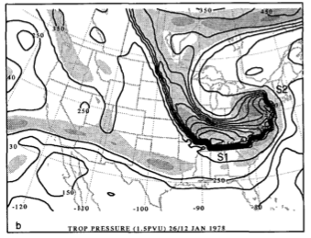
Jet “Mergers”
The closest analog to jet superpositions in the synoptic-dynamic literature is the concept of mid-latitude trough mergers
Hakim et al. 1995; 1996
The amalgamation of two mid-tropospheric vorticity maxima, with origins in distinctly different westerly air streams.
Frequently associated with explosive cyclogenesis.
May be simultaneously characterized by a jet superposition.
The analyses do not:
1) separate the two air streams as distinct polar/subtropical jets.
2) specifically investigate the merger’s impact on the jet structures/reshaping the dynamic tropopause.
12Z 25 Jan. 1978
12Z 26 Jan. 1978

Slide 58
Sawyer-Eliassen Circulation Equation
Static Stability
Across-Front Baroclinicity
Horizontal Relative Vorticity
Geostrophic and Diabatic Forcing
Frontal Characteristics
Where:
X
Y
Shearing
Stretching
Notes:
Vertical relative vorticity. Maybe don’t need the coefficients.

Slide 59
Piecewise Sawyer-Eliassen Circulation
Static Stability
Across-Front Baroclinicity
Horizontal Relative Vorticity
Geostrophic and Diabatic Forcing
Frontal Characteristics
Where:
X
Y
Shearing
Stretching

