Slide 1
Storm Chase May 26-27, 2014

Slide 2
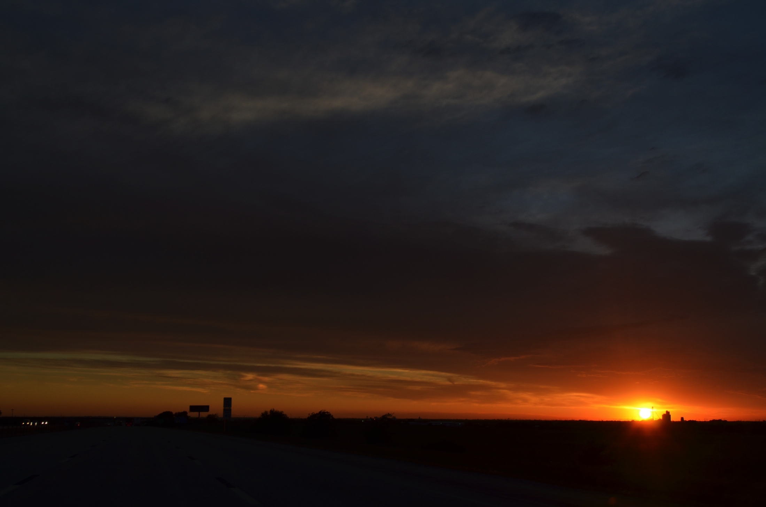
Sunset – El Reno, Oklahoma May 25, 2014

Slide 3
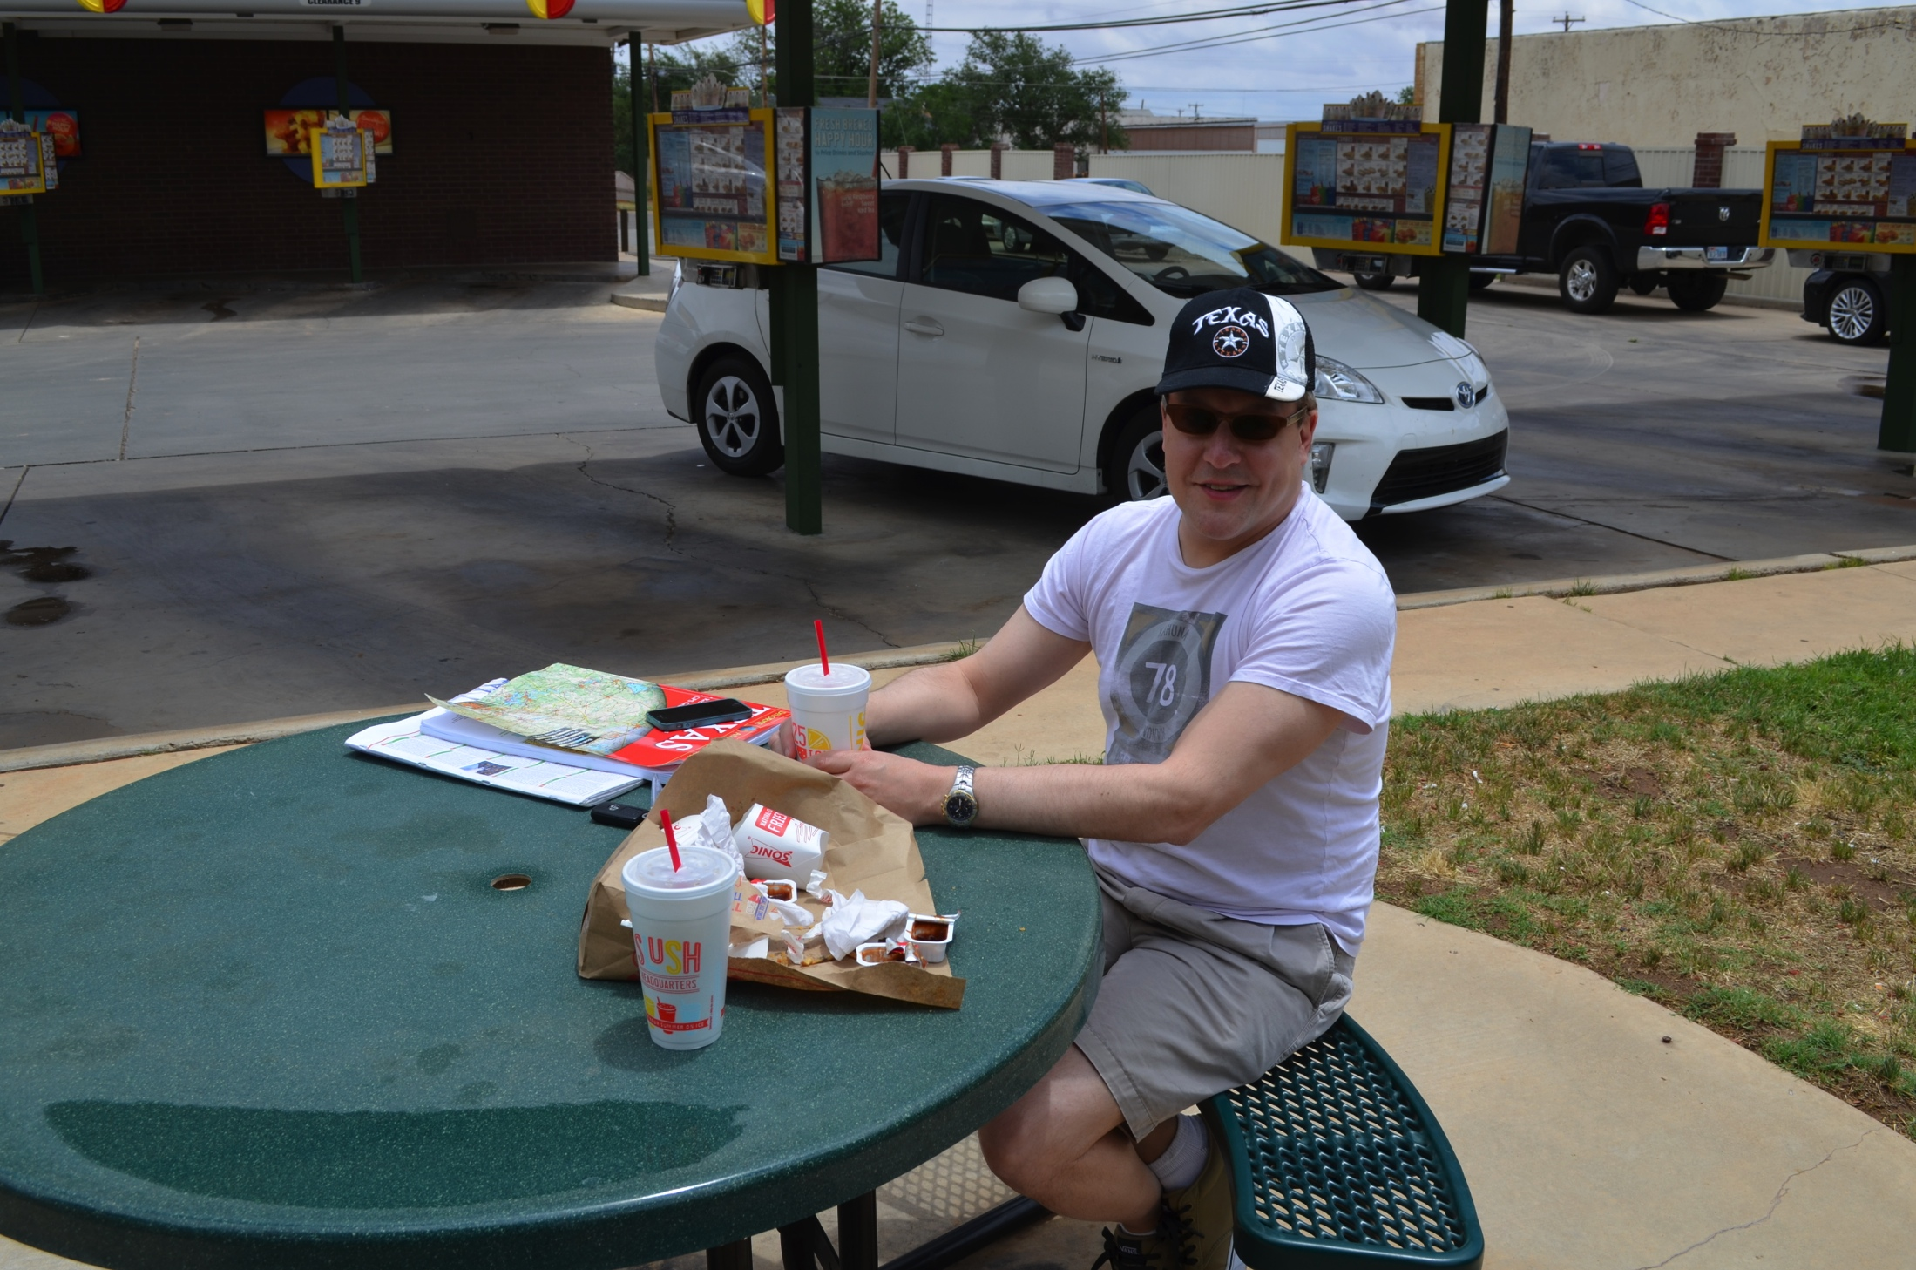
May 26, Lamesa, Texas

Slide 4
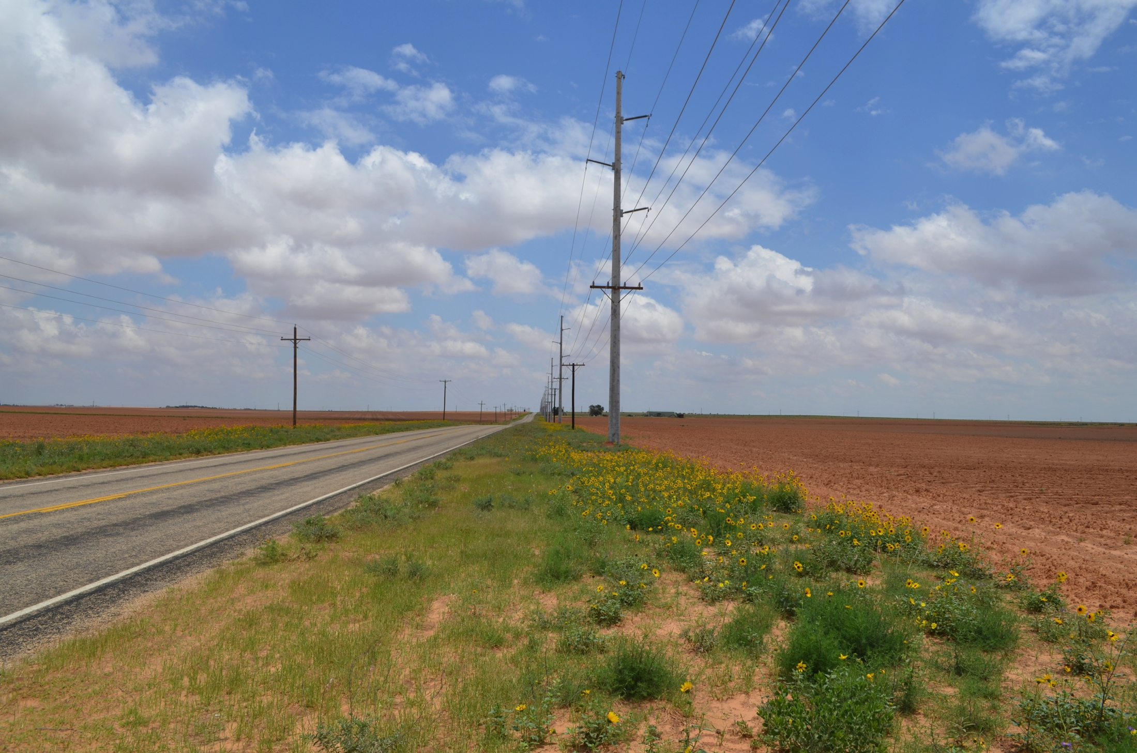
1921 UTC – Near Lamesa, Texas

Slide 5
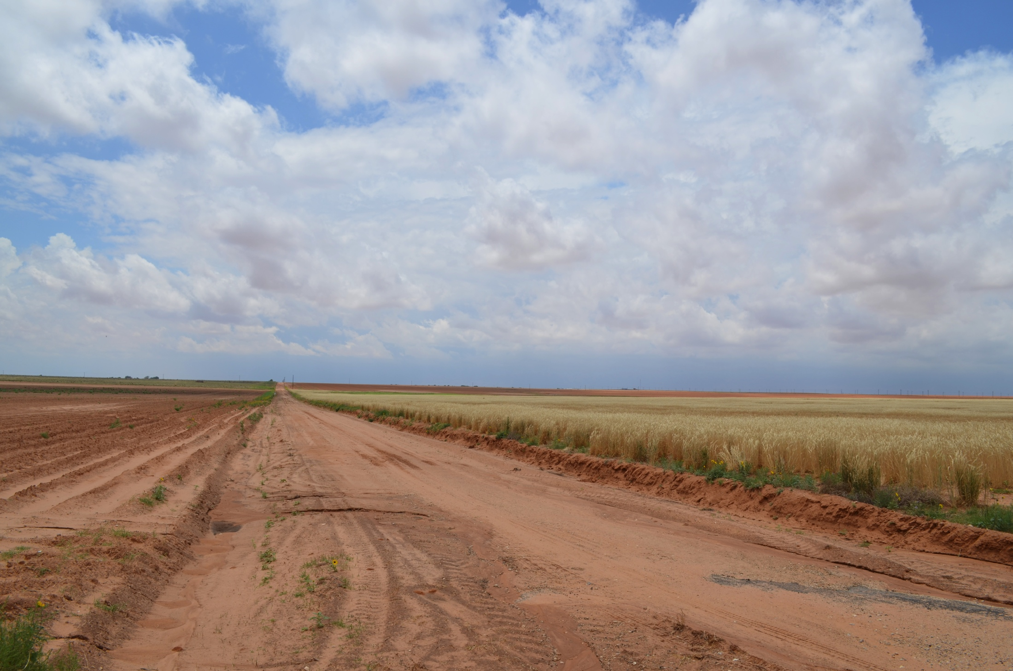
1921 UTC – Near Lamesa, Texas

Slide 6
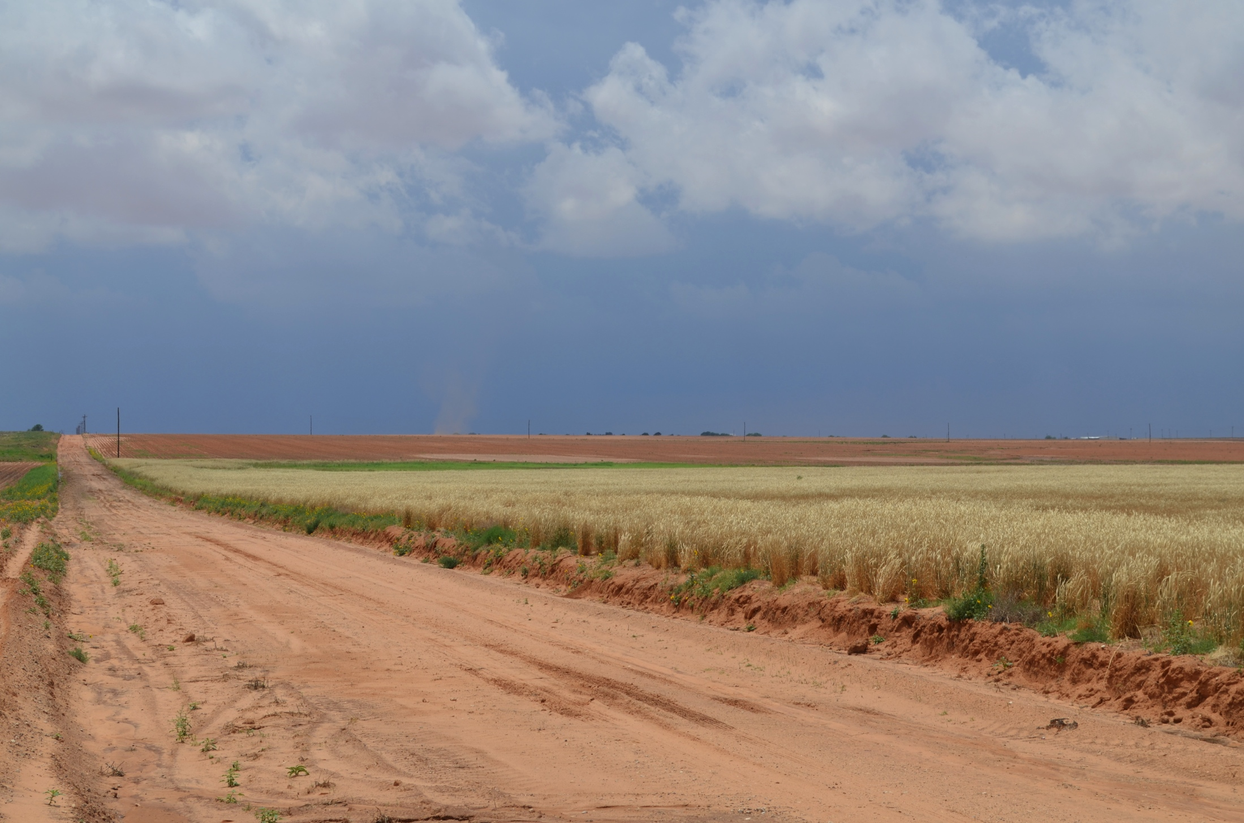
1929 UTC – Near Lamesa, Texas

Slide 7
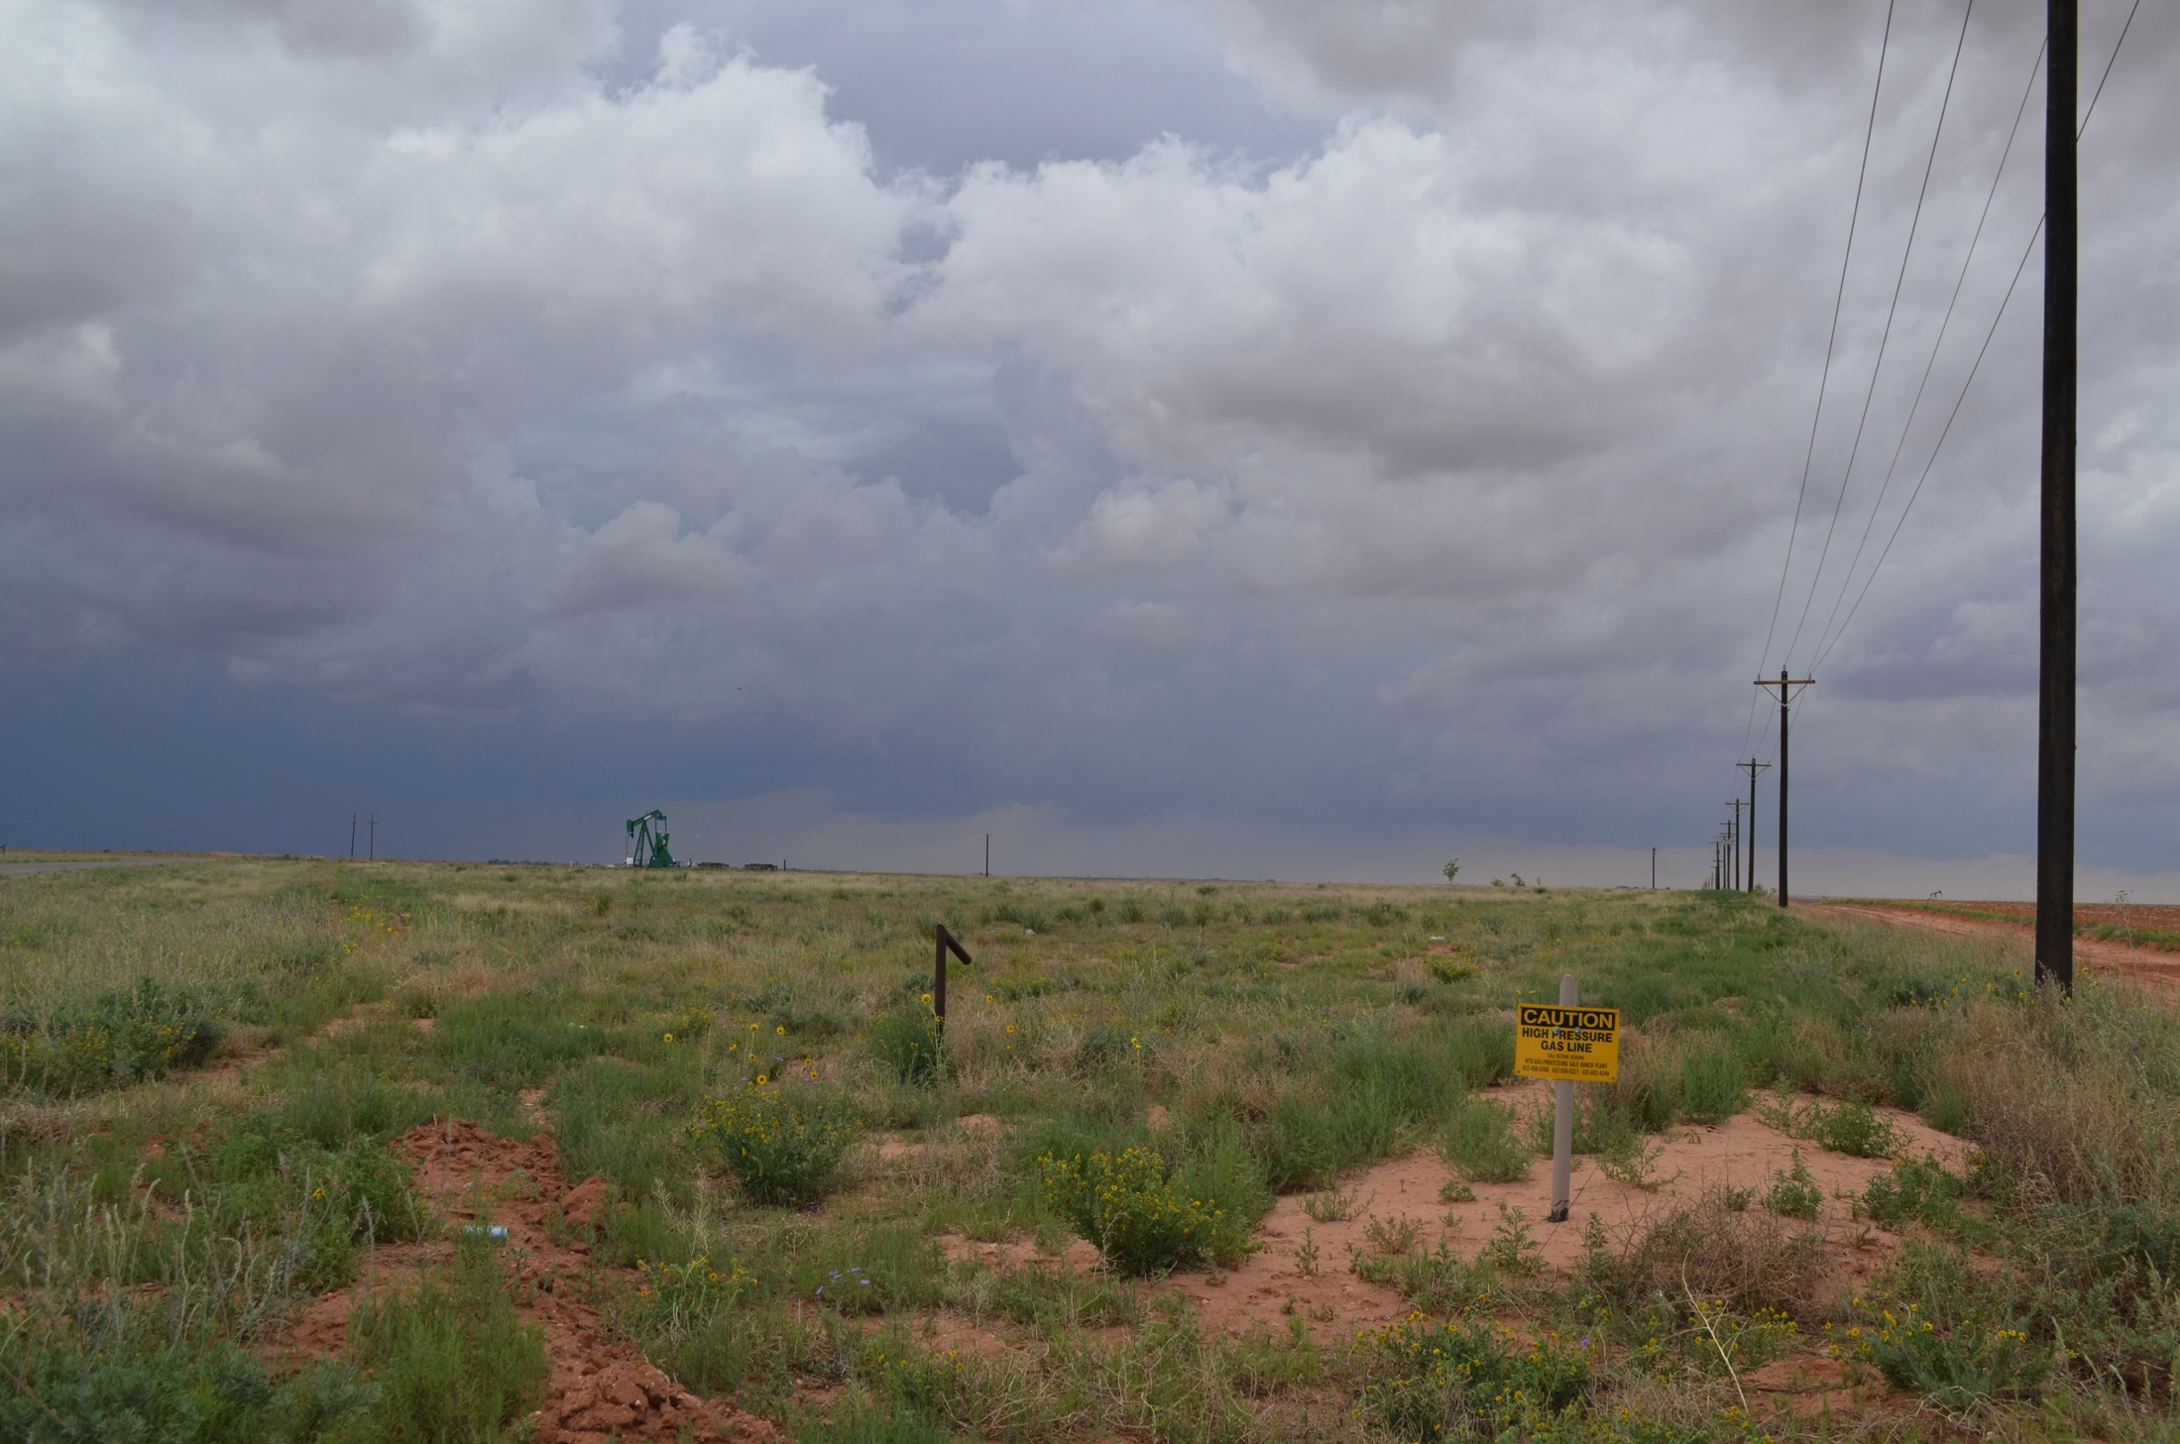
1952 UTC – Near Patricia, Texas

Slide 8
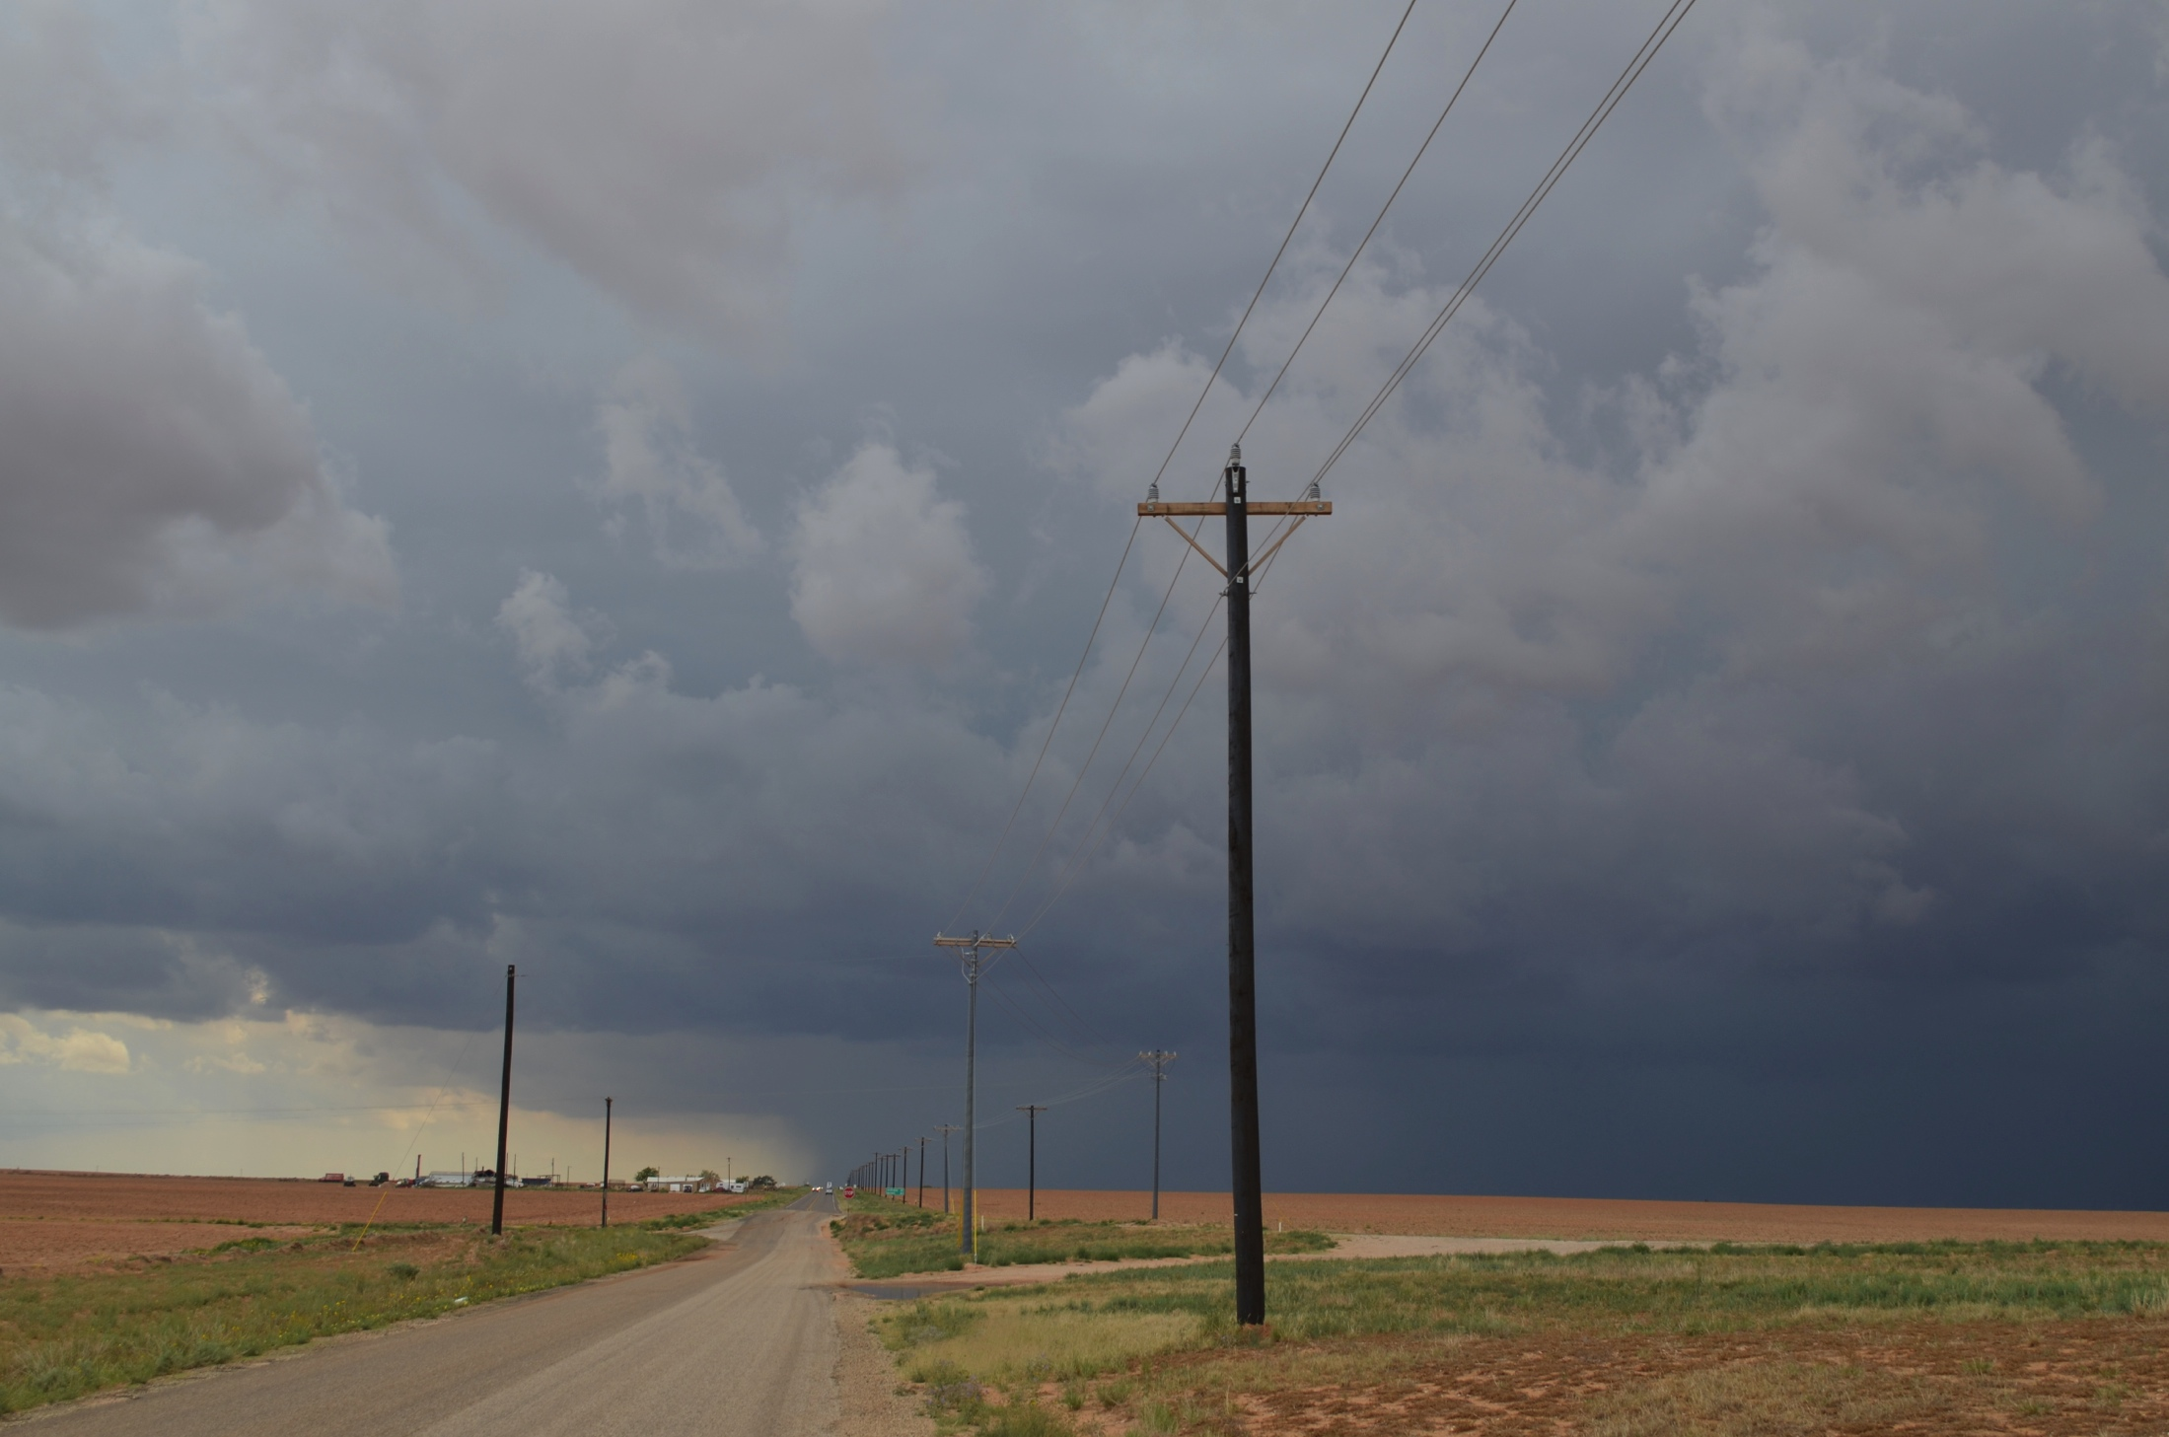
2004 UTC – Patricia, Texas

Slide 9
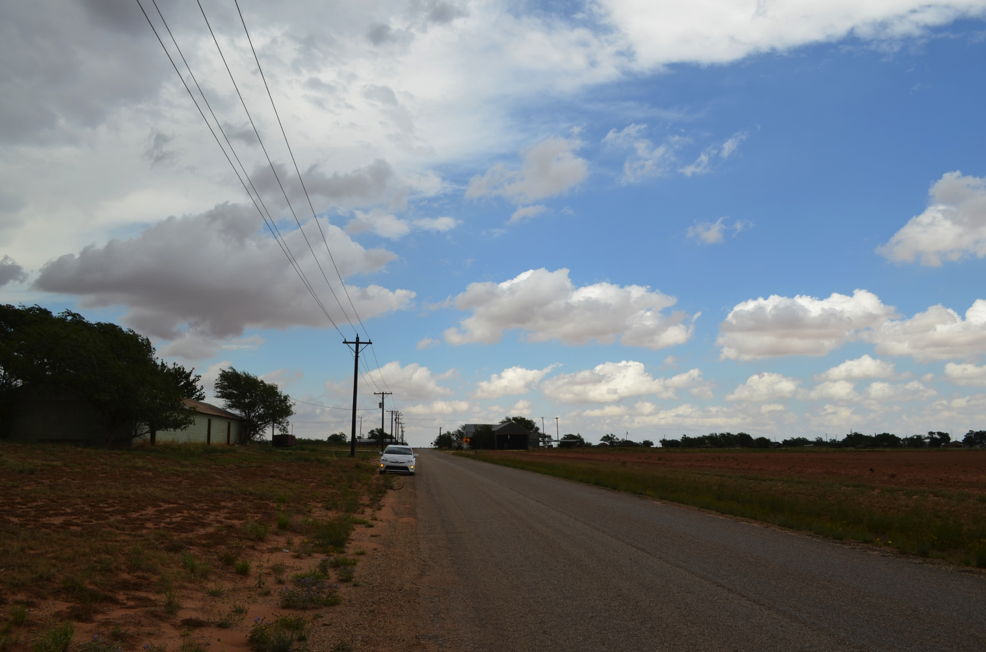
2006 UTC – Patricia, Texas

Slide 10
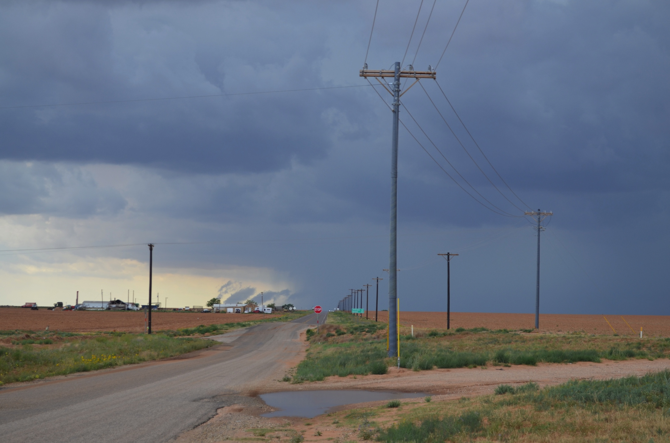
2006 UTC – Patricia, Texas

Slide 11
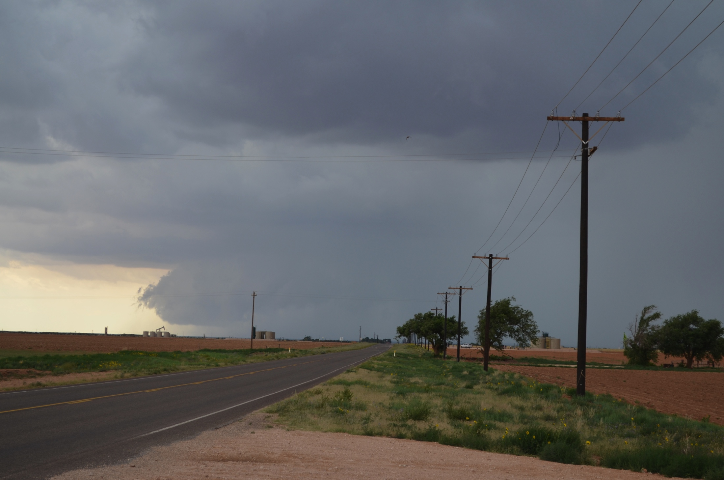
2013 UTC – Patricia, Texas

Slide 12
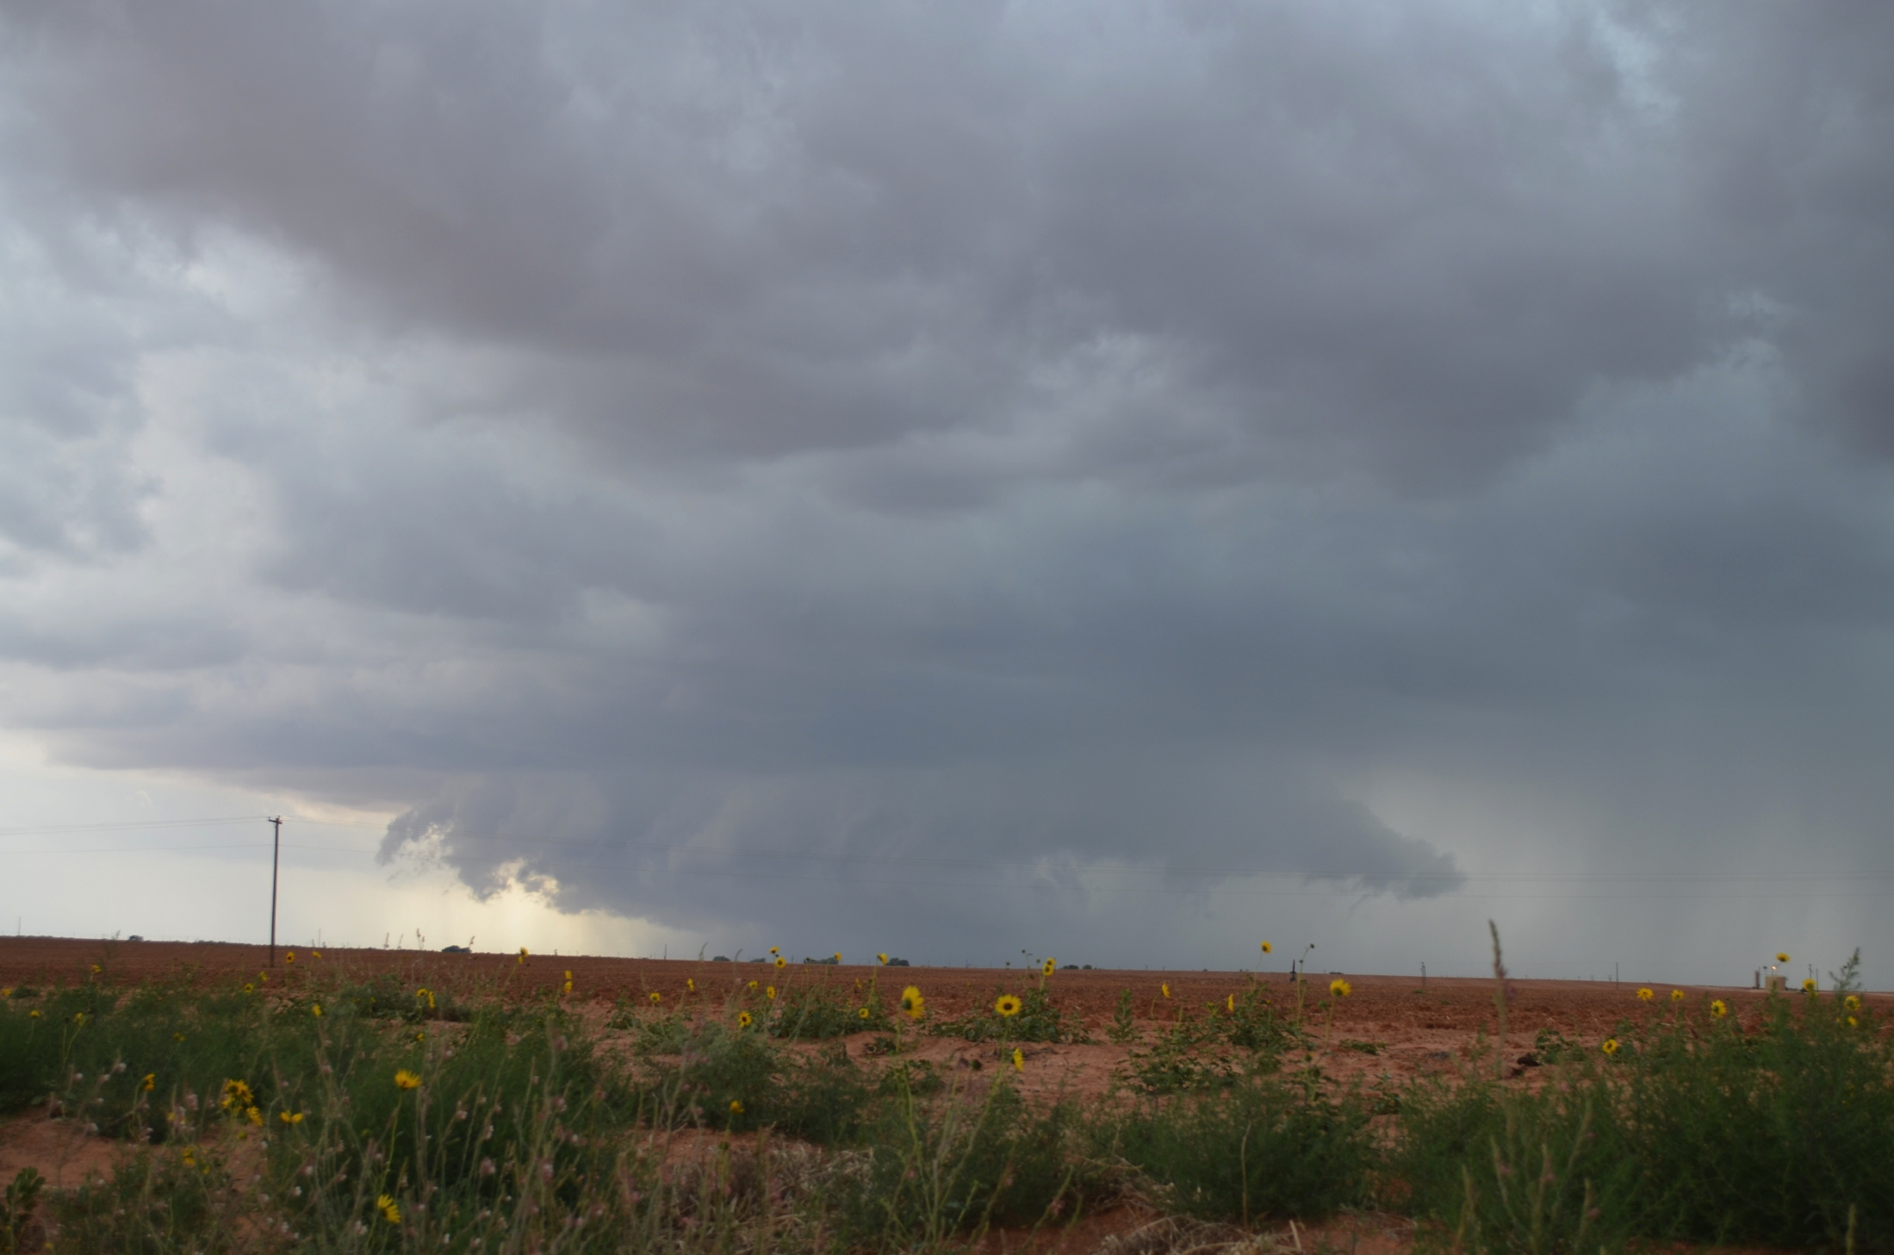
2026 UTC – South of Patricia, Texas

Slide 13
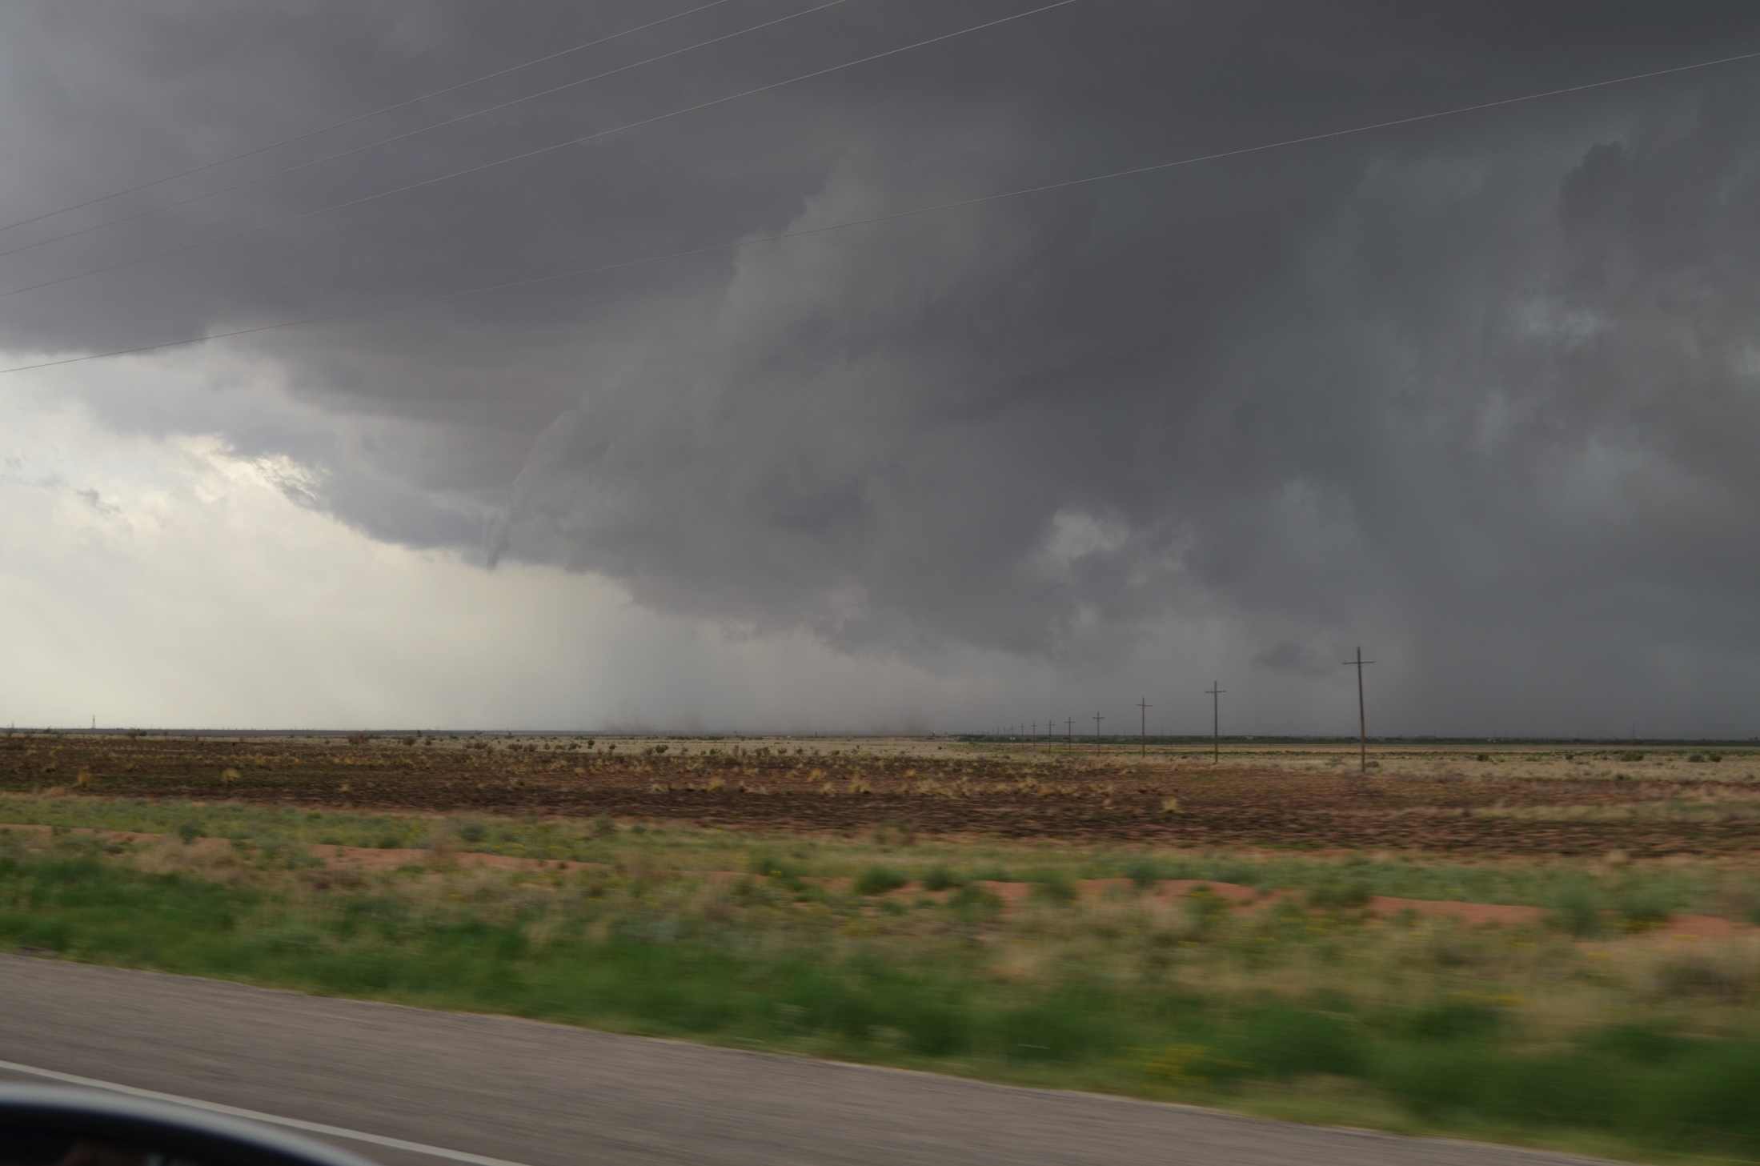
2034 UTC – South of Patricia, Texas

Slide 14
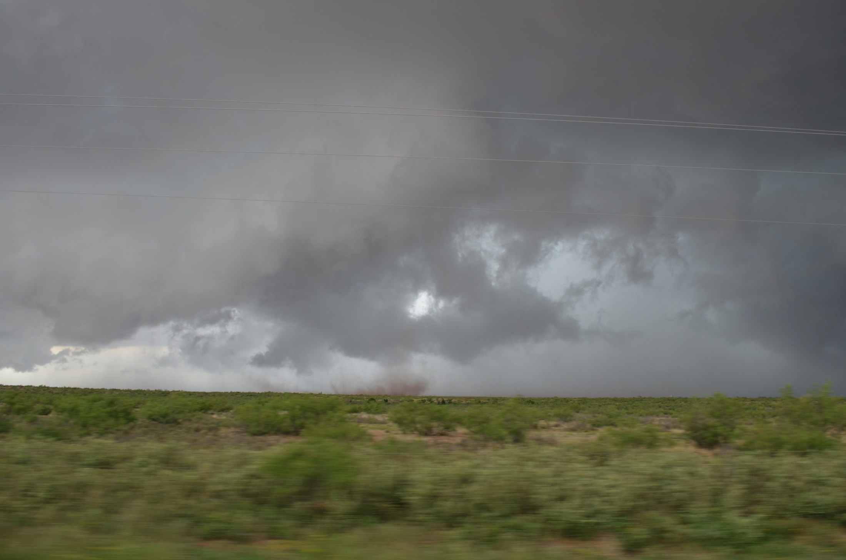
2036 UTC – South of Patricia, Texas

Slide 15
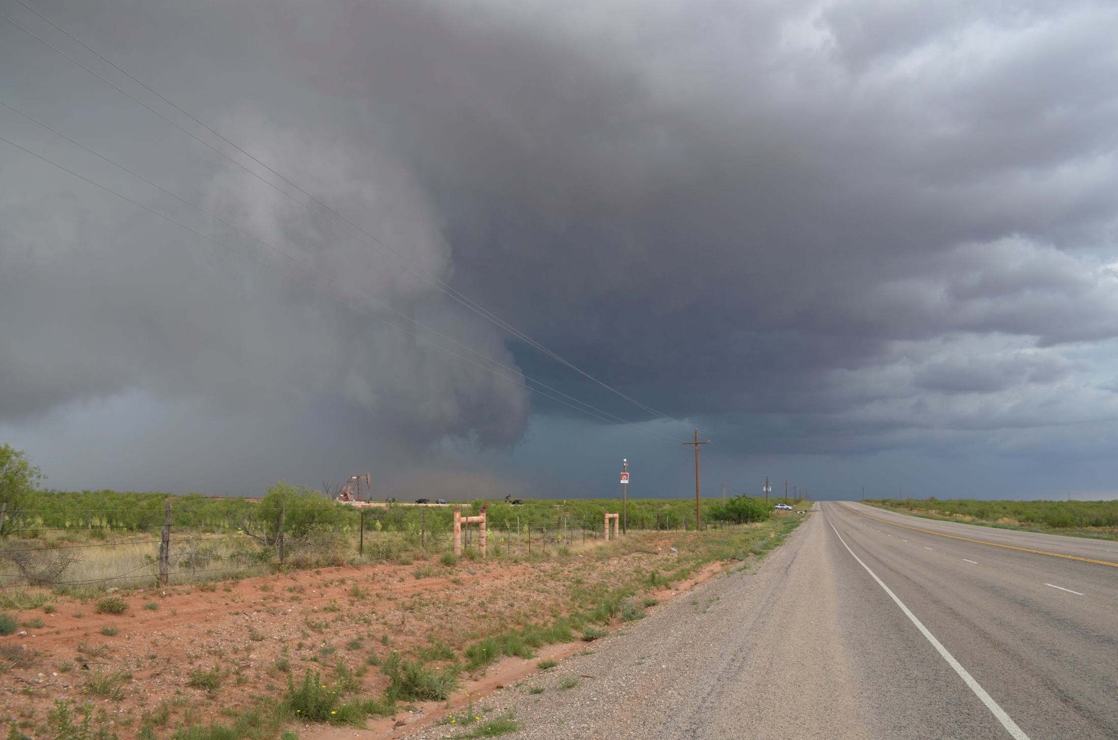
2037 UTC – South of Patricia, Texas

Slide 16
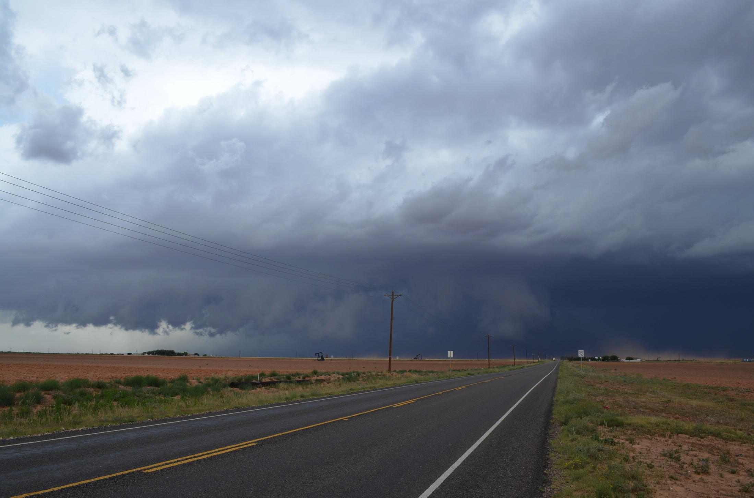
2057 UTC – Tarzan, Texas

Slide 17
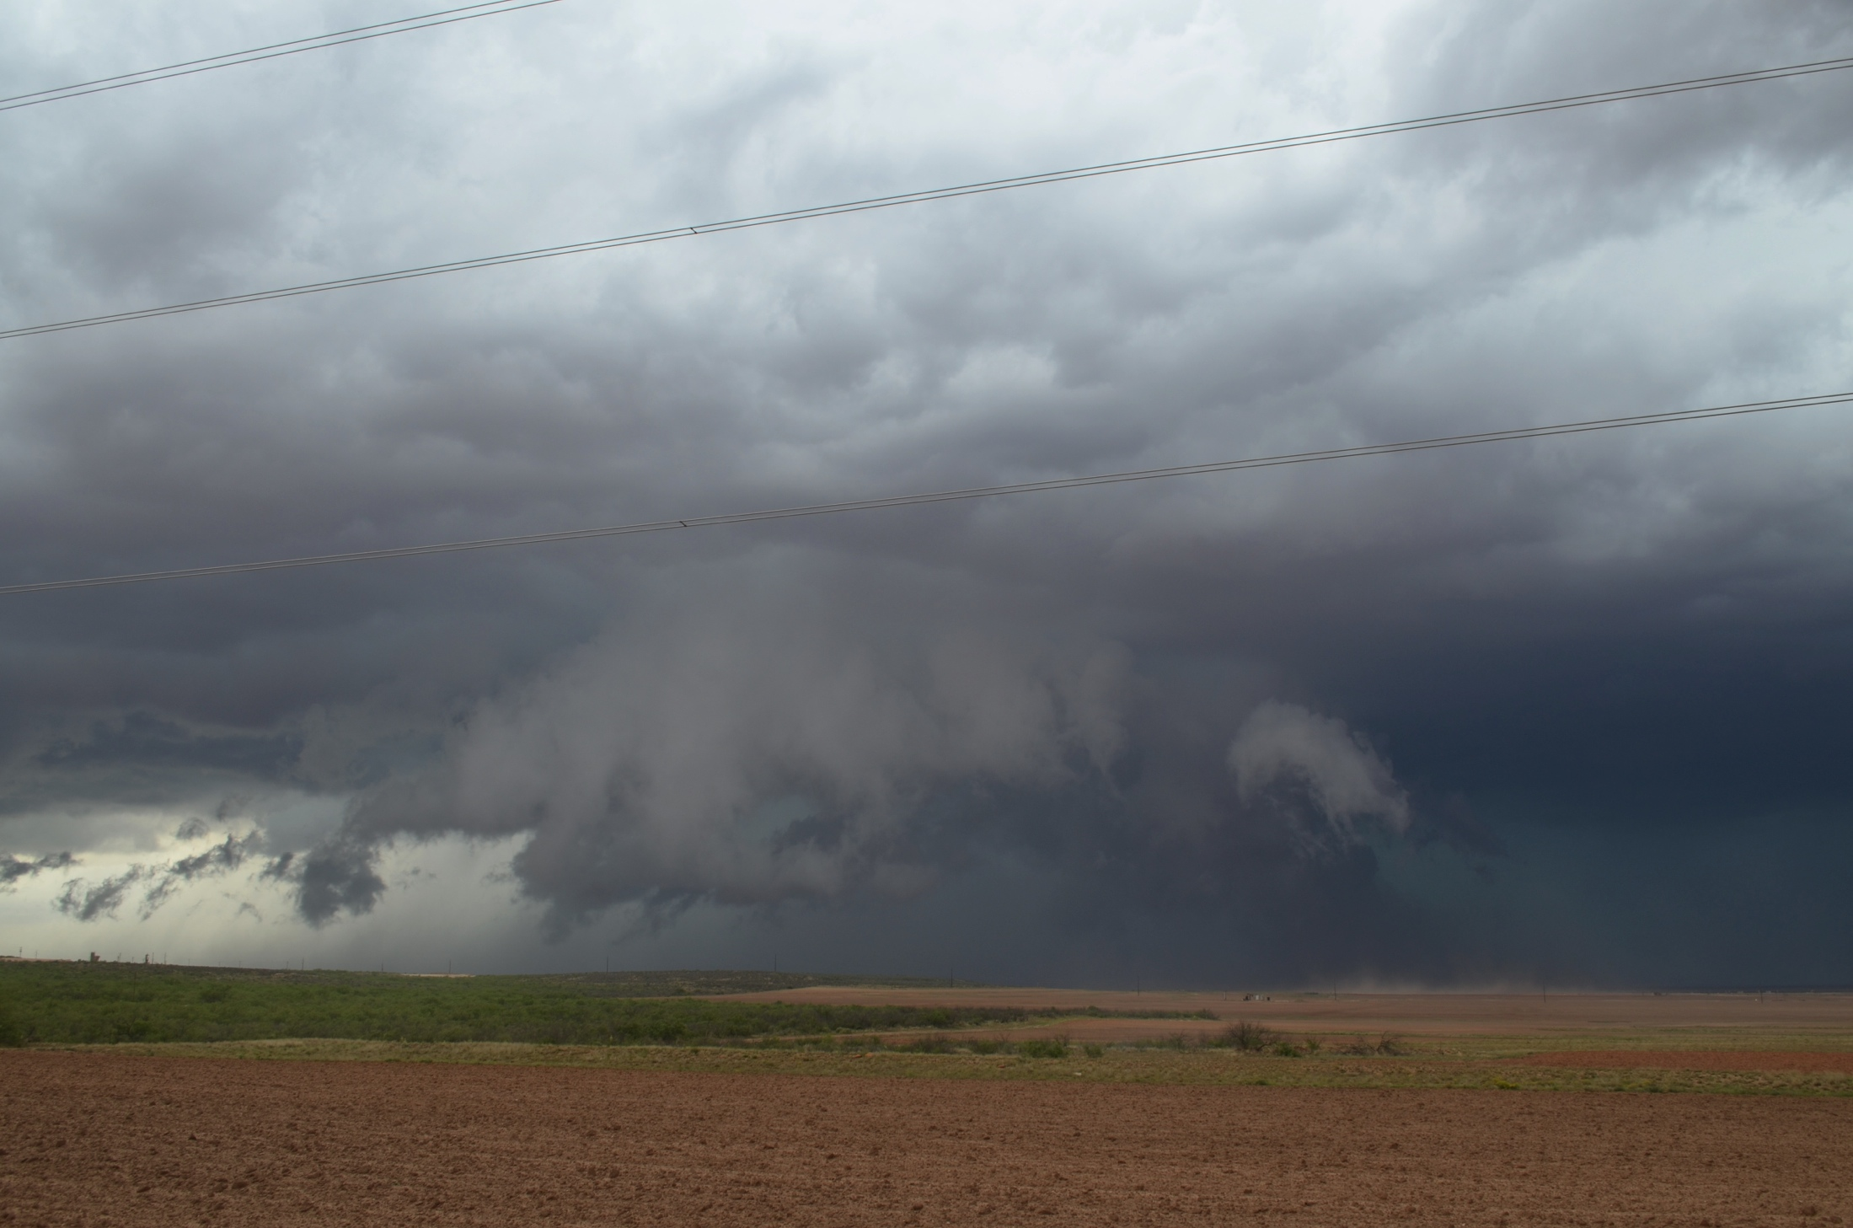
2105 UTC - Knott, Texas

Slide 18
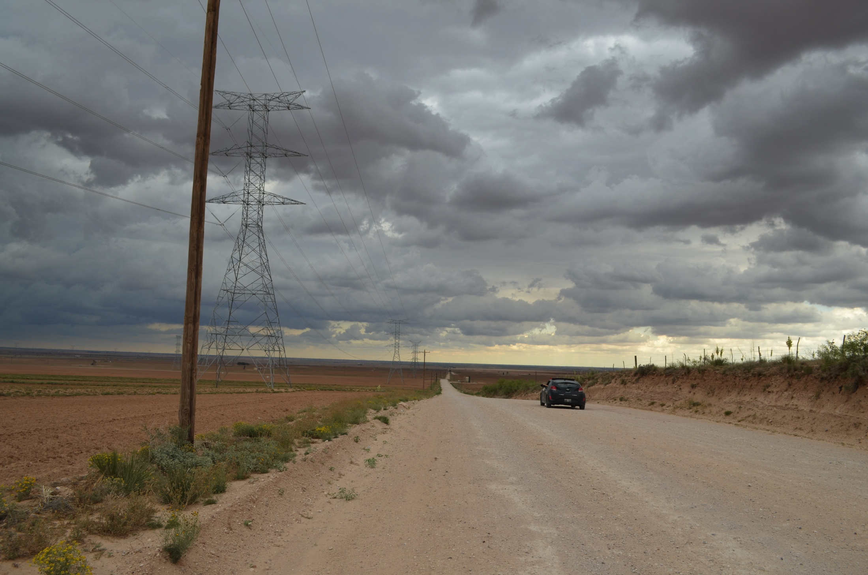
2105 UTC – Farm Rd. 846, Knott, Texas

Slide 19
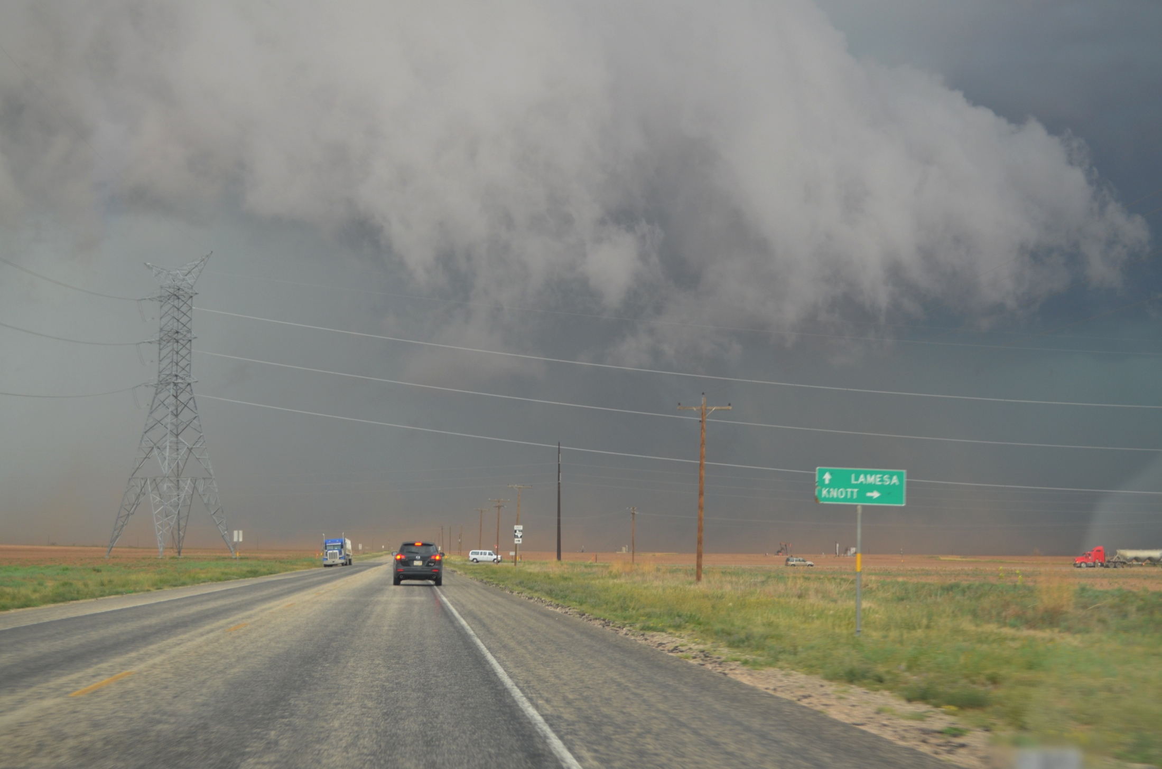
2108 UTC – Knott, Texas

Slide 20
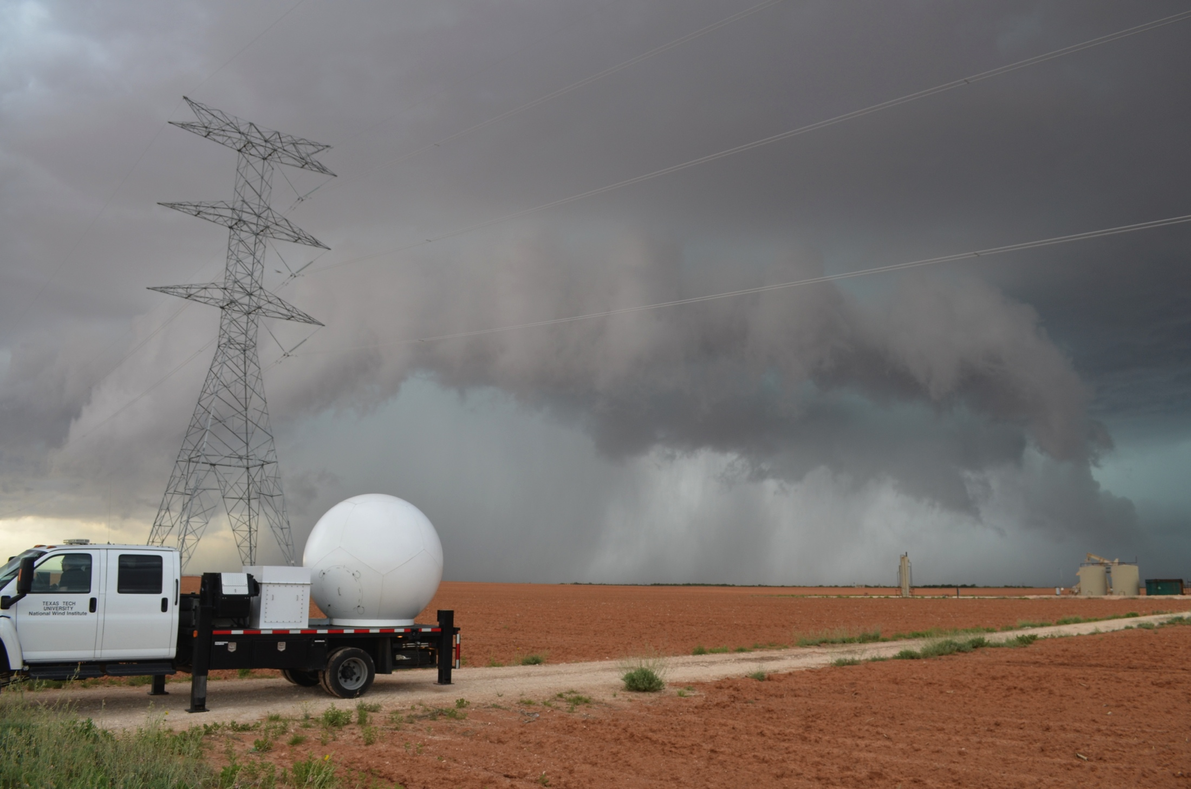
2113 UTC - Knott, Texas

Slide 21
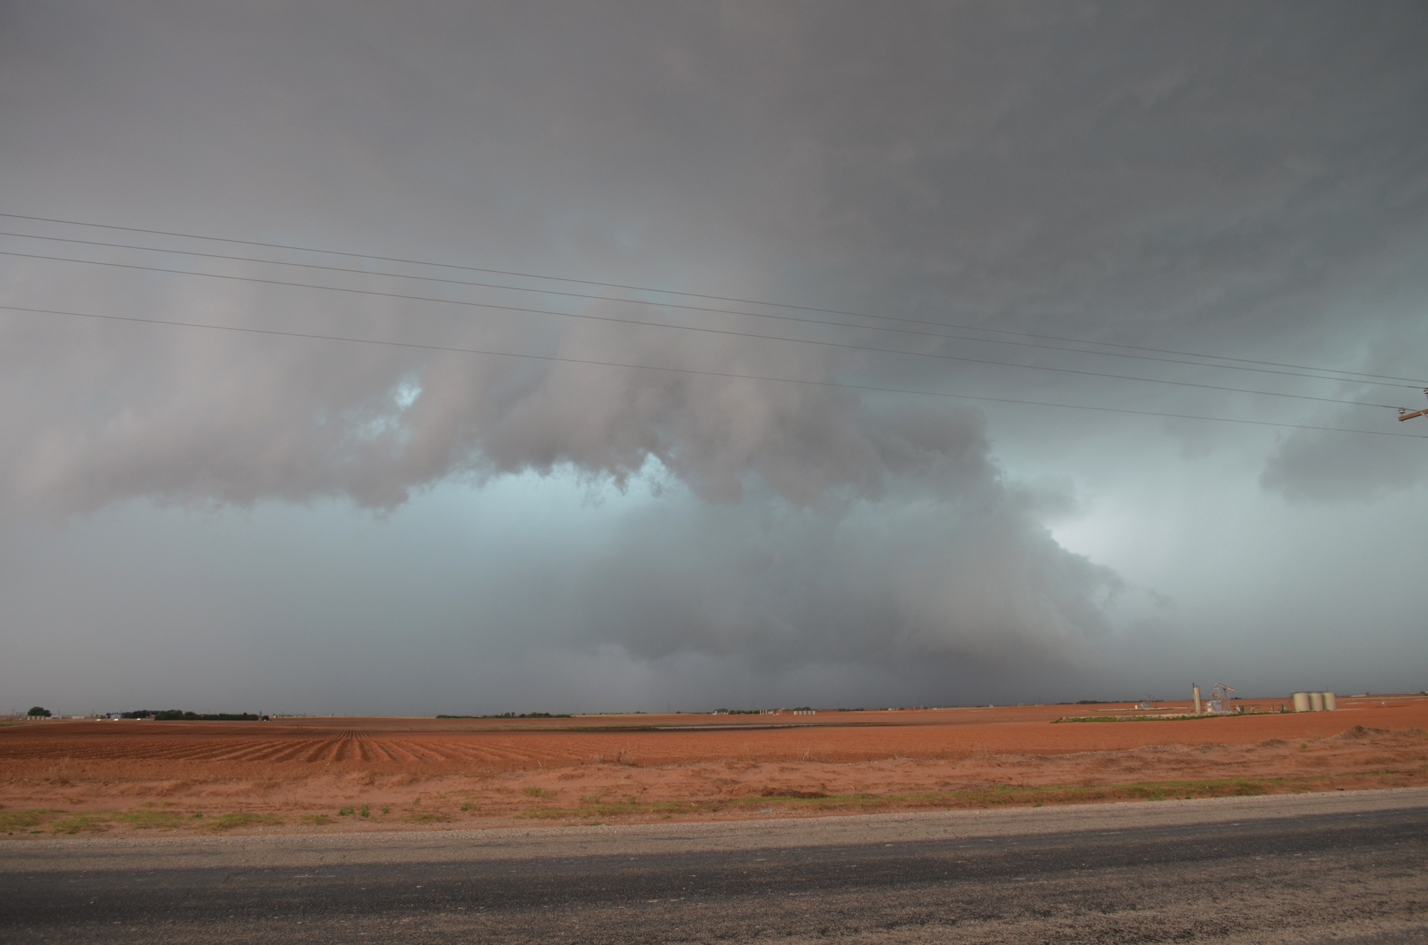
2129 UTC - Knott, Texas

Slide 22
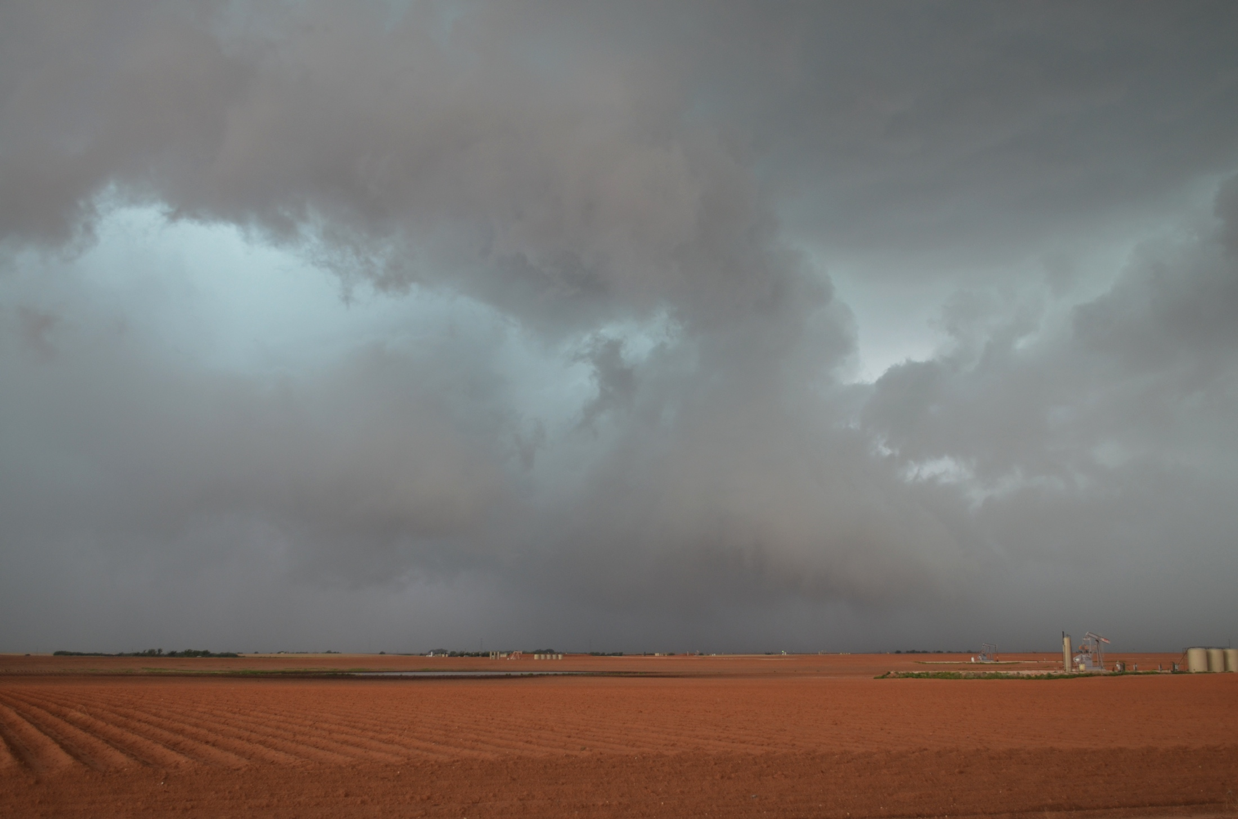
2130 UTC – Knott, Texas

Slide 23
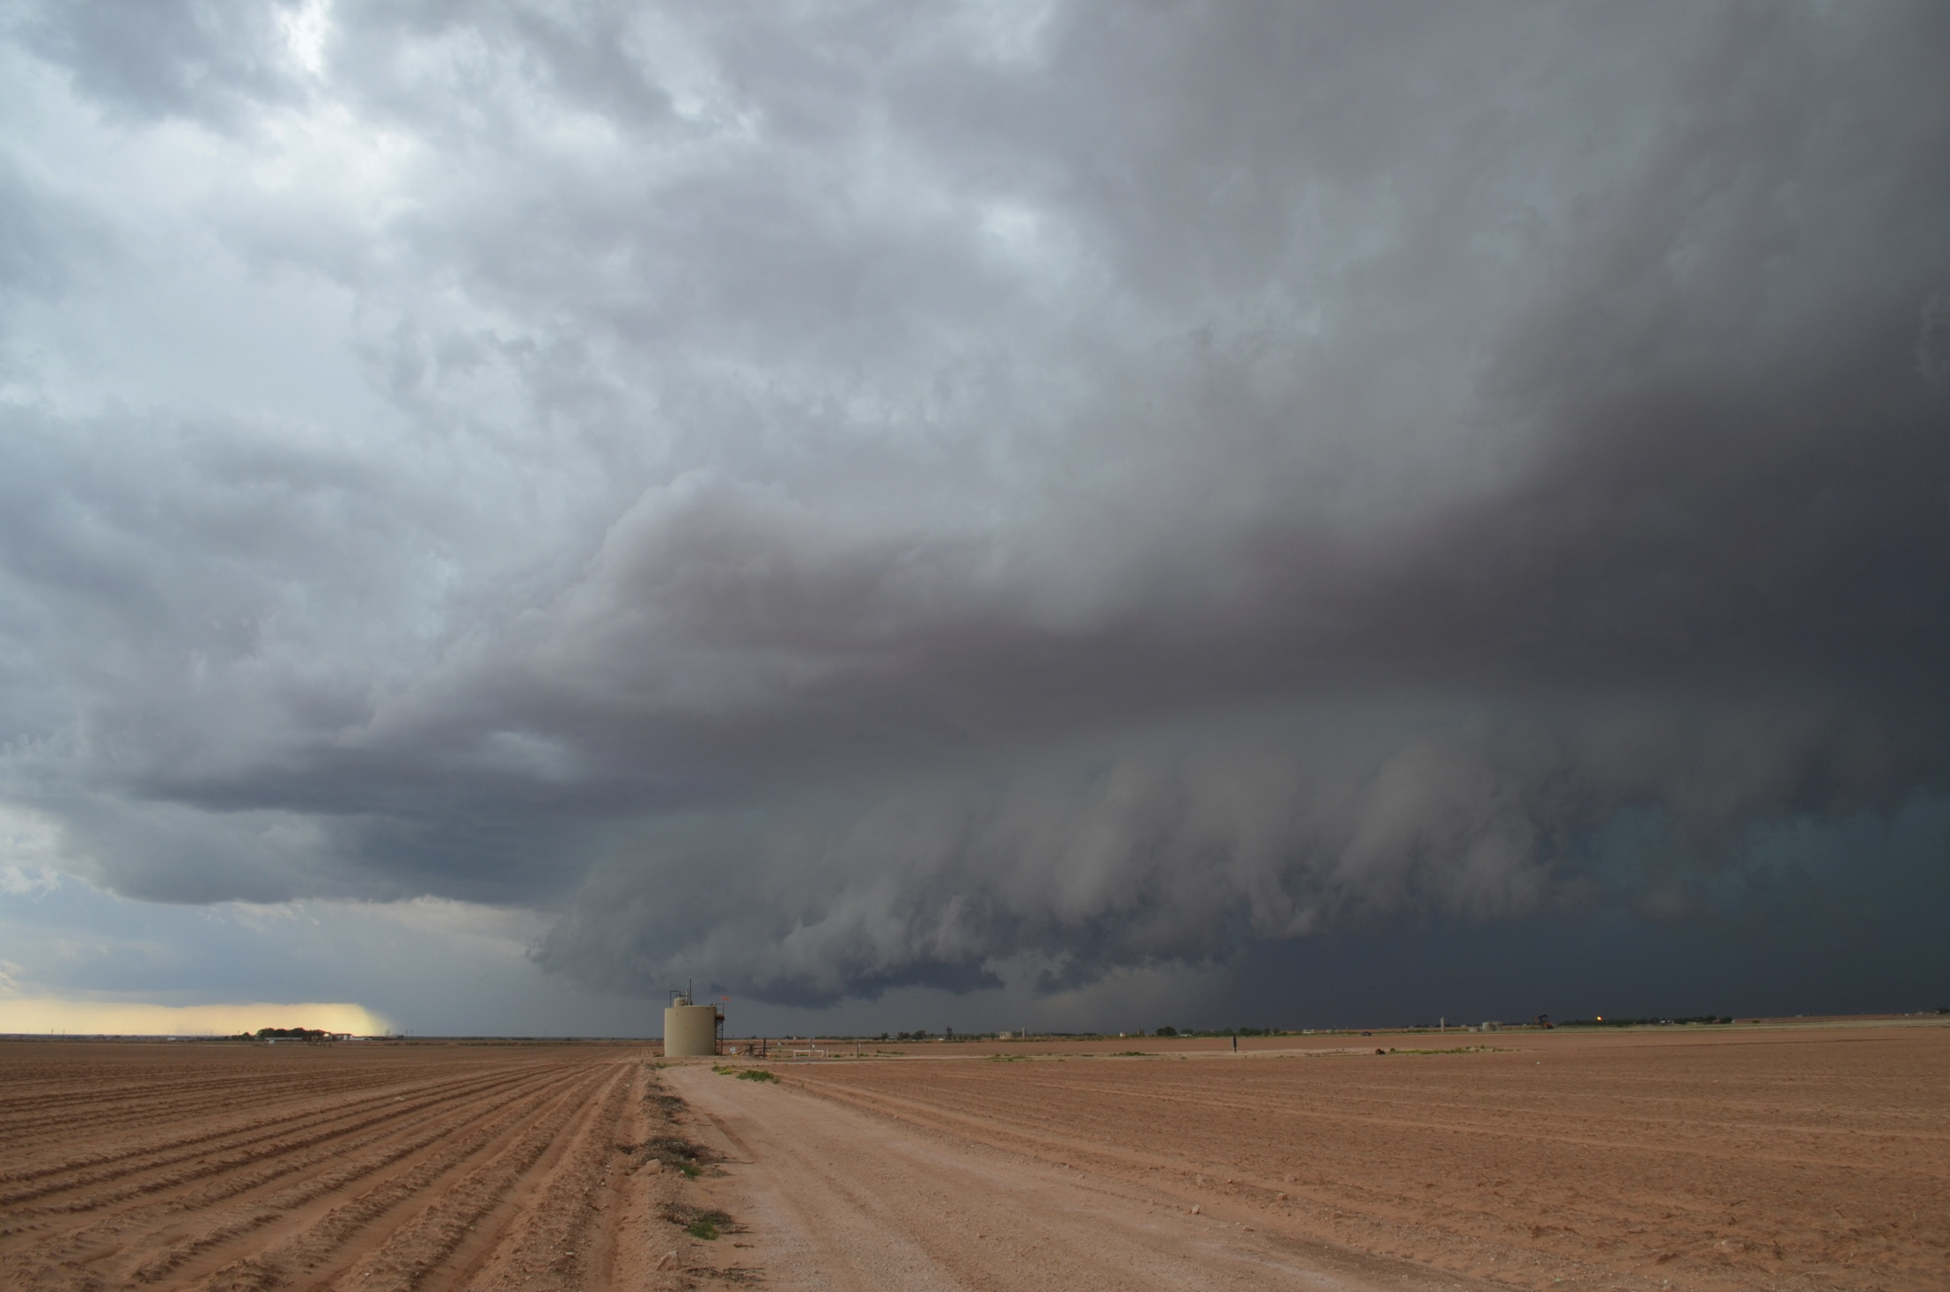
2145 UTC – U.S. 87 North of Big Spring, Texas

Slide 24
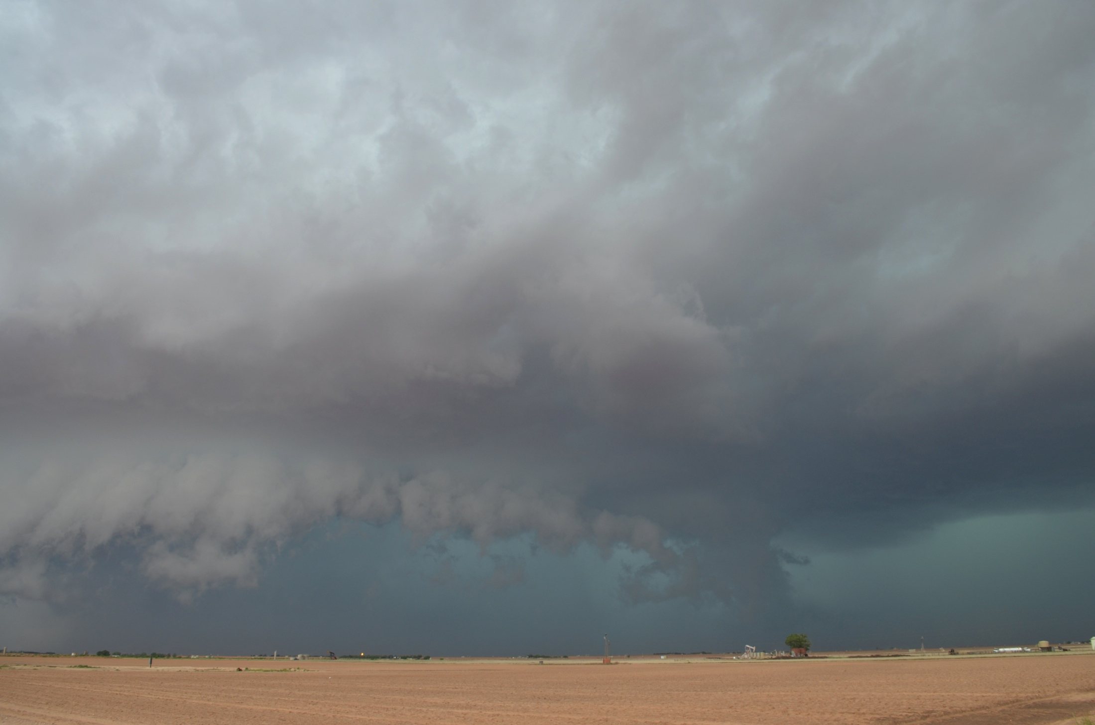
2145 UTC – U.S. 87 North of Big Spring, Texas

Slide 25
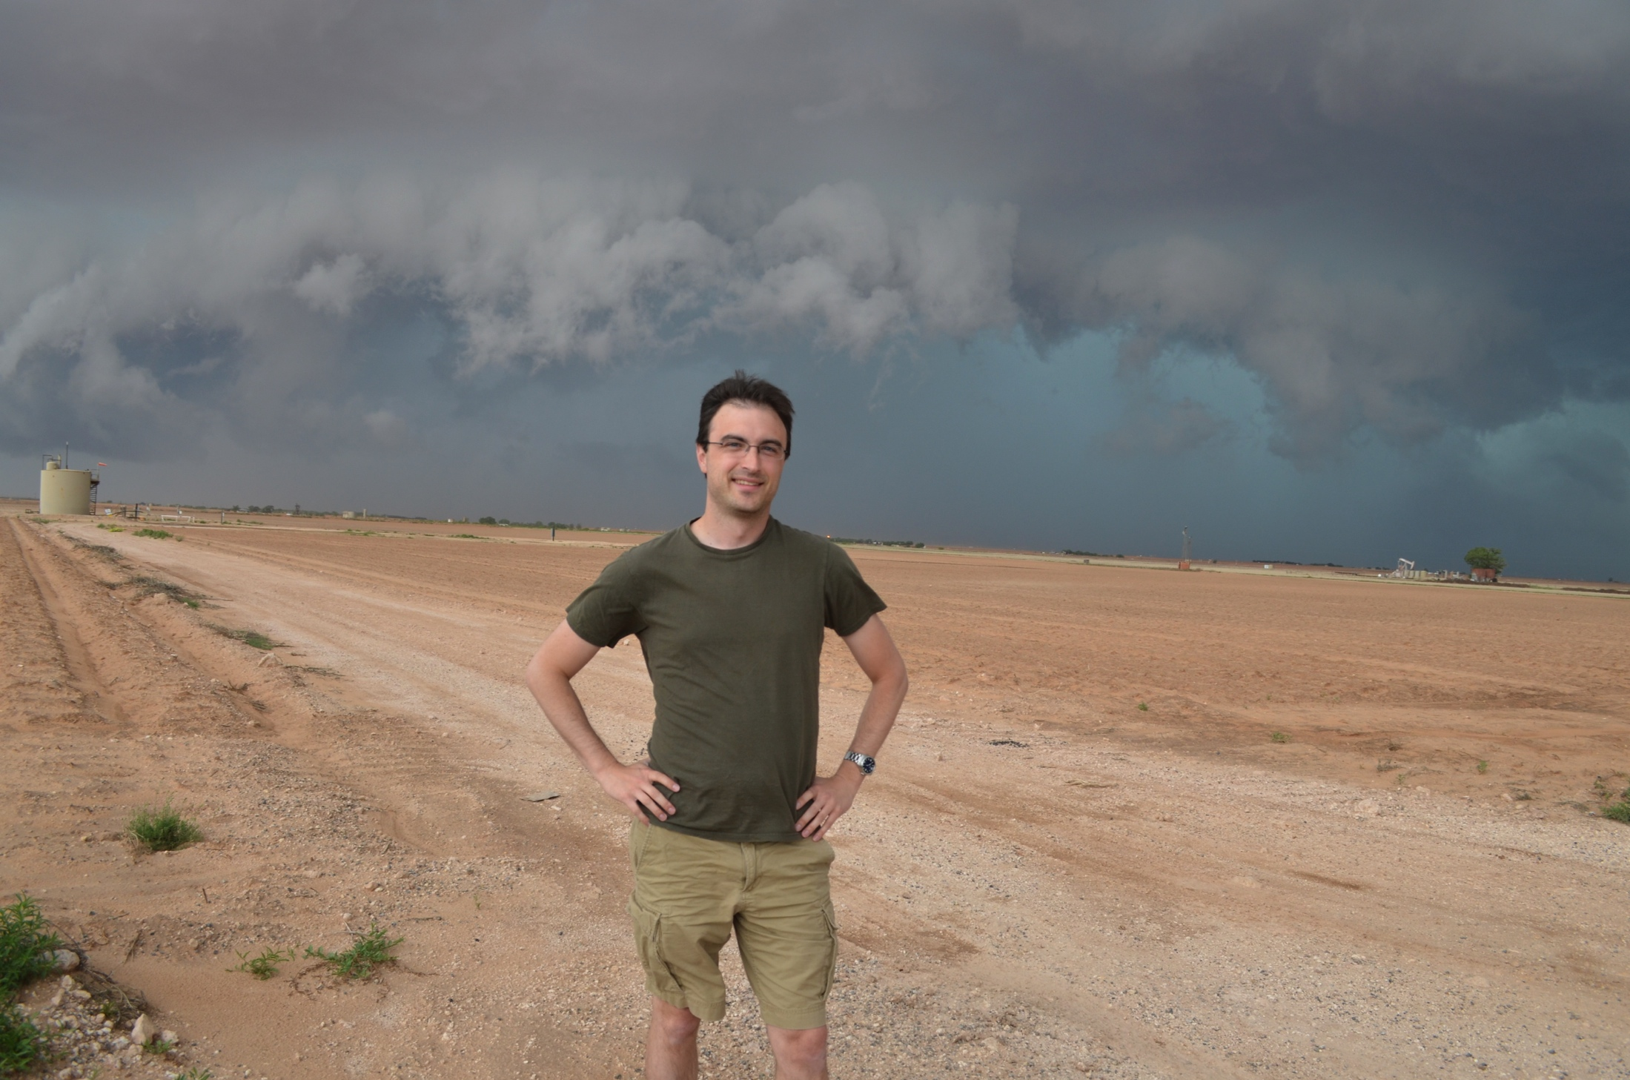
2145 UTC – U.S. 87 North of Big Spring, Texas

Slide 26
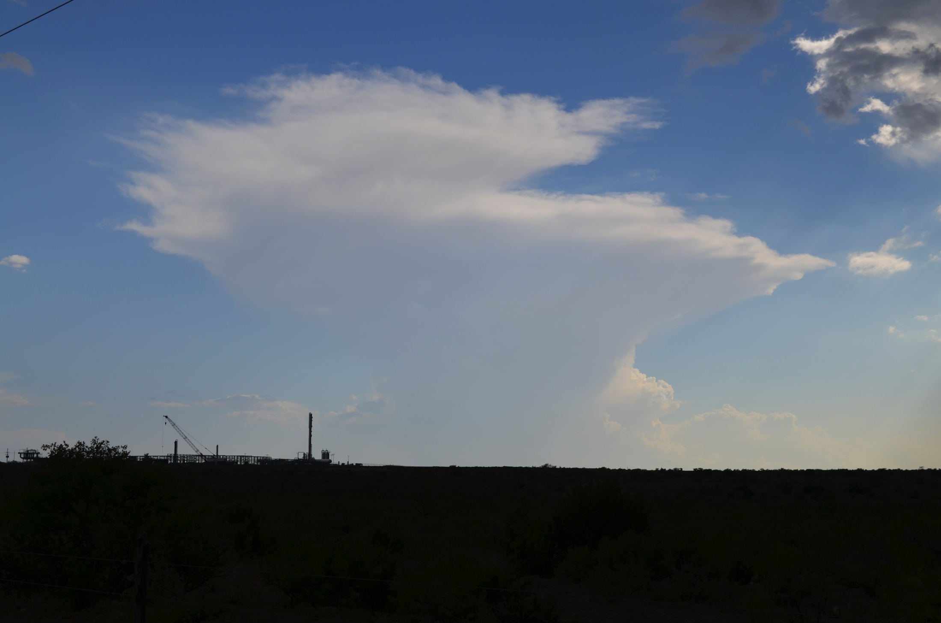
2242 UTC –North of Garden City, Texas

Slide 27
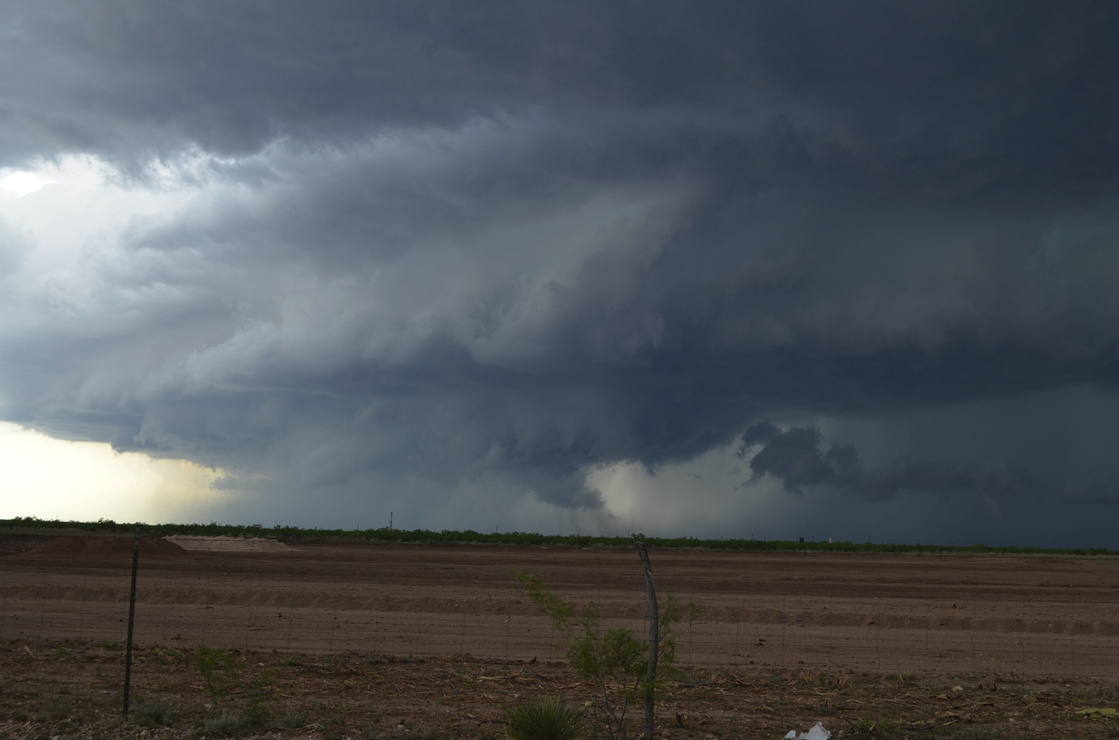
2247 UTC – Garden City, Texas

Slide 28
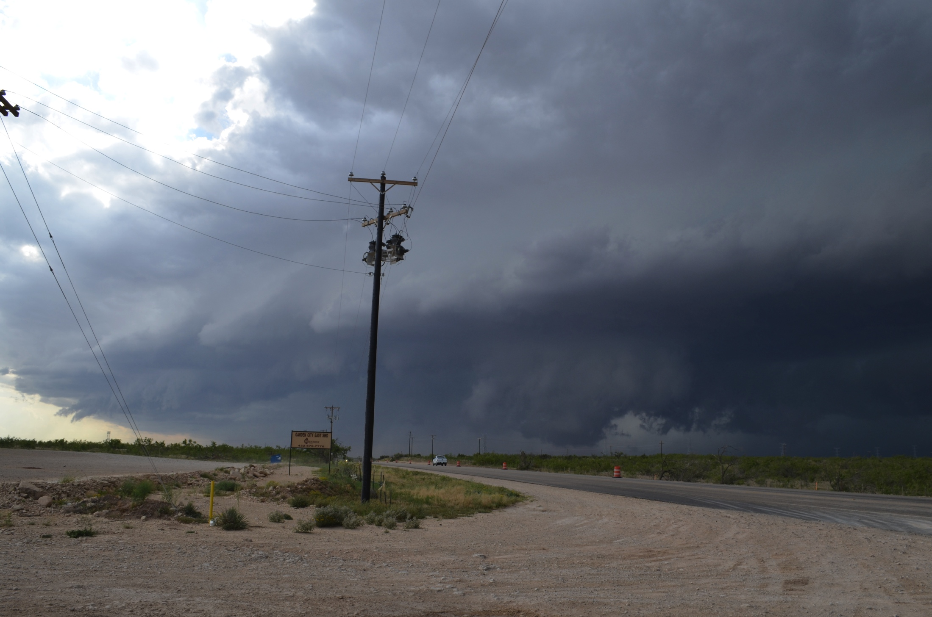
2308 UTC – Garden City, Texas

Slide 29
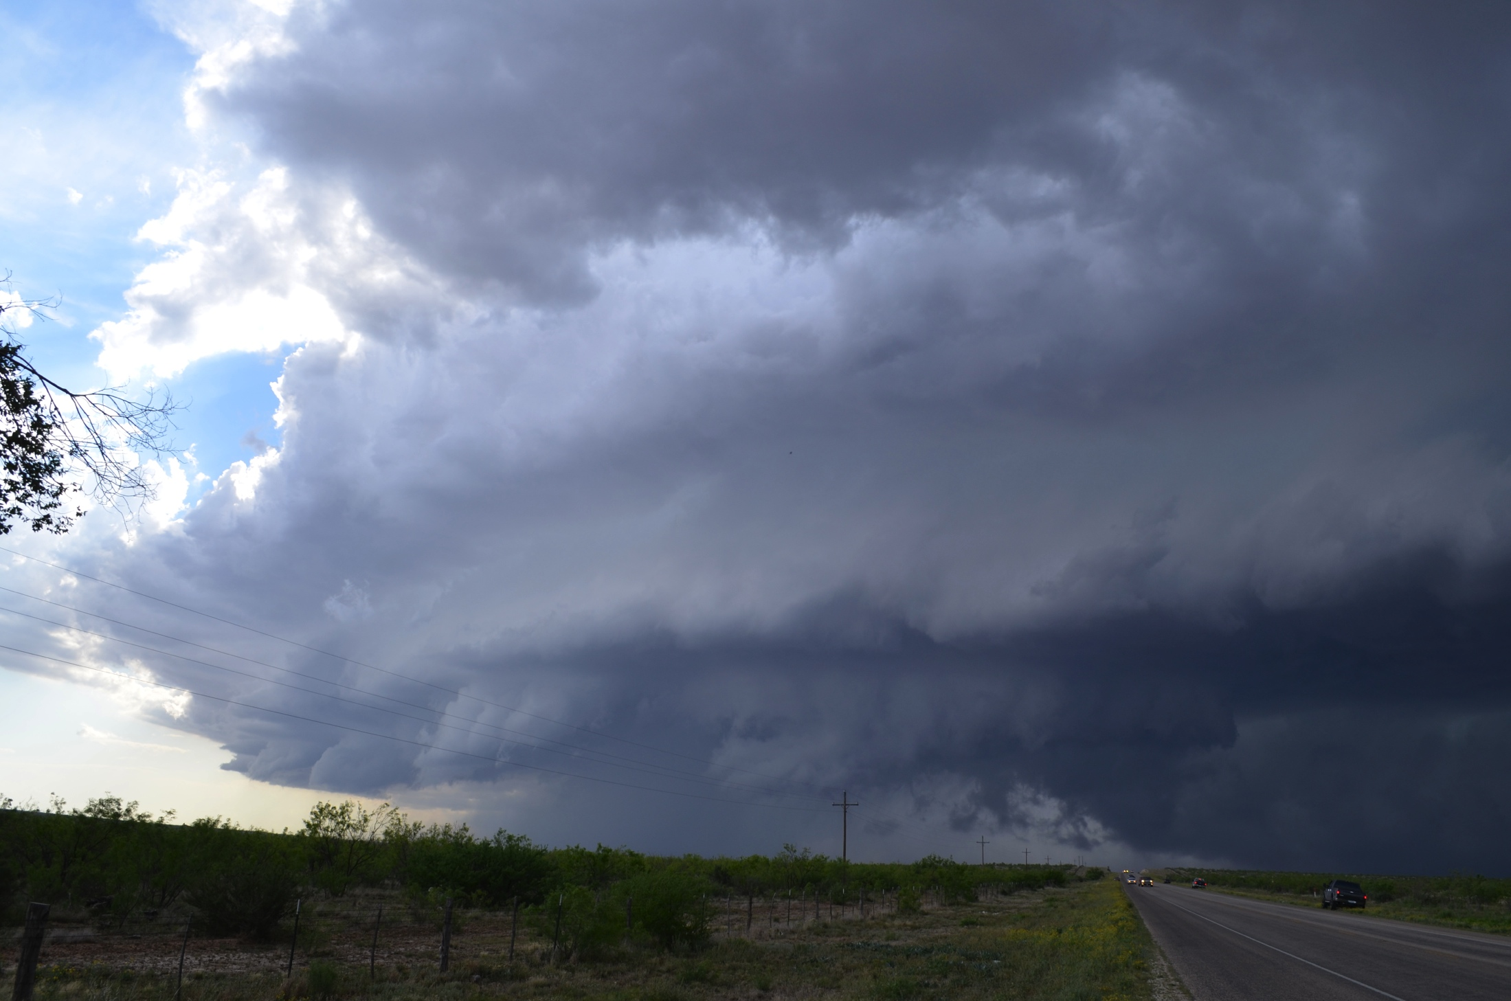
2321 UTC – Garden City, Texas

Slide 30
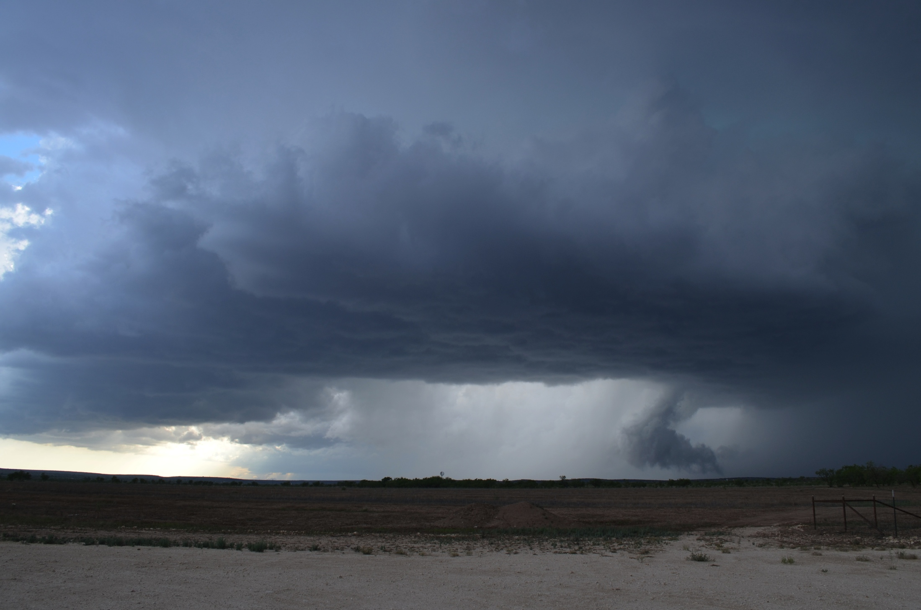
0004 UTC – Sterling City, Texas

Slide 31
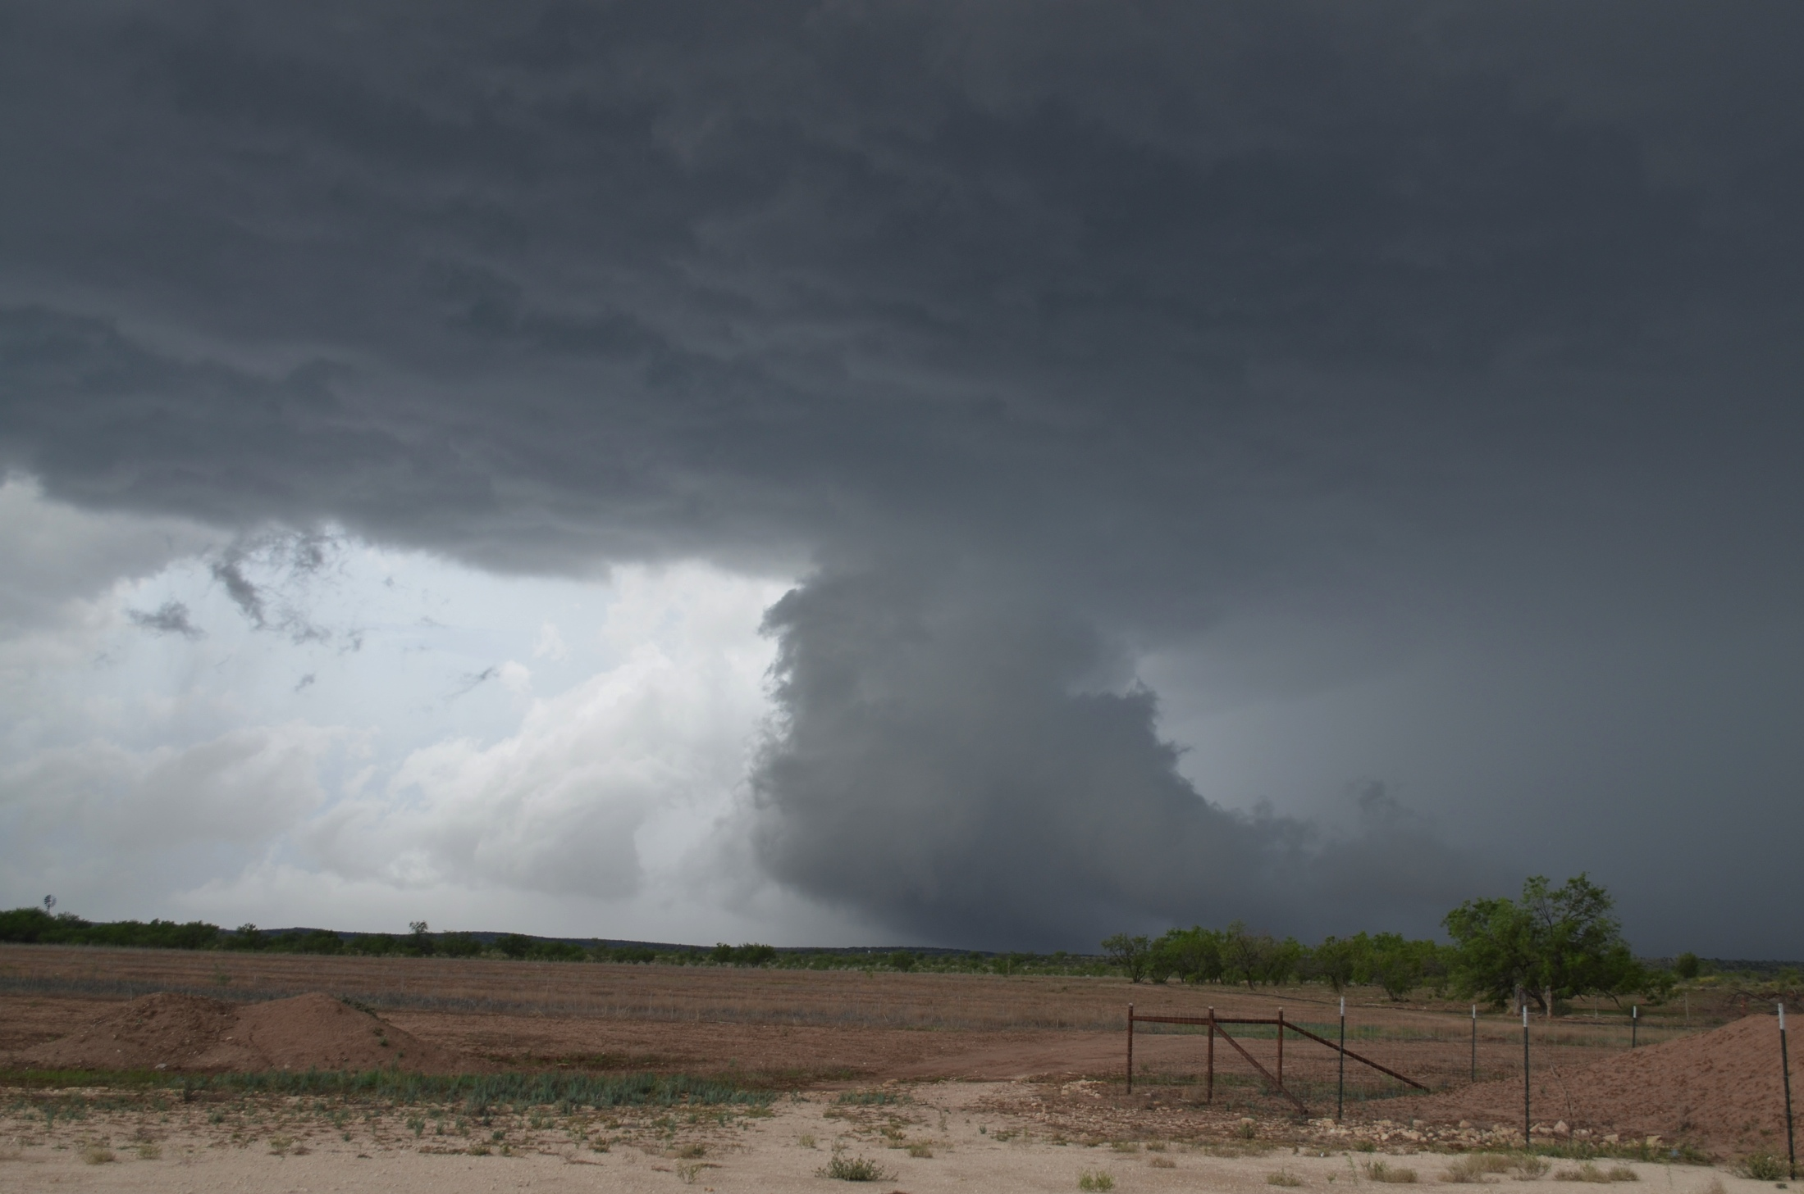
0009 UTC – Sterling City, Texas

Slide 32
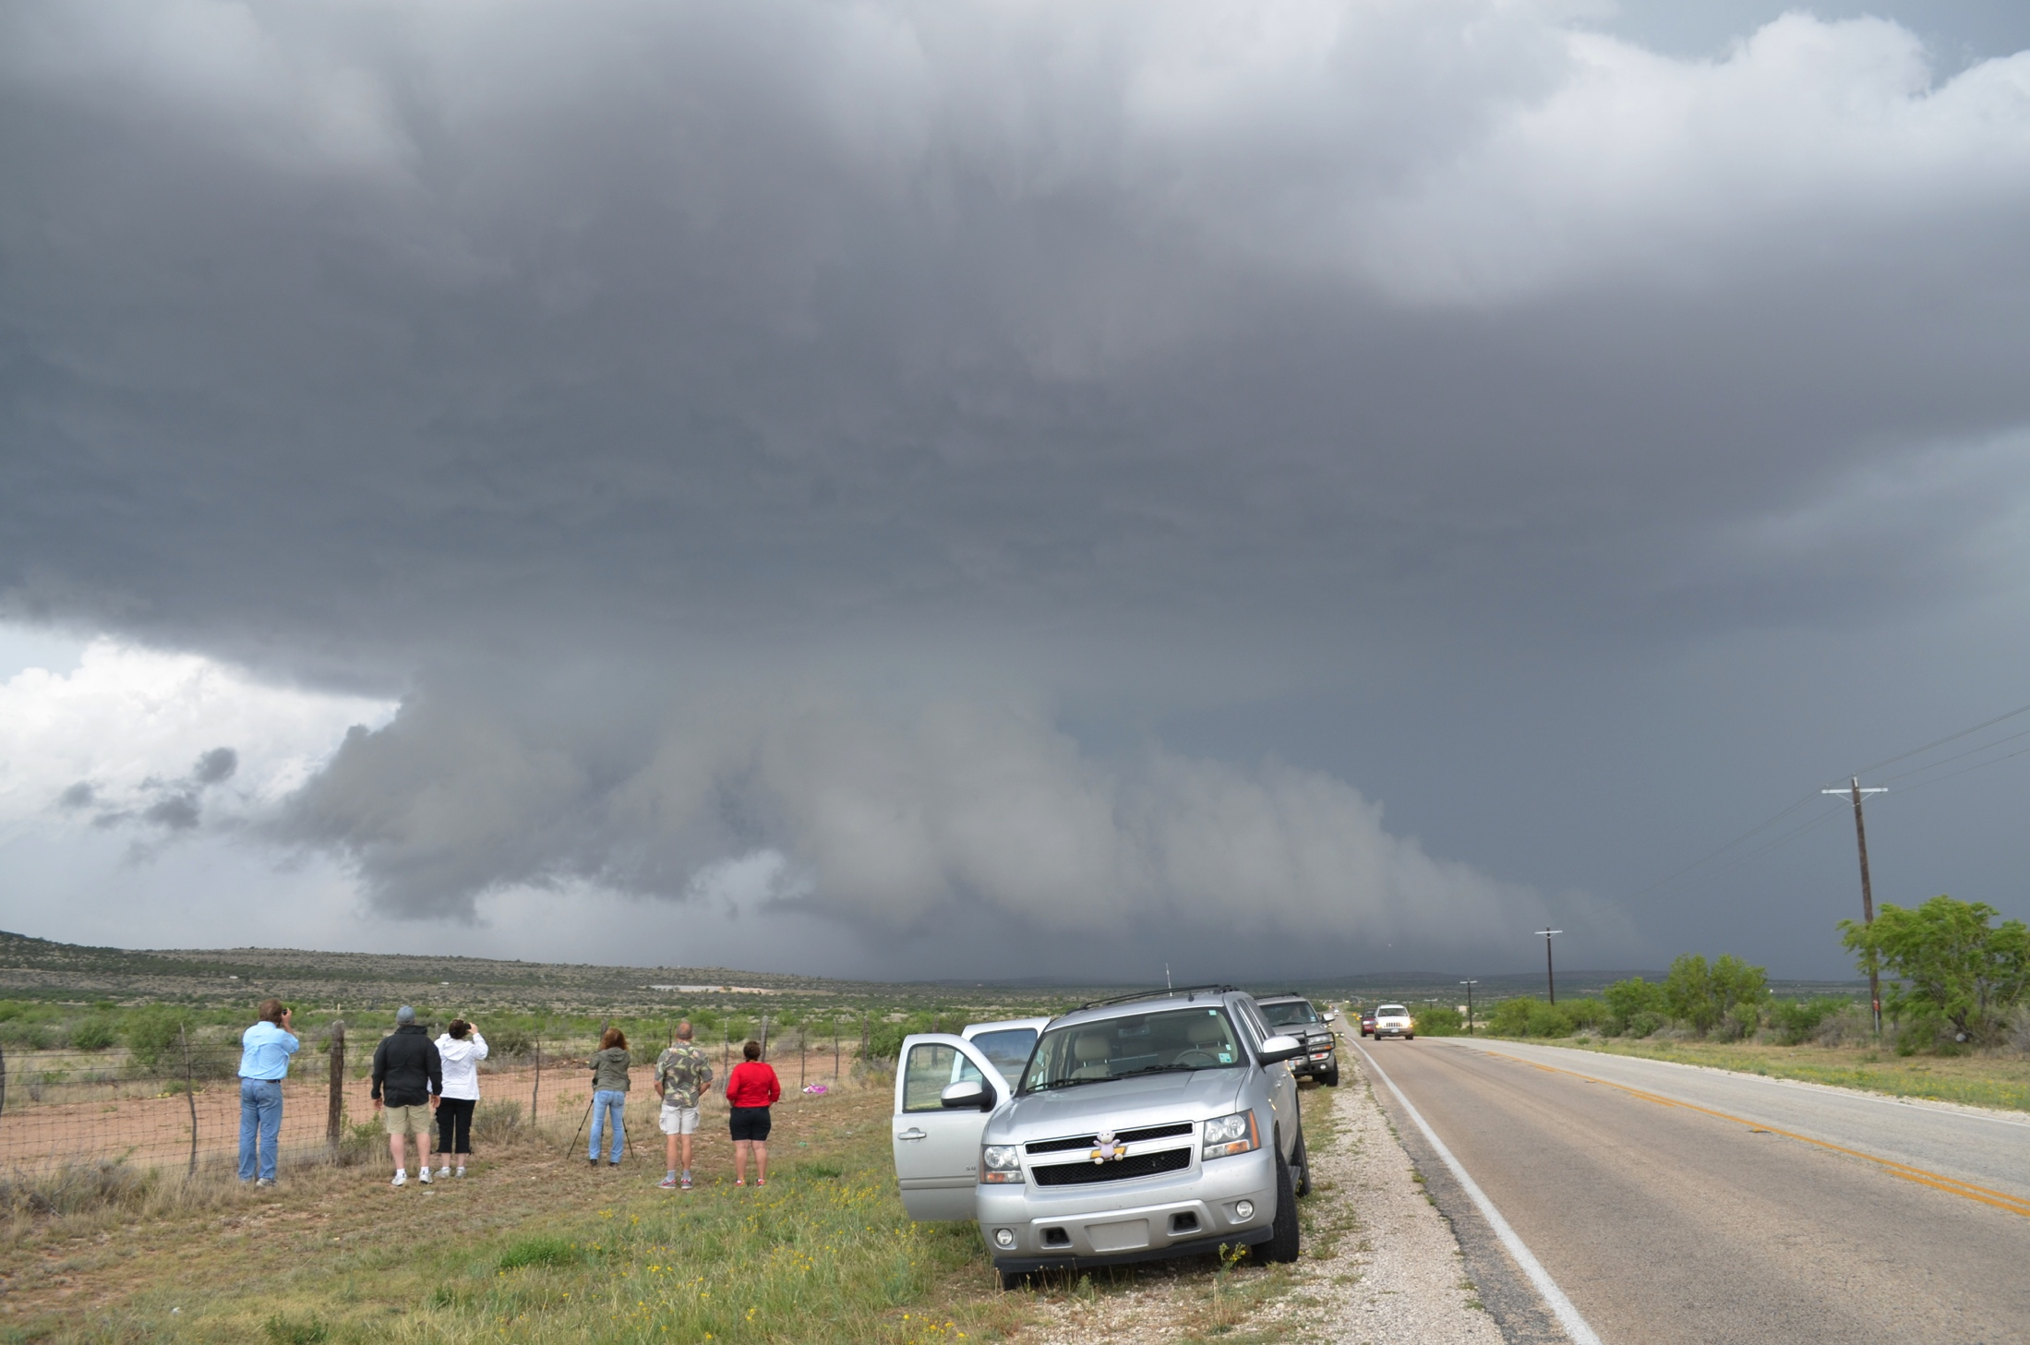
0013 UTC – Sterling City, Texas

Slide 33
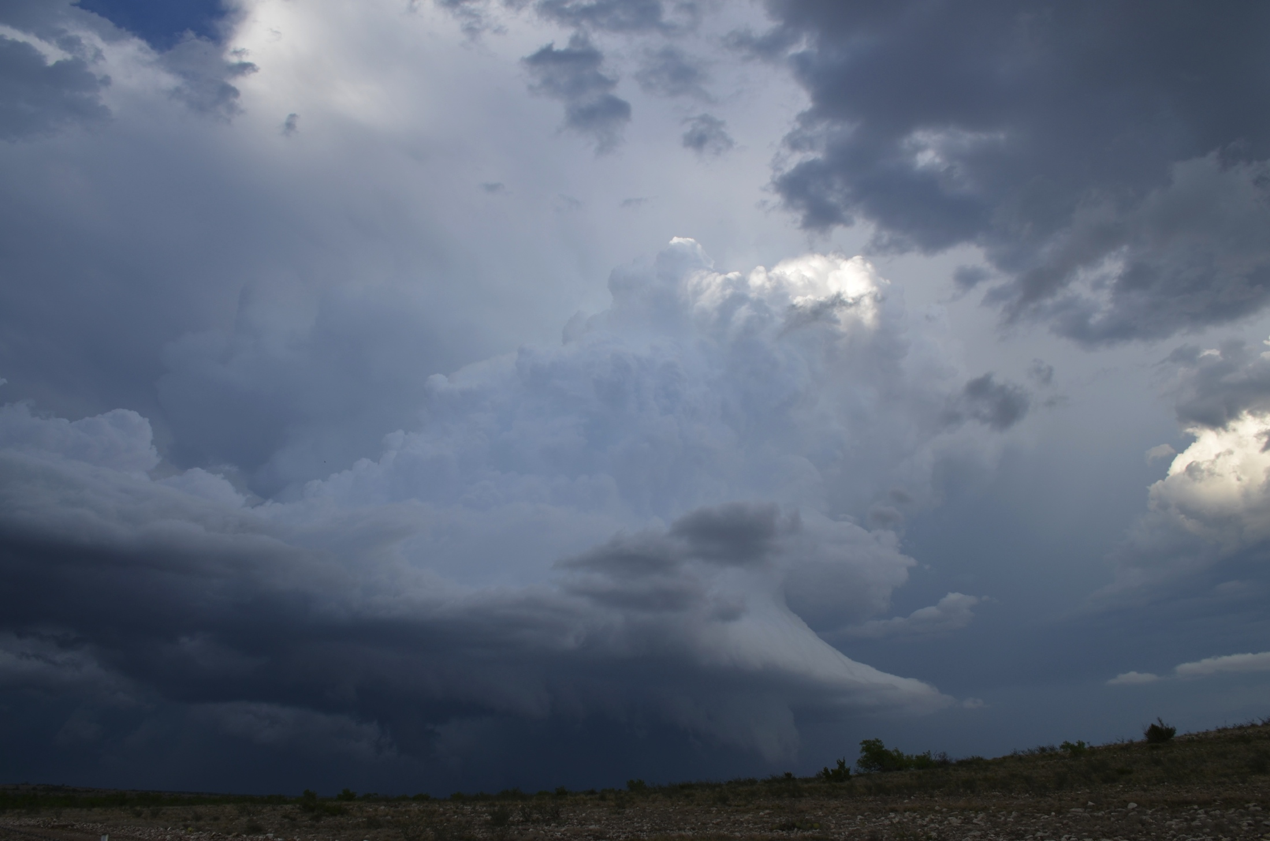
0029 UTC – South of Sterling City, Texas

Slide 34
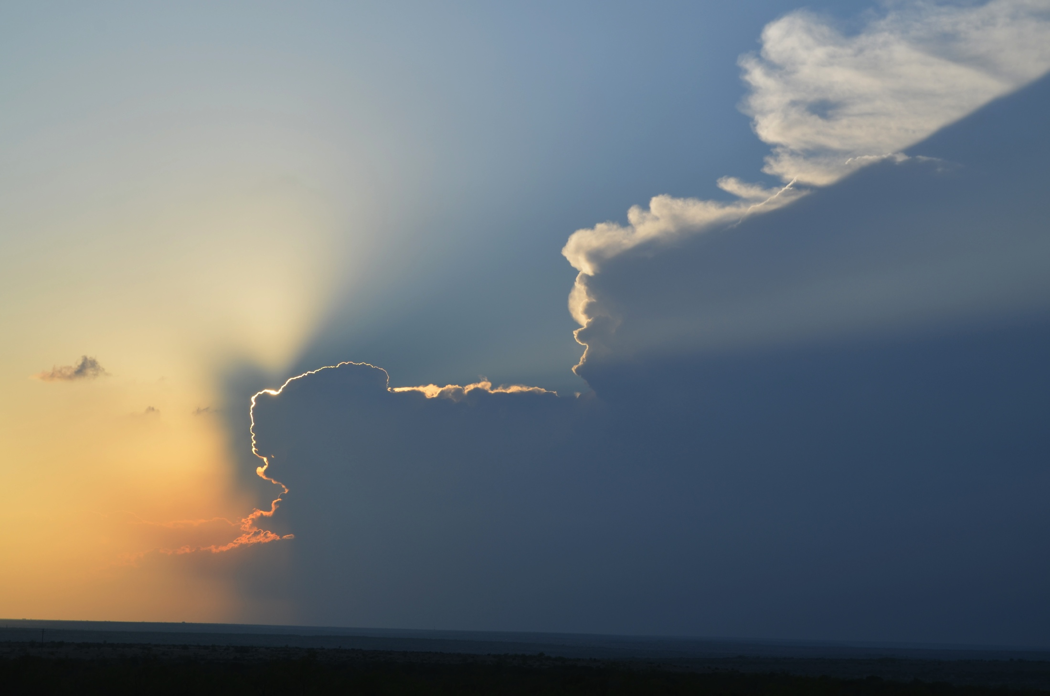
0109 UTC – South of Sterling City, Texas

Slide 35
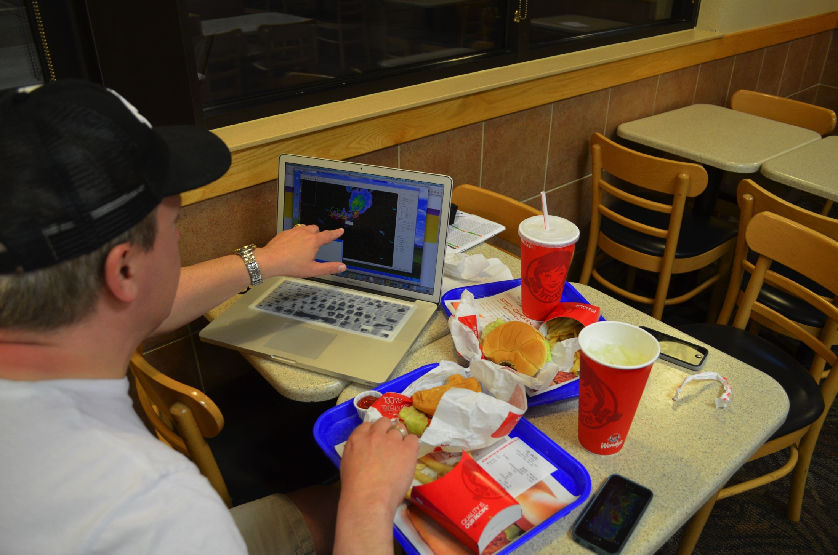
Wendy’s in San Angelo, Texas

