Slide 1
Storm Chase May 26-27, 2014

Slide 2
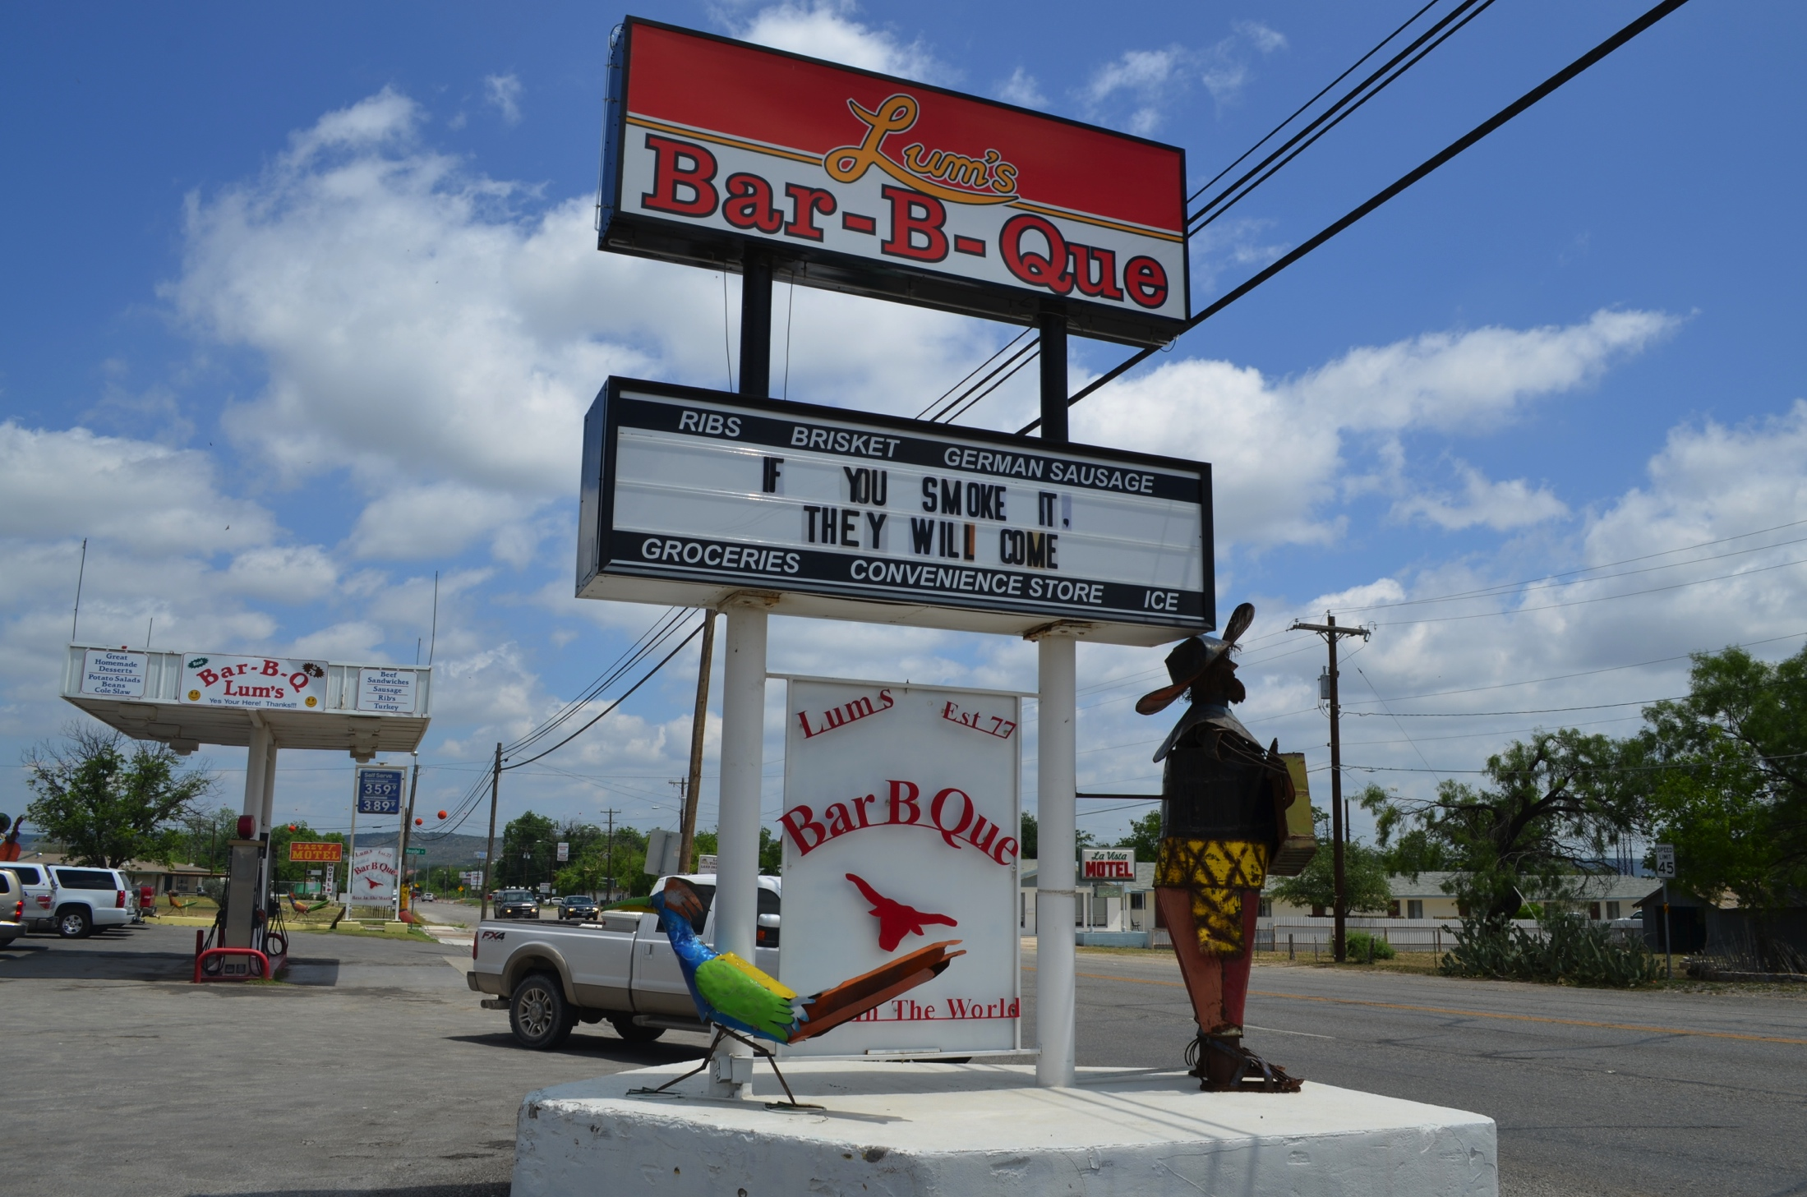
May 27 - Junction, Texas

Slide 3
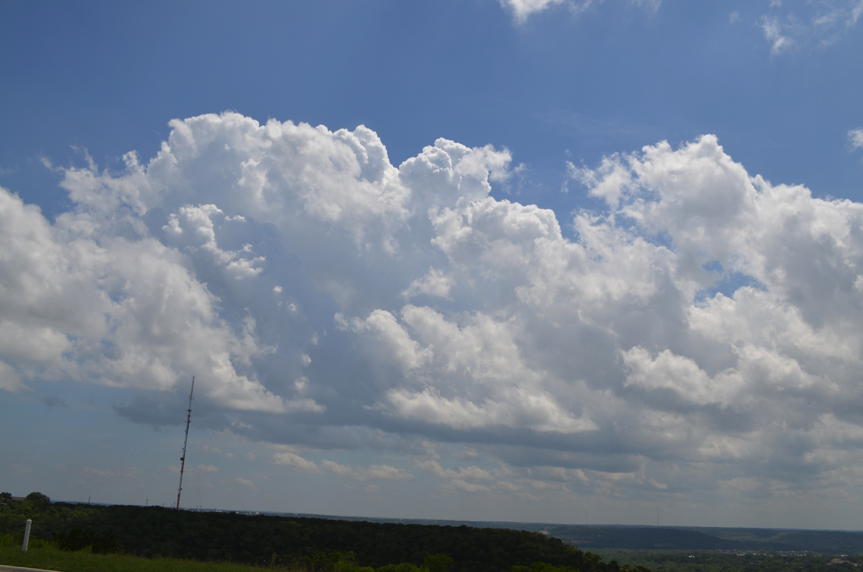
2009 UTC – Kerrville, Texas

Slide 4
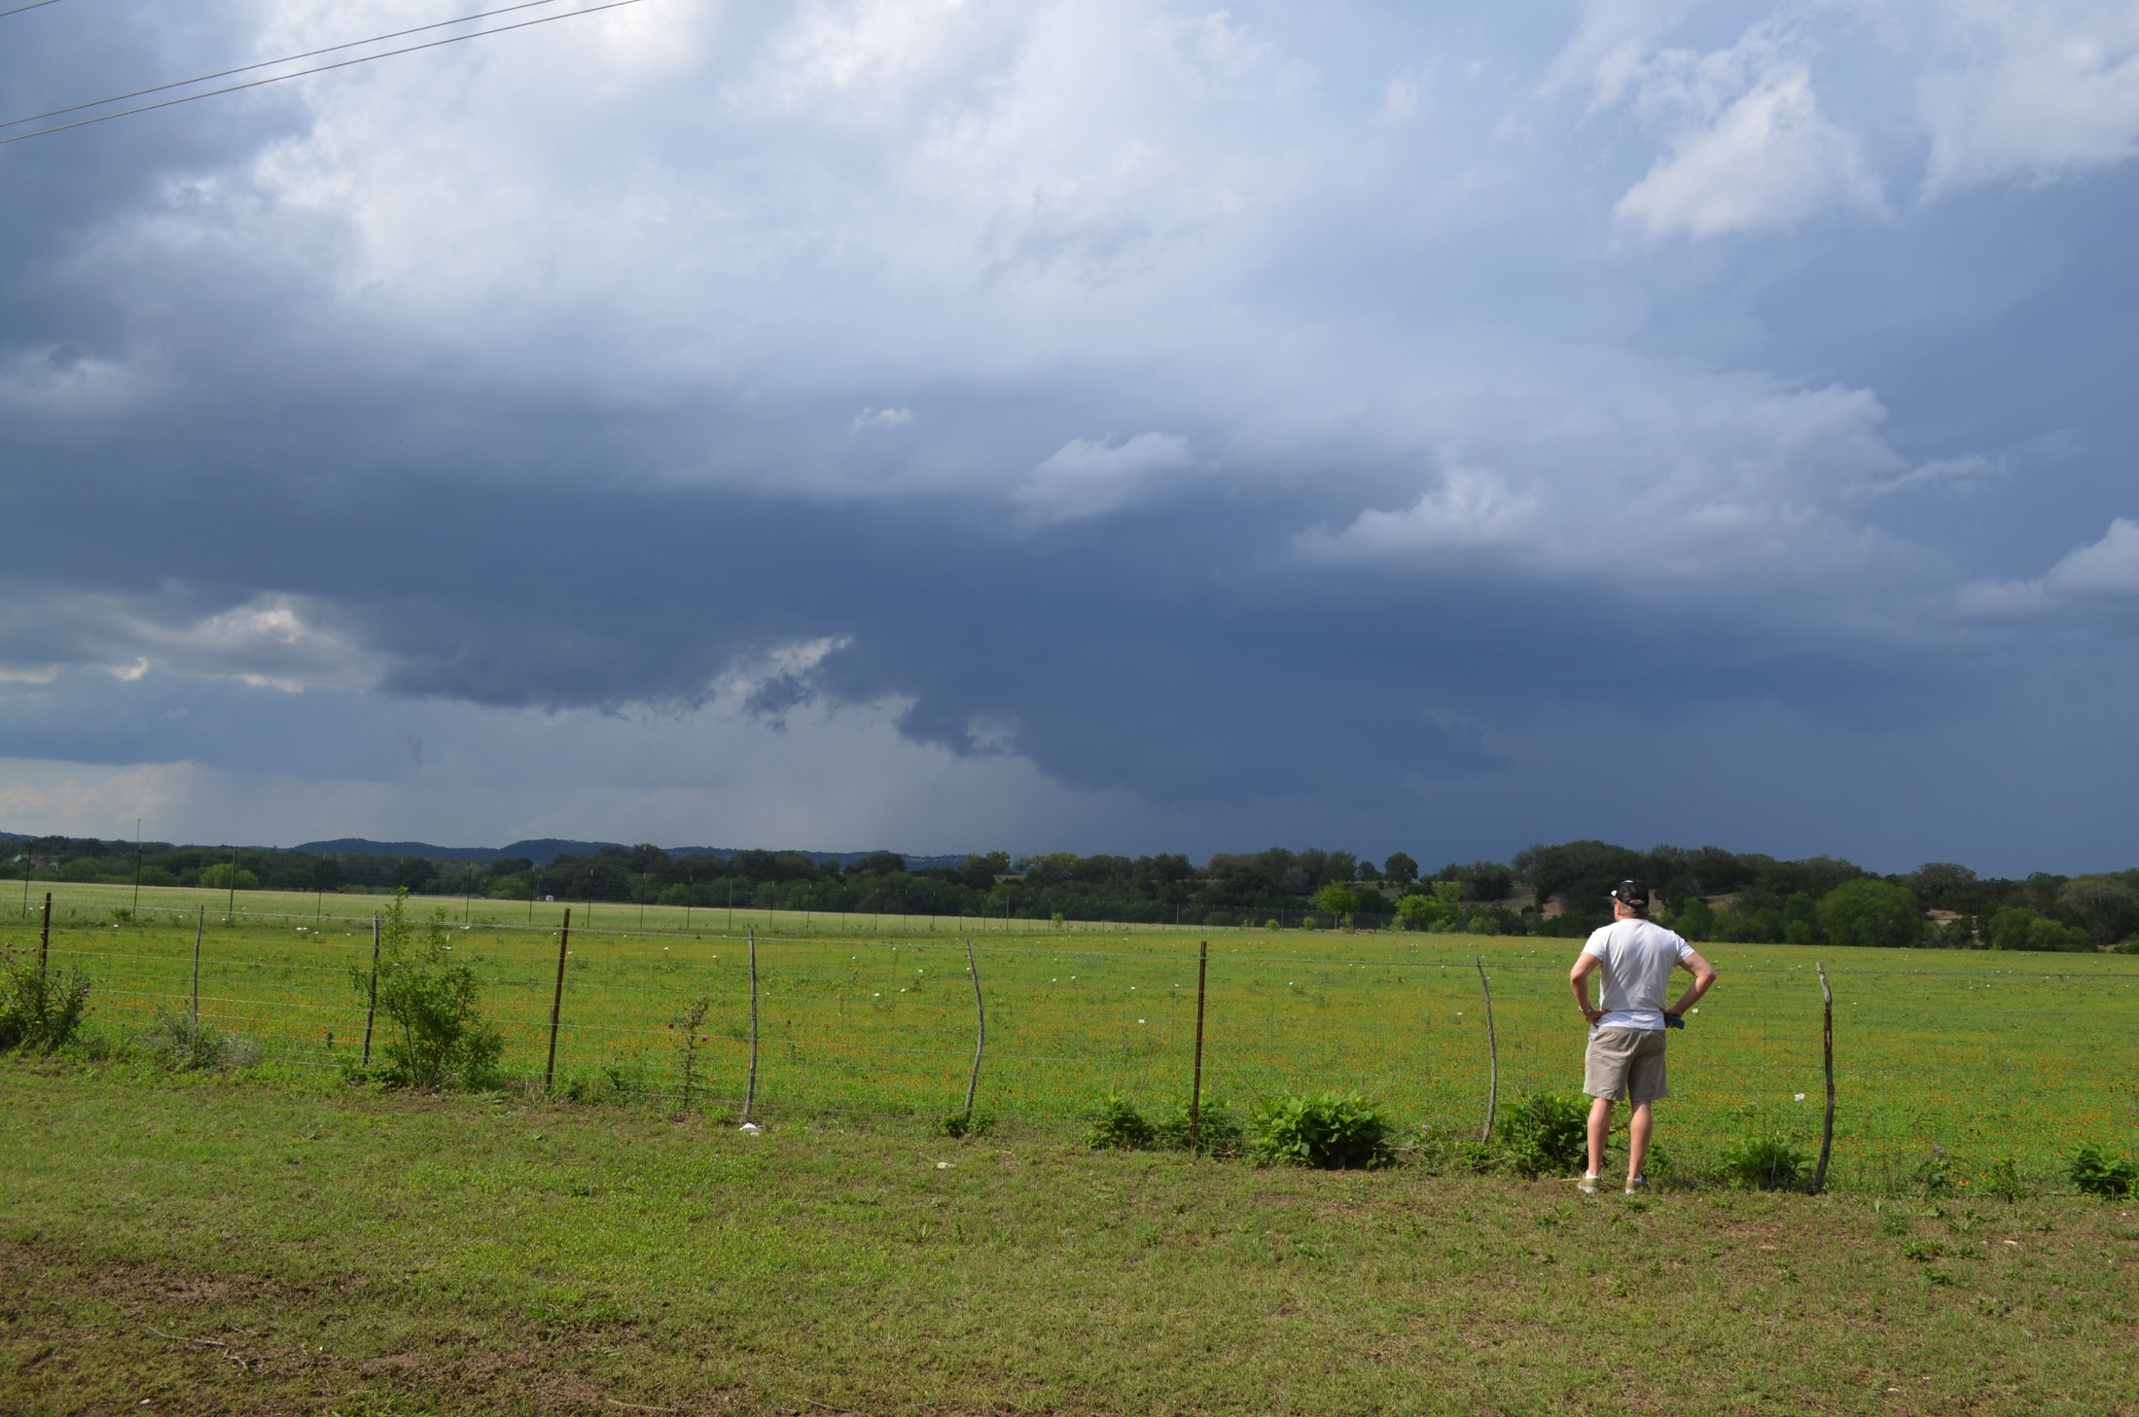
2211 UTC – South of Kerrville, Texas

Slide 5
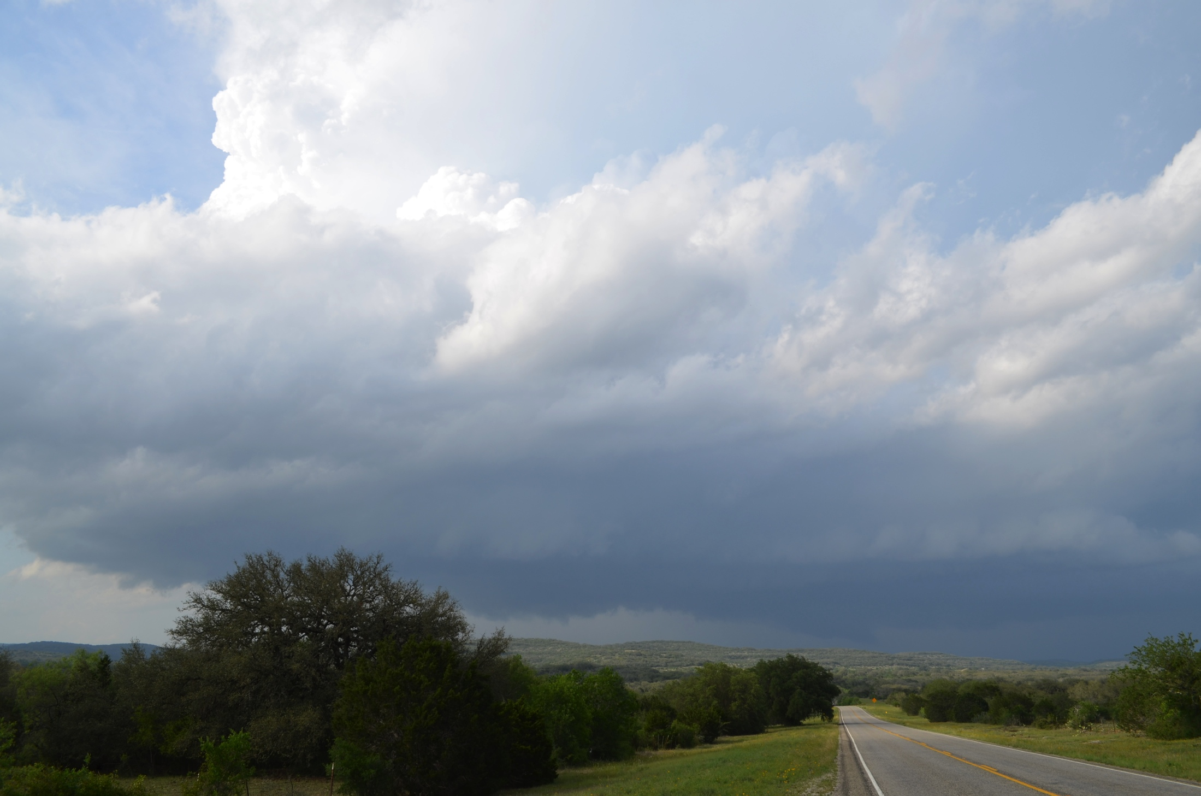
2300 UTC – Near Bandera, Texas

Slide 6
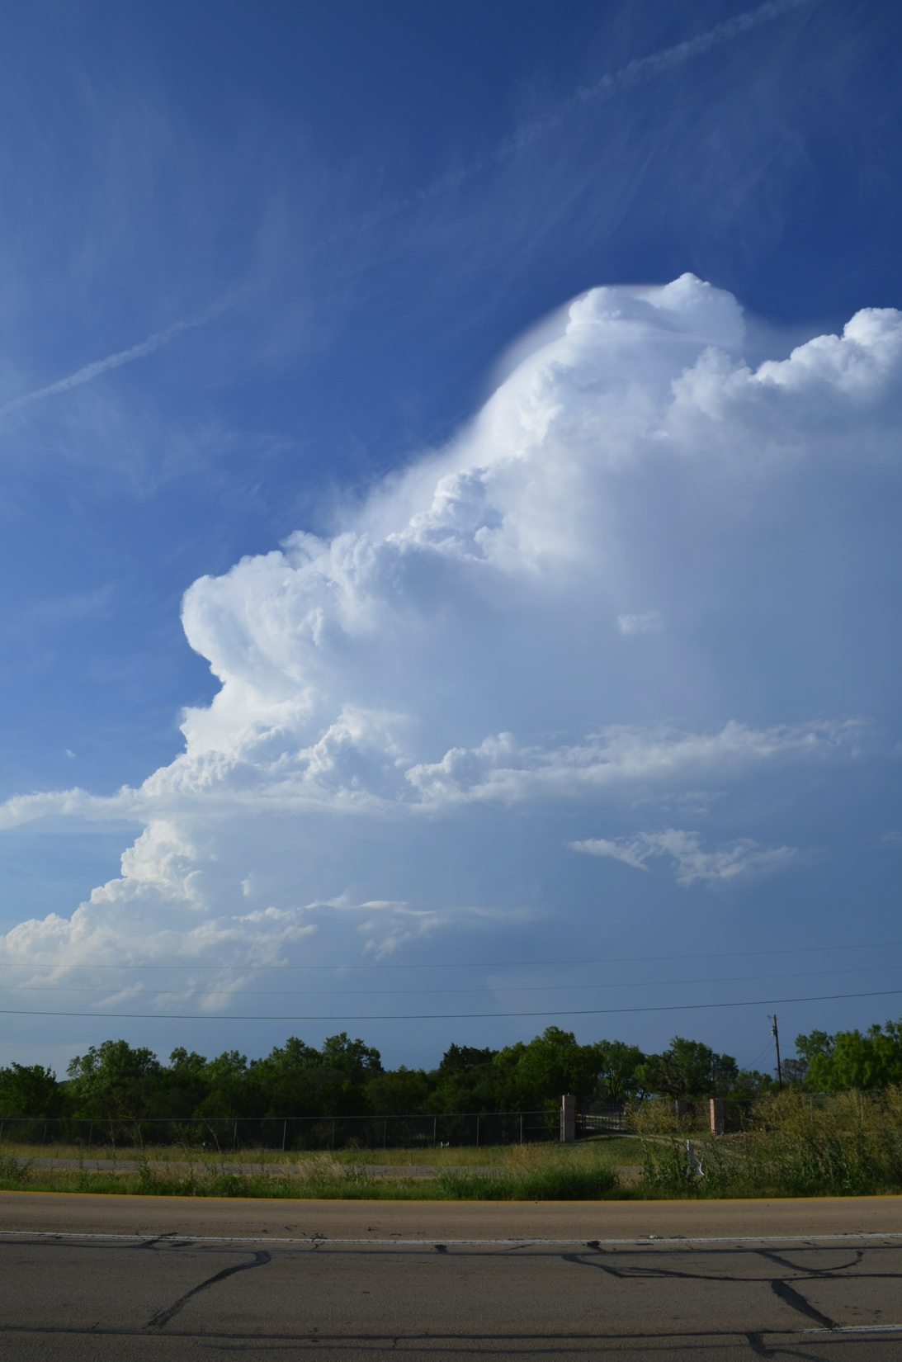
2321 UTC Castroville, Texas

Slide 7
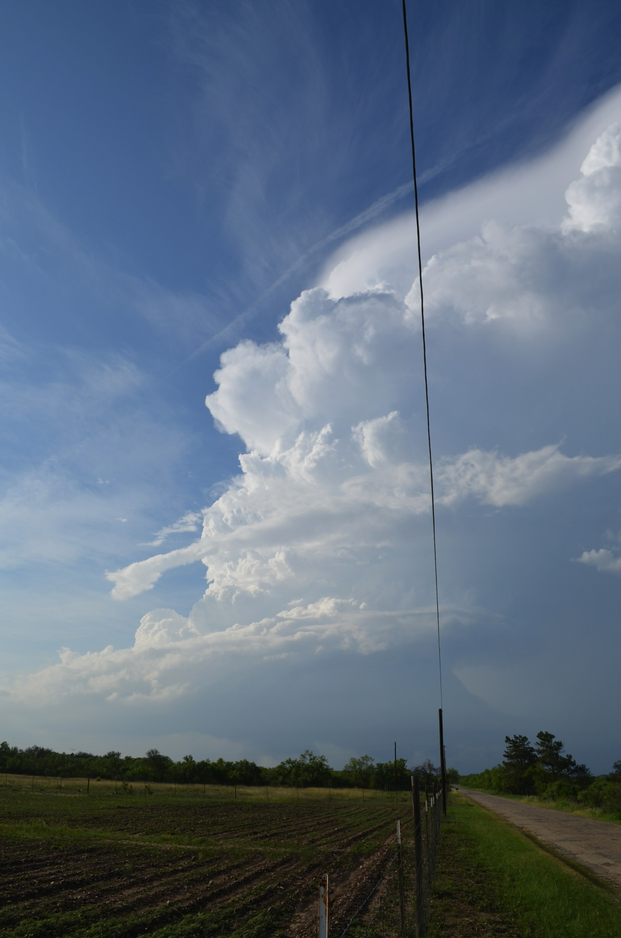
2324 UTC Castroville, Texas

Slide 8
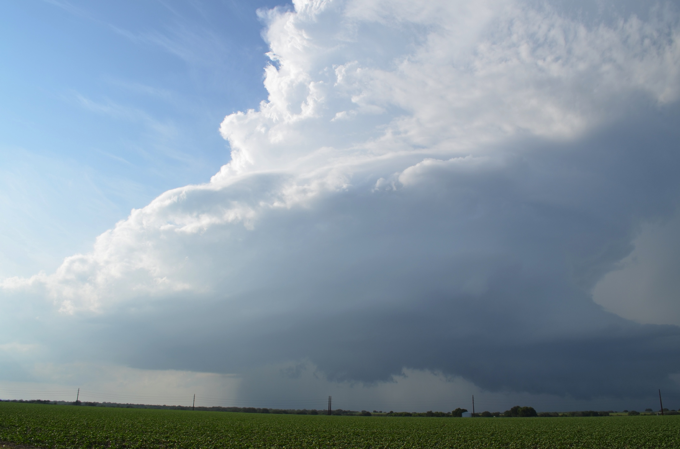
2334 UTC – Castroville, Texas

Slide 9
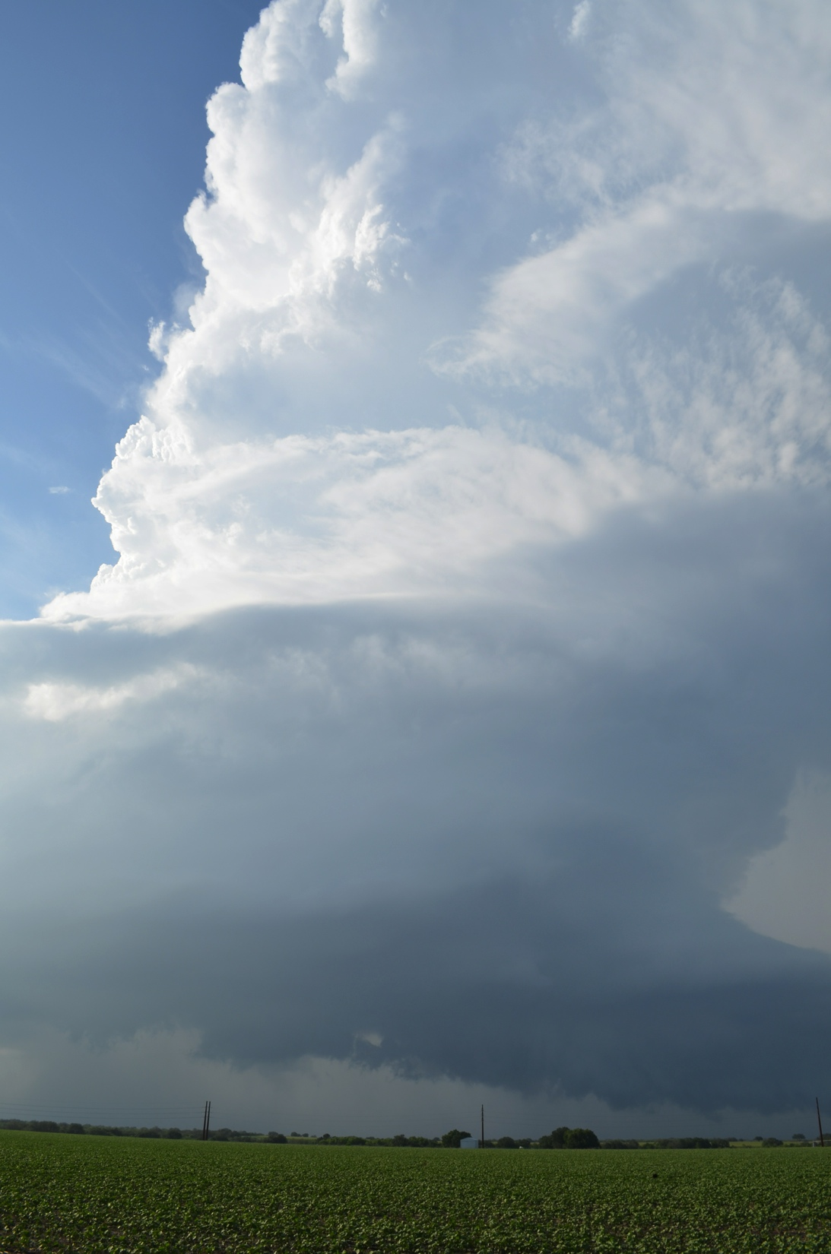
2335 UTC Castroville, Texas

Slide 10
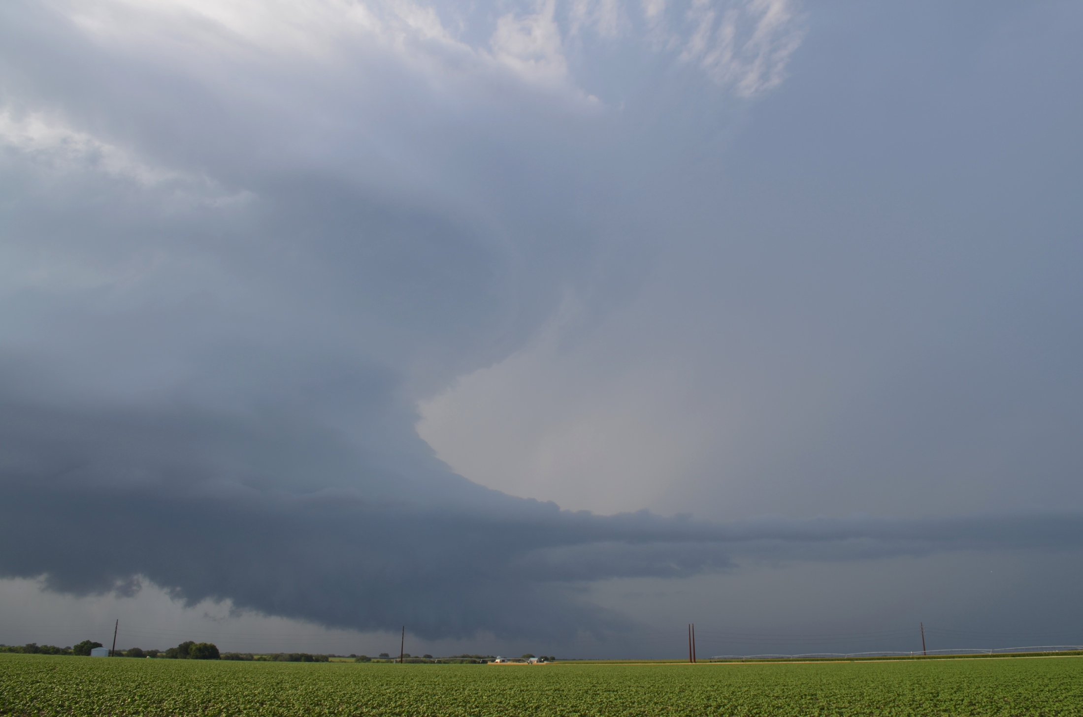
2337 UTC – Castroville, Texas

Slide 11
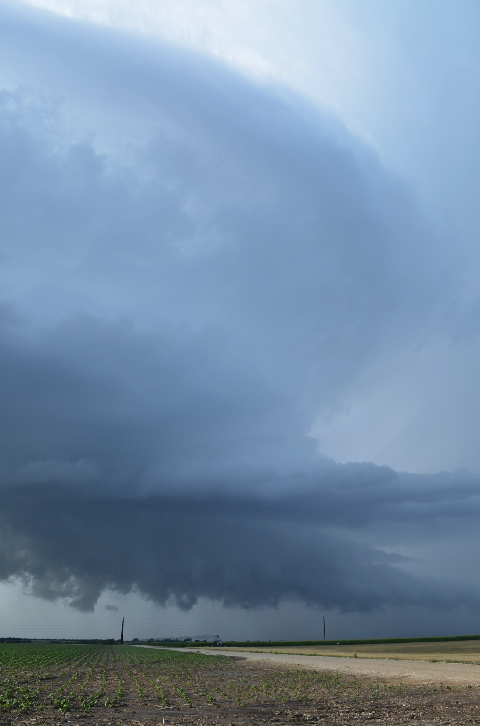
2341 UTC Castroville, Texas

Slide 12
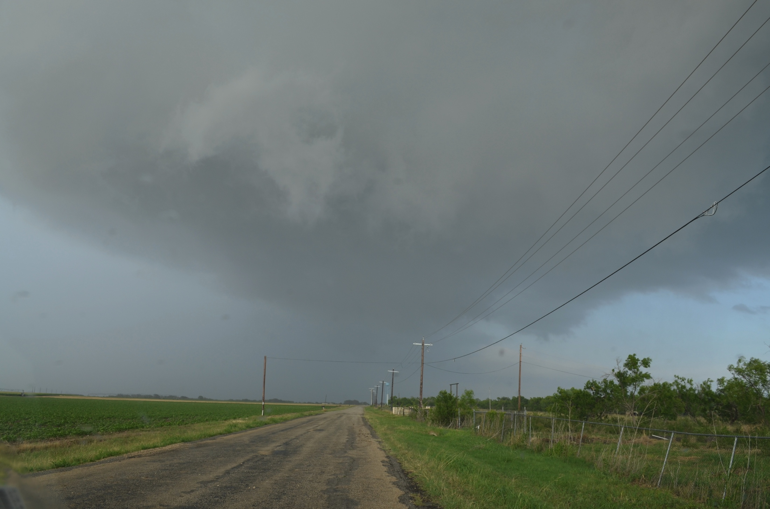
2351 UTC – Castroville, Texas

Slide 13
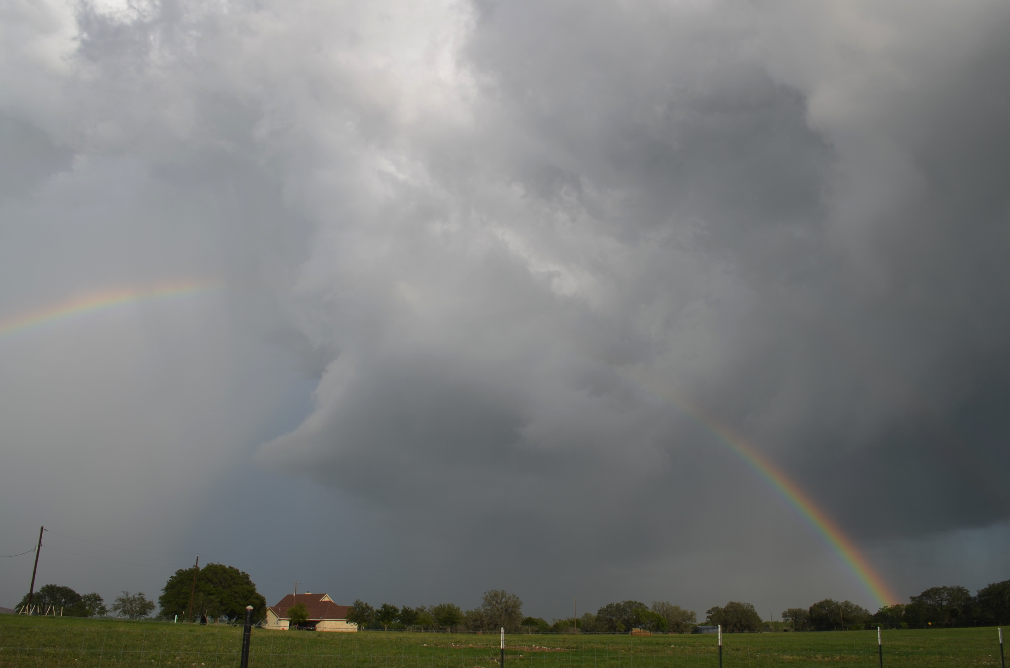
2358 UTC – Castroville, Texas

Slide 14
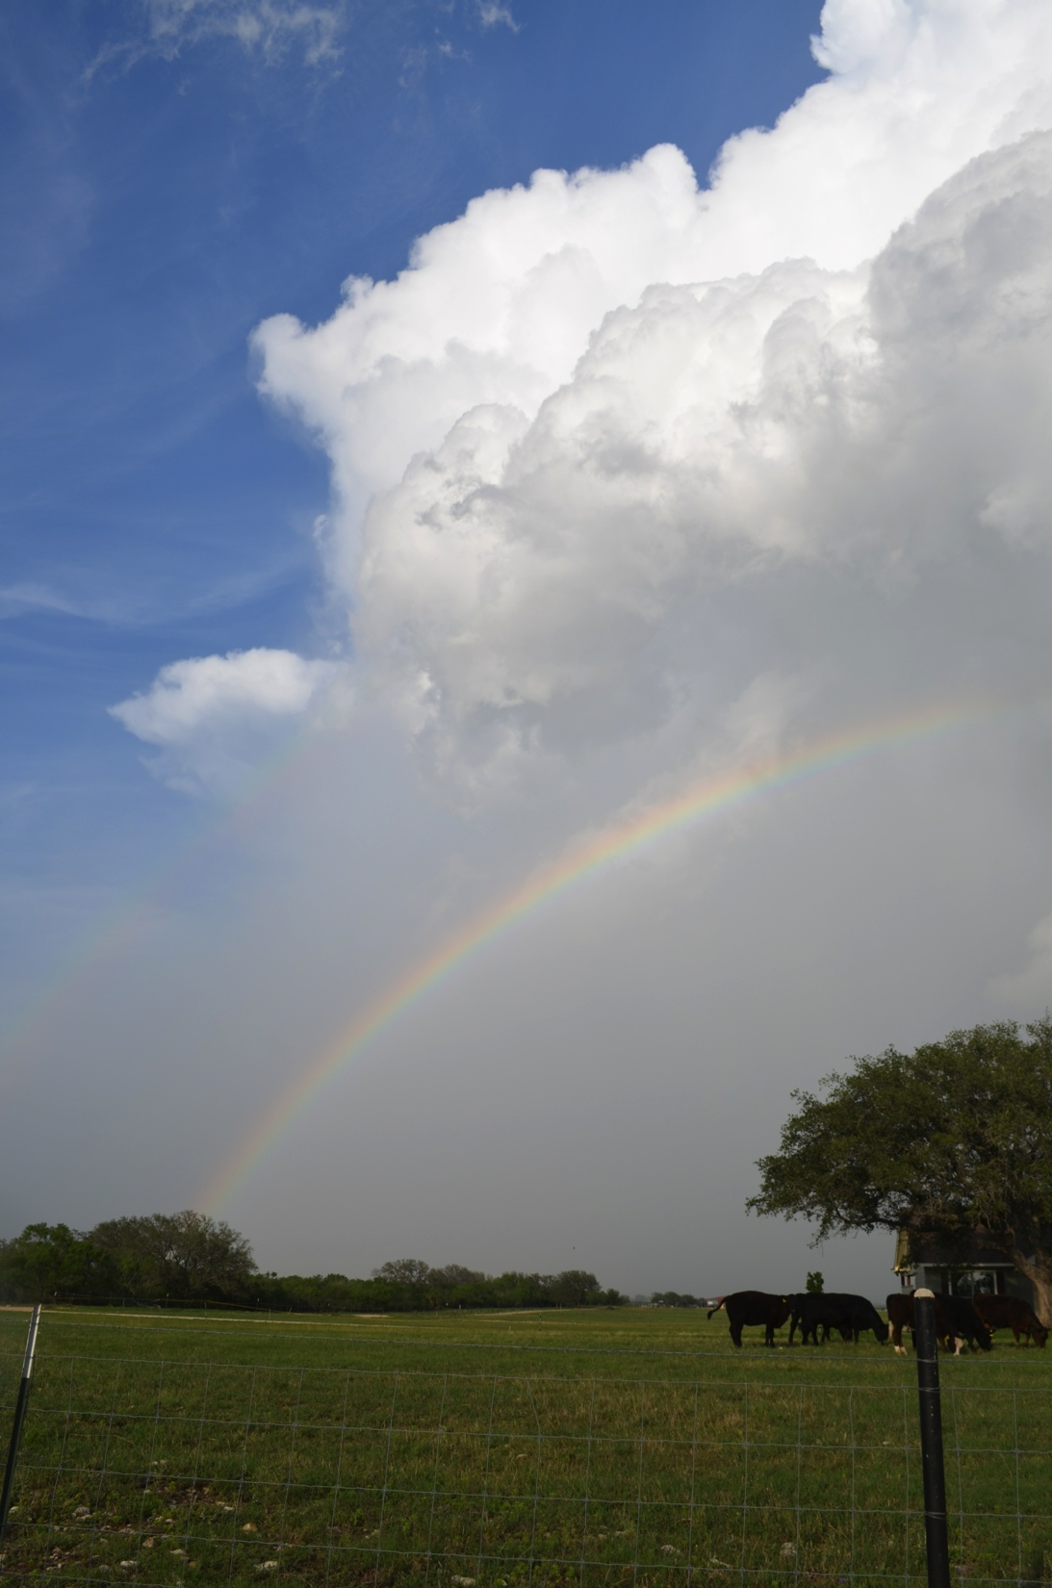
2359 UTC Castroville, Texas

Slide 15
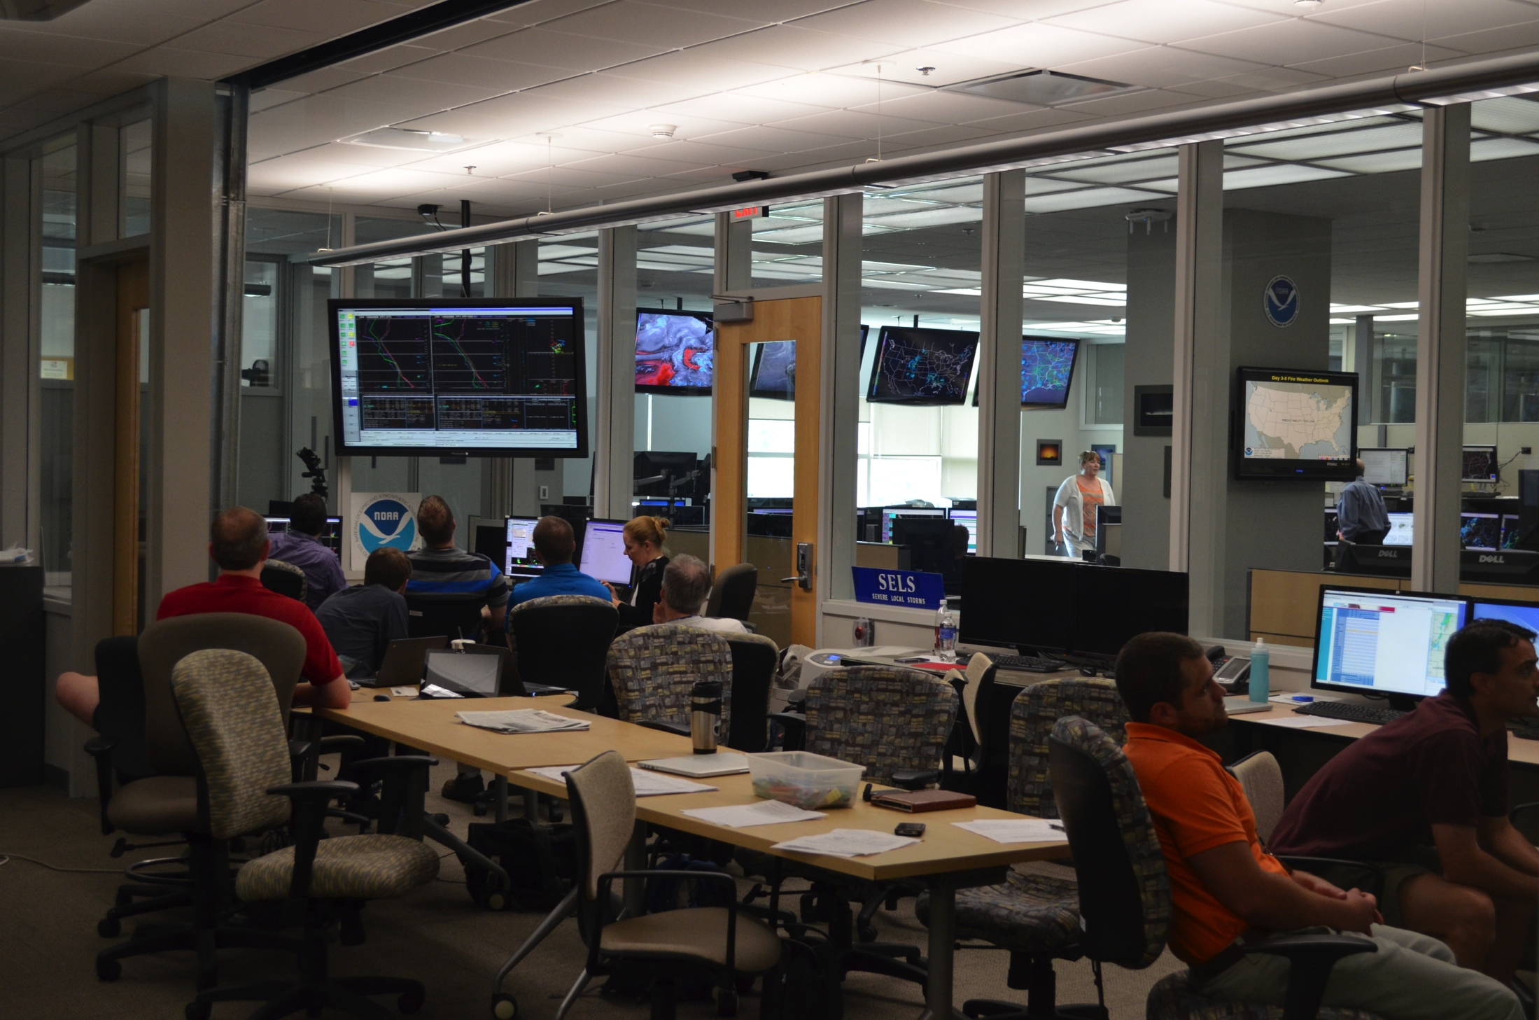
Hazardous Weather Testbed – Norman, OK

Slide 16
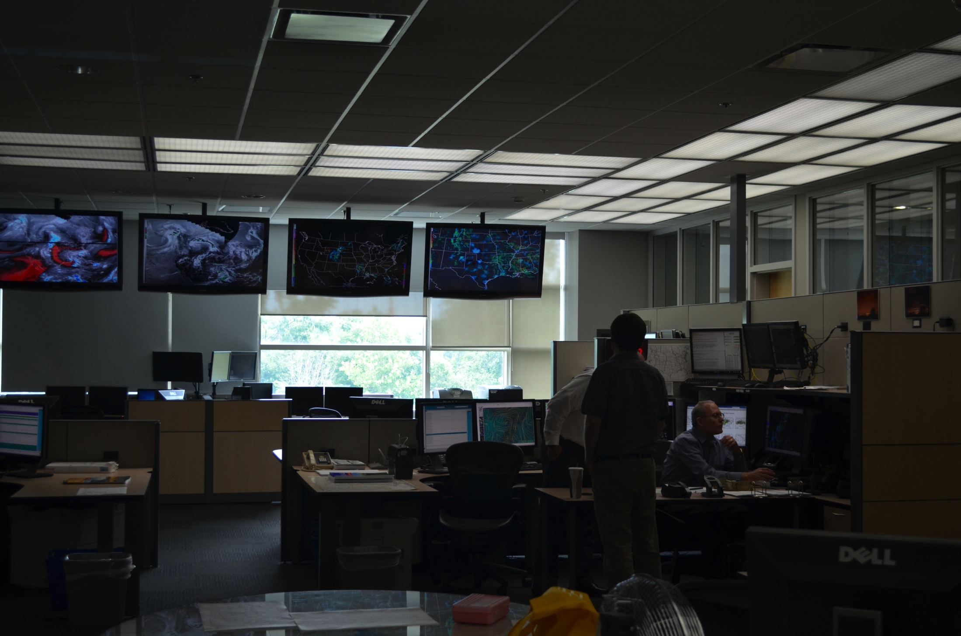
Storm Prediction Center – Norman, OK

Slide 17
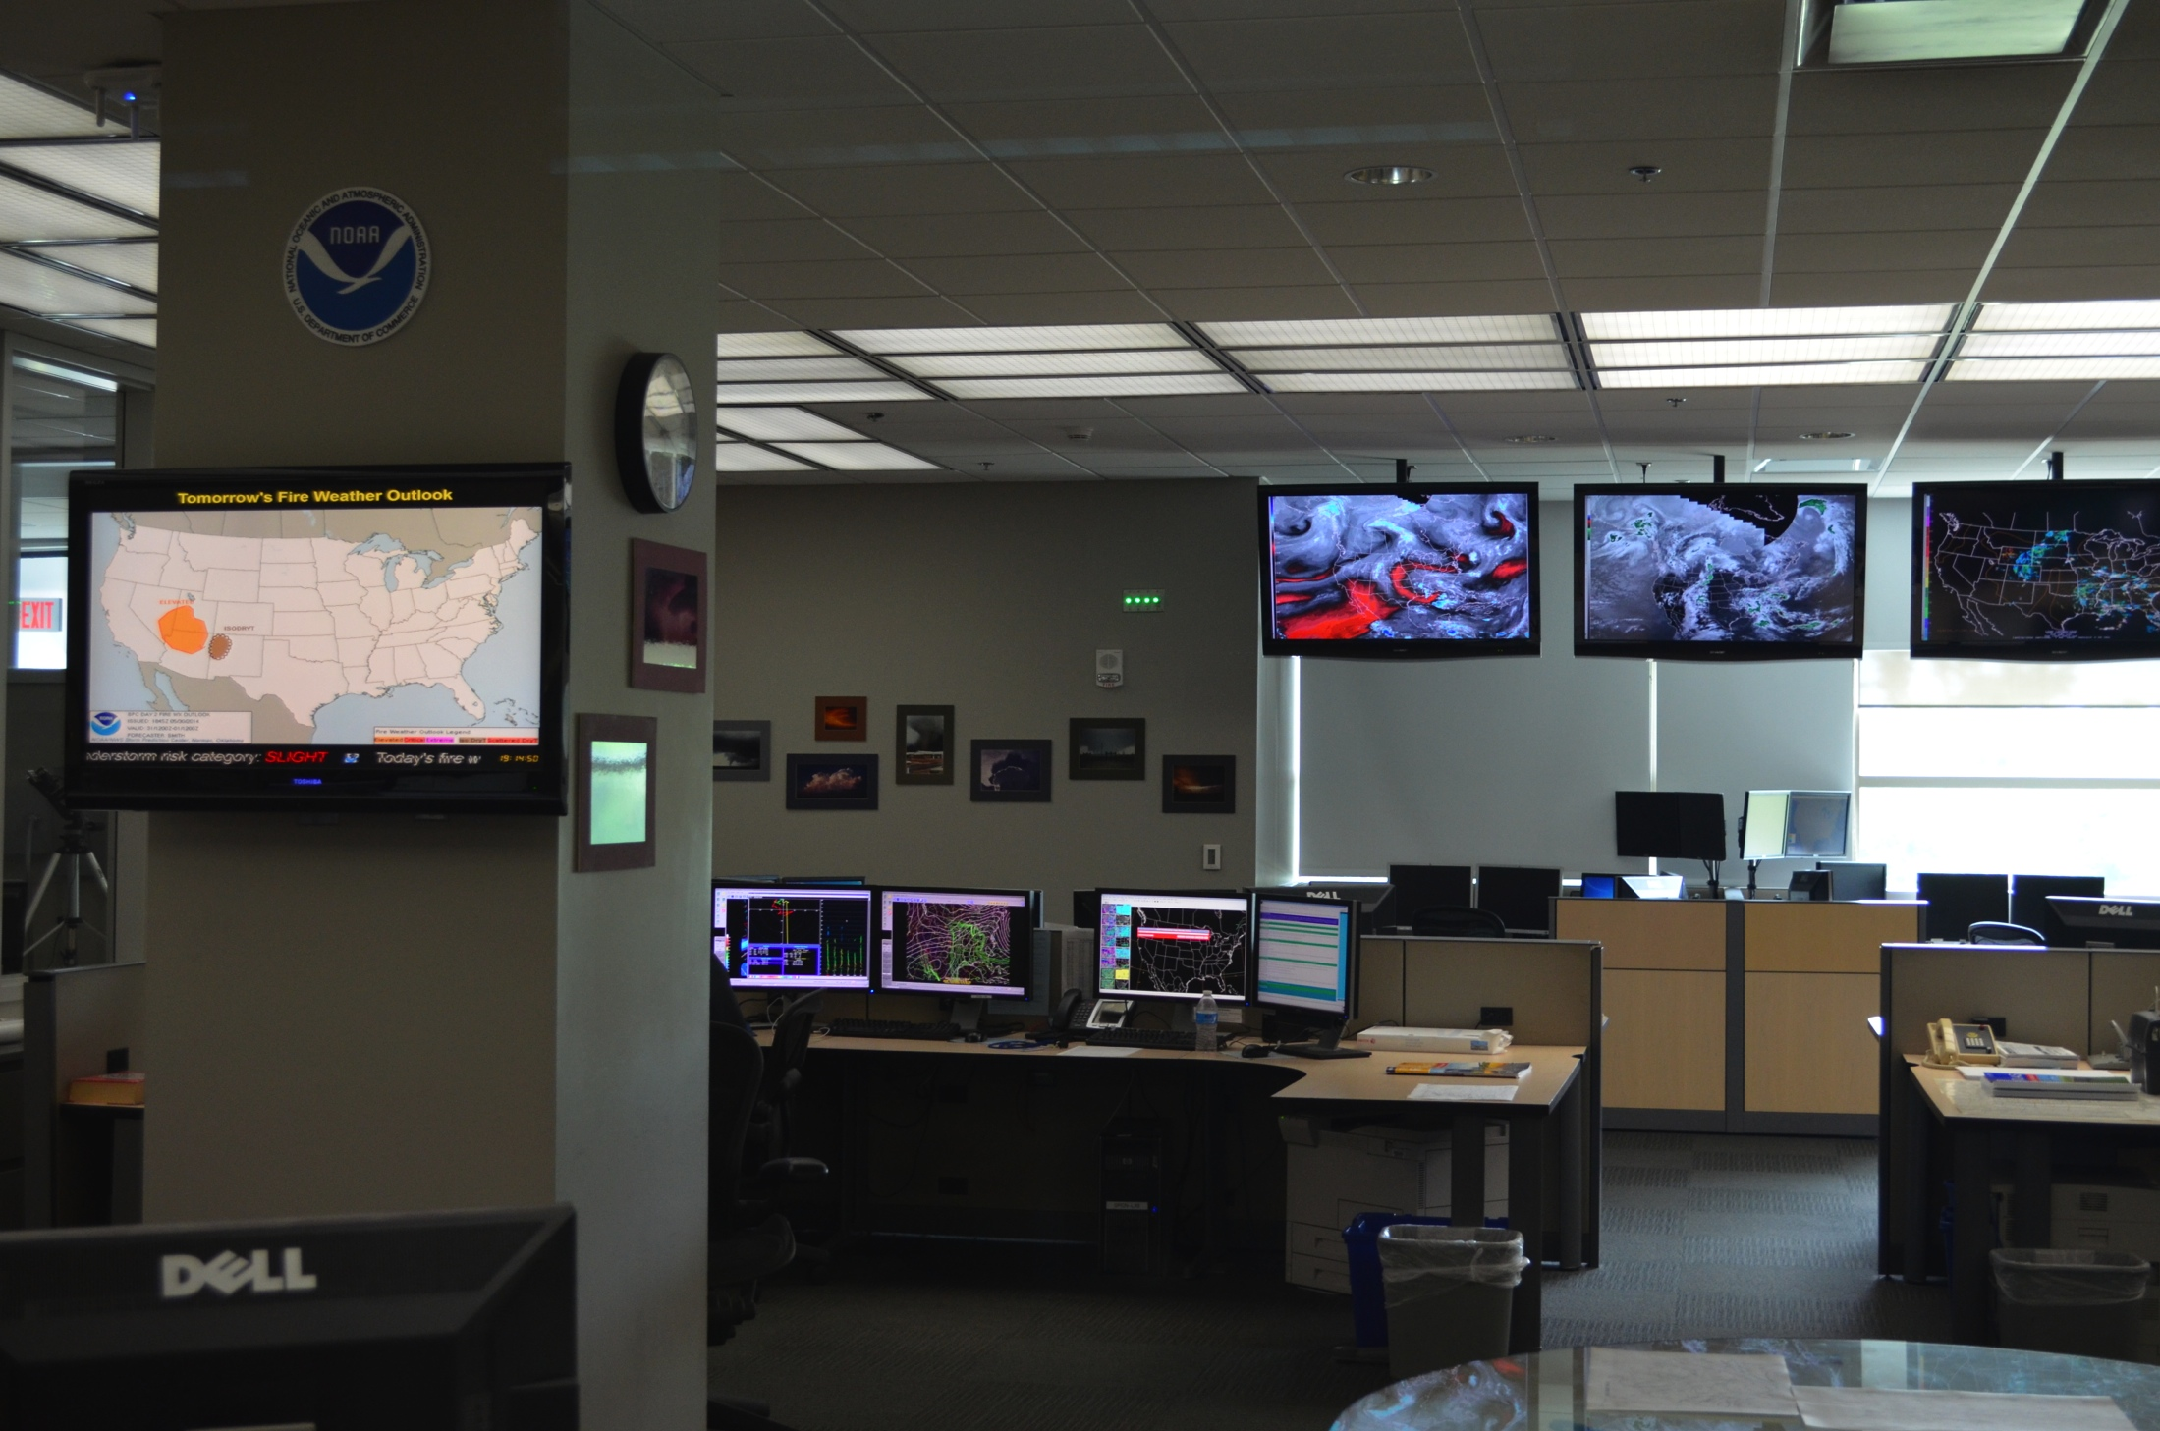
Storm Prediction Center – Norman, OK

Slide 18
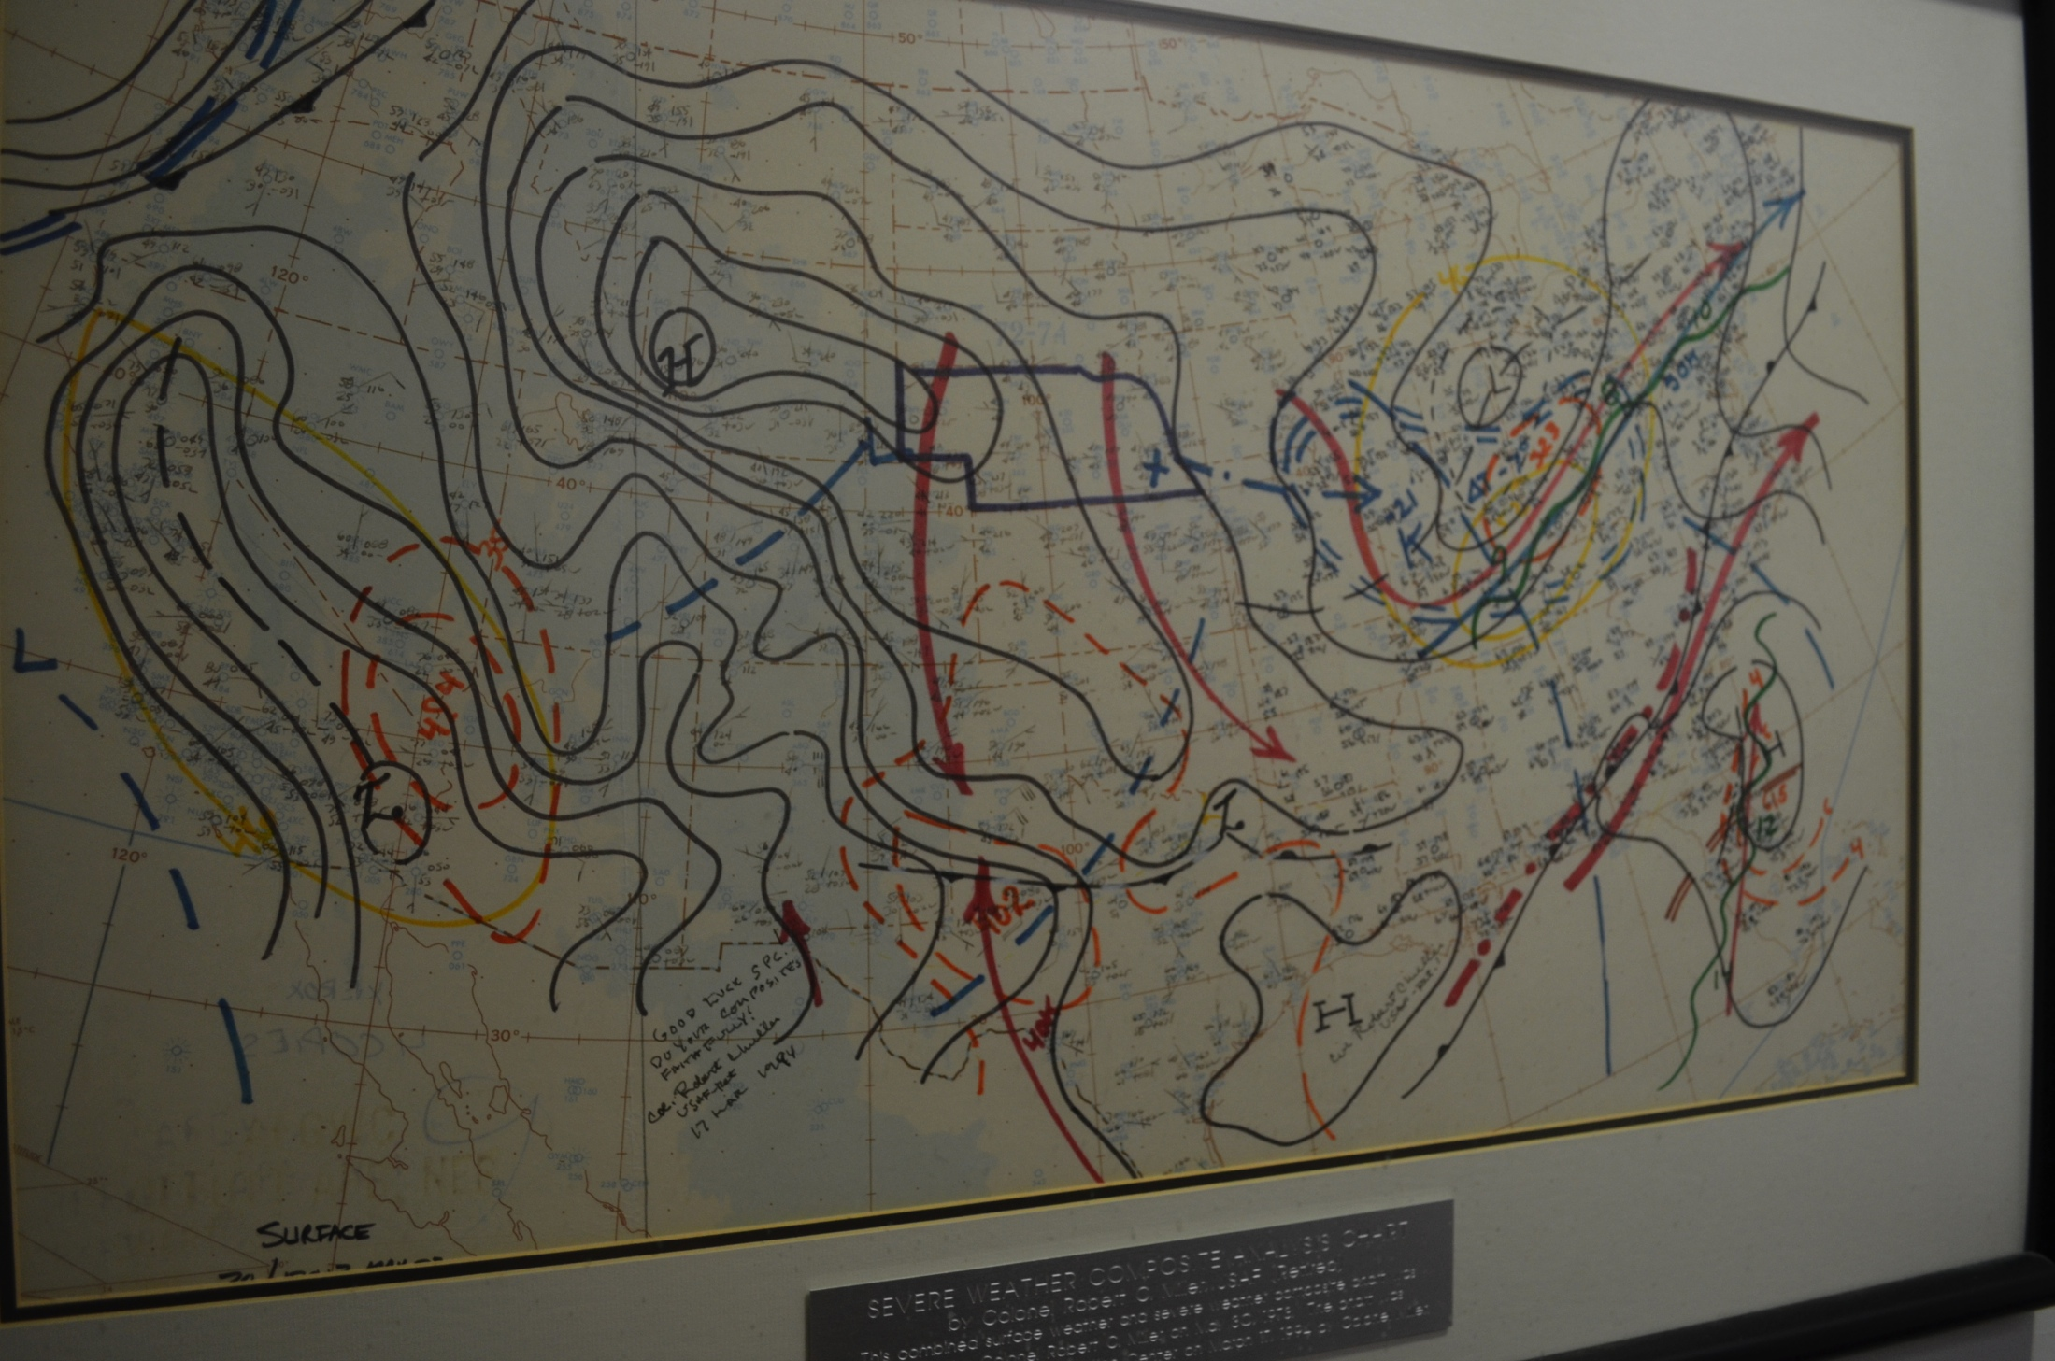
Storm Prediction Center – Norman, OK

